Slide 1
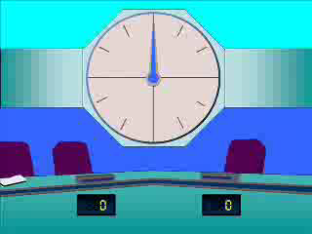




7
Express $\frac{4}{x+3}+\frac{3}{x}$ ($x≠0$, $x≠−3$)
as a single fraction in its simplest form.
a) $\frac{7x+9}{x(x+3)}$
b) $\frac{x+9}{x(x+3)}$
c) $\frac{x+3}{x(x+3)}$
d) $\frac{7x+3}{x(x+3)}$

Slide 2




8
Express $\frac{3}{x+1}−\frac{1}{x−2}$ ($x≠2$, $x≠−1$)
as a single fraction in its simplest form.
a) $\frac{3x−7}{(x−1)(x−2)}$
b) $\frac{2x+7}{(x+1)(x−2)}$
c) $\frac{2x−7}{(x+1)(x−2)}$
d) $\frac{3x+7}{(x+1)(x−2)}$

Slide 3




9
Express $\frac{5}{x−1}−\frac{2}{x+3}$ ($x≠1$, $x≠−3$)
as a single fraction in its simplest form.
a) $\frac{3x+13}{(x−1)(x+3)}$
b) $\frac{3x+17}{(x−1)(x+3)}$
c) $−\frac{3}{4}$
d) $\frac{3}{(x−1)(x+3)}$

