Slide 1
Algebraic fractions (1.2)

Slide 2
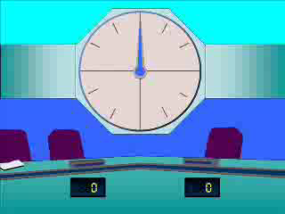
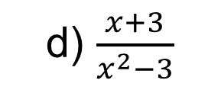
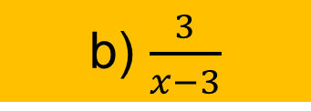
1
Simplify $\frac{3x+9}{x^{2}−9}$ fully.
a) $\frac{3}{x}$
b) $\frac{3}{x−3}$
c) $\frac{3x}{x^{2}}$
d) $\frac{x+3}{x^{2}−3}$

Slide 3

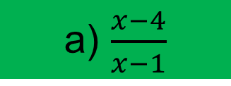
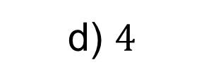
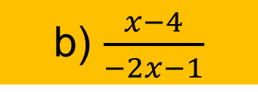
2
Simplify $\frac{x^{2}+x−12}{x^{2}−2x−3}$ fully.
a) $\frac{x−4}{x−1}$
b) $\frac{x−4}{−2x−1}$
c) $\frac{x+4}{x+1}$
d) $4$

Slide 4
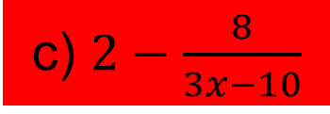
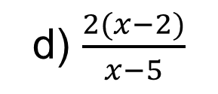

3
Simplify $\frac{2x^{2}−8}{x^{2}−3x−10}$ fully.
a) $\frac{2(x−2)(x−2)}{(x−5)(x+2)}$
b) $\frac{2(x^{2}−4)}{(x−5)(x+2)}$
c) $2−\frac{8}{3x−10}$
d) $\frac{2(x−2)}{x−5}$

Slide 5


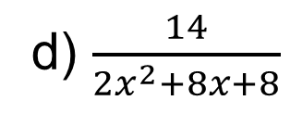
4
Simplify $\frac{2}{2x+4}×\frac{x+2}{7}$ fully.
a) $\frac{2x+4}{14x+28}$
b) $\frac{1}{7}$
c) $\frac{x+4}{2x+11}$
d) $\frac{14}{2x^{2}+8x+8}$

Slide 6


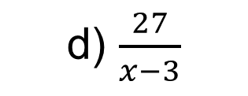
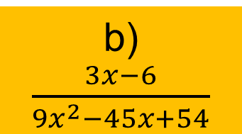
5
Simplify $\frac{3}{x^{2}−5x+6}×\frac{x−2}{9}$ fully.
a) $\frac{1}{3(x−3)}$
b) $\frac{3x−6}{9x^{2}−45x+54}$
c) $\frac{3}{x−3}$
d) $\frac{27}{x−3}$

Slide 7




6
Simplify $\frac{x^{2}+4x−5}{x^{2}+x−2}÷\frac{x^{2}+10x+25}{x^{2}+8x+15}$ fully.
a) $\frac{{\left(x+5\right)}^{2}}{(x+3)(x+2)}$
b) $\frac{x+5}{x+2}$
c) $\frac{x+2}{x+3}$
d) $\frac{x+3}{x+2}$

