Slide 1
Statistics
Data Collection
Twitter: @Owen134866
www.mathsfreeresourcelibrary.com

Slide 2
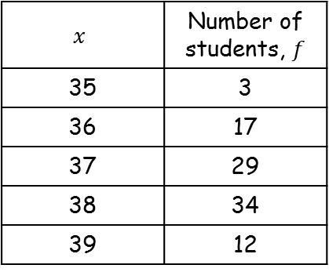
Prior Knowledge Check
Find the mean, median, mode and range of these data sets
1, 3, 4, 4, 6, 7, 8, 9, 11
20, 18, 17, 20, 14, 23, 19, 16
2) Here is a question from a questionnaire surveying TV viewing habits.
Give 2 criticisms and write an improved version of the question.
3) Rebecca records the shoe size, x, of the female students in her year. The results are in the table.
Find the mean shoe size.
5.89, 6, 4, 10
$$x$$ | Number of students, $f$
35 | 3
36 | 17
37 | 29
38 | 34
39 | 12
18.38, 18.5, 20, 9
How much TV do you watch?
0-1 Hours
1-2 Hours
3-4 Hours
Overlapping category
Nothing above 4
No time period etc
37.37

Slide 3
Teachings for Exercise 1A

Slide 4
Data Collection
You need to understand a number of key statistical terms
Population
Census
Sampling Unit
A population is a set of items that are of interest
For example, items manufactured in a factory, people working in a company
A census measures every member of a population
Individual units of a population are known as sampling units. These are often named to form a list or ‘sampling frame’
Sample
A sample is a selection of the population used to estimate information about the population as a whole
1A

Slide 5
Data Collection
You need to understand a number of key statistical terms
 | Advantages | Disadvantages
Census | → Completely accurate result | Time consuming Cannot be used if the sampling process would render the items unusable Processing a lot of data takes a long time
Sample | Less time-consuming Fewer responses needed Les data to process | Data might not be accurate Sample might not be properly representative of the population
1A

Slide 6
Data Collection
You need to understand a number of key statistical terms
A supermarket wants to test a delivery of avocados for ripeness by cutting them in half.
Suggest a reason why the supermarket should choose a sample rather than a census
The supermarket tests a sample of 4 avocados and find that 4 of them are ripe. They estimate that 80% of the total are ripe.
b) Suggest a way this estimate could be improved
A census would involve testing all the avocados, so then none could be sold!
They could test more avocados!
1A

