Slide 1
Statistics
Regression, correlation
and hypothesis testing
Twitter: @Owen134866
www.mathsfreeresourcelibrary.com

Slide 2
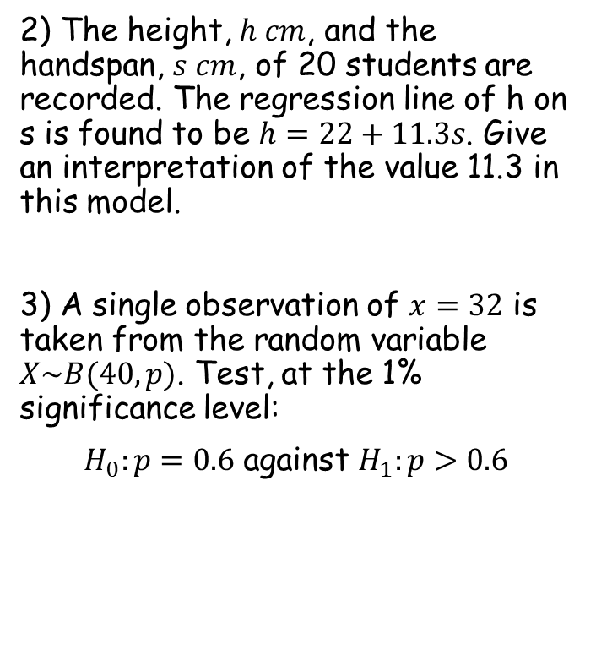

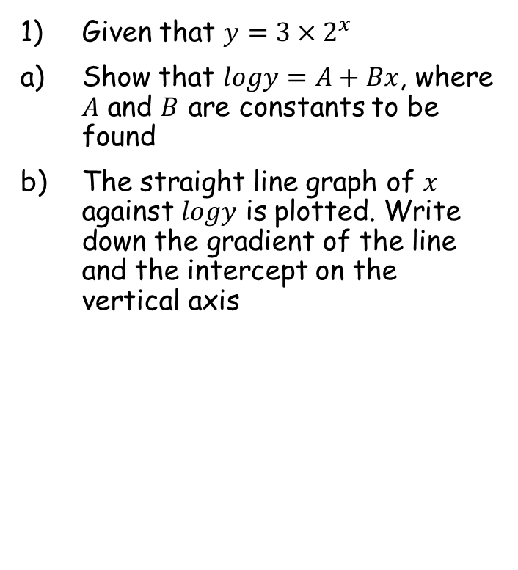




Prior knowledge check
Given that $y=3×2^{x}$
Show that $logy=A+Bx$, where $A$ and $B$ are constants to be found
The straight line graph of $x$ against $logy$ is plotted. Write down the gradient of the line and the intercept on the vertical axis
2) The height, $h cm$, and the handspan, $s cm$, of 20 students are recorded. The regression line of h on s is found to be $h=22+11.3s$. Give an interpretation of the value 11.3 in this model.
3) A single observation of $x=32$ is taken from the random variable $X\sim B(40,p)$. Test, at the 1% significance level:
$H_{0}:p=0.6$ against $H_{1}:p>0.6$
$$A=log3$$
$$B=log2$$
For every 1cm increase in handspan, the person’s height increases by 11.3cm
Gradient = $log2$
y-intercept = $log3$
$$P\left(X≥32\right)=0.0061$$
Less than 0.01 so $H_{0}$ rejected

Slide 3
Teachings for
Exercise 1A

Slide 4






Regression, correlation and hypothesis testing
$$y={ax}^{n}$$
$$logy=loga+nlogx$$
You need to be able to use logarithms and coding to analyse trends in non-linear data
You have seen this in the Pure Year 1 course, chapter 14
Let’s have a reminder of how the relationships should be written…
$$y={ax}^{n}$$
Take logs of both sides
$$logy=log{ax}^{n}$$
Separate using the addition law
$$logy=loga+logx^{n}$$
Use the power law
$$logy=loga+nlogx$$
1A

Slide 5






Regression, correlation and hypothesis testing
$$y={ax}^{n}$$
$$logy=loga+nlogx$$
$$y={ab}^{x}$$
$$logy=loga+xlogb$$
Variable raised to a power
Variable is the power
You need to be able to use logarithms and coding to analyse trends in non-linear data
You have seen this in the Pure Year 1 course, chapter 14
Let’s have a reminder of how the relationships should be written…
$$y={ab}^{x}$$
Take logs of both sides
$$logy=log{ab}^{x}$$
Separate using the addition law
$$logy=loga+logb^{x}$$
Use the power law
$$logy=loga+xlogb$$
1A

Slide 6





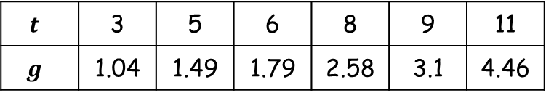





Regression, correlation and hypothesis testing
$$y={ax}^{n}$$
$$logy=loga+nlogx$$
$$y={ab}^{x}$$
$$logy=loga+xlogb$$
You need to be able to use logarithms and coding to analyse trends in non-linear data
$$t$$ | 3 | 5 | 6 | 8 | 9 | 11
$$g$$ | 1.04 | 1.49 | 1.79 | 2.58 | 3.1 | 4.46
The table to the right shows some data collected on the temperature, in °C, of a colony of bacteria (t), and its growth rate (g).
The data are coded using the changes of variable $x=t$ and $y=logg$. The regression line of $y$ on $x$ is found to be:
$y=−0.2215+0.0792x$
a) Mika says that the constant -0.2215 in the regression line means that the colony is shrinking when the temperature is 0°C. Explain why Mika is wrong.
Using the coding, when $t=0$, $x=0$ as well…
Substitute $x=0$ into the equation…
$y=−0.2215+0.0792x$
Let $x=0$
$y=−0.2215$
Remember that $y=logg$
$$logg=−0.2215$$
Inverse log (remember that log on its own means $\log_{10}$)
$$g={10}^{−0.2215}$$
Calculate
$g=0.600$(3sf)
So the growth rate is positive, the colony is not shrinking
1A

Slide 7







Regression, correlation and hypothesis testing
$$y={ax}^{n}$$
$$logy=loga+nlogx$$
$$y={ab}^{x}$$
$$logy=loga+xlogb$$
You need to be able to use logarithms and coding to analyse trends in non-linear data
$$t$$ | 3 | 5 | 6 | 8 | 9 | 11
$$g$$ | 1.04 | 1.49 | 1.79 | 2.58 | 3.1 | 4.46
The table to the right shows some data collected on the temperature, in °C, of a colony of bacteria (t), and its growth rate (g).
The data are coded using the changes of variable $x=t$ and $y=logg$. The regression line of $y$ on $x$ is found to be:
$y=−0.2215+0.0792x$
b) Given that the data can be modelled by an equation of the form $g=kb^{t}$, where $k$ and $b$ are constants, find the values of $k$ and $b$.
You can use the coding again to get the equation in the required form – substitute both ‘codes’ into the equation you are given…
$y=−0.2215+0.0792x$
Sub both the coded expressions in…
$$logg=−0.2215+0.0792t$$
Inverse logarithm
$$g={10}^{−0.2215+0.0792t }$$
Write as two terms multiplied
$$g={10}^{−0.2215}×{10}^{0.0792t}$$
Rewrite second term
$$g={10}^{−0.2215}×{\left({10}^{0.0792}\right)}^{t}$$
Calculate the powers of 10
$$g=0.600×{1.20}^{t}$$
So therefore $k=0.600$ and $b=1.20$ (both to 3sf)
1A

