Slide 1
Teachings for
Exercise 10D

Slide 2

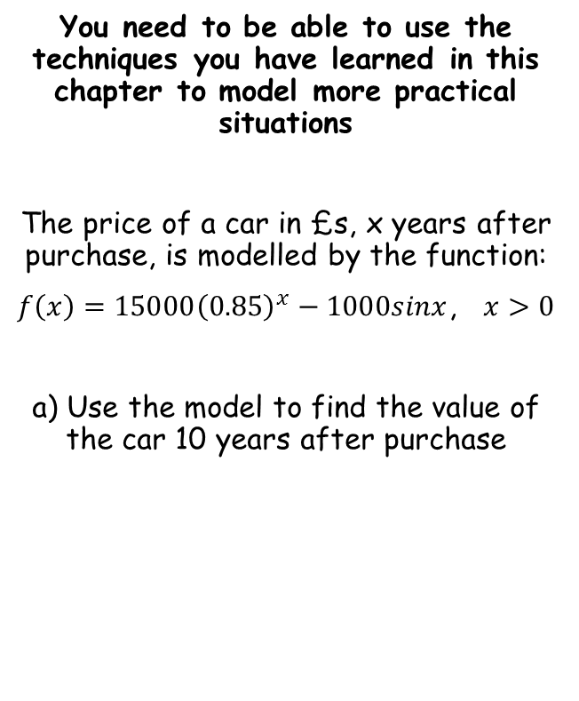
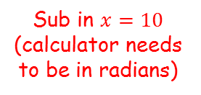


Numerical Methods
You need to be able to use the techniques you have learned in this chapter to model more practical situations
The price of a car in £s, x years after purchase, is modelled by the function:
$f\left(x\right)=15000{\left(0.85\right)}^{x}−1000sinx$, $x>0$
a) Use the model to find the value of the car 10 years after purchase
$$f\left(x\right)=15000{\left(0.85\right)}^{x}−1000sinx$$
Sub in $x=10$ (calculator needs to be in radians)
$$f\left(10\right)=15000{\left(0.85\right)}^{(10)}−1000sin⁡(10)$$
Calculate
$$f\left(10\right)=3497.13$$
So the value of the car will be £3497.13 (remember to round appropriately for pounds)
10D

Slide 3



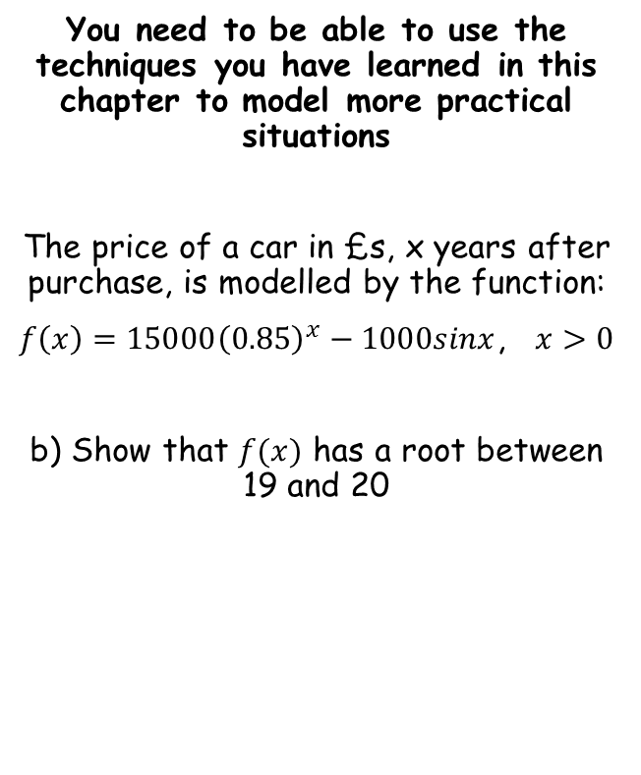



Numerical Methods
You need to be able to use the techniques you have learned in this chapter to model more practical situations
The price of a car in £s, x years after purchase, is modelled by the function:
$f\left(x\right)=15000{\left(0.85\right)}^{x}−1000sinx$, $x>0$
b) Show that $f(x)$ has a root between 19 and 20
$$f\left(x\right)=15000{\left(0.85\right)}^{x}−1000sinx$$
Sub in $x=19$
Sub in $x=20$
$$=534.11$$
$$=−331.55$$
Since the function changes sign across $19<x<20$, and there is a change of sign, there must be at least one root in the interval 19-20.
10D

Slide 4


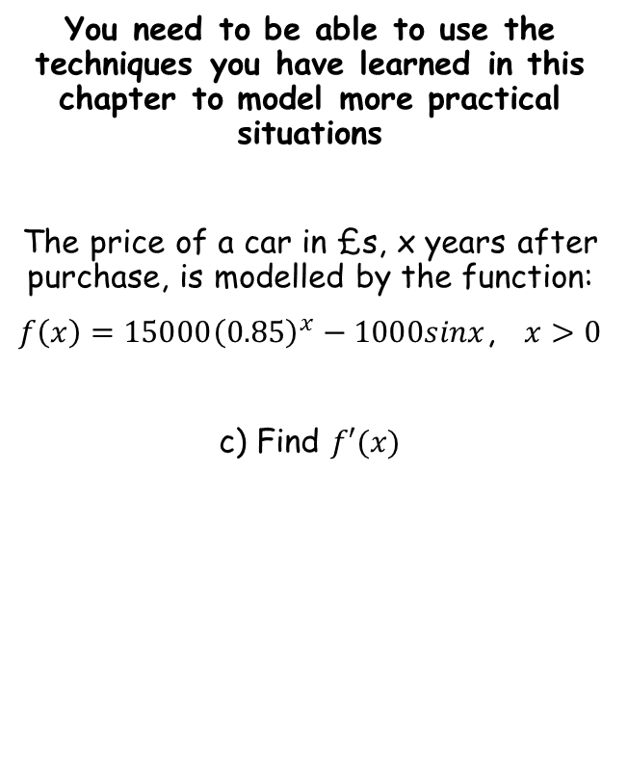



Numerical Methods
You need to be able to use the techniques you have learned in this chapter to model more practical situations
The price of a car in £s, x years after purchase, is modelled by the function:
$f\left(x\right)=15000{\left(0.85\right)}^{x}−1000sinx$, $x>0$
c) Find $f′(x)$
$$f\left(x\right)=15000{\left(0.85\right)}^{x}−1000sinx$$
Differentiate with respect to $x$, using techniques you have learnt previously
$$f′\left(x\right)=$$
$$15000{\left(0.85\right)}^{x}(ln0.85)$$
$$− 1000cosx$$
10D

Slide 5


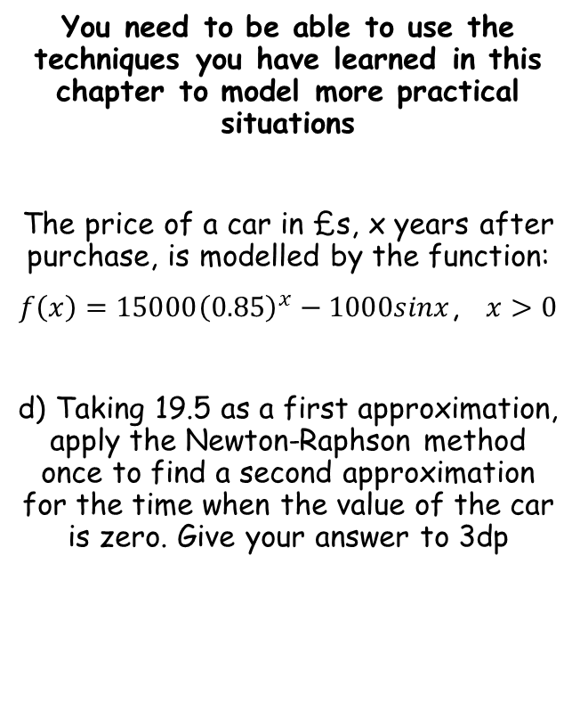



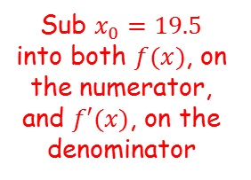
Numerical Methods
$$x_{n+1}=x_{n}−\frac{f(x_{n})}{f′(x_{n}) }$$
Sub $x_{0}=19.5$ into both $f(x)$, on the numerator, and $f′(x)$, on the denominator
You need to be able to use the techniques you have learned in this chapter to model more practical situations
The price of a car in £s, x years after purchase, is modelled by the function:
$f\left(x\right)=15000{\left(0.85\right)}^{x}−1000sinx$, $x>0$
d) Taking 19.5 as a first approximation, apply the Newton-Raphson method once to find a second approximation for the time when the value of the car is zero. Give your answer to 3dp
$$x_{n+1}=x_{n}−\frac{f(x_{n})}{f′(x_{n}) }$$
Write using the appropriate numbers (if needed)
$$x_{1}=x_{0}−\frac{f(x_{0})}{f′(x_{0}) }$$
$$x_{1}=(19.5)−\frac{15000{\left(0.85\right)}^{(19.5)}−1000sin⁡(19.5)}{15000{\left(0.85\right)}^{(19.5)}\left(ln0.85\right)−1000cos⁡(19.5)}$$
$$f^{′}(x)=15000{\left(0.85\right)}^{x}\left(ln0.85\right)−1000cosx$$
$$x_{1}=19.528$$
Calculate
10D

Slide 6
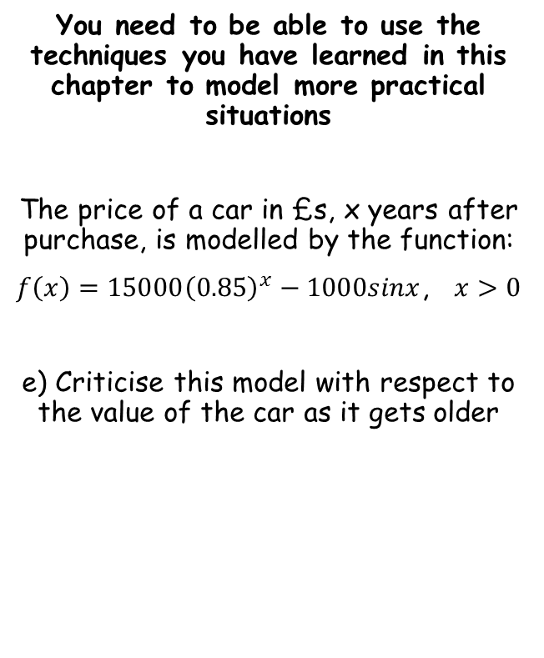
Numerical Methods
$$x_{n+1}=x_{n}−\frac{f(x_{n})}{f′(x_{n}) }$$
You need to be able to use the techniques you have learned in this chapter to model more practical situations
The price of a car in £s, x years after purchase, is modelled by the function:
$f\left(x\right)=15000{\left(0.85\right)}^{x}−1000sinx$, $x>0$
e) Criticise this model with respect to the value of the car as it gets older
$$f^{′}(x)=15000{\left(0.85\right)}^{x}\left(ln0.85\right)−1000cosx$$
Beyond the value calculated in part d) (19.528), the car will take a negative value.
However, this is unrealistic, so the model seems unreasonable for cars that are around 20 years old.
10D

