Slide 1
Applications to modelling (10.4)

Slide 2

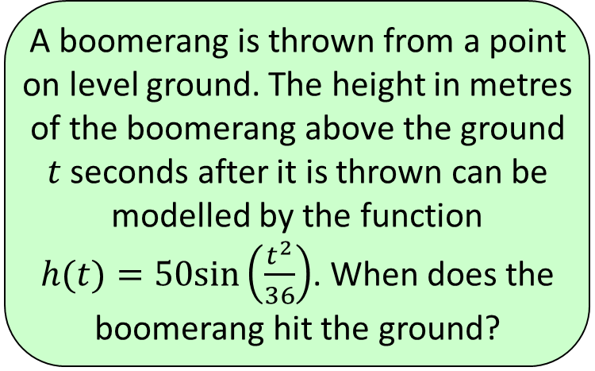




1
A boomerang is thrown from a point
on level ground. The height in metres
of the boomerang above the ground
$t$ seconds after it is thrown can be
modelled by the function
$h(t)=50sin\left(\frac{t^{2}}{36}\right)$. When does the
boomerang hit the ground?
a) $10<t<11$
b) $11<t<12$
c) $9<t<10$
d) $12<t<13$

Slide 3
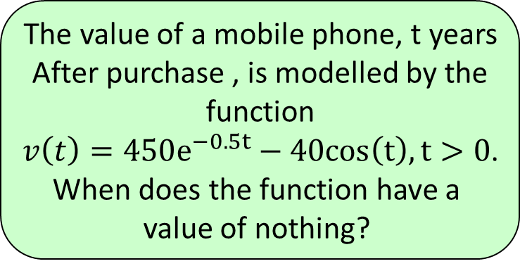




2
The value of a mobile phone, t years
After purchase , is modelled by the
function
$v\left(t\right)=450e^{−0.5t}−40cos\left(t\right), t>0$.
When does the function have a
value of nothing?
a) $1<t<3$
b) $3<t<4$
c) $4<t<5$
d) $5<t<6$

