Slide 1
The Newton-Raphson method (10.3)

Slide 2

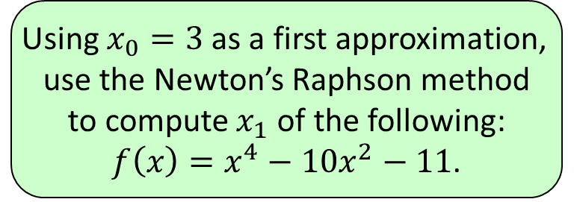




1
Using $x_{0}=3$ as a first approximation,
use the Newton’s Raphson method
to compute $x_{1}$ of the following:
$f\left(x\right)=x^{4}−10x^{2}−11$.
a) $3.5001$
b) $3.4101$
c) $3.4892$
d) $3.4167$

Slide 3
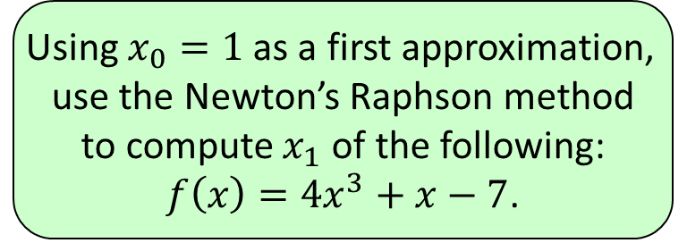




2
Using $x_{0}=1$ as a first approximation,
use the Newton’s Raphson method
to compute $x_{1}$ of the following:
$f\left(x\right)=4x^{3}+x−7$.
a) $1.2109$
b) $1.1555$
c) $1.1538$
d) $1.2001$

Slide 4
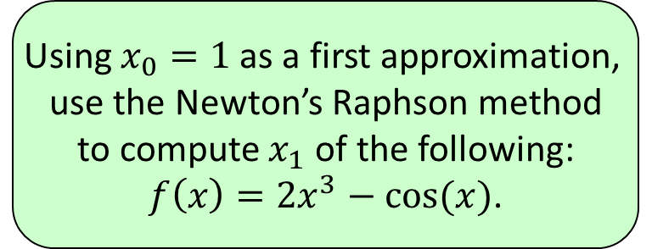




3
Using $x_{0}=1$ as a first approximation,
use the Newton’s Raphson method
to compute $x_{1}$ of the following:
$f\left(x\right)=2x^{3}−cos⁡(x)$.
a) $0.7901$
b) $0.7866$
c) $0.7822$
d) $0.7861$

