Slide 1
Teachings for
Exercise 10B

Slide 2
Numerical Methods
Let’s use this formula to calculate $\sqrt{3}$
You need to be able to solve equations of the form $f\left(x\right)=0$ by using the process of iteration
Iteration is a process where a calculation is repeated multiple times, and each time the answer closes in on a specific value.
How does a calculator calculate a square root, for example?
$$x_{n+1}=\frac{1}{2}\left(x_{n}+\frac{a}{x_{n}}\right)$$
Let our first guess of $\sqrt{3}$, $x_{n}$, be equal to 0.5
We are finding the square root of 3, so $a=3$
$$x_{n+1}=\frac{1}{2}\left((0.5)+\frac{3}{(0.5)}\right)$$
Calculate
$$x_{n+1}=3.25$$
$$x_{n+1}=\frac{1}{2}\left(x_{n}+\frac{a}{x_{n}}\right)$$
Perform the calculation again, but use the newly calculated value instead…
$$x_{n+1}=\frac{1}{2}\left(x_{n}+\frac{a}{x_{n}}\right)$$
$$x_{n+1}=\frac{1}{2}\left((3.25)+\frac{3}{(3.25)}\right)$$
The number we are rooting
Calculate
The ‘next’ number
The ‘current’ number
$$x_{n+1}=2.087$$
10B

Slide 3
Numerical Methods
Keep repeating these calculations, each time using the newly-calculated value…
You need to be able to solve equations of the form $f\left(x\right)=0$ by using the process of iteration
Iteration is a process where a calculation is repeated multiple times, and each time the answer closes in on a specific value.
How does a calculator calculate a square root, for example?
$$x_{0}=0.5$$
$$x_{1}=3.25$$
$$x_{2}=2.087…$$
$$x_{3}=1.7621…$$
$$x_{4}=1.7323…$$
$$x_{5}=1.7320…$$
$$x_{n+1}=\frac{1}{2}\left(x_{n}+\frac{a}{x_{n}}\right)$$
This process has given us the square root of 3 (and to improve the accuracy, you can just keep doing more iterations!)
A calculator can follow this process and do several iterations very quickly…
The number we are rooting
The ‘next’ number
The ‘current’ number
10B

Slide 4
Numerical Methods
But how does this process work?
→ Start with $x=\sqrt{3}$, since this is what we were calculating…
You need to be able to solve equations of the form $f\left(x\right)=0$ by using the process of iteration
Iteration is a process where a calculation is repeated multiple times, and each time the answer closes in on a specific value.
How does a calculator calculate a square root, for example?
$$x=\sqrt{3}$$
Square both sides
$$x^{2}=3$$
Divide all by 2
$$\frac{1}{2}x^{2}=\frac{3}{2}$$
Add $\frac{1}{2}x^{2}$ to both sides
$$x^{2}=\frac{1}{2}x^{2}+\frac{3}{2}$$
Divide all by $x$
$$x=\frac{1}{2}x+\frac{3}{2x}$$
Factorise $\frac{1}{2}$ out of the right side
$$x_{n+1}=\frac{1}{2}\left(x_{n}+\frac{a}{x_{n}}\right)$$
$$x=\frac{1}{2}\left(x+\frac{3}{x}\right)$$
The solution to this equation will be the same as the solution to the original one
These can be found by drawing graphs of each one and finding where they cross…
10B

Slide 5
Numerical Methods
$$x_{0}=0.5$$
$$x_{1}=3.25$$
$$x_{2}=2.087…$$
$$x_{3}=1.7621…$$
$$x_{4}=1.7323…$$
$$y=x$$
$$x_{5}=1.7320…$$
$$y=\frac{1}{2}\left(x+\frac{3}{x}\right)$$
You need to be able to solve equations of the form $f\left(x\right)=0$ by using the process of iteration
$$x=3.25$$
$$x=\frac{1}{2}\left(x+\frac{3}{x}\right)$$
$$x=2.087$$
$$x=1.7621$$
$$y=\frac{1}{2}\left(x+\frac{3}{x}\right)$$
$$y=x$$
We choose a value for $x$ (in this case we chose 0.5), and sub it into the equation on the right side (the blue line)
The answer ($y$) is the next value ($x$) we substitute in. Since the red line is $y=x$, we can show this on the diagram
We then substitute this into the equation on the right side again (the blue line)
$$x=0.5$$
$$x=3.25$$
$$x=2.087$$
$$x=1.7621$$
4) Gradually we close in on the intersection, which is the solution to the original equation, in this case $x=\sqrt{3}$
10B

Slide 6
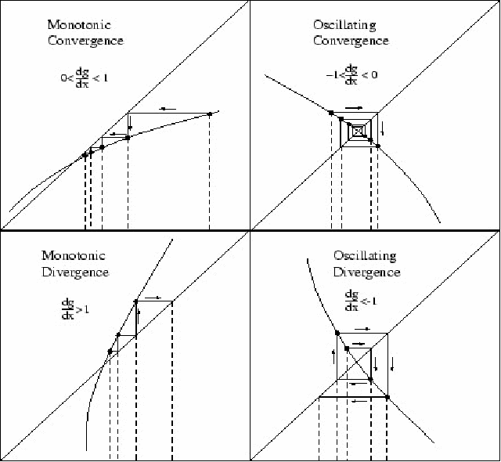
Numerical Methods
The diagram you just saw is sometimes called a convergence cobweb, and can appear in different types…
It is important to note that sometimes this technique causes an answer to diverge away from the solution instead of towards it
→ In that case, the ‘fix’ is usually to choose a different starting value…
10B

Slide 7
Numerical Methods
You need to be able to solve equations of the form $f\left(x\right)=0$ by using the process of iteration
Given that $f\left(x\right)=x^{2}−4x+1$
a) Show that the equation $f\left(x\right)=0$ can be written as $x=4−\frac{1}{x}$, $x≠0$.
The equation $f(x)$ has a root, $α$, in the interval $3<x<4$.
b) Use the iterative formula
$x_{n+1}=4−\frac{1}{x_{n}}$, with $x_{0}=3$ to find the value of $x_{1}$, $x_{2}$ and $x_{3}$.
$$f\left(x\right)=x^{2}−4x+1$$
Set $f(x)=0$
$$0=x^{2}−4x+1$$
Add $4x$ and subtract 1
$$4x−1=x^{2}$$
$$4−\frac{1}{x}=x$$
Divide all by $x$
When rearranging, you should look at the formula you are aiming for first…
This can give you an idea as to how to do the rearrangement
10B

Slide 8
Numerical Methods
$$x_{n+1}=4−\frac{1}{x_{n}}$$
$$x_{n+1}=4−\frac{1}{x_{n}}$$
You need to be able to solve equations of the form $f\left(x\right)=0$ by using the process of iteration
Given that $f\left(x\right)=x^{2}−4x+1$
a) Show that the equation $f\left(x\right)=0$ can be written as $x=4−\frac{1}{x}$, $x≠0$.
The equation $f(x)$ has a root, $α$, in the interval $3<x<4$.
b) Use the iterative formula
$x_{n+1}=4−\frac{1}{x_{n}}$, with $x_{0}=3$ to find the value of $x_{1}$, $x_{2}$ and $x_{3}$.
Write using the specific terms
Write using the specific terms
$$x_{1}=4−\frac{1}{x_{0}}$$
$$x_{2}=4−\frac{1}{x_{1}}$$
Sub values in
Sub values in
$$x_{1}=4−\frac{1}{3}$$
$$x_{2}=4−\frac{1}{3.66…}$$
Calculate
Calculate
$$x_{1}=3.66…$$
$$x_{2}=3.727…$$
$$x_{n+1}=4−\frac{1}{x_{n}}$$
Write using the specific terms
$$x_{3}=4−\frac{1}{x_{2}}$$
Sub values in
$$x_{3}=4−\frac{1}{3.727…}$$
Calculate
$$x_{3}=3.731…$$
10B

Slide 9
Numerical Methods
$$f\left(x\right)=x^{3}−{3x}^{2}−2x+5$$
You need to be able to solve equations of the form $f\left(x\right)=0$ by using the process of iteration
$$f\left(x\right)=x^{3}−{3x}^{2}−2x+5$$
a) Show that the equation $f\left(x\right)=0$ has a root in the interval $3<x<4$
b) Use the iterative formula:
$$x_{n+1}=\sqrt{\frac{x_{n}^{3}−{2x}_{n}+5}{3}}$$
To calculate the values of $x_{1}$, $x_{2}$ and $x_{3}$, giving answers to 4 decimal places, when:
i) $x_{0}=1.5$ ii) $x_{0}=4$
Sub in $x=4$
Sub in $x=3$
$$f\left(3\right)=−1$$
$$f\left(4\right)=13$$
Since the function is continuous, and there is a change of sign, there must be a root in the interval $3<x<4$
10B

Slide 10
Numerical Methods
$$x_{n+1}=\sqrt{\frac{x_{n}^{3}−{2x}_{n}+5}{3}}$$
$$x_{n+1}=\sqrt{\frac{x_{n}^{3}−{2x}_{n}+5}{3}}$$
You need to be able to solve equations of the form $f\left(x\right)=0$ by using the process of iteration
$$f\left(x\right)=x^{3}−{3x}^{2}−2x+5$$
b) Use the iterative formula:
$$x_{n+1}=\sqrt{\frac{x_{n}^{3}−{2x}_{n}+5}{3}}$$
To calculate the values of $x_{1}$, $x_{2}$ and $x_{3}$, giving answers to 4 decimal places, when:
i) $x_{0}=1.5$ ii) $x_{0}=4$
Sub in $x_{0}$
Sub in $x_{1}$
$$x_{1}=\sqrt{\frac{{(1.5)}^{3}−2(1.5)+5}{3}}$$
$$x_{2}=\sqrt{\frac{{(1.3385)}^{3}−2(1.3385)+5}{3}}$$
Work out
Work out
$$x_{1}=1.3385$$
$$x_{2}=1.2544$$
$$x_{n+1}=\sqrt{\frac{x_{n}^{3}−{2x}_{n}+5}{3}}$$
Sub in $x_{2}$
$$x_{3}=\sqrt{\frac{{(1.2544)}^{3}−2(1.2544)+5}{3}}$$
Work out
$$x_{3}=1.2200$$
In this case, the solutions are getting closer to a root. This sequence is therefore convergent.
10B

Slide 11
Numerical Methods
$$x_{n+1}=\sqrt{\frac{x_{n}^{3}−{2x}_{n}+5}{3}}$$
$$x_{n+1}=\sqrt{\frac{x_{n}^{3}−{2x}_{n}+5}{3}}$$
You need to be able to solve equations of the form $f\left(x\right)=0$ by using the process of iteration
$$f\left(x\right)=x^{3}−{3x}^{2}−2x+5$$
b) Use the iterative formula:
$$x_{n+1}=\sqrt{\frac{x_{n}^{3}−{2x}_{n}+5}{3}}$$
To calculate the values of $x_{1}$, $x_{2}$ and $x_{3}$, giving answers to 4 decimal places, when:
i) $x_{0}=1.5$ ii) $x_{0}=4$
Sub in $x_{0}$
Sub in $x_{1}$
$$x_{1}=\sqrt{\frac{{(4)}^{3}−2(4)+5}{3}}$$
$$x_{2}=\sqrt{\frac{{(4.5092)}^{3}−2(4.5092)+5}{3}}$$
Work out
Work out
$$x_{1}=4.5092$$
$$x_{2}=5.4058$$
$$x_{n+1}=\sqrt{\frac{x_{n}^{3}−{2x}_{n}+5}{3}}$$
Sub in $x_{2}$
$$x_{3}=\sqrt{\frac{{(5.4058)}^{3}−2(5.4058)+5}{3}}$$
Work out
$$x_{3}=7.1219$$
In this case, the solutions are getting further to a root. This sequence is therefore divergent.
10B

