Slide 1
Iteration (10.2)

Slide 2
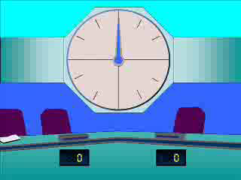
1
Which of the following is not a
rearrangement of
$x^{5}−x^{2}−20=0$?
b) $x=\sqrt[3]{1+\frac{20}{x^{2}}}$
a) $x=\sqrt[5]{x^{2}+20}$
c) $x=20x^{−4}+x^{−2}$
d) $x=\sqrt{20−x^{5}}$

Slide 3
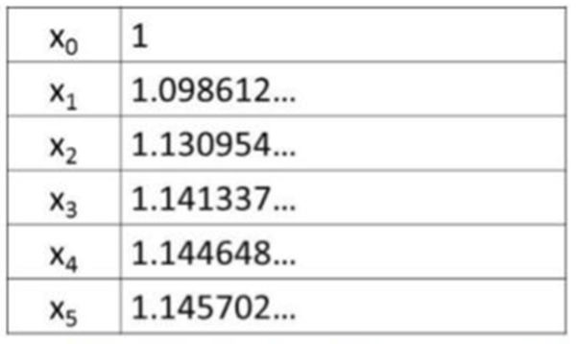
2
Describe the type of convergence/
divergence produced in the table
below:
a) Cobweb convergence
b) Staircase convergence
c) Cobweb divergence
d) Staircase divergence

Slide 4
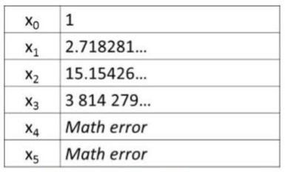
3
Describe the type of convergence/
divergence produced in the table
below:
a) Cobweb convergence
b) Staircase convergence
c) Cobweb divergence
d) Staircase divergence

Slide 5
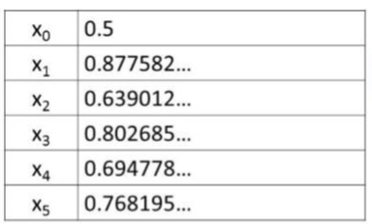
4
Describe the type of convergence/
divergence produced in the table
below:
a) Cobweb convergence
b) Staircase convergence
c) Cobweb divergence
d) Staircase divergence

