Slide 1
Numerical
Methods
Twitter: @Owen134866
www.mathsfreeresourcelibrary.com

Slide 2
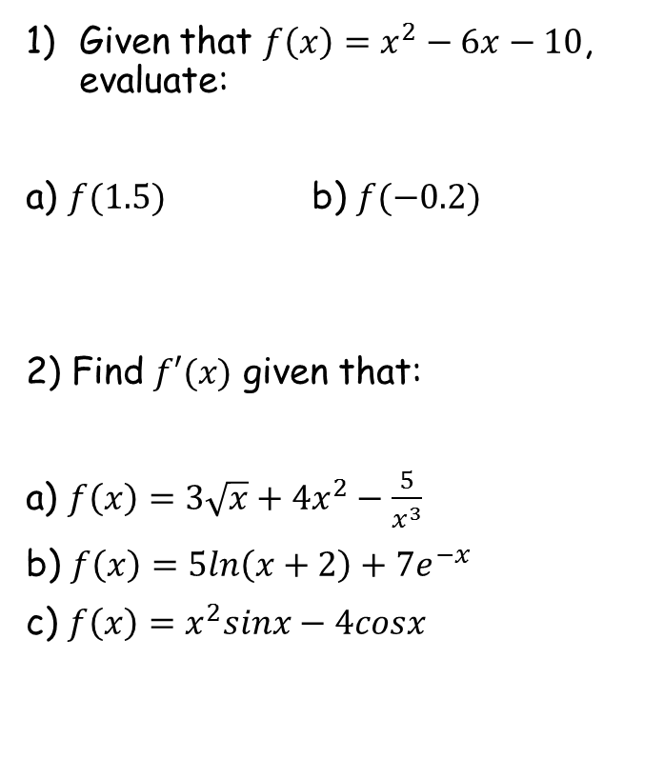
Prior Knowledge Check
Given that $f\left(x\right)=x^{2}−6x−10$, evaluate:
a) $f(1.5)$ b) $f(−0.2)$
2) Find $f′(x)$ given that:
a) $f\left(x\right)=3\sqrt{x}+{4x}^{2}−\frac{5}{x^{3}}$
b) $f\left(x\right)=5ln\left(x+2\right)+{7e}^{−x}$
c) $f\left(x\right)=x^{2}sinx−4cosx$
3) Given that $u_{n+1}=u_{n}+\frac{1}{u_{n}}$, and that $u_{0}=1$, find the values of $u_{1}$, $u_{2}$ and $u_{3}$.
$$u_{1}=2$$
$$u_{2}=2.5$$
$$u_{3}=2.9$$
$$3.25$$
$$11.24$$
$$f^{′}\left(x\right)=\frac{3}{2\sqrt{x}}+8x+\frac{15}{x^{4}}$$
$$f^{′}\left(x\right)=\frac{5}{x+2}−{7e}^{−x}$$
$$f^{′}\left(x\right)=x^{2}cosx+2xsinx+4sinx$$

Slide 3
Teachings for
Exercise 10A

Slide 4
Numerical Methods
$$y$$
$$y=f(x)$$
You need to be able to use numerical methods to locate roots of equations
If the function $f(x)$is continuous on the interval $\left[a,b\right]$ and $f(a)$ and $f(b)$ have opposite signs, then $f(x)$ has at least one root which satisfies $a<x<b$
The diagram shows a sketch of the curve $y=f\left(x\right),$ where $f\left(x\right)=x^{3}−{4x}^{2}+3x+1$
Explain how the graph shows that $f(x)$ has a root between $x=2$ and $x=3$.
b) Show that $f(x)$ has a root between $x=1.4$ and $x=1.5$
1
$$x$$
-3
-2
-1
1
2
3
-1
Since the graph crosses the x-axis between $x=2$ and $x=3$, there must be a root in that interval
10A

Slide 5
Numerical Methods
$$y$$
$$y=f(x)$$
You need to be able to use numerical methods to locate roots of equations
If the function $f(x)$is continuous on the interval $\left[a,b\right]$ and $f(a)$ and $f(b)$ have opposite signs, then $f(x)$ has at least one root which satisfies $a<x<b$
The diagram shows a sketch of the curve $y=f\left(x\right),$ where $f\left(x\right)=x^{3}−{4x}^{2}+3x+1$
Explain how the graph shows that $f(x)$ has a root between $x=2$ and $x=3$.
b) Show that $f(x)$ has a root between $x=1.4$ and $x=1.5$
1
$$x$$
-3
-2
-1
1
2
3
-1
Sub in these two values and show that there is a change of sign…
$$f\left(x\right)=x^{3}−{4x}^{2}+3x+1$$
Sub in $x=1.4$
Sub in $x=1.5$
$$f\left(1.4\right)=0.104$$
$$f\left(1.5\right)=−0.125$$
Since there is a change of sign, there must be a root in the interval $\left[1.4,1.5\right]$
10A

Slide 6
Numerical Methods
You need to be able to use numerical methods to locate roots of equations
It is important to consider the number of roots that are possible, and be careful of some special cases…
$$y$$
$$y$$
$$y$$
$$x$$
$$x$$
$$x$$
$$a$$
$$b$$
$$a$$
$$b$$
$$a$$
$$b$$
Comparing $a$ and $b$ there is a change of sign
→ There can be an odd number of roots
Comparing $a$ and $b$ there is no change of sign
→ There can be an even number of roots
Comparing $a$ and $b$ there is a change of sign
→ There could be no roots

Slide 7
Numerical Methods
$$y$$
You need to be able to use numerical methods to locate roots of equations
The graph of the function
$f\left(x\right)=54x^{3}−225x^{2}+309x−140$
is shown in the diagram.
A student observes that $f(1.1)$ and $f(1.6)$ are both negative and states that $f\left(x\right)$ has no roots in the interval $\left[1.1,1.6\right]$
Explain, referring to the diagram, why the student is incorrect
Calculate $f(1.3)$, $f(1.5)$ and $f(1.7)$ and use your answer to explain why there are at least 3 roots in the interval $1.1<x<1.7$.
1
$$x$$
1
2
-1
If there is no sign change, although there could be no roots, it is also possible that there are 2, 4, 6, or any even number amount
→ From the diagram, since the curve crosses that axis 3 times, it is possible that there are actually 2 roots in the interval given
10A

Slide 8
Numerical Methods
$$y$$
You need to be able to use numerical methods to locate roots of equations
The graph of the function
$f\left(x\right)=54x^{3}−225x^{2}+309x−140$
is shown in the diagram.
A student observes that $f(1.1)$ and $f(1.6)$ are both negative and states that $f\left(x\right)$ has no roots in the interval $\left[1.1,1.6\right]$
Explain, referring to the diagram, why the student is incorrect
Calculate $f(1.3)$, $f(1.5)$ and $f(1.7)$ and use your answer to explain why there are at least 3 roots in the interval $1.1<x<1.7$.
1
$$x$$
1
2
-1
$$f\left(1.1\right)=−0.476$$
Sign change
$$f\left(1.3\right)=0.088$$
Sign change
$$f\left(1.5\right)=−0.5$$
Sign change
$$f\left(1.7\right)=0.352$$
In the intervals given, there are 3 sign changes
That means there are at least 3 roots in the overall interval, $\left[1.1,1.7\right]$
10A

Slide 9
Numerical Methods
$$y=\frac{1}{x}$$
$$y$$
You need to be able to use numerical methods to locate roots of equations
Using the same axes, sketch the graphs of $y=lnx$ and $y=\frac{1}{x}$. Explain how your diagram shows that the function $f\left(x\right)=lnx−\frac{1}{x}$ has only one root
Show that this root lies in the interval $1.7<x<1.8$
Given that the root of $f\left(x\right)=α$, show that $α=1.753$ correct to 3 decimal places
$$y=lnx$$
$$x$$
-3
-2
-1
1
2
3
The roots of an equation are where it is equal to 0.
$$lnx−\frac{1}{x}=0$$
Add $\frac{1}{x}$
$$lnx=\frac{1}{x}$$
So the roots of the equation will be where the graphs cross, and we can see that they only cross in one place
10A

Slide 10
Numerical Methods
$$y=\frac{1}{x}$$
$$y$$
You need to be able to use numerical methods to locate roots of equations
Using the same axes, sketch the graphs of $y=lnx$ and $y=\frac{1}{x}$. Explain how your diagram shows that the function $f\left(x\right)=lnx−\frac{1}{x}$ has only one root
Show that this root lies in the interval $1.7<x<1.8$
Given that the root of $f\left(x\right)=α$, show that $α=1.753$ correct to 3 decimal places
$$y=lnx$$
$$x$$
-3
-2
-1
1
2
3
$$f\left(x\right)=lnx−\frac{1}{x}$$
Sub in $x=1.7$
Sub in $x=1.8$
$$f\left(1.7\right)=−0.0576$$
$$f\left(1.8\right)=0.0322$$
Since the function is continuous across $1.7<x<1.8$, and there is a change of sign, the root must be within this interval
10A

Slide 11
Numerical Methods
$$y=\frac{1}{x}$$
$$y$$
You need to be able to use numerical methods to locate roots of equations
Using the same axes, sketch the graphs of $y=lnx$ and $y=\frac{1}{x}$. Explain how your diagram shows that the function $f\left(x\right)=lnx−\frac{1}{x}$ has only one root
Show that this root lies in the interval $1.7<x<1.8$
Given that the root of $f\left(x\right)=α$, show that $α=1.753$ correct to 3 decimal places
$$y=lnx$$
$$x$$
-3
-2
-1
1
2
3
→ If the root rounds to 1.753 to 3dp, then it must be in the range 1.7525 to 1.7535
Root lies here
$$1.752$$
$$1.753$$
$$1.754$$
→ You need to sub in these limits and show that there is a change of sign between them…
10A

Slide 12
Numerical Methods
$$y=\frac{1}{x}$$
$$y$$
You need to be able to use numerical methods to locate roots of equations
Using the same axes, sketch the graphs of $y=lnx$ and $y=\frac{1}{x}$. Explain how your diagram shows that the function $f\left(x\right)=lnx−\frac{1}{x}$ has only one root
Show that this root lies in the interval $1.7<x<1.8$
Given that the root of $f\left(x\right)=α$, show that $α=1.753$ correct to 3 decimal places
$$y=lnx$$
$$x$$
-3
-2
-1
1
2
3
$$f\left(x\right)=lnx−\frac{1}{x}$$
Sub in $x=1.7525$
Sub in $x=1.7535$
$$=−0.00064$$
$$=0.00024$$
Since the function is continuous across $1.7525<x<1.7535$, and there is a change of sign, the root must be within this interval – it must therefore round to 1.753 to 3dp!
10A

