Slide 1
Chapter 10- Numerical methods

Slide 2
Locating roots (10.1)

Slide 3
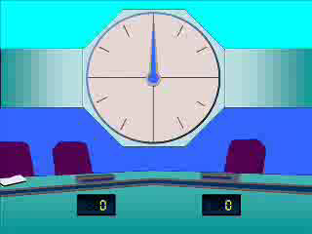
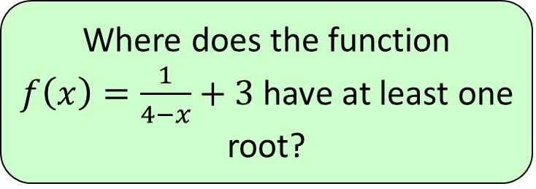




1
Where does the function
$f\left(x\right)=\frac{1}{4−x}+3$ have at least one
root?
a) $3.9<x<4.1$
b) $4.1<x<4.4$
c) $4.1<x<4.3$
d) $3.6<x<3.9$

Slide 4
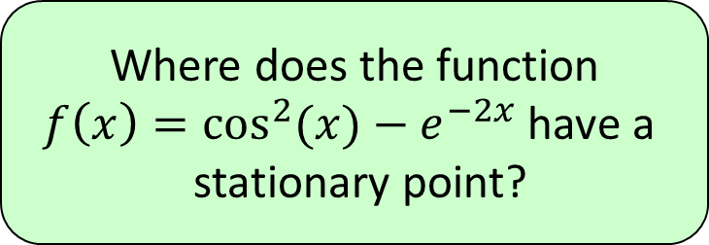




2
Where does the function
$f\left(x\right)=\cos^{2}{(x)}−e^{−2x}$ have a
stationary point?
a) $1.2<x<1.4$
b) $1.3<x<1.4$
c) $3.1<x<3.2$
d) $3.2<x<3.3$

Slide 5
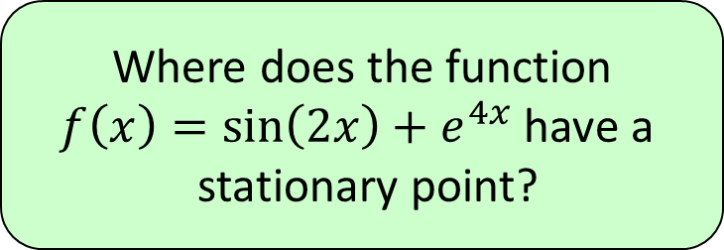




3
Where does the function
$f\left(x\right)=\sin\left(2x\right)+e^{4x}$ have a
stationary point?
a) $−0.3<x<−0.1$
b) $−0.7<x<−0.5$
c) $−1.0<x<−0.9$
d) $−0.9<x<−0.8$

