Slide 1
Statistics
Data Collection
Twitter: @Owen134866
www.mathsfreeresourcelibrary.com

Slide 2
Prior Knowledge Check
Find the mean, median, mode and range of these data sets
1, 3, 4, 4, 6, 7, 8, 9, 11
20, 18, 17, 20, 14, 23, 19, 16
2) Here is a question from a questionnaire surveying TV viewing habits.
Give 2 criticisms and write an improved version of the question.
3) Rebecca records the shoe size, x, of the female students in her year. The results are in the table.
Find the mean shoe size.
5.89, 6, 4, 10
$$x$$ | Number of students, $f$
35 | 3
36 | 17
37 | 29
38 | 34
39 | 12
18.38, 18.5, 20, 9
How much TV do you watch?
0-1 Hours
1-2 Hours
3-4 Hours
Overlapping category
Nothing above 4
No time period etc
37.37

Slide 3
Teachings for Exercise 1A

Slide 4
Data Collection
You need to understand a number of key statistical terms
Population
Census
Sampling Unit
A population is a set of items that are of interest
For example, items manufactured in a factory, people working in a company
A census measures every member of a population
Individual units of a population are known as sampling units. These are often named to form a list or ‘sampling frame’
Sample
A sample is a selection of the population used to estimate information about the population as a whole
1A

Slide 5
Data Collection
You need to understand a number of key statistical terms
 | Advantages | Disadvantages
Census | → Completely accurate result | Time consuming Cannot be used if the sampling process would render the items unusable Processing a lot of data takes a long time
Sample | Less time-consuming Fewer responses needed Les data to process | Data might not be accurate Sample might not be properly representative of the population
1A

Slide 6
Data Collection
You need to understand a number of key statistical terms
A supermarket wants to test a delivery of avocados for ripeness by cutting them in half.
Suggest a reason why the supermarket should choose a sample rather than a census
The supermarket tests a sample of 4 avocados and find that 4 of them are ripe. They estimate that 80% of the total are ripe.
b) Suggest a way this estimate could be improved
A census would involve testing all the avocados, so then none could be sold!
They could test more avocados!
1A

Slide 7
Teachings for Exercise 1B

Slide 8
Data Collection
You need to know about simple, systematic and stratified sampling
When taking a sample, the key idea is that the sample reflects the population as a whole
For example, if the population of a herd of cattle is 30% male, then a sample should contain 30% males
1B

Slide 9
Data Collection
You need to know about simple, systematic and stratified sampling
Simple random sampling
Systematic sampling
Stratified sampling
In a simple random sample, every element in the set has an equal chance of being selected
Selecting members will involve assigning numbers to all members of the set, and generating numbers at random to choose them
In a systematic sample, members are chosen at regular intervals from an ordered list
Choosing 20 people from a population of 100 might involve choosing every 5th person
In a stratified sample, the population is divided into groups (eg) Male and Female
The quantities chosen randomly from each group should mean that the sample reflects the population as a whole
1B

Slide 10
Data Collection
You need to know about simple, systematic and stratified sampling
A yacht club with 100 members are listed alphabetically in the club’s membership book. The committee wants to take a sample of 12 members to fill in a questionnaire.
Explain how they could use a random number generator to generate the sample
Explain how they could use a lottery system to generate the sample
They could assign each member a number from 1-100. Then they could generate 12 numbers and choose the members that were assigned those numbers.
They could write all the members’ names on hats, and then draw out 12 members to make up the sample
1B

Slide 11
Data Collection
Total workers = 300
You need to know about simple, systematic and stratified sampling
A factory manager wants to find out what his workers think of the canteen facilities. He decides to give a questionnaire to a sample of 80 workers. It is believed that different age groups will have different opinions.
The table to the right shows the number of workers in each age bracket.
What sampling method should be used?
How many workers should be selected from each age bracket?
Age | Quantity
18-32 | 75
33-47 | 140
48-62 | 85
$$20$$
As a fraction, $\frac{75}{300}$ workers are from 18-32
→ We need the same fraction, but of 80 workers to be selected…
$$\frac{75}{300}×80$$
$$=20$$
Stratified Sampling
1B

Slide 12
Data Collection
Total workers = 300
You need to know about simple, systematic and stratified sampling
A factory manager wants to find out what his workers think of the canteen facilities. He decides to give a questionnaire to a sample of 80 workers. It is believed that different age groups will have different opinions.
The table to the right shows the number of workers in each age bracket.
What sampling method should be used?
How many workers should be selected from each age bracket?
Age | Quantity
18-32 | 75
33-47 | 140
48-62 | 85
$$20$$
$$37$$
$$23$$
$$\frac{140}{300}×80$$
$$\frac{85}{300}×80$$
$$=37.3$$
$$=22.7$$
$$=37$$
$$=23$$
Stratified Sampling
1B

Slide 13
Data Collection
You need to know about simple, systematic and stratified sampling
 | Advantages | Disadvantages
Simple random sampling | Free of bias Easy and cheap to implement Every unit has an equal chance of selection | Not suitable for a large population or sample size A sampling frame is needed
Systematic Sampling | Simple and quick to use Suitable for large samples and populations | A sampling frame is needed Possible bias as units do not have an equal chance of selection
Stratified Sampling | Sample accurately reflects the population Guarantees proportional representation of groups | Population must be classified into groups which can be time-consuming Selection within a group has the same issues as simple random sampling
1B

Slide 14
Teachings for Exercise 1C

Slide 15
Data Collection
You need to know about non-random sampling
Quota Sampling
Opportunity Sampling
In Quota sampling, an interviewer or researcher selects a sample that reflects the characteristics of the group
In Opportunity sampling, the sample is taken from people available at the time and who fit the criteria needed
→ So an interviewer might meet with factory members to determine their characteristics, and choose the sample from that information
→ An example would be speaking with people who are leaving a supermarket, in order to get their opinions
1C

Slide 16
Data Collection
You need to know about non-random sampling
 | Advantages | Disadvantages
Quota Sampling | Allows a small sample to represent the population No sampling frame required Quick and inexpensive Allows comparison between groups | Potential for bias to be introduced Can take time to divide the population into groups after A more in-depth study would require an increasing number of different groups Some people might not be willing to take part
Opportunity Sampling | Easy to carry out Inexpensive | Unlikely to give a proportional sample Researcher’s ability can affect the outcome People might not want to be interviewed/asked
1C

Slide 17
Teachings for Exercise 1D

Slide 18
Data Collection
There are various different types of data which can be used in statistics
Quantitative data
Discrete data
→ Data which is numerical, such as height
→ Data which can only take certain values. For example, the number of people can only be an integer
Qualitative data
→ Data which is non-numerical, such as colour, or worded answers to questions
Continuous data
→ Data which can take any value, the only limitation being how accurately we can measure it. Eg) Height
1D

Slide 19
Data Collection
There are various different types of data which can be used in statistics
Class Boundaries
→ These are the maximum and minimum values that belong in a group
Length of wing (mm) | Number of butterflies, f
30-31 | 2
32-33 | 25
34-36 | 30
37-39 | 13
Midpoint
→ This is the mean of the class boundaries
Class width
→ This is the difference between the upper and lower class boundaries
1D

Slide 20
Data Collection
There are various different types of data which can be used in statistics
Is the length Qualitative or Quantitative?
→ Quantitative
Length of wing (mm) | Number of butterflies, f
30-31 | 2
32-33 | 25
34-36 | 30
37-39 | 13
Is the length Discrete or Continuous?
→ Continuous
Write down the class boundaries, midpoint and class width for the class 34-36
Class boundaries are 33.5 and 36.5
BE CAREFUL! For continuous data you need to take values from half-way between each group
Midpoint = 35mm
Class width = 3mm (using the boundaries above)
1D

Slide 21
Teachings for Exercise 1E

Slide 22
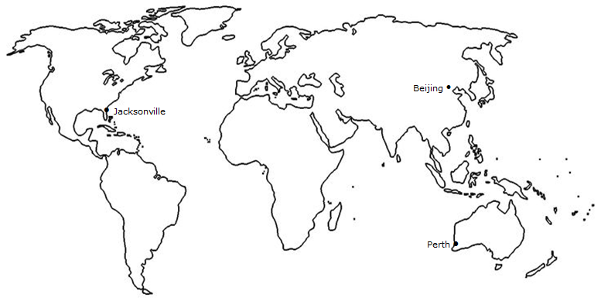
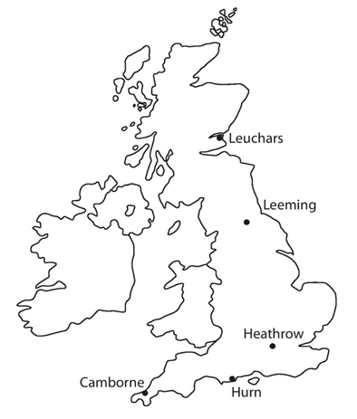
Data Collection
You need to be able to answer exam questions based on large amounts of real data that you will be given
The large data set contains information recorded over a number of years at weather stations around the world (as shown)
The data was recorded in both 1987 and 2015, and you will most likely be asked to draw comparisons between the two
You do not need to memorise the data, but being familiar with it and the locations shown will be useful
1E

Slide 23
Data Collection
Daily mean wind direction and windspeed
You need to be able to answer exam questions based on large amounts of real data that you will be given
The different sets of data recorded are as follows:
Daily mean cloud cover
→ This is measured in knots according to the beaufort scale (more on the next slide)
→ Measured in ‘oktas’, or eighths of the sky covered by cloud
Daily mean temperature
Daily maximum gust
Daily mean visibility
→ The mean temperature on that day
→ The highest instantaneous wind speed recorded, in knots
→ This is measured in decametres (Dm). The greatest distance at which an object can be seen in daylight
Daily total rainfall
The amount of rainfall that day (including snow or hail that has been melted)
Amounts less than 0.05mm are recorded as ‘tr’ (trace)
Daily maximum relative humidity
Daily mean pressure
→ This is a percentage of air saturation with water. Above 95% leads to mist/fog
→ Measured in hectopascals (1hPa = 100 Newtons per square metre)
Daily total sunshine
→ Recorded to the nearest tenth of an hour
1E

Slide 24
Data Collection
You need to be able to answer exam questions based on large amounts of real data that you will be given
Beaufort scale | Descriptive term | Average speed at 10metres above ground
0 | Calm | Less than 1 knot
1-3 | Light | 1-10 knots
4 | Moderate | 11-16 knots
5 | Fresh | 17-21 knots
1 knot is a ‘nautical mile per hour’, and is equivalent to 1.15mph
CLICK
1E

Slide 25
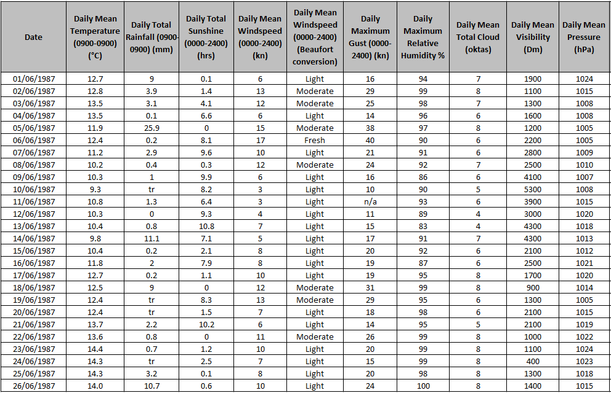
Data Collection
You need to be able to answer exam questions based on large amounts of real data that you will be given
Camborne
1E

Slide 26
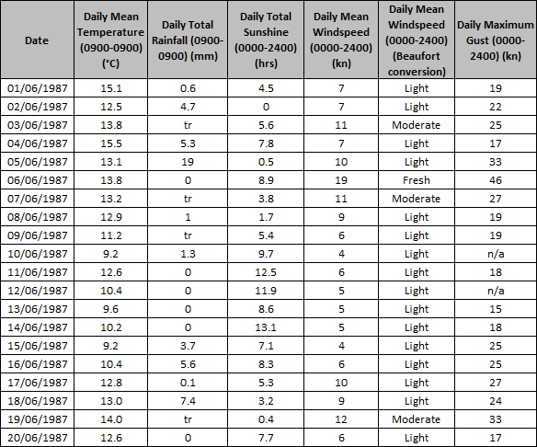
Data Collection
Hurn
You need to be able to answer exam questions based on large amounts of real data that you will be given
Look at the extract given to the right.
Describe the type of data represented by daily total rainfall
→ Continuous Quantitative Data
1E

Slide 27
Data Collection
Hurn
You need to be able to answer exam questions based on large amounts of real data that you will be given
Look at the extract given to the right.
Alison is investigating daily maximum gust. She wants to select a sample size of size 5 from the first 20 days in Hurn in June 1987. She uses the first two digits of the date as the sampling frame and generates 5 random numbers from 1-20
b) State the type of sampling method used
c) Why might the method not generate a sample of size 5?
Simple Random Sampling
Some of the values have n/a, meaning no data was recorded that day
1E

Slide 28
Data Collection
Hurn
You need to be able to answer exam questions based on large amounts of real data that you will be given
Using the extract to the right, calculate:
The mean daily mean temperature for the first 5 days of June in Hurn in 1987
The median daily total rainfall for the week of 14th June to 20th June inclusive
$$\frac{15.1+12.5+13.8+15.5+13.1}{5}$$
The table is to 1dp, so maintain this level of accuracy!
$$=14.0^{°}$$
$$0, 3.7, 5.6, 0.1, 7.4, tr, 0$$
Trace amount are slightly larger than 0
→ Treat them as 0 for any numerical calculations though!
$$0, 0, tr, 0.1, 3.7, 5.6, 7.4$$
$$Median=0.1$$
1E

Slide 29
Data Collection
Hurn
You need to be able to answer exam questions based on large amounts of real data that you will be given
b) The median daily total rainfall for the week of 14th June to 20th June inclusive
The median daily total rainfall for the same week in Perth was 19.0mm. Karl states that more southerly countries experience higher rainfall during June
c) State, with a reason, whether your answer to b) supports this statement
$$Median=0.1mm$$
Perth is in Australia, which is south of the UK, and its median rainfall was higher. However, taking a small sample from a single location is each country means there is not enough data to support the statement.
1E

