Slide 1
Old Spec Q’s
Vectors
Practice F (i)
Practice F (ii)
Practice H
Practice I

Slide 2
Practice F

Slide 3
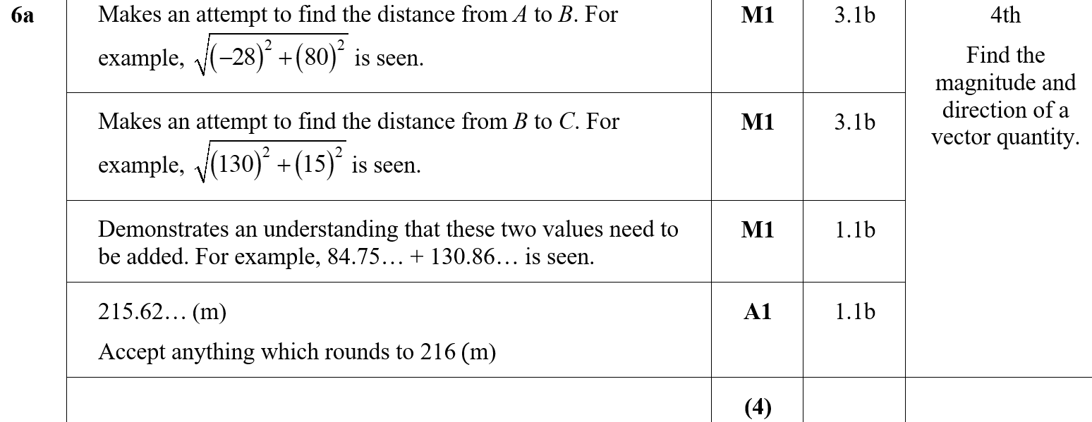
Practice F
A

Slide 4
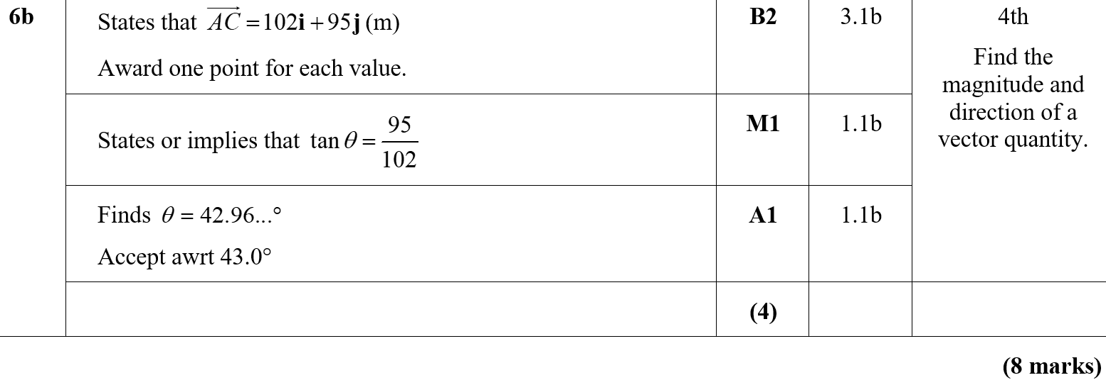
Practice F
B

Slide 5
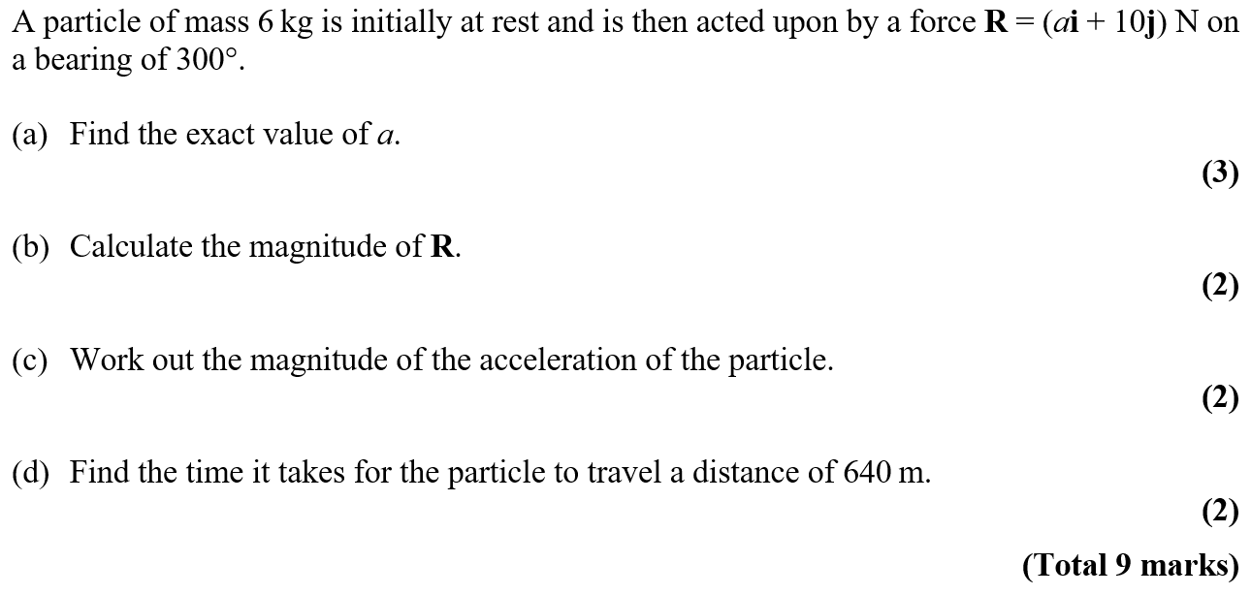
Practice F

Slide 6
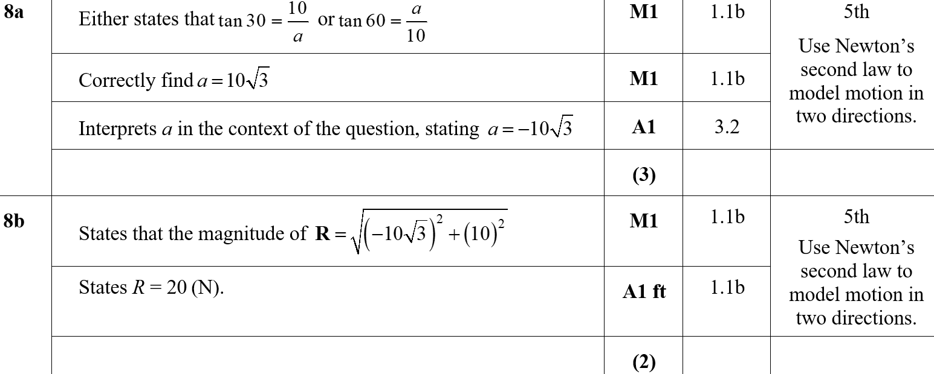
Practice F
A
B
B notes

Slide 7
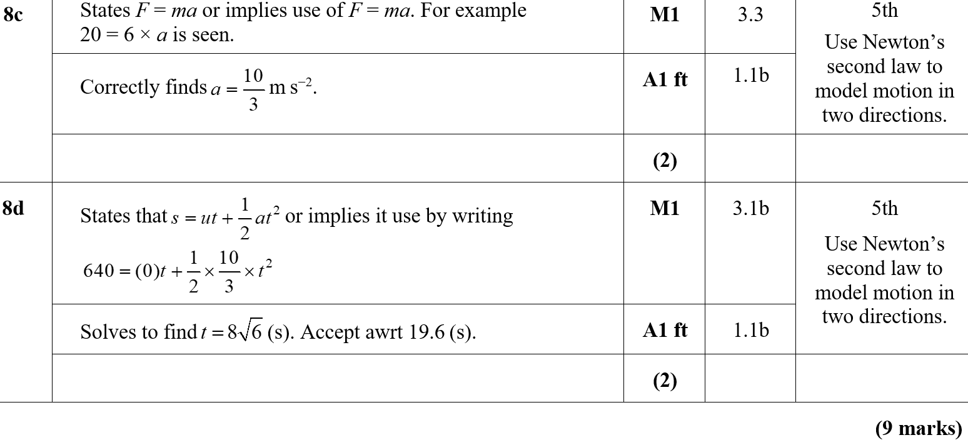
Practice F
C
D
C notes
D notes

Slide 8
Practice H

Slide 9
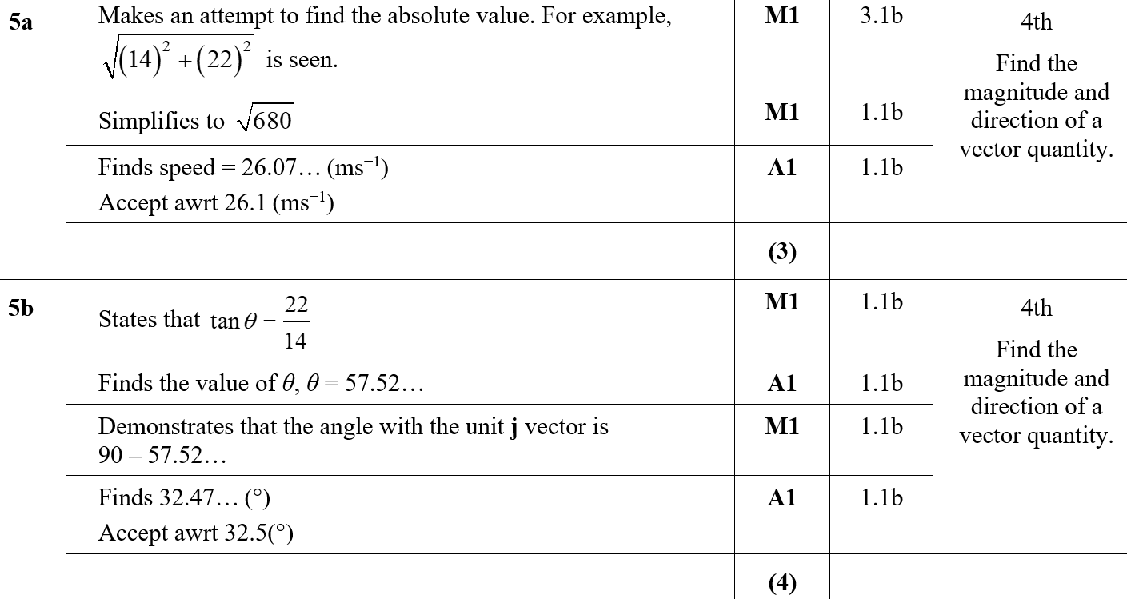
Practice H
A
B

Slide 10
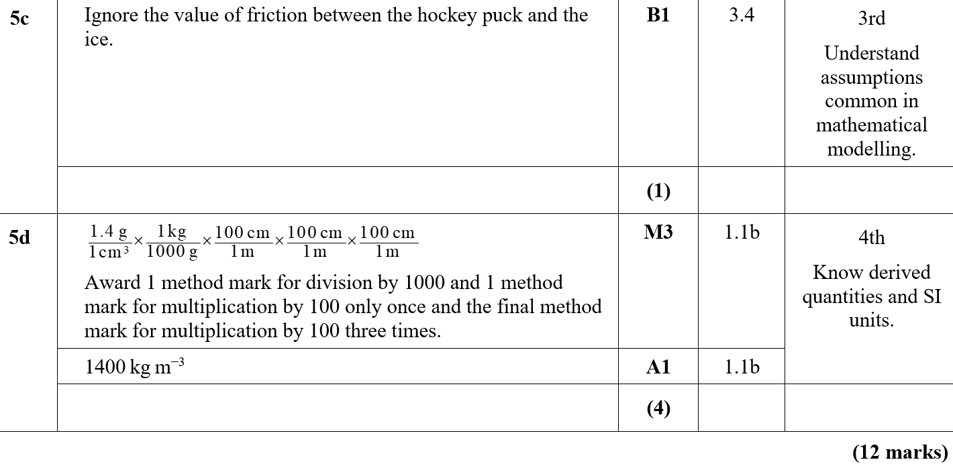
Practice H
C
D
B notes

Slide 11
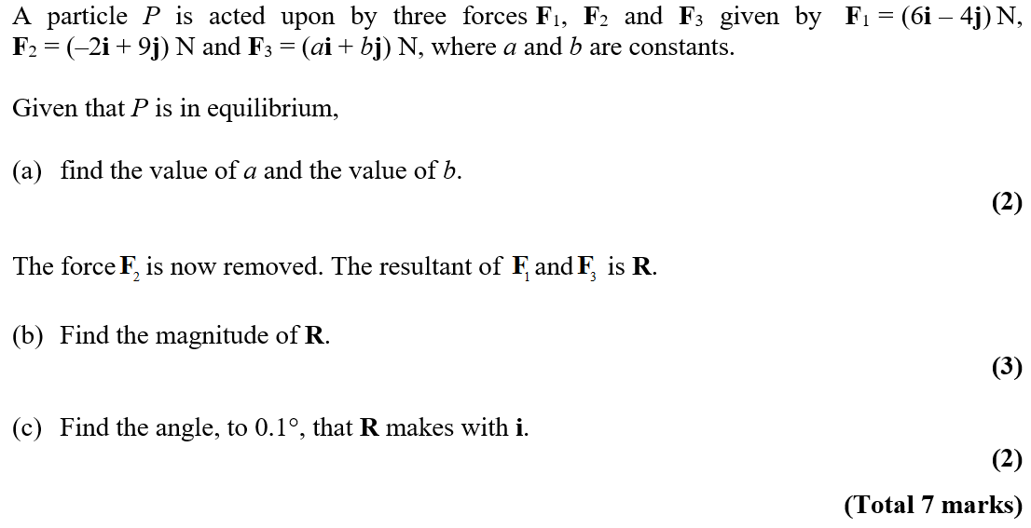
Practice I

Slide 12
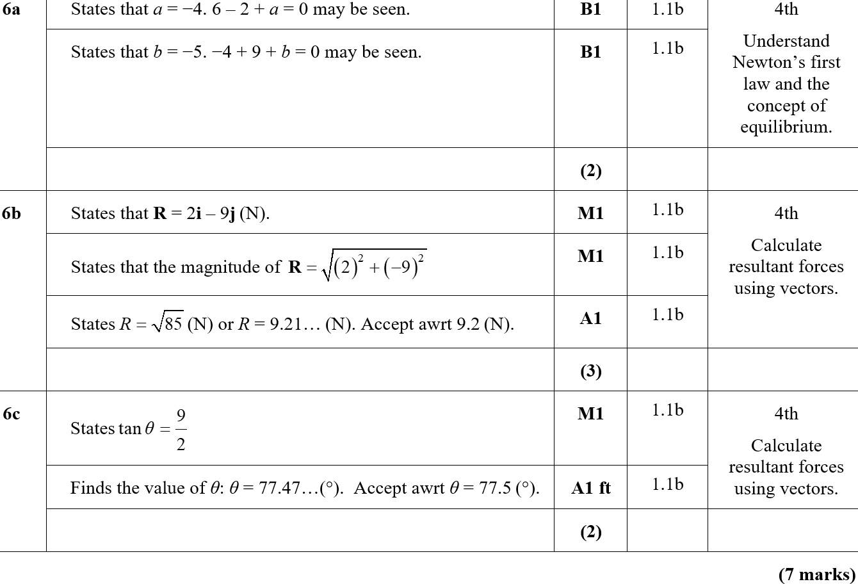
Practice I
A
B
C

Slide 13
Practice I
B notes
C notes

Slide 14
New Spec Q’s
Old Spec Vectors
Jan 2006
Jan 2009
May 2009
Jan 2012
June 2016
June 2017
June 2018

Slide 15
Jan 2006

Slide 16
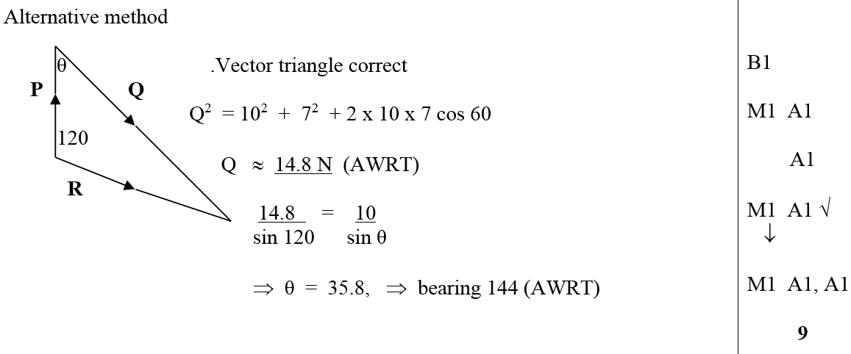
Jan 2006
i
ii
Alternative Method

Slide 17
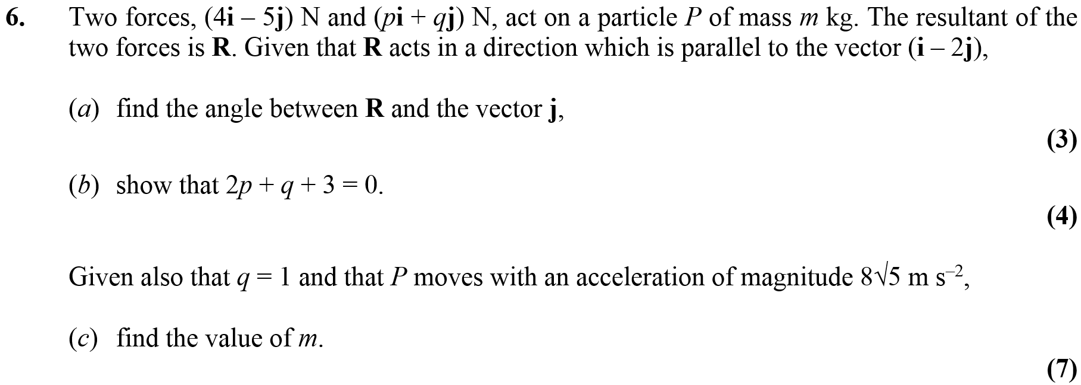
Jan 2009

Slide 18
Jan 2009
A
B
C

Slide 19
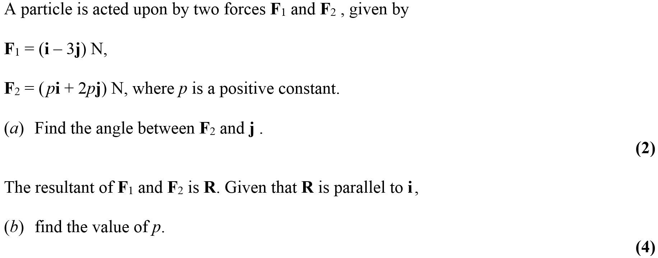
May 2009

Slide 20
May 2009
A
B

Slide 21
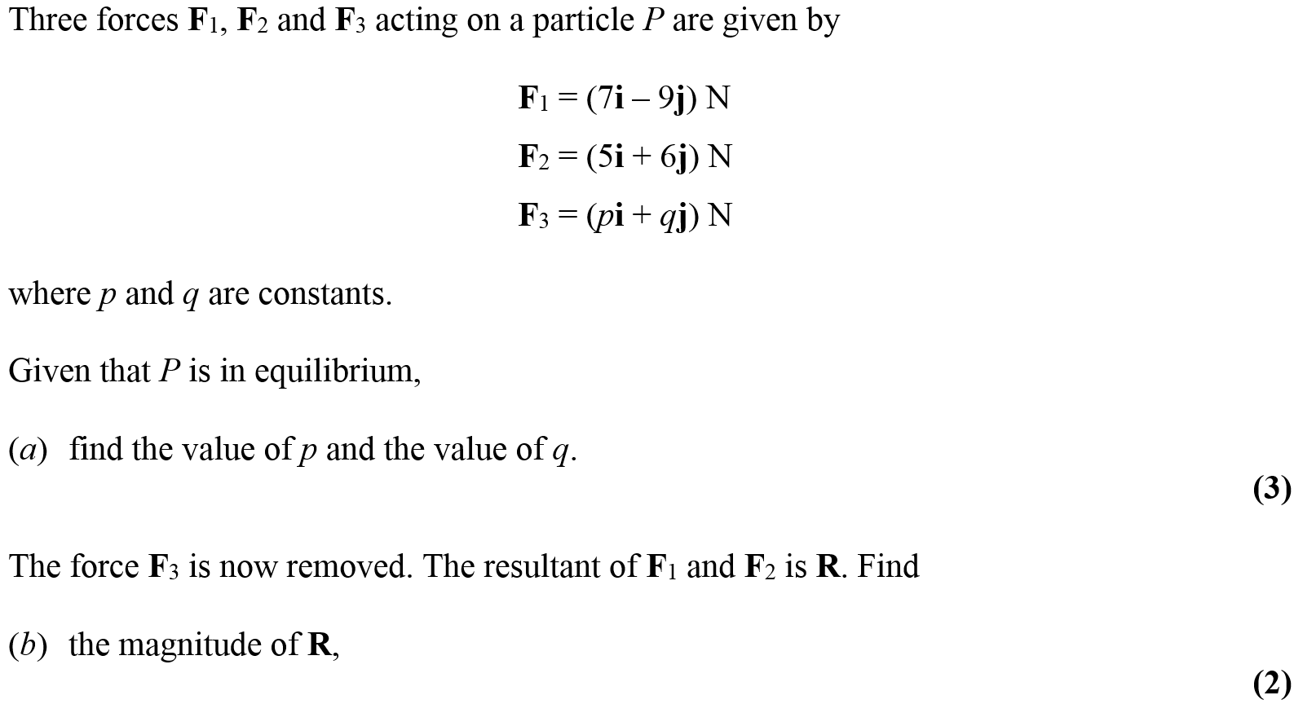
Jan 2012

Slide 22
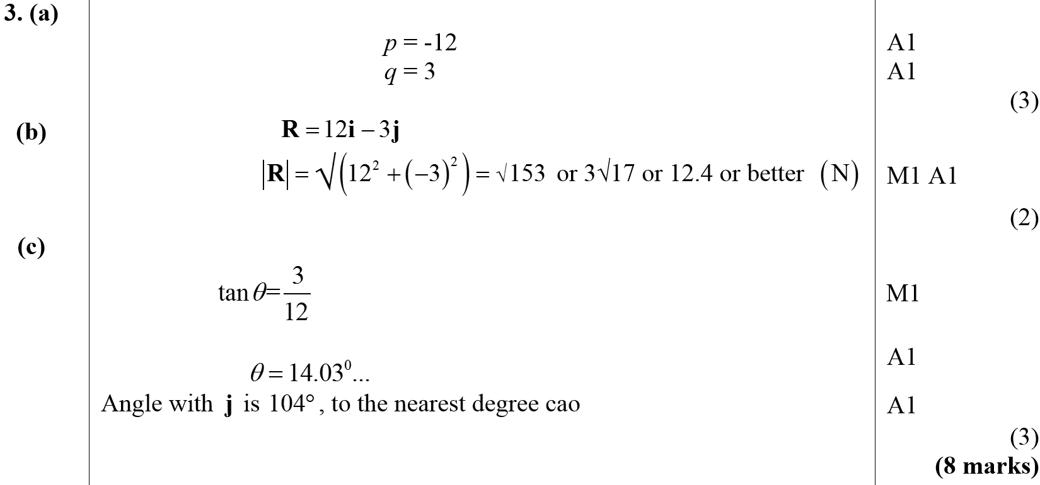
Jan 2012
A
B
C

Slide 23
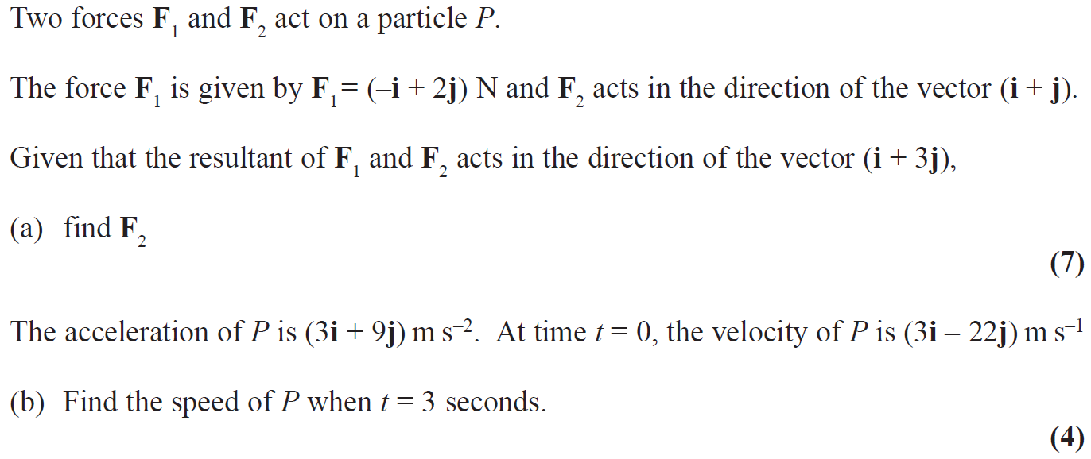
June 2016

Slide 24
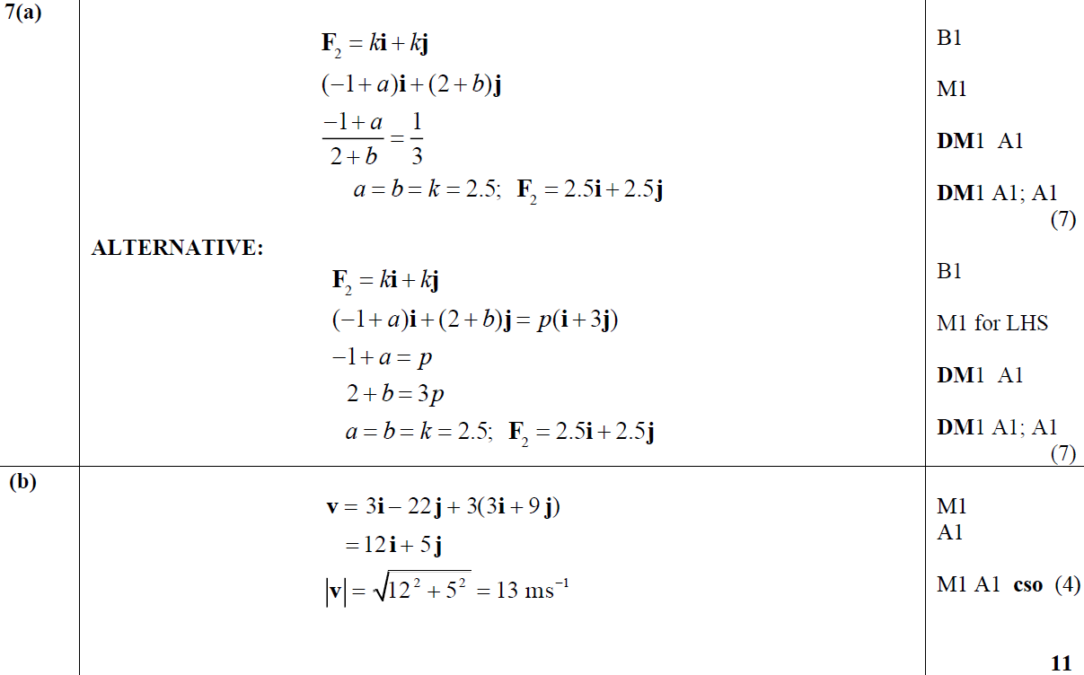
June 2016
A
A Alternative
B

Slide 25
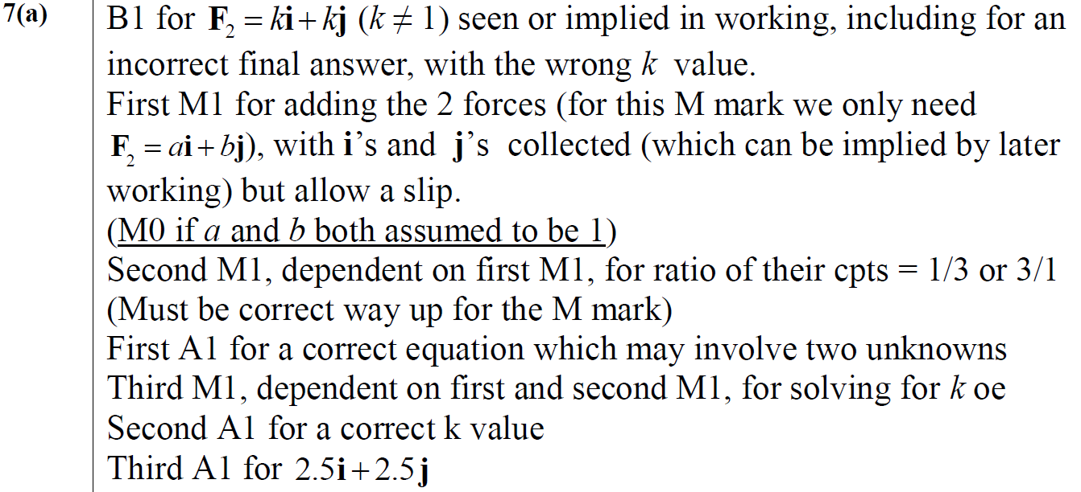
June 2016
A notes

Slide 26
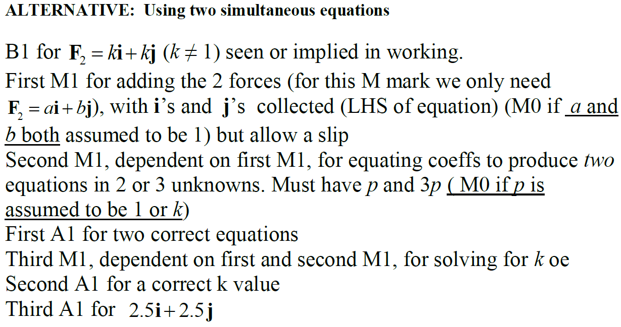
June 2016
A Alternative with simultaneous equations notes

Slide 27
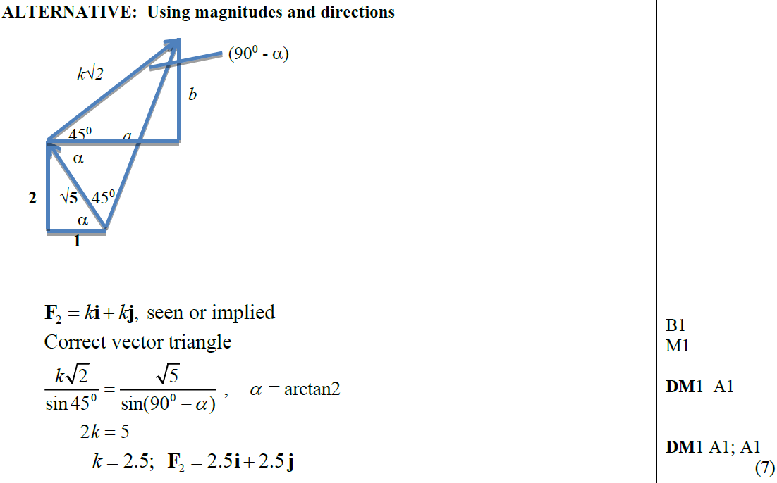
June 2016
A Alternative 1 with magnitudes and directions notes

Slide 28
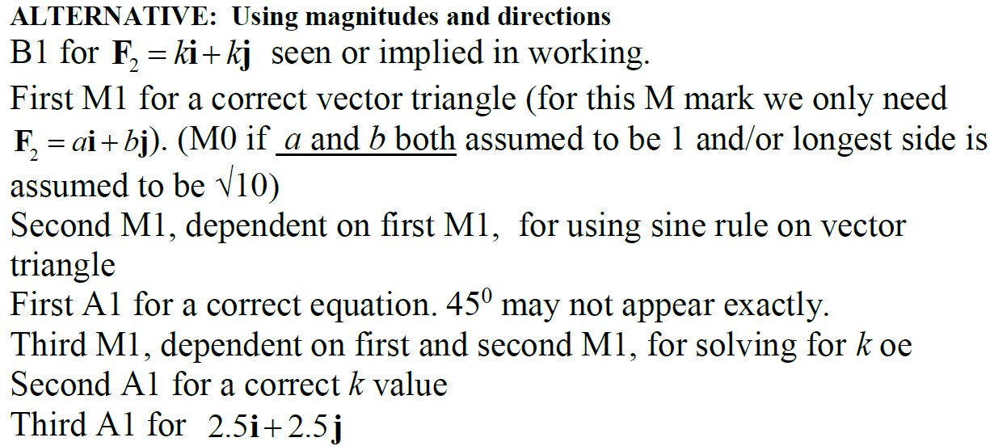
June 2016
A Alternative 2 with magnitudes and directions notes
B Notes

Slide 29
June 2017

Slide 30
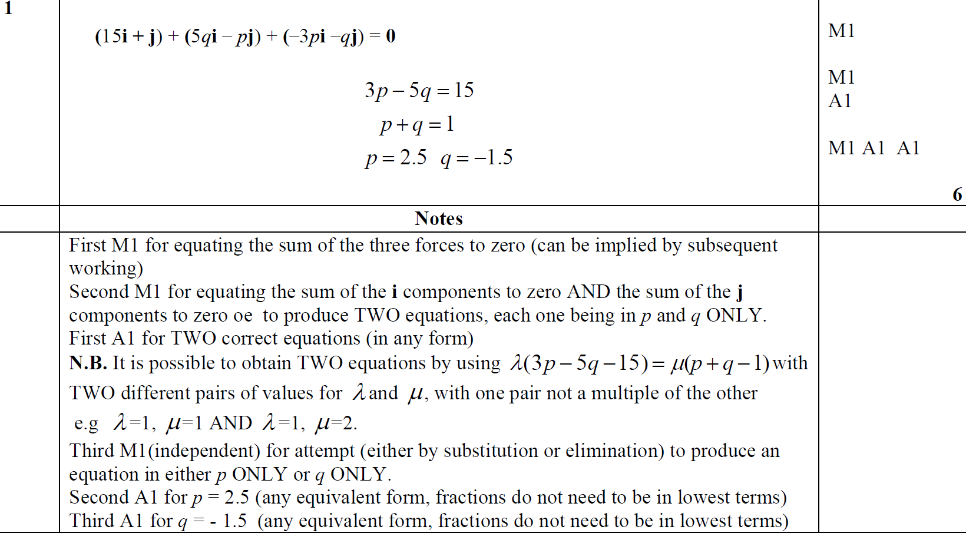
June 2017
A
A notes

Slide 31
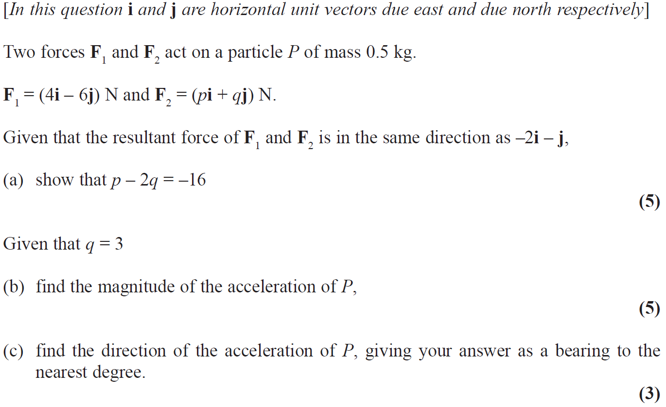
June 2018

Slide 32
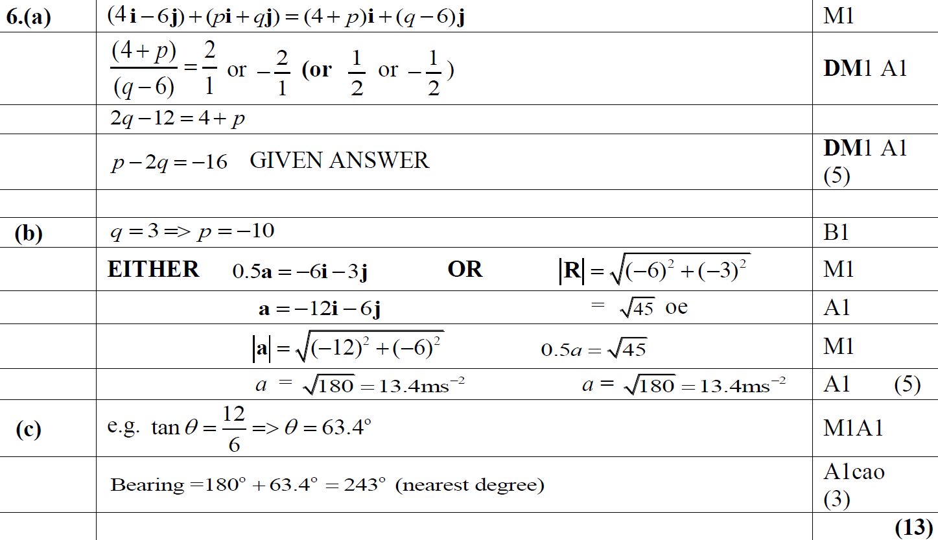
June 2018
A
B
C

Slide 33
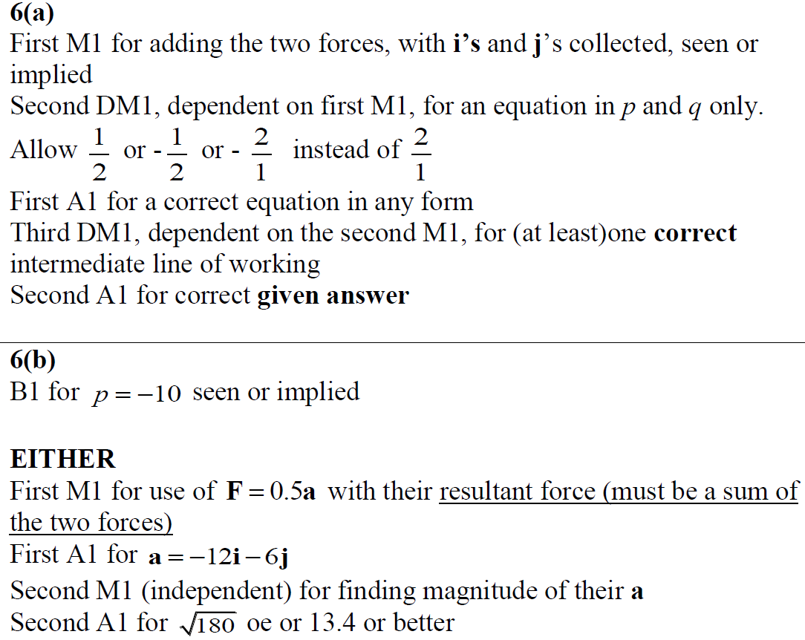
June 2018
A notes
B notes

