Slide 1
Simplifying Basic Expressions
Simplifying Basic Expressions
Edexcel
AQA
Spec 2
2H Q3
OCR

Slide 2
Simplifying Basic Expressions
Simplifying Basic Expressions
Edexcel
May 2018
1H Q3
AQA
SAM
2H Q3
1 Marker
Nov 2018
1H Q3
OCR

Slide 3
Simplifying Basic Expressions
Simplifying Basic Expressions
Edexcel
None to date
AQA
OCR

Slide 4
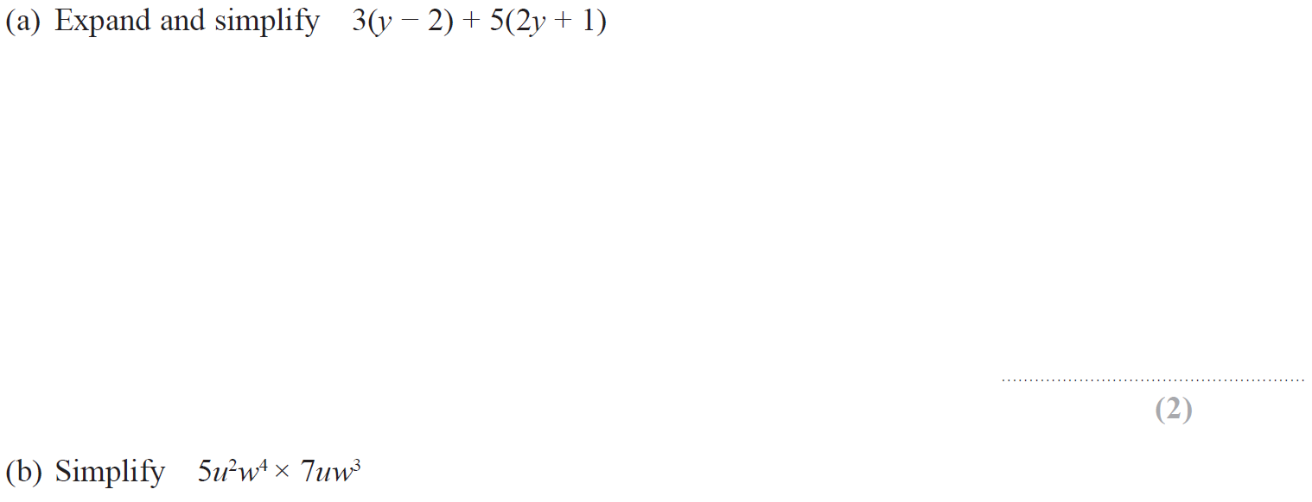
Simplifying Basic Expressions
Specimen Set 2 2H Q3

Slide 5
Simplifying Basic Expressions
Specimen Set 2 2H Q3
A
B

Slide 6
Simplifying Basic Expressions
SAM 2H Q3

Slide 7
Simplifying Basic Expressions
SAM 2H Q3
A

Slide 8
Simplifying Basic Expressions
May 2018 1H Q3

Slide 9
Simplifying Basic Expressions
May 2018 1H Q3
A

Slide 10
Simplifying Basic Expressions
Nov 2018 1H Q3

Slide 11
Simplifying Basic Expressions
Nov 2018 1H Q3
A

