Slide 1
Simplifying Basic Expressions
Simplifying Basic Expressions
Old Spec Q’s
June 2018
2HR Q4

Slide 2
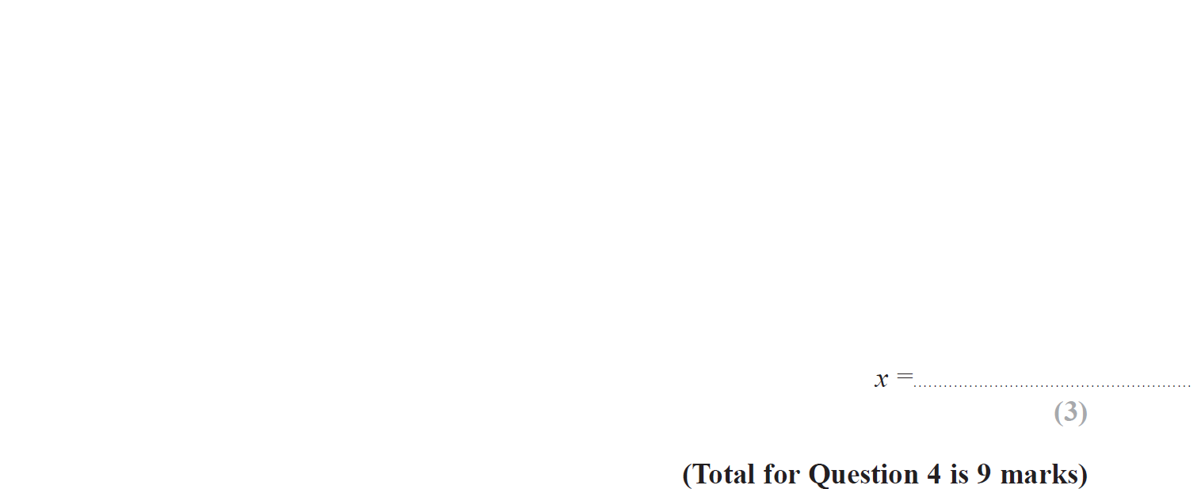
Simplifying Basic Expressions
June 2018 2HR Q4

Slide 3
Simplifying Basic Expressions
June 2018 2HR Q4
A
B
C
D

Slide 4
Simplifying Basic Expressions
Simplifying Basic Expressions
New Spec Q’s
May 2004
4H Q9
Nov 2009
4H Q12
Jan 2014 3HR Q4
May 2017 3HR Q9
Nov 2004
4H Q6
June 2010
3H Q4
May 2014 3H Q4
Jan 2018 3HR Q1
May 2005
4H Q4
June 2011 4H Q5
Jan 2015 3H Q3
Jan 2018 4HR Q11
Nov 2007
4H Q14
May 2012 4H Q10
May 2015 3H Q9
June 2018 4HR Q9
Nov 2008
4H Q1
Jan 2013 4H Q8
Jan 2016 4HR Q6
May 2009
3H Q5
May 2013 3H Q14
June 2016 4H Q5
June 2009
4H Q15
Jan 2014 3H Q5
June 2016 4HR Q2
Nov 2009
3H Q9
Jan 2014 4H Q6
Jan 2017 3H Q5

Slide 5
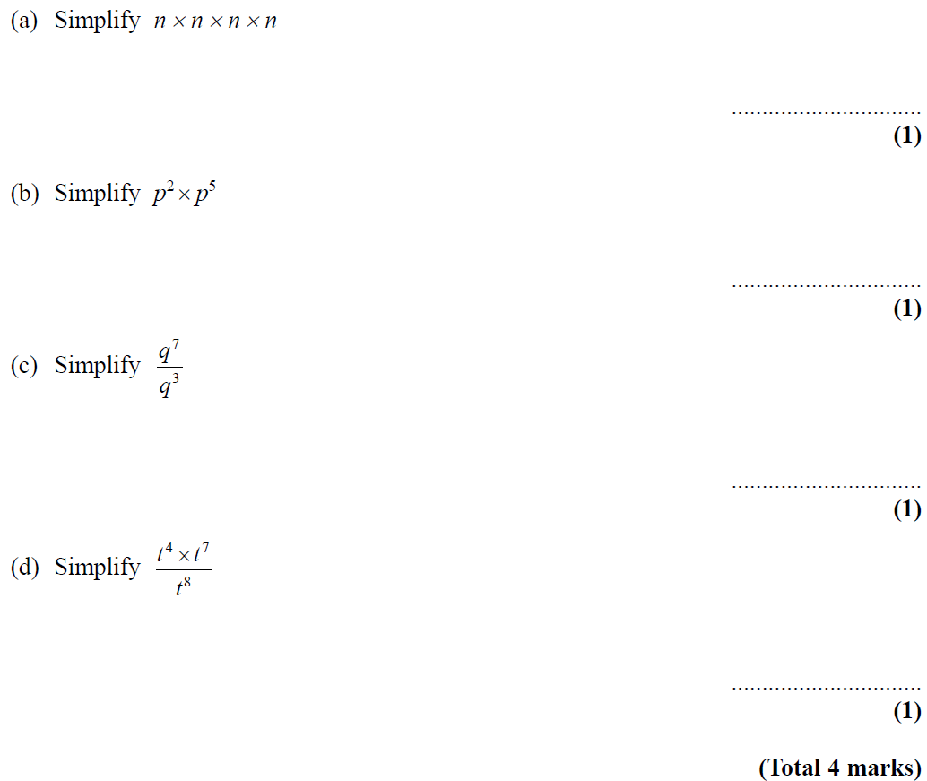
Simplifying Basic Expressions
May 2004 4H Q9

Slide 6
Simplifying Basic Expressions
May 2004 4H Q9
A
B
C
D

Slide 7
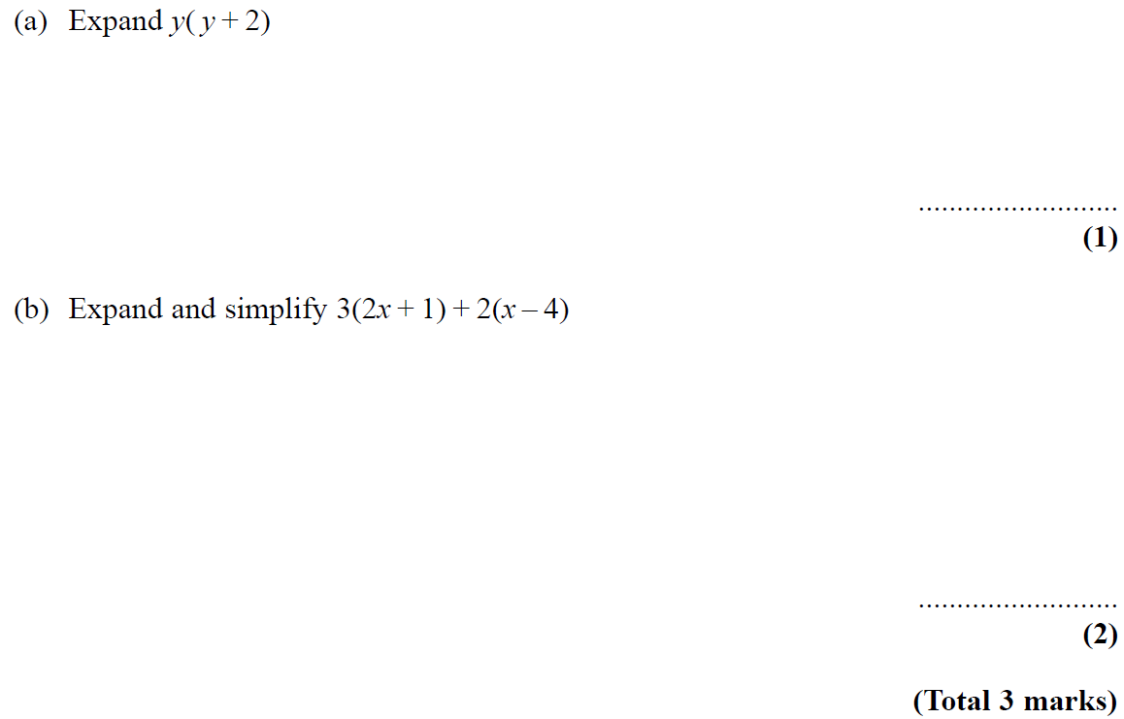
Simplifying Basic Expressions
Nov 2004 4H Q6

Slide 8
Simplifying Basic Expressions
Nov 2004 4H Q6
A
B

Slide 9
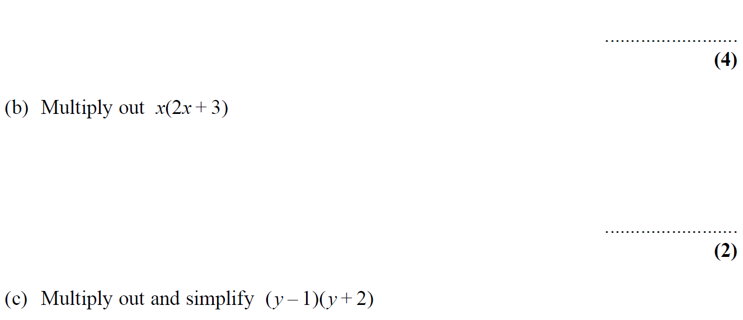
Simplifying Basic Expressions
May 2005 4H Q4

Slide 10
Simplifying Basic Expressions
May 2005 4H Q4
A (i)
A (ii)
A (iii)
B
C

Slide 11
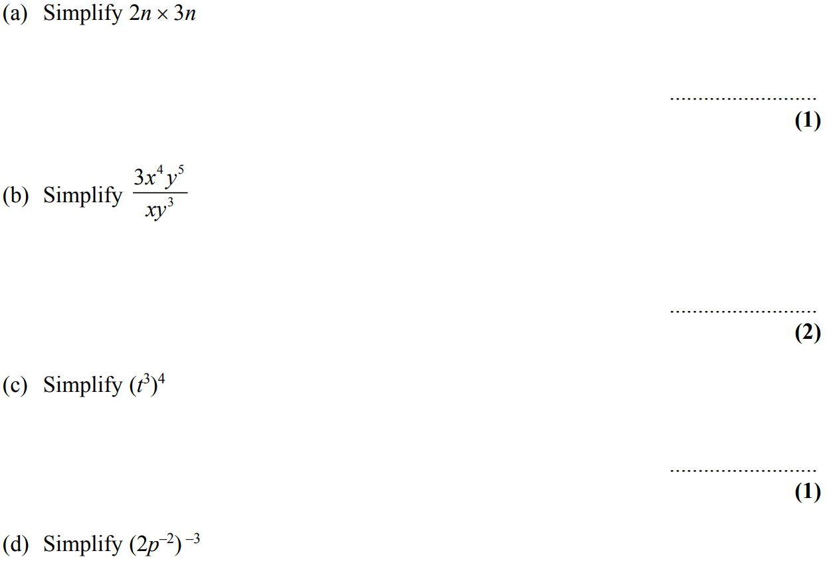
Simplifying Basic Expressions
Nov 2007 4H Q14

Slide 12
Simplifying Basic Expressions
Nov 2007 4H Q14
A
B
C
D

Slide 13
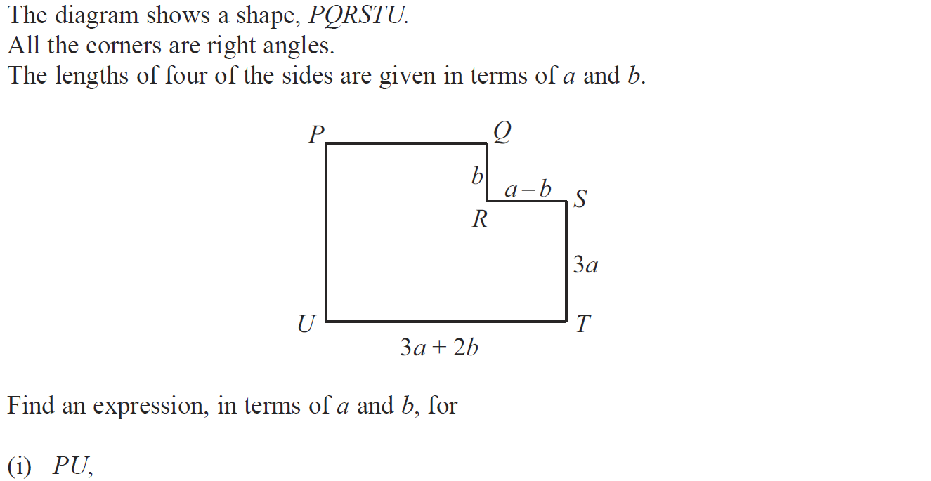
Simplifying Basic Expressions
Nov 2008 4H Q1

Slide 14
Simplifying Basic Expressions
Nov 2008 4H Q1
(i)
(ii)

Slide 15
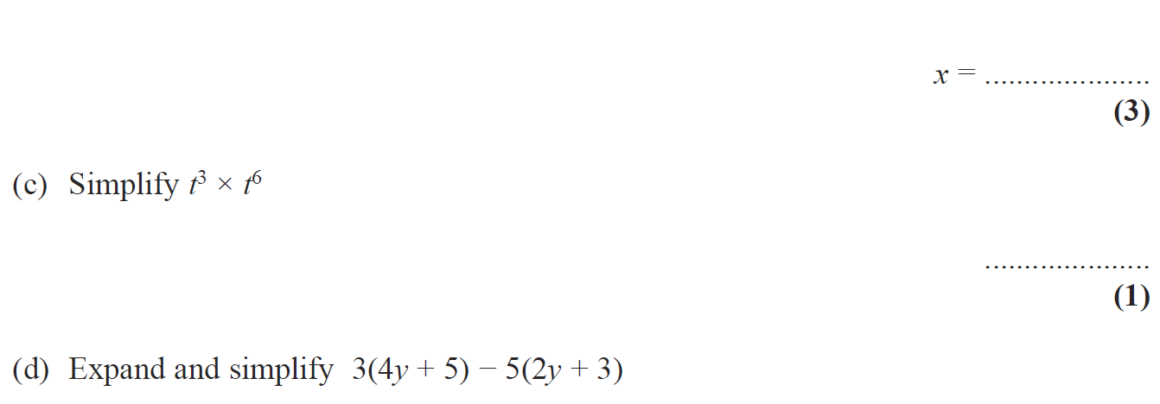
Simplifying Basic Expressions
May 2009 3H Q5

Slide 16
Simplifying Basic Expressions
May 2009 3H Q5
A
B
C
D

Slide 17
Simplifying Basic Expressions
June 2009 4H Q15

Slide 18
Simplifying Basic Expressions
June 2009 4H Q15
A
B
C

Slide 19
Simplifying Basic Expressions
Nov 2009 3H Q9

Slide 20
Simplifying Basic Expressions
Nov 2009 3H Q9
A
B
C

Slide 21
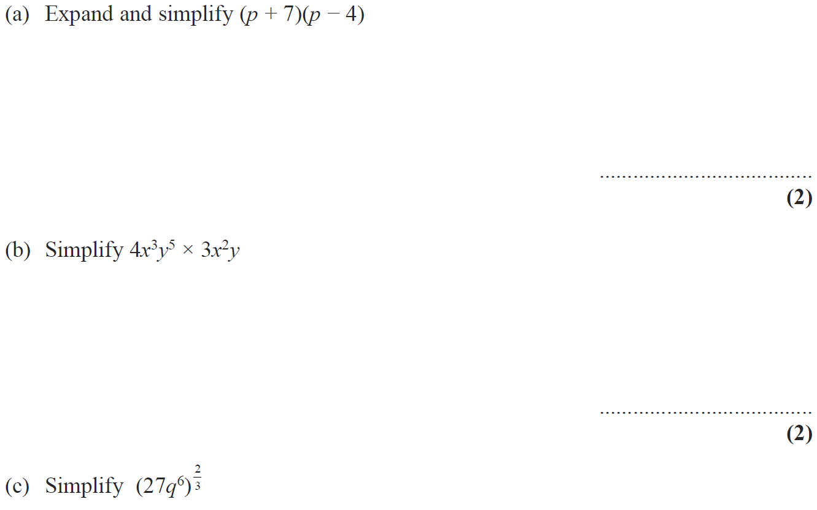
Simplifying Basic Expressions
Nov 2009 4H Q12

Slide 22
Simplifying Basic Expressions
Nov 2009 4H Q12
A
B
C

Slide 23
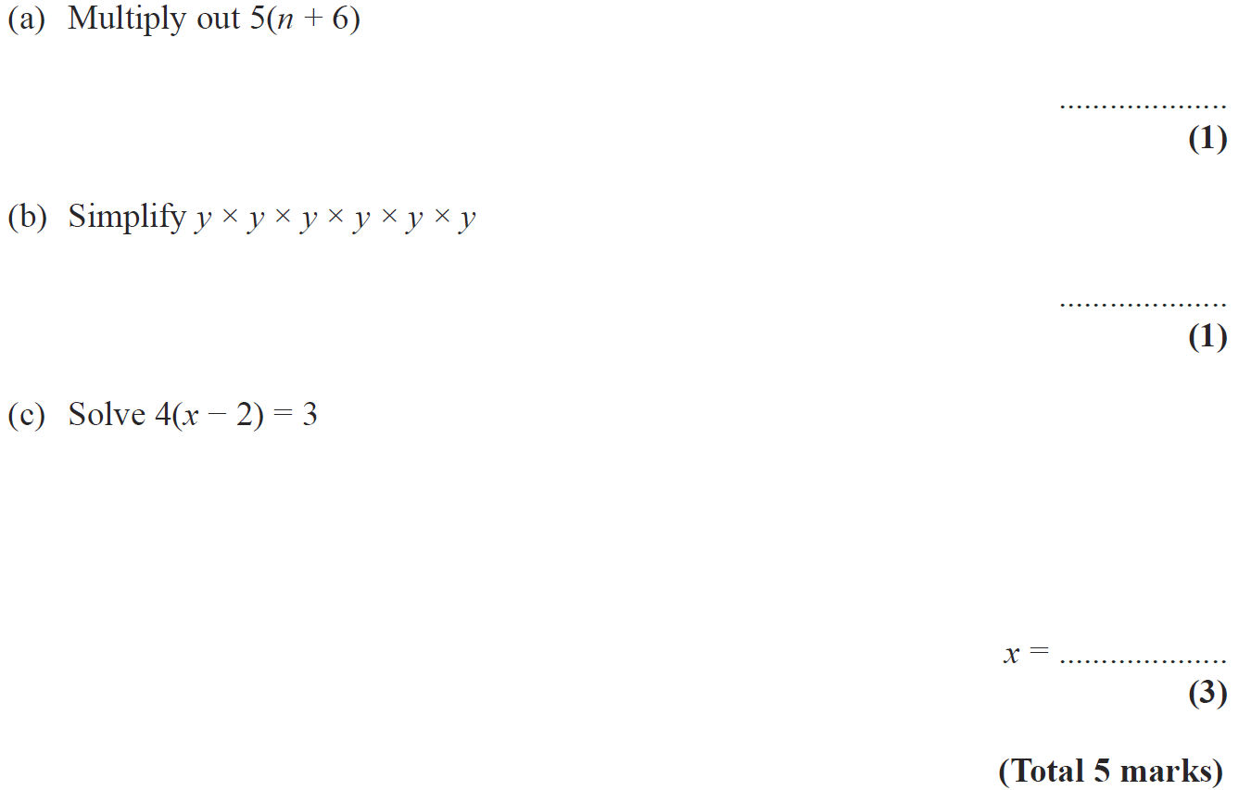
Simplifying Basic Expressions
June 2010 3H Q4

Slide 24
Simplifying Basic Expressions
June 2010 3H Q4
A
B
C

Slide 25
Simplifying Basic Expressions
June 2011 4H Q5

Slide 26
Simplifying Basic Expressions
June 2011 4H Q5
A (i)
A (ii)
A (iii)
B
C

Slide 27
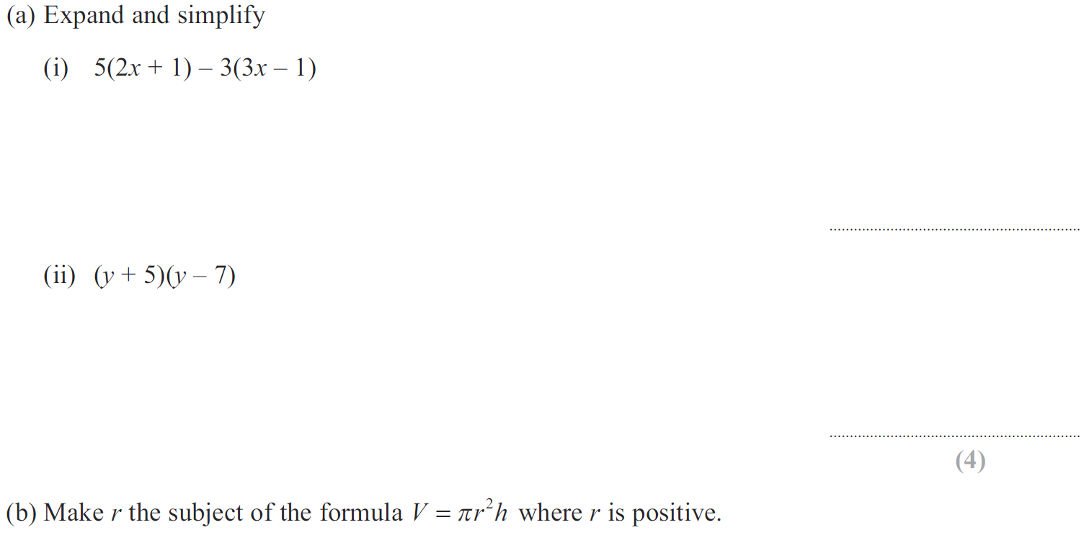
Simplifying Basic Expressions
May 2012 4H Q10

Slide 28
Simplifying Basic Expressions
May 2012 4H Q10
A (i)
A (ii)
B

Slide 29
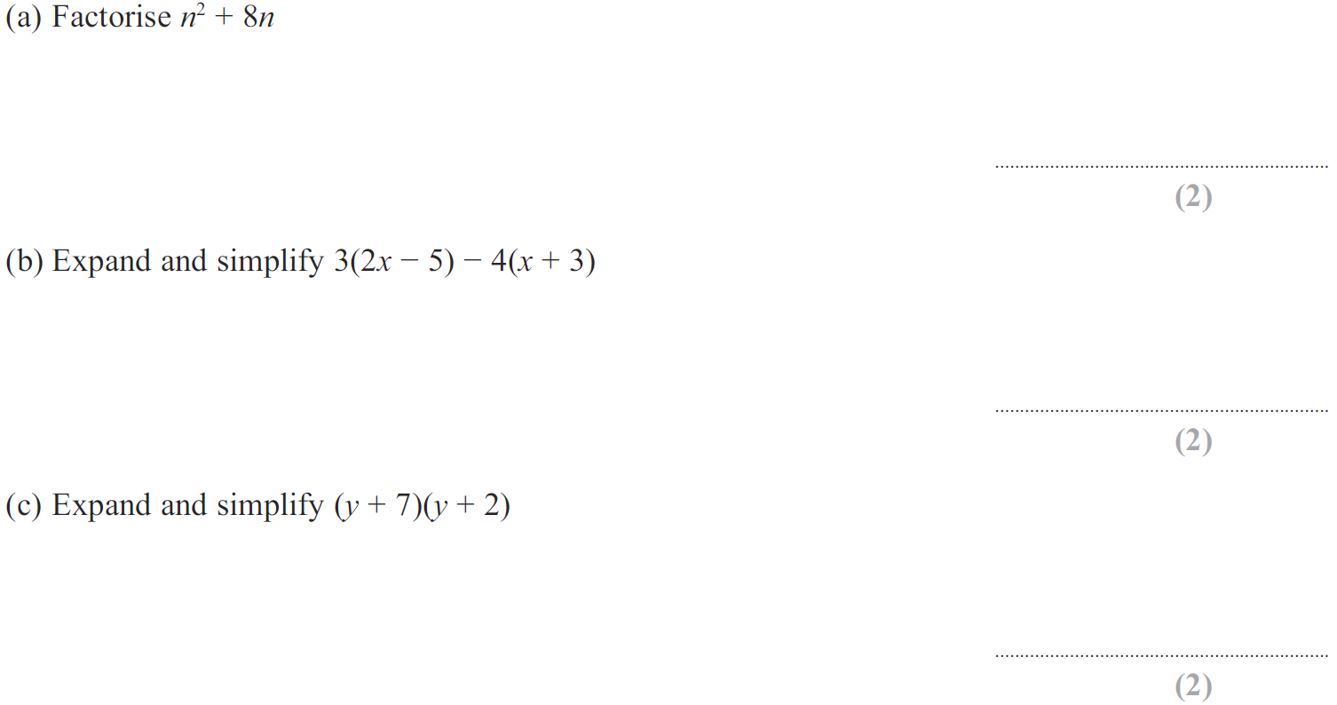
Simplifying Basic Expressions
Jan 2013 4H Q8

Slide 30
Simplifying Basic Expressions
Jan 2013 4H Q8
A
B
C

Slide 31
Simplifying Basic Expressions
May 2013 3H Q14

Slide 32
Simplifying Basic Expressions
May 2013 3H Q14
A
B
C

Slide 33
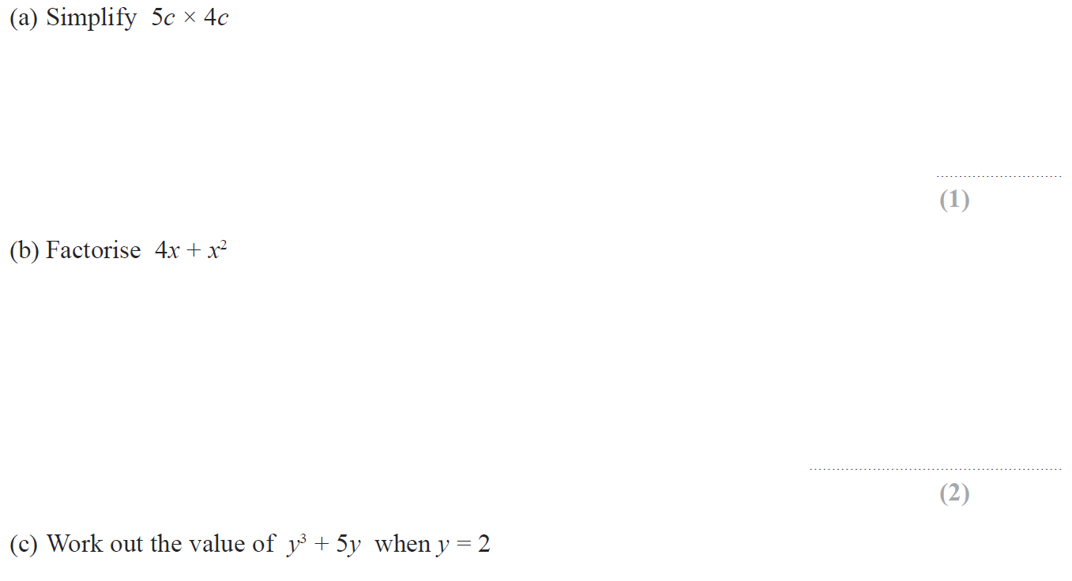
Simplifying Basic Expressions
Jan 2014 3H Q5

Slide 34
Simplifying Basic Expressions
Jan 2014 3H Q5
A
B
C

Slide 35
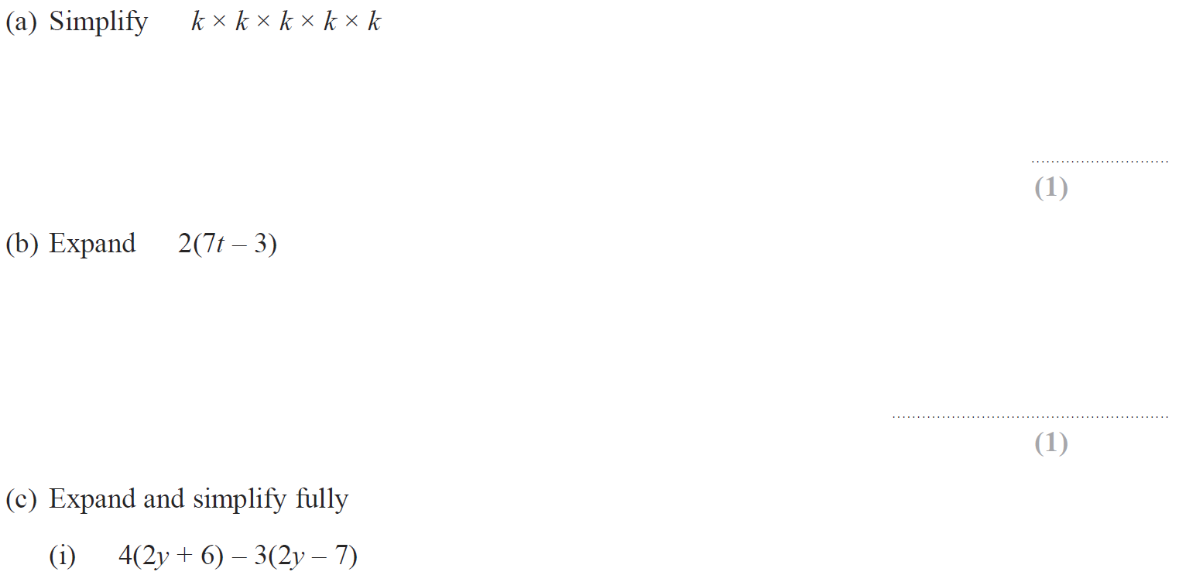
Simplifying Basic Expressions
Jan 2014 4H Q6

Slide 36
Simplifying Basic Expressions
Jan 2014 4H Q6
A
B
C (i)
C (ii)
D

Slide 37
Simplifying Basic Expressions
Jan 2014 3HR Q4

Slide 38
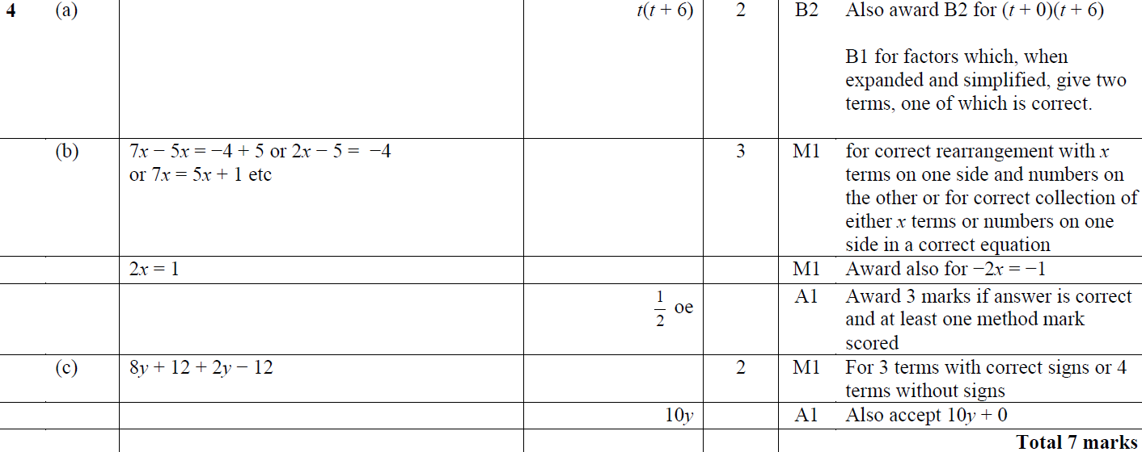
Simplifying Basic Expressions
Jan 2014 3HR Q4
A
B
C

Slide 39
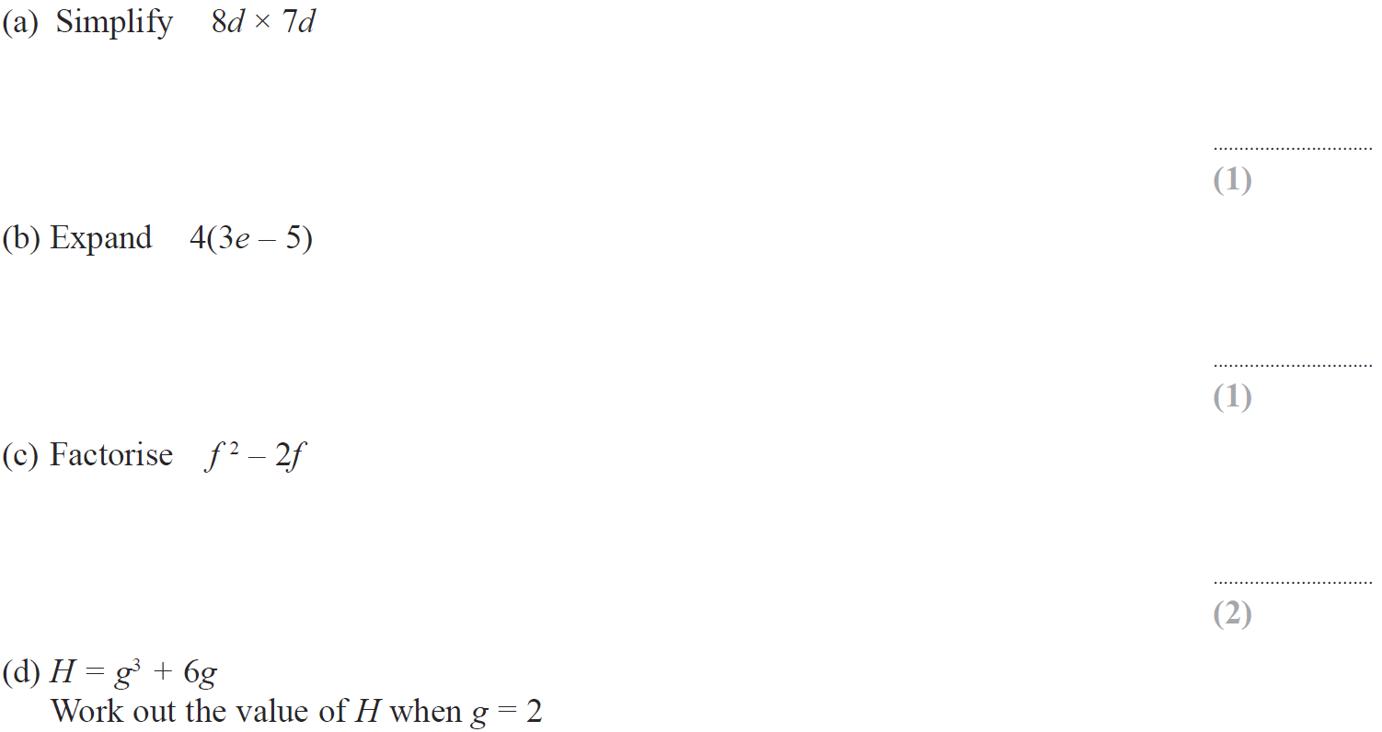
Simplifying Basic Expressions
May 2014 3H Q4

Slide 40
Simplifying Basic Expressions
May 2014 3H Q4
A
B
C
D

Slide 41
Simplifying Basic Expressions
Jan 2015 3H Q3

Slide 42
Simplifying Basic Expressions
Jan 2015 3H Q3
A
B
C
D

Slide 43
Simplifying Basic Expressions
May 2015 3H Q9

Slide 44
Simplifying Basic Expressions
May 2015 3H Q9
A
B
C
D

Slide 45
Simplifying Basic Expressions
Jan 2016 4HR Q6

Slide 46
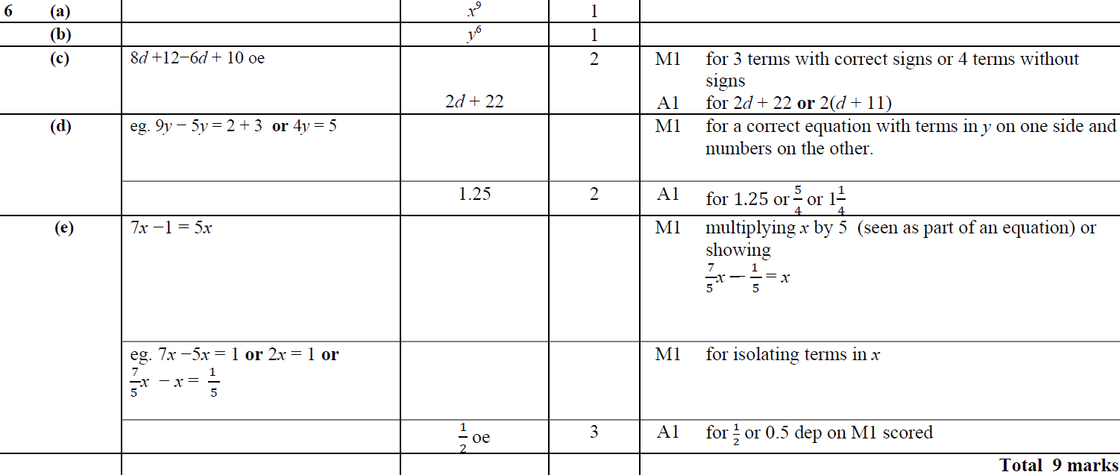
Simplifying Basic Expressions
Jan 2016 4HR Q6
A
B
C
D
E

Slide 47
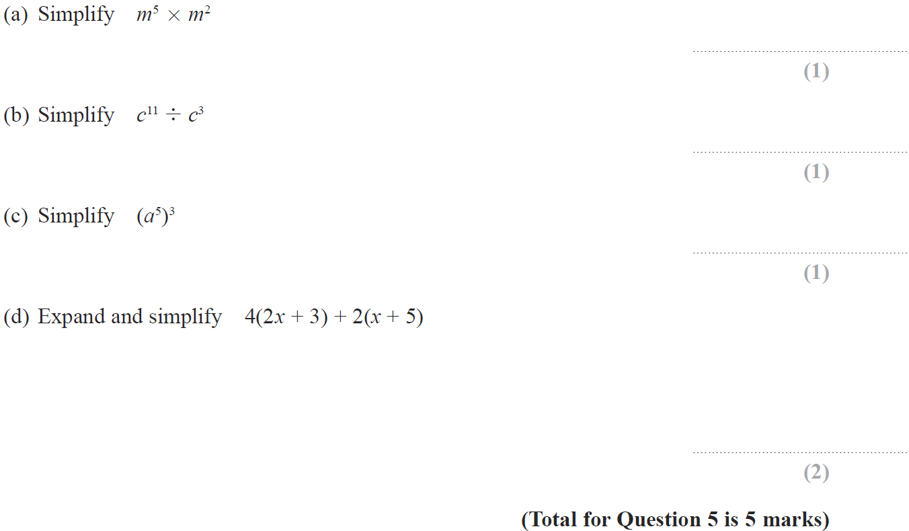
Simplifying Basic Expressions
June 2016 4H Q5

Slide 48
Simplifying Basic Expressions
June 2016 4H Q5
A
B
C
D

Slide 49
Simplifying Basic Expressions
June 2016 4HR Q2

Slide 50
Simplifying Basic Expressions
June 2016 4HR Q2
A
B
C

Slide 51
Simplifying Basic Expressions
Jan 2017 3H Q5

Slide 52
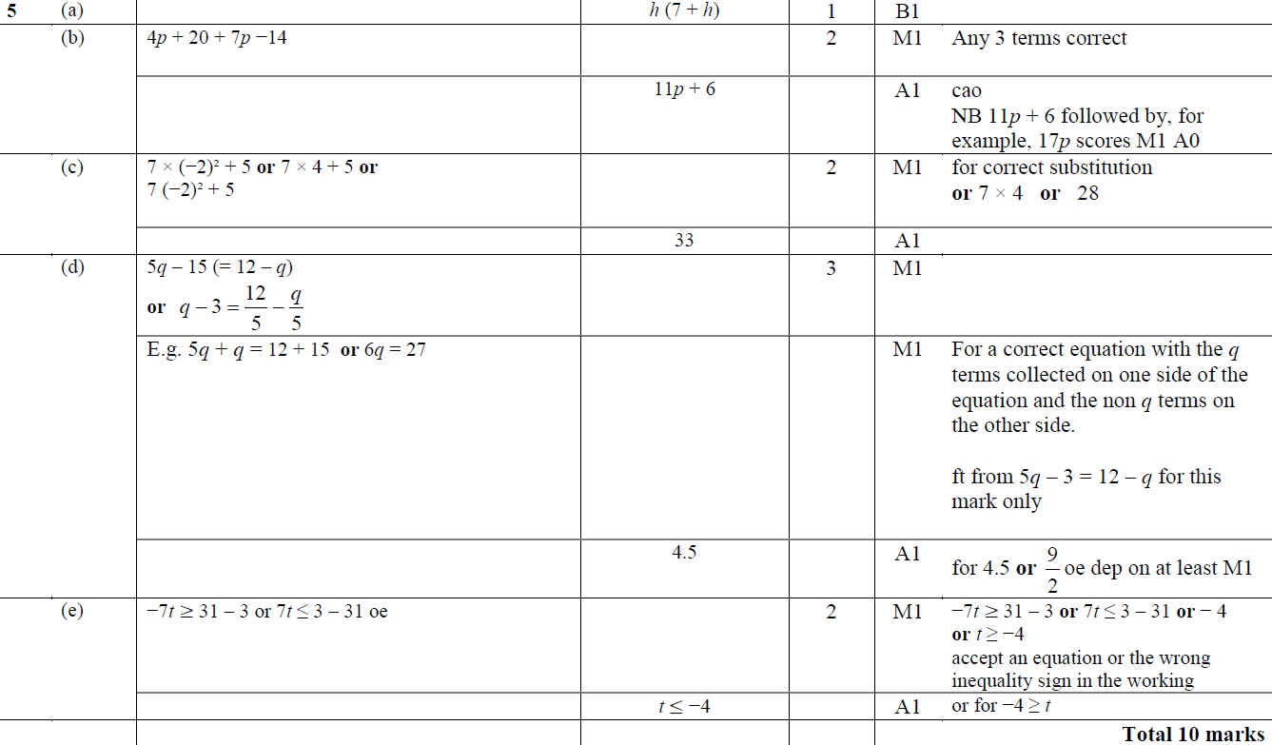
Simplifying Basic Expressions
Jan 2017 3H Q5
A
B
C
D
E

Slide 53
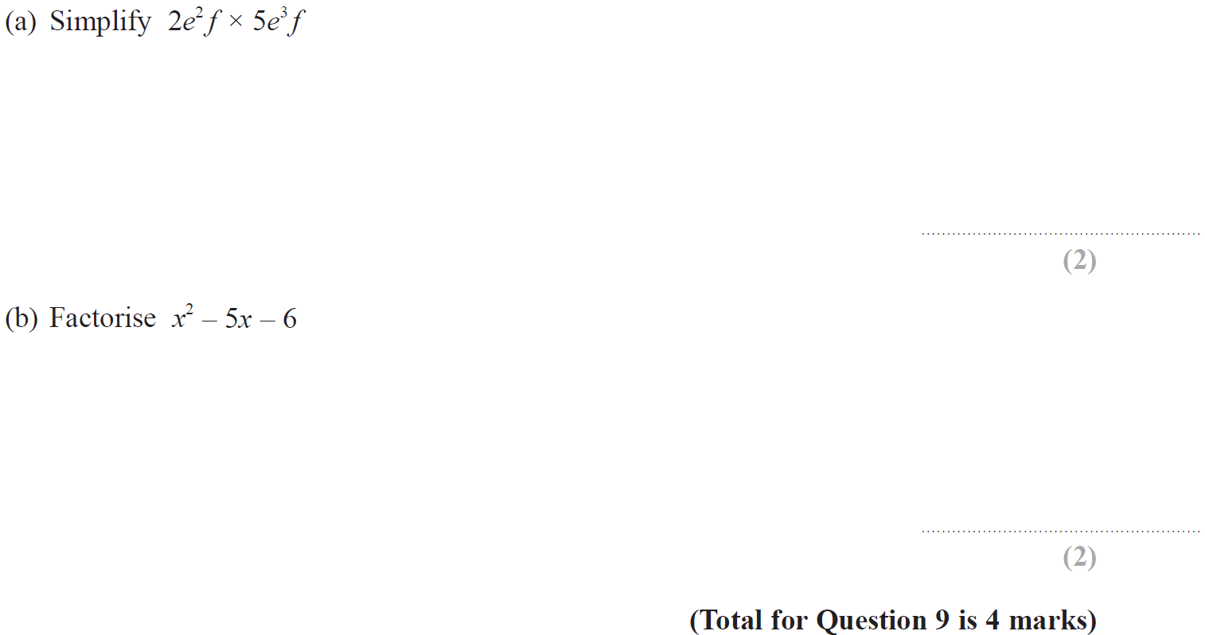
Simplifying Basic Expressions
May 2017 3HR Q9

Slide 54
Simplifying Basic Expressions
May 2017 3HR Q9
A
B

Slide 55
Simplifying Basic Expressions
Jan 2018 3HR Q1

Slide 56
Simplifying Basic Expressions
Jan 2018 3HR Q1
A
B
C

Slide 57
Simplifying Basic Expressions
Jan 2018 4HR Q11

Slide 58
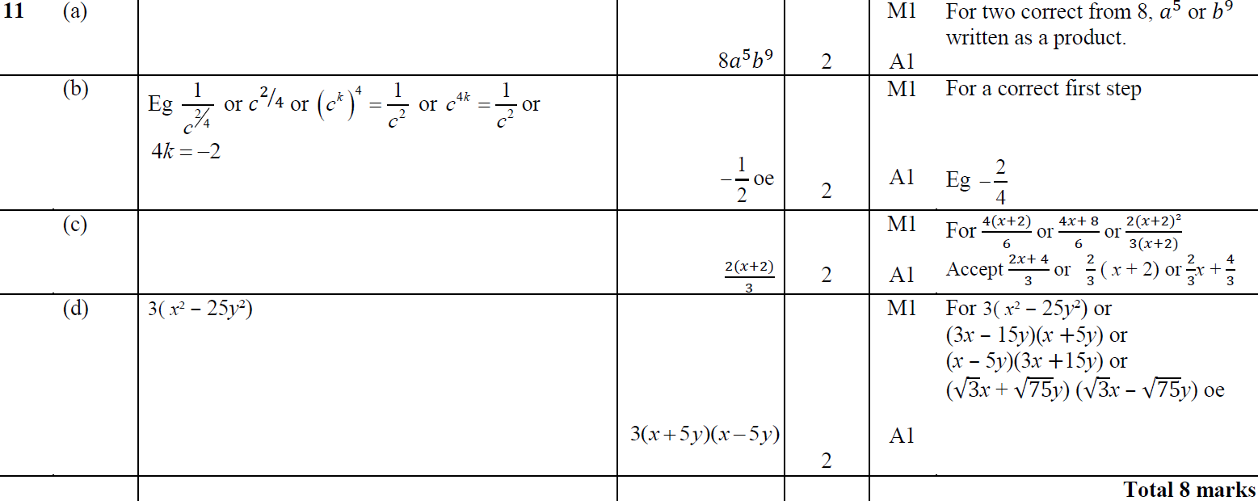
Simplifying Basic Expressions
Jan 2018 4HR Q11
A
B
C
D

Slide 59
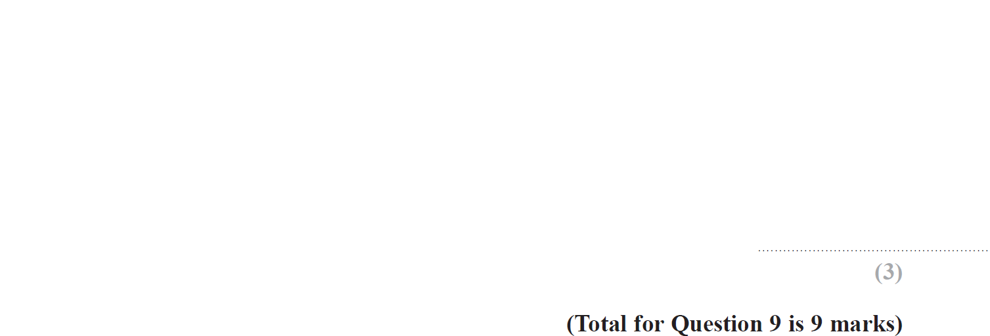
Simplifying Basic Expressions
June 2018 4HR Q9

Slide 60
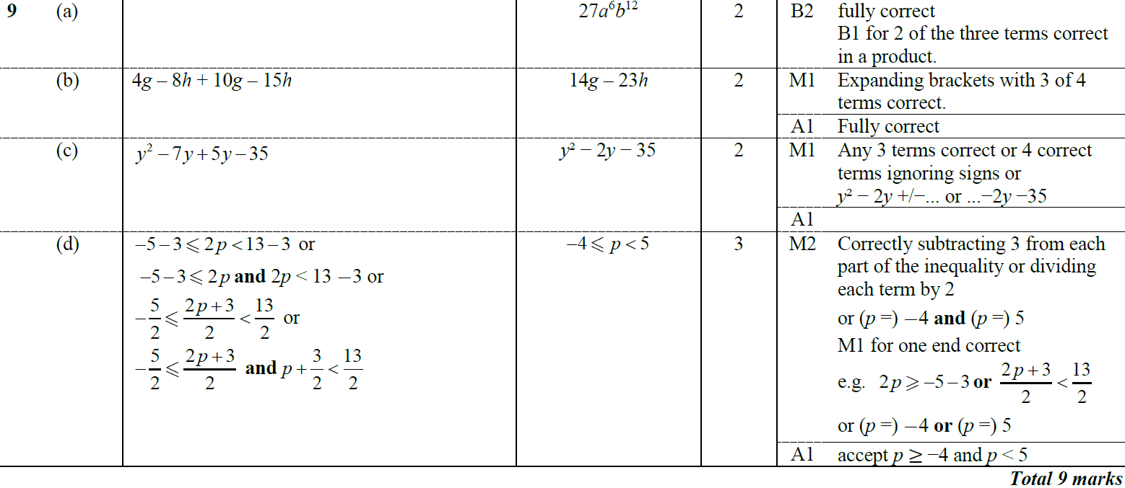
Simplifying Basic Expressions
June 2018 4HR Q9
A
B
C
D

