Slide 1
Simplifying Basic Expressions
Simplifying Basic Expressions
Spec 2
2H Q3

Slide 2
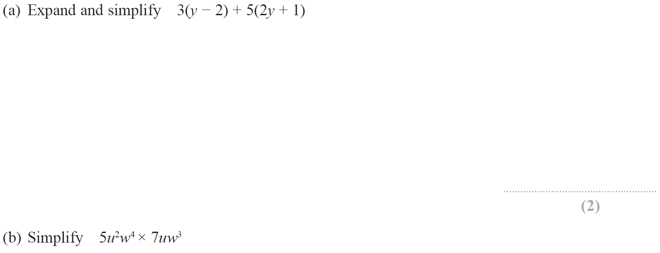
Simplifying Basic Expressions
Specimen Set 2 2H Q3

Slide 3
Simplifying Basic Expressions
Specimen Set 2 2H Q3
A
B

