Slide 1
Old Spec Q’s
Radians
Practice A
SAM 1
2018 1

Slide 2
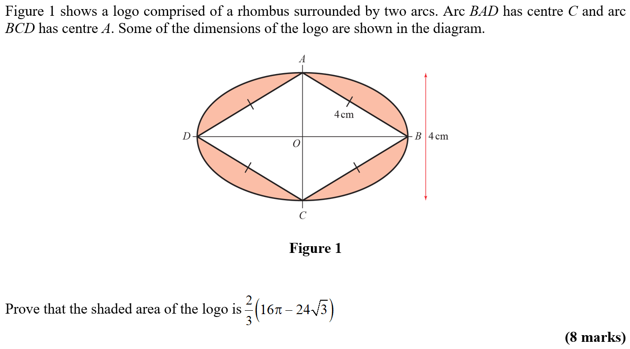
Practice A

Slide 3
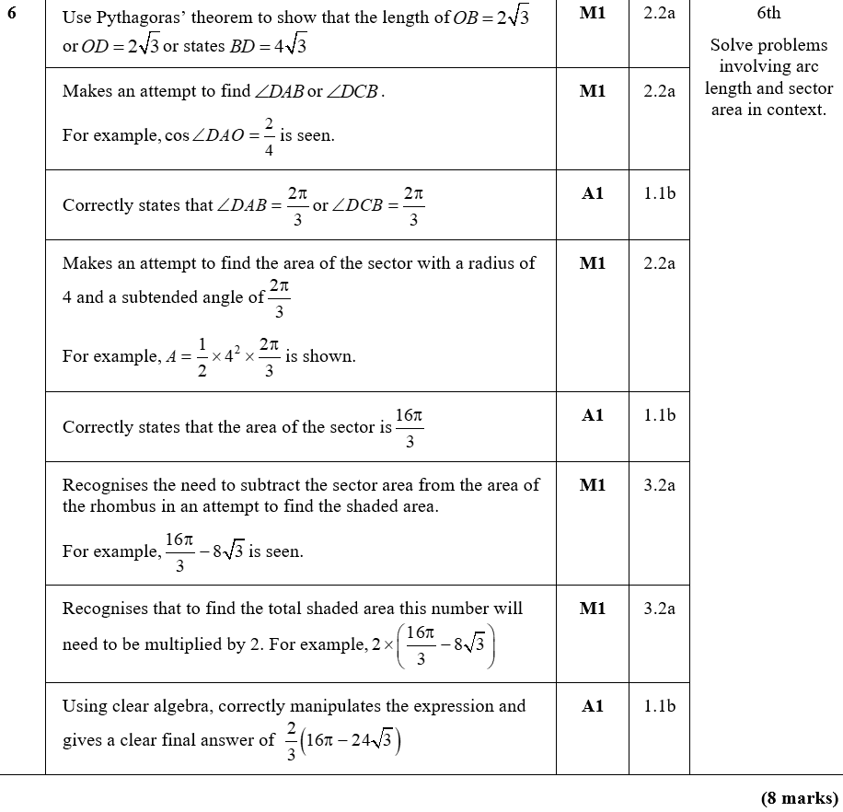
Practice A
A

Slide 4
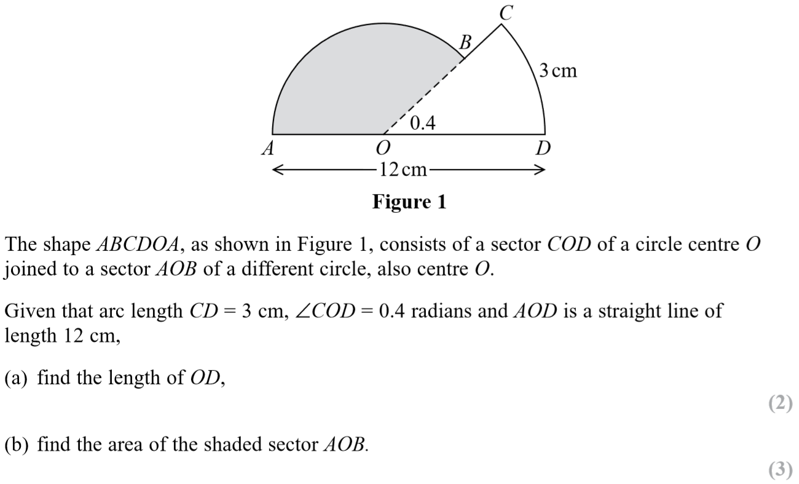
SAM Paper 1

Slide 5
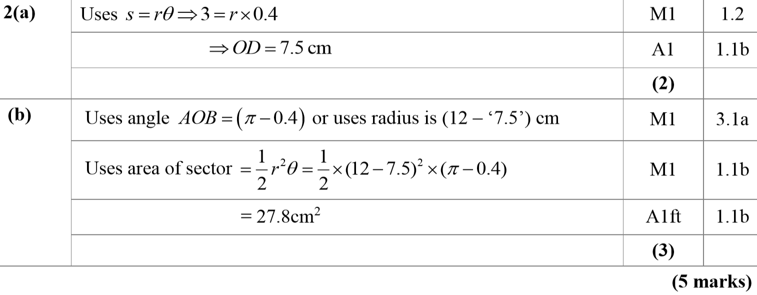
SAM Paper 1
A
B

Slide 6
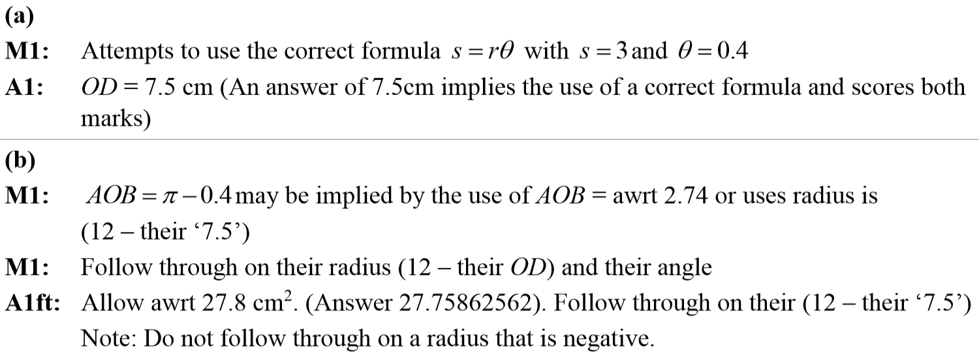
SAM Paper 1
A notes
B notes

Slide 7
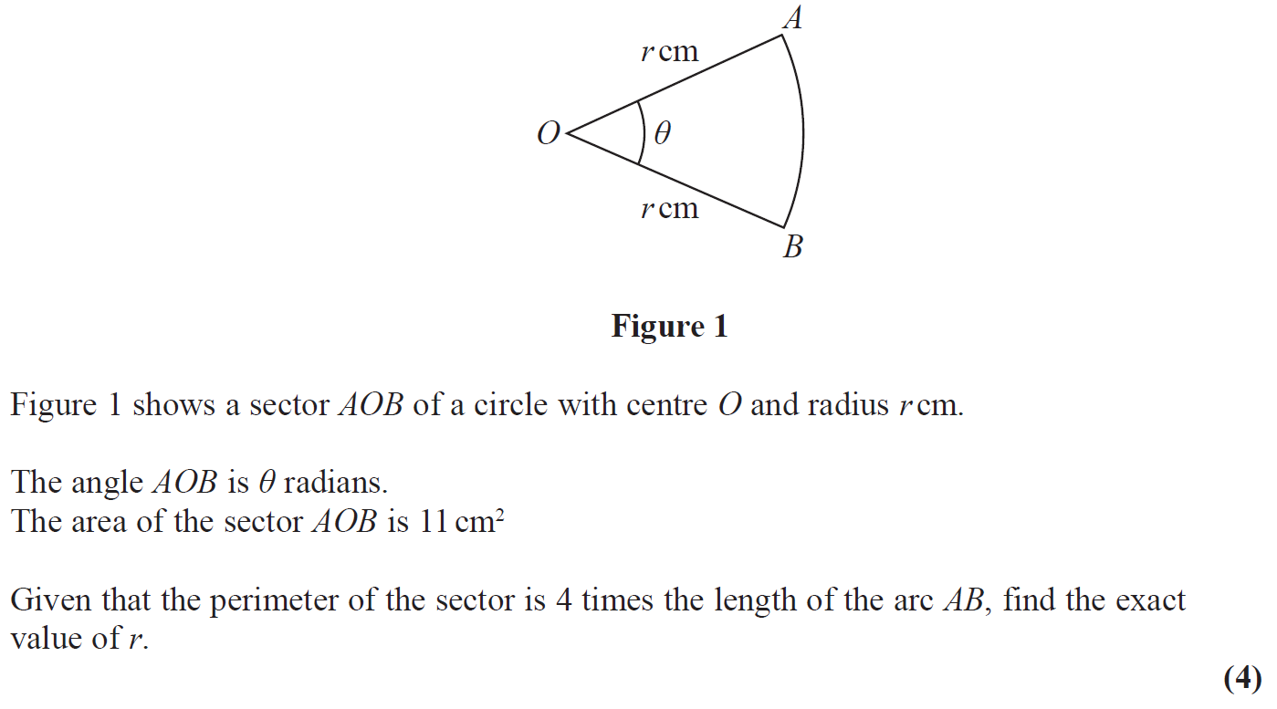
2018 Paper 1

Slide 8
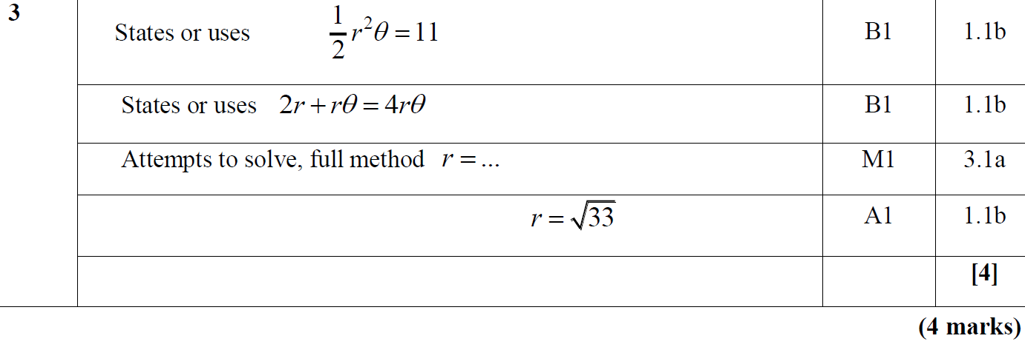
2018 Paper 1
A

Slide 9
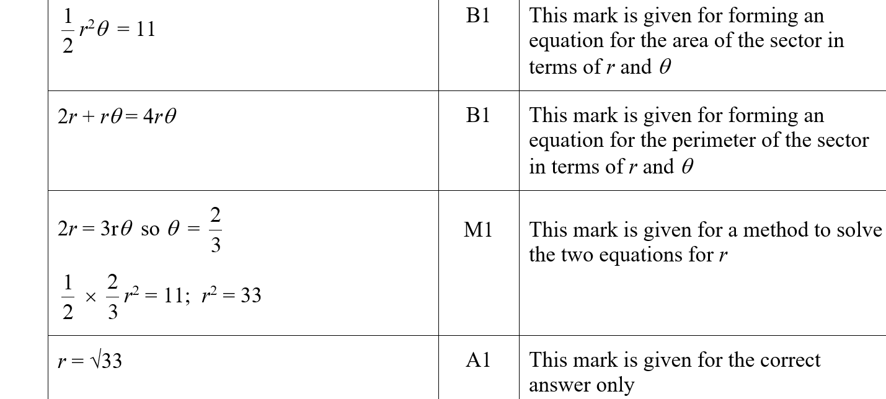
2018 Paper 1
A (SF)

Slide 10
2018 Paper 1
A notes

Slide 11
New Spec Q’s
Old Spec Radians
Jan 2006
June 2009
Jan 2013
May 2006
Jan 2010
May 2013
Jan 2007
June 2010
May 2014
May 2007
Jan 2011
May 2015
Jan 2008
May 2011
May 2016
June 2008
Jan 2012
May 2017
Jan 2009
May 2012
May 2018
Note. these are from C2, which was part of the old AS course

Slide 12
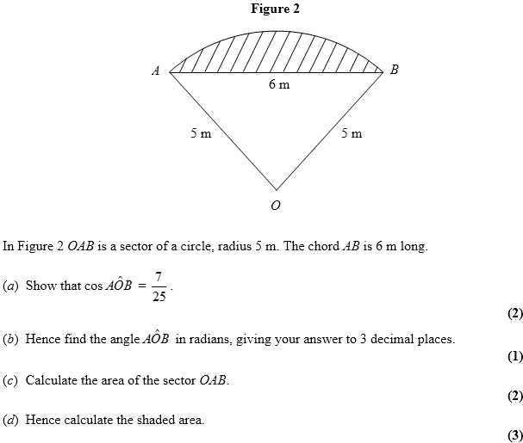
Jan 2006

Slide 13
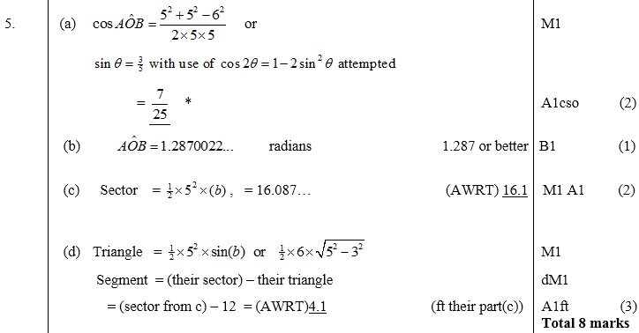
Jan 2006
A
B
C
D

Slide 14
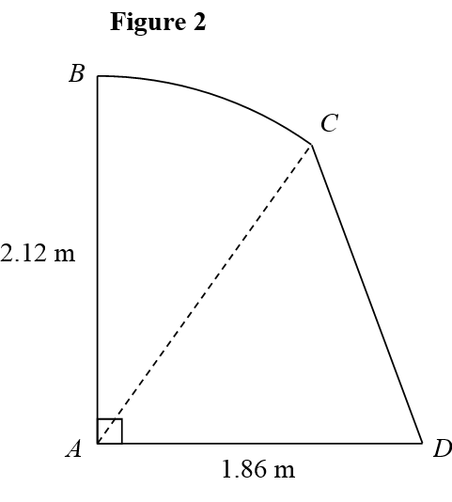
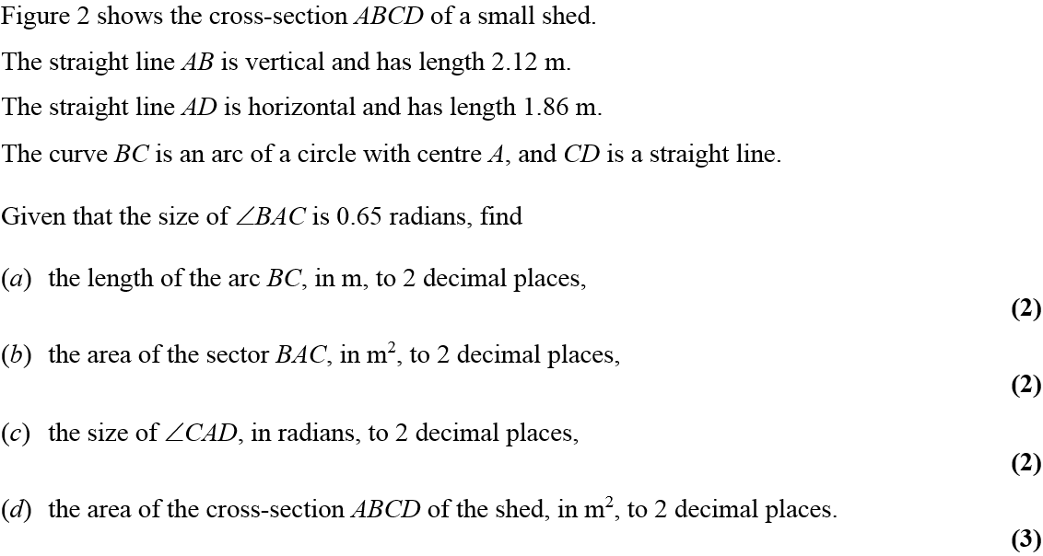
May 2006

Slide 15
May 2006
A
B
C
D

Slide 16
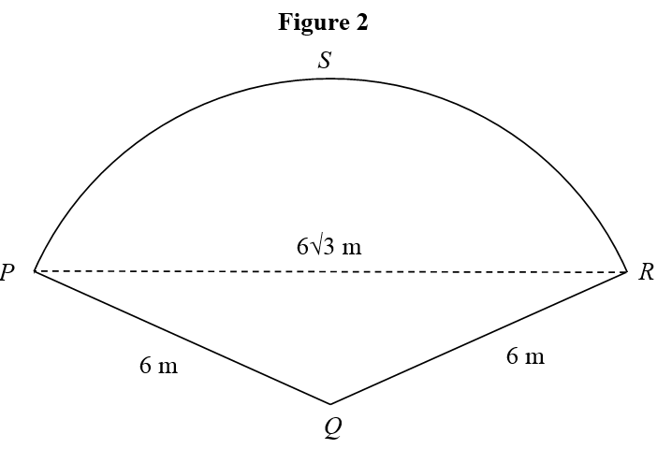
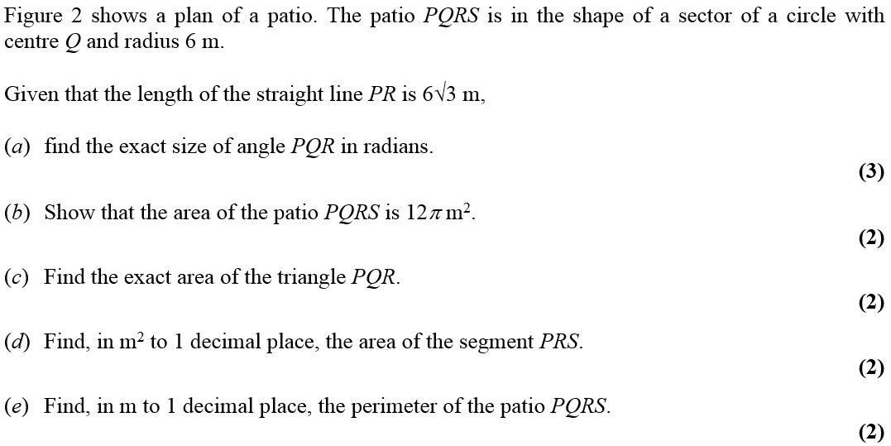
Jan 2007

Slide 17
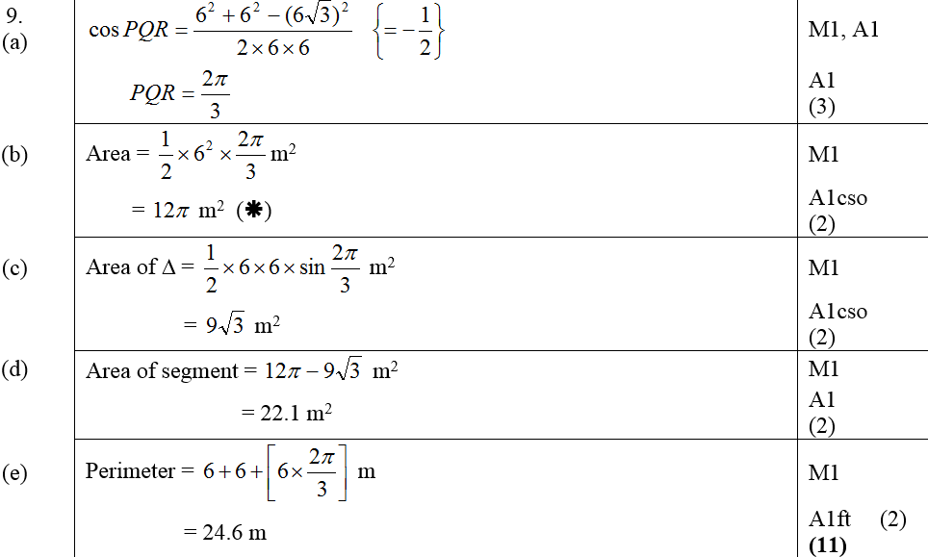
Jan 2007
A
B
C
D
E

Slide 18
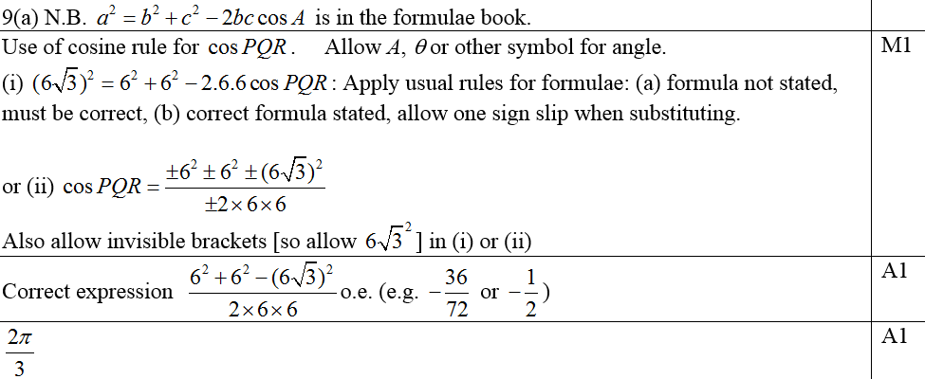
Jan 2007
A
A alternative

Slide 19
Jan 2007
B
C

Slide 20
Jan 2007
Alternative C
D
E

Slide 21
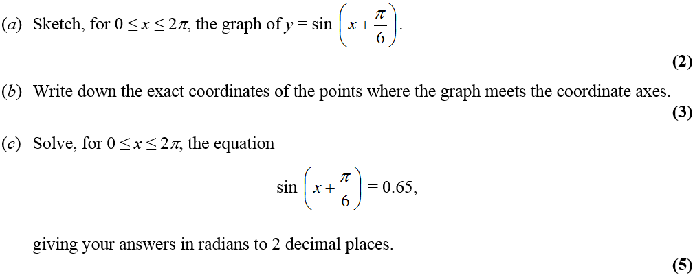
May 2007

Slide 22
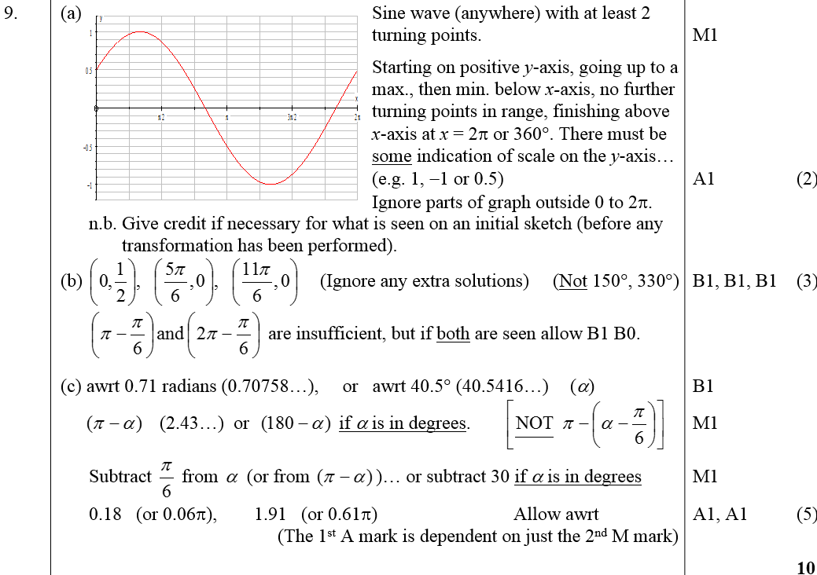
May 2007
A
B
C

Slide 23
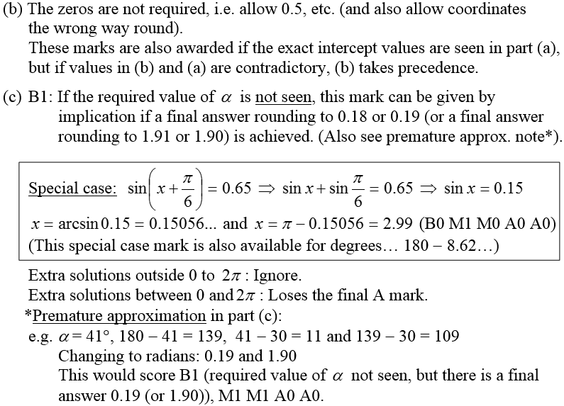
May 2007
B notes
C notes

Slide 24
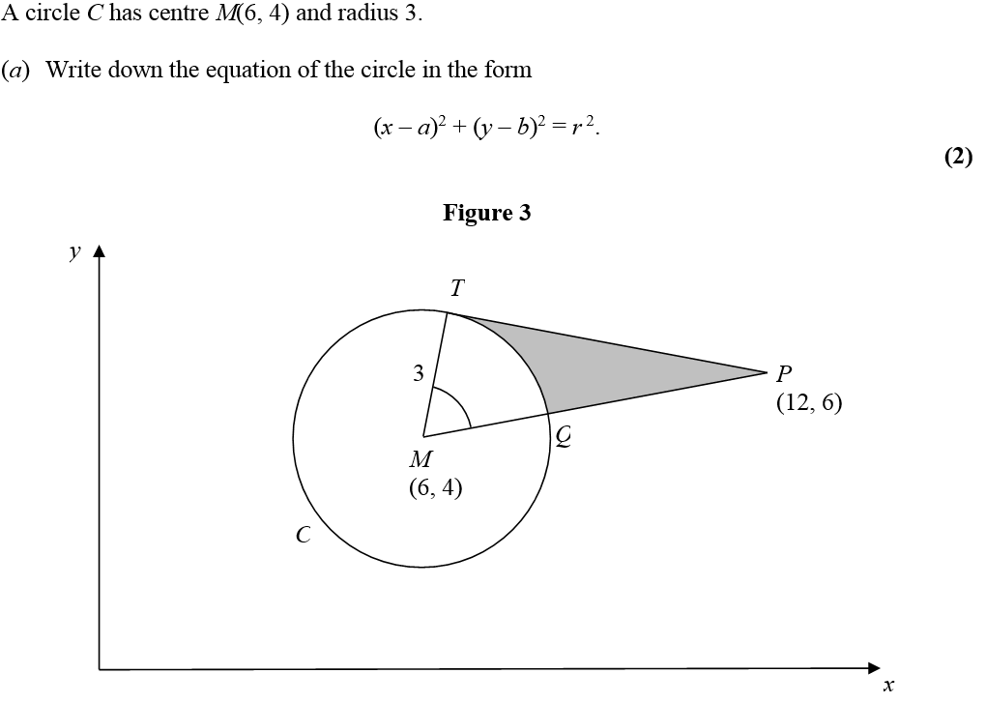
Jan 2008

Slide 25
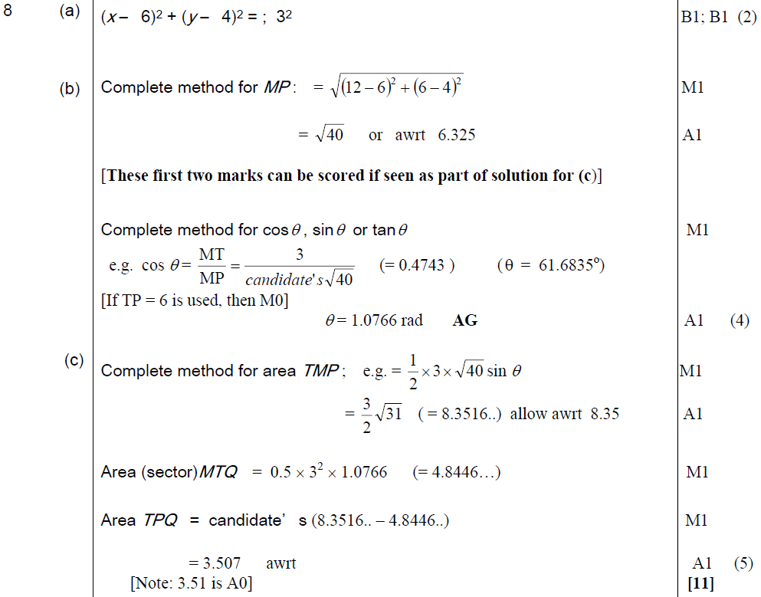
A
Jan 2008
B
C

Slide 26
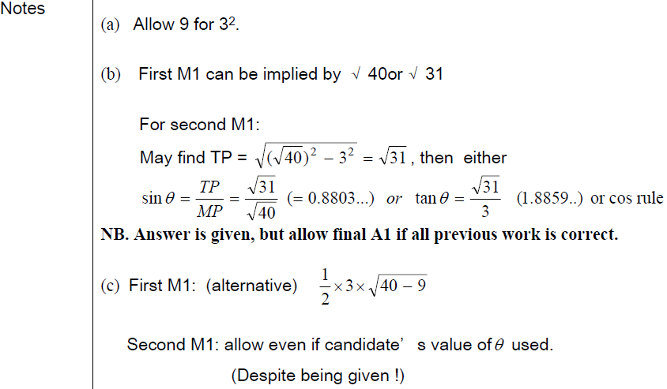
Jan 2008
A notes
B notes
C notes

Slide 27
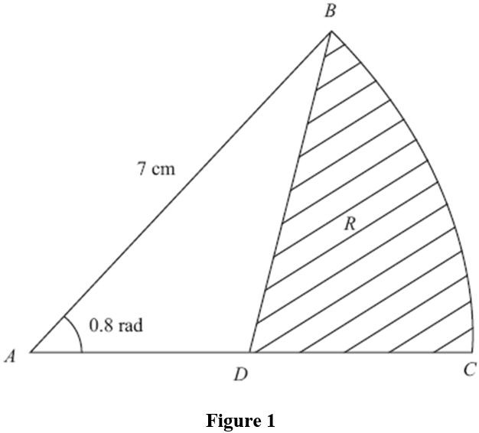
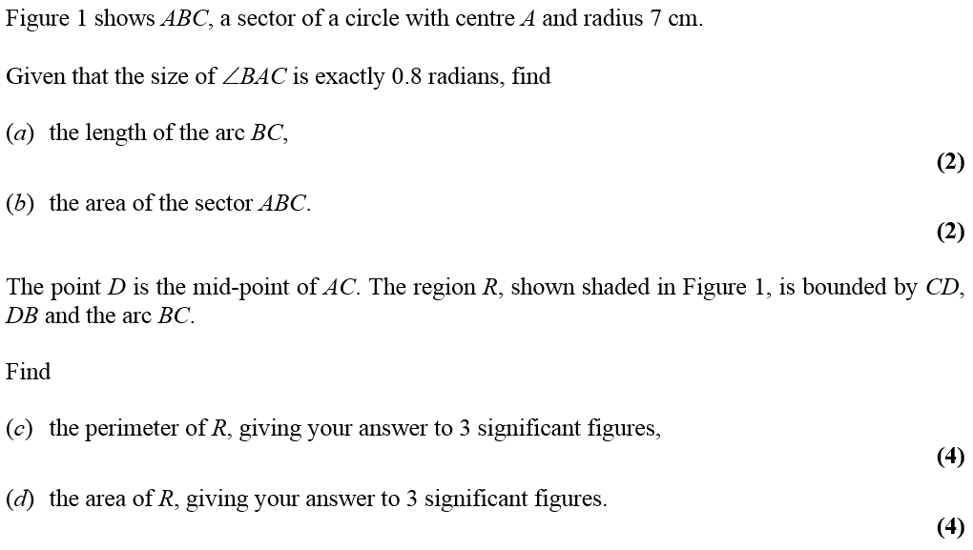
June 2008

Slide 28
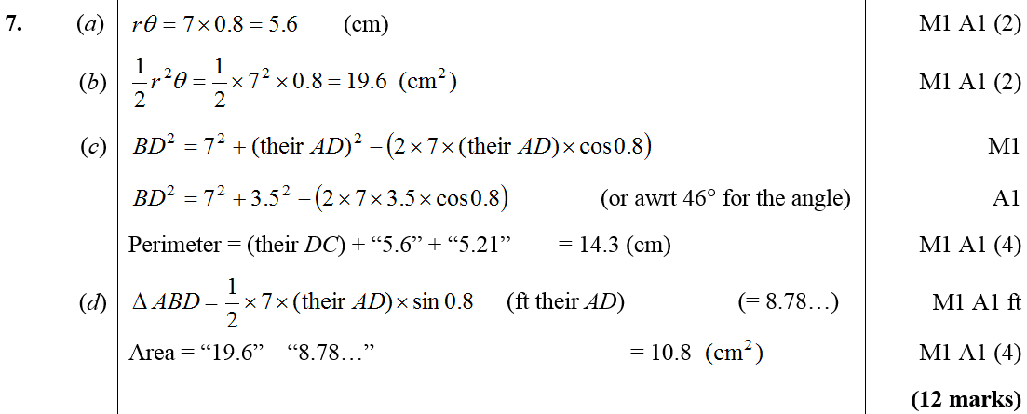
June 2008
A
B
C
D

Slide 29
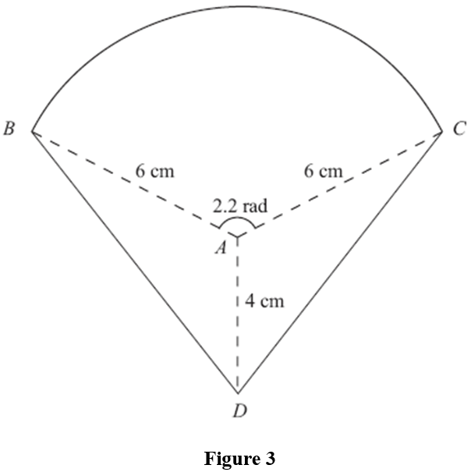
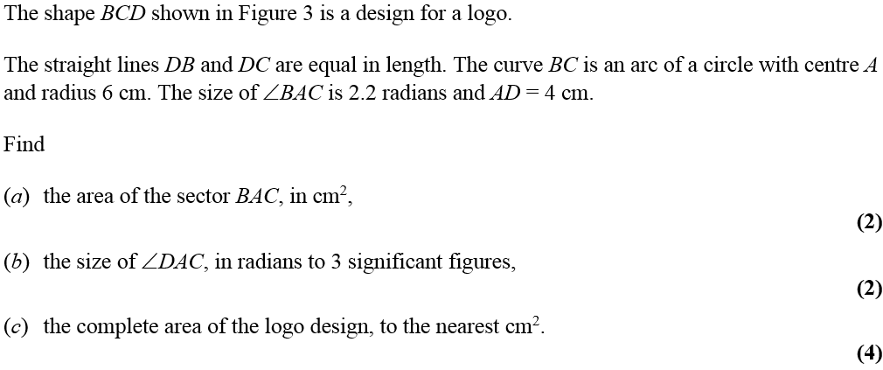
Jan 2009

Slide 30
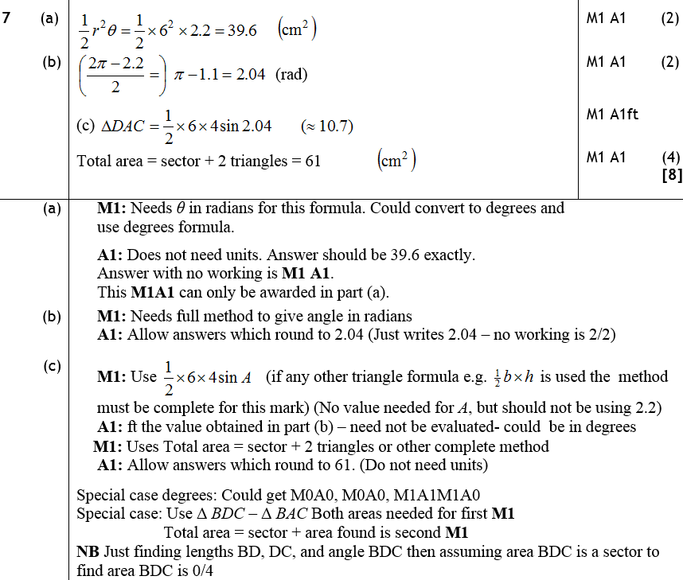
A
Jan 2009
B
C
A notes
B notes
C notes

Slide 31
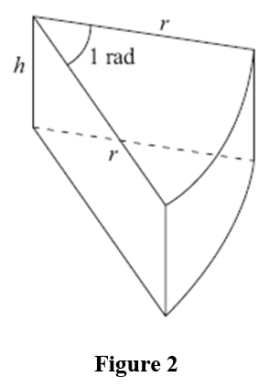
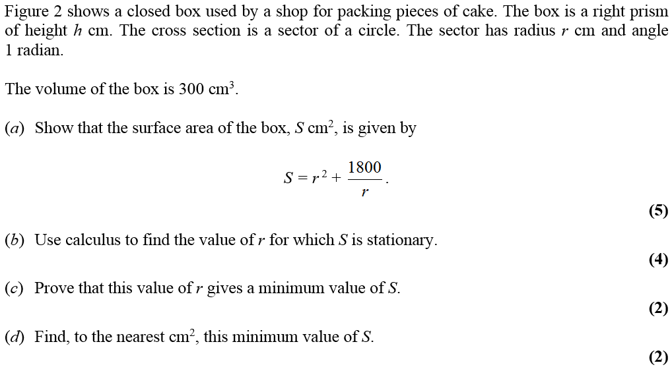
June 2009

Slide 32
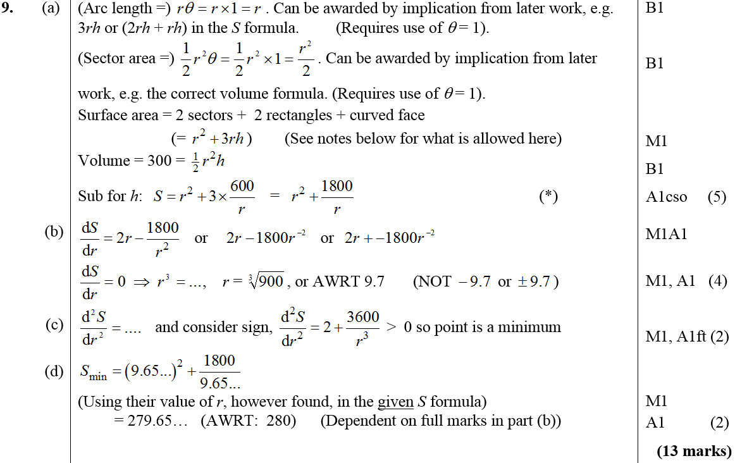
June 2009
A
B
C
D

Slide 33
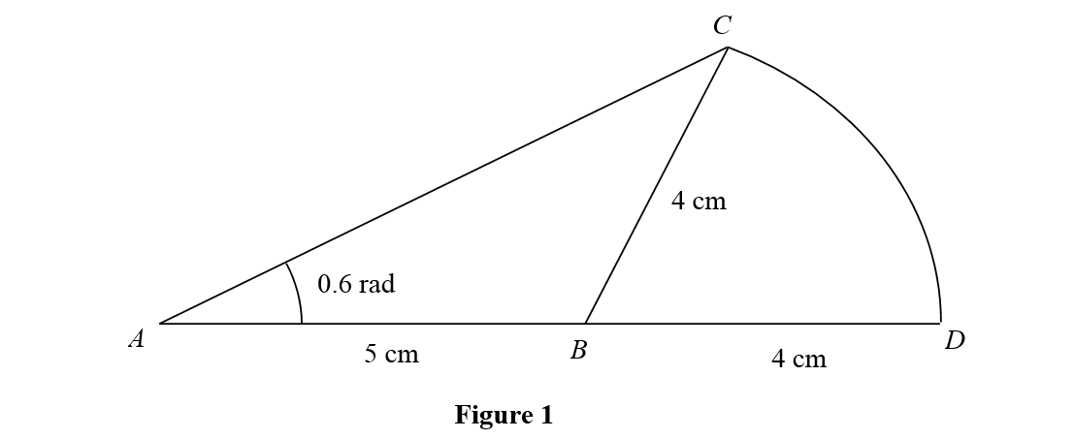
Jan 2010

Slide 34
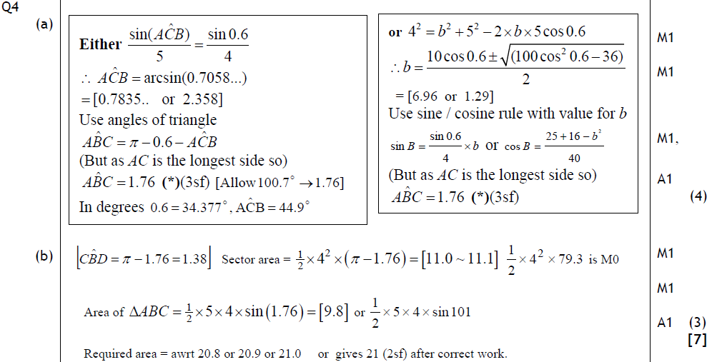
Jan 2010
A
B

Slide 35
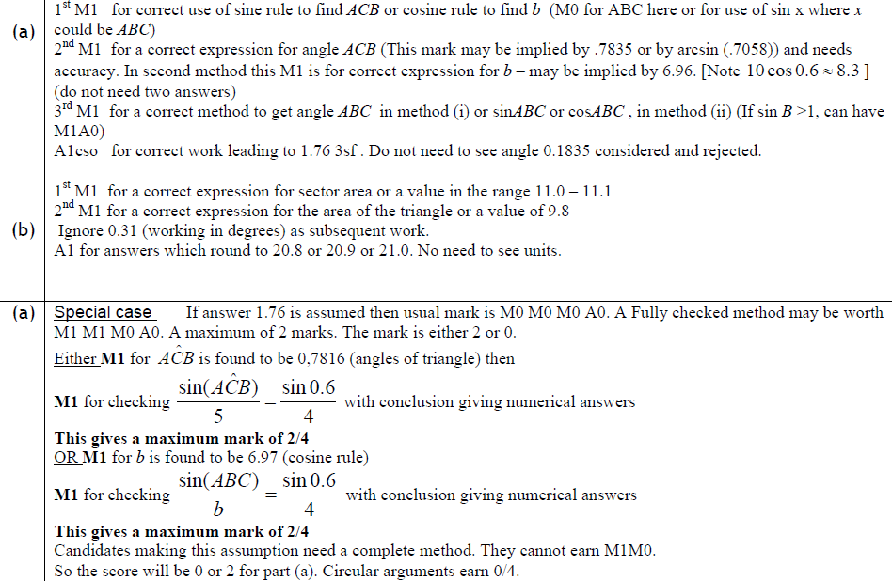
Jan 2010
A
B
Special Case A

Slide 36
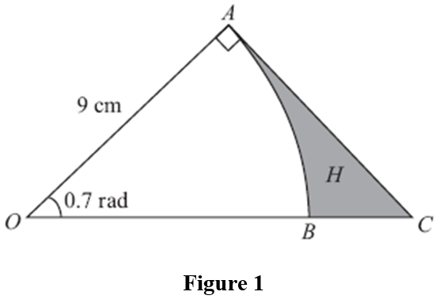
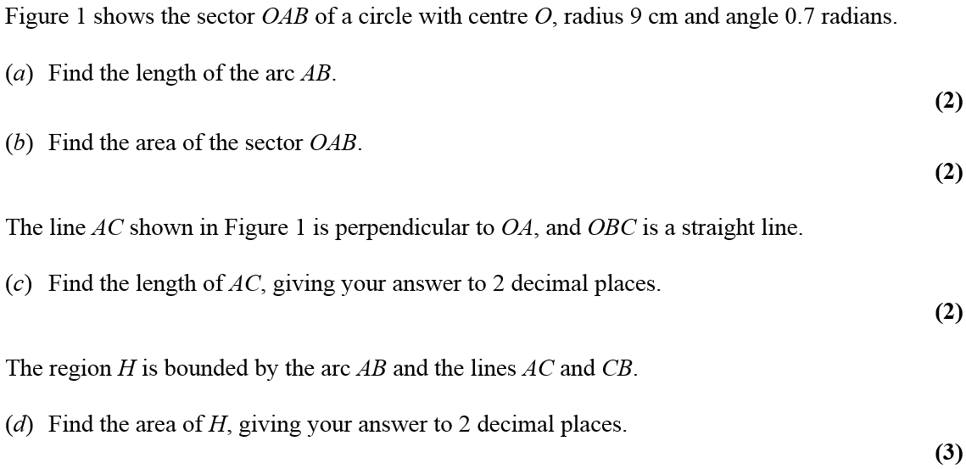
June 2010

Slide 37
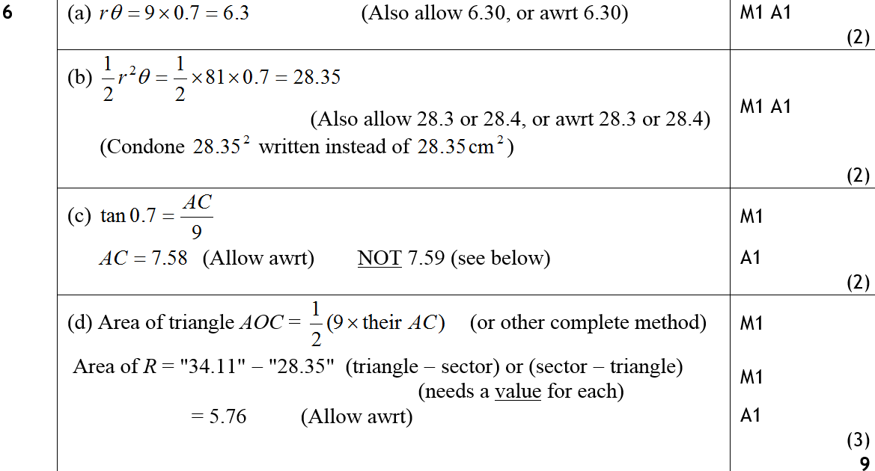
June 2010
A
B
C
D

Slide 38
Jan 2011

Slide 39
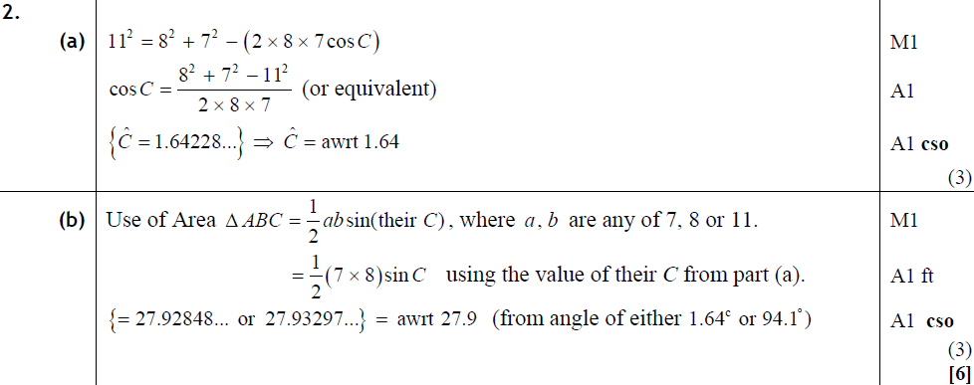
Jan 2011
A
B

Slide 40
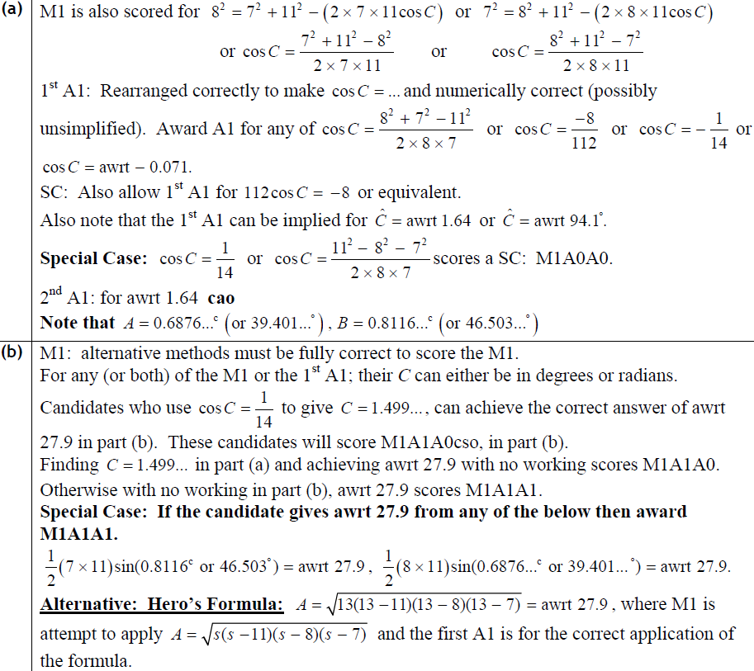
Jan 2011
A
B

Slide 41
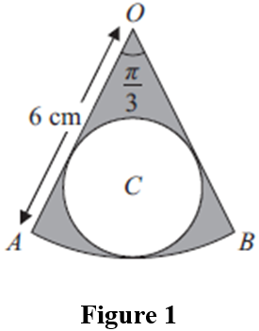
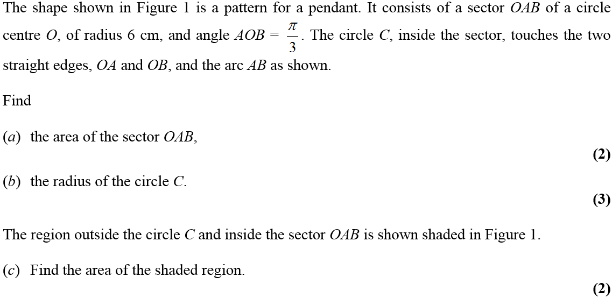
May 2011

Slide 42
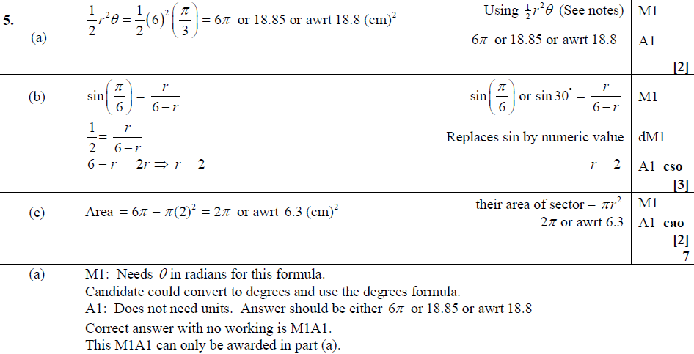
May 2011
A
B
C
A

Slide 43
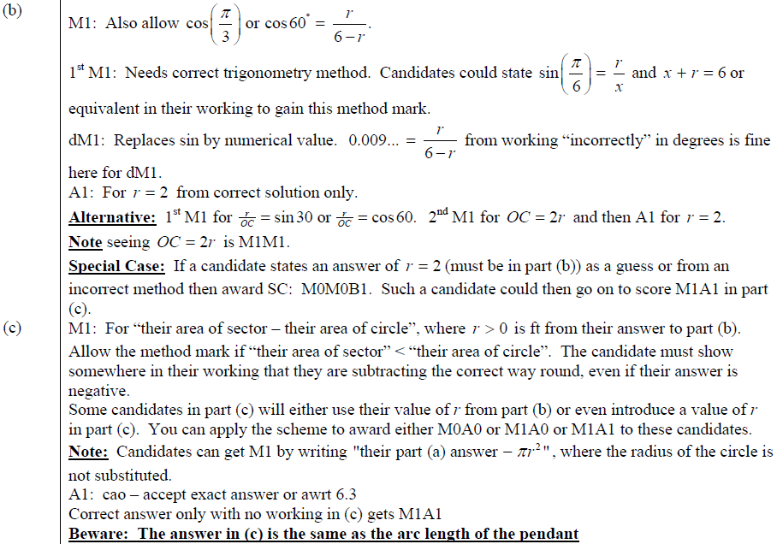
May 2011
B
C

Slide 44
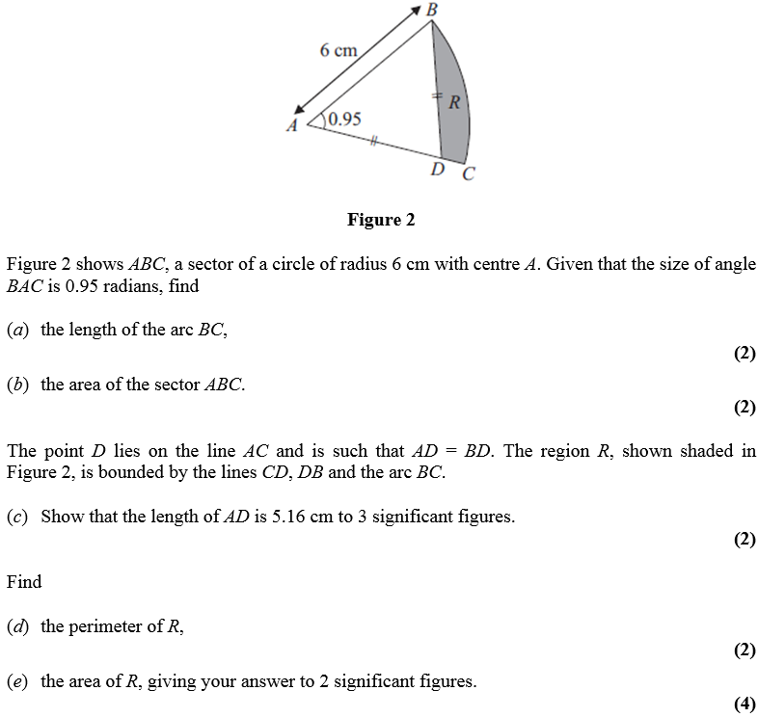
Jan 2012

Slide 45
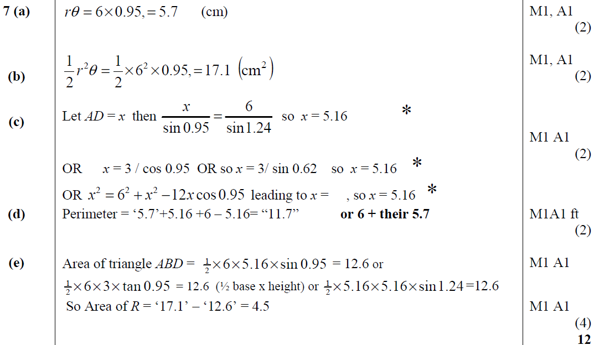
Jan 2012
A
B
C
D
E

Slide 46
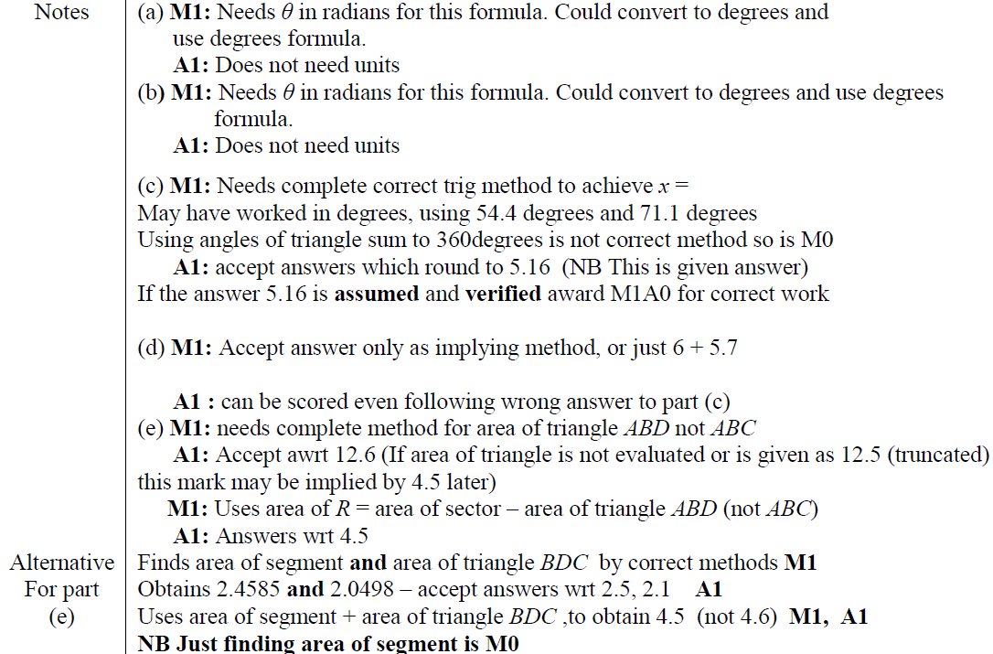
Jan 2012
A
B
C
D
E
E

Slide 47
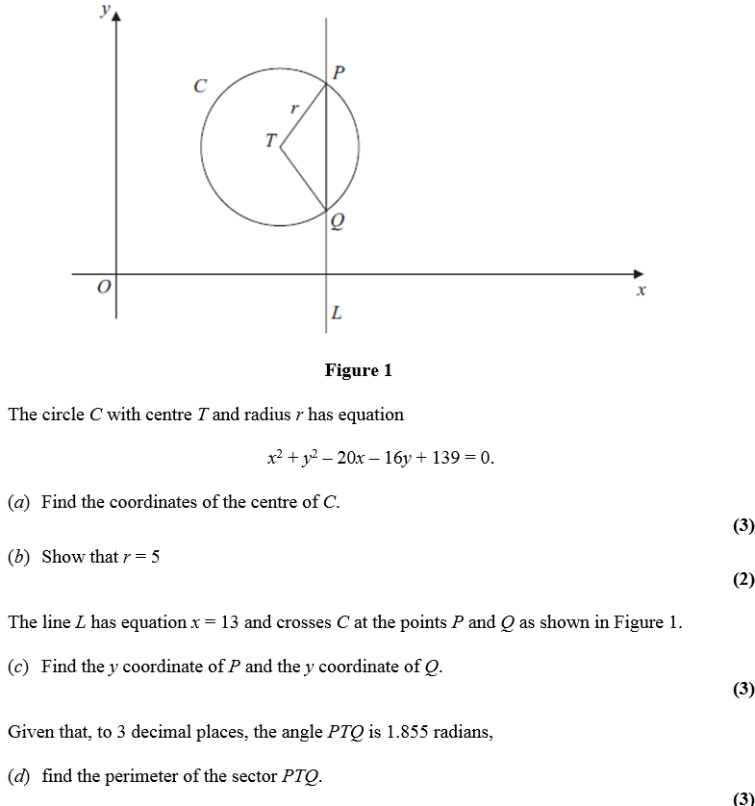
May 2012

Slide 48
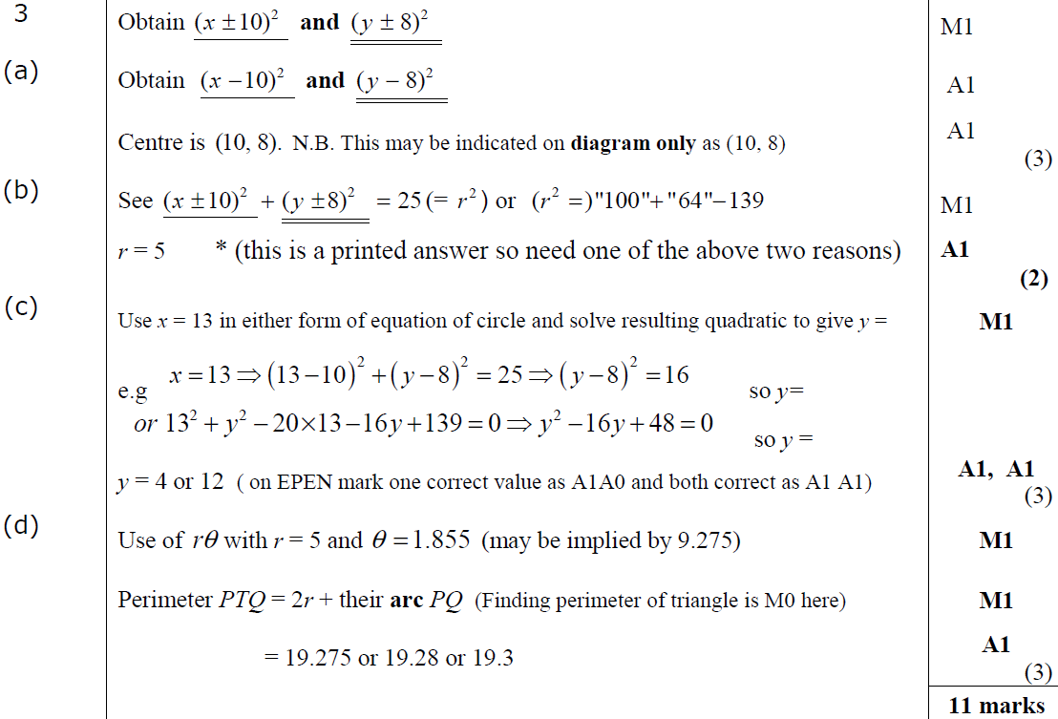
May 2012
A
B
C
D

Slide 49
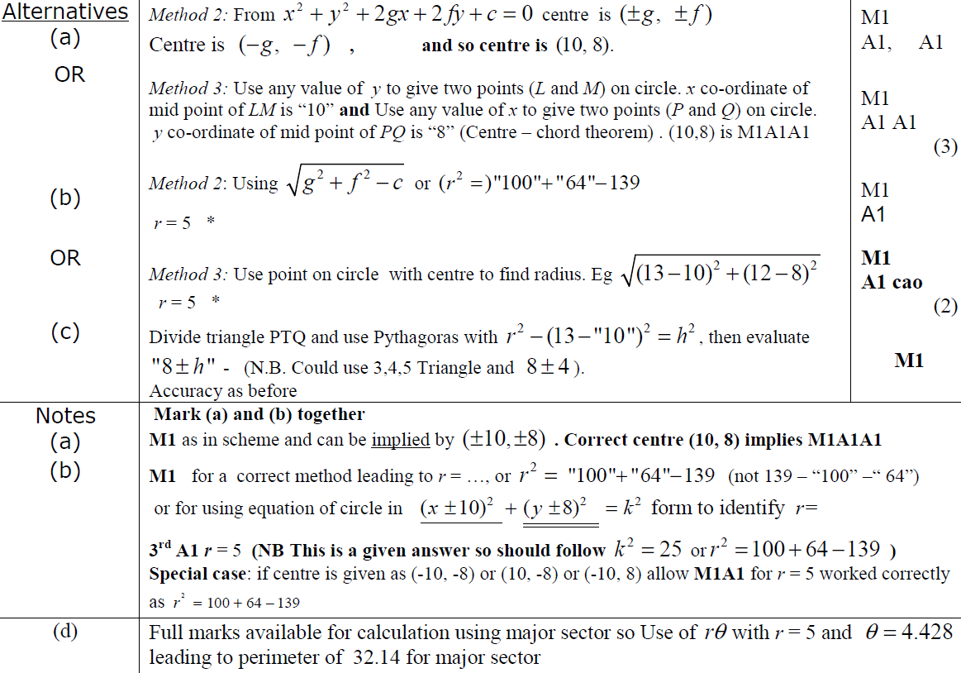
May 2012
A
B
C
A
B
D

Slide 50
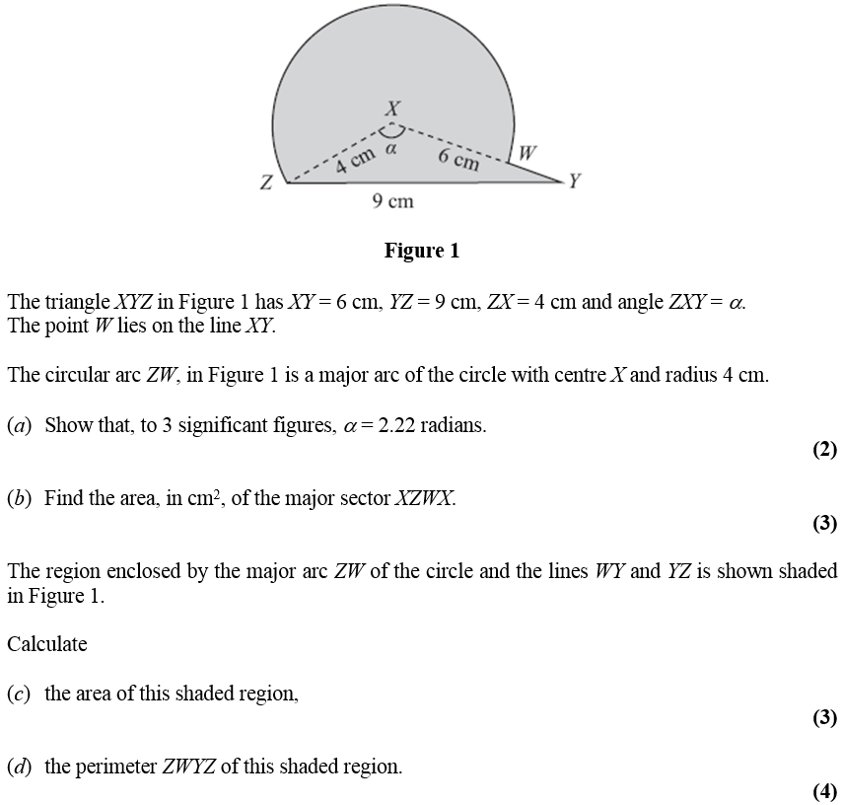
Jan 2013

Slide 51
Jan 2013
A
B
C
D

Slide 52
May 2013

Slide 53
May 2013
A
B

Slide 54
May 2014

Slide 55
May 2014
A
B

Slide 56
May 2014
C

Slide 57
May 2015

Slide 58
May 2015
A
B
C
C Alternative

Slide 59
May 2015
A notes
B notes
C notes

Slide 60
May 2016

Slide 61
May 2016
A
B
C

Slide 62
May 2016
D
E

Slide 63
May 2016
A notes
B notes
C notes

Slide 64
May 2016
D notes
E notes

Slide 65
May 2017

Slide 66
May 2017
A
B
C

Slide 67
May 2017
A notes
B notes
C notes

Slide 68
May 2018

Slide 69
May 2018
A
B
C

Slide 70
May 2018
A notes
B notes
C notes

