Slide 1
Angles and Properties of Polygons
Polygons
May 2017
1H Q18
SAM
1H Q8
June 2017
3H Q5
SAM
3H Q13
Nov 2017
2H Q12
Spec 2
2H Q4
June 2018
3H Q8
June 2019
3H Q5
Properties of Quadrilaterals

Slide 2
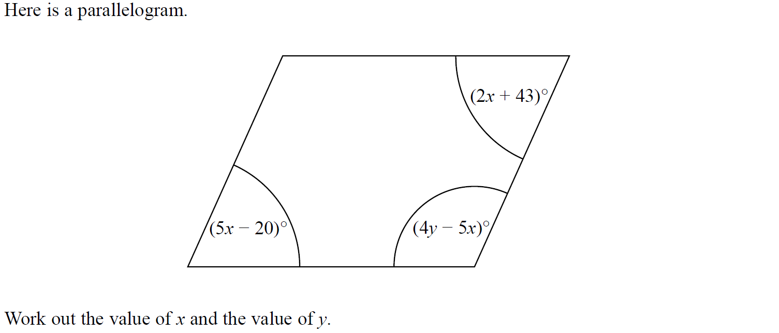
Polygons
SAM 1H Q8

Slide 3
Polygons
SAM 1H Q8
A

Slide 4
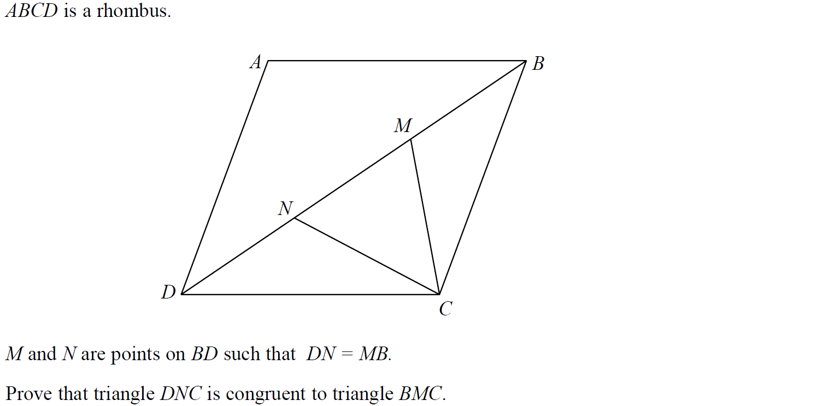
Polygons
SAM 3H Q13

Slide 5
Polygons
SAM 3H Q13
A

Slide 6
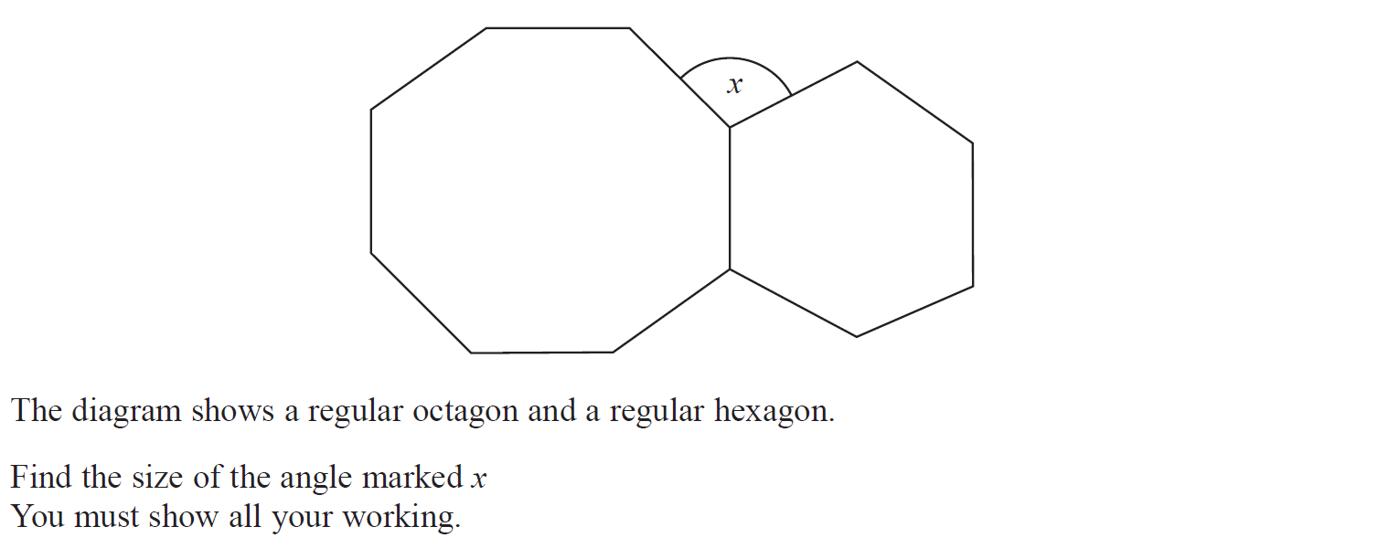
Polygons
Specimen Set 2 2H Q4

Slide 7
Polygons
Specimen Set 2 2H Q4
A

Slide 8
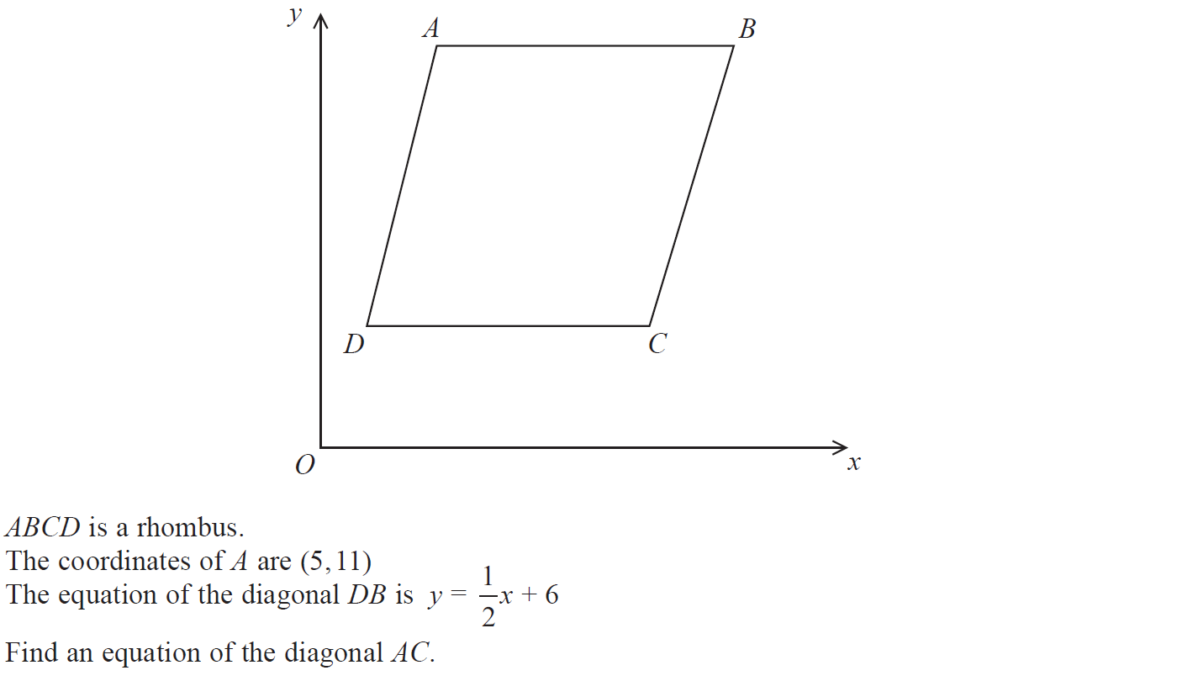
Polygons
May 2017 1H Q18

Slide 9
Polygons
May 2017 1H Q18
A

Slide 10
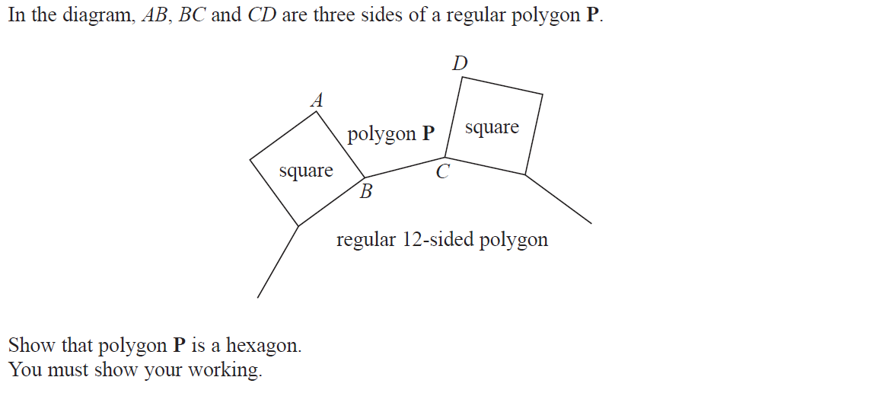
Polygons
June 2017 3H Q5

Slide 11
Polygons
June 2017 3H Q5
A

Slide 12
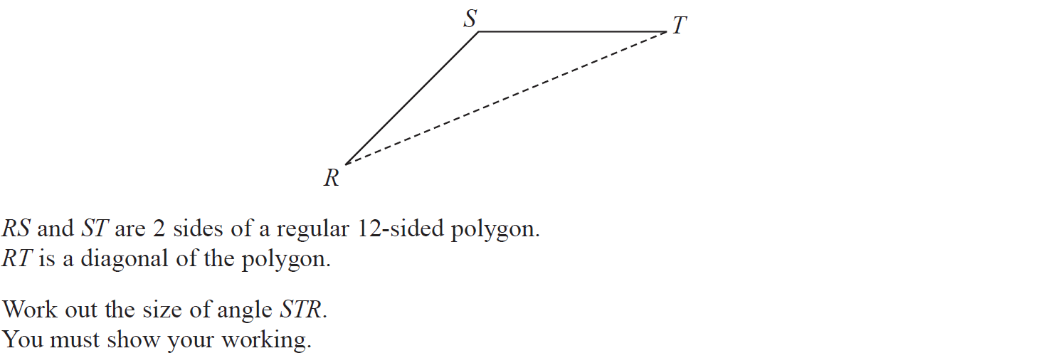
Polygons
Nov 2017 2H Q12

Slide 13
Polygons
Nov 2017 2H Q12
A

Slide 14
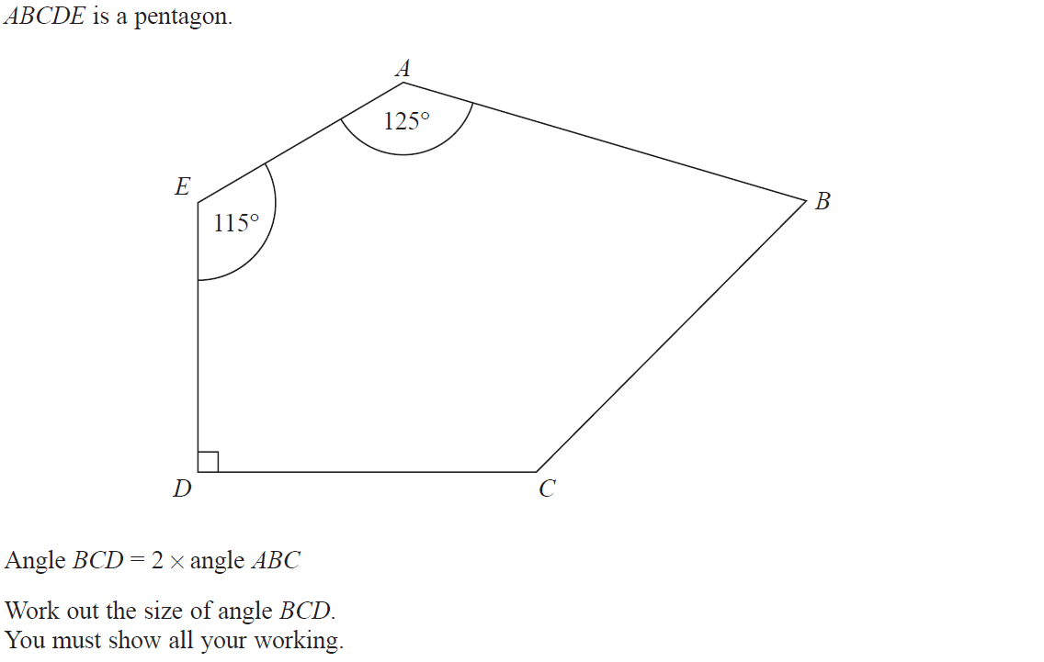
Polygons
June 2018 3H Q8

Slide 15
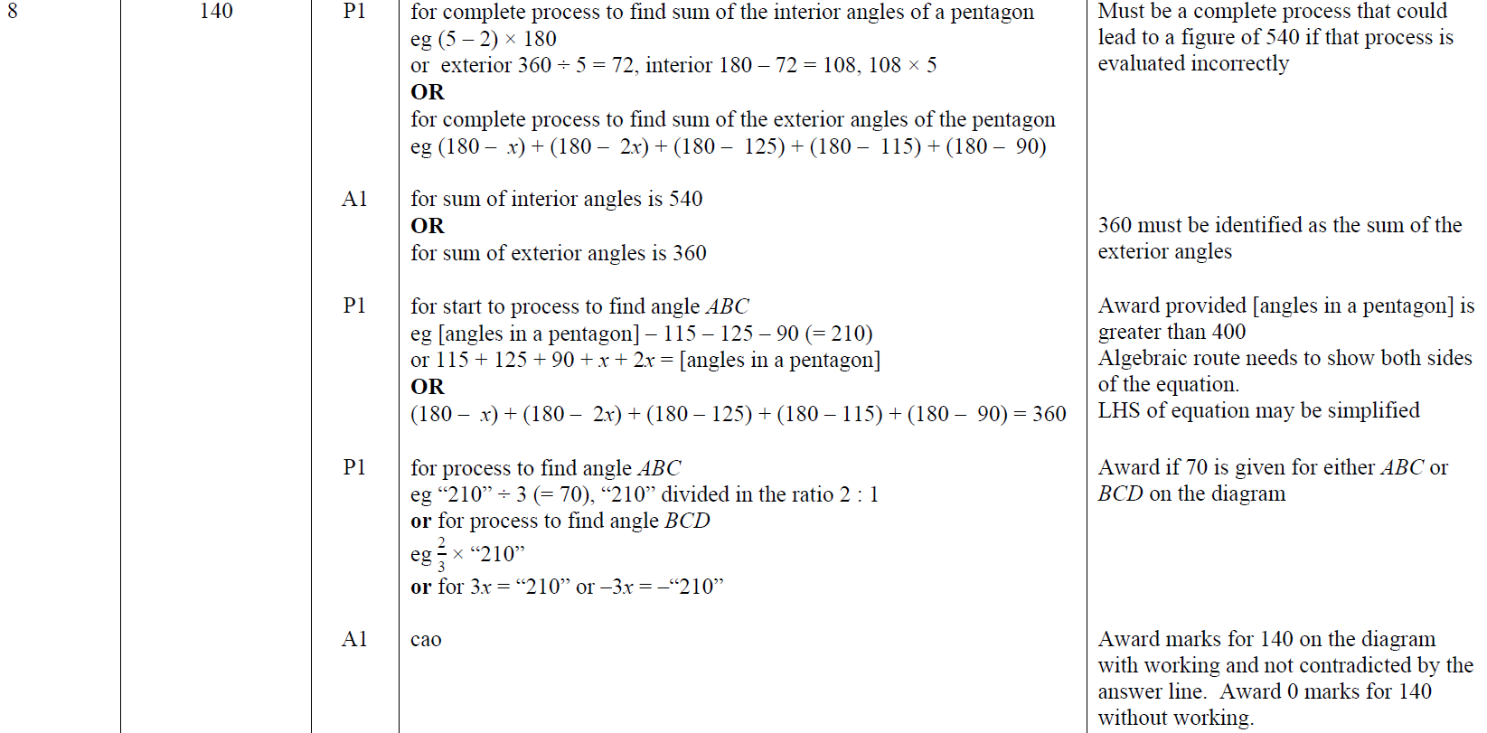
Polygons
June 2018 3H Q8
A

Slide 16
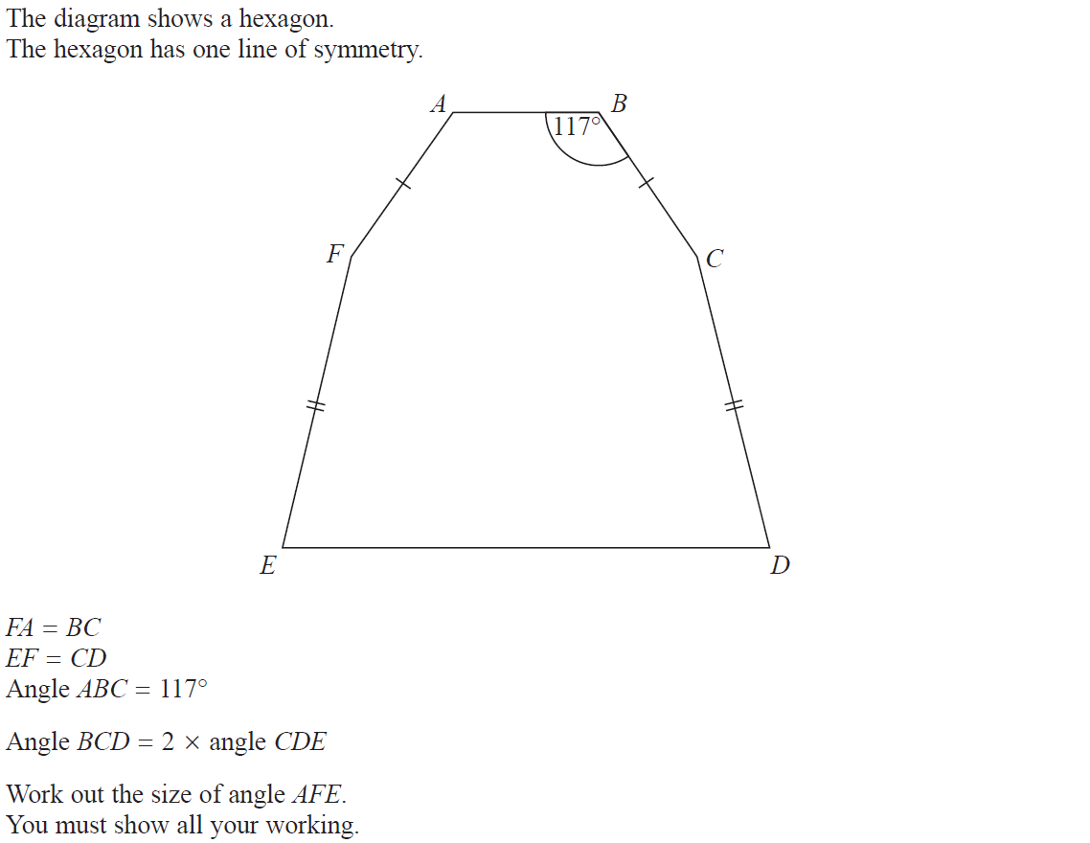
Polygons
June 2019 3H Q5

Slide 17
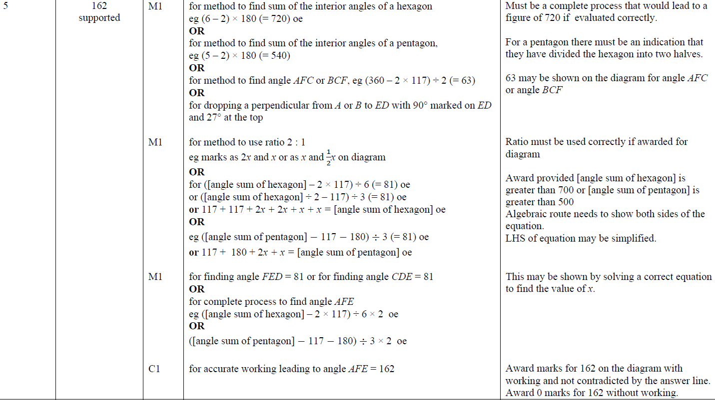
Polygons
June 2019 3H Q5
A

Slide 18
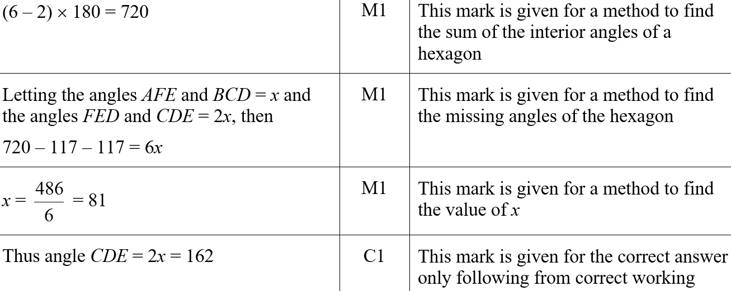
Polygons
June 2019 3H Q5
A SF

