Slide 1
Angles and Properties of Polygons
Polygons
June 2017
2H Q8
Nov 2017
1H Q7
Practice
1H Q4
Nov 2017
2H Q10
Nov 2018
3H Q11
Properties of Quadrilaterals

Slide 2
Polygons
Practice 1H Q4

Slide 3
Polygons
Practice 1H Q4
A

Slide 4
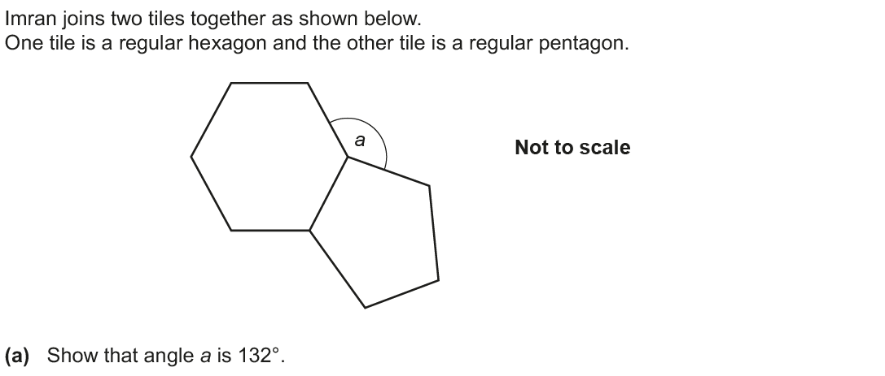
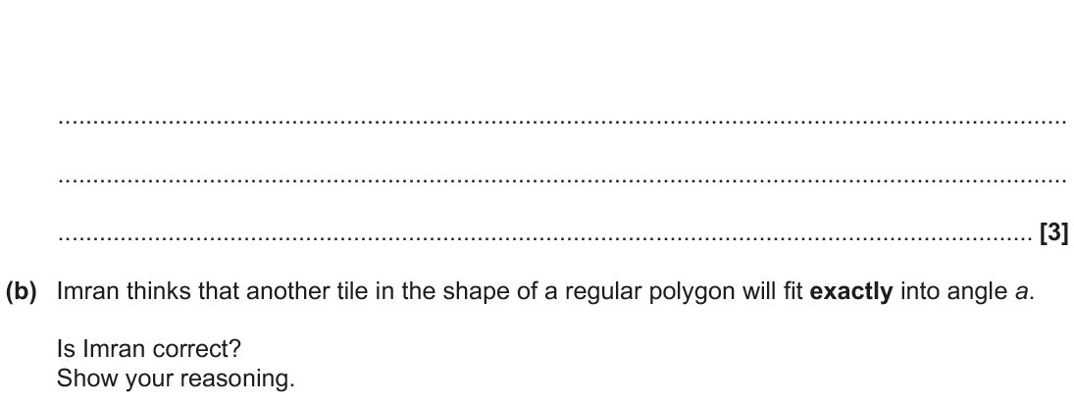
Polygons
June 2017 2H Q8

Slide 5
Polygons
June 2017 2H Q8
A
B

Slide 6
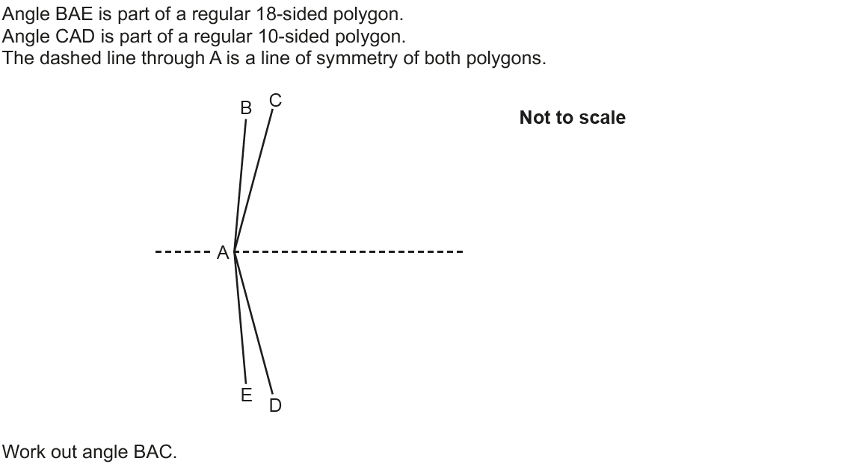
Polygons
Nov 2017 1H Q7

Slide 7
Polygons
Nov 2017 1H Q7
A

Slide 8
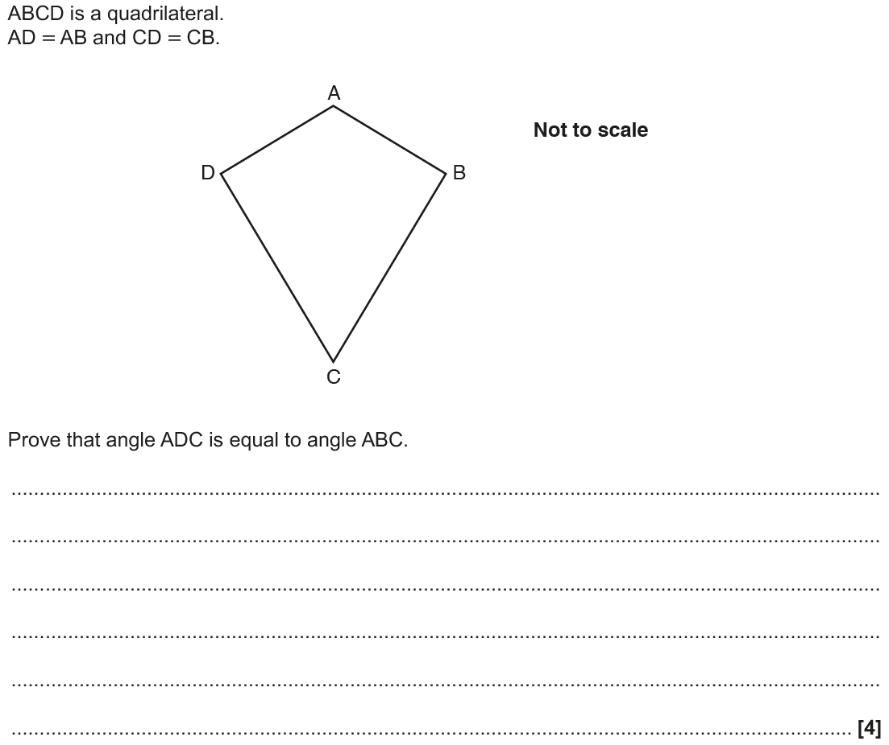
Polygons
Nov 2017 2H Q10

Slide 9
Polygons
Nov 2017 2H Q10
A

Slide 10
Polygons
Nov 2018 3H Q11

Slide 11
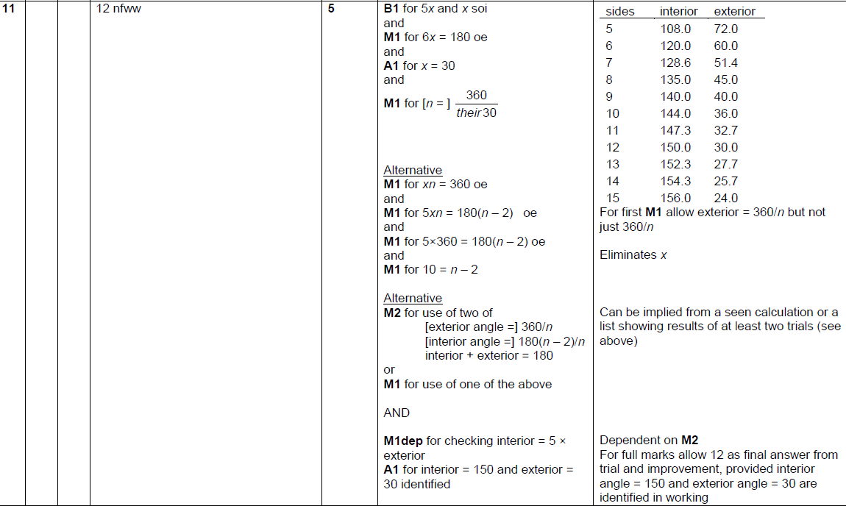
Polygons
Nov 2018 3H Q11
A

