Slide 1
Angles (Including Parallel Lines)
Angles (Including Parallel Lines)
June 2017
3H Q4
June 2017
3H Q10
SAM
1H Q16
Nov 2017
1H Q19
1 Marker
SAM
3H Q10
Nov 2017
3H Q8
Nov 2017
2H Q4
Bearings
Parallel lines

Slide 2
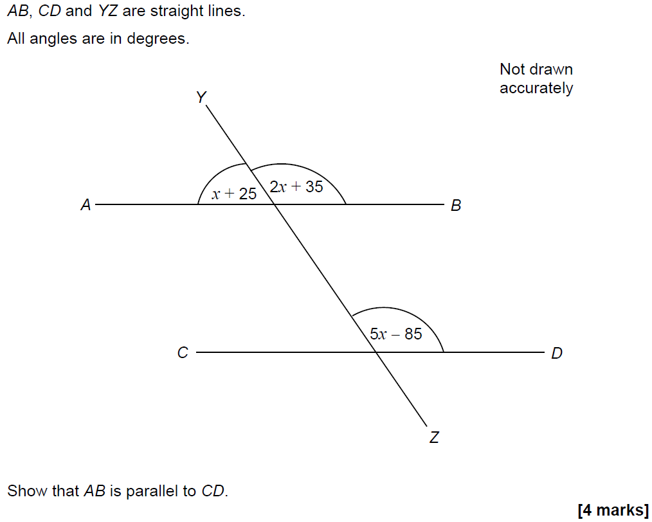
Angles (Including Parallel Lines)
SAM 1H Q16

Slide 3
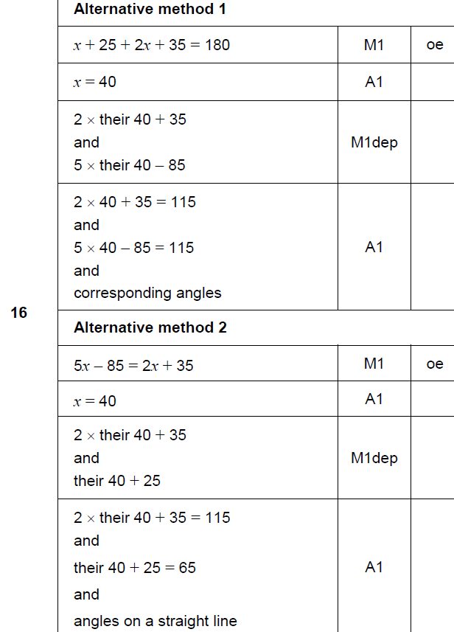
Angles (Including Parallel Lines)
SAM 1H Q16
A

Slide 4
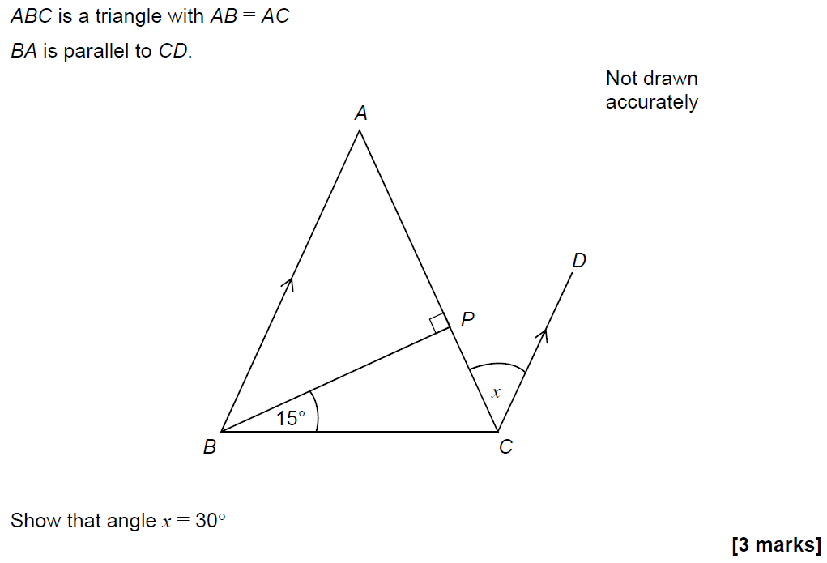
Angles (Including Parallel Lines)
SAM 3H Q10

Slide 5
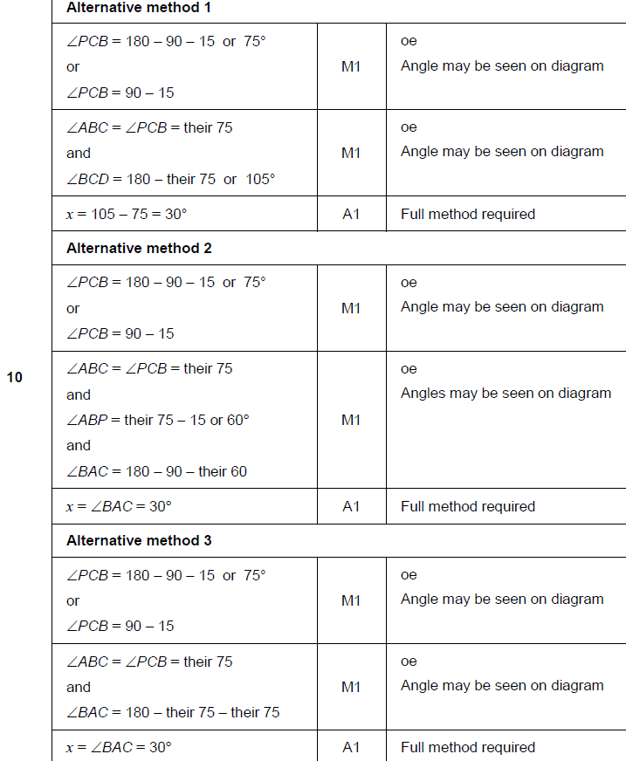
Angles (Including Parallel Lines)
SAM 3H Q10
A

Slide 6
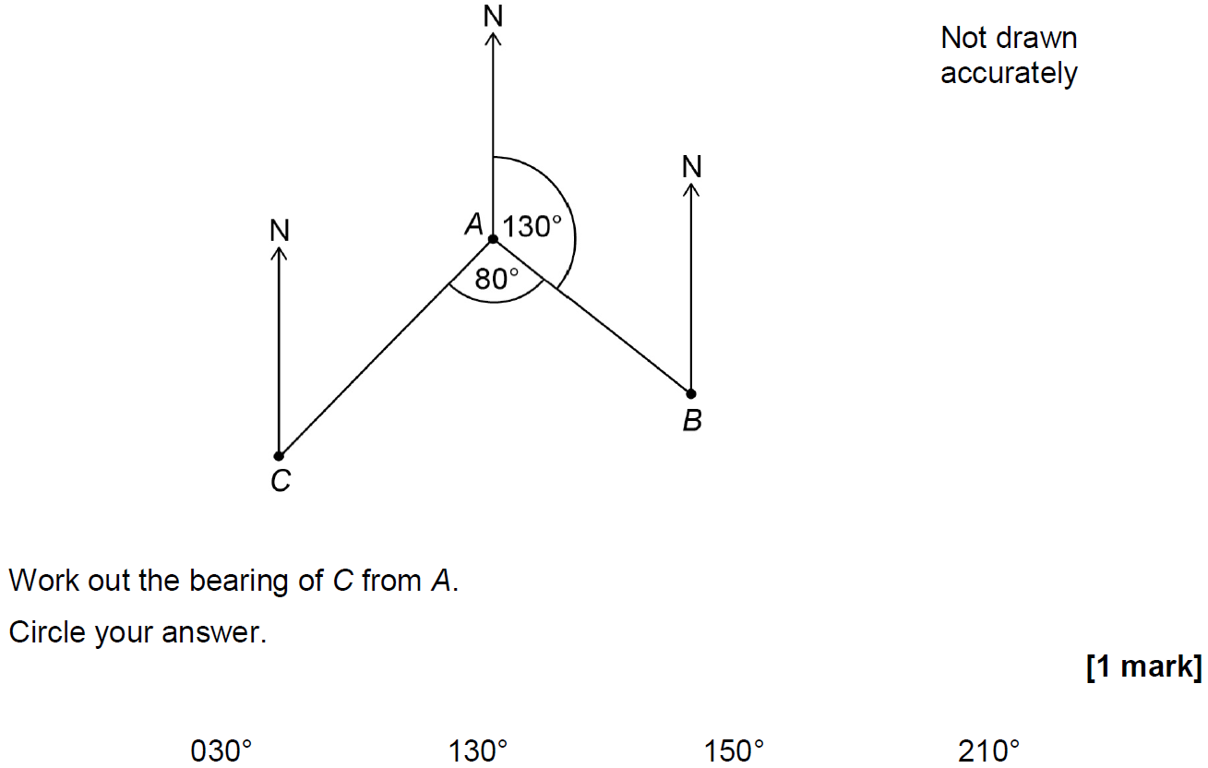
Angles (Including Parallel Lines)
June 2017 3H Q4

Slide 7
Angles (Including Parallel Lines)
June 2017 3H Q4
A

Slide 8
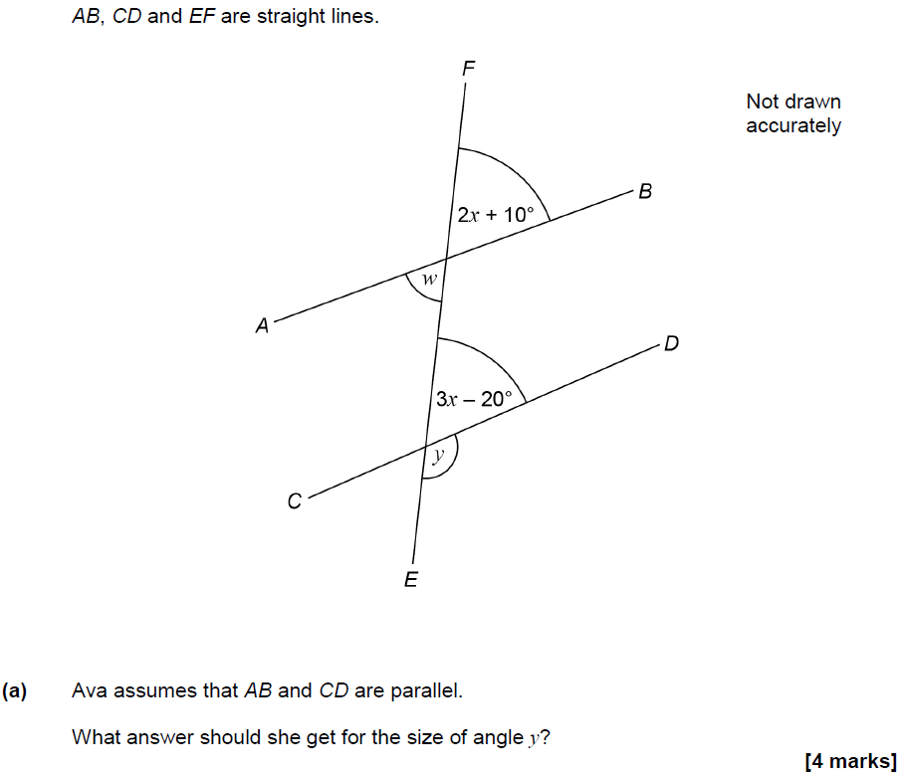
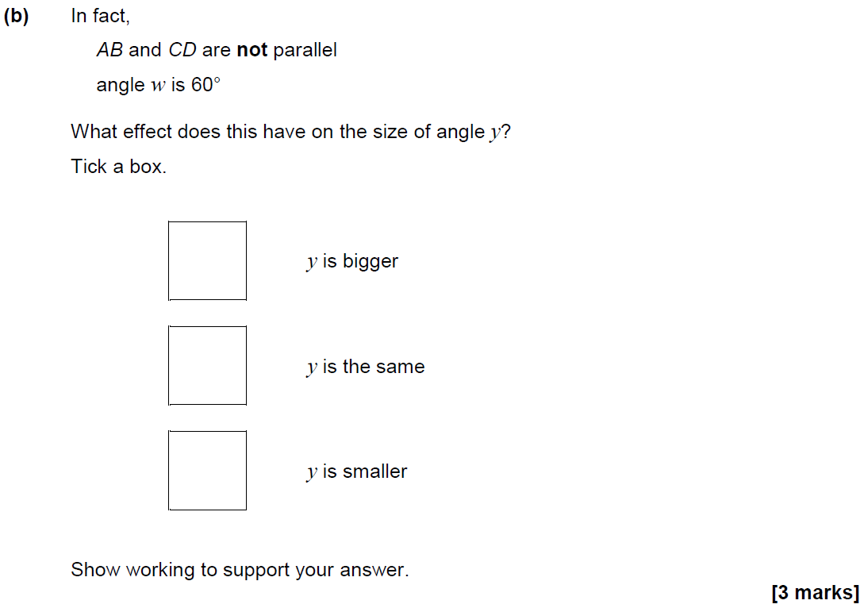
Angles (Including Parallel Lines)
June 2017 3H Q10

Slide 9
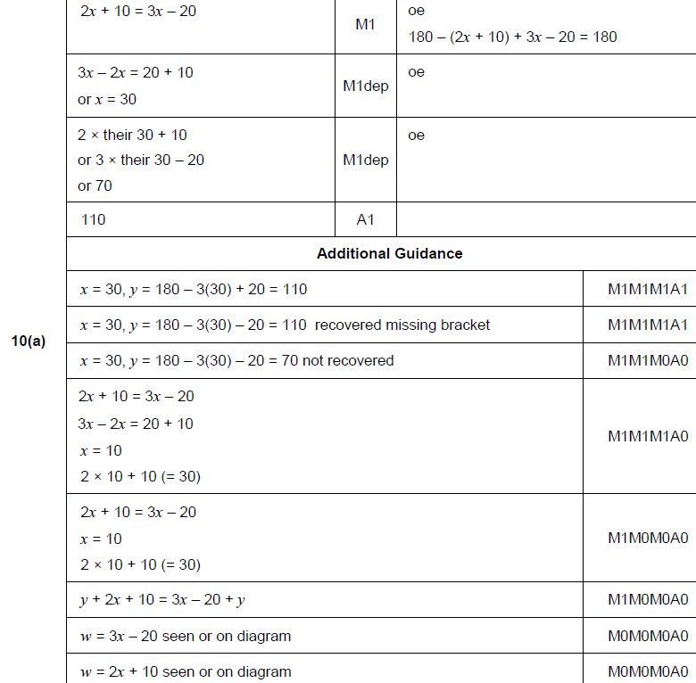
Angles (Including Parallel Lines)
June 2017 3H Q10
A

Slide 10
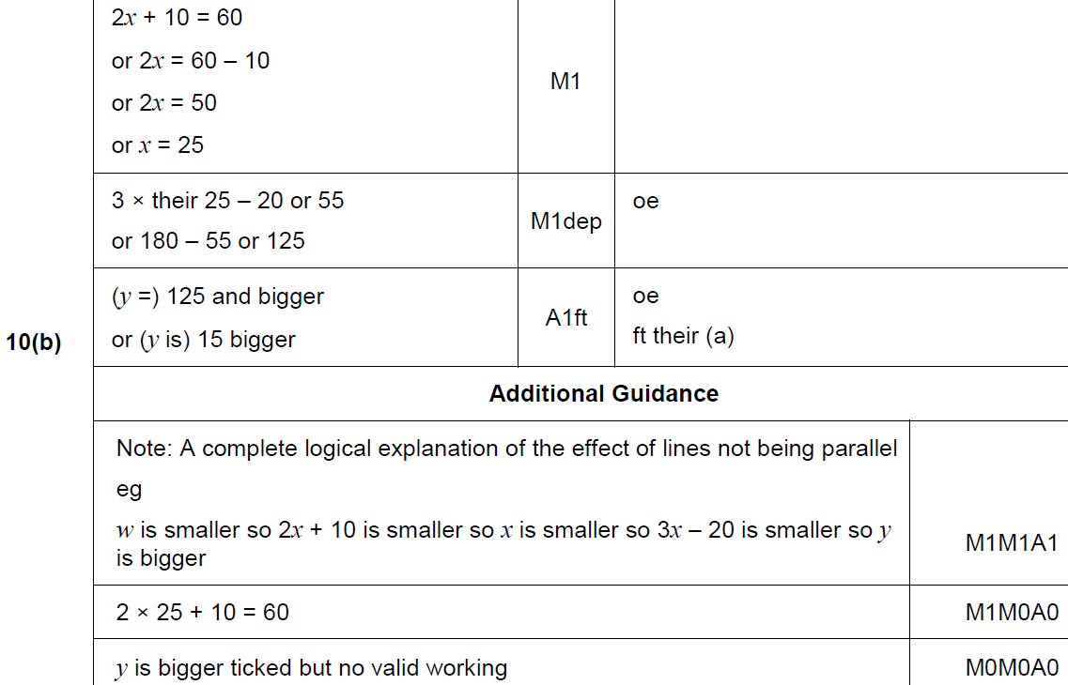
Angles (Including Parallel Lines)
June 2017 3H Q10
B

Slide 11
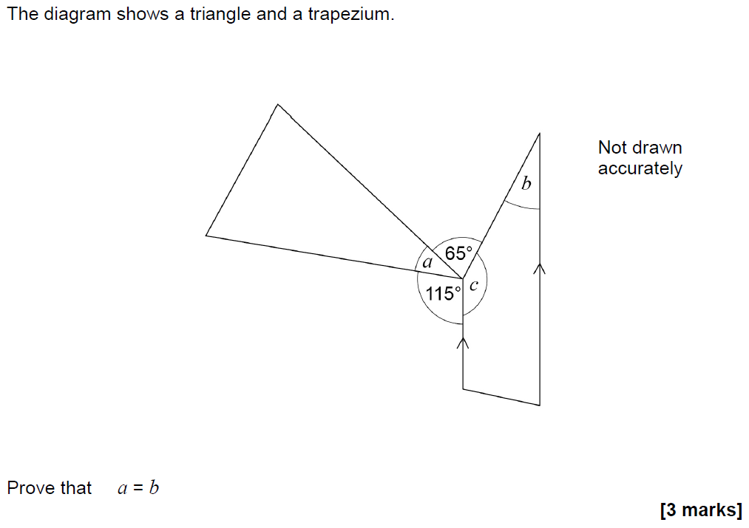
Angles (Including Parallel Lines)
Nov 2017 1H Q19

Slide 12
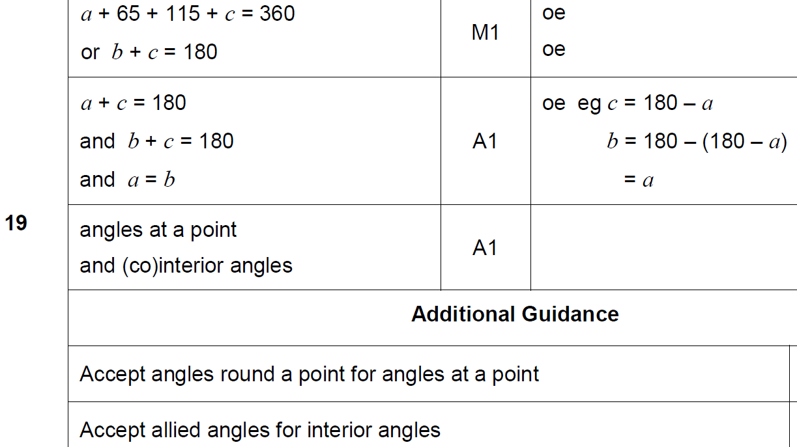
Angles (Including Parallel Lines)
Nov 2017 1H Q19
A

Slide 13
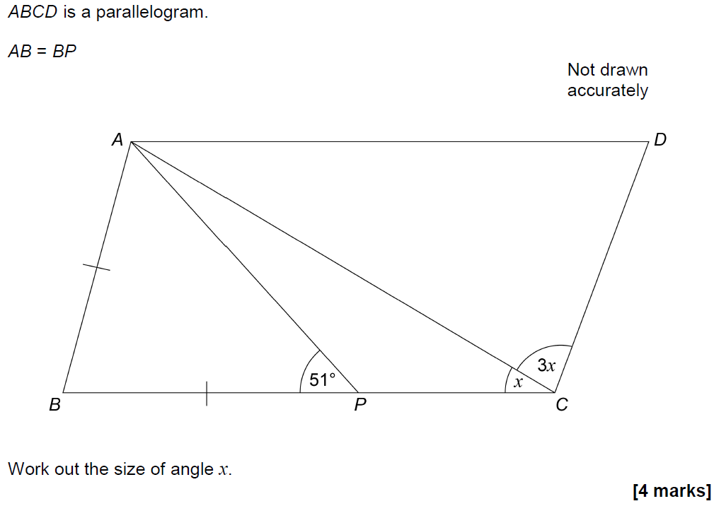
Angles (Including Parallel Lines)
Nov 2017 3H Q8

Slide 14
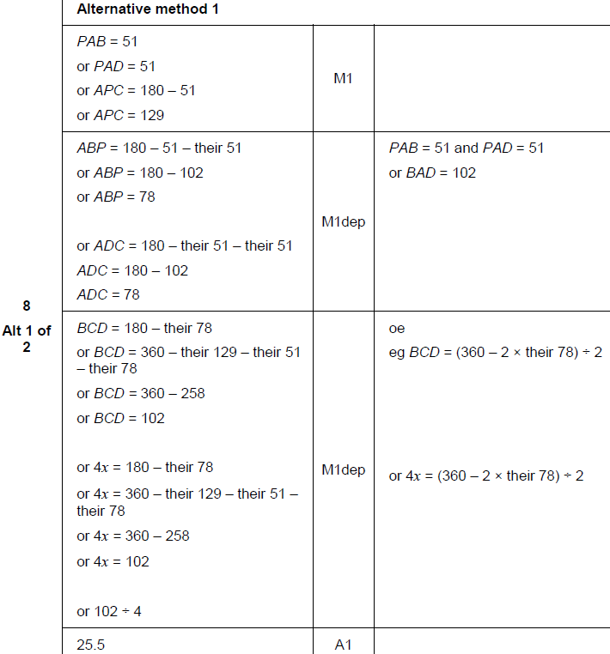
Angles (Including Parallel Lines)
Nov 2017 3H Q8
A

Slide 15
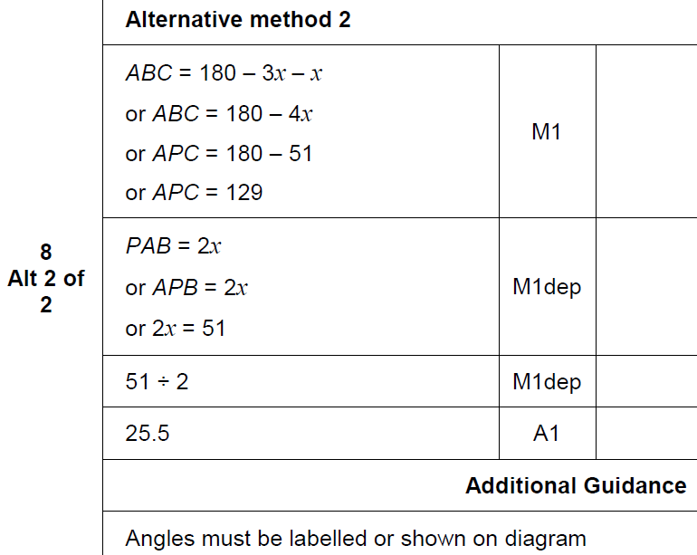
Angles (Including Parallel Lines)
Nov 2017 3H Q8
A Alternative & notes

Slide 16
Angles (Including Parallel Lines)
Nov 2018 2H Q4

Slide 17
Angles (Including Parallel Lines)
Nov 2018 2H Q4
A

