Slide 1
Angles (Including Parallel Lines)
Angles (Including Parallel Lines)
Edexcel
SAM
1H Q3
Nov 2017
1H Q3
AQA
Spec 1
1H Q1
Nov 2017
3H Q20
OCR
Spec 1
2H Q9
Bearings
Parallel lines

Slide 2
Angles (Including Parallel Lines)
Angles (Including Parallel Lines)
June 2017
3H Q4
Edexcel
June 2017
3H Q10
SAM
1H Q16
AQA
Nov 2017
1H Q19
1 Marker
SAM
3H Q10
OCR
Nov 2017
3H Q8
Nov 2017
2H Q4
Bearings
Parallel lines

Slide 3
Angles (Including Parallel Lines)
Angles (Including Parallel Lines)
Edexcel
AQA
Practice
2H Q1
Nov 2017
3H Q9
OCR
Bearings
Parallel lines

Slide 4
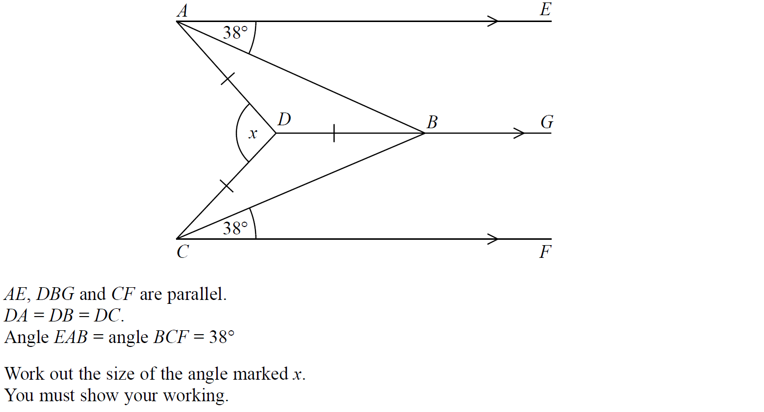
Angles (Including Parallel Lines)
SAM 1H Q3

Slide 5
Angles (Including Parallel Lines)
SAM 1H Q3
A

Slide 6
Angles (Including Parallel Lines)
Specimen Set 1 1H Q1

Slide 7
Angles (Including Parallel Lines)
Specimen Set 1 1H Q1
A

Slide 8
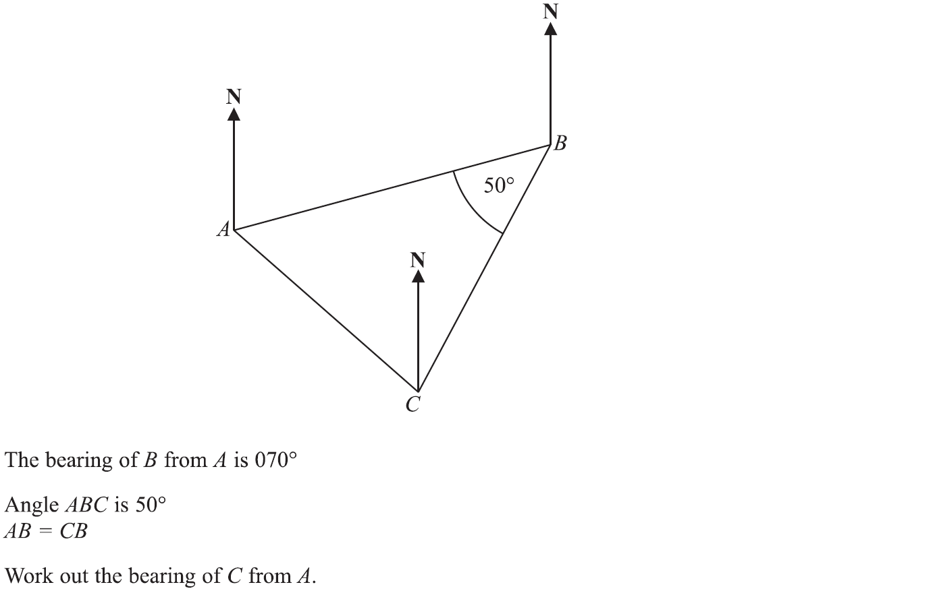
Angles (Including Parallel Lines)
Specimen Set 1 2H Q9

Slide 9
Angles (Including Parallel Lines)
Specimen Set 1 2H Q9
A

Slide 10
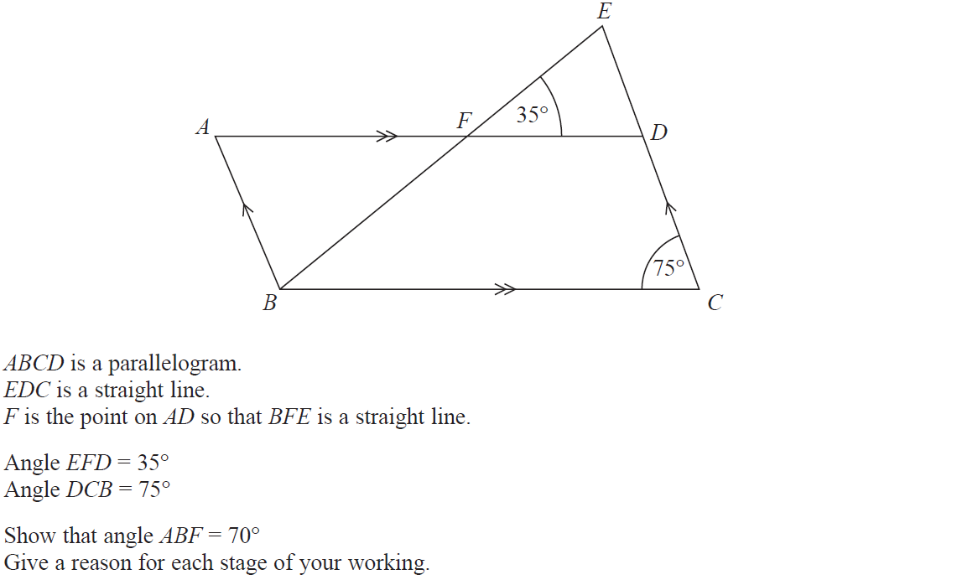
Angles (Including Parallel Lines)
Nov 2017 1H Q3

Slide 11
Angles (Including Parallel Lines)
Nov 2017 1H Q3
A

Slide 12
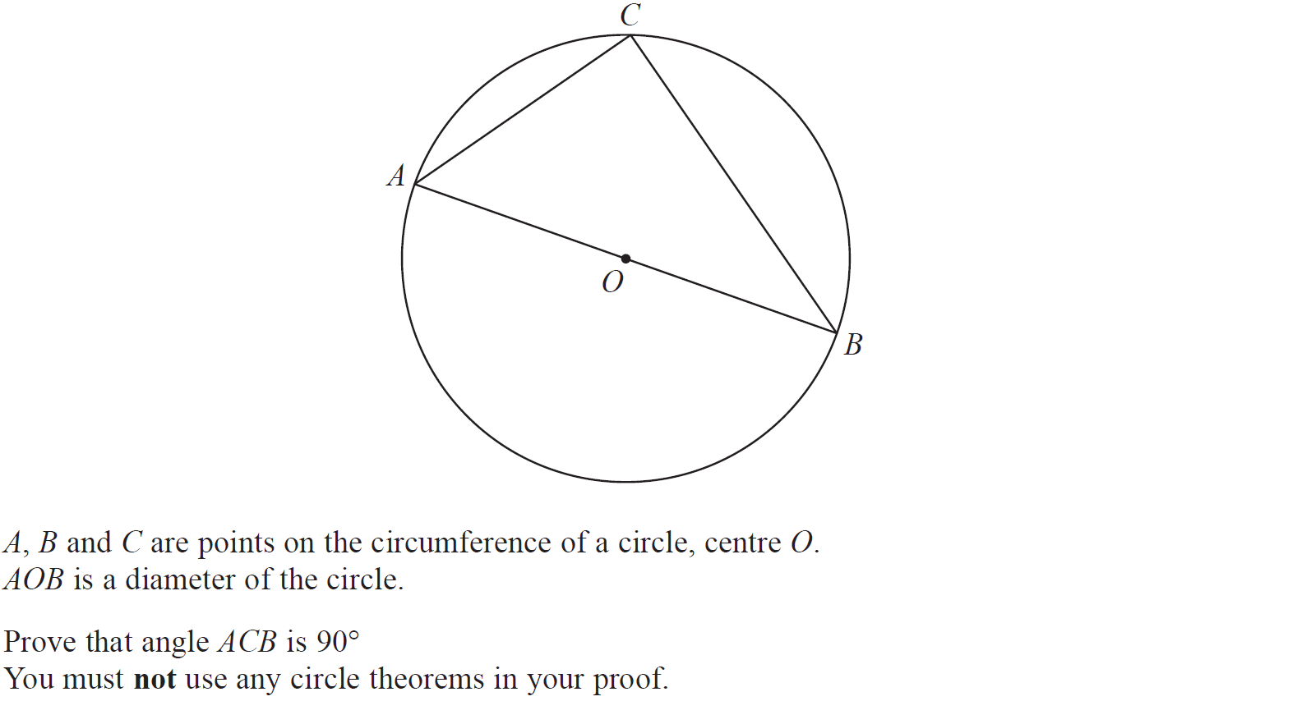
Angles (Including Parallel Lines)
Nov 2017 3H Q20

Slide 13
Angles (Including Parallel Lines)
Nov 2017 3H Q20
A

Slide 14
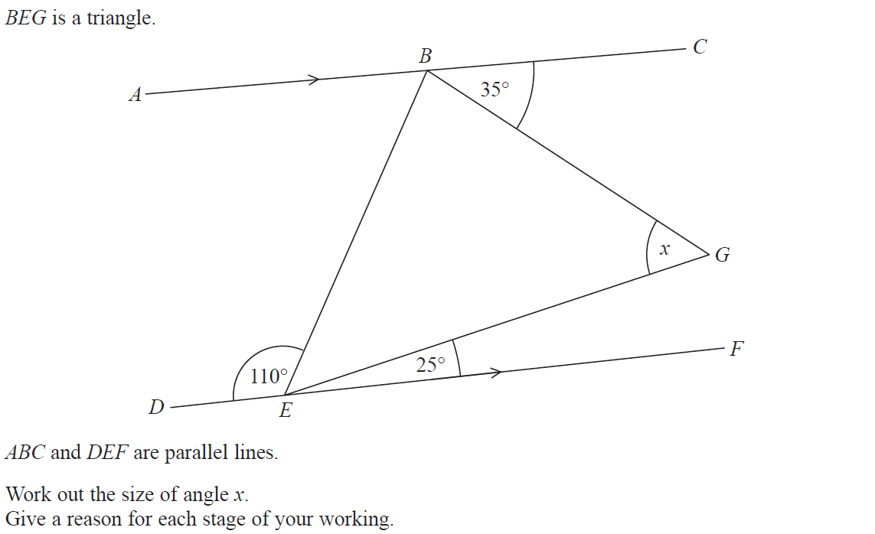
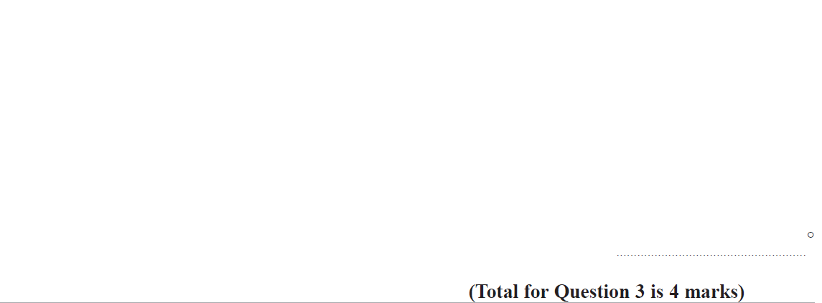
Angles (Including Parallel Lines)
Nov 2018 2H Q3

Slide 15
Angles (Including Parallel Lines)
Nov 2018 2H Q3
A

Slide 16
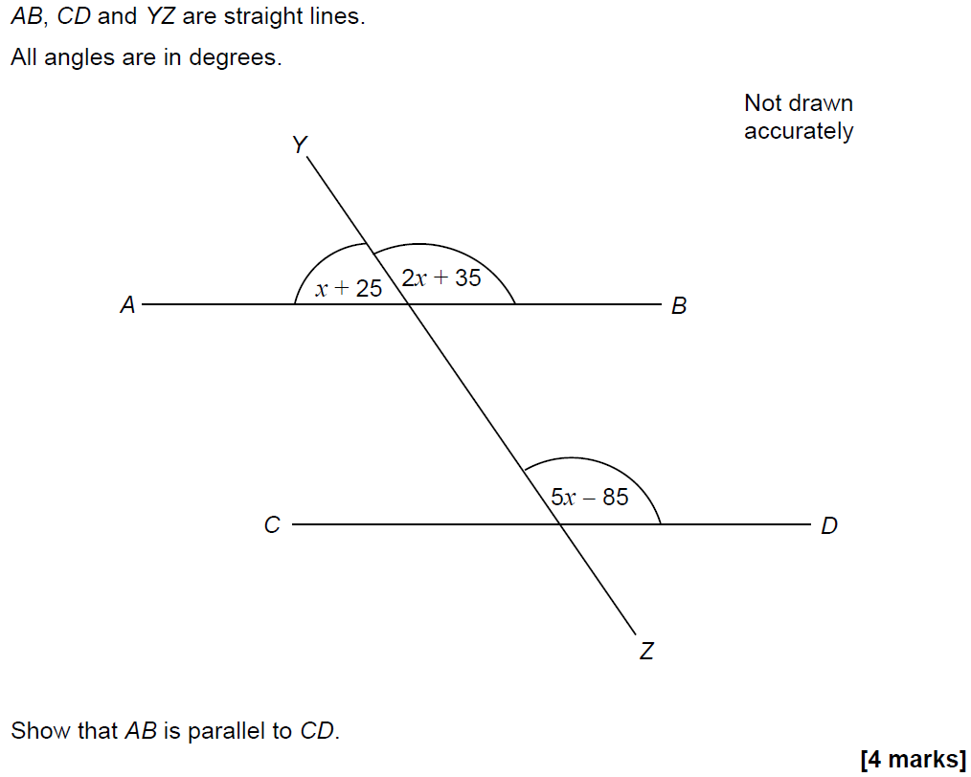
Angles (Including Parallel Lines)
SAM 1H Q16

Slide 17
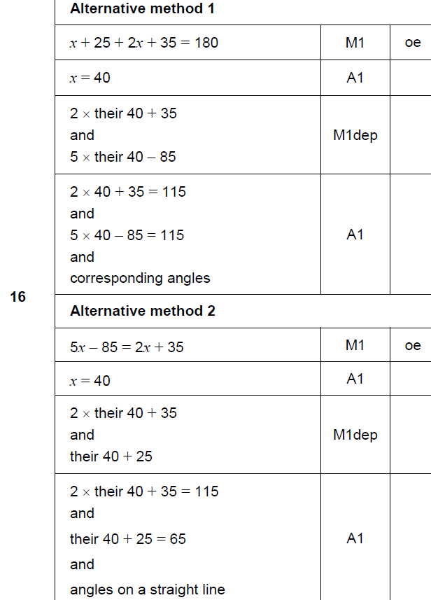
Angles (Including Parallel Lines)
SAM 1H Q16
A

Slide 18
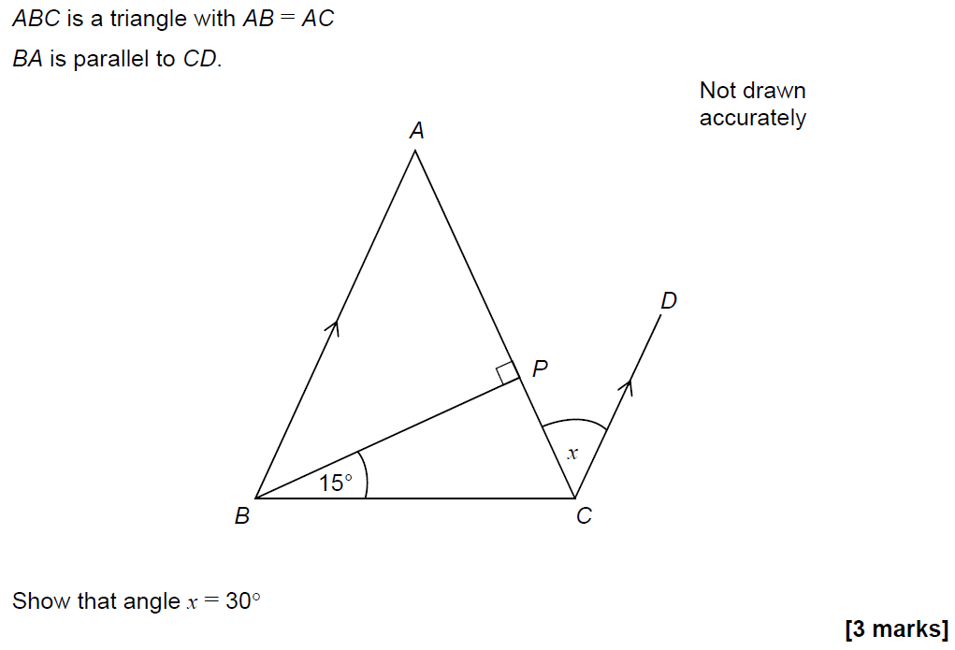
Angles (Including Parallel Lines)
SAM 3H Q10

Slide 19
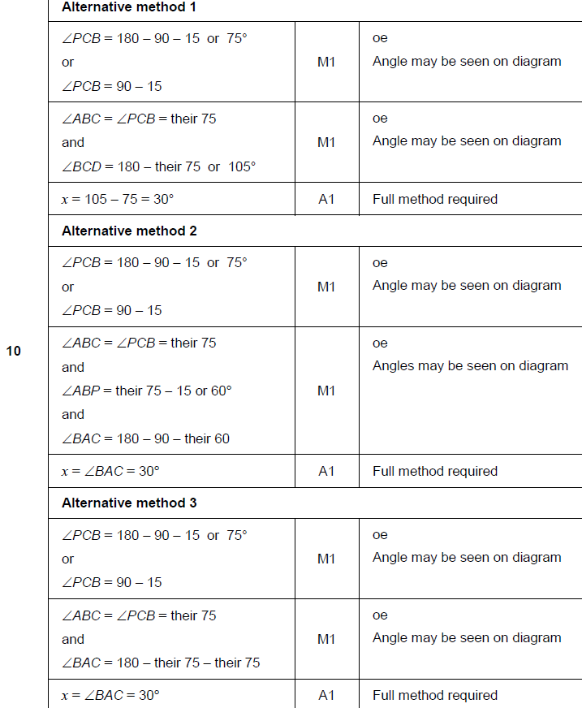
Angles (Including Parallel Lines)
SAM 3H Q10
A

Slide 20
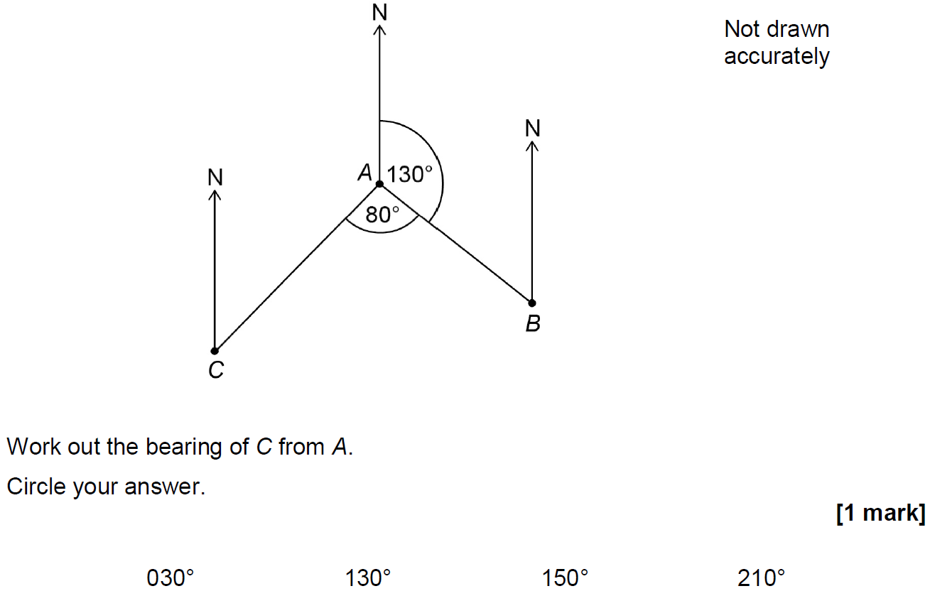
Angles (Including Parallel Lines)
June 2017 3H Q4

Slide 21
Angles (Including Parallel Lines)
June 2017 3H Q4
A

Slide 22
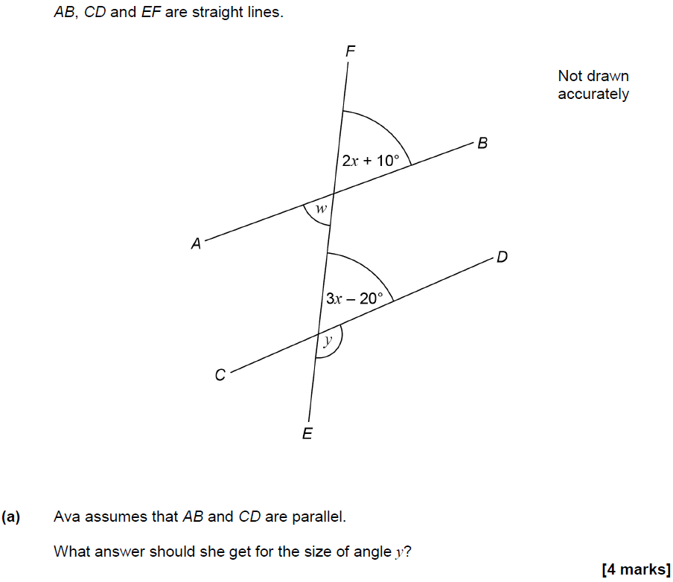
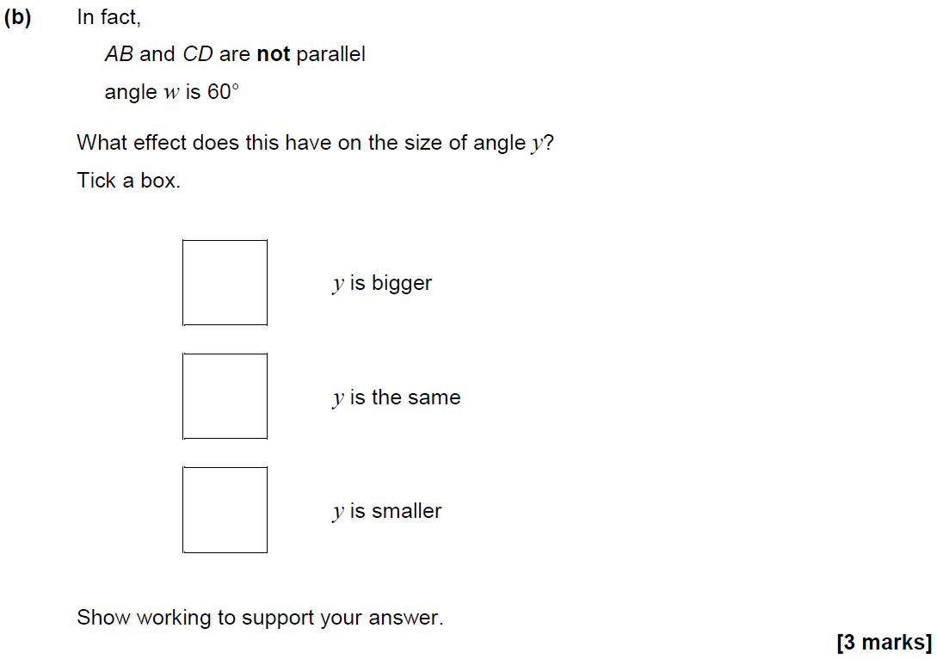
Angles (Including Parallel Lines)
June 2017 3H Q10

Slide 23
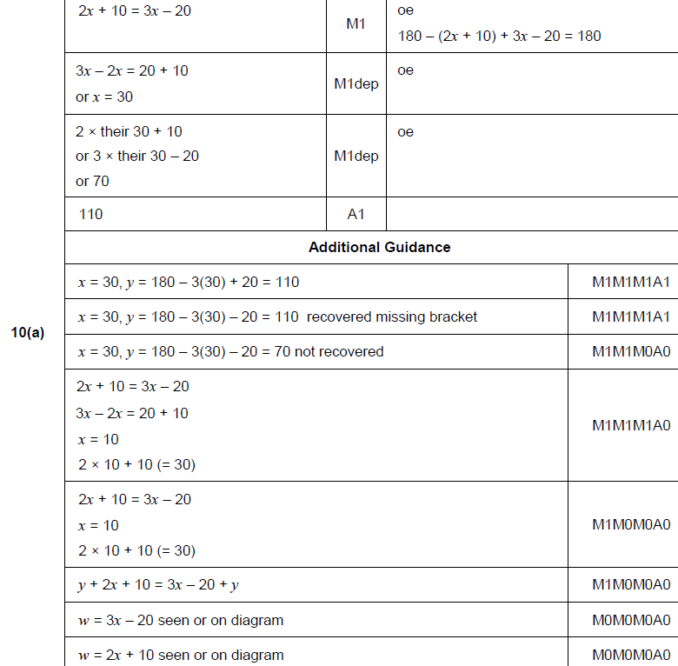
Angles (Including Parallel Lines)
June 2017 3H Q10
A

Slide 24
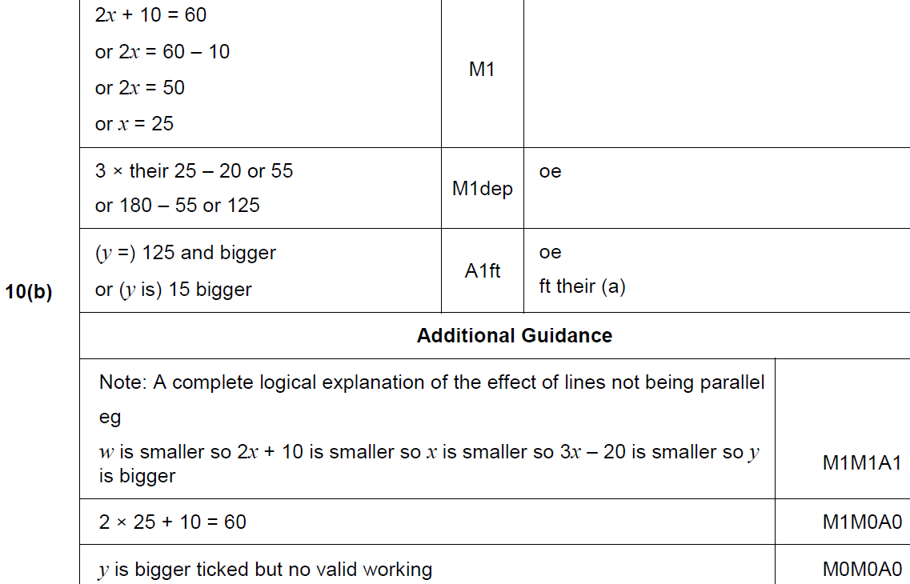
Angles (Including Parallel Lines)
June 2017 3H Q10
B

Slide 25
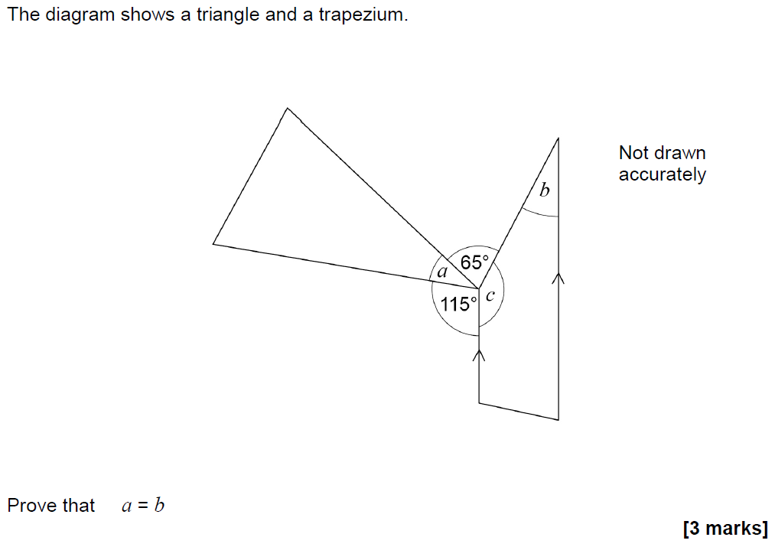
Angles (Including Parallel Lines)
Nov 2017 1H Q19

Slide 26
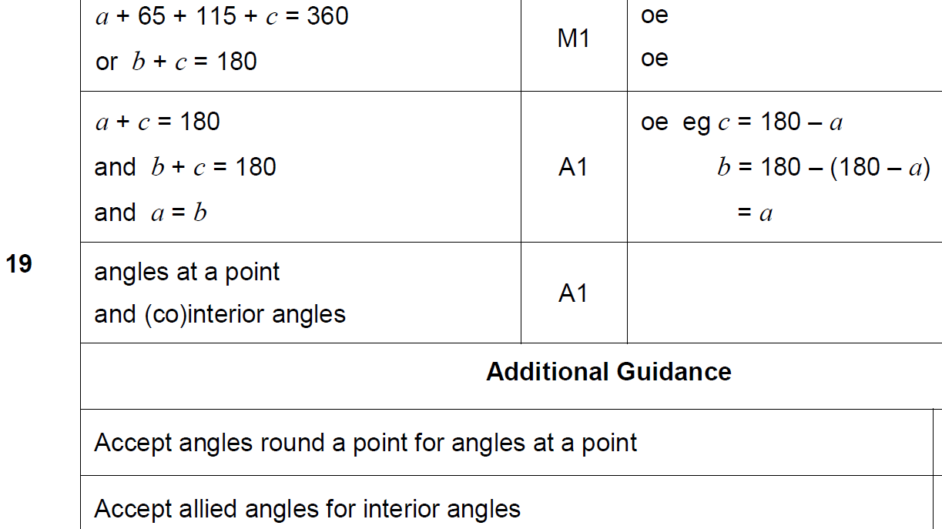
Angles (Including Parallel Lines)
Nov 2017 1H Q19
A

Slide 27
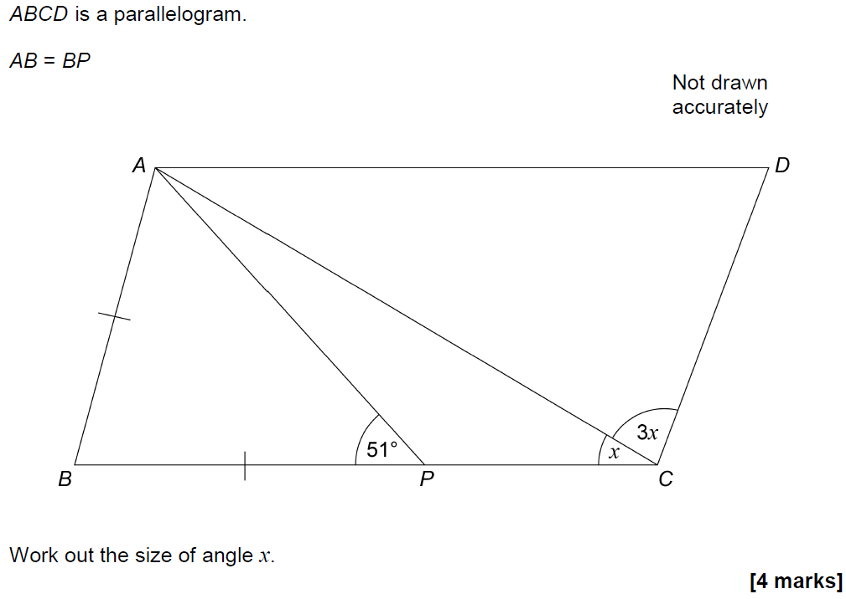
Angles (Including Parallel Lines)
Nov 2017 3H Q8

Slide 28
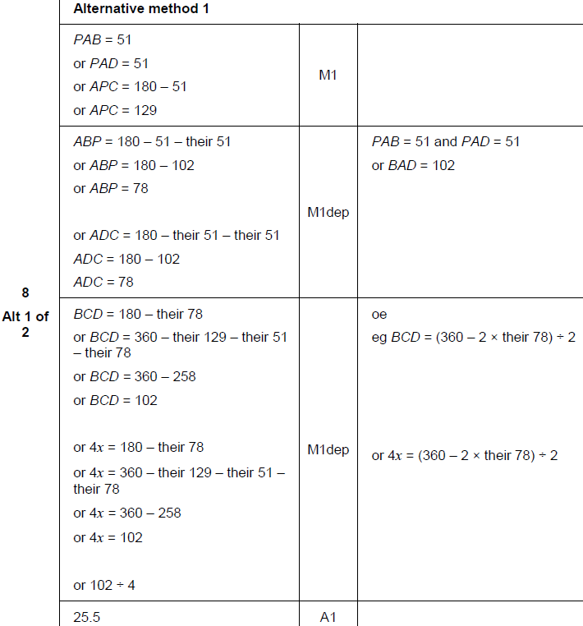
Angles (Including Parallel Lines)
Nov 2017 3H Q8
A

Slide 29
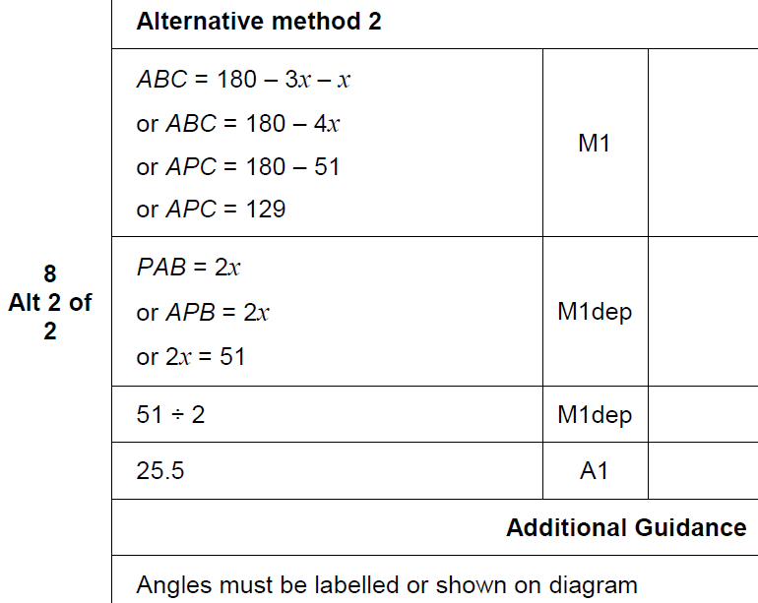
Angles (Including Parallel Lines)
Nov 2017 3H Q8
A Alternative & notes

Slide 30
Angles (Including Parallel Lines)
Nov 2018 2H Q4

Slide 31
Angles (Including Parallel Lines)
Nov 2018 2H Q4
A

Slide 32
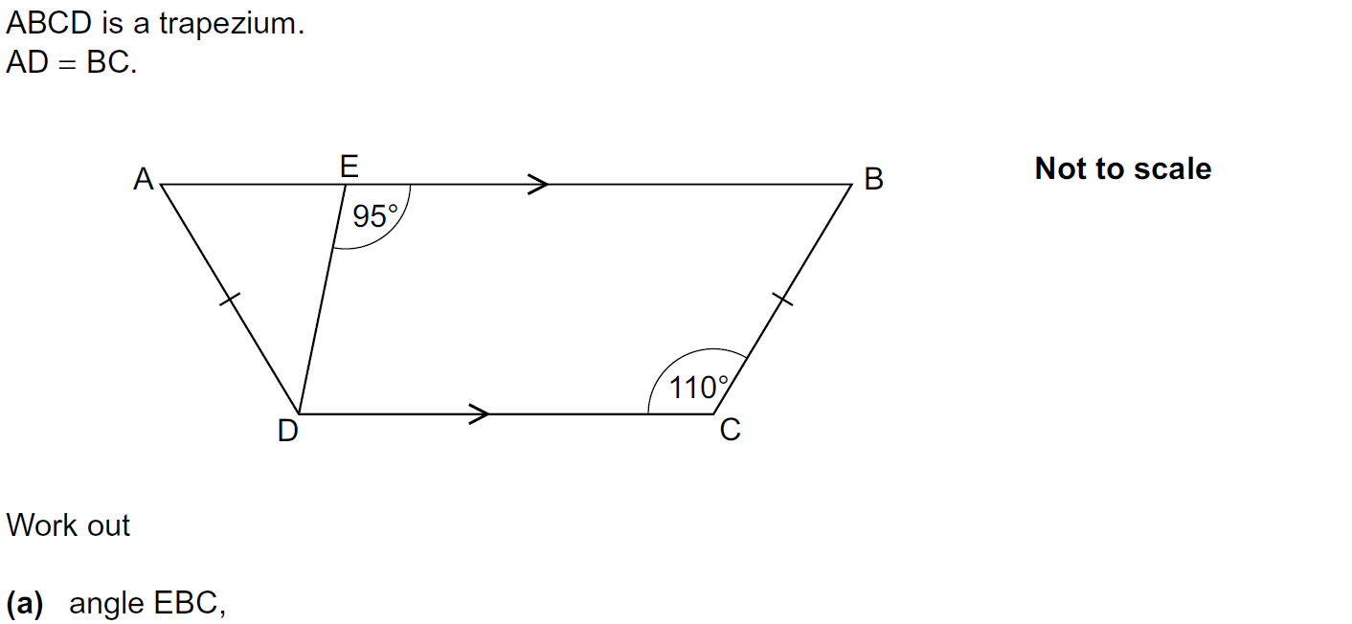
Angles (Including Parallel Lines)
Practice 2H Q1

Slide 33
Angles (Including Parallel Lines)
Practice 2H Q1
A
B

Slide 34
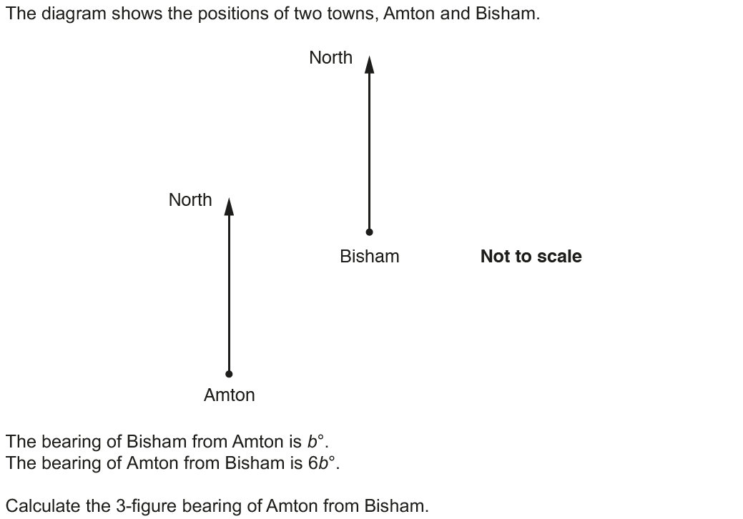
Angles (Including Parallel Lines)
Nov 2017 3H Q9

Slide 35
Angles (Including Parallel Lines)
Nov 2017 3H Q9
A

