Slide 1
Angles (Including Parallel Lines)
Angles (Including Parallel Lines)
Practice
2H Q1
Nov 2017
3H Q9
Bearings
Parallel lines

Slide 2
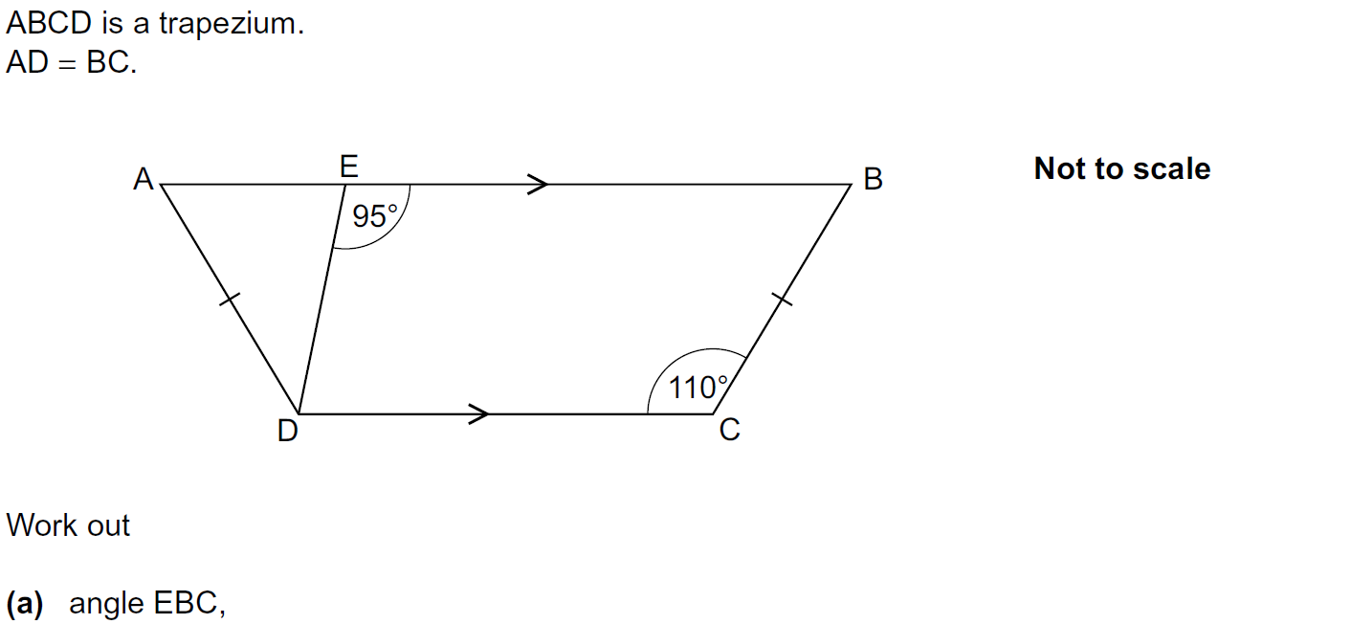
Angles (Including Parallel Lines)
Practice 2H Q1

Slide 3
Angles (Including Parallel Lines)
Practice 2H Q1
A
B

Slide 4
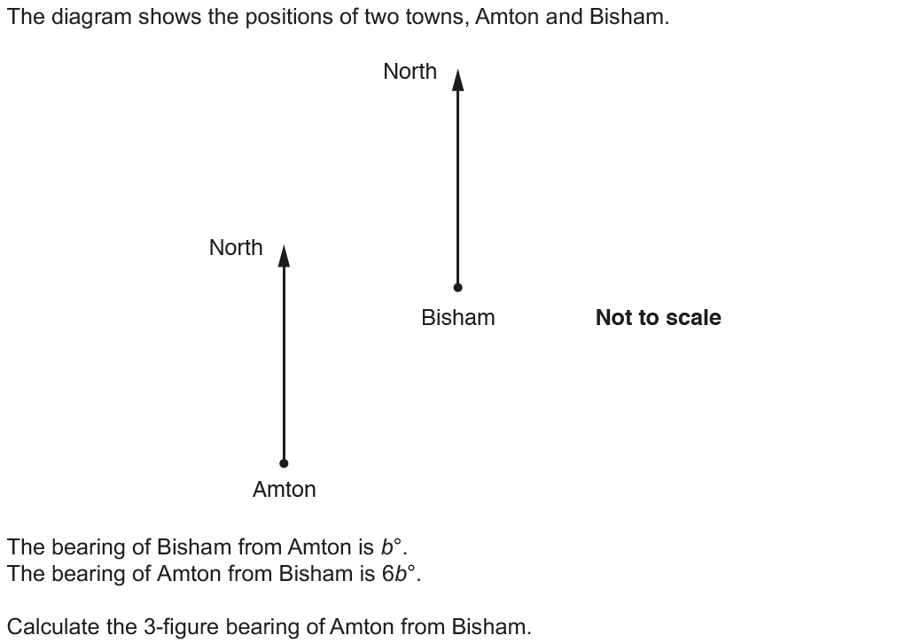
Angles (Including Parallel Lines)
Nov 2017 3H Q9

Slide 5
Angles (Including Parallel Lines)
Nov 2017 3H Q9
A

