Slide 1
Angles (Including Parallel Lines)
Angles (Including Parallel Lines)
SAM
1H Q3
Nov 2017
1H Q3
Spec 1
1H Q1
Nov 2017
3H Q20
Spec 1
2H Q9
Bearings
Parallel lines

Slide 2
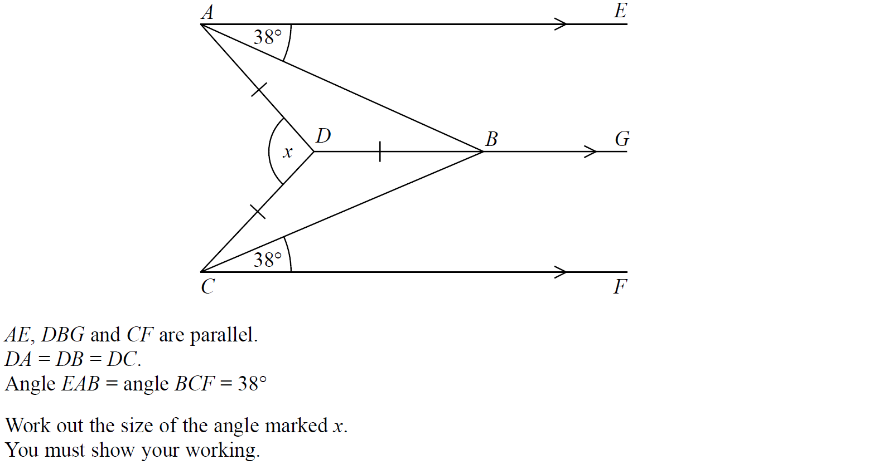
Angles (Including Parallel Lines)
SAM 1H Q3

Slide 3
Angles (Including Parallel Lines)
SAM 1H Q3
A

Slide 4
Angles (Including Parallel Lines)
Specimen Set 1 1H Q1

Slide 5
Angles (Including Parallel Lines)
Specimen Set 1 1H Q1
A

Slide 6
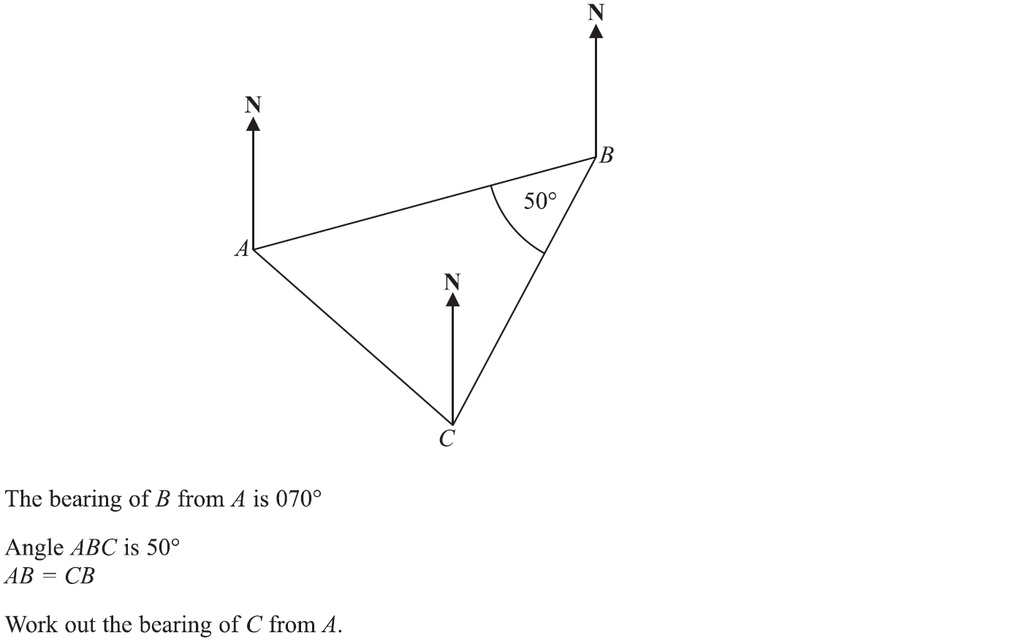
Angles (Including Parallel Lines)
Specimen Set 1 2H Q9

Slide 7
Angles (Including Parallel Lines)
Specimen Set 1 2H Q9
A

Slide 8
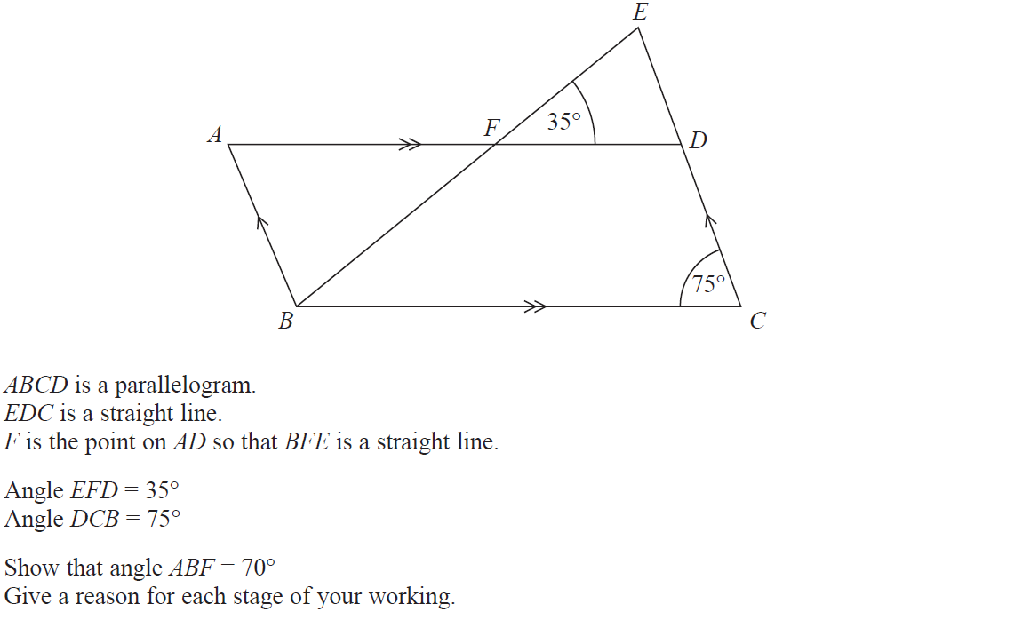
Angles (Including Parallel Lines)
Nov 2017 1H Q3

Slide 9
Angles (Including Parallel Lines)
Nov 2017 1H Q3
A

Slide 10
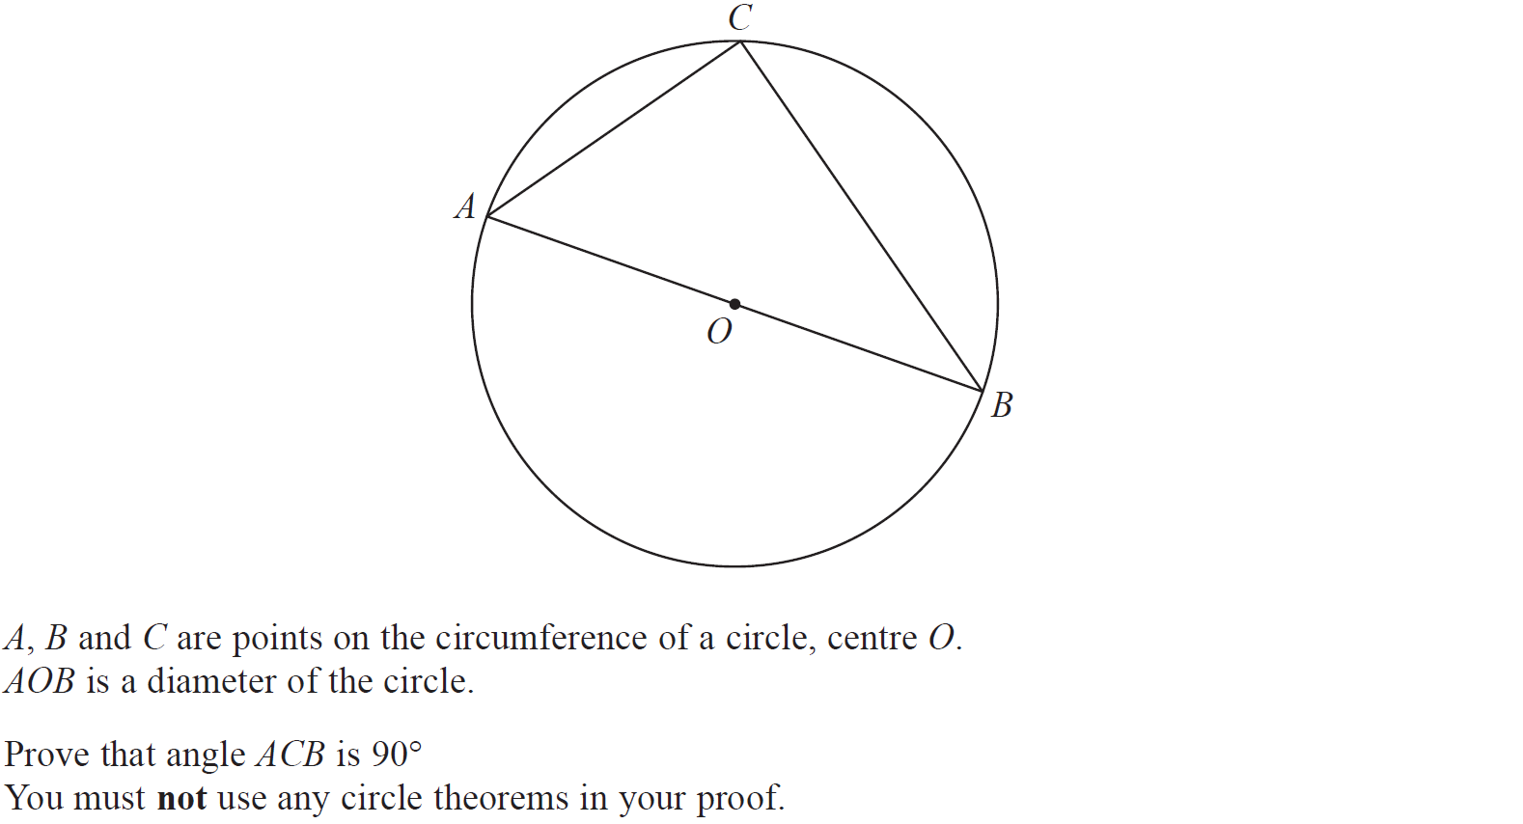
Angles (Including Parallel Lines)
Nov 2017 3H Q20

Slide 11
Angles (Including Parallel Lines)
Nov 2017 3H Q20
A

