Slide 1
Old Spec Q’s
Normal Distribution
Practice G
(i)
Specimen
(i)
Practice G (ii)
Specimen
(ii)
Practice H (i)
Specimen
(iii)
Practice H (ii)
SAM
(i)
Practice H (iii)
SAM
(ii)
Practice H (iv)
SAM
(iii)
Practice I
2018

Slide 2
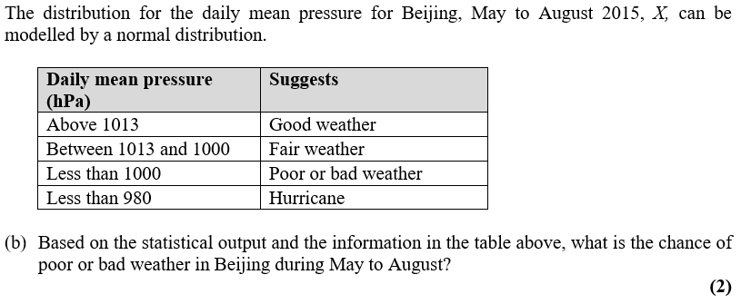
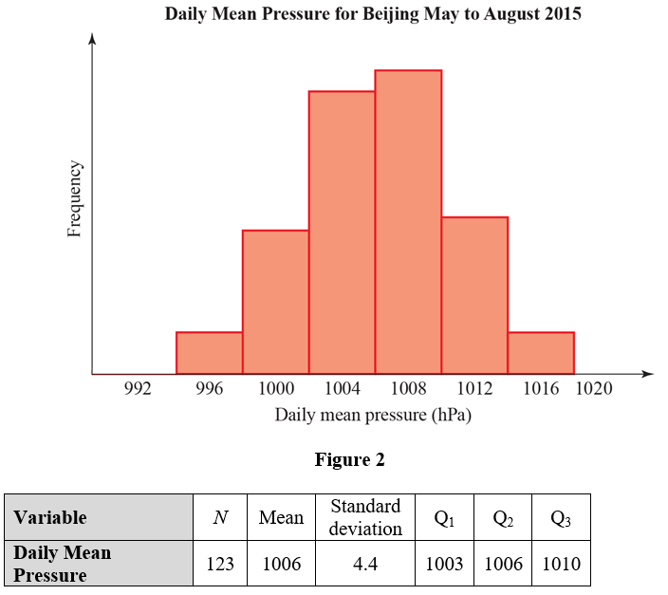
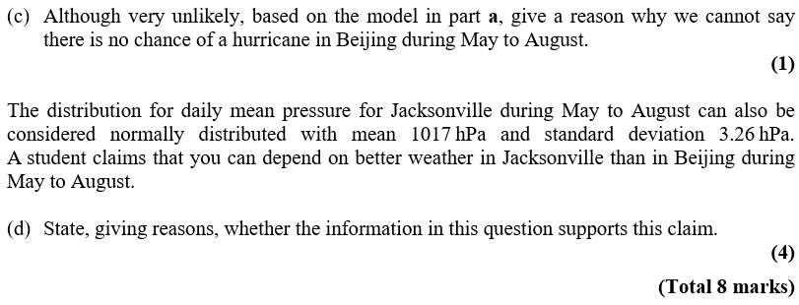
Practice Paper G

Slide 3
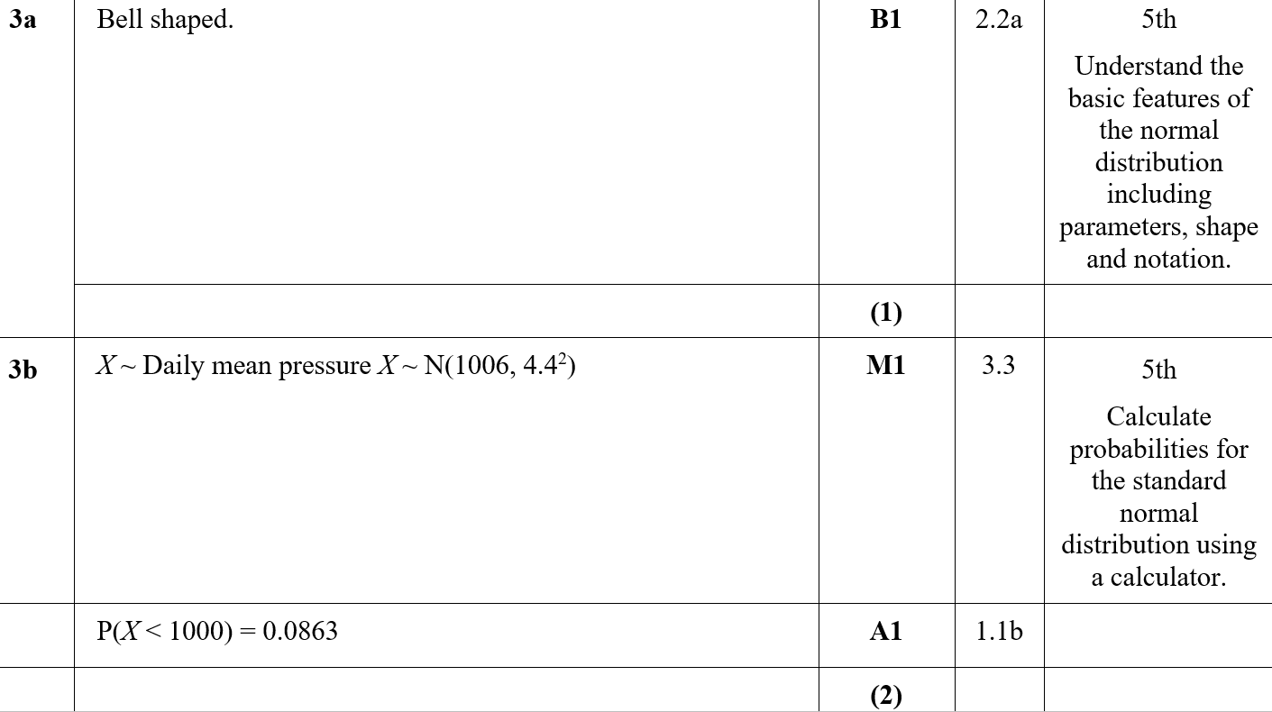
Practice Paper G
A
B
A notes

Slide 4
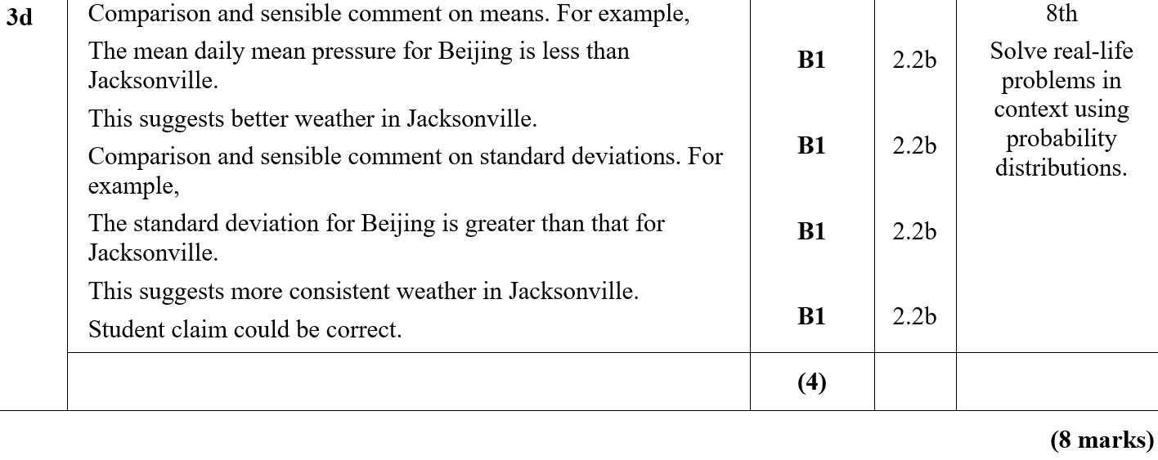
Practice Paper G
C
D
D notes

Slide 5
Practice Paper G

Slide 6
Practice Paper G
A

Slide 7
Practice Paper H

Slide 8
Practice Paper H
A

Slide 9
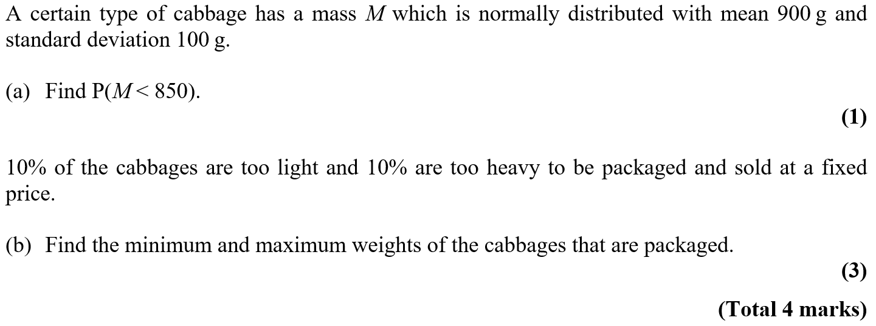
Practice Paper H

Slide 10
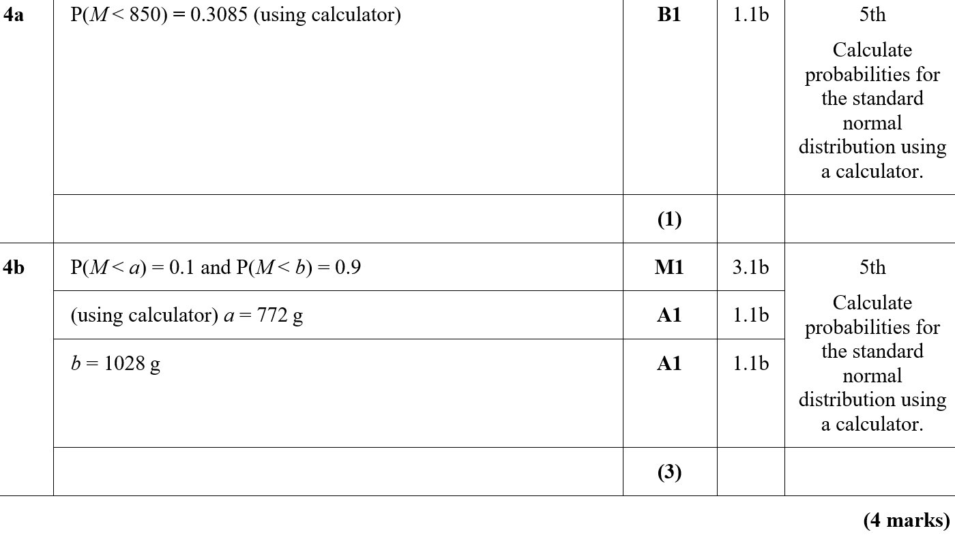
Practice Paper H
A
B

Slide 11
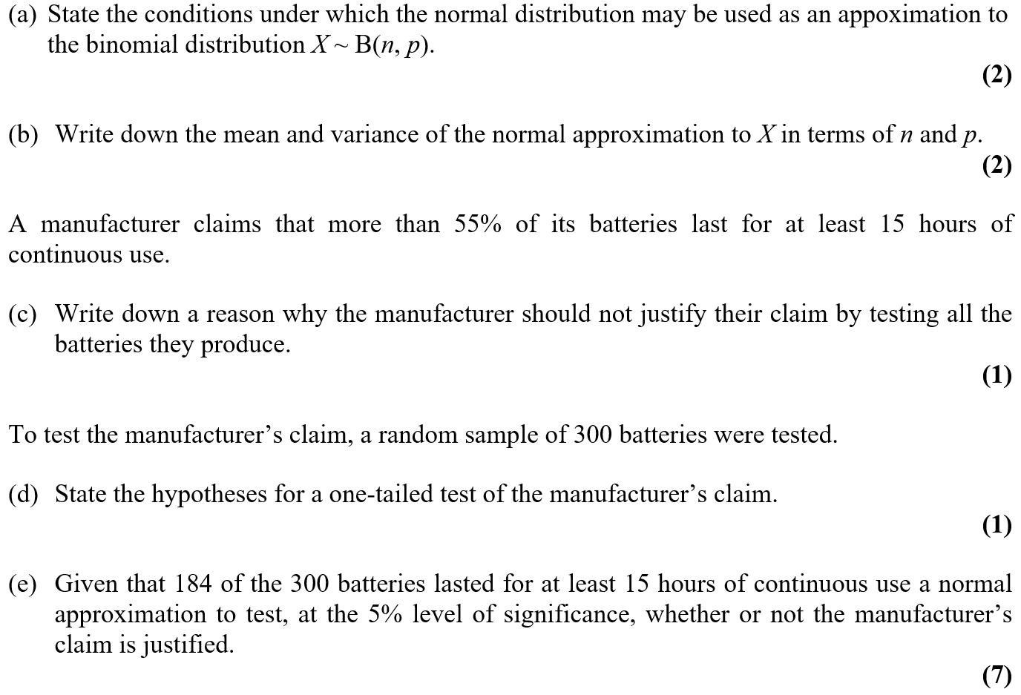
Practice Paper H

Slide 12
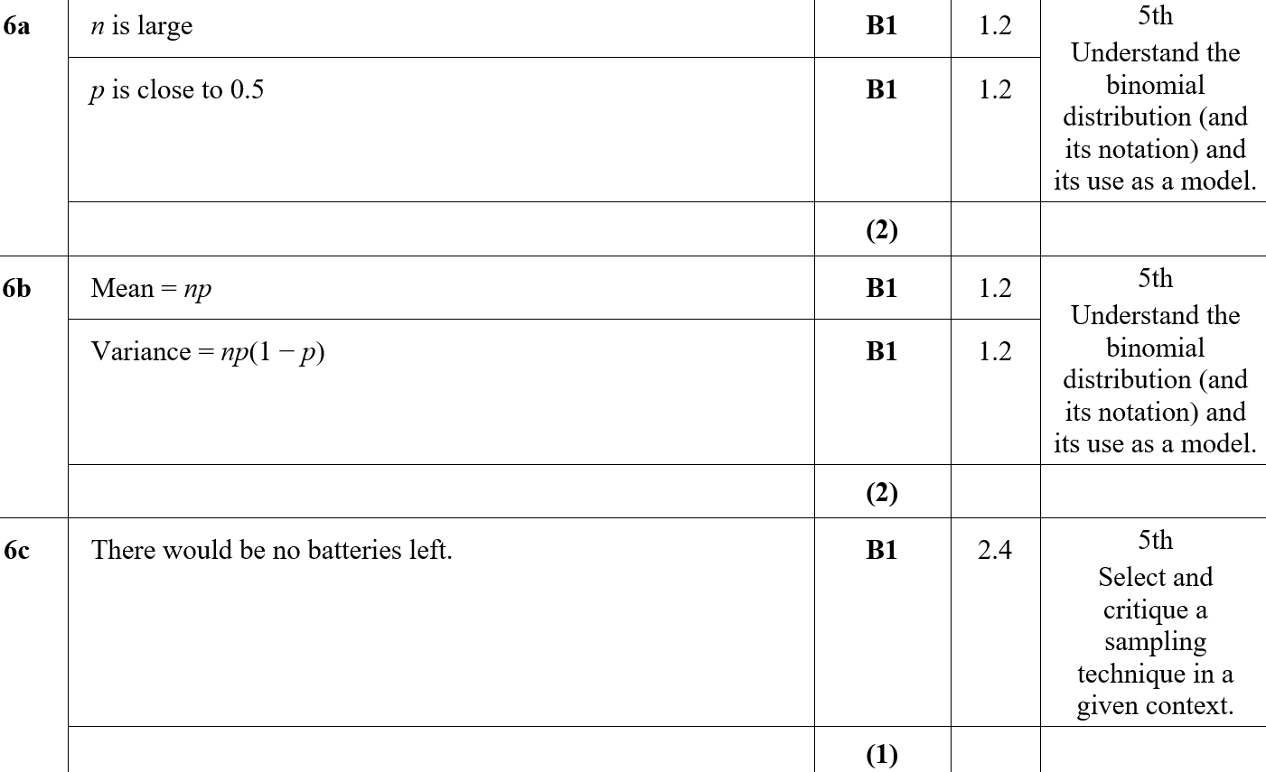
Practice Paper H
A
B
C

Slide 13
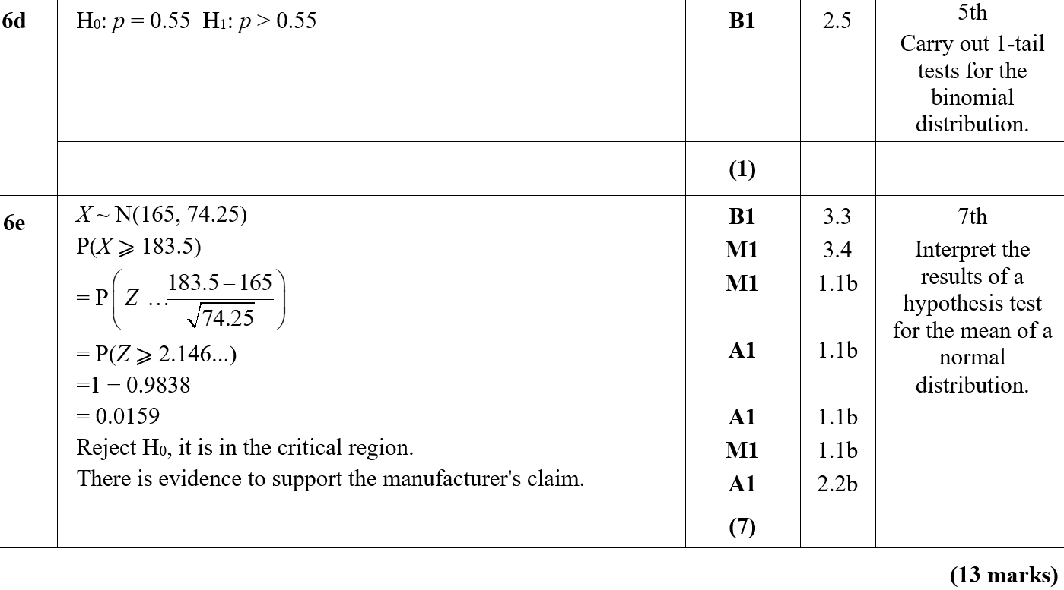
Practice Paper H
D
E

Slide 14
Practice Paper H

Slide 15
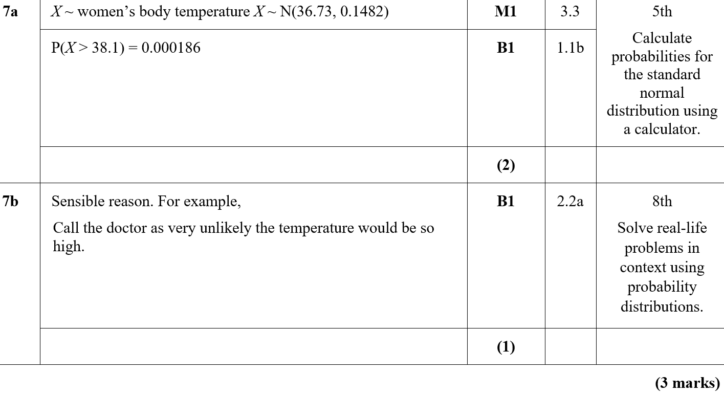
Practice Paper H
A
B

Slide 16
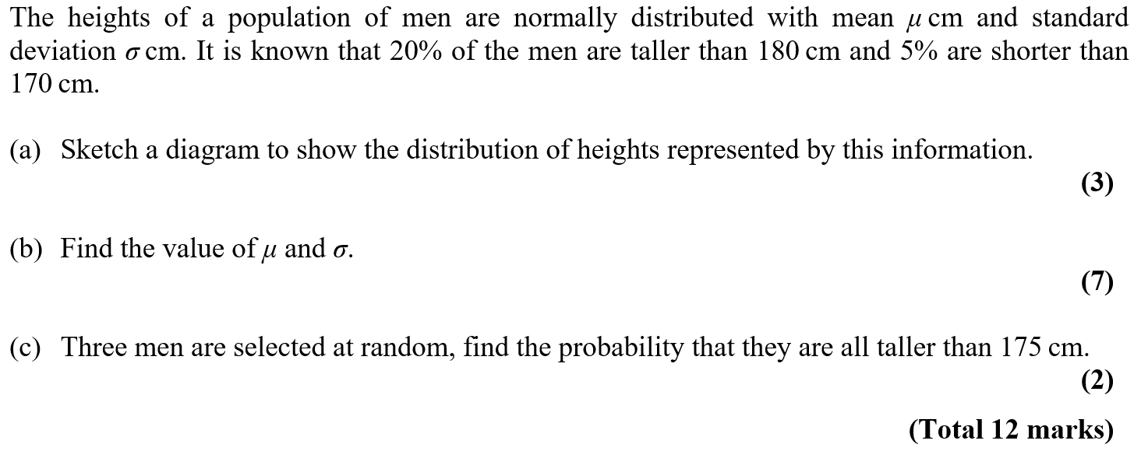
Practice Paper I

Slide 17
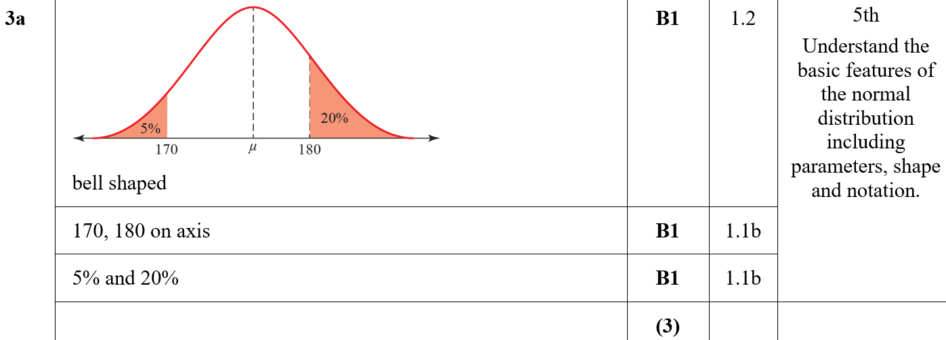
Practice Paper I
A

Slide 18
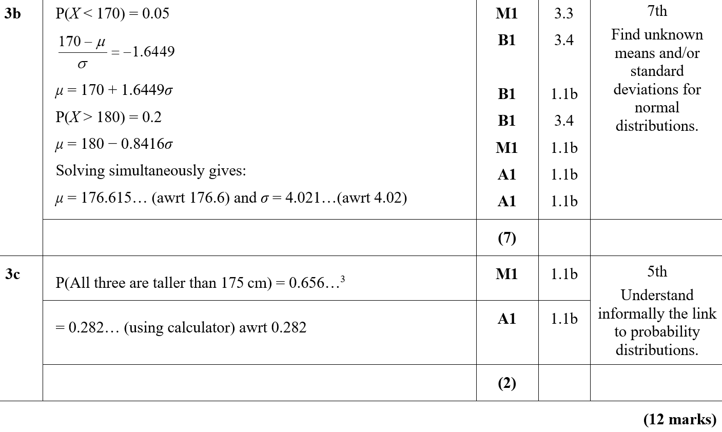
Practice Paper I
B
C

Slide 19
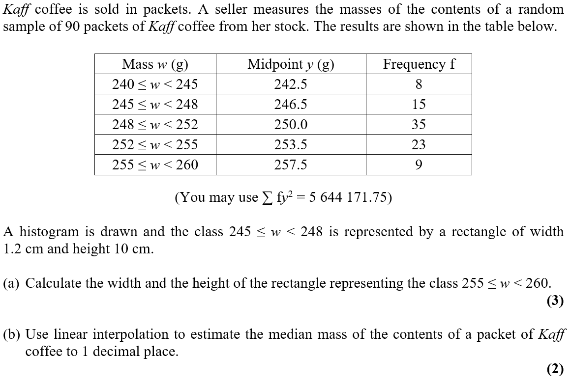
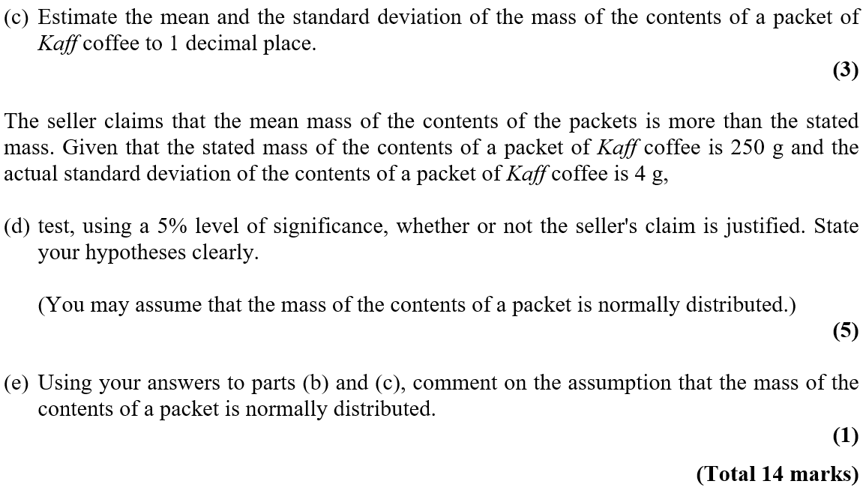
Specimen

Slide 20
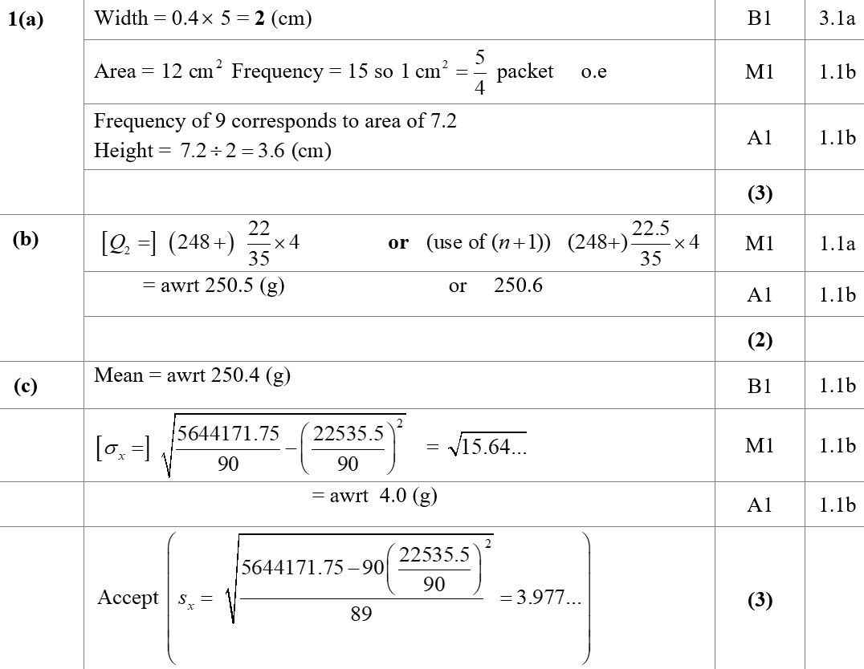
Specimen
A
B
C

Slide 21
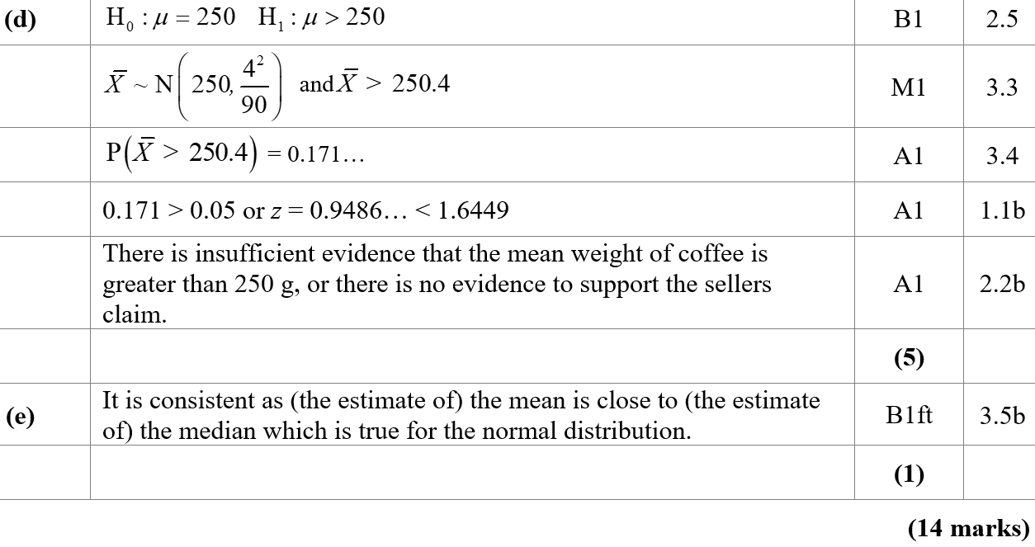
Specimen
D
E

Slide 22
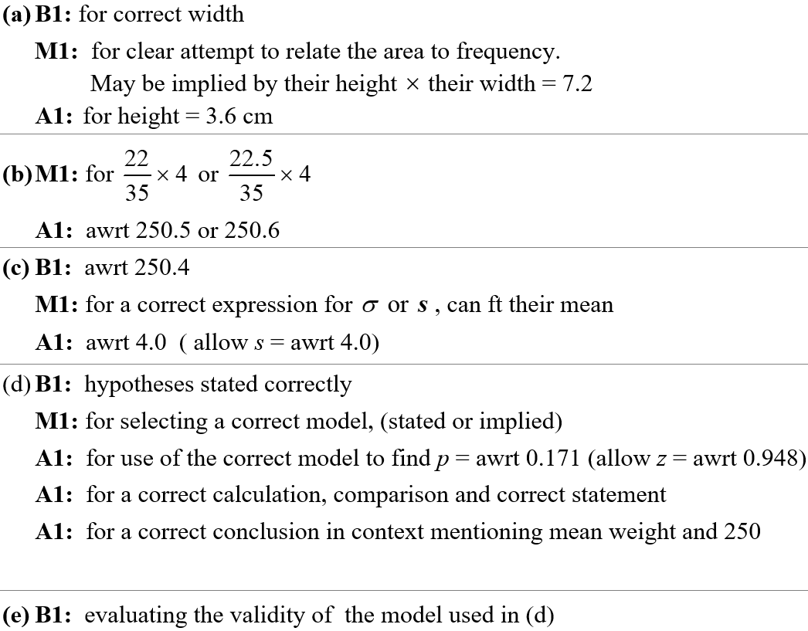
Specimen
A notes
B notes
C notes
D notes
E notes

Slide 23
Specimen

Slide 24
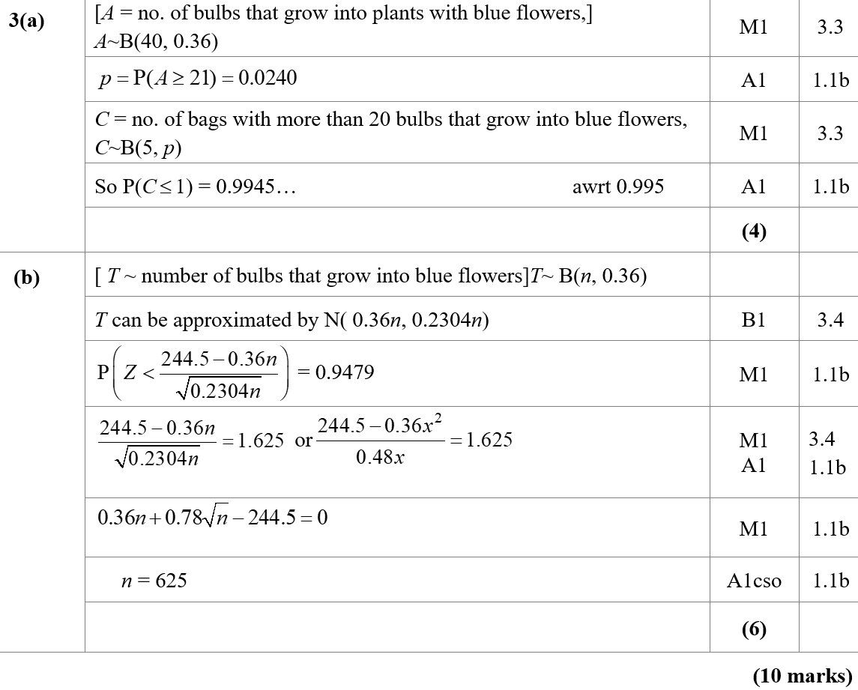
Specimen
A
B

Slide 25
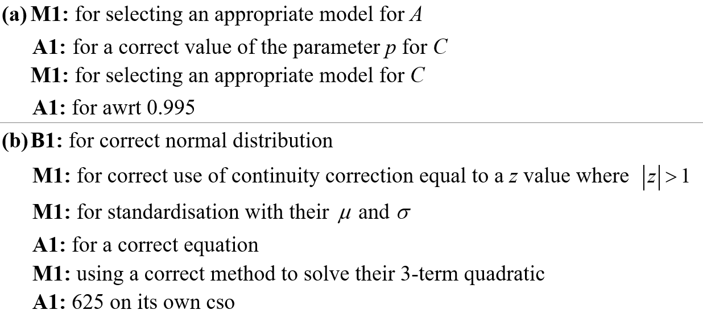
Specimen
A notes
B notes

Slide 26
Specimen

Slide 27
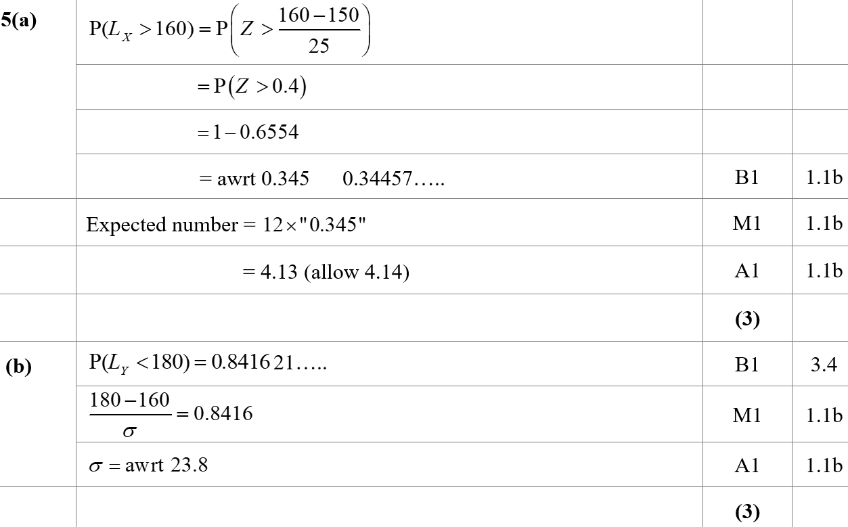
Specimen
A
B

Slide 28
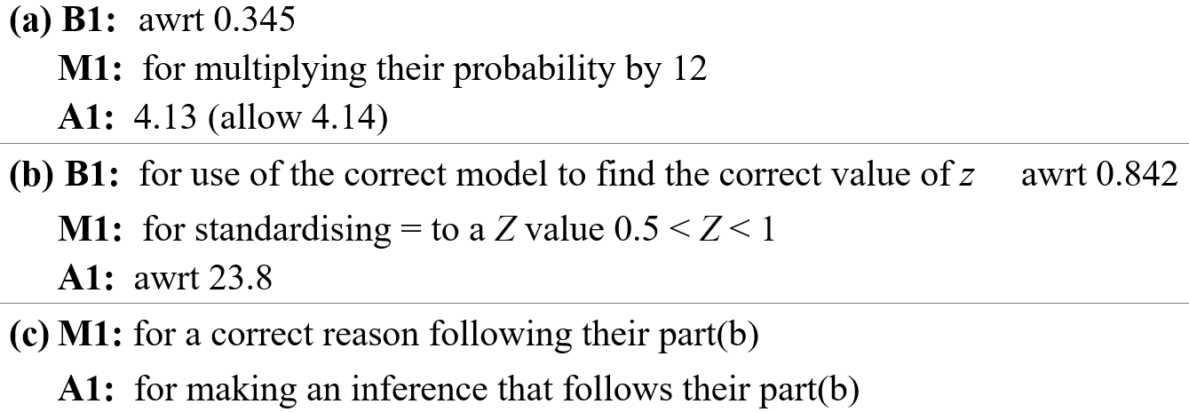
Specimen
C
A notes
B notes
C notes

Slide 29
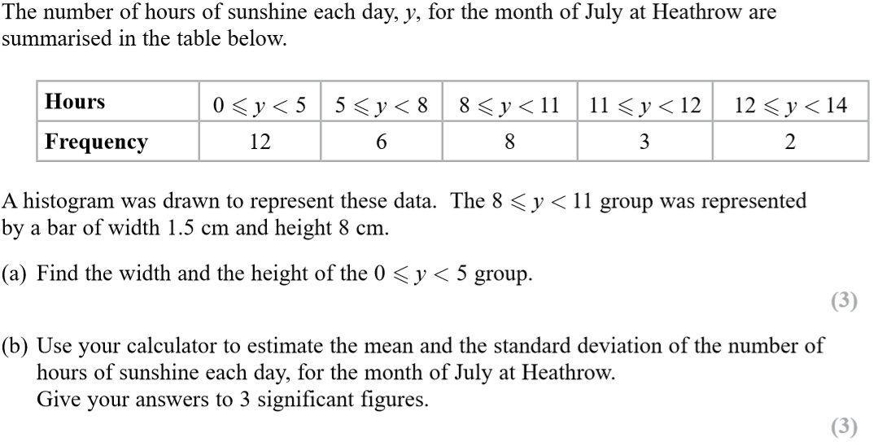
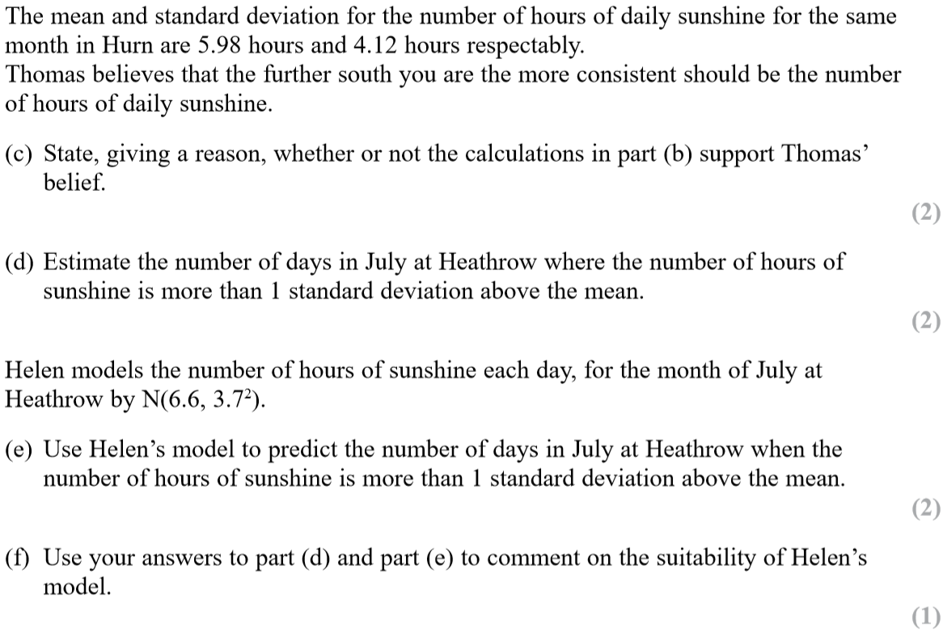
SAM

Slide 30
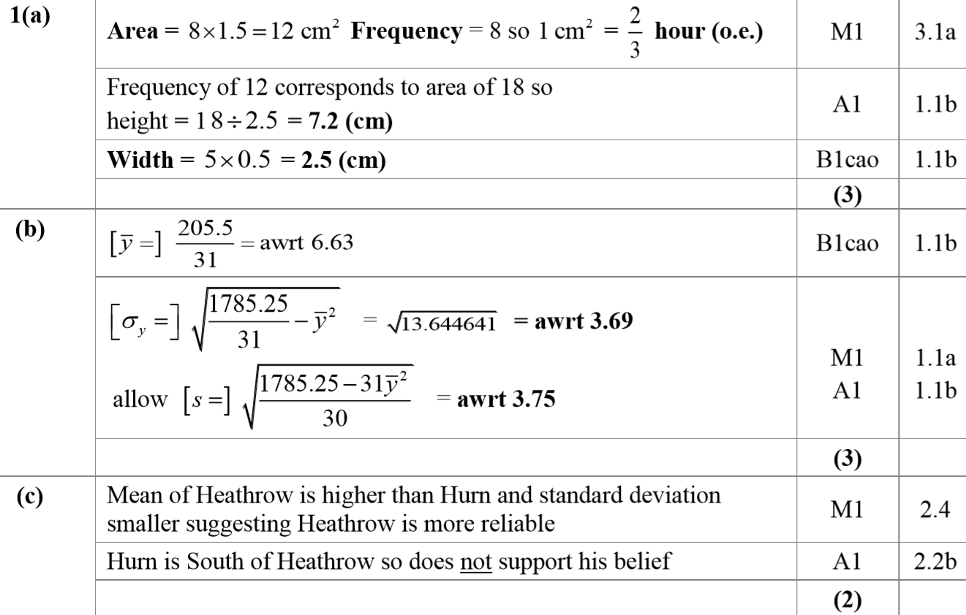
SAM
A
B
C

Slide 31
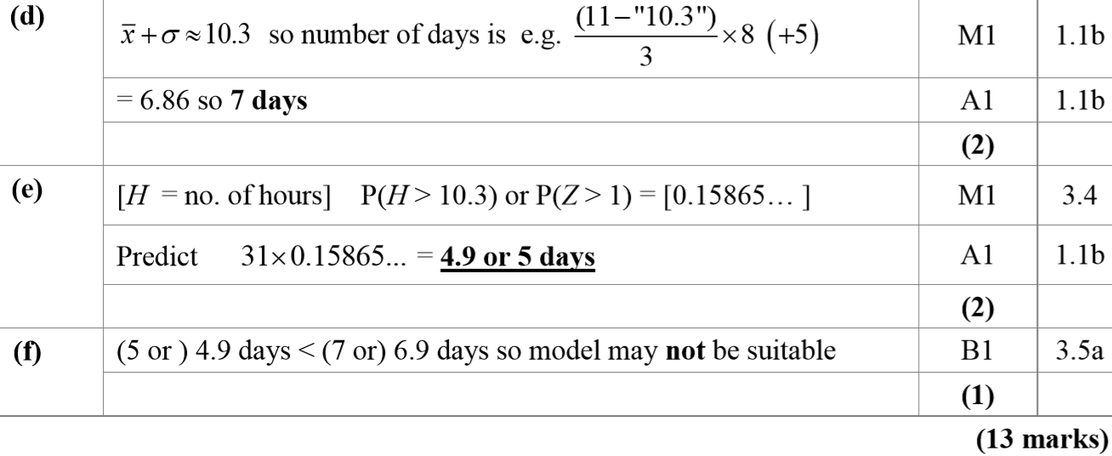
SAM
D
E
F
A notes
B notes

Slide 32
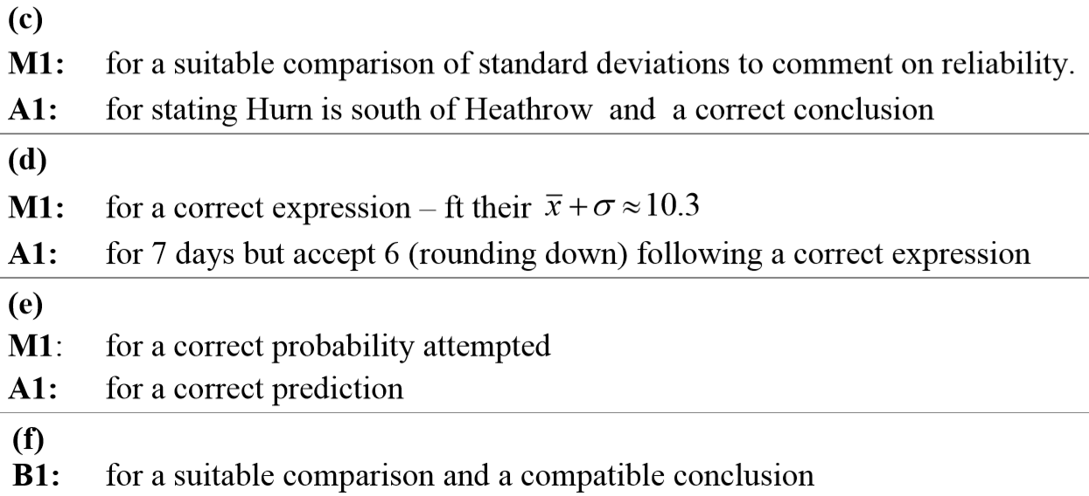
SAM
C notes
D notes
E notes
F notes

Slide 33
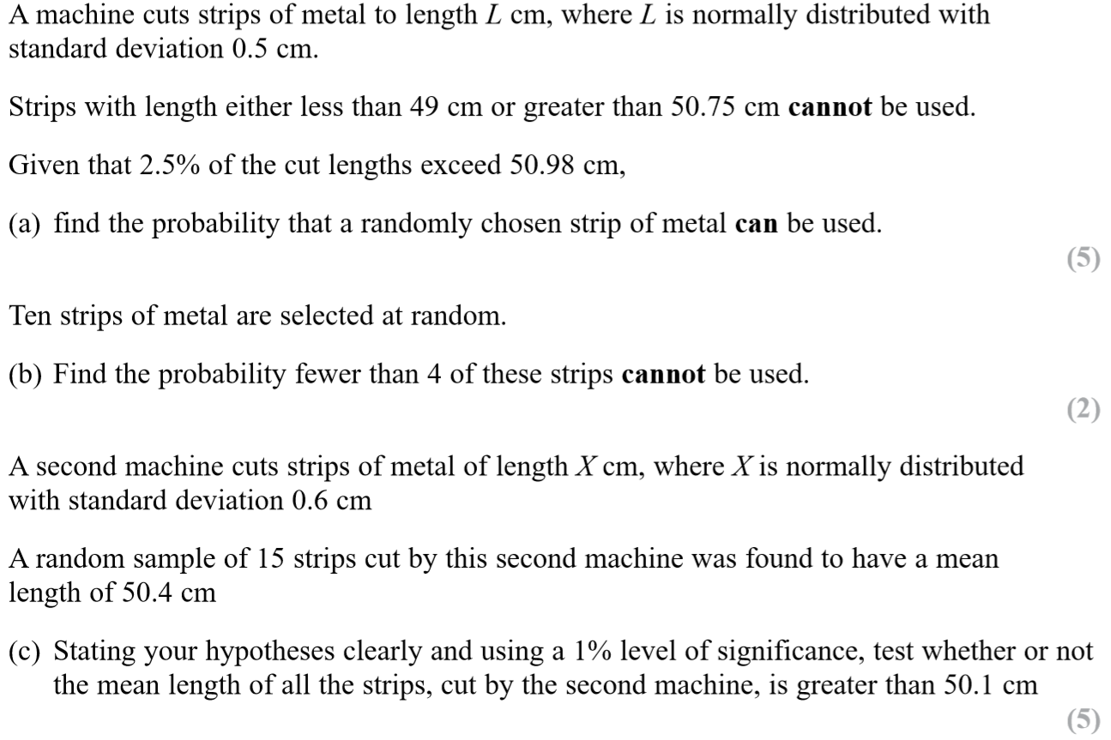
SAM

Slide 34
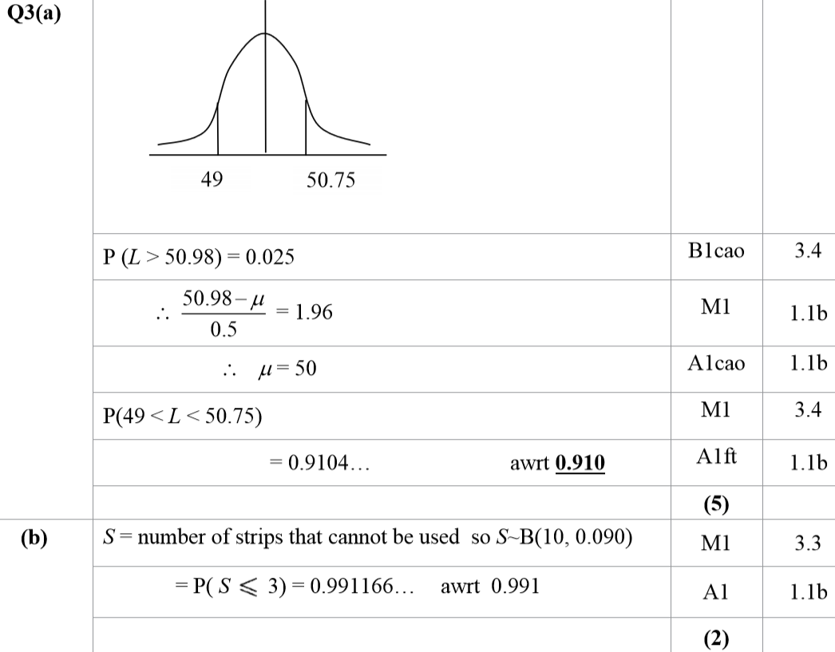
SAM
A
B

Slide 35
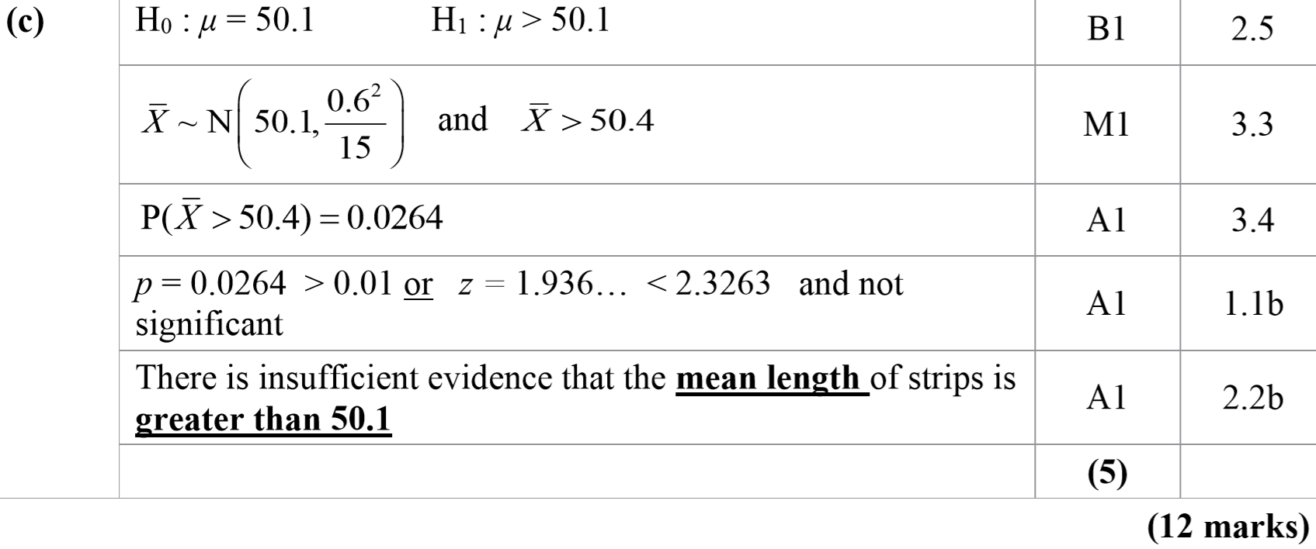
SAM
C

Slide 36
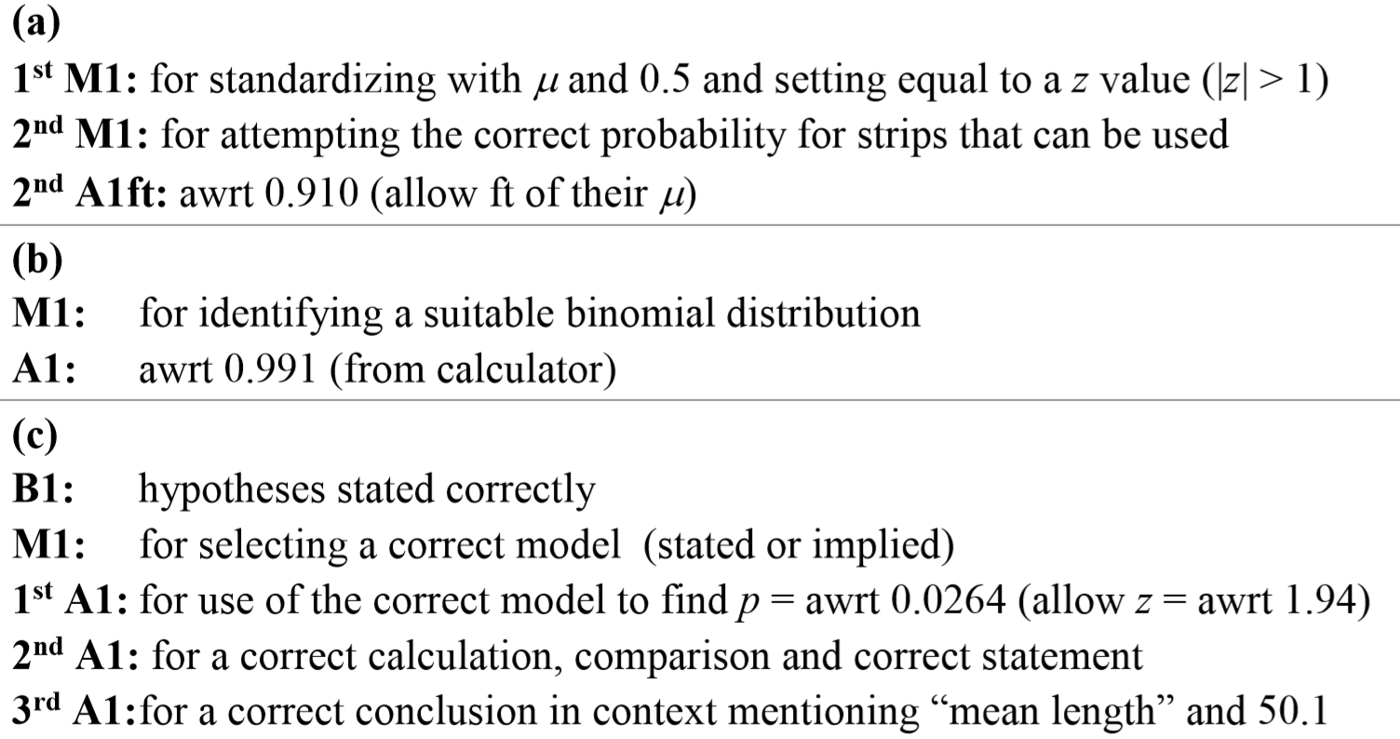
SAM
A notes
B notes
C notes

Slide 37
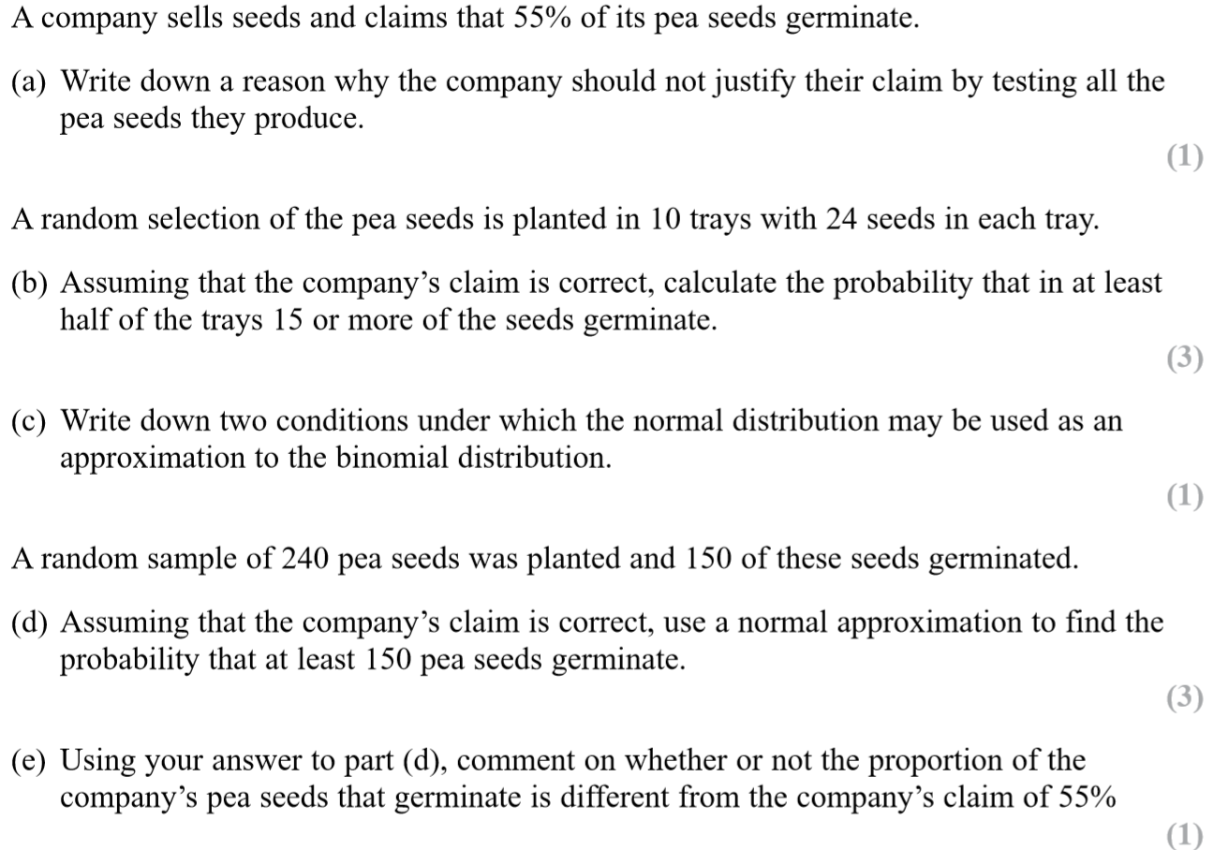
SAM

Slide 38
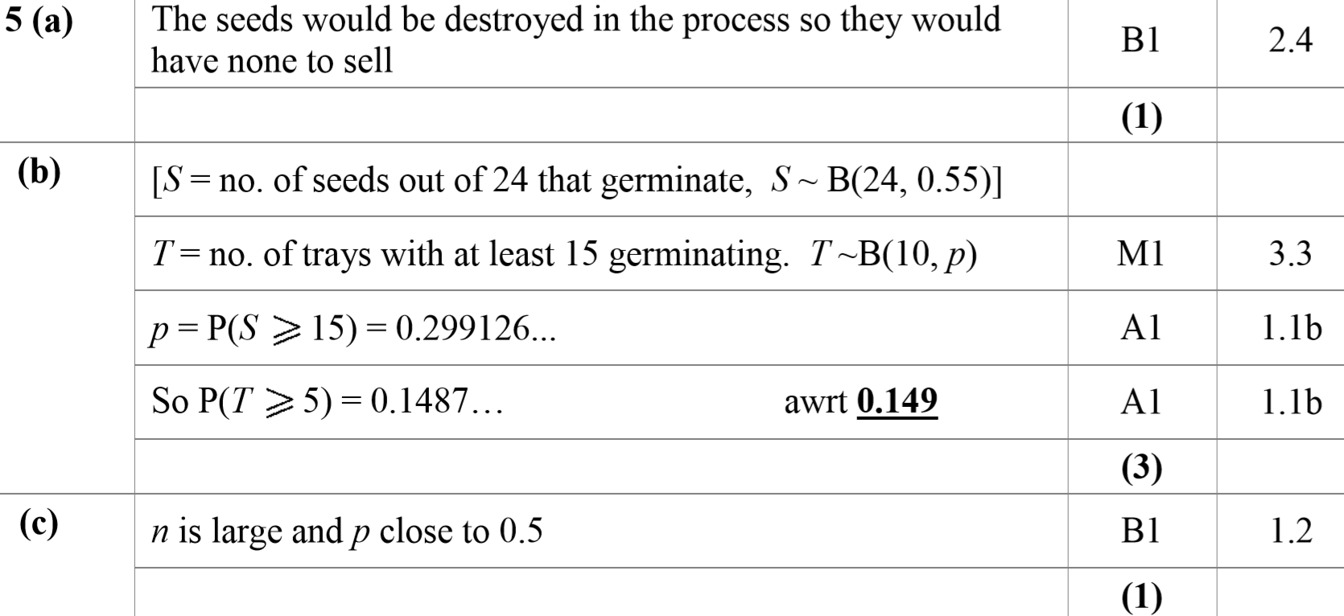
SAM
A
B
C

Slide 39
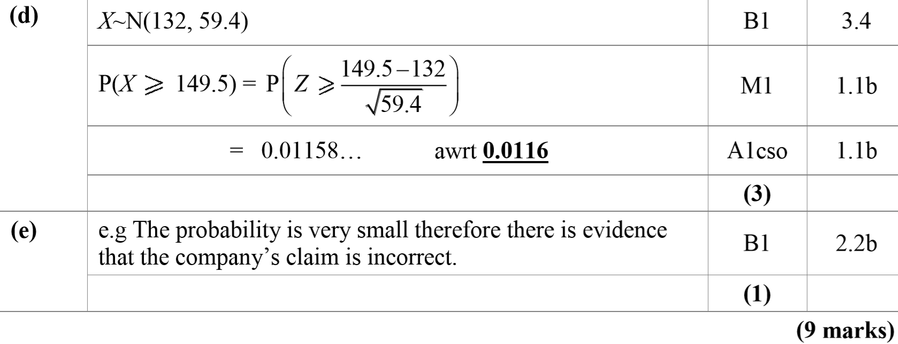
SAM
D
E

Slide 40
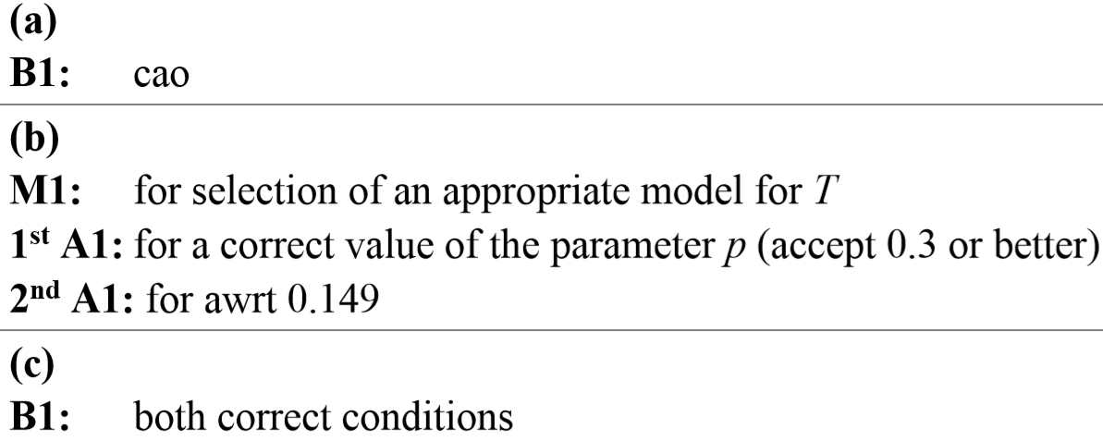
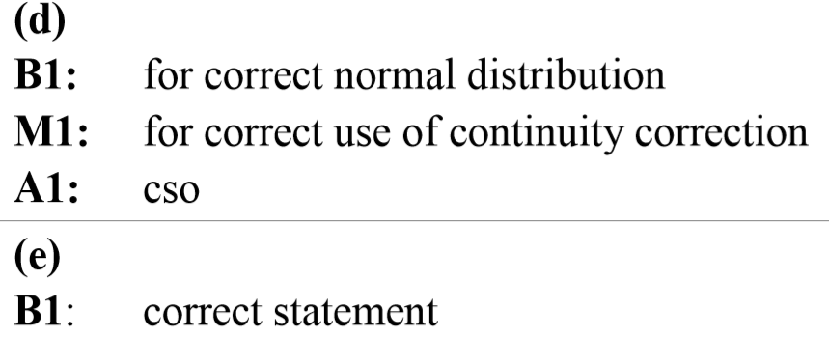
SAM
A notes
B notes
C notes
D notes
E notes

Slide 41
2018

Slide 42
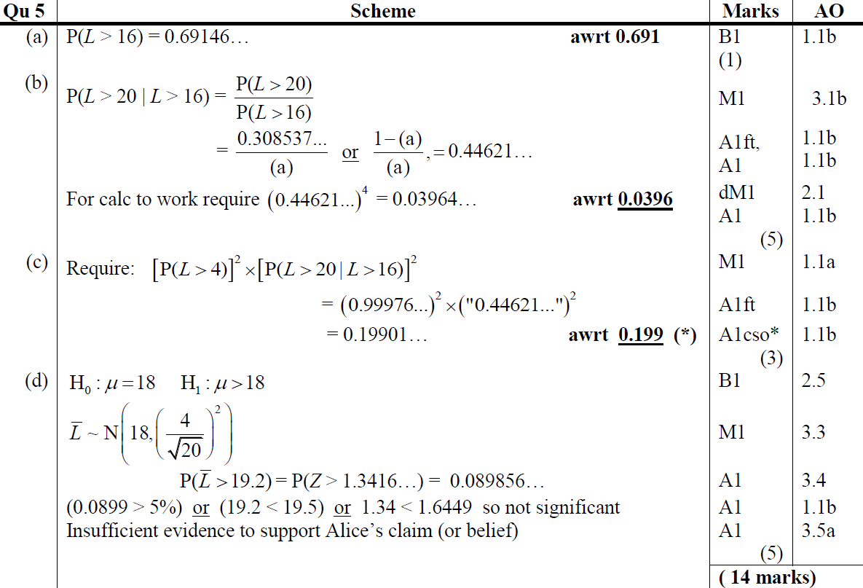
2018
A
B
C
D

Slide 43
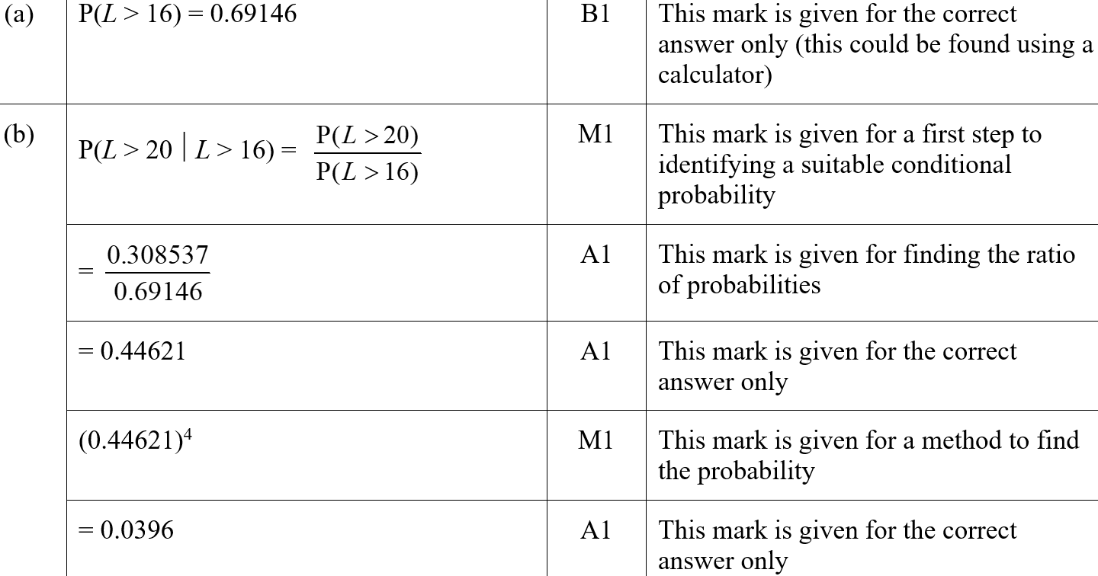
2018
A (SF)
B (SF)

Slide 44
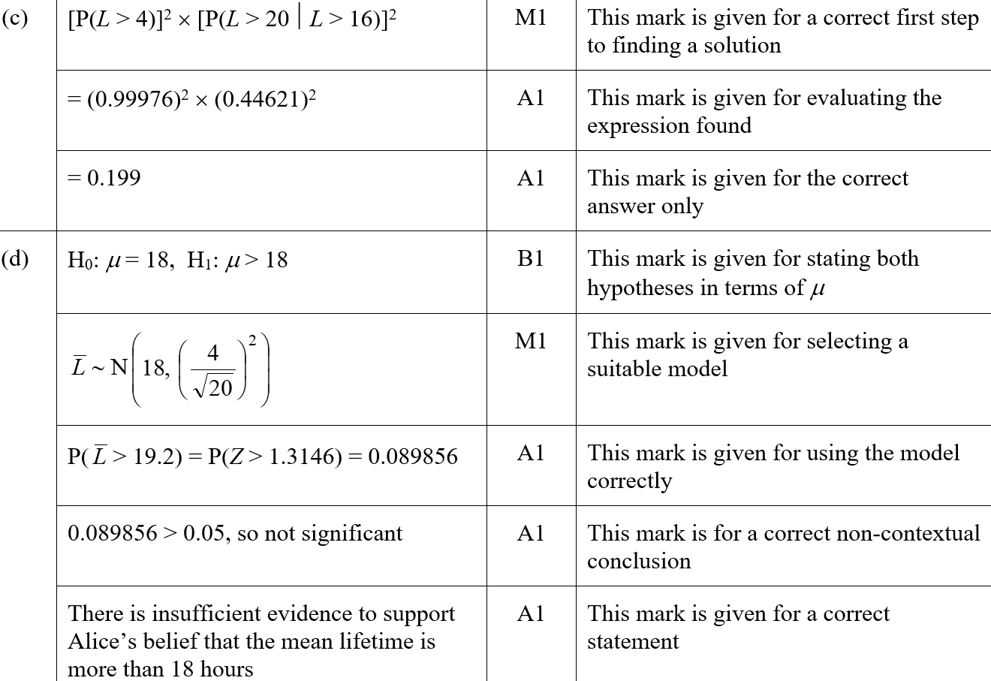
2018
C (SF)
D (SF)

Slide 45
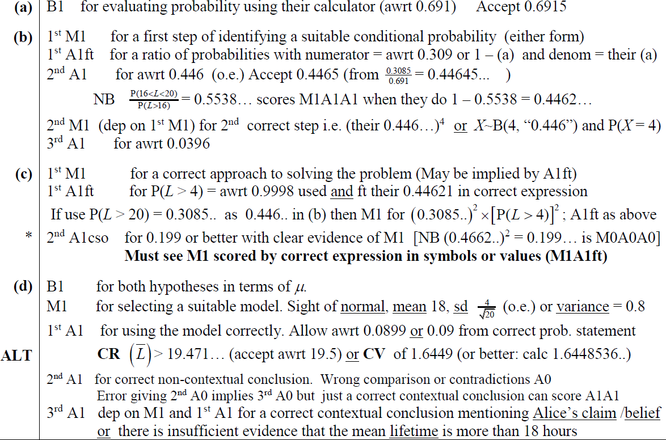
2018
A notes
B notes
C notes
D notes

Slide 46
New Spec Q’s
*Poisson Distribution not on new spec
Old Spec Normal Distribution
S1 & S2 no Hypothesis Testing
S3 Hypothesis Testing
Jan 2006
May 2010
June 2015
S2 May 2006*
S2 June 2018
S3 June 2007
May 2006
Jan 2011
June 2016 (i)
S2 June 2007
S3 June 2010
Jan 2007
May 2011 (i)
June 2016 (ii)
S2 Jan 2008*
S3 June 2011
June 2007
May 2011 (ii)
June 2017
S2 May 2008
Jan 2008
Jan 2012
June 2018 (i)
S2 May 2011 (i)*
May 2008
May 2012
June 2018 (ii)
S2 May 2012
Jan 2009
Jan 2013
S2 June 2014
May 2009
May 2013
S2 June 2016
Jan 2010
May 2014
S2 June 2017

Slide 47
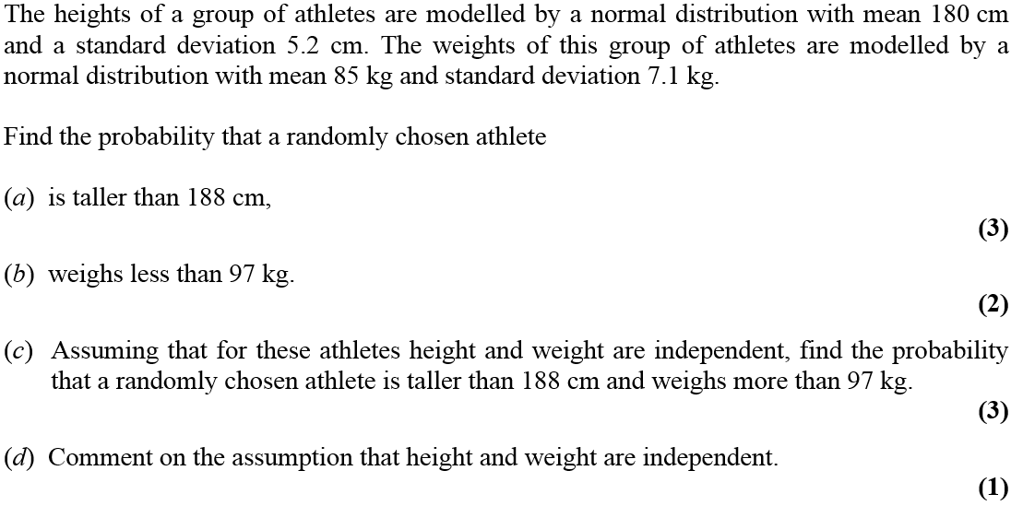
Jan 2006

Slide 48
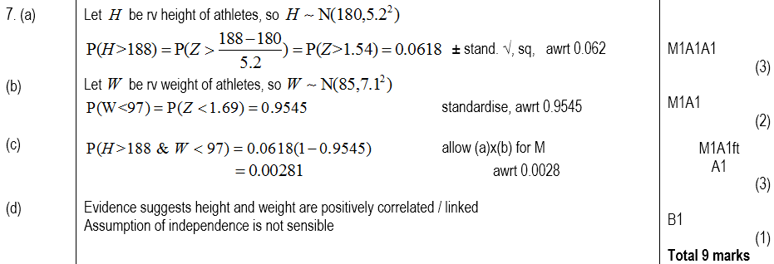
Jan 2006
A
B
C
D

Slide 49
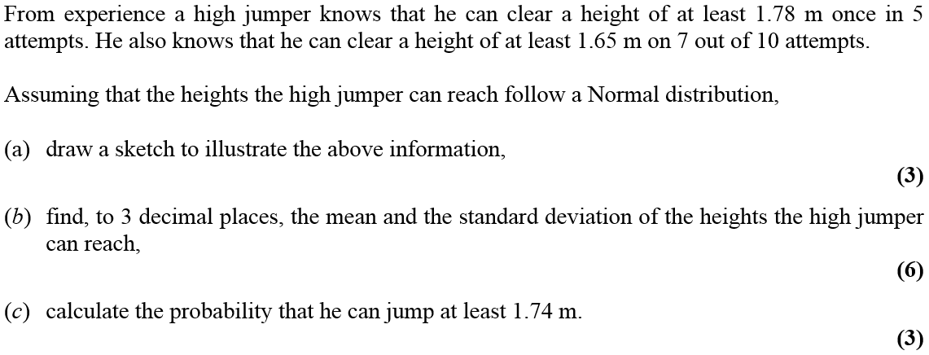
May 2006

Slide 50
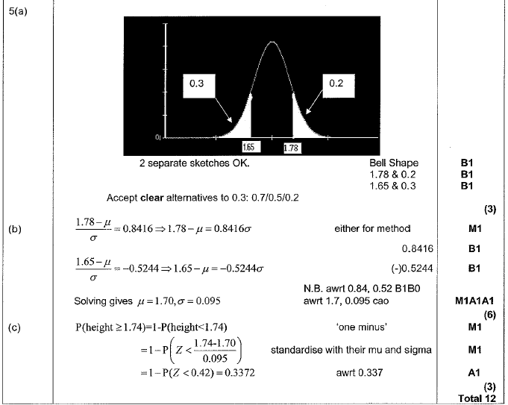
May 2006
A
B
C

Slide 51
Jan 2007

Slide 52
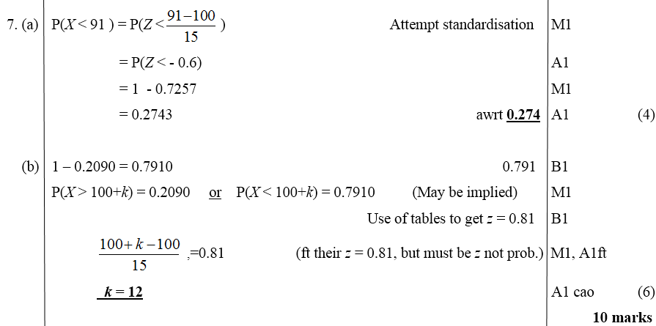
Jan 2007
A
B

Slide 53
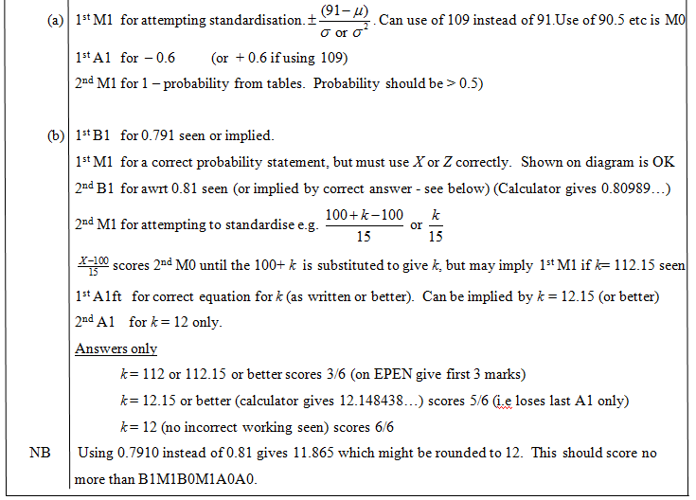
Jan 2007
A
B

Slide 54
June 2007

Slide 55
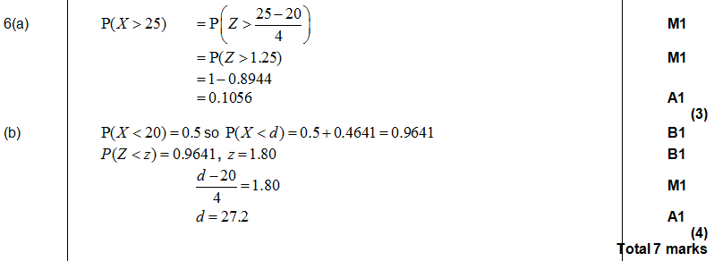
June 2007
A
B
A
B

Slide 56
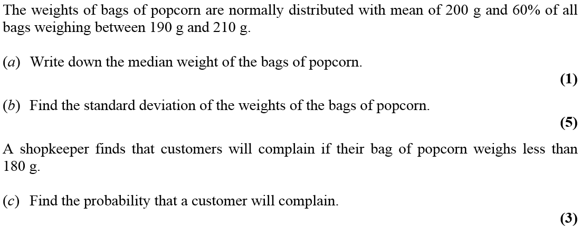
Jan 2008

Slide 57
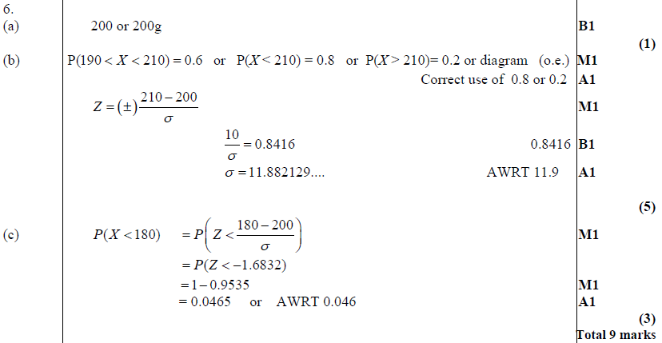
Jan 2008
A
B
C

Slide 58
Jan 2008
A
B
C

Slide 59
May 2008

Slide 60
May 2008
A
B
C

Slide 61
Jan 2009

Slide 62
Jan 2009
A
B
C
D

Slide 63
Jan 2009
A
B
C
D

Slide 64
May 2009

Slide 65
A
May 2009
B
C
D
A
C
D

Slide 66
Jan 2010

Slide 67
Jan 2010
A
B
C
D

Slide 68
Jan 2010
A
B
C
D

Slide 69
May 2010

Slide 70
A
May 2010
B
C
D
E

Slide 71
Jan 2011

Slide 72
Jan 2011
A
B
C

Slide 73
Jan 2011
A
B
C

Slide 74
May 2011

Slide 75
May 2011
A
B
A
B

Slide 76
May 2011

Slide 77
May 2011
A
B

Slide 78
May 2011
A
B

Slide 79
Jan 2012

Slide 80
Jan 2012
A
B
C

Slide 81
May 2012

Slide 82
May 2012
A
B
C

Slide 83
Jan 2013

Slide 84
Jan 2013
A
B
C

Slide 85
May 2013

Slide 86
May 2013
A
B
C

Slide 87
May 2014

Slide 88
May 2014
A
B
C

Slide 89
June 2015

Slide 90
June 2015
A (i)
A (ii)
A (iii)
A (iv)
B

Slide 91
June 2015
A (iii) notes
A (iv) notes
B notes

Slide 92
June 2016

Slide 93
June 2016
A
B
C (i)
C (ii)
D
E
F (i)
F (ii)

Slide 94
June 2016
A notes
B notes
C (i) notes
C (ii) notes
D notes
E notes
F (i) notes
F (ii) notes

Slide 95
June 2016

Slide 96
June 2016
A
B
C

Slide 97
June 2016
A notes
B notes
C notes

Slide 98
June 2017

Slide 99
June 2017
A
B
C

Slide 100
June 2017
A notes
B notes
C notes

Slide 101
June 2018

Slide 102
June 2018
A
B
B Alternative

Slide 103
June 2018
A notes
B notes
B Alternative notes
Diagram

Slide 104
June 2018

Slide 105
June 2018
A
B
C
D

Slide 106
June 2018
A notes
B notes
C notes
D notes

Slide 107
May 2006

Slide 108
May 2006
A
B
C (i)
C (ii)

Slide 109
June 2007

Slide 110
June 2007
A (i)
A (ii)
B

Slide 111
June 2007
C

Slide 112
June 2007

Slide 113
June 2007
A
A notes

Slide 114
Jan 2008

Slide 115
Jan 2008
A (i)
A (ii)

Slide 116
Jan 2008
B
A (i) notes

Slide 117
Jan 2008
A (ii) notes

Slide 118
Jan 2008
B

Slide 119
May 2008

Slide 120
May 2008
A

Slide 121
June 2010

Slide 122
June 2010
A

Slide 123
June 2010
A notes

Slide 124
May 2011

Slide 125
May 2011
A
B
C

Slide 126
June 2011

Slide 127
June 2011
A

Slide 128
May 2012

Slide 129
May 2012
A (i)
A (ii)
B

Slide 130
May 2012
C
A notes
B notes

Slide 131
May 2012
C notes

Slide 132
June 2014

Slide 133
June 2014
A
B
C
D

Slide 134
June 2014
A notes
B notes
C notes
D notes

Slide 135
June 2016

Slide 136
June 2016
A

Slide 137
June 2016
Alternative for final 3 marks

Slide 138
June 2017

Slide 139
June 2017
A
B

Slide 140
June 2017
C

Slide 141
June 2018

Slide 142
June 2018
A
B
C
D
E

Slide 143
June 2018
A notes
B notes
C notes
E notes

