Slide 1
Old Spec Q’s
Logs and exponentials
Practice A (i)
SAM (i)
Practice A (ii)
SAM (ii)
Practice B
2018 (i)
Practice C
2018 (ii)
Practice D (i)
Practice D (ii)

Slide 2
Practice A

Slide 3
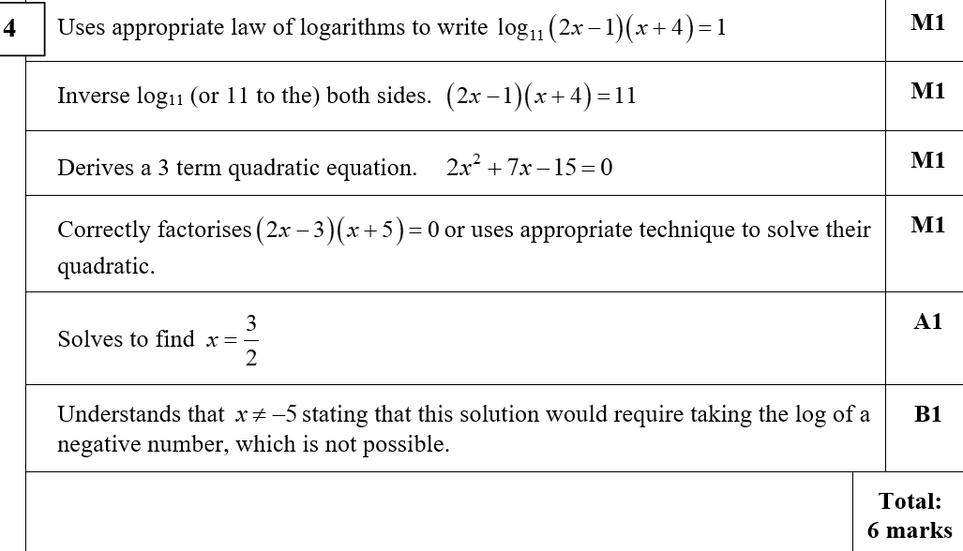
Practice A
A

Slide 4
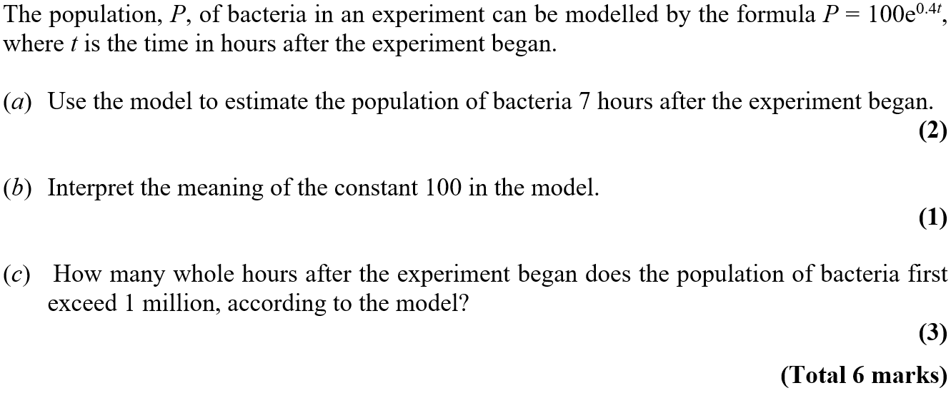
Practice A

Slide 5
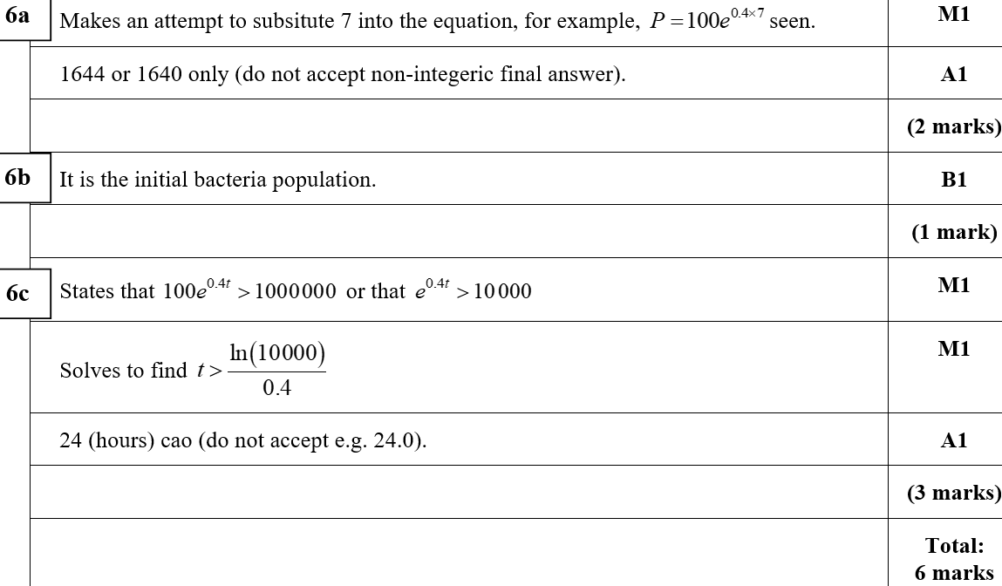
Practice A
A
B
C

Slide 6
Practice B

Slide 7
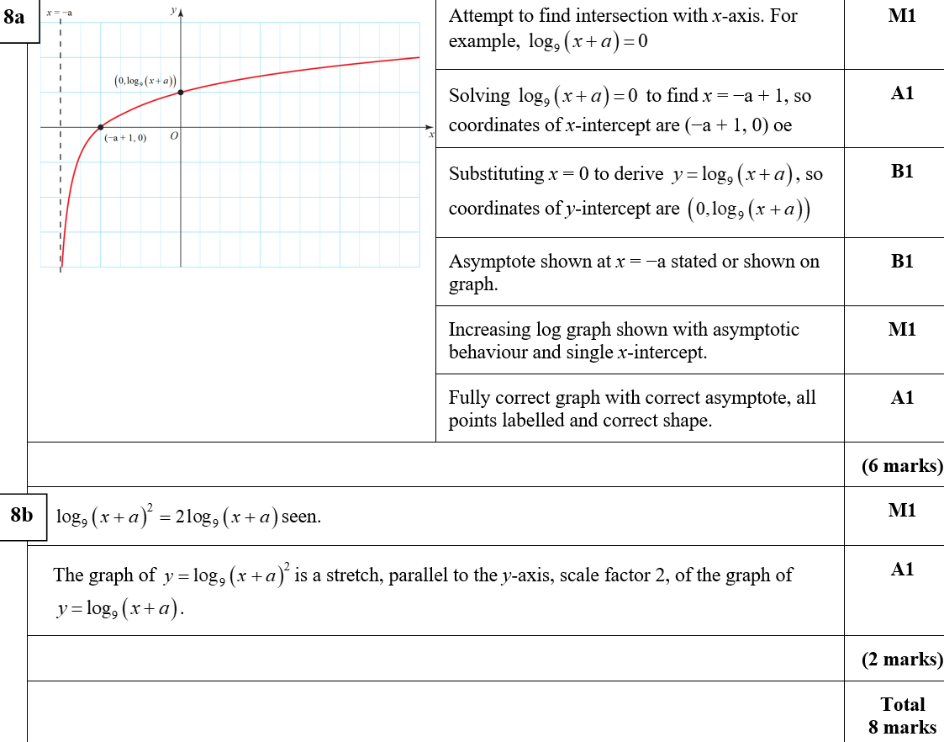
Practice B
A
B
A notes

Slide 8
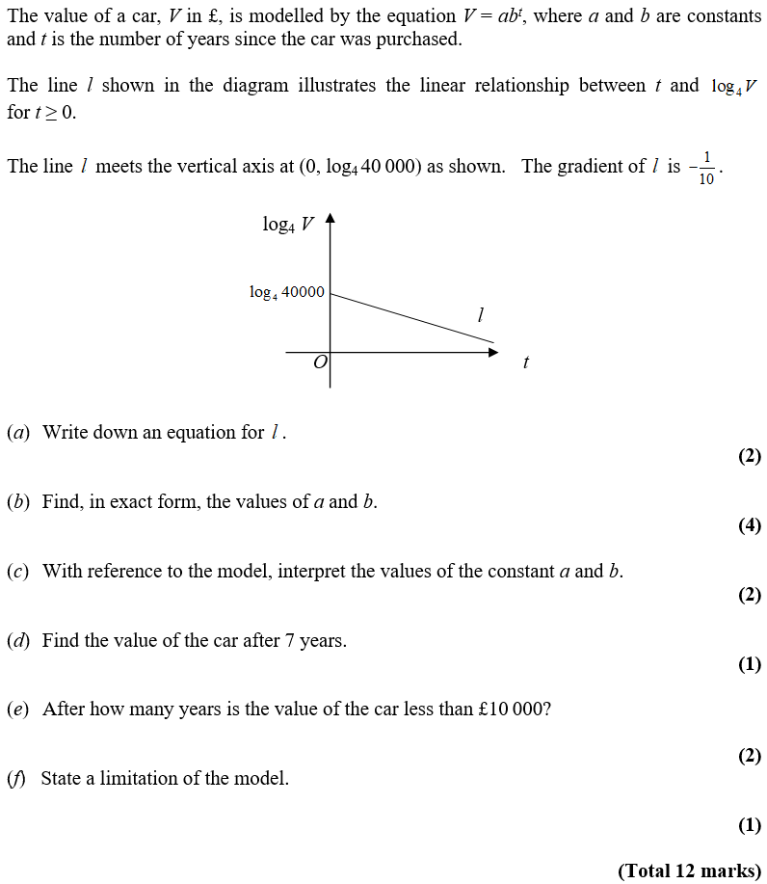
Practice C

Slide 9
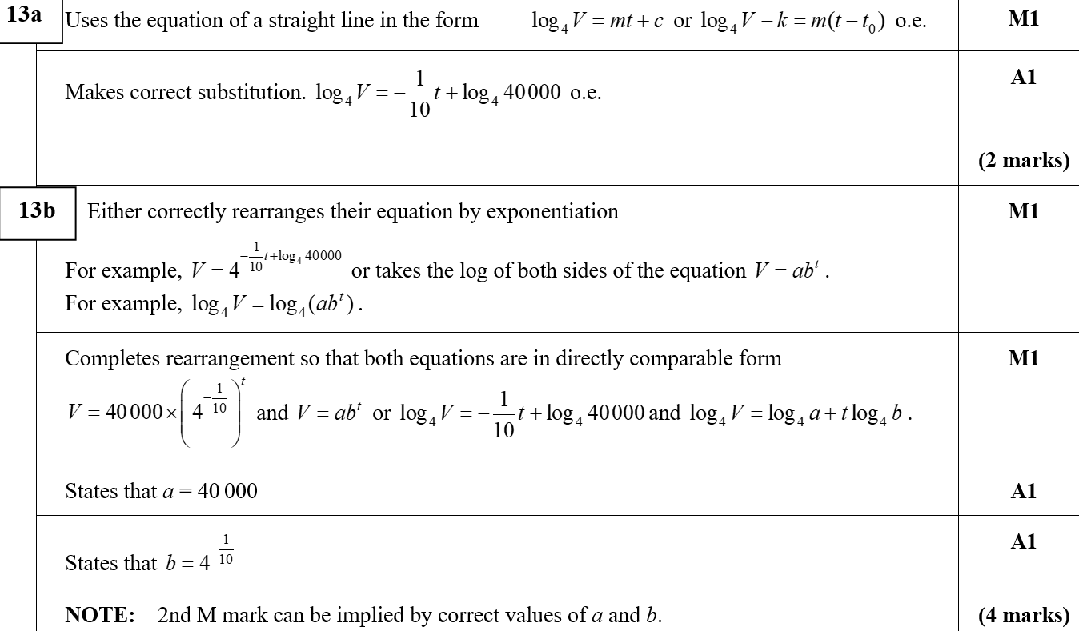
Practice C
A
B

Slide 10
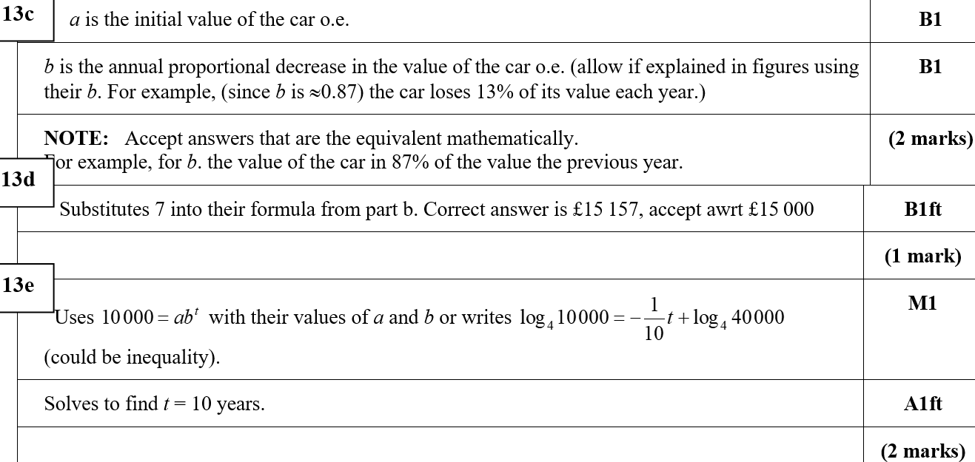
Practice C
C
D
C notes
E
F

Slide 11
Practice D

Slide 12
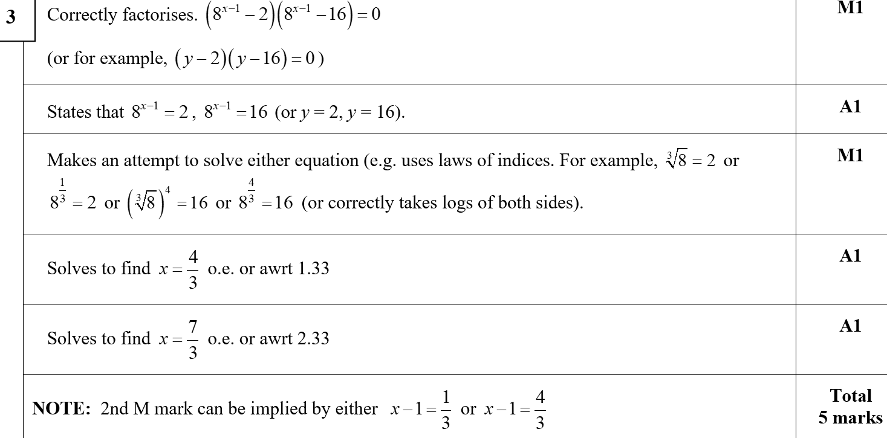
Practice D
A

Slide 13
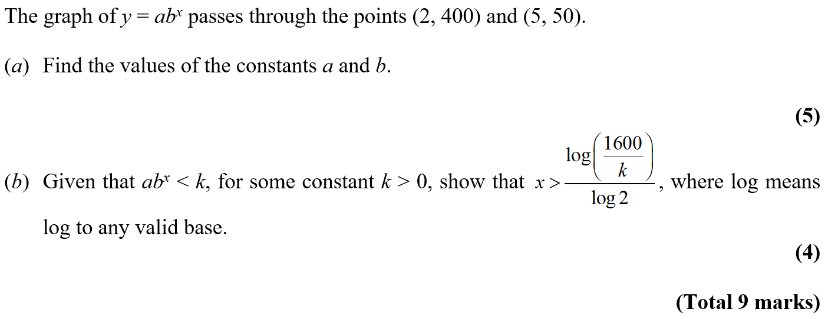
Practice D

Slide 14
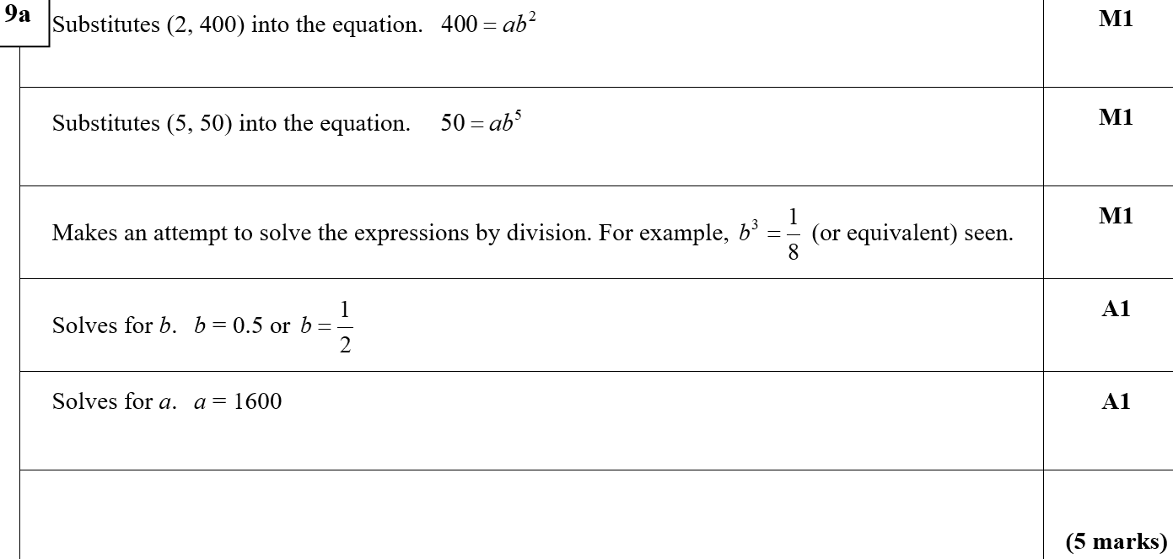
Practice D
A

Slide 15
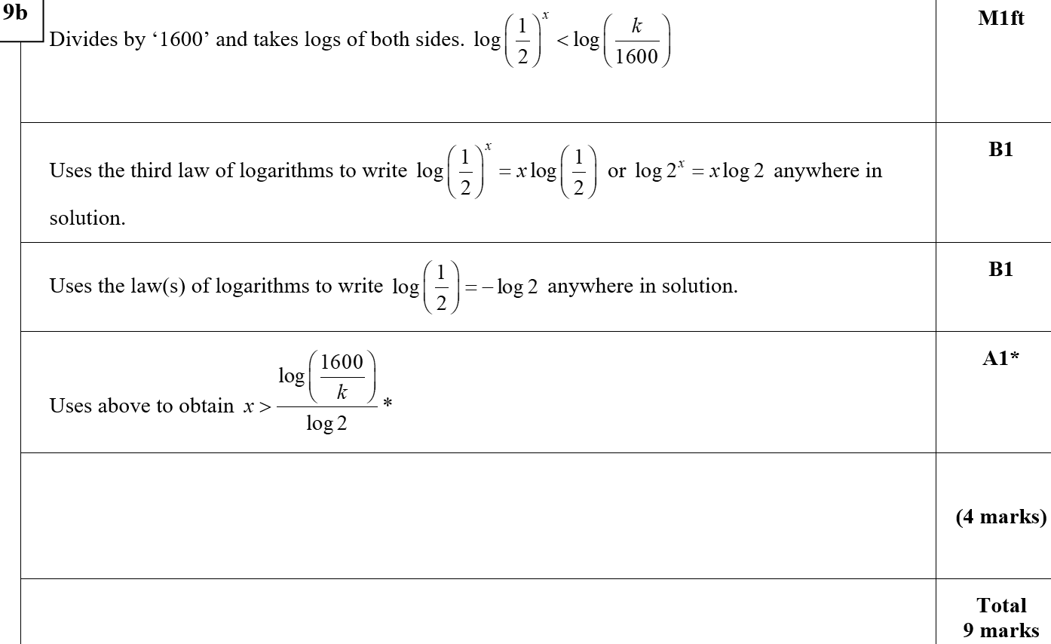
Practice D
B

Slide 16
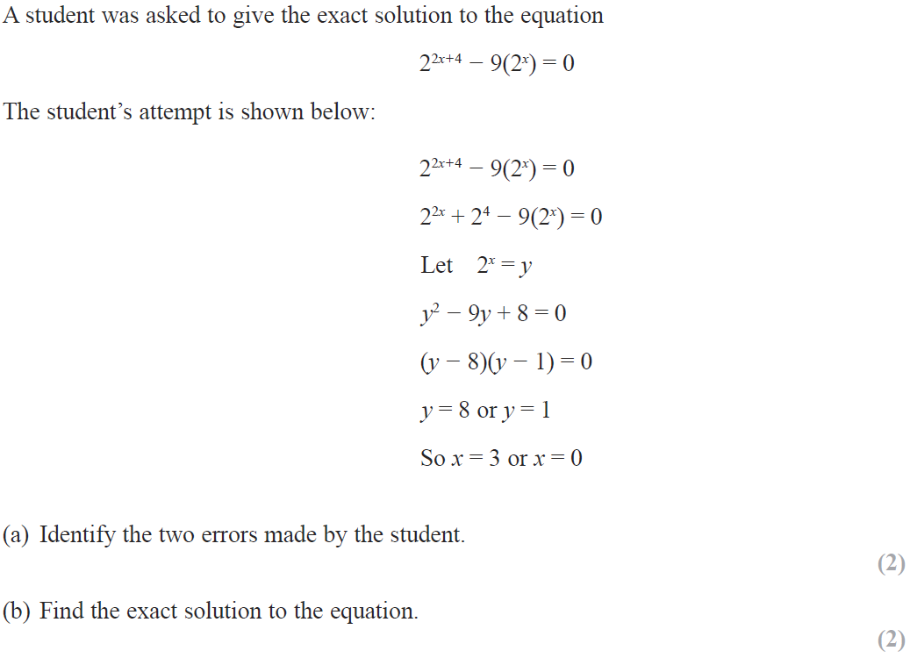
SAM

Slide 17
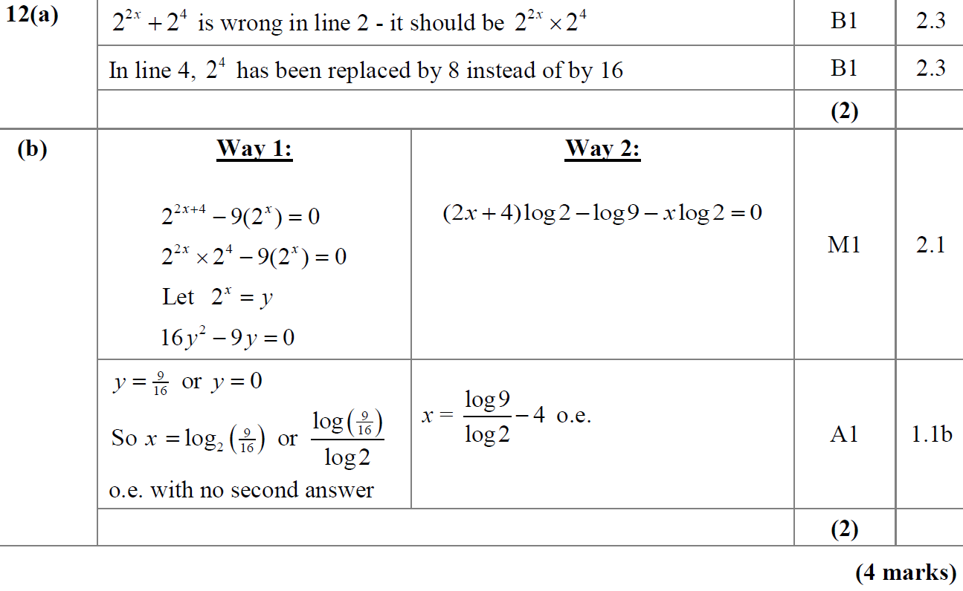
SAM
A
B

Slide 18
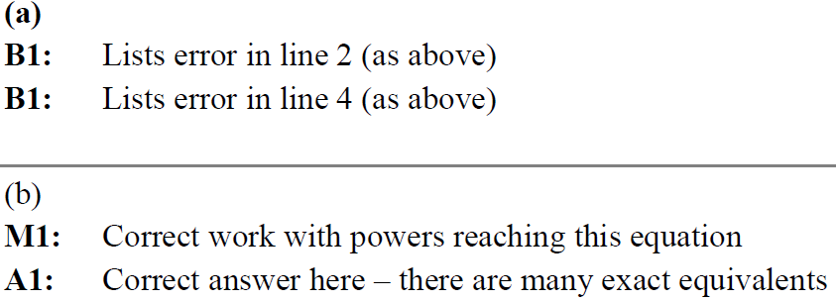
SAM
A notes
B notes

Slide 19
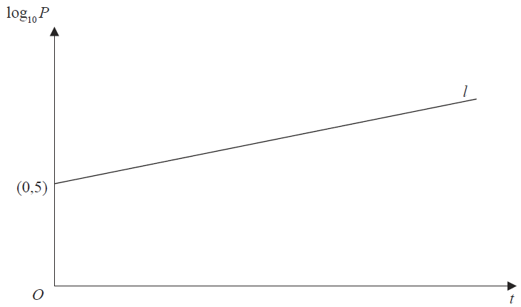
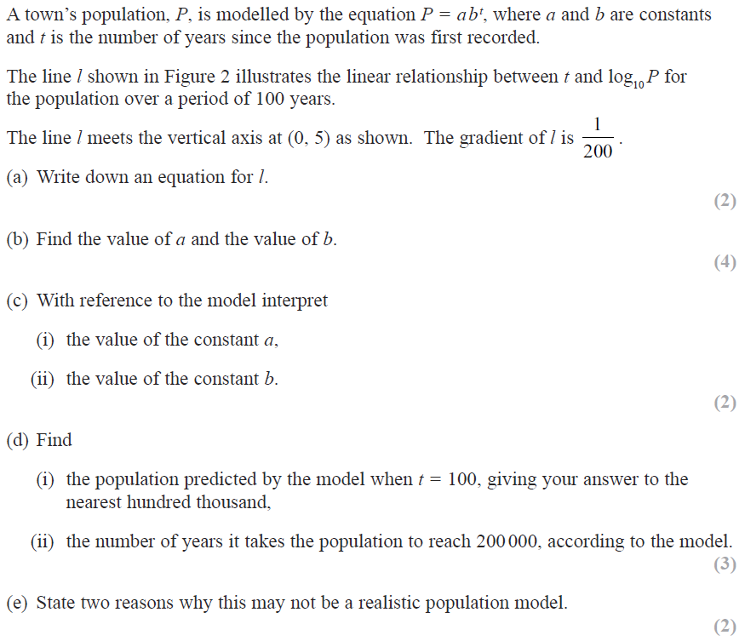
SAM

Slide 20
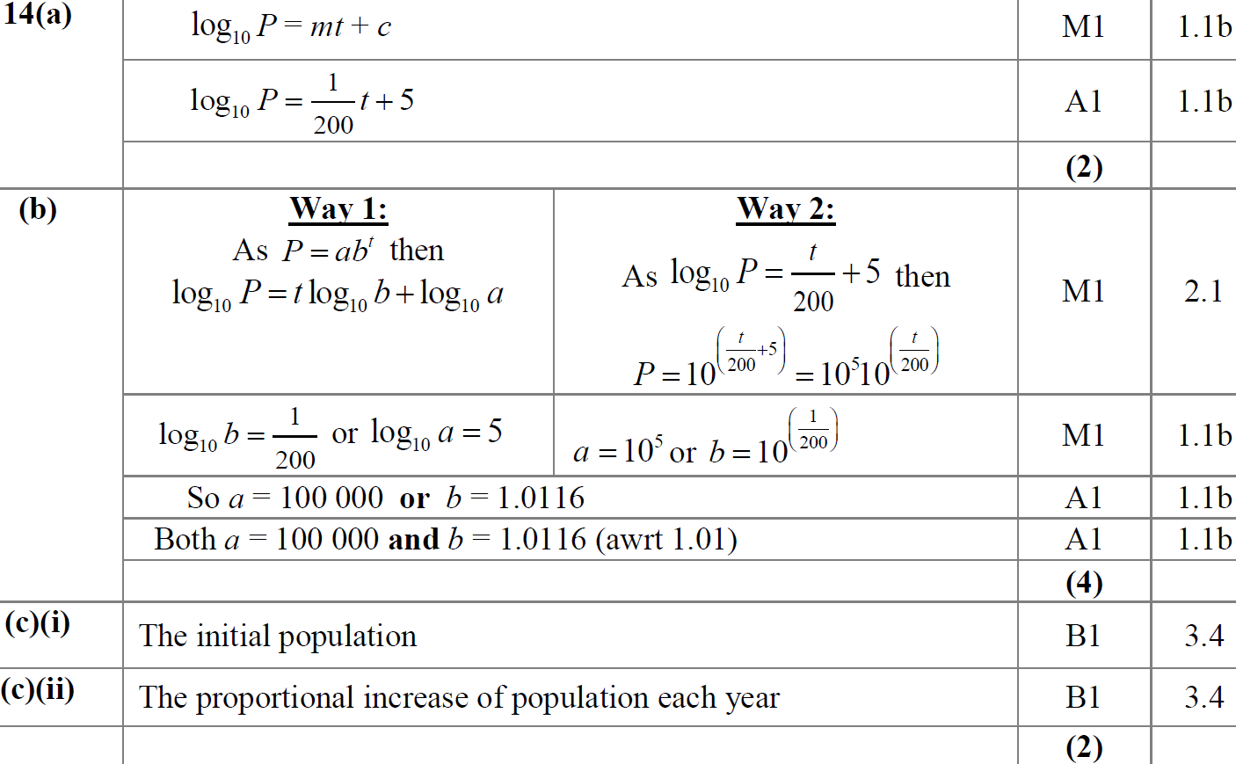
SAM
A
B
C (i)
C (ii)

Slide 21
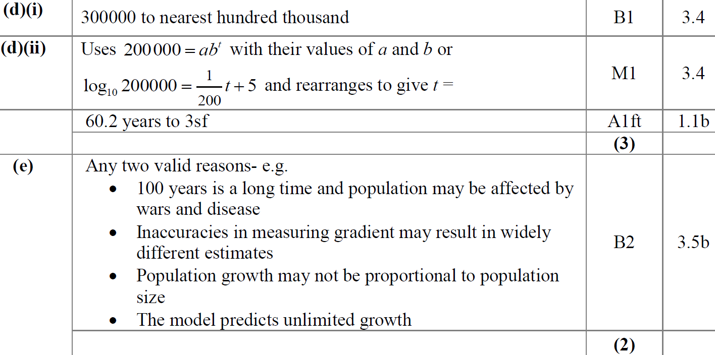
SAM
D (i)
D (ii)
E

Slide 22
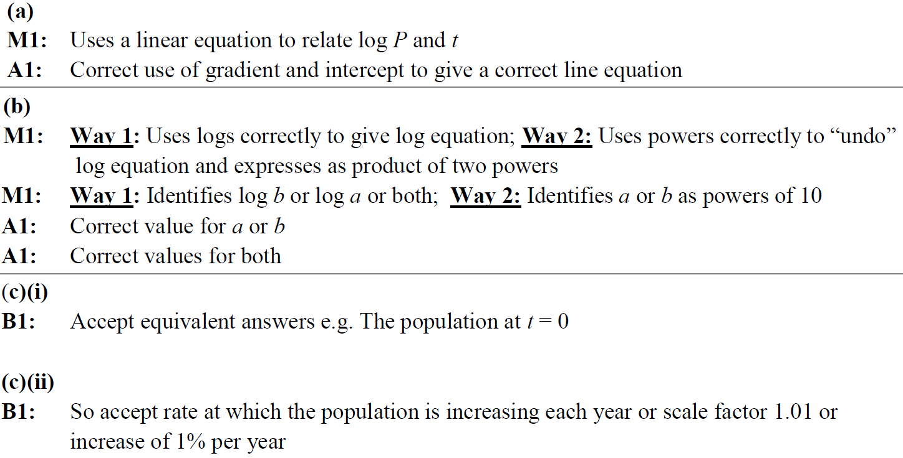
SAM
A notes
B notes
C (i) notes
C (ii) notes

Slide 23
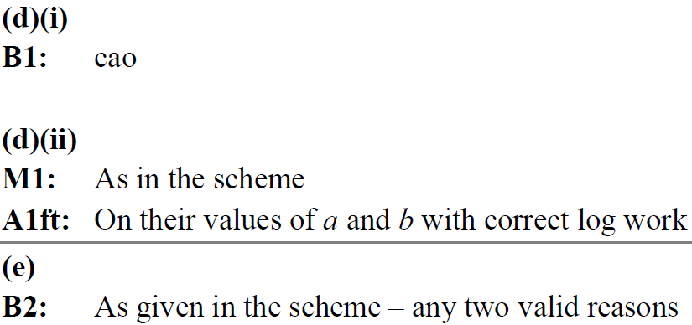
SAM
D (i) notes
D (ii) notes
E notes

Slide 24
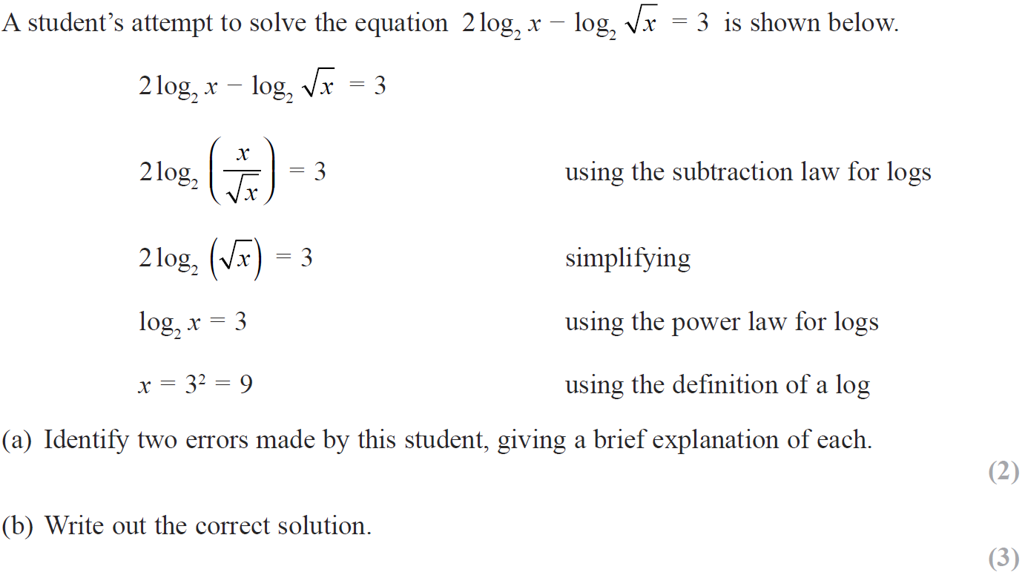
2018

Slide 25
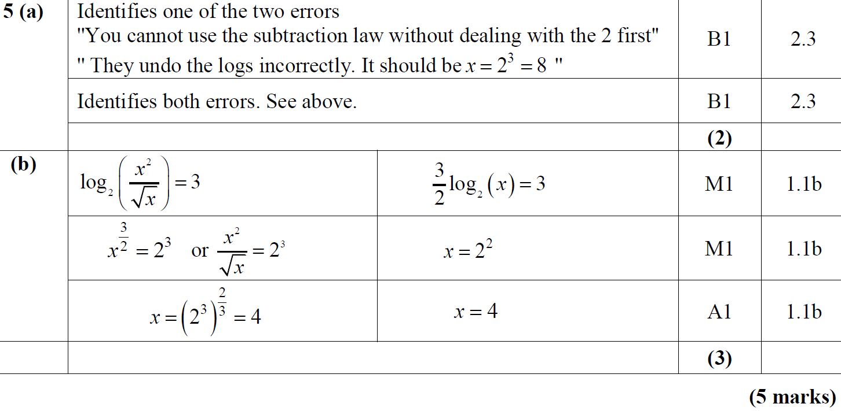
2018
A
B

Slide 26
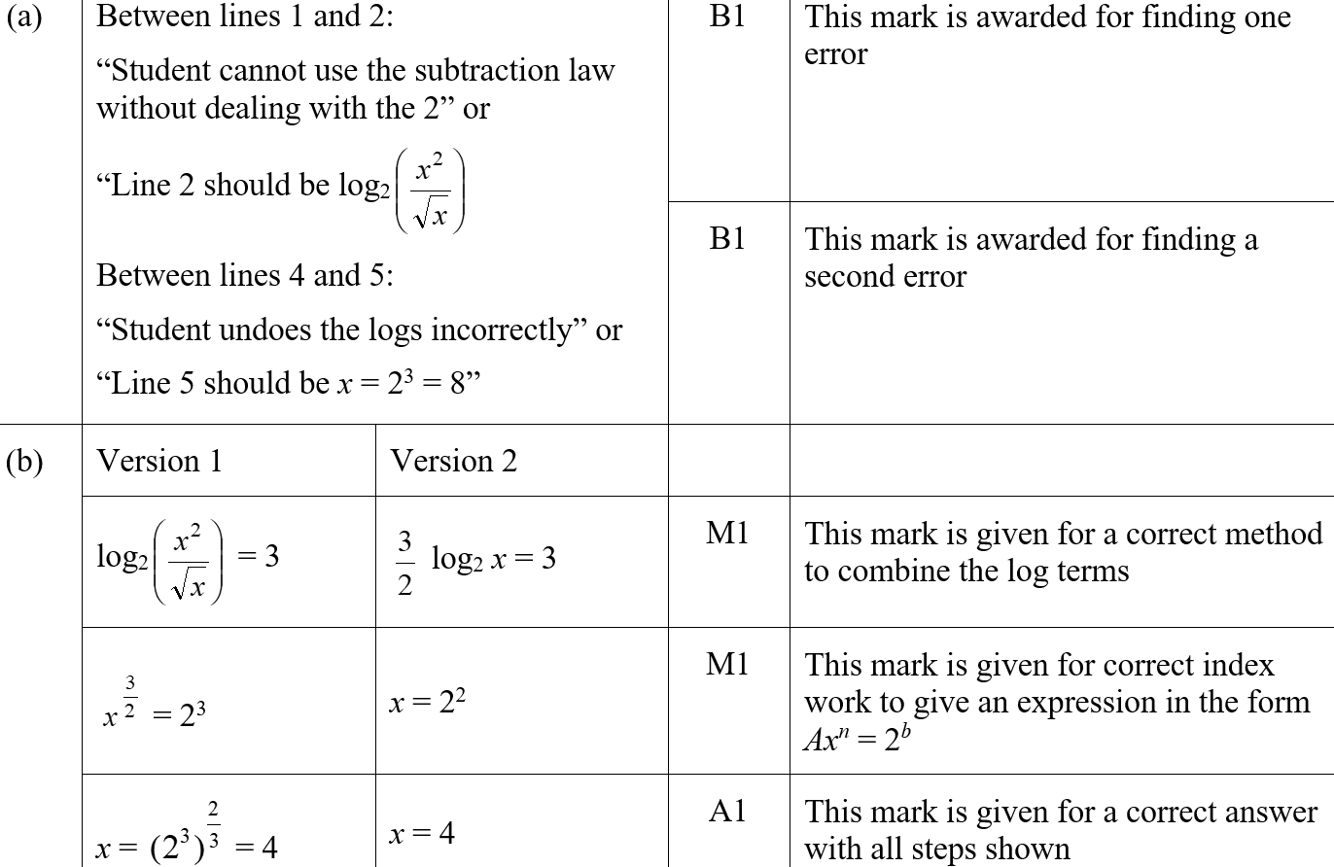
2018
A (SF)
B (SF)

Slide 27
2018
A notes

Slide 28
2018
B notes

Slide 29
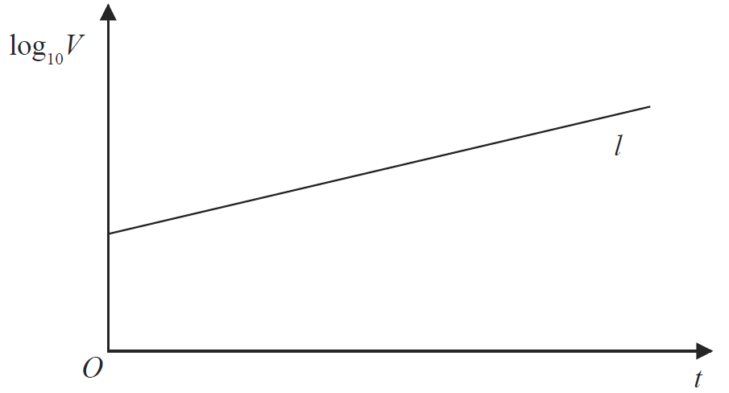
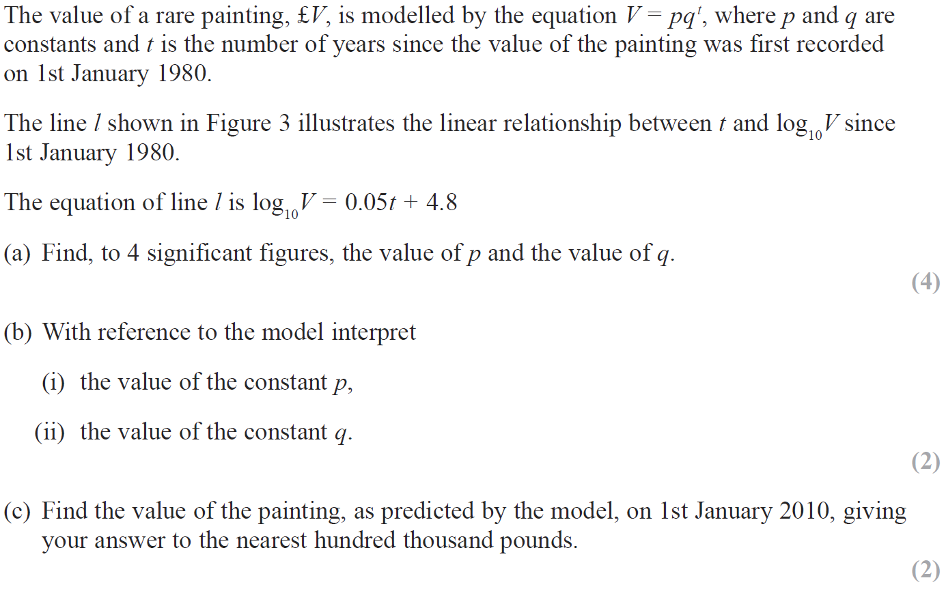
2018

Slide 30
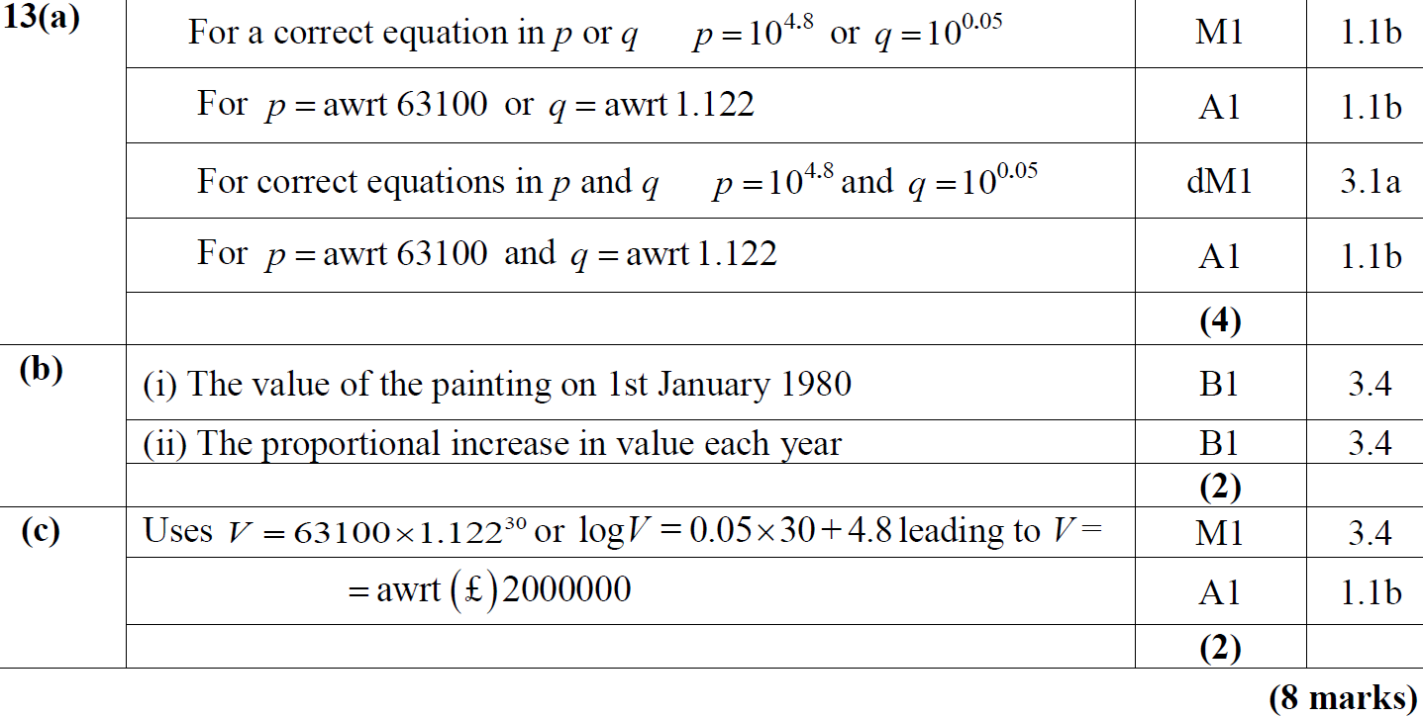
2018
A
B (i)
B (ii)
C

Slide 31
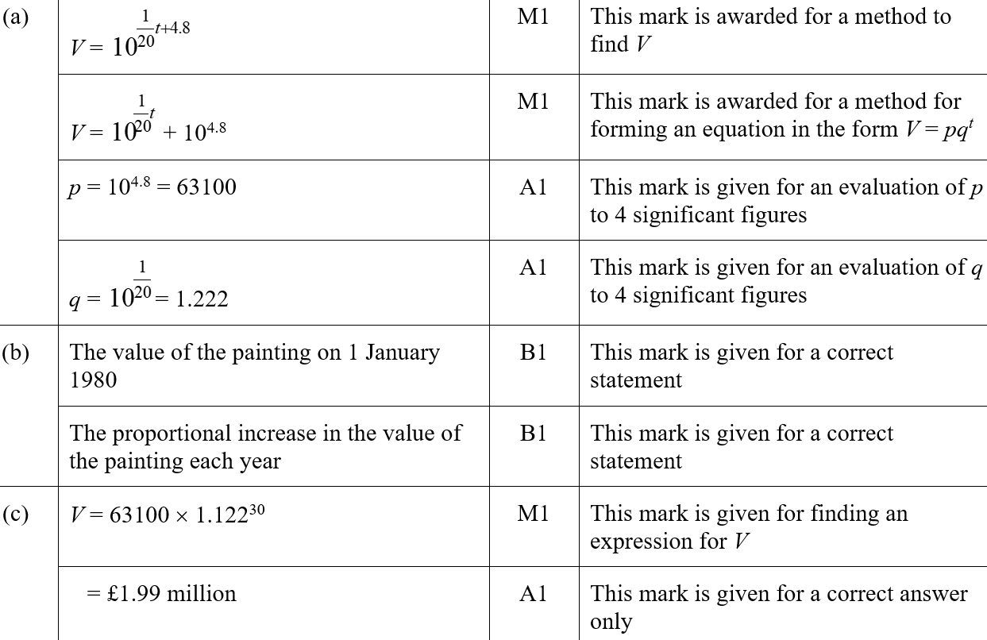
2018
A (SF)
B (i) (SF)
B (ii) (SF)
C (SF)

Slide 32
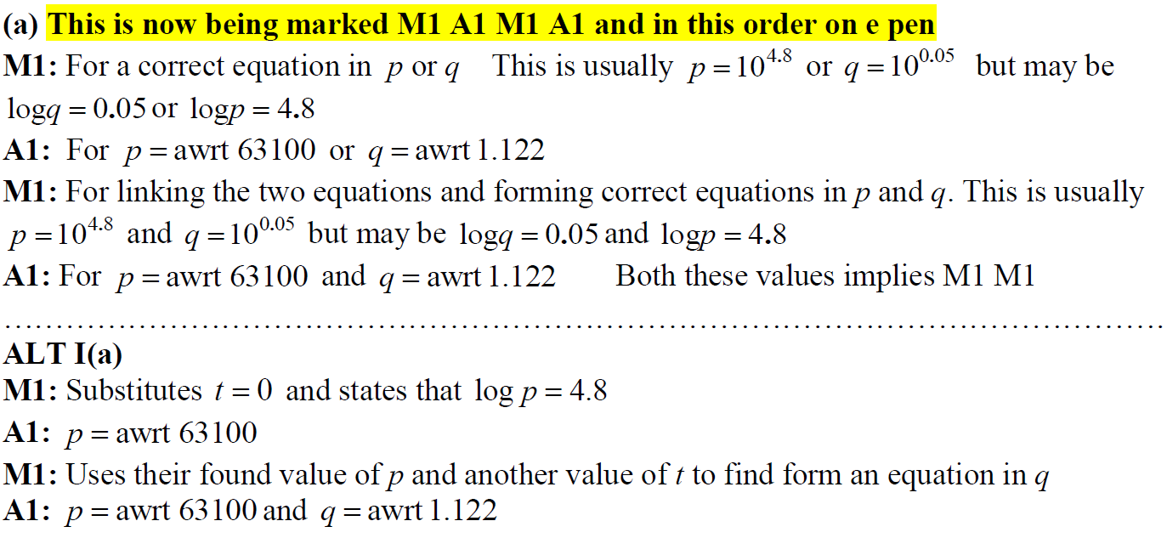
2018
A notes

Slide 33
New Spec Q’s
Old Spec Logs and Exponentials
May 2006
Jan 2010
May 2013
Jan 2007
June 2010
May 2014
May 2007
Jan 2011
May 2015
Jan 2008
May 2011
May 2016
June 2008
Jan 2012
May 2017 (i)
Jan 2009
May 2012
May 2017 (ii)
June 2009
Jan 2013
May 2018

Slide 34
May 2006

Slide 35
May 2006
i
ii

Slide 36
Jan 2007

Slide 37
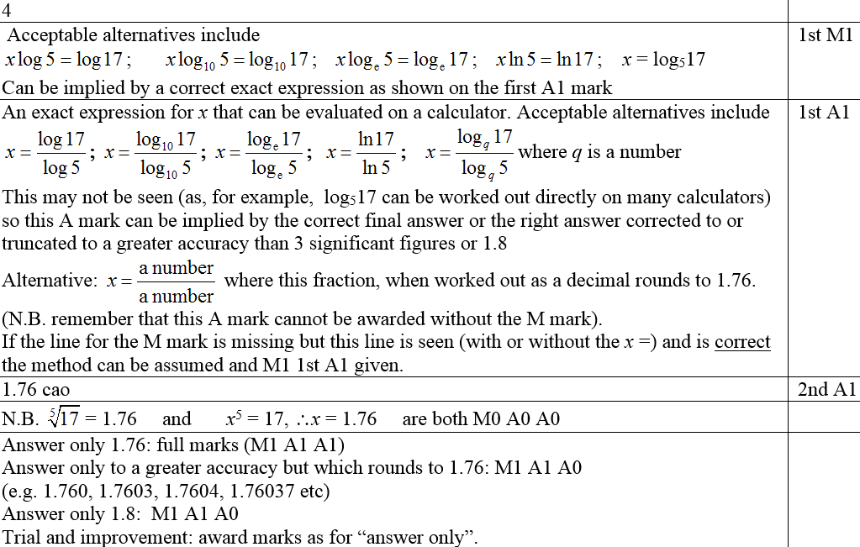
Jan 2007
A
Notes
Possible Ans

Slide 38
May 2007

Slide 39
May 2007
A
B
A notes

Slide 40
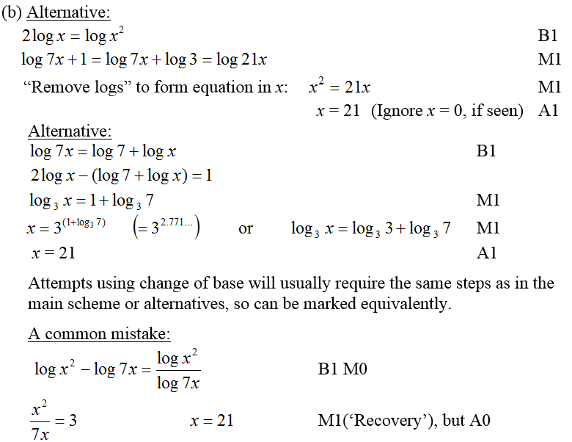
May 2007
B notes

Slide 41
Jan 2008

Slide 42
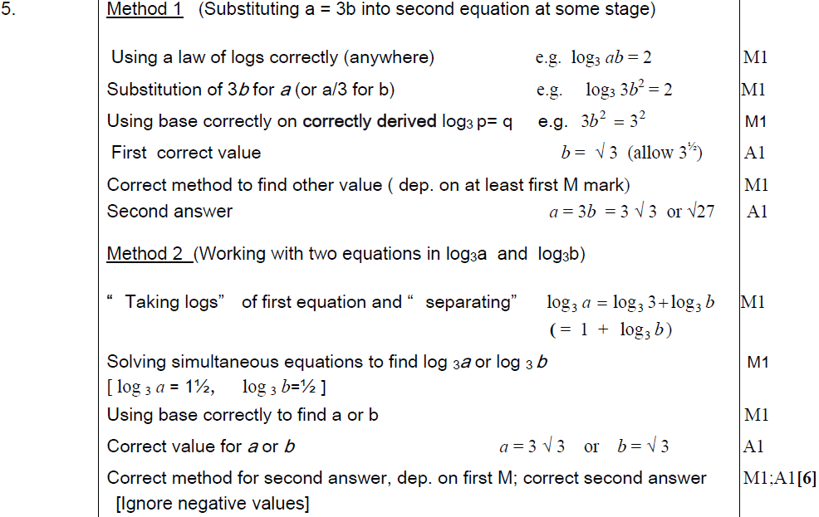
Jan 2008
Method 1
Method 2

Slide 43
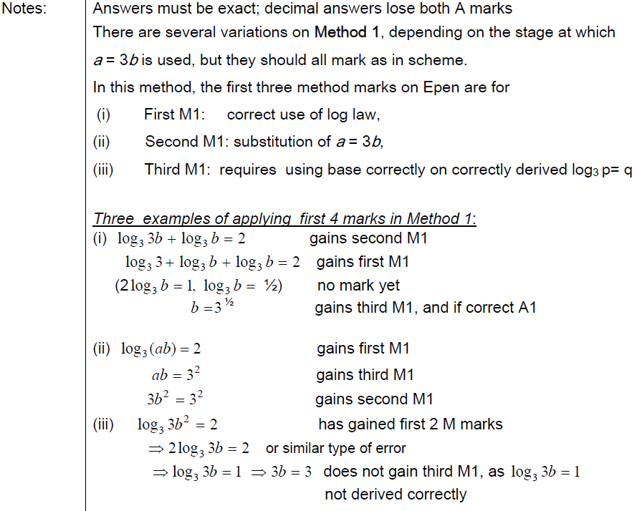
Notes
Jan 2008

Slide 44
June 2008

Slide 45
June 2008
A
B

Slide 46
Jan 2009

Slide 47
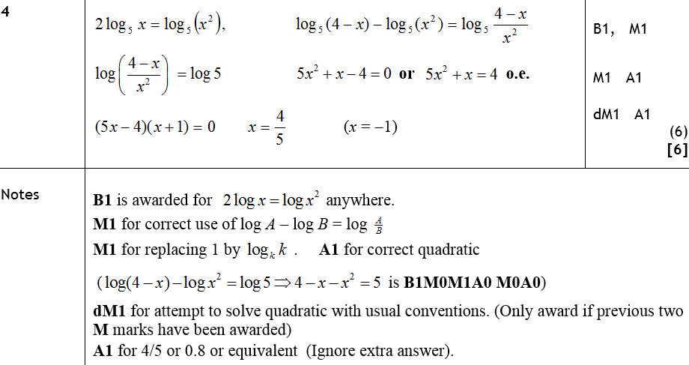
Jan 2009
A
Notes

Slide 48
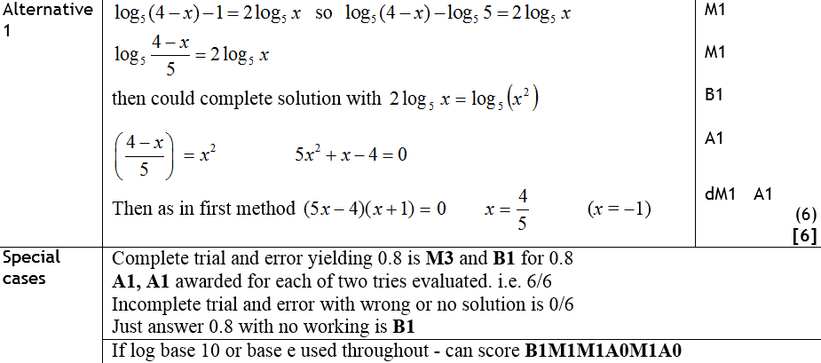
Jan 2009
Alternative Methods
Special Cases

Slide 49
June 2009

Slide 50
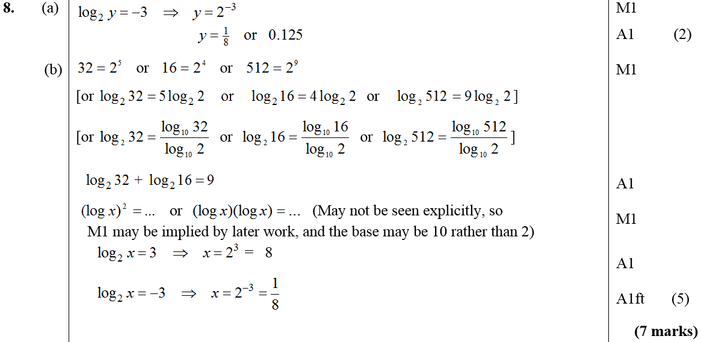
June 2009
A
B

Slide 51
Jan 2010

Slide 52
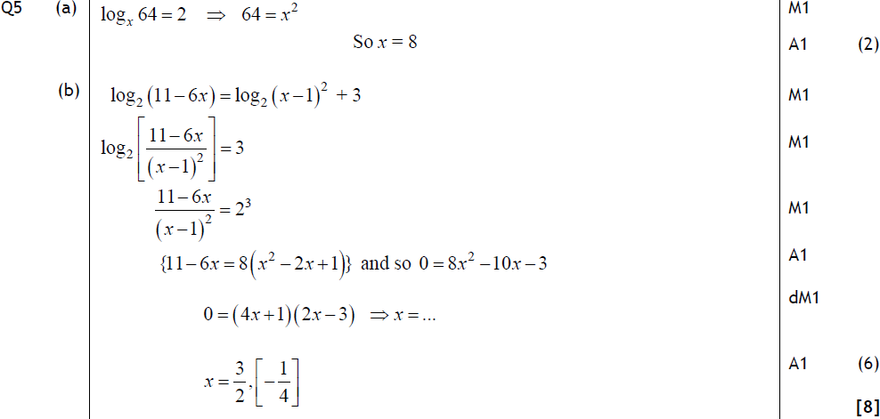
Jan 2010
A
B
Alternative A

Slide 53
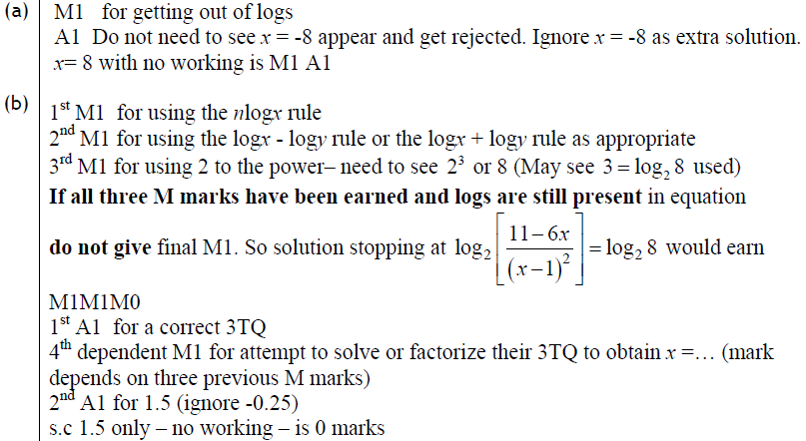
Jan 2010
A
B

Slide 54
June 2010

Slide 55
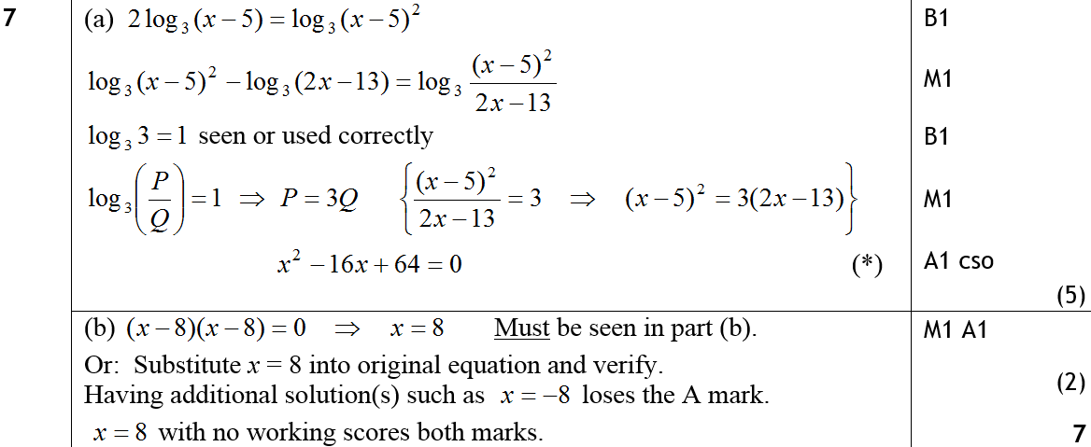
June 2010
A
B

Slide 56
Jan 2011

Slide 57
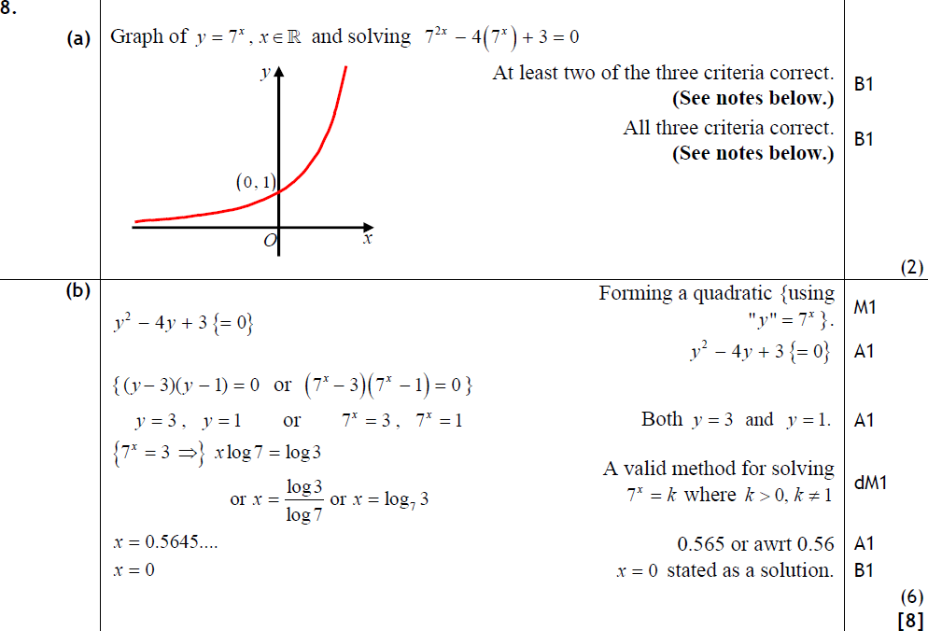
Jan 2011
A
B

Slide 58
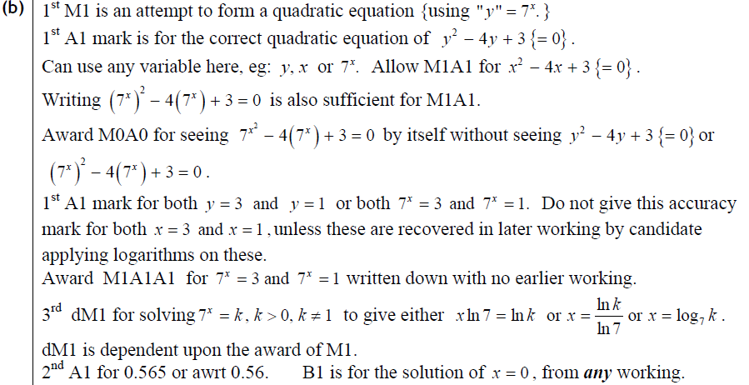
Jan 2011
A
B

Slide 59
May 2011

Slide 60
May 2011
A
B

Slide 61
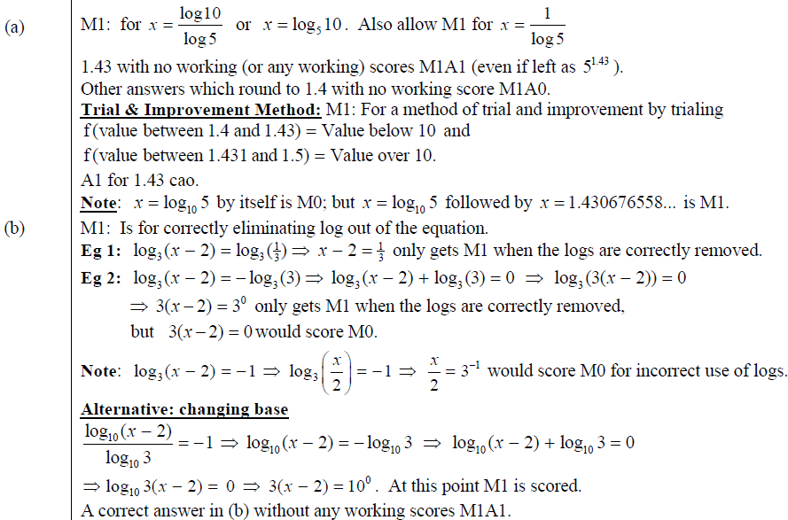
May 2011
A
B

Slide 62
Jan 2012

Slide 63
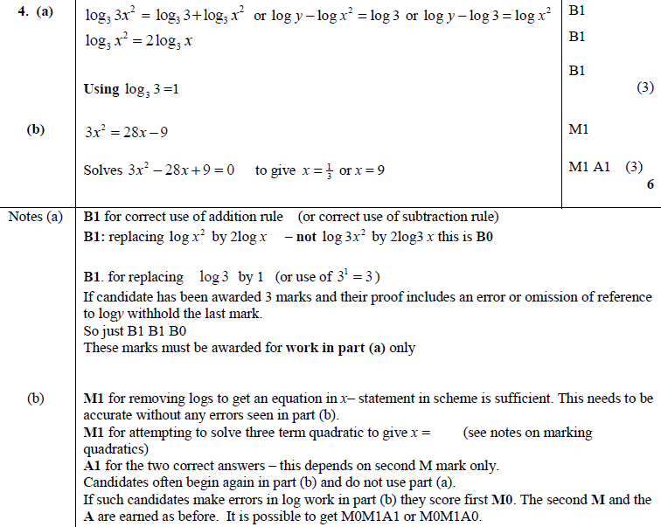
Jan 2012
A
B
A
B
B

Slide 64
May 2012

Slide 65
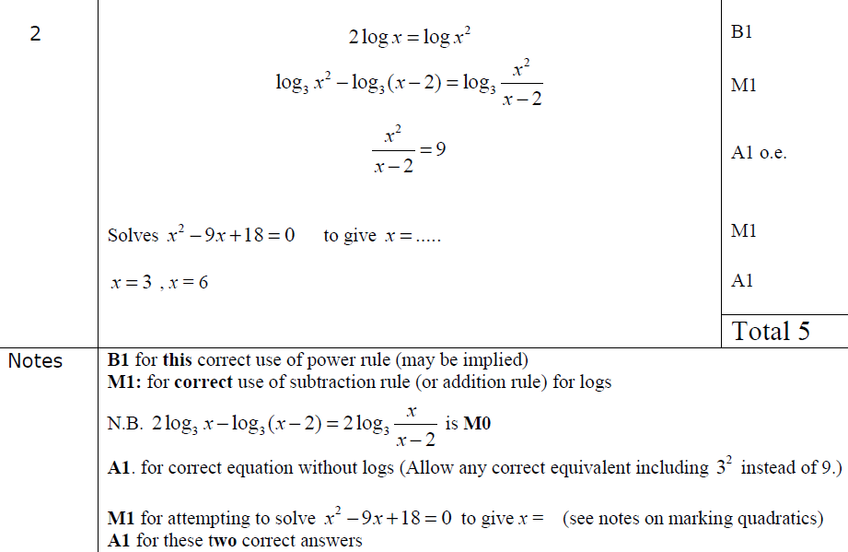
May 2012
A
Notes

Slide 66
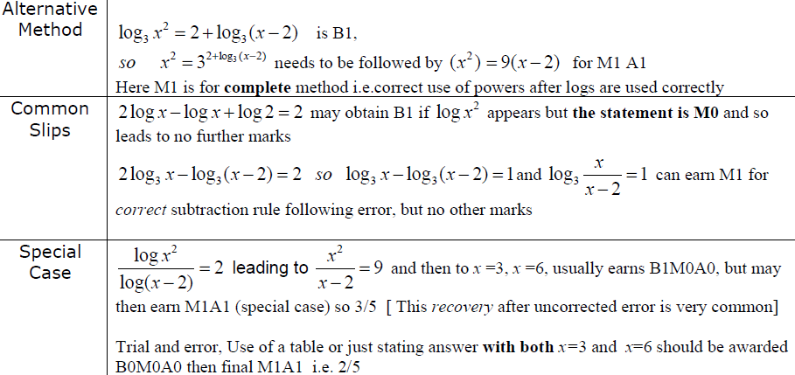
May 2012
Alternative Method
Common Slips
Special Case

Slide 67
Jan 2013

Slide 68
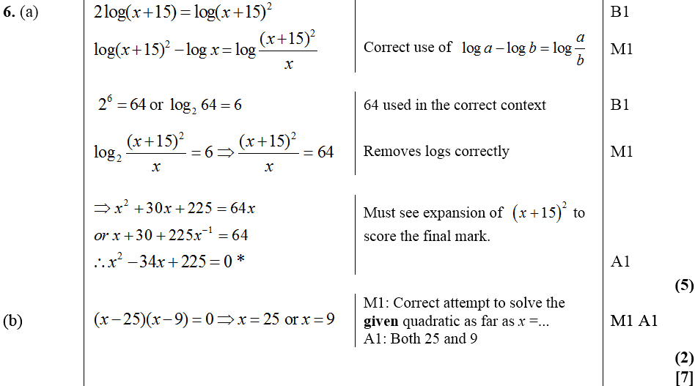
Jan 2013
A
B

Slide 69
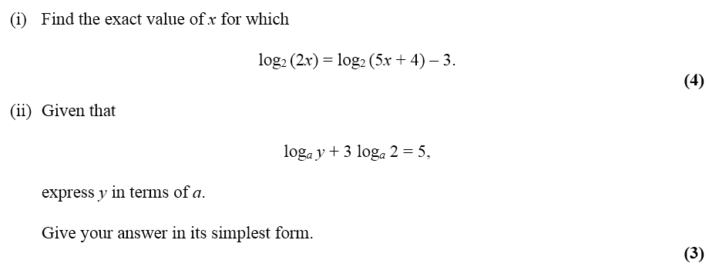
May 2013

Slide 70
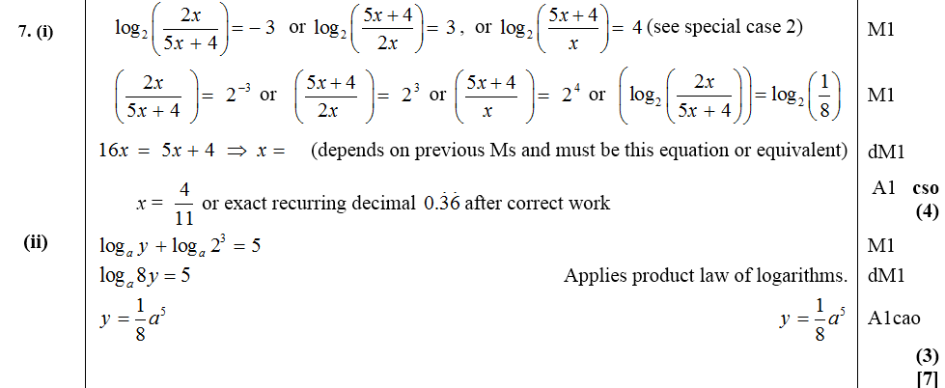
May 2013
i
ii

Slide 71
May 2014

Slide 72
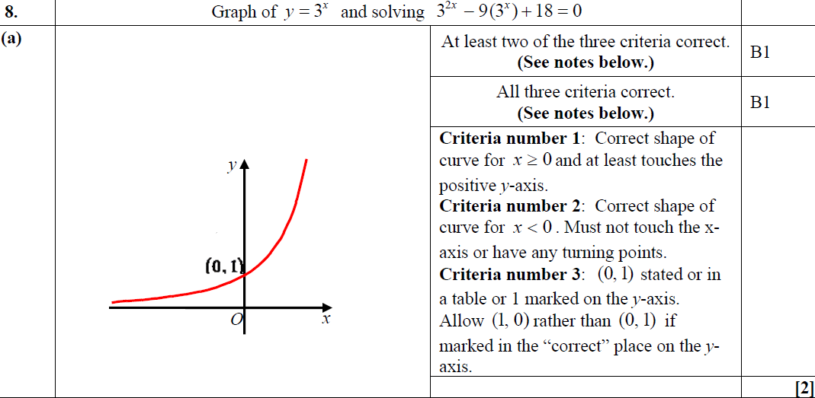
May 2014
A

Slide 73
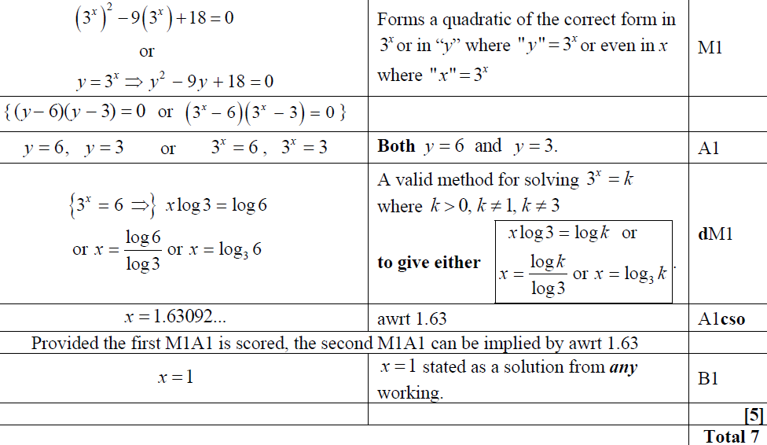
May 2014
B

Slide 74
May 2015

Slide 75
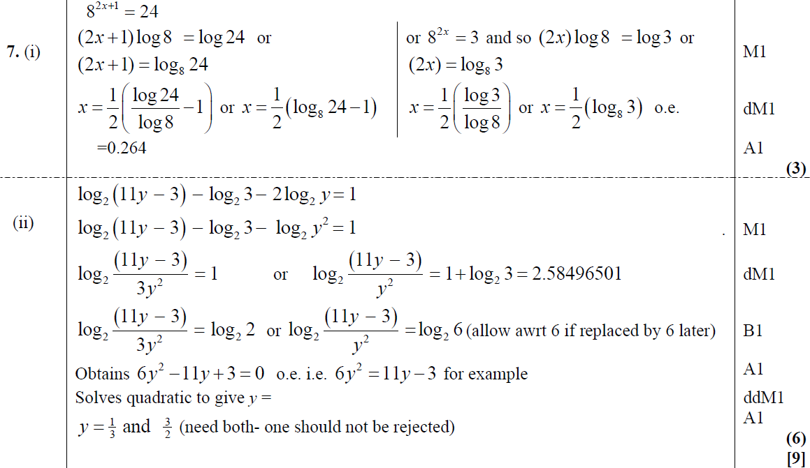
May 2015
(i)
(ii)

Slide 76
May 2015
(i) notes
(ii) notes

Slide 77
May 2016

Slide 78
May 2016
(i)
(i) Alternative

Slide 79
May 2016
(ii)
(ii) Alternative 1

Slide 80
May 2016
(ii) Alternative 2
(ii) Alternative 3
(ii) Alternative 4

Slide 81
May 2016
(i) notes
(ii) notes

Slide 82
May 2017

Slide 83
May 2017
A
B
B Alternative 1
B Alternative 2
C

Slide 84
May 2017
A notes
B notes
C notes

Slide 85
May 2017

Slide 86
May 2017
(i)
(ii)
(ii) Alternative

Slide 87
May 2017
(i) notes
(ii) notes

Slide 88
May 2018

Slide 89
May 2018
(i)
(ii) A
(ii) B

Slide 90
May 2018
(i) notes
(ii) A notes
(ii) B notes

