Slide 1
Old Spec Q’s
Kinematics (time-series graphs)
Practice F
Practice G
SAM
2018

Slide 2
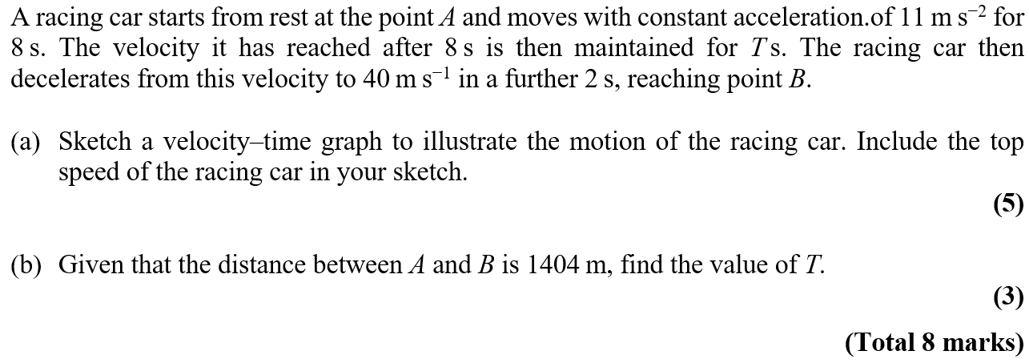
Practice F

Slide 3
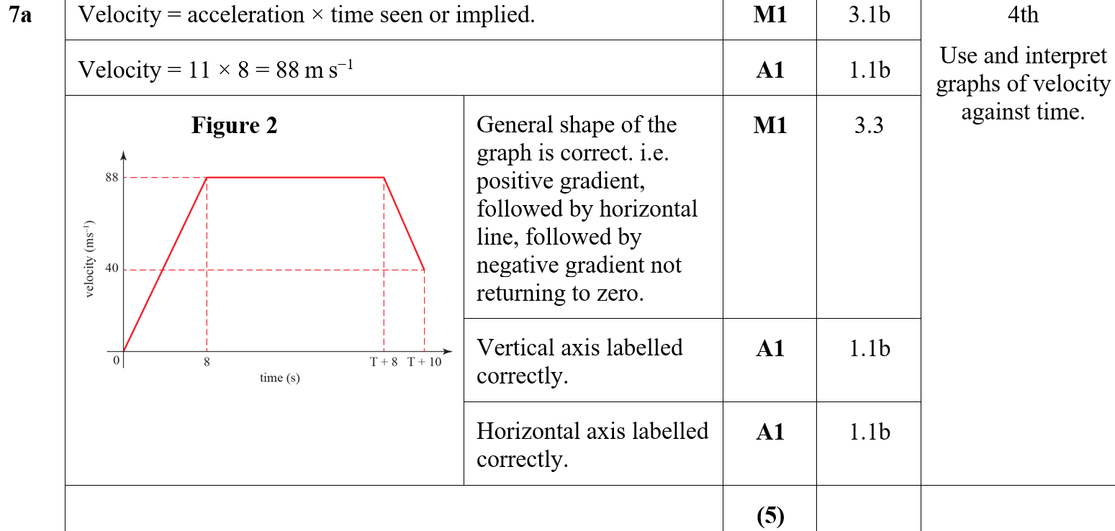
Practice F
A
A notes

Slide 4
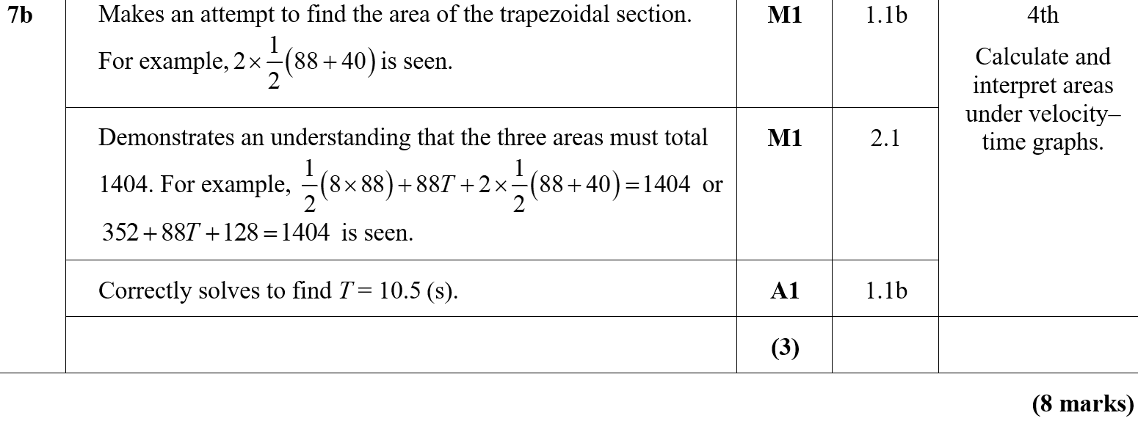
Practice F
B
B notes

Slide 5
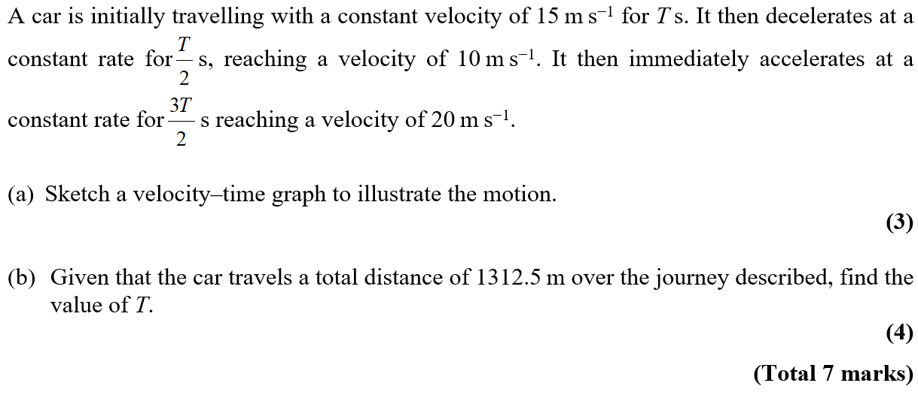
Practice G

Slide 6
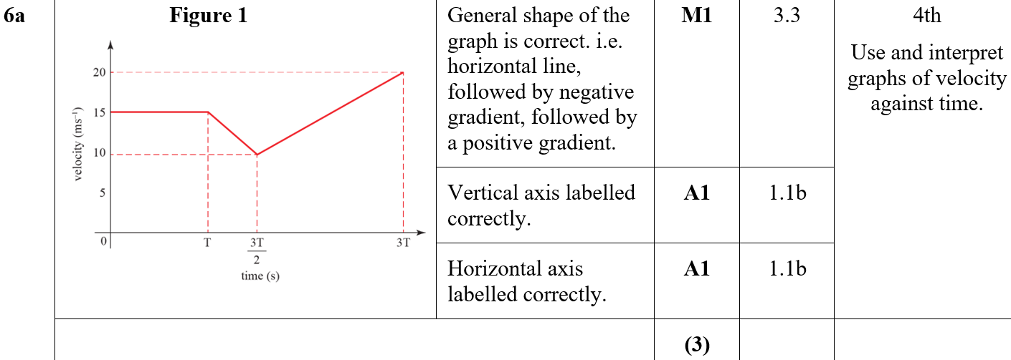
Practice G
A
A notes

Slide 7
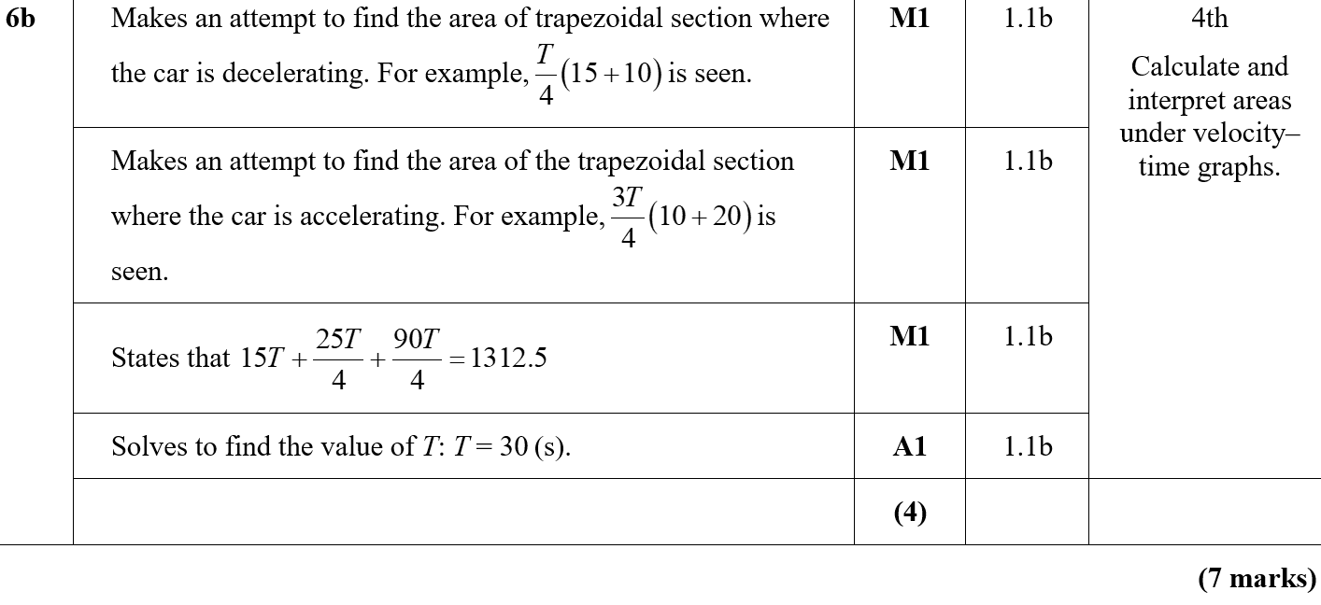
Practice G
B
B notes

Slide 8
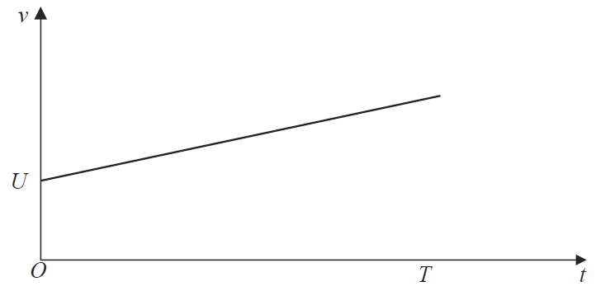
SAM

Slide 9
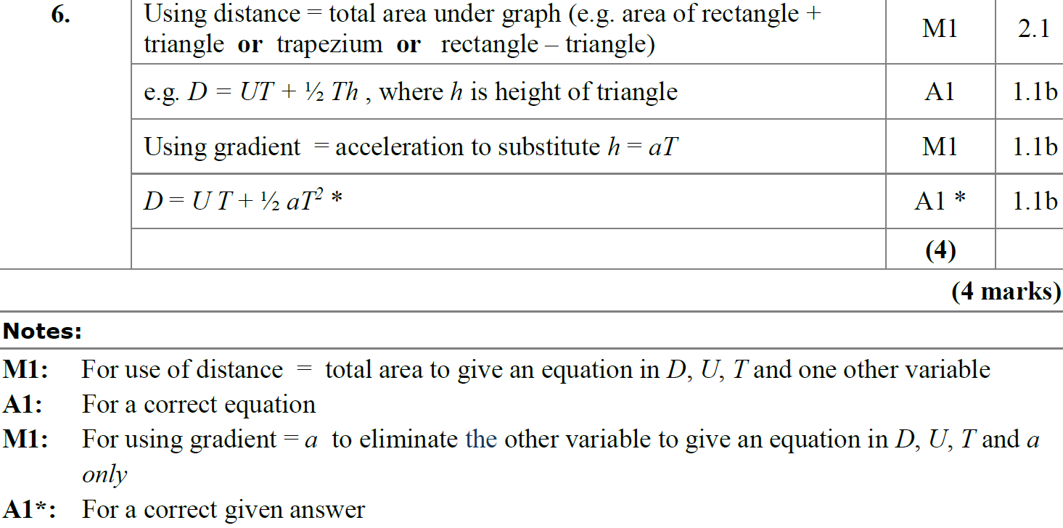
SAM
A
A notes

Slide 10
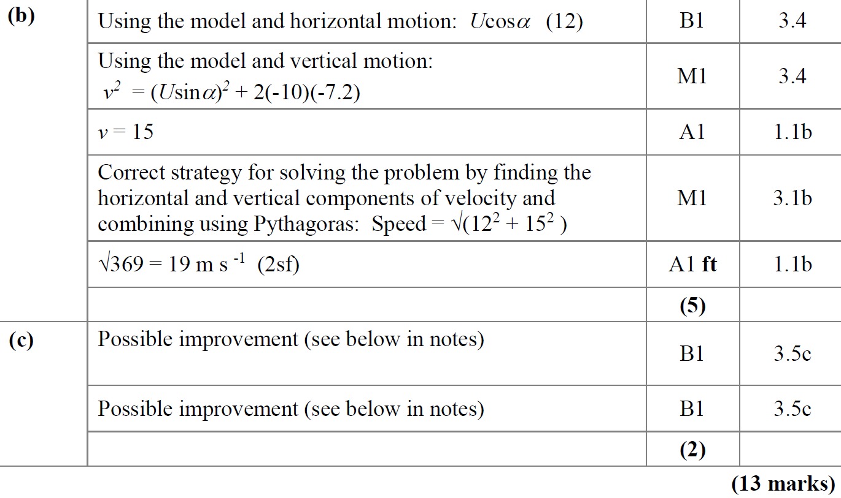
SAM
B
C

Slide 11
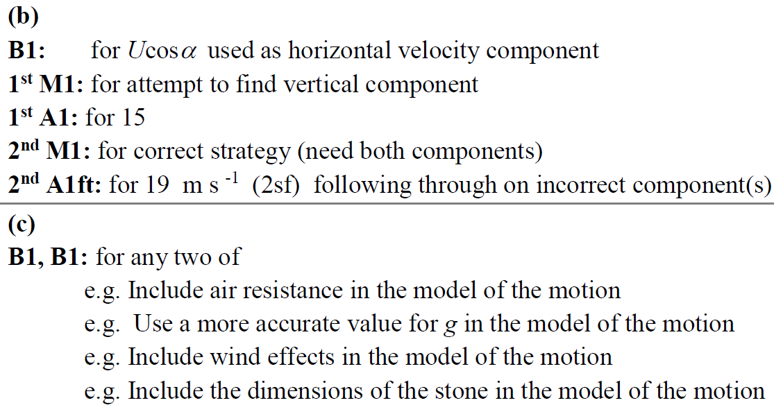
SAM
B notes
C notes

Slide 12
2018

Slide 13
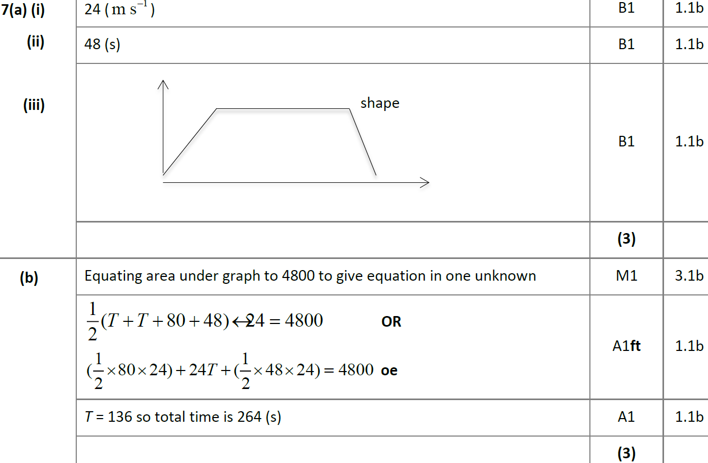
2018
A (i)
A (ii)
A (iii)
B

Slide 14
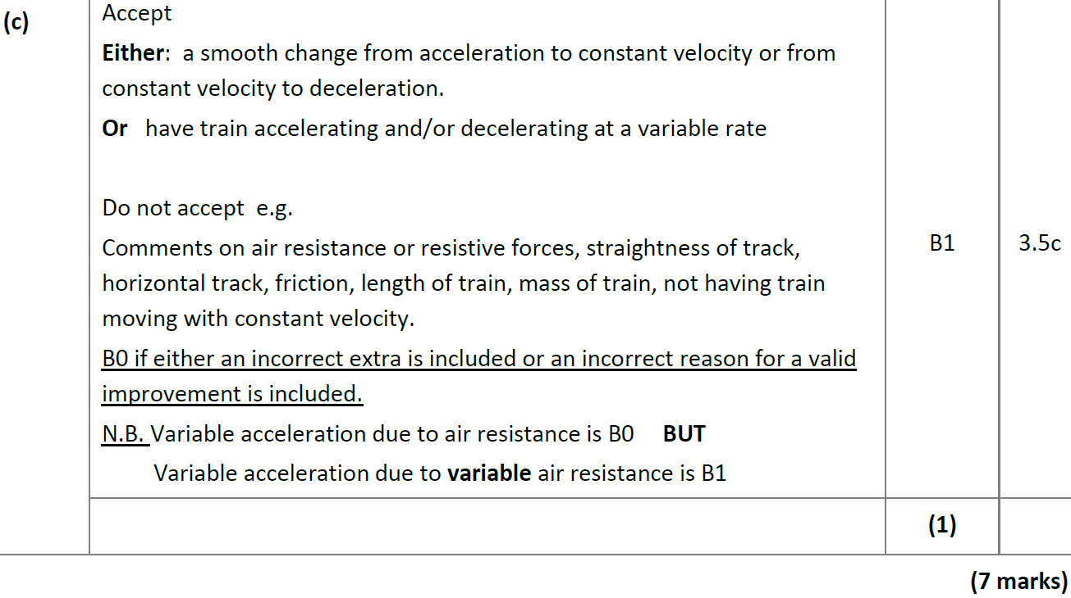
2018
C

Slide 15
2018
A (i) (SF)
A (ii) (SF)
A (iii) (SF)

Slide 16
2018
B (SF)
C (SF)

Slide 17
2018
A (i) notes
A (ii) notes
A (iii) notes
B notes
C notes

Slide 18
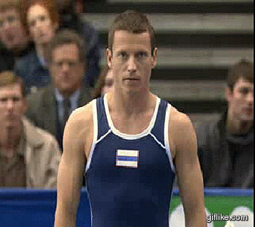
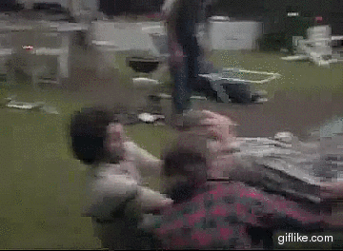
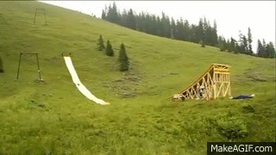
New Spec Q’s
Old Spec Kinematics (Time-Series graphs)
June 2006
May 2011
June 2007
May 2012
Jan 2008
Jan 2013
May 2008
May 2013
Jan 2009
June 2014
Jan 2010
June 2015
May 2010
June 2016
Jan 2011
June 2018

Slide 19
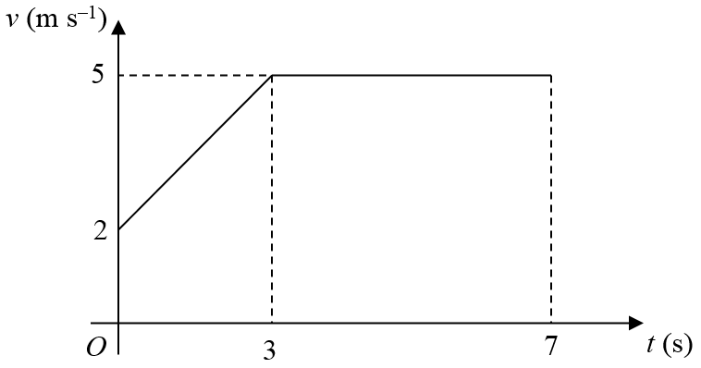
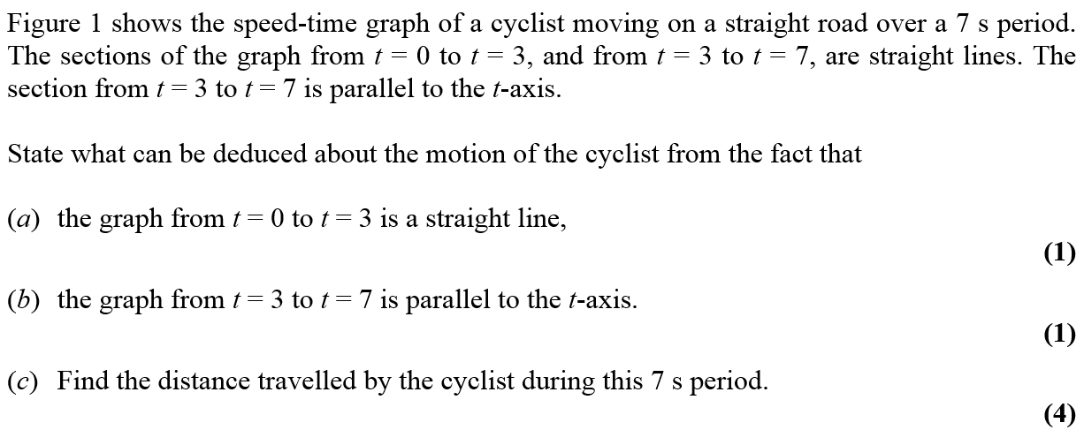
June 2006

Slide 20
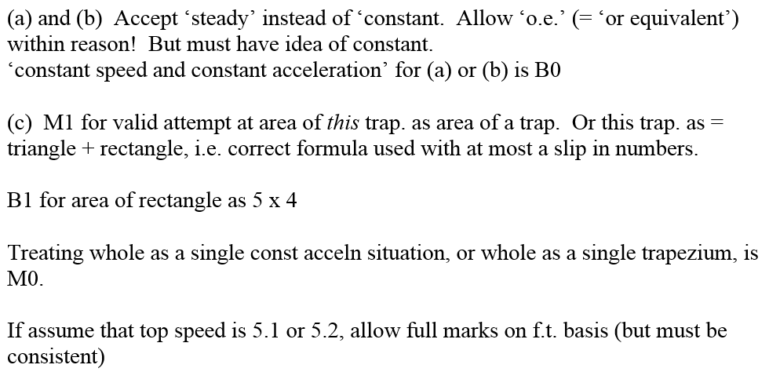
June 2006
A
B
C
A & B Notes
C Notes

Slide 21
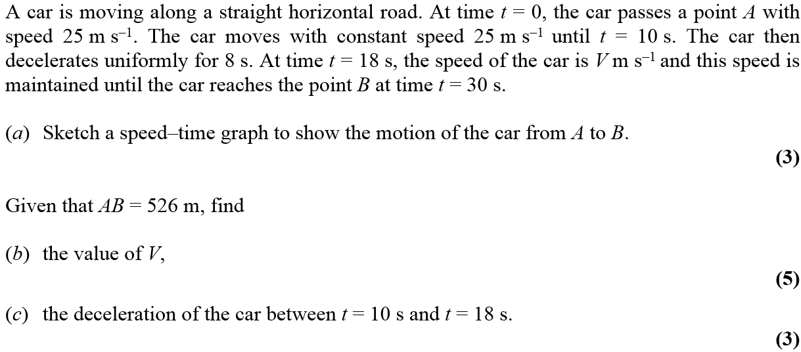
June 2007

Slide 22
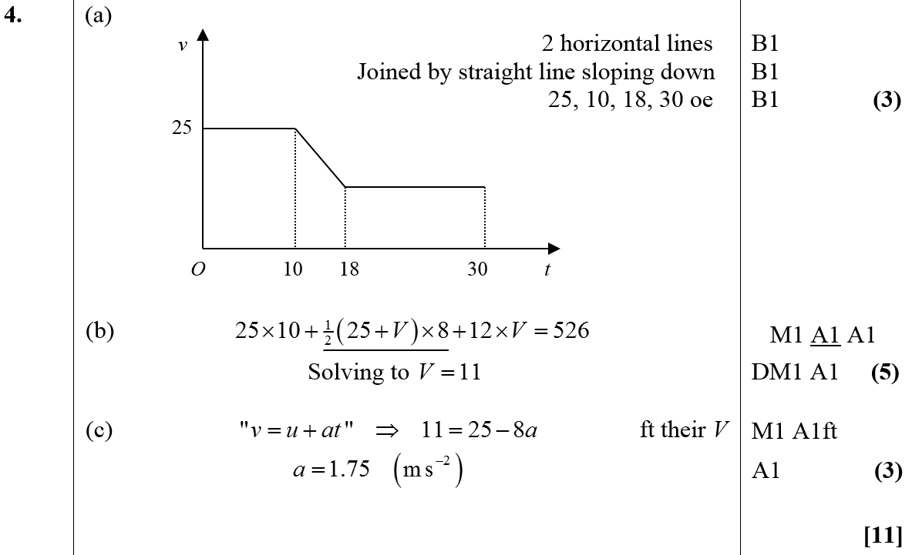
June 2007
A
B
C

Slide 23
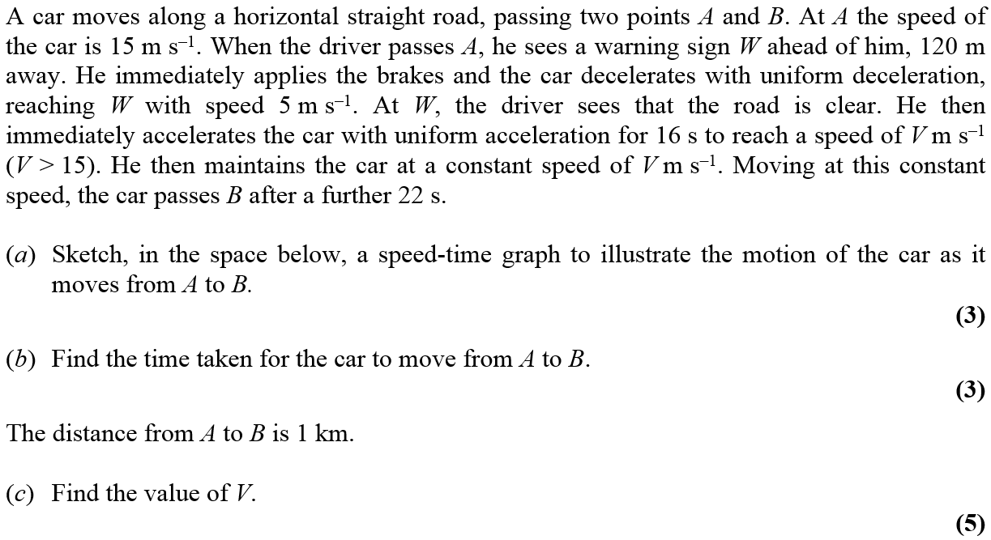
Jan 2008

Slide 24
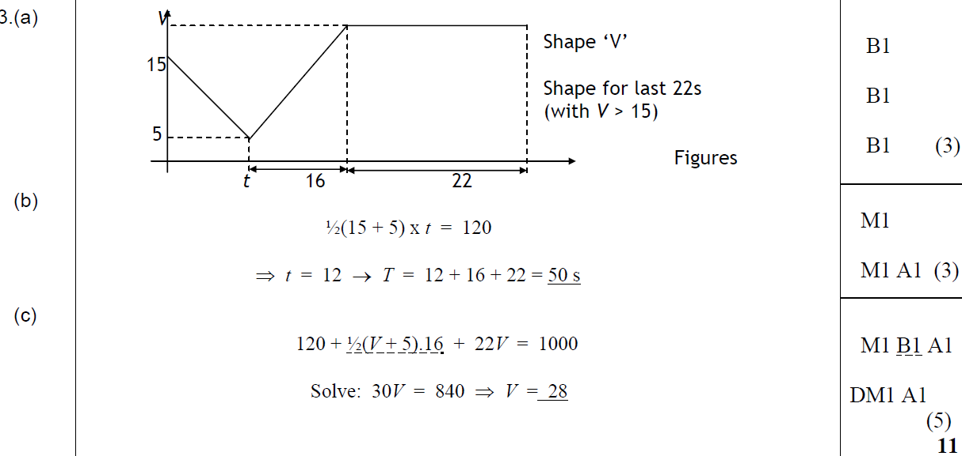
Jan 2008
A
B
C

Slide 25
May 2008

Slide 26
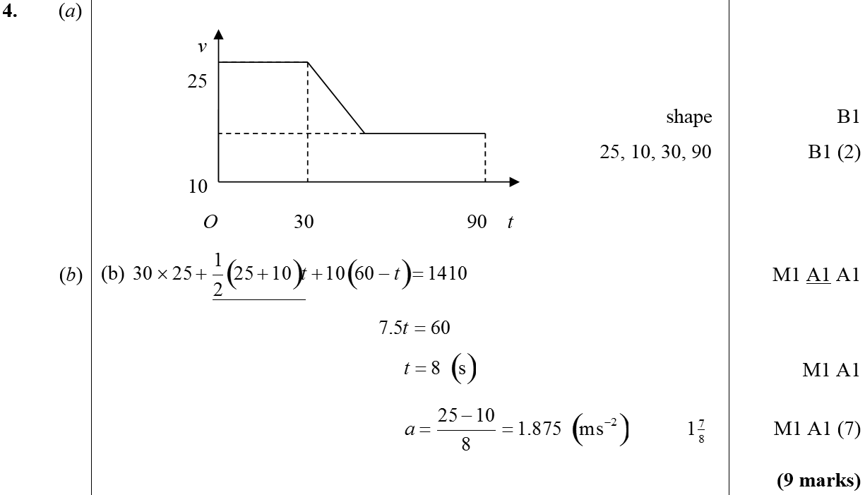
May 2008
A
B

Slide 27
Jan 2009

Slide 28
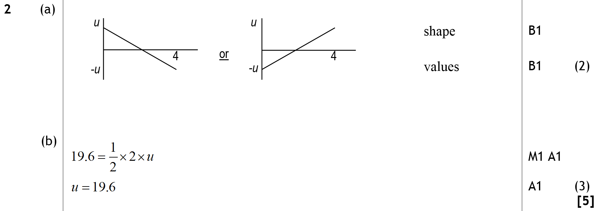
Jan 2009
A
B

Slide 29
Jan 2010

Slide 30
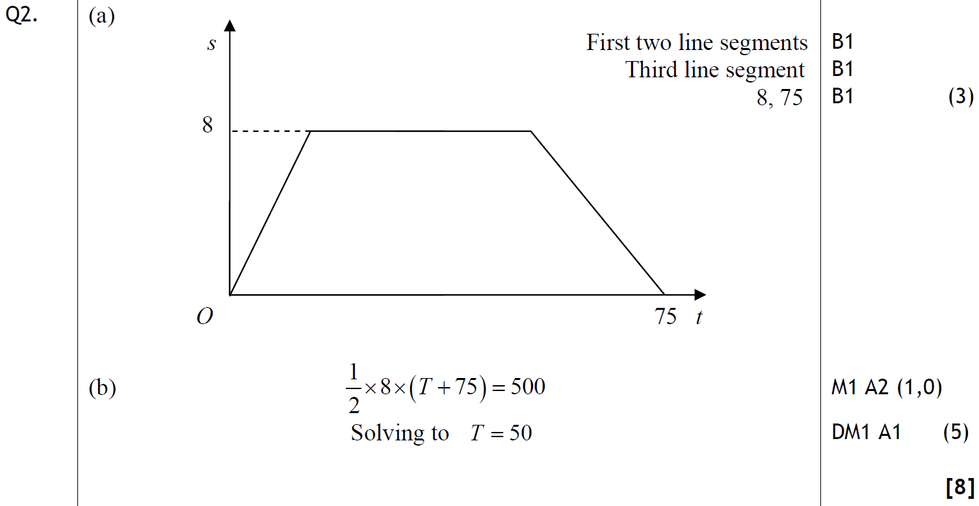
Jan 2010
A
B

Slide 31
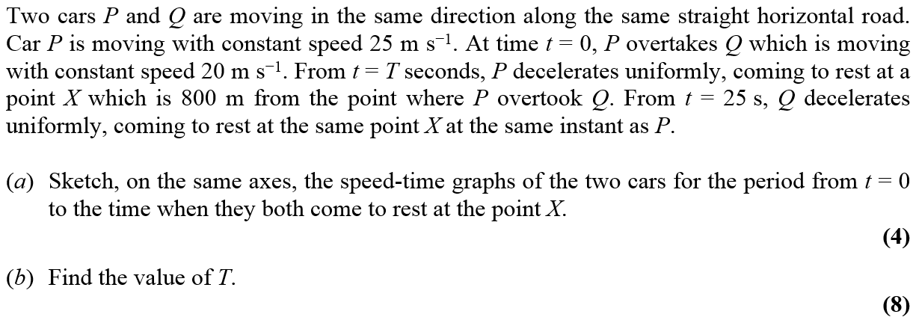
May 2010

Slide 32
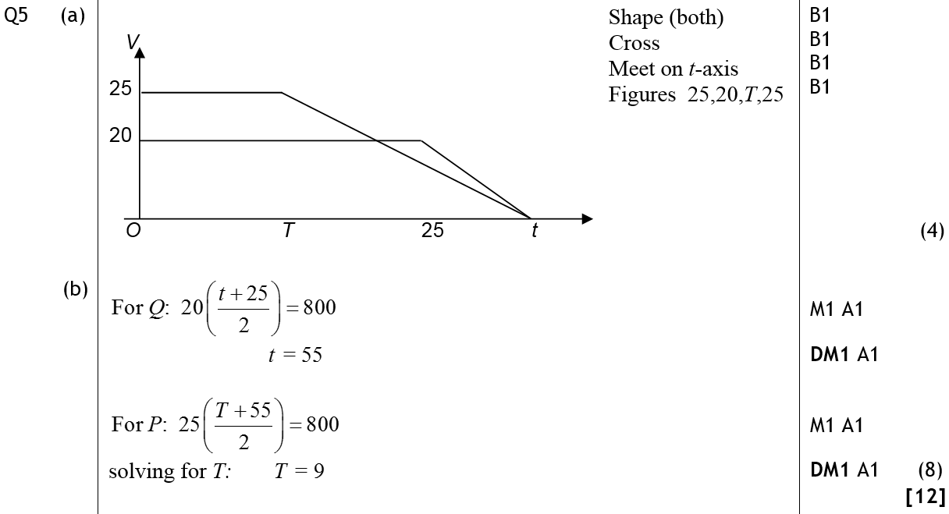
May 2010
A
B

Slide 33
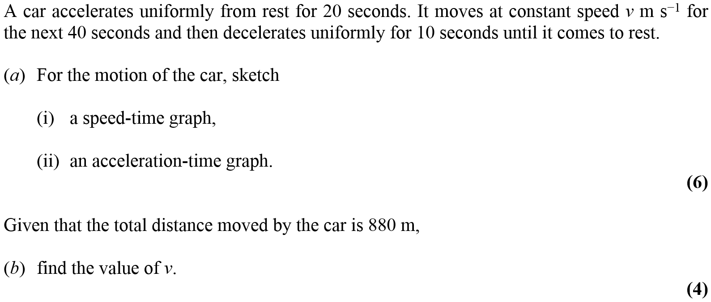
Jan 2011

Slide 34
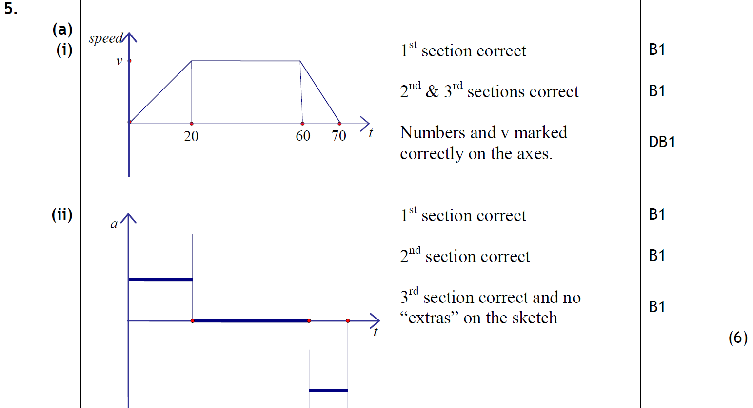
A (i)
Jan 2011
A (ii)
B

Slide 35
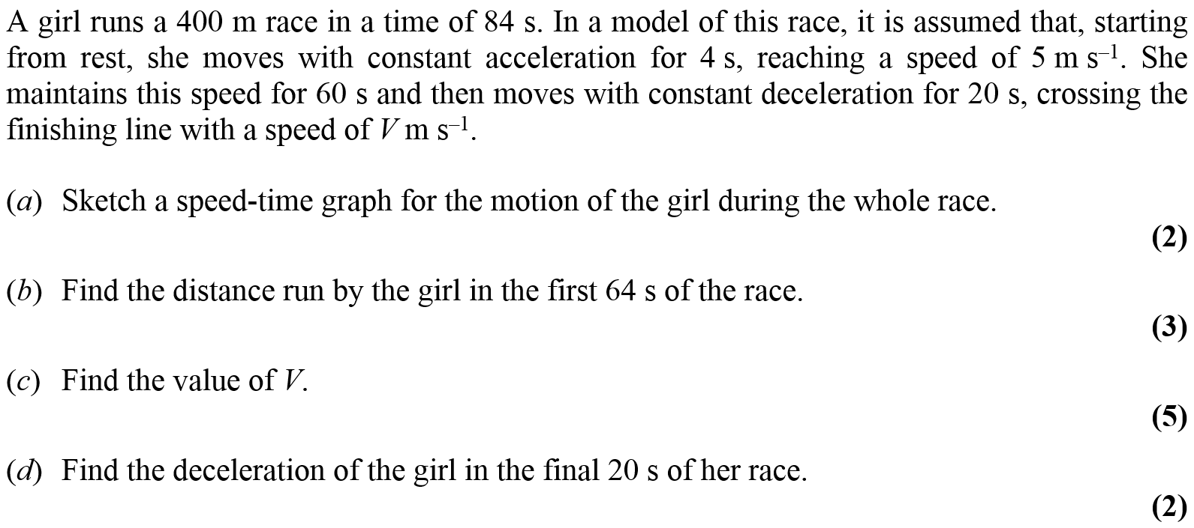
May 2011

Slide 36
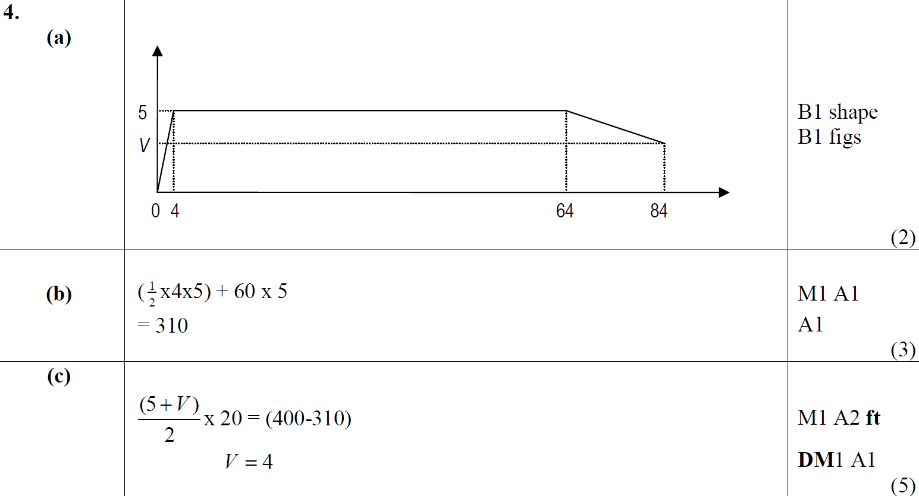
May 2011
A
B
C
D

Slide 37
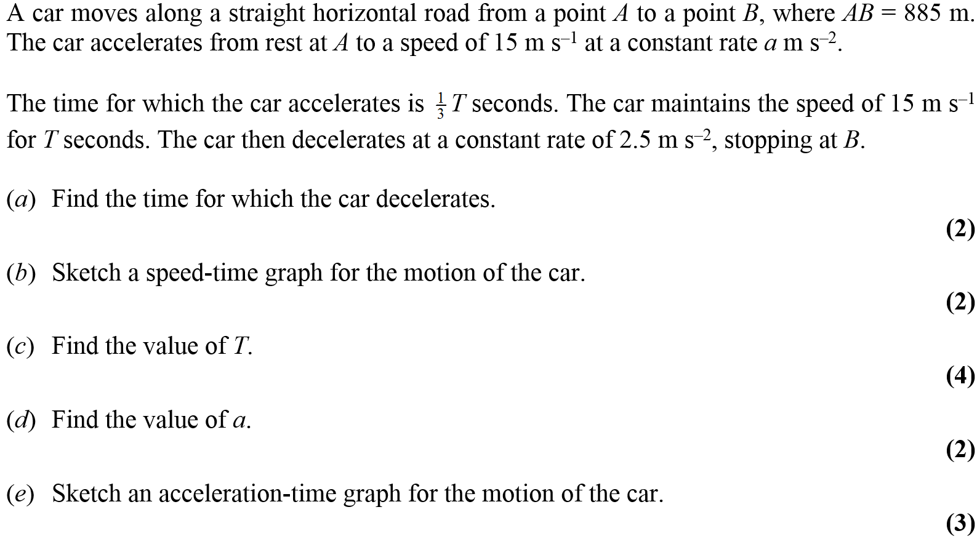
Jan 2012

Slide 38
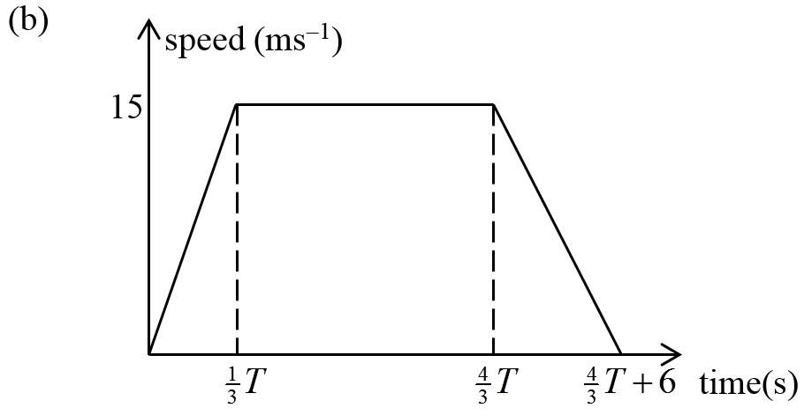
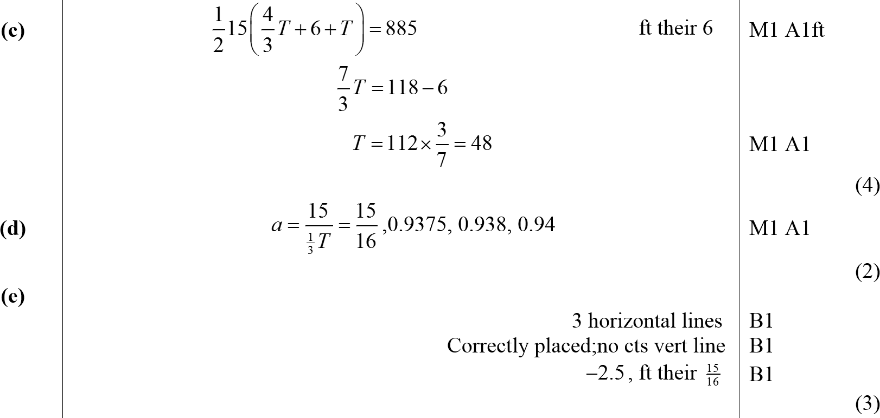
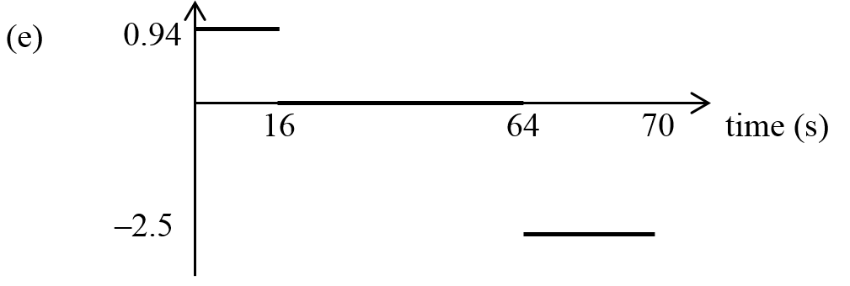
Jan 2012
A
B
C
D
E

Slide 39
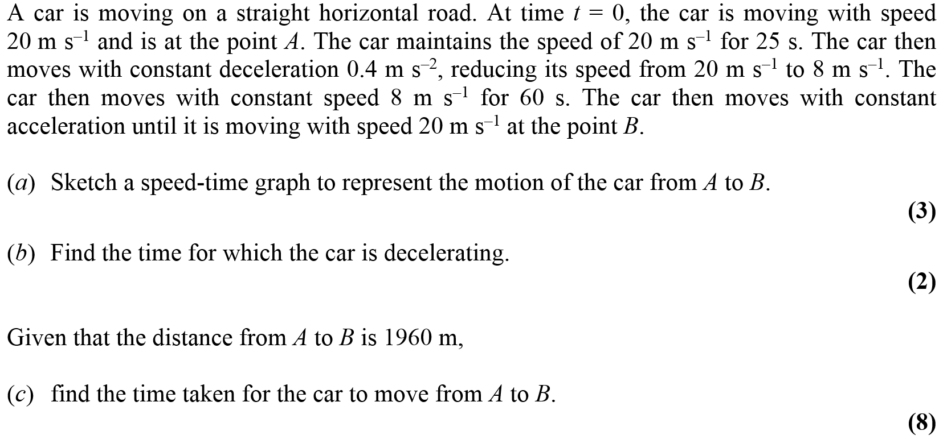
May 2012

Slide 40
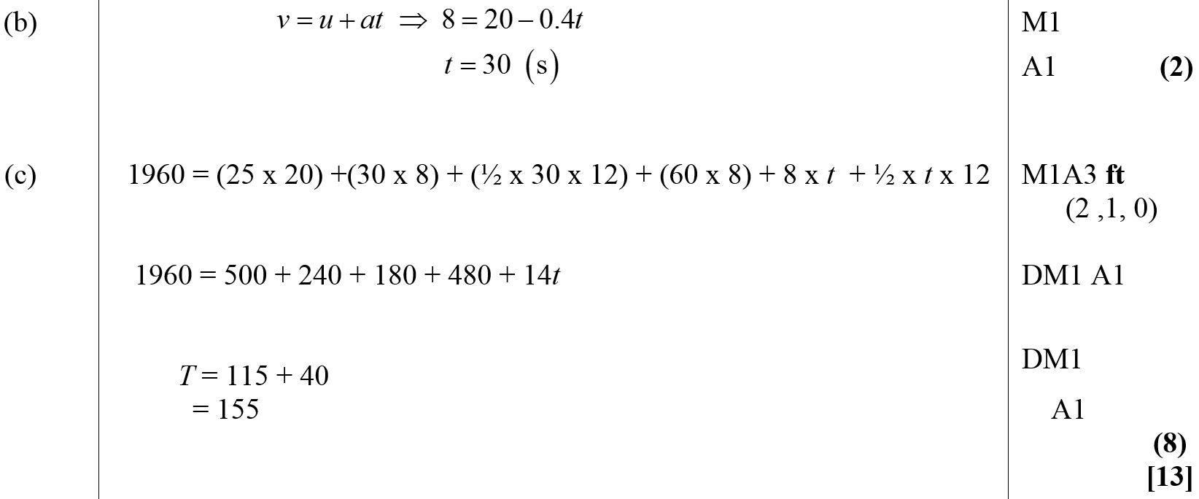
May 2012
A
B
C

Slide 41
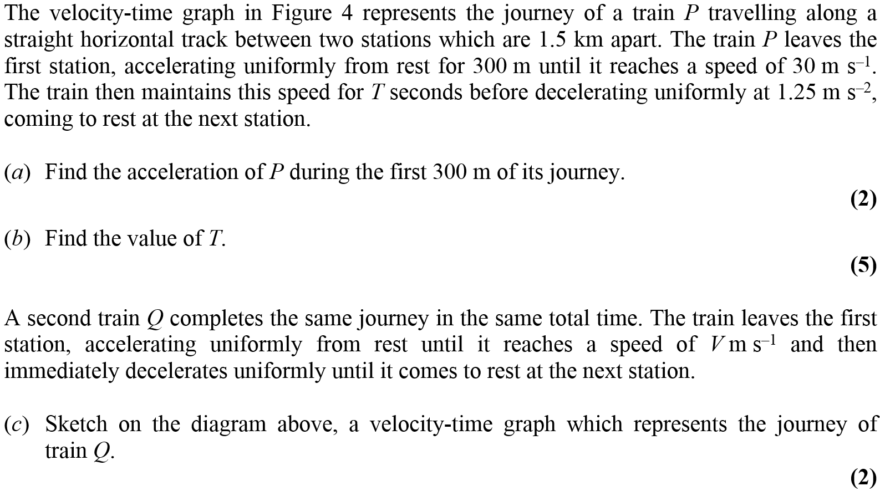
Jan 2013

Slide 42
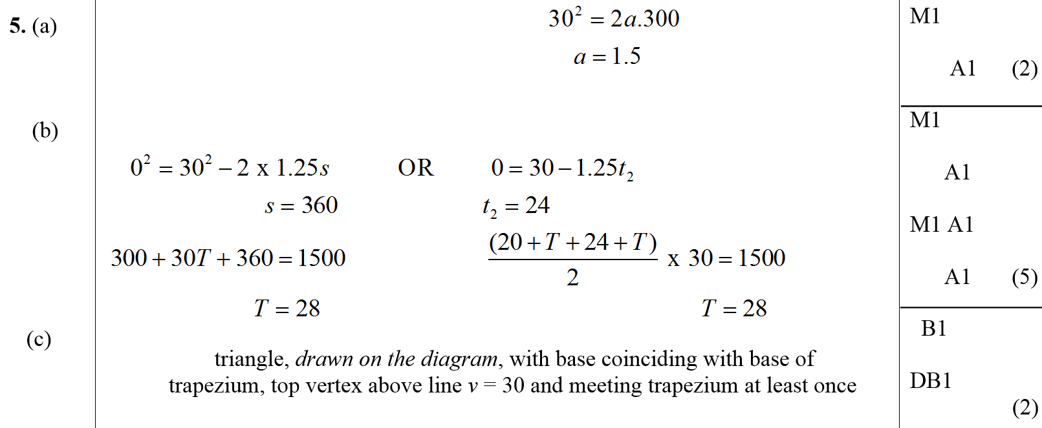
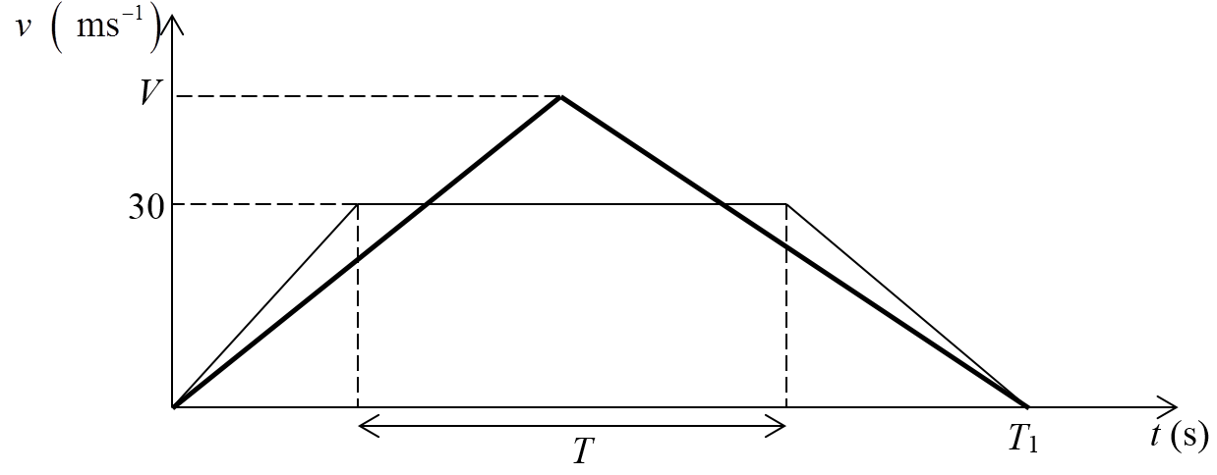
Jan 2013
A
B
C

Slide 43
Jan 2013
D

Slide 44
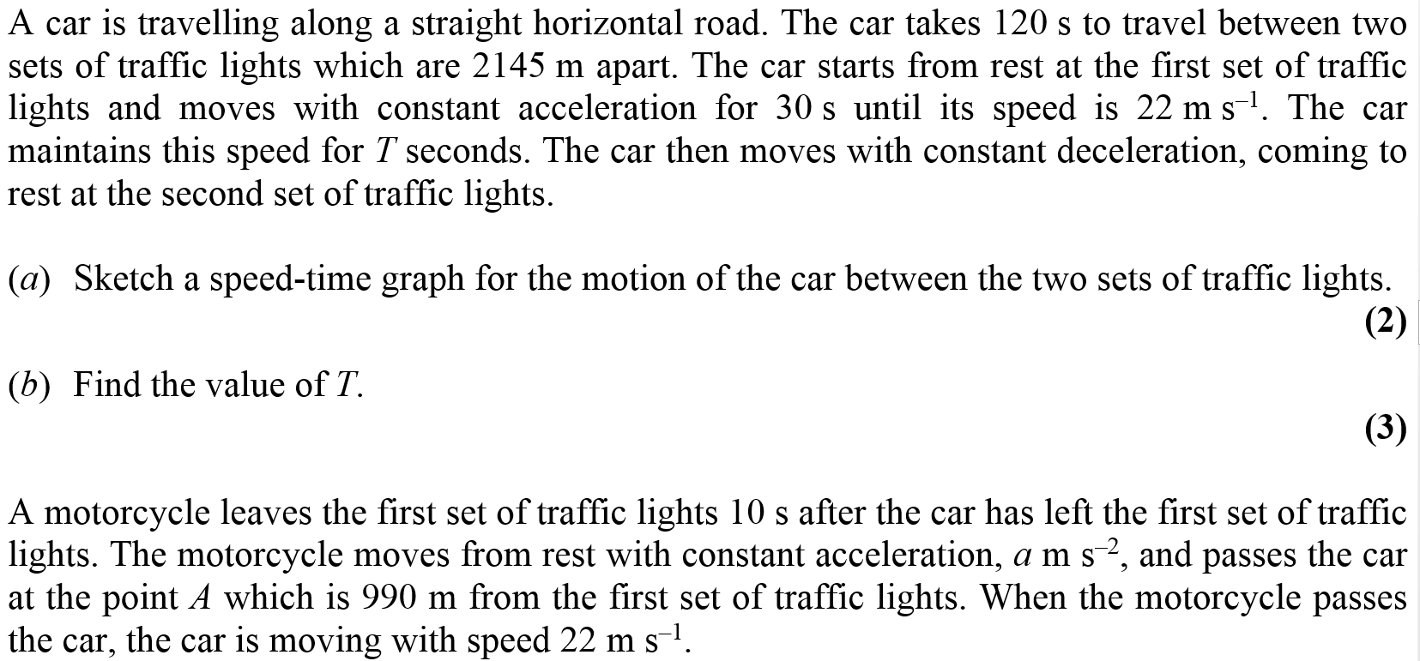
May 2013

Slide 45
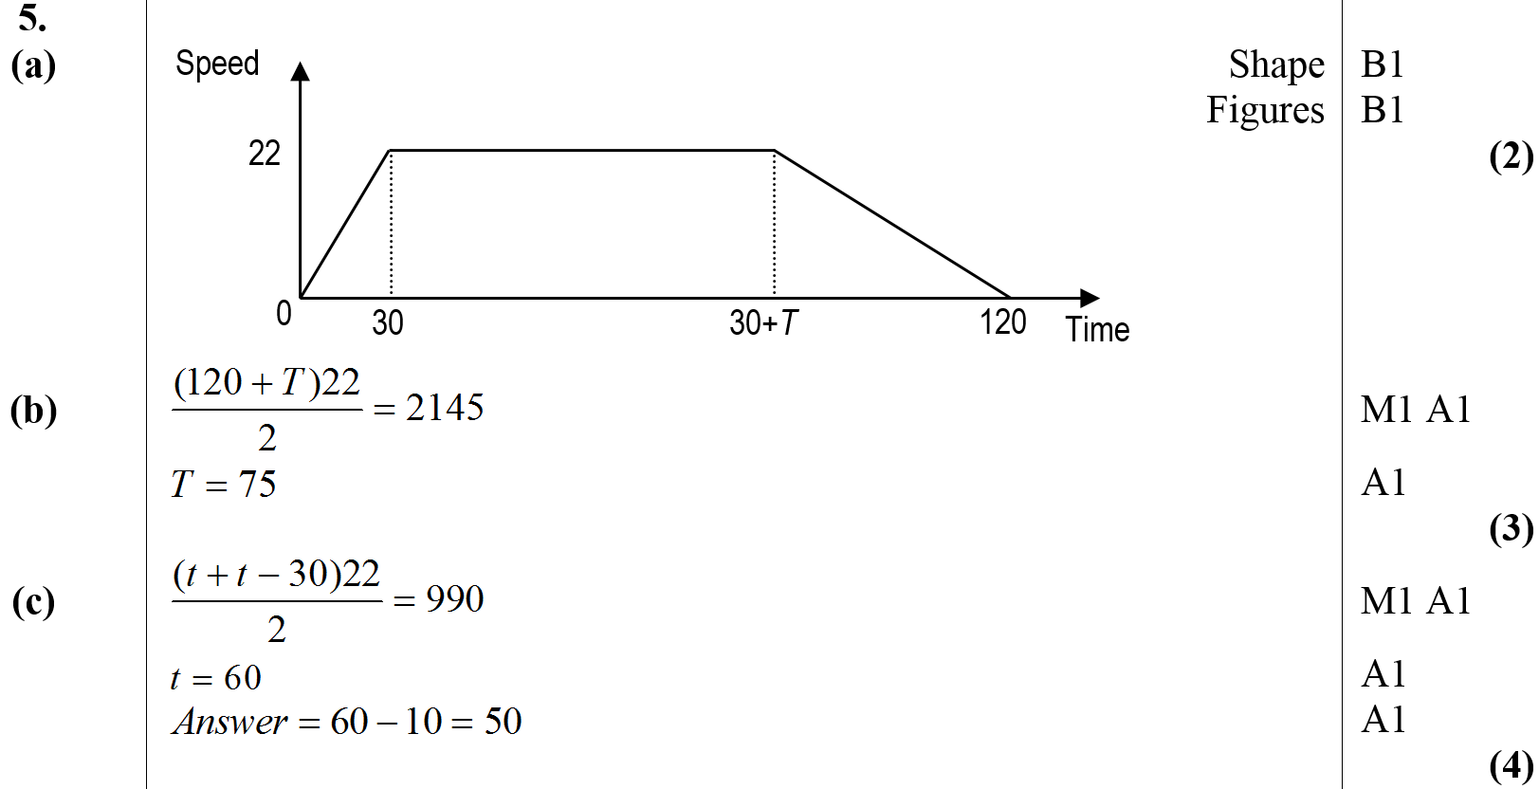
May 2013
A
B
C
D

Slide 46
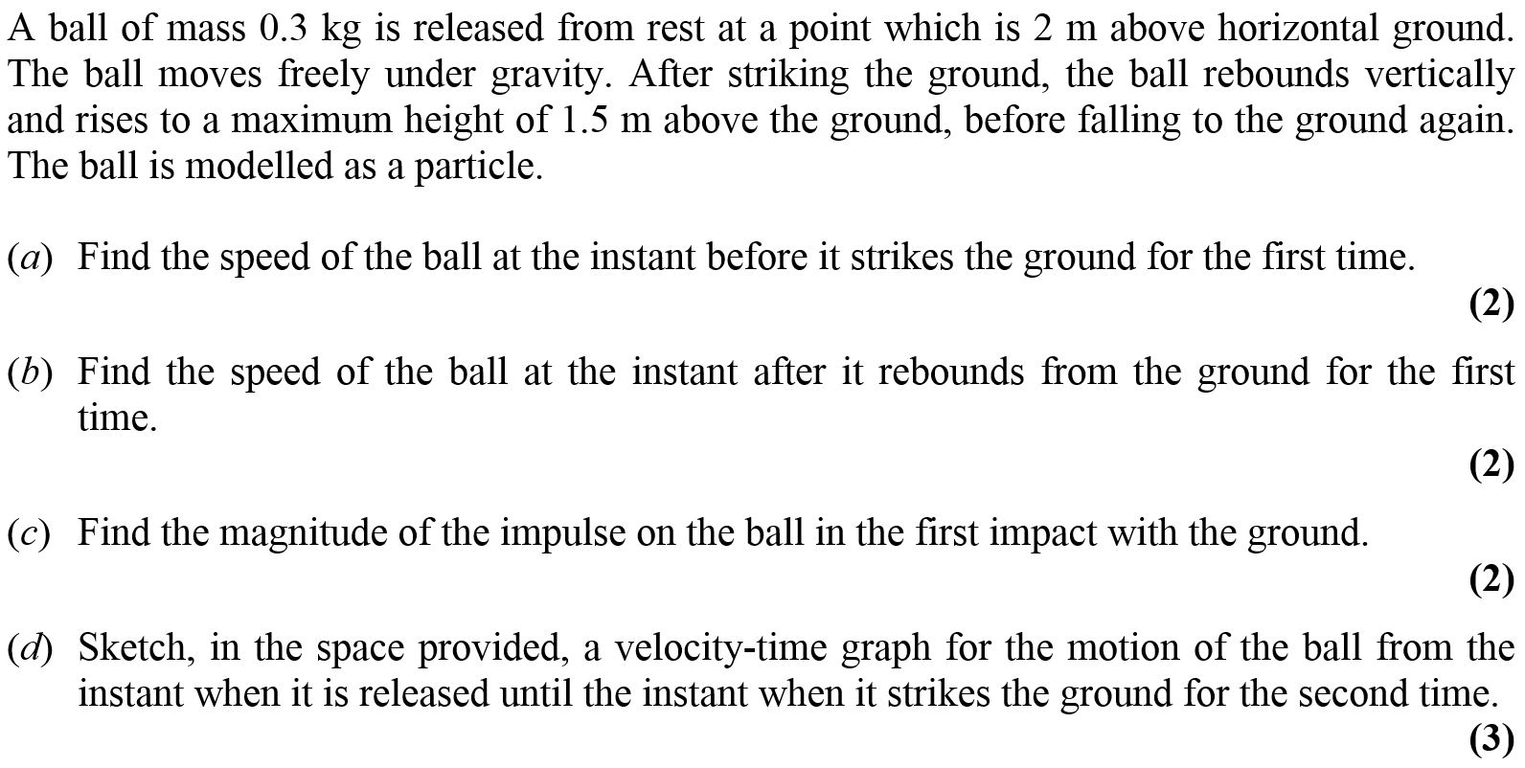
June 2014

Slide 47
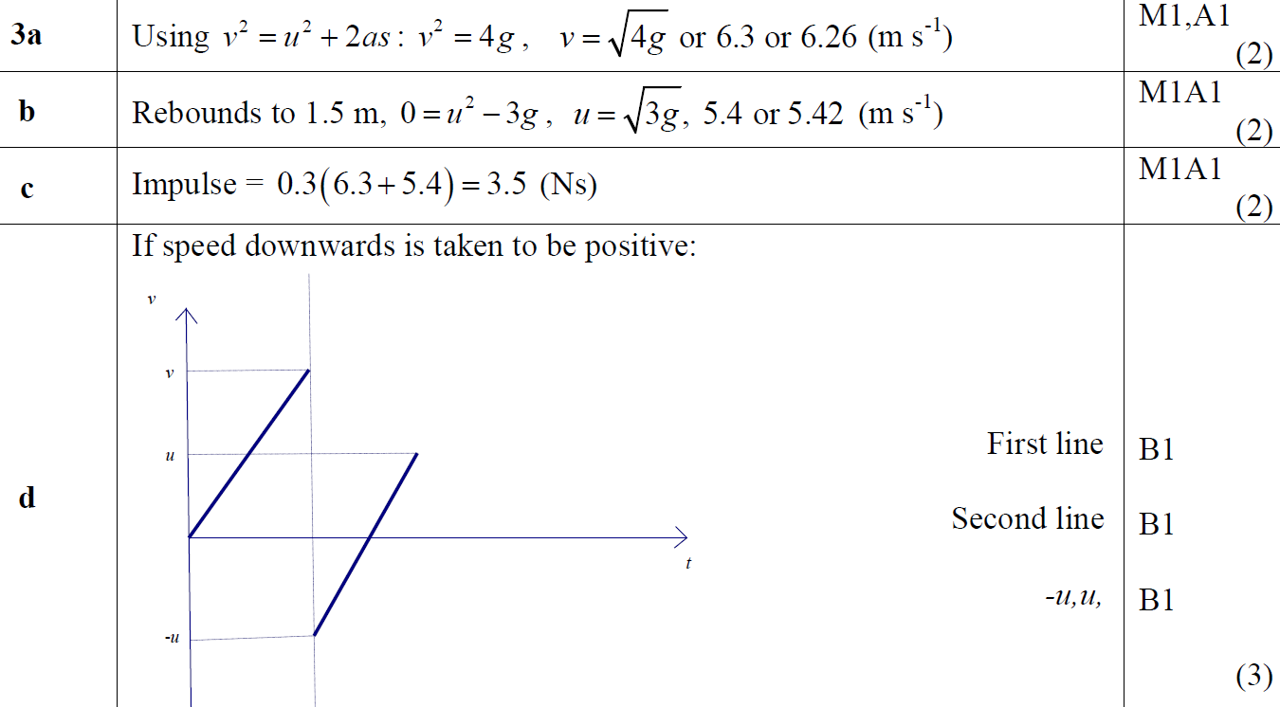
June 2014
A
B
C
D

Slide 48
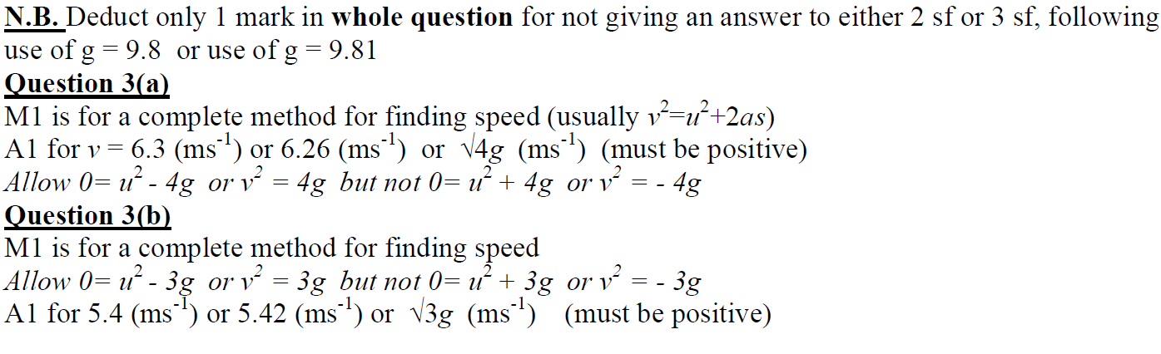
June 2014
E
General Notes
A Notes
B Notes

Slide 49
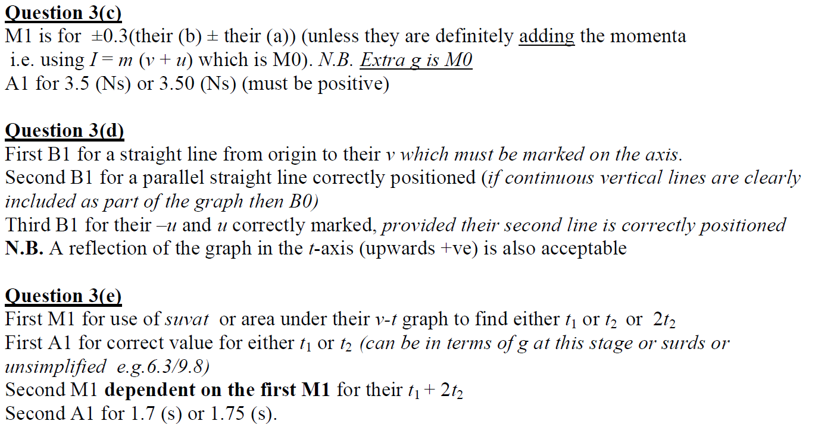
June 2014
C Notes
D Notes
E Notes

Slide 50
June 2015

Slide 51
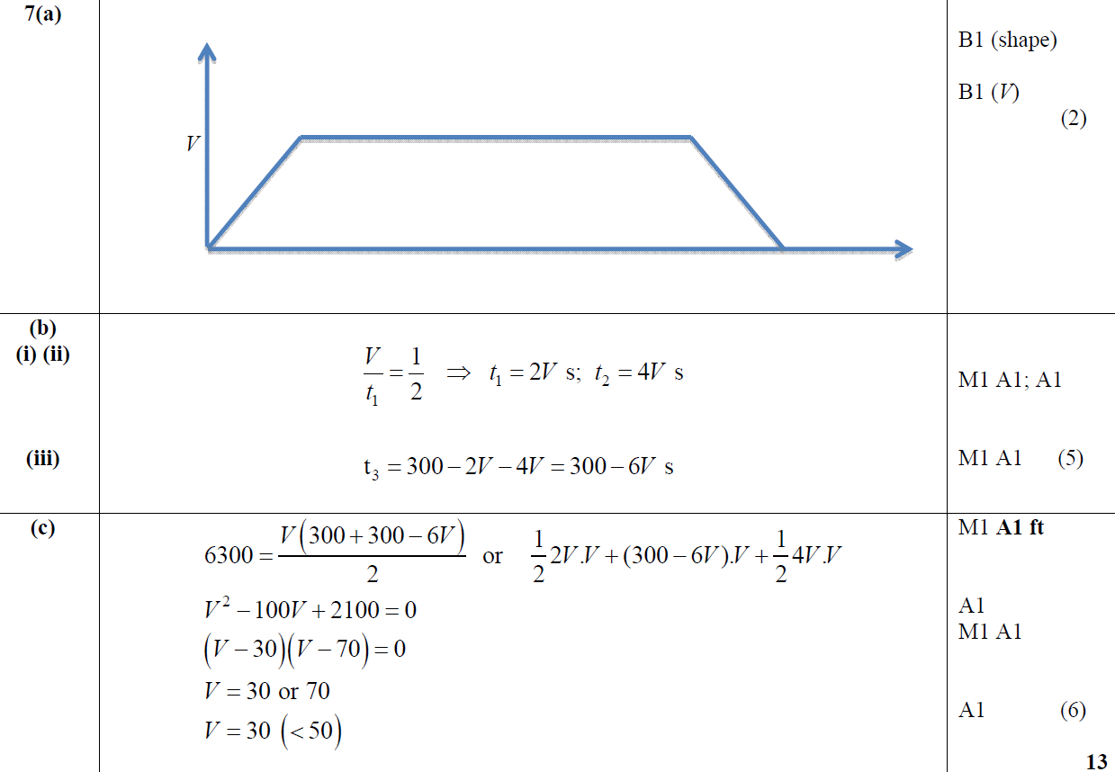
June 2015
A
B (i) & (ii)
B (iii)
C

Slide 52
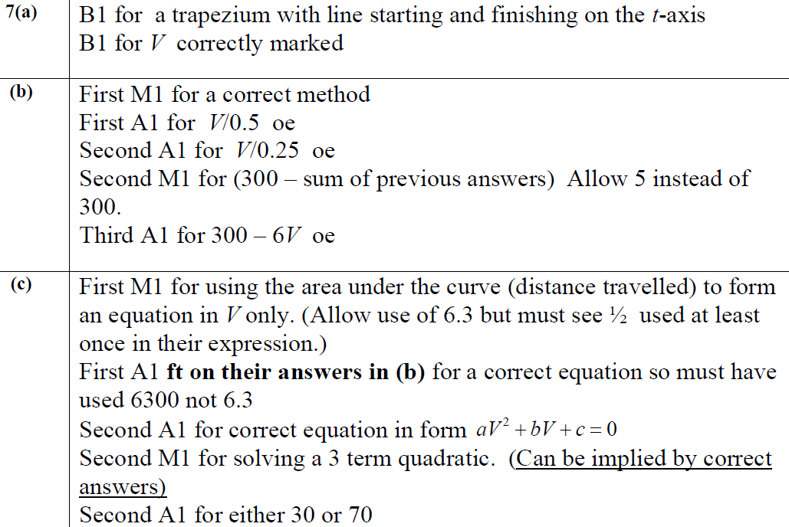
June 2015
A Notes
B Notes
C Notes

Slide 53
June 2016

Slide 54
June 2016
A
A notes

Slide 55
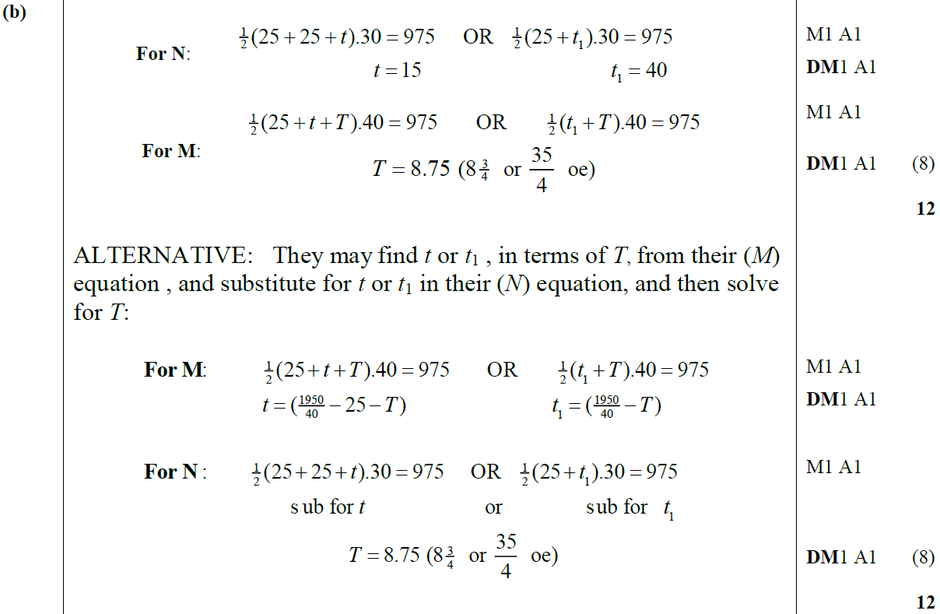
June 2016
B
B Alternative

Slide 56
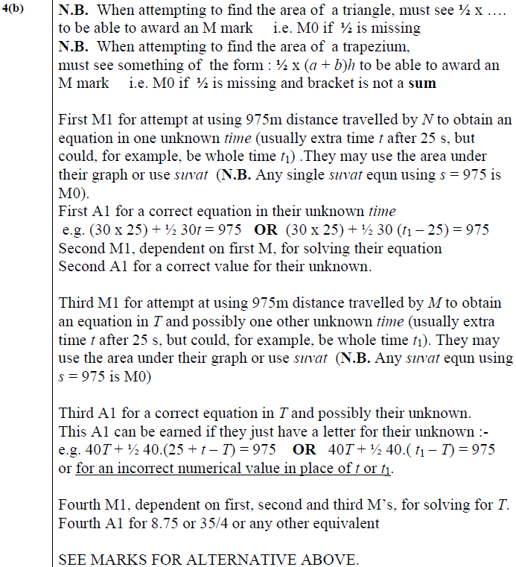
June 2016
B Notes

Slide 57
June 2018

Slide 58
June 2018
A
B
C

Slide 59
June 2018
B Alternative
C Alternative

Slide 60
June 2018
A Notes

Slide 61
June 2018
B Notes
C Notes

Slide 62
June 2018
B Further Notes
C Further Notes

