Slide 1
Old Spec Q’s
Kinematics (SUVAT)
Practice E (i)
Practice E (ii)
Practice F
Practice G
Practice I (i)
Practice I (ii)
SAM
2018

Slide 2
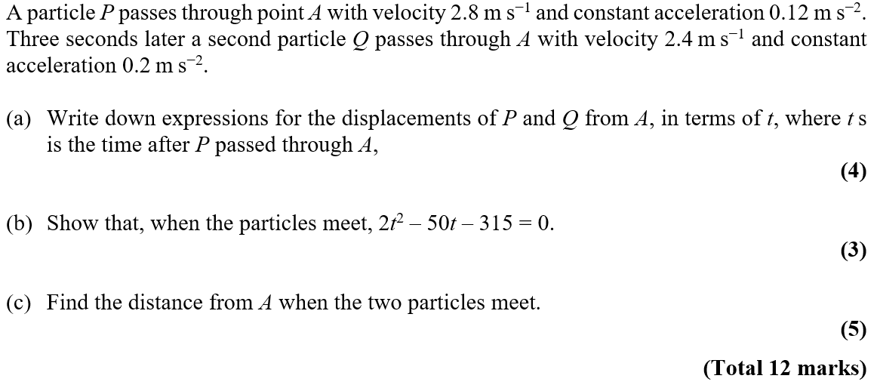
Practice E

Slide 3
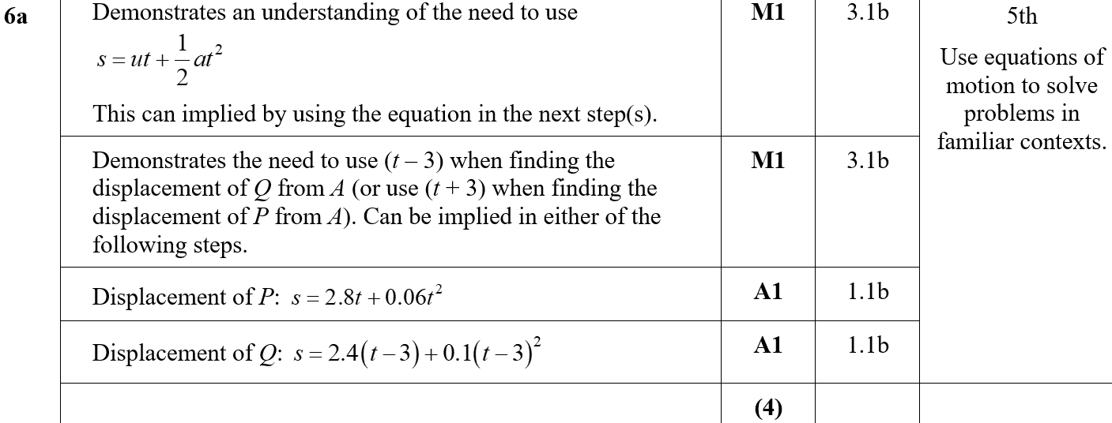
Practice E
A
A notes

Slide 4
Practice E
B

Slide 5
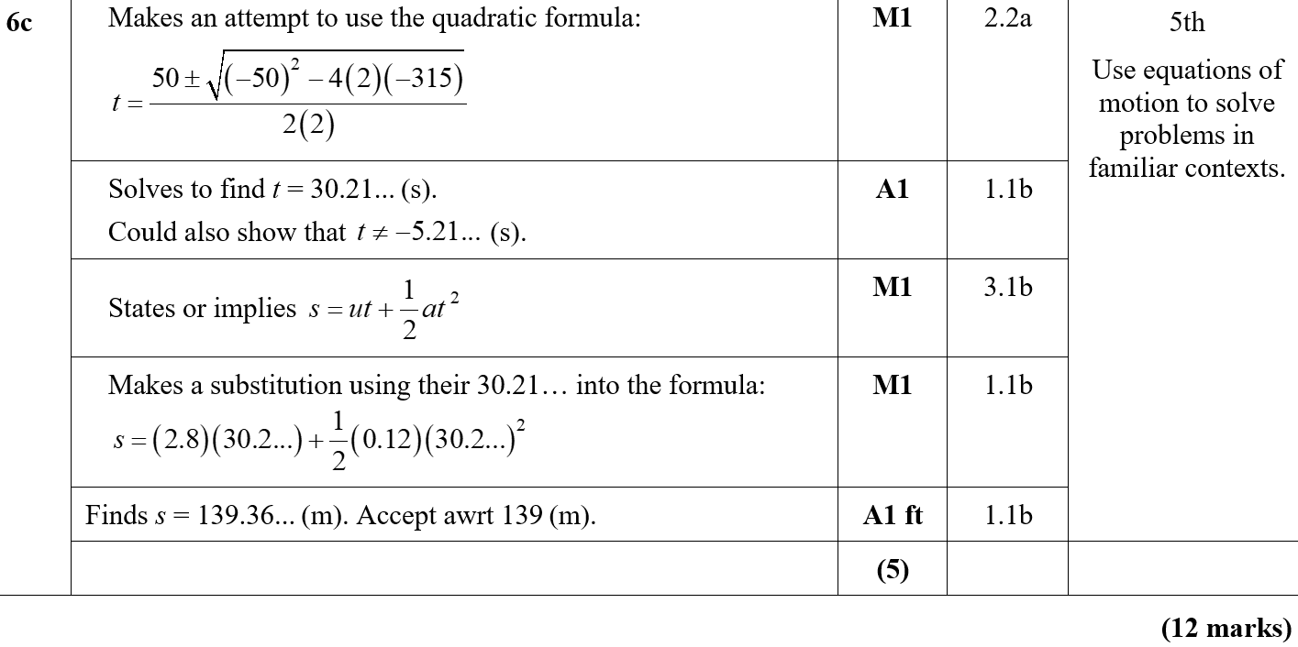
Practice E
C
C notes

Slide 6
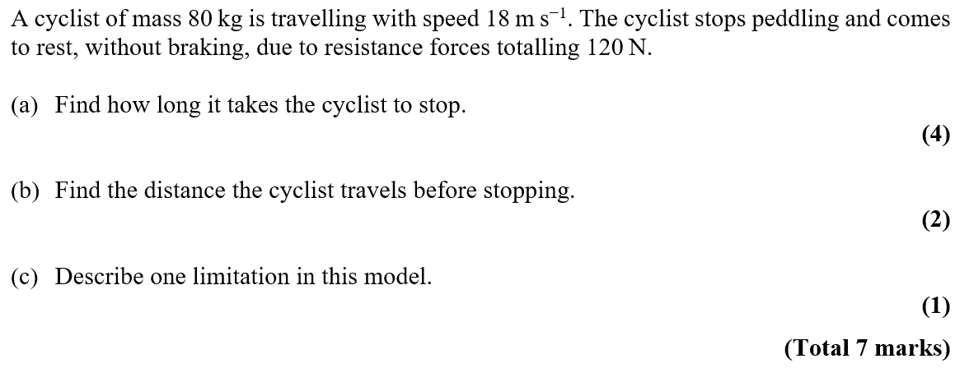
Practice E

Slide 7
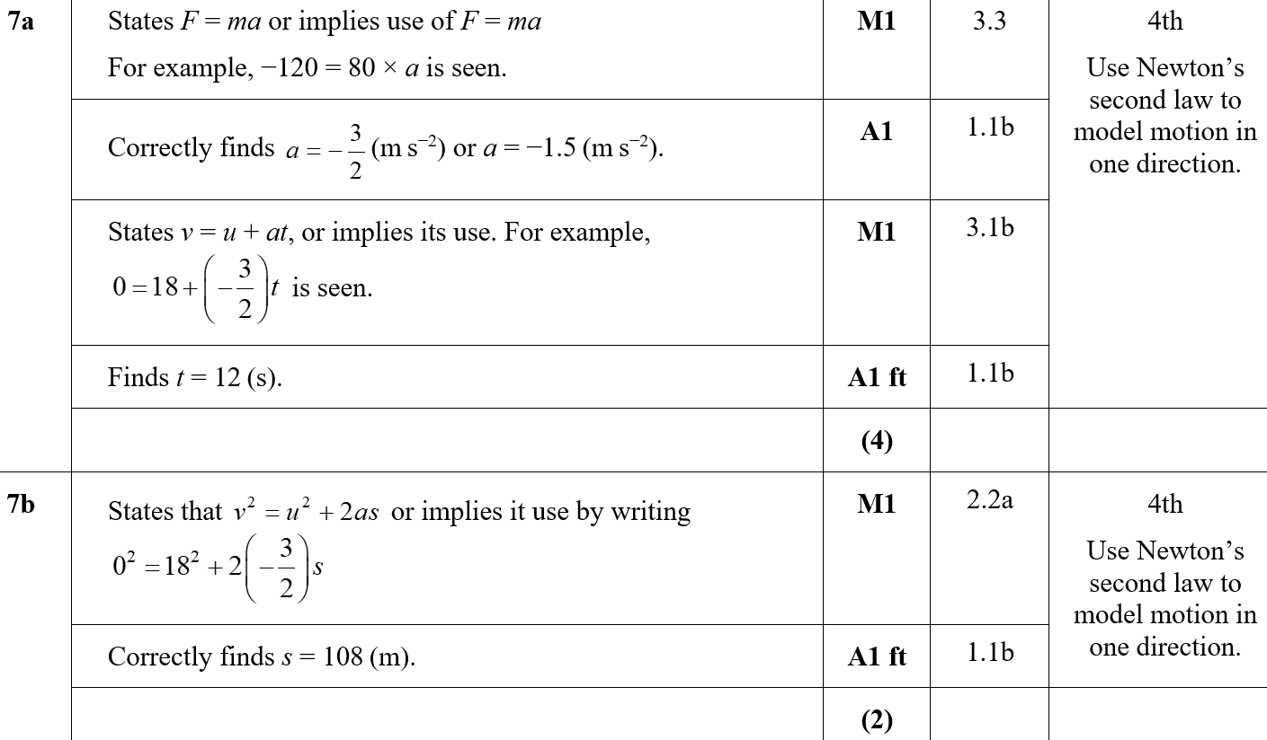
Practice E
A
B

Slide 8
Practice E
C
A notes
B notes

Slide 9
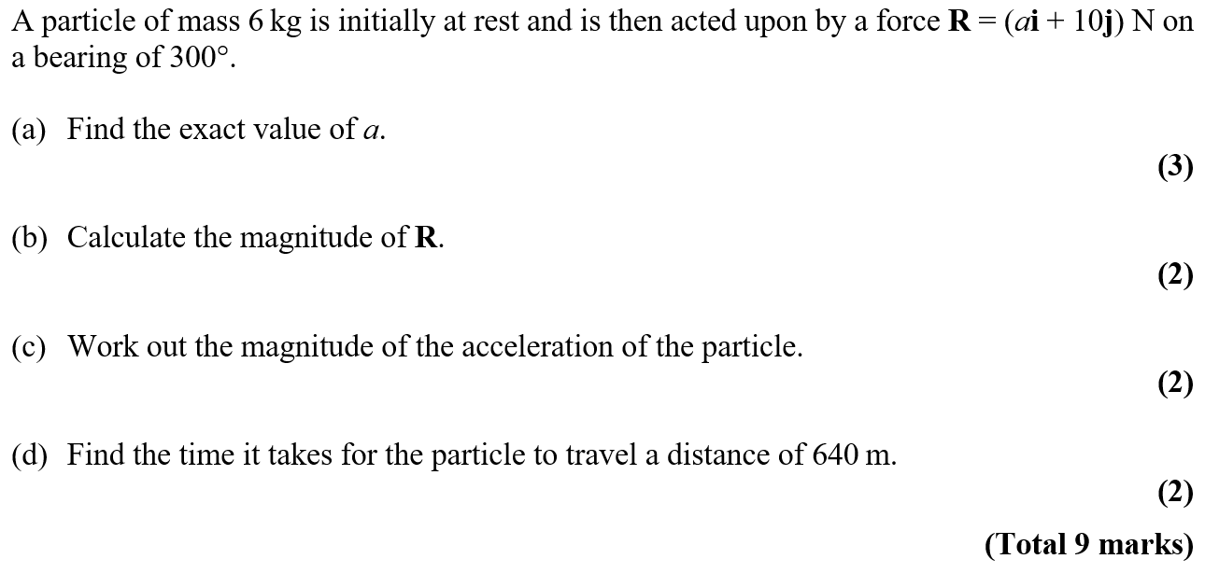
Practice F

Slide 10
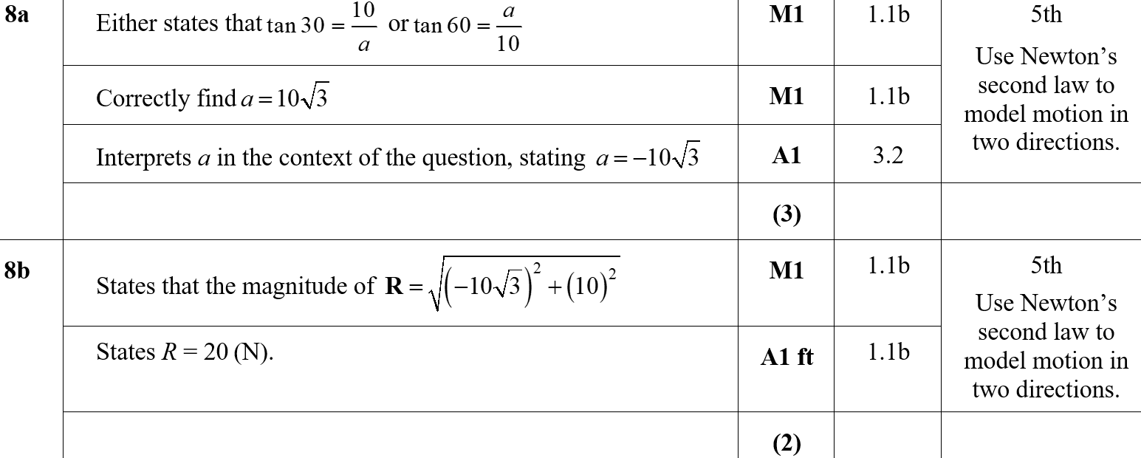
Practice F
A
B
B notes

Slide 11
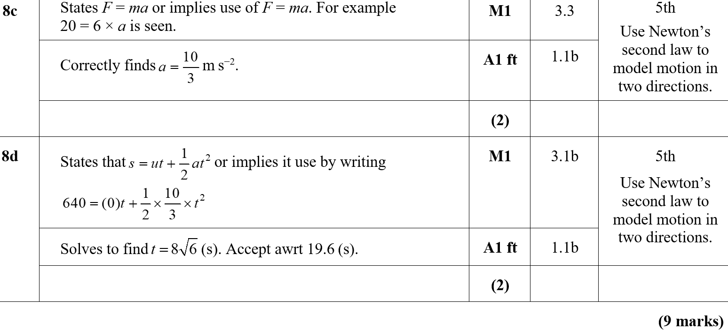
Practice F
C
D
C notes
D notes

Slide 12
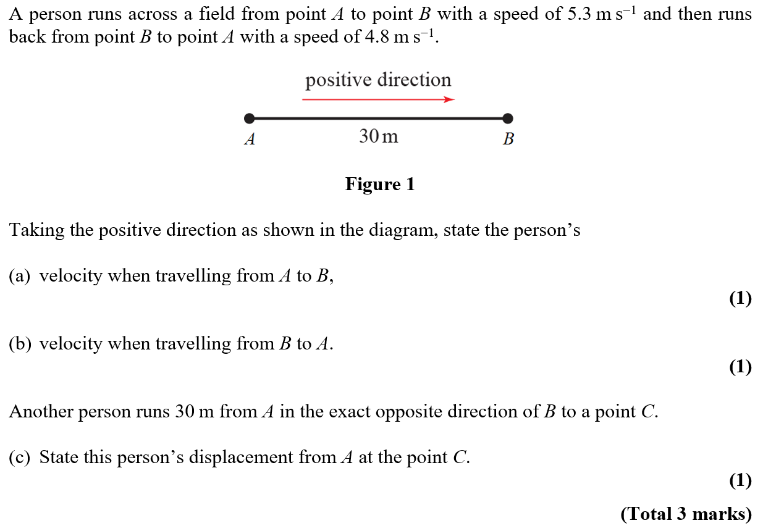
Practice G

Slide 13
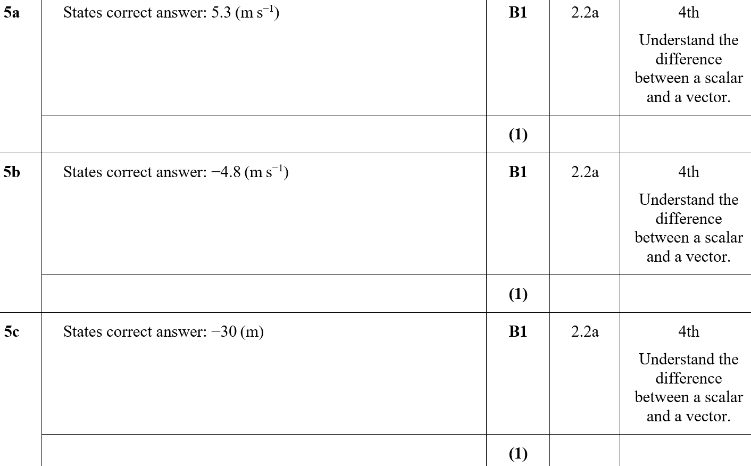
Practice G
A
B
C

Slide 14
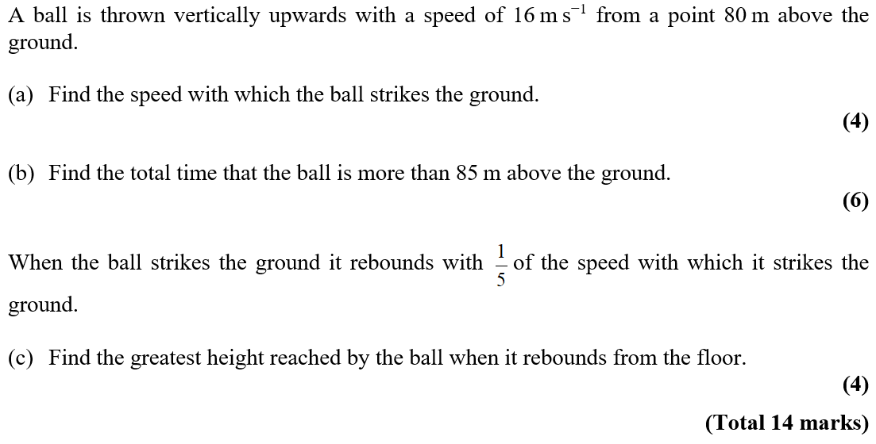
Practice I

Slide 15
Practice I
A

Slide 16
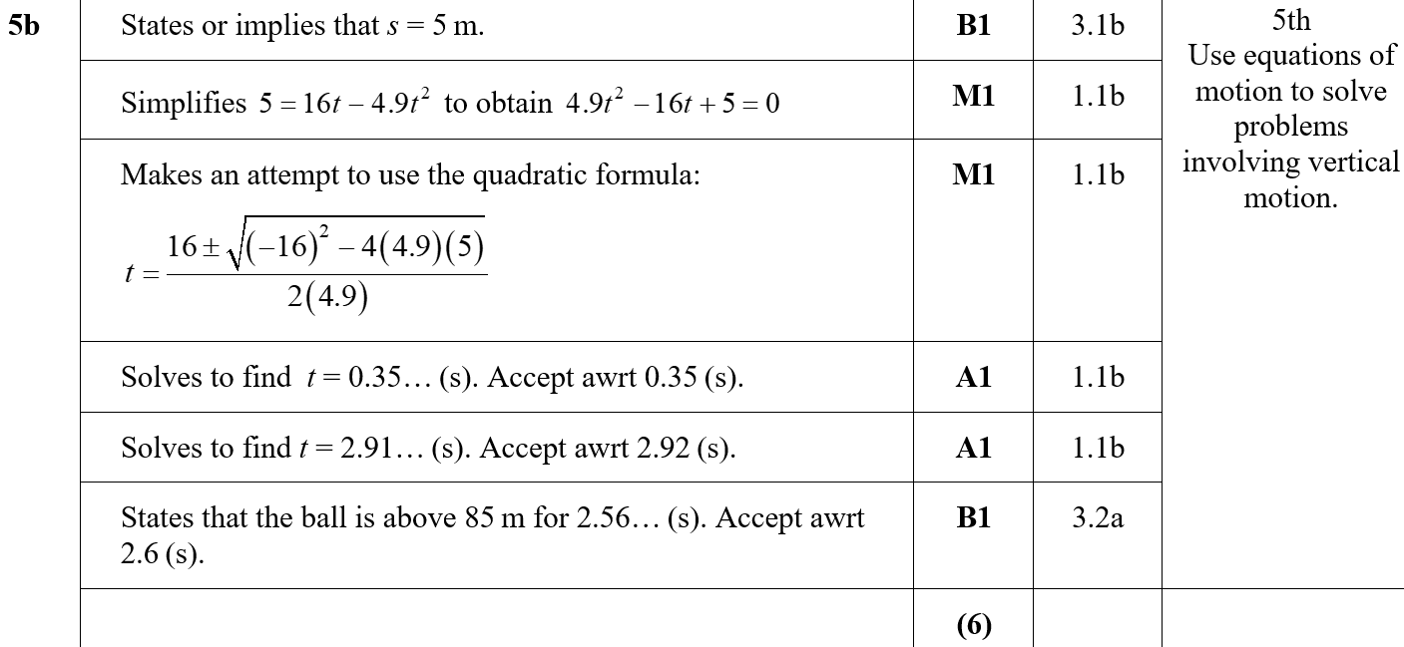
Practice I
B

Slide 17
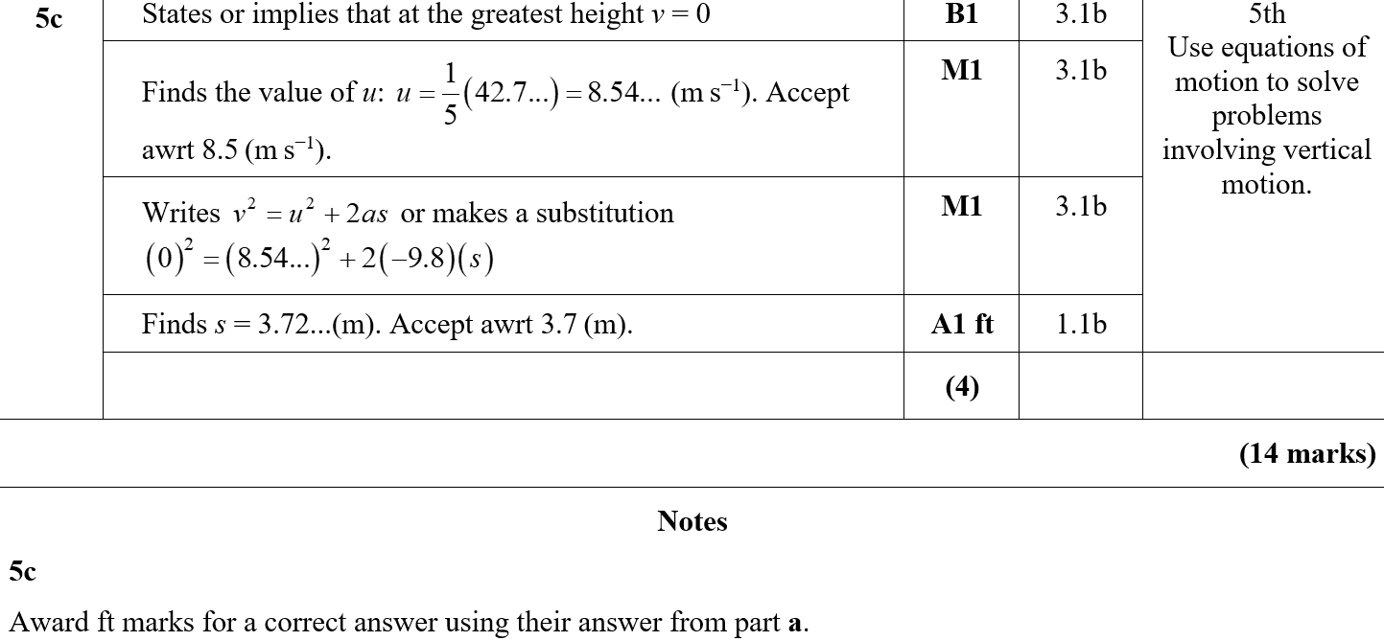
Practice I
C
C notes

Slide 18
Practice I

Slide 19
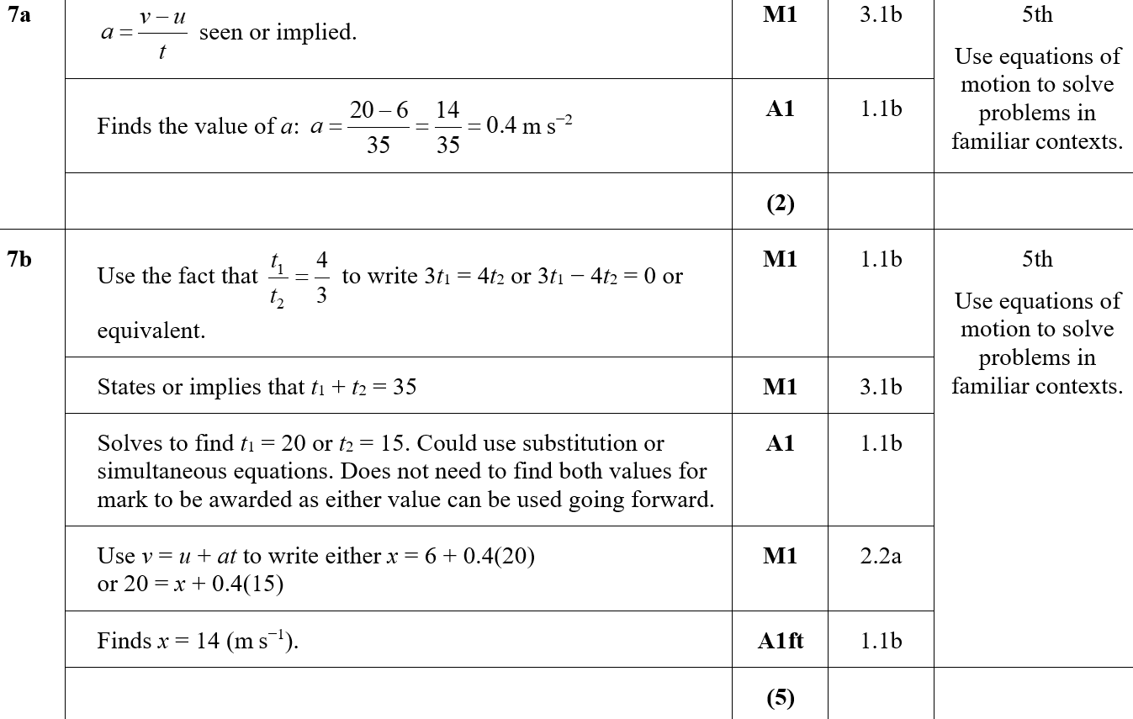
Practice I
A
B

Slide 20
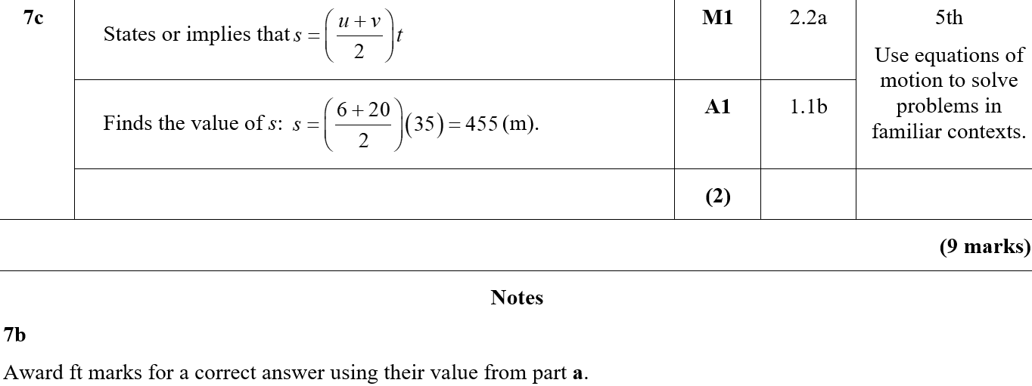
Practice I
C
B notes

Slide 21
SAM

Slide 22
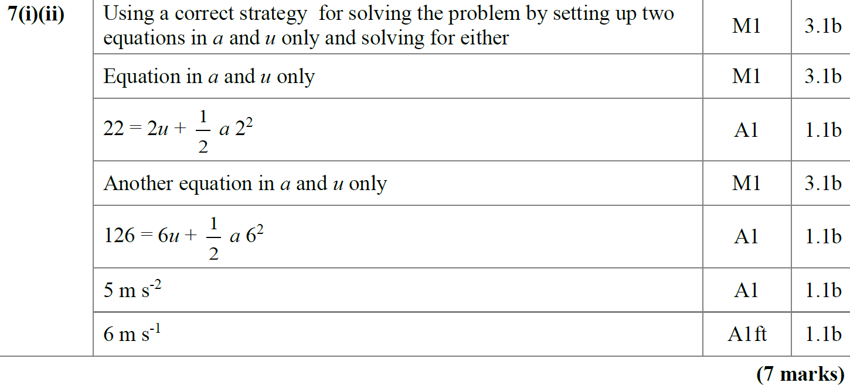
SAM
A

Slide 23
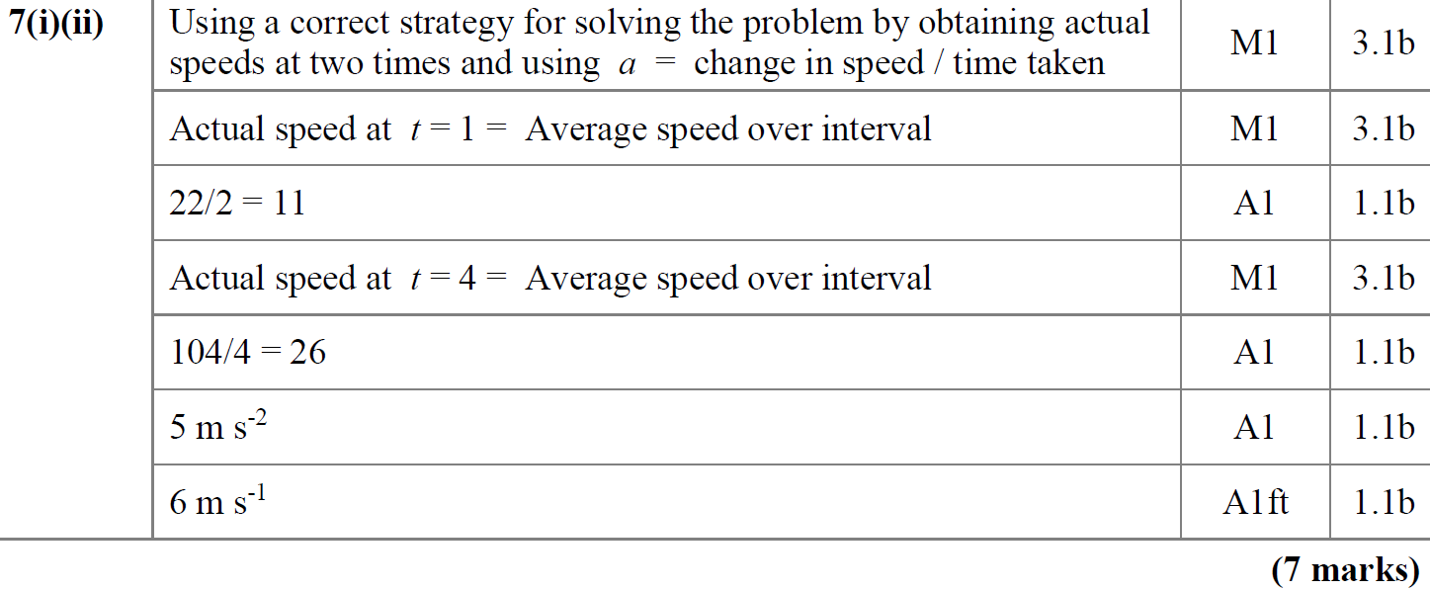
SAM
A Alternative

Slide 24
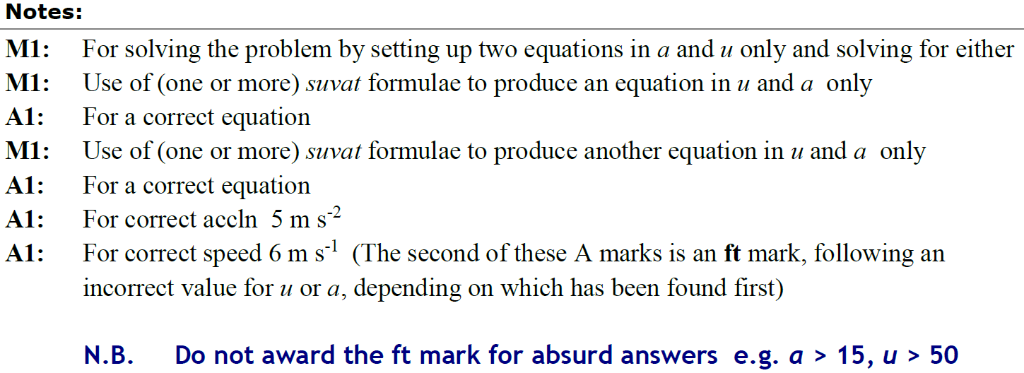
SAM
A notes

Slide 25
SAM
A Alternative notes

Slide 26
2018

Slide 27
2018
A
A (SF)

Slide 28
2018
A notes

Slide 29
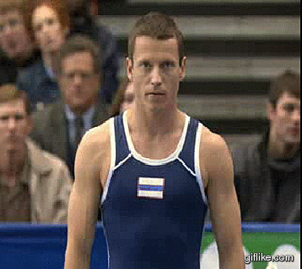
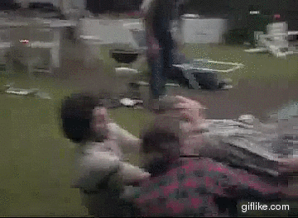
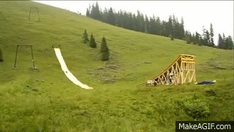
New Spec Q’s
Old Spec Kinematics (SUVAT)
Jan 2006
May 2011
June 2006
Jan 2012
Jan 2007
May 2012
Jan 2008
May 2013
May 2008
June 2015
May 2009
June 2017
May 2010
June 2018
Jan 2011

Slide 30
Jan 2006

Slide 31
Jan 2006
A
B

Slide 32
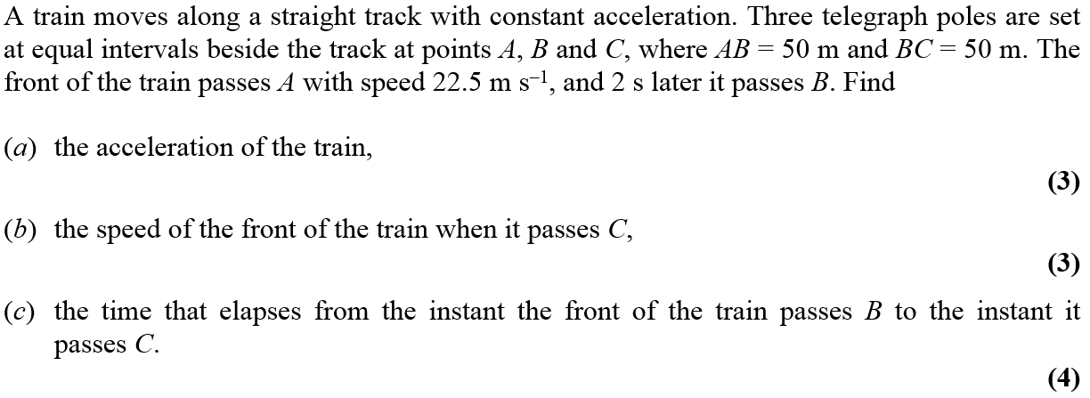
June 2006

Slide 33
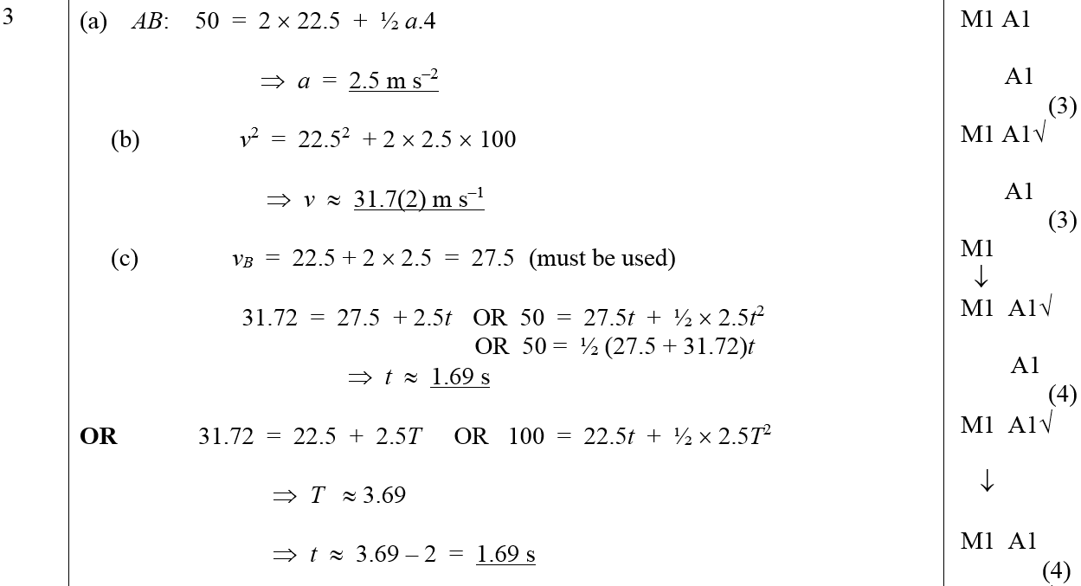
June 2006
A
B
C
Alternative C (i)
Alternative C (ii)

Slide 34
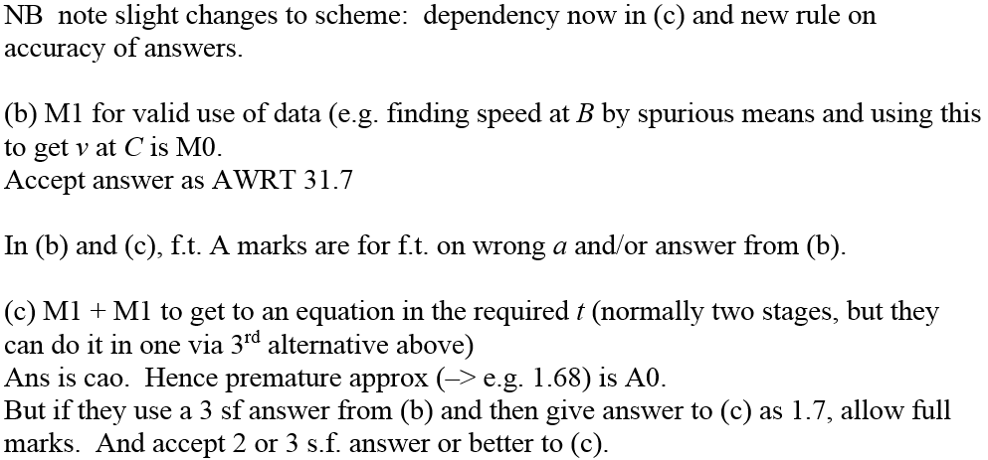
June 2006
B & C Notes

Slide 35
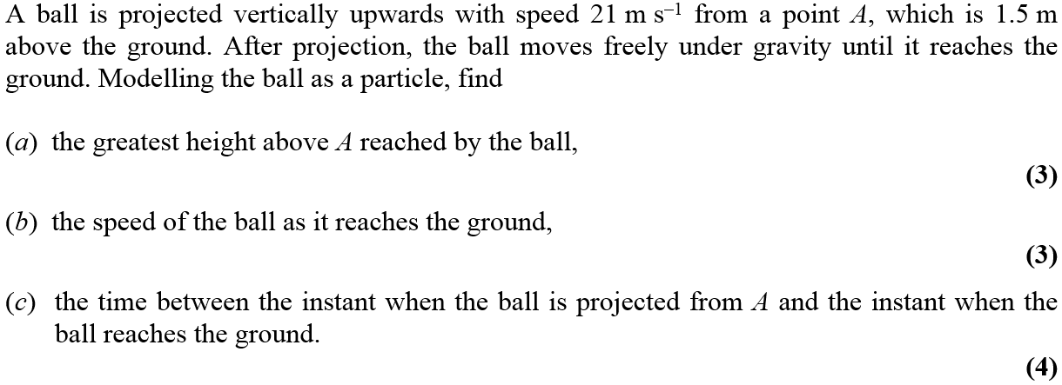
Jan 2007

Slide 36
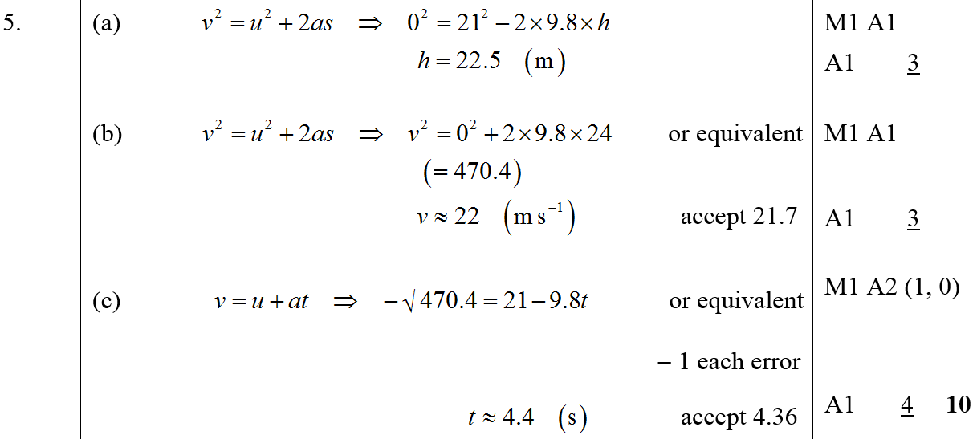
Jan 2007
A
B
C

Slide 37
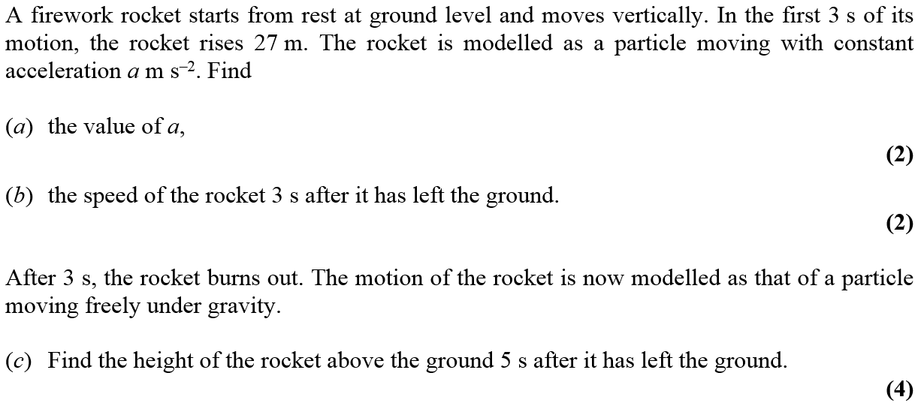
Jan 2008

Slide 38
Jan 2008
A
B
C

Slide 39
May 2008

Slide 40
May 2008
A
B

Slide 41
May 2009

Slide 42
May 2009
A

Slide 43
May 2010

Slide 44
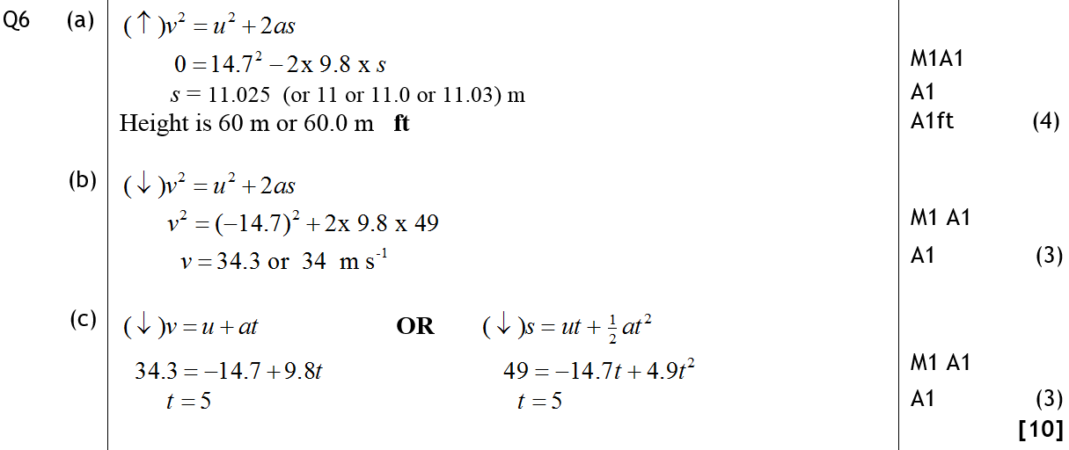
May 2010
A
B
C

Slide 45
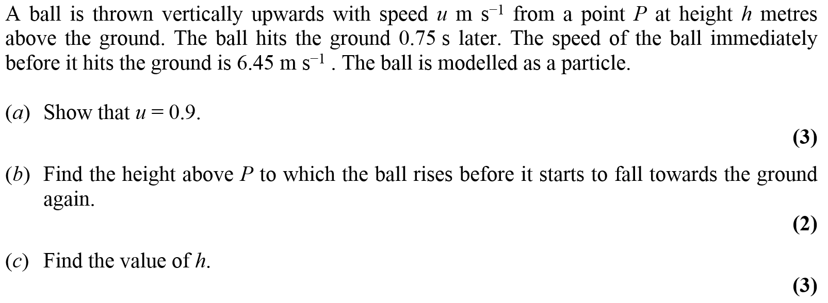
Jan 2011

Slide 46
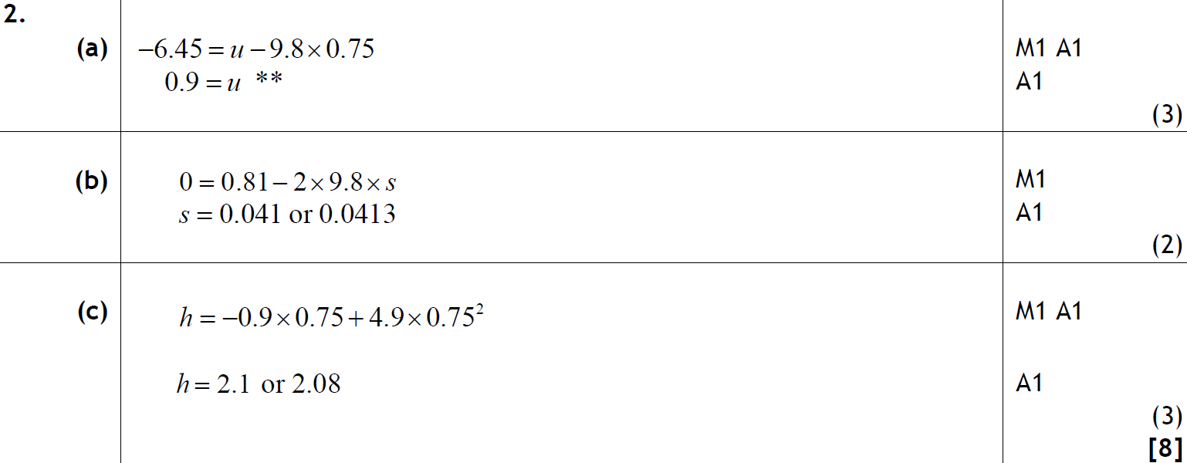
Jan 2011
A
B
C

Slide 47
May 2011

Slide 48
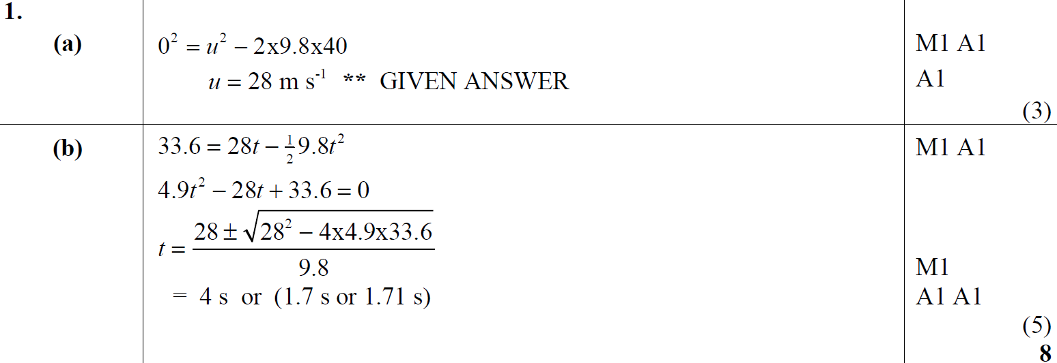
May 2011
A
B

Slide 49
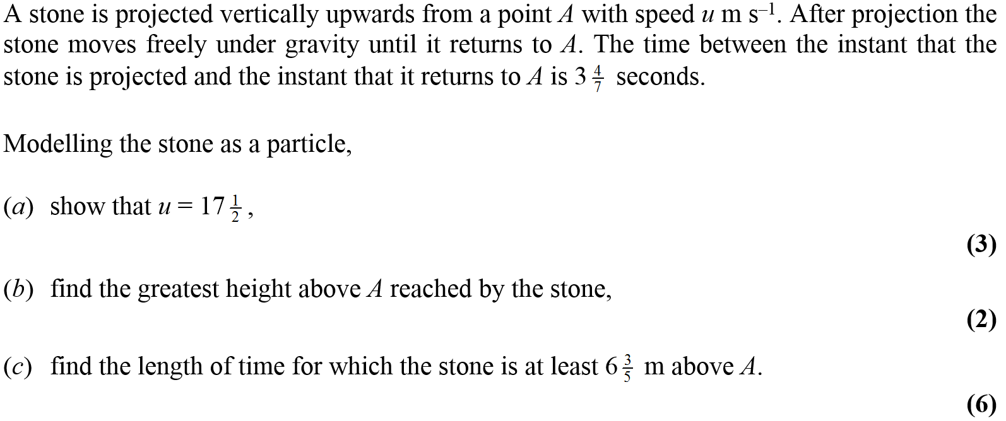
Jan 2012

Slide 50
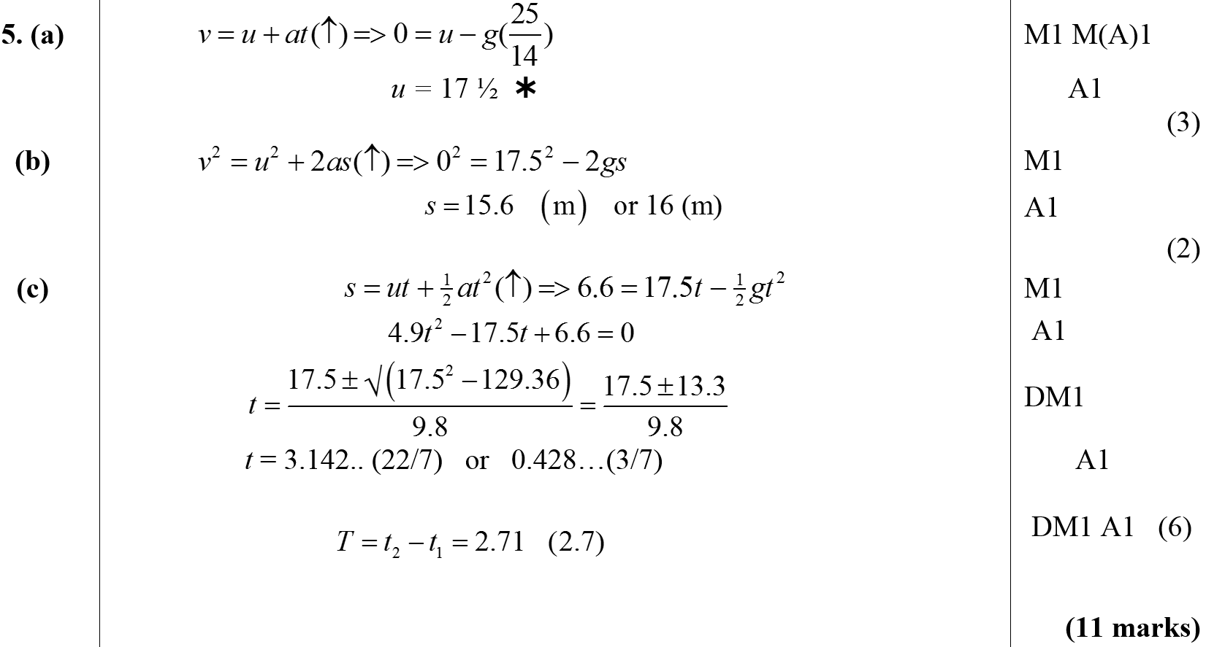
Jan 2012
A
B
C

Slide 51
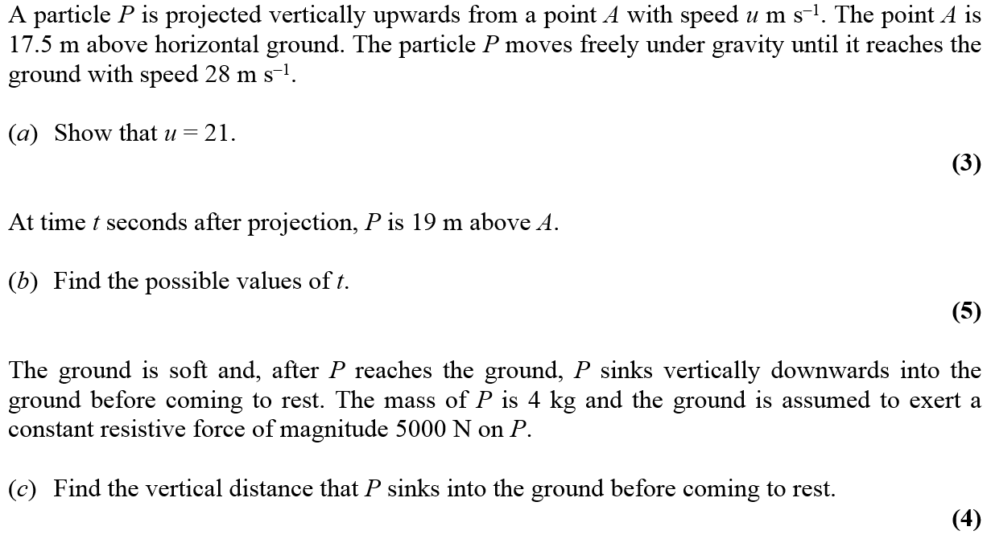
May 2012

Slide 52
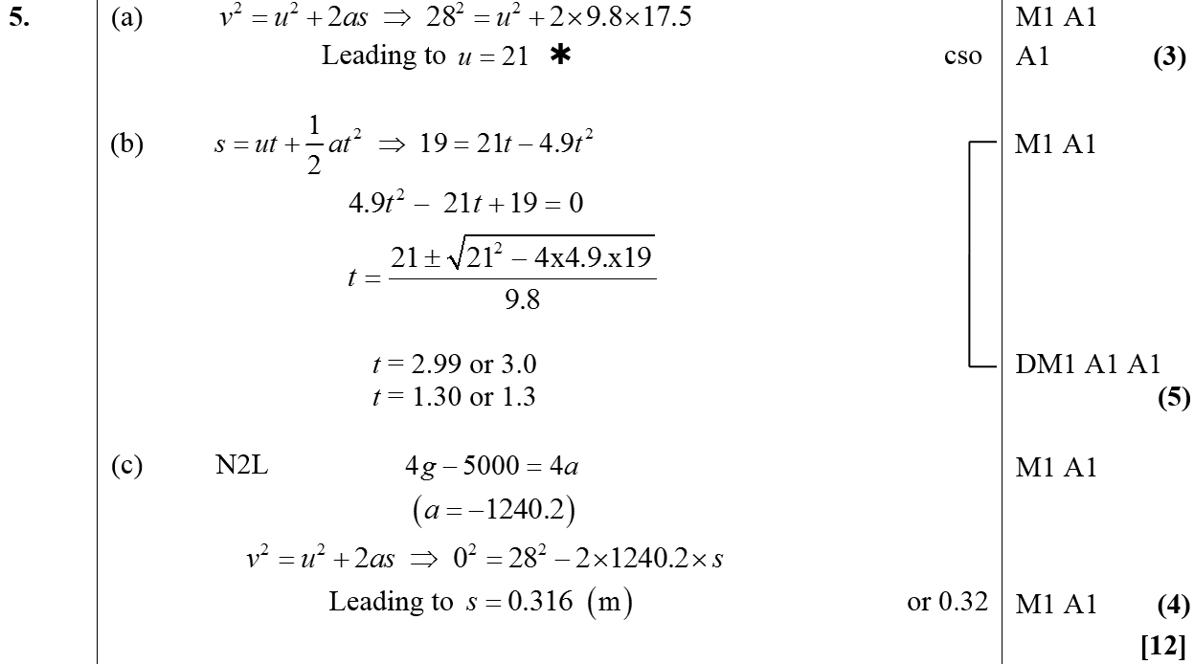
May 2012
A
B
C

Slide 53
May 2013

Slide 54
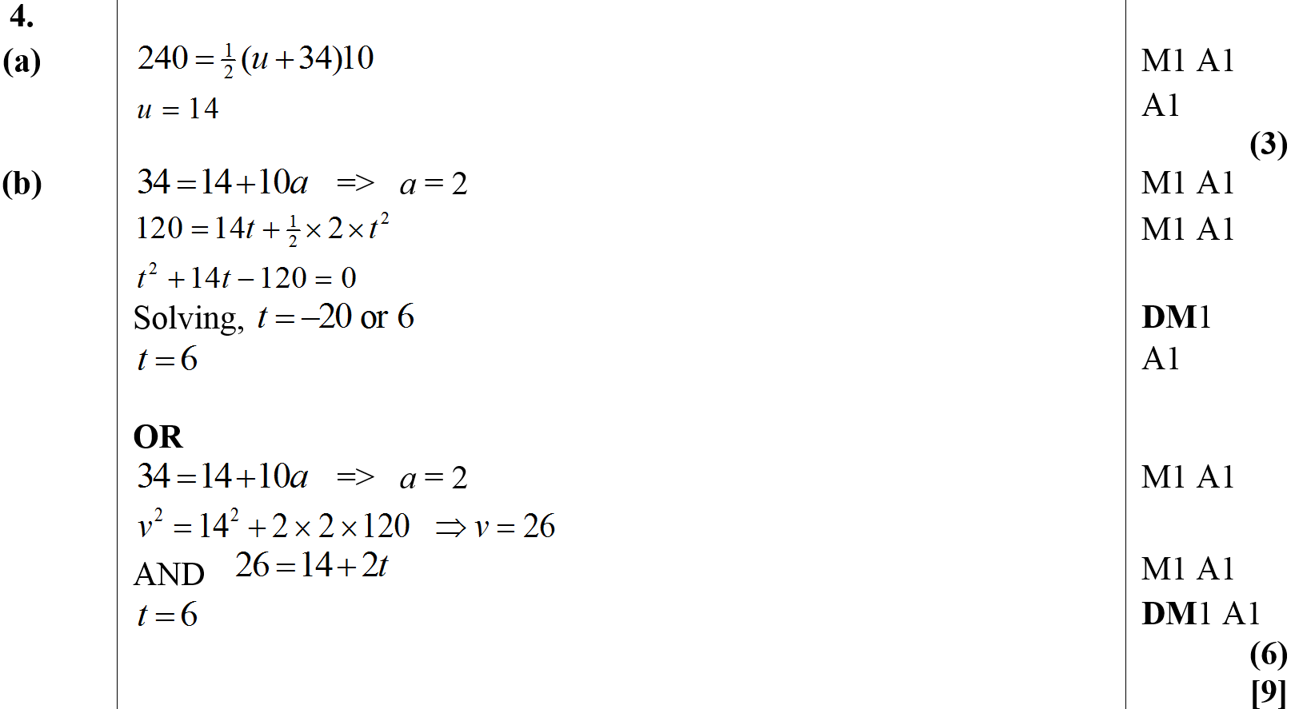
May 2013
A
B
Alternative B

Slide 55
June 2015

Slide 56
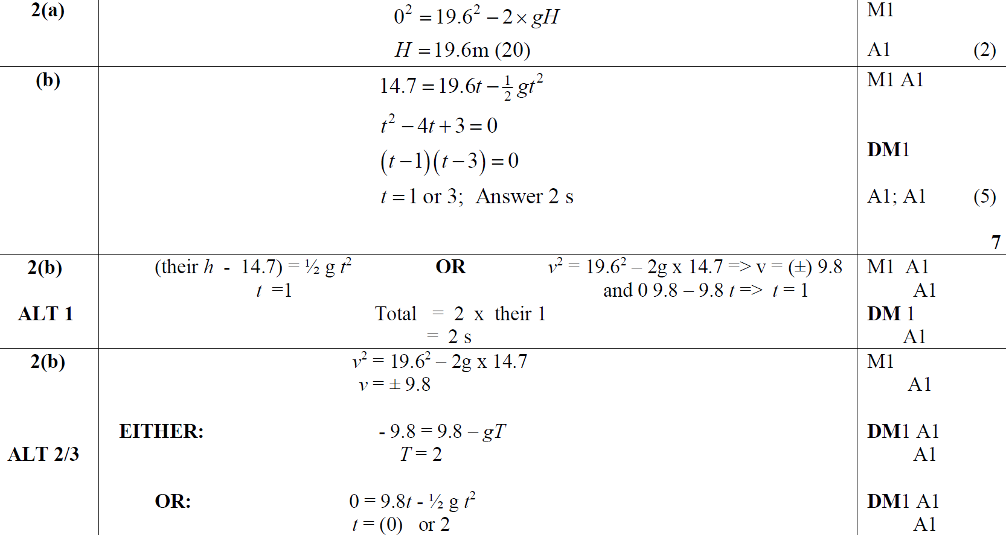
June 2015
A
B
B Alternative 1
B Alternative 2 & 3

Slide 57
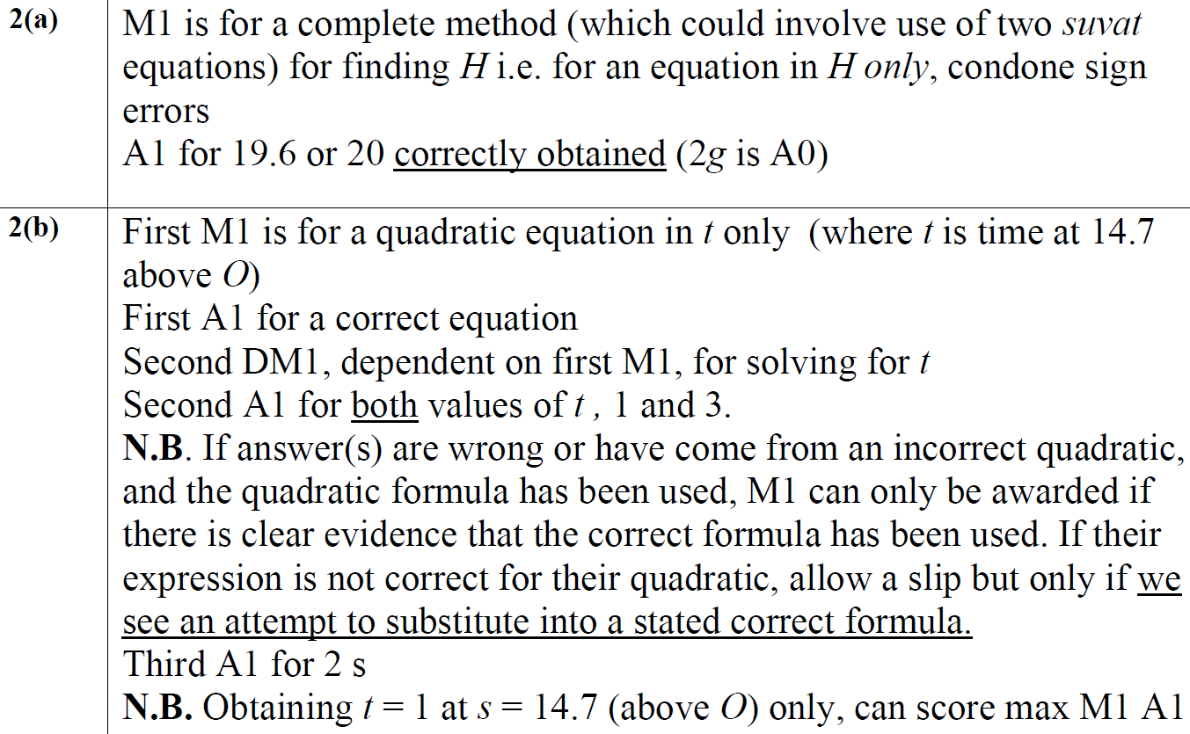
June 2015
A Notes
B Notes

Slide 58
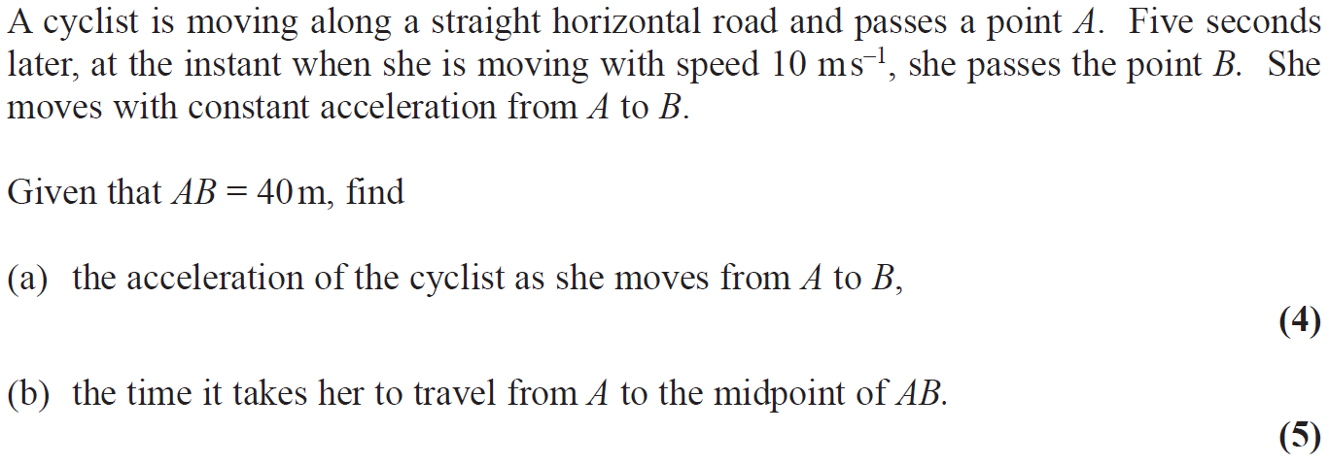
June 2017

Slide 59
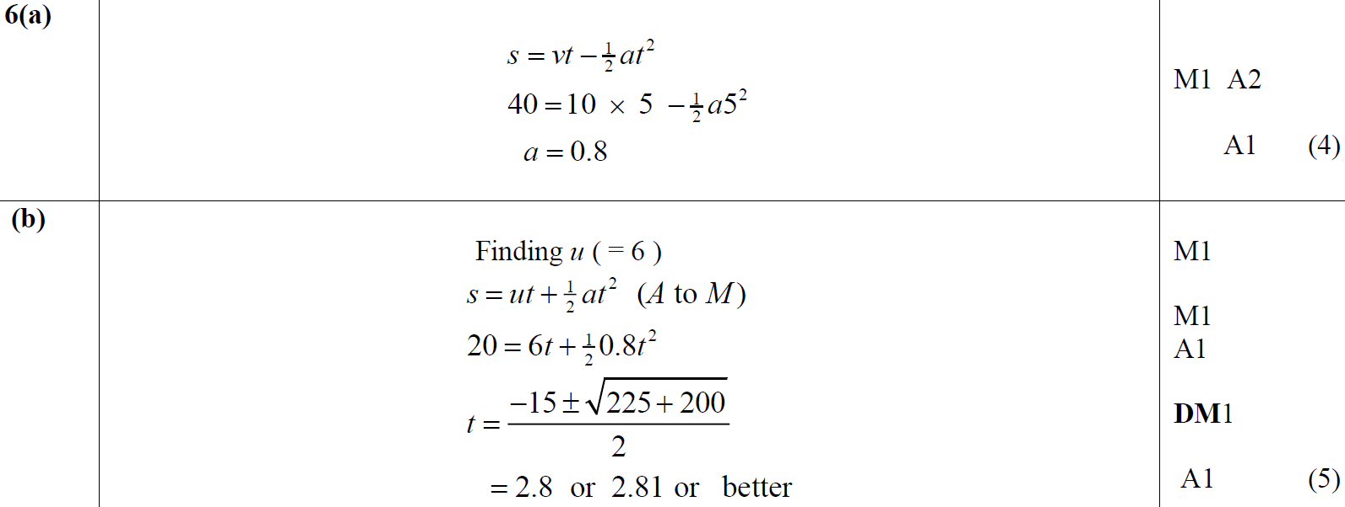
June 2017
A
B

Slide 60
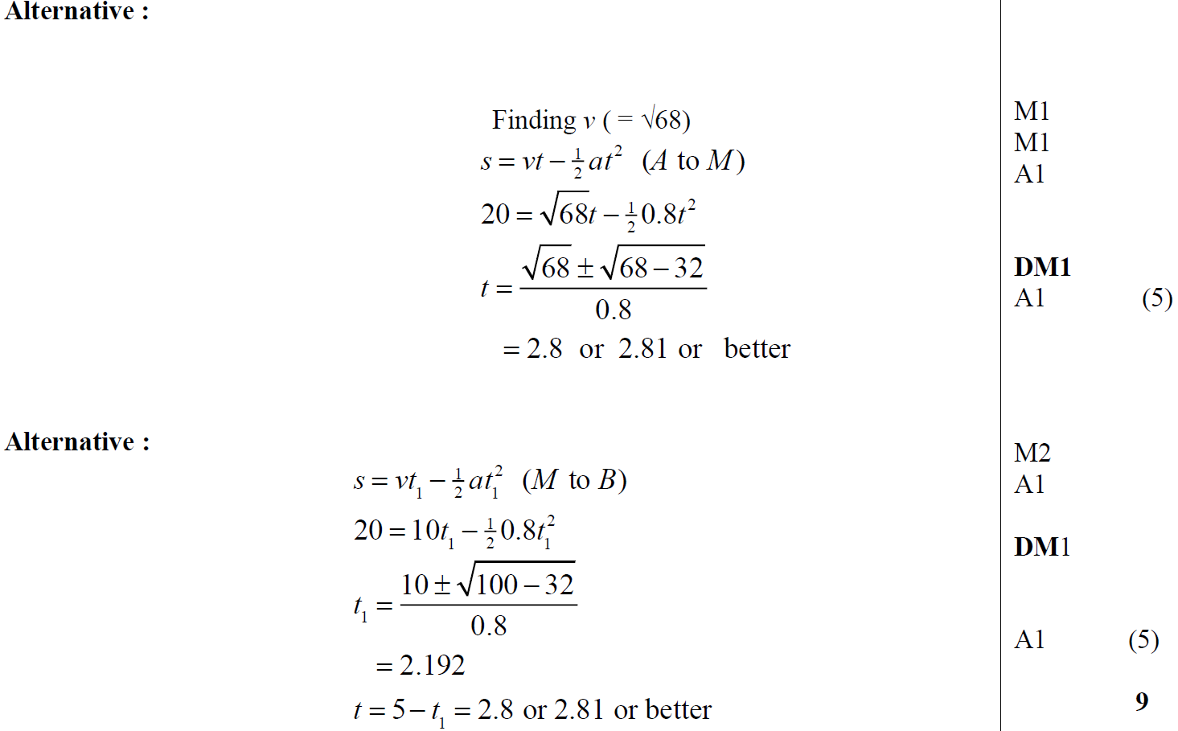
June 2017
B Alternative 1
B Alternative 2

Slide 61
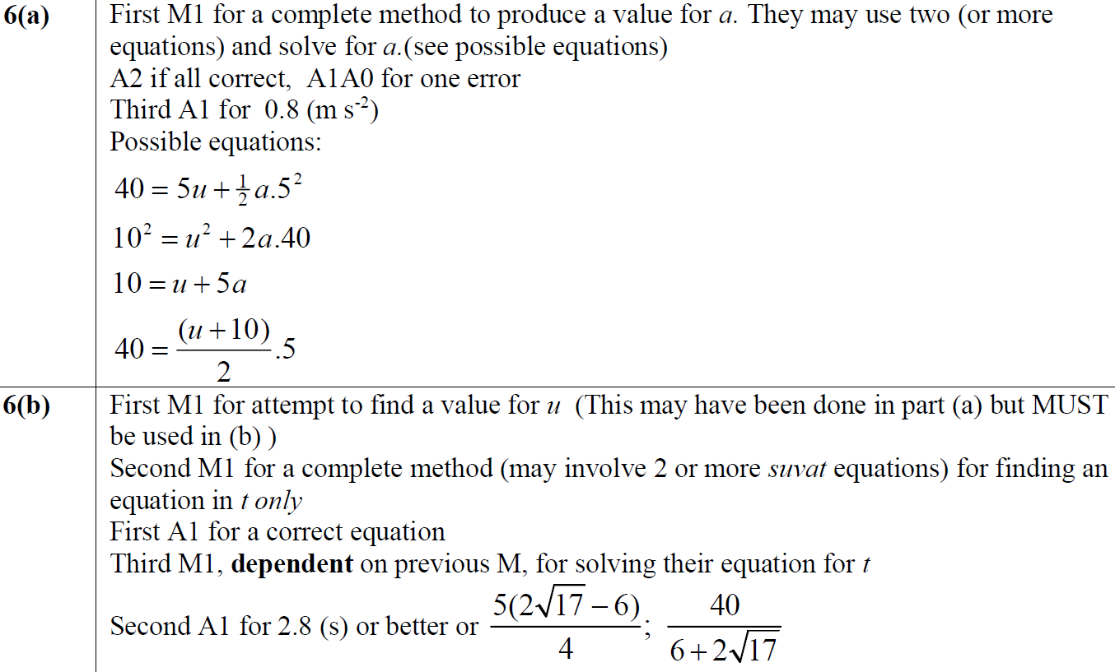
June 2017
A Notes
B Notes

Slide 62
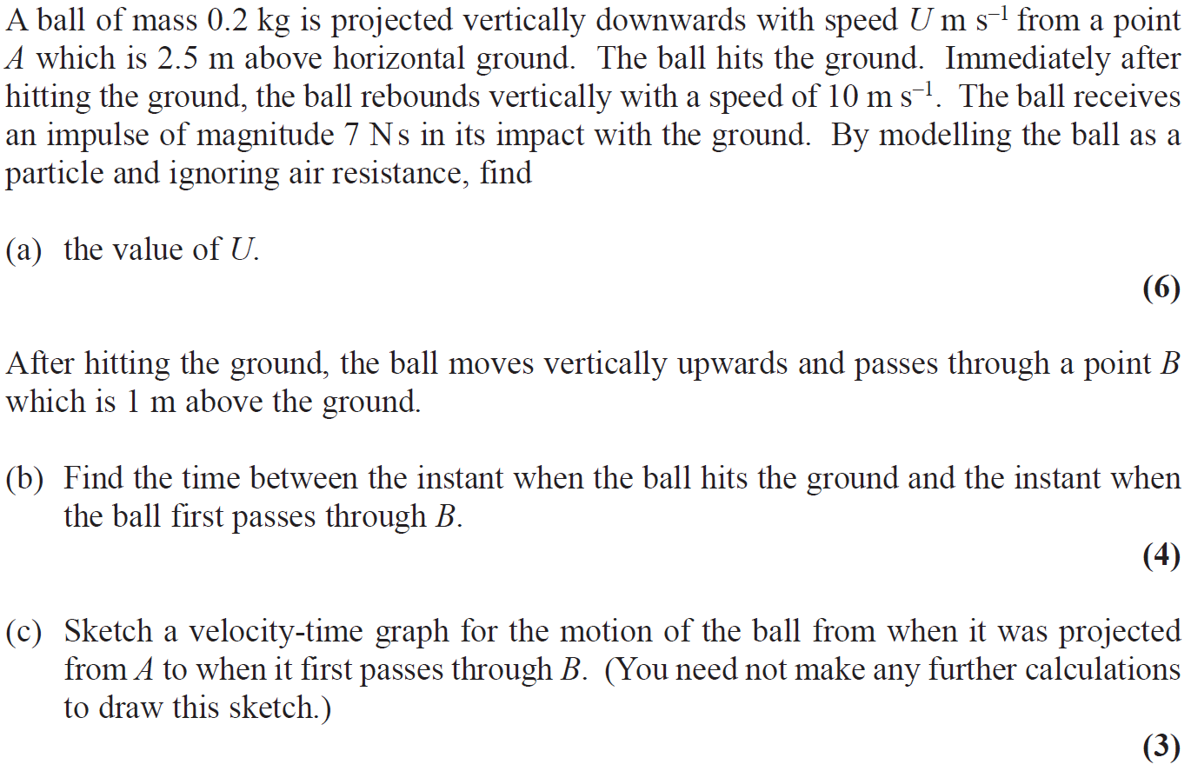
June 2018

Slide 63
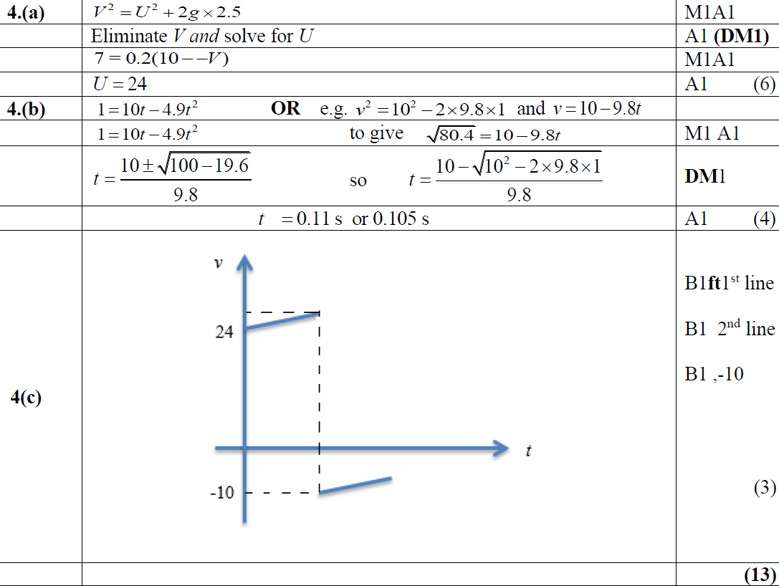
June 2018
A
B
C

Slide 64
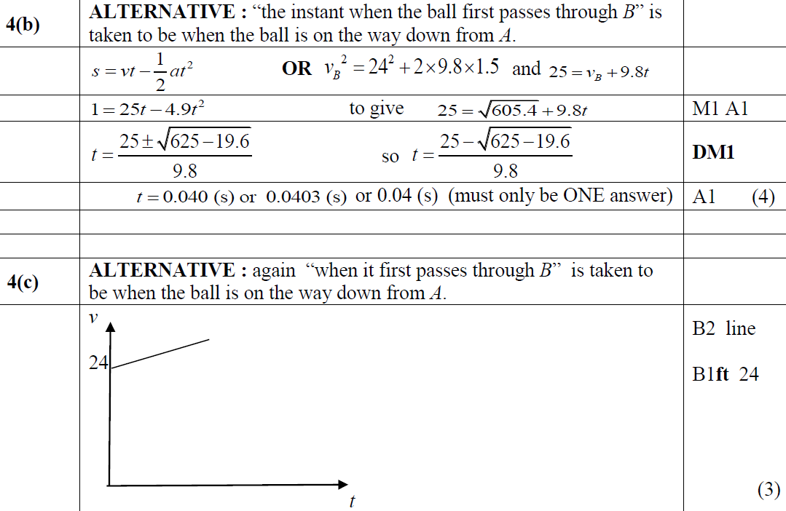
June 2018
B Alternative
C Alternative

Slide 65
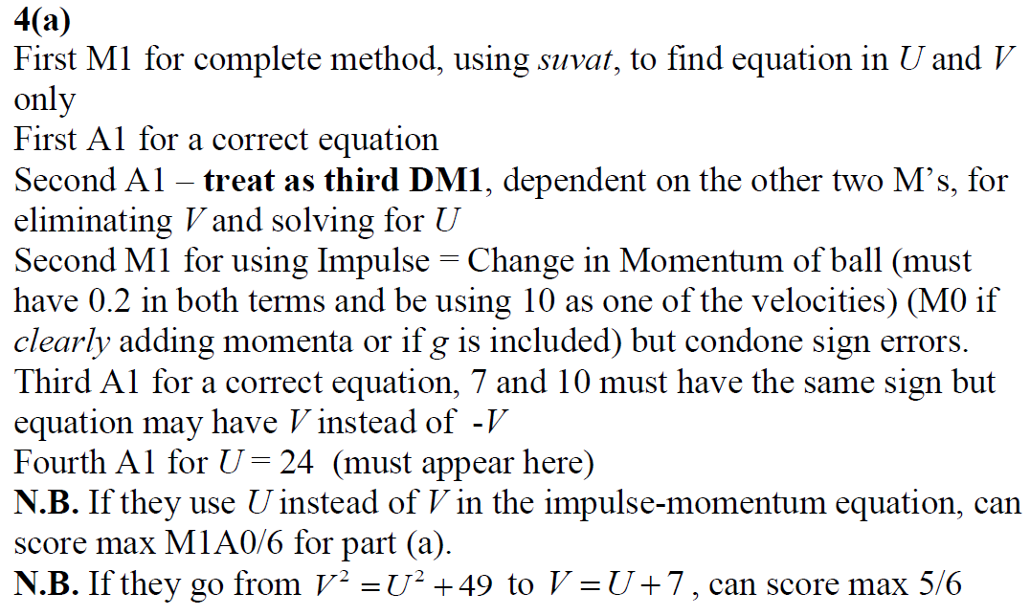
June 2018
A Notes

Slide 66
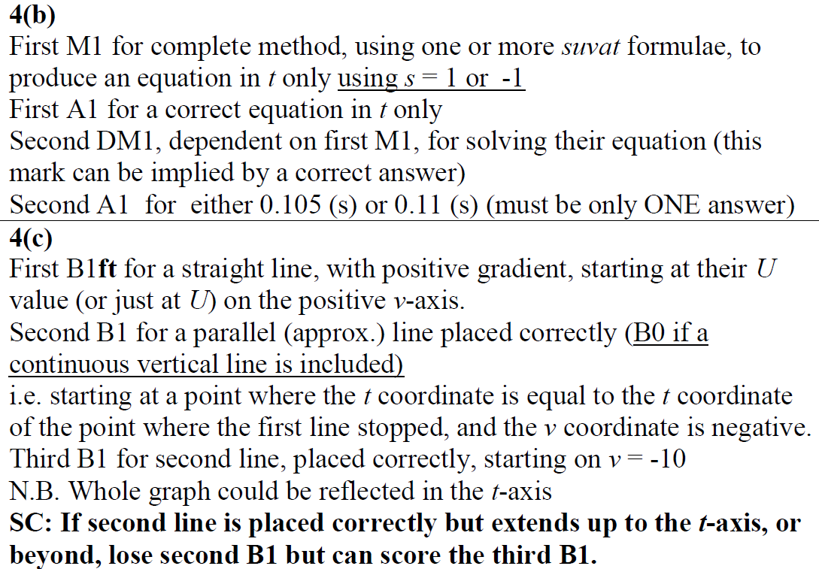
June 2018
B Notes
C Notes

Slide 67
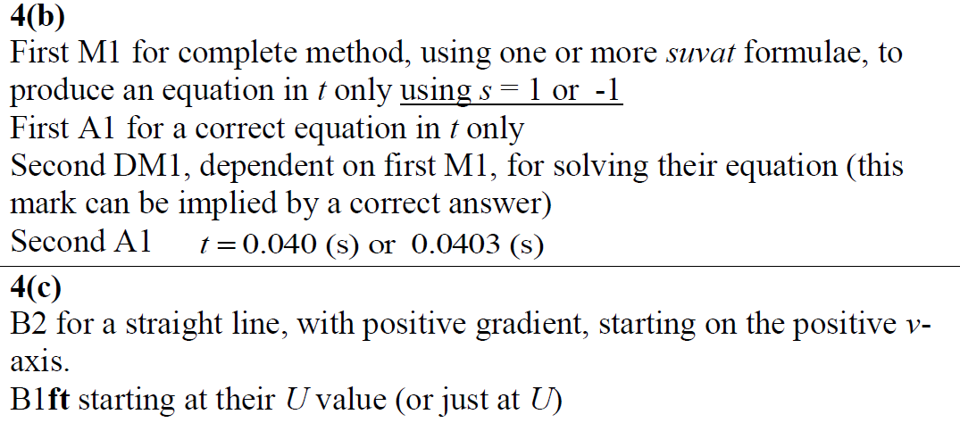
June 2018
B Further Notes
C Further Notes

