Slide 1
Old Spec Q’s
Kinematics (connected particles)
Practice G
Practice J
SAM
2018

Slide 2
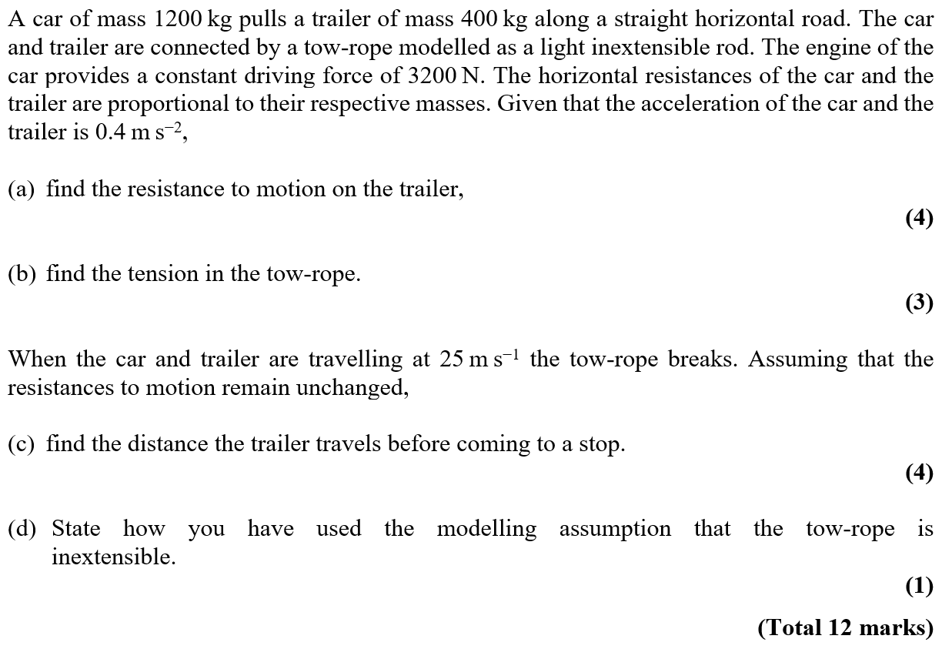
Practice G

Slide 3
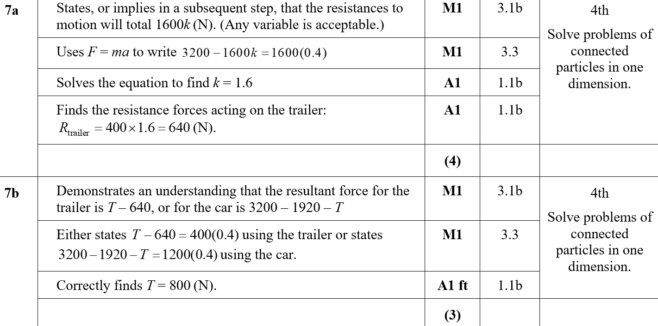
Practice G
A
B
B notes

Slide 4
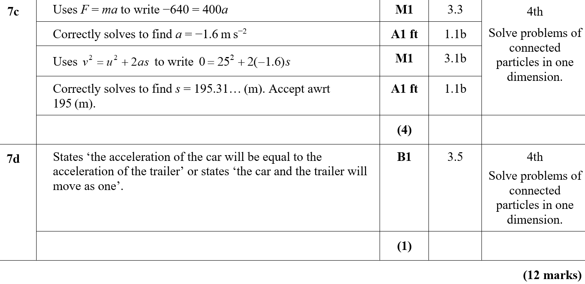
Practice G
C
D
C notes

Slide 5
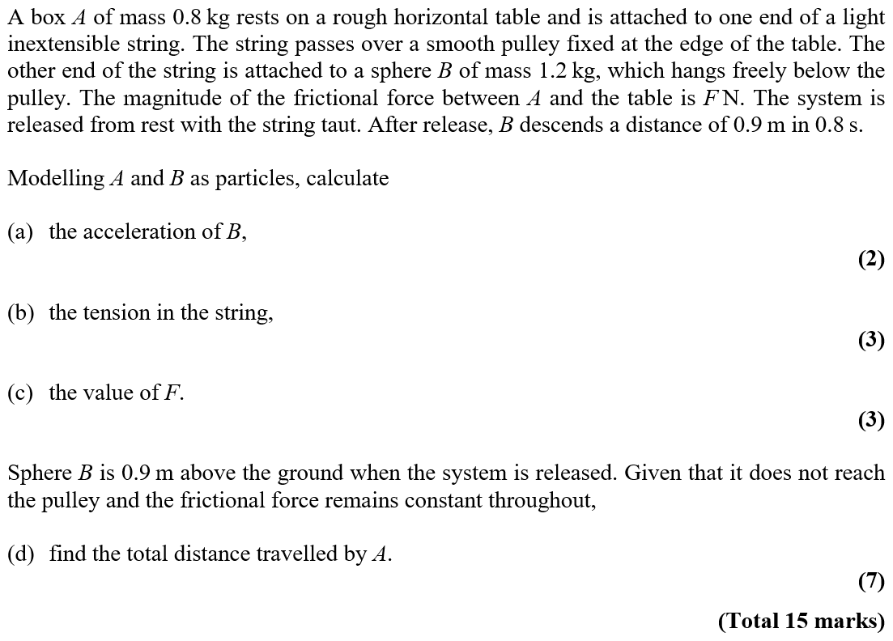
Practice J

Slide 6
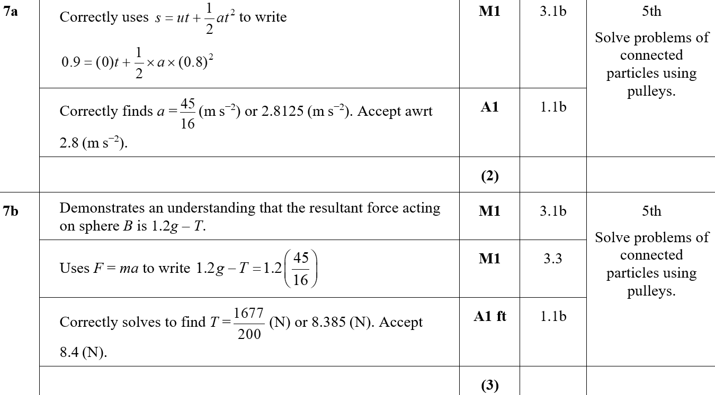
Practice J
A
B
B notes

Slide 7
Practice J
C
C notes

Slide 8
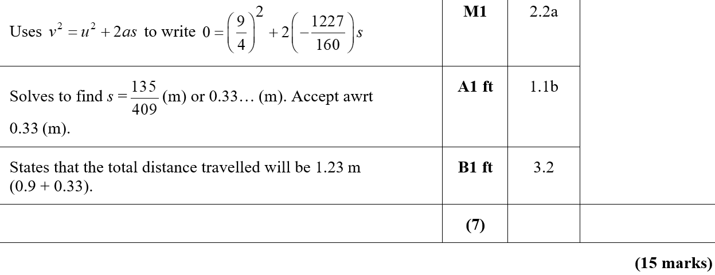
Practice J
D
D notes

Slide 9
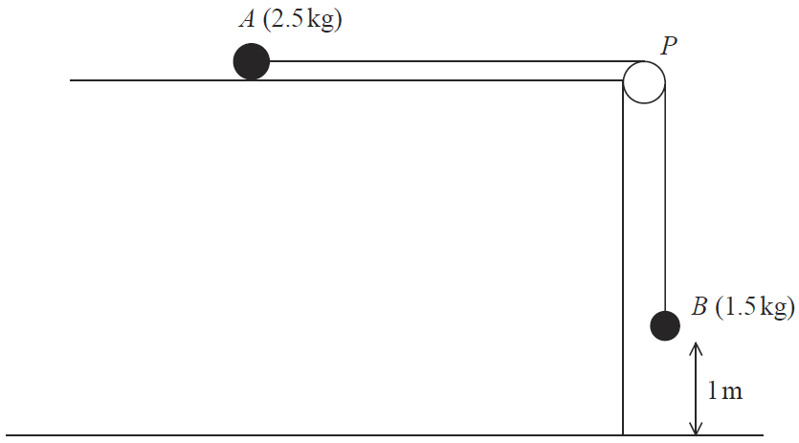
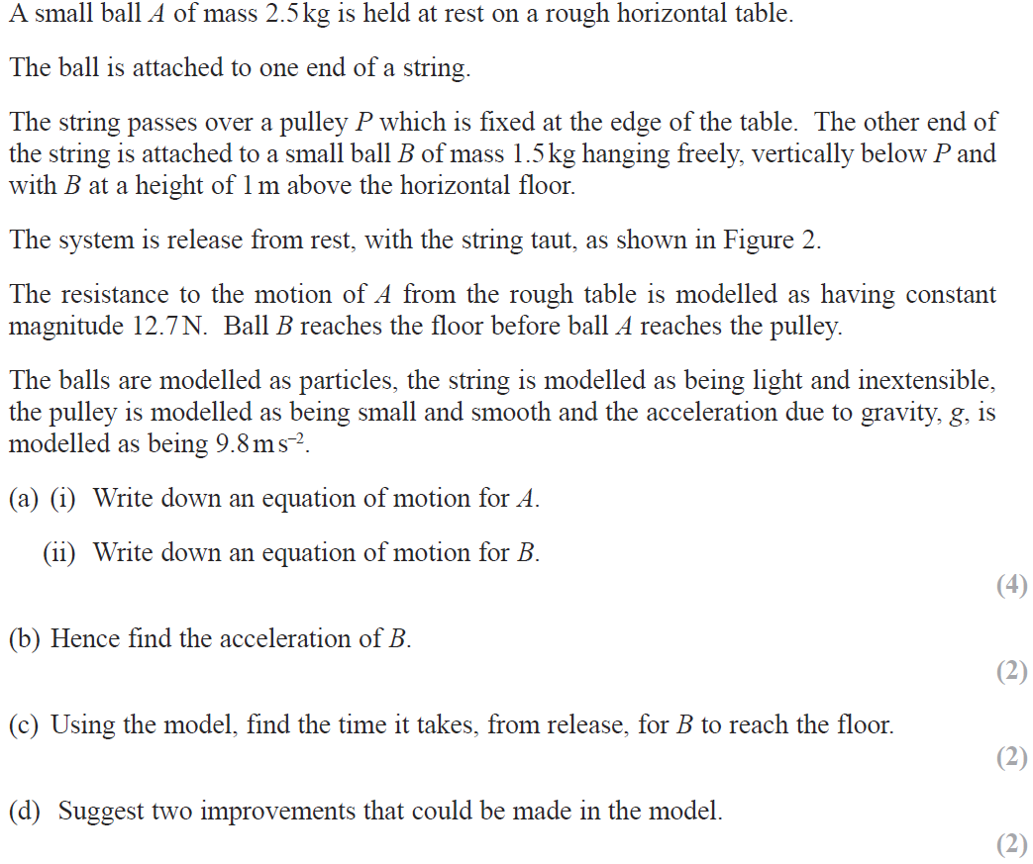
SAM

Slide 10
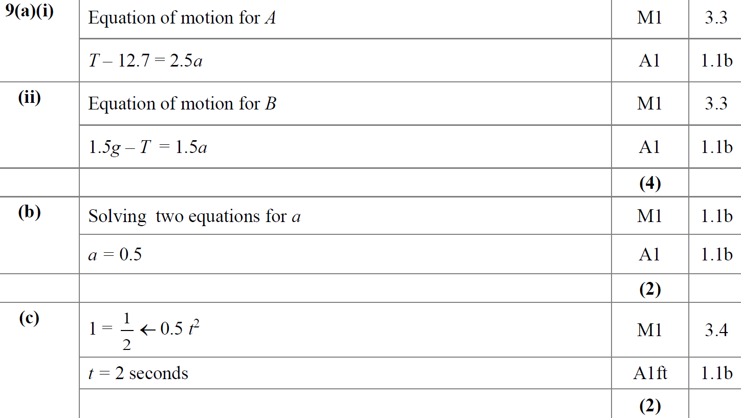
SAM
A (i)
A (ii)
B
C

Slide 11
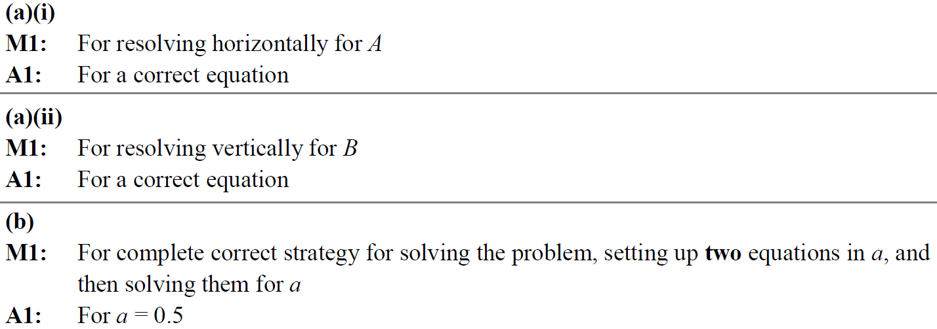
SAM
D
A (i) notes
A (ii) notes
B notes

Slide 12
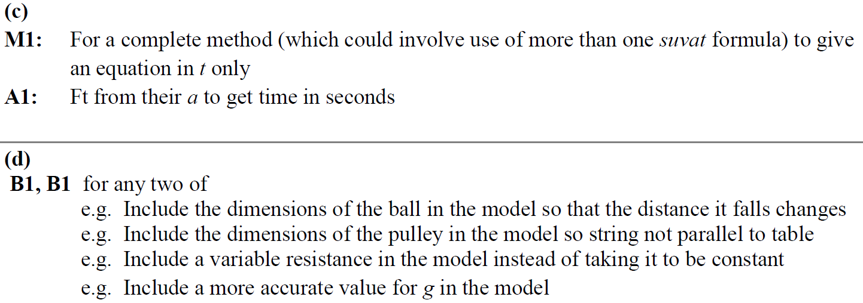
SAM
C notes
D notes

Slide 13
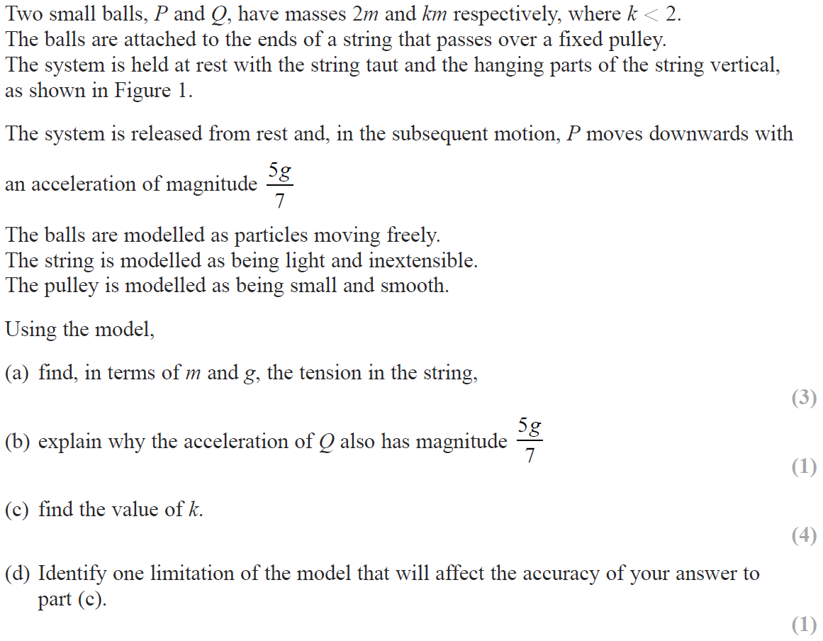
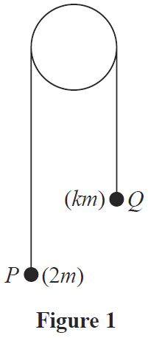
2018

Slide 14
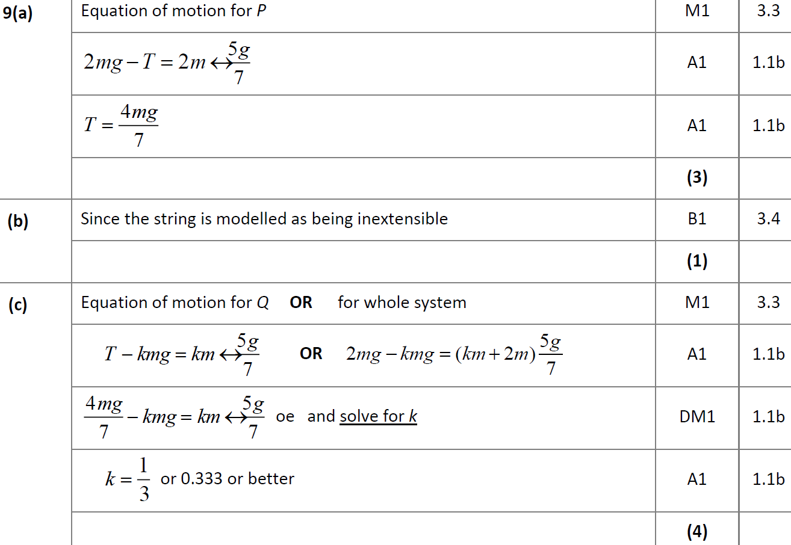
2018
A
B
C

Slide 15
2018
D
A (SF)
B (SF)

Slide 16
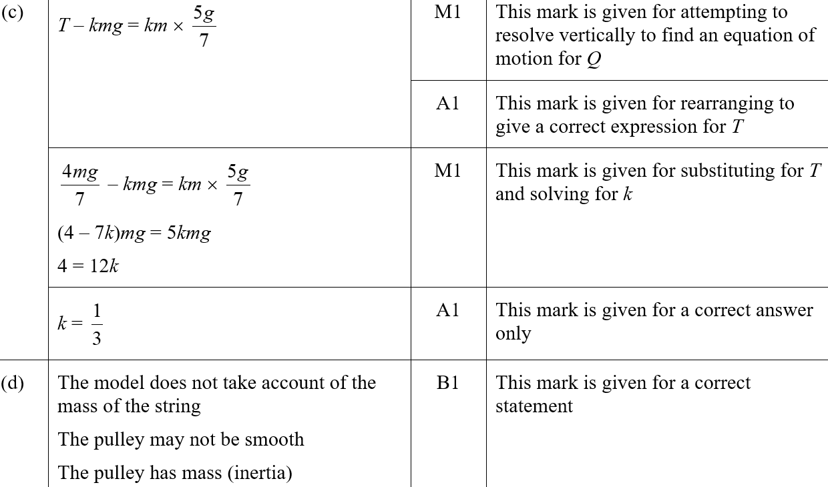
2018
C (SF)
D (SF)

Slide 17
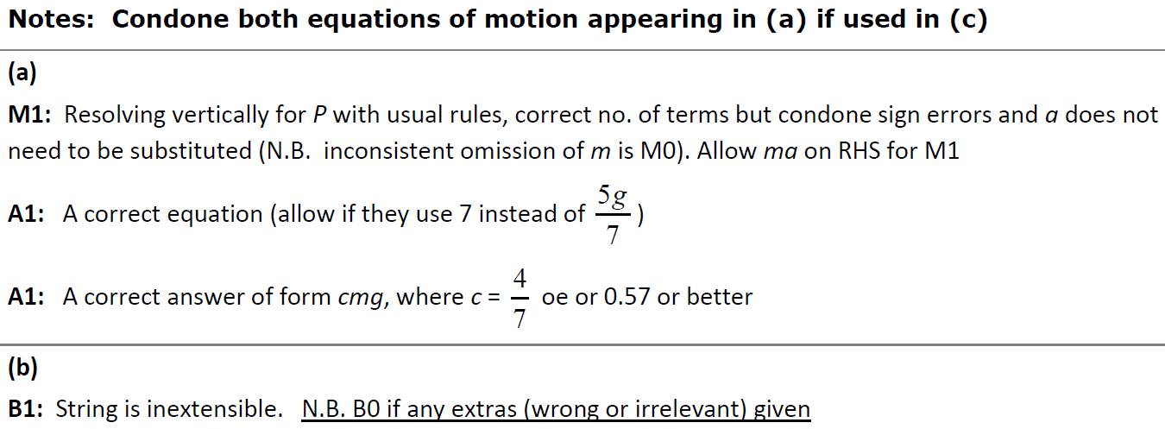
2018
A notes
B notes

Slide 18
2018
C notes

Slide 19
2018
D notes

Slide 20
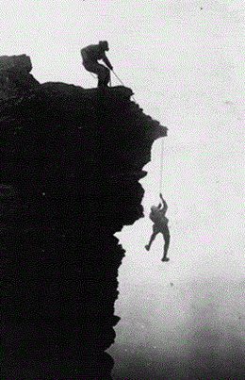
New Spec Q’s
Old Spec Kinematics (connected particles)
June 2006
May 2013 (i)
June 2007
May 2013 (ii)
Jan 2008
June 2014
May 2008
June 2015
May 2009
June 2016 (i)
Jan 2010
June 2016 (ii)
May 2010
June 2017 (i)
Jan 2012
June 2017 (ii)
May 2012
June 2018
Jan 2013

Slide 21
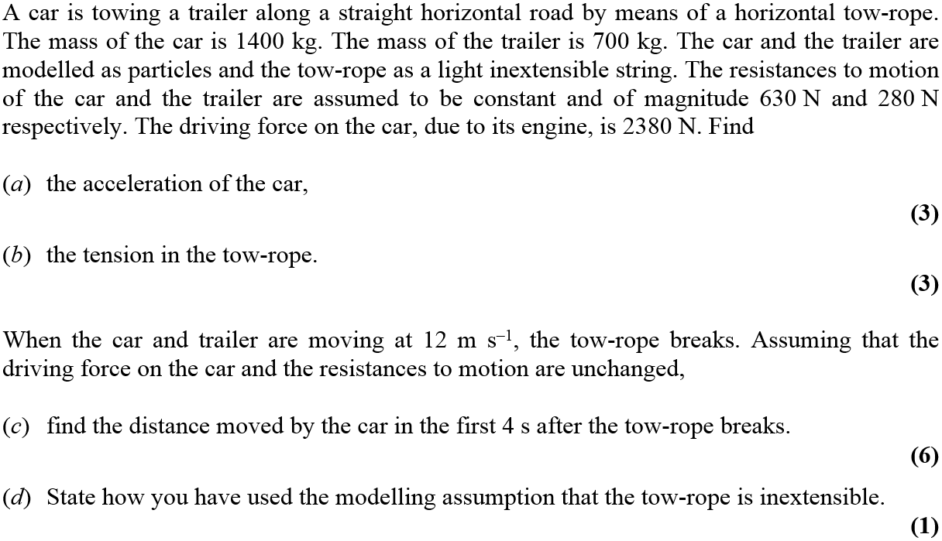
June 2006

Slide 22
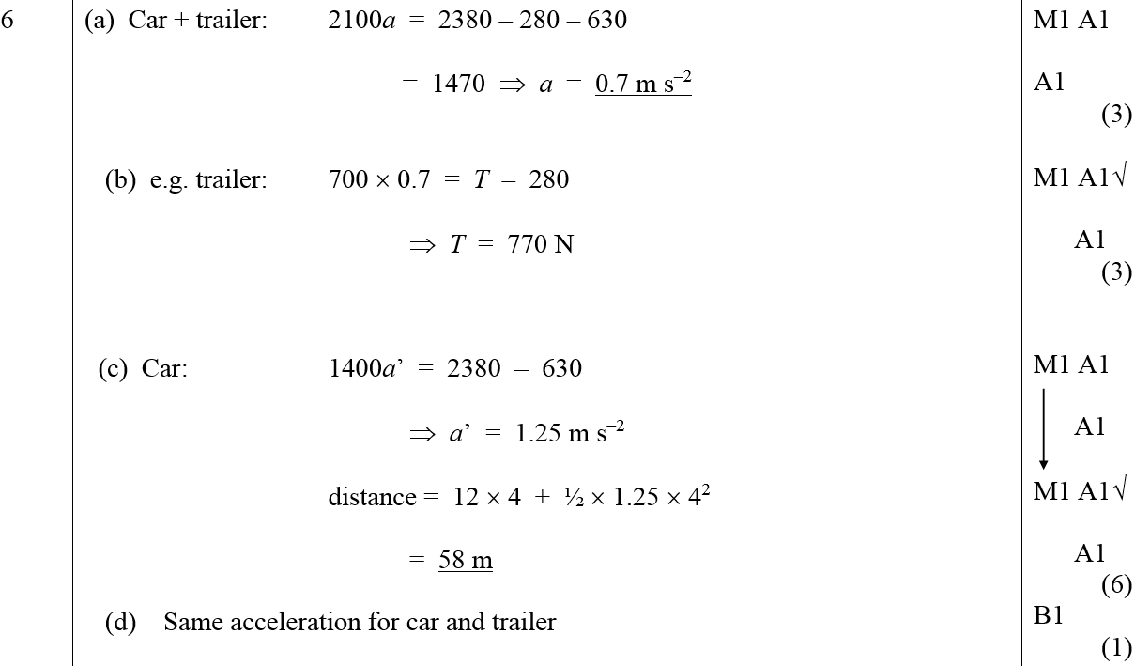
June 2006
A
B
C
D

Slide 23
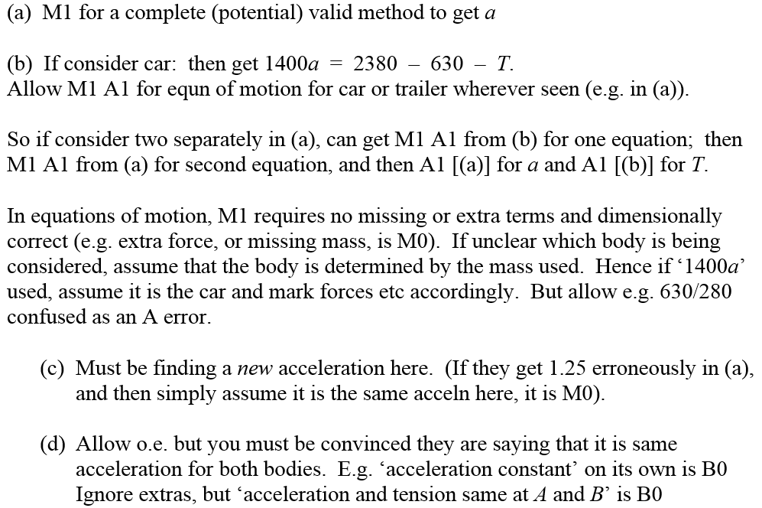
June 2006
A Notes
B Notes
C Notes
D Notes

Slide 24
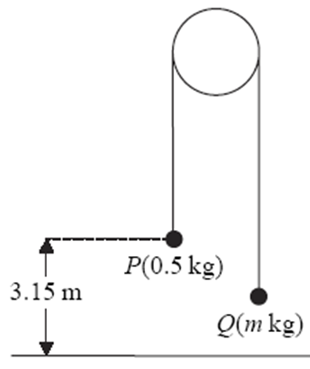
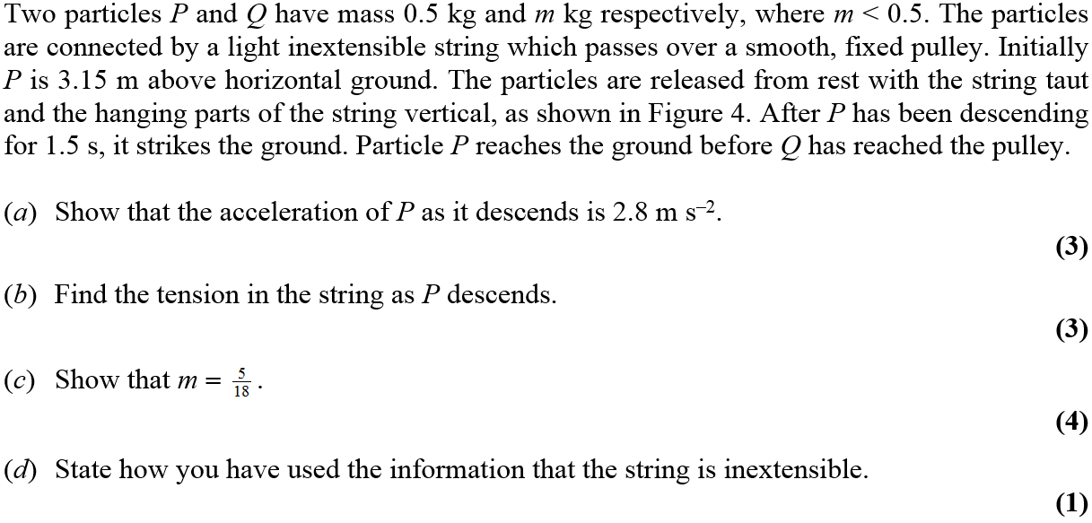
June 2007

Slide 25
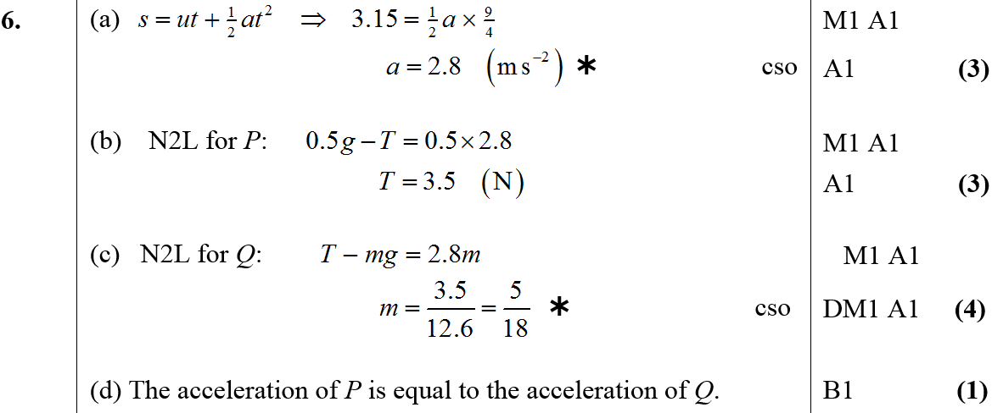
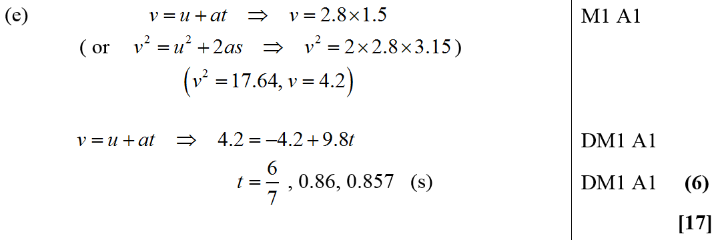
June 2007
A
B
C
D
E

Slide 26
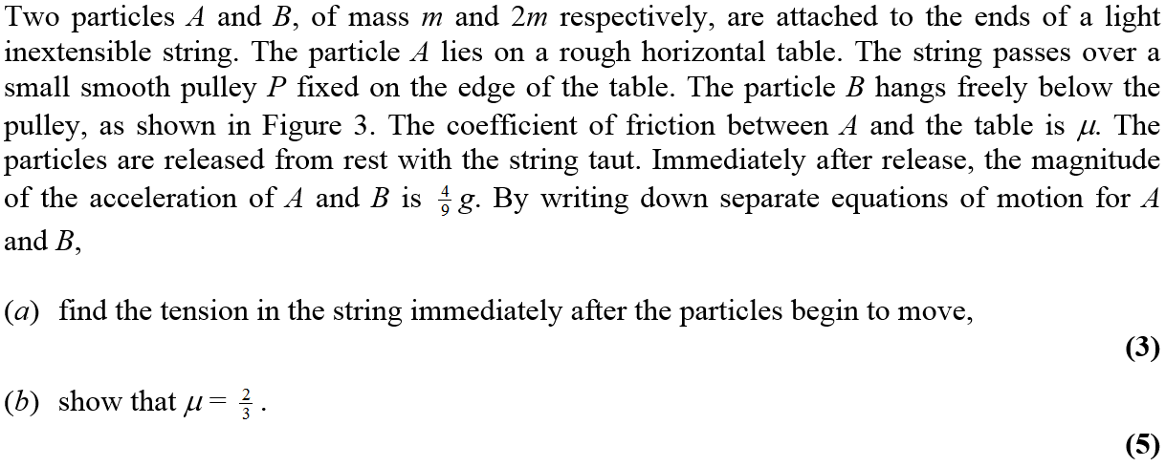
Jan 2008

Slide 27
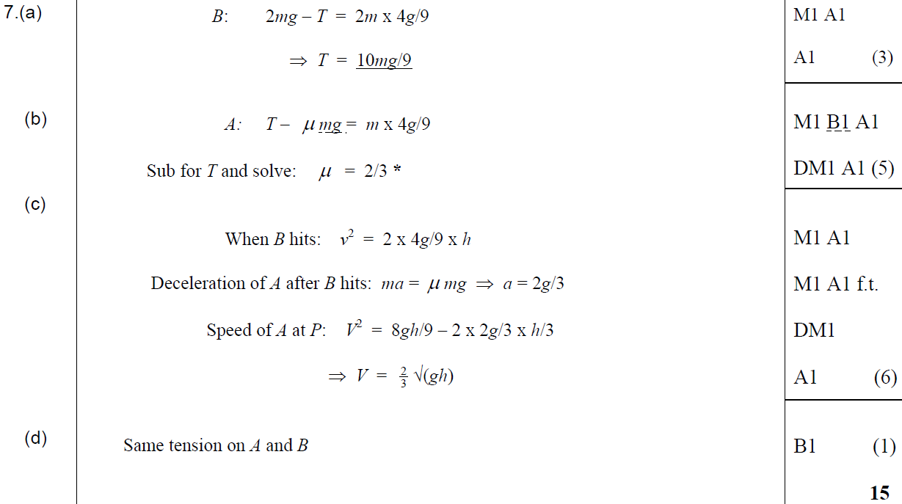
Jan 2008
A
B
C
D

Slide 28
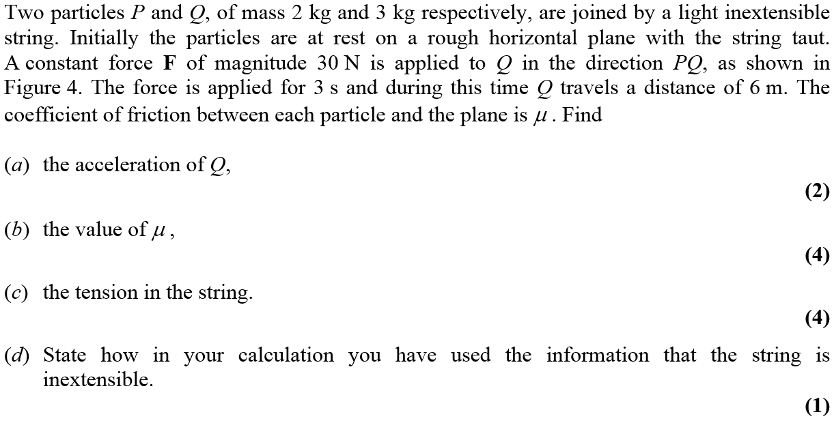
May 2008

Slide 29
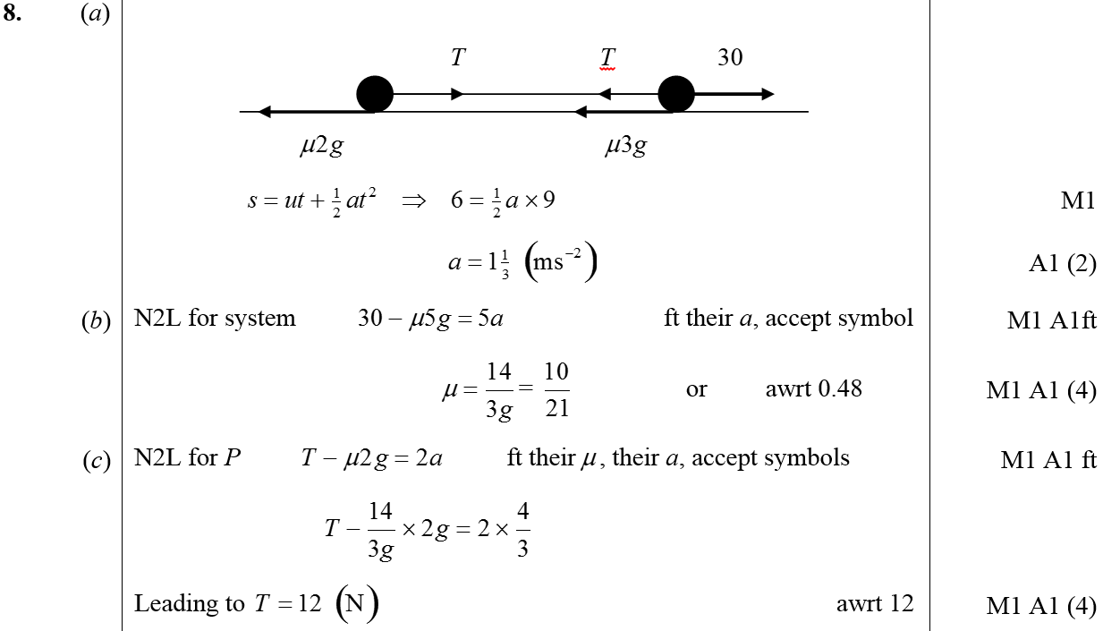
May 2008
A
B
C

Slide 30
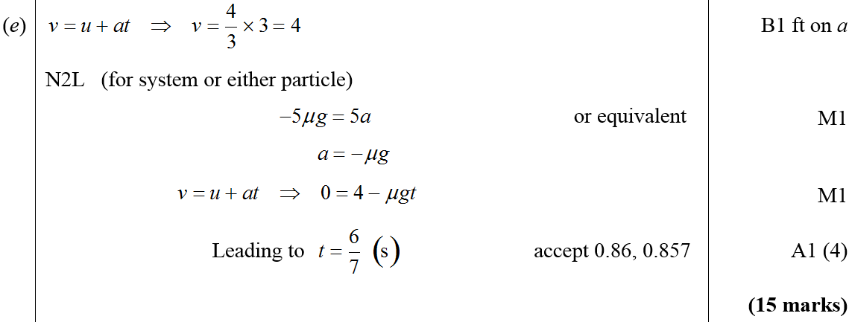
May 2008
D
E

Slide 31
May 2009

Slide 32
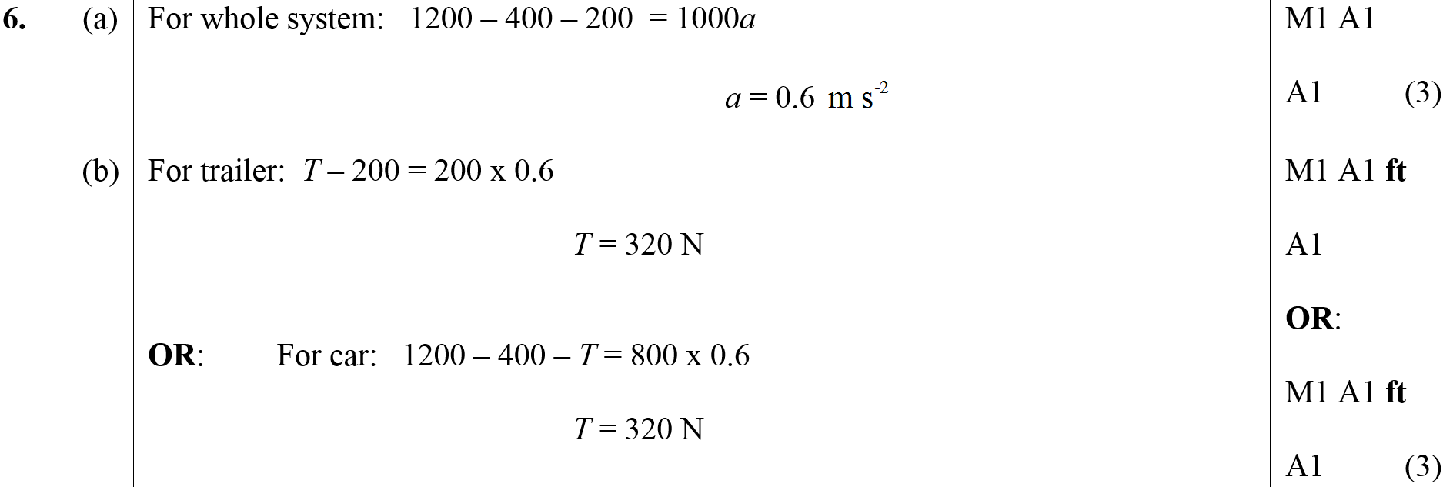
May 2009
A
B
C

Slide 33
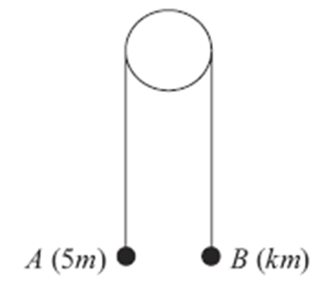
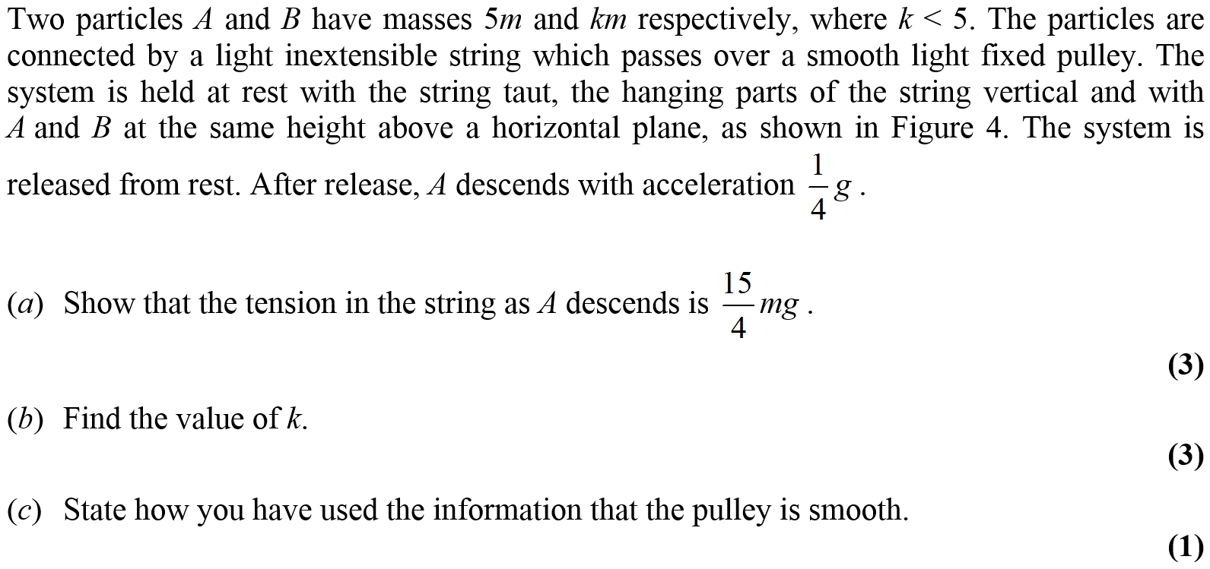
Jan 2010

Slide 34
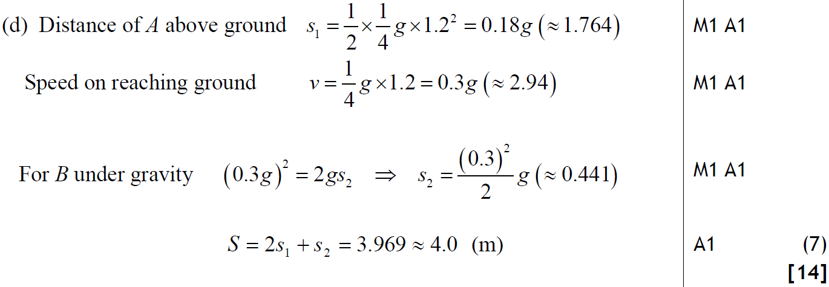
Jan 2010
A
B
C
D

Slide 35
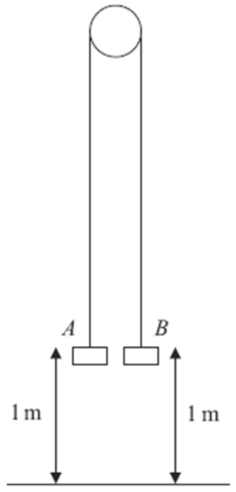
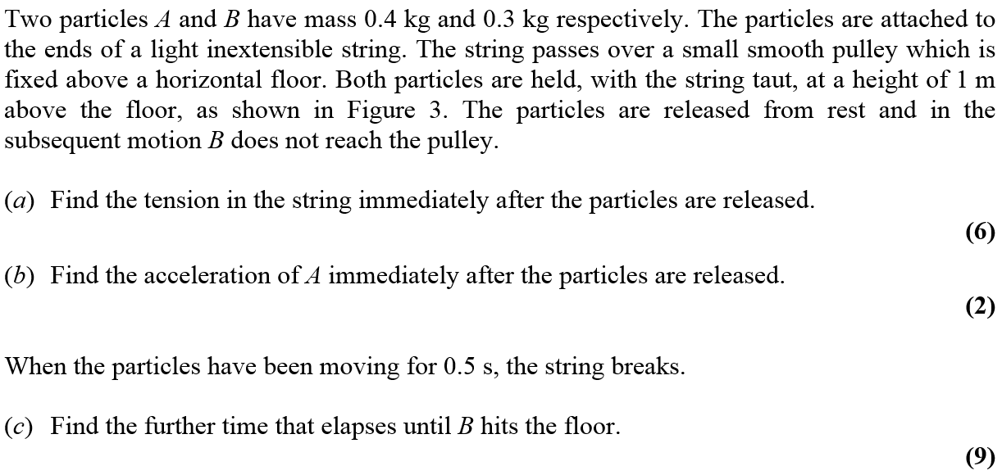
May 2010

Slide 36
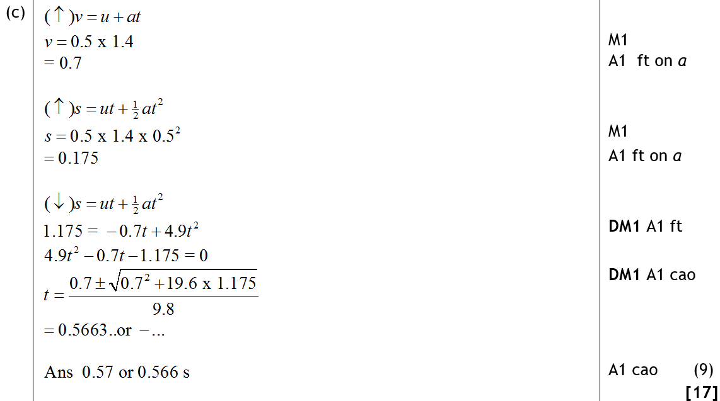
May 2010
A
B
C

Slide 37
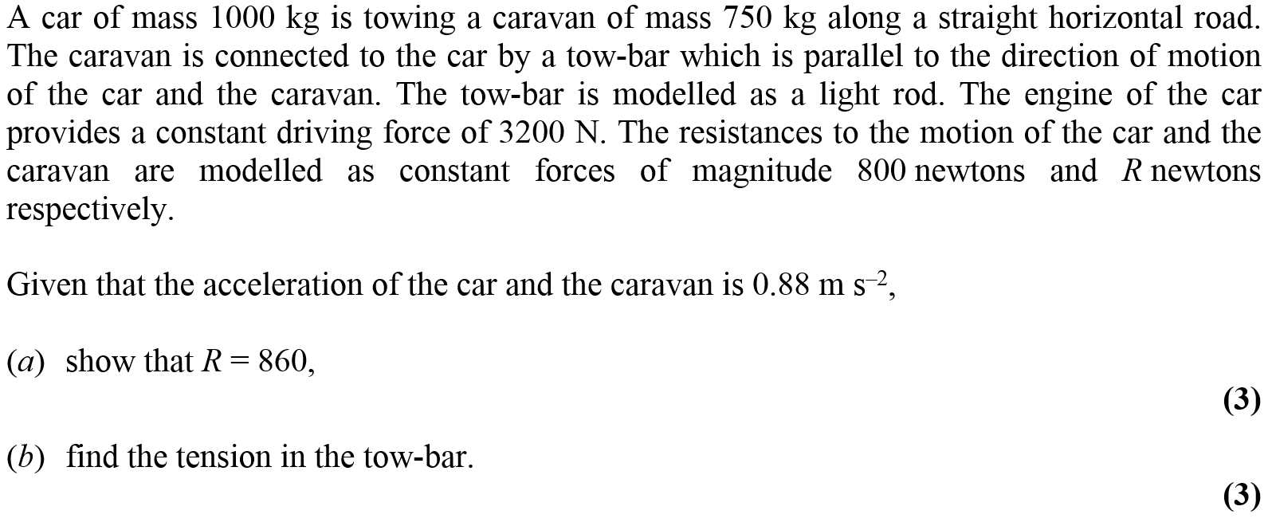
Jan 2012

Slide 38
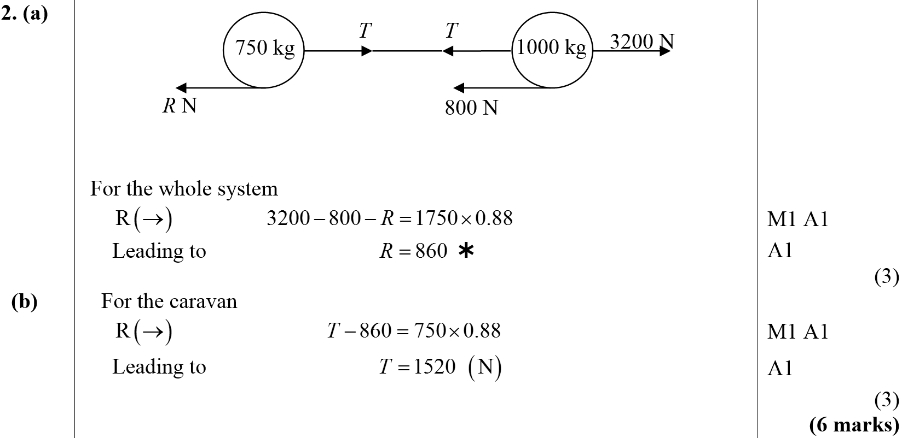
Jan 2012
A
B

Slide 39
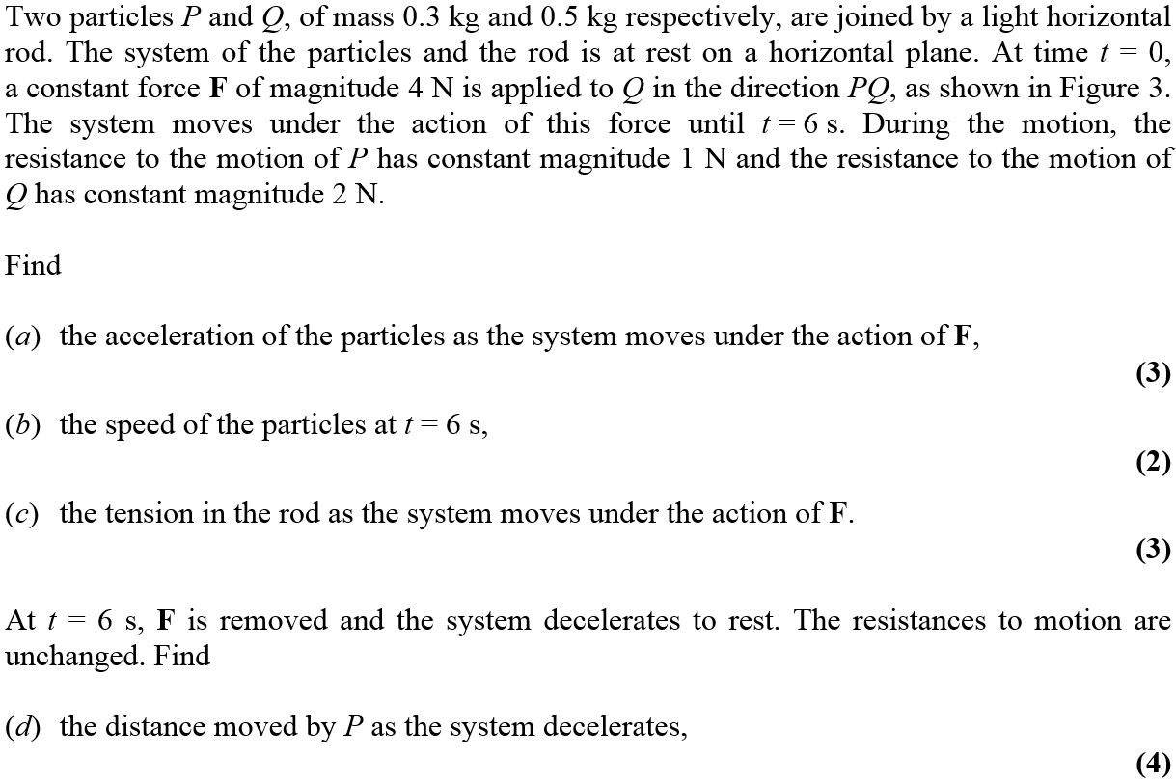
May 2012

Slide 40
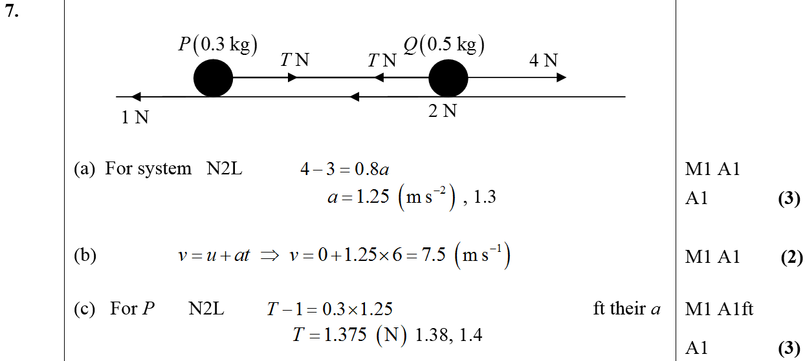
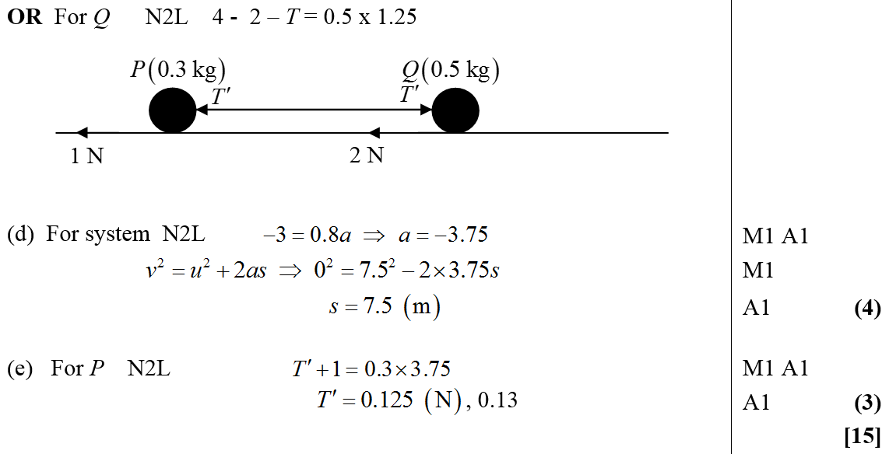
May 2012
A
B
C
D
E

Slide 41
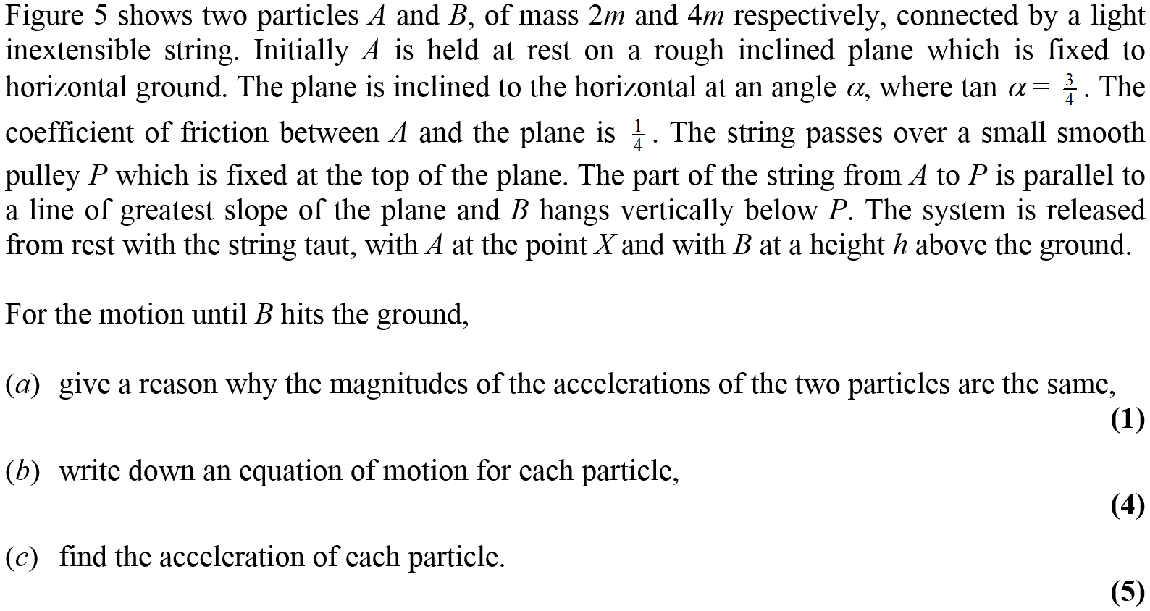
Jan 2013

Slide 42
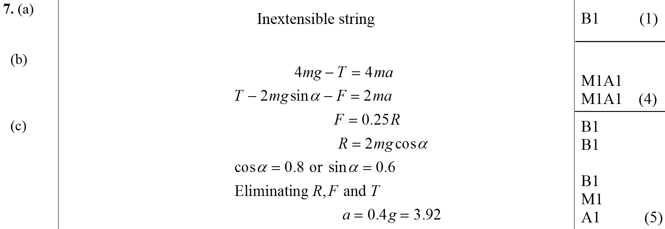
Jan 2013
A
B
C
D

Slide 43
May 2013

Slide 44
May 2013
A
B

Slide 45
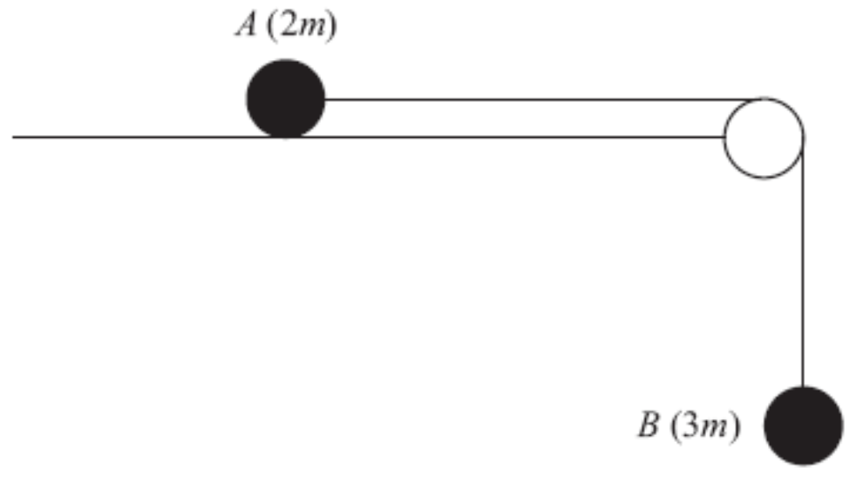
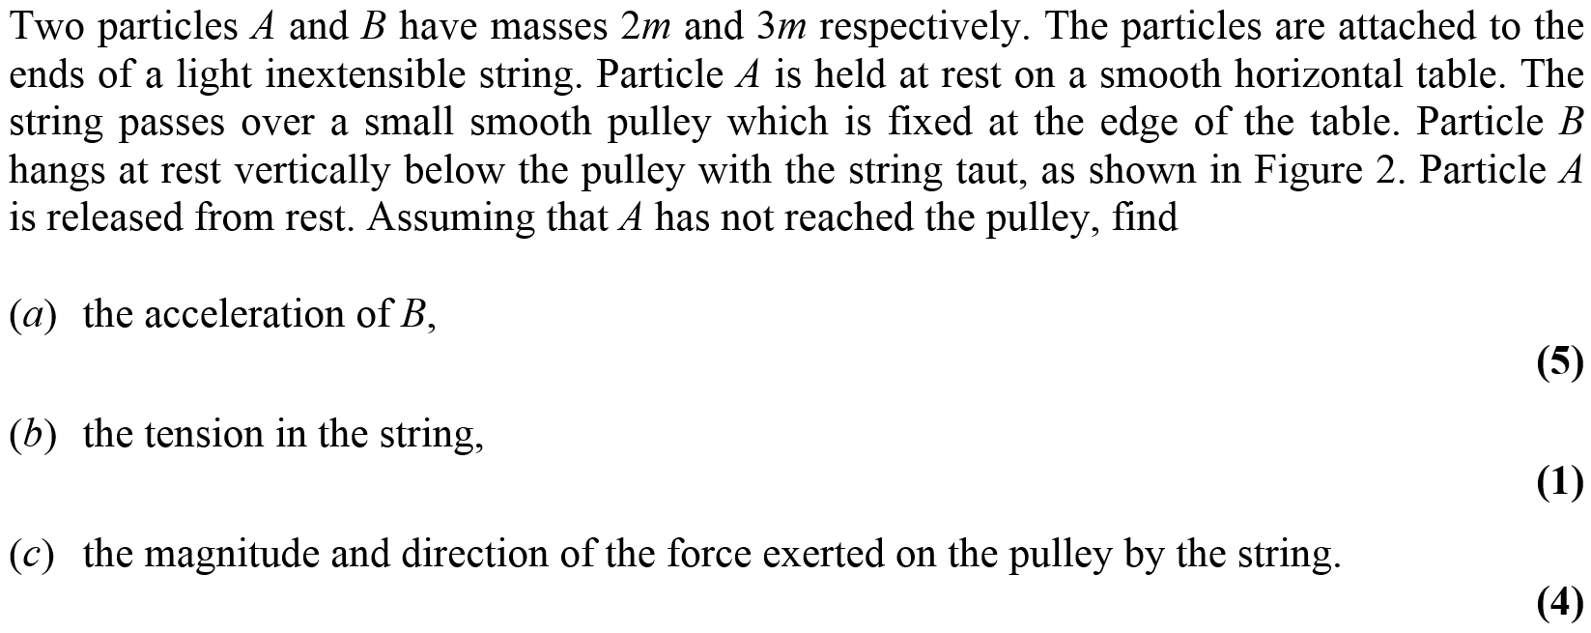
May 2013

Slide 46
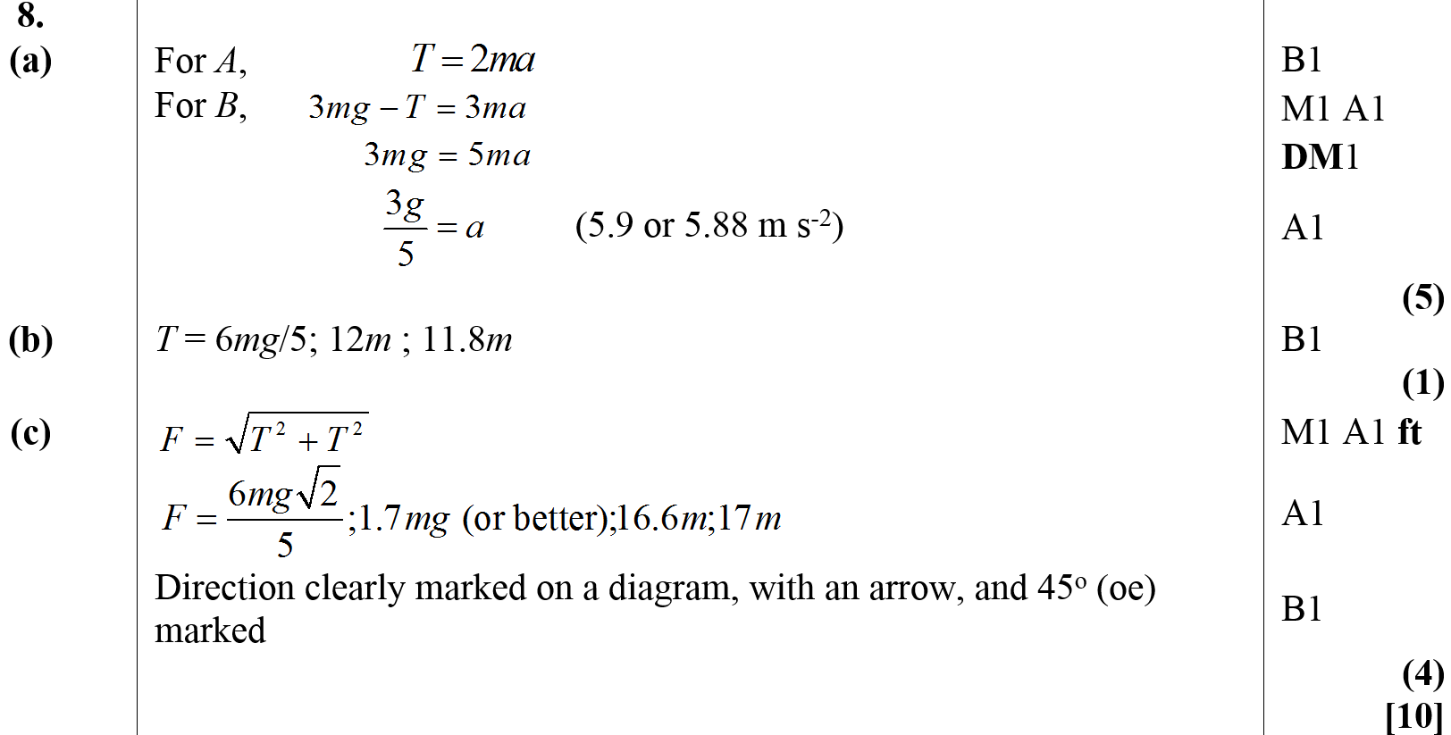
May 2013
A
B
C

Slide 47
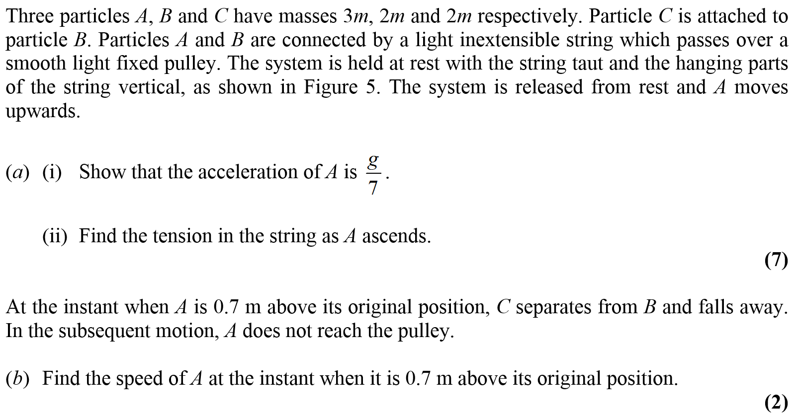
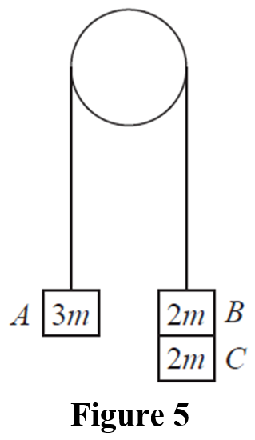
June 2014

Slide 48
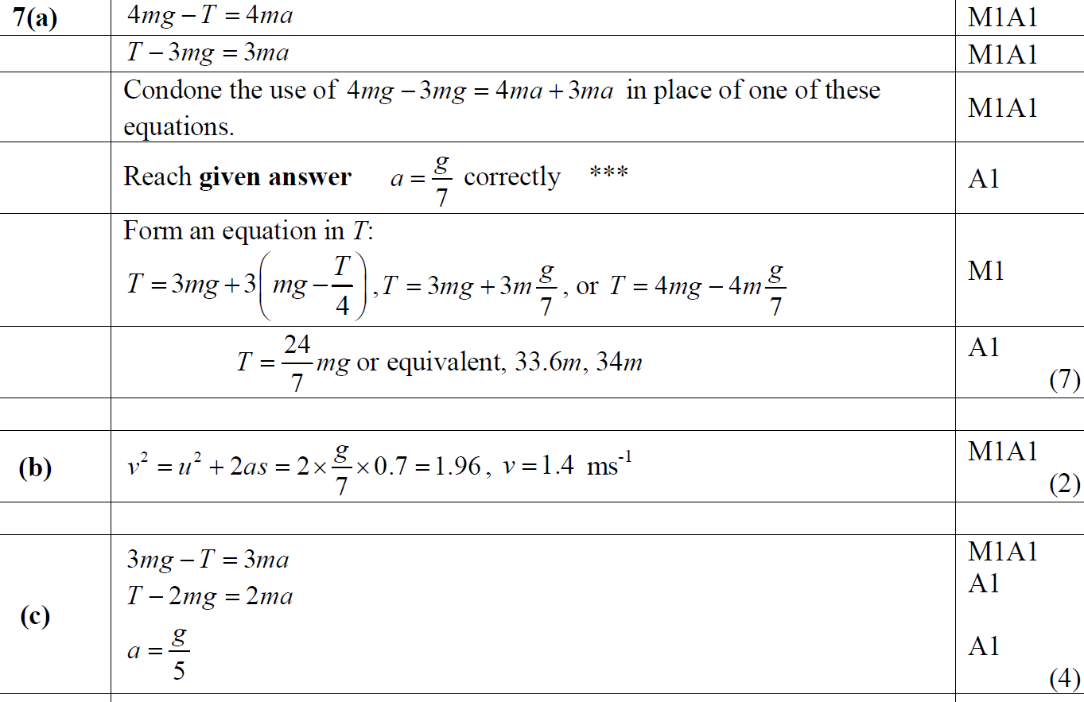
June 2014
A
B
C

Slide 49
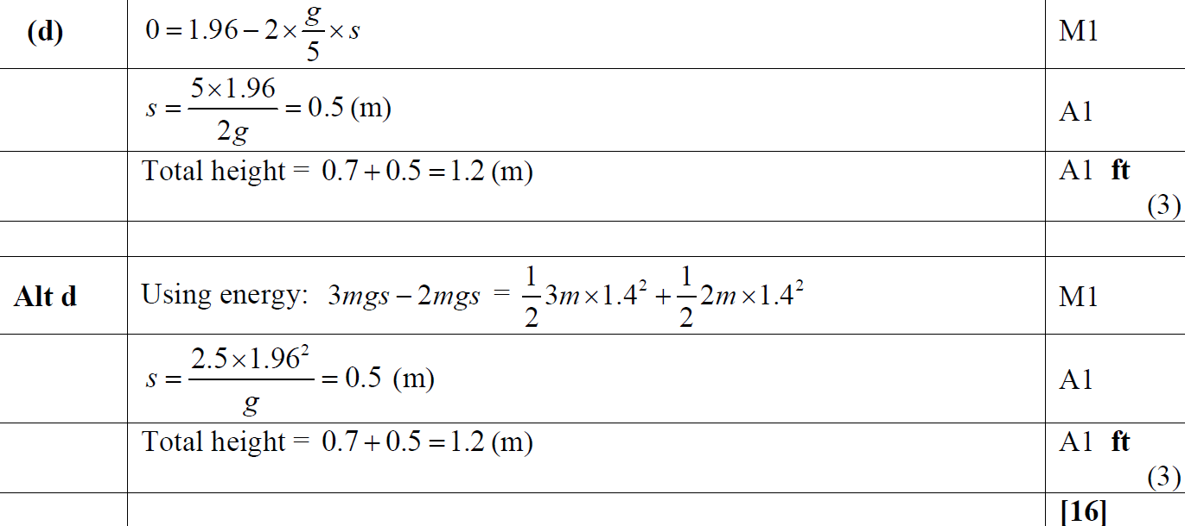
June 2014
D
Alternative D

Slide 50
June 2014
A Notes
B Notes

Slide 51
June 2014
C Notes
D Notes

Slide 52
June 2015

Slide 53
June 2015
A
B
A notes
B notes

Slide 54
June 2016

Slide 55
June 2016
A
B

Slide 56
June 2016
A notes
B notes

Slide 57
June 2016

Slide 58
June 2016
A
B

Slide 59
June 2016
A notes
B notes

Slide 60
June 2017

Slide 61
June 2017
A
A notes

Slide 62
June 2017

Slide 63
June 2017
A
B
C

Slide 64
June 2017
D
E
A notes
B notes
C notes

Slide 65
June 2017
D notes
E notes

Slide 66
June 2018

Slide 67
June 2018
A
B
A notes

Slide 68
June 2018
B notes

