Slide 4
What is a polygon?
What is the difference between regular and irregular polygons?

Slide 5
Polygon
Polygon comes from Greek.
Poly- means "many" and -gon means "angle".
A polygon is a two dimensional shape
They are made of straight lines, and the shape is "closed"
(all the lines connect up).
There are two types of polygon, regular and irregular.

Slide 6
POLYGON (REGULAR)
In a regular polygon all lengths and angles are the same size.
Below is a list of the first six regular polygons
Equilateral
Triangle
Square
Regular
Pentagon
Regular
Hexagon
Regular
Heptagon
Regular
Octagon

Slide 7
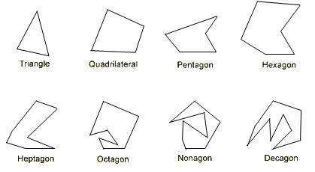
IRREGULAR POLYGONS
In an irregular polygon all lengths and angles are different sizes.
Below are some examples

Slide 8
What do angles in a triangle add up to?
a
a + b + c
=
180 degrees!
b
c

Slide 9
INTERIOR ANGLES
What is the sum of interior angles in a square?
We can divide a square into two triangles
What is the sum of the interior angles of
triangle?
180°
Two triangles in a square gives a total of
2 × 180 = 360°
Size of one interior angle is
90°
90°
90°
90°
360 ÷ 4 = 90°

Slide 10
INTERIOR ANGLES
What is the sum of interior angles in a pentagon?
We can divide a pentagon into three triangles
What is the sum of the interior angles of a triangle?
180°
Three triangles in a pentagon gives a total of
3 × 180 = 540°
Size of one interior angle is
108°
108°
108°
108°
108°
540 ÷ 5 = 108°

Slide 11
Angle facts
Sum of interior angles =
180º x number of triangles
Interior angle =
Sum of interior ÷ number of angles

Slide 12
Investigation: What is the sum of interior angles of a 100 sided shape?
Work in pairs
Use shapes and board pens to complete the table
Use your filled table to put together a “general formula”
General formula must include algebraic expressions to calculate the interior angles of any polygon
e.g. 100 sided shape?
Name of Polygon | Number of sides for the polygon | Number of triangles inside the polygon | Sum of interior angles for the polygon | Size of one interior angle
Triangle
Quadrilateral
Pentagon
Hexagon
Heptagon
Octagon
Nonagon
Decagon
n-sided polygon

Slide 13
In an exam a student is working out the sum of the interior angles of this hexagon.
The student splits the hexagon into triangles.
Is he correct?

Slide 14
INTERIOR ANGLES
 | Regular Polygon | Number of sides | Divide into how many triangles? | Sum of interior angles | Size of one angle
Triangle
Square
Pentagon
3
1
180 × 1 =
180°
180 ÷ 3 =
60°
4
2
180 × 2 =
360°
360 ÷ 4 =
90°
5
3
180 × 3 =
540°
540 ÷ 5 =
108°
 | N - agon

Slide 15
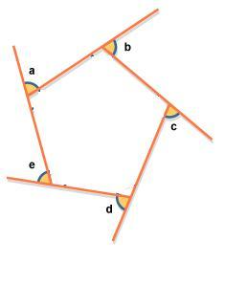
What is the exterior angle of a polygon?
What do the exterior angles of a regular polygon
add up to?

Slide 16
Square
The four angles create 360°
360 ÷ 4 = 90°
Exterior angle is 90°

Slide 17
REGULAR PENTAGON
The five angles create 360°
360 ÷ 5 = 72°
Exterior angle is 72°

Slide 18
REGULAR HEXAGON
The six angles create 360°
360 ÷ 6 = 60°
Exterior angle is 60°

Slide 19
Angle facts about regular polygons
Exterior angle =
360° ÷ number of angles

Slide 20
EXTERIOR + INTERIOR = 180°
Adding the exterior and
interior angles together
always gives a total of 180°
This is true for regular
and irregular polygons

Slide 21
Angle facts about regular and irregular polygons
Interior angle =
180 ° - exterior angle

Slide 22
Summary of Angle facts
Exterior angle =
360° ÷ number of angles
Interior angle =
180 ° - exterior angle
Sum of interior angles =
Interior angle x number of angles

Slide 23
Example 1 – For this regular hexagon calculate: a) exterior angle b) interior angle c) sum of interior angles

Slide 24
Example 2 – For this regular pentagon calculate: a) exterior angle b) interior angle c) sum of interior angles

Slide 25
Example 3 – For this regular octagon calculate: a) exterior angle b) interior angle c) sum of interior angles

Slide 26
IRREGULAR POLYGON
The sum of external angles of a polygon always adds to 360°
73°
73°
65°
65°
59°
+
22°
219°
59°
360°
A
_
22°
219°
141°
A = 141°

Slide 27
IRREGULAR POLYGON
The sum of external angles of a polygon always adds to 360°
88°
45°
45°
38°
38°
88°
43°
+
25°
239°
43°
360°
_
239°
25°
B
121°
B = 121°

Slide 28
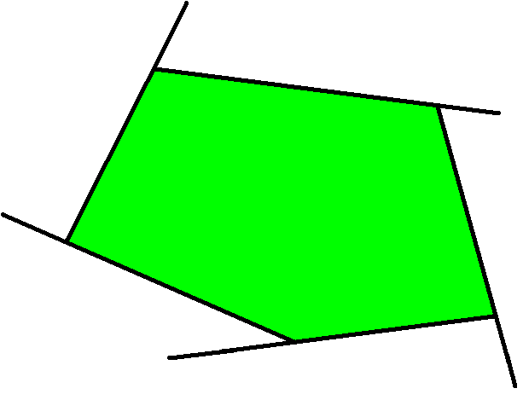
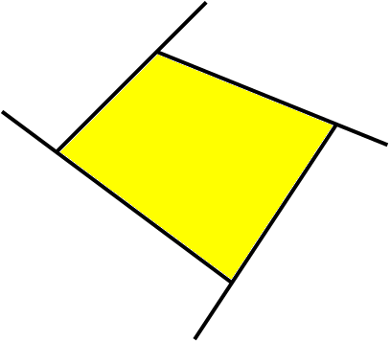
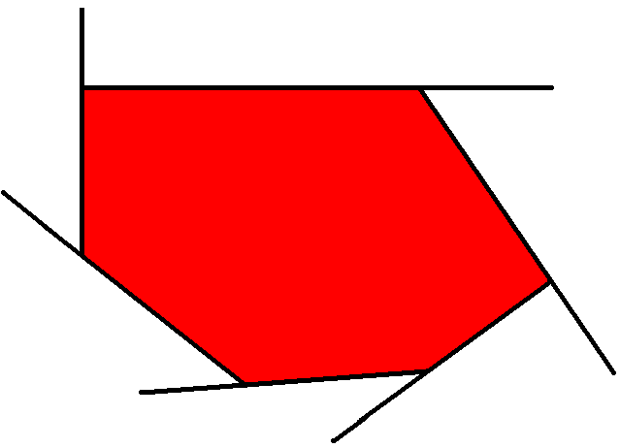
EXERCISES
Calculate the angles marked with letters
80°
66°
75°
100°
98°
91°
A
C
B
95°
90°
85°
57°
25°
33°

Slide 29
ANGLES – Prior knowledge
Names of the types of angles
Angles on a straight line
Sum of angles at a point
Angles in a triangle;
Angles in a quadrilateral
Vertically opposite angles

Slide 30
True or False?
The sum of all the angles around a point is...
360˚
The sum of all the angles on a straight line is...
130˚
The sum of angles in a triangle is...
120˚

Slide 31
True or False?
The sum of all the angles around a point is...
360˚ TRUE :D
The sum of all the angles on a straight line is...
130˚
FALSE correct answer is
180˚
The sum of angles in a triangle is...
120˚
FALSE correct answer is
180˚

