Slide 1
Factorising
Factorising
SAM
1H Q16
Edexcel
SAM
3H Q9
May 2018 1H Q15
AQA
Spec 1
3H Q6
Nov 2018 1H Q10
OCR
Spec 2
1H Q1

Slide 2
Factorising
Factorising
Edexcel
Nov 2017
1H Q5
AQA
SAM
3H Q17
Nov 2017
2H Q16
1 Marker
OCR
May 2018
1H Q27

Slide 3
Factorising
Factorising
June 2017
2H Q5
Edexcel
Nov 2017
1H Q2
AQA
Practice
2H Q12
Nov 2017
2H Q4
OCR
Nov 2018
1H Q13
Nov 2018
2H Q20

Slide 4
Factorising
SAM 1H Q16

Slide 5
Factorising
SAM 1H Q16
A

Slide 6
Factorising
SAM 3H Q9

Slide 7
Factorising
SAM 3H Q9
A
B
C

Slide 8
Factorising
Specimen Set 1 3H Q6

Slide 9
Factorising
Specimen Set 1 3H Q6
A

Slide 10
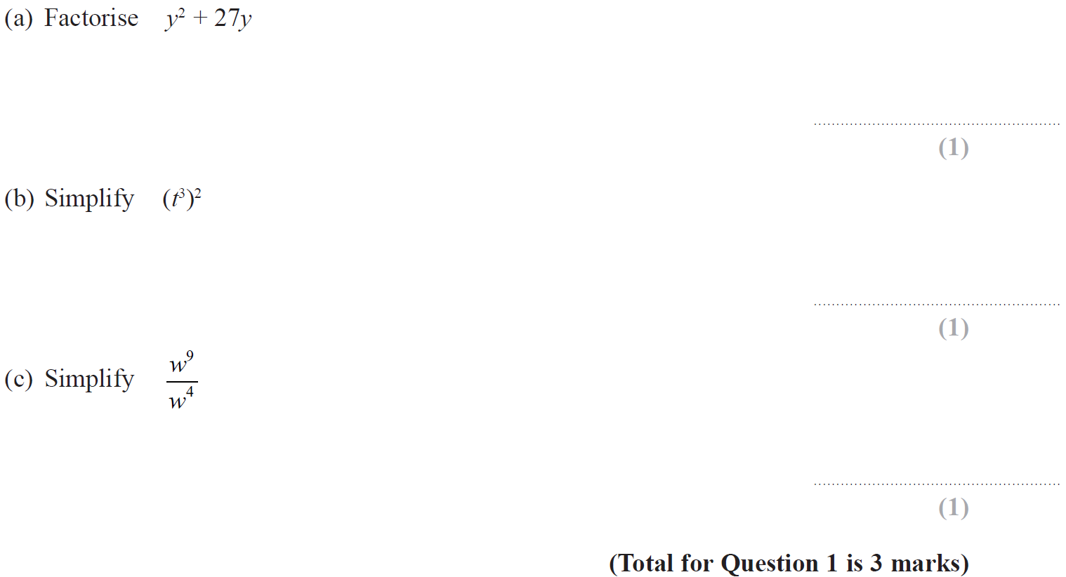
Factorising
Specimen Set 2 1H Q1

Slide 11
Factorising
Specimen Set 2 1H Q1
A
B
C

Slide 12
Factorising
May 2018 1H Q15

Slide 13
Factorising
May 2018 1H Q15
A
B

Slide 14
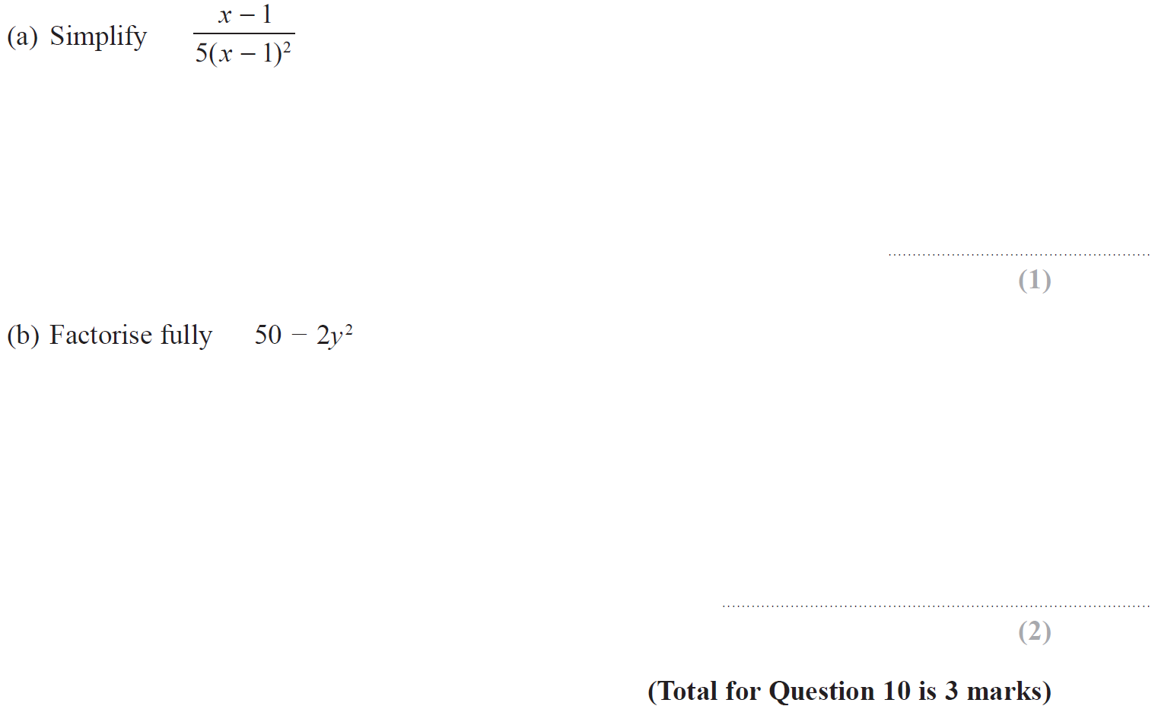
Factorising
Nov 2018 1H Q10

Slide 15
Factorising
Nov 2018 1H Q10
A
B

Slide 16
Factorising
SAM 3H Q17

Slide 17
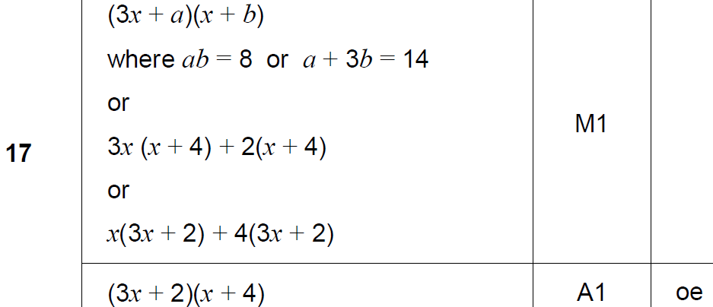
Factorising
SAM 3H Q17
A

Slide 18
Factorising
Nov 2017 1H Q5

Slide 19
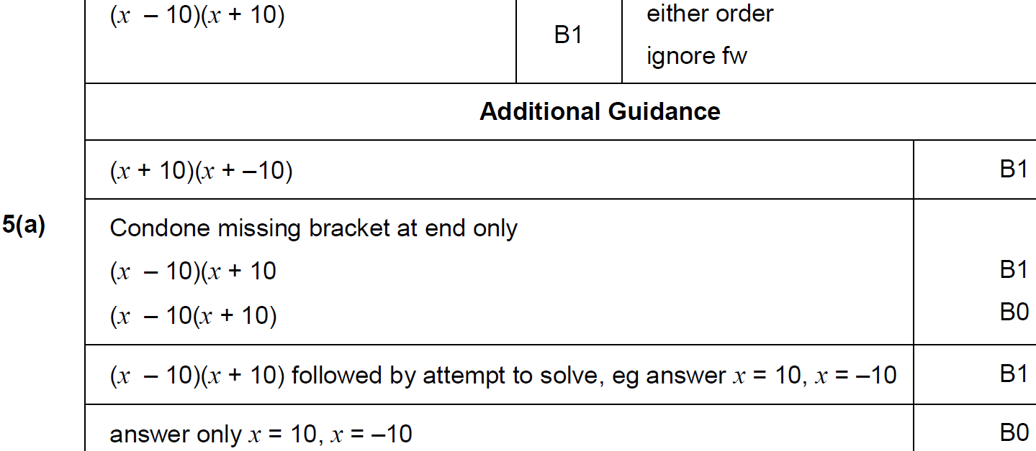
Factorising
Nov 2017 1H Q5
A

Slide 20
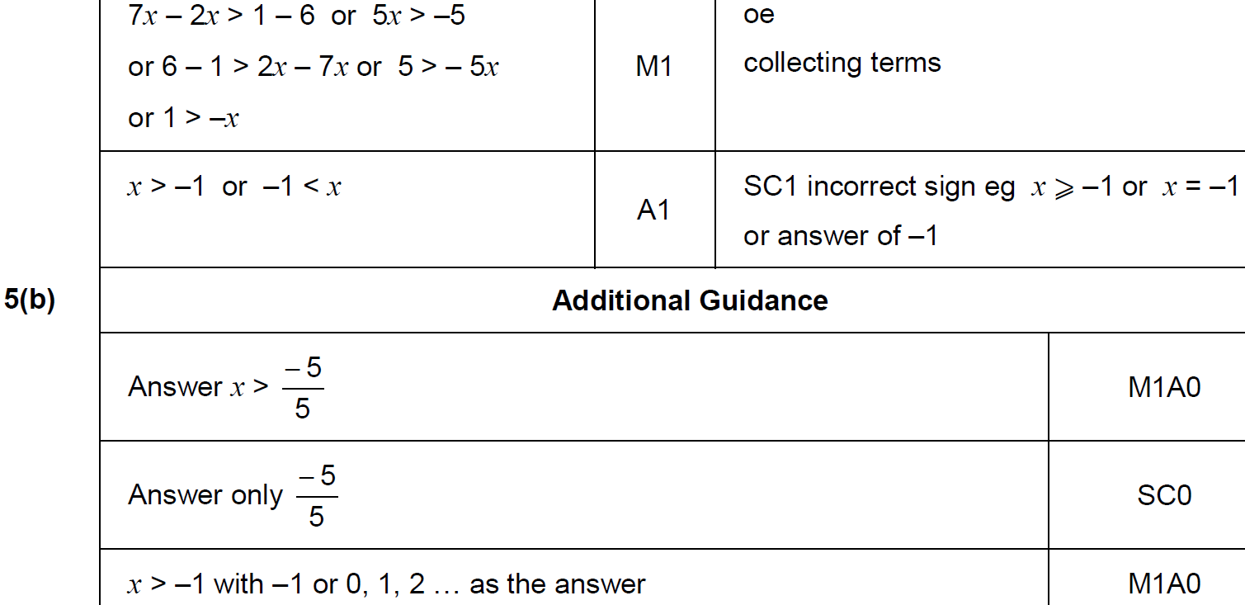
Factorising
Nov 2017 1H Q5
B

Slide 21
Factorising
Nov 2017 2H Q16

Slide 22
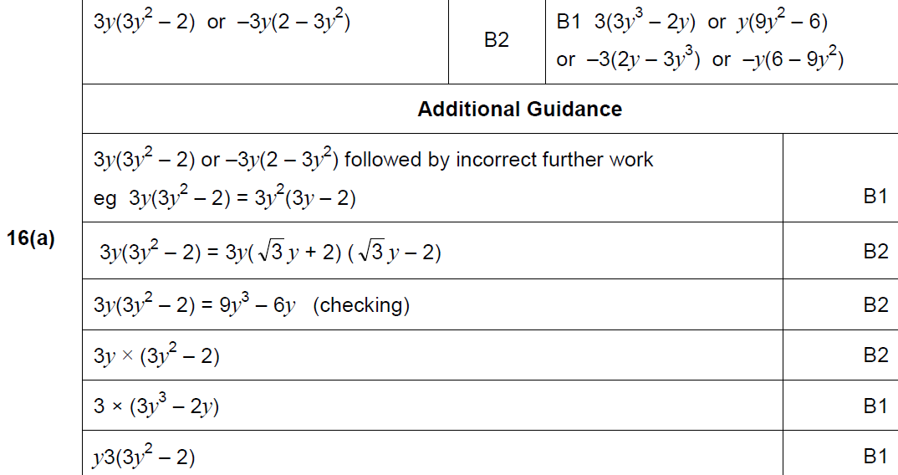
Factorising
Nov 2017 2H Q16
A

Slide 23
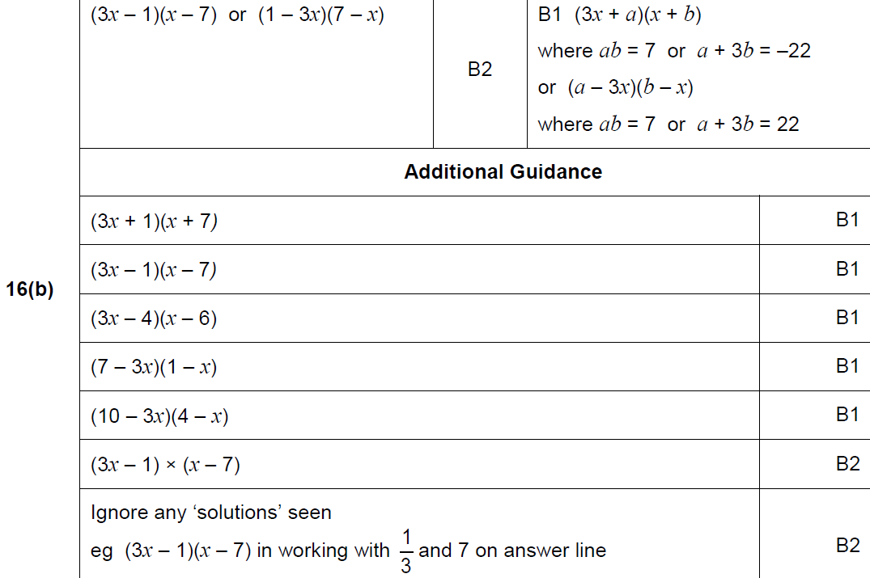
Factorising
Nov 2017 2H Q16
B

Slide 24
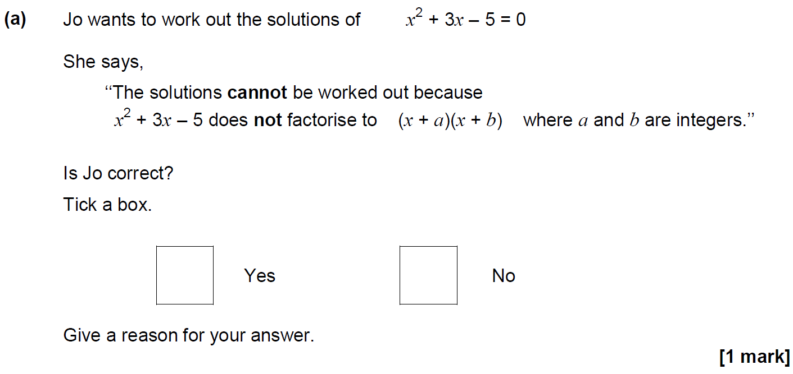
Factorising
May 2018 1H Q27

Slide 25
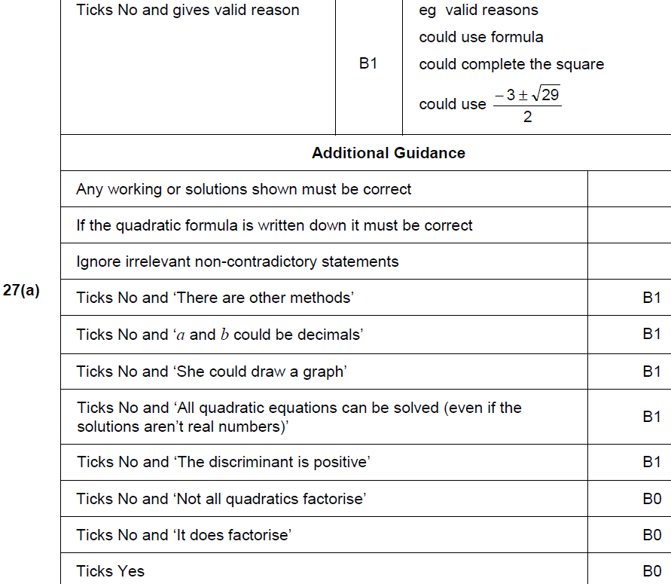
Factorising
May 2018 1H Q27
A

Slide 26
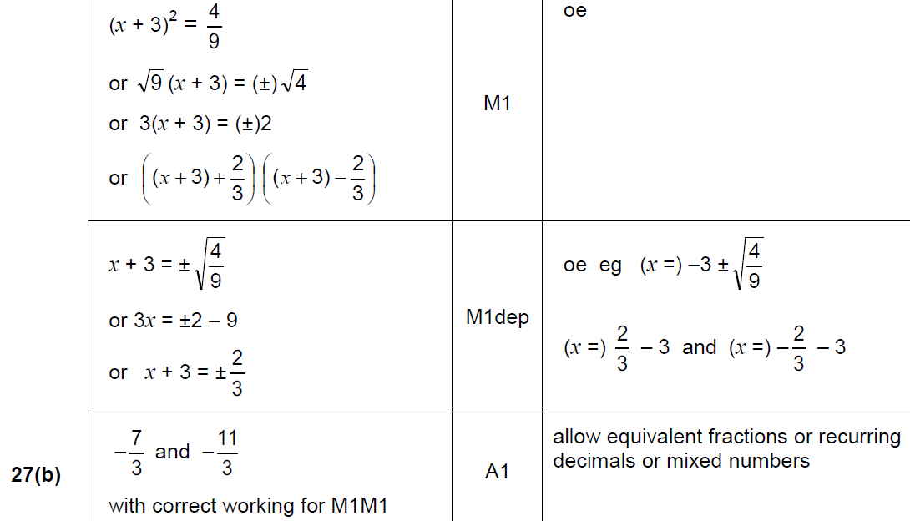
Factorising
May 2018 1H Q27
B

Slide 27
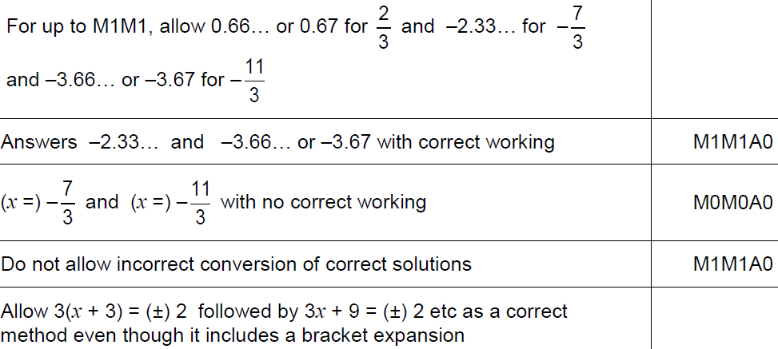
Factorising
May 2018 1H Q27
B notes

Slide 28
Factorising
Practice 2H Q12

Slide 29
Factorising
Practice 2H Q12
A
B
C

Slide 30
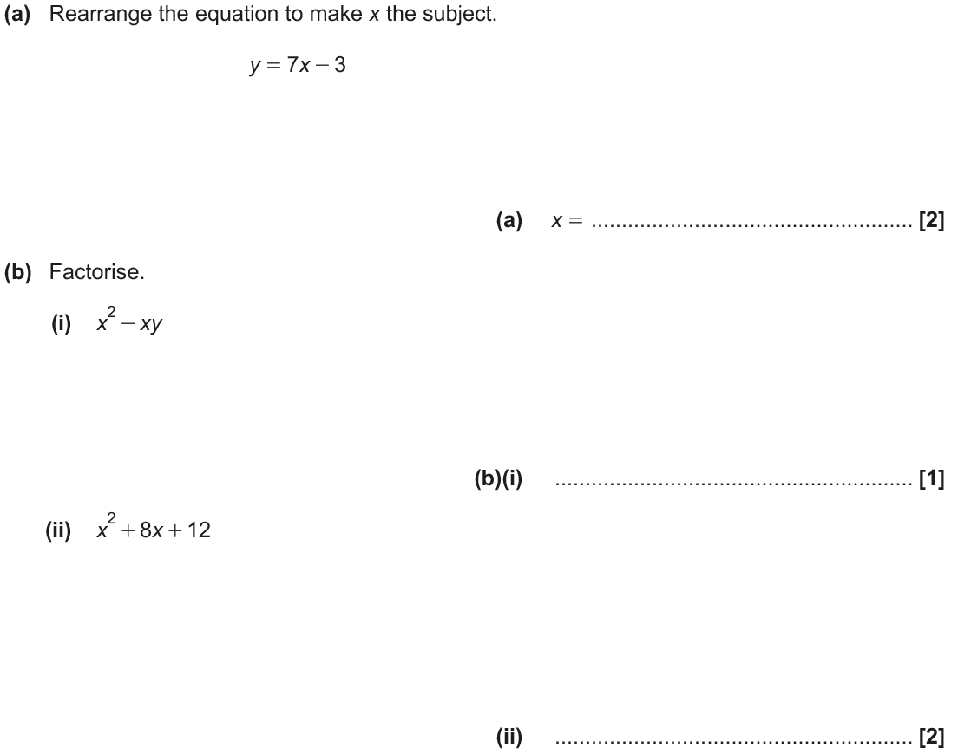
Factorising
June 2017 2H Q5

Slide 31
Factorising
June 2017 2H Q5
A
B (i)
B (ii)

Slide 32
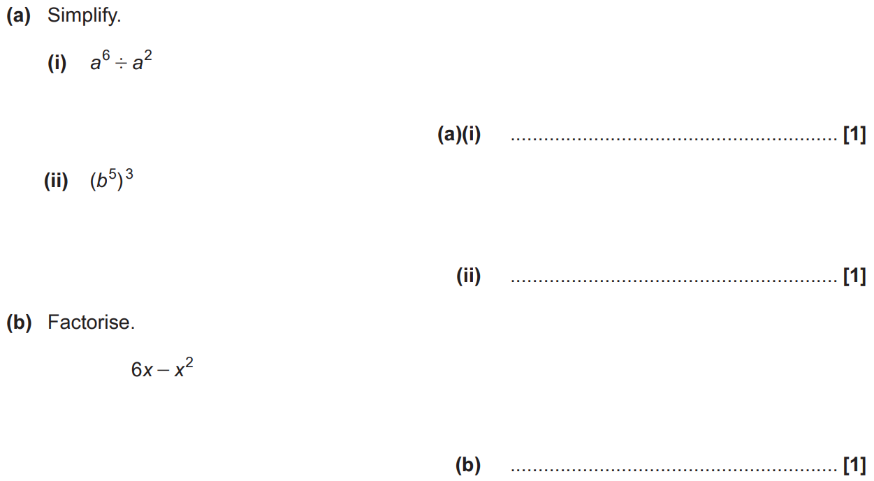
Factorising
Nov 2017 1H Q2

Slide 33
Factorising
Nov 2017 1H Q2
A (i)
A (ii)
B

Slide 34
Factorising
Nov 2017 2H Q4

Slide 35
Factorising
Nov 2017 2H Q4
A
B

Slide 36
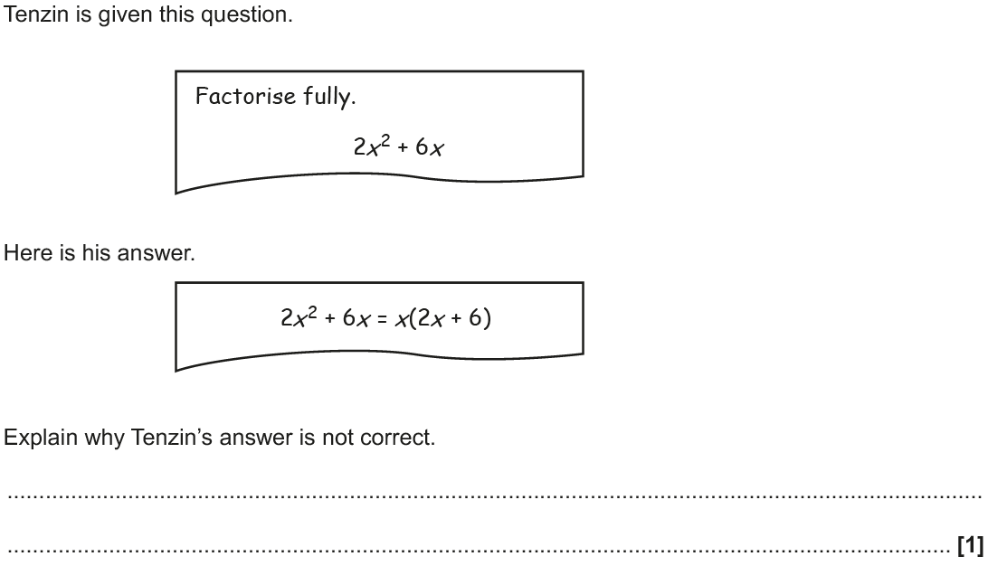
Factorising
Nov 2018 1H Q13

Slide 37
Factorising
Nov 2018 1H Q13
A

Slide 38
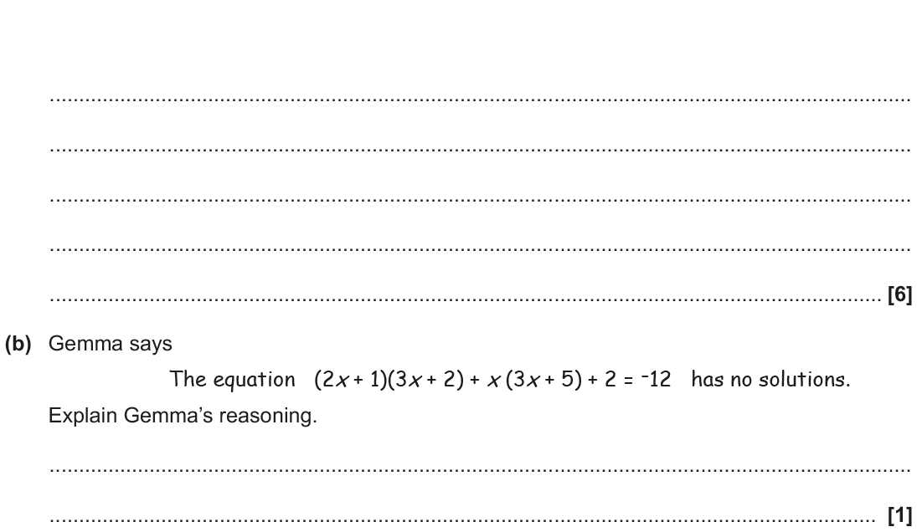
Factorising
Nov 2018 2H Q20

Slide 39
Factorising
Nov 2018 2H Q20
A
B

