Slide 1
Factorising
Factorising
June 2017
2H Q5
Nov 2017
1H Q2
Practice
2H Q12
Nov 2017
2H Q4
Nov 2018
1H Q13
Nov 2018
2H Q20

Slide 2
Factorising
Practice 2H Q12

Slide 3
Factorising
Practice 2H Q12
A
B
C

Slide 4
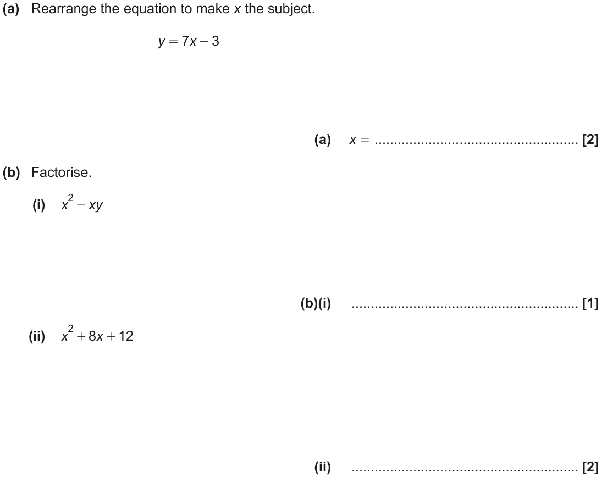
Factorising
June 2017 2H Q5

Slide 5
Factorising
June 2017 2H Q5
A
B (i)
B (ii)

Slide 6
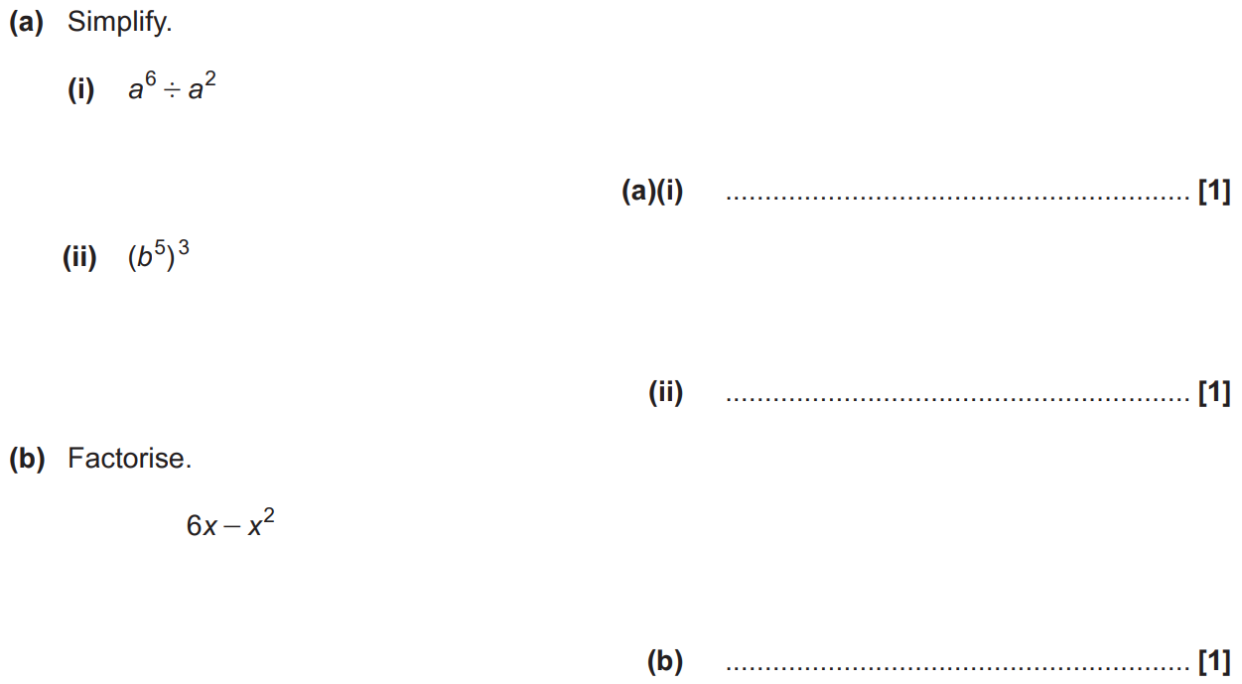
Factorising
Nov 2017 1H Q2

Slide 7
Factorising
Nov 2017 1H Q2
A (i)
A (ii)
B

Slide 8
Factorising
Nov 2017 2H Q4

Slide 9
Factorising
Nov 2017 2H Q4
A
B

Slide 10
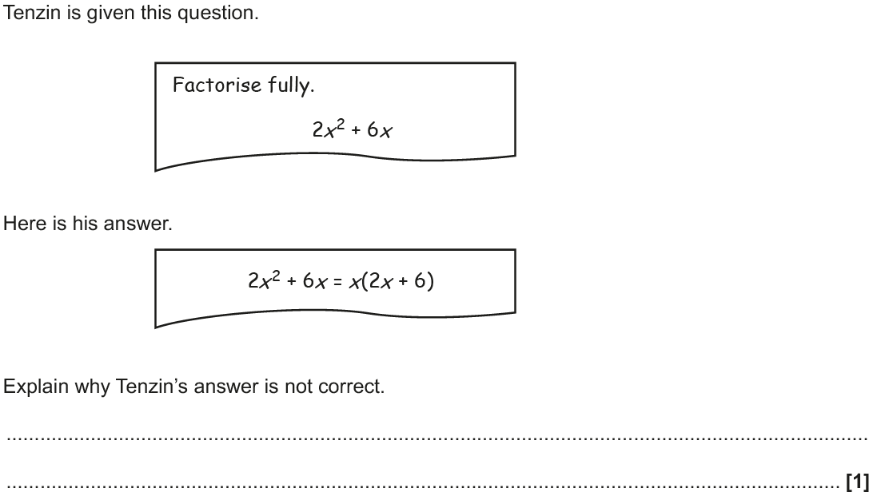
Factorising
Nov 2018 1H Q13

Slide 11
Factorising
Nov 2018 1H Q13
A

Slide 12
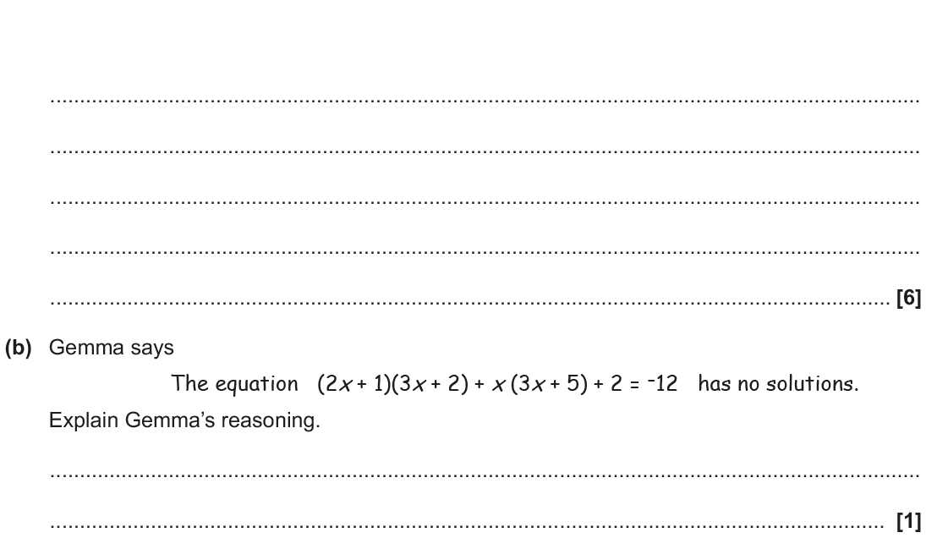
Factorising
Nov 2018 2H Q20

Slide 13
Factorising
Nov 2018 2H Q20
A
B

