Slide 1
Factorising
Factorising
SAM
1H Q16
SAM
3H Q9
May 2018 1H Q15
Spec 1
3H Q6
Nov 2018 1H Q10
Spec 2
1H Q1

Slide 2
Factorising
SAM 1H Q16

Slide 3
Factorising
SAM 1H Q16
A

Slide 4
Factorising
SAM 3H Q9

Slide 5
Factorising
SAM 3H Q9
A
B
C

Slide 6
Factorising
Specimen Set 1 3H Q6

Slide 7
Factorising
Specimen Set 1 3H Q6
A

Slide 8
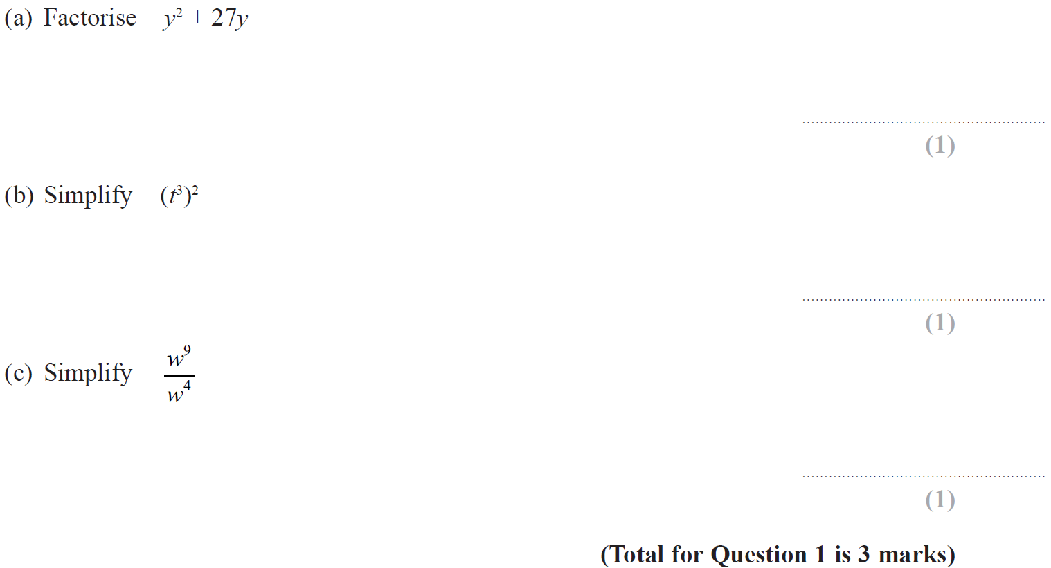
Factorising
Specimen Set 2 1H Q1

Slide 9
Factorising
Specimen Set 2 1H Q1
A
B
C

Slide 10
Factorising
May 2018 1H Q15

Slide 11
Factorising
May 2018 1H Q15
A
B

Slide 12
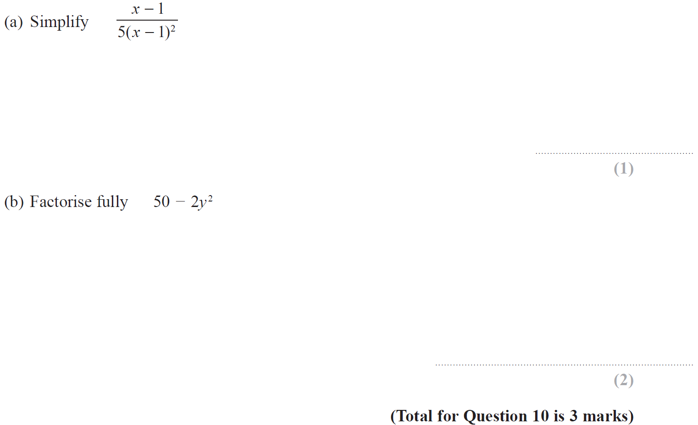
Factorising
Nov 2018 1H Q10

Slide 13
Factorising
Nov 2018 1H Q10
A
B

