Slide 1
Factorising
Factorising
Nov 2017
1H Q5
SAM
3H Q17
Nov 2017
2H Q16
1 Marker
May 2018
1H Q27
See also:
Algebraic Fractions
Solving Quadratics

Slide 2
Factorising
SAM 3H Q17

Slide 3
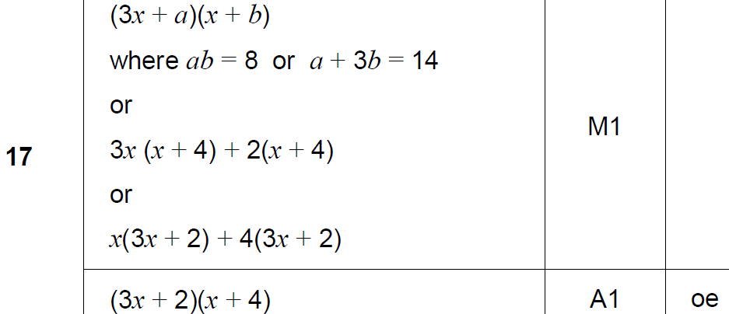
Factorising
SAM 3H Q17
A

Slide 4
Factorising
Nov 2017 1H Q5

Slide 5
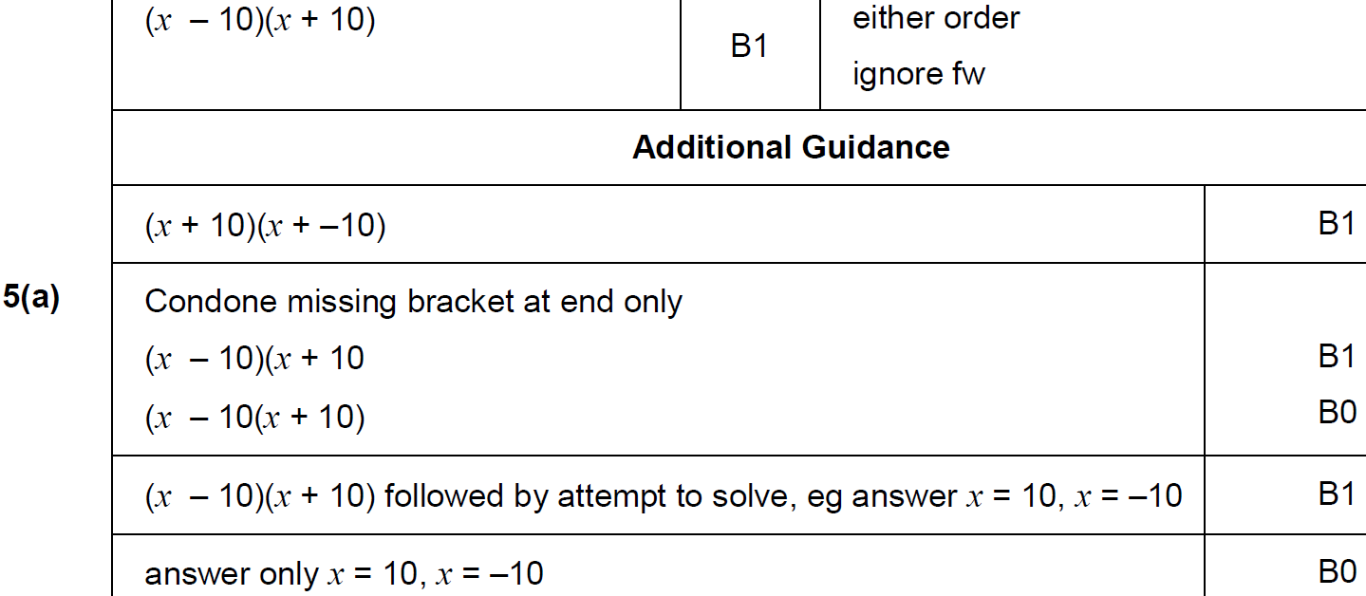
Factorising
Nov 2017 1H Q5
A

Slide 6
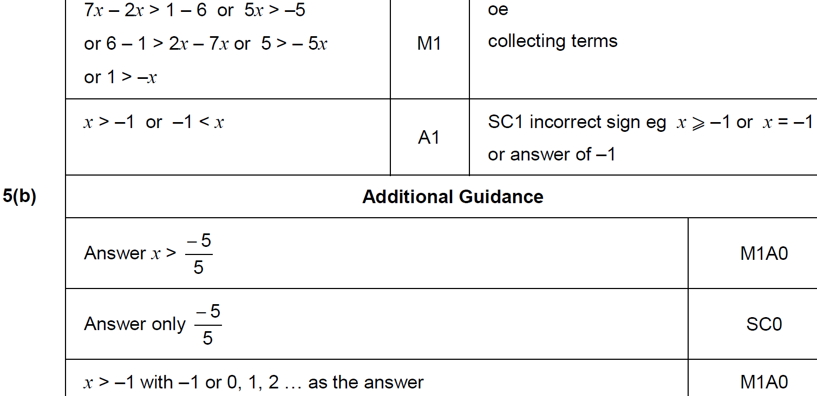
Factorising
Nov 2017 1H Q5
B

Slide 7
Factorising
Nov 2017 2H Q16

Slide 8
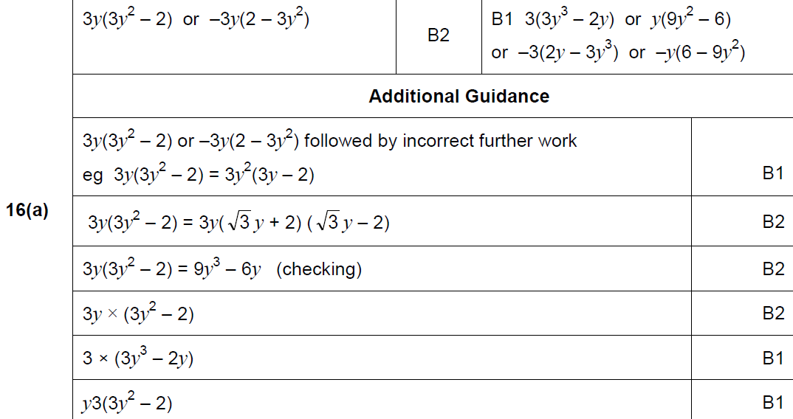
Factorising
Nov 2017 2H Q16
A

Slide 9
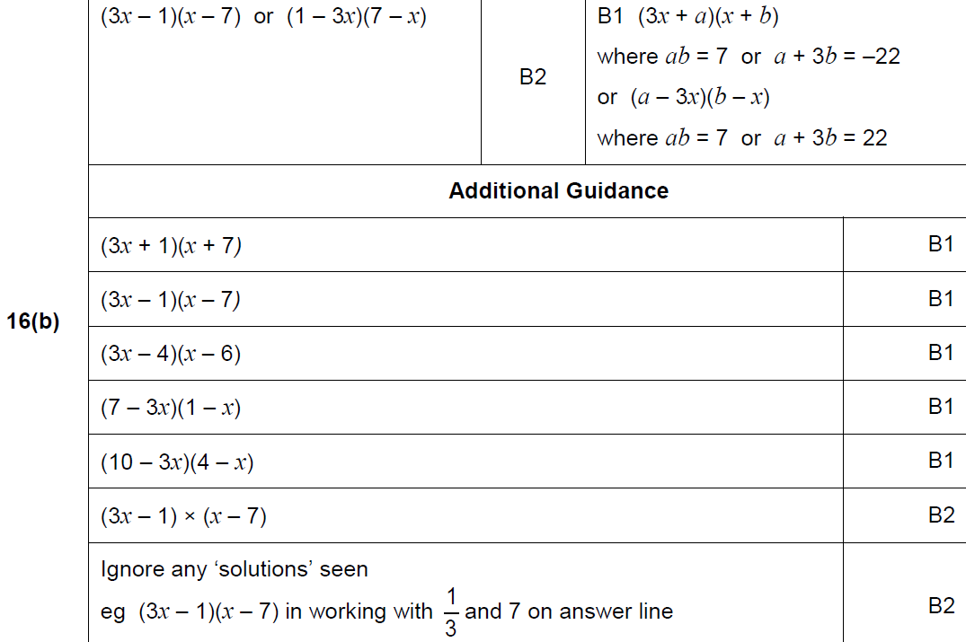
Factorising
Nov 2017 2H Q16
B

Slide 10
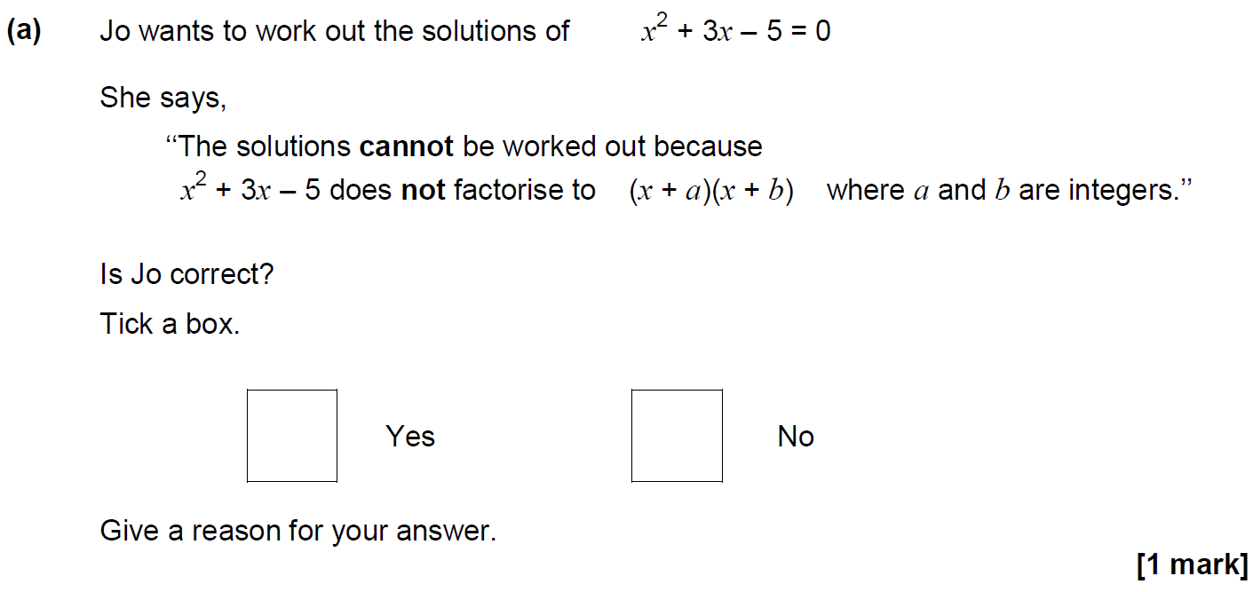
Factorising
May 2018 1H Q27

Slide 11
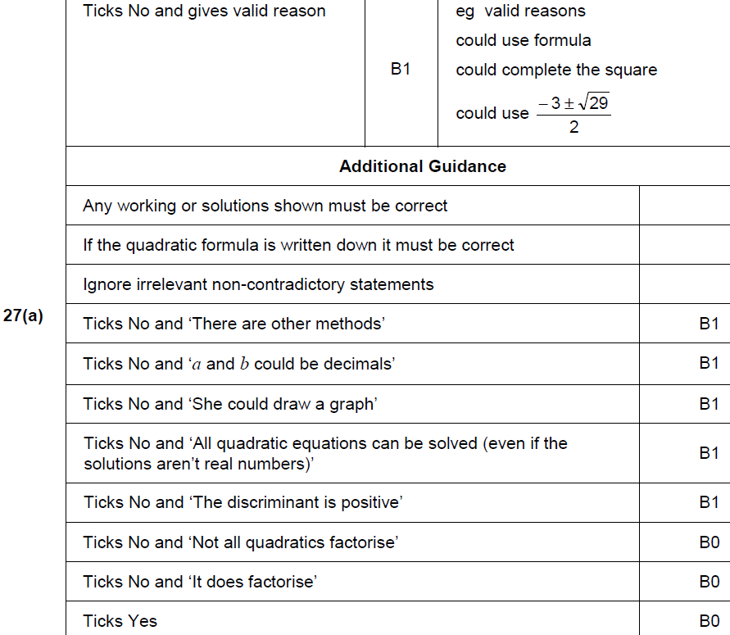
Factorising
May 2018 1H Q27
A

Slide 12
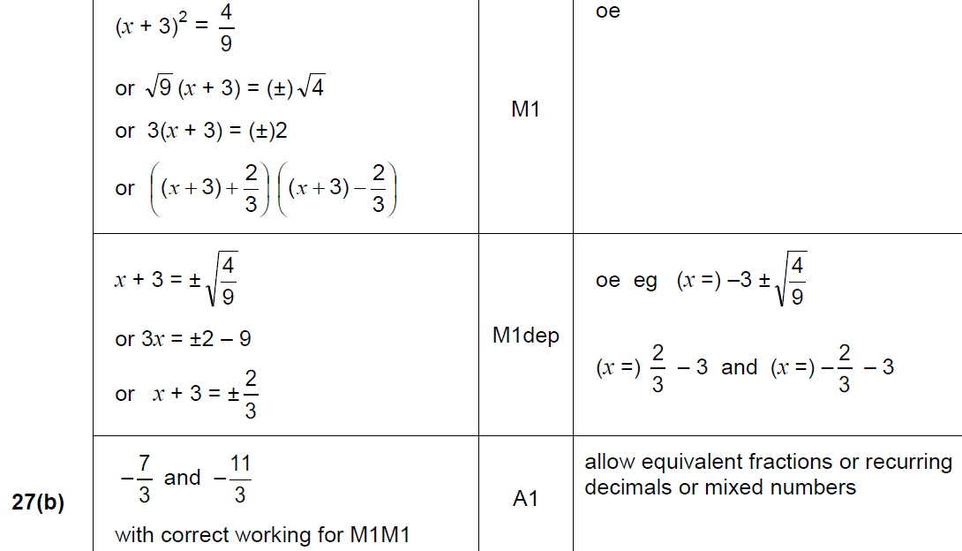
Factorising
May 2018 1H Q27
B

Slide 13
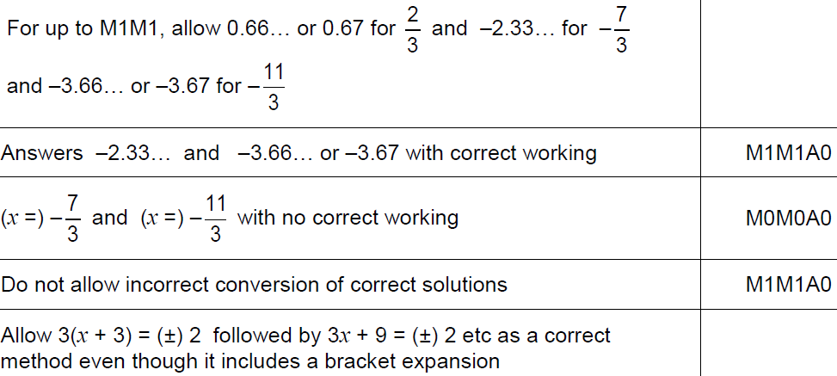
Factorising
May 2018 1H Q27
B notes

