Slide 1
Expanding Brackets
Expanding Brackets
Old Spec Q’s
NTSQ
Q1
NTSQ
Q11
June 2018
2HR Q4
NTSQ
Q3
NTSQ
Q12
Jan 2019
1H Q1
NTSQ
Q4
NTSQ
Q13
Jan 2019
1HR Q15
NTSQ
Q5
NTSQ
Q14
May 2019
1H Q3
NTSQ
Q6
SAM
1H Q11
NTSQ
Q7
SAM
1H Q15
NTSQ
Q8
May 2018
1H Q11
NTSQ
Q9
May 2018
1HR Q14
NTSQ
Q10
May 2018
1HR Q21
Triple Brackets

Slide 2
Expanding Brackets
NTSQ Q1

Slide 3
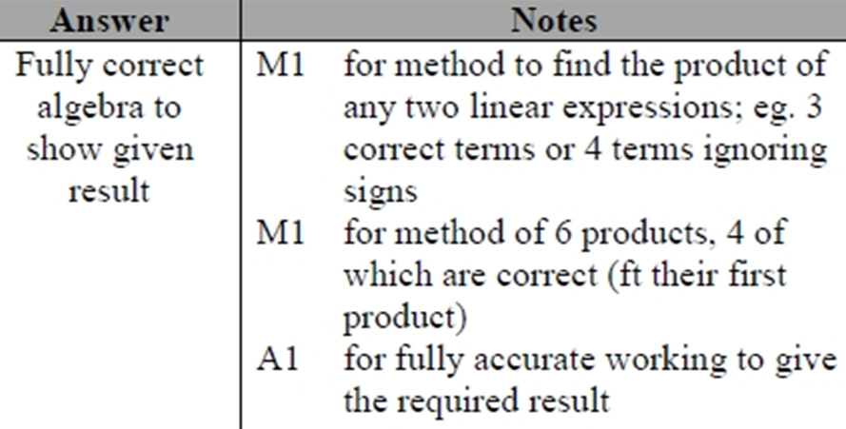
Expanding Brackets
NTSQ Q1
A

Slide 4
Expanding Brackets
NTSQ Q3

Slide 5
Expanding Brackets
NTSQ Q3
A

Slide 6
Expanding Brackets
NTSQ Q4

Slide 7
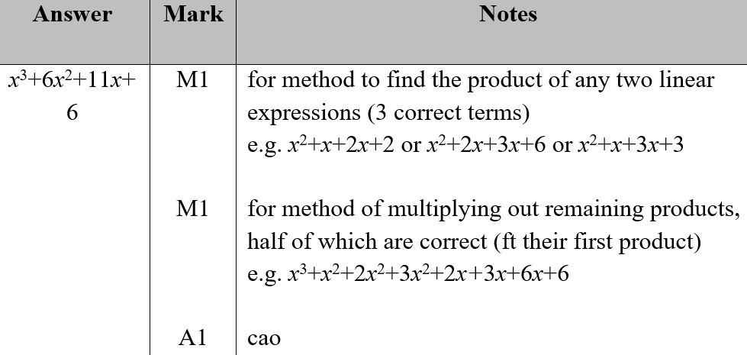
Expanding Brackets
NTSQ Q4
A

Slide 8
Expanding Brackets
NTSQ Q5

Slide 9
Expanding Brackets
NTSQ Q5
A

Slide 10
Expanding Brackets
NTSQ Q6

Slide 11
Expanding Brackets
NTSQ Q6
B

Slide 12
Expanding Brackets
NTSQ Q7

Slide 13
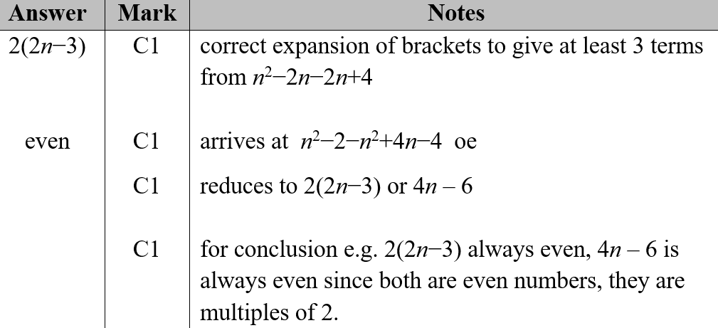
Expanding Brackets
NTSQ Q7
A

Slide 14
Expanding Brackets
NTSQ Q8

Slide 15
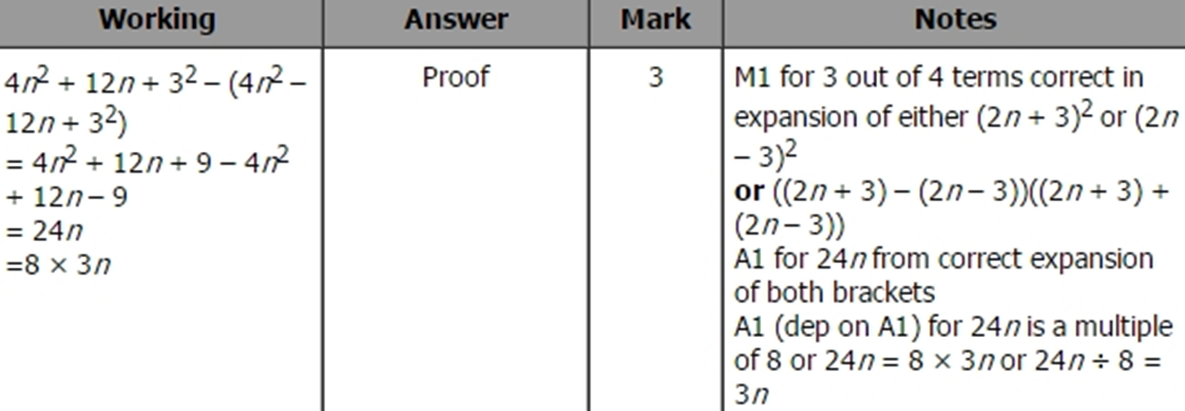
Expanding Brackets
NTSQ Q8
A

Slide 16
Expanding Brackets
NTSQ Q9

Slide 17
Expanding Brackets
NTSQ Q9
A

Slide 18
Expanding Brackets
NTSQ Q10

Slide 19
Expanding Brackets
NTSQ Q10
A

Slide 20
Expanding Brackets
NTSQ Q11

Slide 21
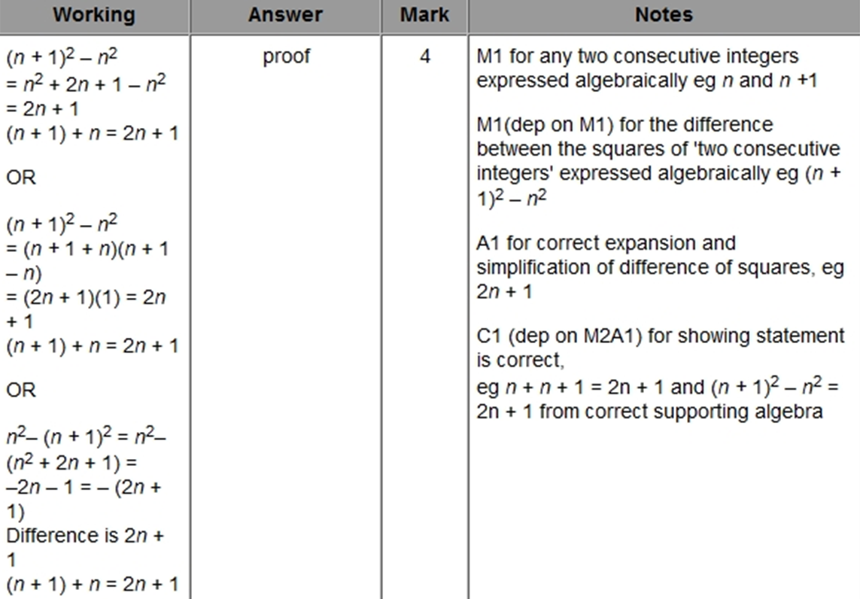
Expanding Brackets
NTSQ Q11
A

Slide 22
Expanding Brackets
NTSQ Q12

Slide 23
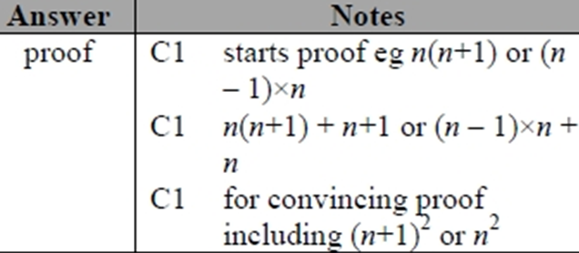
Expanding Brackets
NTSQ Q12
A

Slide 24
Expanding Brackets
NTSQ Q13

Slide 25
Expanding Brackets
NTSQ Q13
A

Slide 26
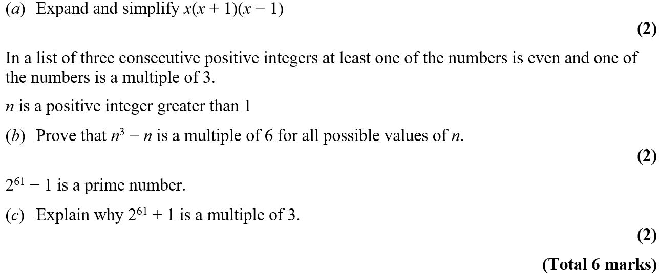
Expanding Brackets
NTSQ Q14

Slide 27
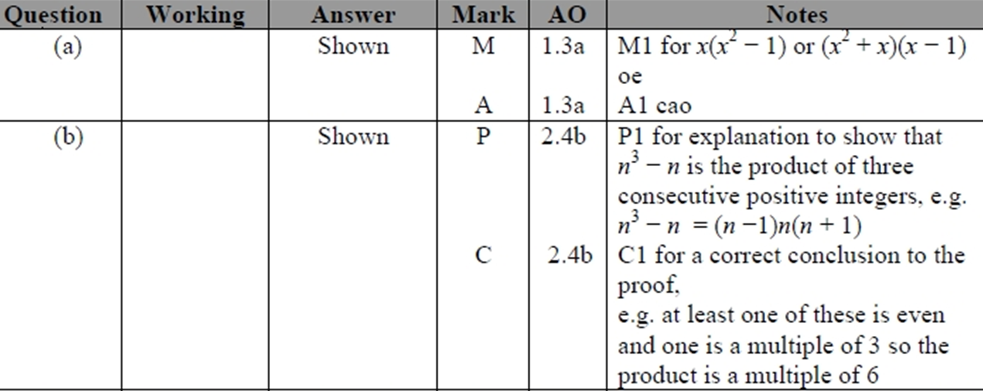
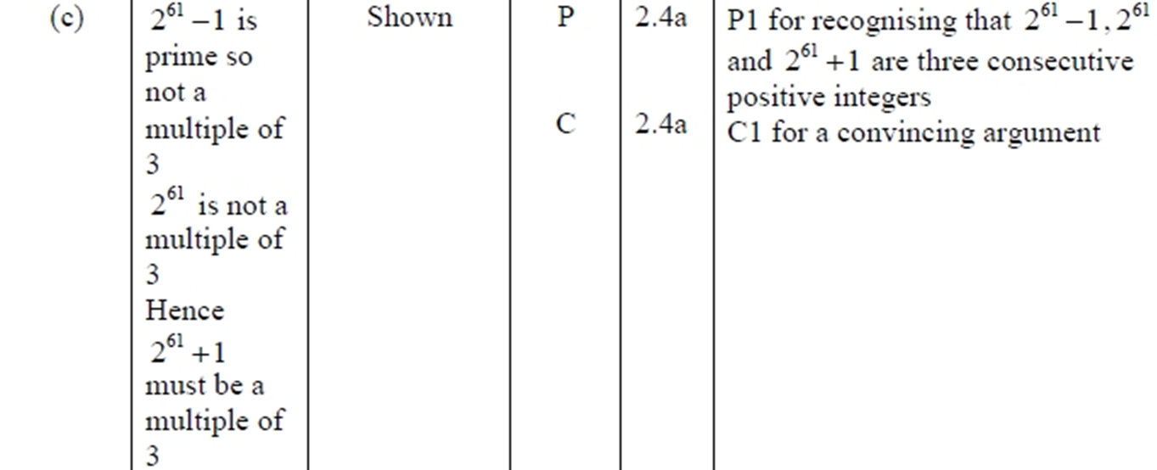
Expanding Brackets
NTSQ Q14
A
B
C

Slide 28
Expanding Brackets
SAM 1H Q11

Slide 29
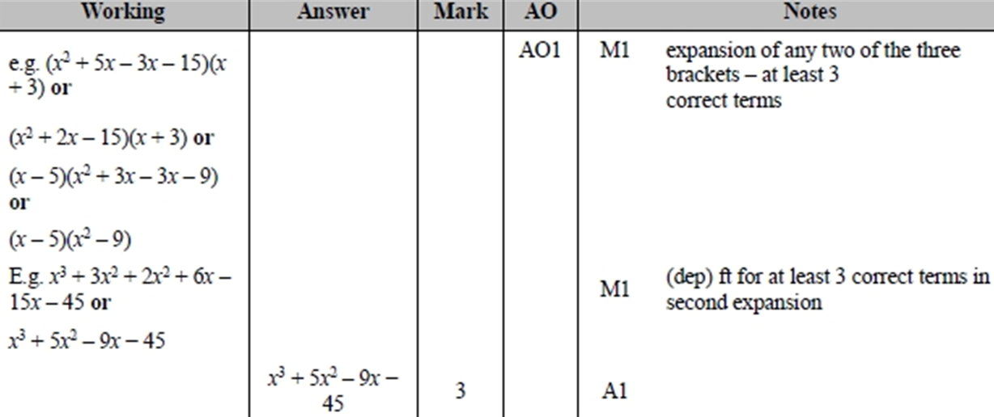
Expanding Brackets
SAM 1H Q11
A

Slide 30
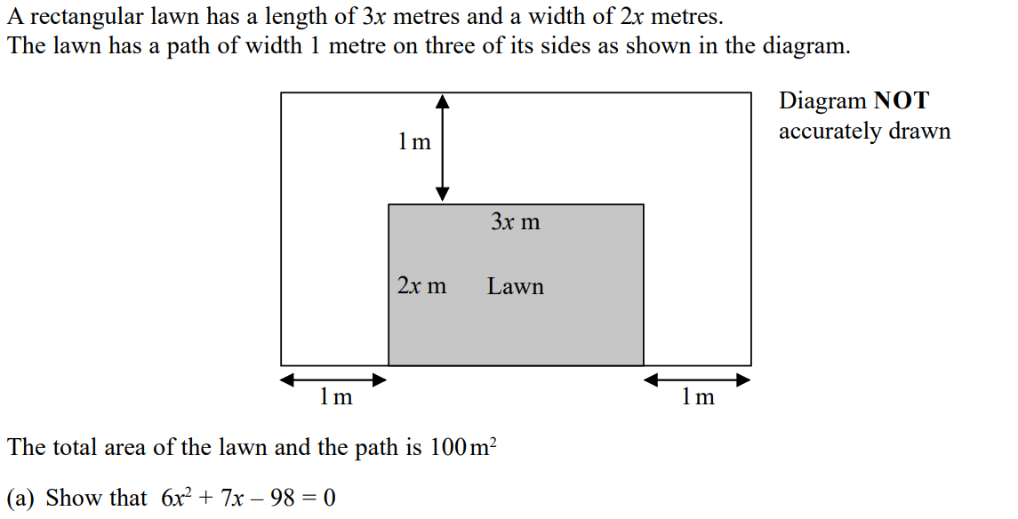
Expanding Brackets
SAM 1H Q15

Slide 31
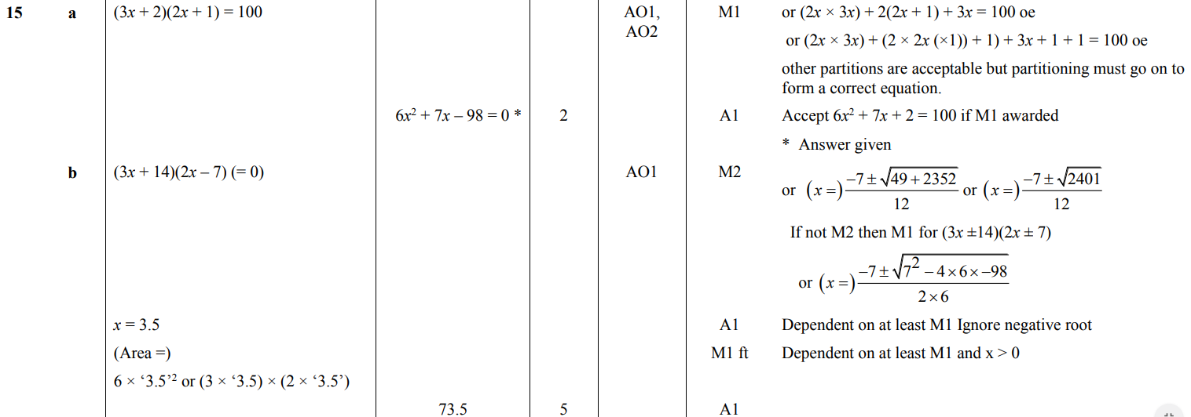
Expanding Brackets
SAM 1H Q15
A
B

Slide 32
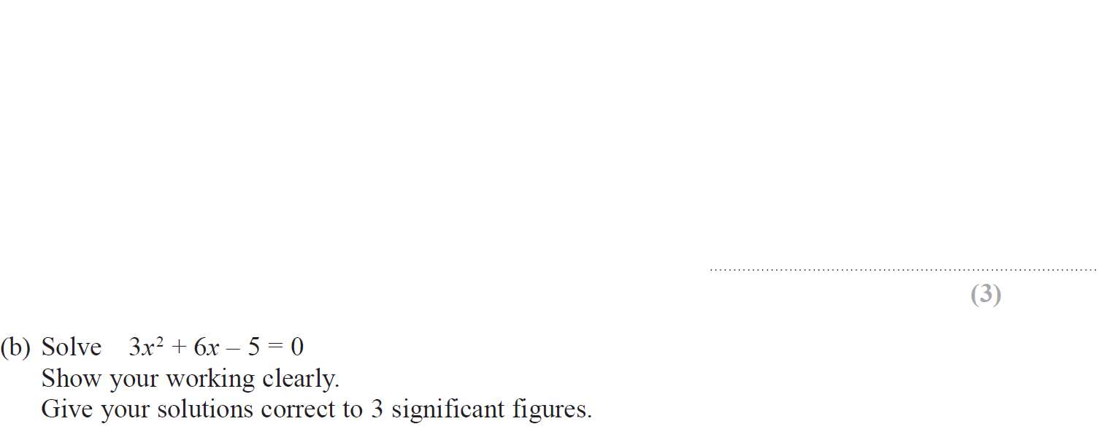
Expanding Brackets
May 2018 1H Q11

Slide 33
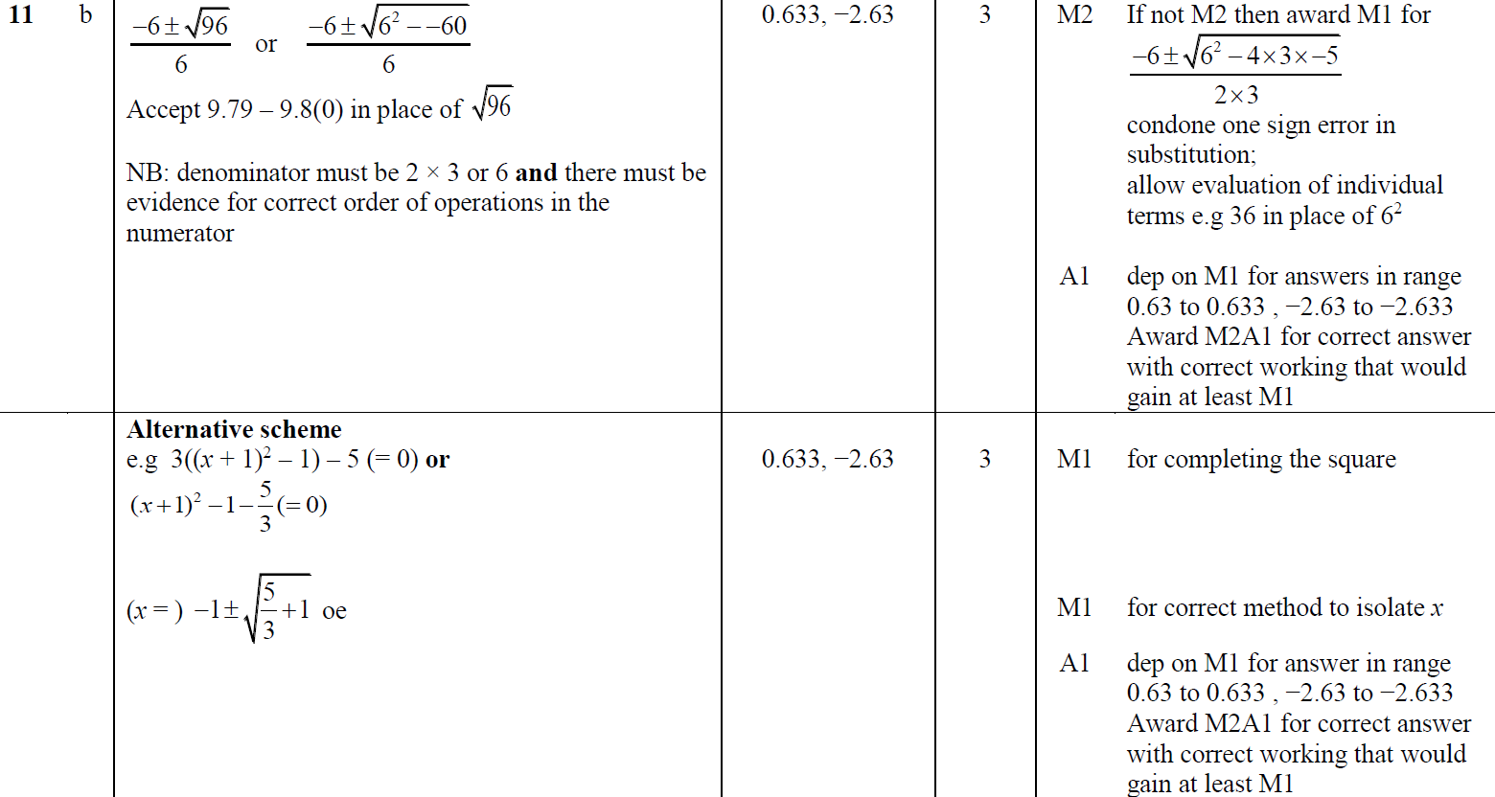
Expanding Brackets
May 2018 1H Q11
A
B

Slide 34
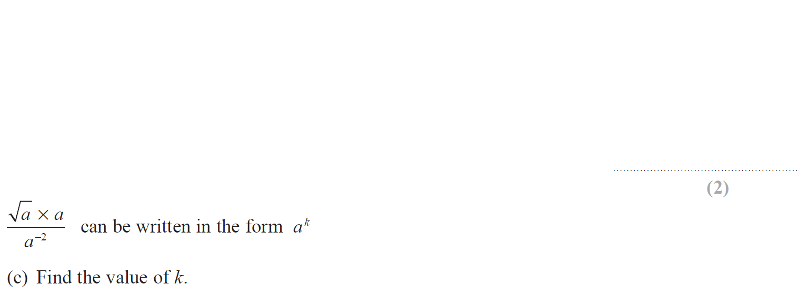
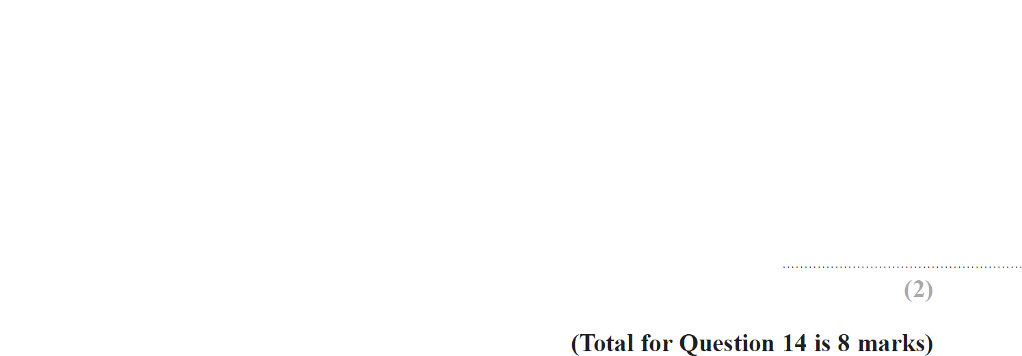
Expanding Brackets
May 2018 1HR Q14

Slide 35
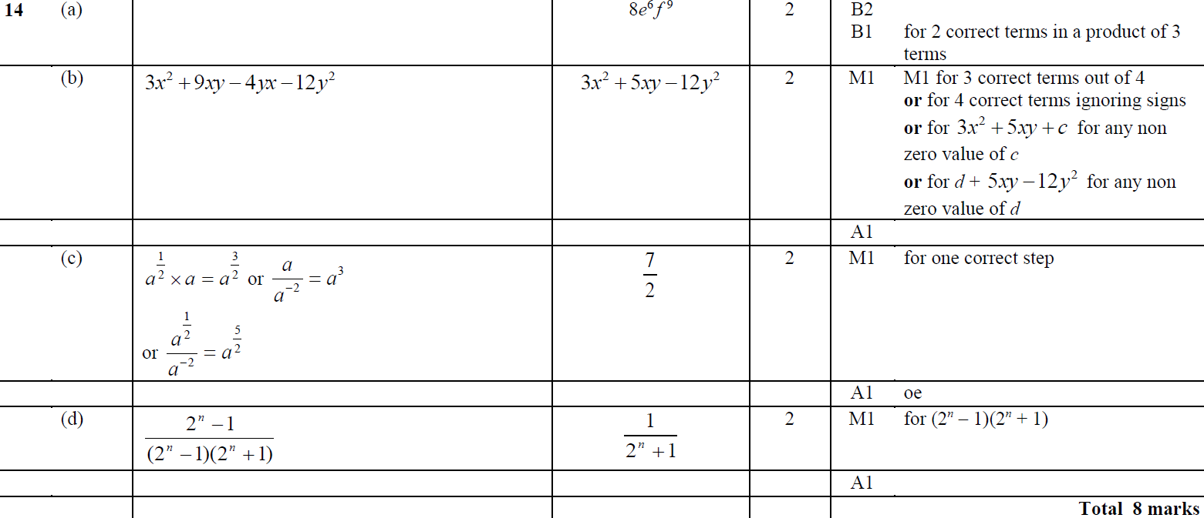
Expanding Brackets
May 2018 1HR Q14
A
B
C
D

Slide 36
Expanding Brackets
May 2018 1HR Q21

Slide 37
Expanding Brackets
May 2018 1HR Q21
A
B

Slide 38
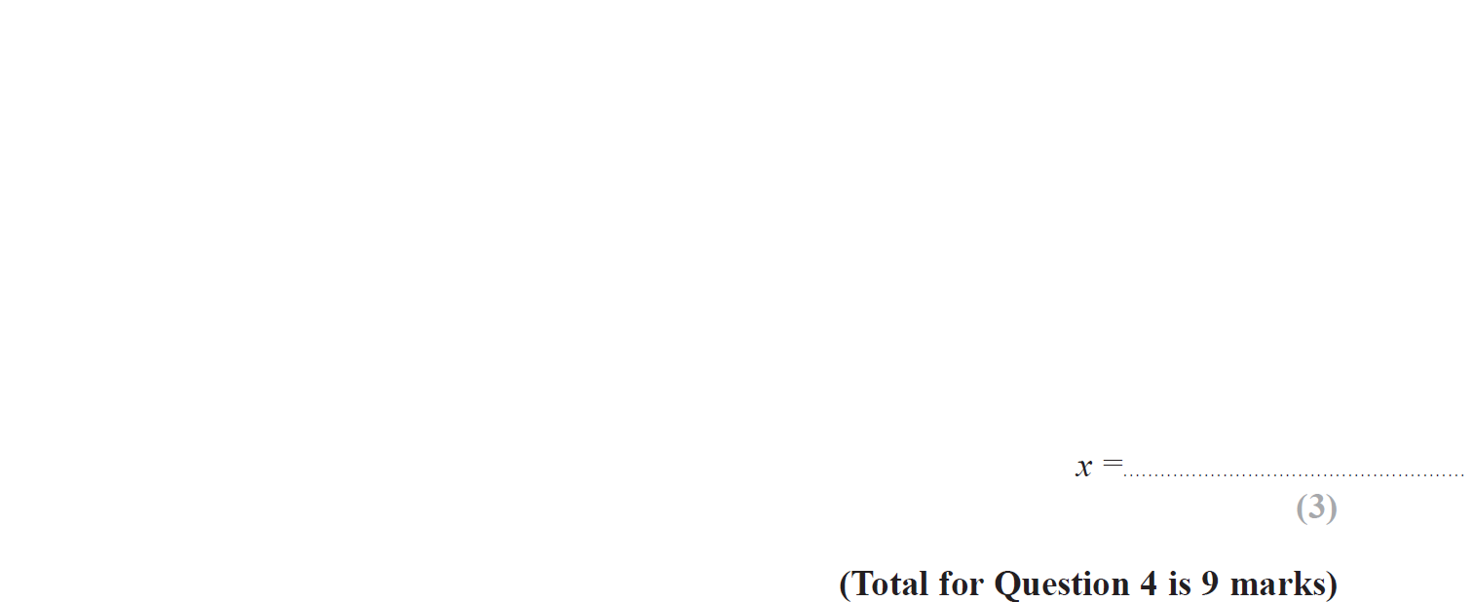
Expanding Brackets
June 2018 2HR Q4

Slide 39
Expanding Brackets
June 2018 2HR Q4
A
B
C
D

Slide 40
Expanding Brackets
Jan 2019 1H Q1

Slide 41
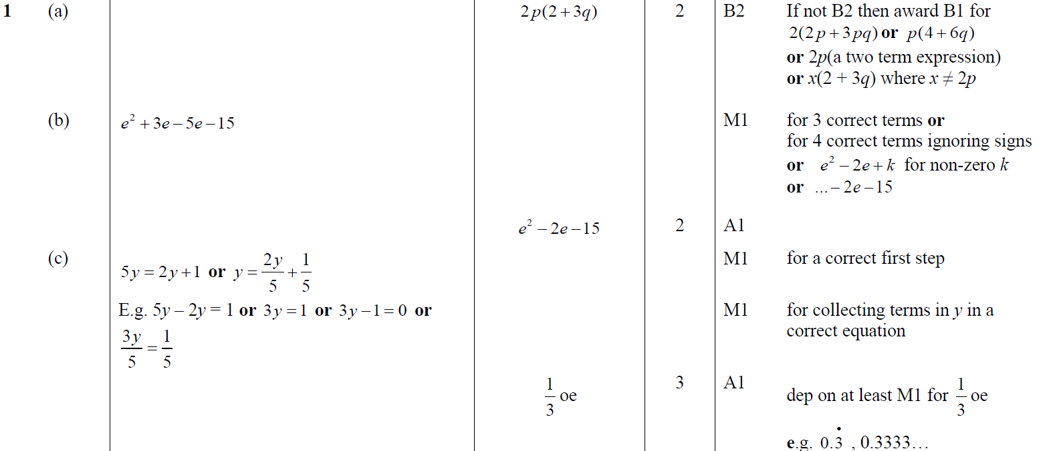
Expanding Brackets
Jan 2019 1H Q1
A
B
C

Slide 42
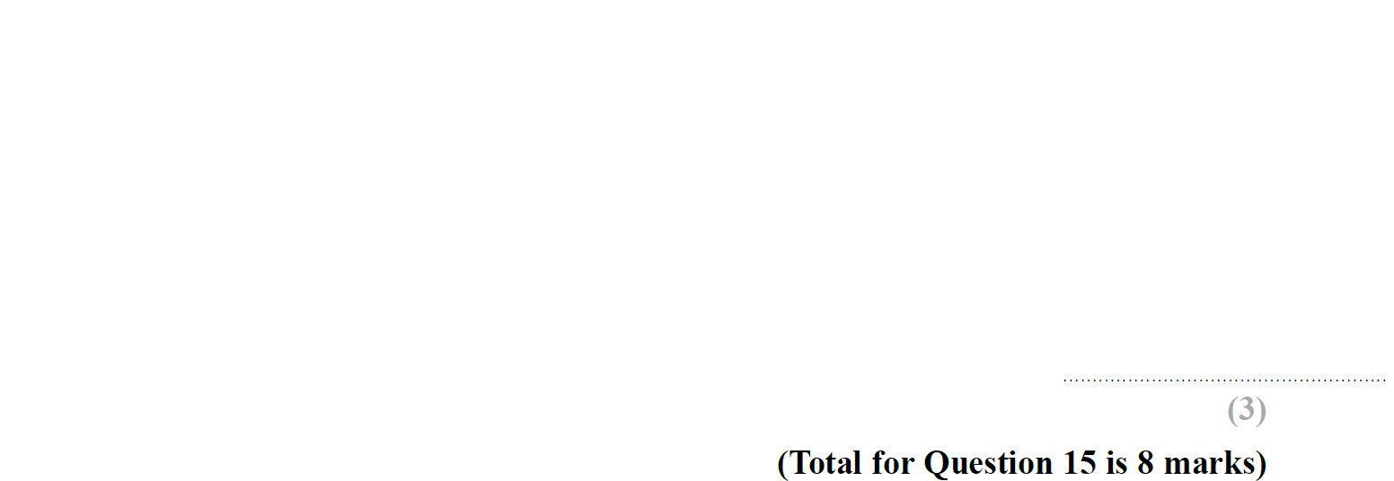
Expanding Brackets
Jan 2019 1HR Q15

Slide 43
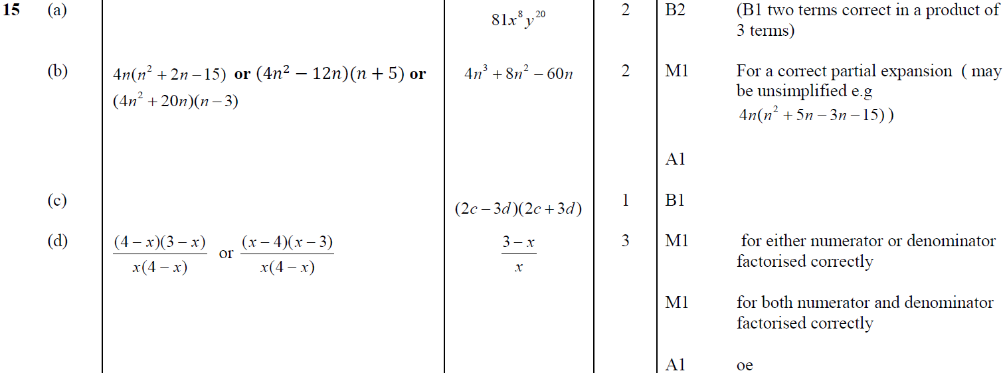
Expanding Brackets
Jan 2019 1HR Q15
A
B
C
D

Slide 44
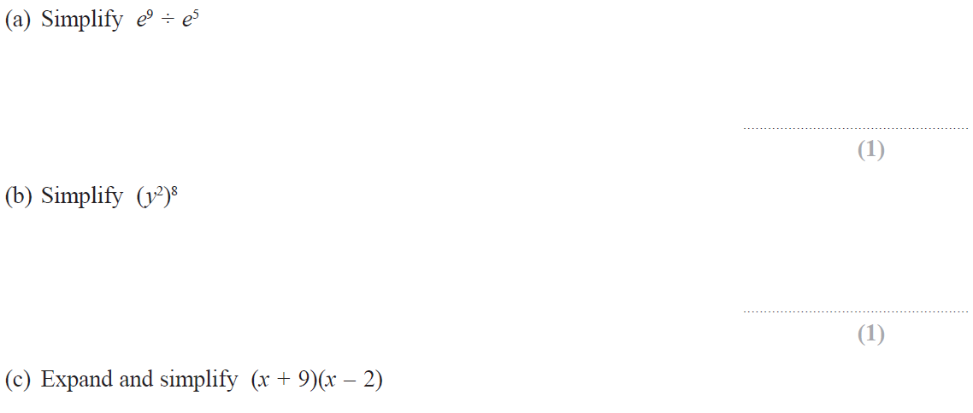
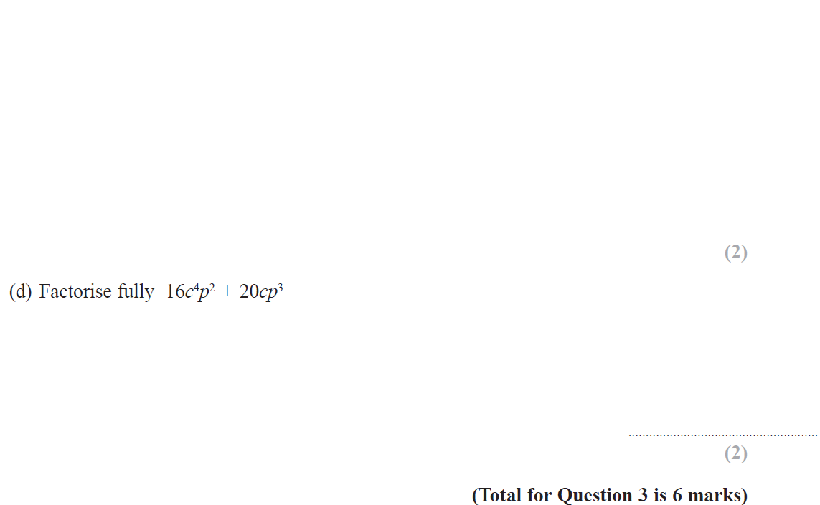
Expanding Brackets
May 2019 1H Q3

Slide 45
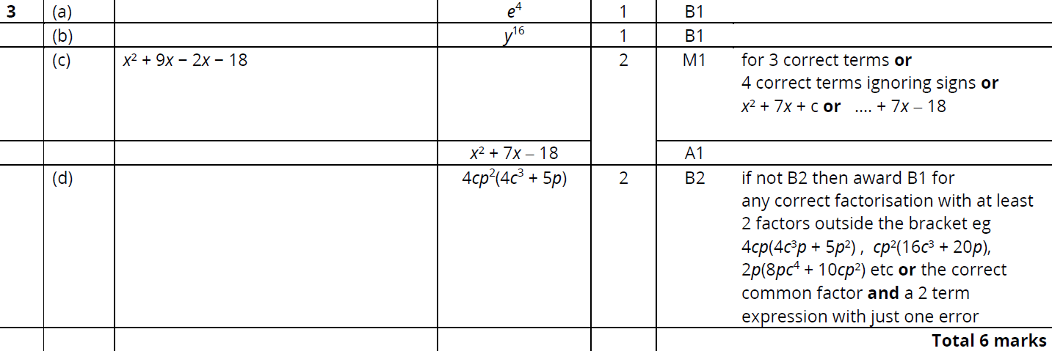
Expanding Brackets
May 2019 1H Q3
A
B
C
D

Slide 46
Expanding Brackets
Expanding Brackets
New Spec Q’s
May 2004
3H Q2
Nov 2006
4H Q2
Nov 2009
4H Q12
Jan 2014 4H Q6
June 2015 4H Q7
June 2016 4HR Q14
Jan 2018 4HR Q7
May 2004
4H Q19
May 2007
3H Q6
June 2010
3H Q4
Jan 2014 3HR Q4
June 2015 4HR Q9
Jan 2017 3H Q5
May 2018 3H Q6
Nov 2004
4H Q6
Nov 2007
3H Q9
Nov 2010
3H Q2
May 2014 3H Q4
Jan 2016 4H Q9
Jan 2017 3H Q9
June 2018 4H Q7
May 2005
3H Q17
May 2008
4H Q4
June 2011 3H Q3
May 2014 4H Q9
Jan 2016 3HR Q2
Jan 2017 3HR Q11
June 2018 4H Q13
May 2005
4H Q4
Nov 2008
3H Q8
June 2011 3H Q21
May 2014 3HR Q5
Jan 2016 4HR Q6
Jan 2017 4HR Q7
June 2018 4HR Q9
May 2005
4H Q14
Nov 2008
3H Q20
Jan 2012 3H Q5
May 2014 4HR Q21
Jan 2016 4HR Q12
Jan 2017 4HR Q21
Nov 2005
4H Q3
Nov 2008
4H Q6
May 2012 4H Q10
Jan 2015 3H Q3
May 2016 3H Q7
May 2017 3H Q1
Nov 2005
4H Q11
May 2009
3H Q5
Jan 2013 4H Q8
Jan 2015 3H Q22
June 2016 4H Q5
June 2017 4HR Q5
May 2006
3H Q13
May 2009
3H Q21
May 2013 3H Q3
Jan 2015 3HR Q4
May 2016 3HR Q12
Jan 2018 4H Q10
May 2006
4H Q2
Nov 2009
3H Q9
May 2013 3HR Q4
Jan 2015 4HR Q11
June 2016 4HR Q2
Jan 2018 3HR Q1

Slide 47
Expanding Brackets
May 2004 3H Q2

Slide 48
Expanding Brackets
May 2004 3H Q2
A
B
C
D

Slide 49
Expanding Brackets
May 2004 4H Q19

Slide 50
Expanding Brackets
May 2004 4H Q19
A
B
C
D

Slide 51
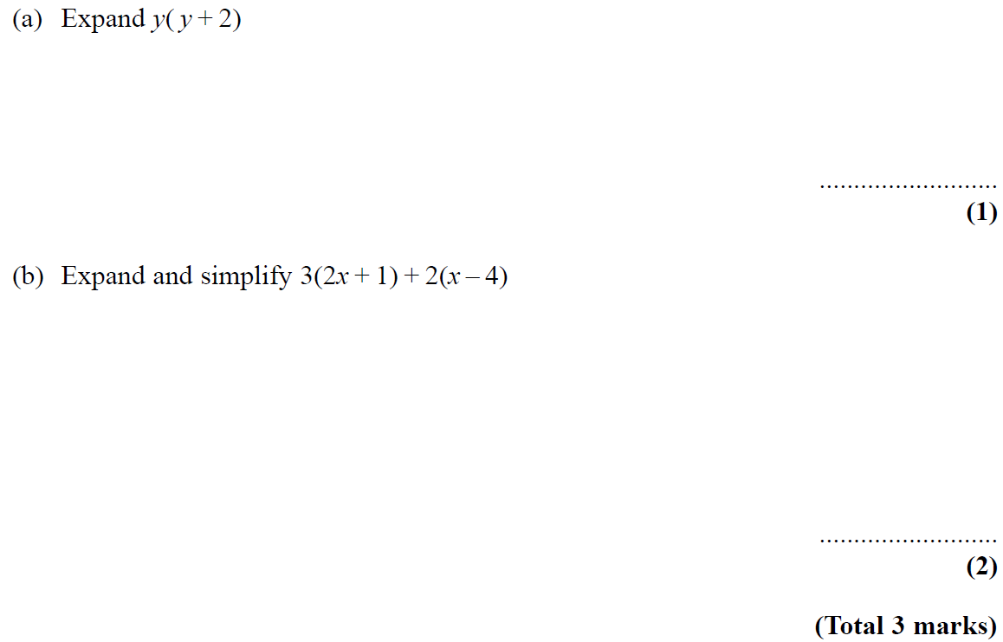
Expanding Brackets
Nov 2004 4H Q6

Slide 52
Expanding Brackets
Nov 2004 4H Q6
A
B

Slide 53
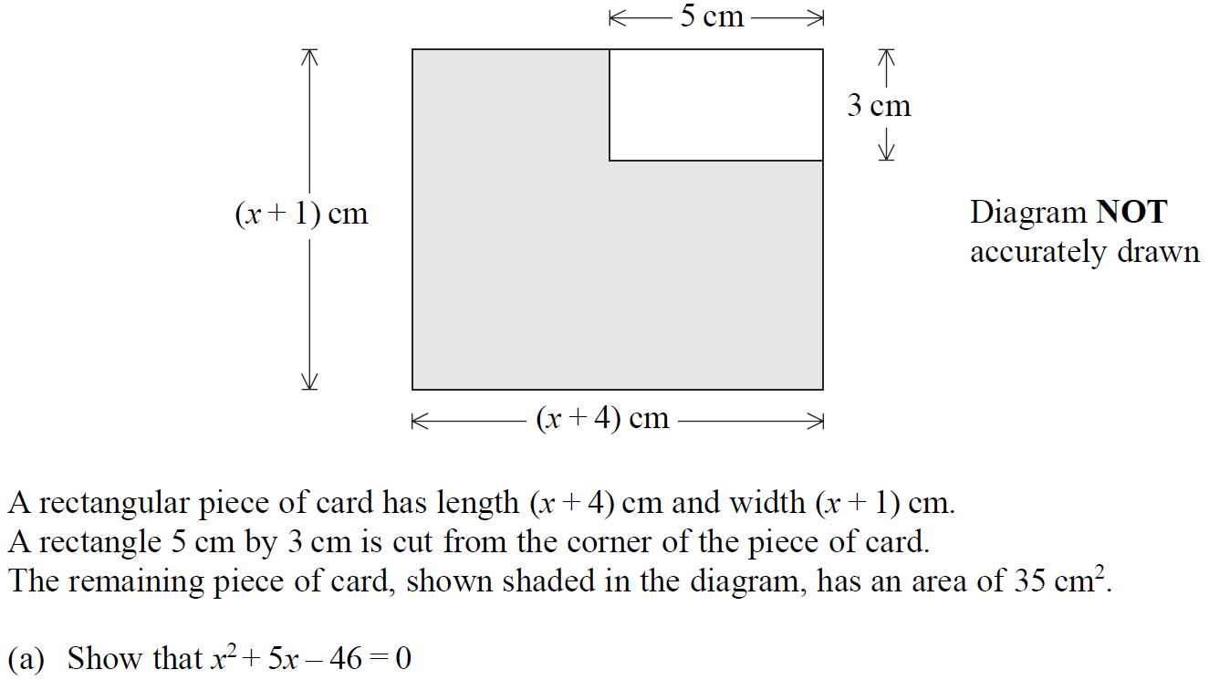
Expanding Brackets
May 2005 3H Q17

Slide 54
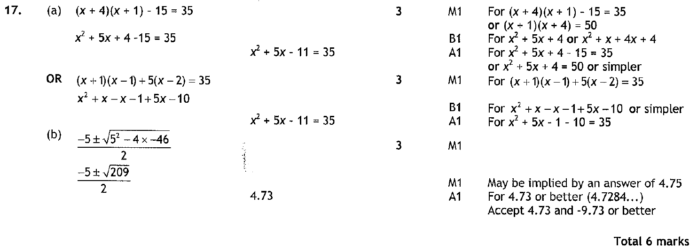
Expanding Brackets
May 2005 3H Q17
A
B

Slide 55
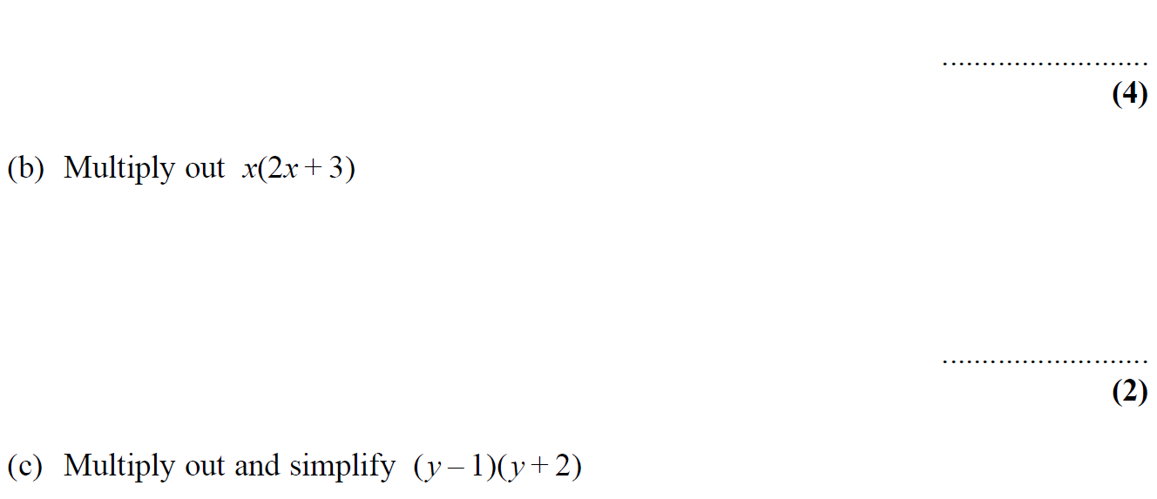
Expanding Brackets
May 2005 4H Q4

Slide 56
Expanding Brackets
May 2005 4H Q4
A (i)
A (ii)
A (iii)
B
C

Slide 57
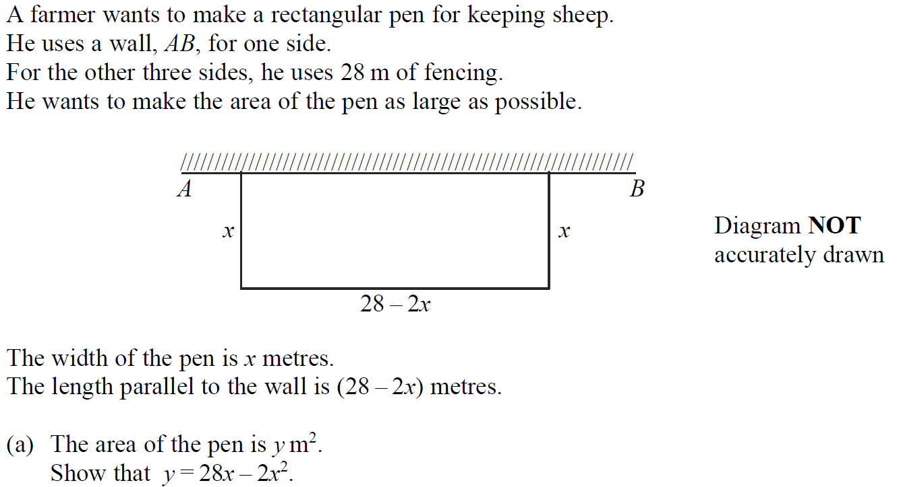
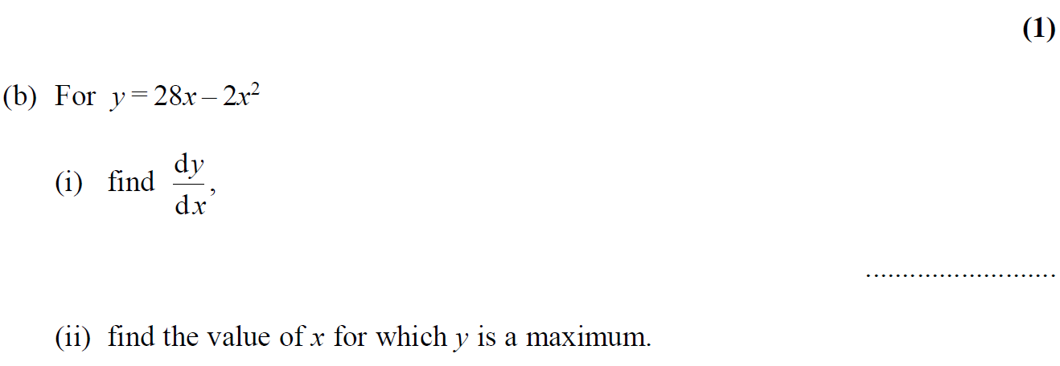
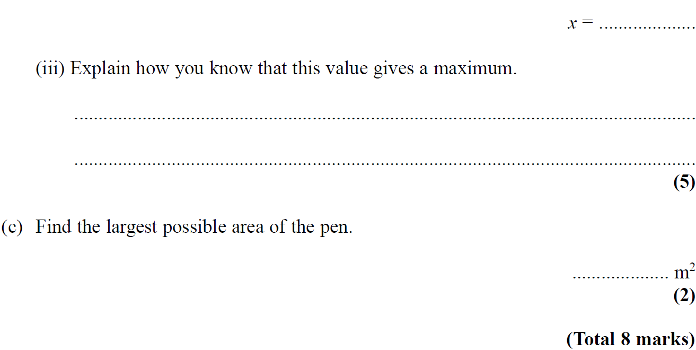
Expanding Brackets
May 2005 4H Q14

Slide 58
Expanding Brackets
May 2005 4H Q14
A
B (i)
B (ii)
B (iii)
C

Slide 59
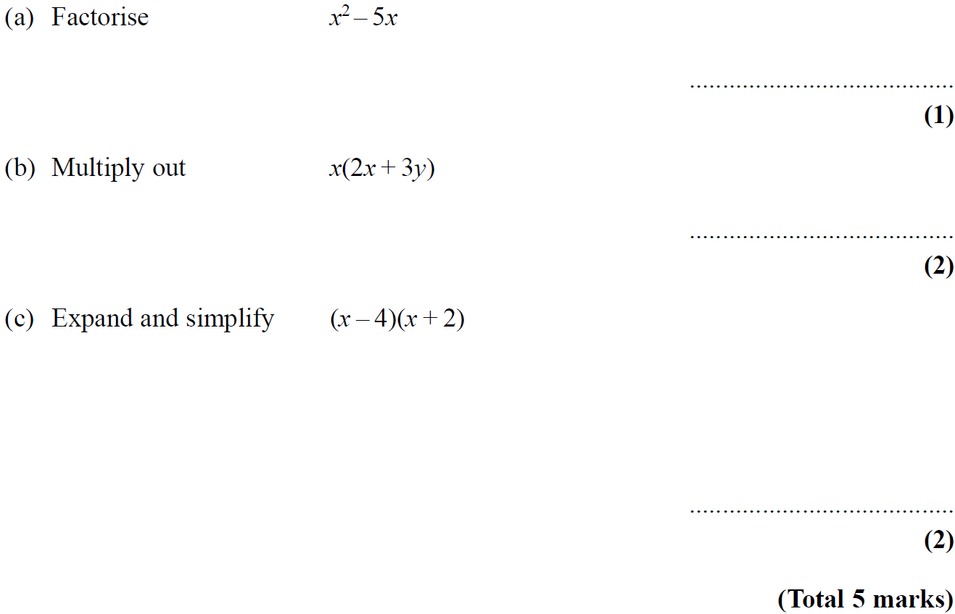
Expanding Brackets
Nov 2005 4H Q3

Slide 60
Expanding Brackets
Nov 2005 4H Q3
A
B
C

Slide 61
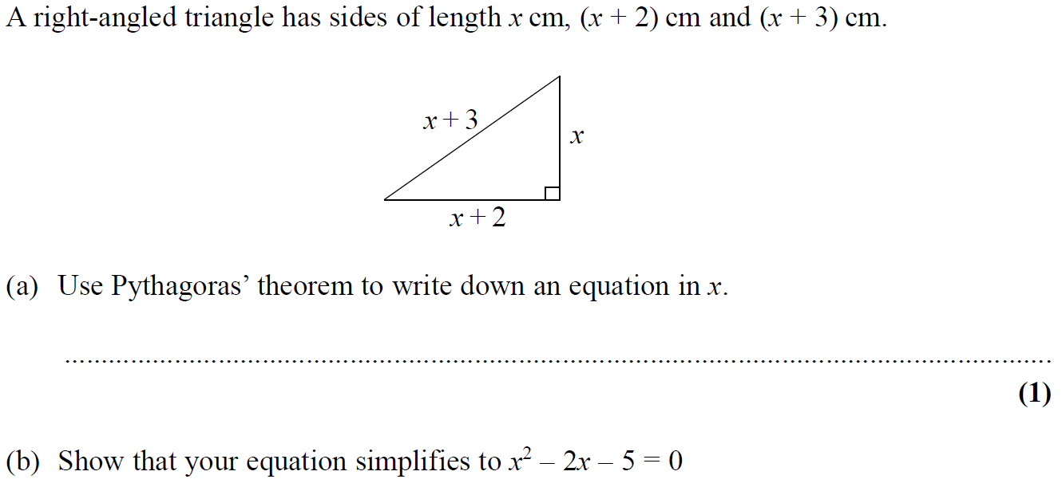
Expanding Brackets
Nov 2005 4H Q11

Slide 62
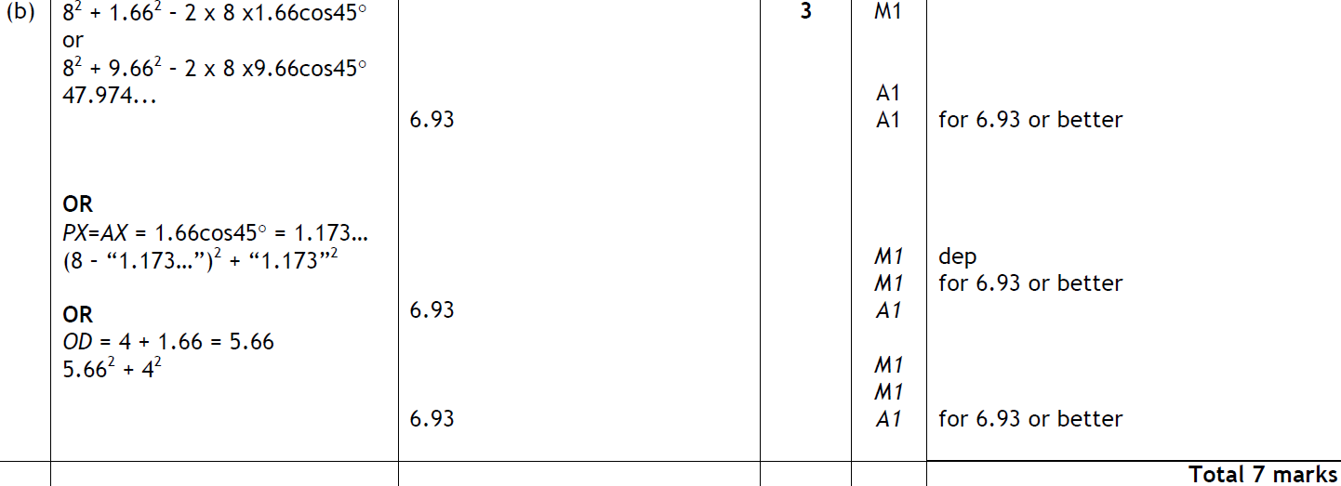
Expanding Brackets
Nov 2005 4H Q11
A
B

Slide 63
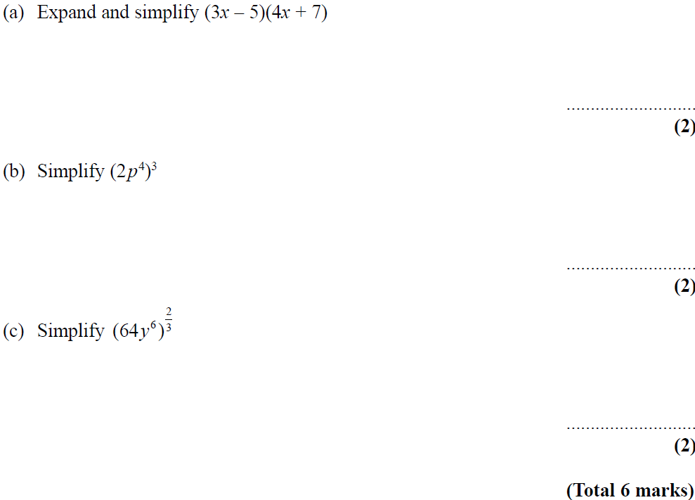
Expanding Brackets
May 2006 3H Q13

Slide 64
Expanding Brackets
May 2006 3H Q13
A
B
C

Slide 65
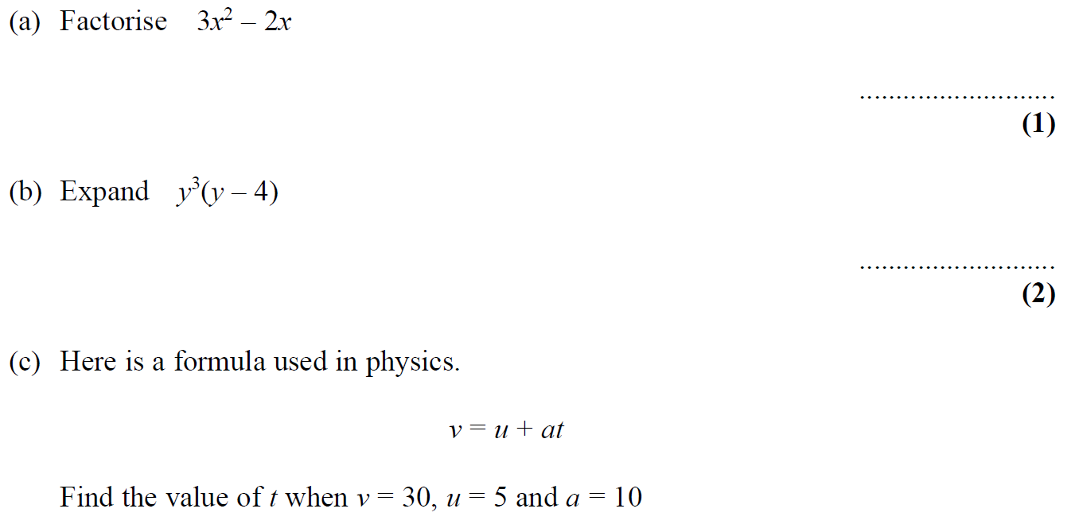
Expanding Brackets
May 2006 4H Q2

Slide 66
Expanding Brackets
May 2006 4H Q2
A
B
C

Slide 67
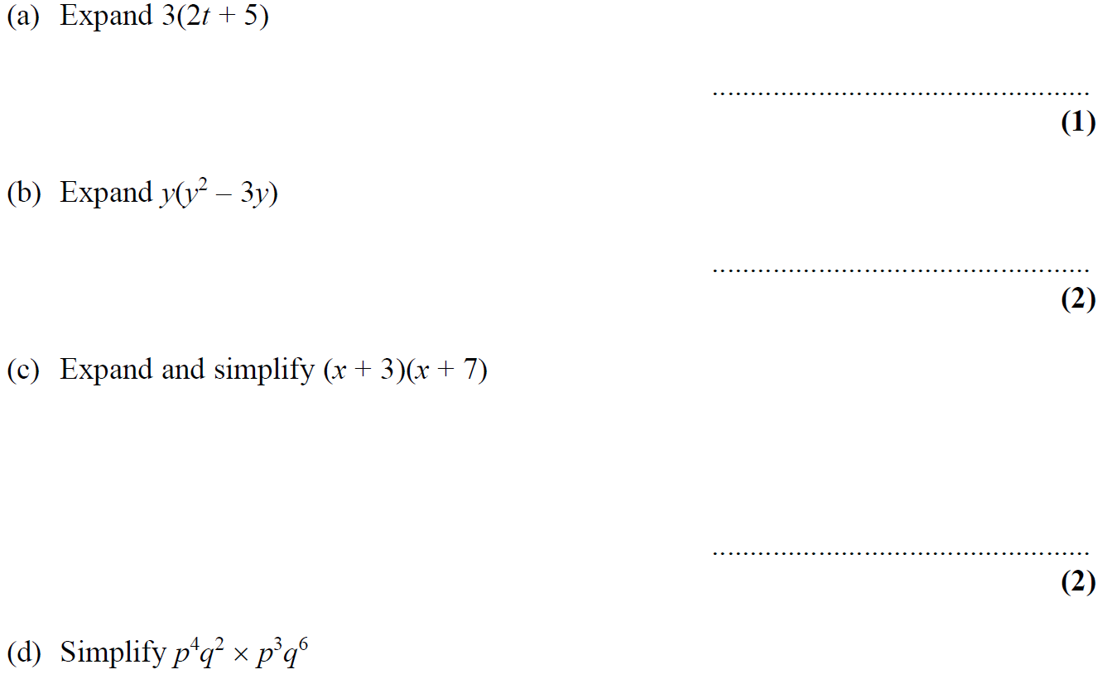
Expanding Brackets
Nov 2006 4H Q2

Slide 68
Expanding Brackets
Nov 2006 4H Q2
A
B
C
D

Slide 69
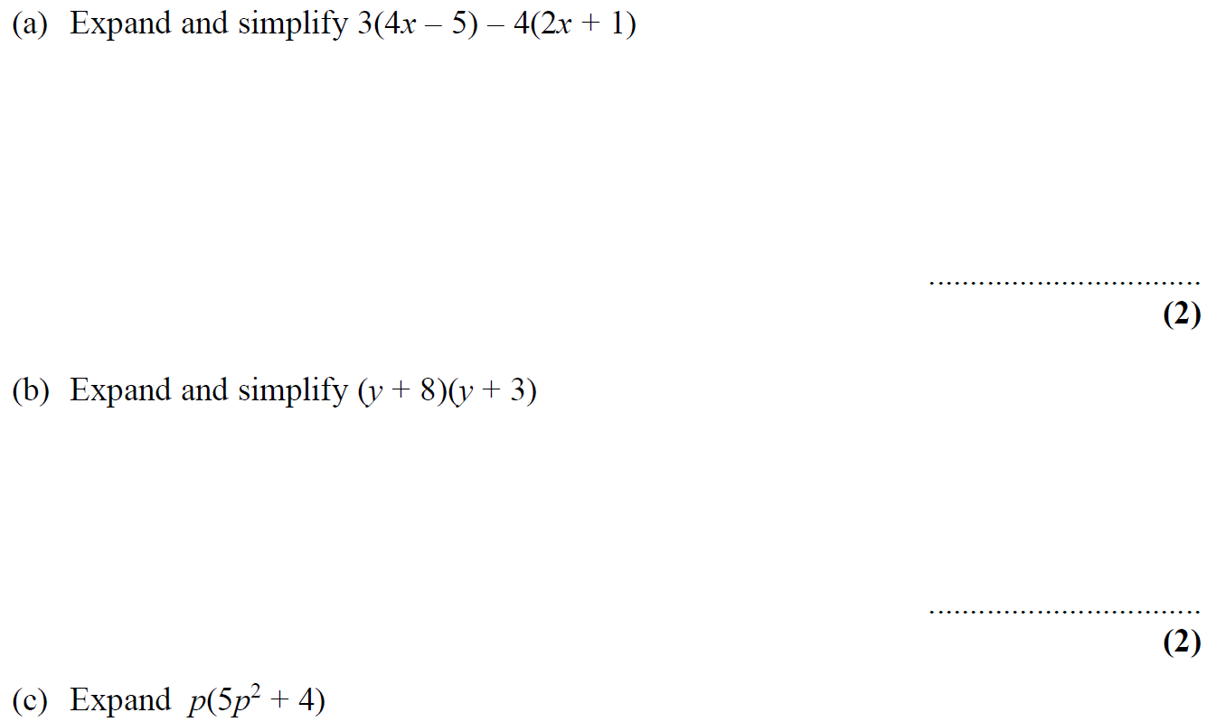
Expanding Brackets
May 2007 3H Q6

Slide 70
Expanding Brackets
May 2007 3H Q6
A
B
C

Slide 71
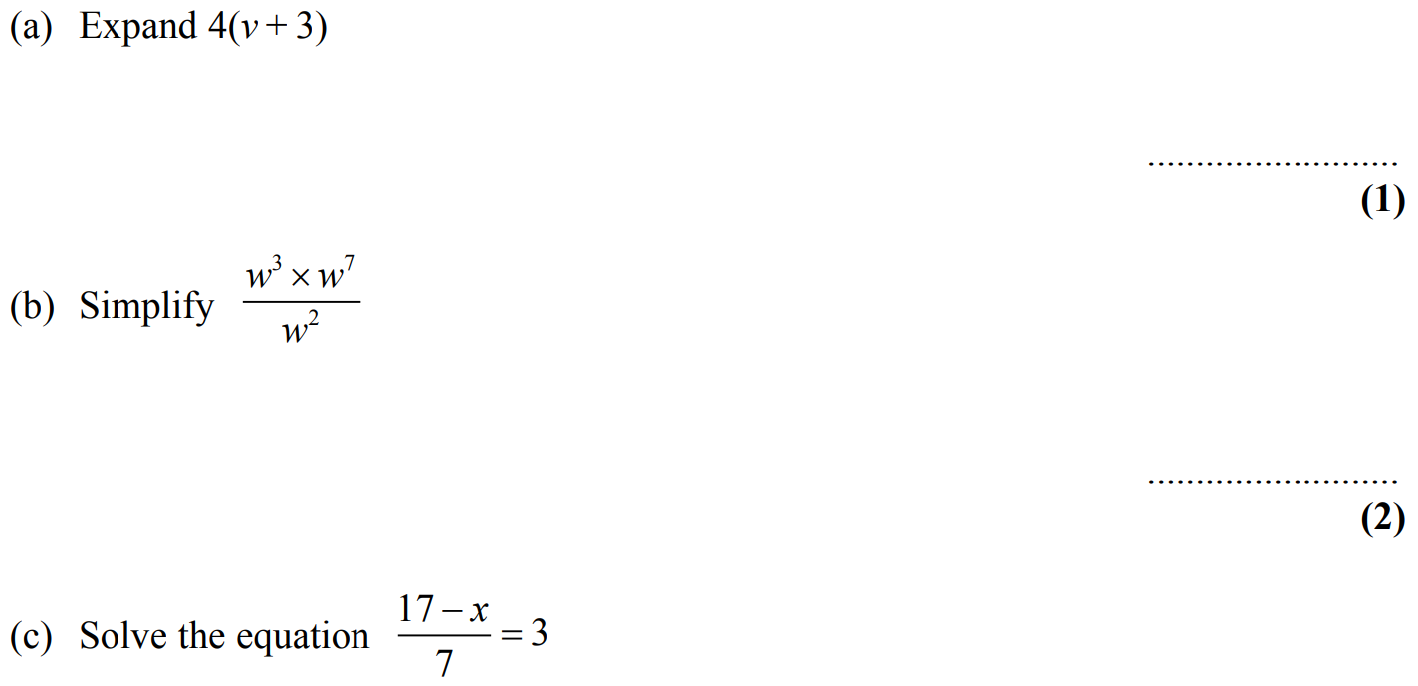
Expanding Brackets
Nov 2007 3H Q9

Slide 72
Expanding Brackets
Nov 2007 3H Q9
A
B
C
D

Slide 73
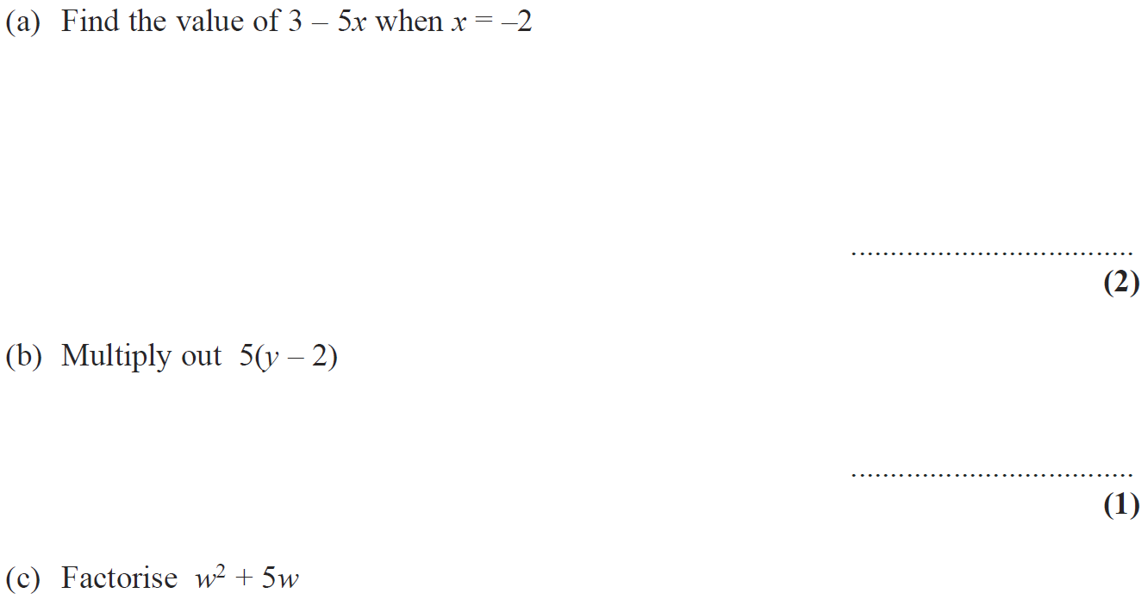
Expanding Brackets
May 2008 4H Q4

Slide 74
Expanding Brackets
May 2008 4H Q4
A
B
C

Slide 75
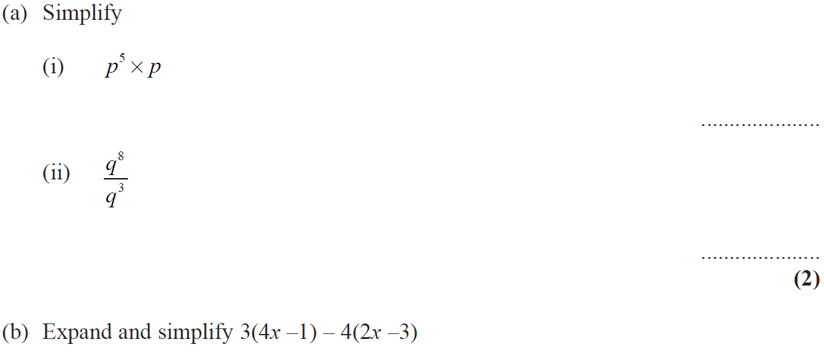
Expanding Brackets
Nov 2008 3H Q8

Slide 76
Expanding Brackets
Nov 2008 3H Q8
A (i)
A (ii)
B
C

Slide 77
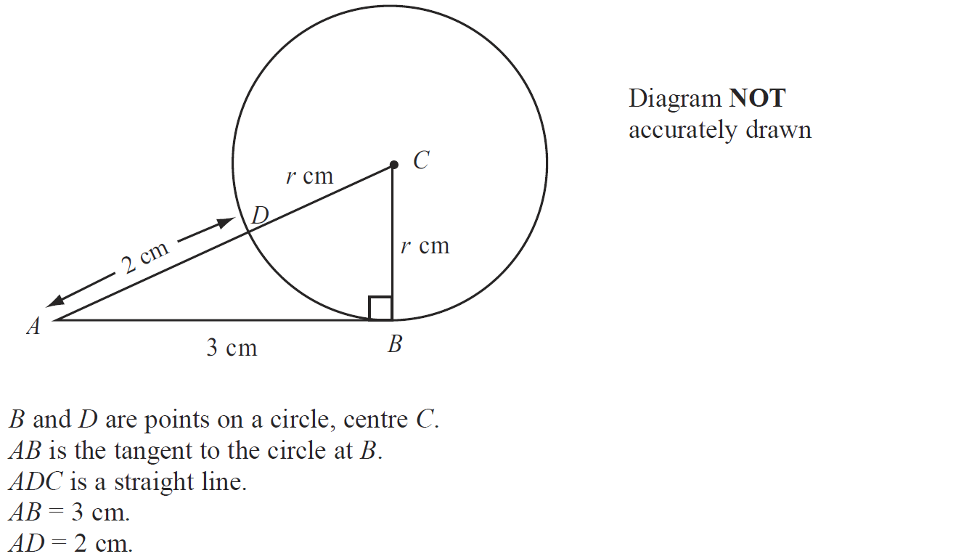
Expanding Brackets
Nov 2008 3H Q20

Slide 78
Expanding Brackets
Nov 2008 3H Q20
A

Slide 79
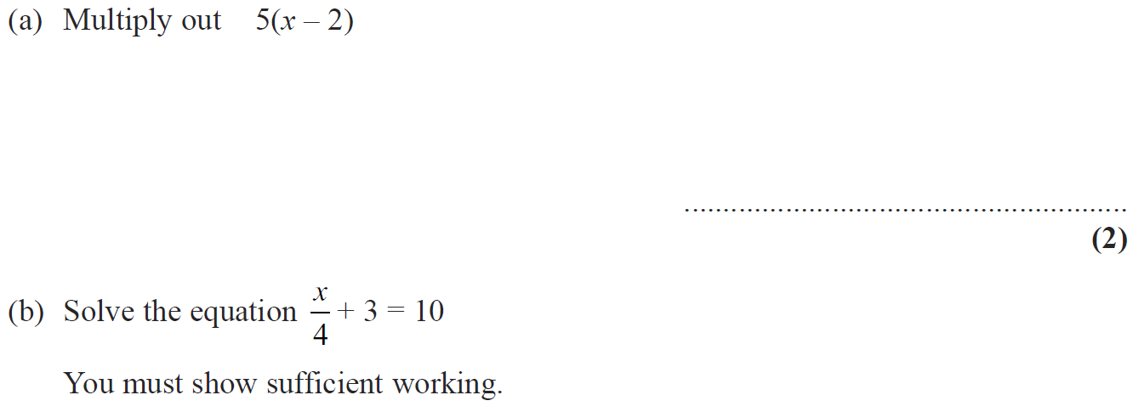
Expanding Brackets
Nov 2008 4H Q6

Slide 80
Expanding Brackets
Nov 2008 4H Q6
A
B
C

Slide 81
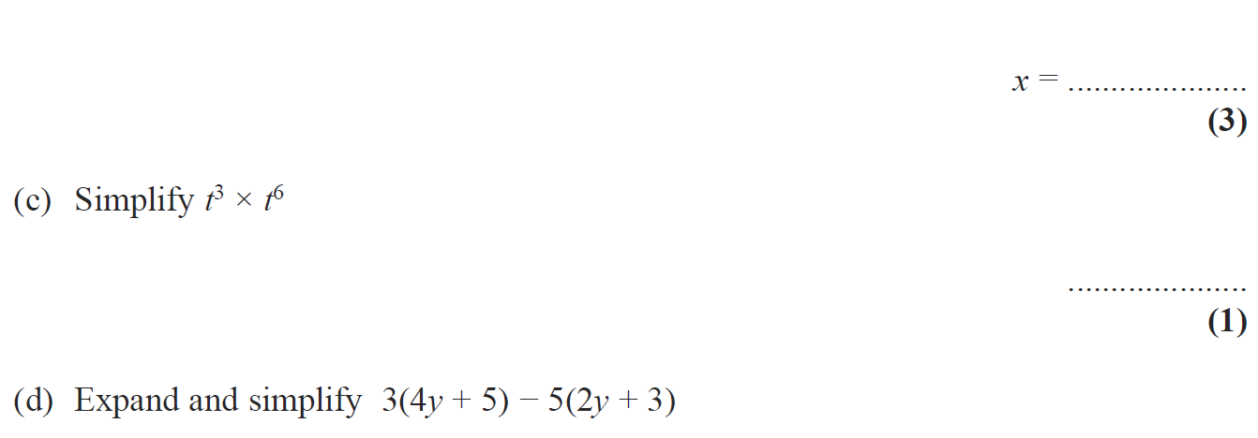
Expanding Brackets
May 2009 3H Q5

Slide 82
Expanding Brackets
May 2009 3H Q5
A
B
C
D

Slide 83
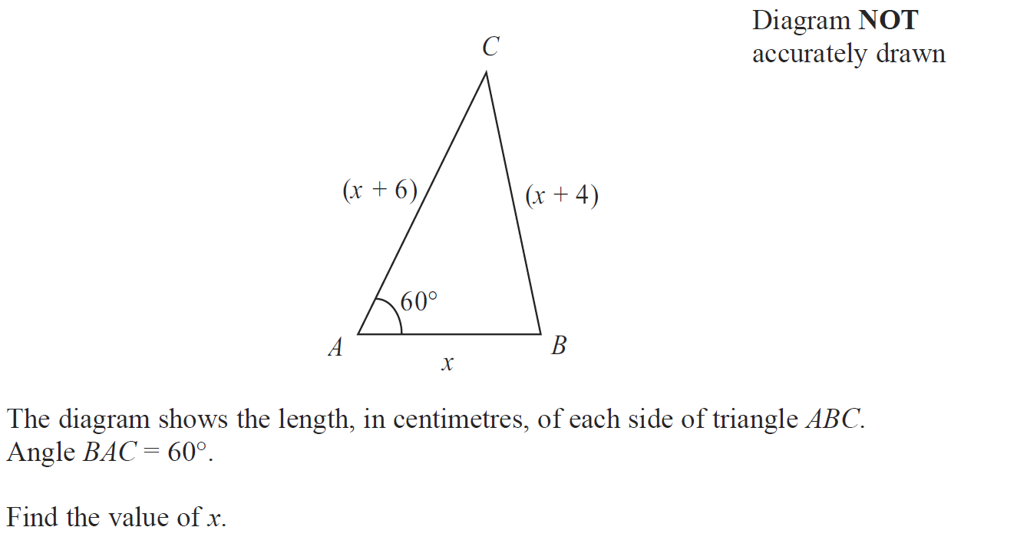
Expanding Brackets
May 2009 3H Q21

Slide 84
Expanding Brackets
May 2009 3H Q21
A

Slide 85
Expanding Brackets
Nov 2009 3H Q9

Slide 86
Expanding Brackets
Nov 2009 3H Q9
A
B
C

Slide 87
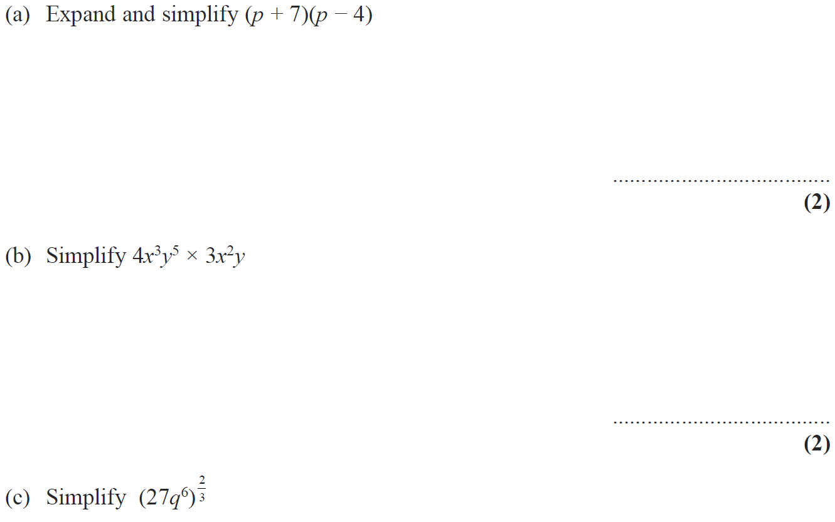
Expanding Brackets
Nov 2009 4H Q12

Slide 88
Expanding Brackets
Nov 2009 4H Q12
A
B
C

Slide 89
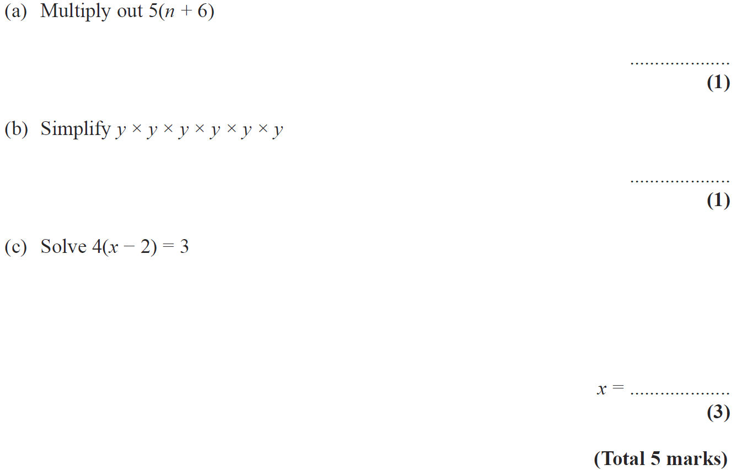
Expanding Brackets
June 2010 3H Q4

Slide 90
Expanding Brackets
June 2010 3H Q4
A
B
C

Slide 91
Expanding Brackets
Nov 2010 3H Q2

Slide 92
Expanding Brackets
Nov 2010 3H Q2
A (i)
A (ii)
B

Slide 93
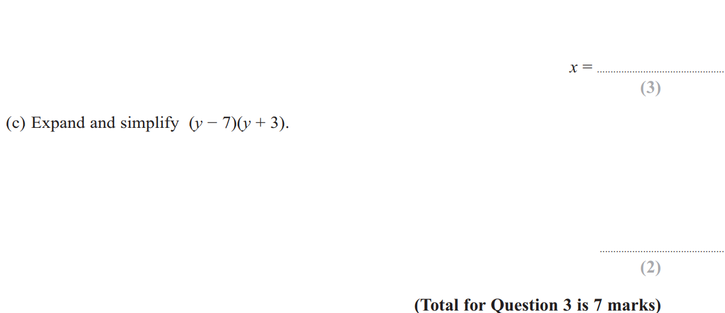
Expanding Brackets
June 2011 3H Q3

Slide 94
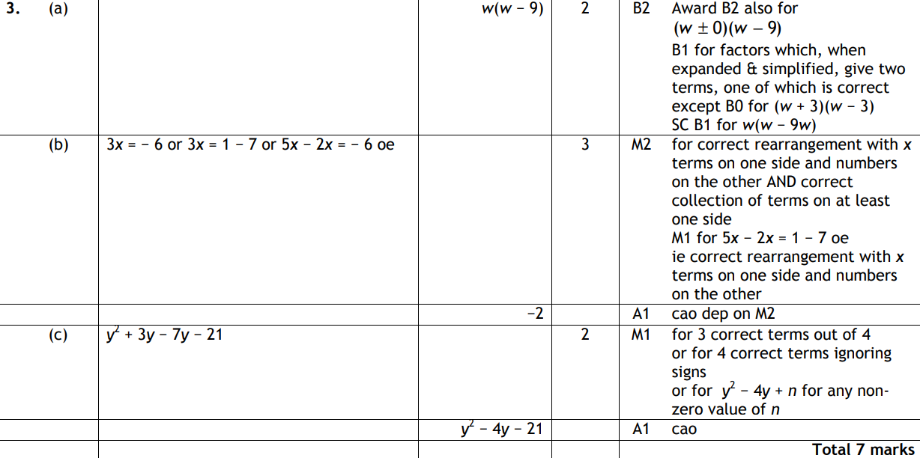
Expanding Brackets
June 2011 3H Q3
A
B
C

Slide 95
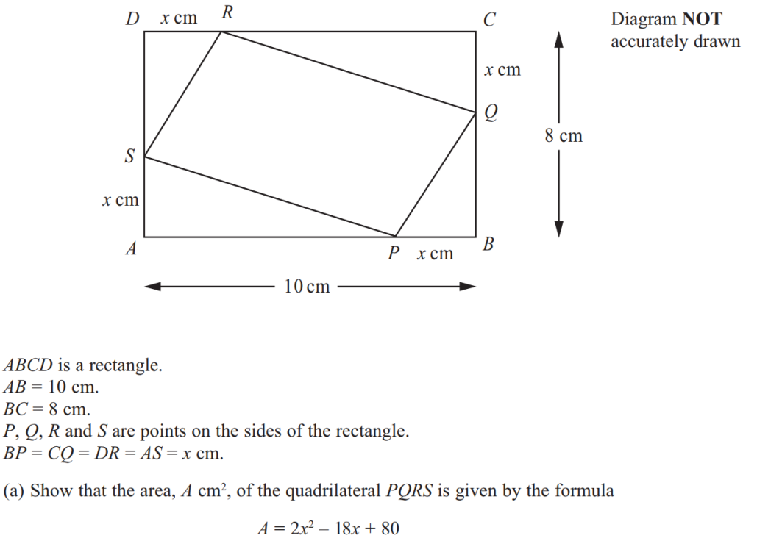
Expanding Brackets
June 2011 3H Q21

Slide 96
Expanding Brackets
June 2011 3H Q21
A
B (i)
B (ii)
B (iii)

Slide 97
Expanding Brackets
Jan 2012 3H Q5

Slide 98
Expanding Brackets
Jan 2012 3H Q5
A
B (i)
B (ii)
C

Slide 99
Expanding Brackets
May 2012 4H Q10

Slide 100
Expanding Brackets
May 2012 4H Q10
A (i)
A (ii)
B

Slide 101
Expanding Brackets
Jan 2013 4H Q8

Slide 102
Expanding Brackets
Jan 2013 4H Q8
A
B
C

Slide 103
Expanding Brackets
May 2013 3H Q3

Slide 104
Expanding Brackets
May 2013 3H Q3
A
B
C

Slide 105
Expanding Brackets
May 2013 3HR Q4

Slide 106
Expanding Brackets
May 2013 3HR Q4
A
B
C

Slide 107
Expanding Brackets
Jan 2014 4H Q6

Slide 108
Expanding Brackets
Jan 2014 4H Q6
A
B
C (i)
C (ii)
D

Slide 109
Expanding Brackets
Jan 2014 3HR Q4

Slide 110
Expanding Brackets
Jan 2014 3HR Q4
A
B
C

Slide 111
Expanding Brackets
May 2014 3H Q4

Slide 112
Expanding Brackets
May 2014 3H Q4
A
B
C
D

Slide 113
Expanding Brackets
May 2014 4H Q9

Slide 114
Expanding Brackets
May 2014 4H Q9
A
B

Slide 115
Expanding Brackets
May 2014 3HR Q5

Slide 116
Expanding Brackets
May 2014 3HR Q5
A
B

Slide 117
Expanding Brackets
May 2014 4HR Q21

Slide 118
Expanding Brackets
May 2014 4HR Q21
A
B

Slide 119
Expanding Brackets
Jan 2015 3H Q3

Slide 120
Expanding Brackets
Jan 2015 3H Q3
A
B
C
D

Slide 121
Expanding Brackets
Jan 2015 3H Q22

Slide 122
Expanding Brackets
Jan 2015 3H Q22
A

Slide 123
Expanding Brackets
Jan 2015 3HR Q4

Slide 124
Expanding Brackets
Jan 2015 3HR Q4
A
B
C

Slide 125
Expanding Brackets
Jan 2015 4HR Q11

Slide 126
Expanding Brackets
Jan 2015 4HR Q11
A
B
C
D

Slide 127
Expanding Brackets
June 2015 4H Q7

Slide 128
Expanding Brackets
June 2015 4H Q7
A
B
C
D
E

Slide 129
Expanding Brackets
June 2015 4HR Q9

Slide 130
Expanding Brackets
June 2015 4HR Q9
A
B
C
D

Slide 131
Expanding Brackets
Jan 2016 4H Q9

Slide 132
Expanding Brackets
Jan 2016 4H Q9
A
B
C

Slide 133
Expanding Brackets
Jan 2016 3HR Q2

Slide 134
Expanding Brackets
Jan 2016 3HR Q2
A
B

Slide 135
Expanding Brackets
Jan 2016 4HR Q6

Slide 136
Expanding Brackets
Jan 2016 4HR Q6
A
B
C
D
E

Slide 137
Expanding Brackets
Jan 2016 4HR Q12

Slide 138
Expanding Brackets
Jan 2016 4HR Q12
A

Slide 139
Expanding Brackets
May 2016 3H Q7

Slide 140
Expanding Brackets
May 2016 3H Q7
A
B
C (i)
C (ii)
D

Slide 141
Expanding Brackets
June 2016 4H Q5

Slide 142
Expanding Brackets
June 2016 4H Q5
A
B
C
D

Slide 143
Expanding Brackets
May 2016 3HR Q12

Slide 144
Expanding Brackets
May 2016 3HR Q12
A
B
C
D

Slide 145
Expanding Brackets
June 2016 4HR Q2

Slide 146
Expanding Brackets
June 2016 4HR Q2
A
B
C

Slide 147
Expanding Brackets
June 2016 4HR Q14

Slide 148
Expanding Brackets
June 2016 4HR Q14
A
B
C

Slide 149
Expanding Brackets
Jan 2017 3H Q5

Slide 150
Expanding Brackets
Jan 2017 3H Q5
A
B
C
D
E

Slide 151
Expanding Brackets
Jan 2017 3H Q9

Slide 152
Expanding Brackets
Jan 2017 3H Q9
A

Slide 153
Expanding Brackets
Jan 2017 3HR Q11

Slide 154
Expanding Brackets
Jan 2017 3HR Q11
A
B
C

Slide 155
Expanding Brackets
Jan 2017 4HR Q7

Slide 156
Expanding Brackets
Jan 2017 4HR Q7
A
B
C
D
E

Slide 157
Expanding Brackets
Jan 2017 4HR Q21

Slide 158
Expanding Brackets
Jan 2017 4HR Q21
A
B

Slide 159
Expanding Brackets
May 2017 3H Q1

Slide 160
Expanding Brackets
May 2017 3H Q1
A
B
C
D
E

Slide 161
Expanding Brackets
June 2017 4HR Q5

Slide 162
Expanding Brackets
June 2017 4HR Q5
A
B
C
D
E
F
G

Slide 163
Expanding Brackets
Jan 2018 4H Q10

Slide 164
Expanding Brackets
Jan 2018 4H Q10
A
B
C
D
E

Slide 165
Expanding Brackets
Jan 2018 3HR Q1

Slide 166
Expanding Brackets
Jan 2018 3HR Q1
A
B
C

Slide 167
Expanding Brackets
Jan 2018 4HR Q7

Slide 168
Expanding Brackets
Jan 2018 4HR Q7
A
B
C
D
E

Slide 169
Expanding Brackets
May 2018 3H Q6

Slide 170
Expanding Brackets
May 2018 3H Q6
A
B
C
D

Slide 171
Expanding Brackets
June 2018 4H Q7

Slide 172
Expanding Brackets
June 2018 4H Q7
A
B (i)
B (ii)
B (iii)
C

Slide 173
Expanding Brackets
June 2018 4H Q13

Slide 174
Expanding Brackets
June 2018 4H Q13
A

Slide 175
Expanding Brackets
June 2018 4HR Q9

Slide 176
Expanding Brackets
June 2018 4HR Q9
A
B
C
D

