Slide 1
Expanding Brackets
Expanding Brackets
May 2017
1H Q4
SAM
1H Q2
May 2017
1H Q10
Edexcel
Spec 1
2H Q13
Nov 2017
1H Q23
AQA
Spec 1
2H Q18
June 2018
3H Q2
OCR
Spec 2
2H Q3
Nov 2018
3H Q9
June 2019
3H Q18
Triple Brackets
See also:
Surds
Solving Simple Equations

Slide 2
Expanding Brackets
Expanding Brackets
May 2017
1H Q26
Edexcel
Nov 2017
3H Q5
AQA
SAM
1H Q12
Nov 2017
3H Q18
1 Marker
OCR
May 2018
1H Q29
Nov 2018
2H Q7
Triple Brackets
See also:
Surds
Solving Simple Equations

Slide 3
Expanding Brackets
Expanding Brackets
June 2017
2H Q17
Edexcel
SAM
3H Q17
Nov 2017
1H Q13
AQA
Practice
2H Q12
June 2018
2H Q17
OCR
Nov 2018
2H Q20
Triple Brackets
See also:
Surds
Solving Simple Equations

Slide 4
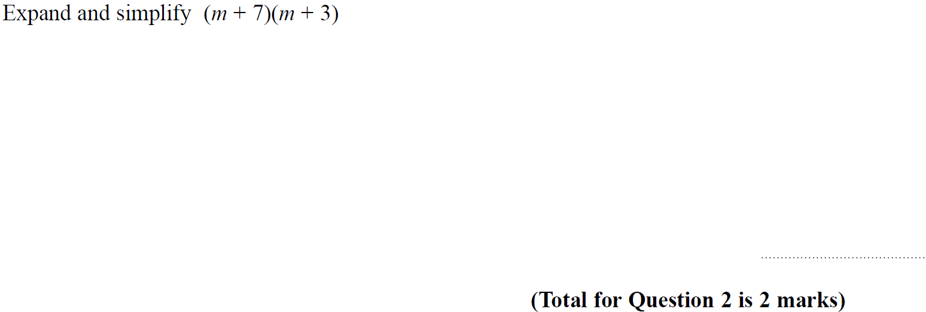
Expanding Brackets
SAM 1H Q2

Slide 5
Expanding Brackets
SAM 1H Q2
A

Slide 6
Expanding Brackets
Specimen Set 1 2H Q13

Slide 7
Expanding Brackets
Specimen Set 1 2H Q13
A

Slide 8
Expanding Brackets
Specimen Set 1 2H Q18

Slide 9
Expanding Brackets
Specimen Set 1 2H Q18
A

Slide 10
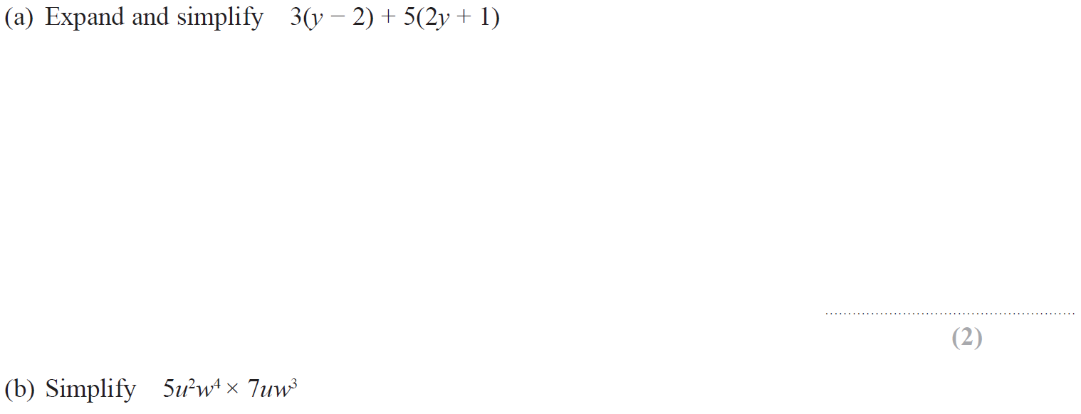
Expanding Brackets
Specimen Set 2 2H Q3

Slide 11
Expanding Brackets
Specimen Set 2 2H Q3
A
B

Slide 12
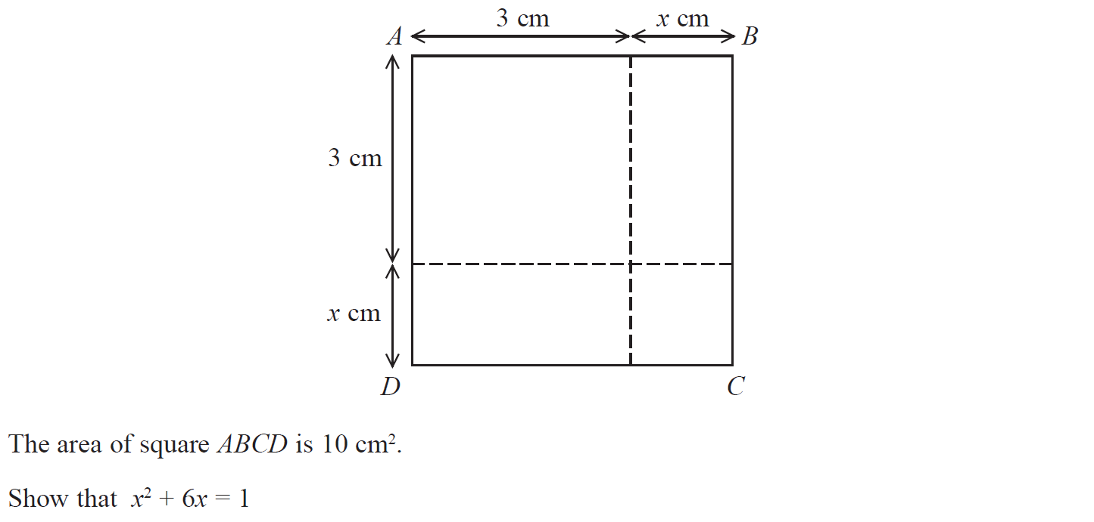
Expanding Brackets
May 2017 1H Q4

Slide 13
Expanding Brackets
Nov 2017 1H Q23
A

Slide 14
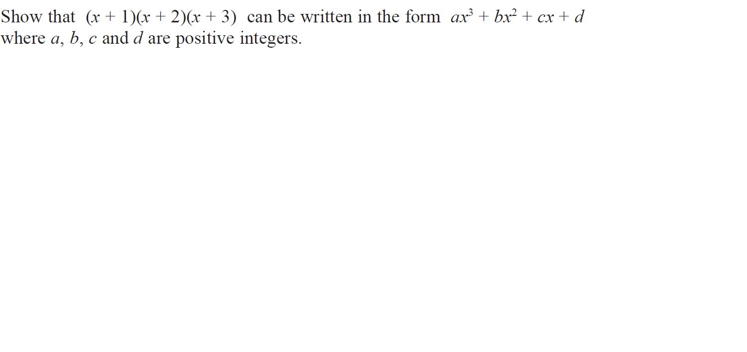
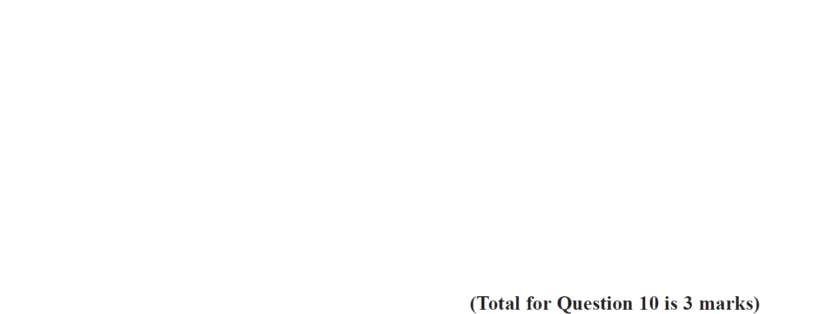
Expanding Brackets
May 2017 1H Q10

Slide 15
Expanding Brackets
May 2017 1H Q10
A

Slide 16
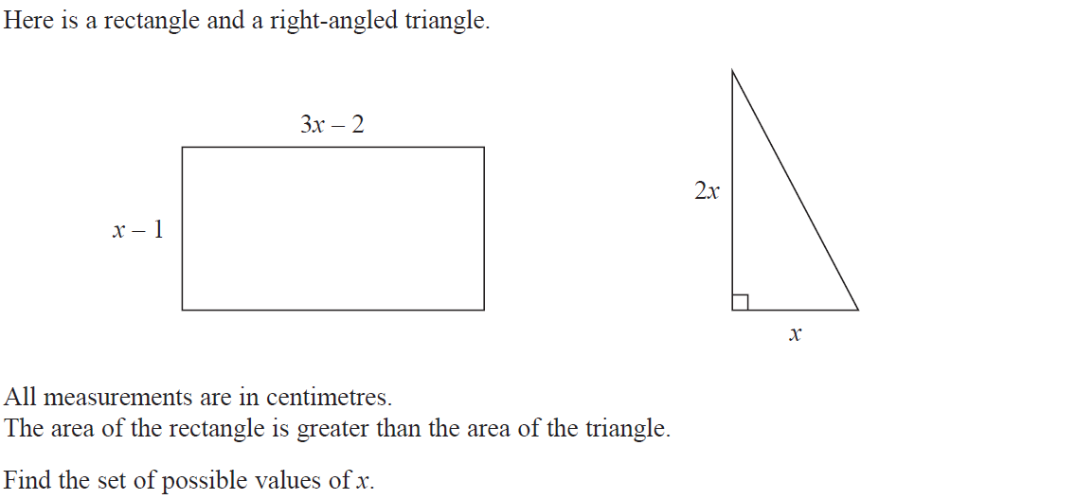
Expanding Brackets
Nov 2017 1H Q23

Slide 17
Forming Equations
Nov 2017 1H Q23
A

Slide 18
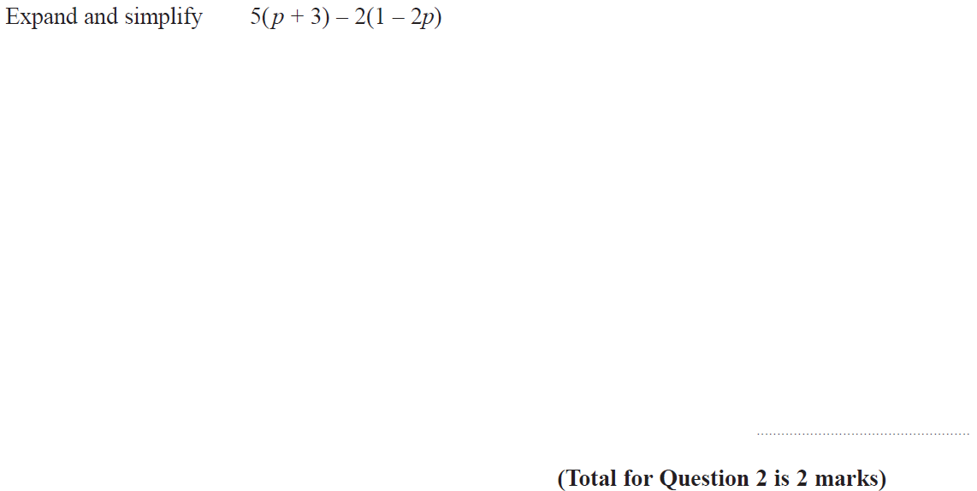
Expanding Brackets
June 2018 3H Q2

Slide 19
Expanding Brackets
June 2018 3H Q2
A

Slide 20
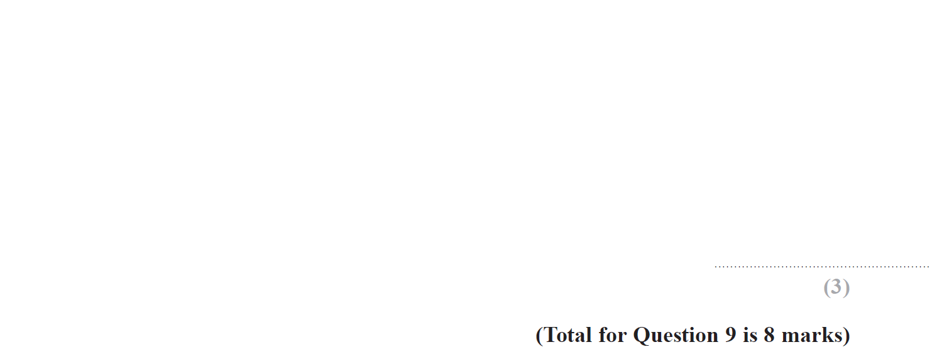
Expanding Brackets
Nov 2018 3H Q9

Slide 21
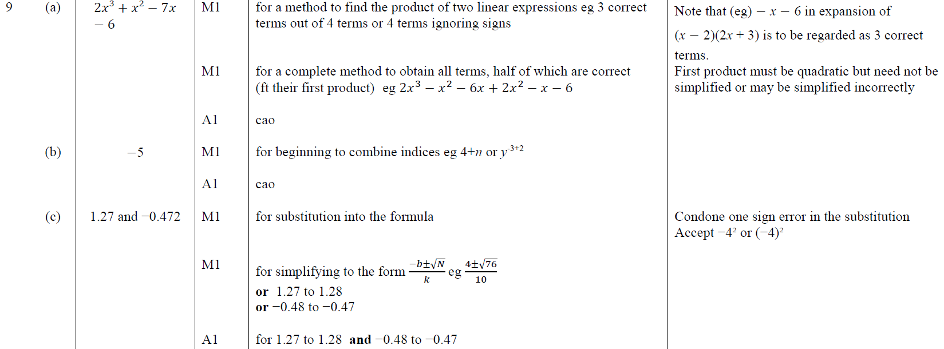
Expanding Brackets
Nov 2018 3H Q9
A
B
C

Slide 22
Expanding Brackets
June 2019 3H Q18

Slide 23
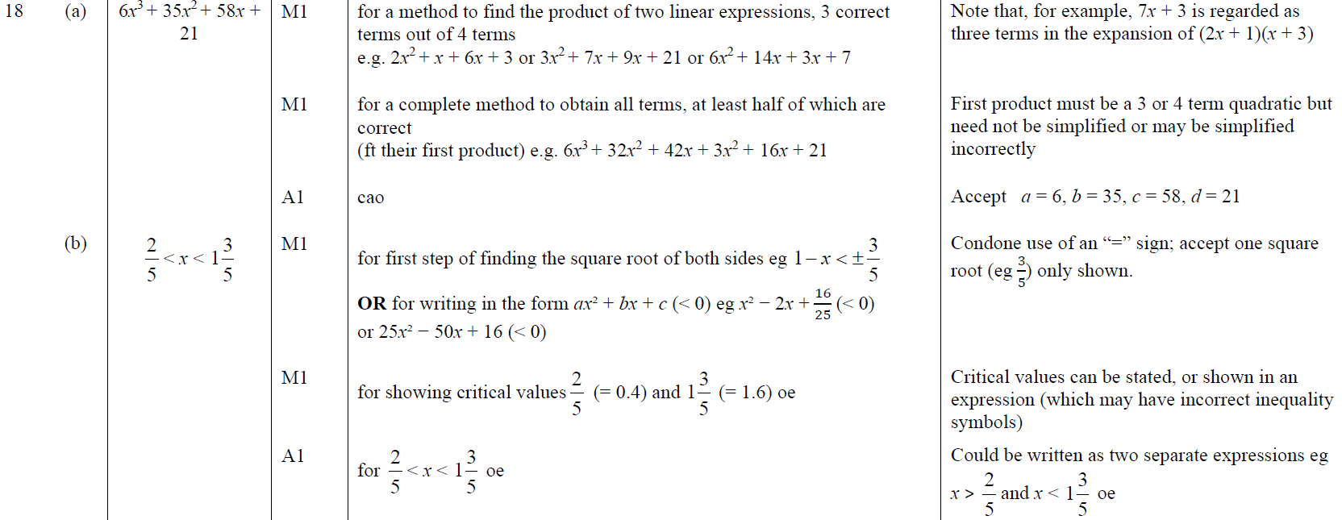
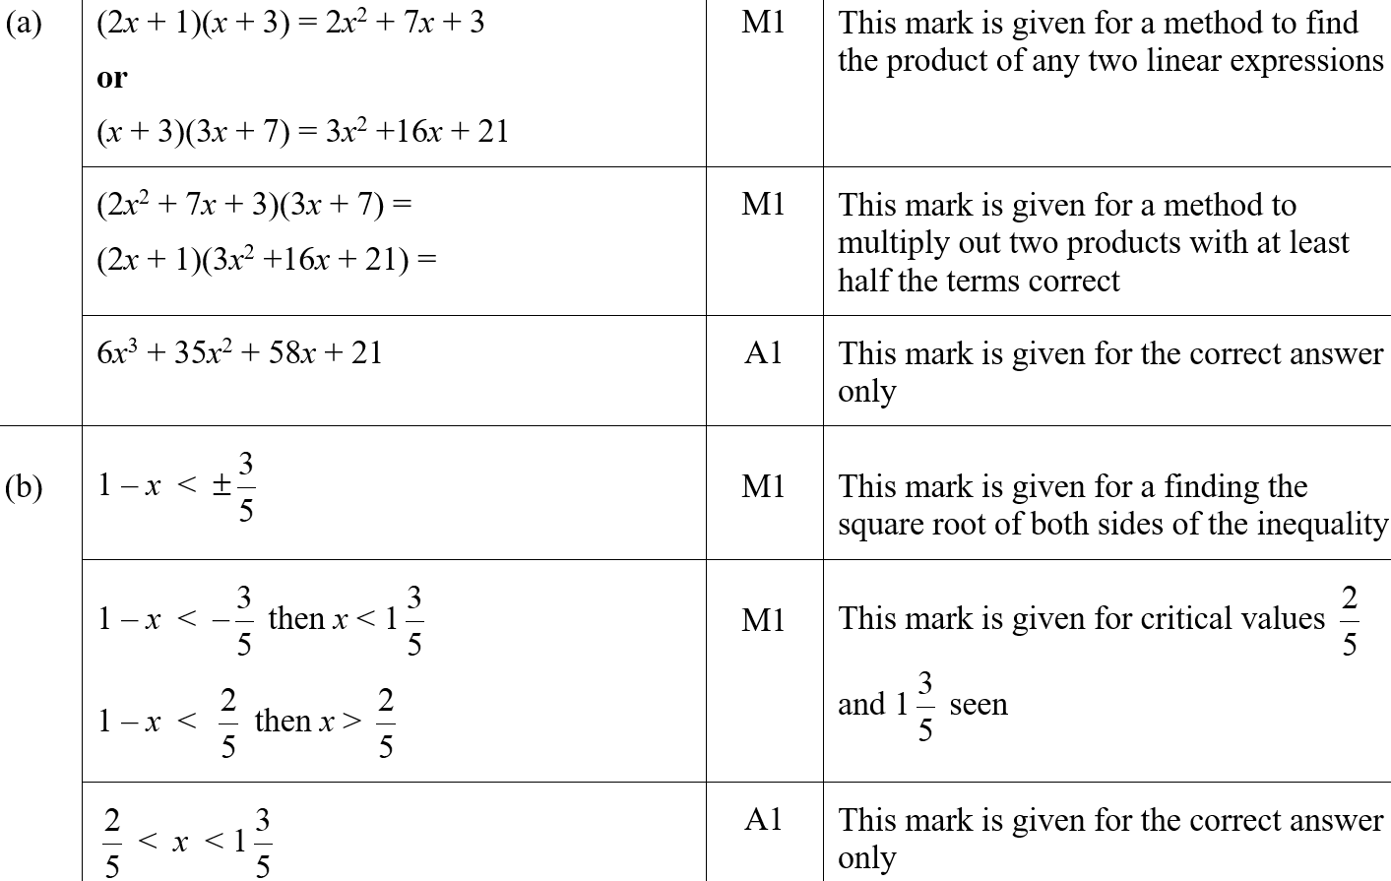
Expanding Brackets
June 2019 3H Q18
A
B
A SF
B SF

Slide 24
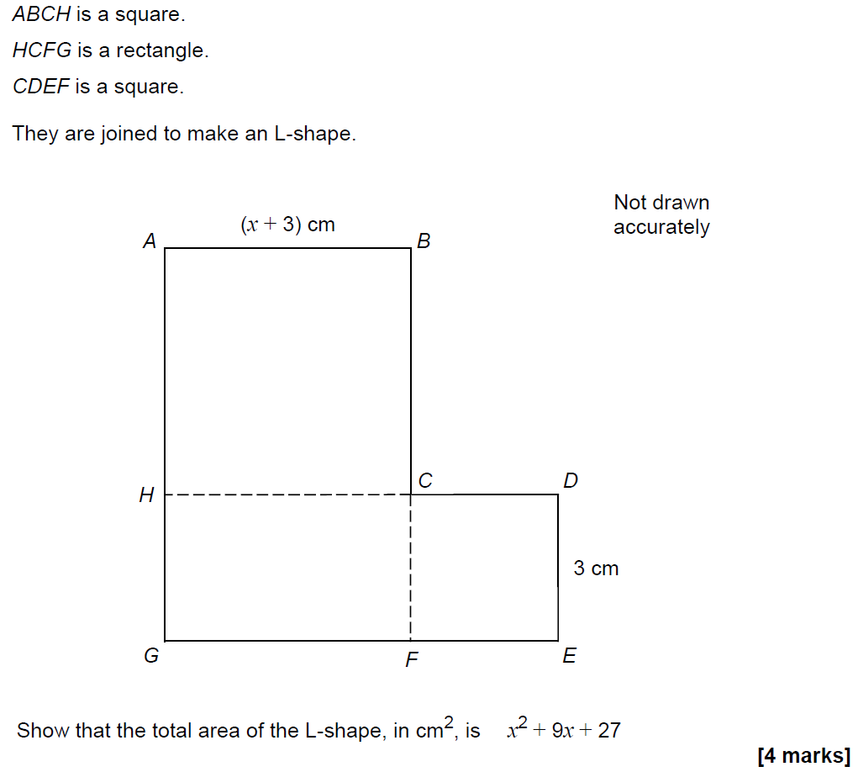
Expanding Brackets
SAM 1H Q12

Slide 25
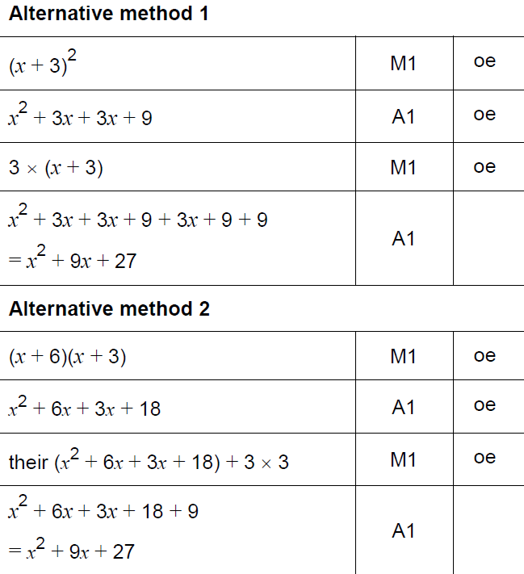
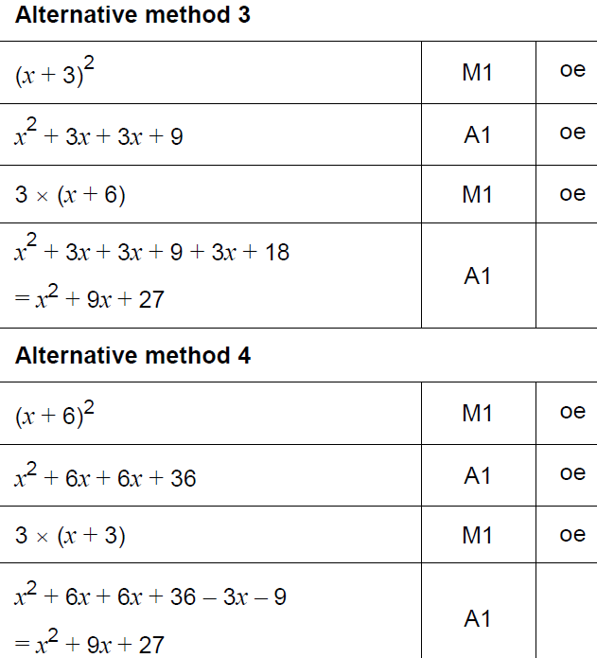
Expanding Brackets
SAM 1H Q12
A

Slide 26
Expanding Brackets
May 2017 1H Q26

Slide 27
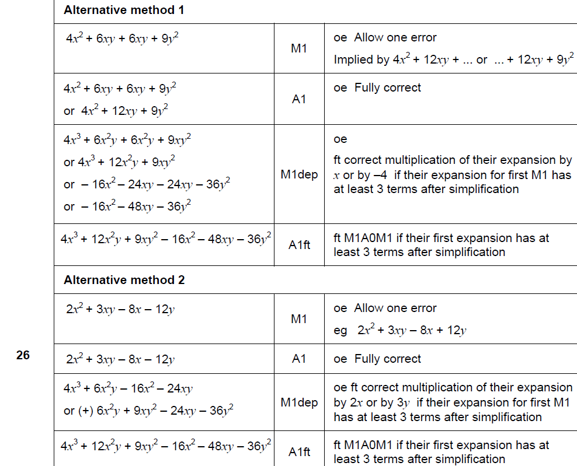
Expanding Brackets
May 2017 1H Q26
A

Slide 28
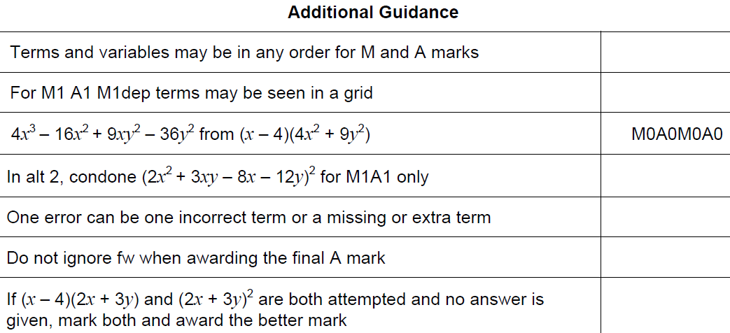
Expanding Brackets
May 2017 1H Q26
A notes

Slide 29
Expanding Brackets
Nov 2017 3H Q5

Slide 30
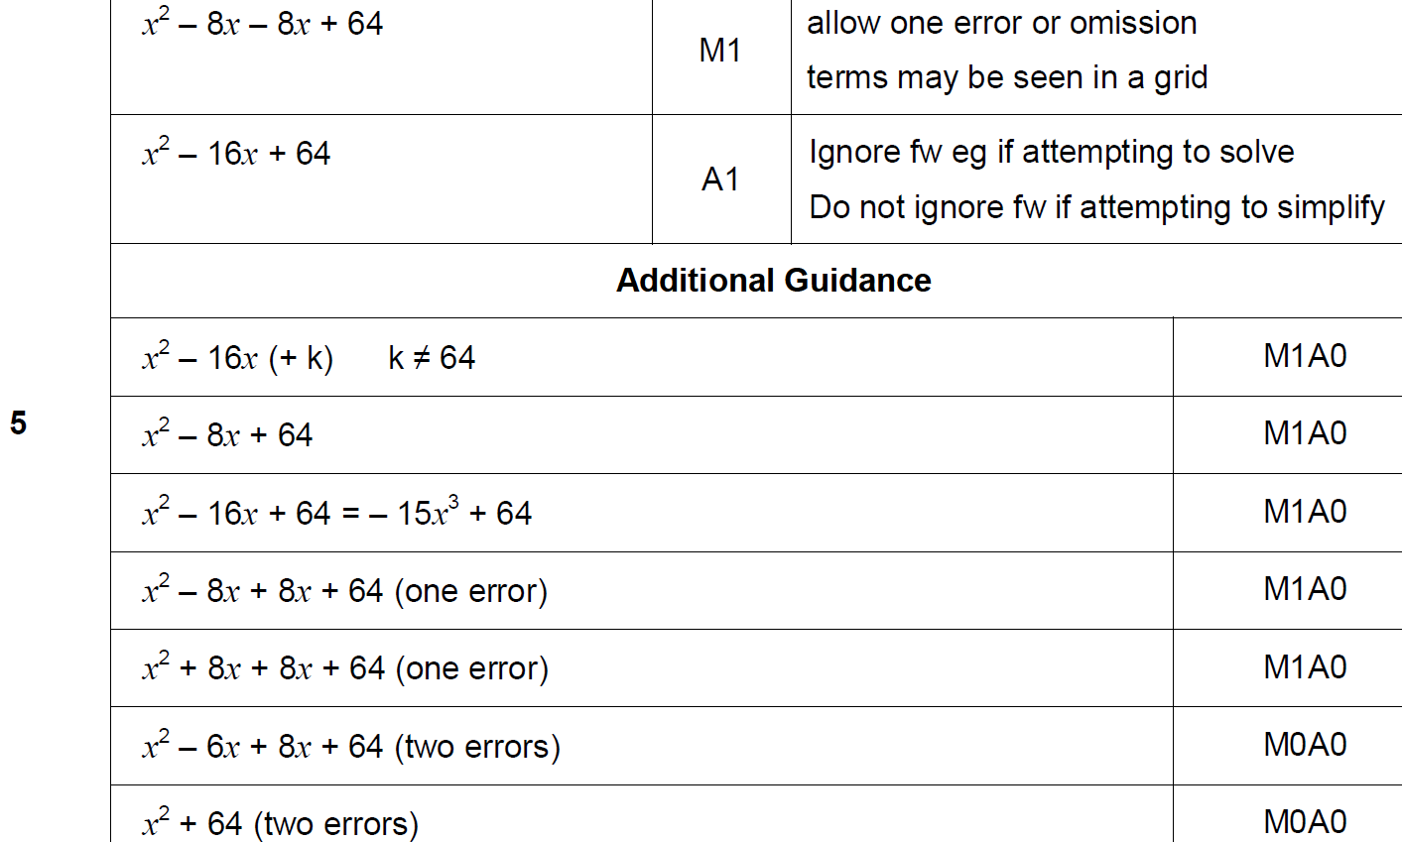
Expanding Brackets
Nov 2017 3H Q5
A

Slide 31
Expanding Brackets
Nov 2017 3H Q18

Slide 32
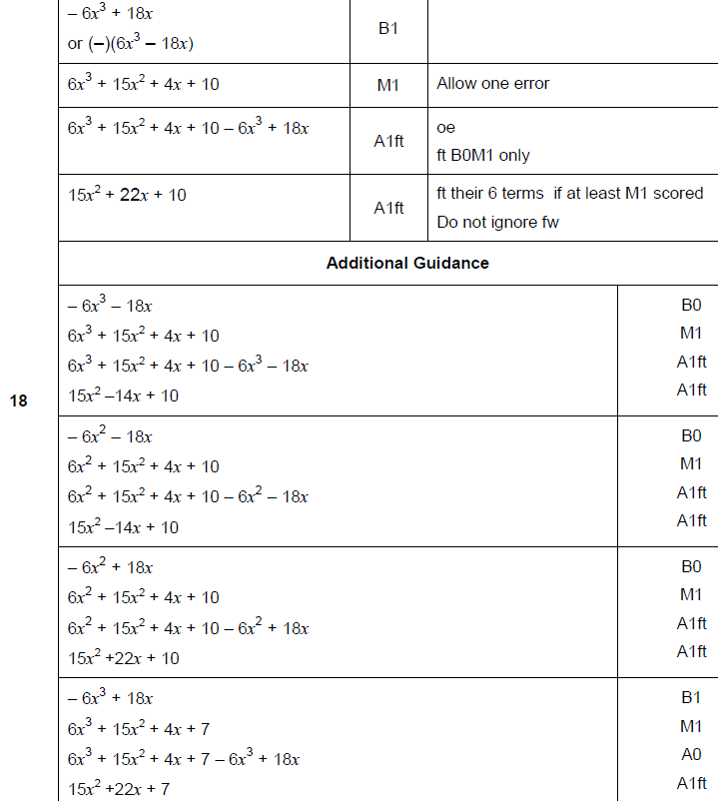
Expanding Brackets
Nov 2017 3H Q18
A

Slide 33
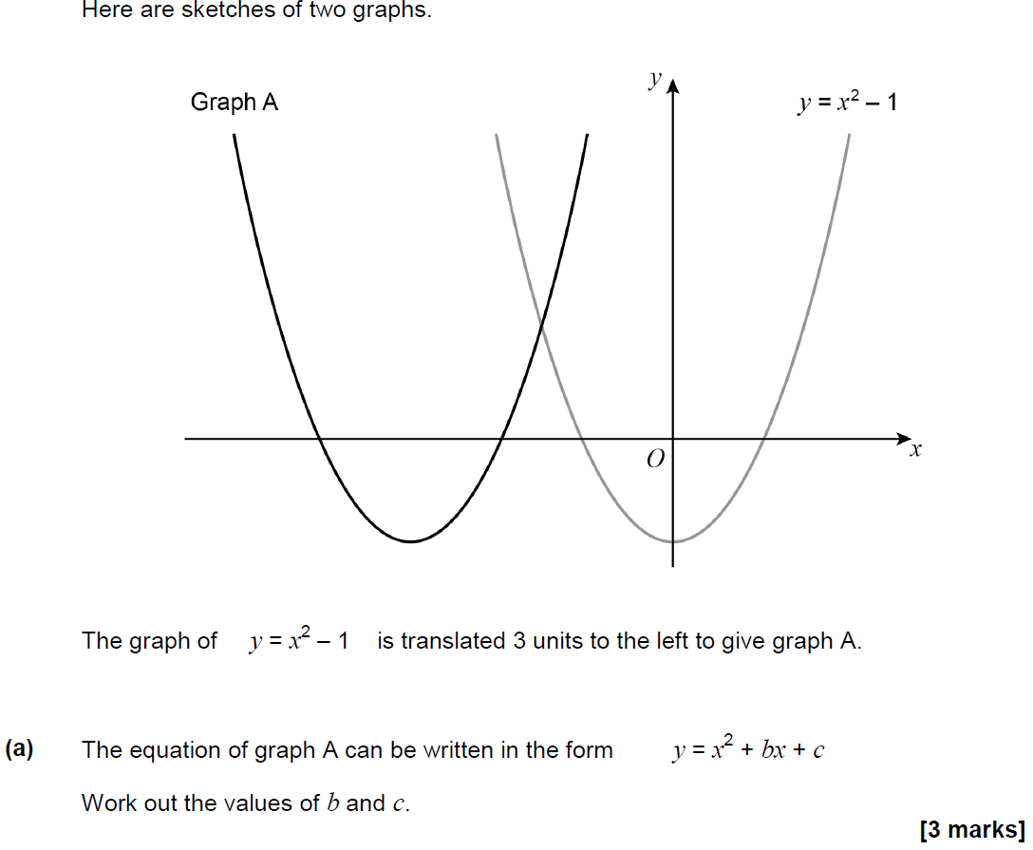
Expanding Brackets
May 2018 1H Q29

Slide 34
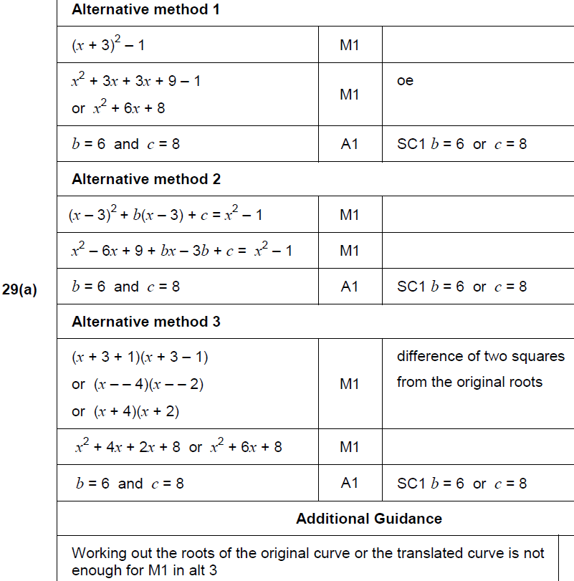
Expanding Brackets
May 2018 1H Q29
A

Slide 35
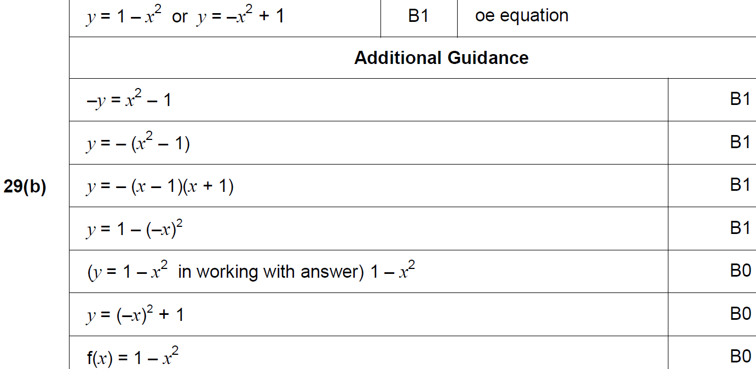
Expanding Brackets
May 2018 1H Q29
B

Slide 36
Expanding Brackets
Nov 2018 2H Q7
Work out the values of a and b in the identity
5(7x + 8) + 3(2x + b) ≡ ax + 13
[4 marks]

Slide 37
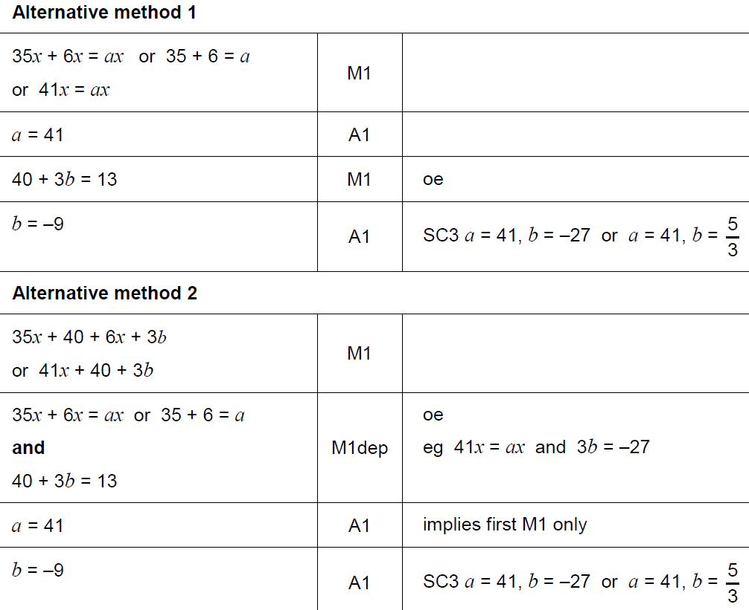
Expanding Brackets
Nov 2018 2H Q7
A

Slide 38
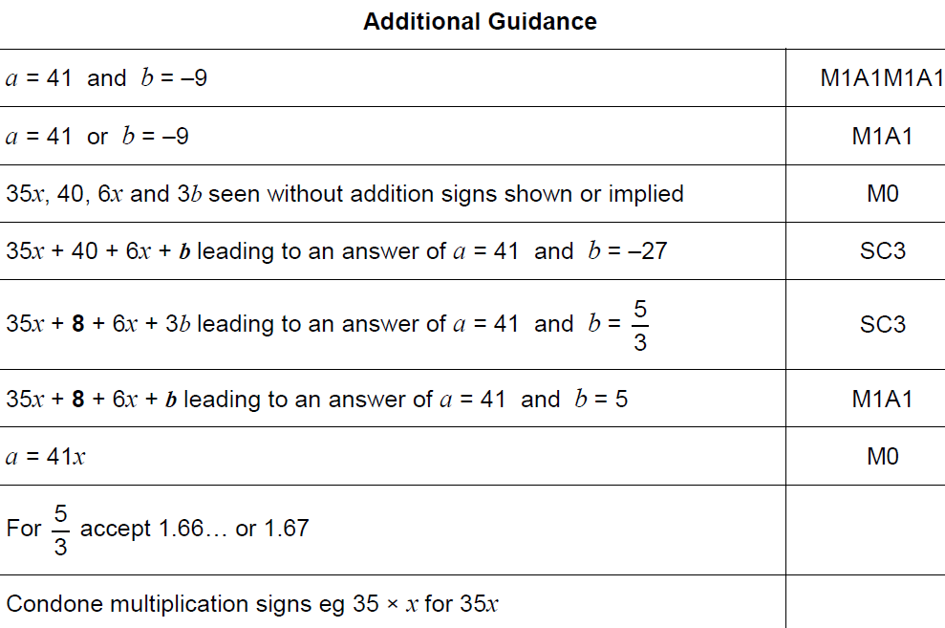
Expanding Brackets
Nov 2018 2H Q7
B

Slide 39
Expanding Brackets
SAM 3H Q17

Slide 40
Expanding Brackets
SAM 3H Q17
A

Slide 41
Expanding Brackets
Practice 2H Q12

Slide 42
Expanding Brackets
Practice 2H Q12
A
B
C

Slide 43
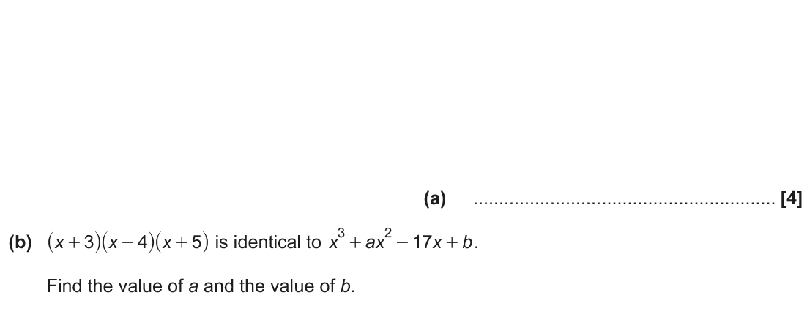
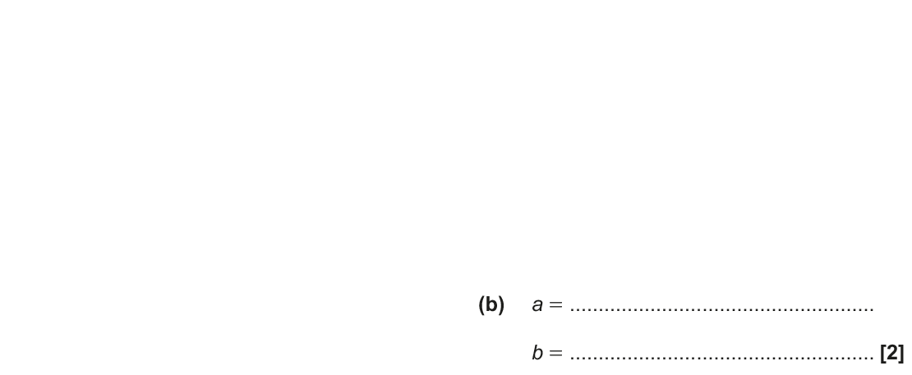
Expanding Brackets
June 2017 2H Q17

Slide 44
Expanding Brackets
June 2017 2H Q17
A
B

Slide 45
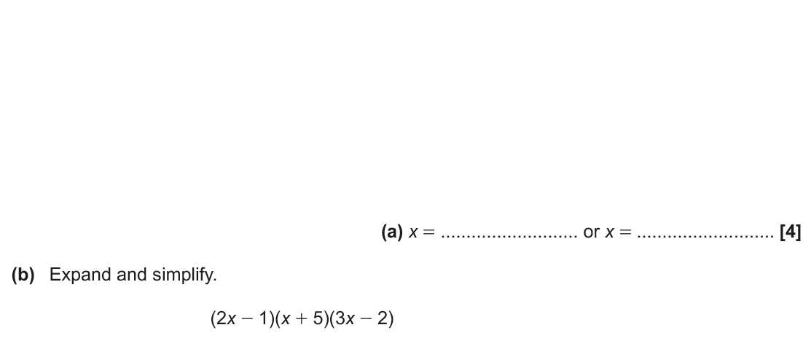
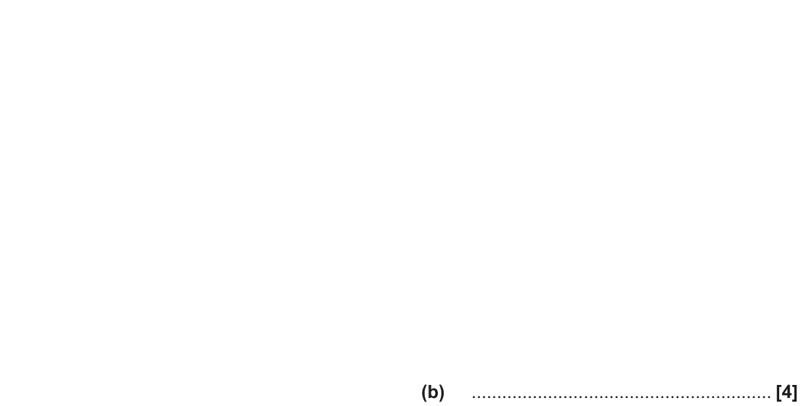
Expanding Brackets
Nov 2017 1H Q13

Slide 46
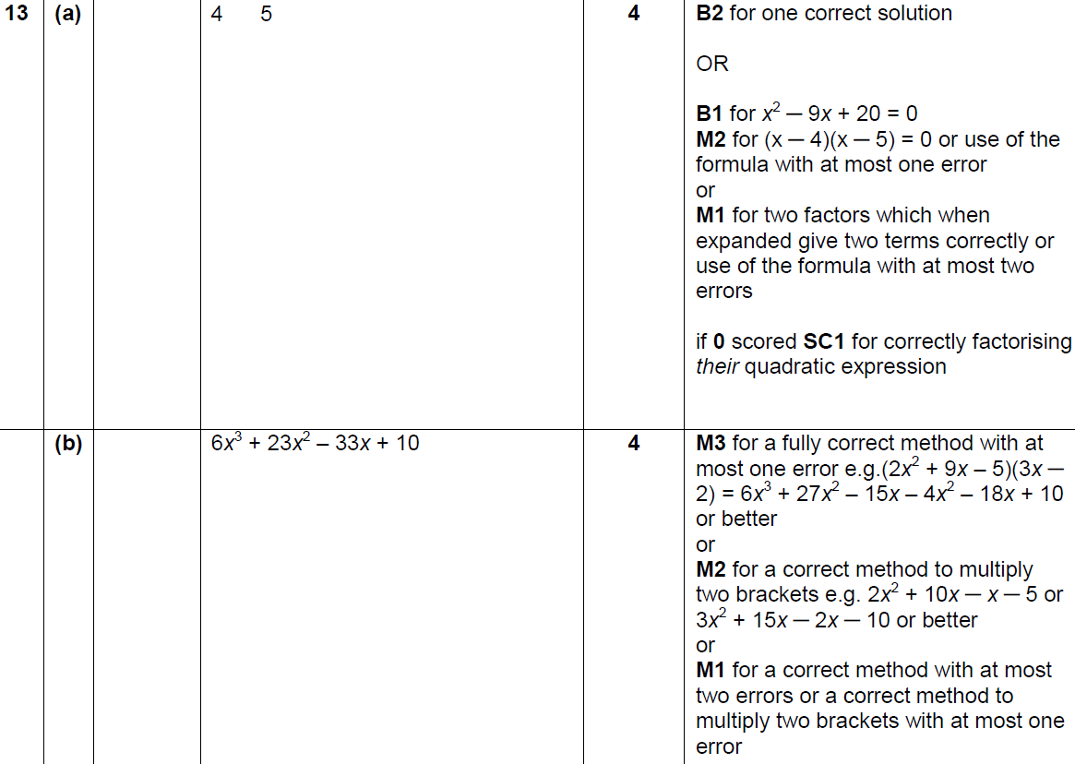
Expanding Brackets
Nov 2017 1H Q13
A
B

Slide 47
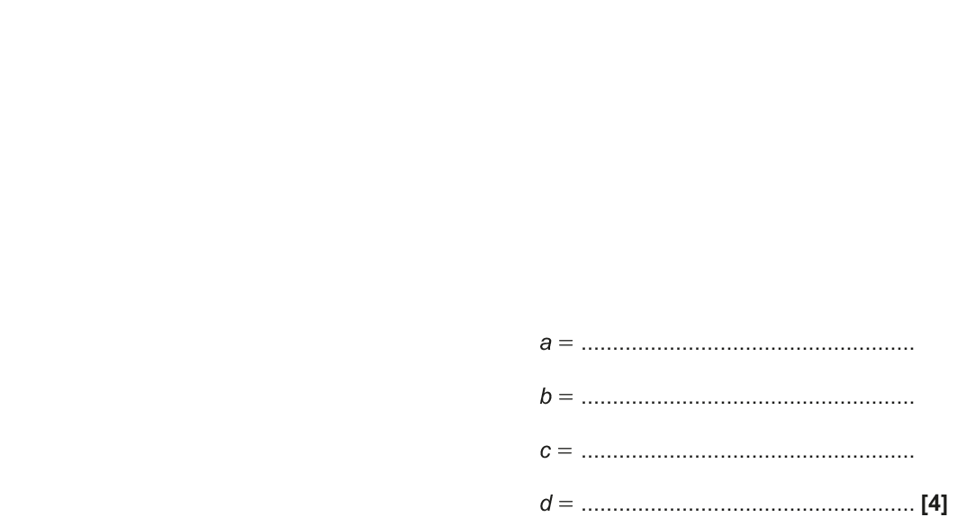
Expanding Brackets
June 2018 2H Q17

Slide 48
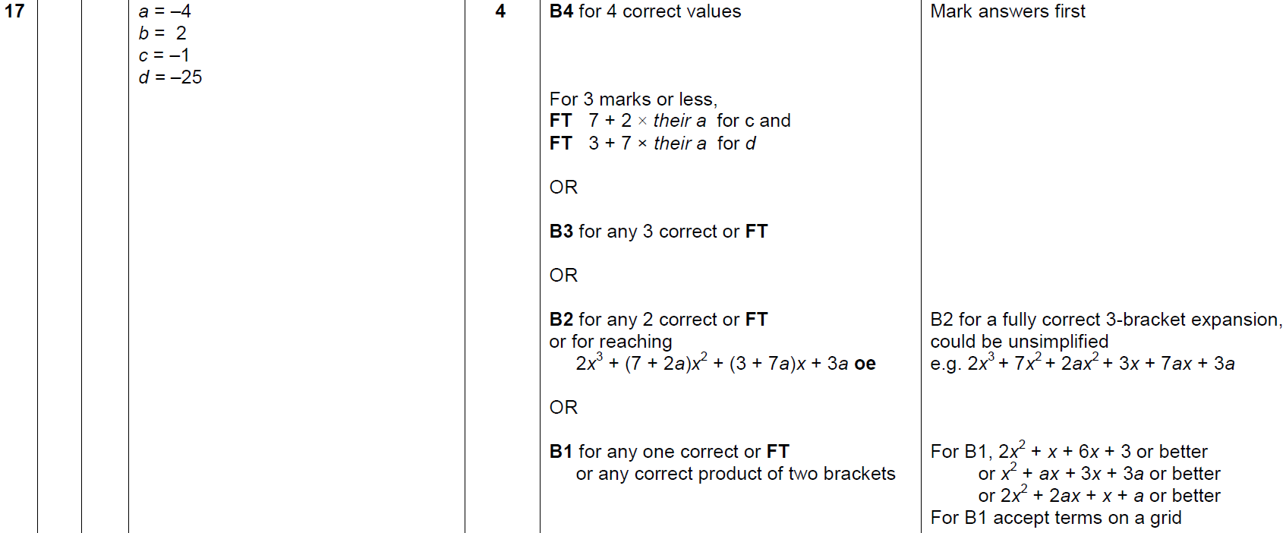
Expanding Brackets
June 2018 2H Q17
A

Slide 49
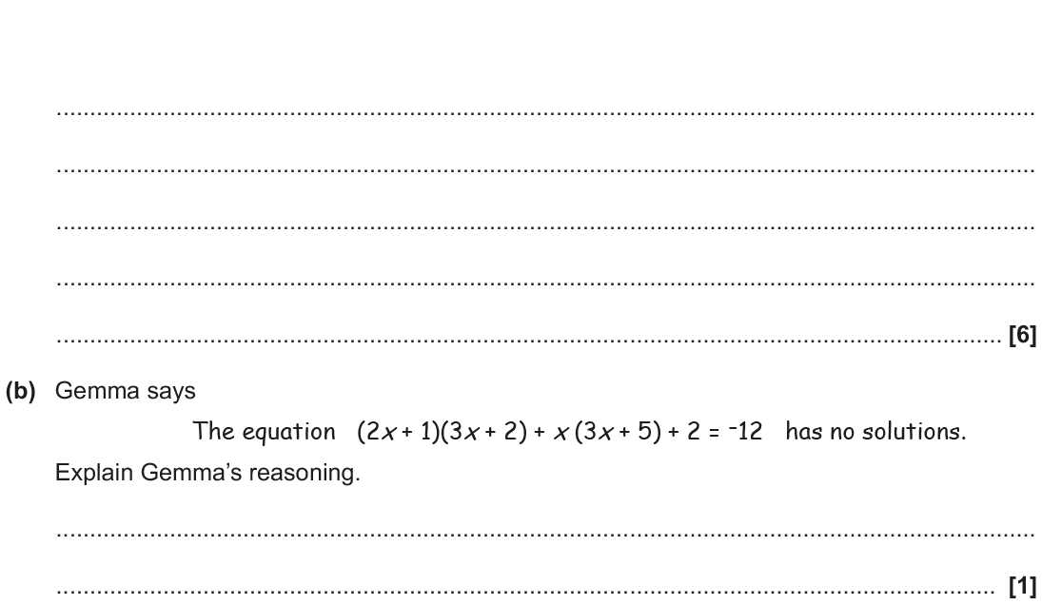
Expanding Brackets
Nov 2018 2H Q20

Slide 50
Expanding Brackets
Nov 2018 2H Q20
A
B

