Slide 1
Expanding Brackets
Expanding Brackets
May 2017
1H Q4
SAM
1H Q2
May 2017
1H Q10
Spec 1
2H Q13
Nov 2017
1H Q23
Spec 1
2H Q18
June 2018
3H Q2
Spec 2
2H Q3
Nov 2018
3H Q9
June 2019
3H Q18
Triple Brackets

Slide 2
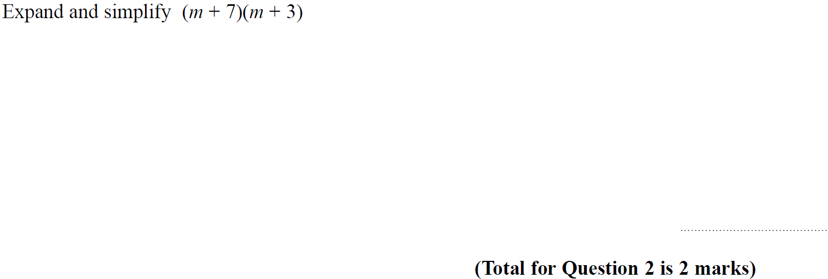
Expanding Brackets
SAM 1H Q2

Slide 3
Expanding Brackets
SAM 1H Q2
A

Slide 4
Expanding Brackets
Specimen Set 1 2H Q13

Slide 5
Expanding Brackets
Specimen Set 1 2H Q13
A

Slide 6
Expanding Brackets
Specimen Set 1 2H Q18

Slide 7
Expanding Brackets
Specimen Set 1 2H Q18
A

Slide 8
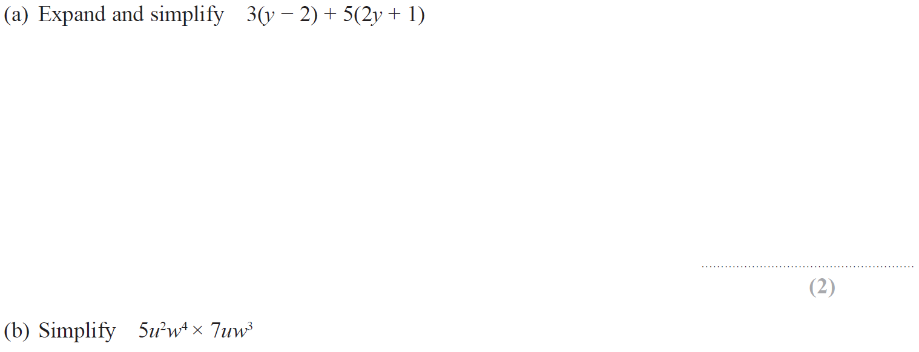
Expanding Brackets
Specimen Set 2 2H Q3

Slide 9
Expanding Brackets
Specimen Set 2 2H Q3
A
B

Slide 10
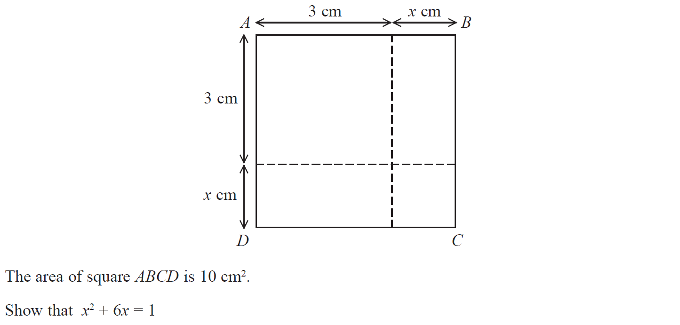
Expanding Brackets
May 2017 1H Q4

Slide 11
Expanding Brackets
Nov 2017 1H Q23
A

Slide 12
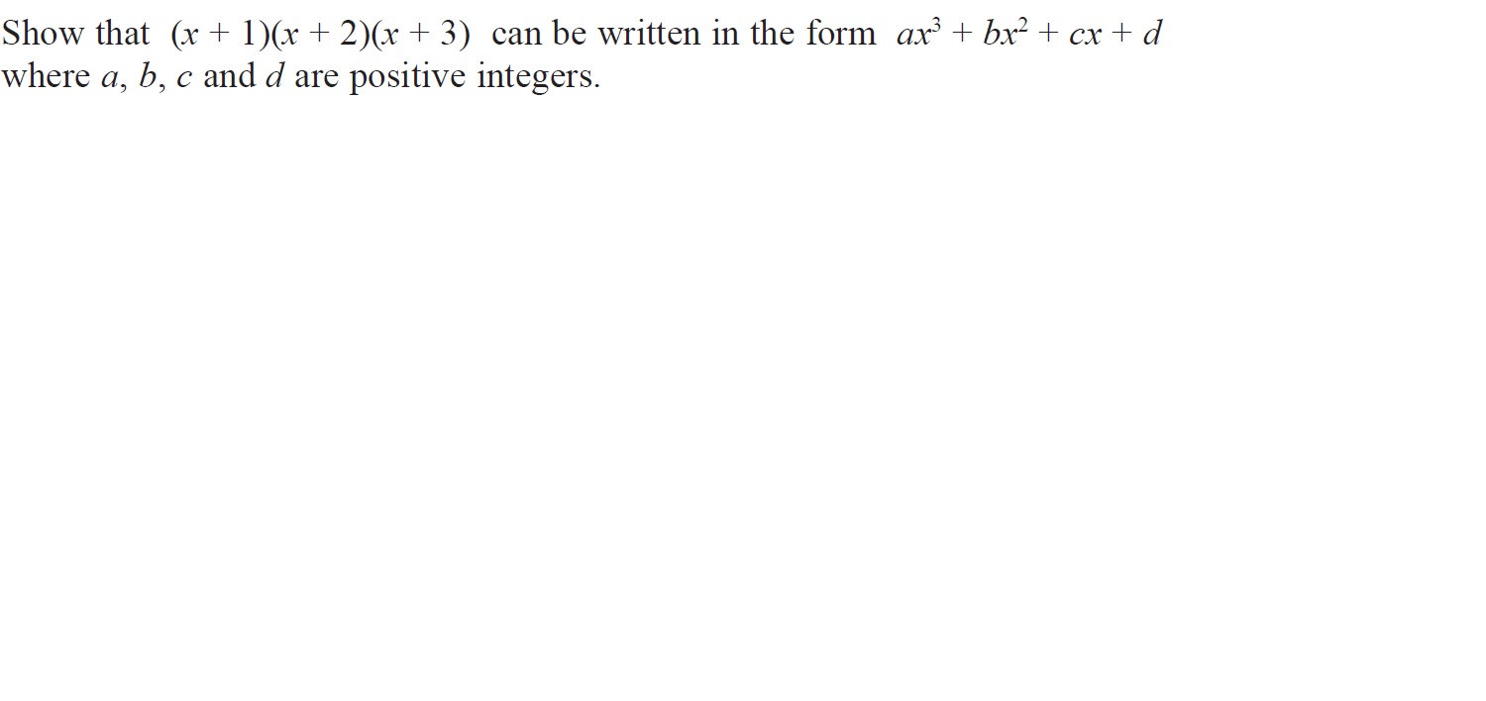
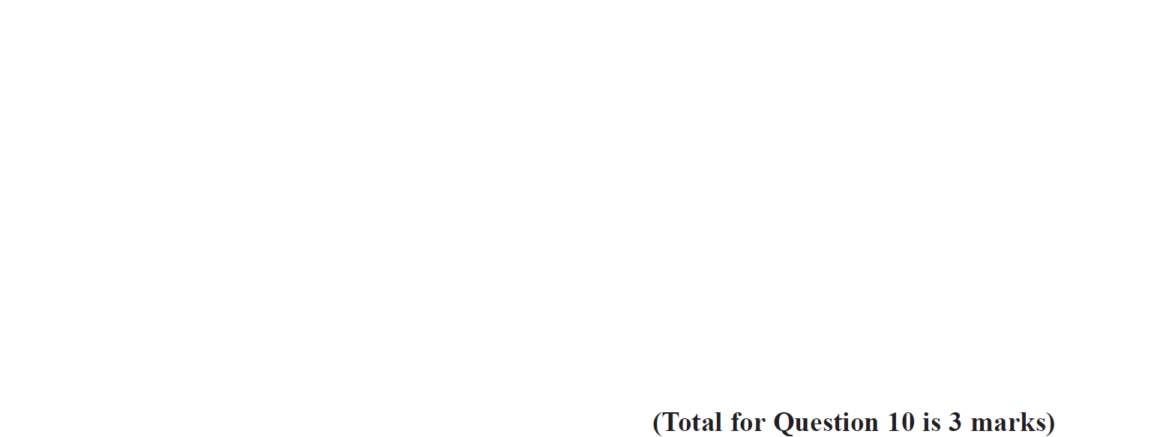
Expanding Brackets
May 2017 1H Q10

Slide 13
Expanding Brackets
May 2017 1H Q10
A

Slide 14
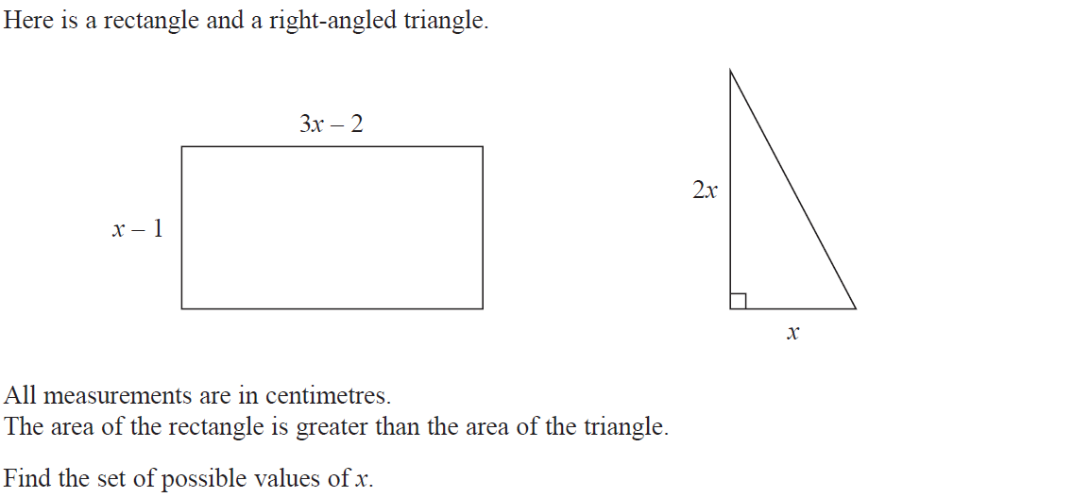
Expanding Brackets
Nov 2017 1H Q23

Slide 15
Forming Equations
Nov 2017 1H Q23
A

Slide 16
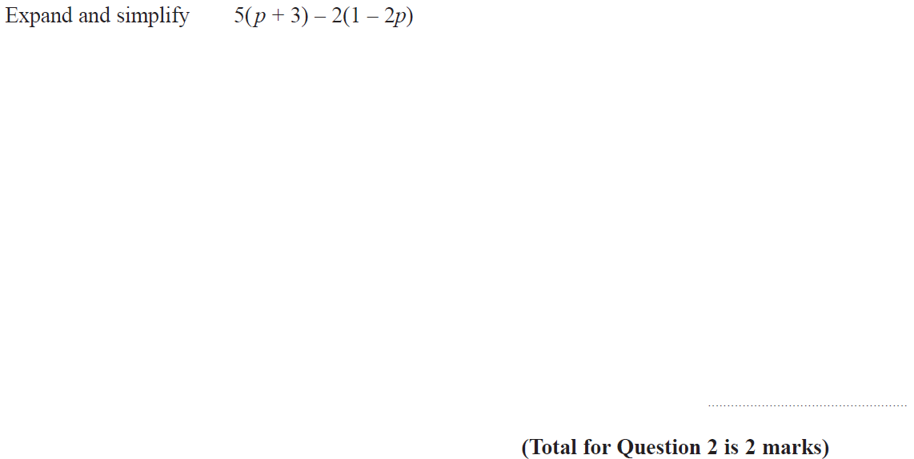
Expanding Brackets
June 2018 3H Q2

Slide 17
Expanding Brackets
June 2018 3H Q2
A

Slide 18
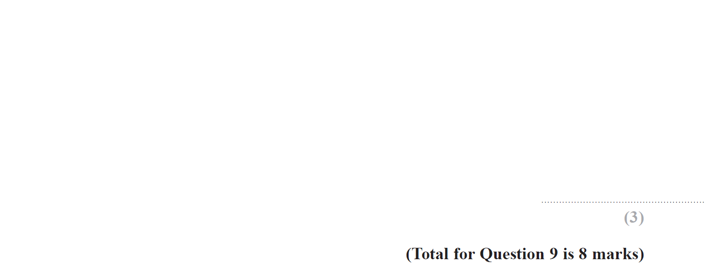
Expanding Brackets
Nov 2018 3H Q9

Slide 19
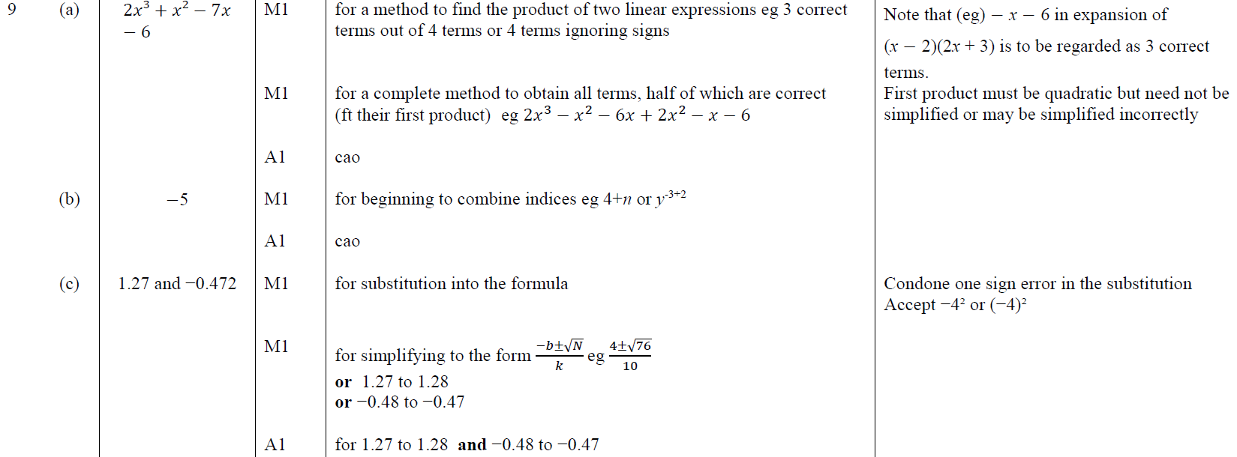
Expanding Brackets
Nov 2018 3H Q9
A
B
C

Slide 20
Expanding Brackets
June 2019 3H Q18

Slide 21
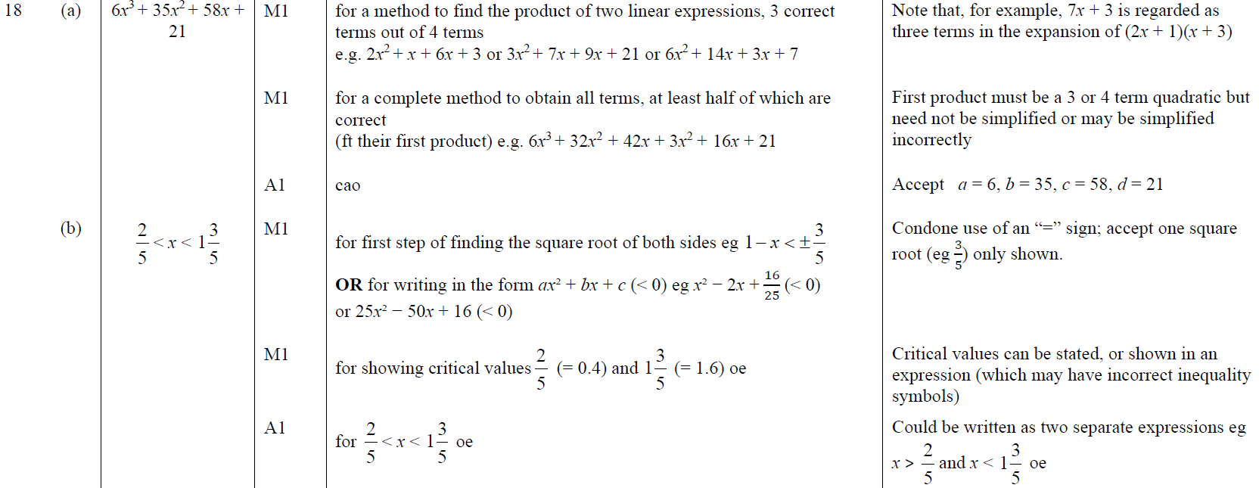
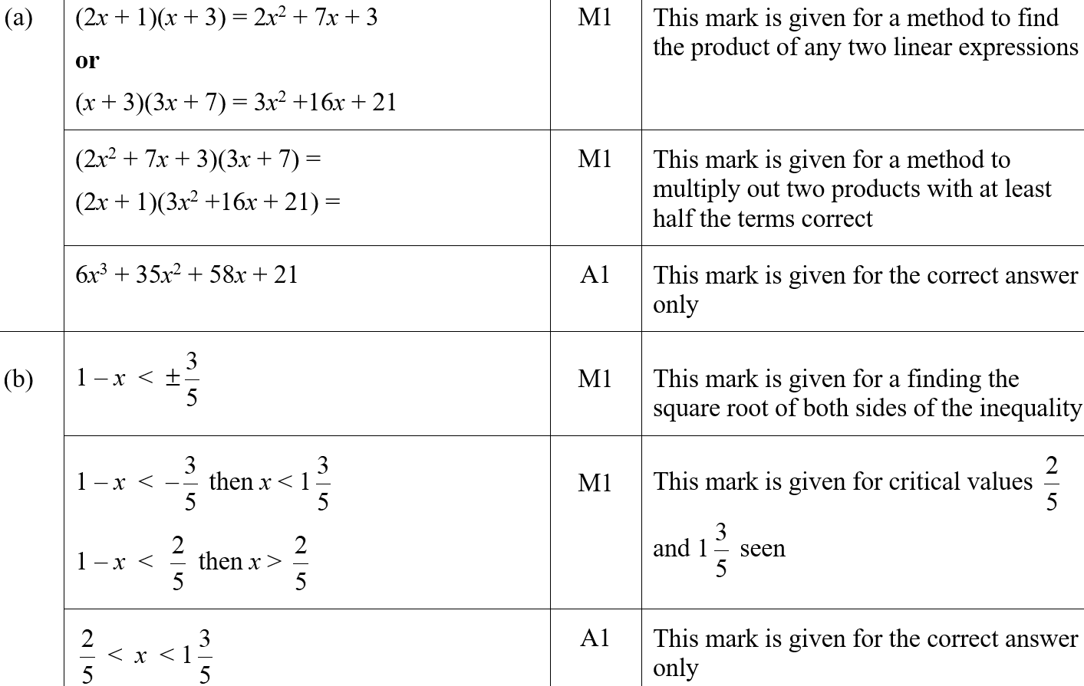
Expanding Brackets
June 2019 3H Q18
A
B
A SF
B SF

