Slide 1
Expanding Brackets
Expanding Brackets
May 2017
1H Q26
Nov 2017
3H Q5
1 Marker
SAM
1H Q12
Nov 2017
3H Q18
May 2018
1H Q29
Nov 2018
2H Q7
Triple Brackets

Slide 2
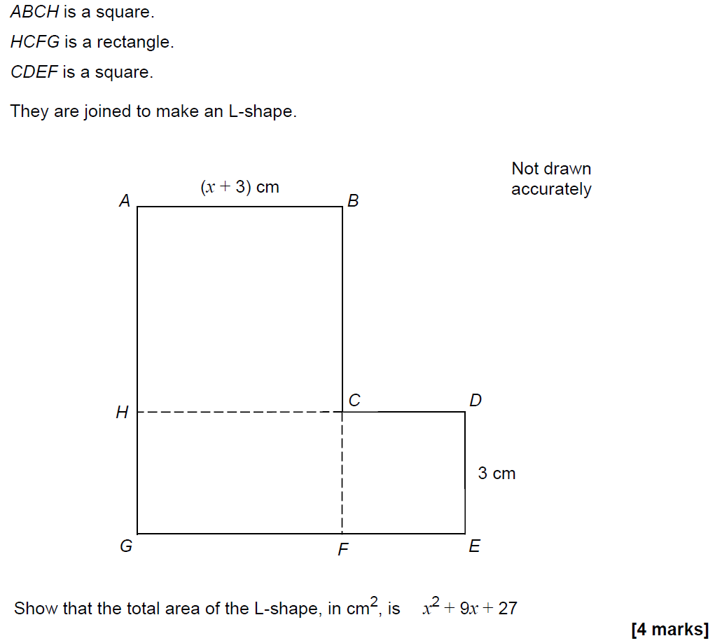
Expanding Brackets
SAM 1H Q12

Slide 3
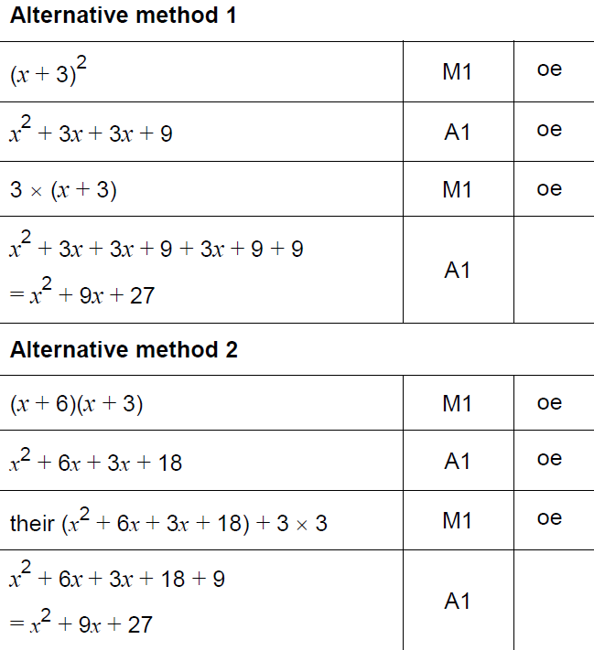
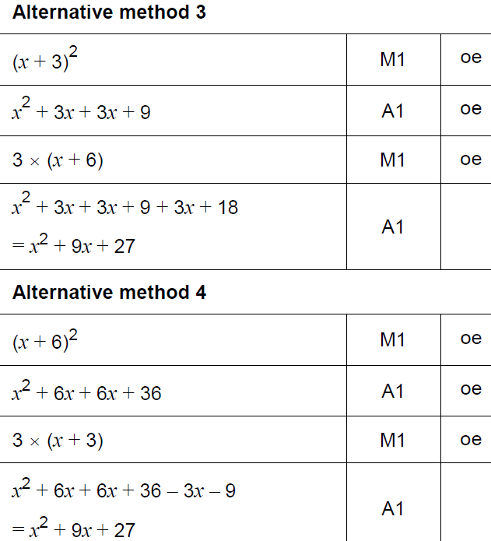
Expanding Brackets
SAM 1H Q12
A

Slide 4
Expanding Brackets
May 2017 1H Q26

Slide 5
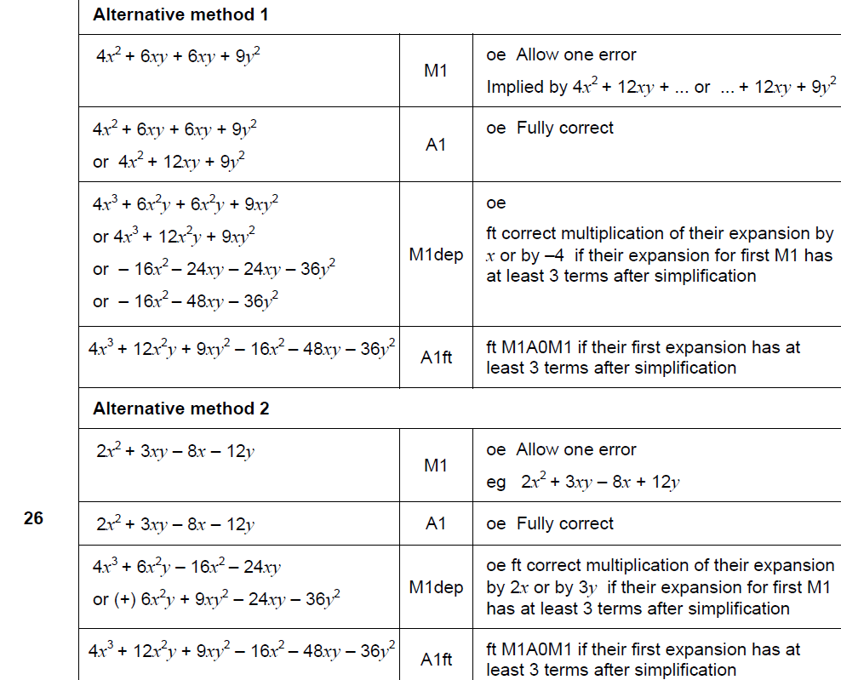
Expanding Brackets
May 2017 1H Q26
A

Slide 6
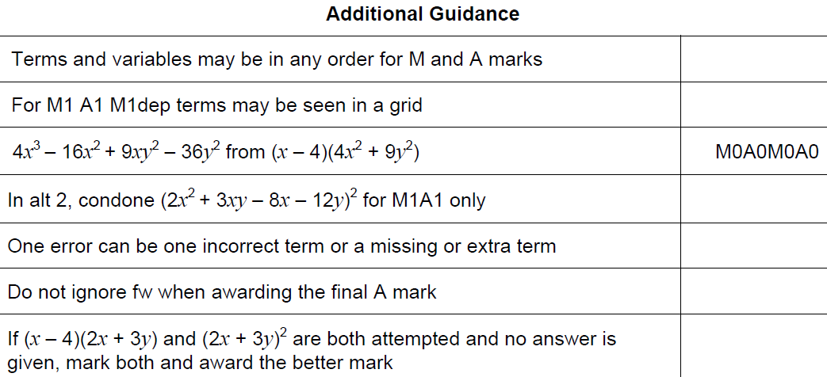
Expanding Brackets
May 2017 1H Q26
A notes

Slide 7
Expanding Brackets
Nov 2017 3H Q5

Slide 8
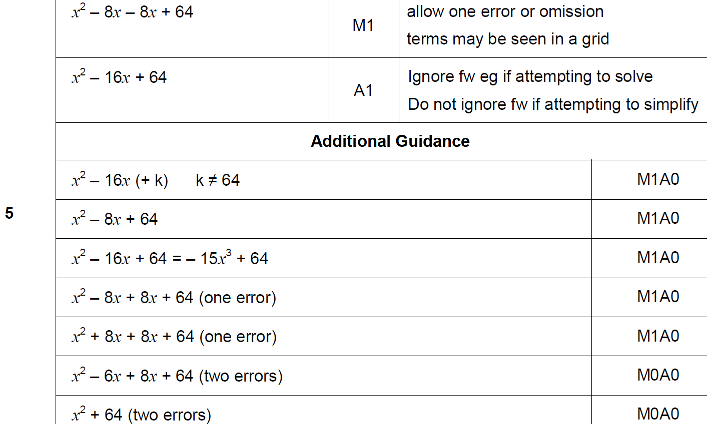
Expanding Brackets
Nov 2017 3H Q5
A

Slide 9
Expanding Brackets
Nov 2017 3H Q18

Slide 10
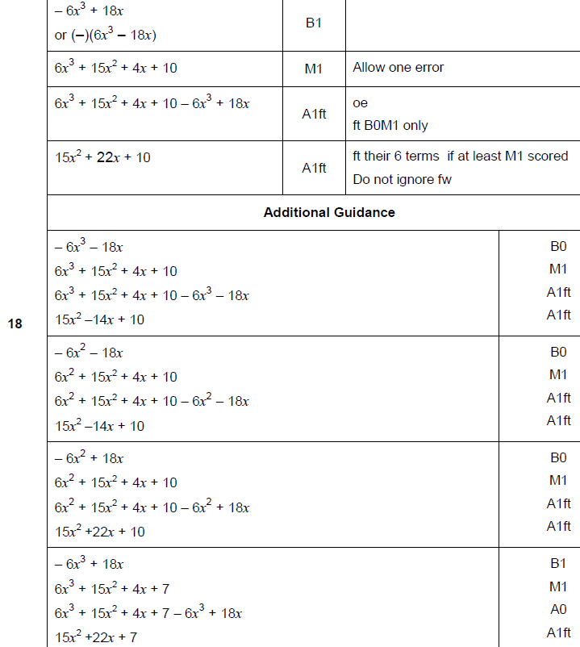
Expanding Brackets
Nov 2017 3H Q18
A

Slide 11
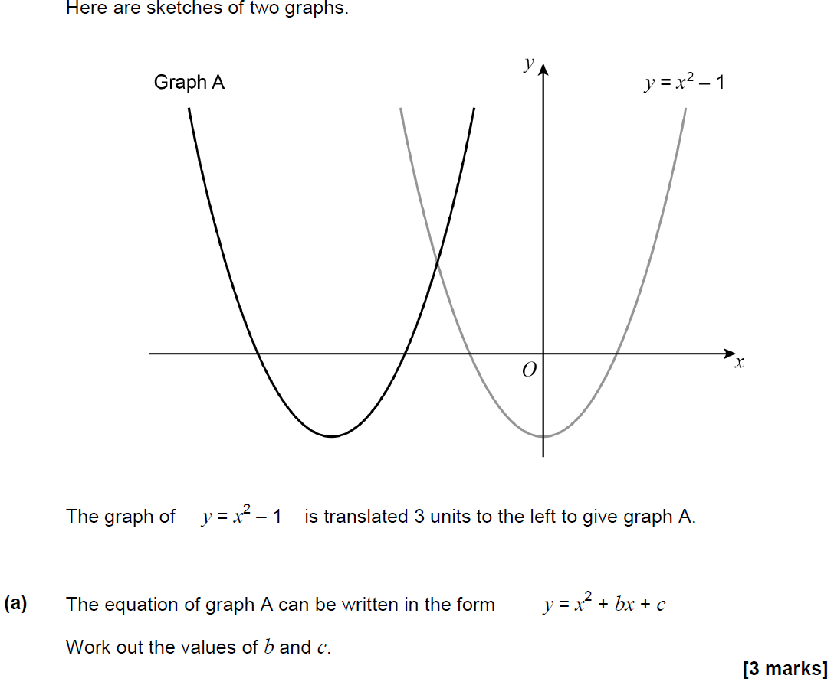
Expanding Brackets
May 2018 1H Q29

Slide 12
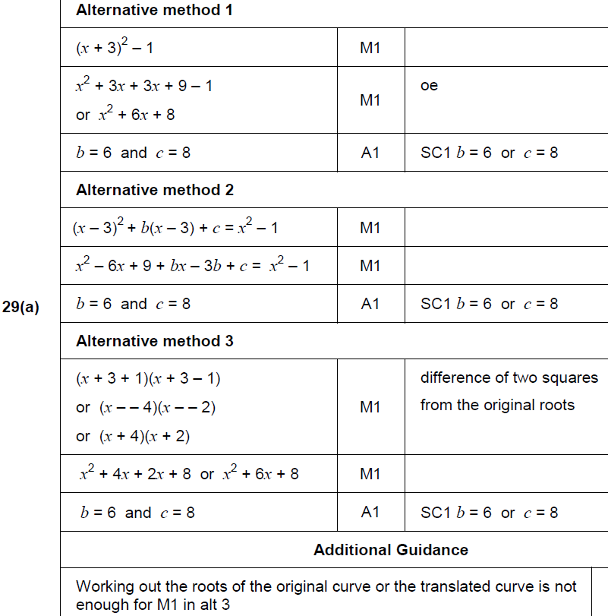
Expanding Brackets
May 2018 1H Q29
A

Slide 13
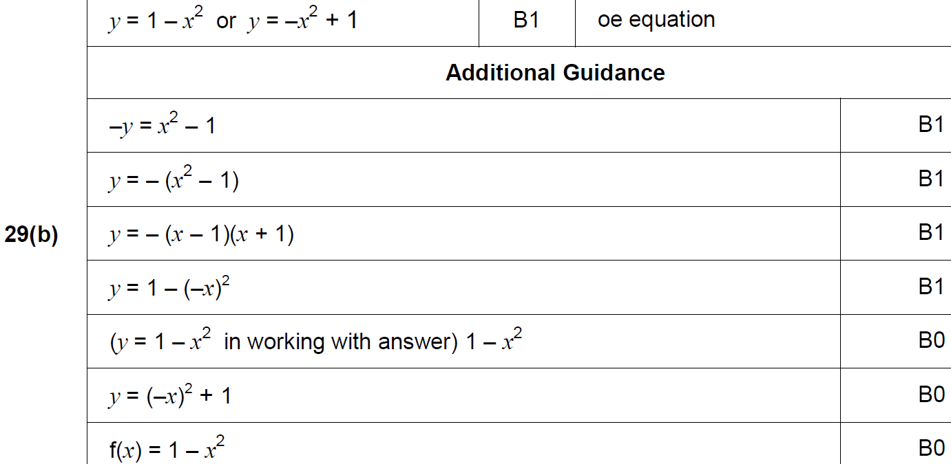
Expanding Brackets
May 2018 1H Q29
B

Slide 14
Expanding Brackets
Nov 2018 2H Q7
Work out the values of a and b in the identity
5(7x + 8) + 3(2x + b) ≡ ax + 13
[4 marks]

Slide 15
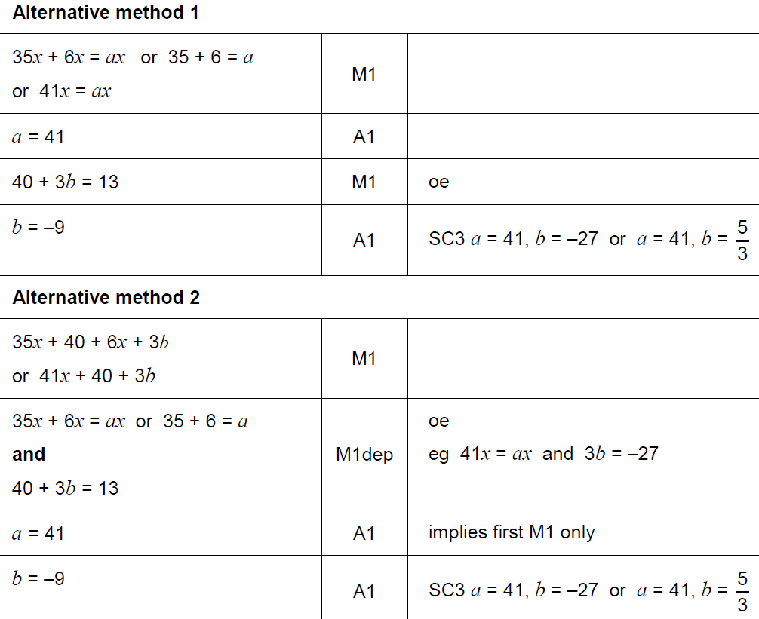
Expanding Brackets
Nov 2018 2H Q7
A

Slide 16
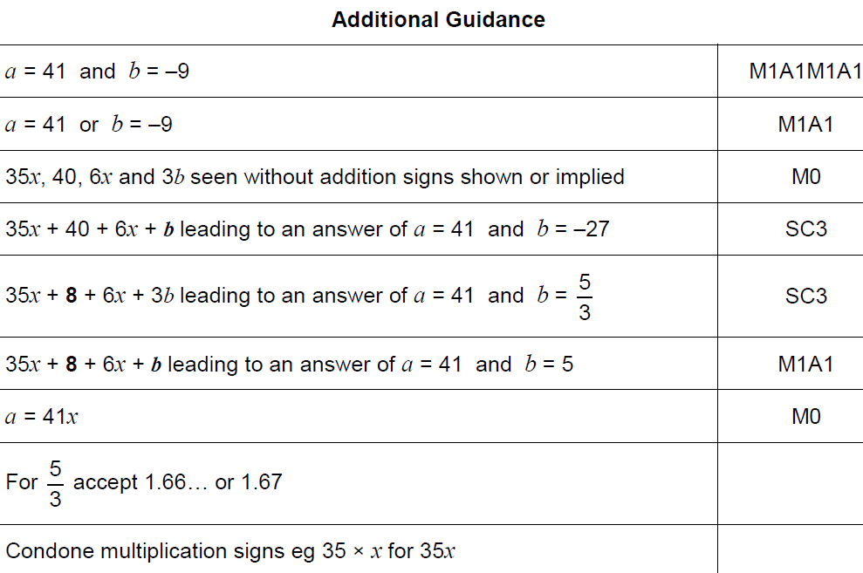
Expanding Brackets
Nov 2018 2H Q7
B

