Slide 1
Old Spec Q’s
Binomial Distribution
Specimen
SAM
2018

Slide 2
Specimen

Slide 3
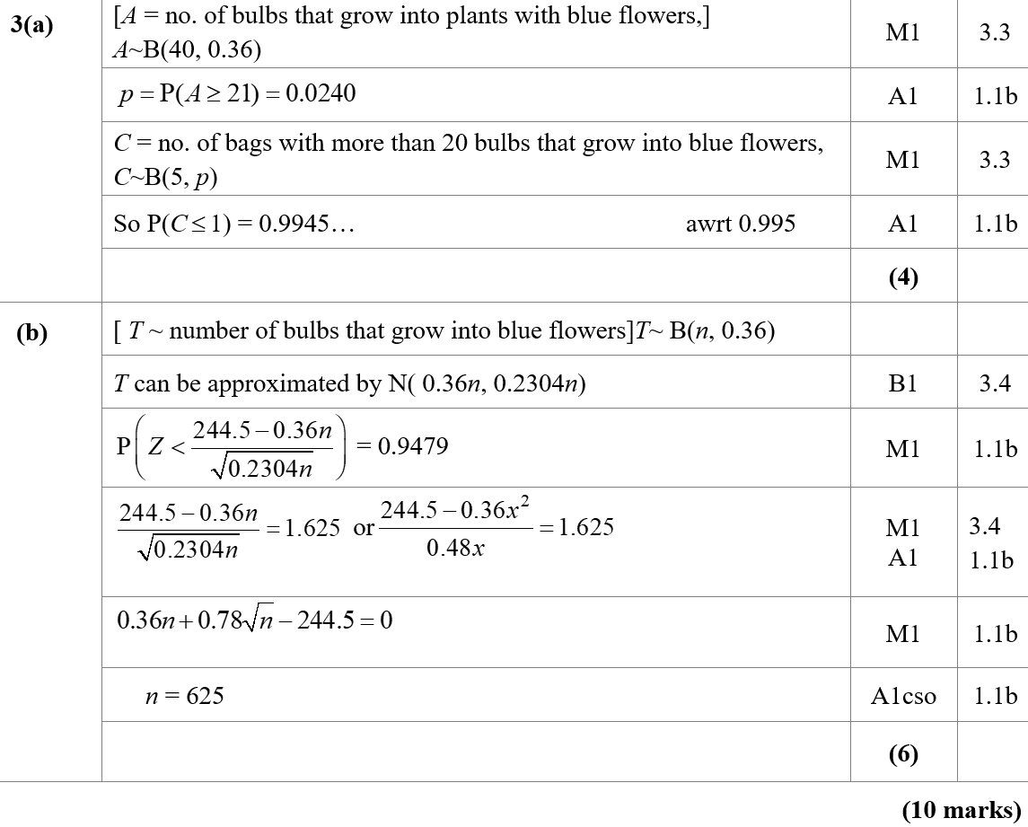
Specimen
A
B

Slide 4
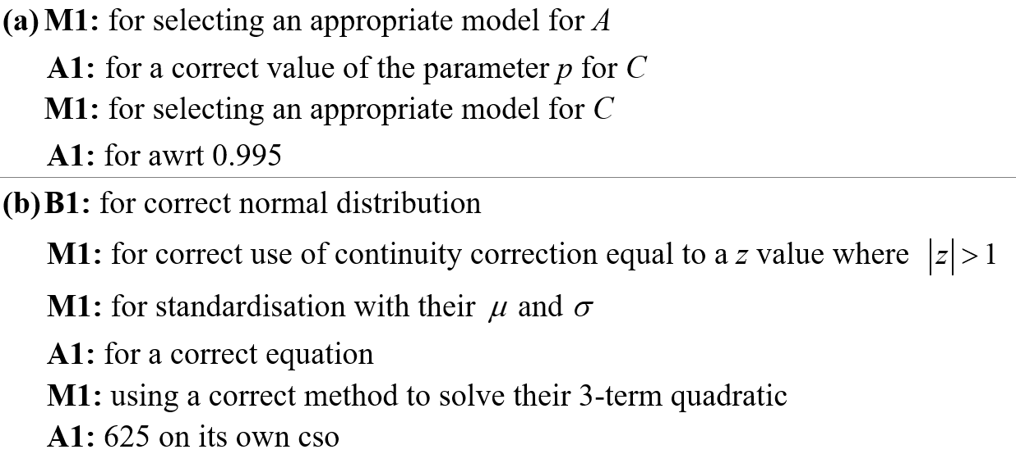
Specimen
A notes
B notes

Slide 5
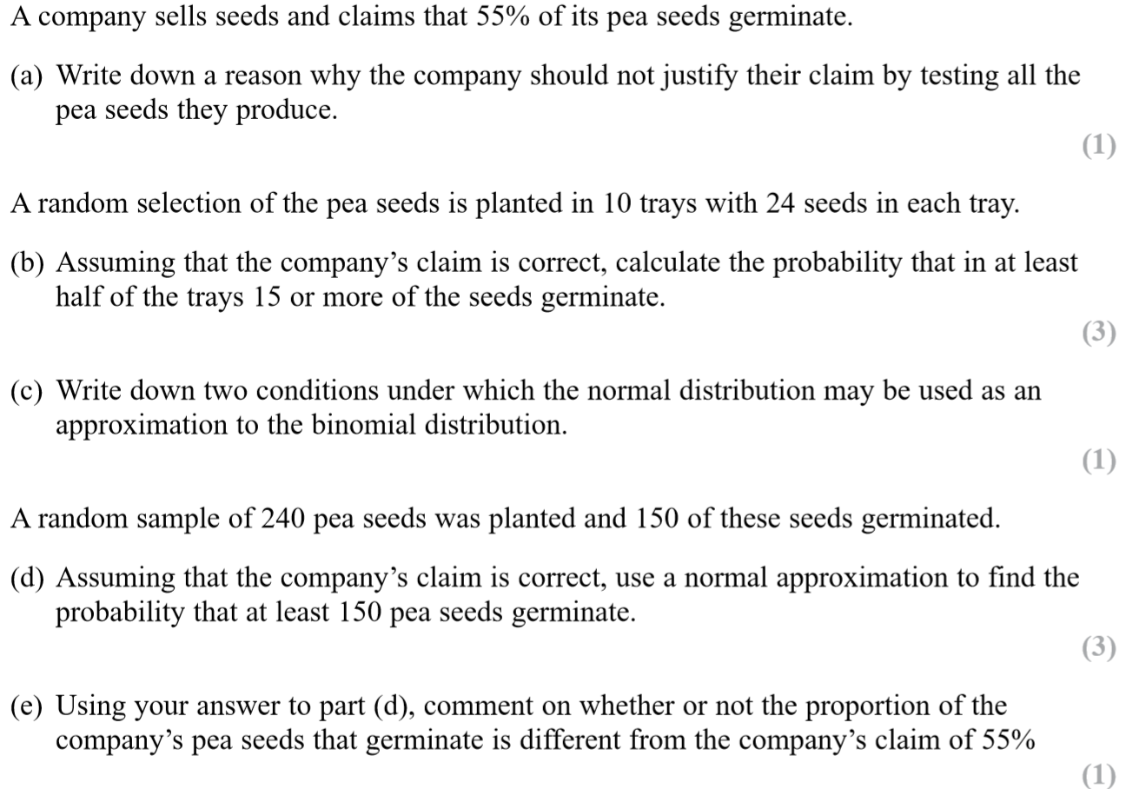
SAM

Slide 6
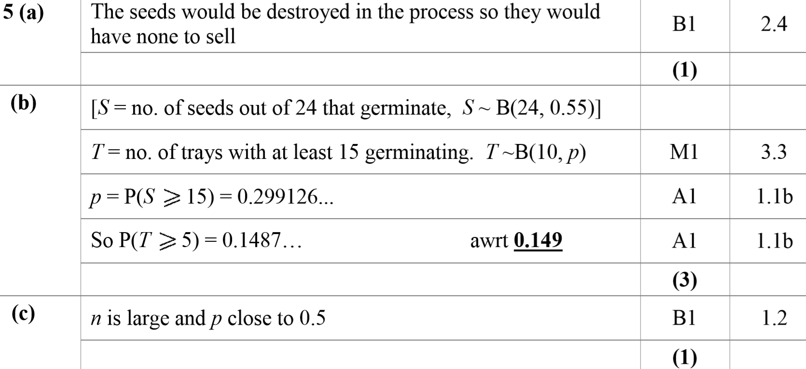
SAM
A
B
C

Slide 7
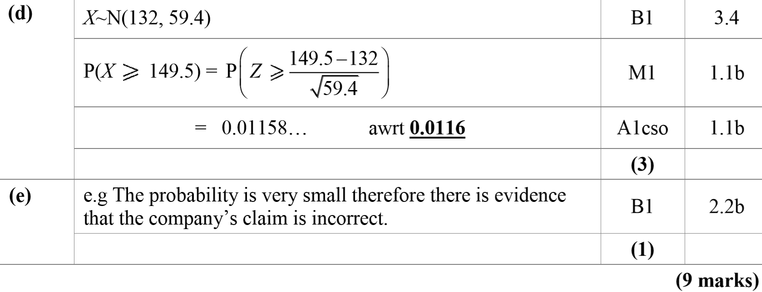
SAM
D
E

Slide 8
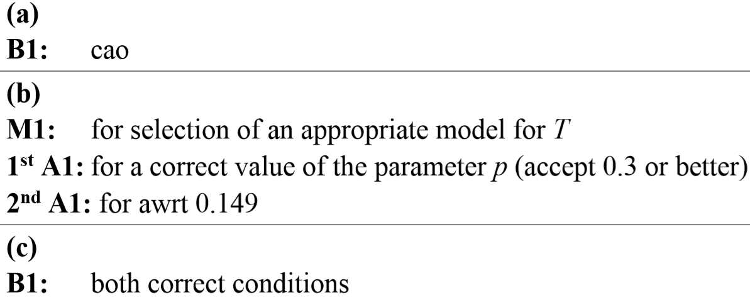
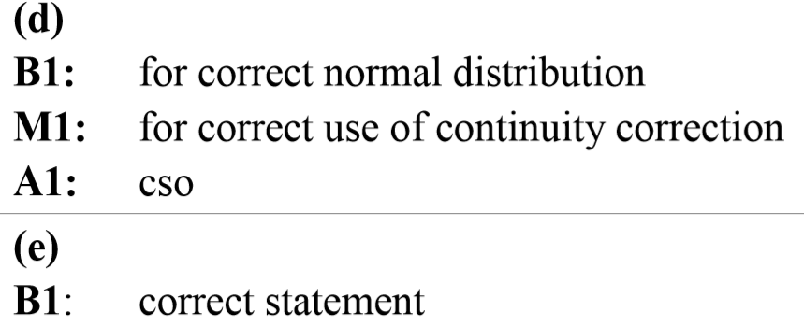
SAM
A notes
B notes
C notes
D notes
E notes

Slide 9
2018

Slide 10
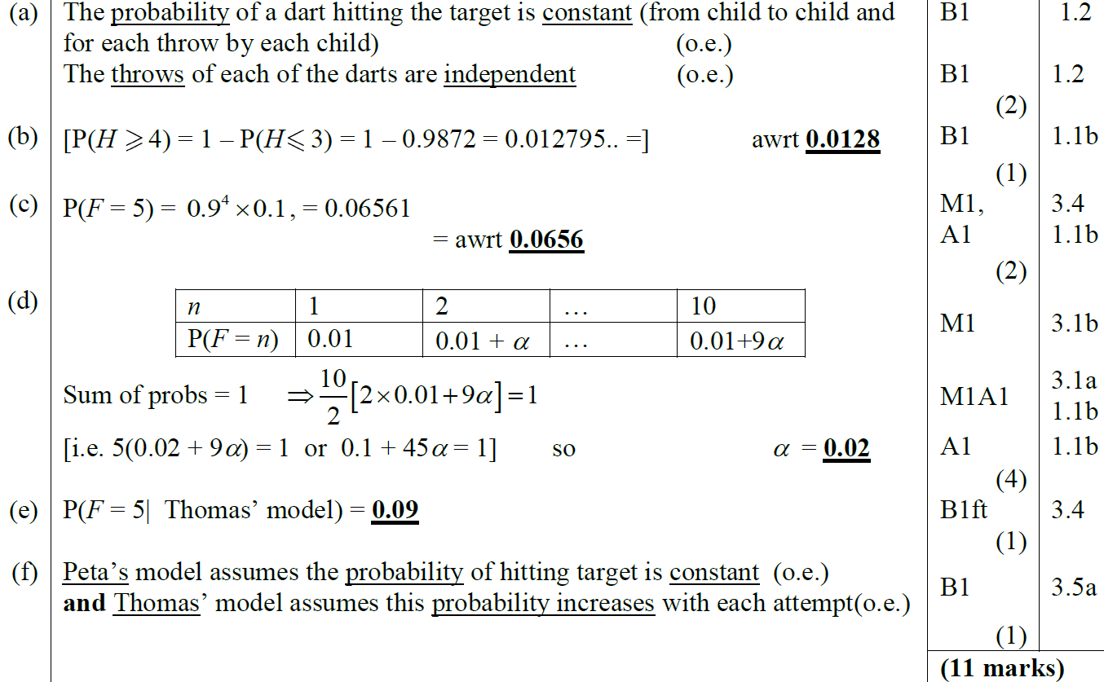
2018
A
B
C
D
E
F

Slide 11
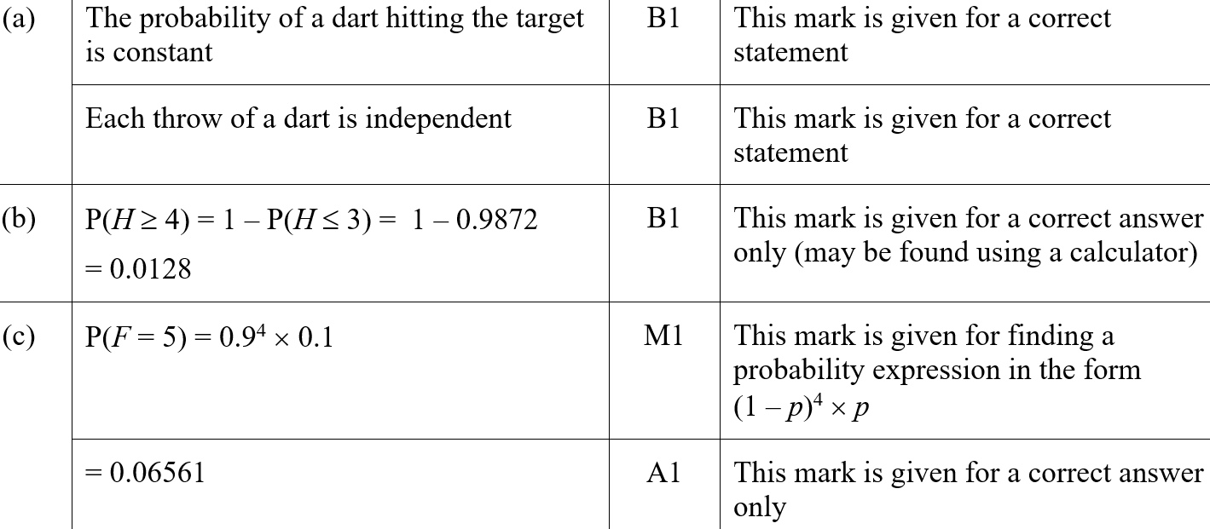
2018
A (SF)
B (SF)
C (SF)

Slide 12
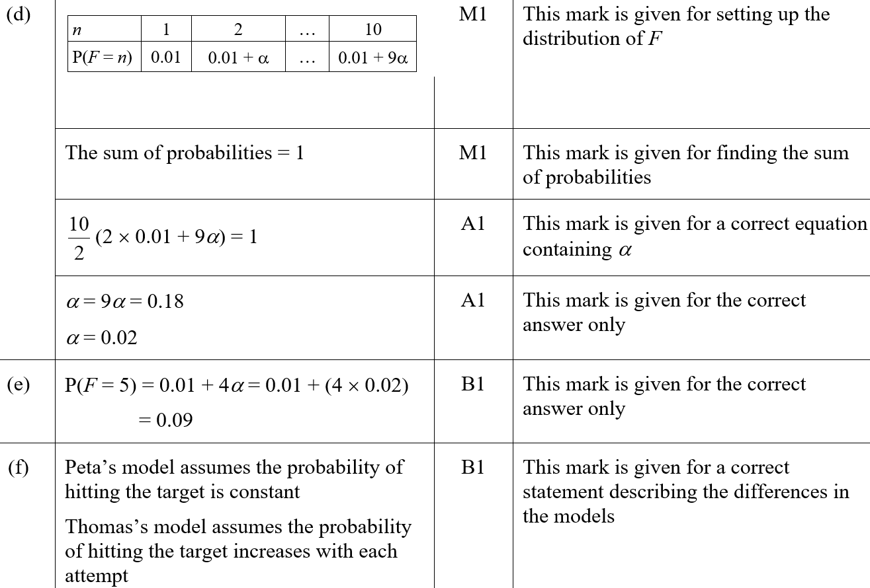
2018
D (SF)
E (SF)
F (SF)

Slide 13
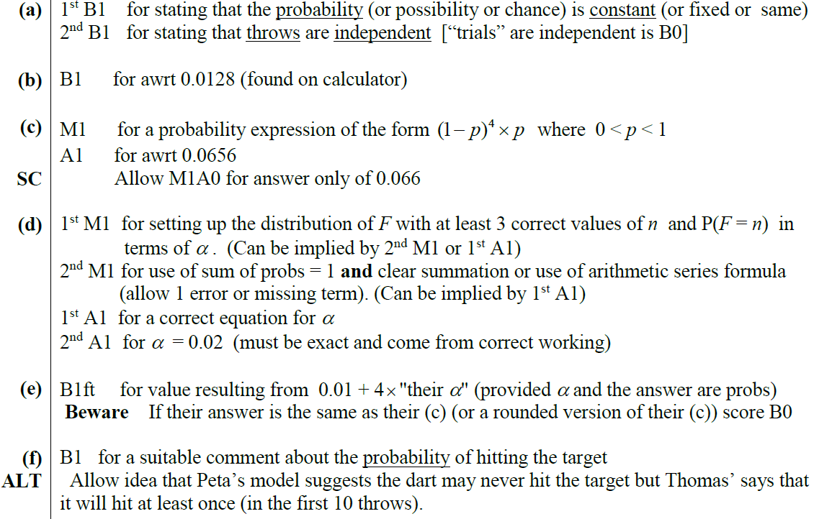
2018
A notes
B notes
C notes
D notes
E notes
F notes

Slide 14
New Spec Q’s
*Poisson Distribution not on new spec
Old Spec Binomial Distribution
Jan 2006 (i)
June 2007 (iii)
Jan 2010 (i)
Jan 2012 (i)
June 2014
Jan 2006 (ii)
Jan 2008 (i)
Jan 2010 (ii)
Jan 2012 (ii)
June 2015
May 2006 (i)*
Jan 2008 (ii)
May 2010 (i)*
May 2012 (i)
June 2016
May 2006 (ii)
May 2008 (i)*
May 2010 (ii)
May 2012 (ii)*
June 2017 (i)
Jan 2007 (i)*
May 2008 (ii)
Jan 2011 (i)*
May 2012 (iii)
June 2017 (ii)
Jan 2007 (ii)*
Jan 2009 (i)
Jan 2011 (ii)
Jan 2013 (i)
June 2018 (i)
Jan 2007 (iii)*
Jan 2009 (ii)*
May 2011 (i)
Jan 2013 (ii)
June 2018 (ii)
June 2007 (i)*
May 2009 (i)*
May 2011 (ii)
May 2013 (i)
June 2007 (ii)
May 2009 (ii)
May 2011 (iii)*
May 2013 (ii)*

Slide 15
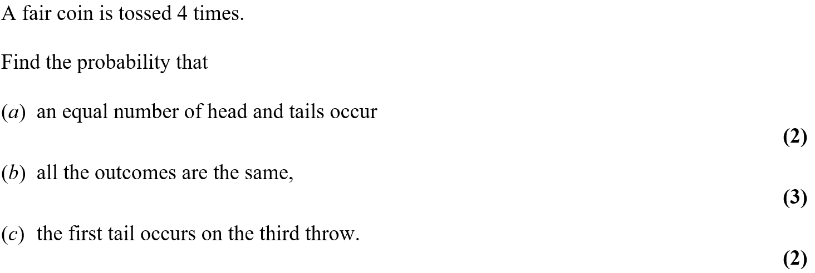
Jan 2006

Slide 16
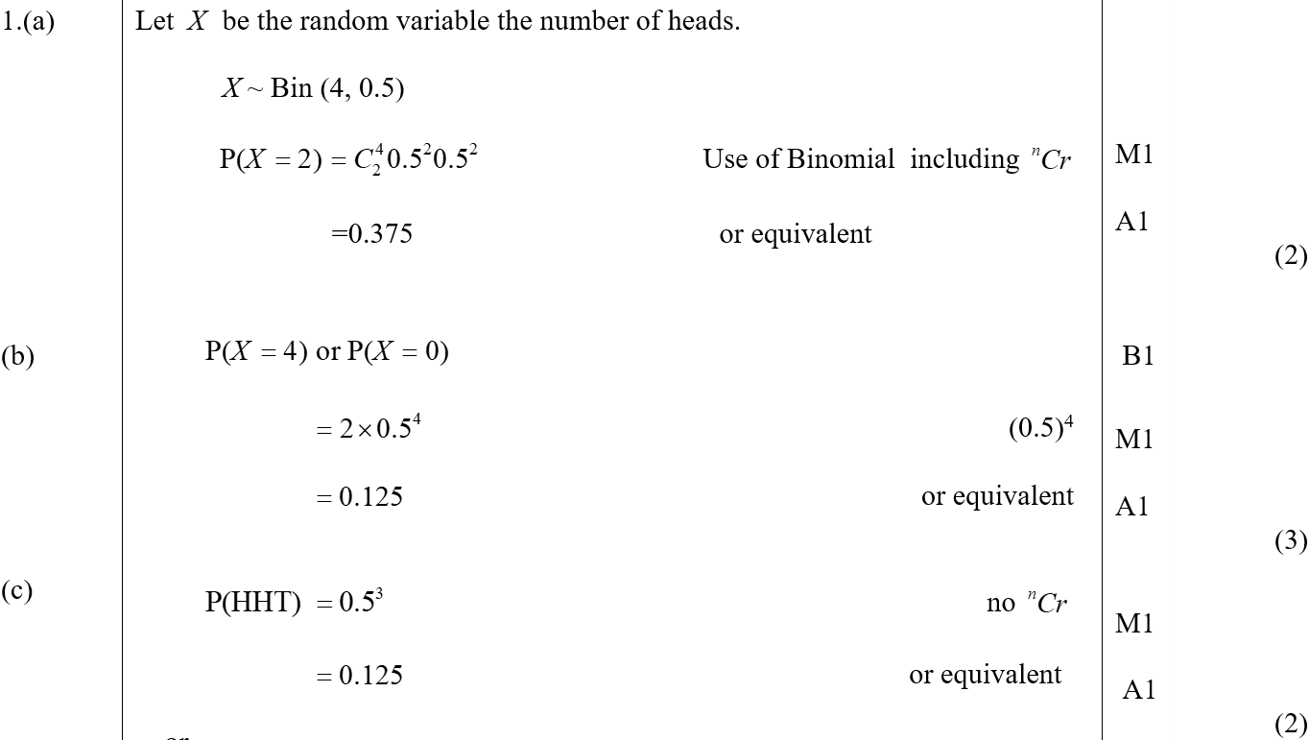
Jan 2006
A
B
C

Slide 17
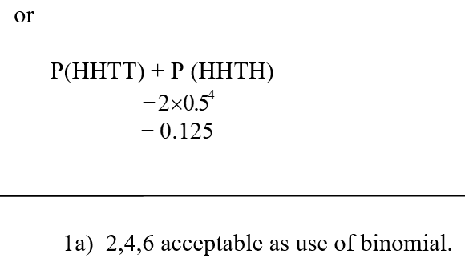
Jan 2006
C Alternative
A notes

Slide 18
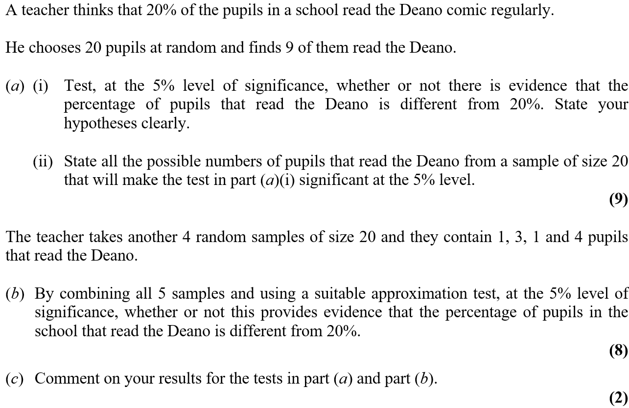
Jan 2006

Slide 19
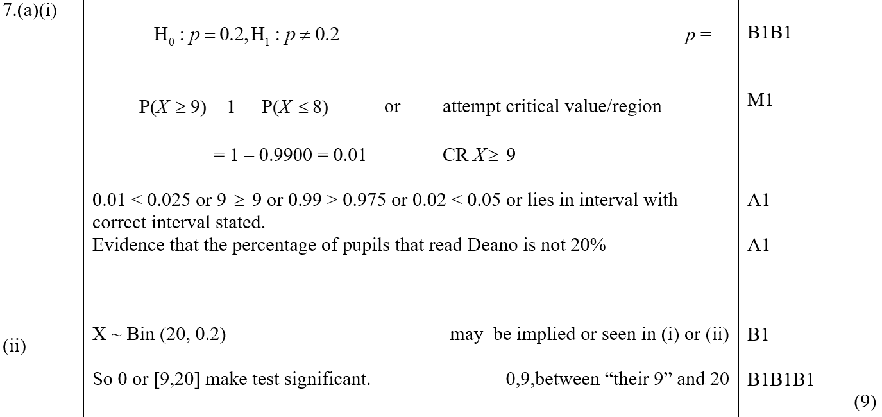
Jan 2006
A (i)
A (ii)

Slide 20
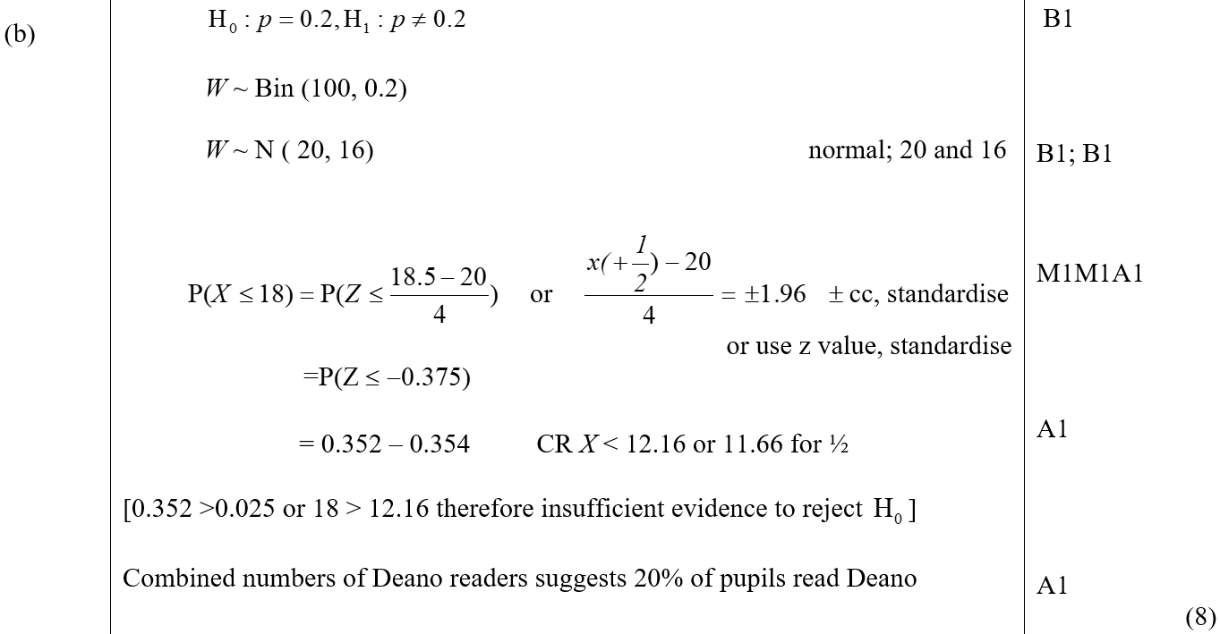
Jan 2006
B

Slide 21
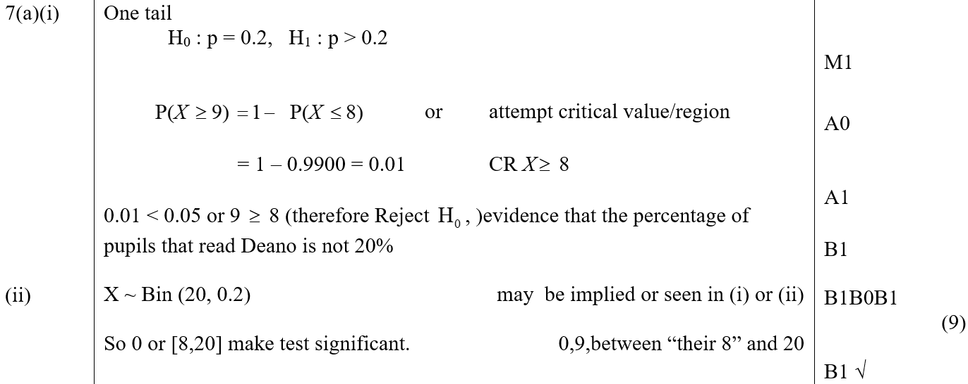
Jan 2006
C
A reduced marks for 1 tailed approach

Slide 22
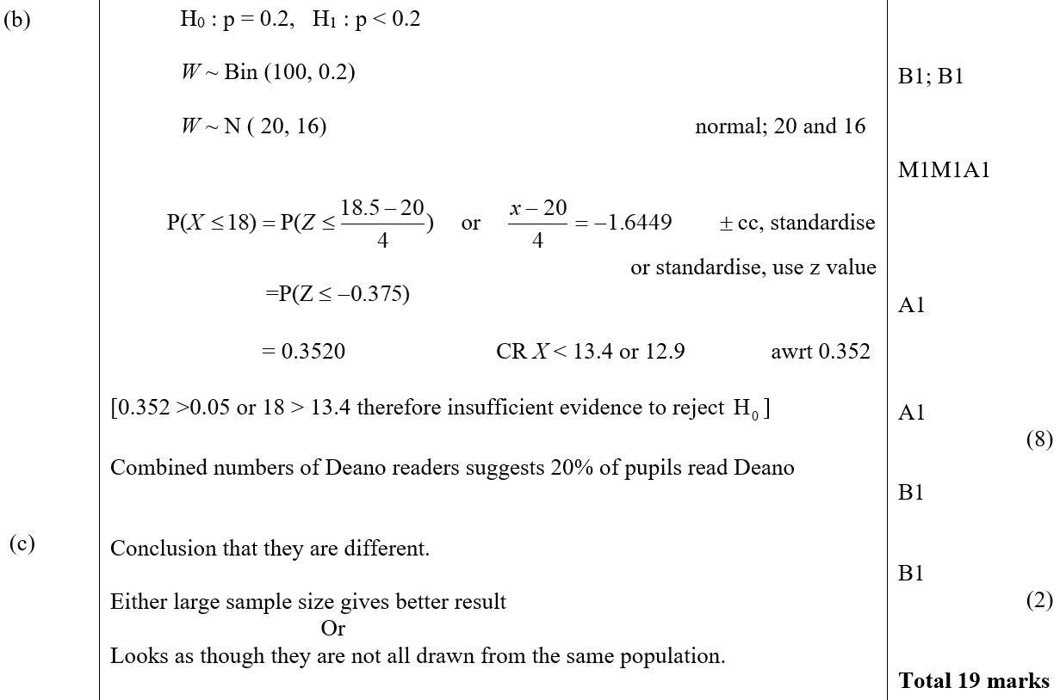
Jan 2006
B marks for 1 tailed approach
C marks for 1 tailed approach

Slide 23
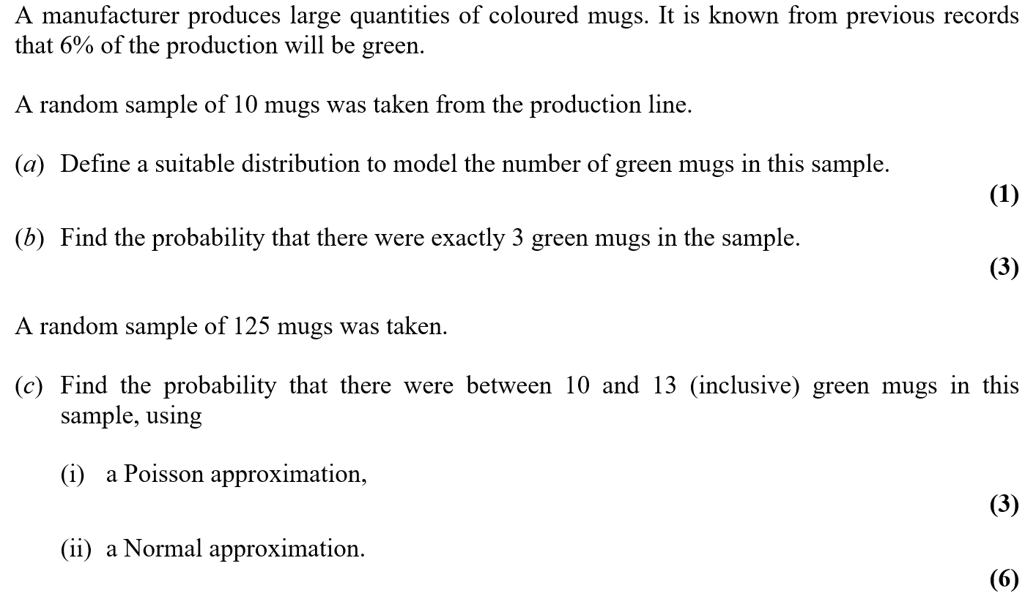
May 2006

Slide 24
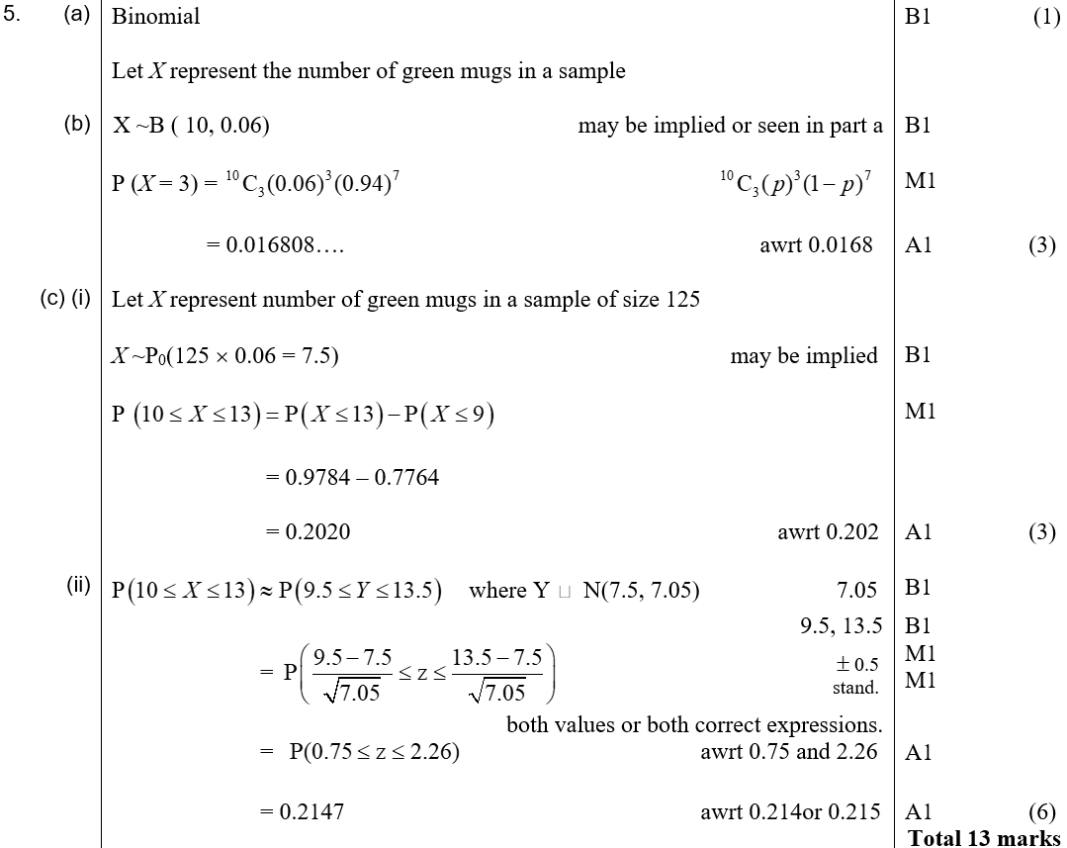
May 2006
A
B
C (i)
C (ii)

Slide 25
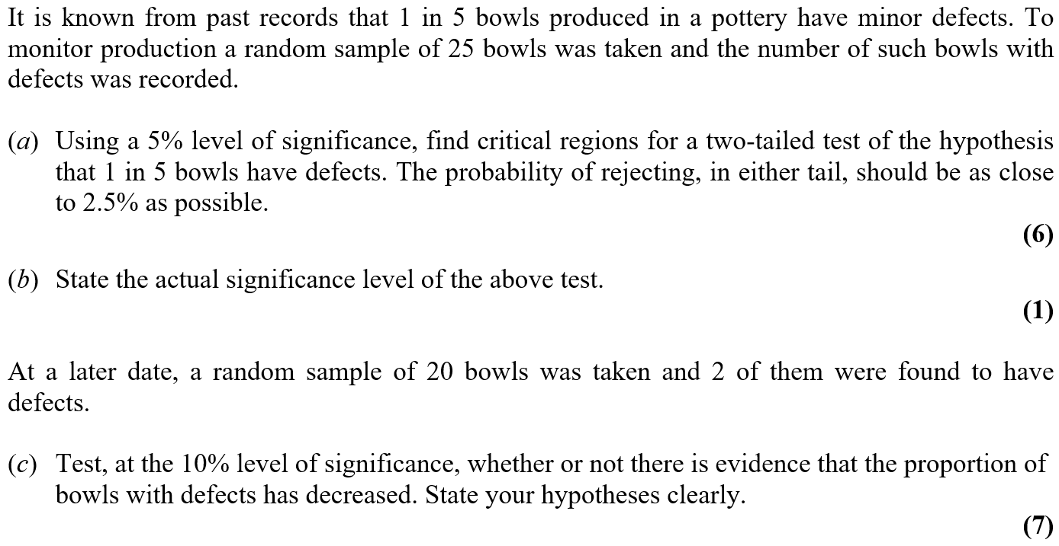
May 2006

Slide 26
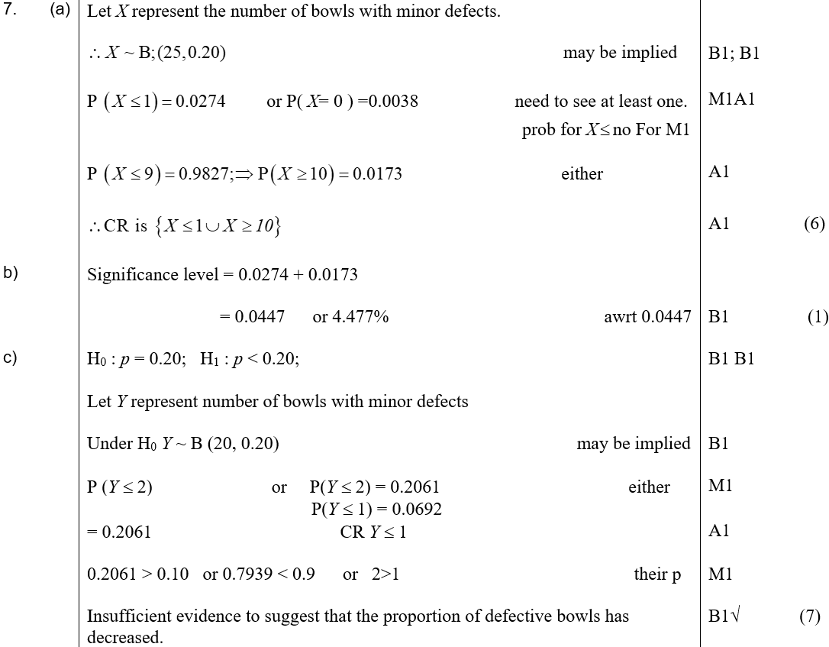
May 2006
A
B
C

Slide 27
Jan 2007

Slide 28
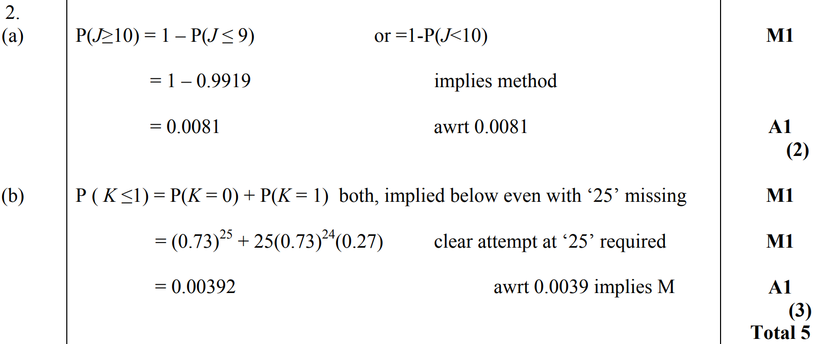
Jan 2007
A
B

Slide 29
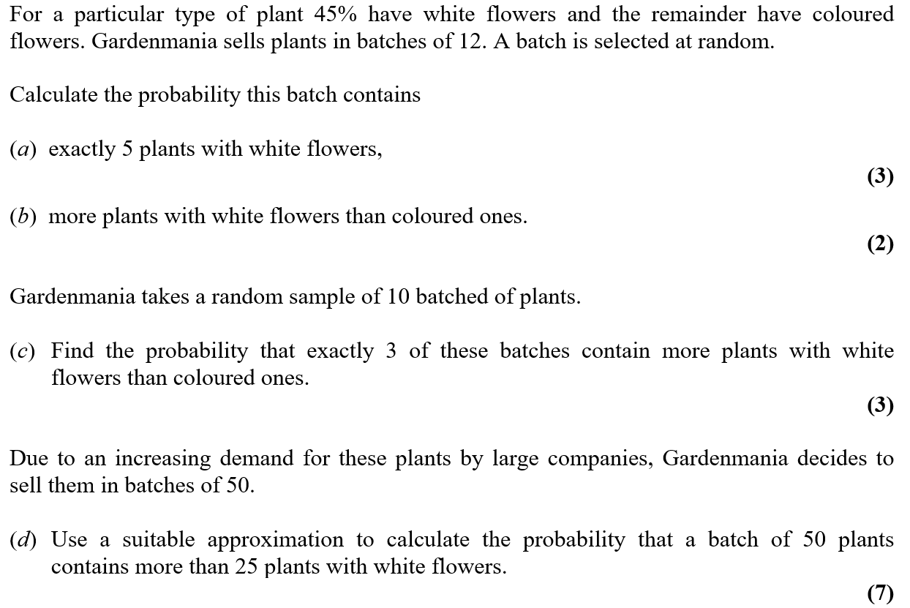
Jan 2007

Slide 30
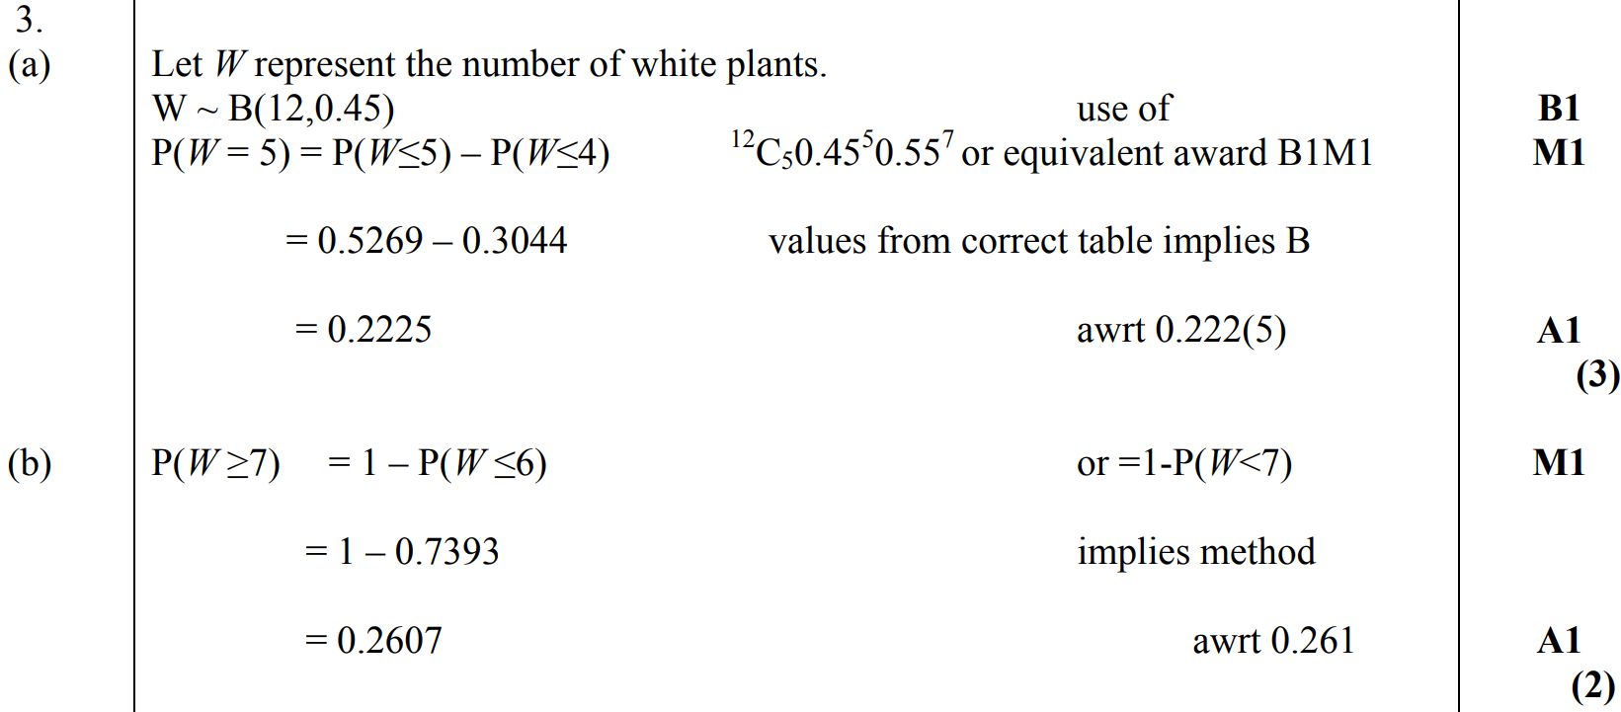
Jan 2007
A
B

Slide 31
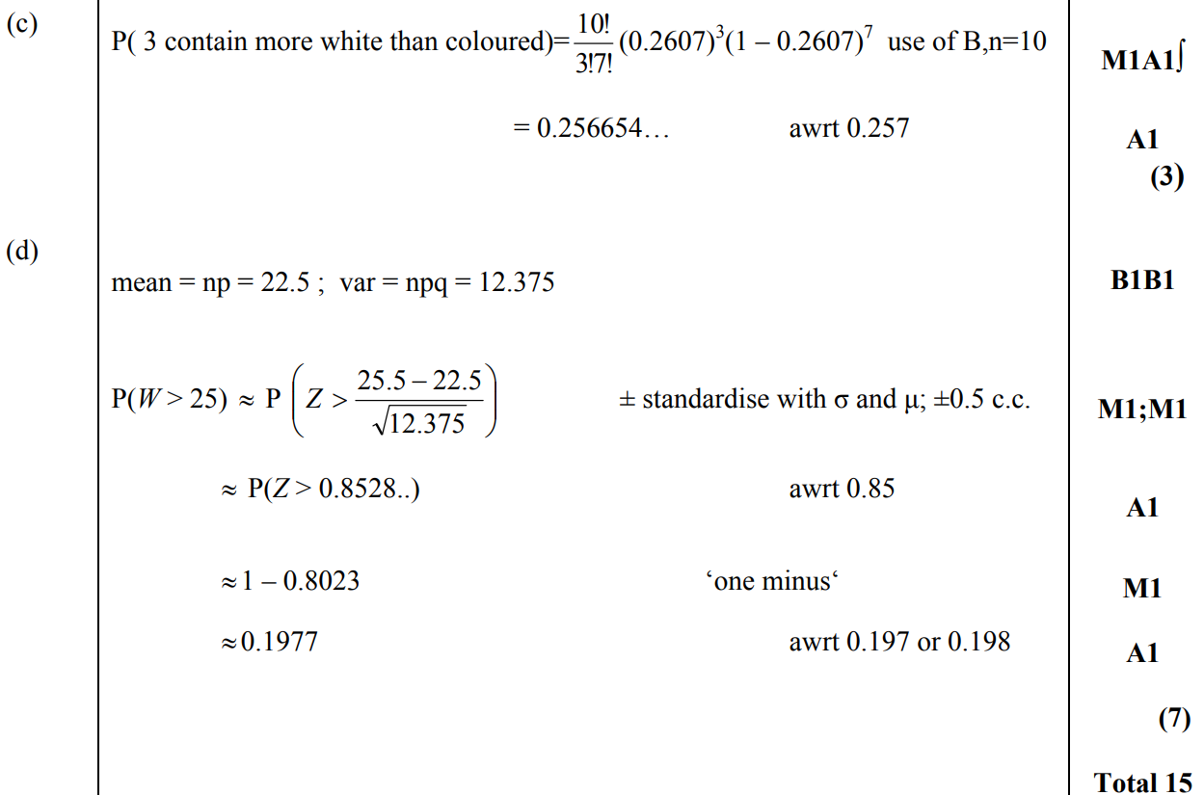
Jan 2007
C
D

Slide 32
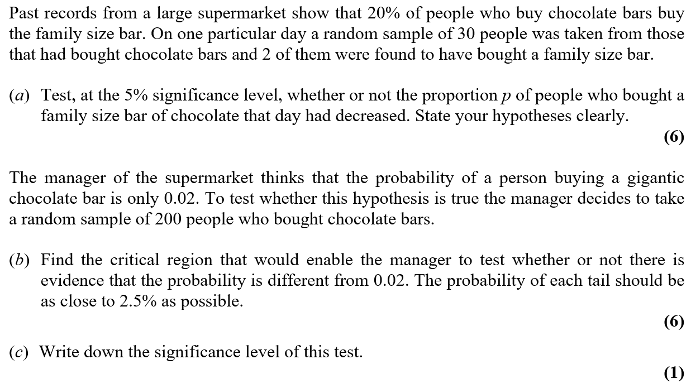
Jan 2007

Slide 33
Jan 2007
A

Slide 34
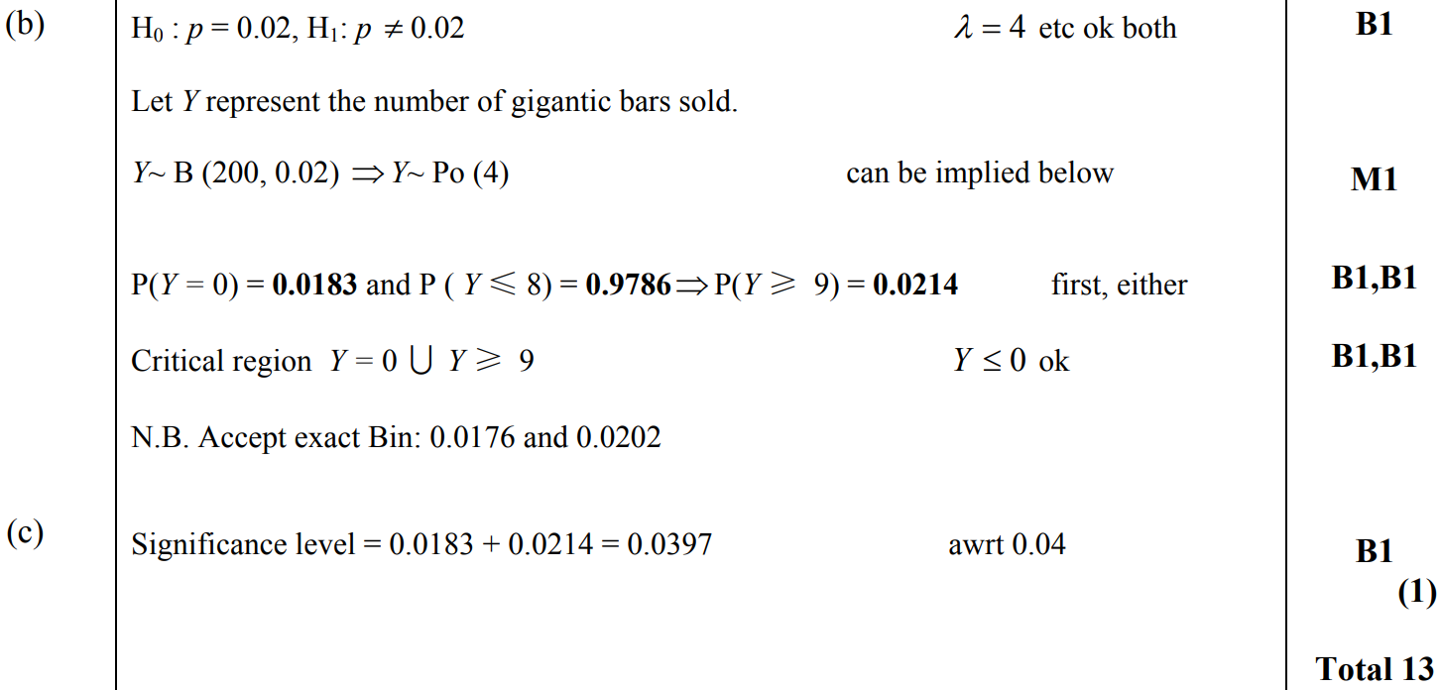
Jan 2007
B
C

Slide 35
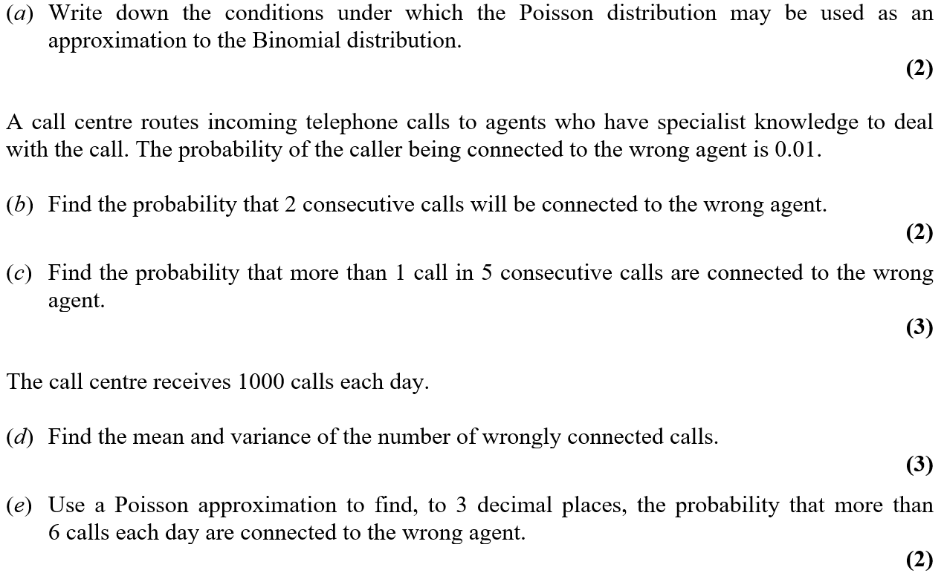
June 2007

Slide 36
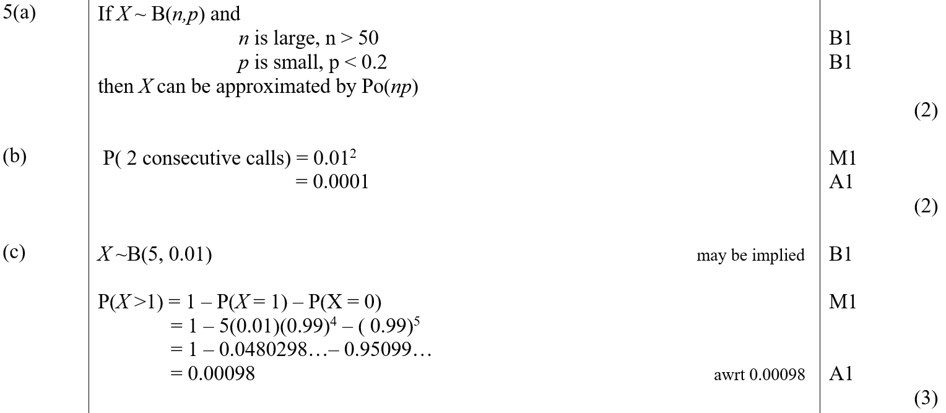
June 2007
A
B
C

Slide 37
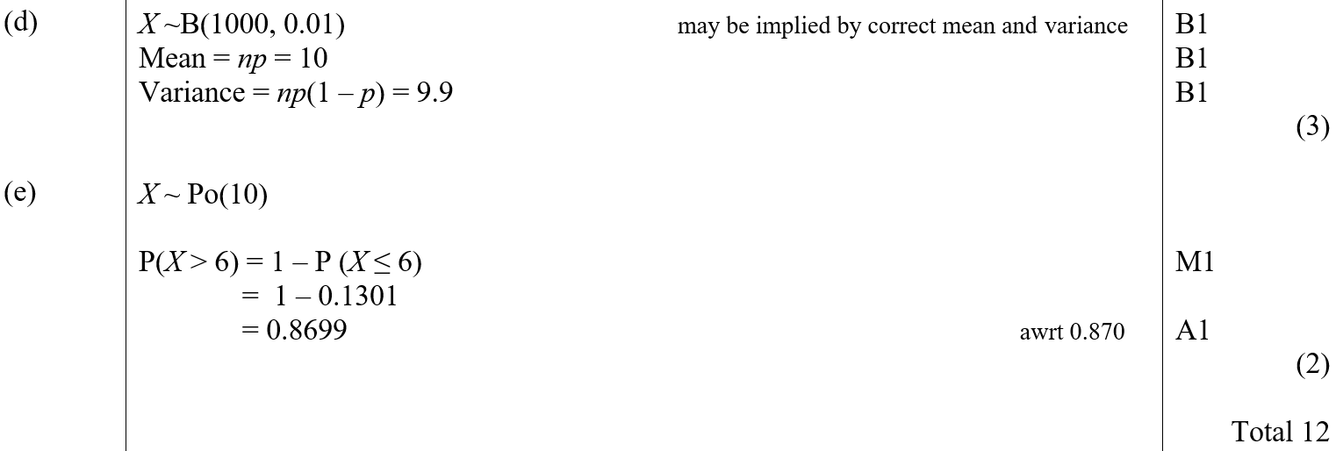
June 2007
D
E

Slide 38
June 2007

Slide 39
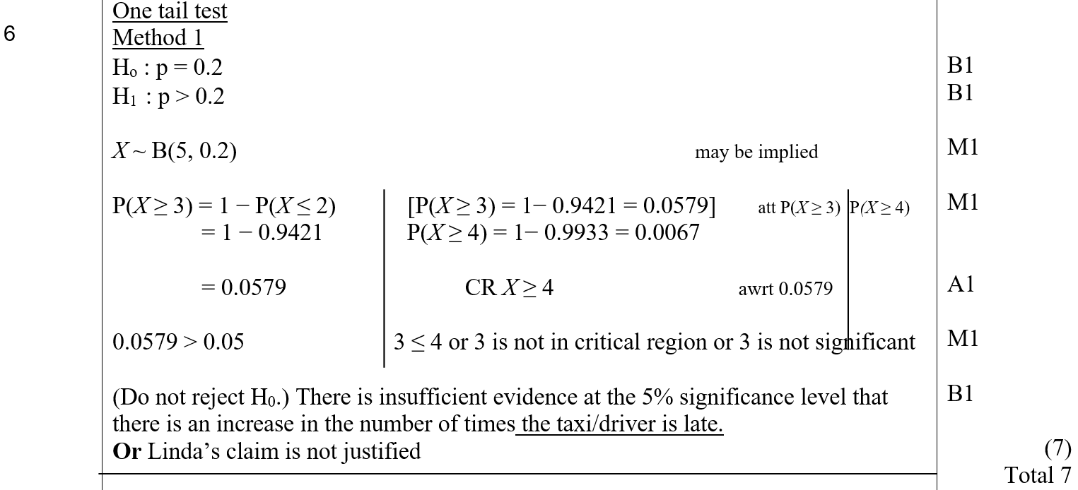
June 2007
A (One-Tailed)

Slide 40
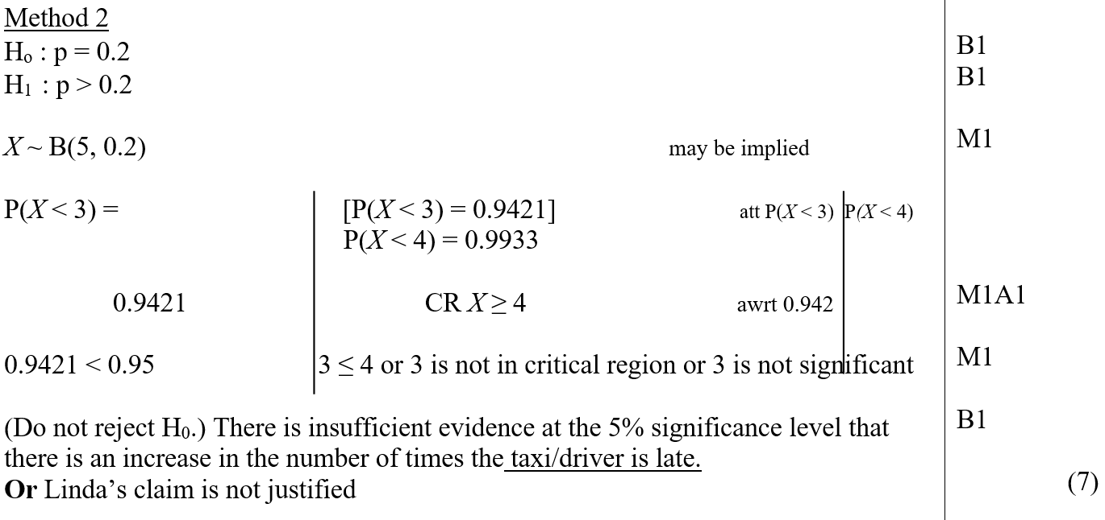
June 2007
A Alternative (One-Tailed)

Slide 41
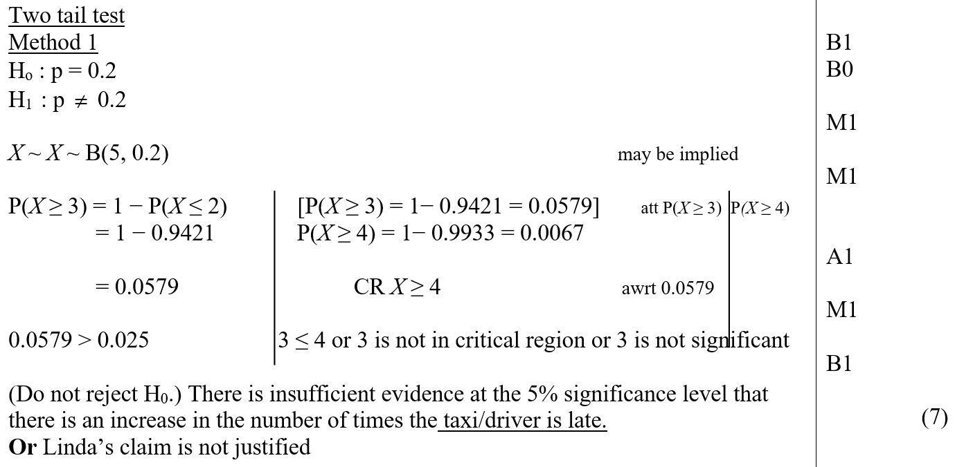
June 2007
A (Two-Tailed)

Slide 42
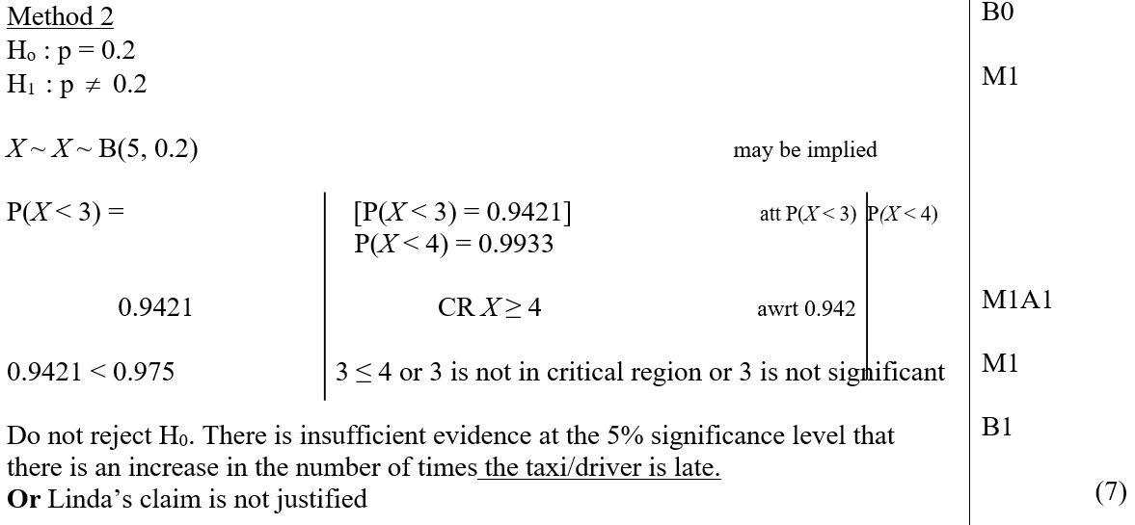
June 2007
A Alternative (Two-Tailed)
Special Case

Slide 43
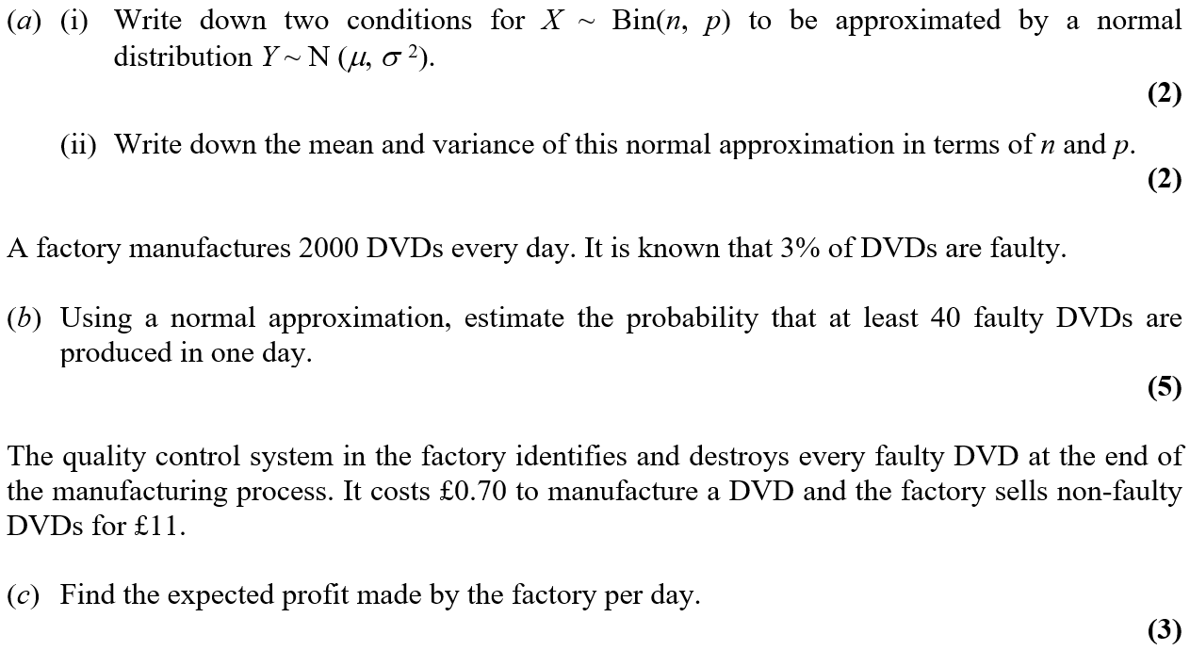
June 2007

Slide 44
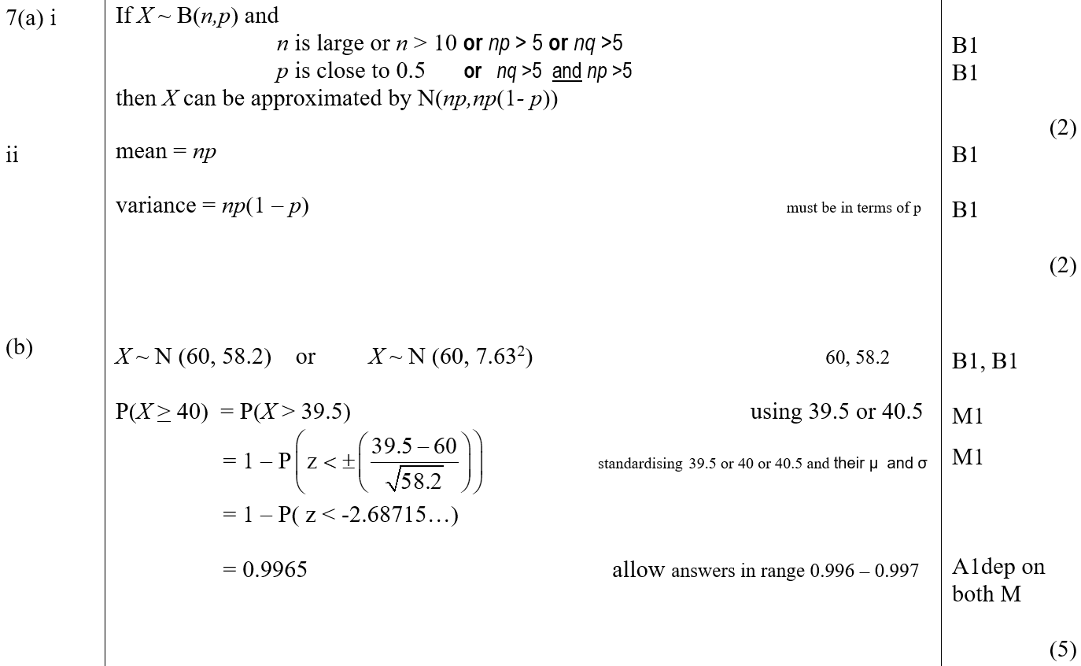
June 2007
A (i)
A (ii)
B

Slide 45
June 2007
C

Slide 46
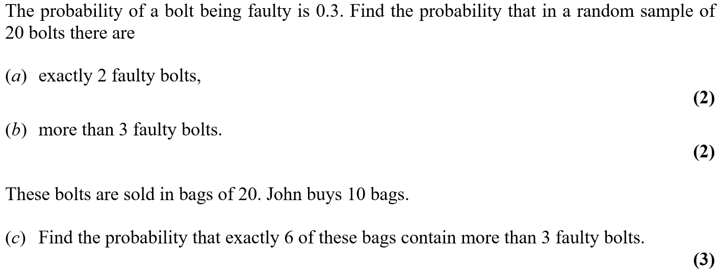
Jan 2008

Slide 47
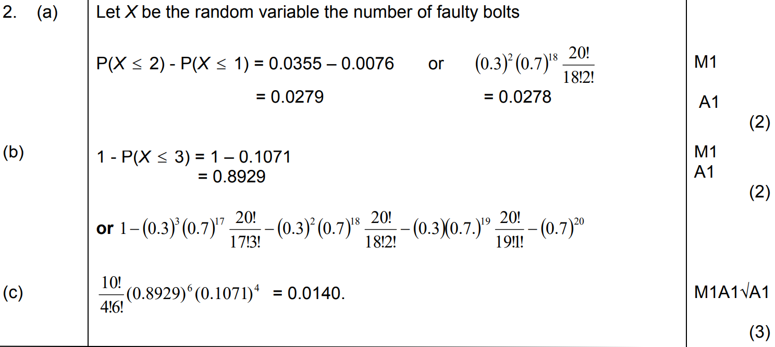
Jan 2008
A
B
C

Slide 48
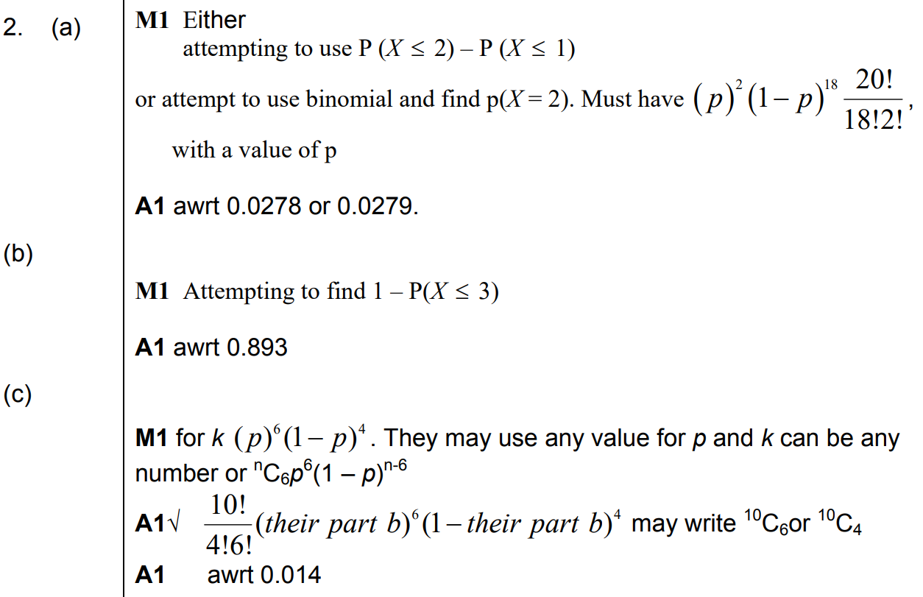
Jan 2008
A notes
B notes
C notes

Slide 49
Jan 2008

Slide 50
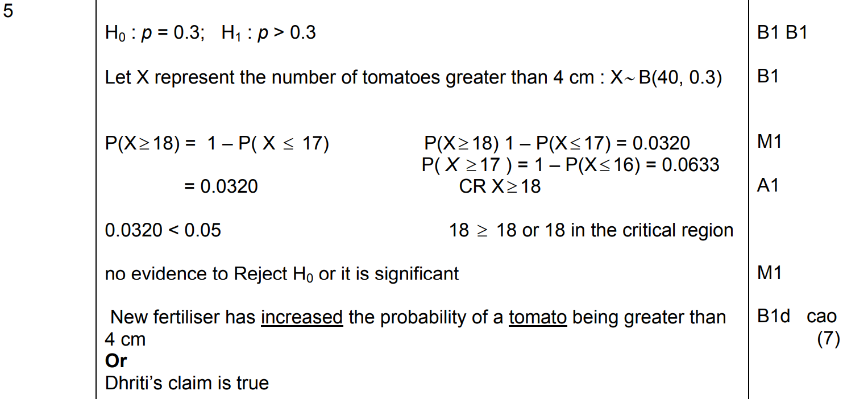
Jan 2008
A

Slide 51
Jan 2008
A notes

Slide 52
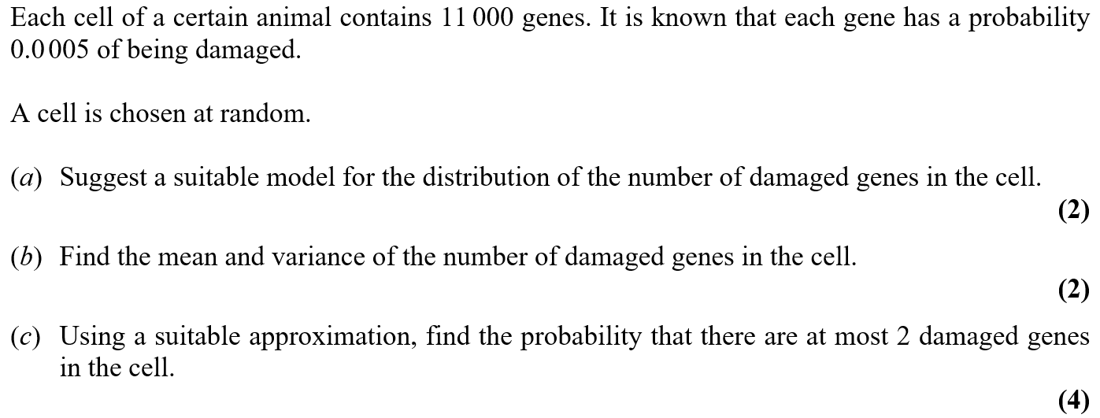
May 2008

Slide 53
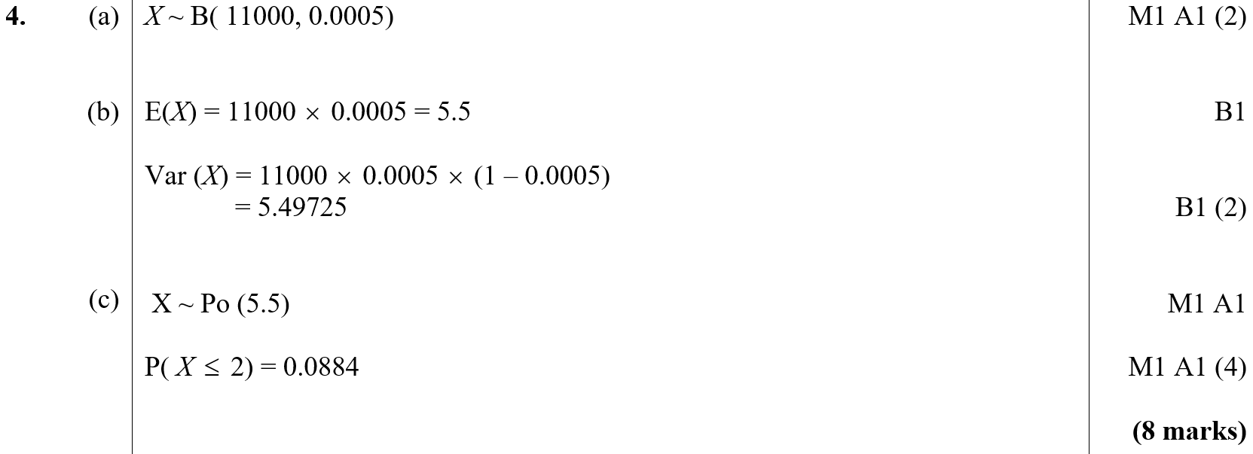
May 2008
A
B
C

Slide 54
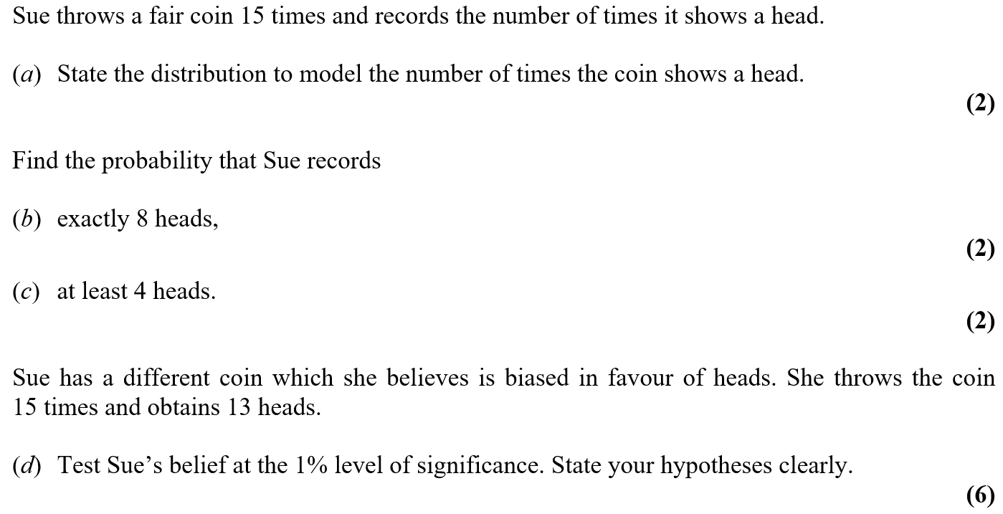
May 2008

Slide 55
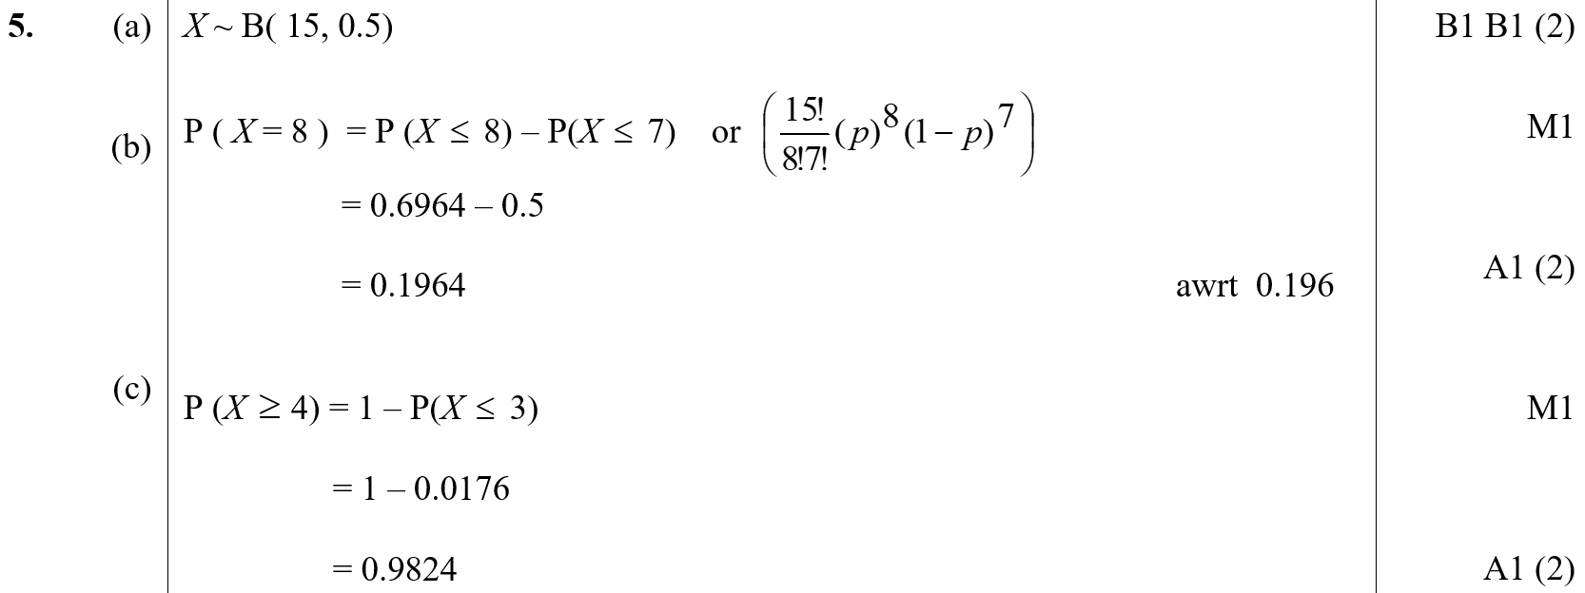
May 2008
A
B
C

Slide 56
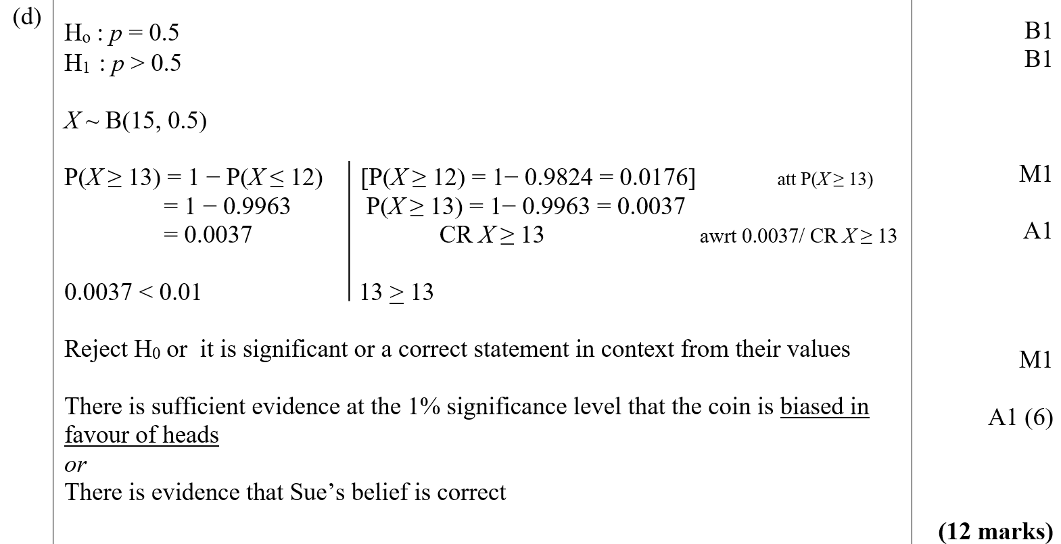
May 2008
D

Slide 57
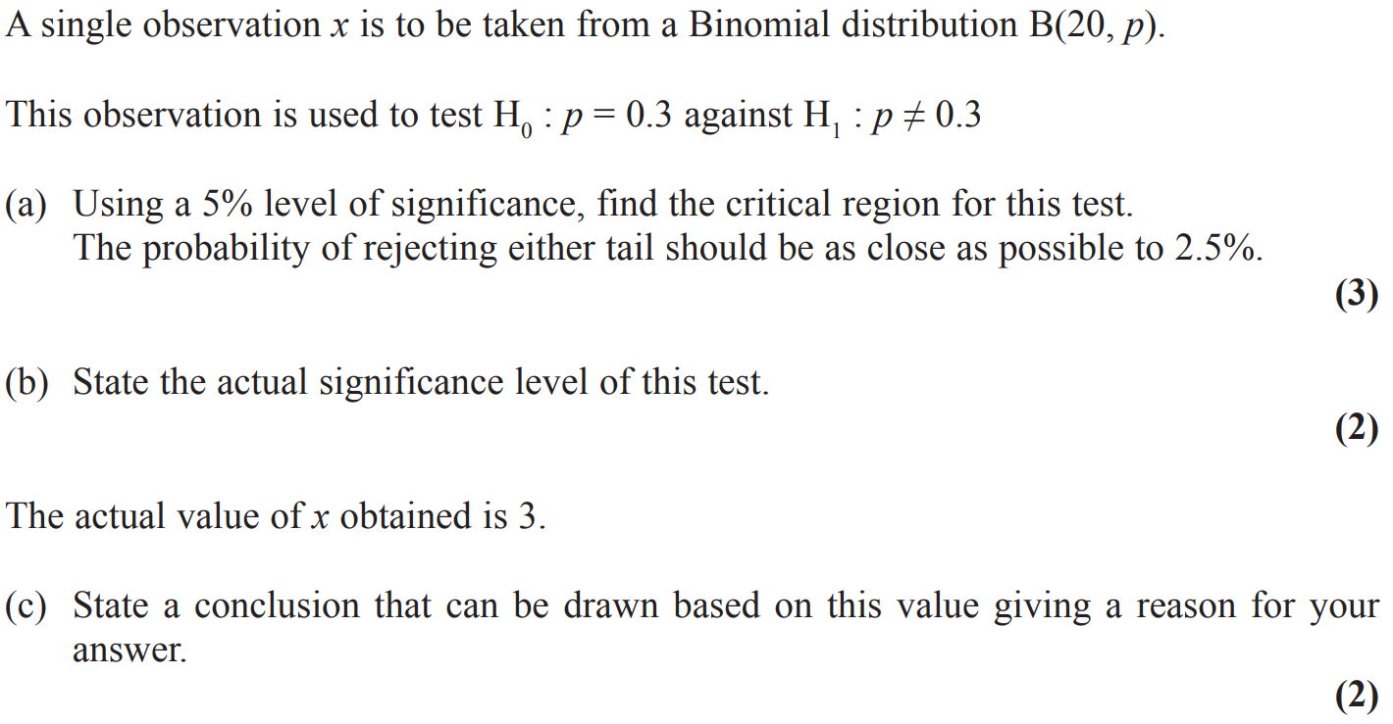
Jan 2009

Slide 58
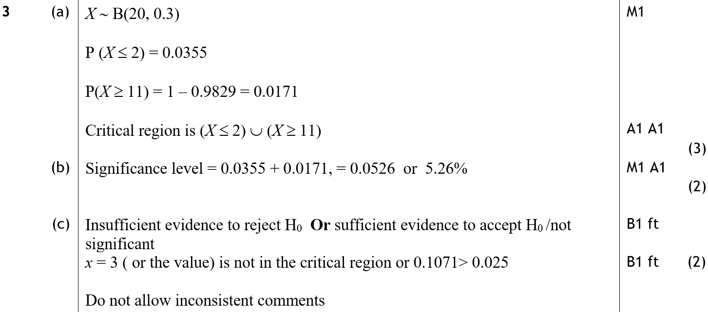
Jan 2009
A
B
C

Slide 59
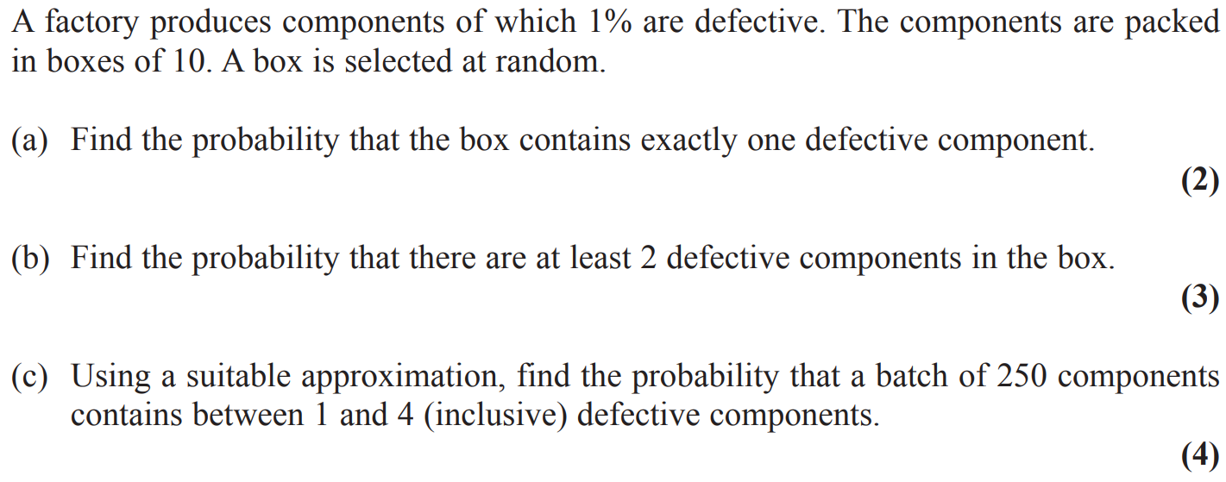
Jan 2009

Slide 60
Jan 2009
A
B
C

Slide 61
Jan 2009
notes

Slide 62
May 2009

Slide 63
May 2009
A
B

Slide 64
May 2009

Slide 65
May 2009
A
B
C

Slide 66
Jan 2010

Slide 67
Jan 2010
A
B
C
D

Slide 68
Jan 2010
A notes
B notes
C notes
D notes

Slide 69
Jan 2010

Slide 70
Jan 2010
A
B
C
D

Slide 71
Jan 2010
A notes
B notes
C notes
D notes

Slide 72
May 2010

Slide 73
May 2010
A
B
C
D

Slide 74
May 2010
A notes
B notes
C notes
D notes

Slide 75
May 2010

Slide 76
May 2010
A
B
C
D
E

Slide 77
May 2010
A notes
B notes
C notes
D notes
E notes

Slide 78
Jan 2011

Slide 79
Jan 2011
A
B
C
D

Slide 80
Jan 2011
A notes
B notes
D notes

Slide 81
Jan 2011

Slide 82
Jan 2011
A

Slide 83
Jan 2011
A notes

Slide 84
May 2011

Slide 85
May 2011
A
B

Slide 86
May 2011

Slide 87
May 2011
A
B

Slide 88
May 2011

Slide 89
May 2011
A
B
C

Slide 90
Jan 2012

Slide 91
Jan 2012
A

Slide 92
Jan 2012
A notes

Slide 93
Jan 2012

Slide 94
Jan 2012
A
B
C
D

Slide 95
Jan 2012
A notes
B notes
C notes
D notes

Slide 96
May 2012

Slide 97
May 2012
A
B

Slide 98
May 2012
A notes
B notes

Slide 99
May 2012

Slide 100
May 2012
A (i)
A (ii)
B

Slide 101
May 2012
C
A notes
B notes

Slide 102
May 2012
C notes

Slide 103
May 2012

Slide 104
May 2012
A (i)
A (ii)
B

Slide 105
May 2012
A (i) notes
A (ii) notes
B notes

Slide 106
Jan 2013

Slide 107
Jan 2013
A (i)
A (ii)
B

Slide 108
Jan 2013
C

Slide 109
Jan 2013
A (ii) notes
B notes
C notes

Slide 110
Jan 2013

Slide 111
Jan 2013
A
B
C

Slide 112
Jan 2013
D
A notes

Slide 113
Jan 2013
C notes
D notes

Slide 114
May 2013

Slide 115
May 2013
A
B

Slide 116
May 2013
A notes
B notes

Slide 117
May 2013

Slide 118
May 2013
A
B
C

Slide 119
May 2013
D
A notes
B notes
C notes
D notes

Slide 120
June 2014

Slide 121
June 2014
A (i)
A (ii)
B
C

Slide 122
June 2014
A (i) notes
A (ii) notes
B notes
C notes

Slide 123
June 2015

Slide 124
June 2015
A

Slide 125
June 2015
B

Slide 126
June 2016

Slide 127
June 2016
A
B (i)
B (ii)

Slide 128
June 2016
C

Slide 129
June 2017

Slide 130
June 2017
A

Slide 131
June 2017
B

Slide 132
June 2017

Slide 133
June 2017
A
B

Slide 134
June 2017
C

Slide 135
June 2018

Slide 136
June 2018
A
B
C
D

Slide 137
June 2018
A notes
B notes
C notes
D notes

Slide 138
June 2018

Slide 139
June 2018
A
B
C
D
E

Slide 140
June 2018
A notes
B notes
C notes
E notes

