Slide 1
Angles and Properties of Polygons
Polygons
June 2017
3H Q8
Nov 2017
1H Q14
SAM
3H Q9
June 2018
3H Q4
1 Marker
June 2018
3H Q13
Nov 2018
1H Q7
Properties of Quadrilaterals

Slide 2
Polygons
SAM 3H Q9

Slide 3
Polygons
SAM 3H Q9
A

Slide 4
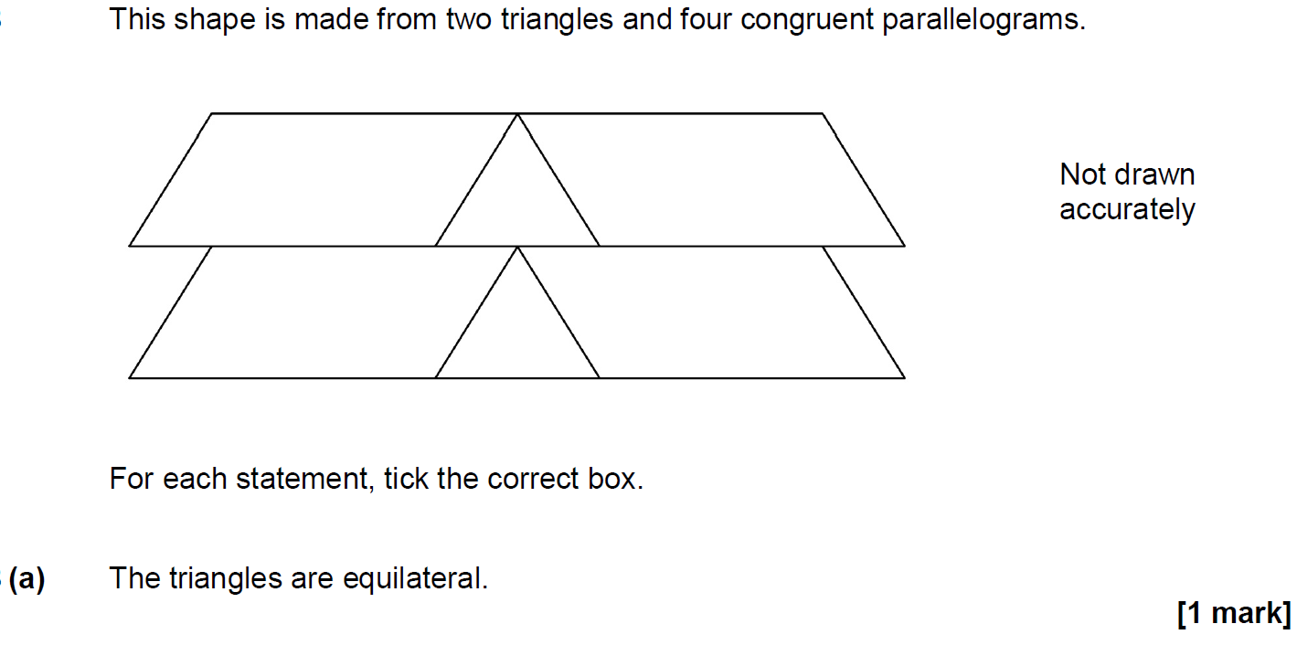
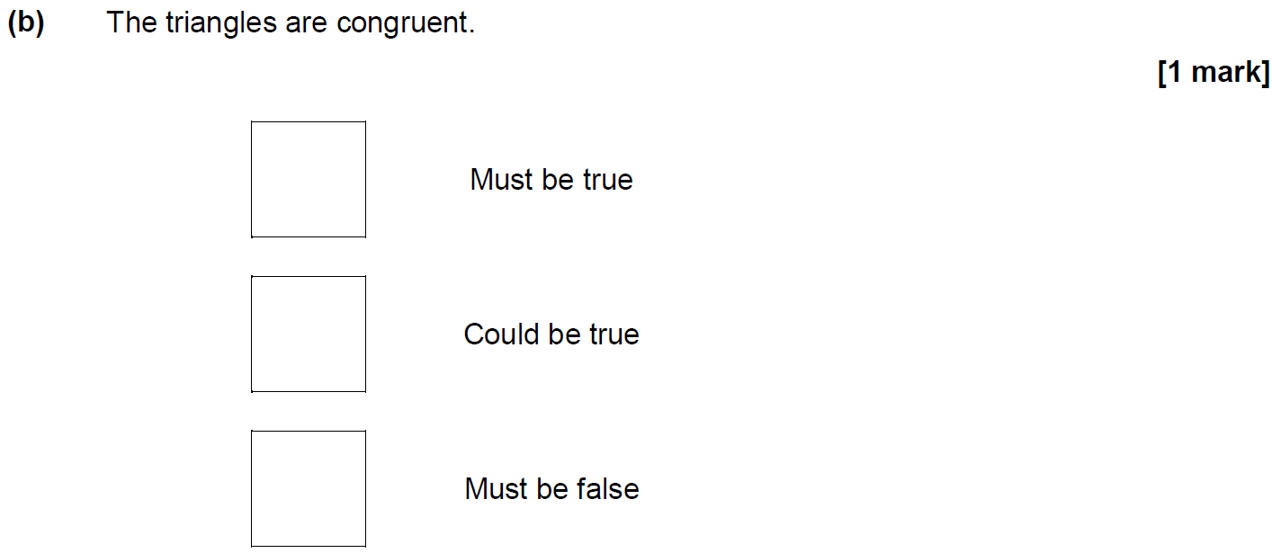
Polygons
June 2017 3H Q8

Slide 5
Polygons
June 2017 3H Q8
A
B

Slide 6
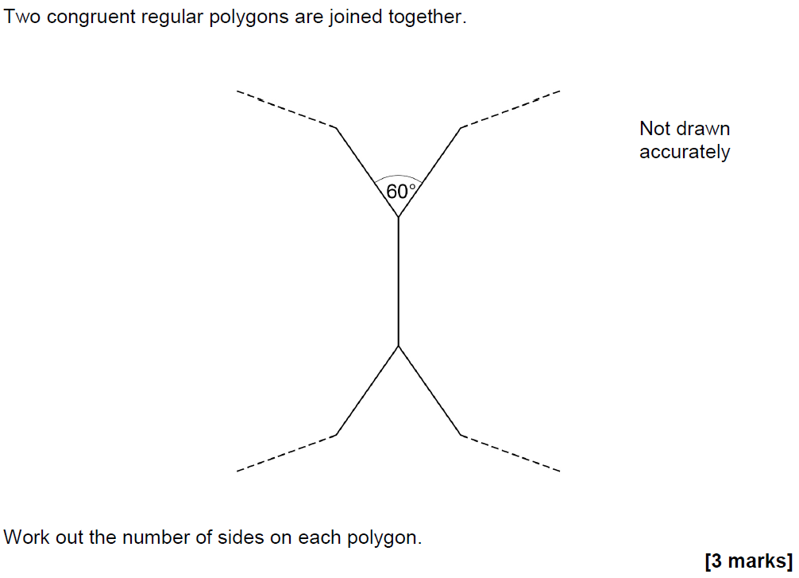
Polygons
Nov 2017 1H Q14

Slide 7
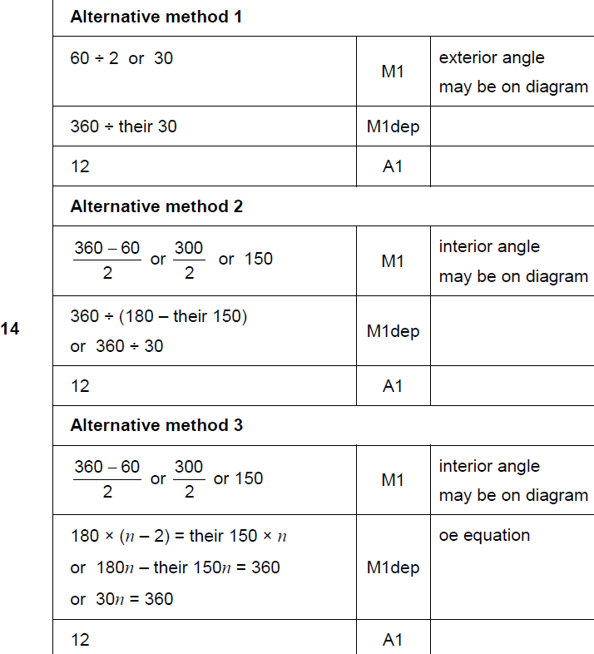
Polygons
Nov 2017 1H Q14
A

Slide 8
Polygons
June 2018 3H Q4

Slide 9
Polygons
June 2018 3H Q4
A

Slide 10
Polygons
June 2018 3H Q13

Slide 11
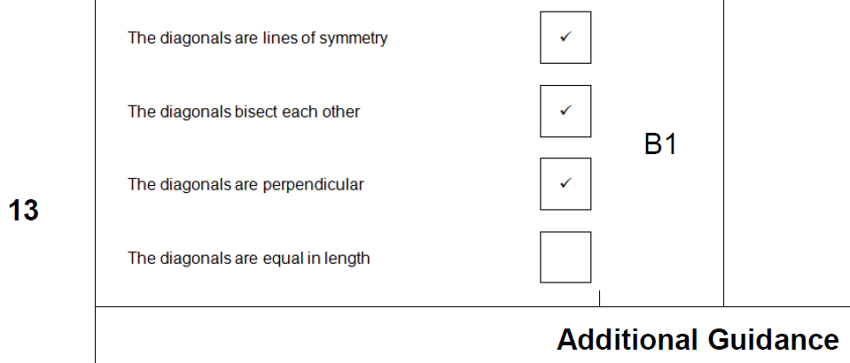
Polygons
June 2018 3H Q13
A

Slide 12
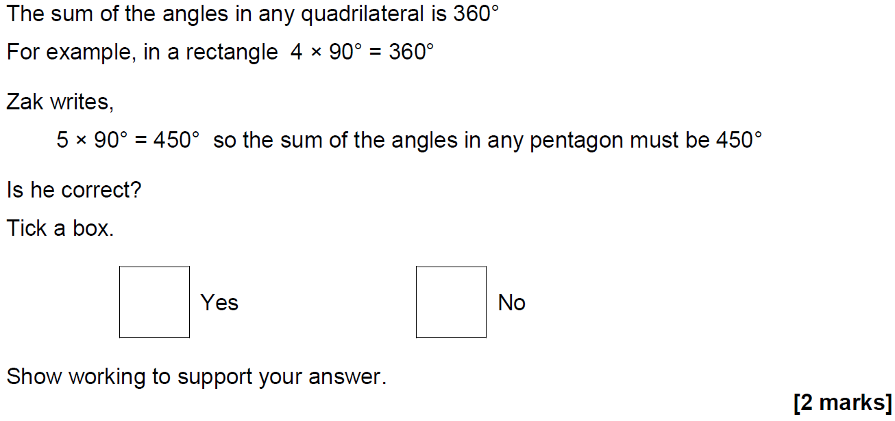
Polygons
Nov 2018 1H Q7

Slide 13
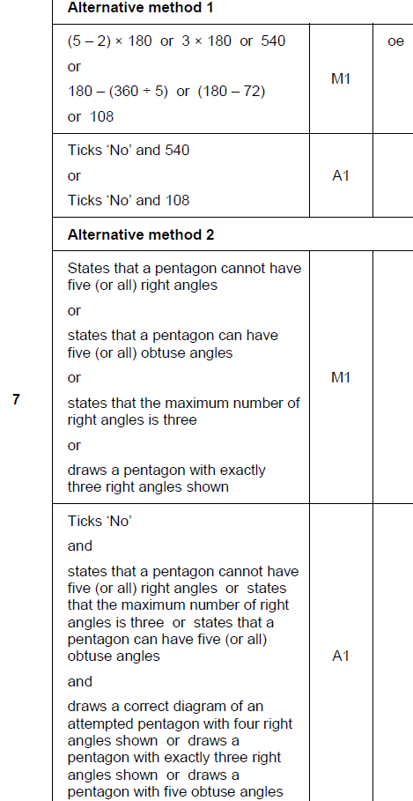
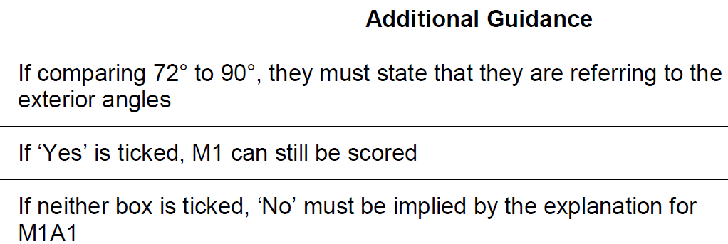
Polygons
Nov 2018 1H Q7
A

