Slide 1
Angles in Polygons
Angles in Polygons
Old Spec Q’s
SAM
2H Q11
June 2018
2H Q12
June 2018
2HR Q9
Jan 2019
1HR Q6
Jan 2019
2HR Q6

Slide 2
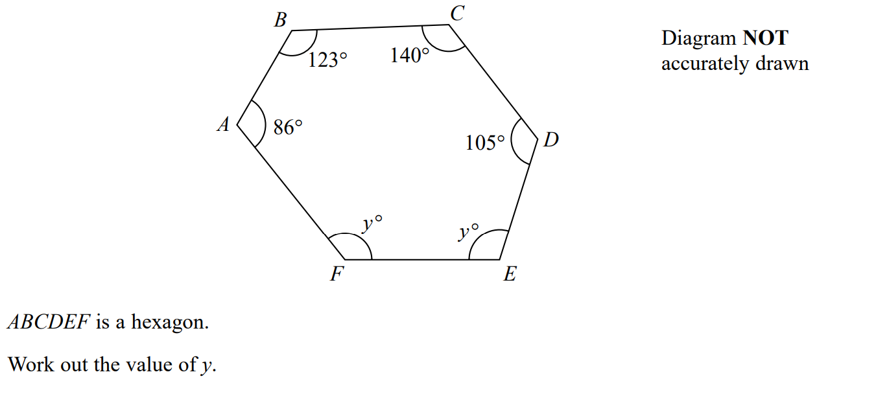
Angles in Polygons
SAM 2H Q11

Slide 3
Angles in Polygons
SAM 2H Q11
A

Slide 4
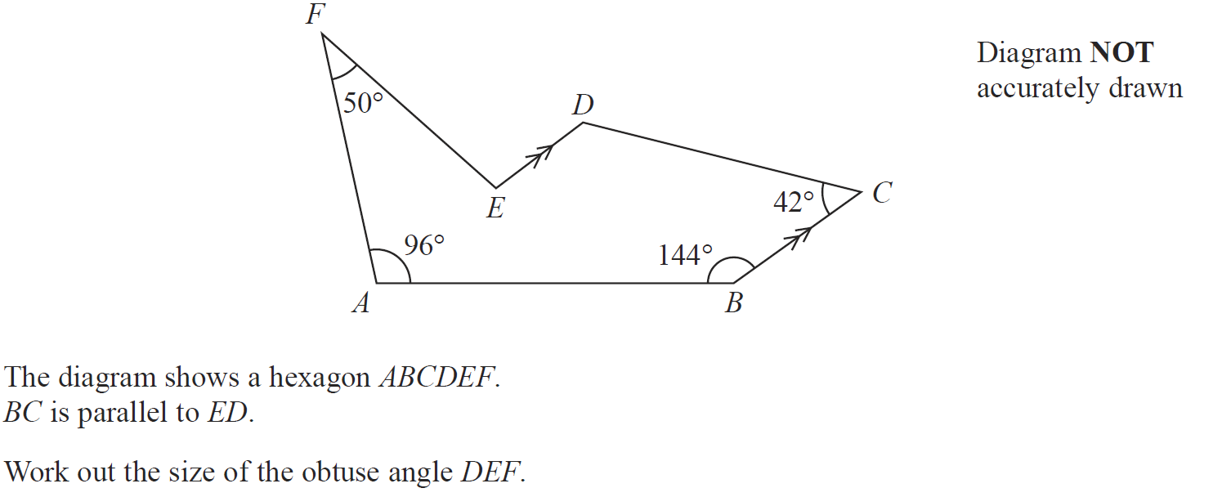
Angles in Polygons
June 2018 2H Q12

Slide 5
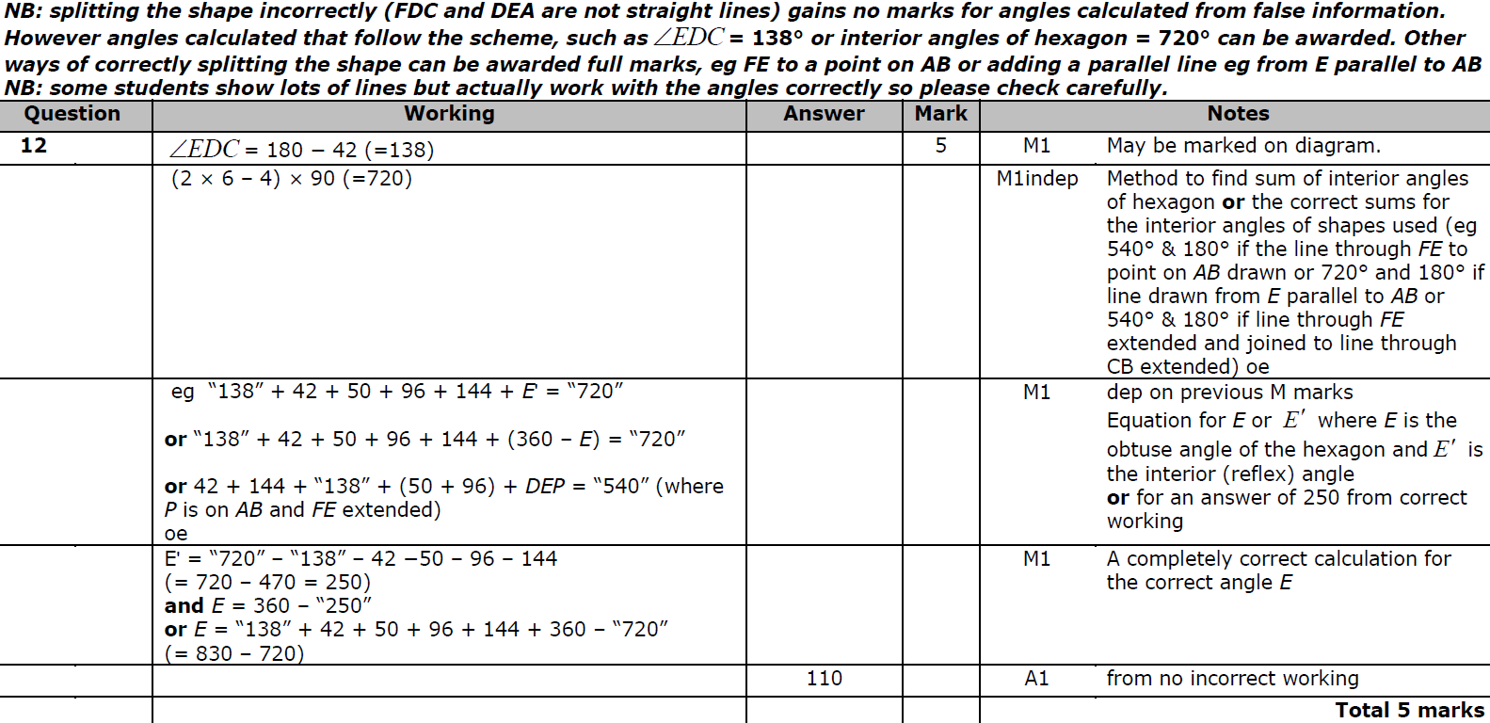
Angles in Polygons
June 2018 2H Q12
A

Slide 6
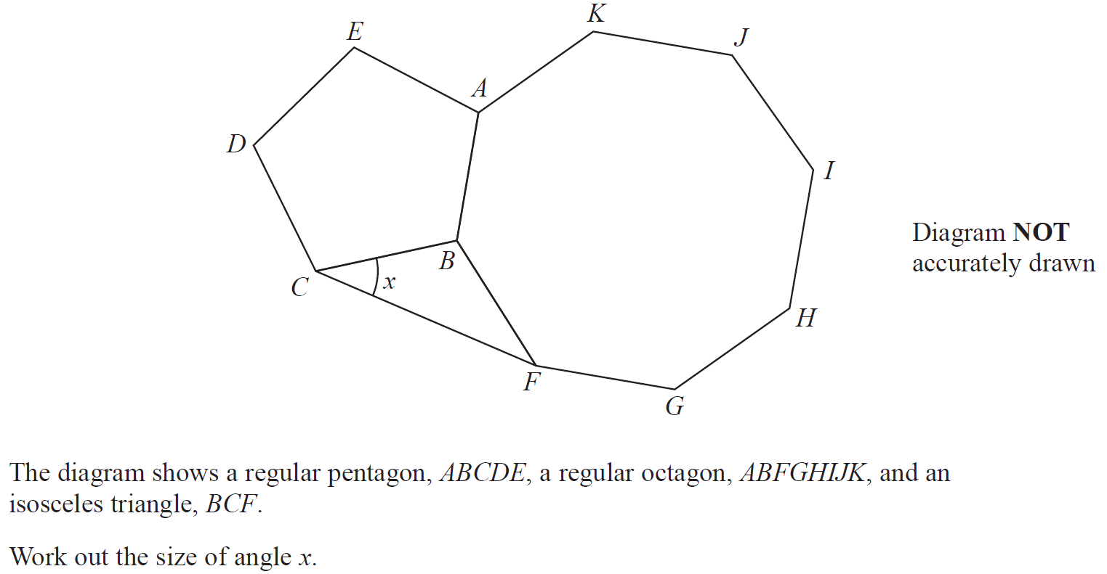
Angles in Polygons
June 2018 2HR Q9

Slide 7
Angles in Polygons
June 2018 2HR Q9
A

Slide 8
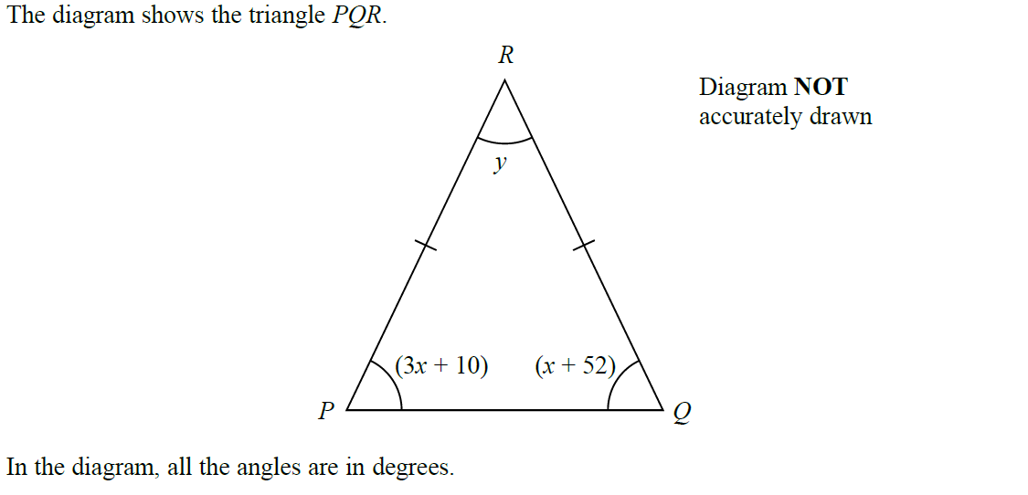
Angles in Polygons
Jan 2019 1HR Q6

Slide 9
Angles in Polygons
Jan 2019 1HR Q6
A

Slide 10
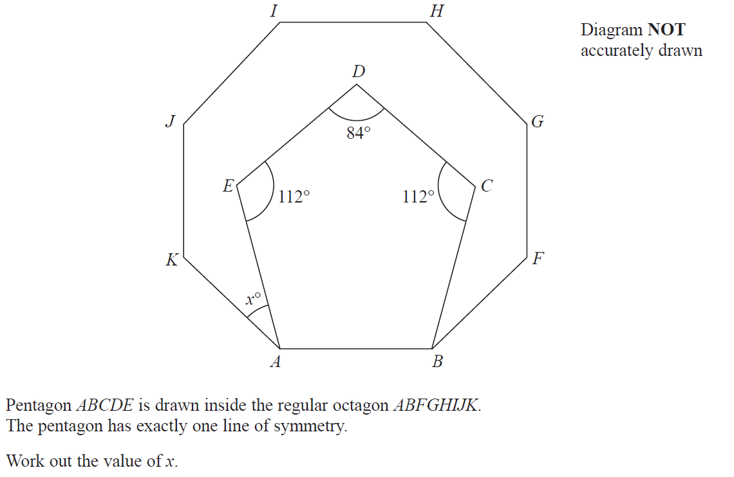
Angles in Polygons
Jan 2019 2HR Q6

Slide 11
Angles in Polygons
Jan 2019 2HR Q6
A

Slide 12
Angles in Polygons
Angles in Polygons
New Spec Q’s
May 2005
3H Q13
May 2013 3H Q4
Jan 2015 3H Q9
June 2016 4HR Q4
Nov 2006
4H Q15
May 2013 4H Q13
Jan 2015 3HR Q14
Jan 2017 3HR Q2
Nov 2007
3H Q1
May 2013 4HR Q6
June 2015 4H Q6
June 2017 4H Q8
May 2008
3H Q13
Jan 2014 4H Q12
May 2015 3HR Q2
Jan 2018 3H Q9
Nov 2009
3H Q3
Jan 2014 4H Q19
Jan 2016 4H Q13
May 2018 3H Q12
Nov 2010
4H Q13
Jan 2014 3HR Q3
Jan 2016 4HR Q2
May 2018 3HR Q5
June 2011 3H Q2
May 2014 4H Q5
June 2016 4H Q4
May 2012 3H Q13
May 2014 4HR Q9
May 2016 3HR Q4

Slide 13
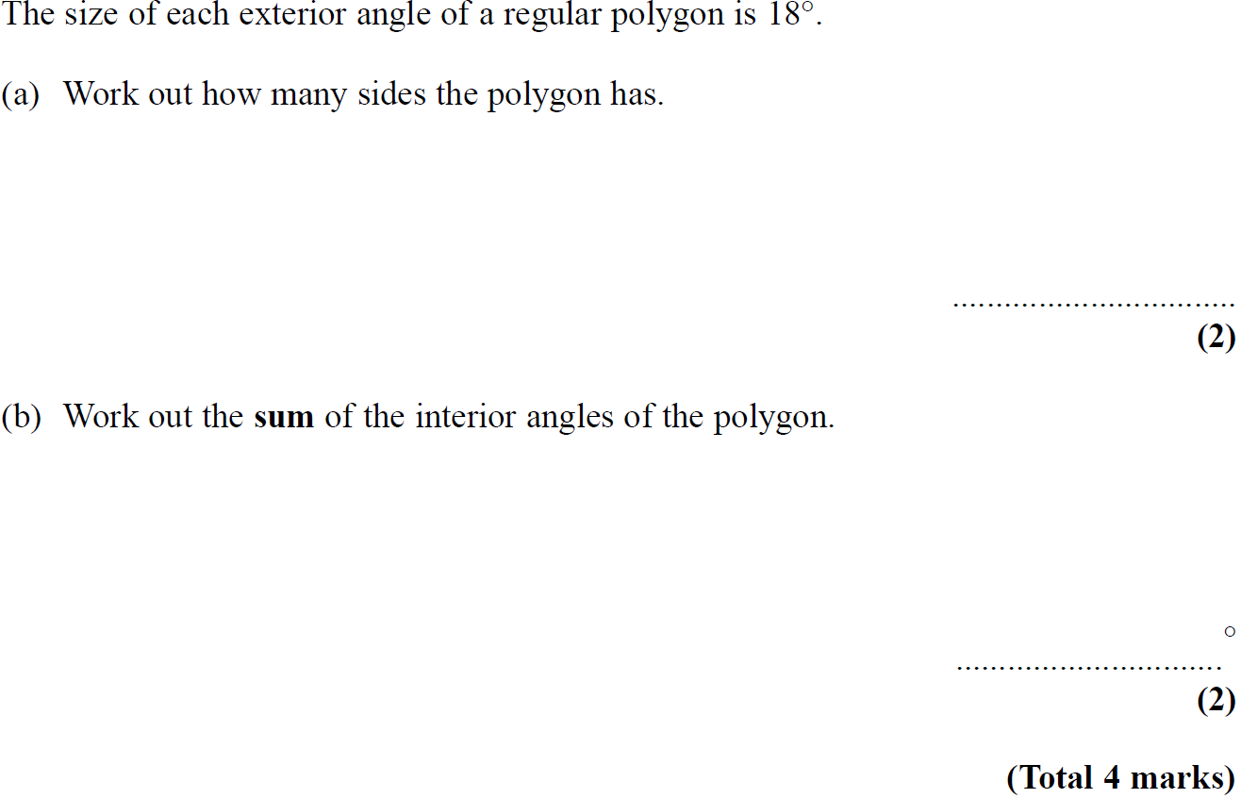
Angles in Polygons
May 2005 3H Q13

Slide 14
Angles in Polygons
May 2005 3H Q13
A
B

Slide 15
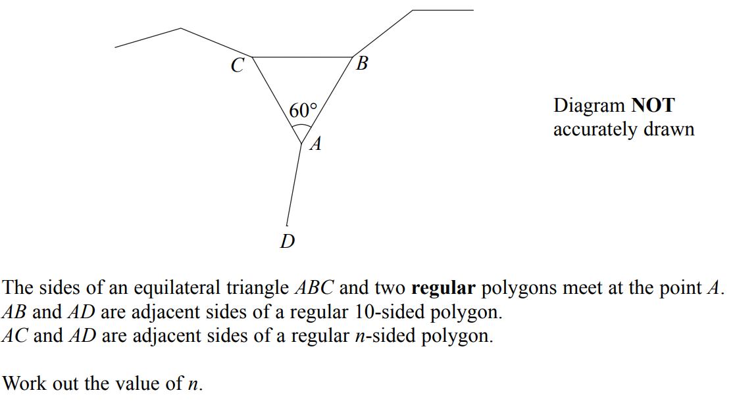
Angles in Polygons
Nov 2006 4H Q15

Slide 16
Angles in Polygons
Nov 2006 4H Q15
A

Slide 17
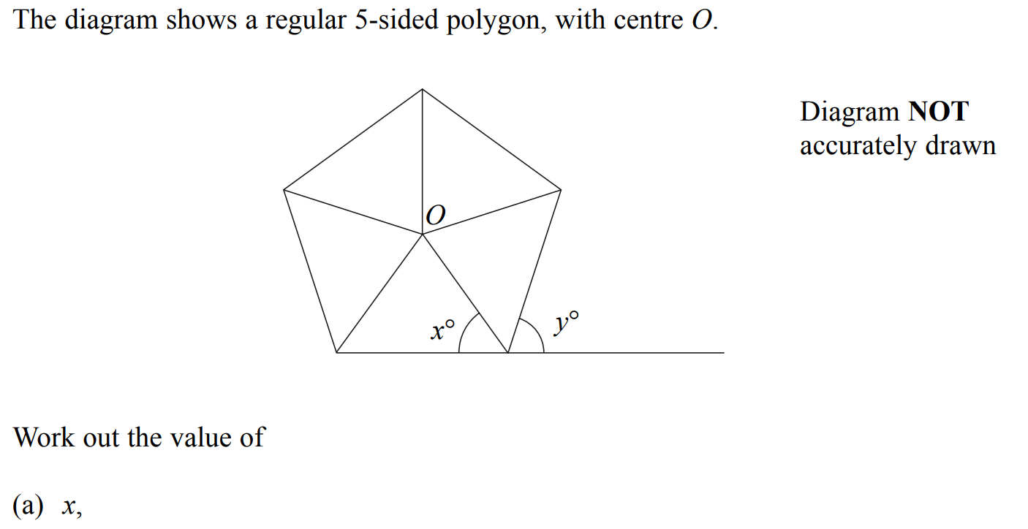
Angles in Polygons
Nov 2007 3H Q1

Slide 18
Angles in Polygons
Nov 2007 3H Q1
A
B

Slide 19
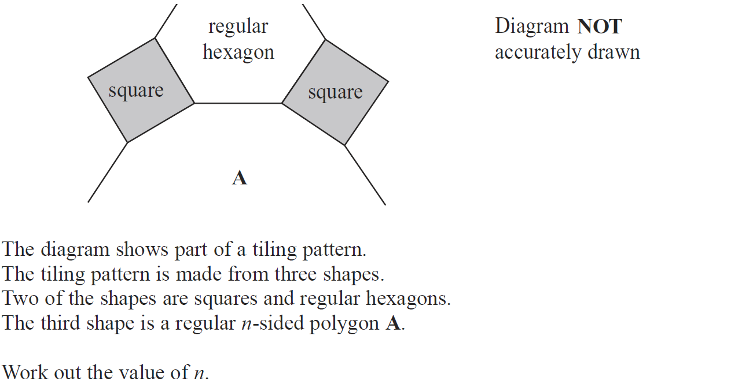
Angles in Polygons
May 2008 3H Q13

Slide 20
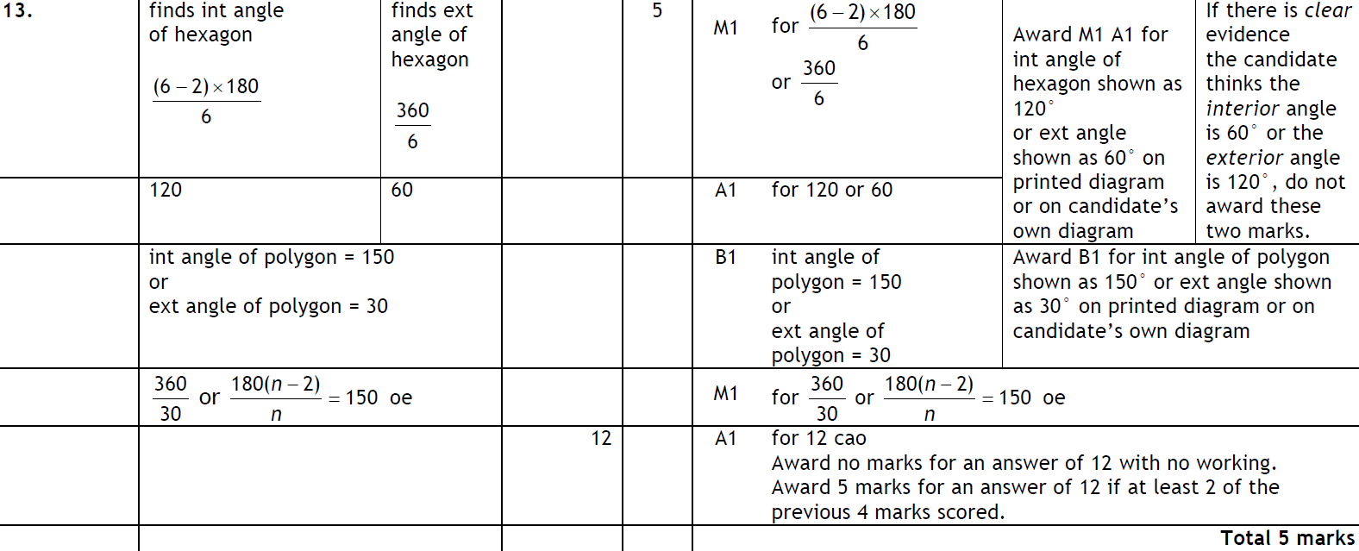
Angles in Polygons
May 2008 3H Q13
A

Slide 21
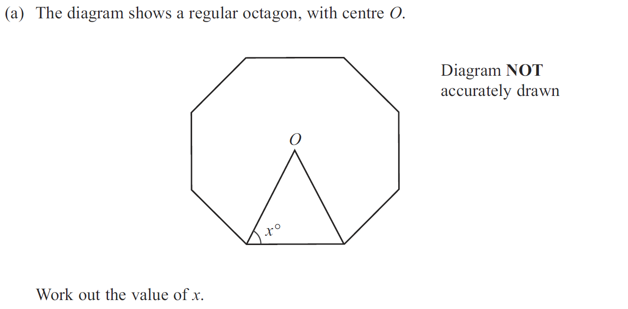
Angles in Polygons
Nov 2009 3H Q3

Slide 22
Angles in Polygons
Nov 2009 3H Q3
A
B

Slide 23
Angles in Polygons
Nov 2010 4H Q13

Slide 24
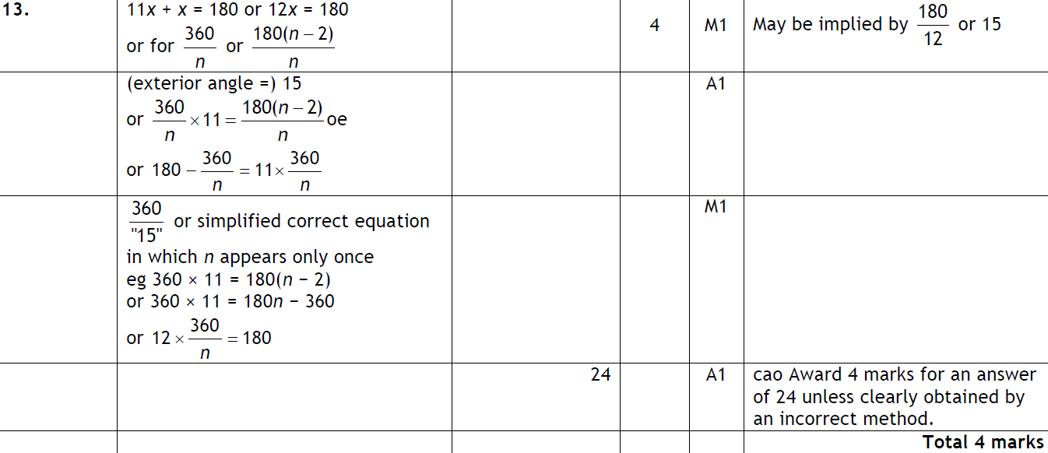
Angles in Polygons
Nov 2010 4H Q13
A

Slide 25
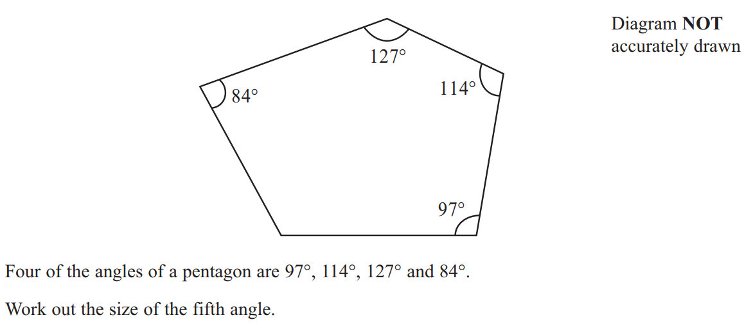
Angles in Polygons
June 2011 3H Q2

Slide 26
Angles in Polygons
June 2011 3H Q2
A

Slide 27
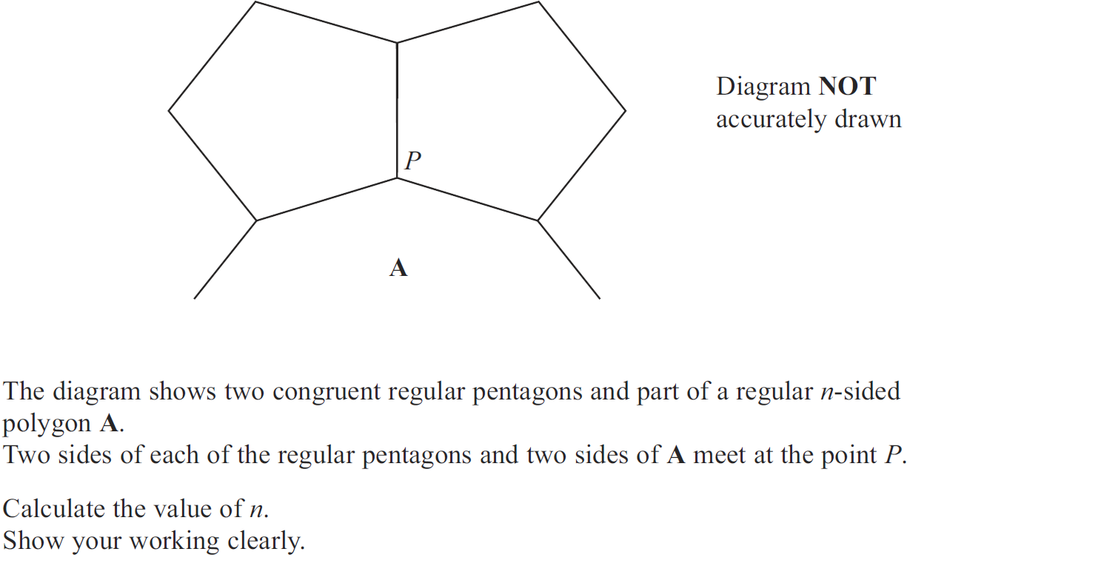
Angles in Polygons
May 2012 3H Q13

Slide 28
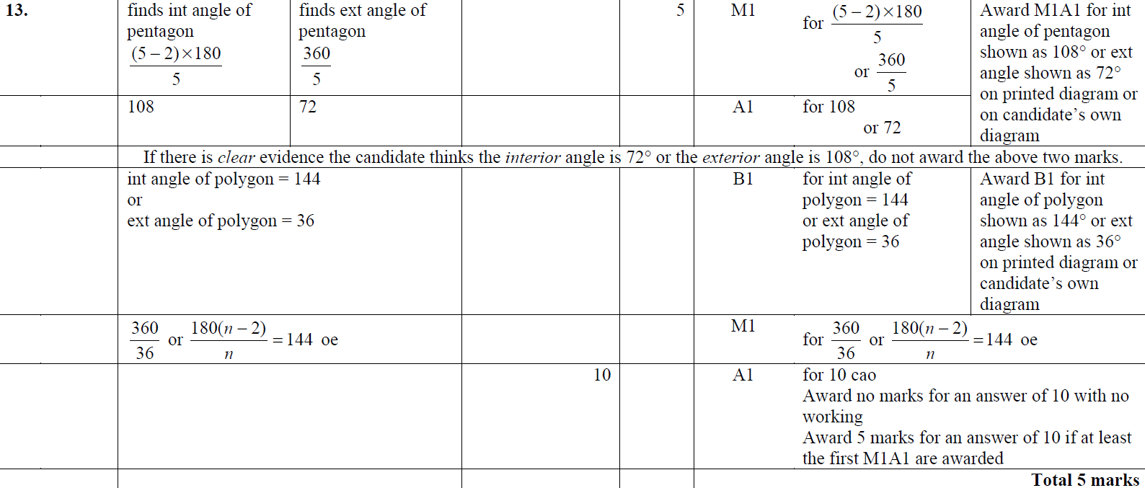
Angles in Polygons
May 2012 3H Q13
A

Slide 29
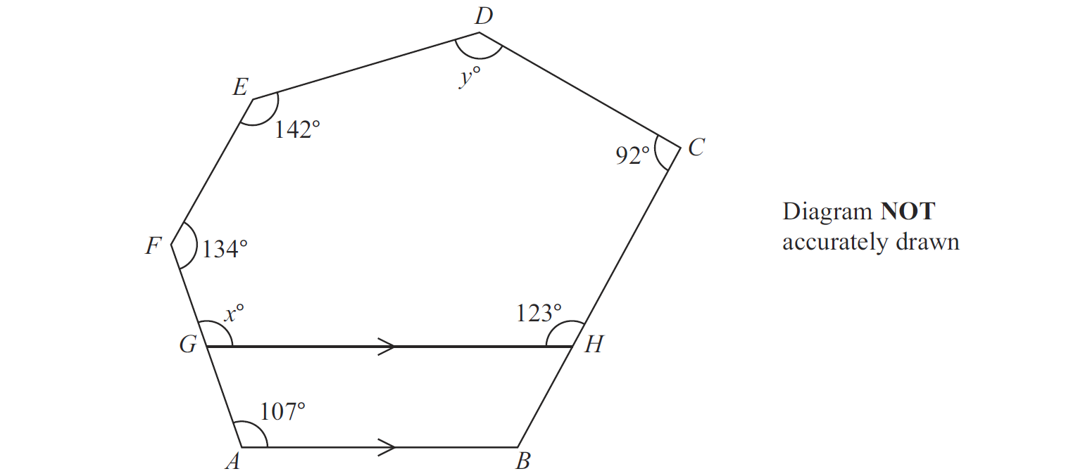
Angles in Polygons
May 2013 3H Q4

Slide 30
Angles in Polygons
May 2013 3H Q4
A
B

Slide 31
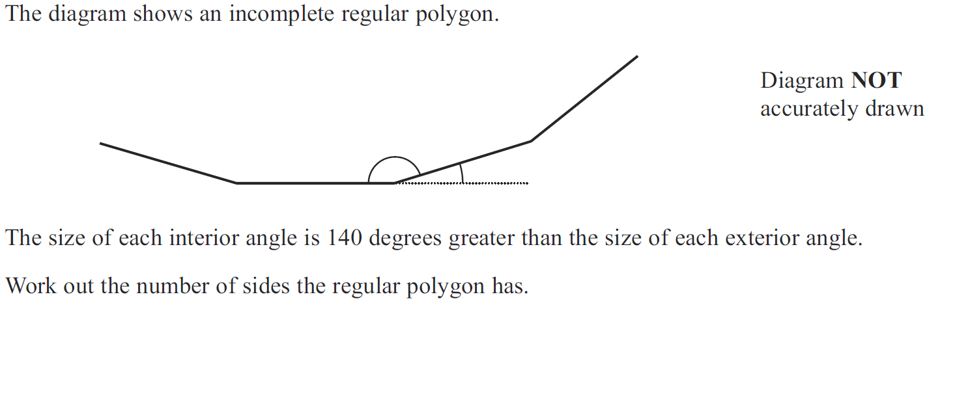
Angles in Polygons
May 2013 4H Q13

Slide 32
Angles in Polygons
May 2013 4H Q13
A

Slide 33
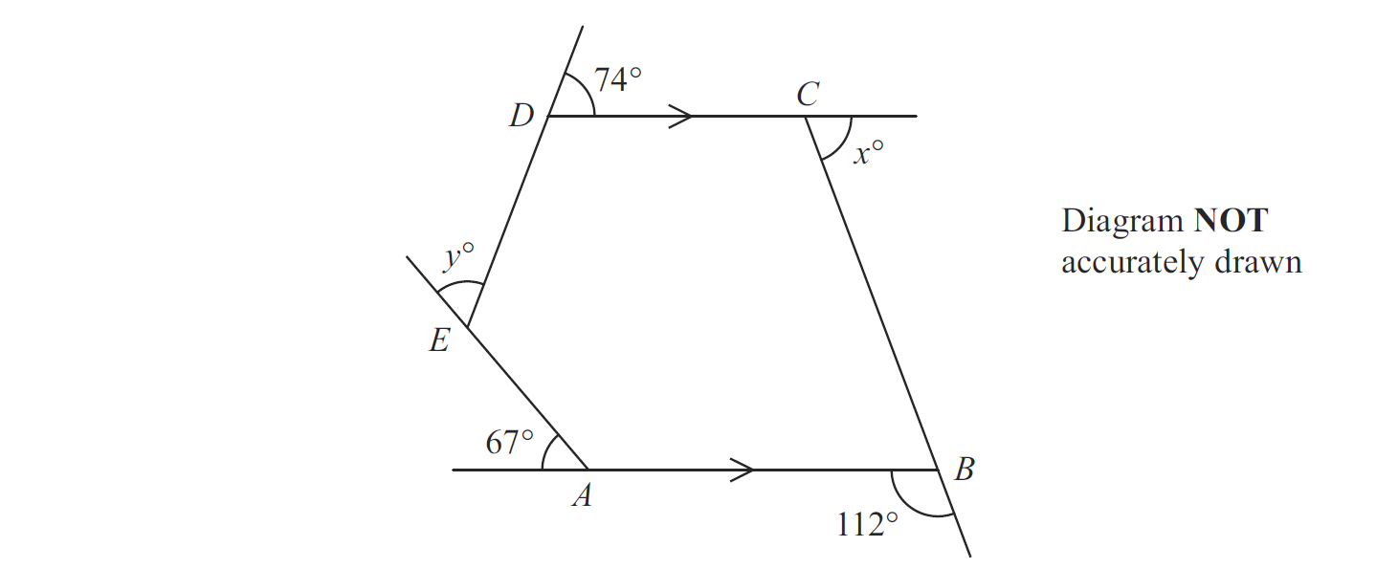
Angles in Polygons
May 2013 4HR Q6

Slide 34
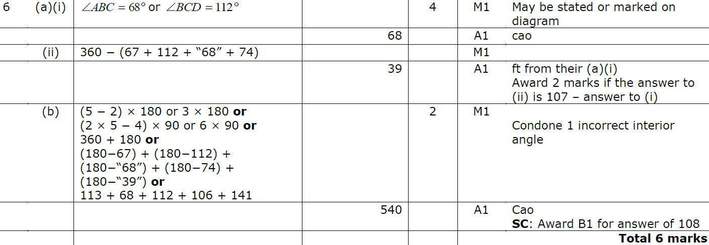
Angles in Polygons
May 2013 4HR Q6
A (i)
A (ii)
B

Slide 35
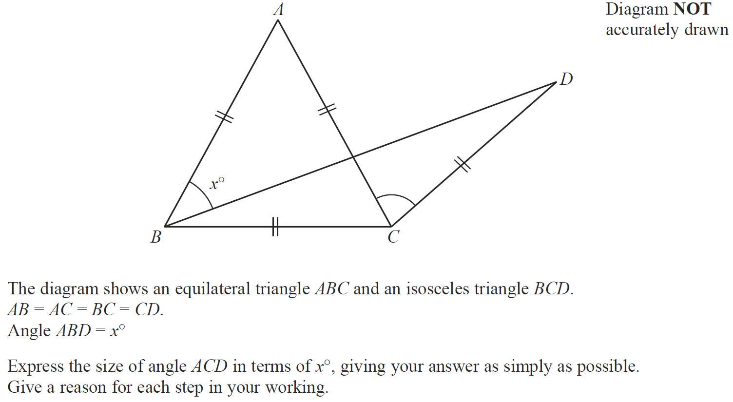
Angles in Polygons
Jan 2014 4H Q12

Slide 36
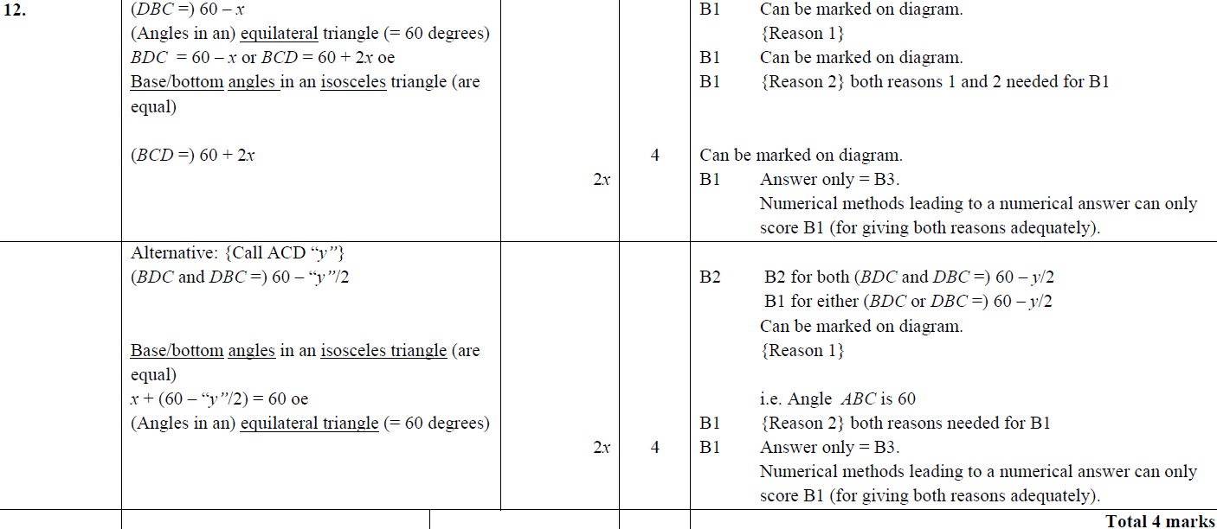
Angles in Polygons
Jan 2014 4H Q12
A

Slide 37
Angles in Polygons
Jan 2014 4H Q19

Slide 38
Angles in Polygons
Jan 2014 4H Q19
A

Slide 39
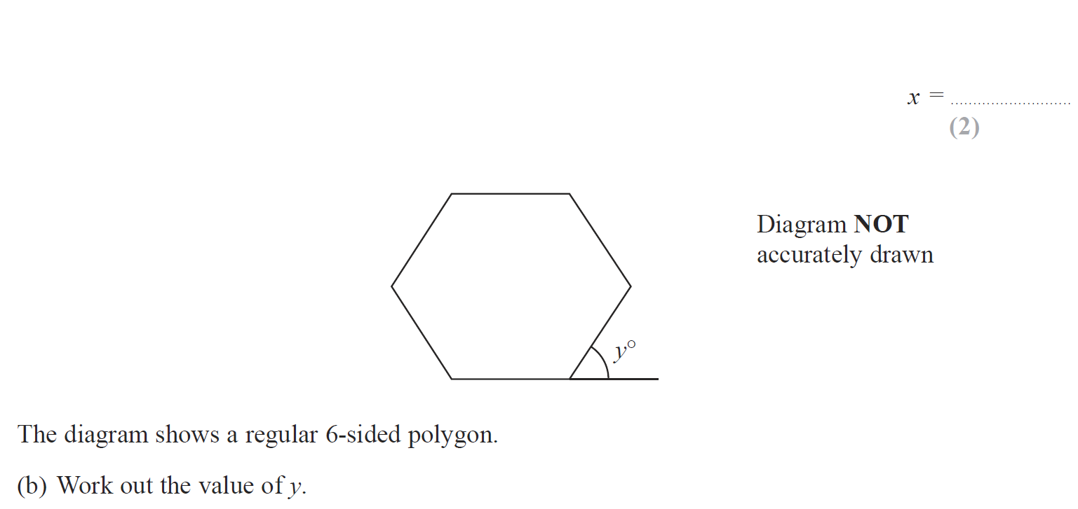
Angles in Polygons
Jan 2014 3HR Q3

Slide 40
Angles in Polygons
Jan 2014 3HR Q3
A
B

Slide 41
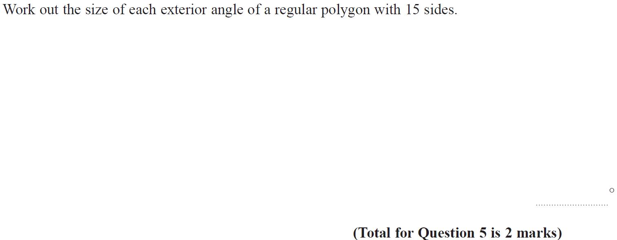
Angles in Polygons
May 2014 4H Q5

Slide 42
Angles in Polygons
May 2014 4H Q5
A

Slide 43
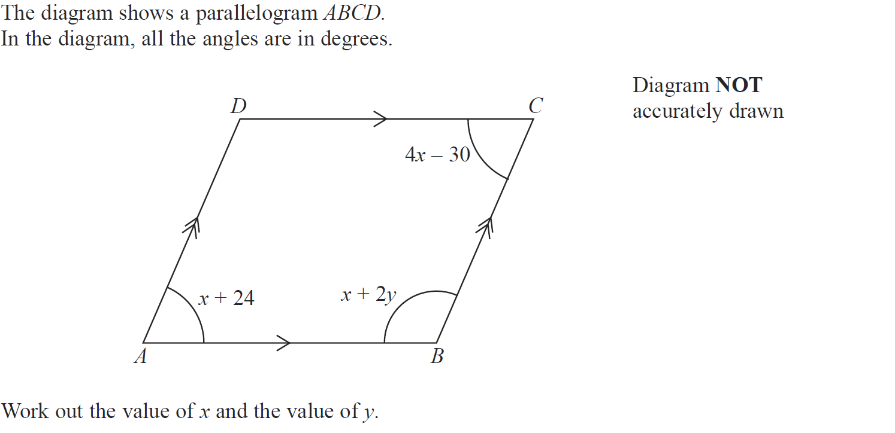
Angles in Polygons
May 2014 4HR Q9

Slide 44
Angles in Polygons
May 2014 4HR Q9
A

Slide 45
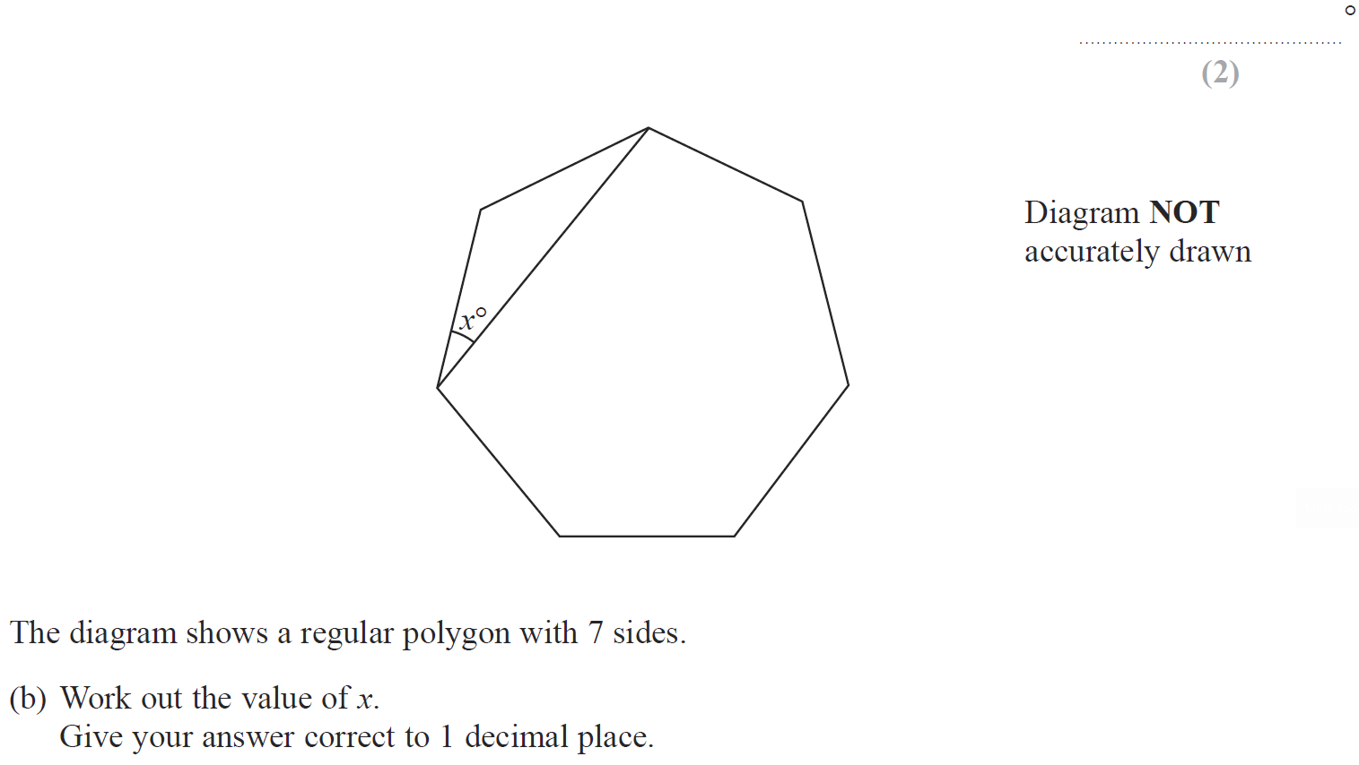
Angles in Polygons
Jan 2015 3H Q9

Slide 46
Angles in Polygons
Jan 2015 3H Q9
A
B

Slide 47
Angles in Polygons
Jan 2015 3HR Q14

Slide 48
Angles in Polygons
Jan 2015 3HR Q14
A

Slide 49
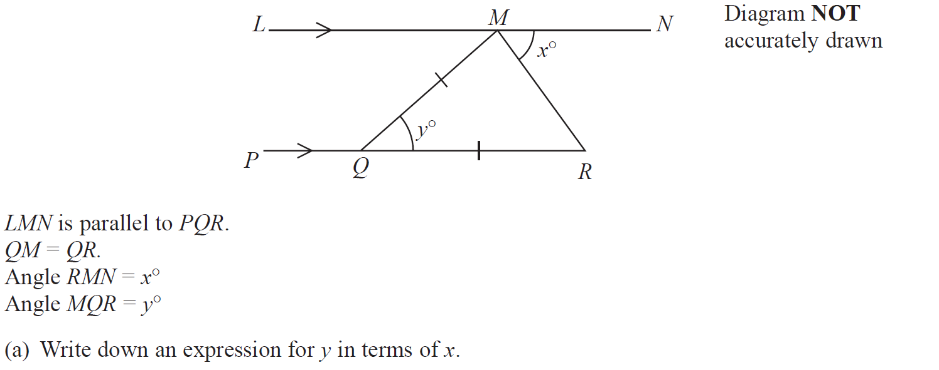
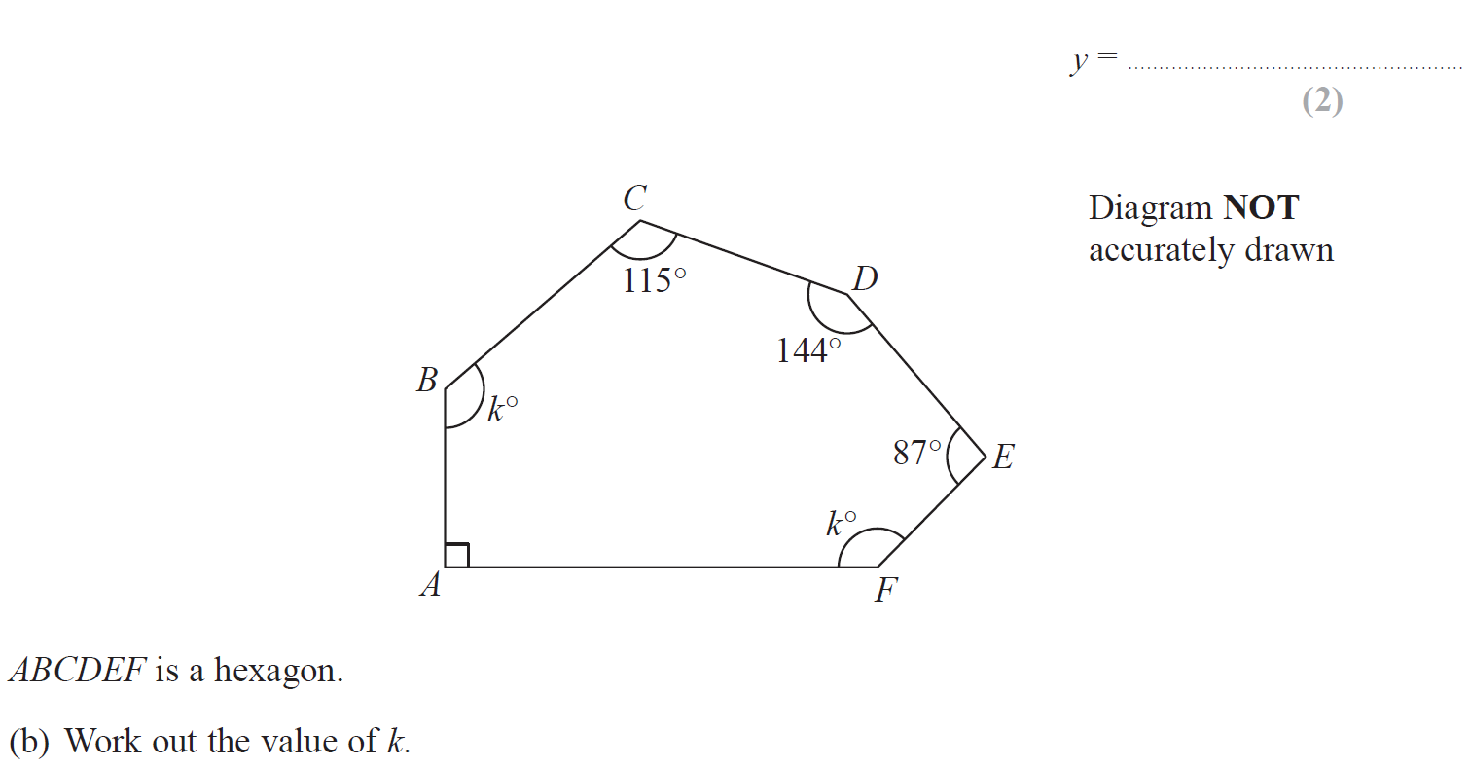
Angles in Polygons
June 2015 4H Q6

Slide 50
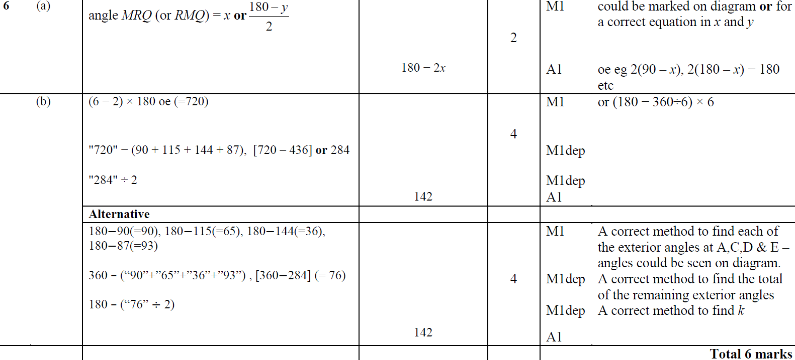
Angles in Polygons
June 2015 4H Q6
A
B

Slide 51
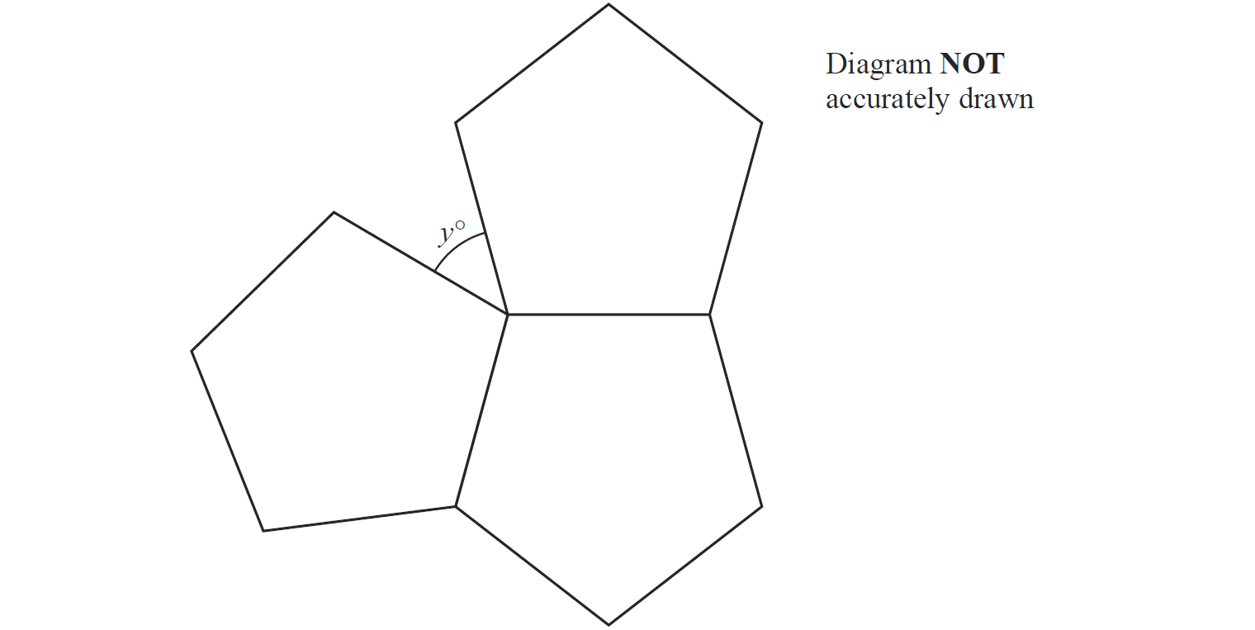
Angles in Polygons
May 2015 3HR Q2

Slide 52
Angles in Polygons
May 2015 3HR Q2
A
B

Slide 53
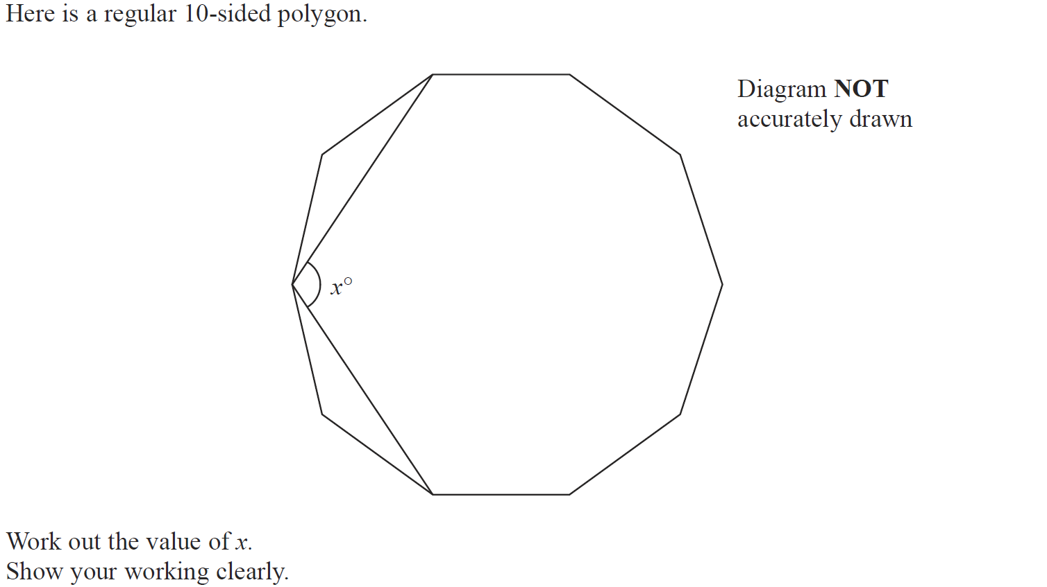
Angles in Polygons
Jan 2016 4H Q13

Slide 54
Angles in Polygons
Jan 2016 4H Q13
A

Slide 55
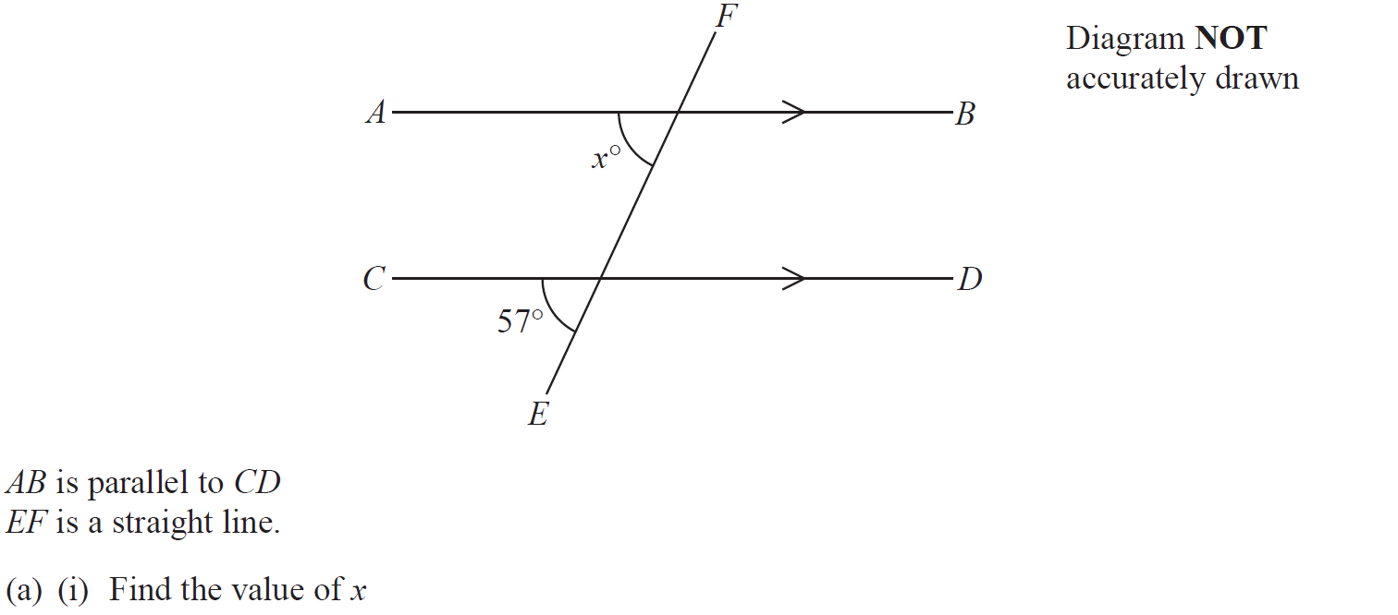
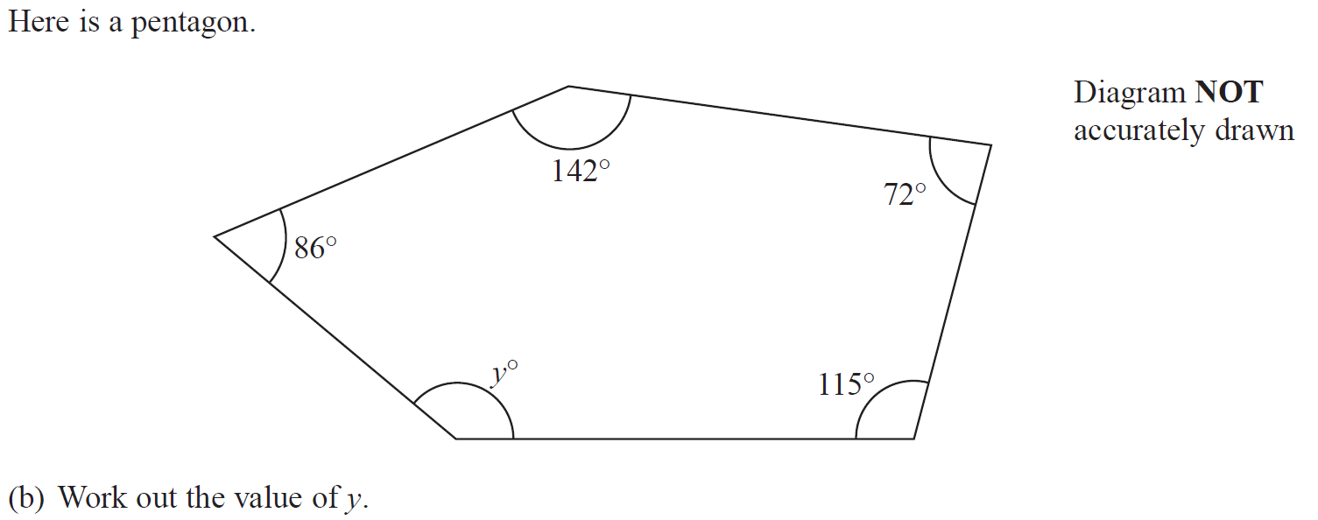
Angles in Polygons
Jan 2016 4HR Q2

Slide 56
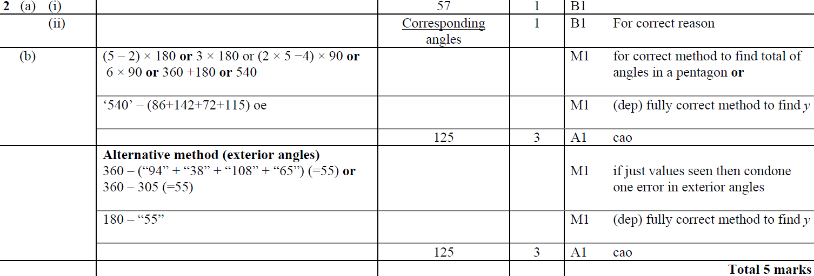
Angles in Polygons
Jan 2016 4HR Q2
A (i)
A (ii)
B

Slide 57
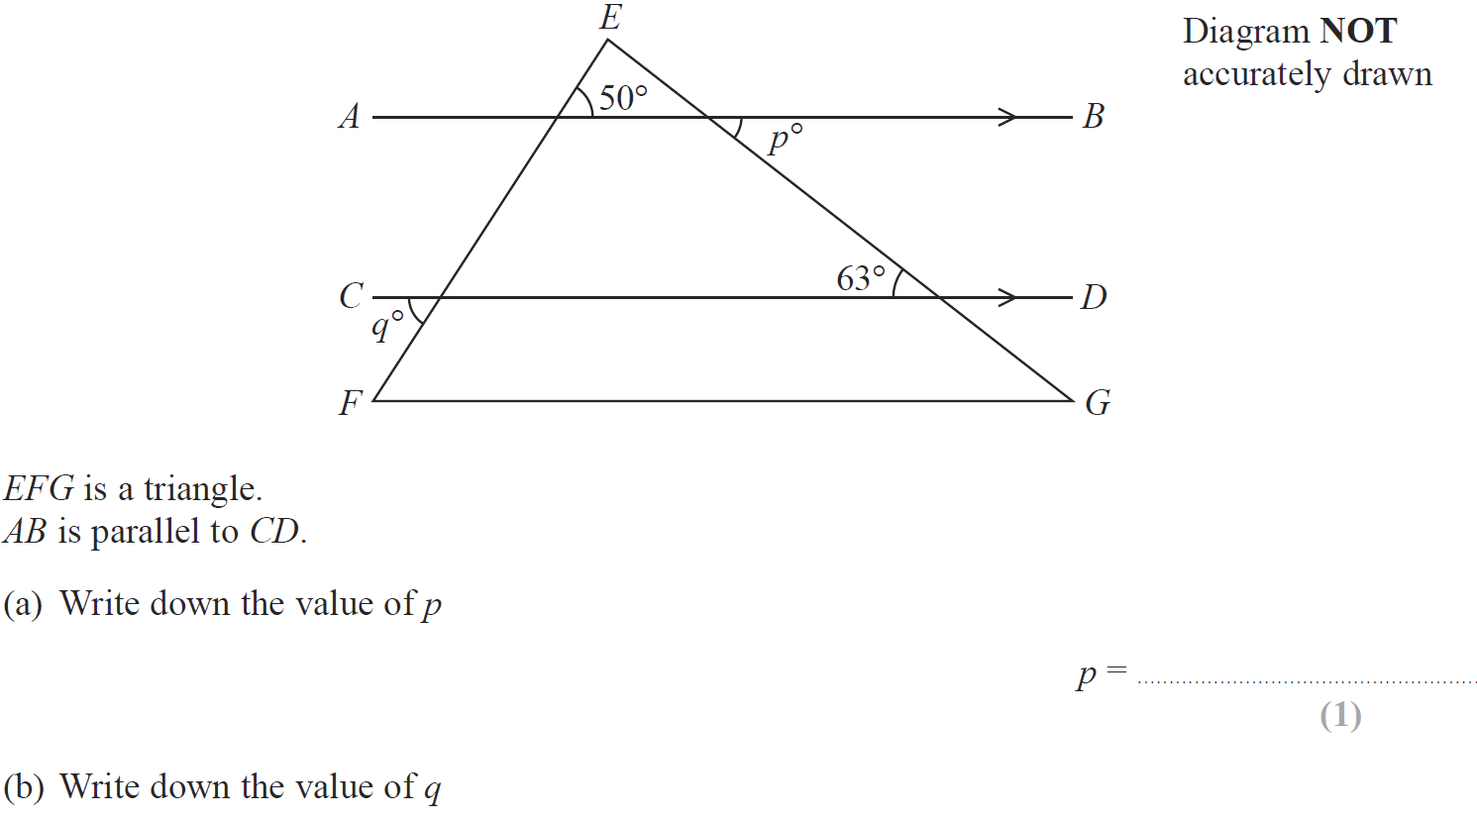
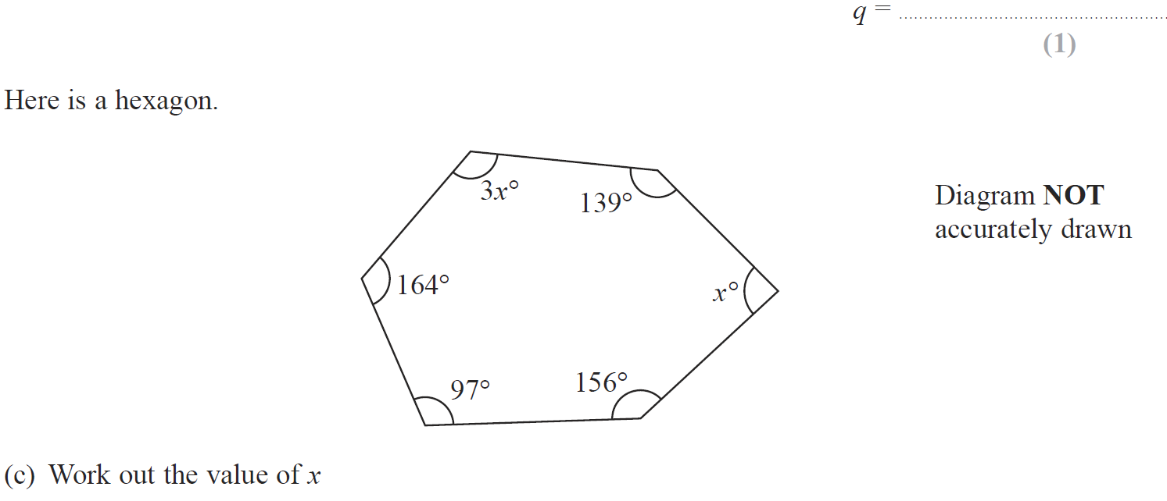
Angles in Polygons
June 2016 4H Q4

Slide 58
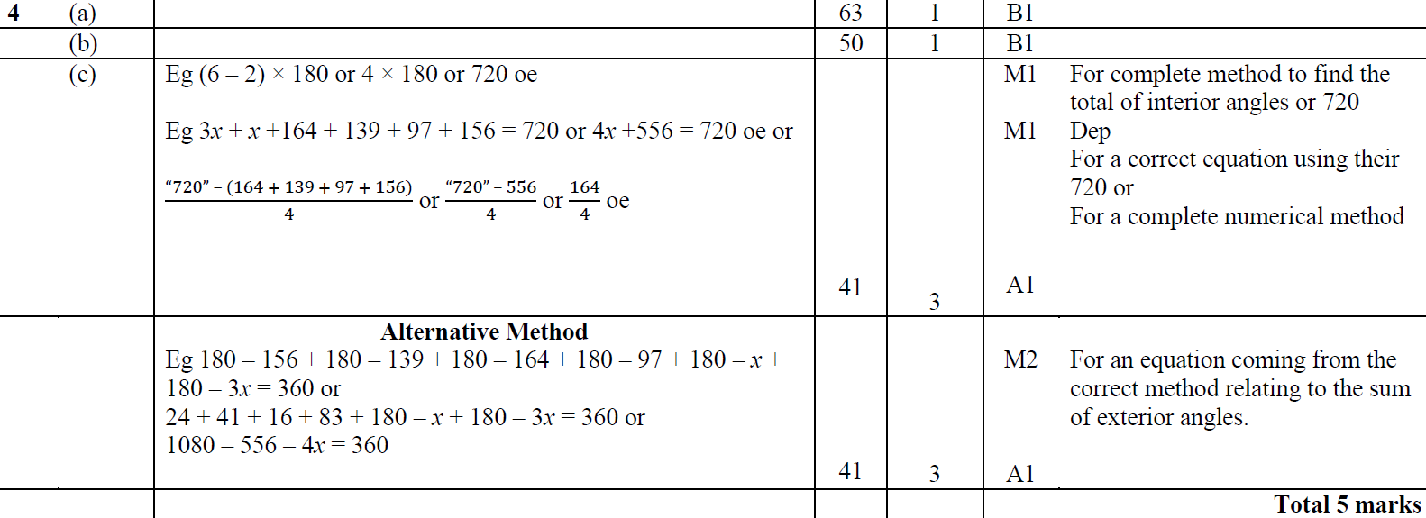
Angles in Polygons
June 2016 4H Q4
A
B
C

Slide 59
Angles in Polygons
May 2016 3HR Q4

Slide 60
Angles in Polygons
May 2016 3HR Q4
A

Slide 61
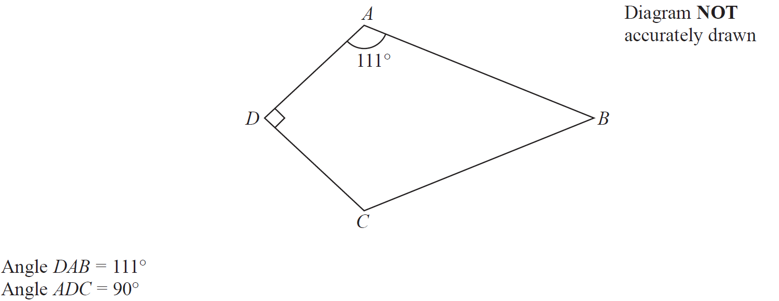
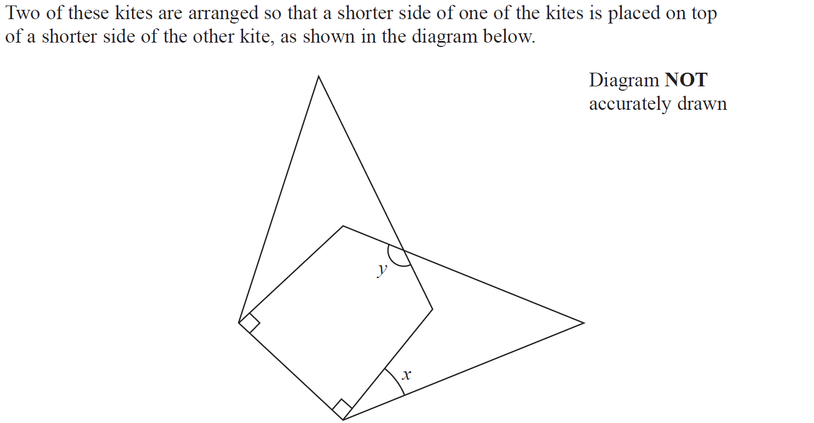
Angles in Polygons
June 2016 4HR Q4

Slide 62
Angles in Polygons
June 2016 4HR Q4
A
B
C

Slide 63
Angles in Polygons
Jan 2017 3HR Q2

Slide 64
Angles in Polygons
Jan 2017 3HR Q2
A

Slide 65
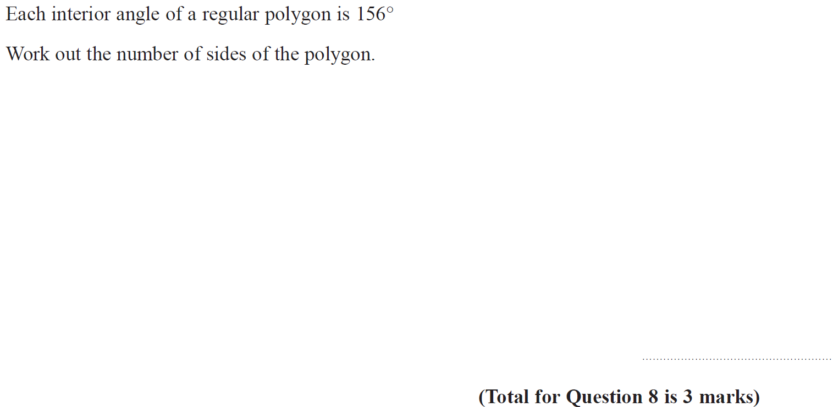
Angles in Polygons
June 2017 4H Q8

Slide 66
Angles in Polygons
June 2017 4H Q8
A

Slide 67
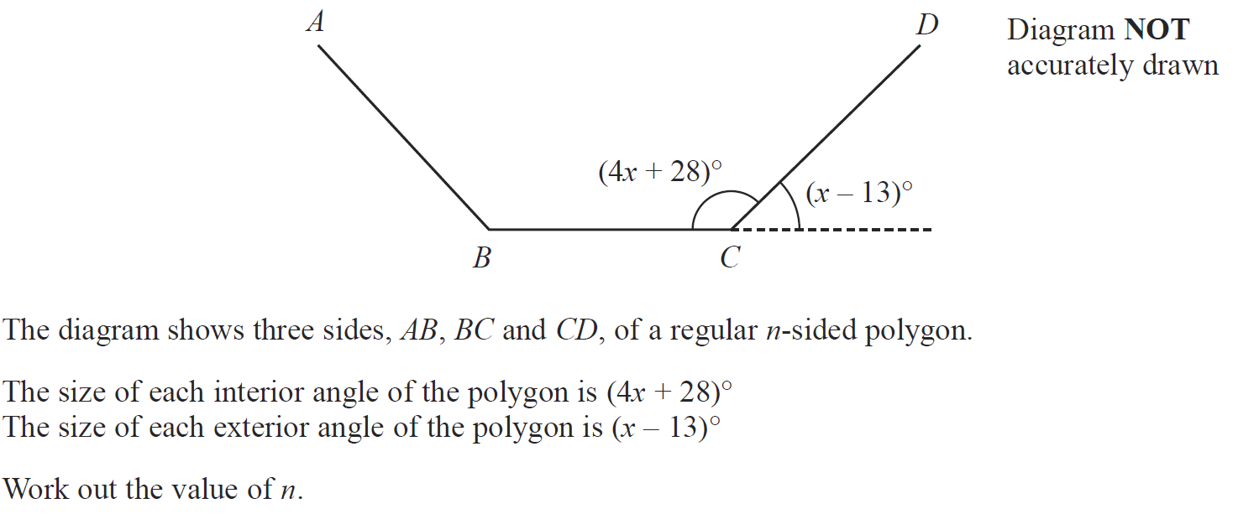
Angles in Polygons
Jan 2018 3H Q9

Slide 68
Angles in Polygons
Jan 2018 3H Q9
A

Slide 69
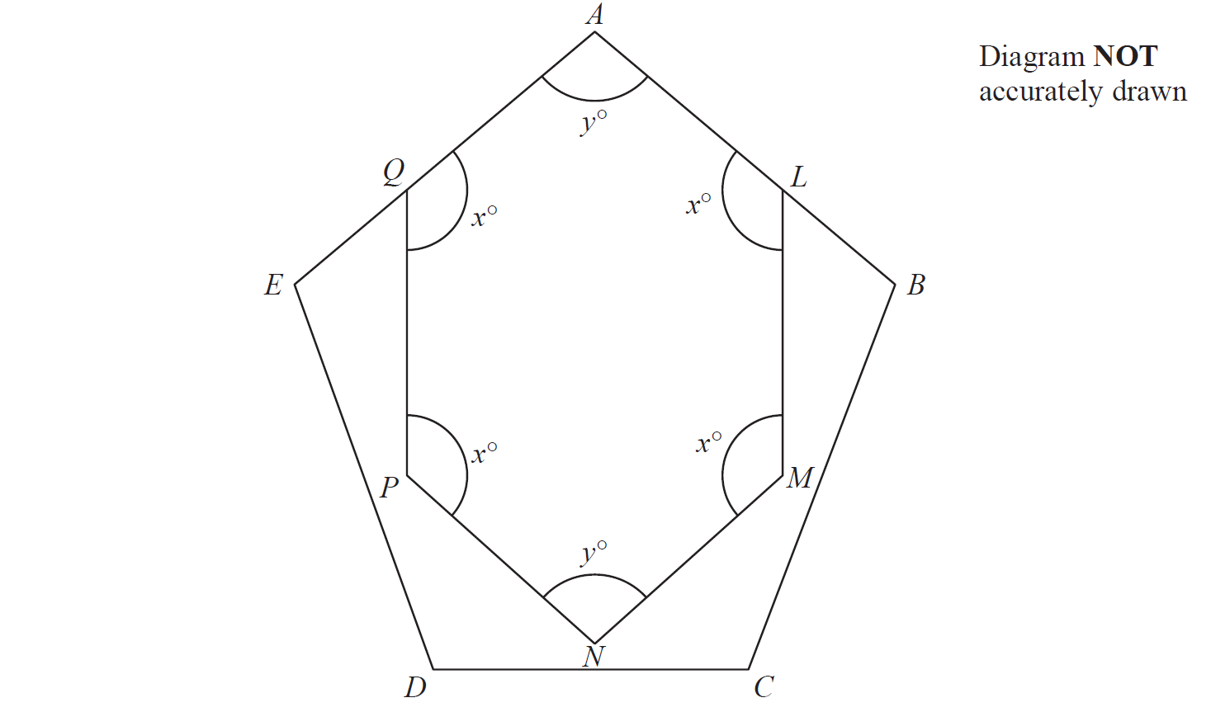
Angles in Polygons
May 2018 3H Q12

Slide 70
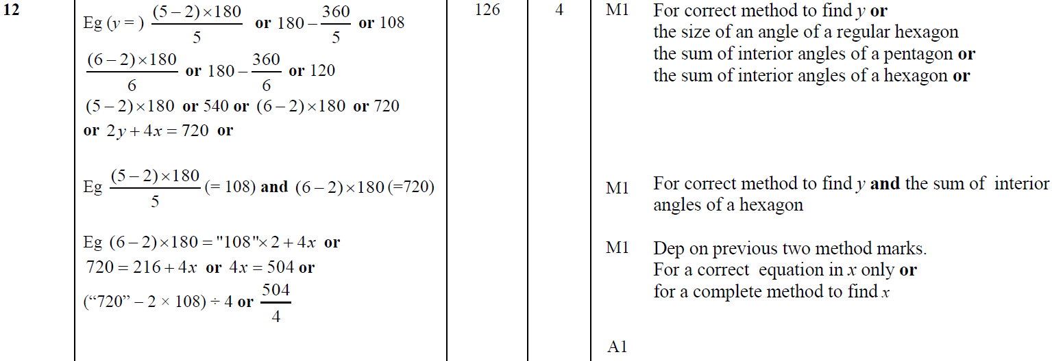
Angles in Polygons
May 2018 3H Q12
A

Slide 71
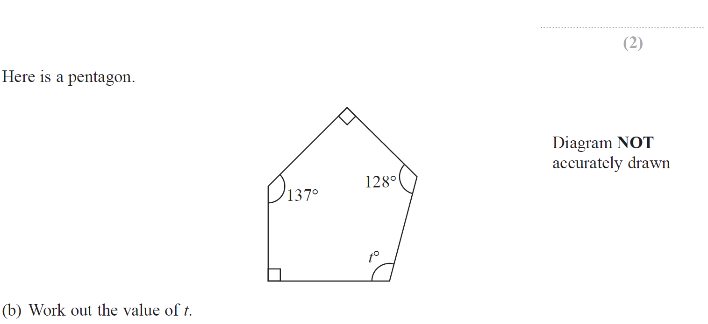
Angles in Polygons
May 2018 3HR Q5

Slide 72
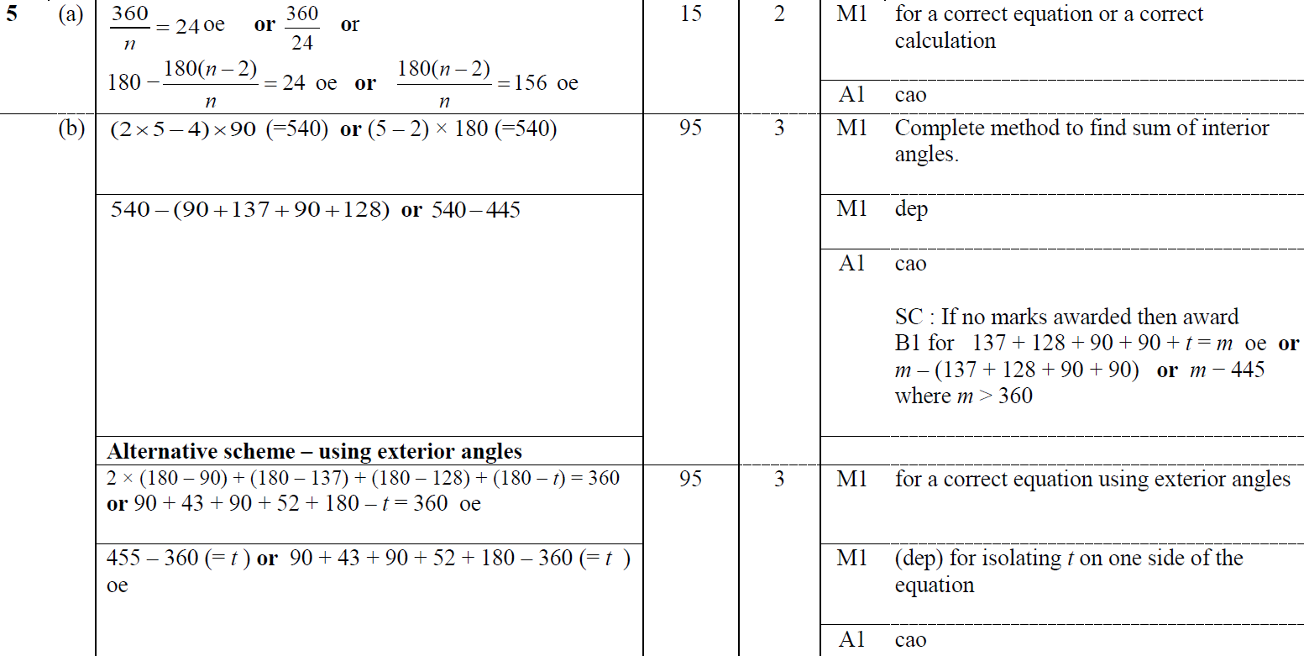
Angles in Polygons
May 2018 3HR Q5
A
B

