Slide 1
Angles (Including Parallel Lines)
Angles (Including Parallel Lines)
Old Spec Q’s
June 2018
2H Q12
May 2018
1HR Q6
Jan 2019
1H Q5
Jan 2019
1HR Q19
Parallel lines

Slide 2
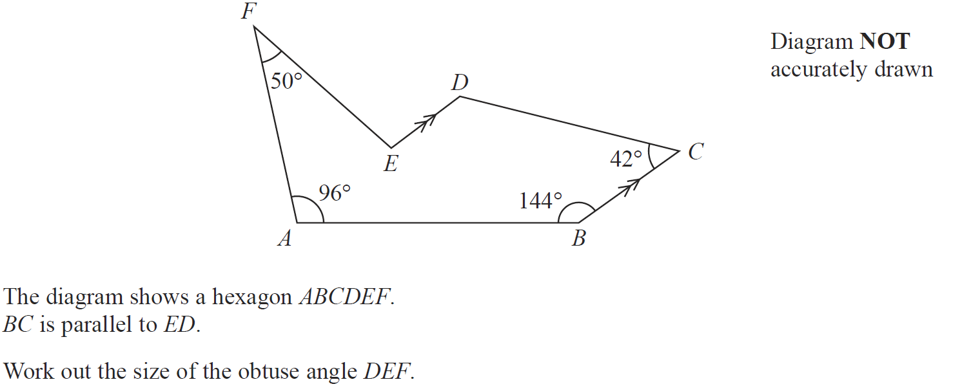
Angles (Including Parallel Lines)
June 2018 2H Q12

Slide 3
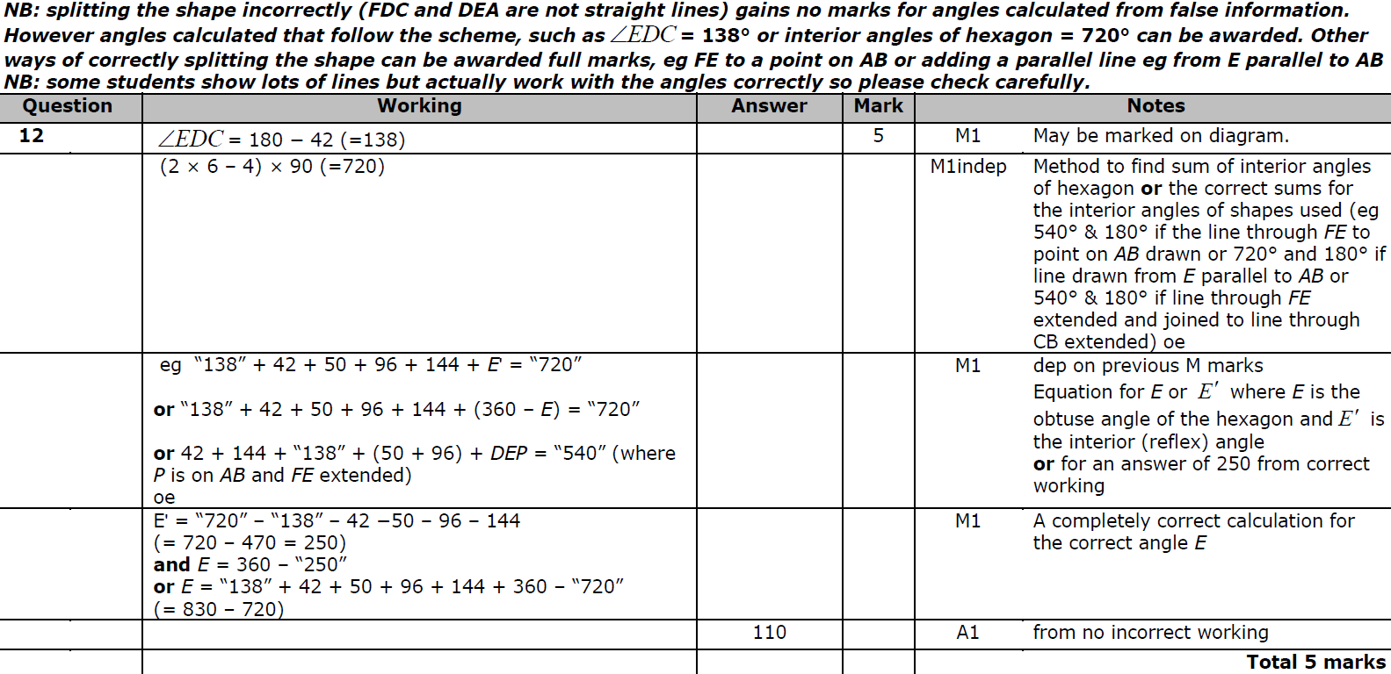
Angles (Including Parallel Lines)
June 2018 2H Q12
A

Slide 4
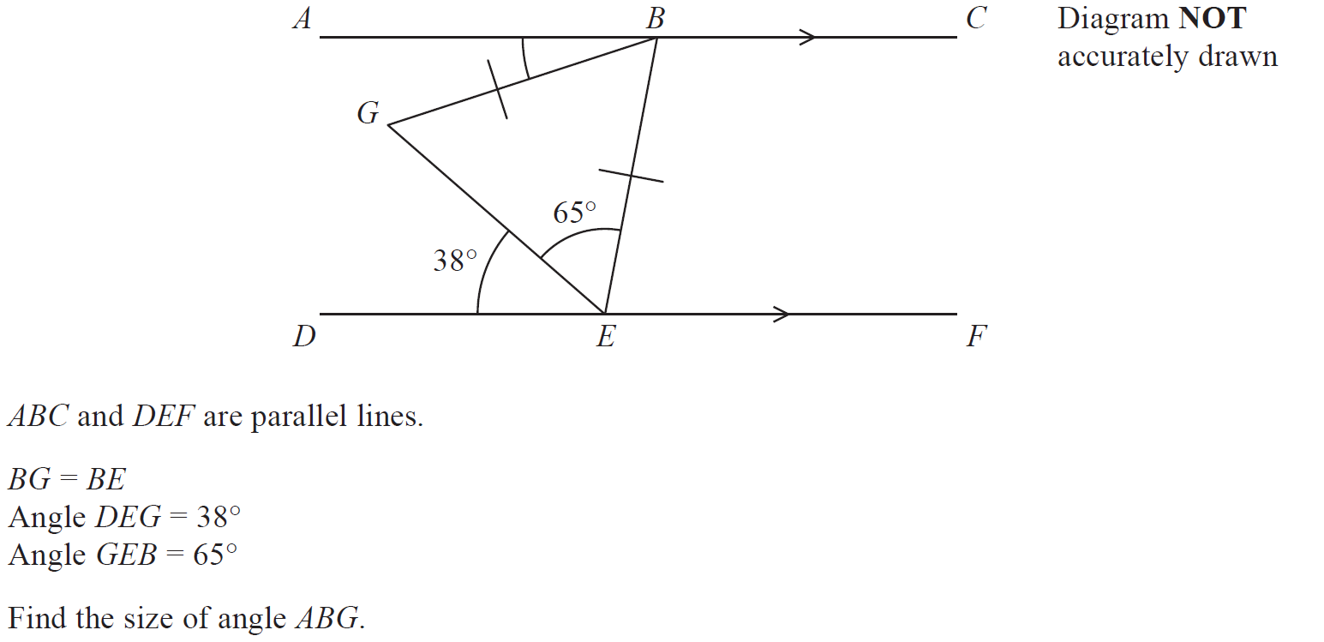
Angles (Including Parallel Lines)
May 2018 1HR Q6

Slide 5
Angles (Including Parallel Lines)
May 2018 1HR Q6
A

Slide 6
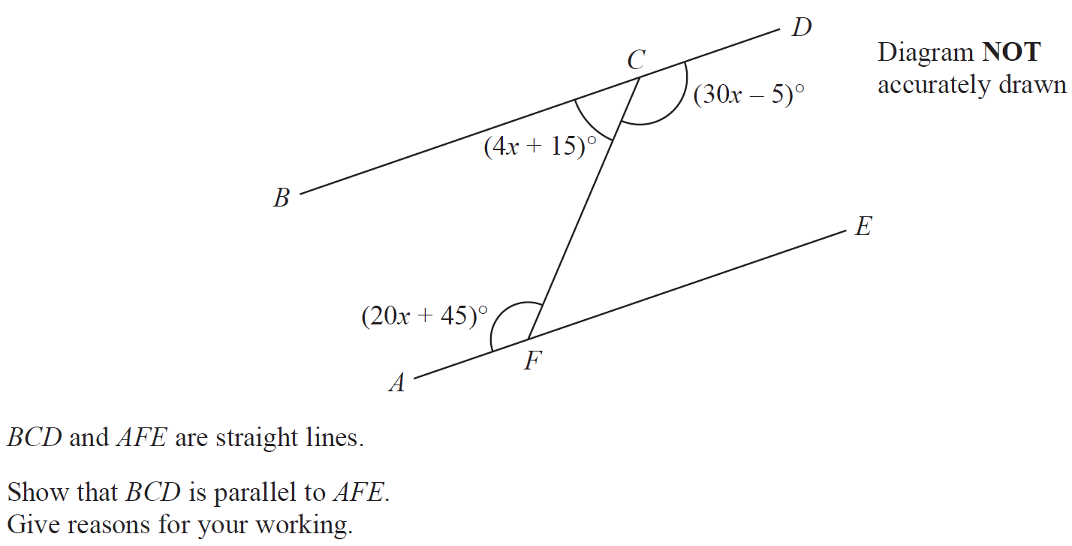
Angles (Including Parallel Lines)
Jan 2019 1H Q5
Shape & Space

Slide 7
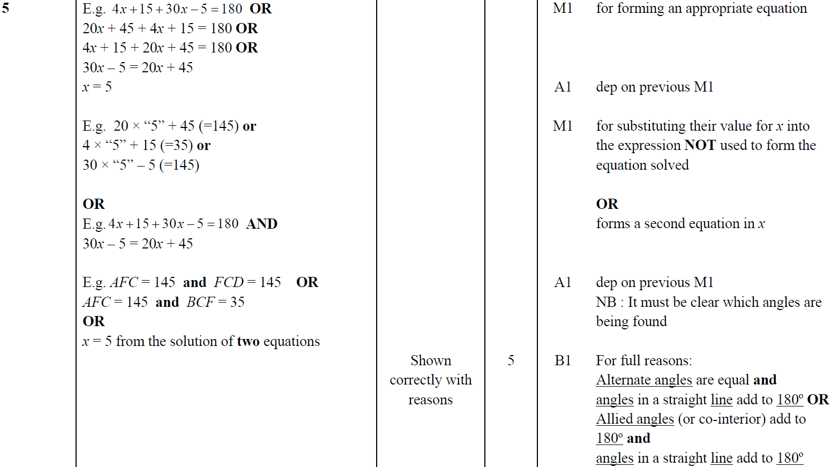
Angles (Including Parallel Lines)
Jan 2019 1H Q5
A

Slide 8
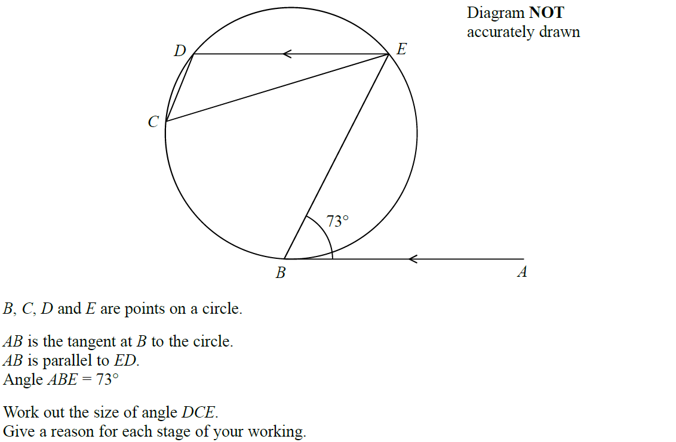
Angles (Including Parallel Lines)
Jan 2019 1HR Q19

Slide 9
Angles (Including Parallel Lines)
Jan 2019 1HR Q19
A

Slide 10
Angles (Including Parallel Lines)
Angles (Including Parallel Lines)
New Spec Q’s
Nov 2004 3H Q1
May 2008 4H Q2
Jan 2014 4HR Q3
May 2016 4H Q4
June 2018 4HR Q2
May 2005 4H Q3
May 2009 3H Q14
Jan 2014 4HR Q10
Jan 2017 4H Q8
Nov 2005 3H Q5
Nov 2009 4H Q3
May 2014 4HR Q9
Jan 2017 4HR Q8
Nov 2005 4H Q5
June 2010 3H Q2
Jan 2015 4HR Q3
Jan 2017 4HR Q9
May 2006 3H Q10
June 2010 4H Q2
June 2015 4H Q6
May 2017 3HR Q3
May 2006 4H Q1
Nov 2010 3H Q3
June 2015 4HR Q7
Jan 2018 3HR Q2
Nov 2006 3H Q1
May 2013 3H Q4
Jan 2016 4H Q5
Jan 2018 4HR Q19
Nov 2007 4H Q6
Jan 2014 3H Q6
Jan 2016 4HR Q2
June 2018 4H Q4
Parallel lines

Slide 11
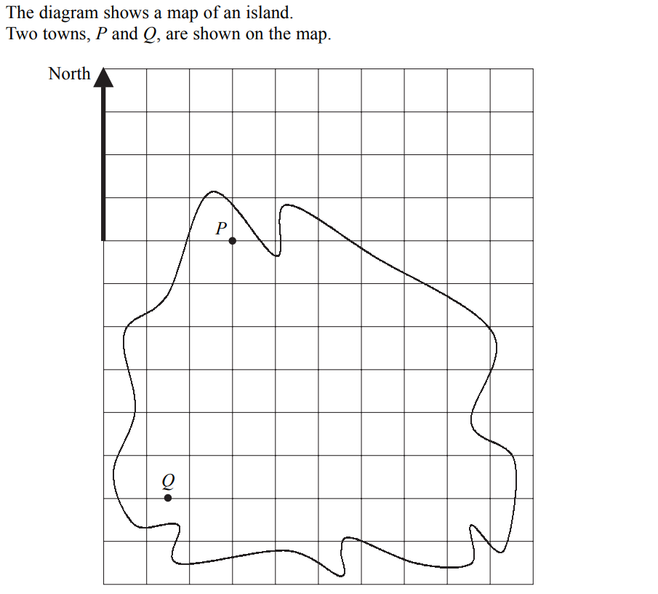
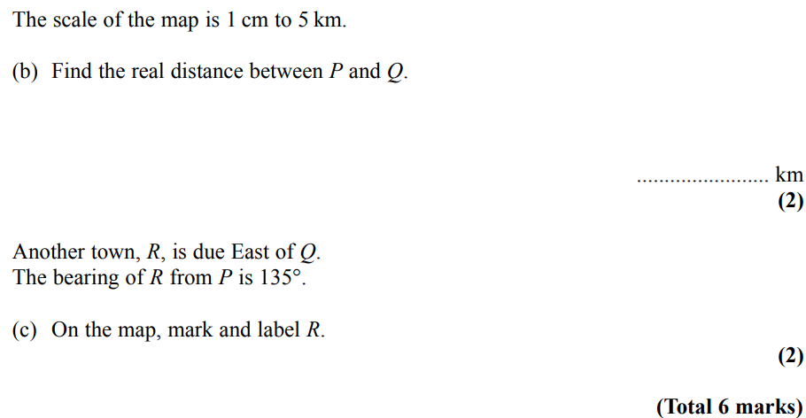
Angles (Including Parallel Lines)
Nov 2004 3H Q1

Slide 12
Angles (Including Parallel Lines)
Nov 2004 3H Q1
A
B
C

Slide 13
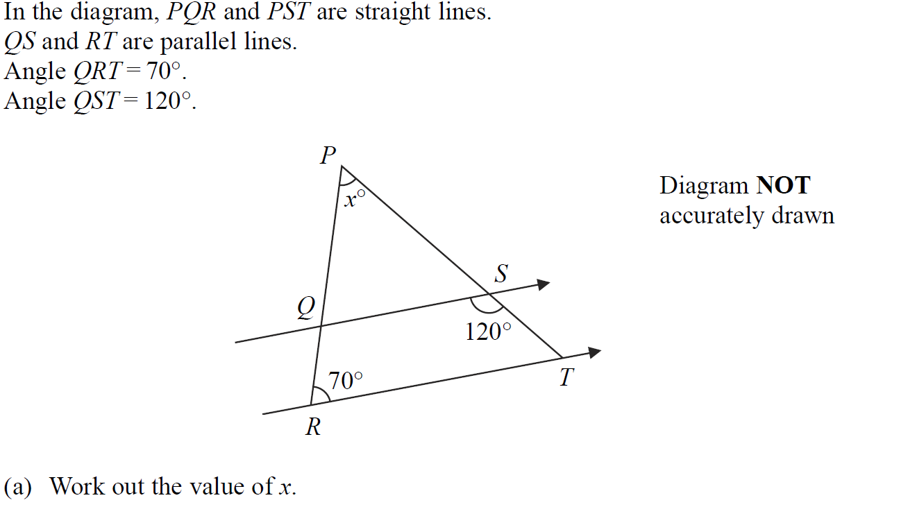
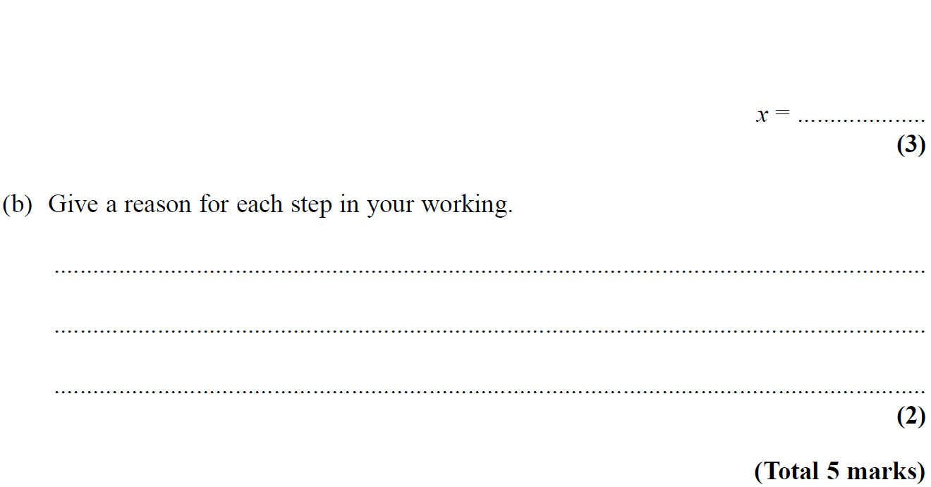
Angles (Including Parallel Lines)
May 2005 4H Q3

Slide 14
Angles (Including Parallel Lines)
May 2005 4H Q3
A
B

Slide 15
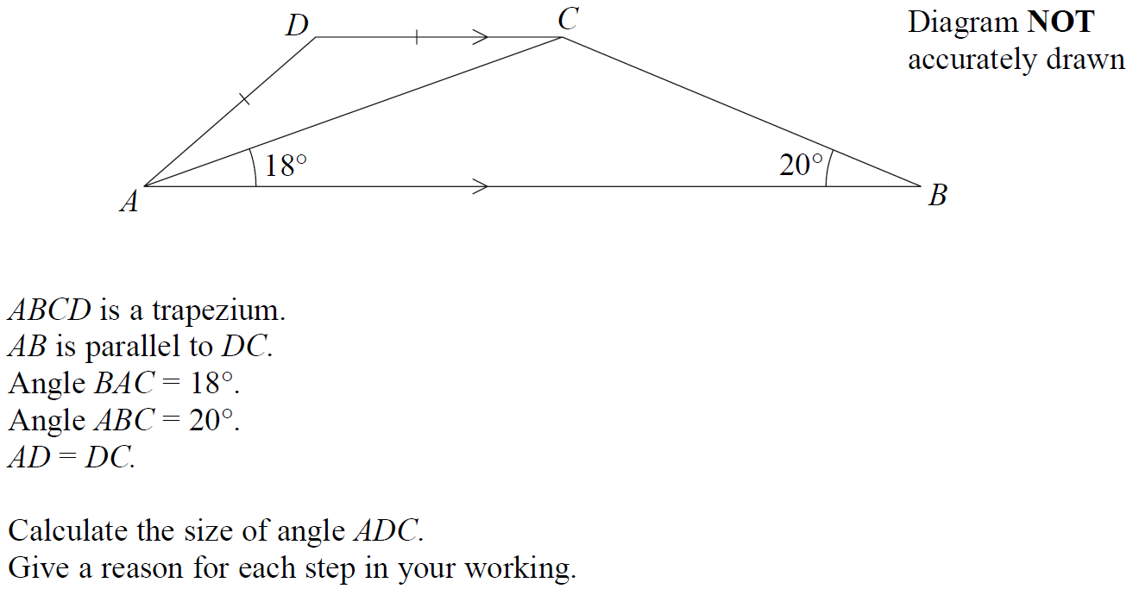
Angles (Including Parallel Lines)
Nov 2005 3H Q5

Slide 16
Angles (Including Parallel Lines)
Nov 2005 3H Q5
A

Slide 17
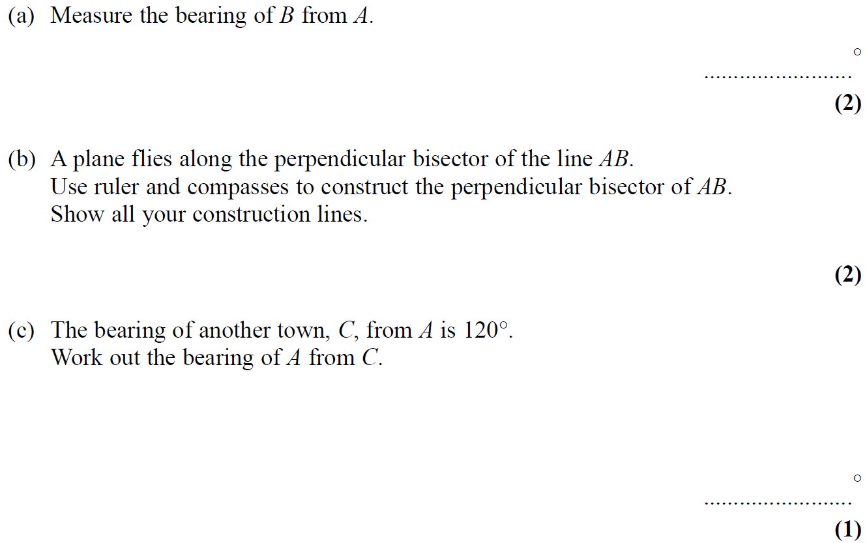
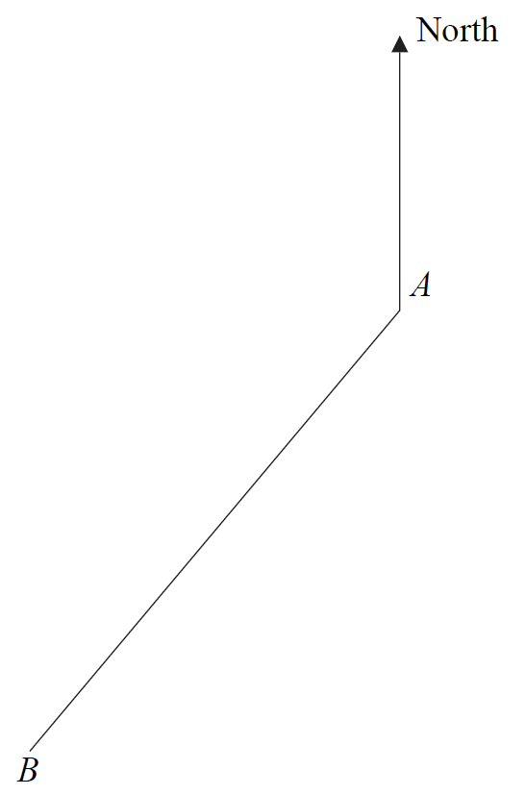
Angles (Including Parallel Lines)
Nov 2005 4H Q5

Slide 18
Angles (Including Parallel Lines)
Nov 2005 4H Q5
A
B
C

Slide 19
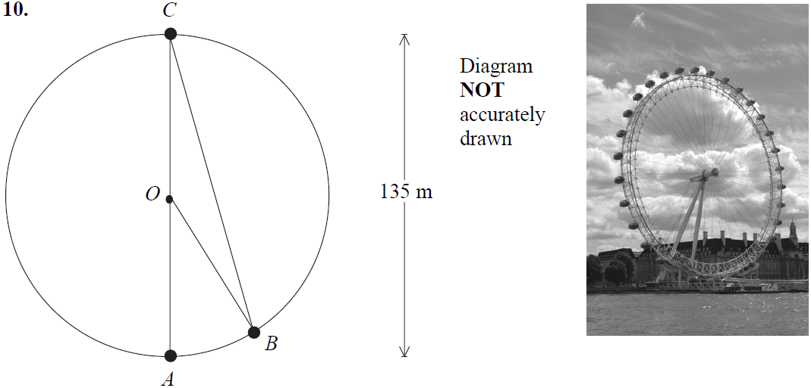
Angles (Including Parallel Lines)
May 2006 3H Q10

Slide 20
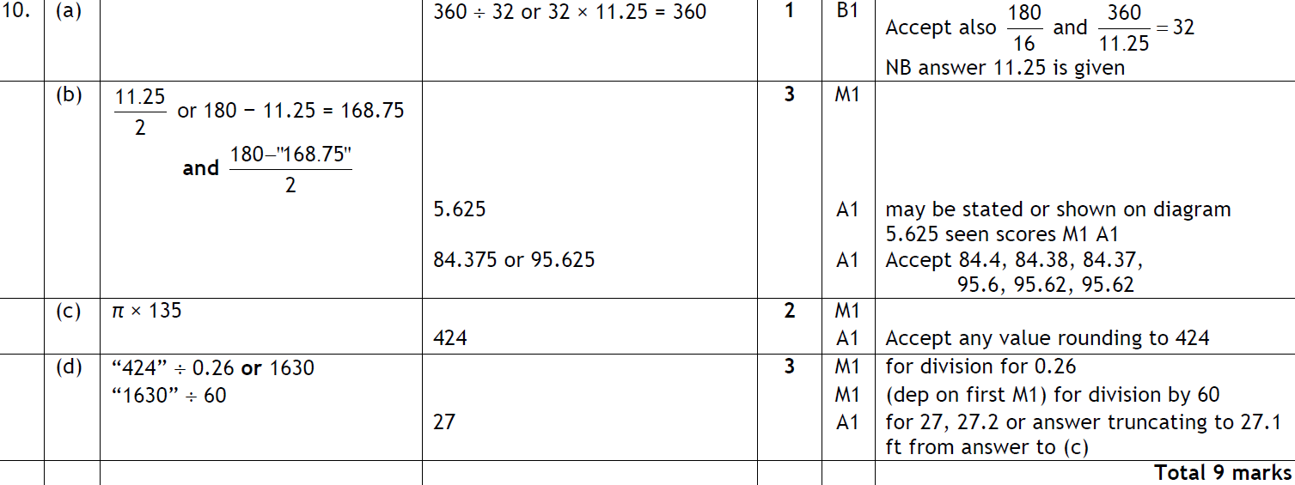
Angles (Including Parallel Lines)
May 2006 3H Q10
A
B
C
D

Slide 21
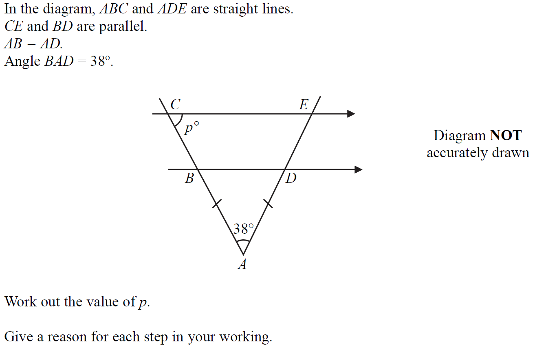
Angles (Including Parallel Lines)
May 2006 4H Q1

Slide 22
Angles (Including Parallel Lines)
May 2006 4H Q1
A

Slide 23
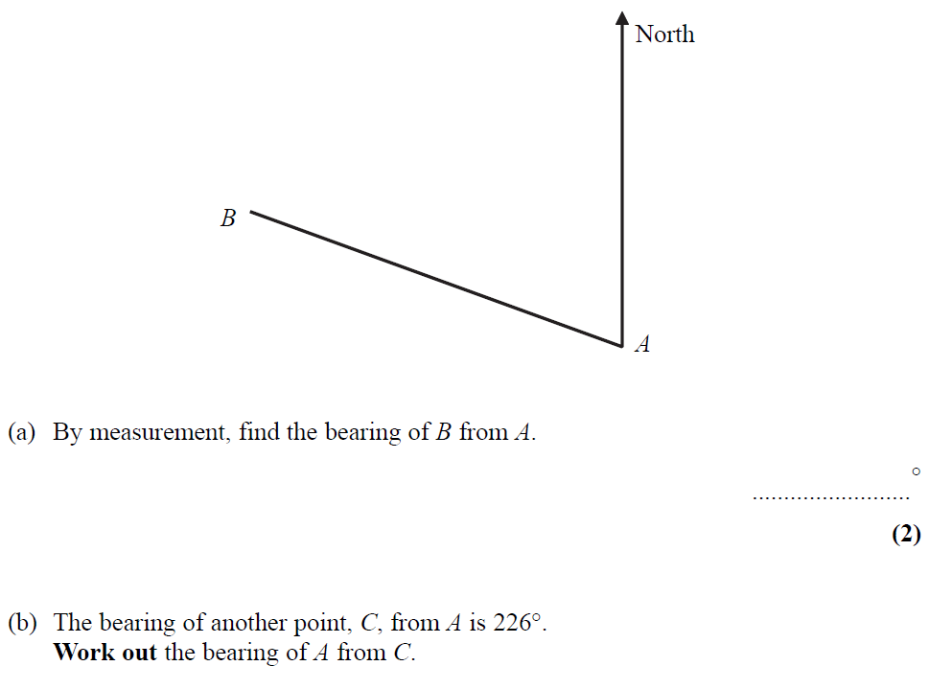
Angles (Including Parallel Lines)
Nov 2006 3H Q1

Slide 24
Angles (Including Parallel Lines)
Nov 2006 3H Q1
A
B

Slide 25
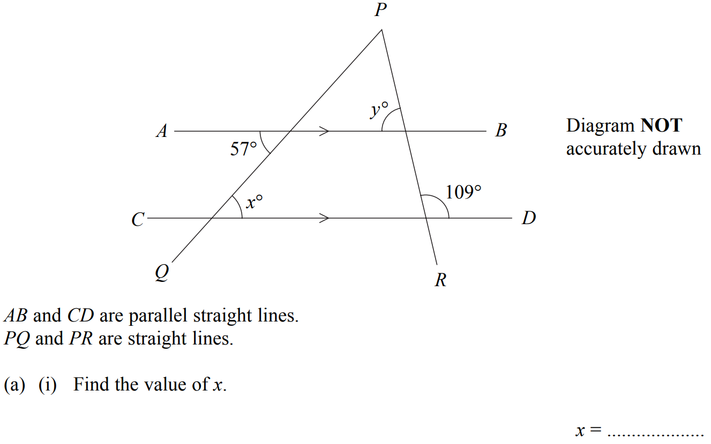
Angles (Including Parallel Lines)
Nov 2007 4H Q6

Slide 26
Angles (Including Parallel Lines)
Nov 2007 4H Q6
A (i)
A (ii)
B

Slide 27
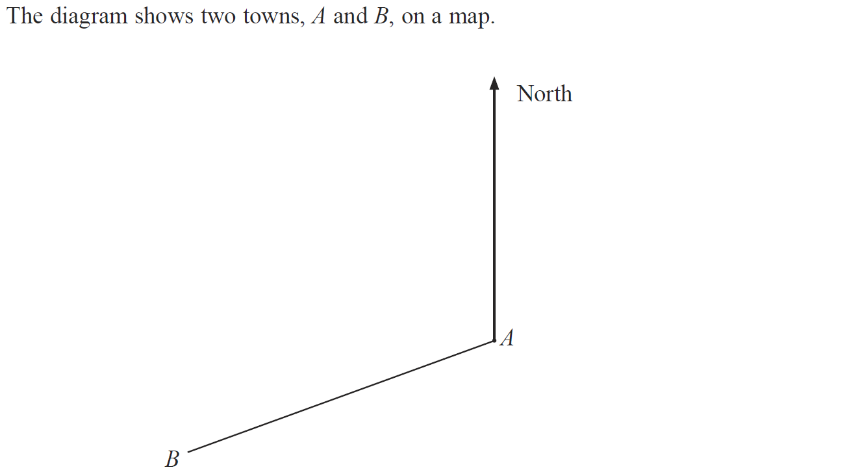
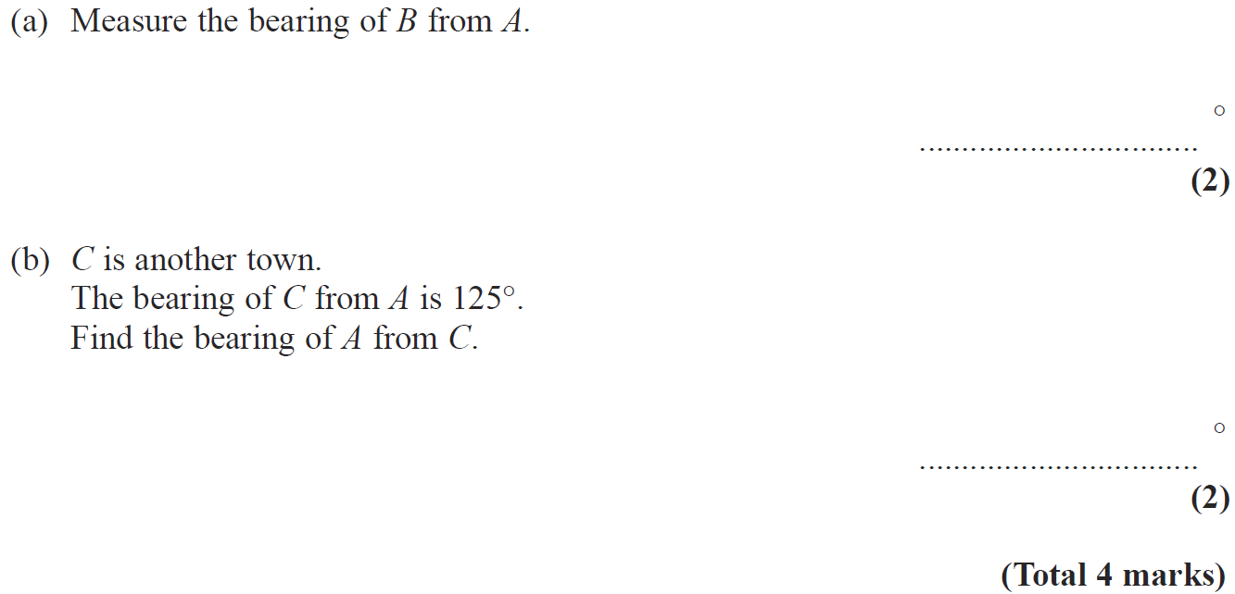
Angles (Including Parallel Lines)
May 2008 4H Q2

Slide 28
Angles (Including Parallel Lines)
May 2008 4H Q2
A
B

Slide 29
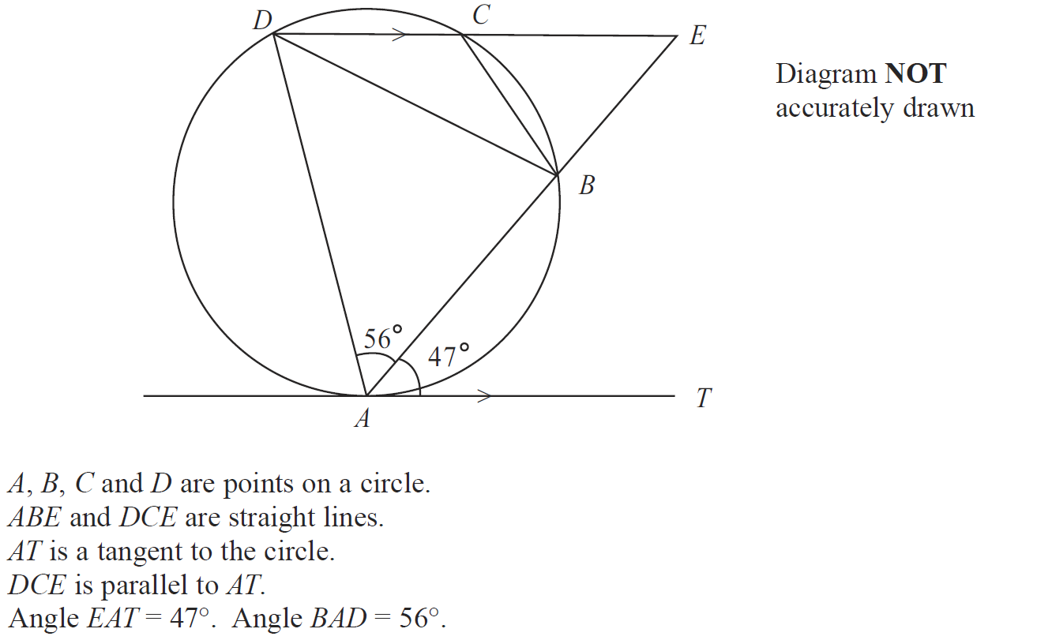
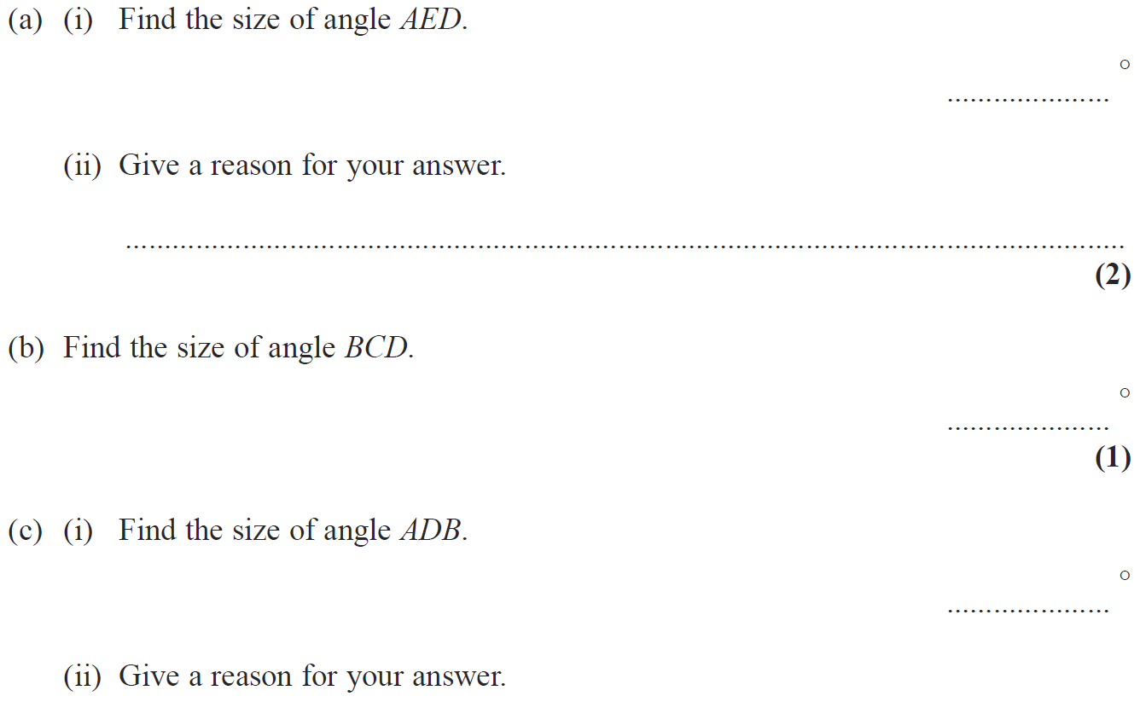
Angles (Including Parallel Lines)
May 2009 3H Q14

Slide 30
Angles (Including Parallel Lines)
May 2009 3H Q14
A (i)
A (ii)
B
C (i)
C (ii)

Slide 31
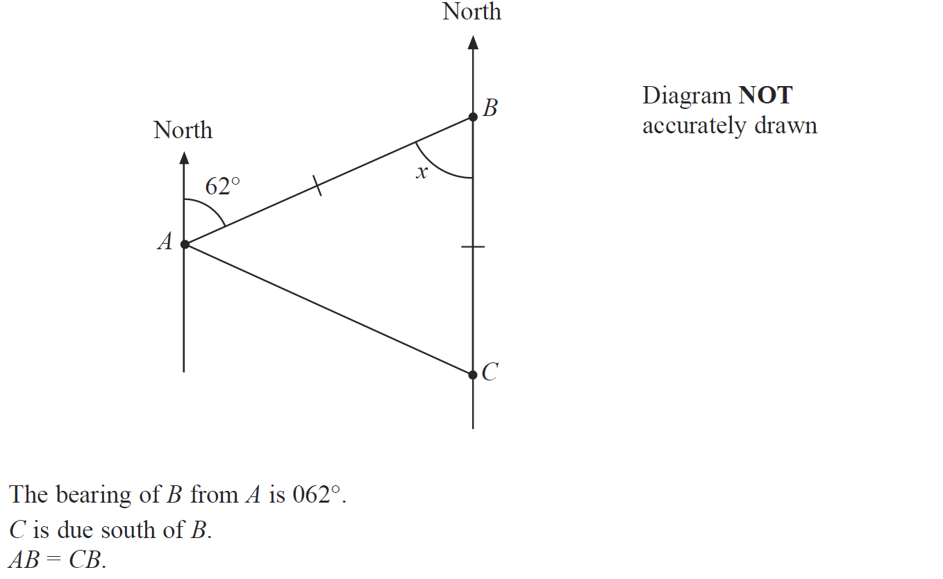
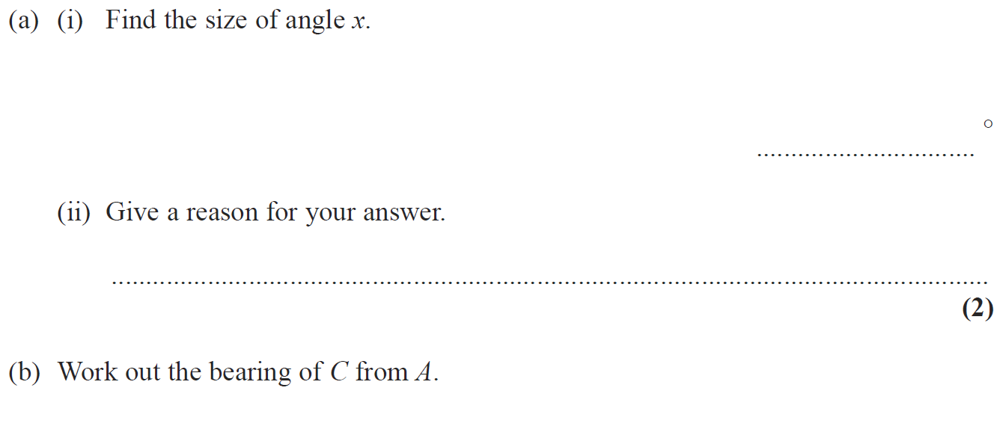
Angles (Including Parallel Lines)
Nov 2009 4H Q3

Slide 32
Angles (Including Parallel Lines)
Nov 2009 4H Q3
A (i)
A (ii)
B

Slide 33
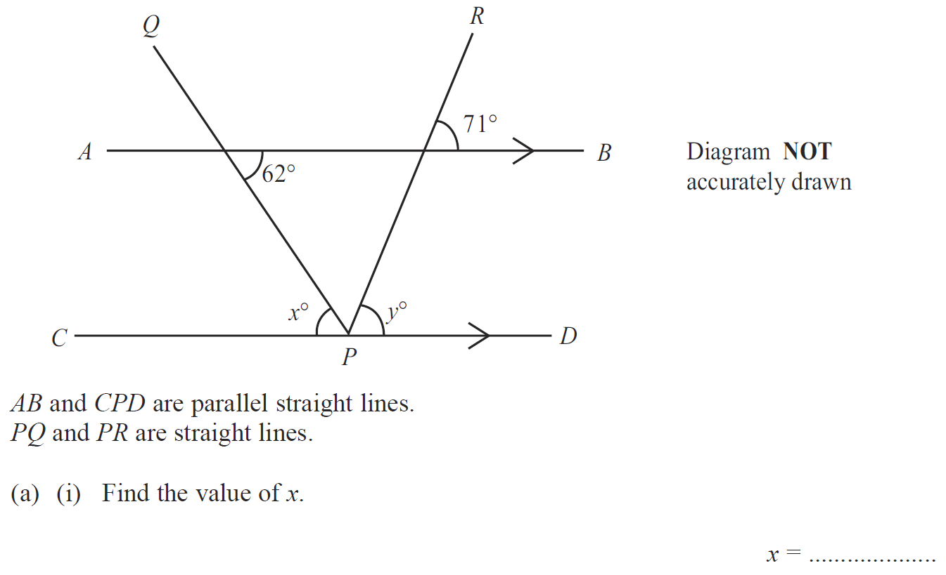
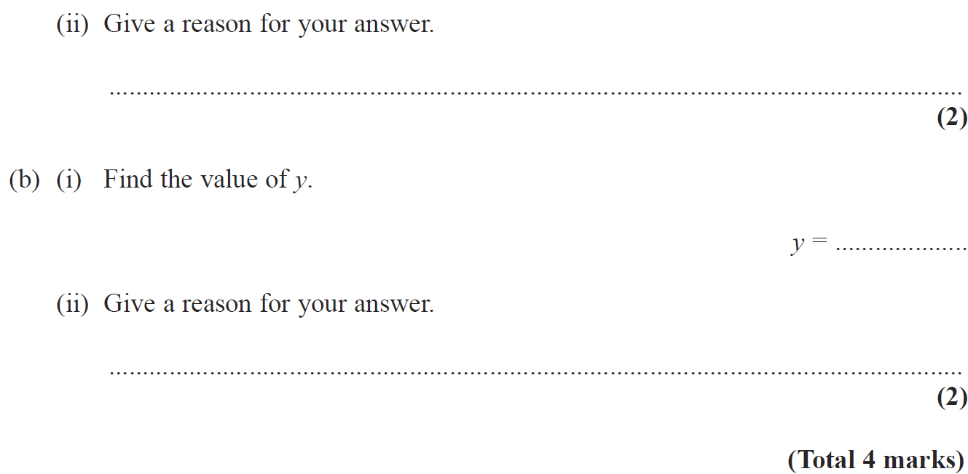
Angles (Including Parallel Lines)
June 2010 3H Q2

Slide 34
Angles (Including Parallel Lines)
June 2010 3H Q2
A (i)
A (ii)
B (i)
B (ii)

Slide 35
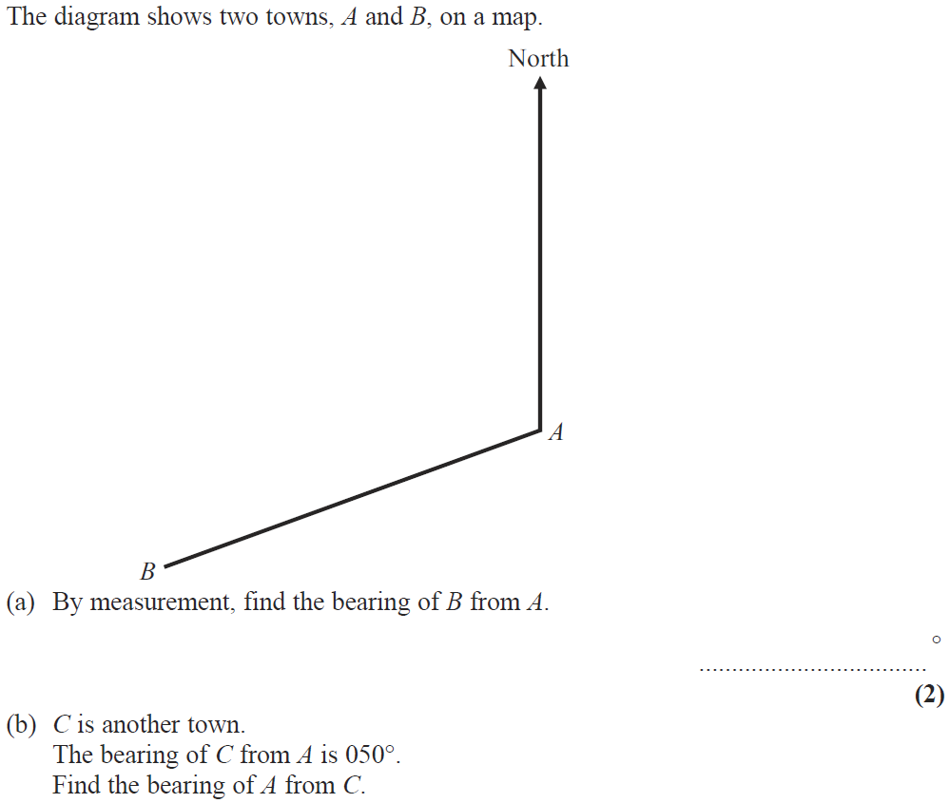
Angles (Including Parallel Lines)
June 2010 4H Q2

Slide 36
Angles (Including Parallel Lines)
June 2010 4H Q2
A
B

Slide 37
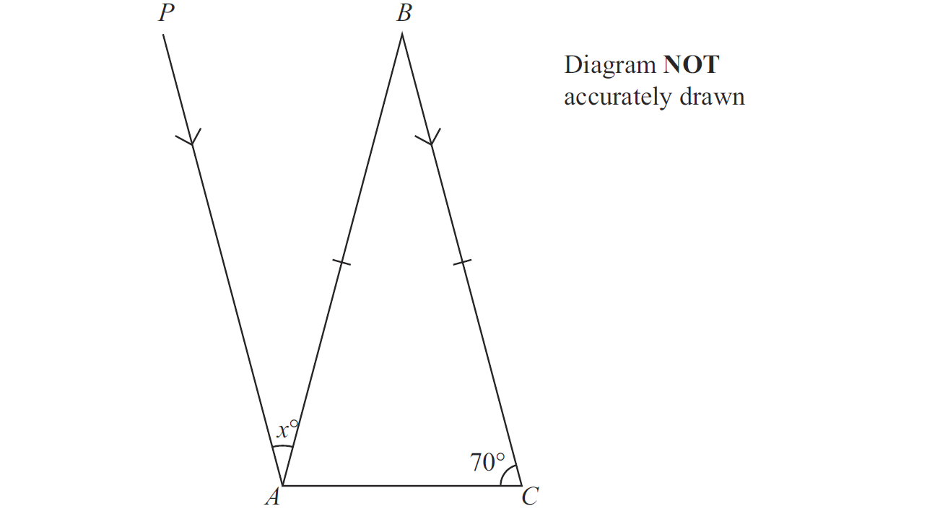
Angles (Including Parallel Lines)
Nov 2010 3H Q3

Slide 38
Angles (Including Parallel Lines)
Nov 2010 3H Q3
A

Slide 39
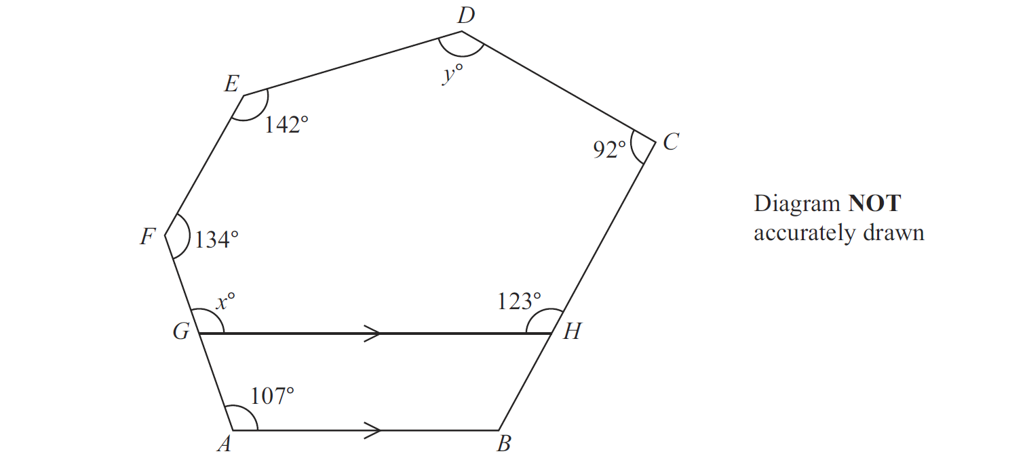
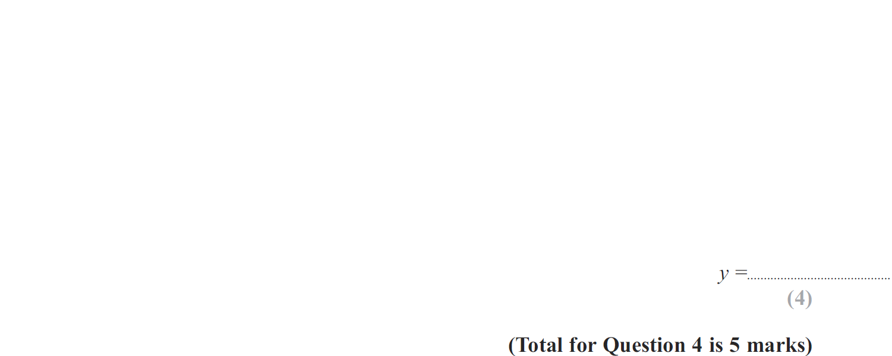
Angles (Including Parallel Lines)
May 2013 3H Q4

Slide 40
Angles (Including Parallel Lines)
May 2013 3H Q4
A
B

Slide 41
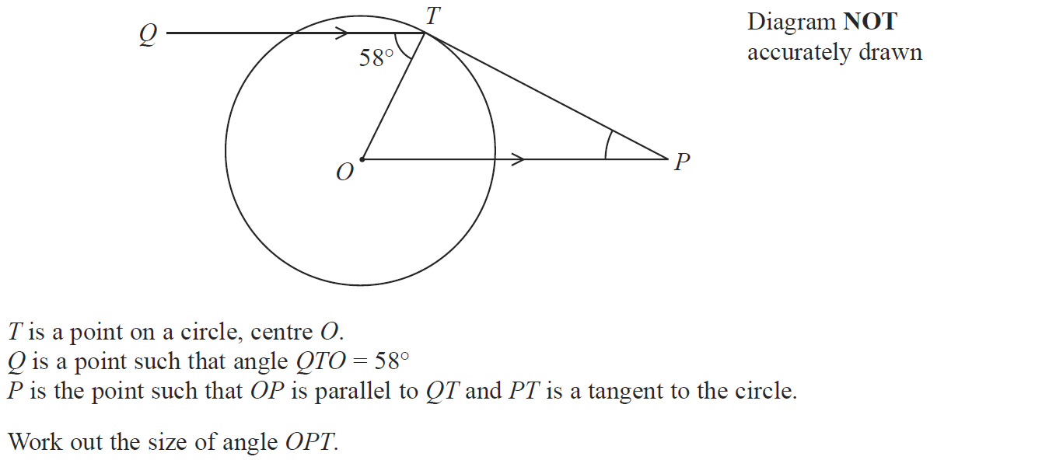
Angles (Including Parallel Lines)
Jan 2014 3H Q6

Slide 42
Angles (Including Parallel Lines)
Jan 2014 3H Q6
A

Slide 43
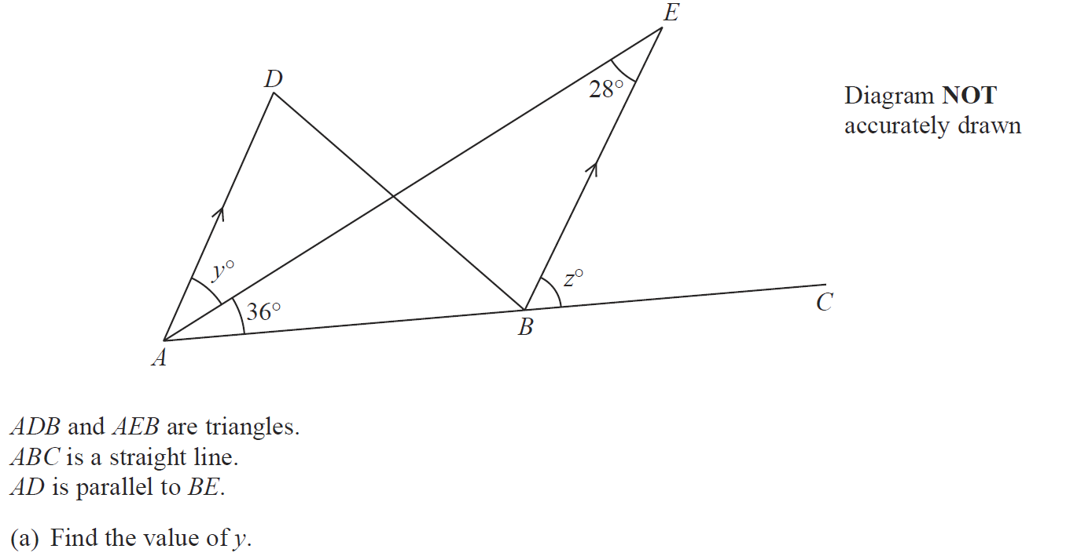
Angles (Including Parallel Lines)
Jan 2014 4HR Q3

Slide 44
Angles (Including Parallel Lines)
Jan 2014 4HR Q3
A
B

Slide 45
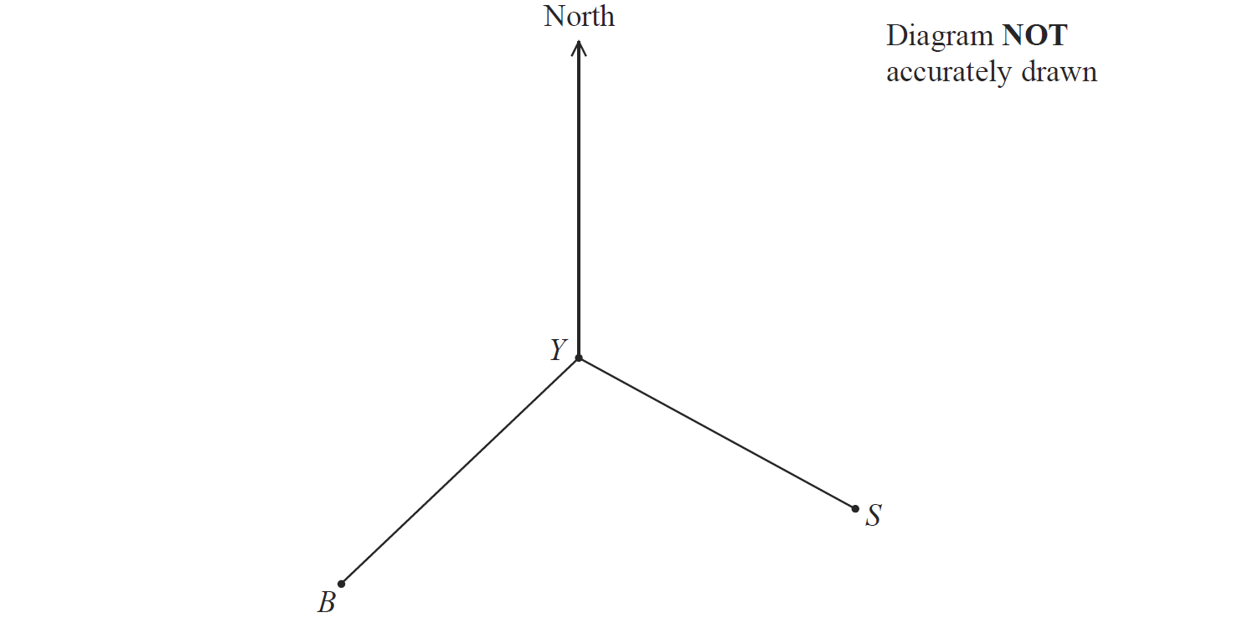
Angles (Including Parallel Lines)
Jan 2014 4HR Q10

Slide 46
Angles (Including Parallel Lines)
Jan 2014 4HR Q10
A
B
C

Slide 47
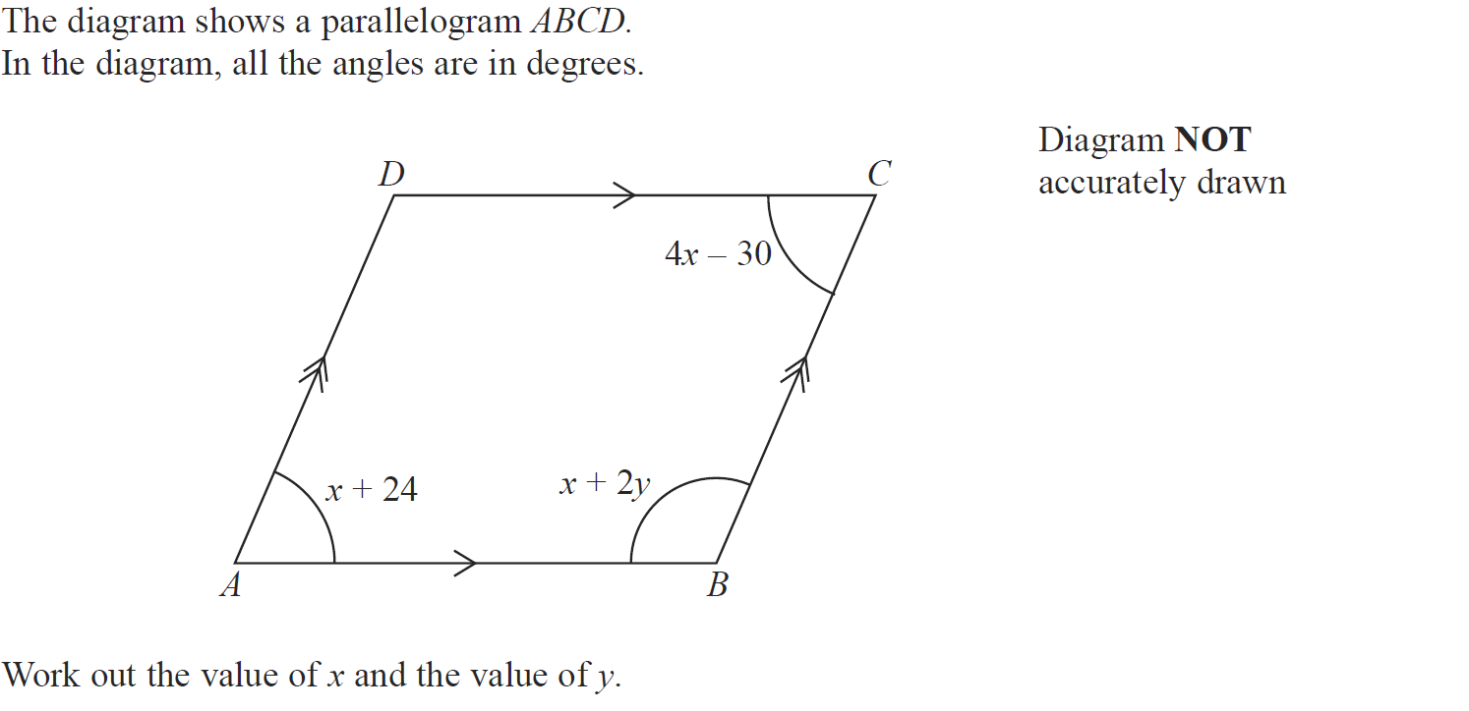
Angles (Including Parallel Lines)
May 2014 4HR Q9

Slide 48
Angles (Including Parallel Lines)
May 2014 4HR Q9
A

Slide 49
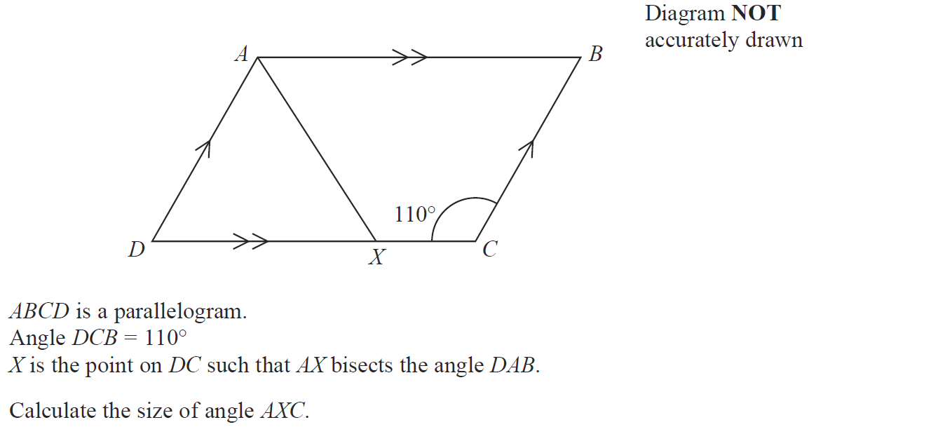
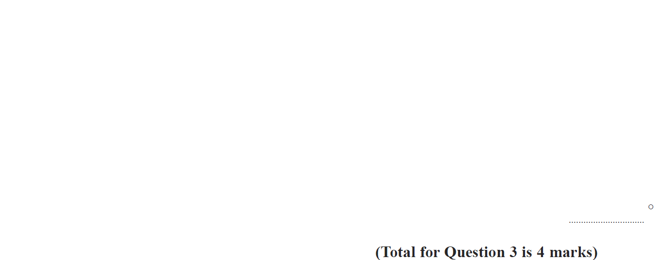
Angles (Including Parallel Lines)
Jan 2015 4HR Q3

Slide 50
Angles (Including Parallel Lines)
Jan 2015 4HR Q3
A

Slide 51
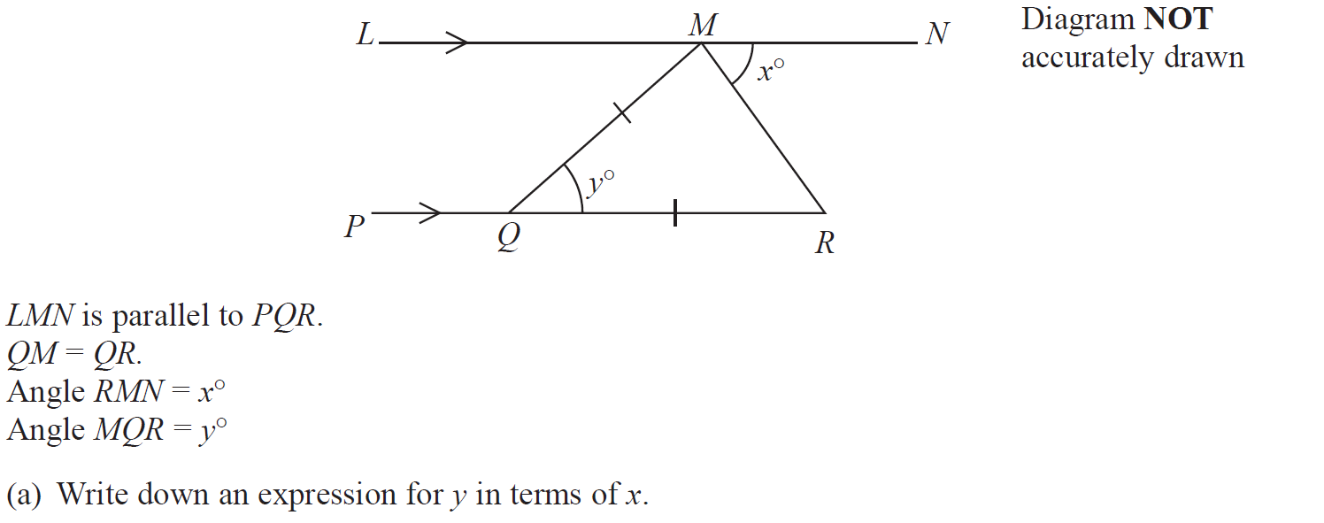
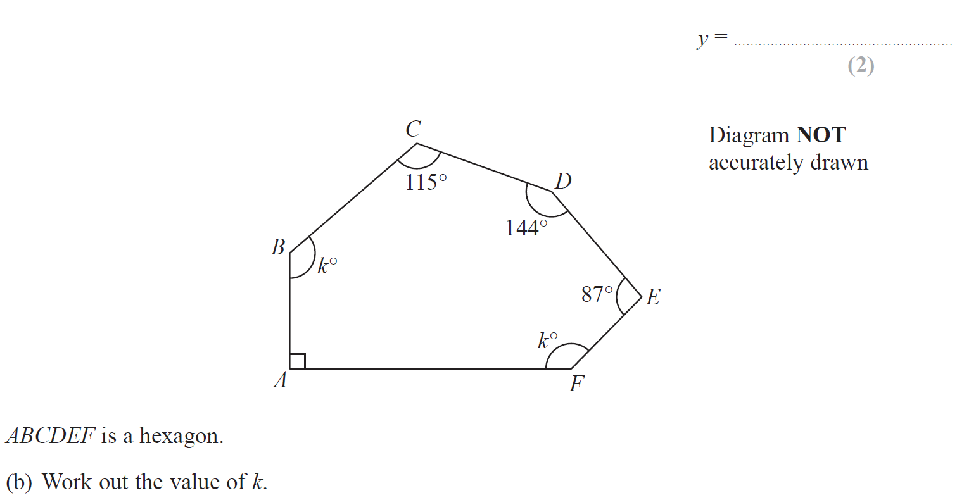
Angles (Including Parallel Lines)
June 2015 4H Q6

Slide 52
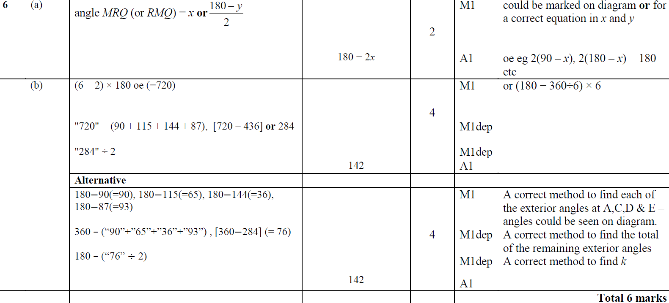
Angles (Including Parallel Lines)
June 2015 4H Q6
A
B

Slide 53
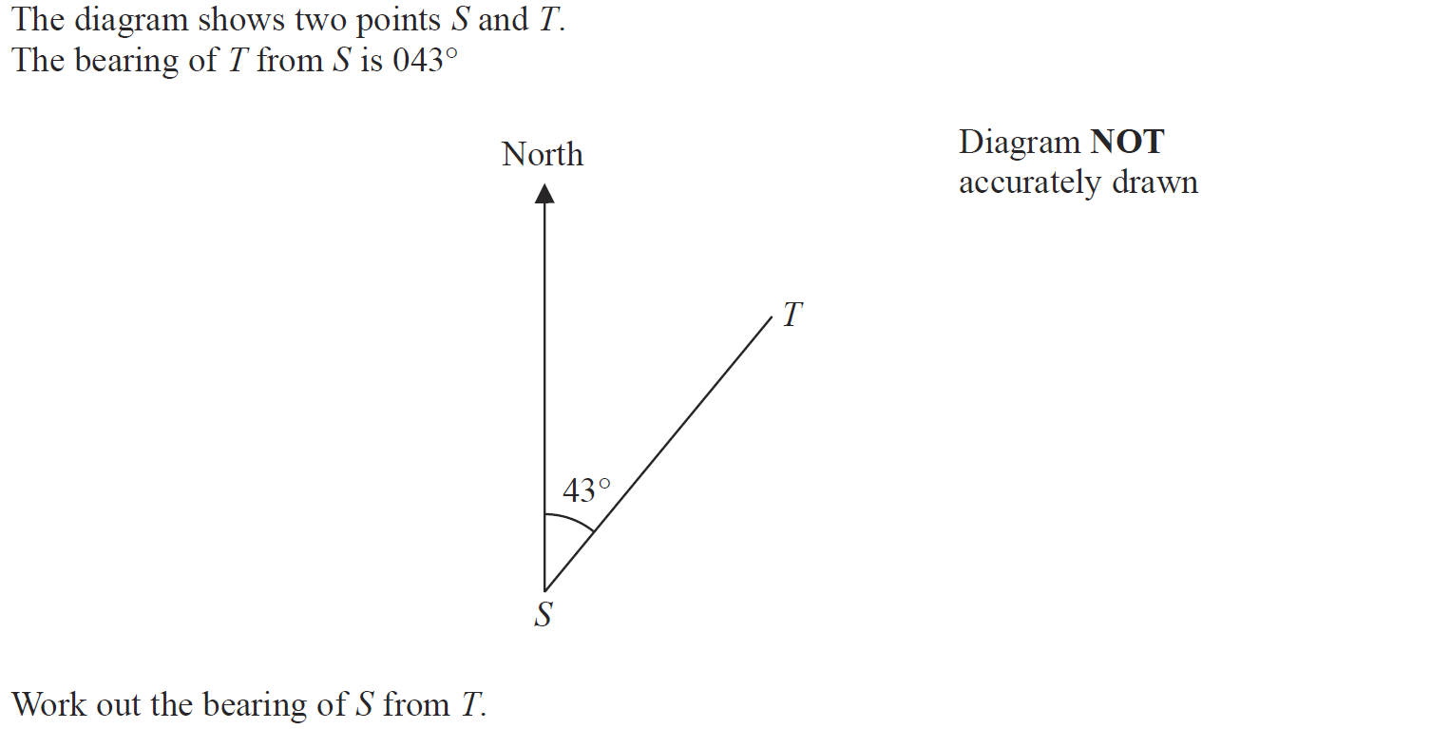
Angles (Including Parallel Lines)
June 2015 4HR Q7

Slide 54
Angles (Including Parallel Lines)
June 2015 4HR Q7
A

Slide 55
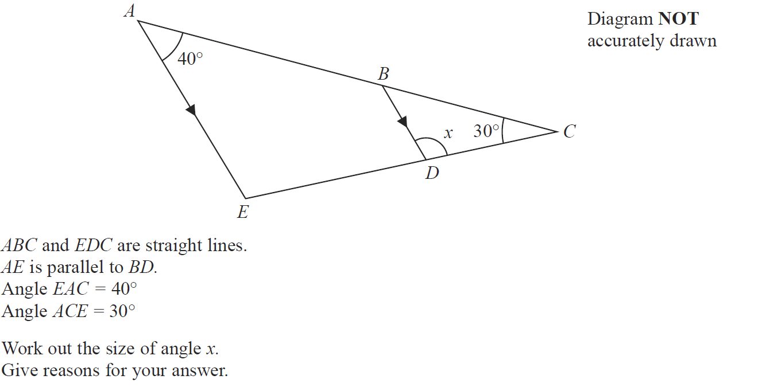
Angles (Including Parallel Lines)
Jan 2016 4H Q5

Slide 56
Angles (Including Parallel Lines)
Jan 2016 4H Q5
A

Slide 57
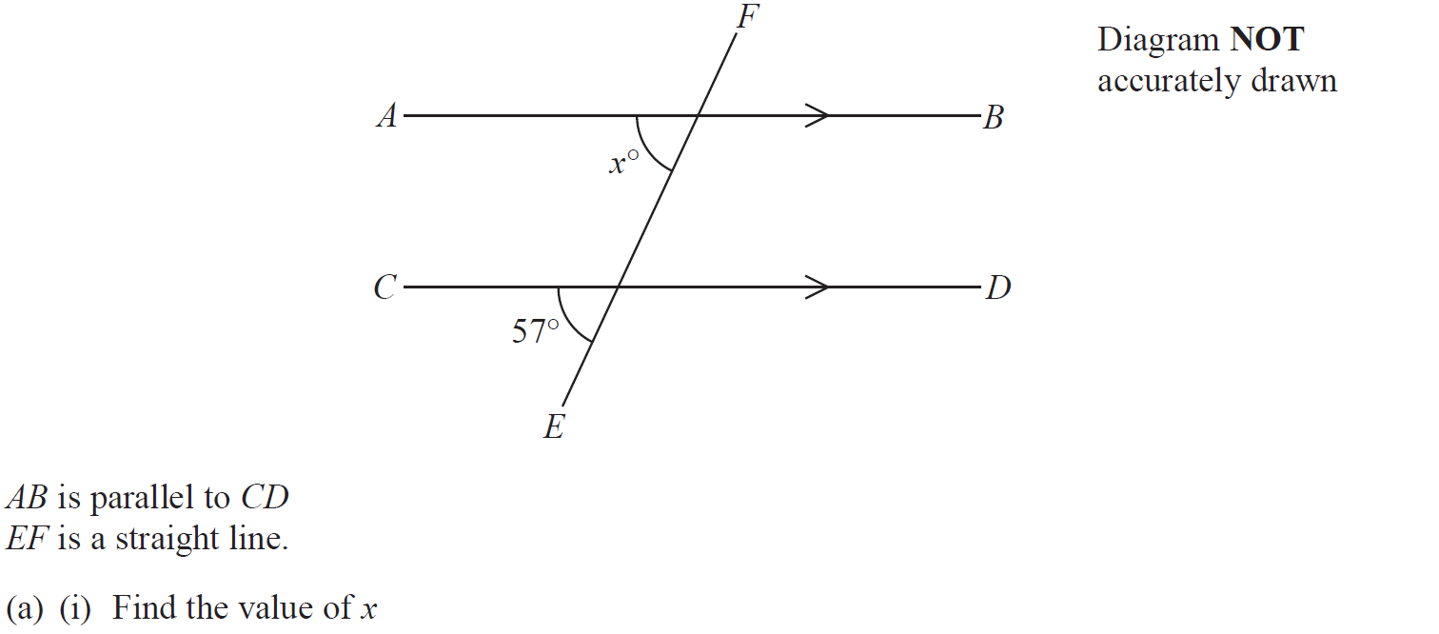
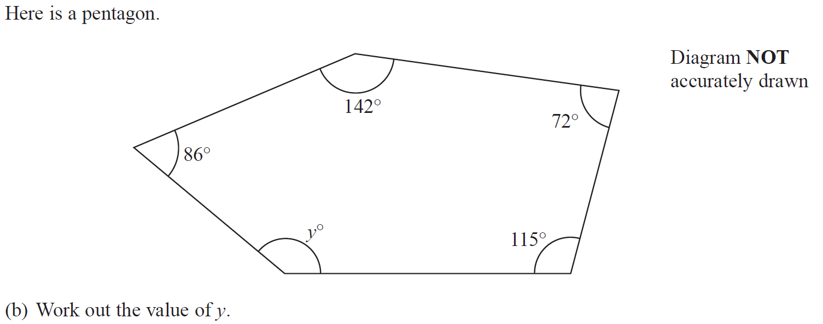
Angles (Including Parallel Lines)
Jan 2016 4HR Q2

Slide 58
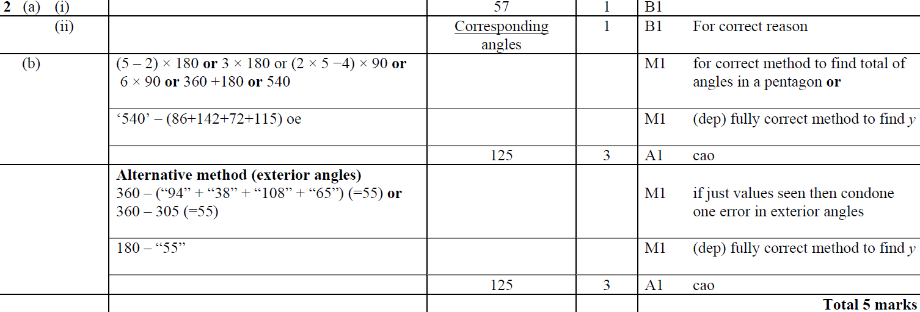
Angles (Including Parallel Lines)
Jan 2016 4HR Q2
A (i)
A (ii)
B

Slide 59
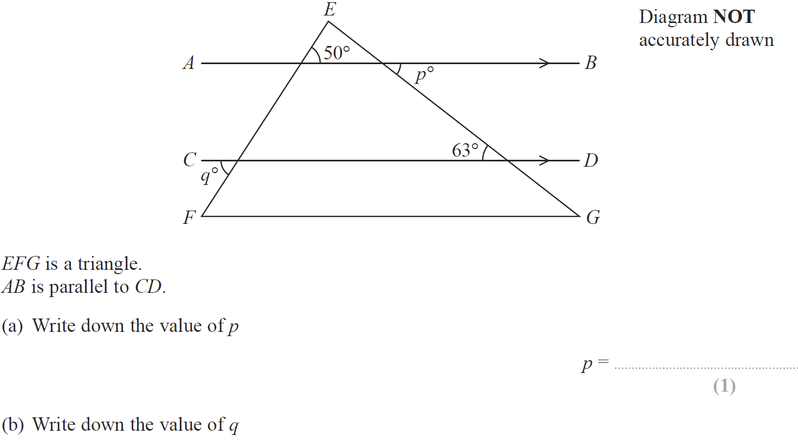
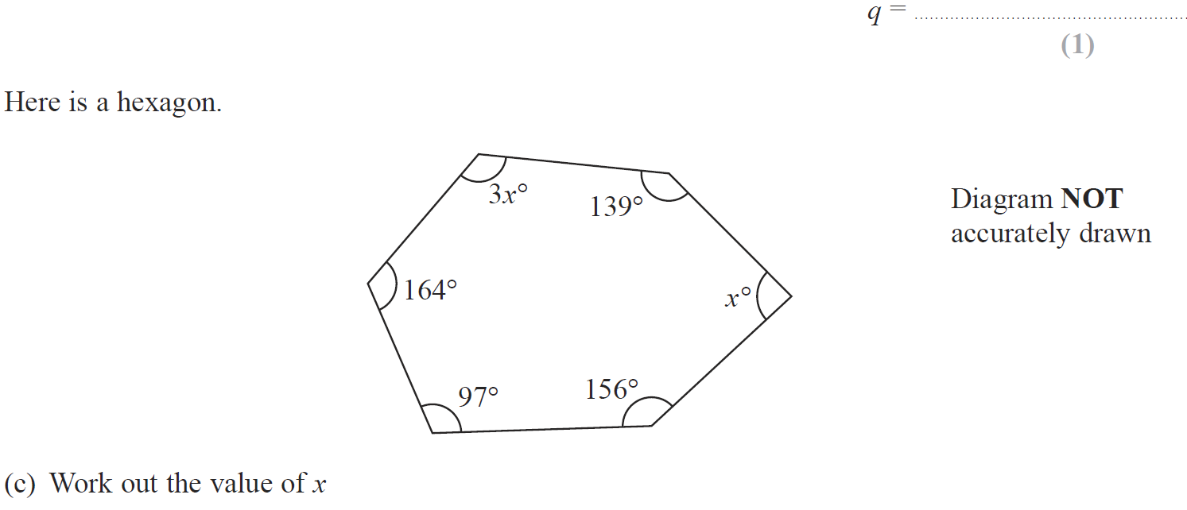
Angles (Including Parallel Lines)
June 2016 4H Q4

Slide 60
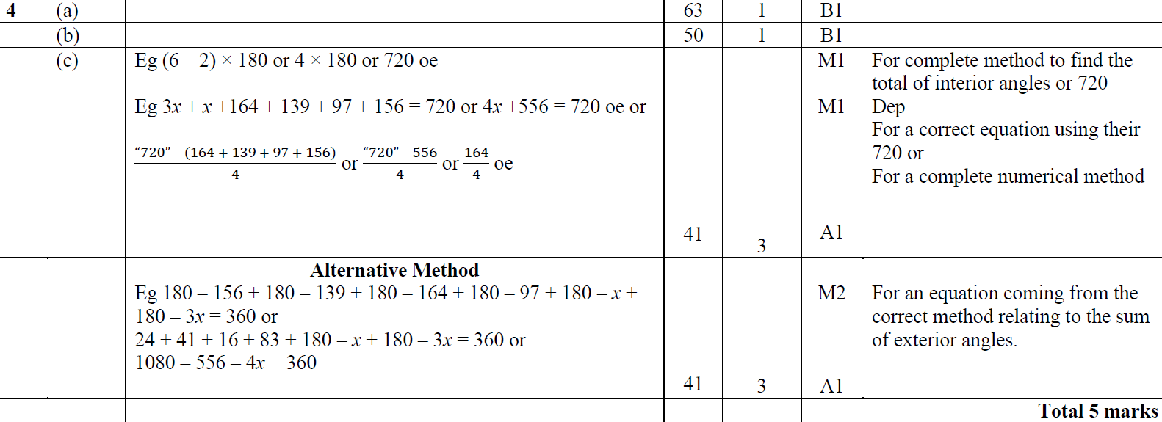
Angles (Including Parallel Lines)
June 2016 4H Q4
A
B
C

Slide 61
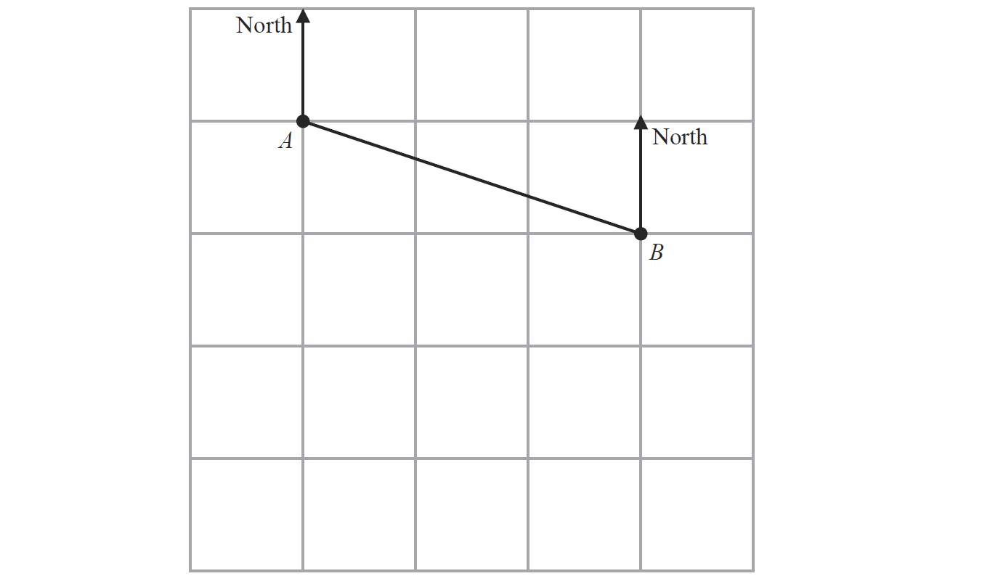
Angles (Including Parallel Lines)
Jan 2017 4H Q8

Slide 62
Angles (Including Parallel Lines)
Jan 2017 4H Q8
A
B
C

Slide 63
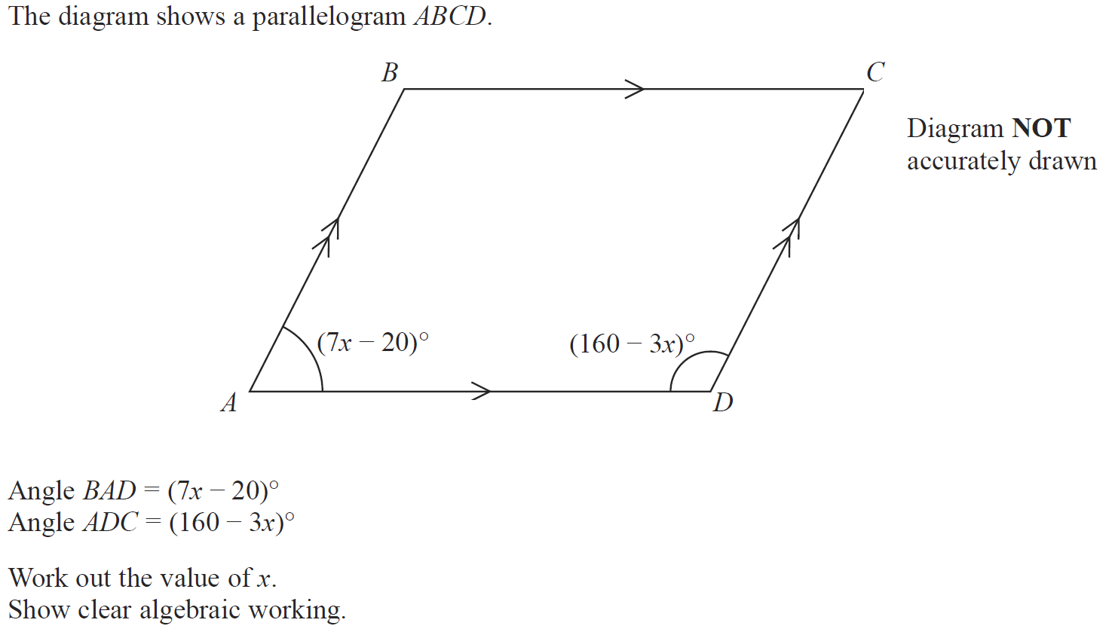
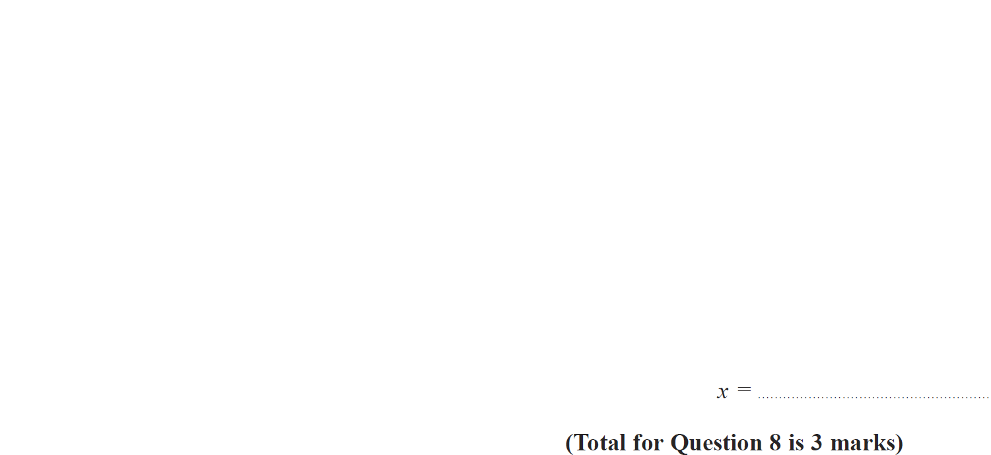
Angles (Including Parallel Lines)
Jan 2017 4HR Q8

Slide 64
Angles (Including Parallel Lines)
Jan 2017 4HR Q8
A

Slide 65
Angles (Including Parallel Lines)
Jan 2017 4HR Q9

Slide 66
Angles (Including Parallel Lines)
Jan 2017 4HR Q9
A
B
C (i)
C (ii)

Slide 67
Angles (Including Parallel Lines)
May 2017 3HR Q3

Slide 68
Angles (Including Parallel Lines)
May 2017 3HR Q3
A

Slide 69
Angles (Including Parallel Lines)
Jan 2018 3HR Q2

Slide 70
Angles (Including Parallel Lines)
Jan 2018 3HR Q2
A

Slide 71
Angles (Including Parallel Lines)
Jan 2018 4HR Q19

Slide 72
Angles (Including Parallel Lines)
Jan 2018 4HR Q19
A

Slide 73
Angles (Including Parallel Lines)
June 2018 4H Q4

Slide 74
Angles (Including Parallel Lines)
June 2018 4H Q4
A

Slide 75
Angles (Including Parallel Lines)
June 2018 4HR Q2

Slide 76
Angles (Including Parallel Lines)
June 2018 4HR Q2
A (i)
A (ii)
B

