Slide 1
Old Spec Q’s
Algebraic Models/ Calculus
no calculus
Practice E
Practice F
Practice G
SAM
Practice H (i)
2018
Practice H (ii)
Practice J

Slide 2
Practice E

Slide 3
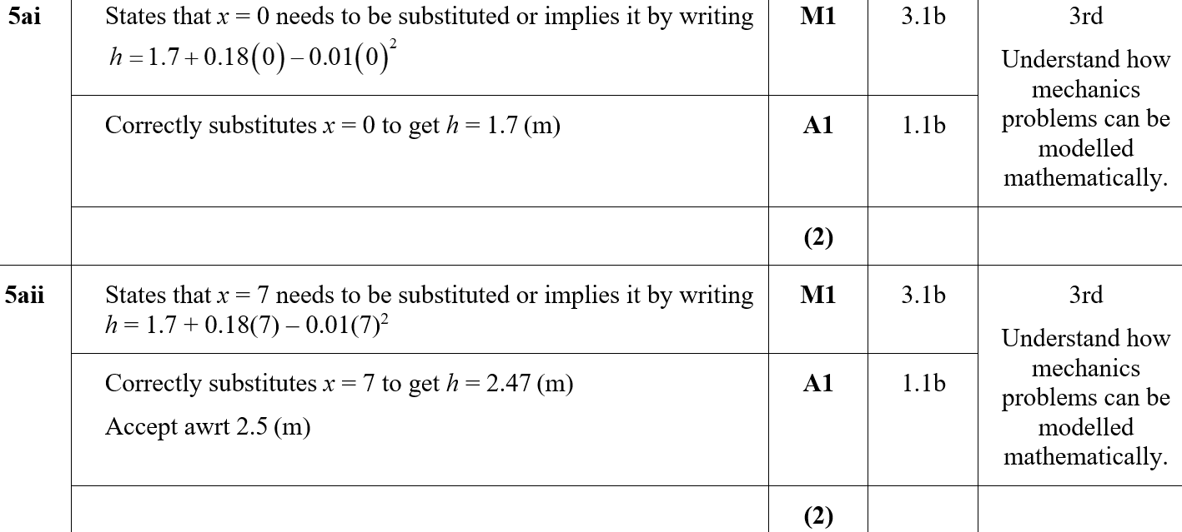
Practice E
A (i)
A (ii)

Slide 4
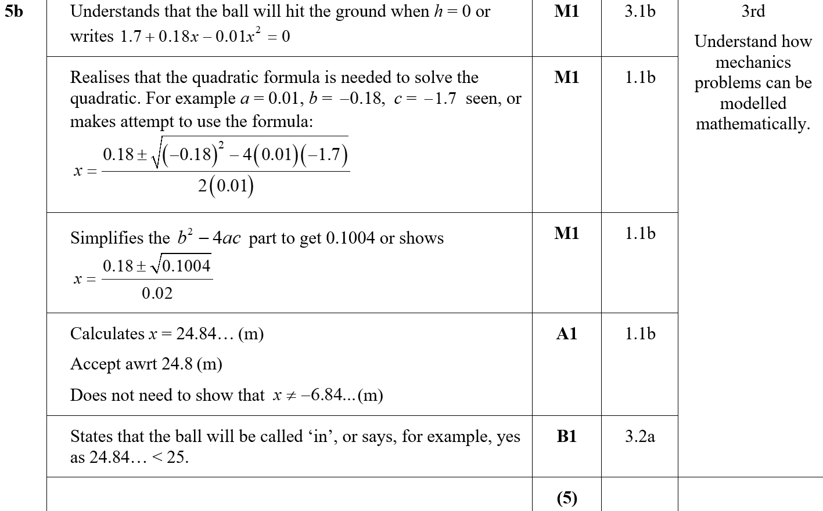
Practice E
B

Slide 5
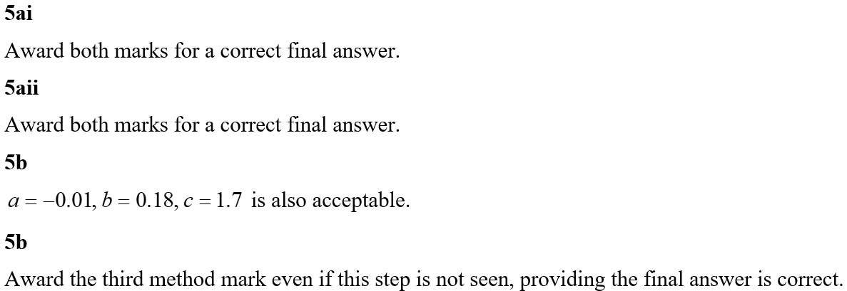
Practice E
C
A (i) notes
A (ii) notes
B notes

Slide 6
Practice F

Slide 7
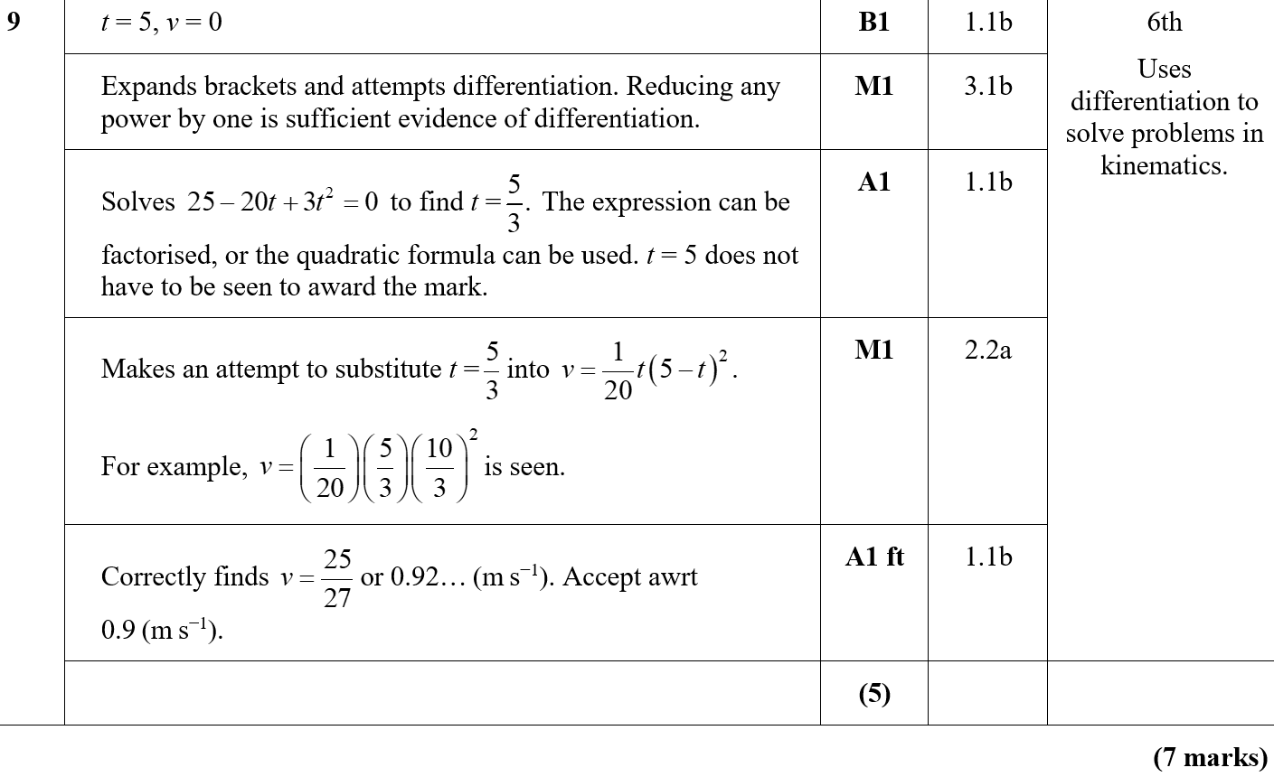
Practice F
A
A notes

Slide 8
Practice G

Slide 9
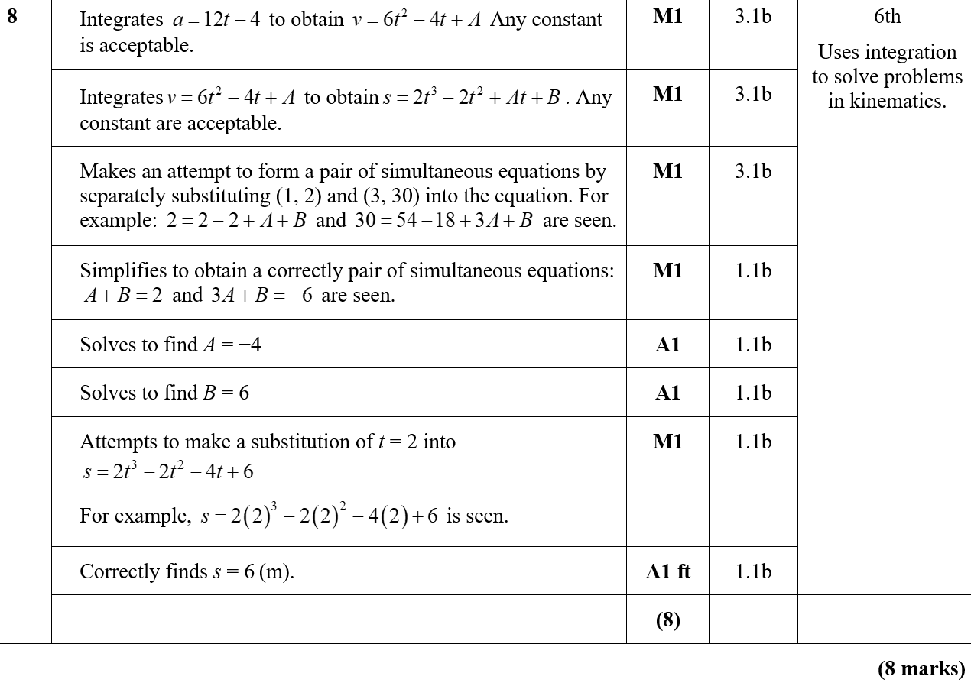
Practice G
A
A notes

Slide 10
Practice H

Slide 11
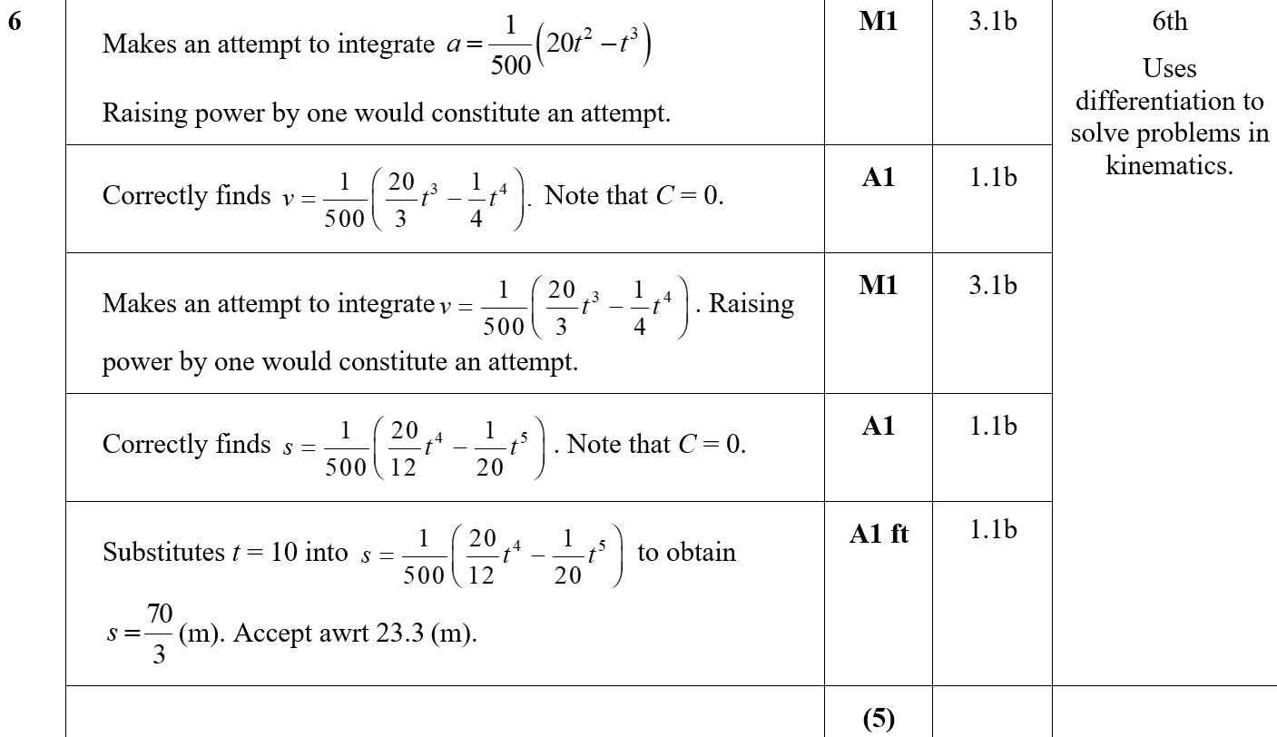
Practice H
A
A notes

Slide 12
Practice H

Slide 13
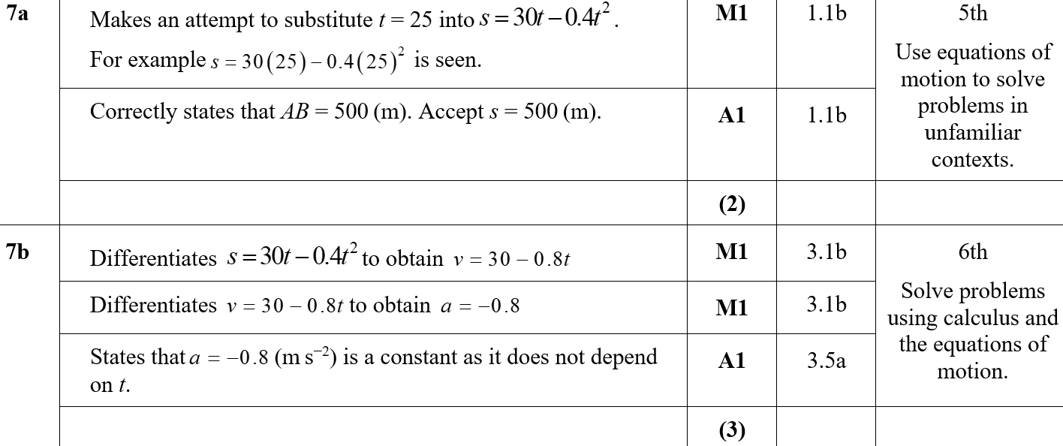
Practice H
A
B

Slide 14
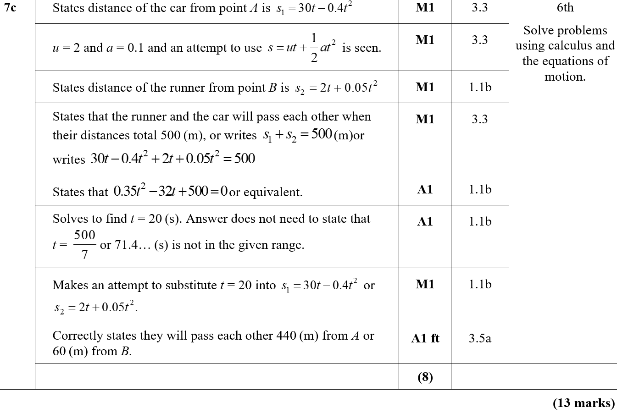
Practice H
C

Slide 15
Practice J

Slide 16
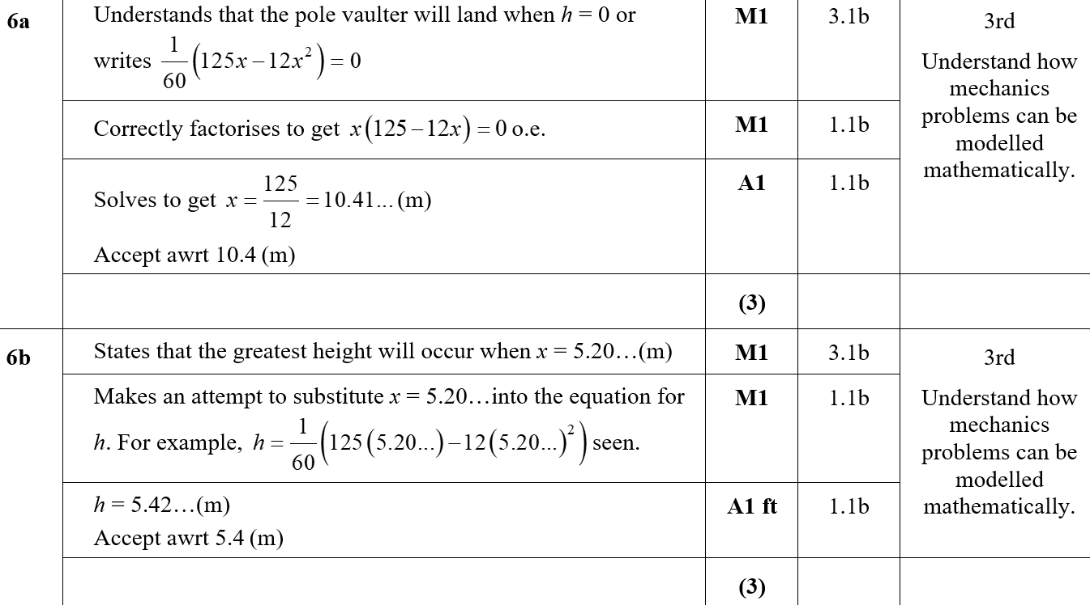
Practice J
A
B

Slide 17
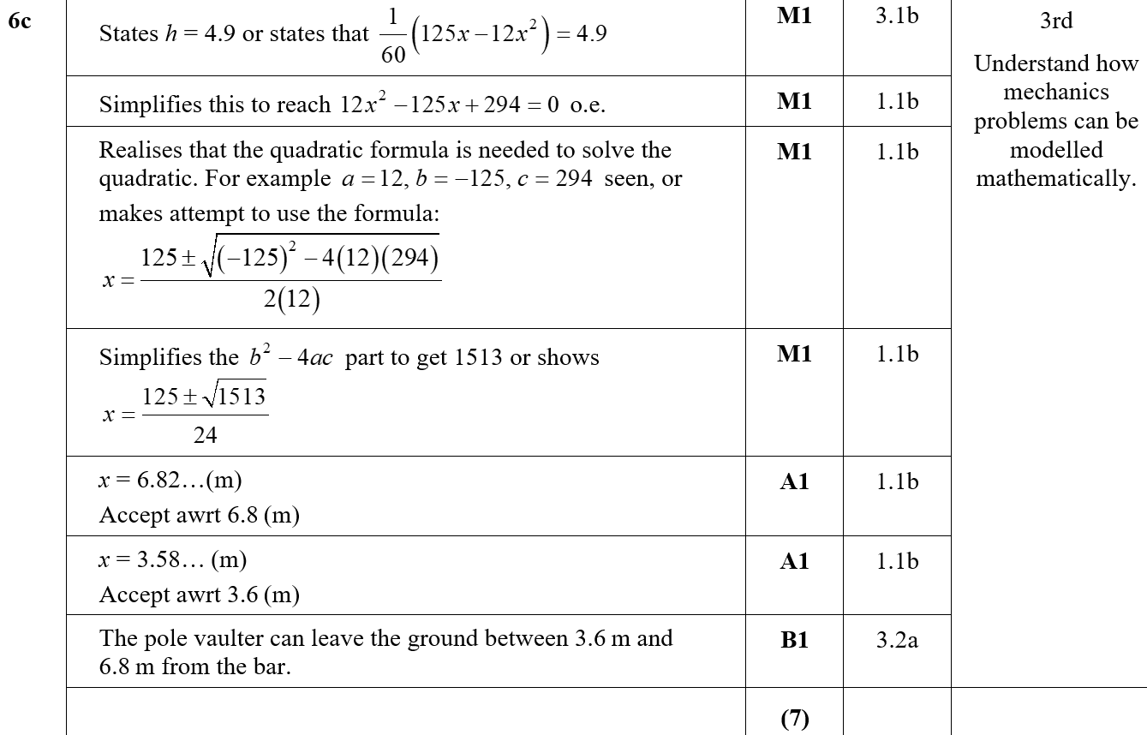
Practice J
C

Slide 18
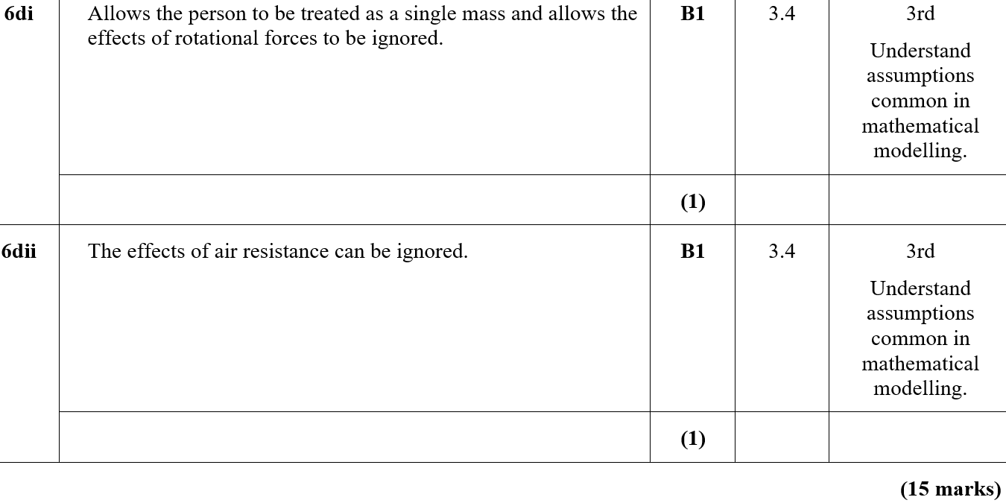
Practice J
D (i)
D (ii)

Slide 19
Practice J
B notes
C notes

Slide 20
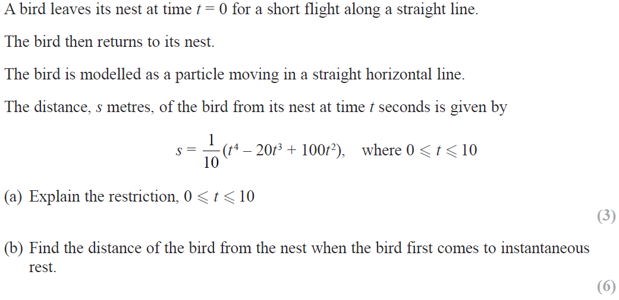
SAM

Slide 21
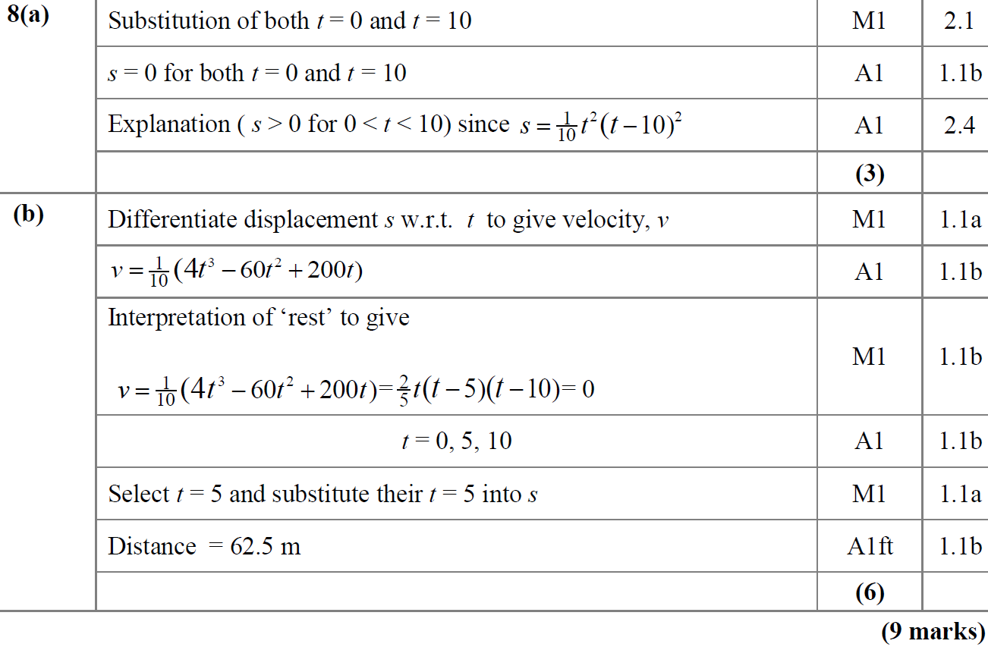
SAM
A
B

Slide 22
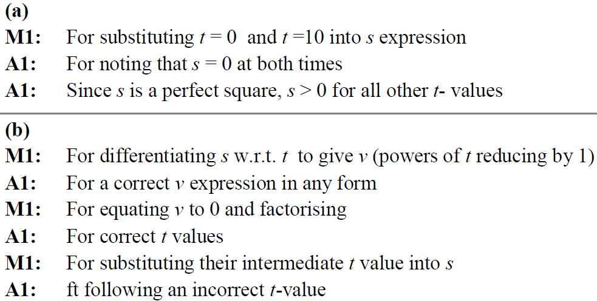
SAM
A notes
B notes

Slide 23
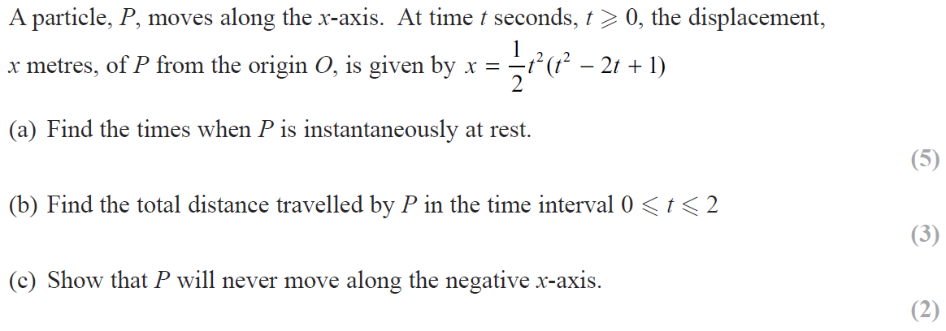
2018

Slide 24
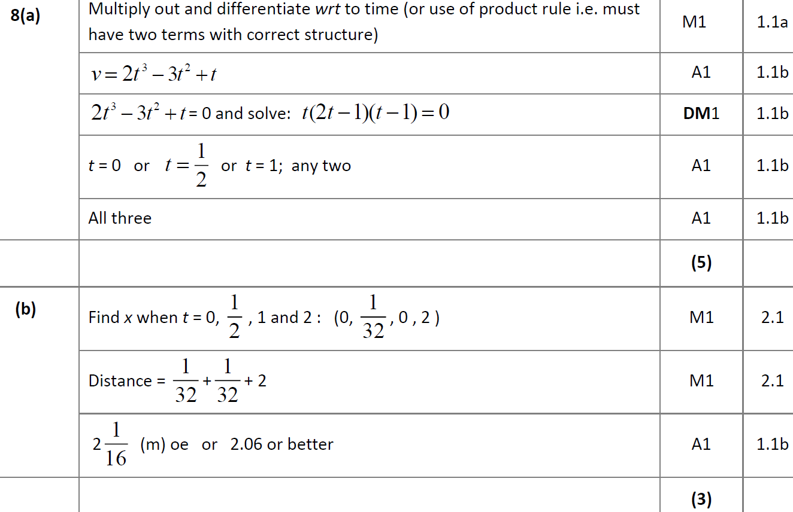
2018
A
B

Slide 25
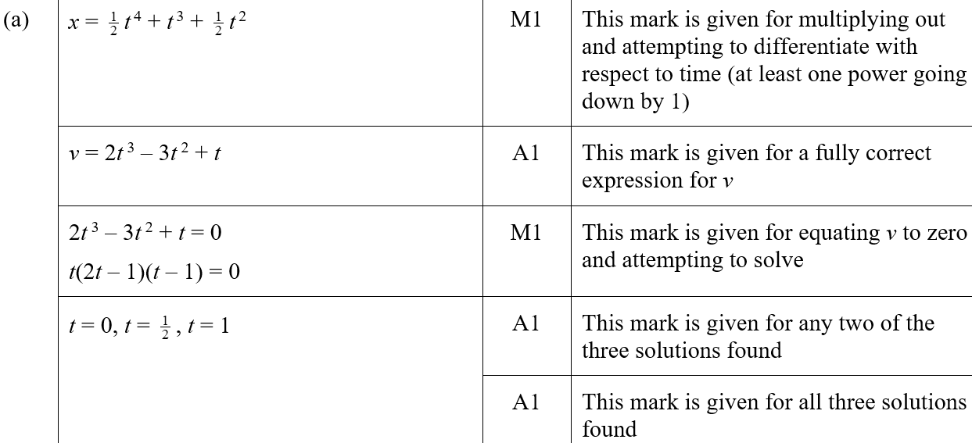
2018
C
A (SF)

Slide 26
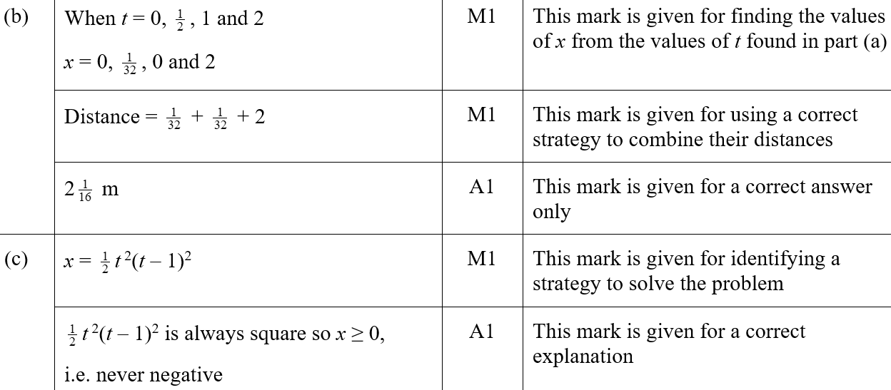
2018
B (SF)
C (SF)
A notes

Slide 27
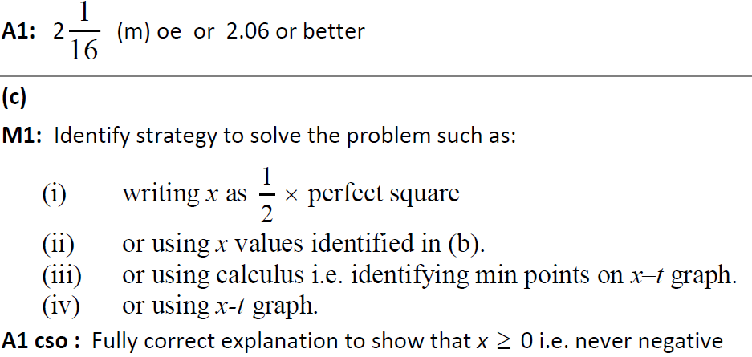
2018
B notes
C notes

Slide 28
New Spec Q’s
Old Spec Algebraic Models/ Calculus
June 2006
June 2011
May 2009
June 2013
Jan 2010
June 2015
June 2010
June 2016
Jan 2011
June 2017

Slide 29
June 2006

Slide 30
June 2006
A

Slide 31
May 2009

Slide 32
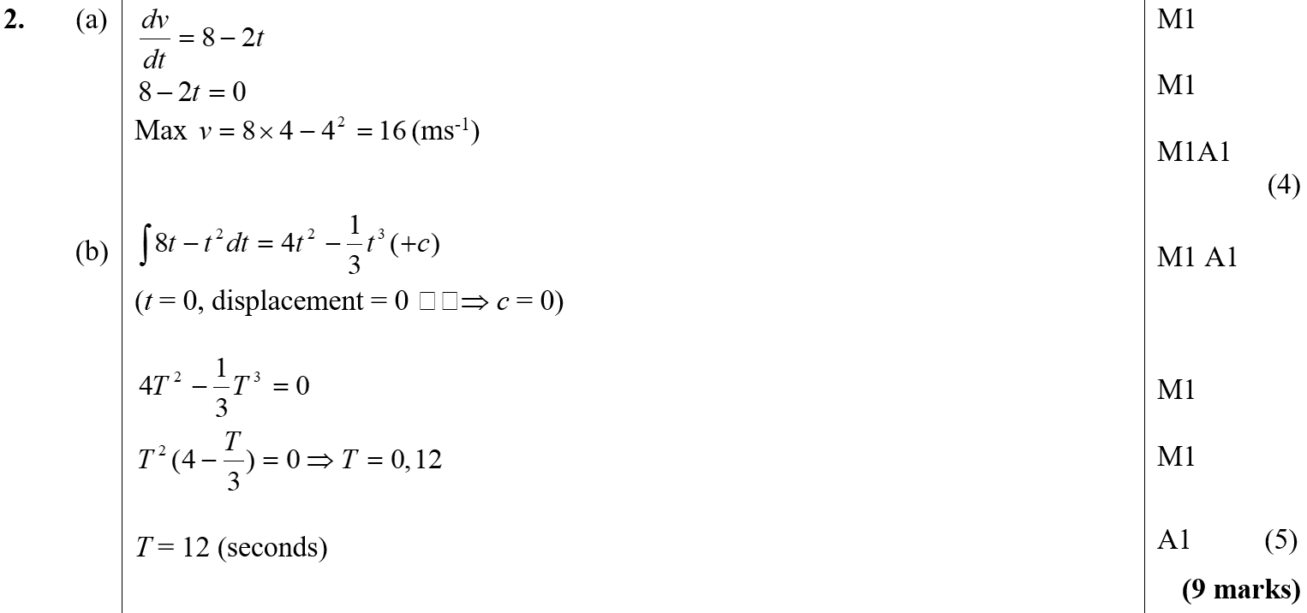
May 2009
A
B

Slide 33
Jan 2010

Slide 34
Jan 2010
A

Slide 35
June 2010

Slide 36
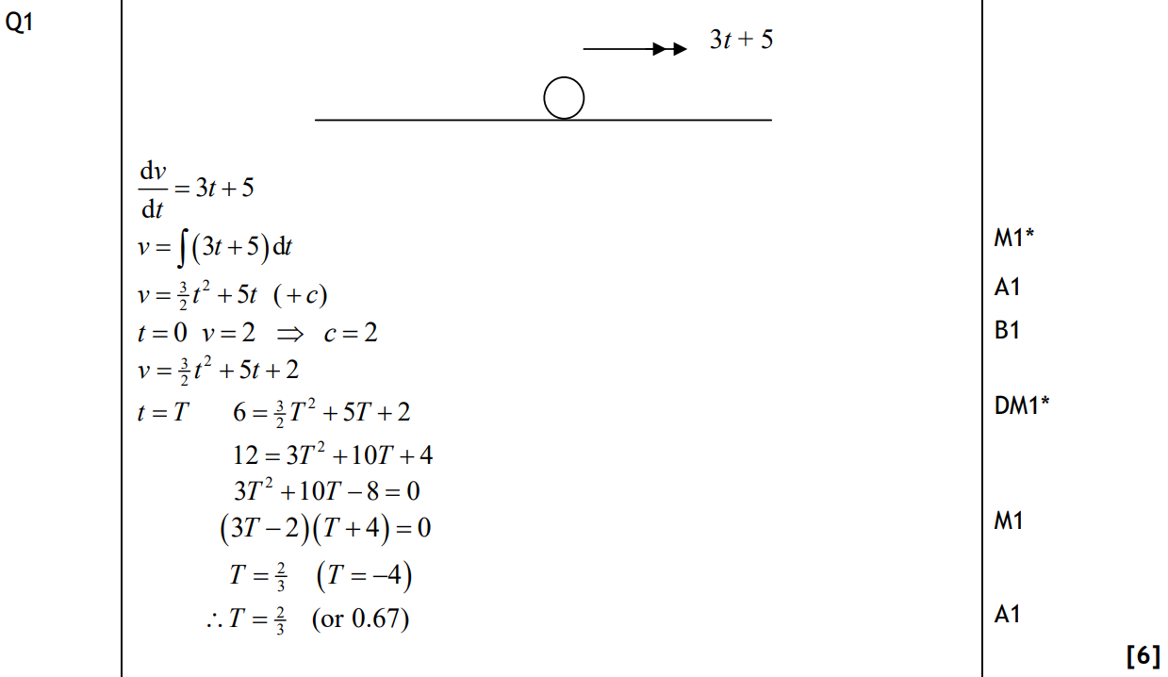
June 2010
A

Slide 37
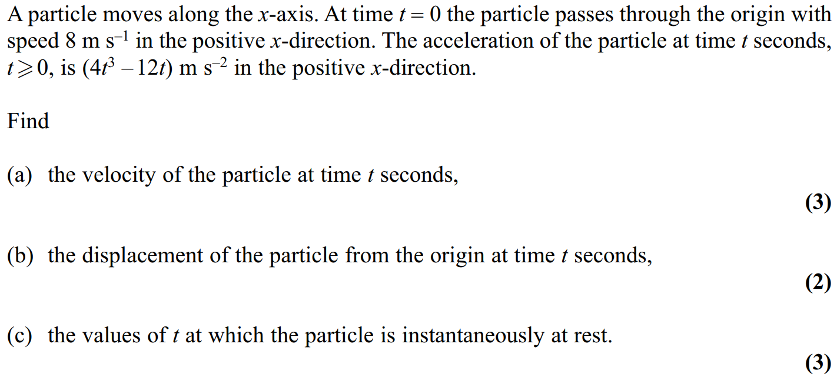
Jan 2011

Slide 38
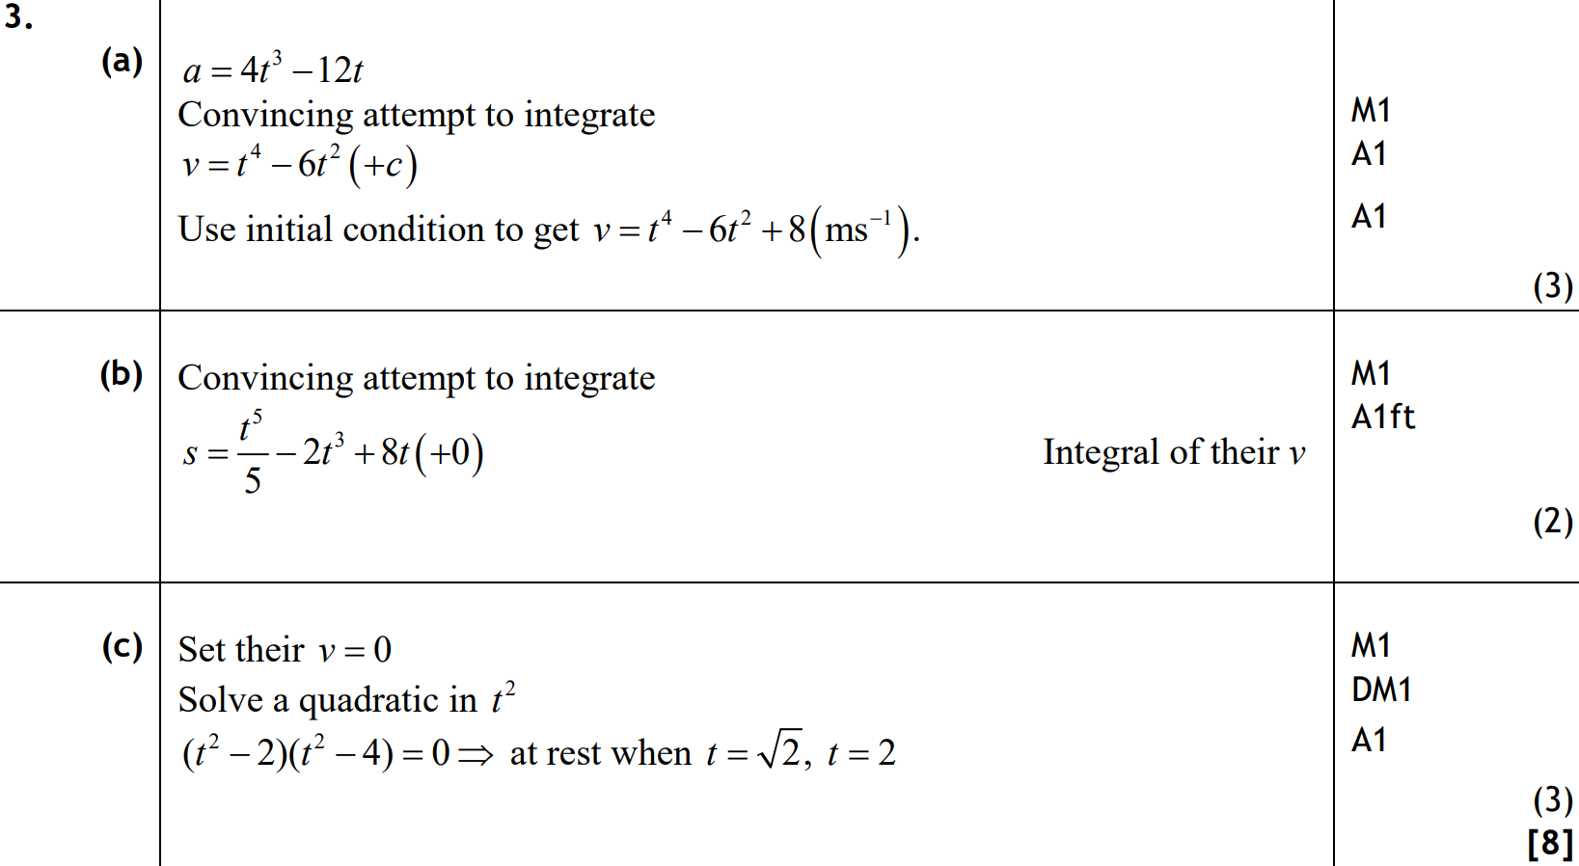
Jan 2011
A
B
C

Slide 39
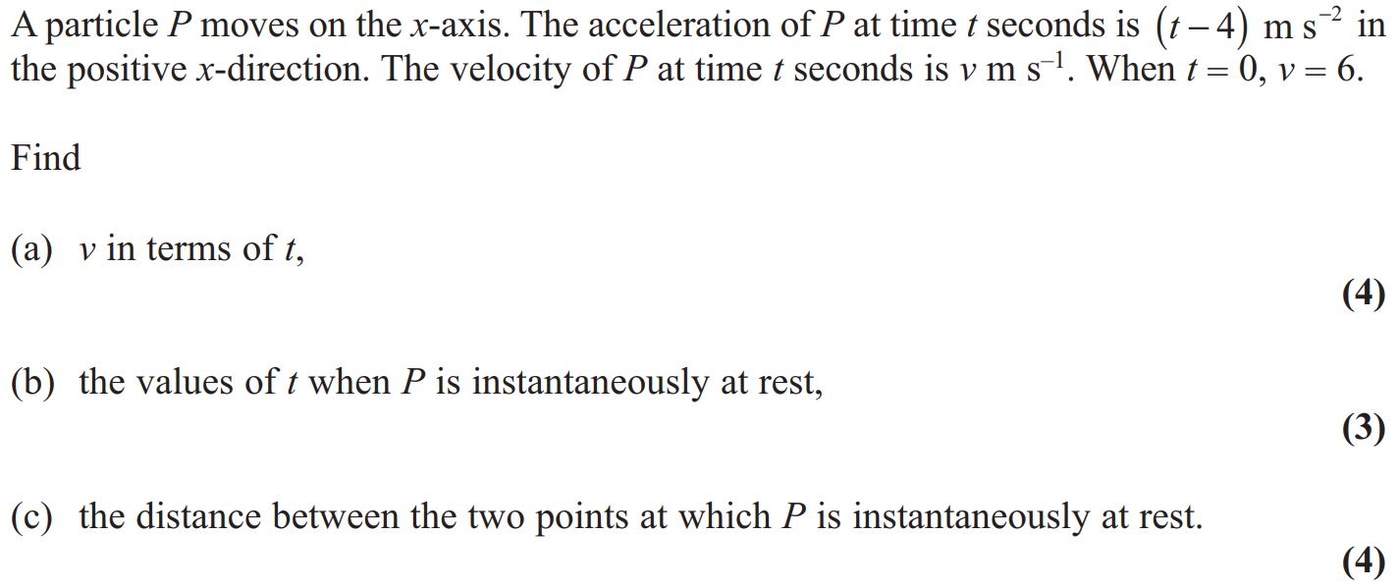
June 2011

Slide 40
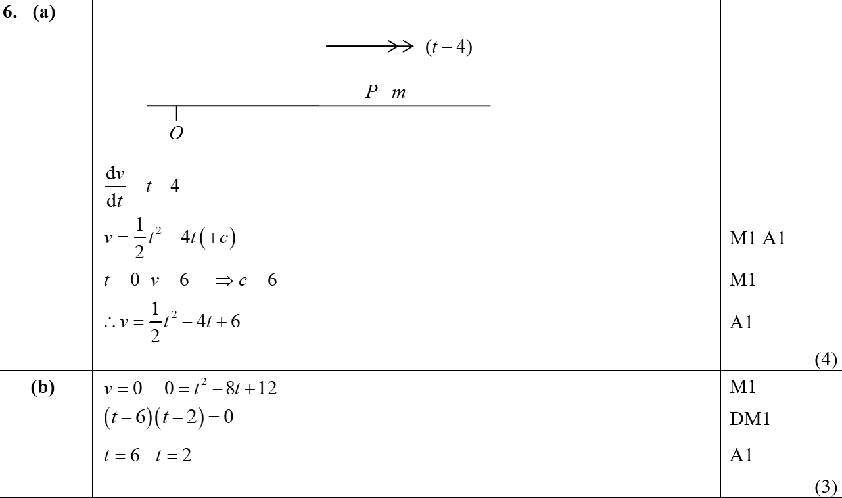
June 2011
A
B

Slide 41
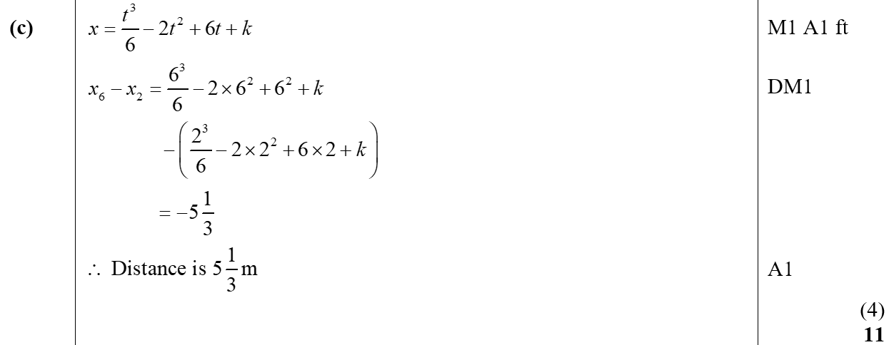
June 2011
C

Slide 42
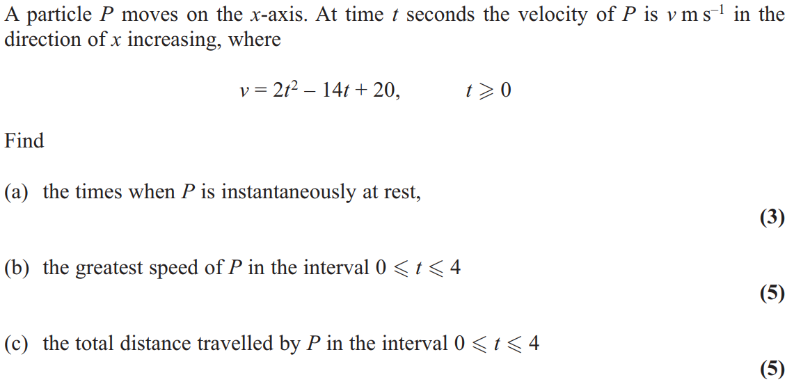
June 2013

Slide 43
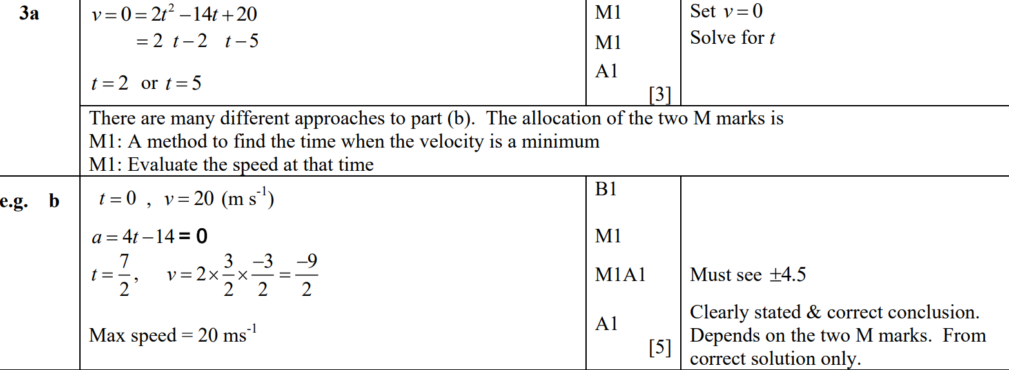
June 2013
A
B
B alternative 1

Slide 44
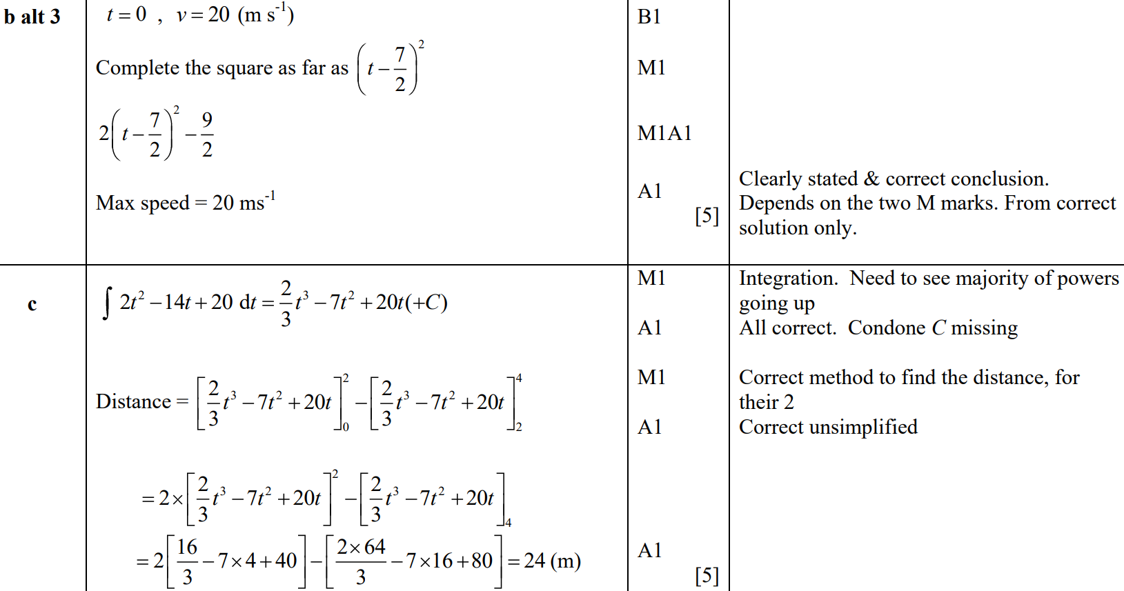
June 2013
B Alternative 2
B Alternative 3
C

Slide 45
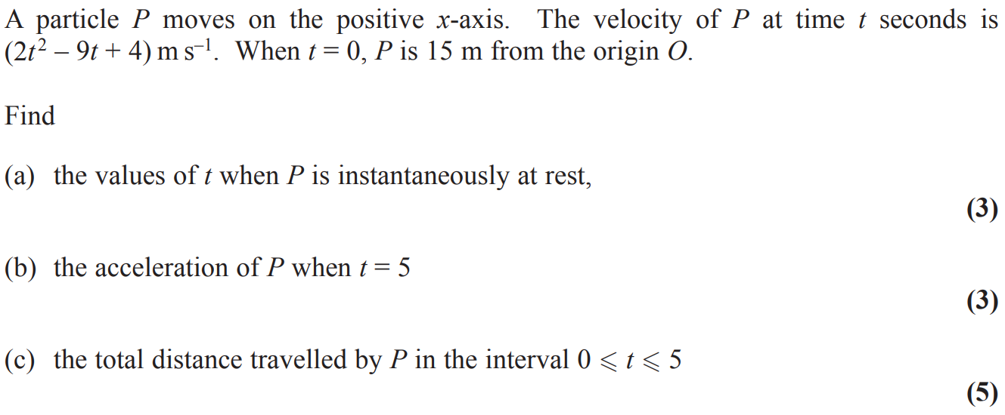
June 2015

Slide 46
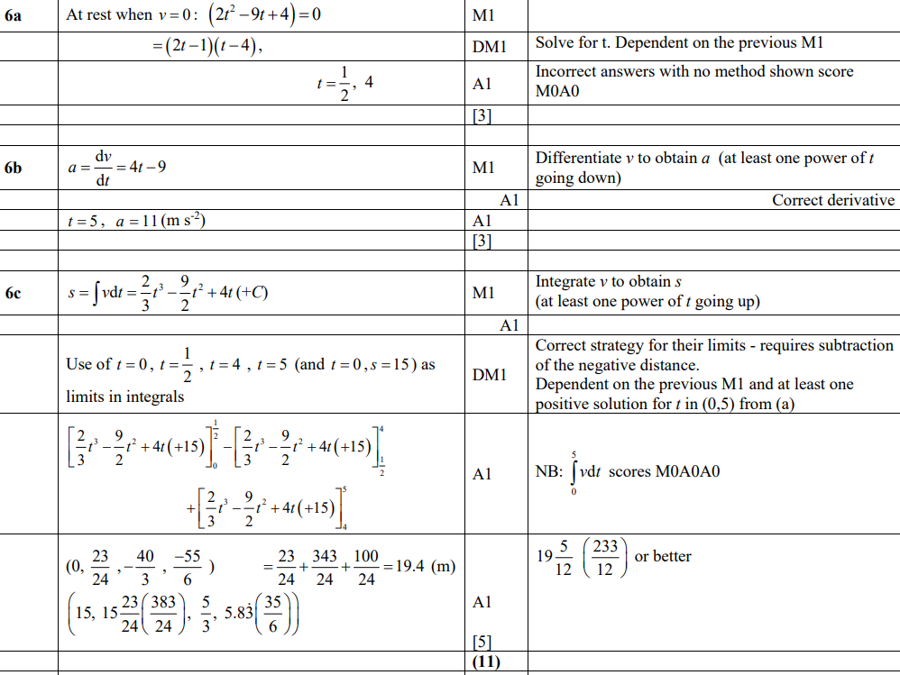
June 2015
A
B
C

Slide 47
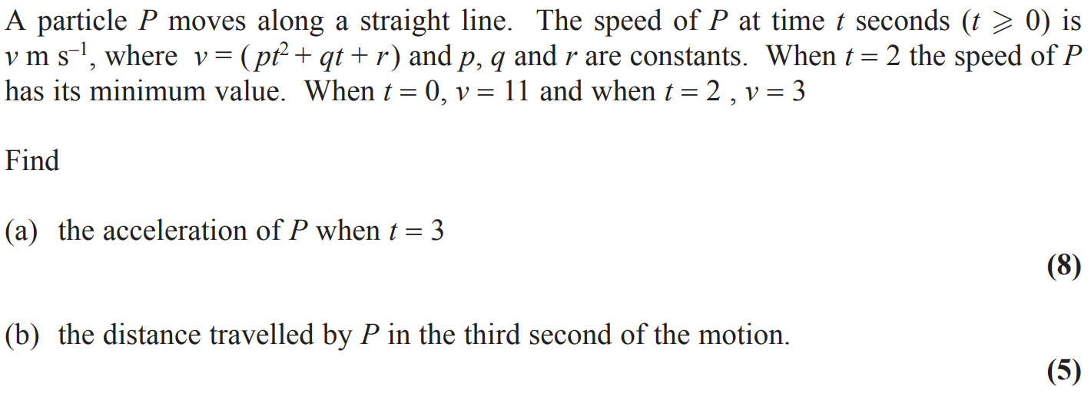
June 2016

Slide 48
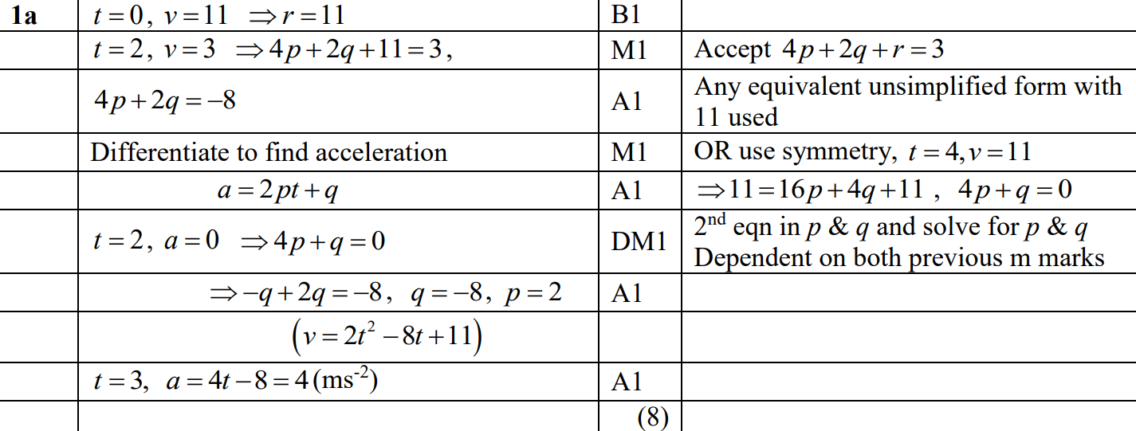
June 2016
A

Slide 49
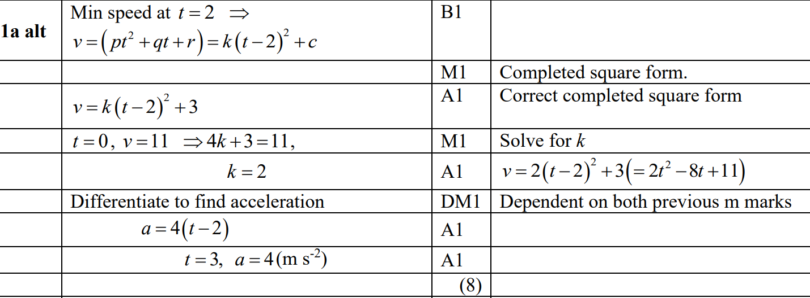
June 2016
A Alternative

Slide 50
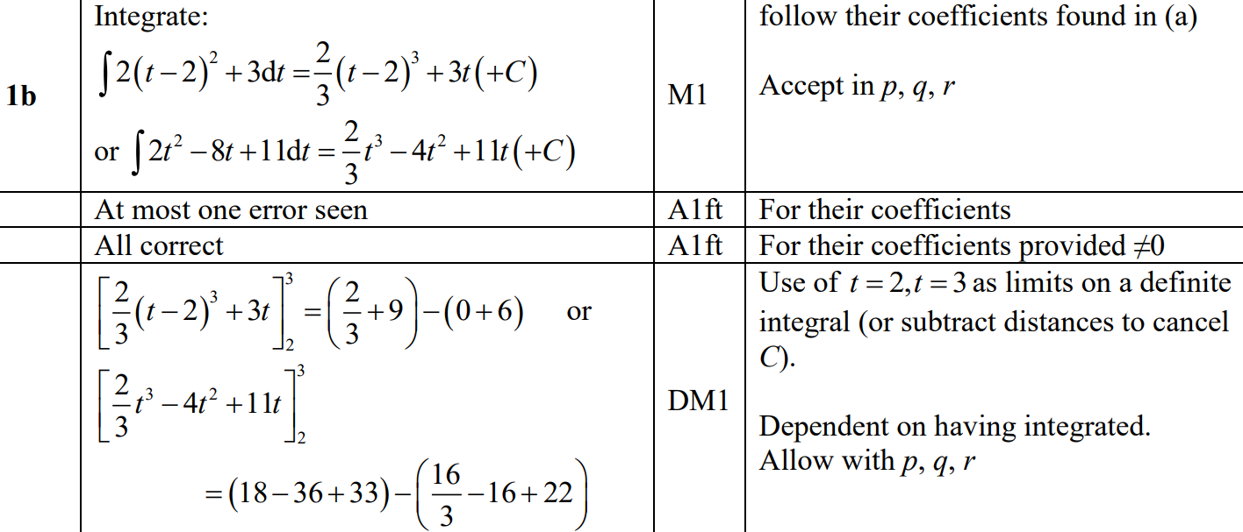
June 2016
B

Slide 51
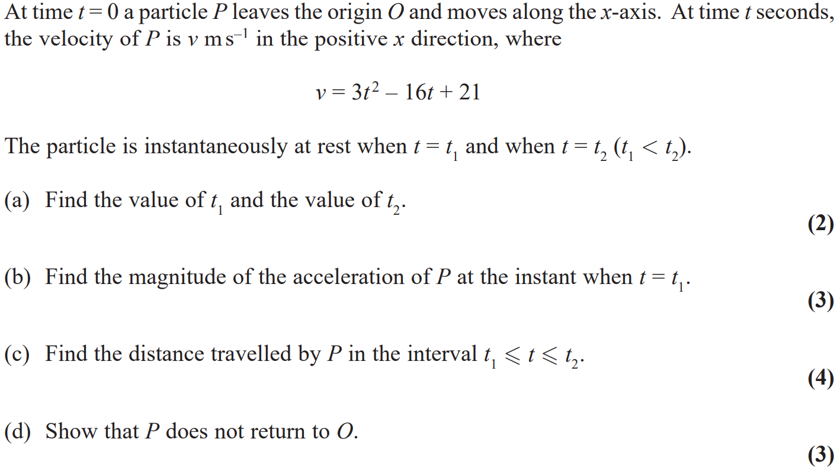
June 2017

Slide 52
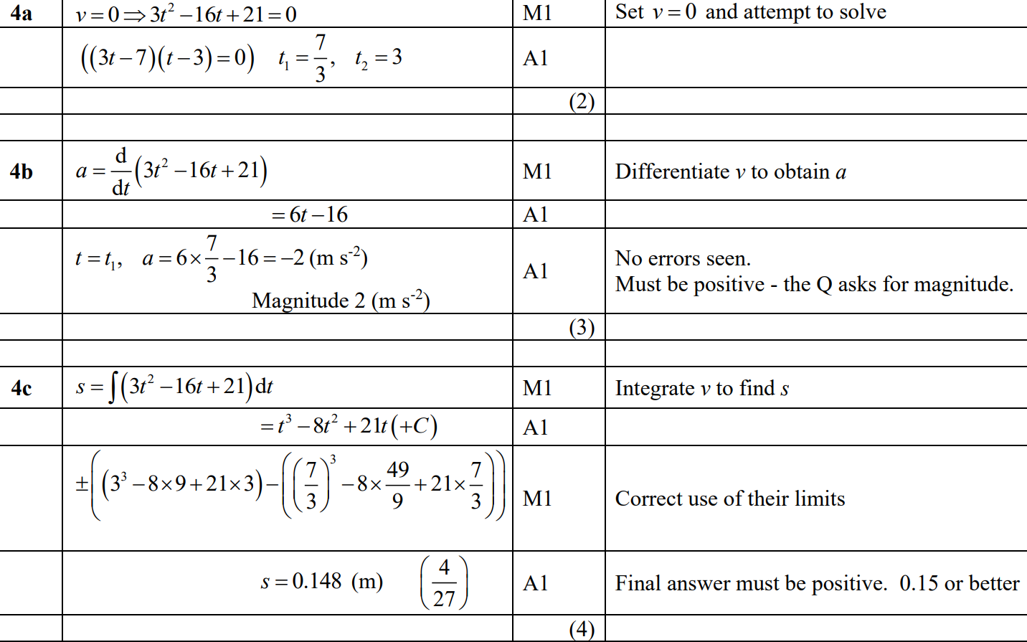
June 2017
A
B
C

Slide 53
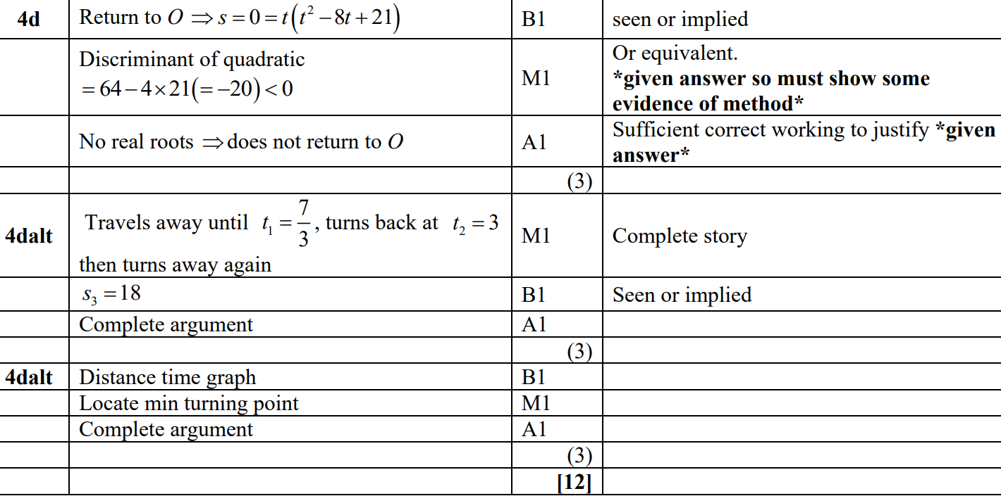
June 2017
D
D Alternative 1
D Alternative 2

