Slide 1
The Normal Distribution Quiz
Instructions: Write A,B,C or D on a mini whiteboard to illustrate which picture represents the given distribution

Slide 2
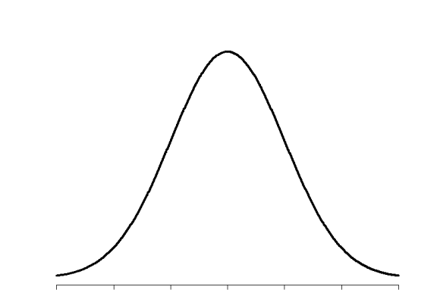
a
b
$$P\left(Z<−1.2\right)$$
d
c

Slide 3
a
b
d
c
$$P\left(Z>−0.5\right)$$

Slide 4
a
b
$$P\left(Z>1.1\right)$$
d
c

Slide 5
a
b
$$P\left(Z<0.3\right)$$
d
c

Slide 6
a
b
$$P\left(Z>−0.3\right)$$
d
c

Slide 7
a
b
$$P\left(Z<−0.9\right)$$
d
c

Slide 8
a
b
$$P\left(Z<1.1\right)$$
d
c

Slide 9
a
b
$$P\left(Z>0.01\right)$$
d
c

Slide 10
Comparing things from the real world

Slide 11
a
b
d
c
$$P\left(X<a\right)=0.34$$

Slide 12
a
b
d
c
$$P\left(X<a\right)=0.684$$

Slide 13
a
b
d
c
$$P\left(X>a\right)=0.399$$

Slide 14
a
b
d
c
$$P\left(X<a\right)=0.01$$

Slide 15
a
b
d
c
$$P\left(X>a\right)=0.824$$

Slide 16
a
b
d
c
$$P\left(X<a\right)=0.737$$

Slide 17
a
b
d
c
$$P\left(X>a\right)=0.519$$

Slide 18
a
b
d
c
$$P\left(X>a\right)=0.37$$

