Slide 1




Stats Past Paper Questions
Revision Past Paper Questions
Go back to home screen to select a topic
Go back to topic screen to select a question
Go to the mark scheme for that question
Go back to the question from the mark scheme
Or see more solutions
Or go back to first solutions
Next

Slide 2
Notes on operating this resource
When creating this, I used and to quickly navigate between slides directly before or after the slide in question.
As some mark schemes give additional notes, you can continue to see answers by clicking but you will not return to the original question with one click of .
To view the original question again, continue to click which should take you back.
Next

Slide 3
Notes on Edexcel Statistics Questions
The statistics course is split into probability related topics (tree and Venn diagrams, DRV’s and the binomial distribution) and those handling data.
For ease of use, the probability tab only deals with problems involving tree or Venn diagrams.
There are normally a few questions on handling and representing data from a variety of topics including scatter diagrams, histograms, boxplots, sampling methods and measures of dispersion and variation.
These may include data from the large data set and have been labelled to help highlight questions of a particular topic, (except questions with histograms and box plots to prevent too many labels).
As well as the practice papers, I have attached the Sample Assessment Materials and Specimen papers
Edexcel have provided ‘student-friendly’ mark schemes to help explain where marks are awarded along with expected student solutions. These have been attached where possible in addition to the official mark scheme and labelled SF
Next

Slide 4
Home
Data Processing
Binomial Distribution
DRVs
Probability

Slide 5
New Spec Q’s
note. ignore all E(X) and Var(X) questions
Old Spec Probability Distributions
Jan 2007
May 2012
Jan 2008
Jan 2013
Jan 2010
May 2014
May 2011
June 2015
Jan 2012

Slide 6
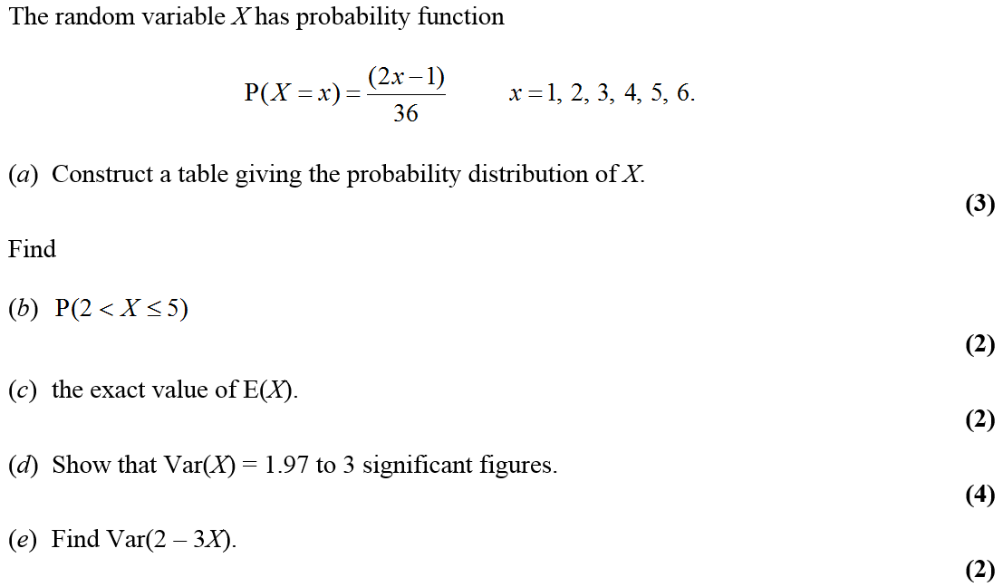
Jan 2007

Slide 7
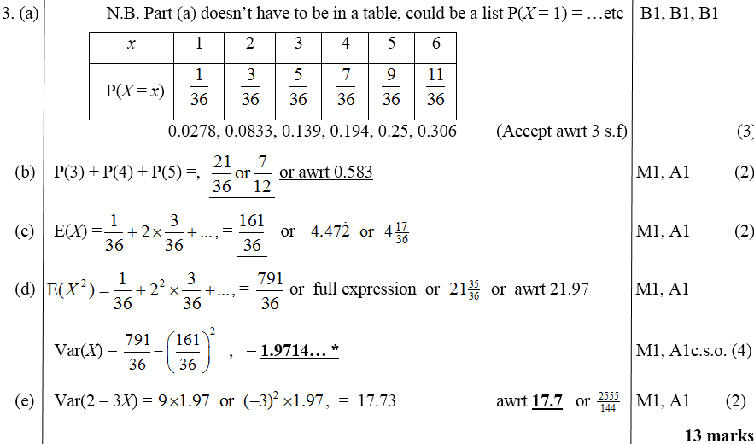
Jan 2007
A
B
C
D
E

Slide 8
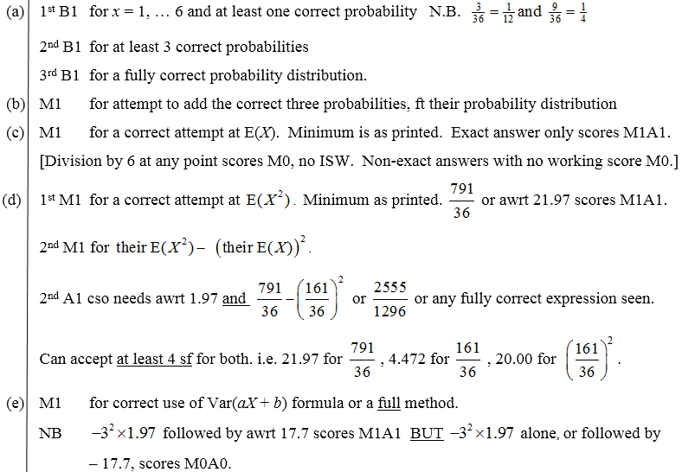
Jan 2007
A
B
C
D
E

Slide 9
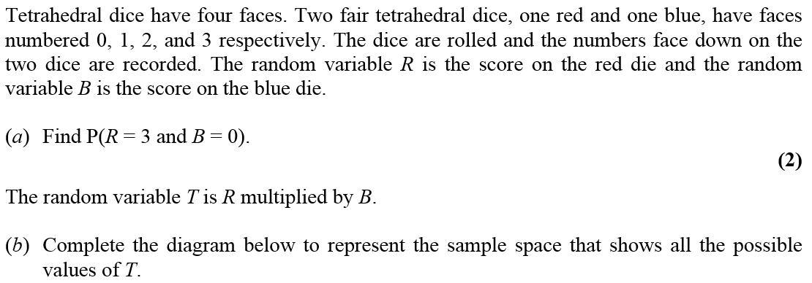
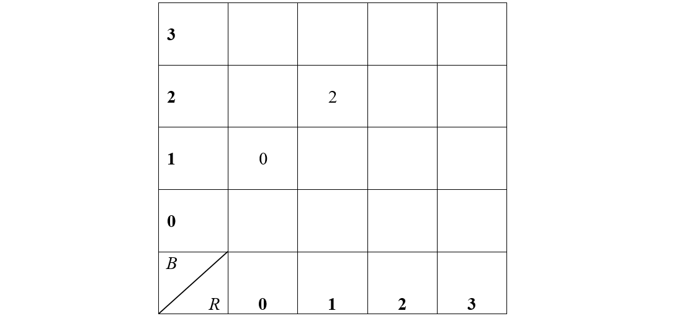
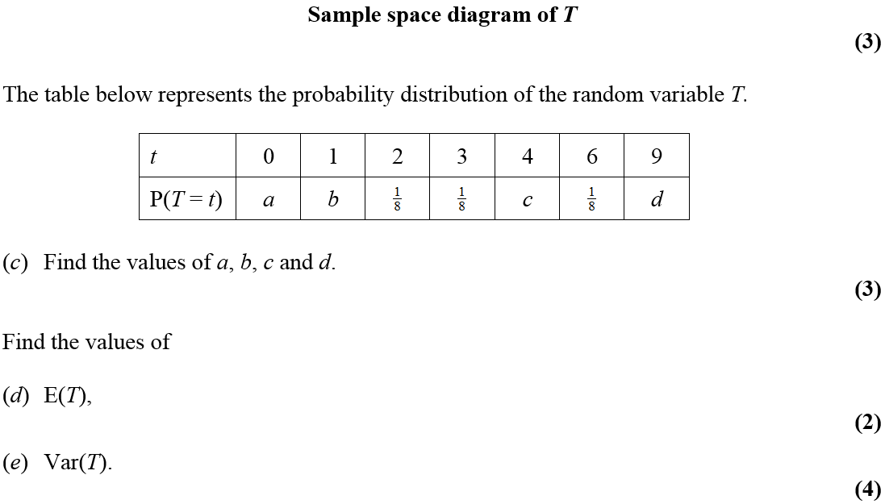
Jan 2008

Slide 10
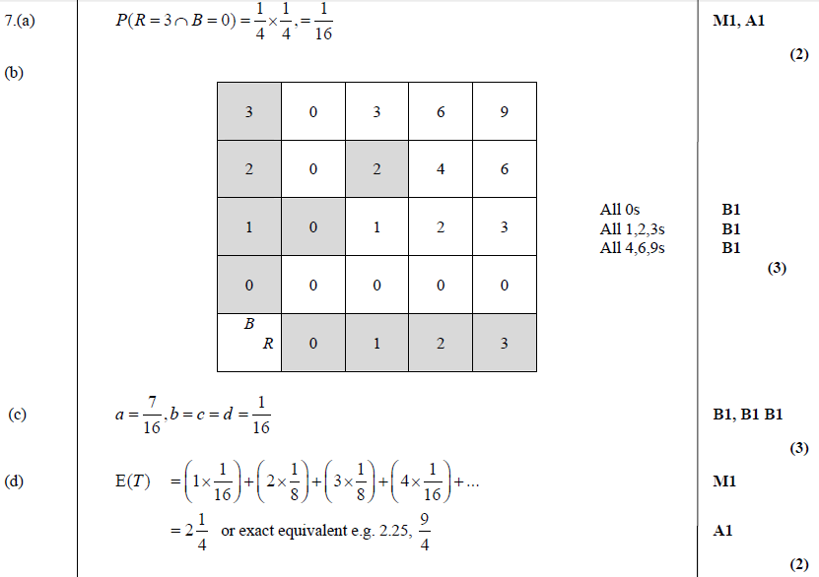
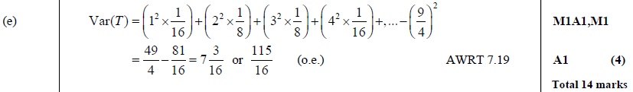
A
Jan 2008
B
C
D
E

Slide 11
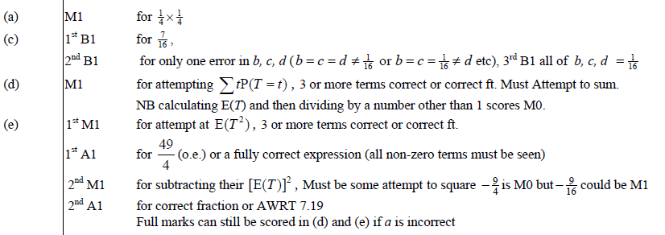
Jan 2008
A
C
D
E

Slide 12
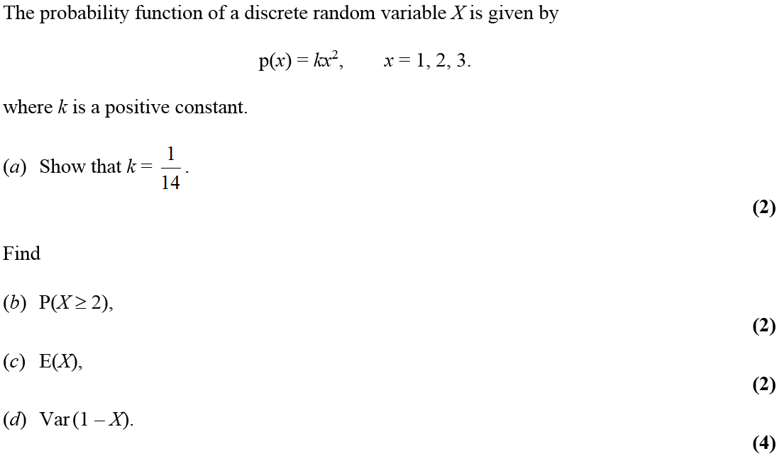
Jan 2010

Slide 13
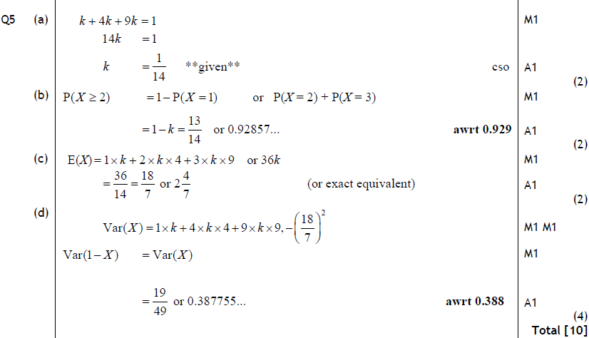
Jan 2010
A
B
C
D

Slide 14
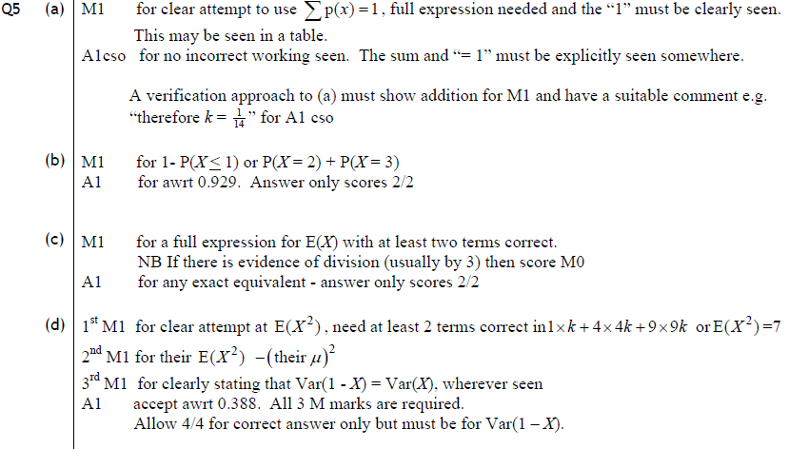
Jan 2010
A
B
C
D

Slide 15
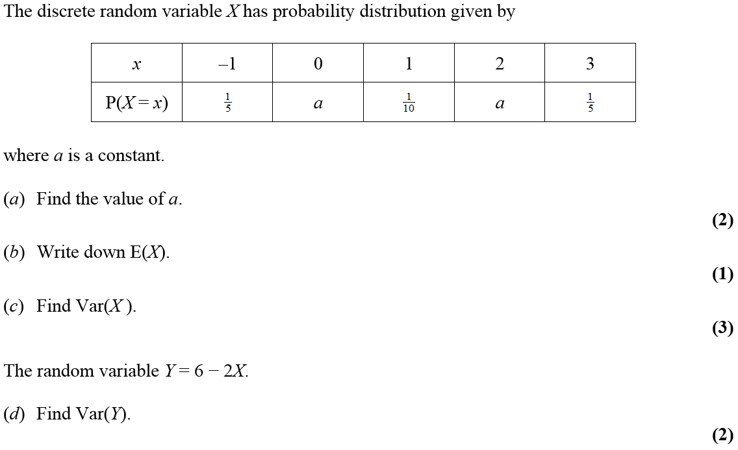
May 2010

Slide 16
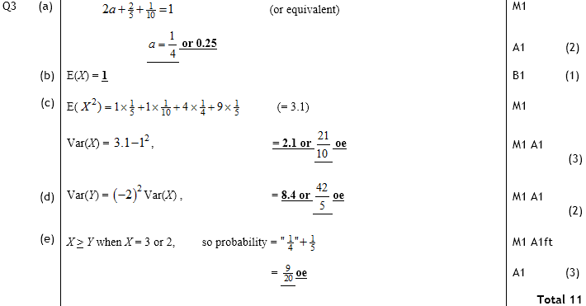
May 2010
A
B
C
D
E

Slide 17
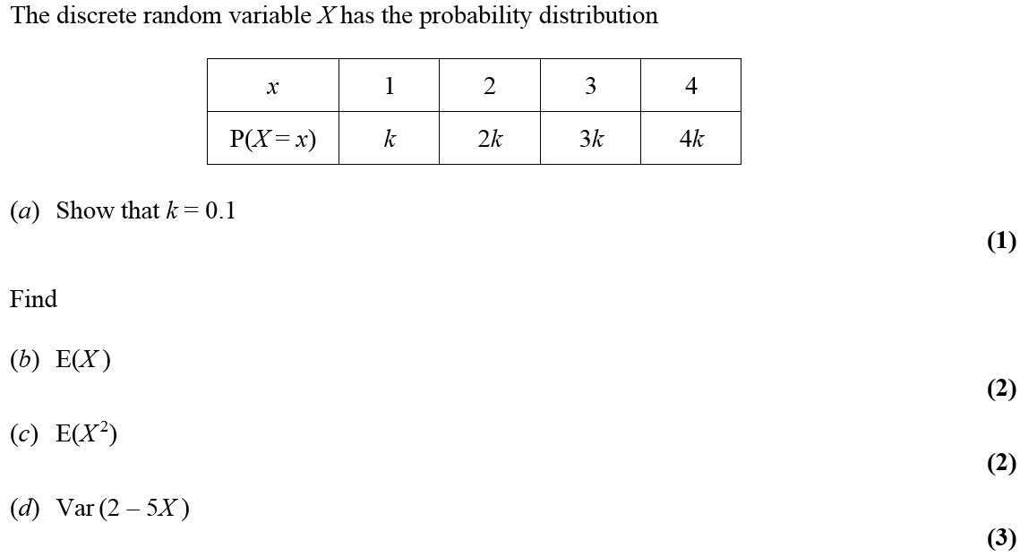
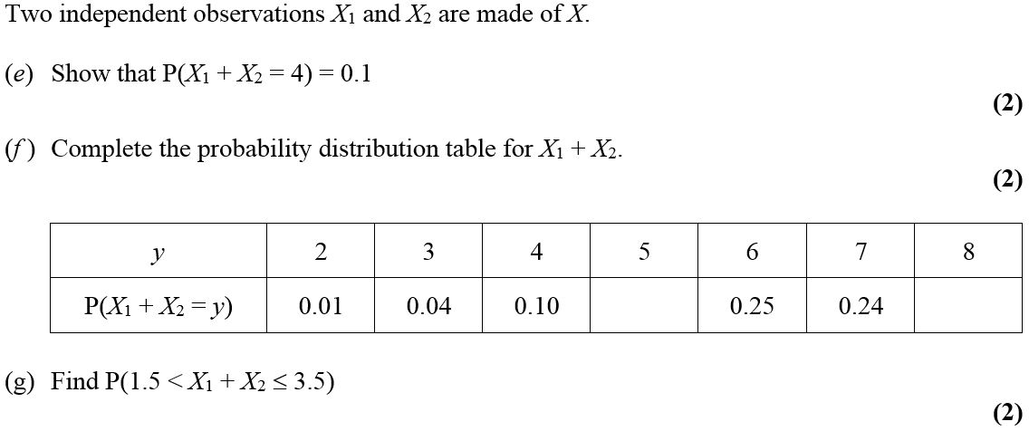
Jan 2011

Slide 18
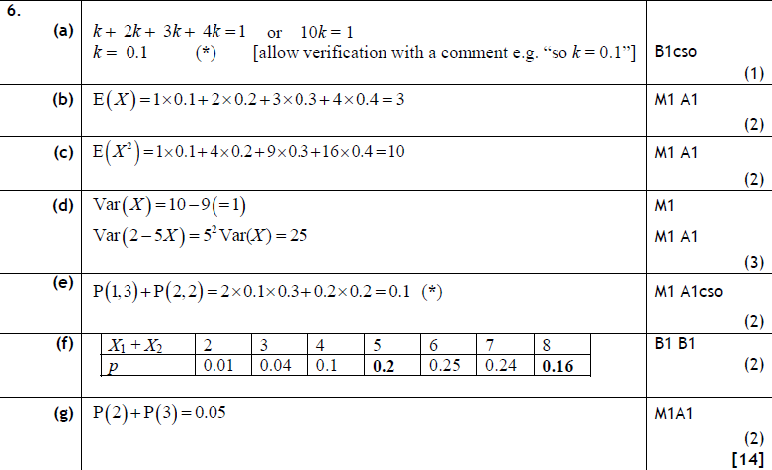
Jan 2011
A
B
C
D
E
F
G

Slide 19
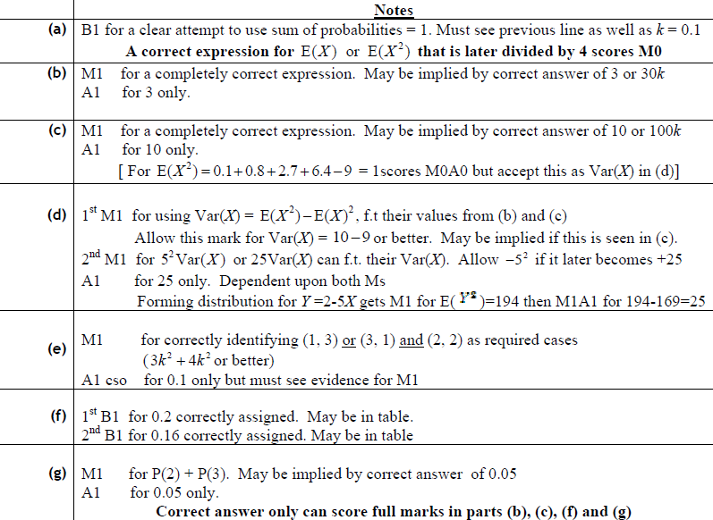
Jan 2011
A
B
C
D
E
F
G

Slide 20
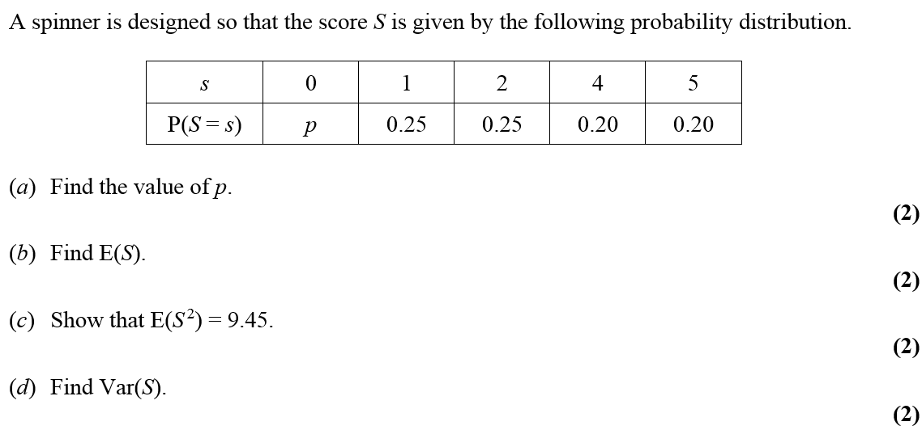
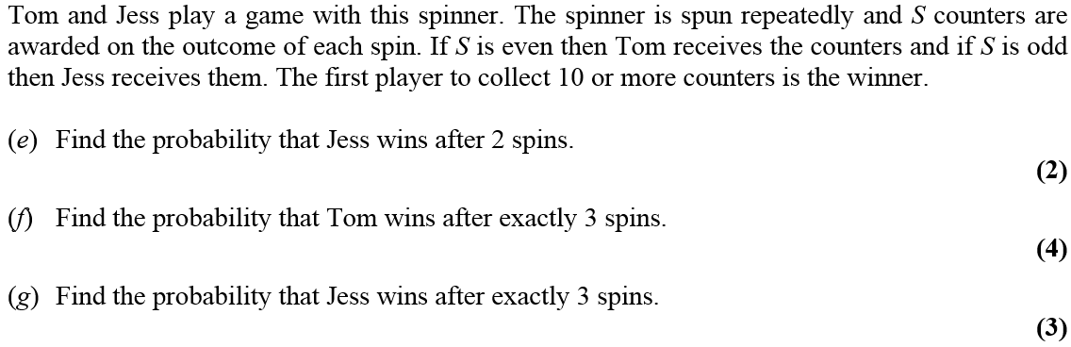
May 2011

Slide 21
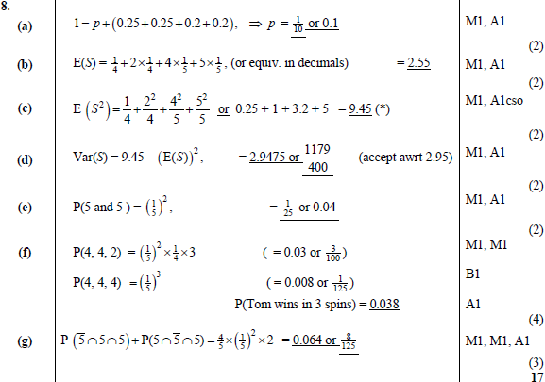
A
May 2011
B
C
D
E
F
G

Slide 22
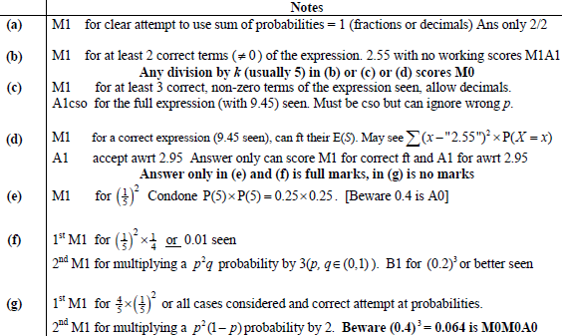
May 2011
A
B
C
D
E
F
G

Slide 23
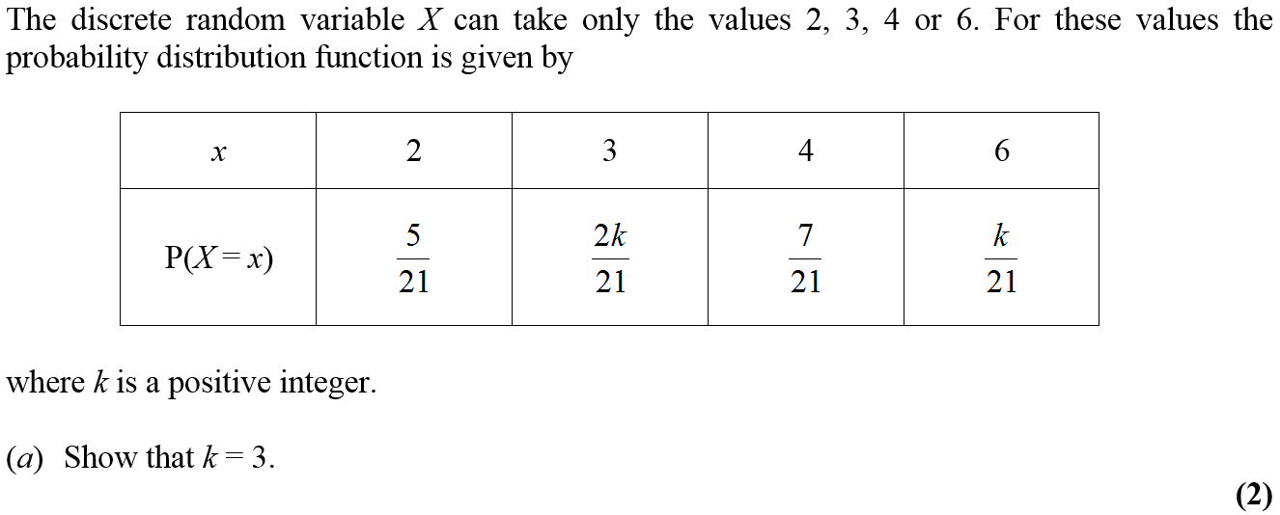
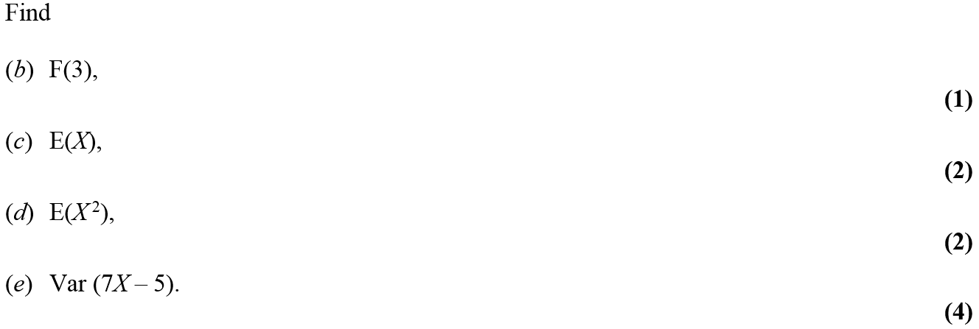
Jan 2012

Slide 24
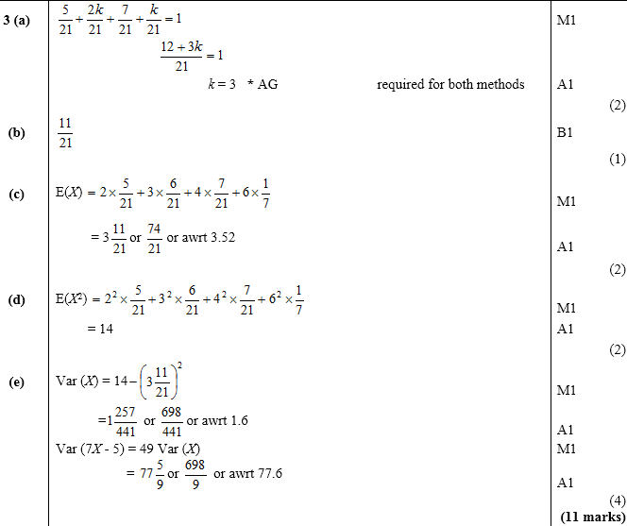
A
Jan 2012
B
C
D
E

Slide 25
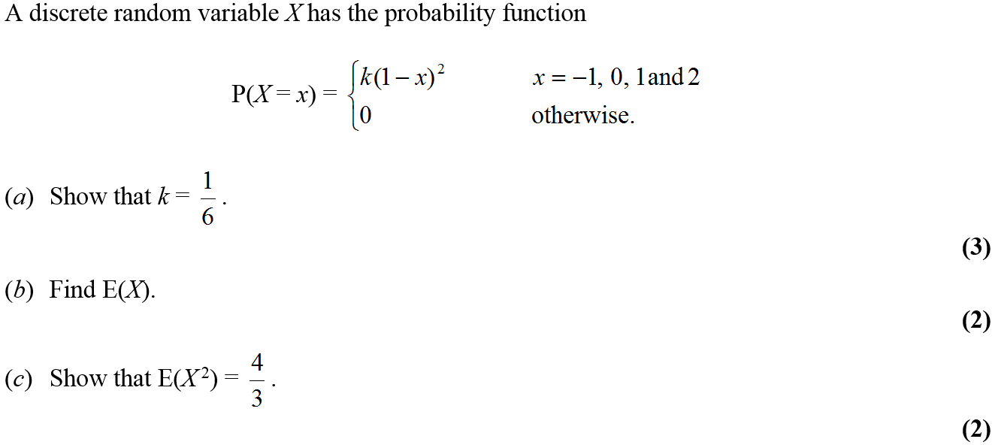
May 2012

Slide 26
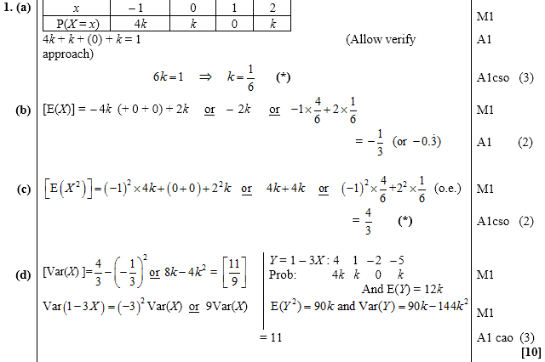
May 2012
A
B
C
D

Slide 27
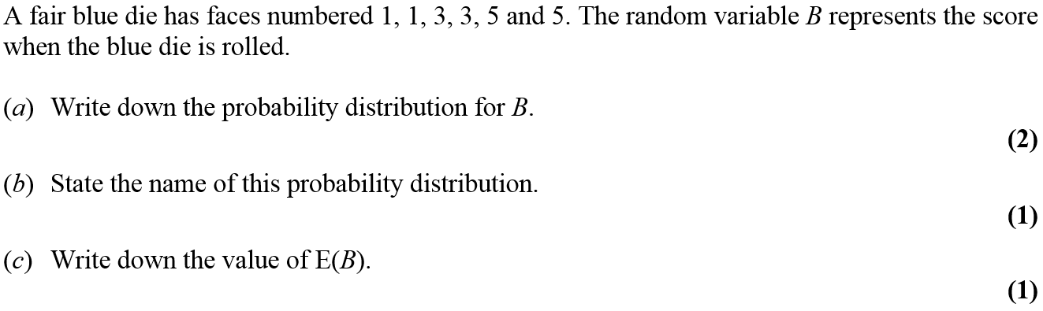
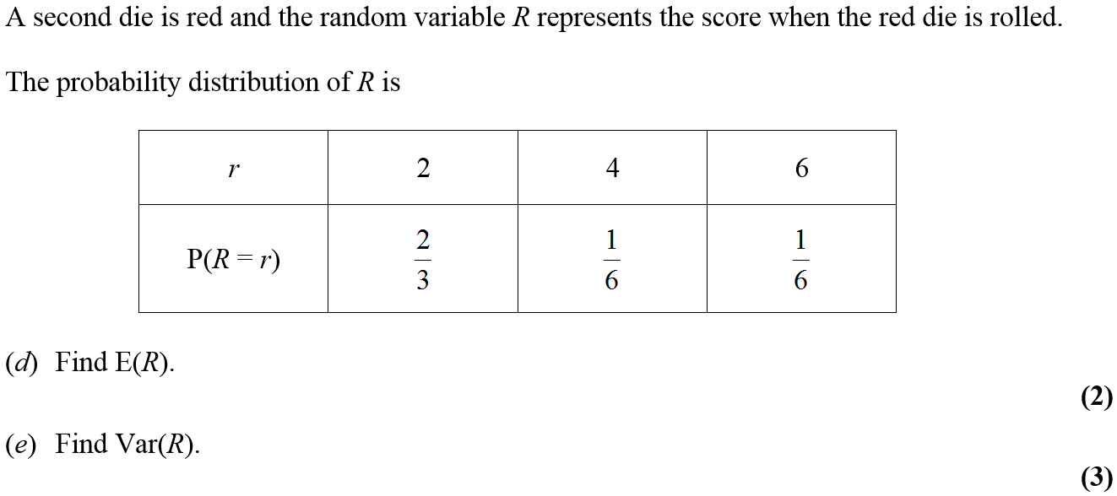
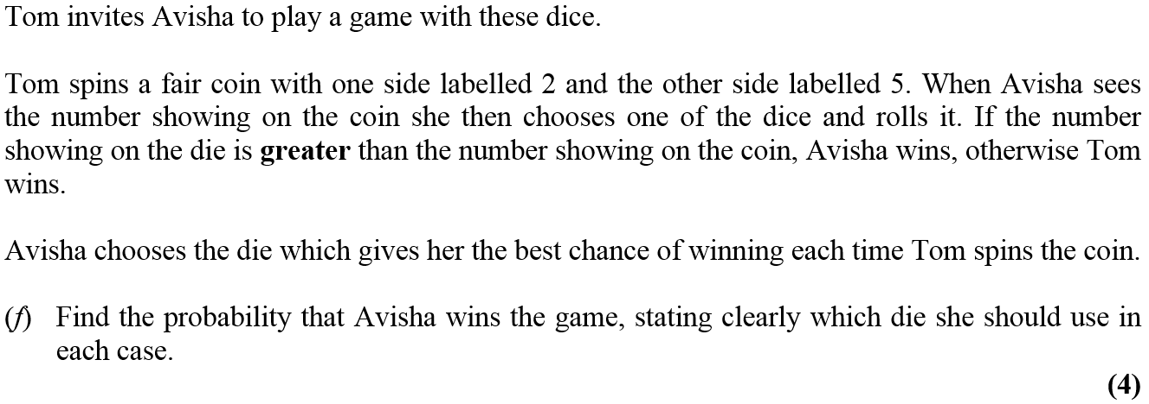
Jan 2013

Slide 28
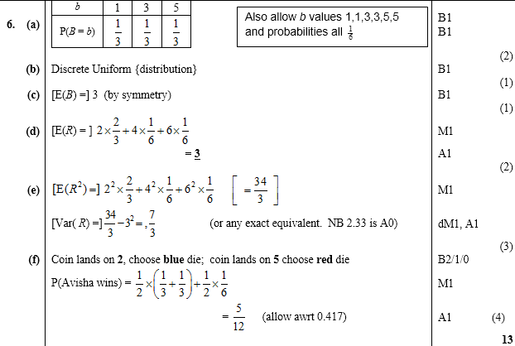
Jan 2013
A
B
C
D
E
F

Slide 29
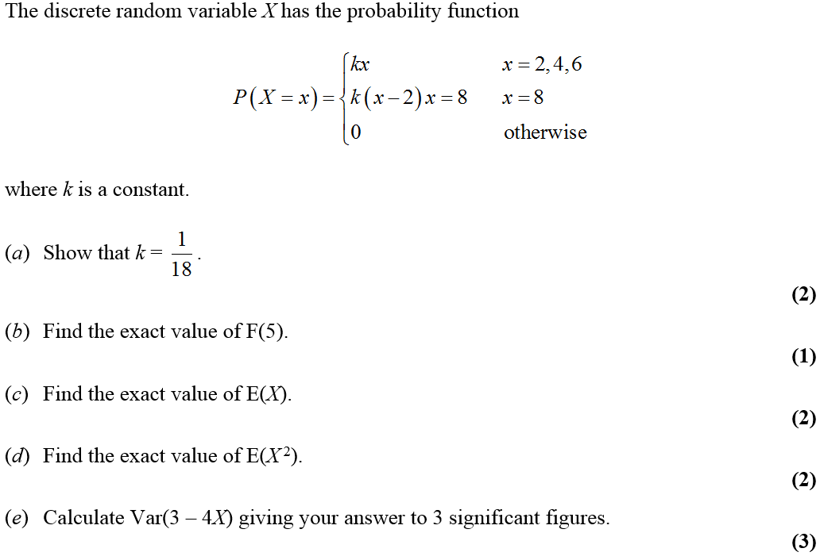
May 2014

Slide 30
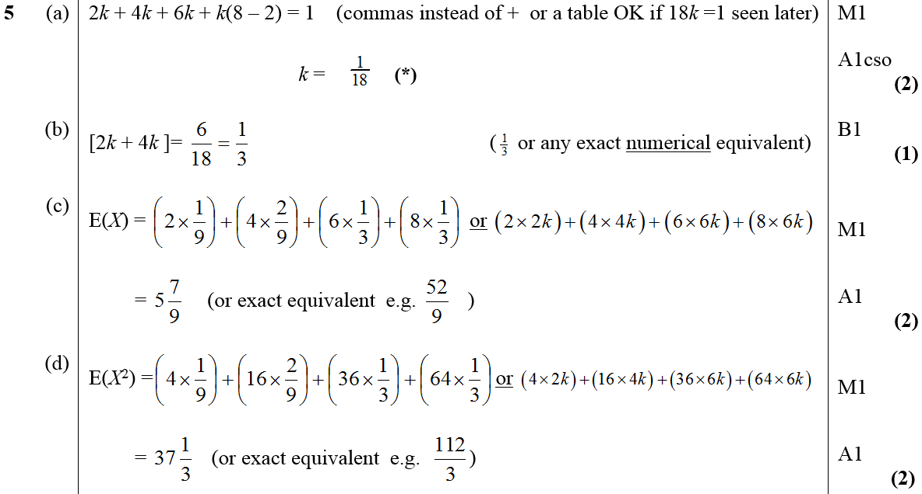
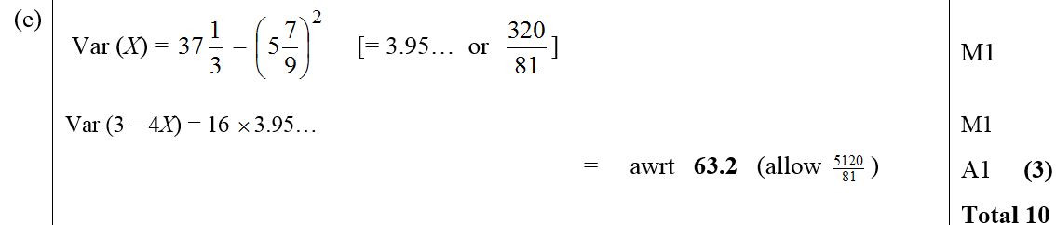
May 2014
A
B
C
D
E

Slide 31
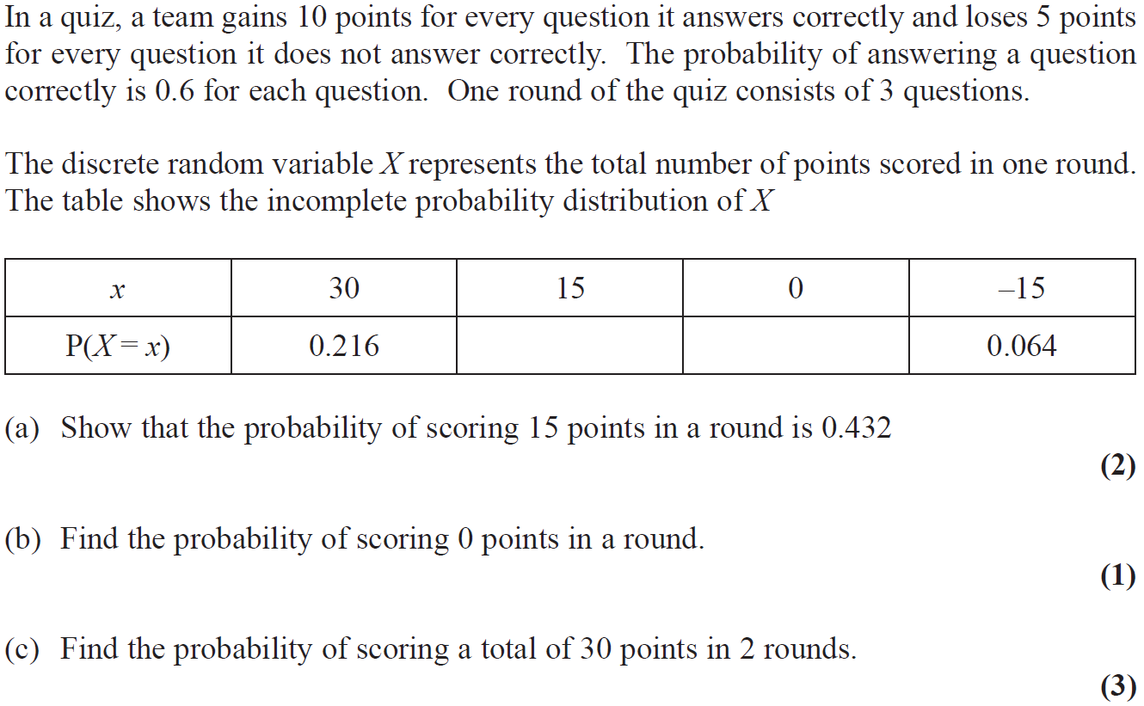
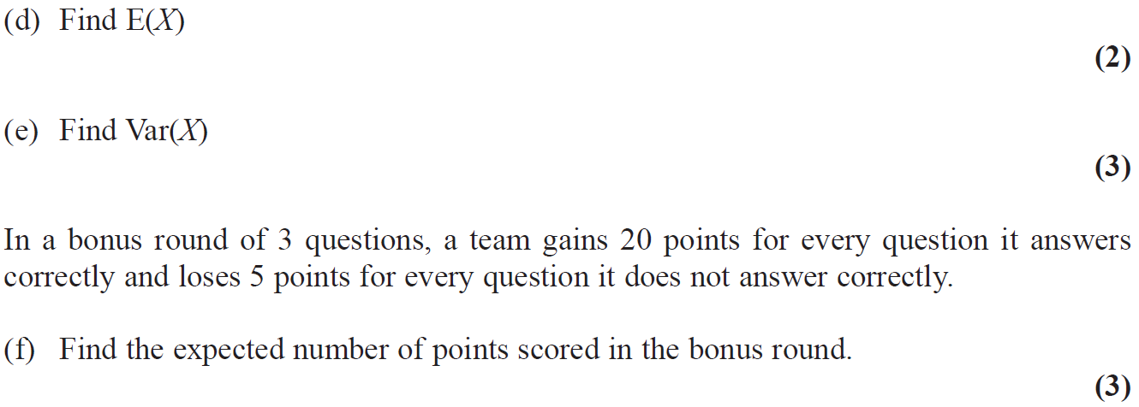
June 2015

Slide 32
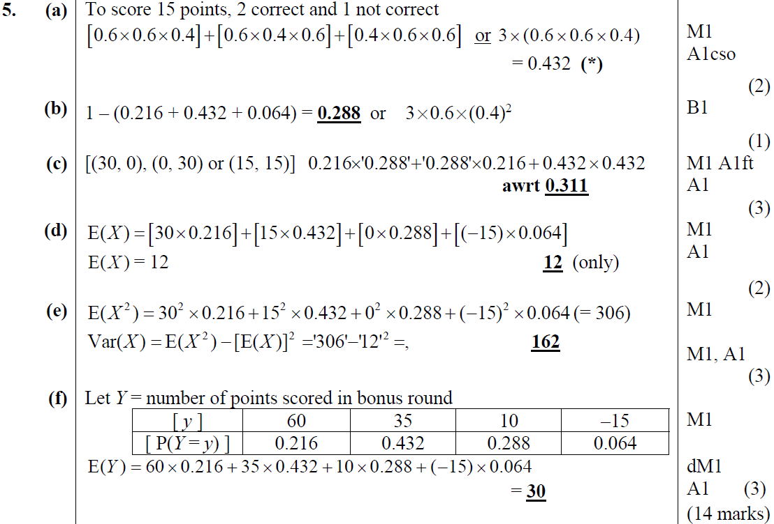
June 2015
A
B
C
D
E
F

Slide 33
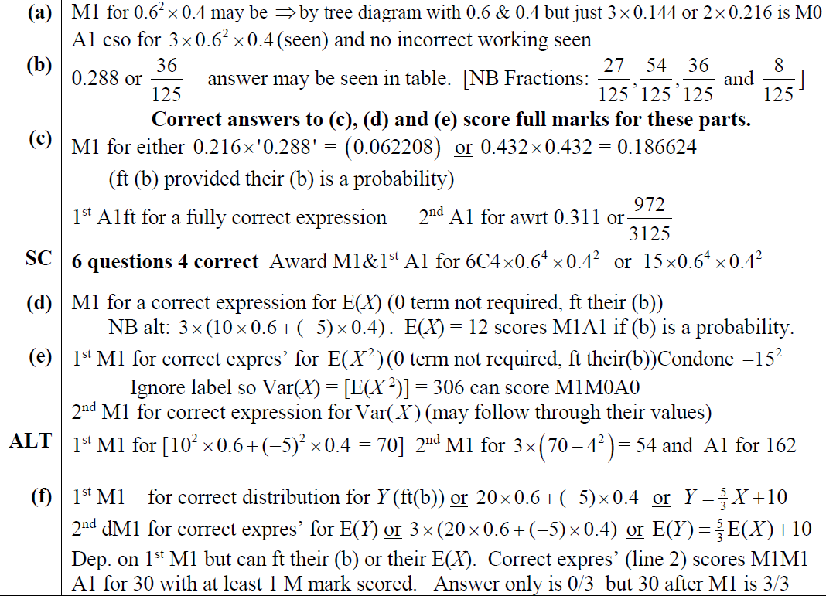
June 2015
A notes
B notes
C notes
D notes
E notes
F notes

Slide 34
Old Spec Q’s
Discrete Random Variables
Practice G
Practice J
2018 Binomial

Slide 35
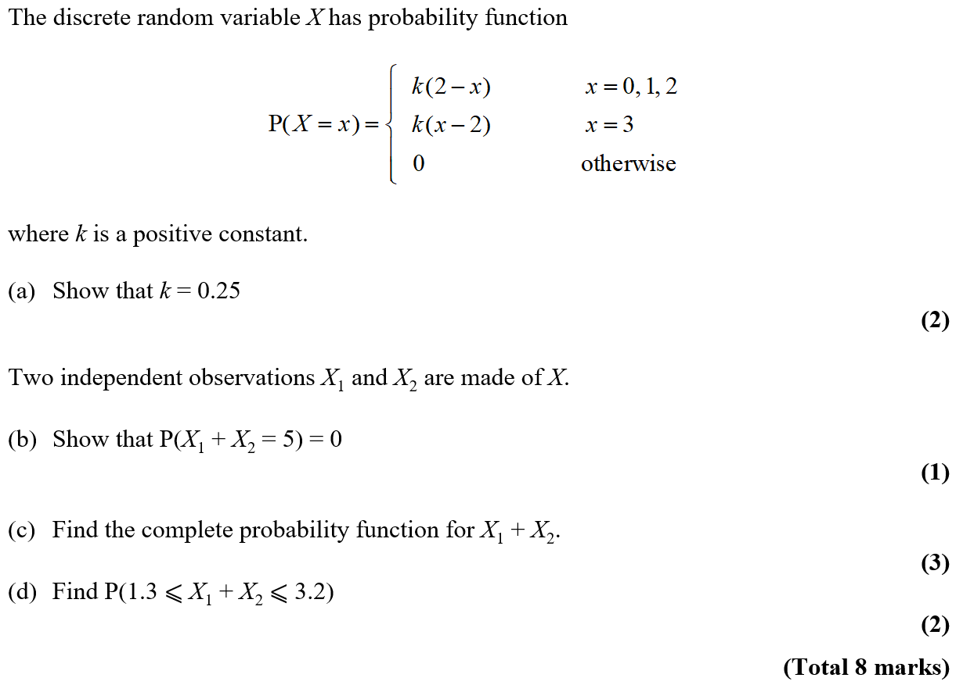
Practice G

Slide 36
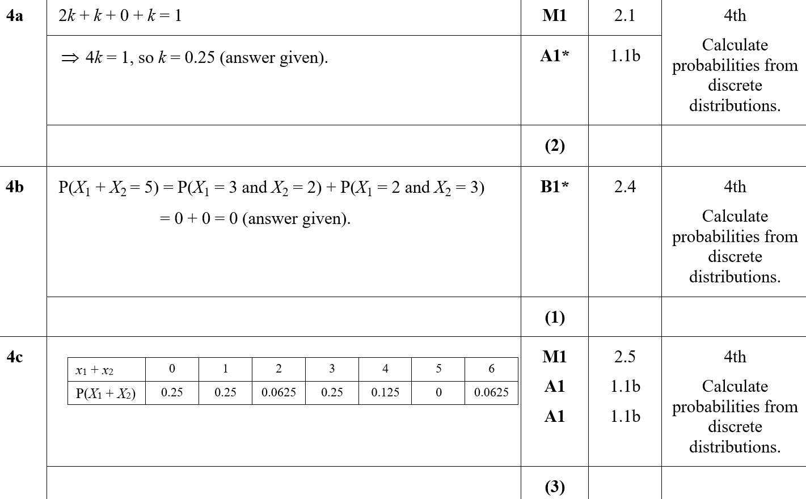
Practice G
A
B
C

Slide 37
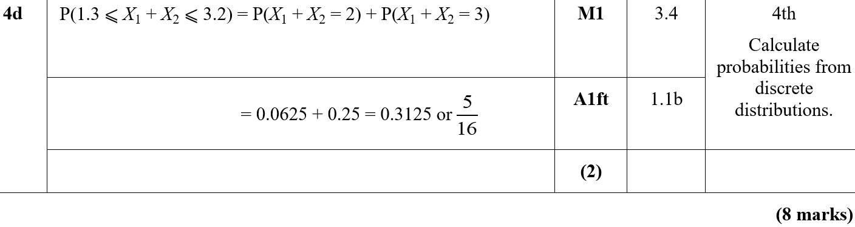
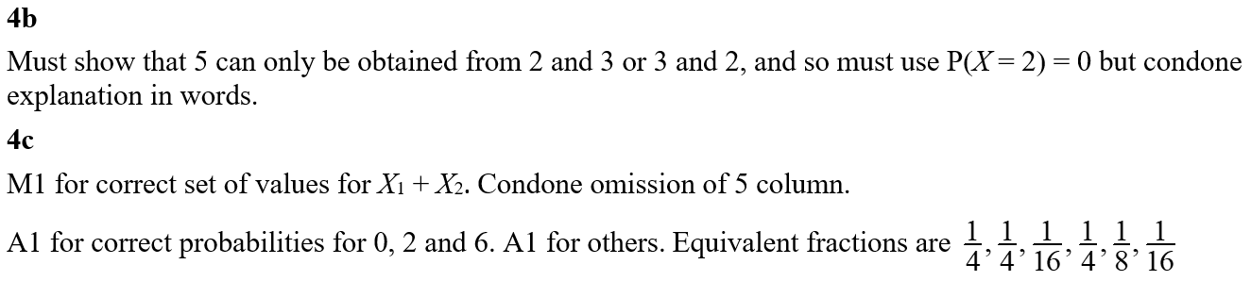
Practice G
D
B notes
C notes

Slide 38
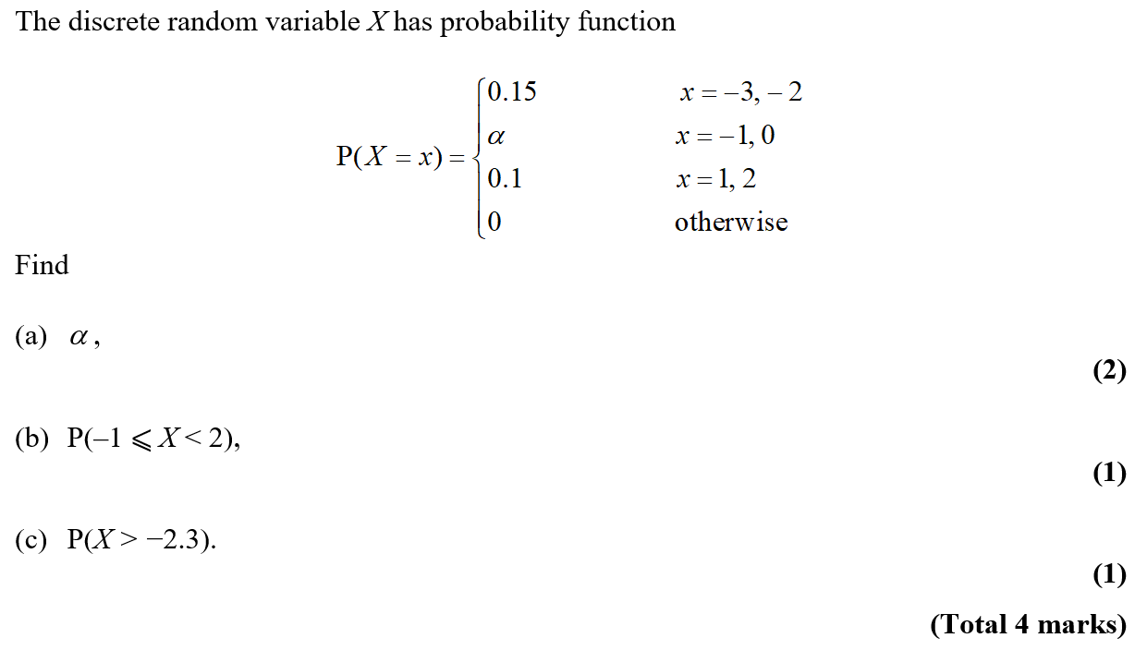
Practice J

Slide 39
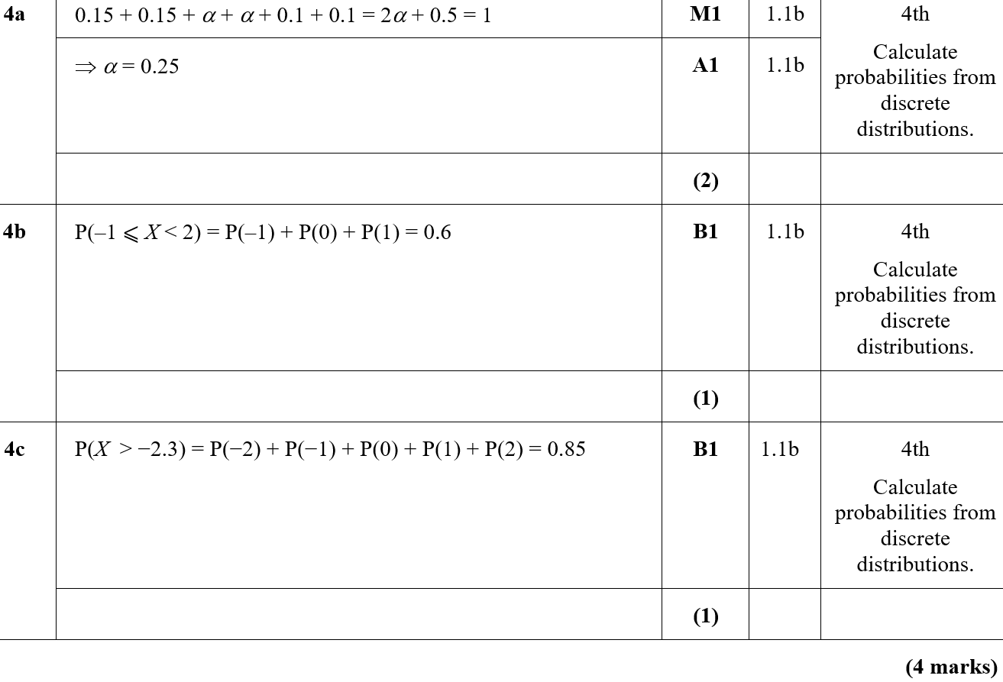
Practice Paper I
A
B
C

Slide 40
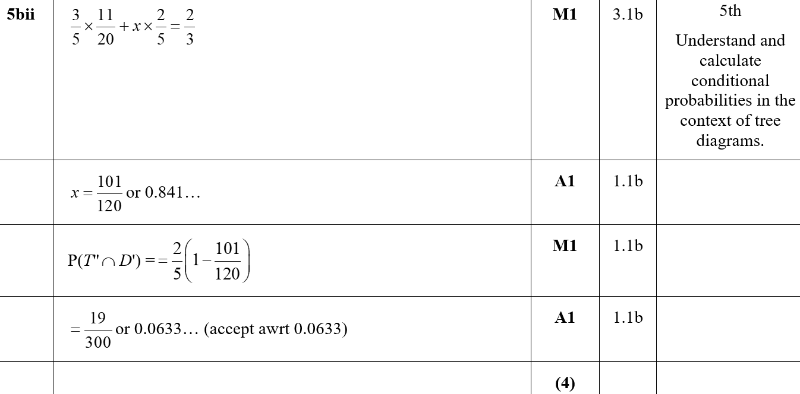
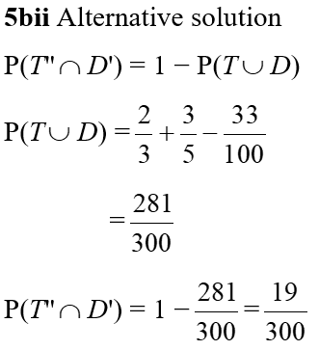
Practice Paper I
B (ii)
B (ii) (Alternative)

Slide 41
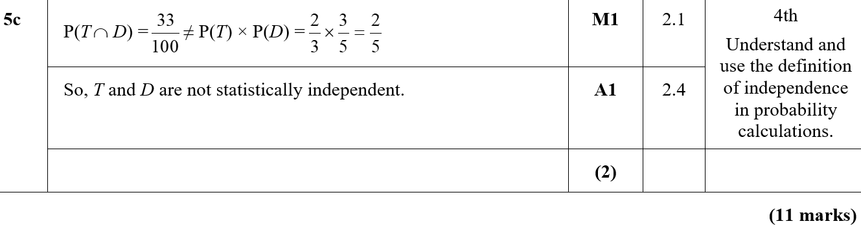
Practice Paper I
C

Slide 42
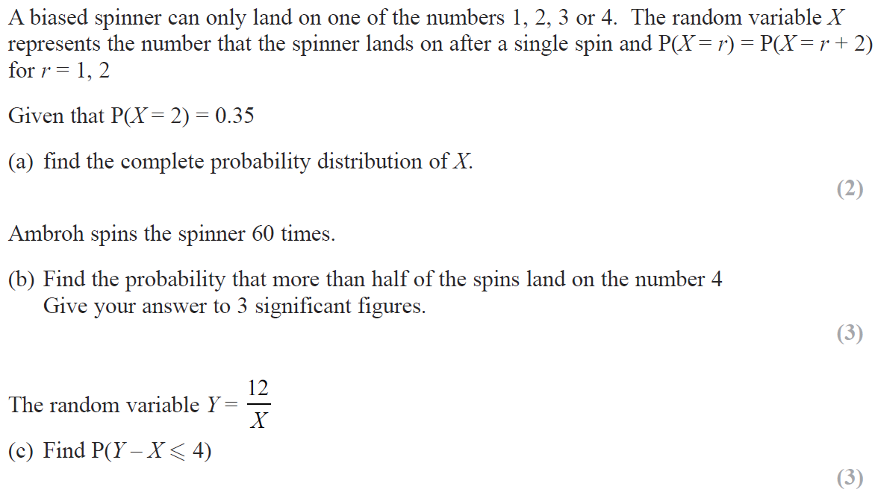
2018

Slide 43
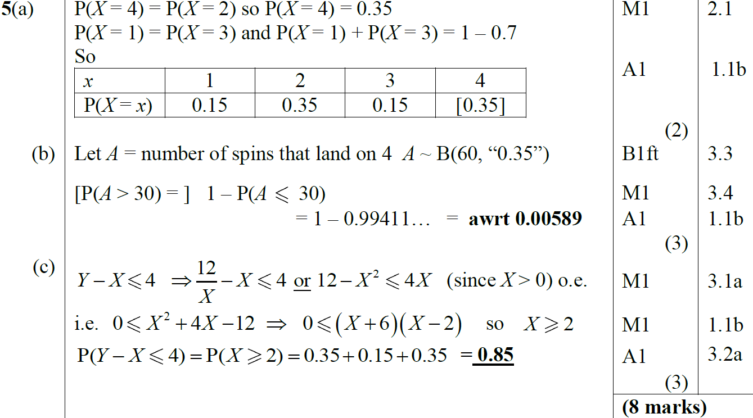
2018
A
B
C

Slide 44
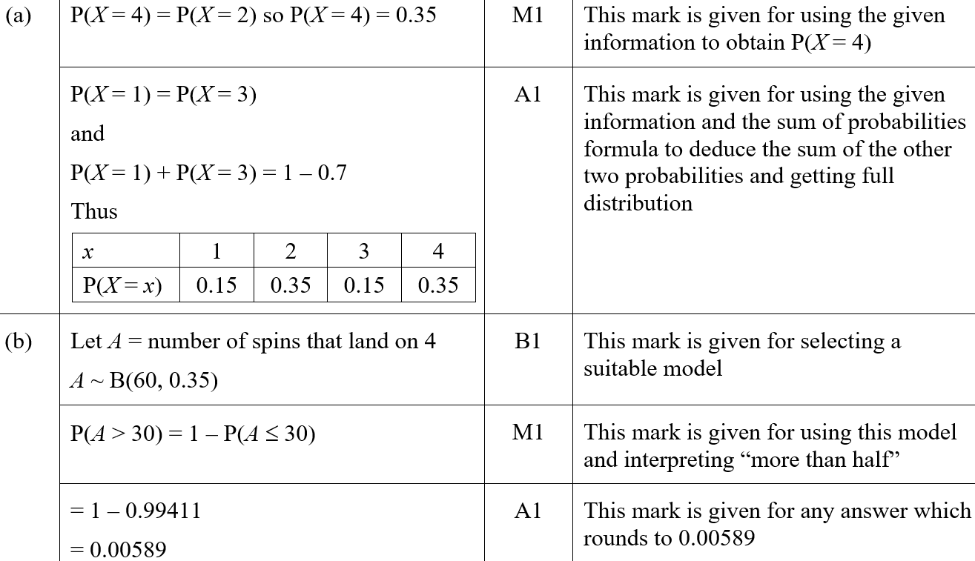
2018
A (SF)
B (SF)

Slide 45


2018
C (SF)
A notes

Slide 46

2018
B notes
C notes

Slide 47
New Spec Q’s
*Poisson Distribution not on new spec
Old Spec Binomial Distribution
Jan 2006 (i)
June 2007 (iii)
Jan 2010 (i)
Jan 2012 (i)
June 2014
Jan 2006 (ii)
Jan 2008 (i)
Jan 2010 (ii)
Jan 2012 (ii)
June 2015
May 2006 (i)*
Jan 2008 (ii)
May 2010 (i)*
May 2012 (i)
June 2016
May 2006 (ii)
May 2008 (i)*
May 2010 (ii)
May 2012 (ii)*
June 2017 (i)
Jan 2007 (i)*
May 2008 (ii)
Jan 2011 (i)*
May 2012 (iii)
June 2017 (ii)
Jan 2007 (ii)*
Jan 2009 (i)
Jan 2011 (ii)
Jan 2013 (i)
June 2018 (i)
Jan 2007 (iii)*
Jan 2009 (ii)*
May 2011 (i)
Jan 2013 (ii)
June 2018 (ii)
June 2007 (i)*
May 2009 (i)*
May 2011 (ii)
May 2013 (i)
June 2007 (ii)
May 2009 (ii)
May 2011 (iii)*
May 2013 (ii)*

Slide 48

Jan 2006

Slide 49

Jan 2006
A
B
C

Slide 50

Jan 2006
C Alternative
A notes

Slide 51

Jan 2006

Slide 52

Jan 2006
A (i)
A (ii)

Slide 53

Jan 2006
B

Slide 54


Jan 2006
C
A reduced marks for 1 tailed approach

Slide 55

Jan 2006
B marks for 1 tailed approach
C marks for 1 tailed approach

Slide 56

May 2006

Slide 57

May 2006
A
B
C (i)
C (ii)

Slide 58

May 2006

Slide 59

May 2006
A
B
C

Slide 60

Jan 2007

Slide 61

Jan 2007
A
B

Slide 62

Jan 2007

Slide 63

Jan 2007
A
B

Slide 64

Jan 2007
C
D

Slide 65

Jan 2007

Slide 66

Jan 2007
A

Slide 67

Jan 2007
B
C

Slide 68

June 2007

Slide 69

June 2007
A
B
C

Slide 70

June 2007
D
E

Slide 71

June 2007

Slide 72

June 2007
A (One-Tailed)

Slide 73

June 2007
A Alternative (One-Tailed)

Slide 74

June 2007
A (Two-Tailed)

Slide 75


June 2007
A Alternative (Two-Tailed)
Special Case

Slide 76

June 2007

Slide 77

June 2007
A (i)
A (ii)
B

Slide 78

June 2007
C

Slide 79

Jan 2008

Slide 80

Jan 2008
A
B
C

Slide 81

Jan 2008
A notes
B notes
C notes

Slide 82

Jan 2008

Slide 83

Jan 2008
A

Slide 84

Jan 2008
A notes

Slide 85

May 2008

Slide 86

May 2008
A
B
C

Slide 87

May 2008

Slide 88

May 2008
A
B
C

Slide 89

May 2008
D

Slide 90

Jan 2009

Slide 91

Jan 2009
A
B
C

Slide 92

Jan 2009

Slide 93

Jan 2009
A
B
C

Slide 94

Jan 2009
notes

Slide 95

May 2009

Slide 96

May 2009
A
B

Slide 97

May 2009

Slide 98

May 2009
A
B
C

Slide 99

Jan 2010

Slide 100

Jan 2010
A
B
C
D

Slide 101

Jan 2010
A notes
B notes
C notes
D notes

Slide 102

Jan 2010

Slide 103

Jan 2010
A
B
C
D

Slide 104

Jan 2010
A notes
B notes
C notes
D notes

Slide 105

May 2010

Slide 106

May 2010
A
B
C
D

Slide 107

May 2010
A notes
B notes
C notes
D notes

Slide 108

May 2010

Slide 109

May 2010
A
B
C
D
E

Slide 110

May 2010
A notes
B notes
C notes
D notes
E notes

Slide 111

Jan 2011

Slide 112

Jan 2011
A
B
C
D

Slide 113

Jan 2011
A notes
B notes
D notes

Slide 114

Jan 2011

Slide 115

Jan 2011
A

Slide 116

Jan 2011
A notes

Slide 117

May 2011

Slide 118

May 2011
A
B

Slide 119

May 2011

Slide 120

May 2011
A
B

Slide 121

May 2011

Slide 122

May 2011
A
B
C

Slide 123

Jan 2012

Slide 124

Jan 2012
A

Slide 125

Jan 2012
A notes

Slide 126

Jan 2012

Slide 127

Jan 2012
A
B
C
D

Slide 128

Jan 2012
A notes
B notes
C notes
D notes

Slide 129

May 2012

Slide 130

May 2012
A
B

Slide 131

May 2012
A notes
B notes

Slide 132

May 2012

Slide 133

May 2012
A (i)
A (ii)
B

Slide 134

May 2012
C
A notes
B notes

Slide 135

May 2012
C notes

Slide 136

May 2012

Slide 137

May 2012
A (i)
A (ii)
B

Slide 138

May 2012
A (i) notes
A (ii) notes
B notes

Slide 139

Jan 2013

Slide 140

Jan 2013
A (i)
A (ii)
B

Slide 141

Jan 2013
C

Slide 142

Jan 2013
A (ii) notes
B notes
C notes

Slide 143

Jan 2013

Slide 144

Jan 2013
A
B
C

Slide 145

Jan 2013
D
A notes

Slide 146

Jan 2013
C notes
D notes

Slide 147

May 2013

Slide 148

May 2013
A
B

Slide 149

May 2013
A notes
B notes

Slide 150

May 2013

Slide 151

May 2013
A
B
C

Slide 152

May 2013
D
A notes
B notes
C notes
D notes

Slide 153

June 2014

Slide 154

June 2014
A (i)
A (ii)
B
C

Slide 155

June 2014
A (i) notes
A (ii) notes
B notes
C notes

Slide 156

June 2015

Slide 157

June 2015
A

Slide 158

June 2015
B

Slide 159

June 2016

Slide 160

June 2016
A
B (i)
B (ii)

Slide 161

June 2016
C

Slide 162

June 2017

Slide 163

June 2017
A

Slide 164

June 2017
B

Slide 165

June 2017

Slide 166

June 2017
A
B

Slide 167

June 2017
C

Slide 168

June 2018

Slide 169

June 2018
A
B
C
D

Slide 170

June 2018
A notes
B notes
C notes
D notes

Slide 171

June 2018

Slide 172

June 2018
A
B
C
D
E

Slide 173

June 2018
A notes
B notes
C notes
E notes

Slide 174
Old Spec Q’s
Binomial Distribution
Practice E
2018 (i)
Practice F (i)
2018 (ii) DRV
Practice F (ii)
Practice H
Practice I
Specimen
SAM

Slide 175

Practice E

Slide 176


Practice E
A
B
C
B notes

Slide 177

Practice F

Slide 178

Practice F
A
B (i)
B (ii)

Slide 179

Practice F
B (i) notes

Slide 180

Practice F

Slide 181


Practice F
A
B
C
C notes

Slide 182

Practice H

Slide 183


Practice H
A
B
A notes

Slide 184

Practice I

Slide 185

Practice I
A

Slide 186

Practice J

Slide 187

Practice J
A
B

Slide 188

Practice J
A notes
B notes

Slide 189

Specimen

Slide 190






Specimen
A
B
$$≥$$
$$≥$$
$$≥$$
$$≥$$

Slide 191




Specimen
C
A notes
B notes
$$≥$$
$$≥$$
$$≥$$
C notes
$$≥$$

Slide 192

SAM

Slide 193

SAM
A
B
C
D

Slide 194


SAM
E
F
A notes
B notes

Slide 195

SAM
C notes
D notes
E notes
F notes

Slide 196

2018

Slide 197

2018
A (i)
A (ii)
B

Slide 198

2018
A (i) (SF)
A (ii) (SF)
B (SF)

Slide 199

2018
A notes
B notes

Slide 200

2018
B Alternative notes
general notes

Slide 201
2018

Slide 202
2018
A
B
C

Slide 203
2018
A (SF)
B (SF)

Slide 204
2018
C (SF)
A notes

Slide 205
2018
B notes
C notes

Slide 206
New Spec Q’s
Old Spec Probability
Jan 2006 (i)
May 2008 (ii)
Jan 2011
May 2014 (i)
Jan 2006 (ii)*
Jan 2009
May 2011
May 2014 (ii)
Jan 2006 (iii)
May 2009 (i)
Jan 2012 (i)
June 2015
May 2006
May 2009 (ii)
Jan 2012 (ii)
June 2016
Jan 2007
Jan 2010 (i)
May 2012 (i)
June 2017
June 2007
Jan 2010 (ii)
May 2012 (ii)
June 2018
Jan 2008
May 2010 (i)
Jan 2013
May 2008 (i)
May 2010 (ii)
May 2013
*discrete uniform distribution

Slide 207

Jan 2006

Slide 208

A
Jan 2006
B
C

Slide 209

Jan 2006

Slide 210

Jan 2006
A
B(i)
B(ii)

Slide 211

Jan 2006

Slide 212


Jan 2006
A
B
C
D

Slide 213


May 2006

Slide 214


May 2006
A
B
C
D
E

Slide 215

Jan 2007

Slide 216

Jan 2007
A
B (i)
B (ii)
C

Slide 217

Jan 2007
A
B
C

Slide 218

June 2007

Slide 219

June 2007
A
B
C

Slide 220

June 2007
A
B
C

Slide 221


Jan 2008

Slide 222


Jan 2008
A
B
C
D
E
F

Slide 223

Jan 2008
A
B
C,D,E
C
D
E
F

Slide 224

May 2008

Slide 225


A
May 2008
B
C
D

Slide 226


May 2008

Slide 227


May 2008
A
B
C
D

Slide 228

Jan 2009

Slide 229

Jan 2009
A
B
C

Slide 230

Jan 2009
A
B
C
Diagrams
A errors
B errors

Slide 231

May 2009

Slide 232


May 2009
A
B (i)
B (ii)
C

Slide 233

May 2009
A
B (i)
B (ii)
C

Slide 234

May 2009

Slide 235

A (i)
May 2009
A (ii)
B
C
D
A

Slide 236

Jan 2010

Slide 237

Jan 2010
A
B

Slide 238

Jan 2010
A
B
A
B

Slide 239


Jan 2010

Slide 240

A
Jan 2010
B
C
D

Slide 241

Jan 2010
A
B
C
D

Slide 242




May 2010

Slide 243

May 2010
A
B
C
D

Slide 244


May 2010

Slide 245

May 2010
A
B
C
D
E

Slide 246



Jan 2011

Slide 247

Jan 2011
A

Slide 248


Jan 2011
B
C
D
E
F

Slide 249

Jan 2011
B
C
E
F

Slide 250


May 2011

Slide 251

May 2011
A
B
C
D
E

Slide 252

May 2011
B
C
D
E

Slide 253

Jan 2012

Slide 254

Jan 2012
A
B
C
D

Slide 255


Jan 2012

Slide 256

Jan 2012
A
B
C
D
E

Slide 257



May 2012

Slide 258

May 2012
A
B
C
D
E

Slide 259


May 2012

Slide 260

May 2012
A
B
C
D

Slide 261


Jan 2013

Slide 262

Jan 2013
A
B
C
D
E

Slide 263



May 2013

Slide 264

May 2013
A
B
C
D
E

Slide 265

May 2014

Slide 266


May 2014
A
B
C
D

Slide 267

May 2014

Slide 268


May 2014
A
B
C
D

Slide 269

June 2015

Slide 270

June 2015
A
B
C
D

Slide 271

June 2015
E
A notes
C notes
D notes
E notes

Slide 272


June 2016

Slide 273

June 2016
A
B
C
D (i)
D (ii)
E

Slide 274

June 2016
B notes
C notes
D (i) notes
D (ii) notes
E notes

Slide 275

June 2017

Slide 276

June 2017
A
B
C
D
E

Slide 277

June 2017
A, B & C notes
D notes
E notes

Slide 278

June 2018

Slide 279

June 2018
A
B
C
D

Slide 280

June 2018
A notes
B notes
C notes
D notes

Slide 281
Old Spec Q’s
Probability
With data
Practice E
Specimen
Practice F
SAM
Practice G
2018
Practice H
Practice I
Practice J

Slide 282

Practice E

Slide 283

Practice E
A

Slide 284

Practice E
B (i)
B (ii)
C

Slide 285

Practice F

Slide 286

Practice F
A

Slide 287

Practice F
B
B notes

Slide 288

Practice G

Slide 289

Practice G
A
B
C

Slide 290


Practice G
D
E
E notes

Slide 291

Practice H

Slide 292

Practice H
A

Slide 293


Practice H
B (i)
B (ii)
B (ii) notes

Slide 294

Practice I

Slide 295

Practice I
A
B

Slide 296

Practice I
A notes

Slide 297

Practice J

Slide 298

Practice J
A
B

Slide 299



Specimen

Slide 300

Specimen
A
B
C
D

Slide 301

Specimen
A notes
B notes
C notes
D notes

Slide 302



SAM

Slide 303


SAM
A
B
C

Slide 304

SAM
A notes
B notes
C notes

Slide 305

2018

Slide 306


2018
A
B
diagrams

Slide 307

2018
A (SF)
B (SF)

Slide 308

2018
A notes
B notes

Slide 309
New Spec Q’s
*Skew and Stem & Leaf not on new spec
Old Spec Data Processing
Jan 2006
S&L*
Jan 2008 (ii)
histogram
Jan 2011 (ii)
Box plot*
May 2013 (ii)
S2 & S3 sampling
May 2006 (i)
Box plot
May 2008
S&L*
Jan 2011 (iii)*
May 2014 (i) S&L, Box Plot*
May 2006
Jan 2006
Jan 2007
May 2006
May 2006 (ii)
Jan 2009
histogram*
May 2011
Some normal distribution*
May 2014 (ii)
Jan 2008
June 2009
Jan 2007 (i)*
May 2009 (i) histogram
May 2009
June 2010
Jan 2012 (i)
histogram
May 2014 (iii) histogram*
Jan 2007 (ii)
histogram
May 2010
June 2012
May 2009 (ii)
Some Normal distribution*
Jan 2012 (ii)
S&L*
June 2013
Jan 2007 (iii)
General
June 2015
Box plot
May 2011
May 2012
histogram
June 2015
June 2007 (i)
Some normal distribution*
June 2016 (i)
Jan 2010 (i)
S&L*
June 2016
Jan 2013
histogram*
June 2016 (ii) Histogram
Jan 2010 (ii)*
June 2017
June 2007 (ii)
histogram*
May 2013 (i)
Box and S&L*
June 2017 Histogram*
Jan 2008 (i)*
May 2010*
Jan 2011 (i)
June 2018 Histogram*

Slide 310


Jan 2006

Slide 311

Jan 2006
A
B
C
D
E

Slide 312


May 2006

Slide 313


May 2006
A
B
C
D
E

Slide 314


May 2006

Slide 315

May 2006
A
B
C
D

Slide 316


Jan 2007

Slide 317

Jan 2007
A
B
C
D
E
F
G

Slide 318

Jan 2007
B
C
D
E
F

Slide 319

Jan 2007

Slide 320


Jan 2007
A
B
C
D
B
C
D

Slide 321

Jan 2007

Slide 322

Jan 2007
A
B
A
B

Slide 323


June 2007

Slide 324

June 2007
A
B
C
D
E

Slide 325

June 2007
A
B
C
D
E

Slide 326


June 2007

Slide 327

June 2007
A
B
C
D
E
F

Slide 328

June 2007
B
C
D
E
F

Slide 329


Jan 2008

Slide 330

Jan 2008
A
B
C
D

Slide 331

Jan 2008
A
B
C
D

Slide 332


Jan 2008

Slide 333

Jan 2008
A

Slide 334



May 2008

Slide 335


A
May 2008
B
C (i)
C (ii)
D
E

Slide 336


Jan 2009

Slide 337

Jan 2009
A
B
C
D
E

Slide 338

Jan 2009
A
B
C
D
E

Slide 339

May 2009

Slide 340

May 2009
A
B

Slide 341


May 2009

Slide 342

May 2009
A
B
C
D

Slide 343

May 2009
A
B
C
D

Slide 344


Jan 2010

Slide 345

Jan 2010
A
B
C
D

Slide 346

Jan 2010
B
C
D

Slide 347


Jan 2010

Slide 348

Jan 2010
A
B
C
D
E

Slide 349

Jan 2010
B
C
D
E

Slide 350


May 2010

Slide 351

May 2010
A
B
C
D
E

Slide 352

Jan 2011

Slide 353

Jan 2011
A
B
A
B

Slide 354



Jan 2011

Slide 355

Jan 2011
A
B
C

Slide 356

Jan 2011
A
B
C

Slide 357


Jan 2011

Slide 358

Jan 2011
A
B
C

Slide 359

Jan 2011
A
B
C

Slide 360


May 2011

Slide 361

May 2011
A
B
C
D
E

Slide 362


May 2011
A
B
C
D
E

Slide 363

Jan 2012

Slide 364


Jan 2012
A
B
A
B

Slide 365



Jan 2012

Slide 366

Jan 2012
A
B
C
D
E

Slide 367


May 2012

Slide 368

May 2012
A
B
C
D
E

Slide 369




Jan 2013

Slide 370

A
Jan 2013
B
C
D
E
F

Slide 371




May 2013

Slide 372

May 2013
A
B
C
D

Slide 373



May 2013

Slide 374

May 2013
A
B
C
D
E
F

Slide 375



May 2014

Slide 376

May 2014
A
B
C

Slide 377

May 2014

Slide 378

May 2014
A

Slide 379


May 2014

Slide 380


May 2014
A
B
C
D

Slide 381



June 2015

Slide 382

June 2015
A
B
C
D
E
F

Slide 383

June 2015
C notes
D notes
E notes
F notes

Slide 384


June 2016

Slide 385

June 2016
A
B
C
D
E

Slide 386

June 2016
A notes
B notes
C notes
D notes
E notes

Slide 387


June 2016

Slide 388

June 2016
A
B
C (i)
C (ii)
D
E
F (i)
F (ii)

Slide 389

June 2016
A notes
B notes
C (i) notes
C (ii) notes
D notes
E notes
F (i) notes
F (ii) notes

Slide 390


June 2017

Slide 391

June 2017
A
B
C
D
E
F
G

Slide 392

June 2017
A notes
B notes
C (i) notes
D notes
E notes
F notes
G notes

Slide 393


June 2018

Slide 394

June 2018
A
B
C
D
E
F

Slide 395

June 2018
A notes
B notes
C notes
D notes
E notes
F notes

Slide 396

Jan 2006

Slide 397

Jan 2006
A

Slide 398

May 2006

Slide 399

May 2006
A
B
C

Slide 400

May 2006

Slide 401

May 2006
A
B

Slide 402

Jan 2007

Slide 403

Jan 2007
A
B (i)
B (ii)

Slide 404

Jan 2008

Slide 405

Jan 2008
A
B
C
D
A notes

Slide 406

Jan 2008
B notes
C notes
D notes

Slide 407

May 2009

Slide 408

May 2009
A
B
C

Slide 409

June 2009

Slide 410

June 2009
A
B (i)
B (ii)

Slide 411

June 2009
A notes
B (i) notes
B (ii) notes

Slide 412

June 2010

Slide 413

June 2010
A
B
A notes

Slide 414

May 2010

Slide 415

May 2010
A
B
C
D
A notes

Slide 416

May 2010
B notes
C notes
D notes

Slide 417
May 2011

Slide 418
May 2011
A
B

Slide 419

June 2012

Slide 420

June 2012
A
B
C
D

Slide 421

June 2012
A notes
C notes
D notes

Slide 422

June 2013

Slide 423


June 2013
A (i)
A (ii)
A notes

Slide 424

June 2014

Slide 425
June 2014
A
B
C

Slide 426

June 2015

Slide 427
June 2015
A

Slide 428

June 2016

Slide 429

June 2016
A

Slide 430

June 2016
B
notes

Slide 431

June 2017

Slide 432

June 2017
A
B
C

Slide 433
Old Spec Q’s
Data Processing
sampling techniques
correlation and regression
Practice E (i)
Practice I (i)
SAM (i)
Practice E (ii)
Practice I (ii)
SAM (ii)
large data set
Practice F (i)
Practice I (iii)
SAM (iii)
Practice F (ii)
Practice J (i)
2018 (i)
measures of central tendency and variation
Practice G (i)
Practice J (ii)
2018 (ii)
Practice G (ii)
Practice J (iii)
Practice H (i)
Specimen (i)
Practice H (ii)
Specimen (ii)

Slide 434

Practice E

Slide 435

Practice E
A
B

Slide 436

Practice E
C
D

Slide 437


Practice E

Slide 438

Practice E
A
B

Slide 439


Practice E
C
A notes
C notes

Slide 440

Practice E
D

Slide 441

Practice F

Slide 442

Practice F
A
B
C

Slide 443

Practice F
D
E

Slide 444





Practice F

Slide 445

Practice F
A

Slide 446

Practice G

Slide 447

Practice G
A
B
C

Slide 448


Practice G
D
E
D notes

Slide 449

Practice G

Slide 450

Practice G
A
B

Slide 451

Practice H

Slide 452

Practice H
A
B

Slide 453

Practice H
C
D

Slide 454




Practice H

Slide 455

Practice H
A
B

Slide 456

Practice H
C
D

Slide 457

Practice H
E
F

Slide 458

Practice H
A notes
B notes
E notes
F notes

Slide 459

Practice I

Slide 460

Practice I
A
B
C

Slide 461

Practice I
D
E

Slide 462



Practice I

Slide 463

Practice I
A (i)
A (ii)
B

Slide 464


Practice I
C
D
C notes

Slide 465

Practice I
E

Slide 466
Practice I

Slide 467
Practice I
A
B

Slide 468
Practice I
A notes

Slide 469

Practice J

Slide 470

Practice J
A
B
C

Slide 471

Practice J
D

Slide 472

Practice J

Slide 473

Practice J
A

Slide 474
Practice J

Slide 475
Practice J
A
B

Slide 476



Specimen

Slide 477

Specimen
A
B
C

Slide 478

Specimen
D
A notes
B notes

Slide 479

Specimen
C notes
D notes

Slide 480





Specimen

Slide 481

Specimen
A
B
C
D

Slide 482

Specimen
D
A notes
B notes
C notes
D notes
E notes

Slide 483

SAM

Slide 484


SAM
A
B
C
B notes
C notes

Slide 485



SAM

Slide 486

SAM
A
A notes

Slide 487



SAM

Slide 488

SAM
A
B (i)
B (ii)
C
D

Slide 489


SAM
E (i)
E (ii)
A notes
B (i) notes
B (ii) notes
C notes

Slide 490

SAM
D notes
E (i) notes
E (ii) notes

Slide 491

2018

Slide 492


2018
A
B
C
A (SF)
B (SF)
C (SF)

Slide 493

2018
A notes
B notes
C notes

Slide 494



2018

Slide 495

2018
A
B
C
D (i)
D (ii)

Slide 496

2018
A (SF)
B (SF)
C (SF)

Slide 497

2018
D (i) (SF)
D (ii) (SF)
A notes

Slide 498


2018
B notes
C notes
D (i) notes
D (ii) notes
D Alternative notes

