Slide 1
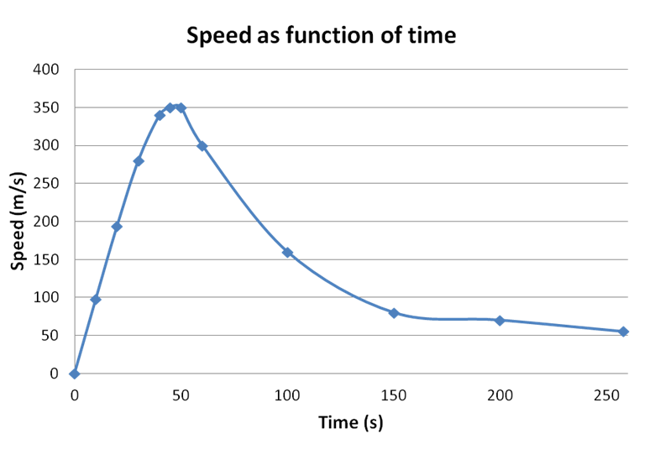
What is this real life graph showing?

Slide 2
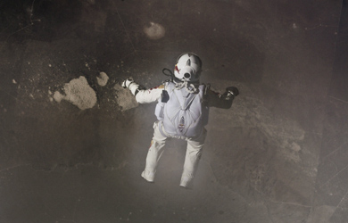
Felix Baumgartner Falling From Space
http://www.redbullstratos.com
watch ‘day of the supersonic jump’

Slide 3
Cool Chart

Slide 4
Records Broken
First skydiver to go faster than the speed of sound – maximum velocity 1,342km/h.
Highest ever freefall – 39,045m.
Also the highest altitude for a manned balloon flight – unofficial record.
Notes:
Highest altitude not an official record as balloonist must bring envelope down to claim a record.

Slide 5
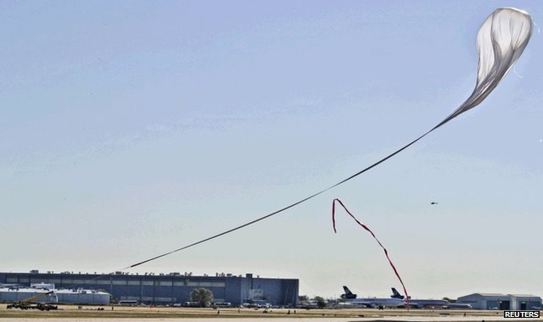
The Ascent
The ascent took 2 hours 30 to reach an altitude of 39,045m
Q: What was the average velocity of the ascent?
Q: Sketch a distance-time graph – assume constant velocity.

Slide 6
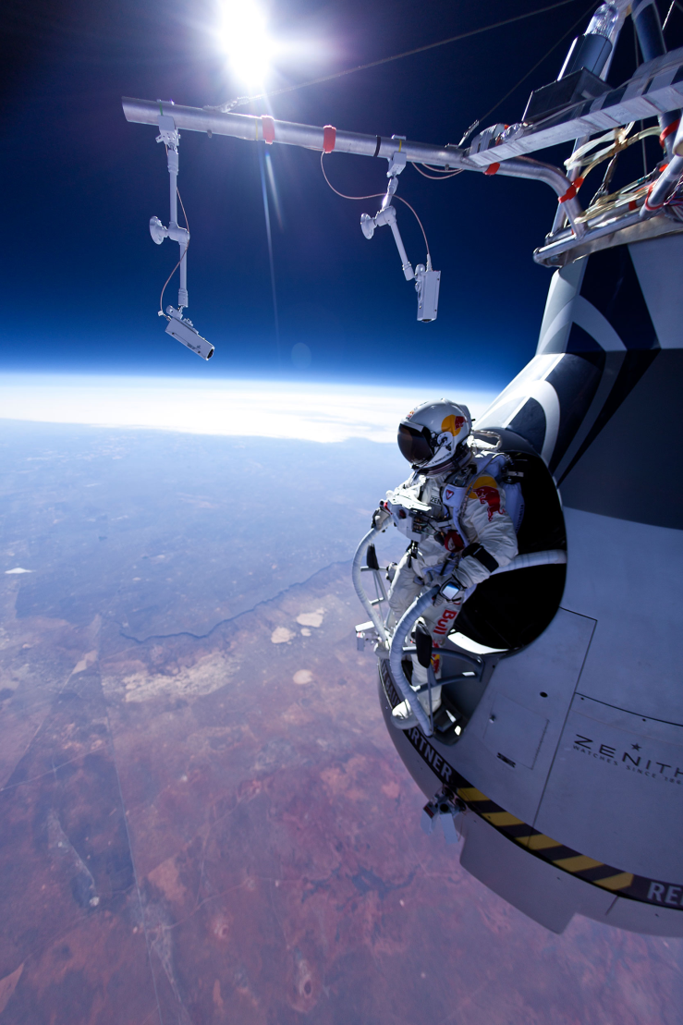
The Freefall
Felix was in freefall for 4:20 minutes.
He reached his terminal velocity of 1,342km/h after 42 seconds.
Q: What was his average acceleration until reaching terminal velocity?

Slide 7
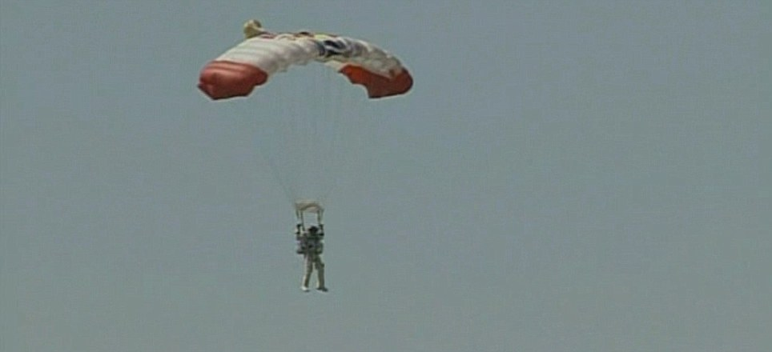
The Parachute is Deployed
His parachute was opened after 4:20 minutes.
His total descent (including freefall) took 9:09 minutes.
Q: Sketch a velocity-time graph for the whole descent.

Slide 8
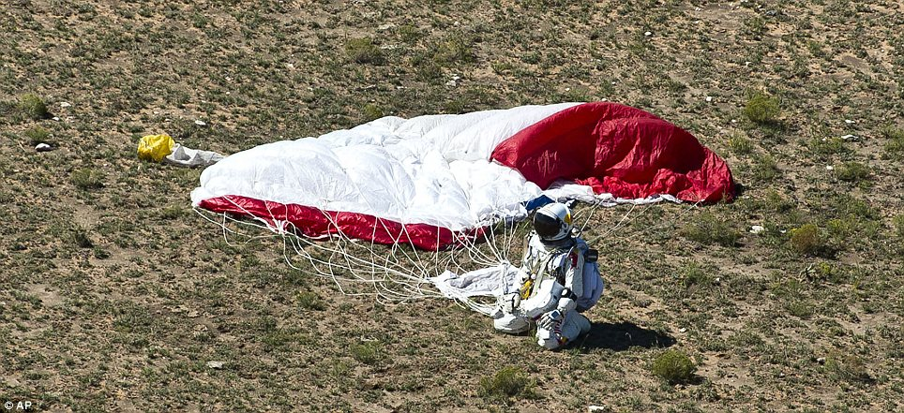
“Sometimes you have to go up really high to see how small you are.”
Felix Baumgartner’s last words before jumping (14th October 2012)

Slide 9
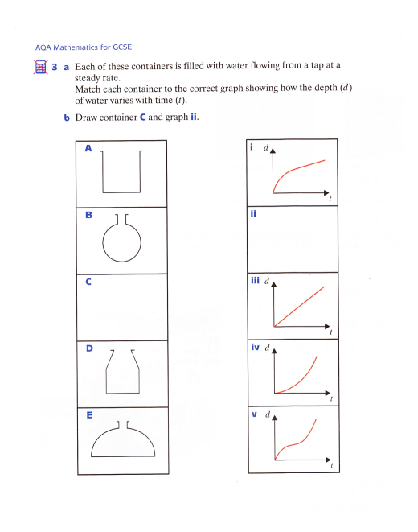
To discuss and interpret graphs, modelling real life situations

