Slide 1
Pure Past Paper Questions
Revision Past Paper Questions
Go back to home screen to select a topic
Go back to topic screen to select a question
Go to the mark scheme for that question
Go back to the question from the mark scheme
Or see more solutions
Or go back to first solutions
Next

Slide 2
Notes on operating this resource
When creating this, I used and to quickly navigate between slides directly before or after the slide in question.
As some mark schemes give additional notes, you can continue to see answers by clicking but you will not return to the original question with one click of .
To view the original question again, continue to click which should take you back.
Next

Slide 3
Notes on Edexcel questions
The Practice papers uploaded may not represent a true distribution of what type of questions are likely to come up. The questions styles are also slightly closer to the old spec of Edexcel. I have left them in to practise core skills, but pupils should not anticipate all questions within future papers looking like these.
Edexcel have strongly used questions from the old C1 and C2 papers in other released practice material (these are not included in this presentation, please see my older PowerPoints for more practice material.
Other than this, 1 set of Sample Assessment Material (SAM) and Specimen Papers have been released.
A question asking pupils to spot mistakes in a mock pupil’s attempt has appeared in each of the SAM, specimen and 2018 papers.
There is also more overlapping in general between topics. Where questions have a large element of more than one topic, these questions have been duplicated. If the secondary topic only has a small part to play then they have not.
Edexcel have provided ‘student-friendly’ mark schemes to help explain where marks are awarded along with expected student solutions. These have been attached where possible in addition to the official mark scheme and labelled SF
Next

Slide 4
Home
Sketching and Transforming Graphs
Quadratics
Differentiation
Modelling
Vectors
Polynomials
Proof
Binomial Expansion
Co-ordinate Geometry
Logs and exponentials
Integration
Trigonometry

Slide 5
New Spec Q’s
Old Spec Co-ordinate Geometry
C1
C2
Jan 2006
June 2010
May 2015 (i)
Jan 2006
May 2011
May 2018
May 2006
Jan 2011
May 2015 (ii)
May 2006
Jan 2012
May 2007
May 2011
May 2016 (i)
Jan 2007
May 2012
Jan 2008
Jan 2012
May 2016 (ii)
May 2007
Jan 2013
June 2008
May 2012
May 2017 (i)
June 2008
May 2013
Jan 2009
Jan 2013
May 2017 (ii)
Jan 2009
May 2014
June 2009
May 2013
May 2017 (iii)
June 2009
May 2015
Jan 2010 (i)
May 2014 (i)
May 2018
Jan 2010
May 2016
Jan 2010 (ii)
May 2014 (ii)
Jan 2011
May 2017

Slide 6
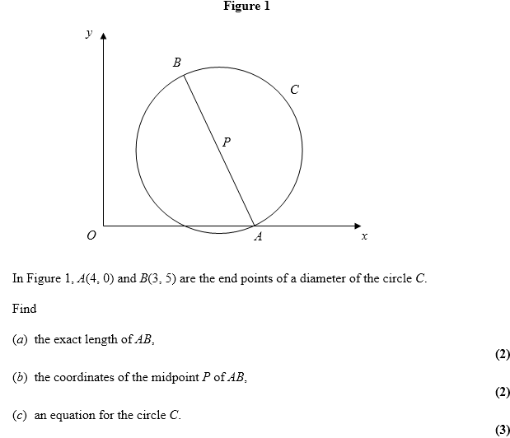
Jan 2006

Slide 7
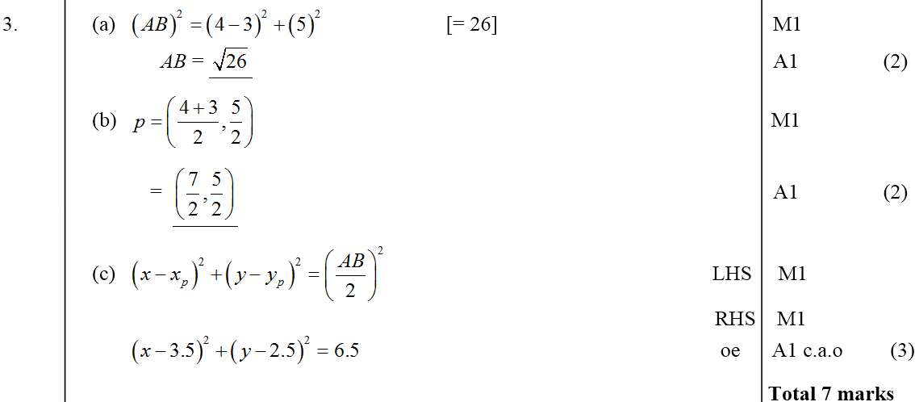
Jan 2006
A
B
C

Slide 8
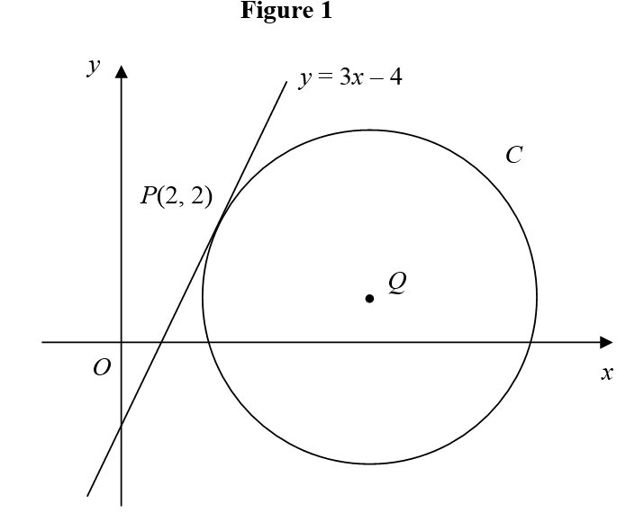
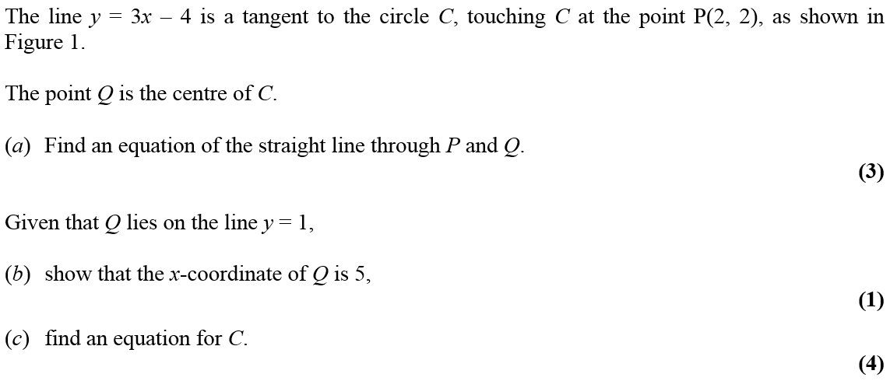
May 2006

Slide 9
May 2006
A
B
C

Slide 10
Jan 2007

Slide 11
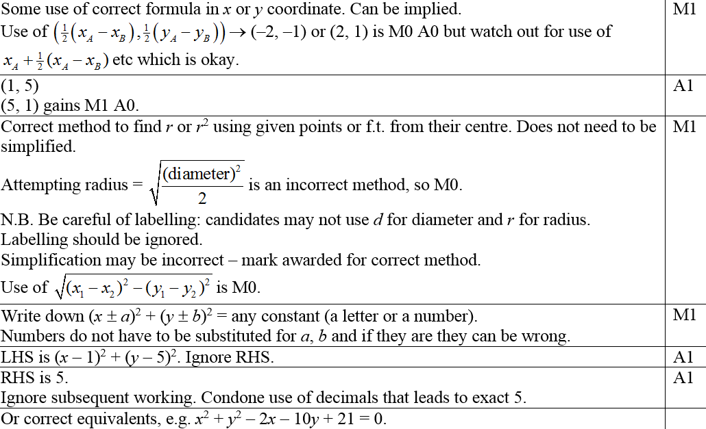
Jan 2007
A
Notes

Slide 12
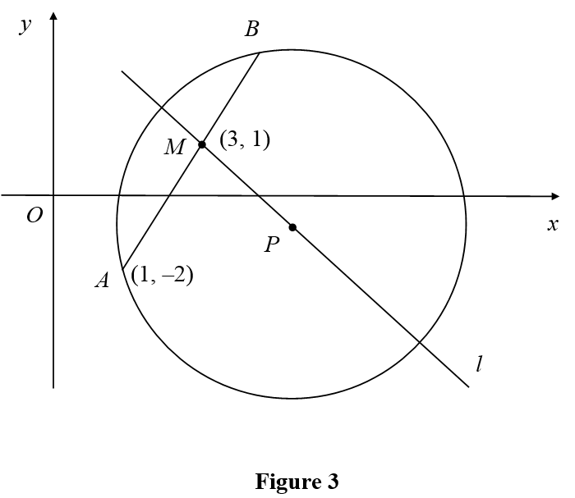
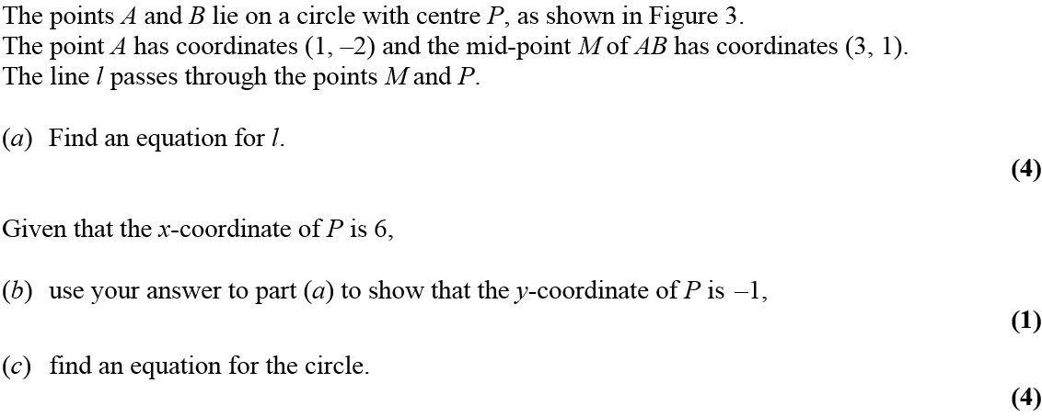
May 2007

Slide 13
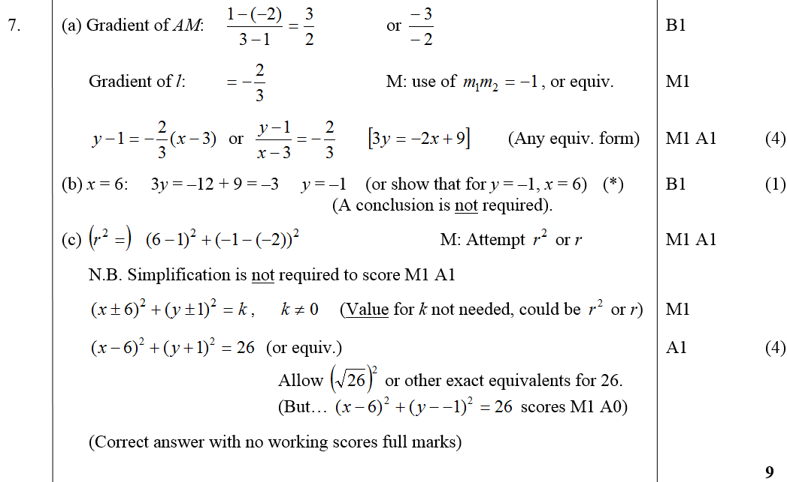
May 2007
A
B
C

Slide 14
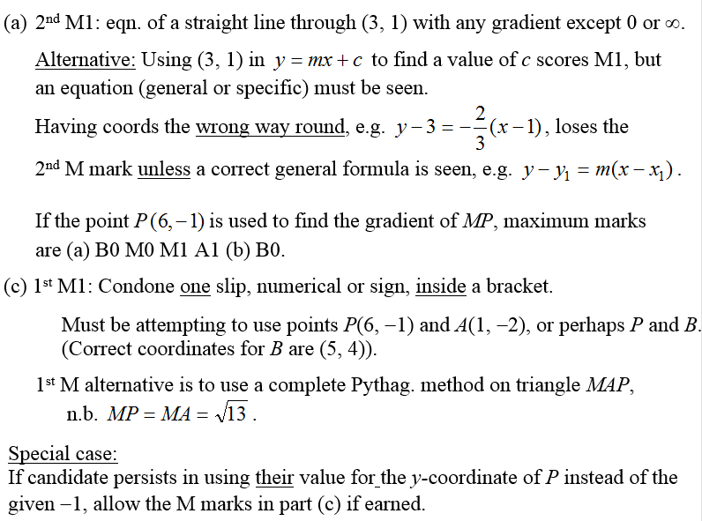
May 2007
A notes
C notes

Slide 15
June 2008

Slide 16
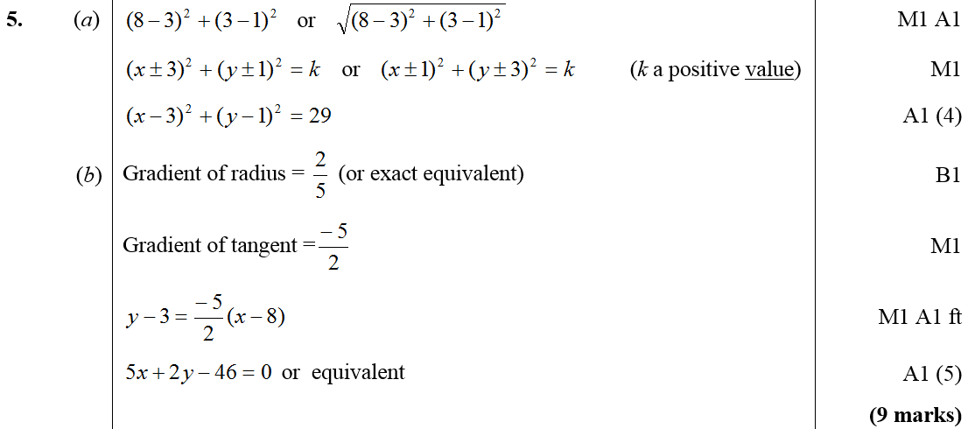
June 2008
A
B

Slide 17
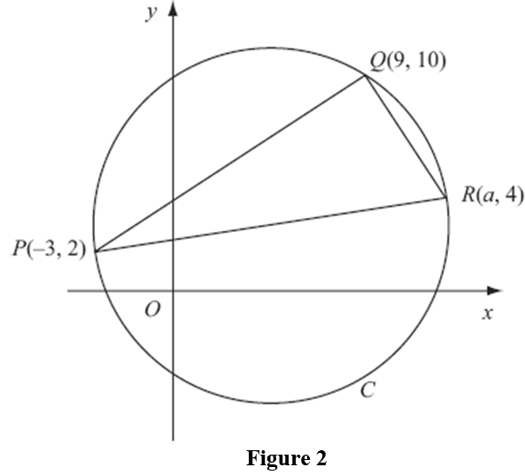
Jan 2009

Slide 18
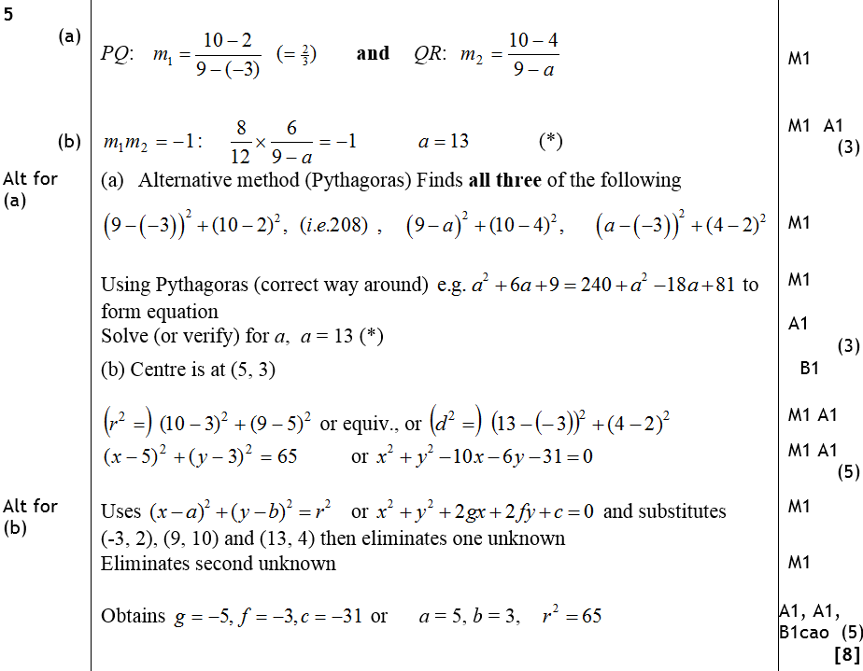
Jan 2009
A
B
Alternative A
Alternative B

Slide 19
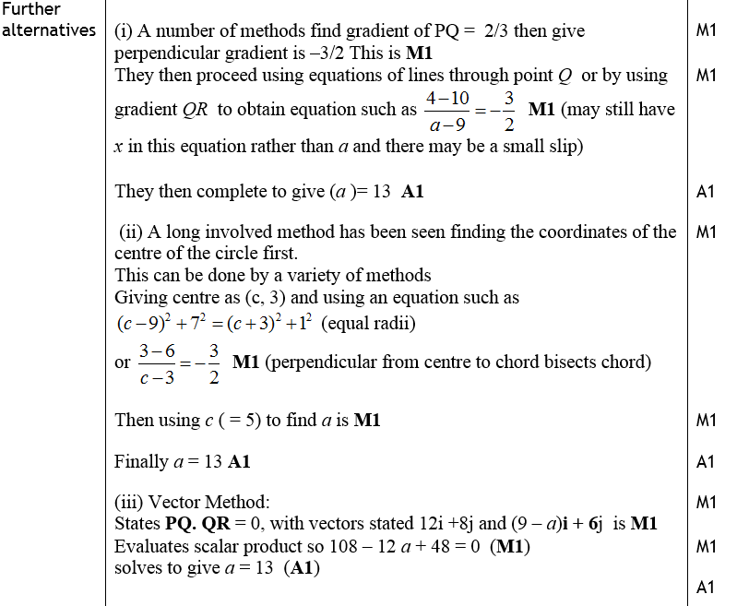
Jan 2009
Further Alternatives

Slide 20
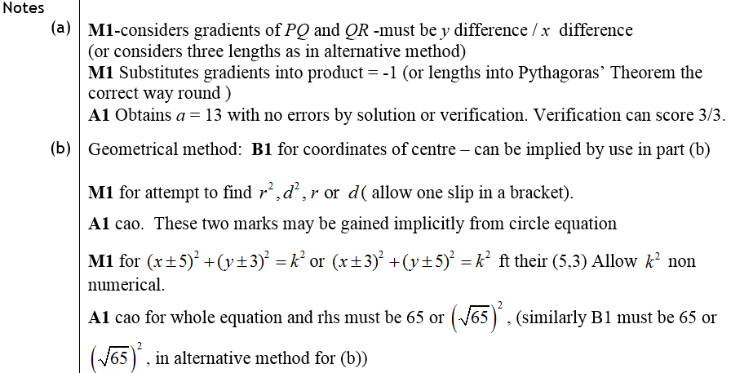
Jan 2009
A notes
B notes

Slide 21
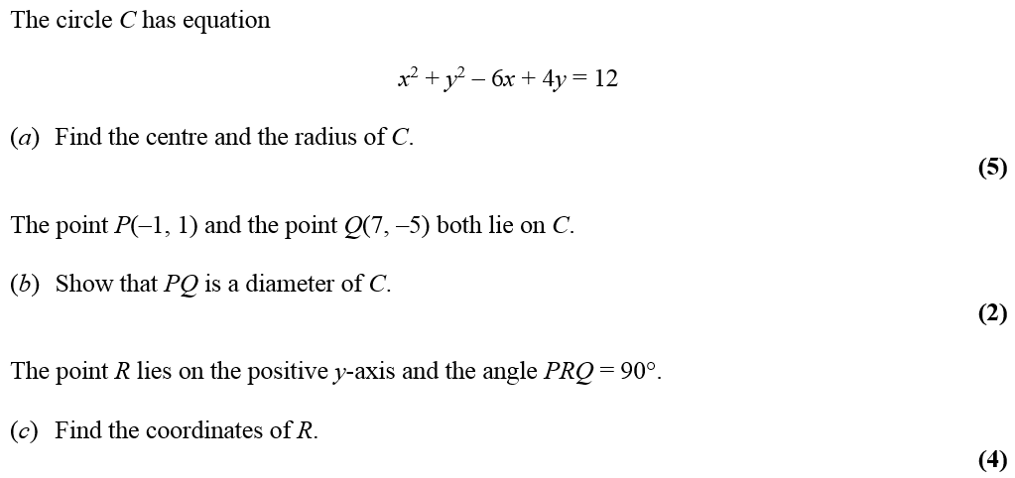
June 2009

Slide 22
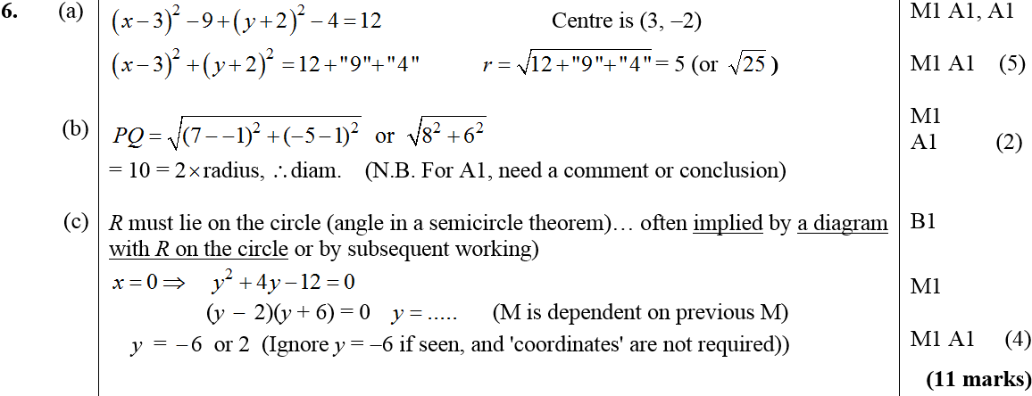
June 2009
A
B
C

Slide 23
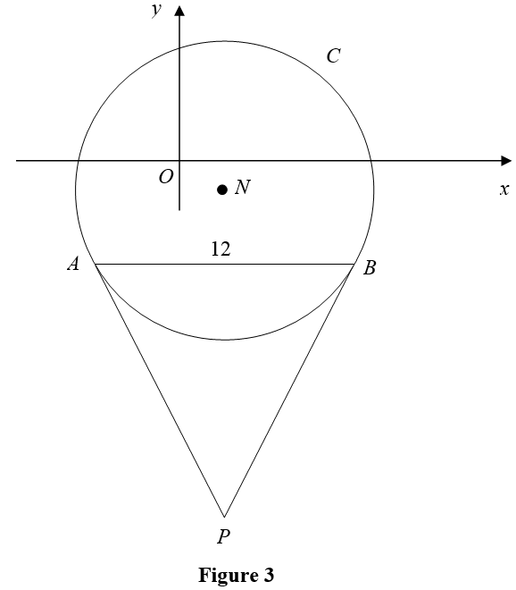
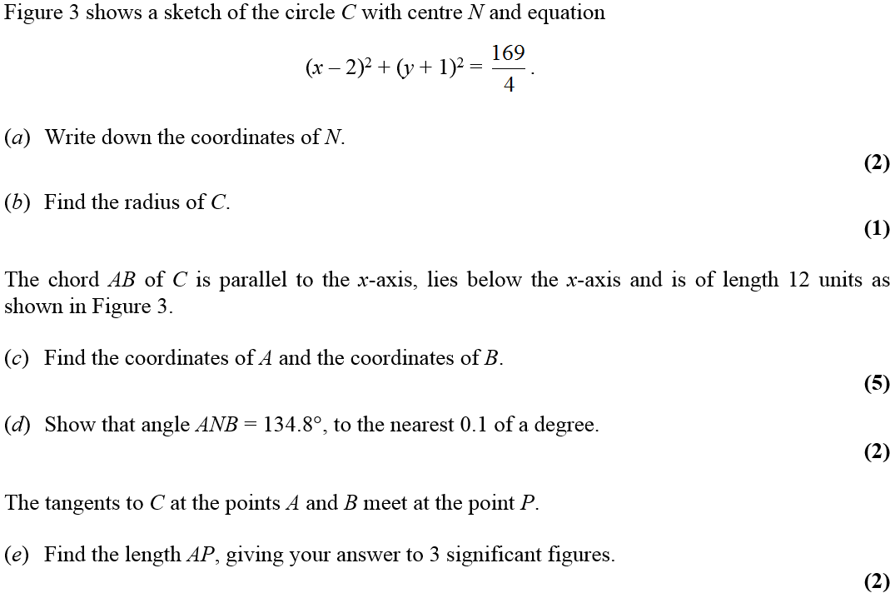
Jan 2010

Slide 24
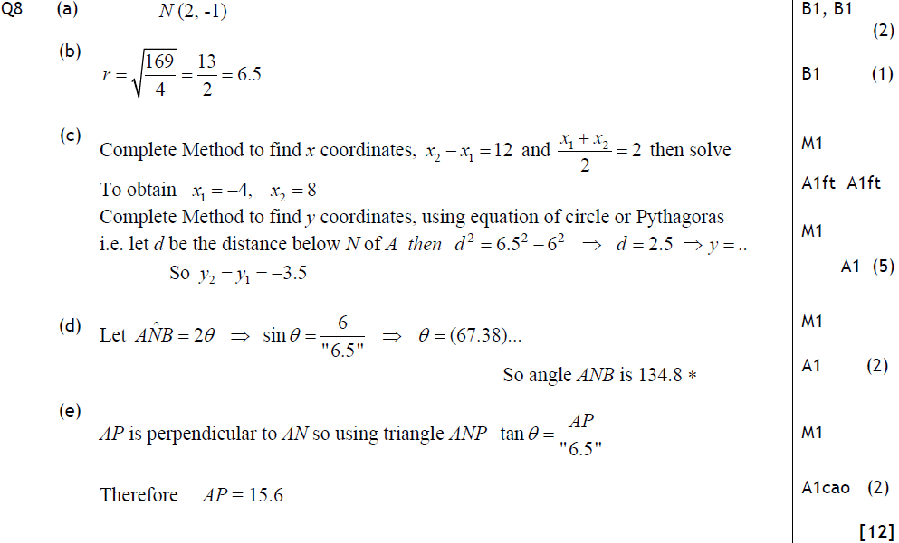
Jan 2010
A
B
C
D
E

Slide 25
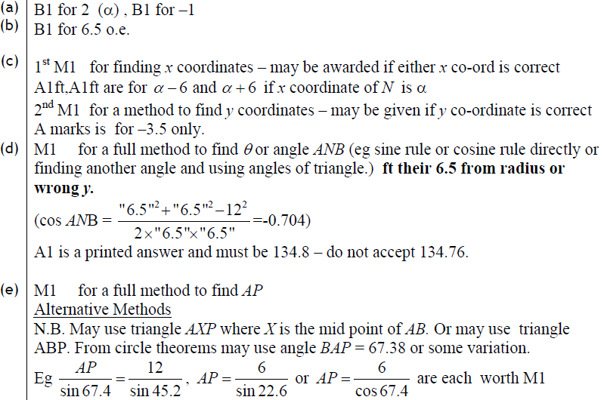
Jan 2010
A
B
C
D
E

Slide 26
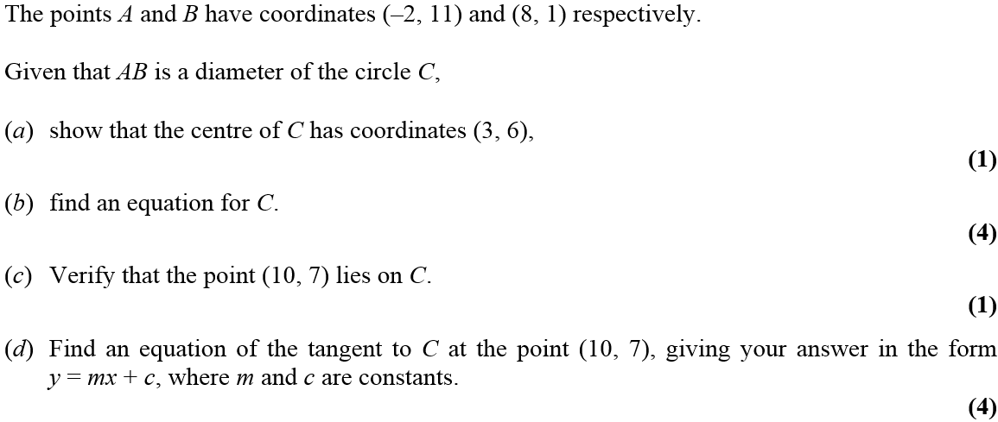
Jan 2011

Slide 27
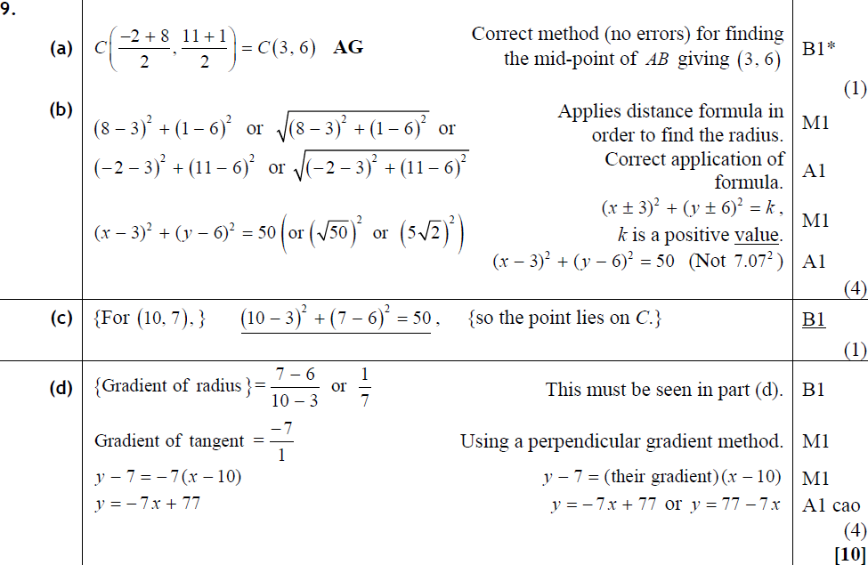
Jan 2011
A
B
C
D

Slide 28
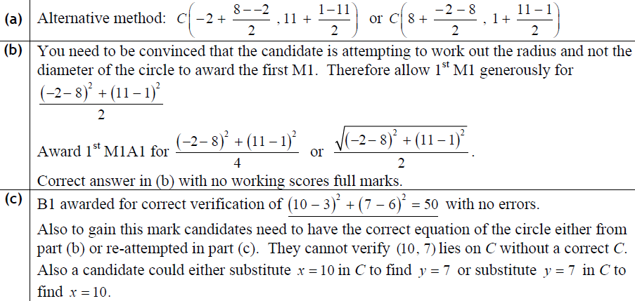
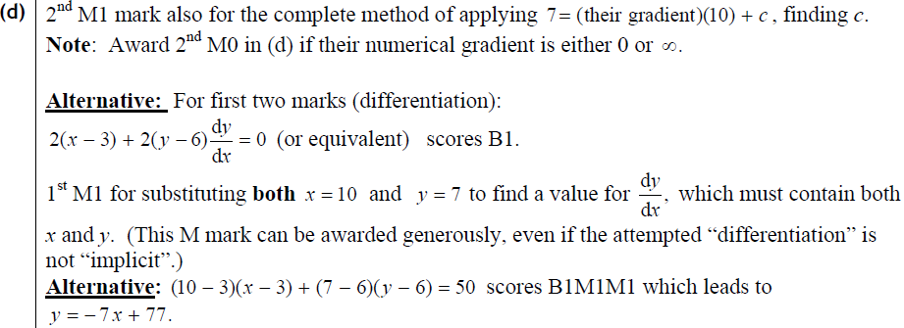
Jan 2011
A
B
C
D

Slide 29
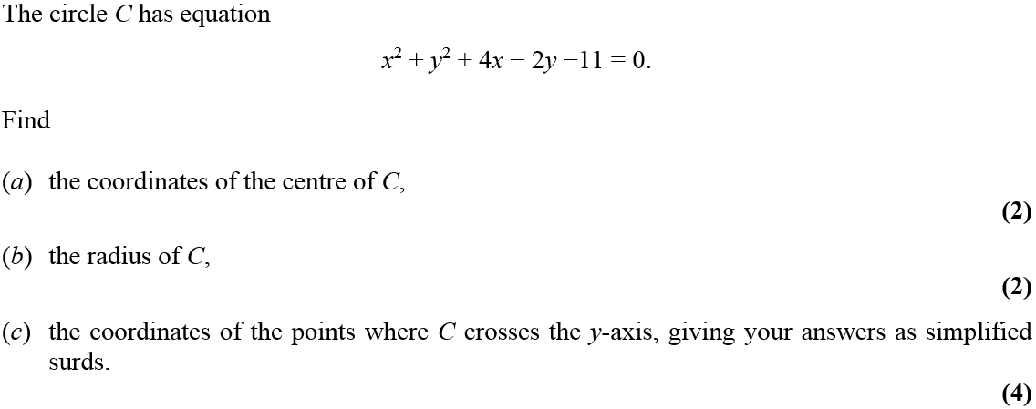
May 2011

Slide 30
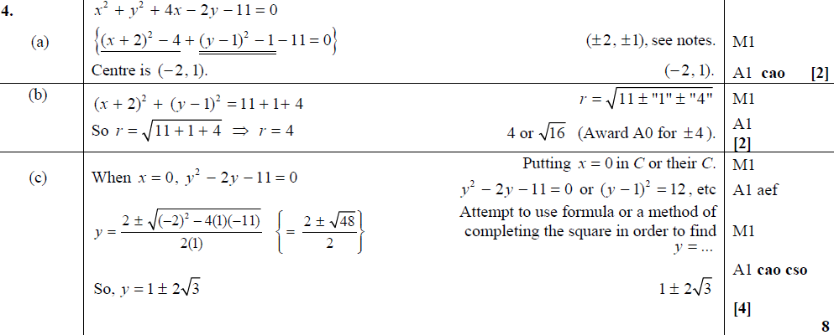
May 2011
A
B
C

Slide 31
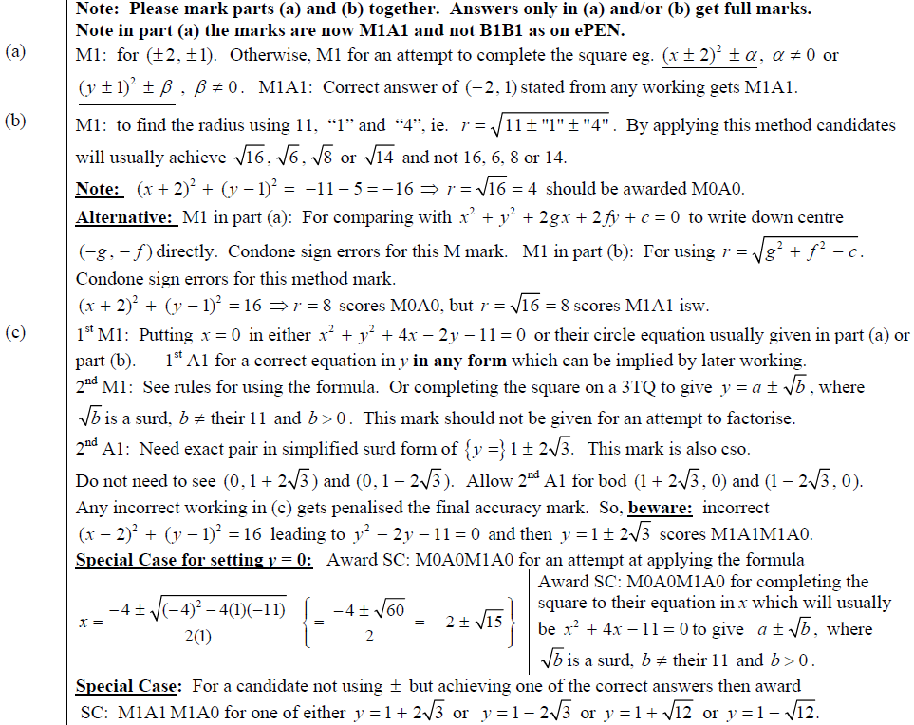
May 2011
A
B
C

Slide 32
Jan 2012

Slide 33
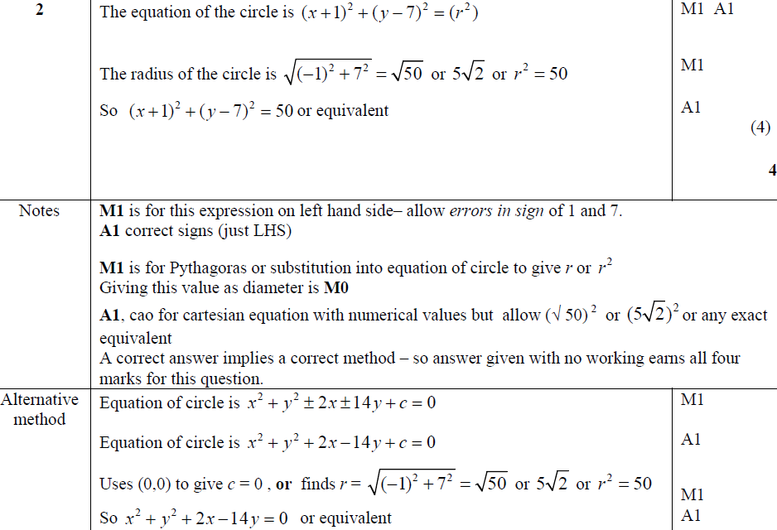
Jan 2012
A
Notes
Alternative Method

Slide 34
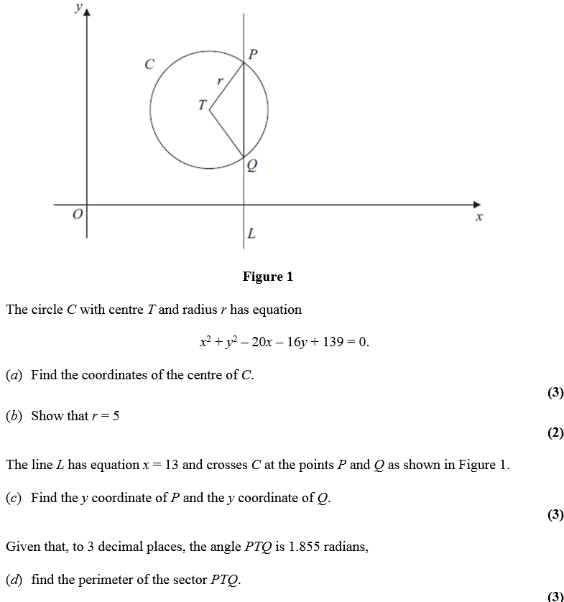
May 2012

Slide 35
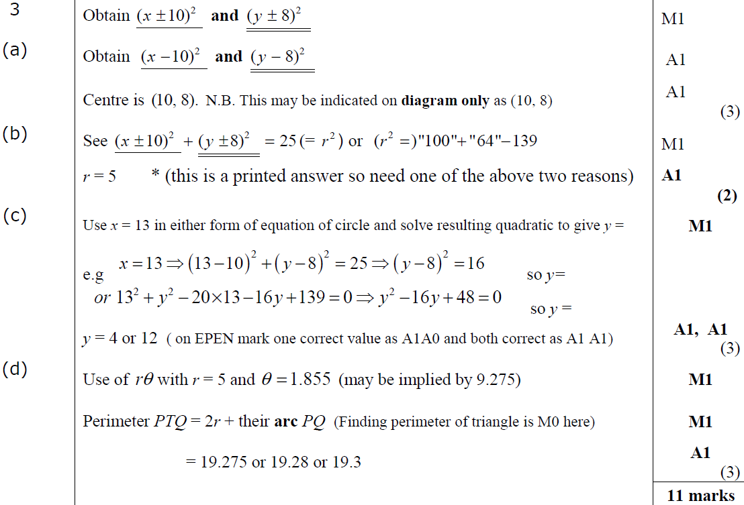
May 2012
A
B
C
D

Slide 36
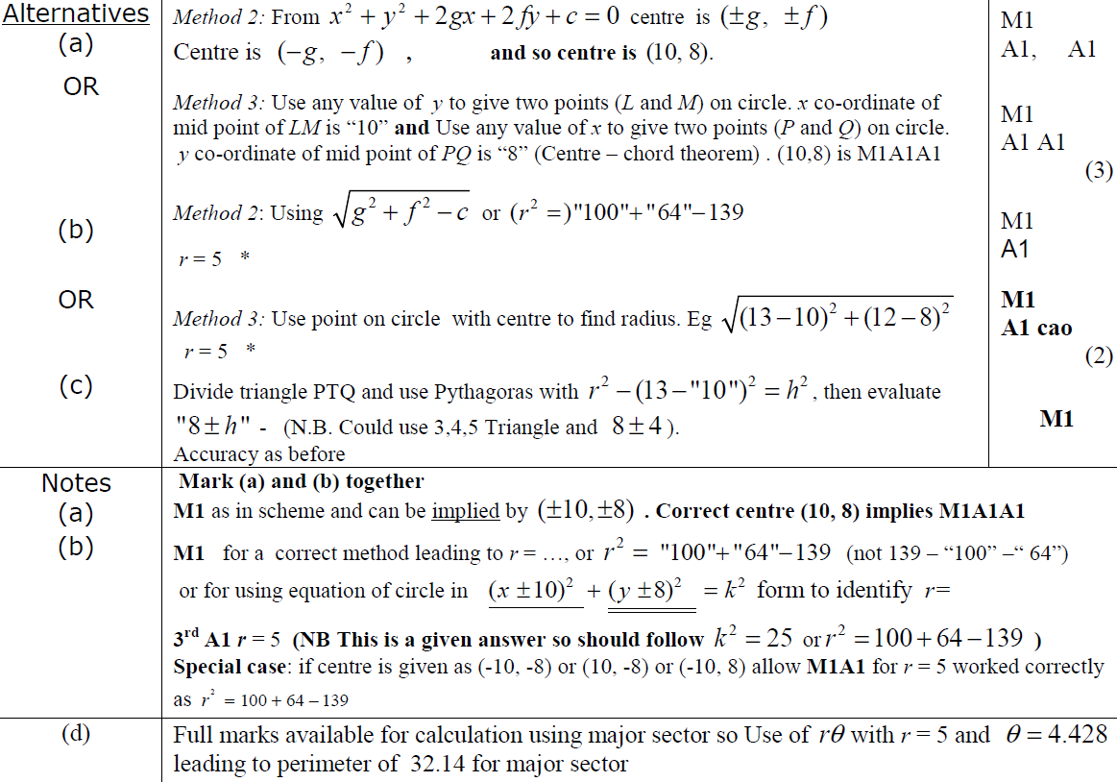
May 2012
A
B
C
A
B
D

Slide 37
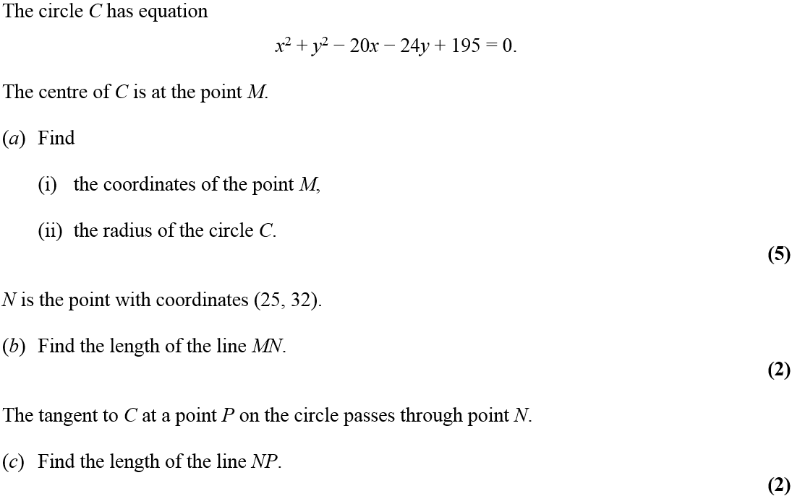
Jan 2013

Slide 38
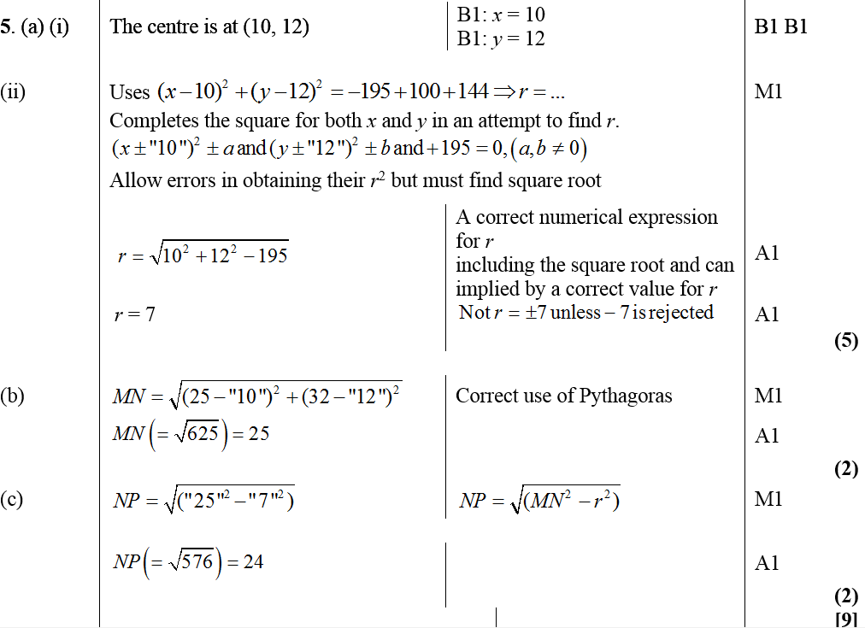
A (i)
Jan 2013
A (ii)
B
C

Slide 39
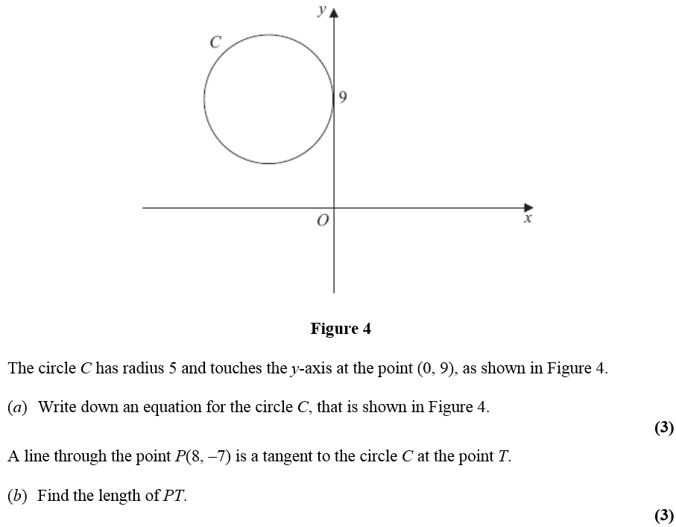
May 2013

Slide 40
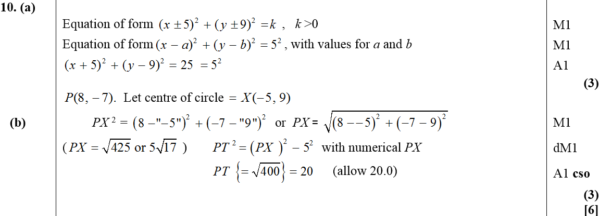
May 2013
A
B

Slide 41
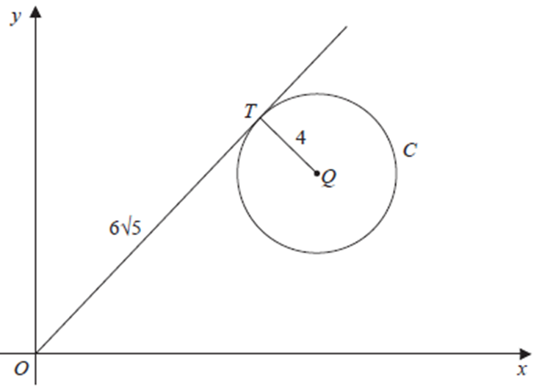
May 2014

Slide 42
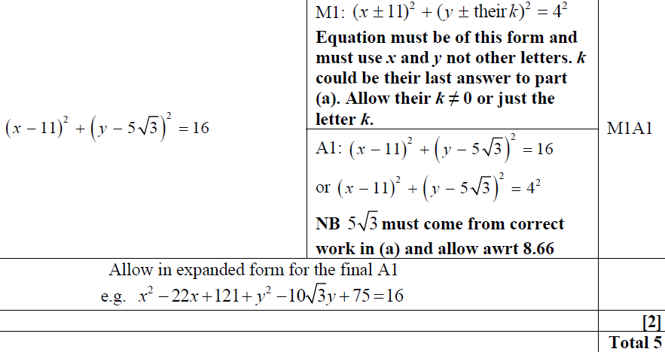
May 2014
A
B

Slide 43
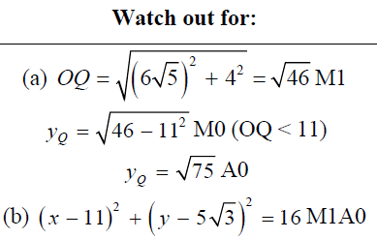
May 2014
Watch out for

Slide 44
May 2015

Slide 45
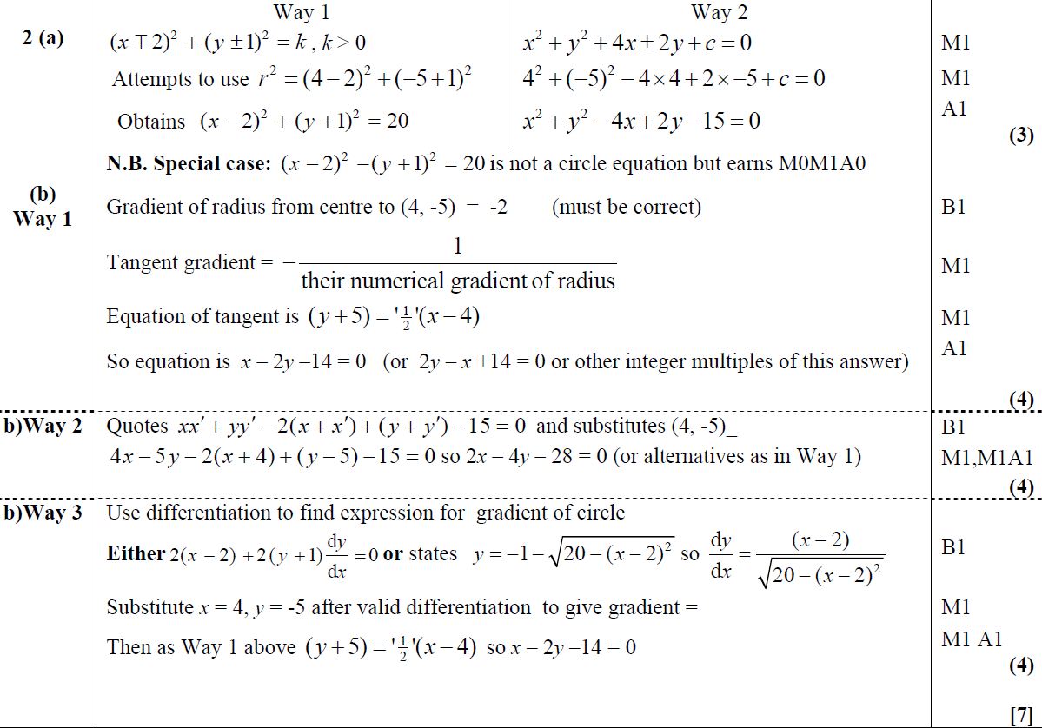
May 2015
A
B
B Alternative 1
B Alternative 2

Slide 46
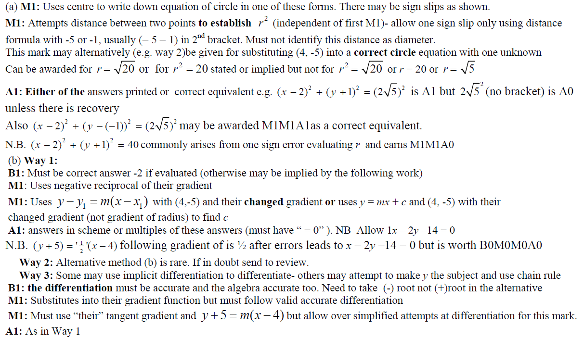
May 2015
A notes
B notes
B Alternative 1 notes
B Alternative 2 notes

Slide 47
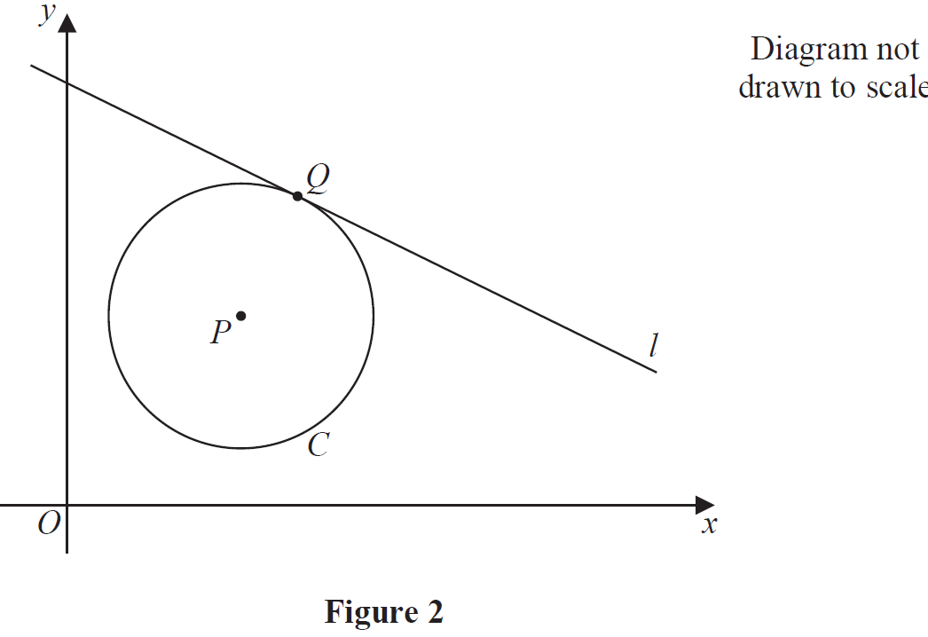
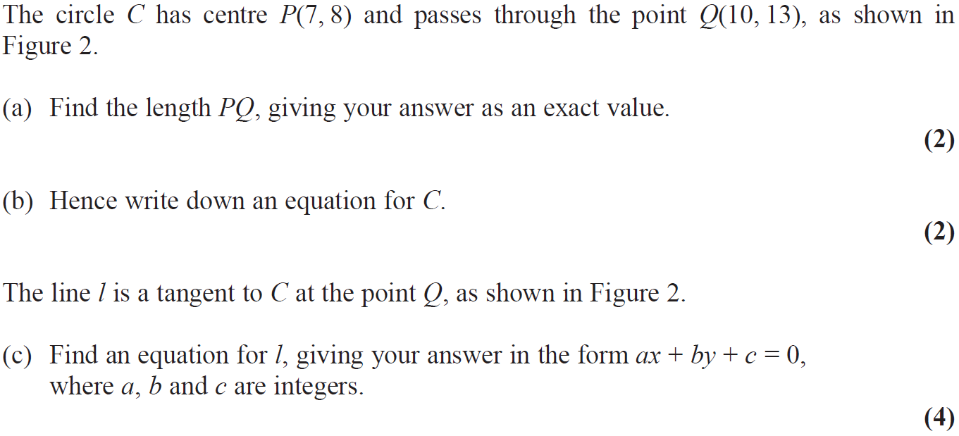
May 2016

Slide 48
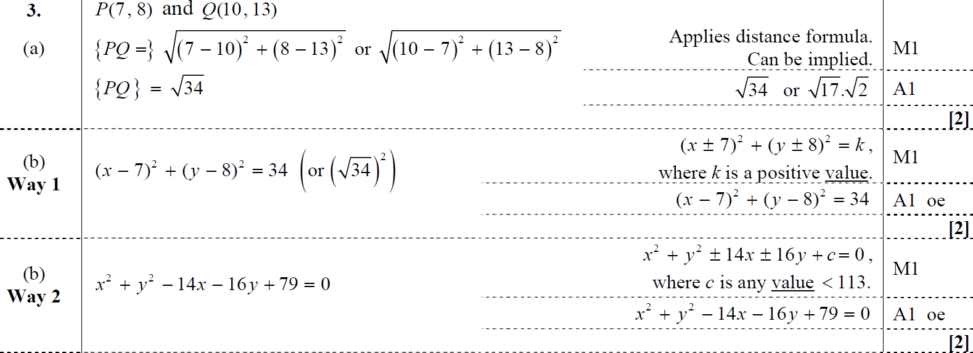
May 2016
A
B
B Alternative
A notes
B notes

Slide 49
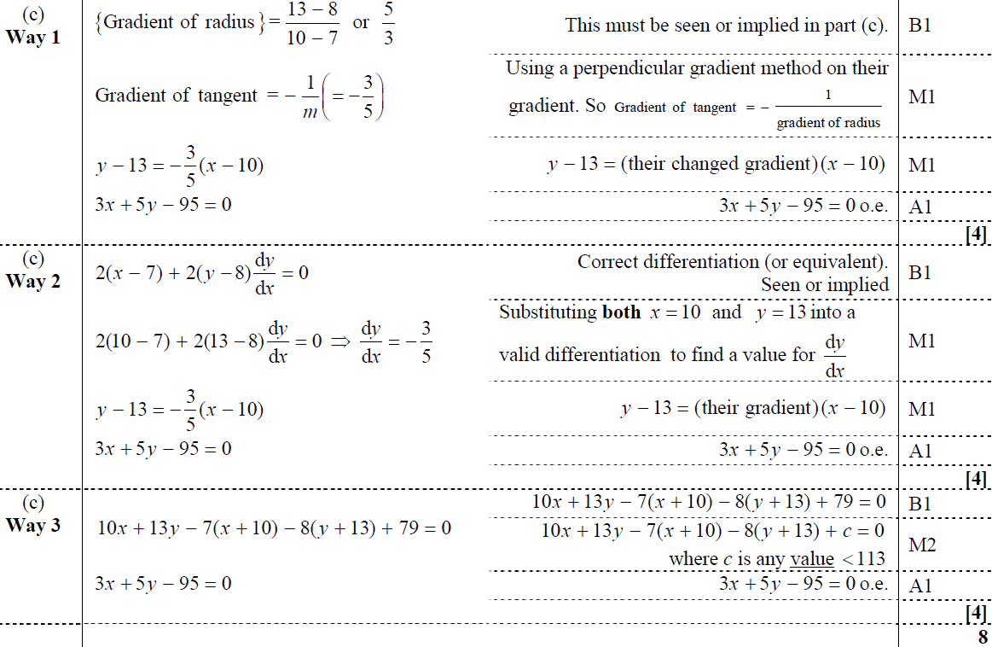
May 2016
C
C Alternative 1
C Alternative 2

Slide 50
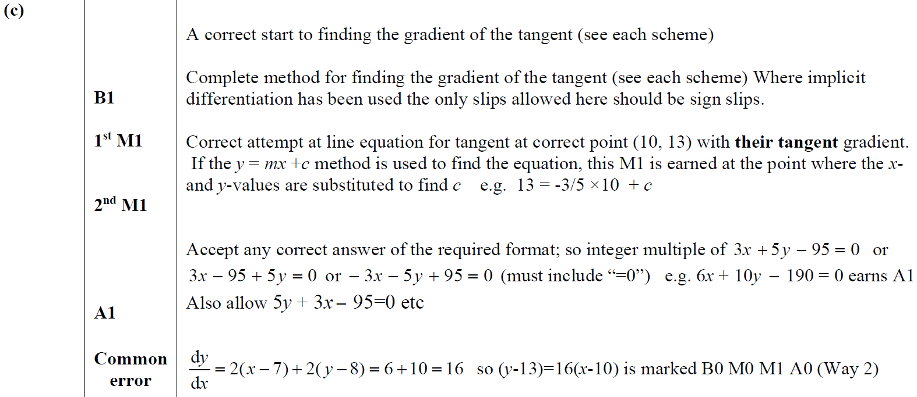
May 2016
C notes

Slide 51
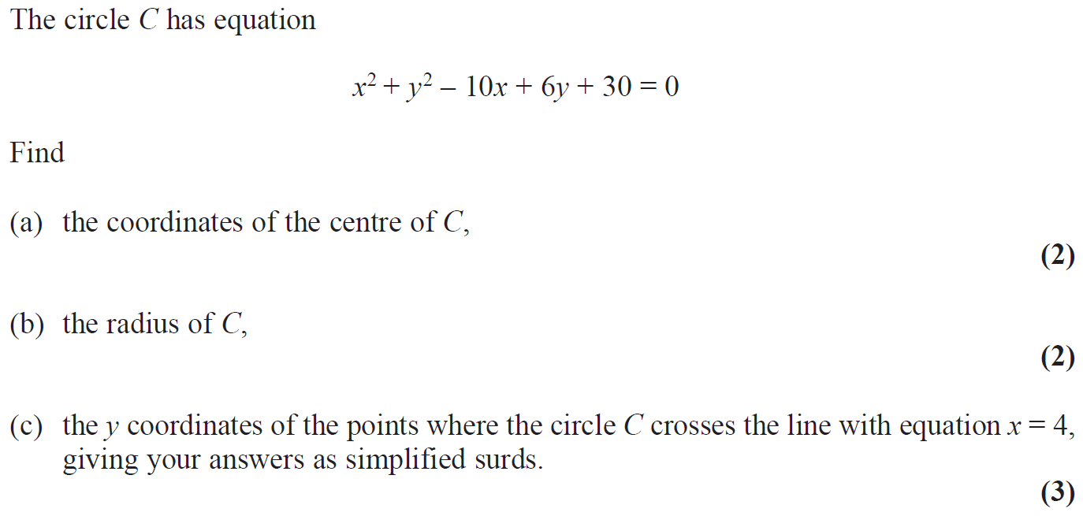
May 2017

Slide 52
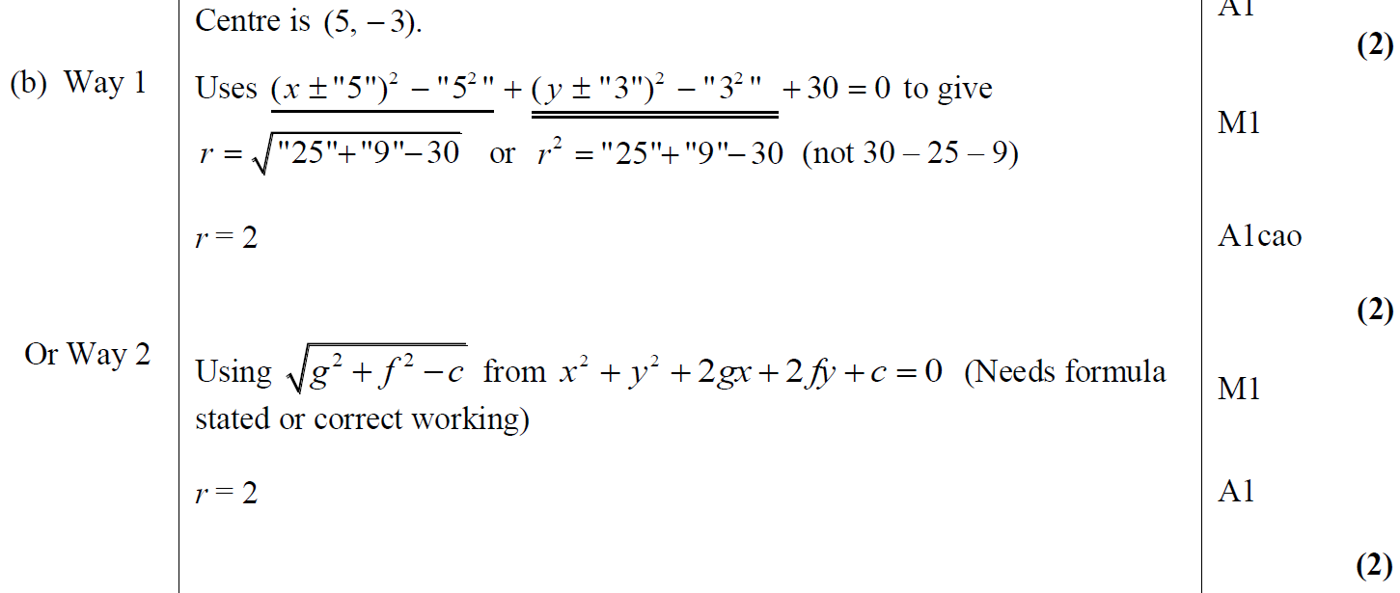
May 2017
A
B
B Alternative

Slide 53
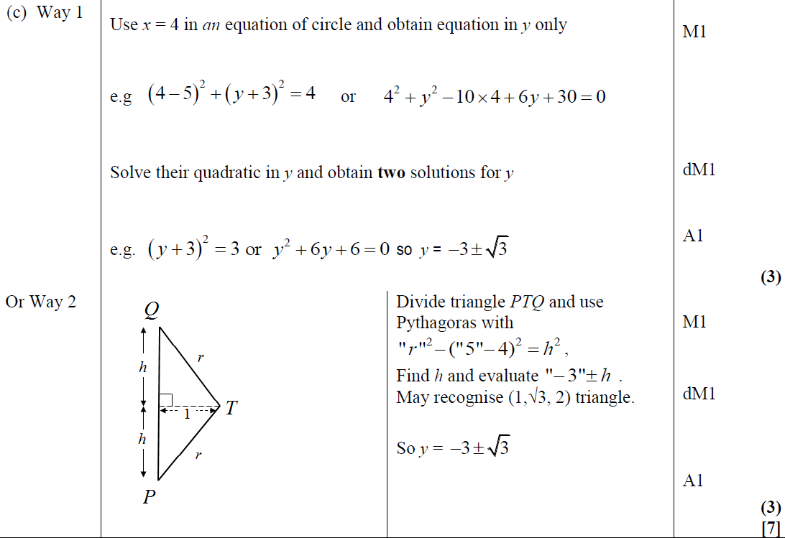
May 2017
C
C Alternative

Slide 54
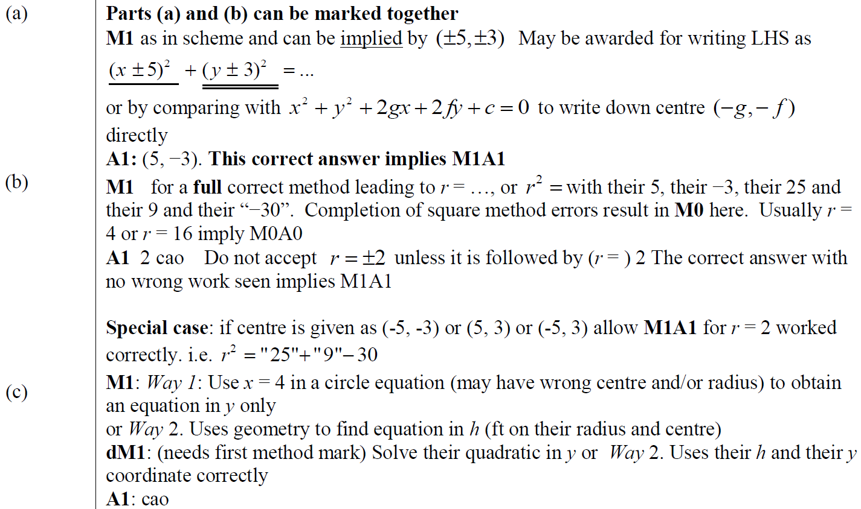
May 2017
A notes
B notes
C notes

Slide 55
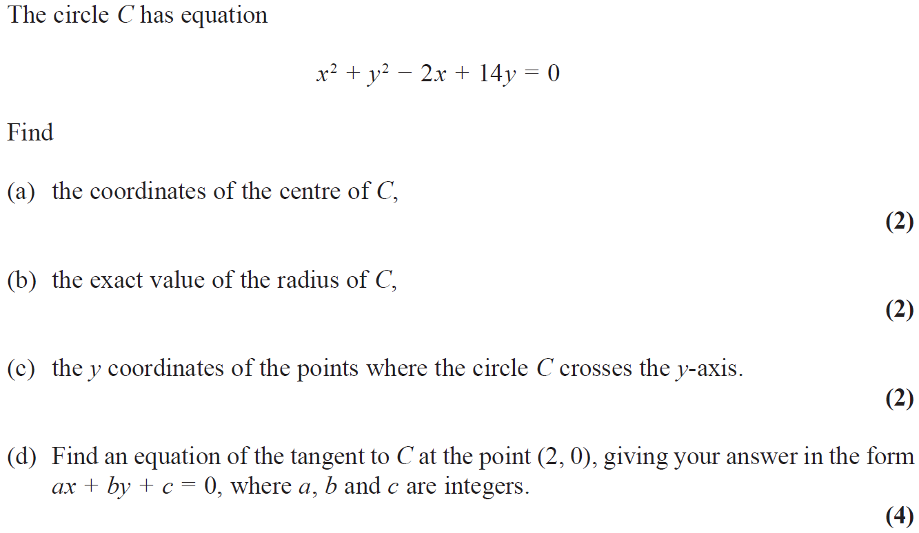
May 2018

Slide 56
May 2018
A
B
C
D

Slide 57
May 2018
A Alternative
B Alternative
D Alternative 1

Slide 58
May 2018
A notes
B notes
C notes

Slide 59
May 2018
D notes
D Alternative 1 notes
D Alternative 2 notes

Slide 60
Jan 2006

Slide 61
Jan 2006
A
B

Slide 62
May 2006

Slide 63
May 2006
A
B
C
D

Slide 64
May 2007

Slide 65
May 2007
A
B
C

Slide 66
May 2007
A notes
B notes
C notes

Slide 67
Jan 2008

Slide 68
Jan 2008
A
B

Slide 69
Jan 2008
A notes
B notes

Slide 70
June 2008

Slide 71
June 2008
A
B
C
D

Slide 72
Jan 2009

Slide 73
Jan 2009
A
B
C
D
A notes

Slide 74
Jan 2009
B notes
C notes
D notes

Slide 75
June 2009

Slide 76
June 2009
A
B
C

Slide 77
Jan 2010

Slide 78
Jan 2010
A
B

Slide 79
Jan 2010

Slide 80
Jan 2010
A
B
C
D

Slide 81
June 2010

Slide 82
June 2010
A
B
C
D

Slide 83
Jan 2011

Slide 84
Jan 2011
A
B
C
D
E

Slide 85
Jan 2011
B notes
C notes
D notes
E notes

Slide 86
May 2011

Slide 87
May 2011
A
A notes

Slide 88
Jan 2012

Slide 89
Jan 2012
A
B
C

Slide 90
May 2012

Slide 91
May 2012
A
B
C
D
E

Slide 92
May 2012
A notes
B notes
C notes

Slide 93
May 2012
D notes
E notes
Alternative E (i)

Slide 94
May 2012
Alternative E (ii)
Alternative E (iii)

Slide 95
Jan 2013

Slide 96
Jan 2013
A
B
C

Slide 97
May 2013

Slide 98
May 2013
A
B

Slide 99
May 2014

Slide 100
May 2014
A
B

Slide 101
May 2014
A Notes
B Notes

Slide 102
May 2014
Alternative Method (i)
Alternative Method (ii)
Alternative Method (iii)

Slide 103
May 2014
Alternative Method (i)
Alternative Method (ii)
Alternative Method (iii)

Slide 104
May 2014

Slide 105
May 2014
A
B

Slide 106
May 2014
A Notes
B Notes

Slide 107
May 2015

Slide 108
May 2015
A

Slide 109
May 2015
B

Slide 110
May 2015
C

Slide 111
May 2015

Slide 112
May 2015
A

Slide 113
May 2015
B

Slide 114
May 2016

Slide 115
May 2016
A
B

Slide 116
May 2016
C

Slide 117
May 2016
C Shapes

Slide 118
May 2016
C notes

Slide 119
May 2016
C Alternative 1 notes

Slide 120
May 2016
C Alternative 2 notes

Slide 121
May 2016
C Alternative 3 notes

Slide 122
May 2016
C Alternative 4 notes

Slide 123
May 2016
C Alternative 5 notes

Slide 124
May 2016
C Alternative 6 notes

Slide 125
May 2016
C Alternative 7 notes

Slide 126
May 2016
C further diagrams

Slide 127
May 2016

Slide 128
May 2016
A
B

Slide 129
May 2016
C
D

Slide 130
May 2017

Slide 131
May 2017
A

Slide 132
May 2017
B

Slide 133
May 2017
C

Slide 134
May 2017

Slide 135
May 2017
A

Slide 136
May 2017
B

Slide 137
May 2017

Slide 138
May 2017
A

Slide 139
May 2017
B

Slide 140
May 2017
B Alternatives

Slide 141
May 2018

Slide 142
May 2018
A
B

Slide 143
May 2018
C

Slide 144
May 2018
D
D Alternative 1
D Alternative 2
D Alternative 3

Slide 145
Old Spec Q’s
Coordinate Geometry
with Circles
Practice A (i)
Specimen (i)
2018 (ii)
Practice A (ii)
Specimen (ii)
Practice B (i)
Specimen (iii)
Practice B (ii)
SAM (i)
Practice C (i)
SAM (ii)
Practice C (ii)
SAM (iii)
Practice D
2018 (i)

Slide 146
Practice A

Slide 147
Practice A
A
B

Slide 148
Practice A

Slide 149
Practice A
A

Slide 150
Practice A
A notes

Slide 151
Practice B

Slide 152
Practice B
A
B
B notes

Slide 153
Practice B

Slide 154
Practice B
A
B

Slide 155
Practice B
C

Slide 156
Practice B
D

Slide 157
Practice B
E

Slide 158
Practice C

Slide 159
Practice C
A
B

Slide 160
Practice C
A

Slide 161
Practice C

Slide 162
Practice C
A
B

Slide 163
Practice C
C
D
C notes
E
F

Slide 164
Practice D

Slide 165
Practice D
A

Slide 166
Practice D
B

Slide 167
Specimen

Slide 168
Specimen
A
B

Slide 169
Specimen
C

Slide 170
Specimen
A notes
B notes
C notes

Slide 171
Specimen

Slide 172
Specimen
A
B

Slide 173
Specimen
A notes

Slide 174
Specimen
B notes

Slide 175
Specimen

Slide 176
Specimen
A
B

Slide 177
Specimen
A notes

Slide 178
Specimen
B notes

Slide 179
SAM

Slide 180
SAM
A
A Alternative 1

Slide 181
SAM
A Alternative 2
A notes

Slide 182
SAM

Slide 183
SAM
A
B
C (i)
C (ii)

Slide 184
SAM
D (i)
D (ii)
E

Slide 185
SAM
A notes
B notes
C (i) notes
C (ii) notes

Slide 186
SAM
D (i) notes
D (ii) notes
E notes

Slide 187
SAM

Slide 188
SAM
A
A notes

Slide 189
SAM
B

Slide 190
SAM
B notes

Slide 191
2018

Slide 192
2018
A

Slide 193
2018
A (SF)

Slide 194
2018
A notes

Slide 195
2018

Slide 196
2018
A
B

Slide 197
2018
B Alternative

Slide 198
2018
A (i) (SF)
A (ii) (SF)

Slide 199
2018
B (SF)

Slide 200
2018
A notes

Slide 201
2018
B notes

Slide 202
Modelling
Practice A
SAM (i)
Practice C (i)
SAM (ii)
Practice C (ii)
2018 (i)
Practice C (iii)
2018 (ii)
Practice D (i)
2018 (iii)
Practice D (ii)
Specimen (i)
Specimen (ii)

Slide 203
Practice A

Slide 204
Practice A
A
B
C

Slide 205
Practice C

Slide 206
Practice C
A
B

Slide 207
Practice C
C (i)
C (ii)
C notes

Slide 208
Practice C

Slide 209
Practice C
A

Slide 210
Practice C
B
B notes

Slide 211
Practice C

Slide 212
Practice C
A
B

Slide 213
Practice C
C
D
C notes
E
F

Slide 214
Practice D

Slide 215
Practice D
A
B

Slide 216
Practice D
C

Slide 217
Practice D

Slide 218
Practice D
A

Slide 219
Specimen

Slide 220
Specimen
A
B

Slide 221
Specimen
C

Slide 222
Specimen
A notes
B notes
C notes

Slide 223
Specimen

Slide 224
Specimen
A
B
C

Slide 225
Specimen
D
A notes
B notes
C notes
D notes

Slide 226
SAM

Slide 227
SAM
A
B
C (i)
C (ii)

Slide 228
SAM
D (i)
D (ii)
E

Slide 229
SAM
A notes
B notes
C (i) notes
C (ii) notes

Slide 230
SAM
D (i) notes
D (ii) notes
E notes

Slide 231
SAM

Slide 232
SAM
A
B

Slide 233
SAM
C

Slide 234
SAM
A notes
B notes
C notes

Slide 235
2018

Slide 236
2018
A
B
C

Slide 237
2018
A
B
C

Slide 238
2018
A notes

Slide 239
2018
B notes
C (i) notes
C (ii) notes

Slide 240
2018

Slide 241
2018
A (i)
A (ii)
B
C

Slide 242
2018
A (i) (SF)
A (ii) (SF)

Slide 243
2018
B (SF)
C (SF)

Slide 244
2018
A (i) notes

Slide 245
2018
A (ii) notes

Slide 246
2018
B notes
C notes

Slide 247
2018

Slide 248
2018
A
B (i)
B (ii)
C

Slide 249
2018
A (SF)
B (i) (SF)
B (ii) (SF)
C (SF)

Slide 250
2018
A notes

Slide 251
2018
B (i) notes
B (ii) notes
C notes

Slide 252
New Spec Q’s
Old Spec Quadratics
Jan 2006
June 2009
Jan 2013 (i)
May 2017 (i)
May 2006
Jan 2010
Jan 2013 (ii)
May 2017 (ii)
Jan 2007
June 2010
May 2013
May 2017 (iii)
May 2007
Jan 2011
May 2014
May 2018 (i)
Jan 2008
May 2011
May 2015 (i)
May 2018 (ii)
June 2008
Jan 2012
May 2015 (ii)
Jan 2009
May 2012
May 2016

Slide 253
Jan 2006

Slide 254
Jan 2006
A
B
C
D

Slide 255
May 2006

Slide 256
May 2006
A
B

Slide 257
Jan 2007

Slide 258
A
Jan 2007
Notes

Slide 259
May 2007

Slide 260
May 2007
A
B

Slide 261
May 2007
A notes
B notes

Slide 262
Jan 2008

Slide 263
Jan 2008
A
B
B notes

Slide 264
Jan 2008
A notes

Slide 265
June 2008

Slide 266
June 2008
A
B

Slide 267
Jan 2009

Slide 268
Jan 2009
A
B
A notes

Slide 269
Jan 2009
B notes

Slide 270
June 2009

Slide 271
June 2009
A

Slide 272
Jan 2010

Slide 273
A
Jan 2010
B
C

Slide 274
June 2010

Slide 275
June 2010
A
B
C

Slide 276
Jan 2011

Slide 277
Jan 2011
A
B
A notes
B notes

Slide 278
May 2011

Slide 279
May 2011
A
B
C
A notes
B notes
C notes

Slide 280
Jan 2012

Slide 281
Jan 2012
A
B

Slide 282
May 2012

Slide 283
May 2012
A
B
C

Slide 284
May 2012
A notes
Alternative A (i)
Alternative A (ii)
Alternative A (iii)
Special Case A

Slide 285
May 2012
B notes
C notes

Slide 286
Jan 2013

Slide 287
Jan 2013
A Method 1
A Method 2
B

Slide 288
Jan 2013

Slide 289
Jan 2013
A
B

Slide 290
May 2013

Slide 291
May 2013
A
B
C

Slide 292
May 2014

Slide 293
May 2014
A
B
A Notes
B Notes

Slide 294
May 2014
C (Method 1A)
C (Method 1A) Notes

Slide 295
May 2014
C (Method 1B)
C (Method 1B) Notes

Slide 296
May 2014
C (Method 2)
C (Method 2) Notes

Slide 297
May 2014
C (Method 3)
C (Method 3) Notes

Slide 298
May 2014
Special case uses perpendicular gradient

Slide 299
May 2015

Slide 300
May 2015
A

Slide 301
May 2015
B

Slide 302
May 2015

Slide 303
May 2015
A
B

Slide 304
May 2016

Slide 305
May 2016
A

Slide 306
May 2016
B

Slide 307
May 2017

Slide 308
May 2017
A

Slide 309
May 2017
B

Slide 310
May 2017
C

Slide 311
May 2017

Slide 312
May 2017
A

Slide 313
May 2017
A notes

Slide 314
May 2017
B

Slide 315
May 2017

Slide 316
May 2017
A (i)

Slide 317
May 2017
A (ii)

Slide 318
May 2017
B

Slide 319
May 2017
C

Slide 320
May 2018

Slide 321
May 2018
A
B

Slide 322
May 2018
C

Slide 323
May 2018

Slide 324
May 2018
A

Slide 325
May 2018
B

Slide 326
Old Spec Q’s
Quadratics
Practice A (i)
Specimen (i)
Practice A (ii)
Specimen (ii)
Practice A (iii)
SAM (i)
Practice B
SAM (ii)
Practice C
SAM (iii)
Practice D (i)
2018 (i)
Practice D (ii)
2018 (ii)
Practice D (iii)
2018 (iii)

Slide 327
Practice A

Slide 328
Practice Algebra part 1
A

Slide 329
Practice Algebra part 1
A notes

Slide 330
Practice A

Slide 331
Practice A
A
A notes

Slide 332
Practice A
B
B notes

Slide 333
Practice A

Slide 334
Practice A
A
A notes

Slide 335
Practice A
B
B notes

Slide 336
Practice A
C
D
C notes

Slide 337
Practice B

Slide 338
Practice B
A
B
A notes

Slide 339
Practice B
C
D

Slide 340
Practice C

Slide 341
Practice C
A
B

Slide 342
Practice C
C (i)
C (ii)
C notes

Slide 343
Practice D

Slide 344
Practice D
A

Slide 345
Practice D

Slide 346
Practice D
A

Slide 347
Practice D

Slide 348
Practice D
A
B

Slide 349
Practice D
A
A notes
B notes
C notes

Slide 350
Specimen

Slide 351
Specimen
A

Slide 352
Specimen
A notes
B notes

Slide 353
Specimen

Slide 354
Specimen
A
B

Slide 355
Specimen
A notes

Slide 356
Specimen
B notes

Slide 357
SAM

Slide 358
SAM
A
B

Slide 359
SAM
A notes
B notes

Slide 360
SAM

Slide 361
SAM
A
A notes

Slide 362
SAM

Slide 363
SAM
A
B

Slide 364
SAM
C
A notes
B notes
C notes

Slide 365
2018

Slide 366
2018
(i)
(ii)

Slide 367
2018
(i) (SF)
(ii) (SF)

Slide 368
2018
(i) notes on completing the square method

Slide 369
2018
(i) notes on discriminant method
(i) notes on differentiation method
(i) notes on graph sketching method

Slide 370
2018
(ii) notes on numerical approach
(ii) notes on algebraic approach

Slide 371
2018

Slide 372
2018
A
B
C

Slide 373
2018
A
B
C

Slide 374
2018
A notes

Slide 375
2018
B notes
C (i) notes
C (ii) notes

Slide 376
2018

Slide 377
2018
A
B

Slide 378
2018
B Alternative

Slide 379
2018
A (i) (SF)
A (ii) (SF)

Slide 380
2018
B (SF)

Slide 381
2018
A notes

Slide 382
2018
B notes

Slide 383
New Spec Q’s
Old Spec Logs and Exponentials
May 2006
Jan 2010
May 2013
Jan 2007
June 2010
May 2014
May 2007
Jan 2011
May 2015
Jan 2008
May 2011
May 2016
June 2008
Jan 2012
May 2017 (i)
Jan 2009
May 2012
May 2017 (ii)
June 2009
Jan 2013
May 2018

Slide 384
May 2006

Slide 385
May 2006
i
ii

Slide 386
Jan 2007

Slide 387
Jan 2007
A
Notes
Possible Ans

Slide 388
May 2007

Slide 389
May 2007
A
B
A notes

Slide 390
May 2007
B notes

Slide 391
Jan 2008

Slide 392
Jan 2008
Method 1
Method 2

Slide 393
Notes
Jan 2008

Slide 394
June 2008

Slide 395
June 2008
A
B

Slide 396
Jan 2009

Slide 397
Jan 2009
A
Notes

Slide 398
Jan 2009
Alternative Methods
Special Cases

Slide 399
June 2009

Slide 400
June 2009
A
B

Slide 401
Jan 2010

Slide 402
Jan 2010
A
B
Alternative A

Slide 403
Jan 2010
A
B

Slide 404
June 2010

Slide 405
June 2010
A
B

Slide 406
Jan 2011

Slide 407
Jan 2011
A
B

Slide 408
Jan 2011
A
B

Slide 409
May 2011

Slide 410
May 2011
A
B

Slide 411
May 2011
A
B

Slide 412
Jan 2012

Slide 413
Jan 2012
A
B
A
B
B

Slide 414
May 2012

Slide 415
May 2012
A
Notes

Slide 416
May 2012
Alternative Method
Common Slips
Special Case

Slide 417
Jan 2013

Slide 418
Jan 2013
A
B

Slide 419
May 2013

Slide 420
May 2013
i
ii

Slide 421
May 2014

Slide 422
May 2014
A

Slide 423
May 2014
B

Slide 424
May 2015

Slide 425
May 2015
(i)
(ii)

Slide 426
May 2015
(i) notes
(ii) notes

Slide 427
May 2016

Slide 428
May 2016
(i)
(i) Alternative

Slide 429
May 2016
(ii)
(ii) Alternative 1

Slide 430
May 2016
(ii) Alternative 2
(ii) Alternative 3
(ii) Alternative 4

Slide 431
May 2016
(i) notes
(ii) notes

Slide 432
May 2017

Slide 433
May 2017
A
B
B Alternative 1
B Alternative 2
C

Slide 434
May 2017
A notes
B notes
C notes

Slide 435
May 2017

Slide 436
May 2017
(i)
(ii)
(ii) Alternative

Slide 437
May 2017
(i) notes
(ii) notes

Slide 438
May 2018

Slide 439
May 2018
(i)
(ii) A
(ii) B

Slide 440
May 2018
(i) notes
(ii) A notes
(ii) B notes

Slide 441
Old Spec Q’s
Logs and exponentials
Practice A (i)
SAM (i)
Practice A (ii)
SAM (ii)
Practice B
2018 (i)
Practice C
2018 (ii)
Practice D (i)
Practice D (ii)
Specimen (i)
Specimen (ii)

Slide 442
Practice A

Slide 443
Practice A
A

Slide 444
Practice A

Slide 445
Practice A
A
B
C

Slide 446
Practice B

Slide 447
Practice B
A
B
A notes

Slide 448
Practice C

Slide 449
Practice C
A
B

Slide 450
Practice C
C
D
C notes
E
F

Slide 451
Practice D

Slide 452
Practice D
A

Slide 453
Practice D

Slide 454
Practice D
A

Slide 455
Practice D
B

Slide 456
Specimen

Slide 457
Specimen
A

Slide 458
Specimen
A notes

Slide 459
Specimen

Slide 460
Specimen
A
B
C

Slide 461
Specimen
D
A notes
B notes
C notes
D notes

Slide 462
SAM

Slide 463
SAM
A
B

Slide 464
SAM
A notes
B notes

Slide 465
SAM

Slide 466
SAM
A
B
C (i)
C (ii)

Slide 467
SAM
D (i)
D (ii)
E

Slide 468
SAM
A notes
B notes
C (i) notes
C (ii) notes

Slide 469
SAM
D (i) notes
D (ii) notes
E notes

Slide 470
2018

Slide 471
2018
A
B

Slide 472
2018
A (SF)
B (SF)

Slide 473
2018
A notes

Slide 474
2018
B notes

Slide 475
2018

Slide 476
2018
A
B (i)
B (ii)
C

Slide 477
2018
A (SF)
B (i) (SF)
B (ii) (SF)
C (SF)

Slide 478
2018
A notes

Slide 479
New Spec Q’s
Old Spec Polynomials
Jan 2006
June 2009
Jan 2013
May 2006
Jan 2010
May 2013
Jan 2007
June 2010
May 2014
May 2007
Jan 2011
May 2015
Jan 2008
May 2011
May 2016
June 2008
Jan 2012
May 2017
Jan 2009
May 2012
May 2018

Slide 480
Jan 2006

Slide 481
Jan 2006
A
B
C

Slide 482
May 2006

Slide 483
May 2006
A
B
C
A
B

Slide 484
May 2006
C

Slide 485
Jan 2007

Slide 486
Jan 2007
A
B
C
A notes

Slide 487
Jan 2007
B notes (i)
B notes (comparing coefficents)

Slide 488
Jan 2007
B notes (factor theorem)
C notes

Slide 489
May 2007

Slide 490
May 2007
A
B
A notes

Slide 491
May 2007
B notes

Slide 492
Jan 2008

Slide 493
Jan 2008
A (i)
A (ii)
B
A notes

Slide 494
Jan 2008
B

Slide 495
June 2008

Slide 496
June 2008
A
B

Slide 497
Jan 2009

Slide 498
Jan 2009
A
B
Alternative A
Alternative B

Slide 499
Jan 2009
A notes
B notes
Alternative A
Alternative B
Beware

Slide 500
June 2009

Slide 501
June 2009
A
B
C

Slide 502
Jan 2010

Slide 503
Jan 2010
A
B
Alternative A
Alternative B

Slide 504
Jan 2010
A
B

Slide 505
June 2010

Slide 506
June 2010
A
B

Slide 507
Jan 2011

Slide 508
Jan 2011
A
B

Slide 509
Jan 2011
A
B
A (long division)
B (long division)

Slide 510
May 2011

Slide 511
May 2011
A
B
C
A
B

Slide 512
May 2011
C

Slide 513
Jan 2012

Slide 514
Jan 2012
A
B
Long Division

Slide 515
Jan 2012
A
B

Slide 516
May 2012

Slide 517
May 2012
A
B
A
B

Slide 518
Jan 2013

Slide 519
Jan 2013
A
B

Slide 520
May 2013

Slide 521
May 2013
A
B
C

Slide 522
May 2014

Slide 523
May 2014
A

Slide 524
May 2014
B

Slide 525
May 2015

Slide 526
May 2015
A
B
A Alternative
B Alternative
C

Slide 527
May 2015
A notes
A Alternative notes
B notes
B Alternative notes
C notes

Slide 528
May 2016

Slide 529
May 2016
A
B
C
A notes

Slide 530
May 2016
B notes
C notes

Slide 531
May 2017

Slide 532
May 2017
A
B
B Alternative 1
B Alternative 2
C

Slide 533
May 2017
A notes
B notes
C notes

Slide 534
May 2018

Slide 535
May 2018
A
B
C
D

Slide 536
May 2018
A notes
A Alternative notes
B notes
B Alternative notes
C notes
D notes

Slide 537
Old Spec Q’s
Polynomials
Practice C
Practice D
Specimen
SAM
2018

Slide 538
Practice C

Slide 539
Practice C
A

Slide 540
Practice C
A notes

Slide 541
Practice D

Slide 542
Practice D
A

Slide 543
Practice D
B

Slide 544
Specimen

Slide 545
Specimen
A
B

Slide 546
Specimen
C

Slide 547
Specimen
A notes
B notes

Slide 548
Specimen
C notes

Slide 549
SAM

Slide 550
SAM
A
B

Slide 551
SAM
A notes
B notes

Slide 552
2018

Slide 553
2018
A
B
C

Slide 554
2018
B Alternative

Slide 555
2018
A (SF)
B (SF)

Slide 556
2018
C (i) (SF)
C (ii) (SF)
A notes

Slide 557
2018
B notes

Slide 558
2018
C notes

Slide 559
Due to the large change in spec, I have not included any old spec questions on vectors
Vectors
Practice A (i)
Practice D
Practice A (ii)
Specimen
Practice B (i)
SAM
Practice B (ii)
2018
Practice C (i)
Practice C (ii) (mainly trig)

Slide 560
Practice A

Slide 561
Practice A
A
B

Slide 562
Practice A

Slide 563
Practice A
A
B

Slide 564
Practice B

Slide 565
Practice B
A

Slide 566
Practice B

Slide 567
Practice B
A
B
C

Slide 568
Practice C

Slide 569
Practice C
A
B

Slide 570
Practice C

Slide 571
Practice C
A

Slide 572
Practice C
B

Slide 573
Practice D

Slide 574
Practice D
A
B

Slide 575
Practice D
C

Slide 576
Practice D
C notes
C Alternative

Slide 577
Specimen

Slide 578
Specimen
A
B
A notes
B notes

Slide 579
SAM

Slide 580
SAM
A
B
A notes
B notes

Slide 581
2018

Slide 582
2018
A
B

Slide 583
2018
A (SF)
B (SF)

Slide 584
2018
A notes
B notes

Slide 585
New Spec Q’s
Old Spec Integration
Jan 2006
Jan 2009
Jan 2013 T
May 2006 (i)
June 2009
May 2013
May 2006 (ii)
Jan 2010
May 2014
Jan 2007 (i)
June 2010
May 2015
Jan 2007 (ii)
Jan 2011
May 2016
May 2007
May 2011
May 2017
Jan 2008
Jan 2012 T
May 2018
June 2008
May 2012

Slide 586
Jan 2006

Slide 587
Jan 2006
A
B

Slide 588
May 2006

Slide 589
May 2006
A

Slide 590
May 2006

Slide 591
May 2006
A
B
C
D

Slide 592
Jan 2007

Slide 593
Jan 2007
A
B
A notes

Slide 594
Jan 2007
B notes

Slide 595
Jan 2007

Slide 596
Jan 2007
A
Notes for first 4 marks

Slide 597
Jan 2007
Notes for last 5 marks

Slide 598
May 2007

Slide 599
May 2007
A

Slide 600
May 2007
A notes

Slide 601
Jan 2008

Slide 602
Jan 2008
A
B
C

Slide 603
Jan 2008
B notes
C notes and alternative method

Slide 604
June 2008

Slide 605
June 2008
A
B

Slide 606
Jan 2009

Slide 607
A
Jan 2009
Notes
Special Cases

Slide 608
June 2009

Slide 609
June 2009
A

Slide 610
Jan 2010

Slide 611
Jan 2010
A
B
C
D
Alternative D (i)

Slide 612
Jan 2010
A
B
C
D
Alternative D (ii)
Alternative D (iii)

Slide 613
June 2010

Slide 614
June 2010
A
B

Slide 615
Jan 2011

Slide 616
Jan 2011
A
B

Slide 617
Jan 2011
A
B

Slide 618
May 2011

Slide 619
May 2011
A
B

Slide 620
May 2011
A
B

Slide 621
May 2011
Alternative B

Slide 622
May 2011
Notes on Alternative B

Slide 623
May 2011
2 more methods for B

Slide 624
Jan 2012

Slide 625
Jan 2012
A
B
C

Slide 626
Jan 2012
A
B
C
B

Slide 627
May 2012

Slide 628
May 2012
A
Method 1
B

Slide 629
May 2012
Method 1
Notes
A
B

Slide 630
May 2012
B
Method 2
Special case for above method

Slide 631
May 2012
Method 2
Special Case 2
Notes
Notes

Slide 632
Jan 2013

Slide 633
Jan 2013
A
B
C

Slide 634
May 2013

Slide 635
May 2013
A
B

Slide 636
May 2014

Slide 637
May 2014
A

Slide 638
May 2014
Common Errors

Slide 639
May 2015

Slide 640
May 2015
A
B

Slide 641
May 2015
A notes
B notes

Slide 642
May 2016

Slide 643
May 2016
A
B

Slide 644
May 2016
A notes
B notes

Slide 645
May 2017

Slide 646
May 2017
A
B

Slide 647
May 2017
B Alternative

Slide 648
May 2017
B Special case

Slide 649
May 2017
A notes
B notes

Slide 650
May 2017
B Alternative notes

Slide 651
May 2018

Slide 652
May 2018
A
B
B Alternative

Slide 653
May 2018
C
C Alternative

Slide 654
May 2018
A notes
B notes
B Alternative notes

Slide 655
May 2018
C notes
C Alternative notes

Slide 656
Old Spec Q’s
Integration
Practice A
2018 (i)
Practice B (i)
2018 (ii)
Practice B (ii)
Practice C
Practice D (i)
Practice D (ii)
Specimen (i)
Specimen (ii)
SAM (i)

Slide 657
Practice A

Slide 658
Practice A
A
A notes

Slide 659
Practice A
B
B notes

Slide 660
Practice B

Slide 661
Practice B
A
A notes

Slide 662
Practice B

Slide 663
Practice B
A
B
A notes

Slide 664
Practice B
C
D

Slide 665
Practice C

Slide 666
Practice C
A

Slide 667
Practice C
B
C

Slide 668
Practice D

Slide 669
Practice D
A

Slide 670
Practice D

Slide 671
Practice D
A

Slide 672
Specimen

Slide 673
Specimen
A (i)
A (ii)
B

Slide 674
Specimen
A (i) notes
A (ii) notes

Slide 675
Specimen
B notes

Slide 676
Specimen

Slide 677
Specimen
A

Slide 678
Specimen
A notes

Slide 679
SAM

Slide 680
SAM
A
A notes

Slide 681
2018

Slide 682
2018
A notes

Slide 683
2018
A (SF)

Slide 684
2018
A notes

Slide 685
2018

Slide 686
2018
A

Slide 687
2018
A (SF)

Slide 688
2018
A notes part 1

Slide 689
2018
A notes part 2

Slide 690
There are no old past paper questions on proof (new to spec)
Proof
Practice B
Specimen
SAM

Slide 691
Practice B

Slide 692
Practice B
A
B

Slide 693
Specimen

Slide 694
Specimen
(i)
(ii)

Slide 695
Specimen
(ii) Alternative
(i) notes
(ii) notes

Slide 696
SAM

Slide 697
SAM
A
A Alternative

Slide 698
SAM
B
A notes
B notes

Slide 699
New Spec Q’s
Old Spec Trigonometry
Jan 2006
Jan 2009
Jan 2013
May 2006
June 2009
May 2013
Jan 2007
Jan 2010
May 2014
May 2007 (i)
June 2010
May 2015
May 2007 (ii)
Jan 2011
May 2016
Jan 2008 (i)
May 2011
May 2017 (i)
Jan 2008 (ii)
Jan 2012
May 2017 (ii)
June 2008
May 2012
May 2018

Slide 700
Jan 2006

Slide 701
Jan 2006
A
B

Slide 702
May 2006

Slide 703
May 2006
A
B

Slide 704
Jan 2007

Slide 705
Jan 2007
A
Notes (first 4 marks)

Slide 706
Jan 2007
Notes (last 2 marks and in general)

Slide 707
May 2007

Slide 708
May 2007
A
B

Slide 709
May 2007
A notes
B notes

Slide 710
May 2007

Slide 711
May 2007
A
B
C

Slide 712
May 2007
B notes
C notes

Slide 713
Jan 2008

Slide 714
Jan 2008
A
B

Slide 715
A notes
Jan 2008
B notes

Slide 716
Jan 2008

Slide 717
Jan 2008
A
B

Slide 718
A notes
Jan 2008
B notes (several other methods)

Slide 719
June 2008

Slide 720
June 2008
A
B

Slide 721
Jan 2009

Slide 722
Jan 2009
A
B
A notes
B notes
Special case for B

Slide 723
June 2009

Slide 724
June 2009
(i)
(ii)

Slide 725
Jan 2010

Slide 726
Jan 2010
A
B

Slide 727
Jan 2010
A
B

Slide 728
June 2010

Slide 729
June 2010
A
B

Slide 730
Jan 2011

Slide 731
Jan 2011
A
B

Slide 732
Jan 2011
A
B

Slide 733
May 2011

Slide 734
May 2011
A
B

Slide 735
May 2011
A

Slide 736
May 2011
B

Slide 737
Jan 2012

Slide 738
i
Jan 2012
ii
Alternative Method

Slide 739
Jan 2012
i
ii

Slide 740
May 2012

Slide 741
May 2012
A
B

Slide 742
May 2012
A
B

Slide 743
Jan 2013

Slide 744
Jan 2013
A

Slide 745
May 2013

Slide 746
May 2013
i
ii (a)
ii (b)

Slide 747
May 2014

Slide 748
May 2014
i

Slide 749
May 2014
ii

Slide 750
May 2015

Slide 751
May 2015
(i)
(ii) A
(ii) B

Slide 752
May 2015
(i) notes
(ii) A notes
(ii) B notes

Slide 753
May 2016

Slide 754
May 2016
(i)
(i) notes

Slide 755
May 2016
(ii)

Slide 756
May 2016
(ii) notes

Slide 757
May 2017

Slide 758
May 2017
A
A Alternative

Slide 759
May 2017
A notes

Slide 760
May 2017

Slide 761
May 2017
A
B

Slide 762
May 2017
A notes
B notes

Slide 763
May 2018

Slide 764
May 2018
(i)
(ii)

Slide 765
May 2018
(i) notes
(ii) notes

Slide 766
Old Spec Q’s
Trigonometry
Practice A (i)
Specimen
Practice A (ii)
SAM (i)
Practice B (i)
SAM (ii)
Practice B (ii)
2018 (i)
Practice C (i) (with vectors)
2018 (ii)
Practice C (ii)
Practice D (i)
Practice D (ii)

Slide 767
Practice A

Slide 768
Practice A
A

Slide 769
Practice A

Slide 770
Practice A
A
A notes

Slide 771
Practice A
B
B notes

Slide 772
Practice B

Slide 773
Practice B
A
A notes

Slide 774
Practice B

Slide 775
Practice B
A

Slide 776
Practice C

Slide 777
Practice C
A

Slide 778
Practice C
B

Slide 779
Practice C

Slide 780
Practice C
A

Slide 781
Practice C
B

Slide 782
Practice D

Slide 783
Practice D
A
B

Slide 784
Practice D
C

Slide 785
Practice D

Slide 786
Practice D
A
B

Slide 787
Practice D
C
D
B notes
C notes

Slide 788
Specimen

Slide 789
Specimen
A (i)
A (ii)
B

Slide 790
Specimen
A (i) notes
A (ii) notes
B notes

Slide 791
SAM

Slide 792
SAM
A
B

Slide 793
SAM
A notes
B notes

Slide 794
SAM

Slide 795
SAM
A
A notes

Slide 796
2018

Slide 797
2018
A
B

Slide 798
2018
A (SF)
B (SF)

Slide 799
2018
A notes
B notes

Slide 800
2018

Slide 801
2018
A
B

Slide 802
2018
A (SF)
B (SF)

Slide 803
2018
A notes

Slide 804
2018
B notes

Slide 805
2018 Paper 1
A notes

Slide 806
New Spec Q’s
Old Spec Differentiation
Jan 2006
June 2009
Jan 2013
May 2006
Jan 2010
May 2013
Jan 2007 (i)
June 2010 (i)
May 2014
Jan 2007 (ii)
June 2010 (ii)
May 2015
May 2007
Jan 2011
May 2016
Jan 2008
May 2011
May 2017
June 2008
Jan 2012
May 2018
Jan 2009
May 2012

Slide 807
Jan 2006

Slide 808
Jan 2006
A
B
C
D

Slide 809
May 2006

Slide 810
May 2006
A
B
C
D

Slide 811
Jan 2007

Slide 812
Jan 2007
A
B
A notes

Slide 813
Jan 2007
B notes

Slide 814
Jan 2007

Slide 815
Jan 2007
A
B
C

Slide 816
Jan 2007
A notes
A trial and improvement
A graph

Slide 817
Jan 2007
B notes
C notes

Slide 818
May 2007

Slide 819
May 2007
A
B
C
A notes

Slide 820
May 2007
B notes
C notes

Slide 821
Jan 2008

Slide 822
Jan 2008
A
B
C
D

Slide 823
Jan 2008
A
B
C

Slide 824
June 2008

Slide 825
June 2008
A
B

Slide 826
Jan 2009

Slide 827
Jan 2009
A
B
C
Other methods for C

Slide 828
Jan 2009
Alternative A
A notes
B notes
C notes

Slide 829
June 2009

Slide 830
June 2009
A
B
C
D

Slide 831
Jan 2010

Slide 832
Jan 2010
A
B
C

Slide 833
Jan 2010
A
B
C

Slide 834
June 2010

Slide 835
June 2010
A
B

Slide 836
June 2010

Slide 837
June 2010
A
B

Slide 838
Jan 2011

Slide 839
Jan 2011
A
B
C

Slide 840
Jan 2011
A
B
C

Slide 841
May 2011

Slide 842
May 2011
A
B
C

Slide 843
May 2011
A
B
C

Slide 844
Jan 2012

Slide 845
A
Jan 2012
B
C
D

Slide 846
Jan 2012
A
B
C
D

Slide 847
May 2012

Slide 848
A
May 2012
B
C
D
E

Slide 849
May 2012
A
B
C
D
E

Slide 850
Jan 2013

Slide 851
Jan 2013
A
B
C
D

Slide 852
May 2013

Slide 853
May 2013
A
B

Slide 854
May 2014

Slide 855
May 2014
A

Slide 856
May 2014
B

Slide 857
May 2014
C

Slide 858
May 2014
D

Slide 859
May 2015

Slide 860
May 2015
A
B
C

Slide 861
May 2015
A notes

Slide 862
May 2015
B notes

Slide 863
May 2015
C notes

Slide 864
May 2016

Slide 865
May 2016
A
B
C

Slide 866
May 2016
D
E

Slide 867
May 2016
A notes
B notes
C notes

Slide 868
May 2016
D notes
E notes

Slide 869
May 2017

Slide 870
May 2017
A
B

Slide 871
May 2017
B Alternative

Slide 872
May 2017
B Special case

Slide 873
May 2017
A notes
B notes

Slide 874
May 2017
B Alternative notes

Slide 875
May 2018

Slide 876
May 2018
A
B
B Alternative

Slide 877
May 2018
C
C Alternative

Slide 878
May 2018
A notes
B notes
B Alternative notes

Slide 879
May 2018
C notes
C Alternative notes

Slide 880
Old Spec Q’s
Differentiation
First Principles
Practice A
SAM
(ii)
Practice B
SAM
(iii)
Practice C (i)
SAM
(iv)
Practice C (ii)
2018 (i)
Practice D (i)
2018 (ii)
Practice D (ii)
2018 (iii)
Specimen (i)
Specimen (ii)
SAM
(i)

Slide 881
Practice A

Slide 882
Practice A
A
A notes

Slide 883
Practice A
B
C
C notes

Slide 884
Practice B

Slide 885
Practice B
A

Slide 886
Practice B
A notes

Slide 887
Practice C

Slide 888
Practice C
A
A notes

Slide 889
Practice C

Slide 890
Practice C
A

Slide 891
Practice C
B
B notes

Slide 892
Practice D

Slide 893
Practice D
A

Slide 894
Practice D

Slide 895
Practice D
A
B

Slide 896
Practice D
C
B notes
C notes

Slide 897
Specimen

Slide 898
Specimen
A

Slide 899
Specimen
A notes
B notes

Slide 900
Specimen

Slide 901
Specimen
A

Slide 902
Specimen
A notes

Slide 903
SAM

Slide 904
SAM
A
A notes

Slide 905
SAM

Slide 906
SAM
A
A notes

Slide 907
SAM

Slide 908
SAM
A

Slide 909
SAM
A notes

Slide 910
SAM

Slide 911
SAM
A
B

Slide 912
SAM
C

Slide 913
SAM
A notes
B notes
C notes

Slide 914
2018

Slide 915
2018
A (i)
A (ii)
B
C

Slide 916
2018
A (i) (SF)
A (ii) (SF)

Slide 917
2018
B (SF)
C (SF)

Slide 918
2018
A (i) notes

Slide 919
2018
A (ii) notes

Slide 920
2018
B notes
C notes

Slide 921
2018

Slide 922
2018
A

Slide 923
2018
A (SF)

Slide 924
2018
A notes

Slide 925
2018

Slide 926
2018
A

Slide 927
2018
A (SF)

Slide 928
2018
A notes part 1

Slide 929
2018
A notes part 2

Slide 930
New Spec Q’s
Old Spec Binomial Expansion
Jan 2006
June 2009
Jan 2013
May 2006
Jan 2010
May 2013
Jan 2007
June 2010
May 2014
May 2007
Jan 2011
May 2015
Jan 2008
May 2011
May 2016
June 2008
Jan 2012
May 2017
Jan 2009
May 2012
May 2018

Slide 931
Jan 2006

Slide 932
Jan 2006
A
B

Slide 933
May 2006

Slide 934
May 2006
A

Slide 935
Jan 2007

Slide 936
Jan 2007
A
B
B notes

Slide 937
Jan 2007
A notes

Slide 938
May 2007

Slide 939
May 2007
A
B
C
B notes

Slide 940
May 2007
A notes

Slide 941
Jan 2008

Slide 942
A
Jan 2008
B
A notes
B notes

Slide 943
June 2008

Slide 944
June 2008
A
B

Slide 945
Jan 2009

Slide 946
Jan 2009
A
Notes

Slide 947
Jan 2009
Special Cases

Slide 948
June 2009

Slide 949
June 2009
A
B

Slide 950
Jan 2010

Slide 951
Jan 2010
A
Notes
Alternative Method

Slide 952
June 2010

Slide 953
June 2010
A
B

Slide 954
Jan 2011

Slide 955
Jan 2011
A
B

Slide 956
Jan 2011
A
B

Slide 957
May 2011

Slide 958
May 2011
A
B
A

Slide 959
May 2011
B

Slide 960
Jan 2012

Slide 961
Jan 2012
A
B
Alternative B

Slide 962
Jan 2012
A
B

Slide 963
May 2012

Slide 964
May 2012
A

Slide 965
May 2012
Special Case
Alternative Methods

Slide 966
Jan 2013

Slide 967
Jan 2013
A

Slide 968
May 2013

Slide 969
May 2013
A
B

Slide 970
May 2014

Slide 971
May 2014
A
Alternative A

Slide 972
May 2014
B

Slide 973
May 2015

Slide 974
May 2015
A
A Alternative

Slide 975
May 2015
A notes

Slide 976
May 2016

Slide 977
May 2016
A
A Alternative 1
A Alternative 2

Slide 978
May 2016
B
C
D

Slide 979
May 2016
A & A Alternative 2 notes

Slide 980
May 2016
A Alternative 1 notes
B notes
C notes
D notes

Slide 981
May 2017

Slide 982
May 2017
A
A Alternative

Slide 983
May 2017
A notes

Slide 984
May 2018

Slide 985
May 2018
A
B
A Alternative

Slide 986
May 2018
A notes
B notes

Slide 987
Old Spec Q’s
Binomial Expansion
Practice A
Practice B (i)
Practice B (ii)
Practice C
Specimen
SAM
2018

Slide 988
Practice A

Slide 989
Practice A
A

Slide 990
Practice A
B (i)
B (ii)
B notes

Slide 991
Practice B

Slide 992
Practice B
A
B

Slide 993
Practice B

Slide 994
Practice B
A
B

Slide 995
Practice C

Slide 996
Practice C
A

Slide 997
Practice C
B

Slide 998
Specimen

Slide 999
Specimen
A
B
C

Slide 1000
Specimen
A notes
B notes
C notes

Slide 1001
SAM

Slide 1002
SAM
A
B

Slide 1003
SAM
A notes
B notes

Slide 1004
2018

Slide 1005
2018
A
B

Slide 1006
2018
C
A Alternative

Slide 1007
2018
A (SF)
B (SF)
C (SF)

Slide 1008
2018
A notes

Slide 1009
2018
B notes
C notes

Slide 1010
New Spec Q’s
Old Spec Sketching & Transforming Graphs
Jan 2006
June 2008 (ii)
Jan 2011 (i)
May 2013
May 2006 (i)
Jan 2009 (i)
Jan 2011 (ii)
May 2014
May 2006 (ii)
Jan 2009 (ii)
May 2011 (i)
May 2015
Jan 2007 (i)
June 2009
May 2011 (ii)
May 2016
Jan 2007 (ii)
Jan 2010 (i)
Jan 2012 (i)
May 2017 (i)
May 2007 (i)
Jan 2010 (ii)
Jan 2012 (ii)
May 2017 (ii)
May 2007 (ii)
Jan 2010 (iii)
May 2012 (i)
May 2017 (iii)
Jan 2008 (i)
June 2010 (i)
May 2012 (ii)
May 2018 (i)
Jan 2008 (ii)
June 2010 (ii)
Jan 2013 (i)
May 2018 (ii)
June 2008 (i)
June 2010 (iii)
Jan 2013 (ii)

Slide 1011
Jan 2006

Slide 1012
Jan 2006
A
B
C

Slide 1013
May 2006

Slide 1014
May 2006
A
B

Slide 1015
May 2006

Slide 1016
May 2006
A
B
C

Slide 1017
Jan 2007

Slide 1018
Jan 2007
A
B

Slide 1019
Jan 2007
A notes
B notes

Slide 1020
Jan 2007

Slide 1021
Jan 2007
A
B

Slide 1022
Jan 2007
A notes
B notes

Slide 1023
May 2007

Slide 1024
May 2007
A
B

Slide 1025
May 2007
A notes
B notes

Slide 1026
May 2007

Slide 1027
May 2007
A
B
C
A notes

Slide 1028
May 2007
B notes
C notes

Slide 1029
Jan 2008

Slide 1030
Jan 2008
A
B
C

Slide 1031
Jan 2008
A & B notes
B Special Case

Slide 1032
Jan 2008

Slide 1033
Jan 2008
A
B
C

Slide 1034
Jan 2008
A notes
B notes
C notes

Slide 1035
June 2008

Slide 1036
June 2008
A
B

Slide 1037
June 2008

Slide 1038
June 2008
A
B

Slide 1039
Jan 2009

Slide 1040
Jan 2009
A
B

Slide 1041
Jan 2009
A notes
B notes

Slide 1042
Jan 2009

Slide 1043
Jan 2009
A
B
C

Slide 1044
Jan 2009
B notes
C notes

Slide 1045
June 2009

Slide 1046
June 2009
A
B
C

Slide 1047
Jan 2010

Slide 1048
Jan 2010
A
B
C
A
B
C

Slide 1049
Jan 2010

Slide 1050
Jan 2010
A
B
C
D

Slide 1051
Jan 2010

Slide 1052
A
Jan 2010
B
C

Slide 1053
June 2010

Slide 1054
June 2010
A
B
C

Slide 1055
June 2010

Slide 1056
June 2010
A
B
C

Slide 1057
June 2010

Slide 1058
June 2010
A
B
C

Slide 1059
Jan 2011

Slide 1060
Jan 2011
A
B

Slide 1061
Jan 2011
B notes

Slide 1062
Jan 2011

Slide 1063
Jan 2011
A
B
B notes

Slide 1064
May 2011

Slide 1065
May 2011
A
B
C

Slide 1066
May 2011
A
B
C

Slide 1067
May 2011

Slide 1068
May 2011
A
B
C
D

Slide 1069
May 2011
A notes
B notes
C notes
D notes

Slide 1070
Jan 2012

Slide 1071
Jan 2012
A
B

Slide 1072
Jan 2012

Slide 1073
Jan 2012
A
B
C
D

Slide 1074
May 2012

Slide 1075
May 2012
A
B
C

Slide 1076
May 2012
A notes
Alternative A (i)
Alternative A (ii)
Alternative A (iii)
Special Case A

Slide 1077
May 2012
B notes
C notes

Slide 1078
May 2012

Slide 1079
May 2012
A
B (i)
B (ii)
C

Slide 1080
May 2012
A notes
B (i) notes
B (ii) notes
C notes

Slide 1081
Jan 2013

Slide 1082
Jan 2013
A
B
C

Slide 1083
Jan 2013

Slide 1084
Jan 2013
A
B

Slide 1085
May 2013

Slide 1086
May 2013
A
B
C

Slide 1087
May 2014

Slide 1088
May 2014
A
B
C

Slide 1089
May 2014
A Notes
B Notes
C Notes

Slide 1090
May 2015

Slide 1091
May 2015
A

Slide 1092
May 2015
B

Slide 1093
May 2015
C

Slide 1094
May 2016

Slide 1095
May 2016
A

Slide 1096
May 2016
B

Slide 1097
May 2017

Slide 1098
May 2017
A

Slide 1099
May 2017
B

Slide 1100
May 2017
C

Slide 1101
May 2017

Slide 1102
May 2017
A (i)

Slide 1103
May 2017
A (ii)

Slide 1104
May 2017
B

Slide 1105
May 2017
C

Slide 1106
May 2017

Slide 1107
May 2017
A (i)
A (ii)

Slide 1108
May 2017
B
B Alternative

Slide 1109
May 2017
C

Slide 1110
May 2018

Slide 1111
May 2018
A
B
C
D

Slide 1112
May 2018

Slide 1113
May 2018
A
B

Slide 1114
May 2018
B Alternative 1
B Alternative 2
B notes

Slide 1115
May 2018
C

Slide 1116
Old Spec Q’s
Sketching & Transforming Graphs
Practice A
Practice D (iii)
Practice B (i)
Specimen
Practice B (ii)
SAM
Practice C (i)
2018
Practice C (ii)
Practice D (i)
Practice D (ii)

Slide 1117
Practice A

Slide 1118
Practice A
A
A notes

Slide 1119
Practice A
B
B notes

Slide 1120
Practice A
C
D
C notes

Slide 1121
Practice B

Slide 1122
Practice B
A
B
A notes

Slide 1123
Practice B

Slide 1124
Practice B
A

Slide 1125
Practice B
A notes

Slide 1126
Practice C

Slide 1127
Practice C
A

Slide 1128
Practice C

Slide 1129
Practice C
A

Slide 1130
Practice D

Slide 1131
Practice D
A

Slide 1132
Practice D
B

Slide 1133
Practice D

Slide 1134
Practice D
A
B

Slide 1135
Practice D
C

Slide 1136
Practice D

Slide 1137
Practice D
A
B

Slide 1138
Practice D
C
D
B notes
C notes

Slide 1139
Specimen

Slide 1140
Specimen
A
B
C
D

Slide 1141
SAM

Slide 1142
SAM
A
B

Slide 1143
SAM
C
A notes
B notes
C notes

Slide 1144
2018

Slide 1145
2018
A
B
C

Slide 1146
2018
B Alternative

Slide 1147
2018
A (SF)
B (SF)

Slide 1148
2018
C (i) (SF)
C (ii) (SF)
A notes

Slide 1149
2018
B notes

Slide 1150
2018
C notes

