Slide 1
Angles and Properties of Polygons
Polygons
May 2017
1H Q18
Edexcel
SAM
1H Q8
June 2017
3H Q5
AQA
SAM
3H Q13
Nov 2017
2H Q12
OCR
Spec 2
2H Q4
June 2018
3H Q8
June 2019
3H Q5
Properties of Quadrilaterals

Slide 2
Angles and Properties of Polygons
Polygons
June 2017
3H Q8
Edexcel
Nov 2017
1H Q14
AQA
SAM
3H Q9
June 2018
3H Q4
1 Marker
OCR
June 2018
3H Q13
Nov 2018
1H Q7
Properties of Quadrilaterals

Slide 3
Angles and Properties of Polygons
Polygons
June 2017
2H Q8
Edexcel
Nov 2017
1H Q7
AQA
Practice
1H Q4
Nov 2017
2H Q10
OCR
Nov 2018
3H Q11
Properties of Quadrilaterals

Slide 4
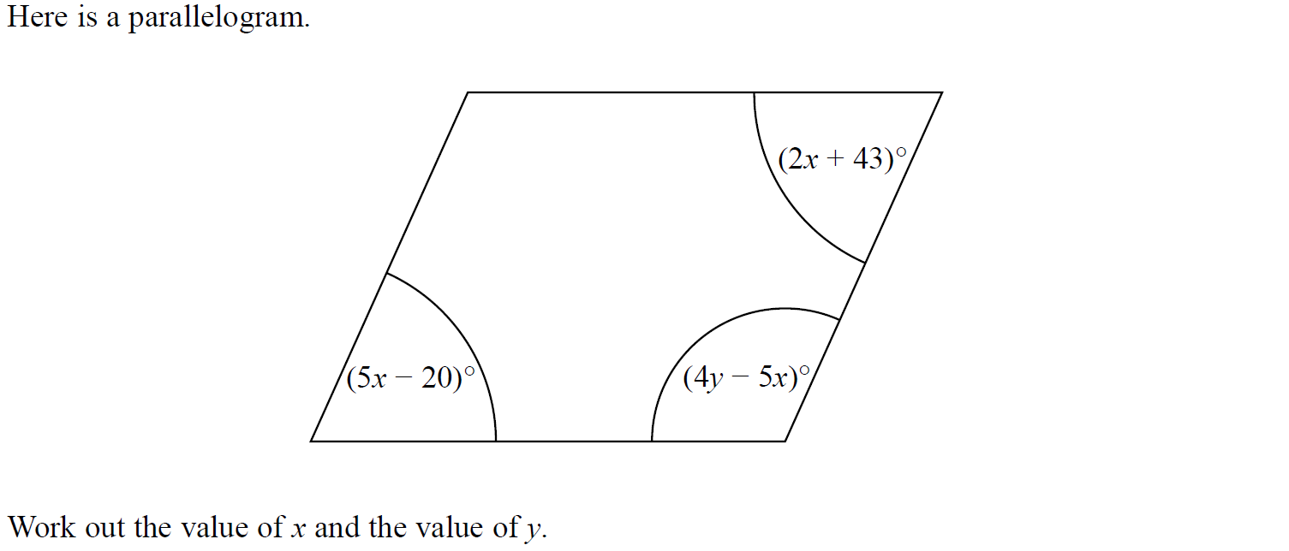
Polygons
SAM 1H Q8

Slide 5
Polygons
SAM 1H Q8
A

Slide 6
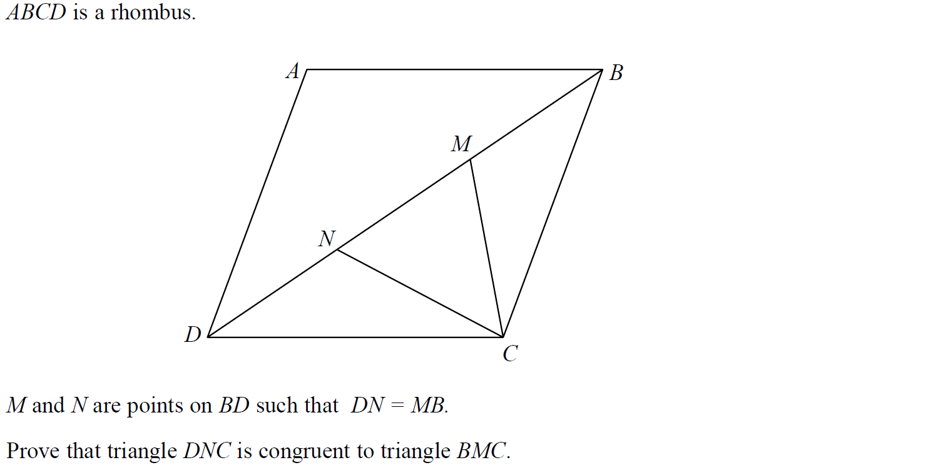
Polygons
SAM 3H Q13

Slide 7
Polygons
SAM 3H Q13
A

Slide 8
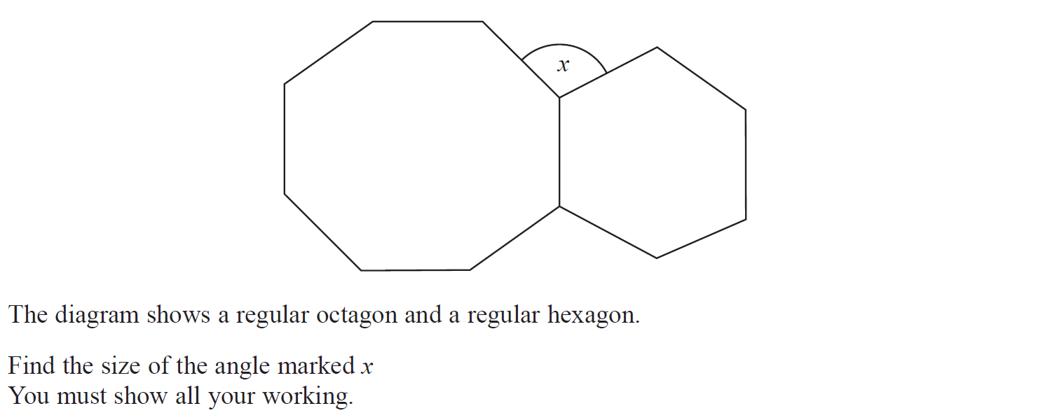
Polygons
Specimen Set 2 2H Q4

Slide 9
Polygons
Specimen Set 2 2H Q4
A

Slide 10
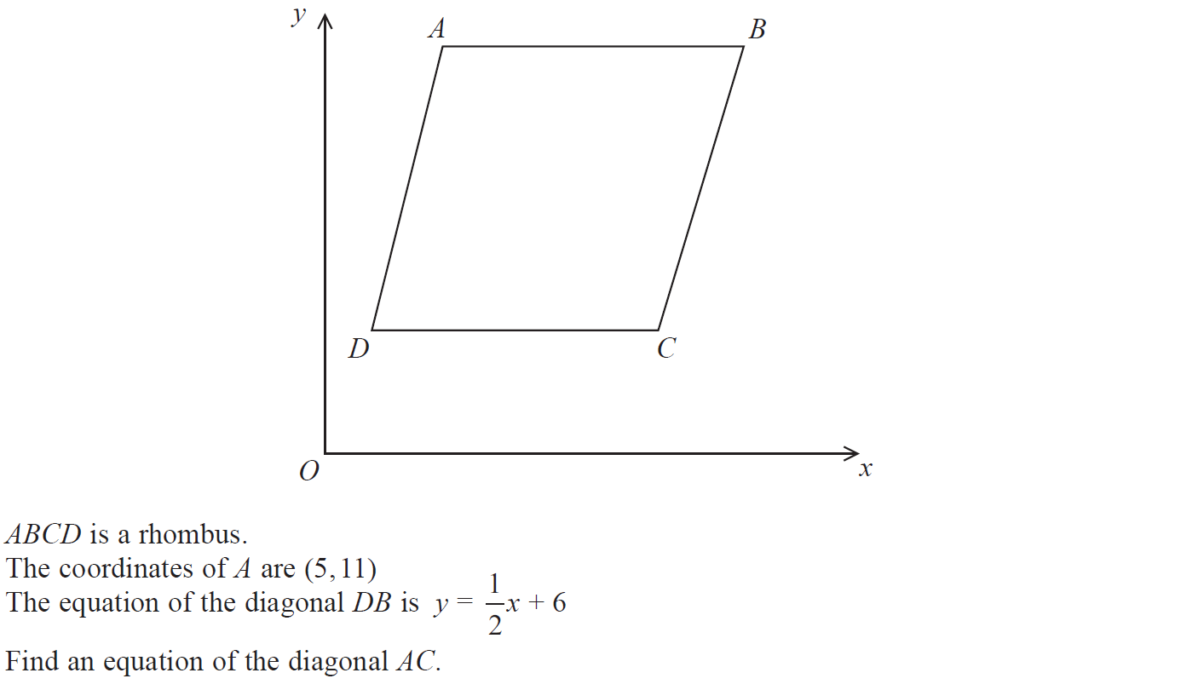
Polygons
May 2017 1H Q18

Slide 11
Polygons
May 2017 1H Q18
A

Slide 12
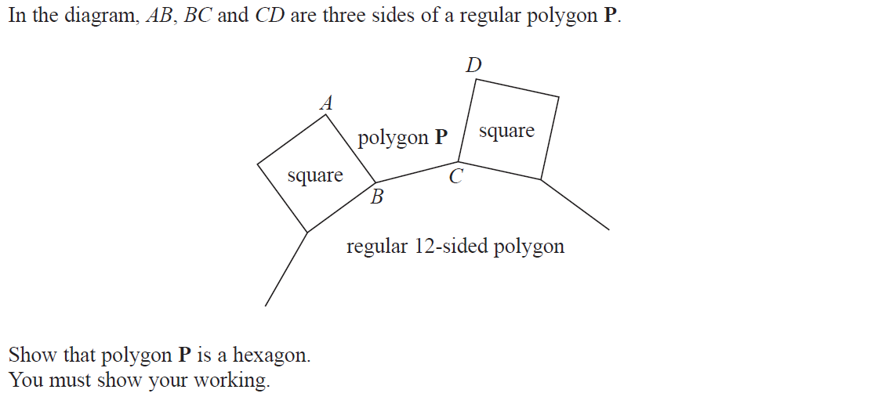
Polygons
June 2017 3H Q5

Slide 13
Polygons
June 2017 3H Q5
A

Slide 14
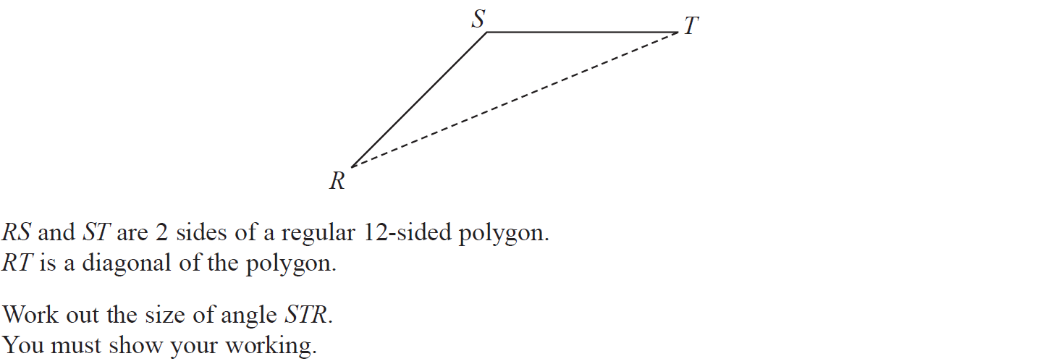
Polygons
Nov 2017 2H Q12

Slide 15
Polygons
Nov 2017 2H Q12
A

Slide 16
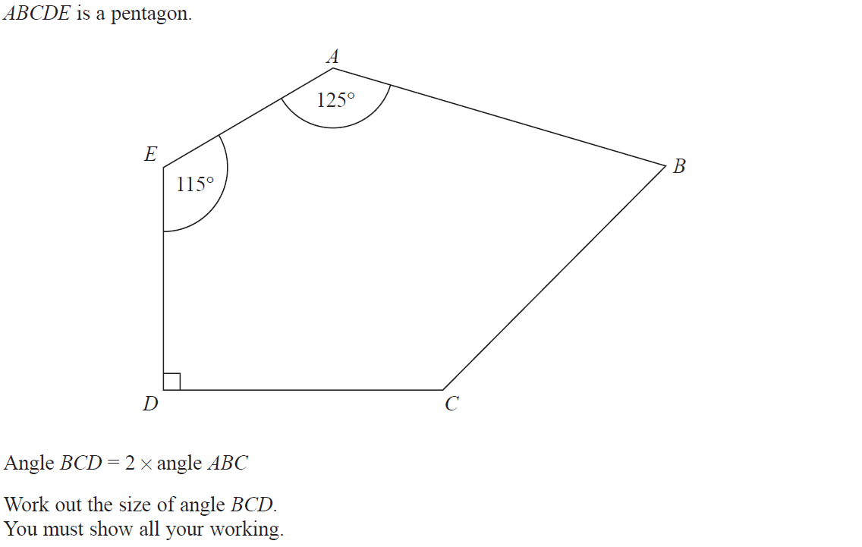
Polygons
June 2018 3H Q8

Slide 17
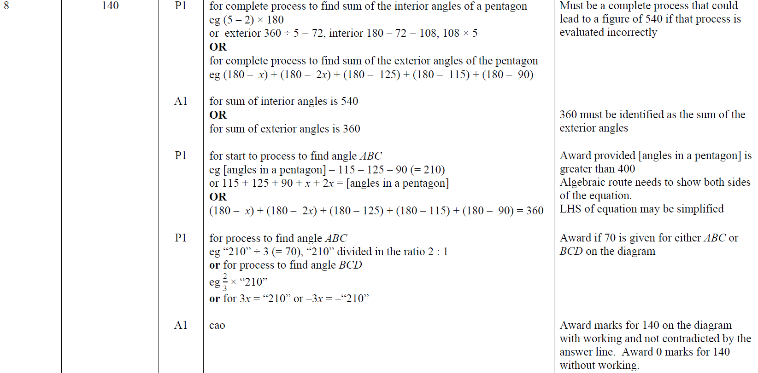
Polygons
June 2018 3H Q8
A

Slide 18
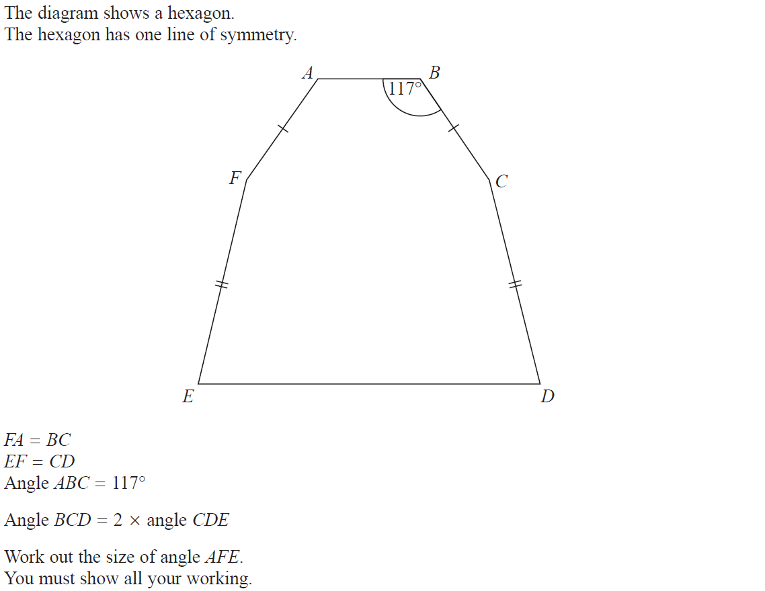
Polygons
June 2019 3H Q5

Slide 19
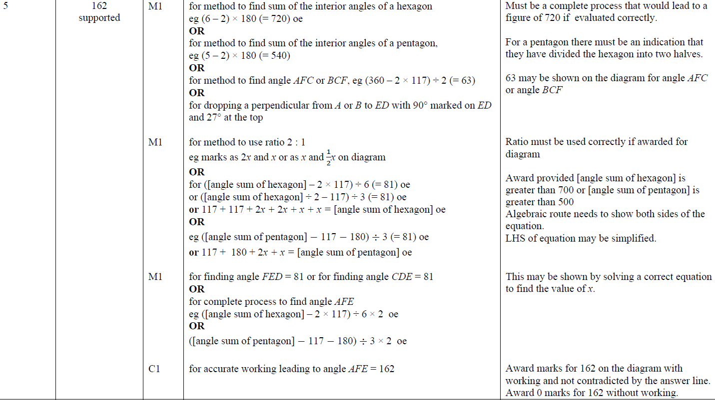
Polygons
June 2019 3H Q5
A

Slide 20
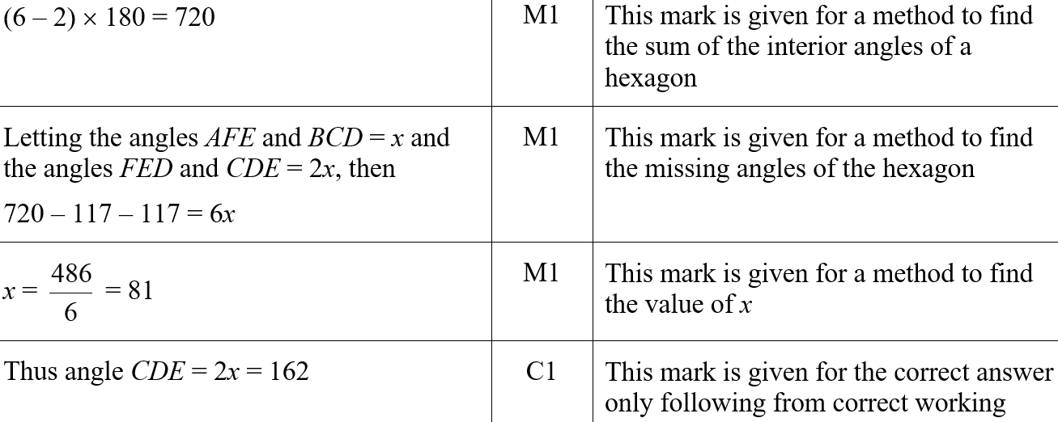
Polygons
June 2019 3H Q5
A SF

Slide 21
Polygons
SAM 3H Q9

Slide 22
Polygons
SAM 3H Q9
A

Slide 23
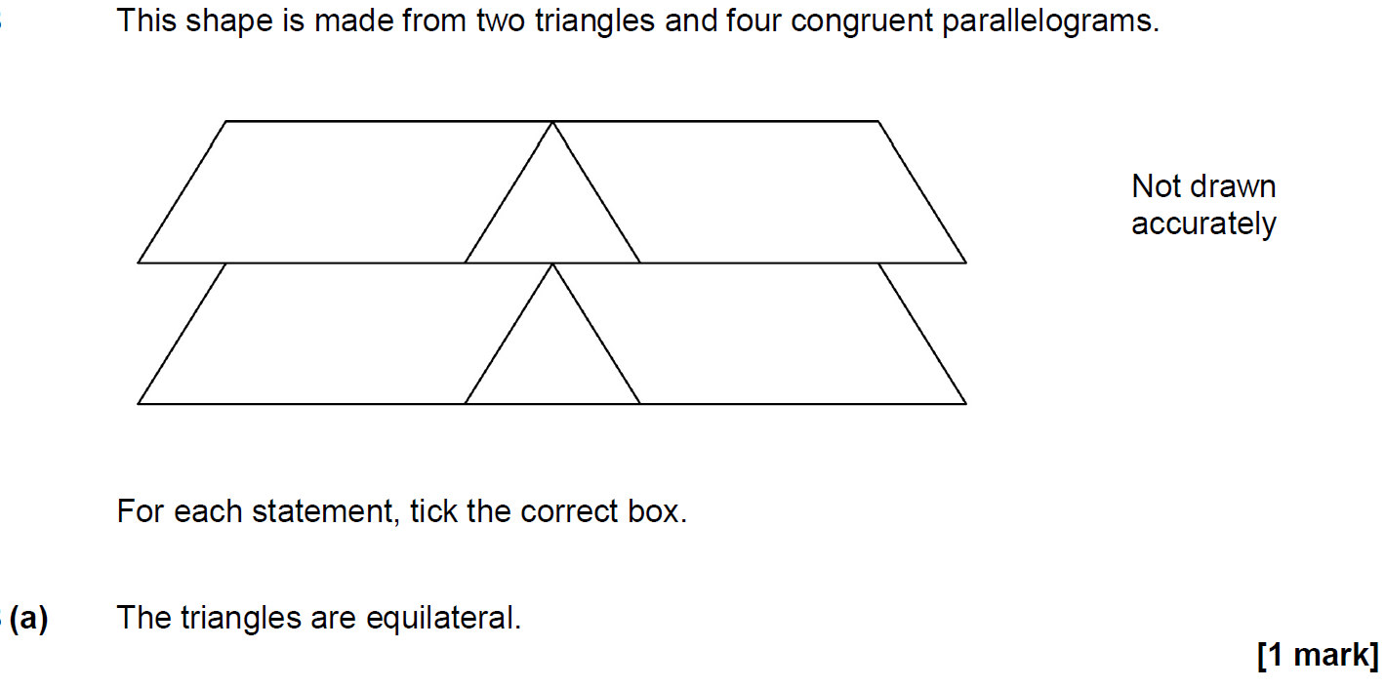
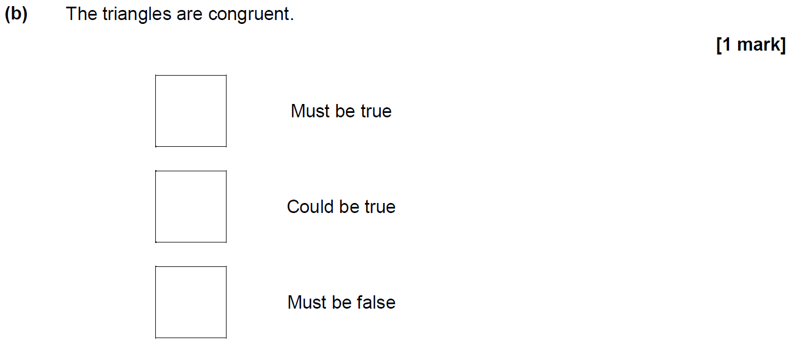
Polygons
June 2017 3H Q8

Slide 24
Polygons
June 2017 3H Q8
A
B

Slide 25
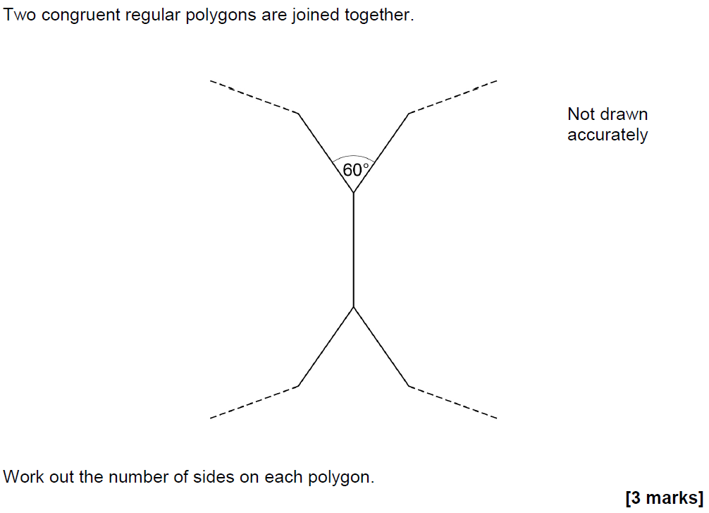
Polygons
Nov 2017 1H Q14

Slide 26
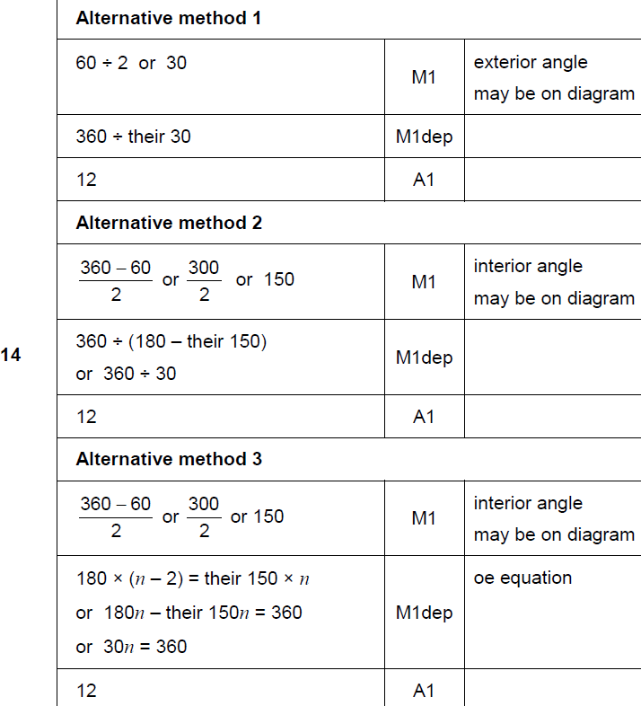
Polygons
Nov 2017 1H Q14
A

Slide 27
Polygons
June 2018 3H Q4

Slide 28
Polygons
June 2018 3H Q4
A

Slide 29
Polygons
June 2018 3H Q13

Slide 30
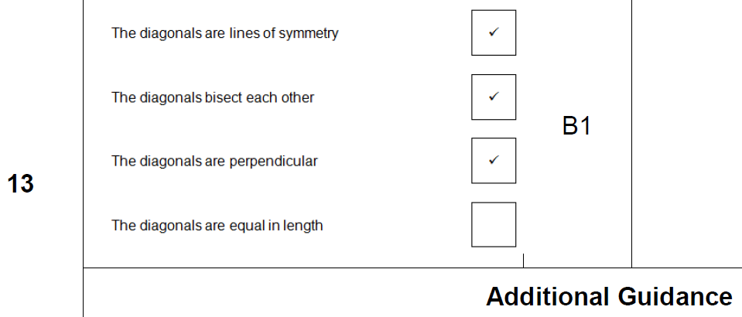
Polygons
June 2018 3H Q13
A

Slide 31
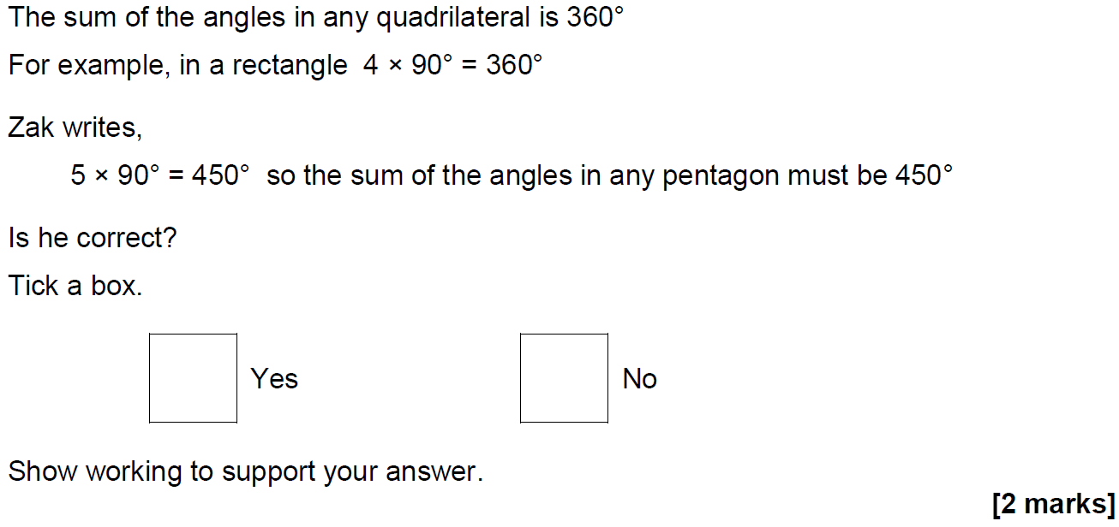
Polygons
Nov 2018 1H Q7

Slide 32
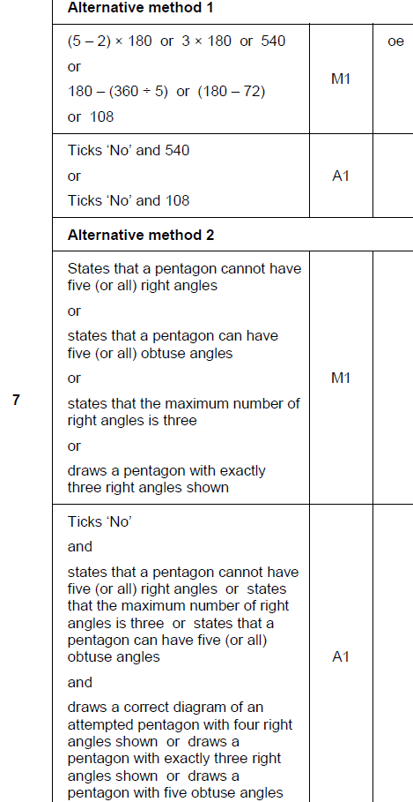
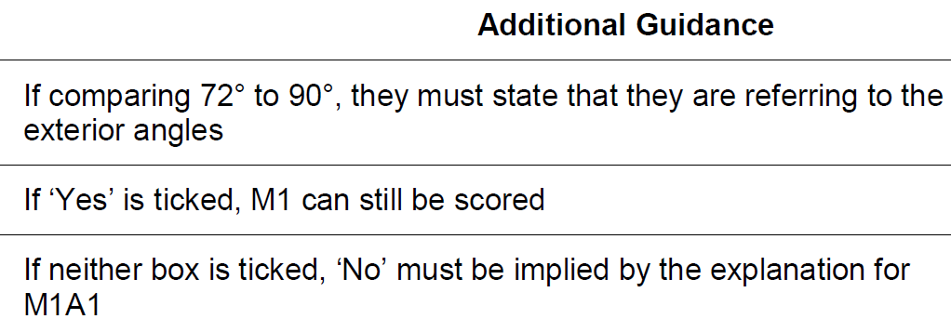
Polygons
Nov 2018 1H Q7
A

Slide 33
Polygons
Practice 1H Q4

Slide 34
Polygons
Practice 1H Q4
A

Slide 35
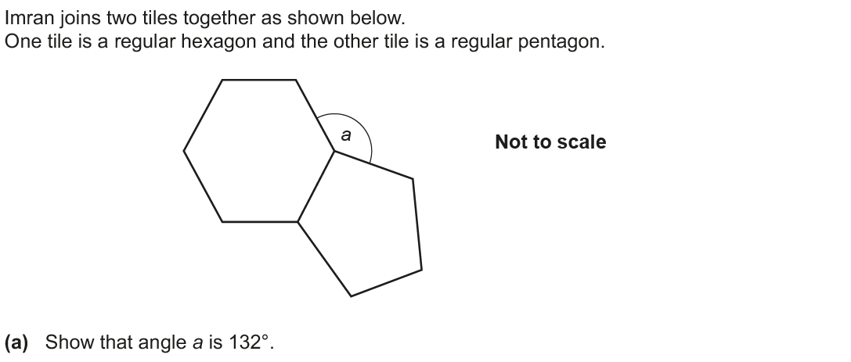
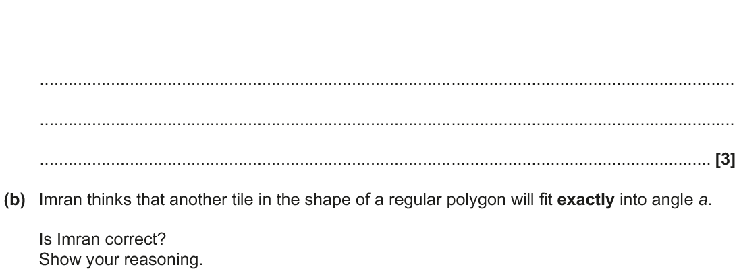
Polygons
June 2017 2H Q8

Slide 36
Polygons
June 2017 2H Q8
A
B

Slide 37
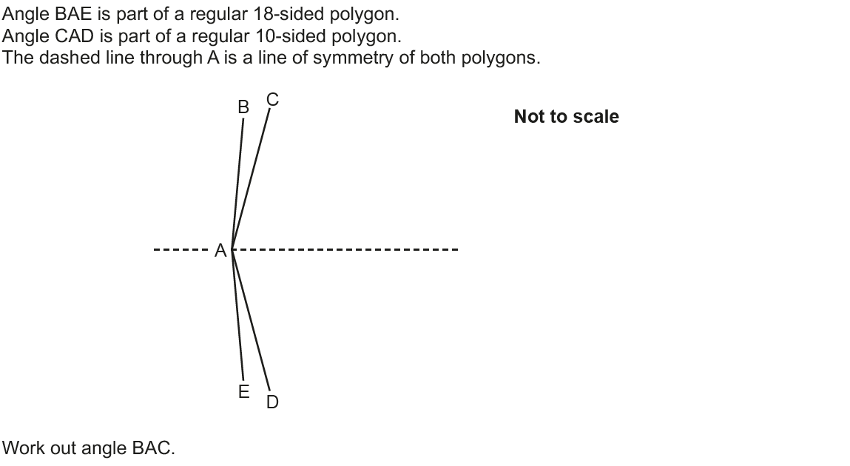
Polygons
Nov 2017 1H Q7

Slide 38
Polygons
Nov 2017 1H Q7
A

Slide 39
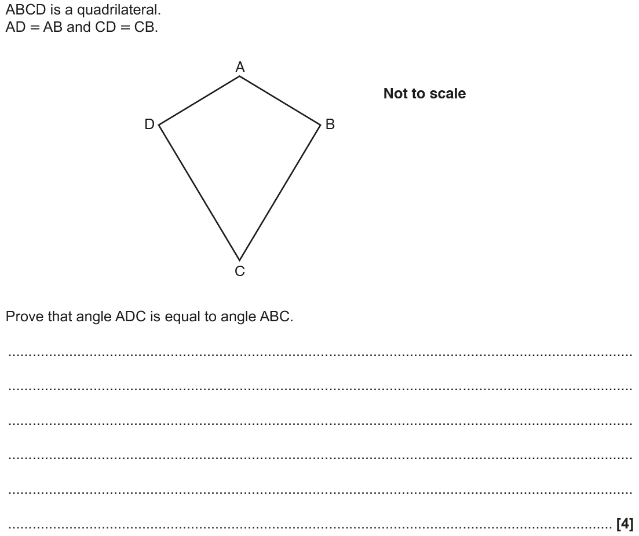
Polygons
Nov 2017 2H Q10

Slide 40
Polygons
Nov 2017 2H Q10
A

Slide 41
Polygons
Nov 2018 3H Q11

Slide 42
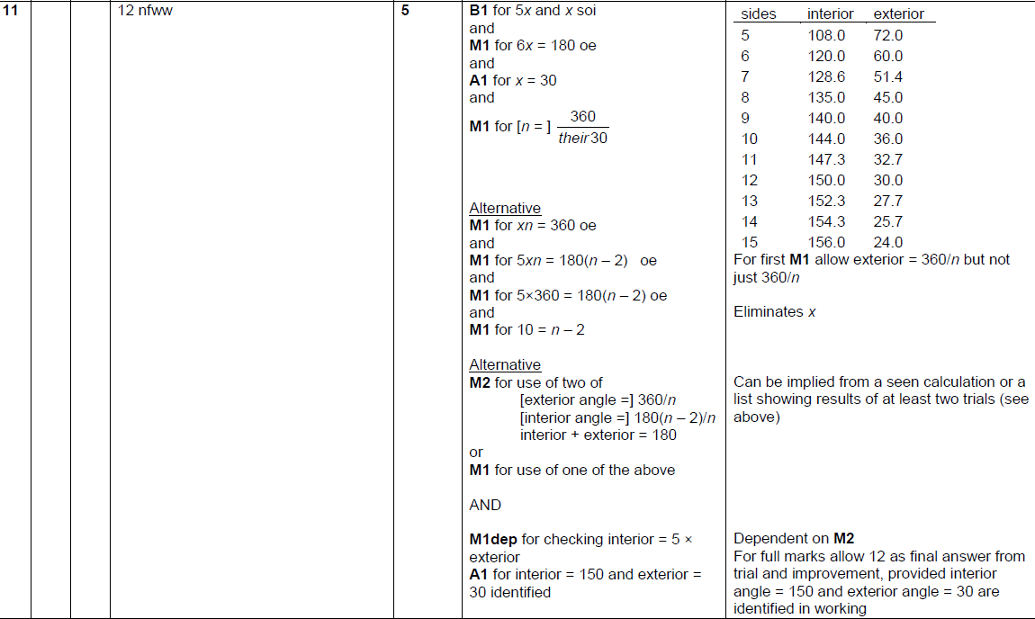
Polygons
Nov 2018 3H Q11
A

