Slide 1
Rounding to 1 Decimal Place (1DP)
4 . 8 3 2 5
4 . 8 4 2 5
4 . 8 5 2
5 or more?
5 or more?
5 or more?
No
No
Yes
4 . 8
4 . 8
4 . 9
4 . 8 7
5 . 2 6 7 1 4
1 . 9 6 7
5 or more?
5 or more?
5 or more?
Yes
Yes
Yes
4 . 9
5 . 3
2 . 0

Slide 2
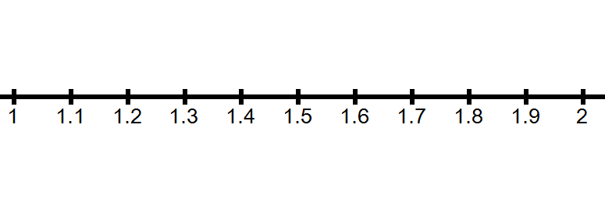

Slide 3
Rounding to Decimal Places: 2DP
4 . 8 3 2 5
4 . 8 4 6
4 . 8 5 9 5 1
5 or more?
5 or more?
5 or more?
No
Yes
Yes
4 . 8 3
4 . 8 5
4 . 8 6
1 . 6 9 4 9
5 . 2 6 7 1
1 . 8 9 7
5 or more?
5 or more?
5 or more?
No
Yes
Yes
1 . 6 9
5 . 2 7
1 . 9 0

Slide 4
Rounding to Decimal Places: 3DP
4 . 8 3 2 5
4 . 8 4 6 2
4 . 8 5 9 5
5 or more?
5 or more?
5 or more?
Yes
No
Yes
4 . 8 3 3
4 . 8 4 6
4 . 8 6 0
1 . 6 9 4 2
5 . 2 6 2 7
1 . 9 9 9 9
5 or more?
5 or more?
5 or more?
No
Yes
Yes
1 . 6 9 4
5 . 2 6 3
2 . 0 0 0

Slide 5
Rounding to Decimal Places
4 . 8 5 2
1DP
2DP
3DP
1 . 6 9 4 9
5 . 2 6 2 7
5 or more?
5 or more?
5 or more?
Yes
No
Yes
4 . 9
1 . 6 9
5 . 2 6 3
Copy &
complete
this table:
Number | To 1DP | To 2DP | To 3DP
63.4721
87.6564
149.9875
3.54029
0.59999
Your Turn

Slide 6
Number | To 1DP | To 2DP | To 3DP
63.4721
87.6564
149.9875
3.54029
0.59999
63.5
63.472
63.47
87.7
87.66
87.656
150.0
149.99
149.988
3.5
3.54
3.540
0.6
0.60
0.600

Slide 7
How could I estimate an answer without a calculator?
38.2 x 10.78
38.2 ≈ 40
10.78 ≈ 10
So…
38.2 x 10.78 ≈ 40 x 10
≈ 400

Slide 8
How could I estimate an answer without a calculator?
23.2 $÷$ 7.8
7.8 ≈ 8
23.2 ≈ 24
So…
23.2 $÷$ 7.8 ≈ 24 $÷$ 8
≈ 3
Note → 24 (not 23) was used because I saw that dividing by 8 would work

Slide 9
Without a calculator, estimate;
a) 27.2 x 51.7
b) 78.9 ÷ 1.923
c) 12% of £411.55
≈ 30 x 50
≈ 1500
≈ 80 ÷ 2
≈ 40
≈ 10% of £400
≈ £40

Slide 10
Rounding to Significant Figures (SF)
When rounding to significant figures we always look for where the first non-zero value is
Eg. Round this number to 3 SF
0 0 3 0 . 6 4 3 3 2
1
This is our first significant figure, every number after this is now also a significant figure – even if it is 0!
0 0 3 0 . 6 4 3 3 2
1
2
3

Slide 11
Rounding to Significant Figures (SF)
Here is a second example
Eg. Round this number to 2 SF
0 0 0 0 . 0 0 3 3 7
1
This is our first significant figure, every number after this is now also a significant figure – even if it is 0!
0 0 0 0 . 0 0 3 3 7
4
1
2

Slide 12
Rounding to 1 Significant Figure (1SF)
0 . 0 7 6 5
0 . 0 0 1 2
1 . 0 0 9 5
5 or more?
5 or more?
5 or more?
Yes
No
No
0 . 0 8
0 . 0 0 1
1
2 4 1
5 8 7
7 5
5 or more?
5 or more?
5 or more?
No
Yes
Yes
2 0 0
6 0 0
8 0

Slide 13
Rounding to 2 Significant Figure (2SF)
1 4 7 2
1 . 4 2 7 9
0 . 0 5 3 5
5 or more?
5 or more?
5 or more?
Yes
No
Yes
1 5 0 0
1 . 4
0 . 0 5 4
4 2 7 2 8
2 0 4 4 7 8
0 . 0 6 9 6
5 or more?
5 or more?
5 or more?
Yes
No
Yes
4 3 0 0 0
2 0 0 0 0 0
0 . 0 7 0

Slide 14
Rounding to 3 Significant Figure (3SF)
0 . 0 2 6 7 1
3 . 2 9 4 9
3 4 7 2 8
5 or more?
5 or more?
5 or more?
No
No
No
0 . 0 2 6 7
3 . 2 9
3 4 7 0 0
1 3 7 9 8
9 7 4 9 7 8
1 2 . 0 6 9
5 or more?
5 or more?
5 or more?
Yes
Yes
Yes
1 3 8 0 0
9 7 5 0 0 0
1 2 . 1

Slide 15
Rounding to Significant Figures
0 . 0 7 6 5
1SF
4 2 7 2 8
2SF
1 2 . 0 6 9
3SF
5 or more?
5 or more?
5 or more?
Yes
Yes
Yes
0 . 0 8
4 3 0 0 0
1 2 . 1
Copy &
complete
this table:
Number | To 1SF | To 2SF | To 3SF
6.3528
34.026
0.005708
150.932
0.00007835
Your Turn

Slide 16
Number | To 1SF | To 2SF | To 3SF
6.3528
34.026
0.005708
150.932
0.00007835
6
6.4
6.35
30
34
34.0
0.006
0.0057
0.00571
200
150
151
0.00008
0.000078
0.0000784

