Slide 1
Mechanics Past Paper Questions
Revision Past Paper Questions
Go back to home screen to select a topic
Go back to topic screen to select a question
Go to the mark scheme for that question
Go back to the question from the mark scheme
Or see more solutions
Or go back to first solutions
Next

Slide 2
Notes on operating this resource
When creating this, I used and to quickly navigate between slides directly before or after the slide in question.
As some mark schemes give additional notes, you can continue to see answers by clicking but you will not return to the original question with one click of .
To view the original question again, continue to click which should take you back.
Next

Slide 3
Notes on Edexcel Mechanics Questions
There is some overlap between topics
Throughout the topics, F=ma can be necessary as well as the SUVAT equations.
Edexcel have provided ‘student-friendly’ mark schemes to help explain where marks are awarded along with expected student solutions. These have been attached where possible in addition to the official mark scheme and labelled SF
Next

Slide 4
Home
Kinematics (SUVAT)
Kinematics (time-series graphs)
Kinematics (connected particles)
Vectors
Algebraic Models / Calculus

Slide 5
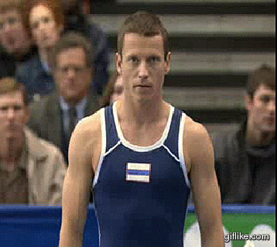
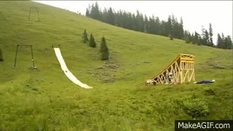
New Spec Q’s
Old Spec Kinematics (SUVAT)
Jan 2006
May 2011
June 2006
Jan 2012
Jan 2007
May 2012
Jan 2008
May 2013
May 2008
June 2015
May 2009
June 2017
May 2010
June 2018
Jan 2011

Slide 6
Jan 2006

Slide 7
Jan 2006
A
B

Slide 8
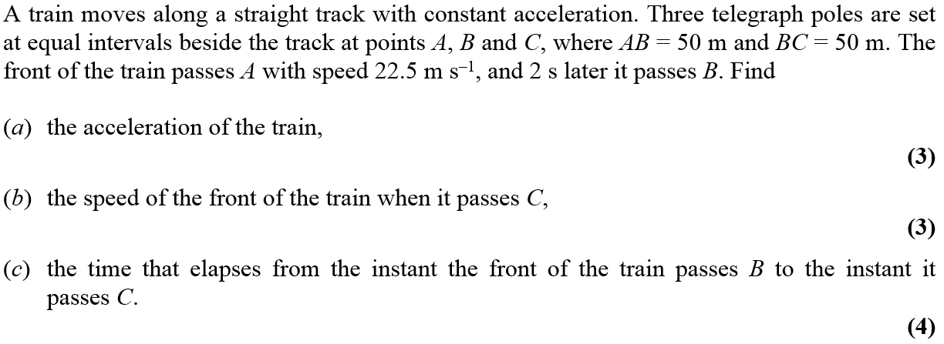
June 2006

Slide 9
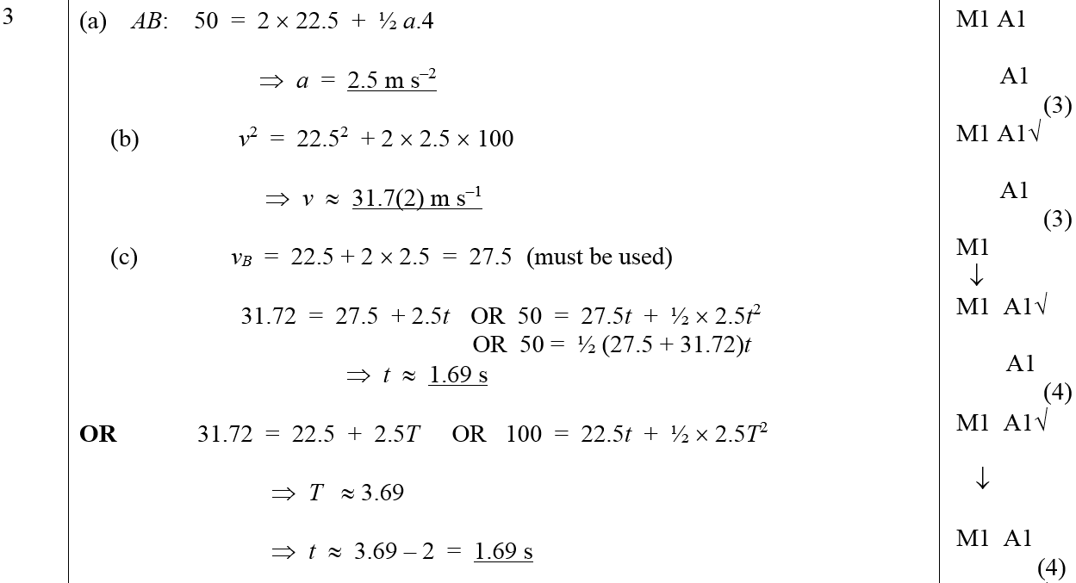
June 2006
A
B
C
Alternative C (i)
Alternative C (ii)

Slide 10
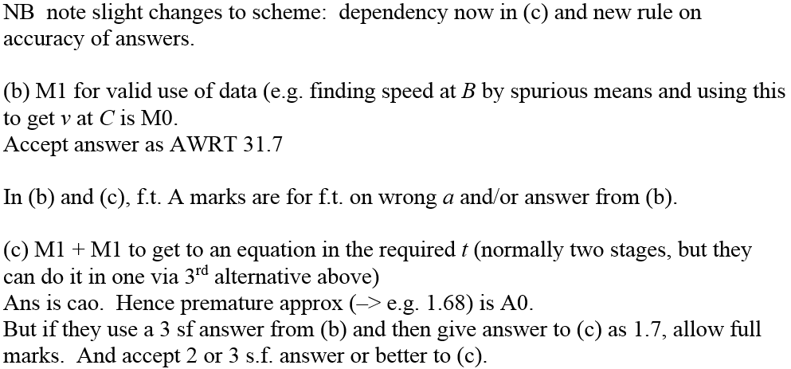
June 2006
B & C Notes

Slide 11
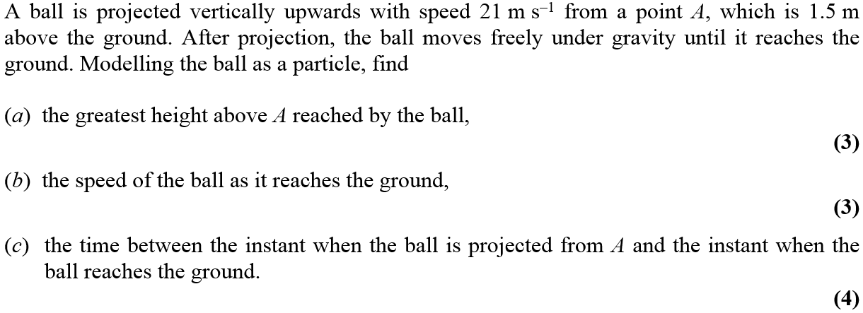
Jan 2007

Slide 12
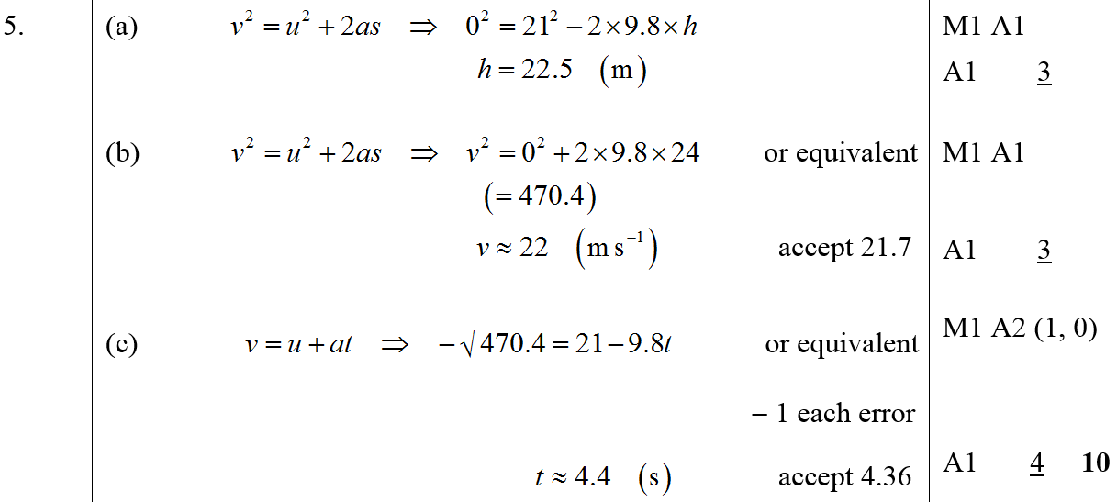
Jan 2007
A
B
C

Slide 13
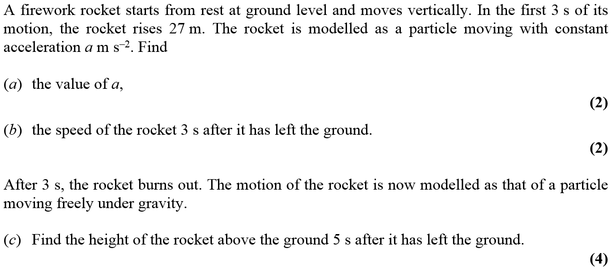
Jan 2008

Slide 14
Jan 2008
A
B
C

Slide 15
May 2008

Slide 16
May 2008
A
B

Slide 17
May 2009

Slide 18
May 2009
A

Slide 19
May 2010

Slide 20
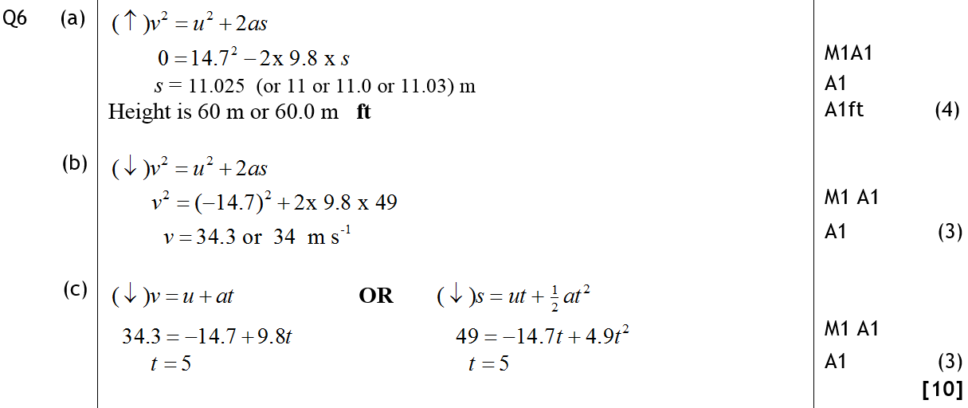
May 2010
A
B
C

Slide 21
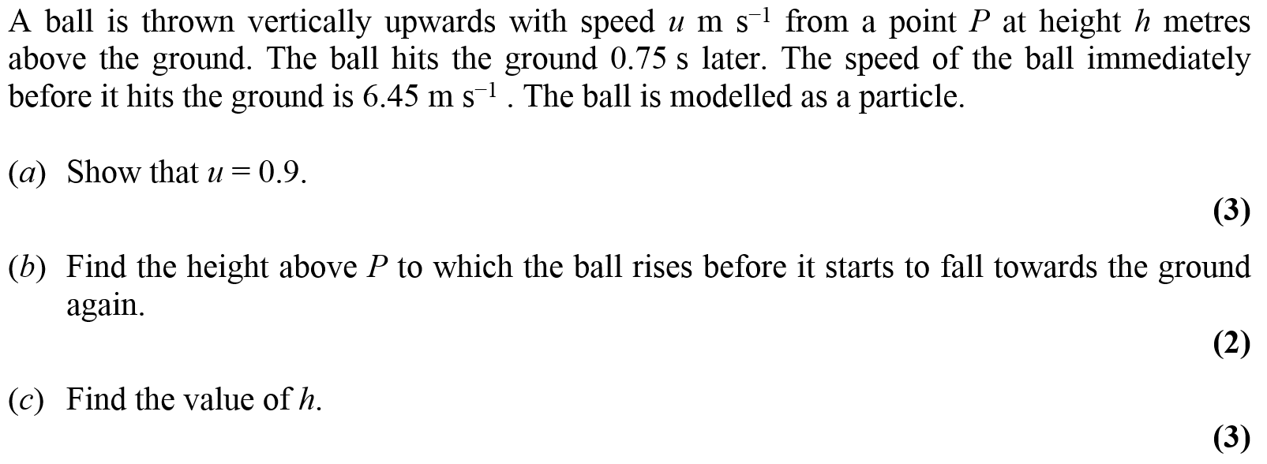
Jan 2011

Slide 22
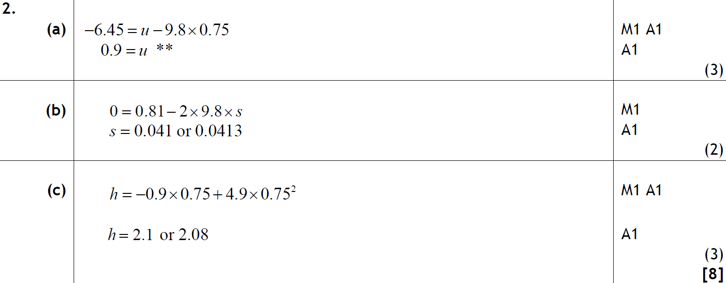
Jan 2011
A
B
C

Slide 23
May 2011

Slide 24
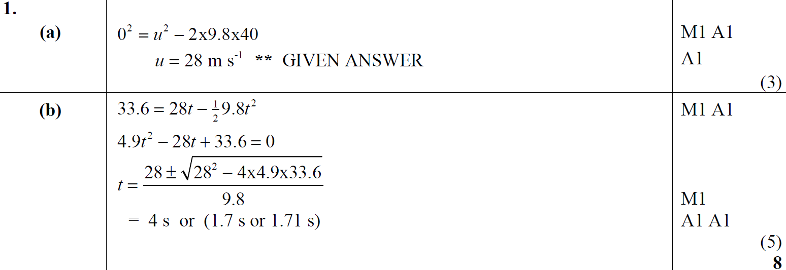
May 2011
A
B

Slide 25
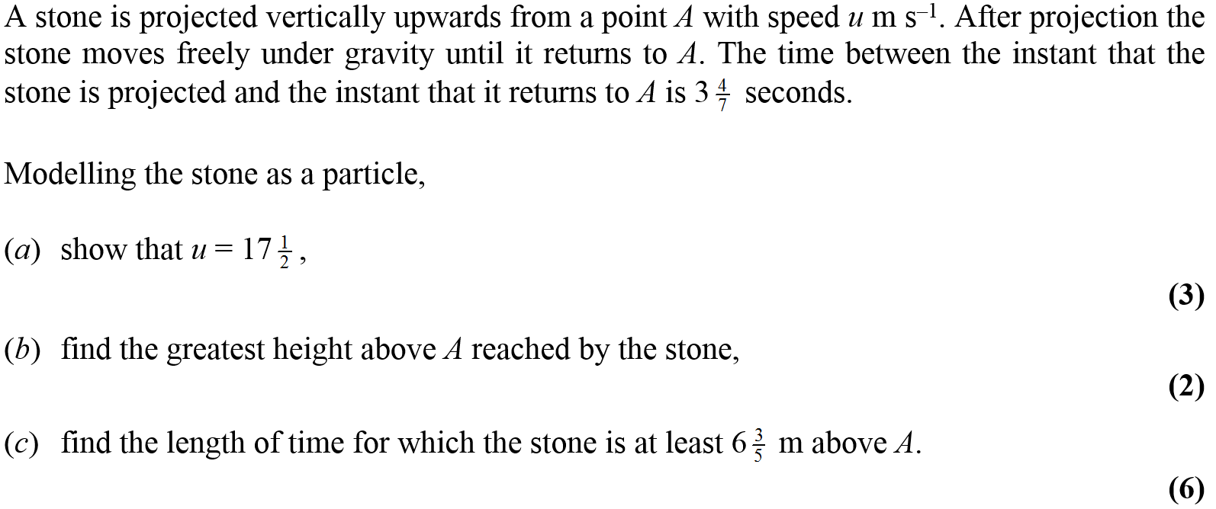
Jan 2012

Slide 26
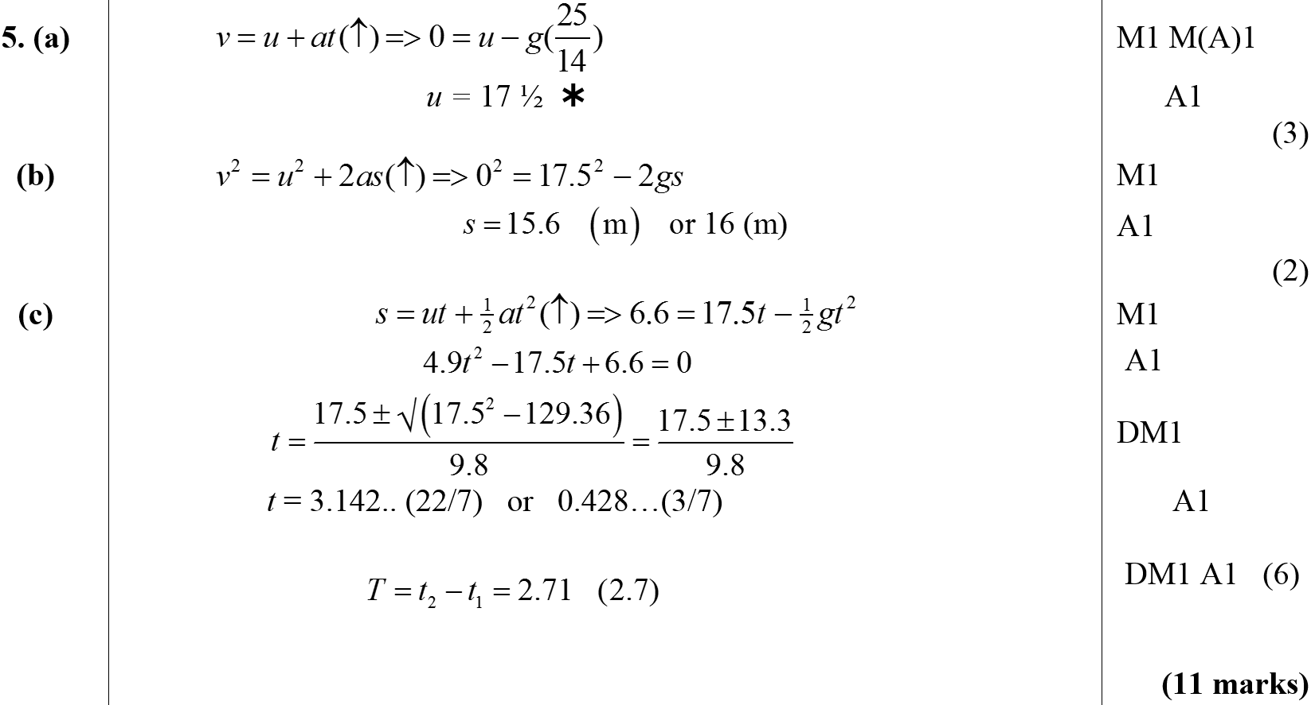
Jan 2012
A
B
C

Slide 27
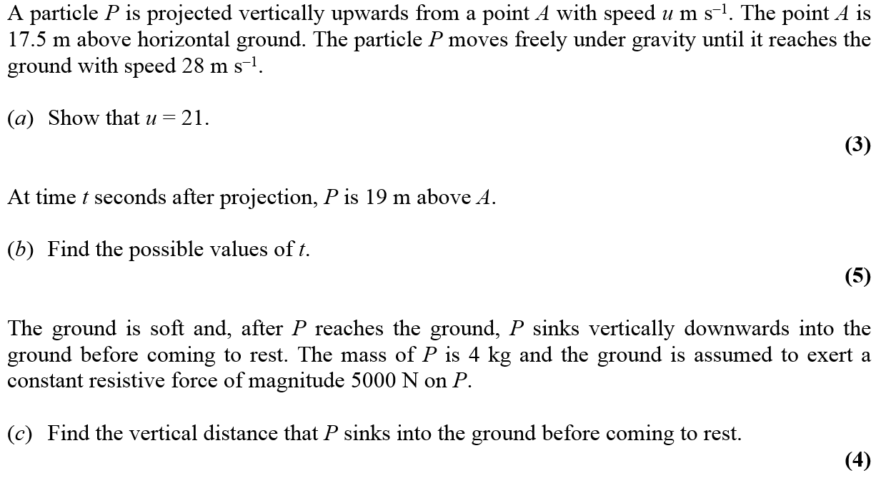
May 2012

Slide 28
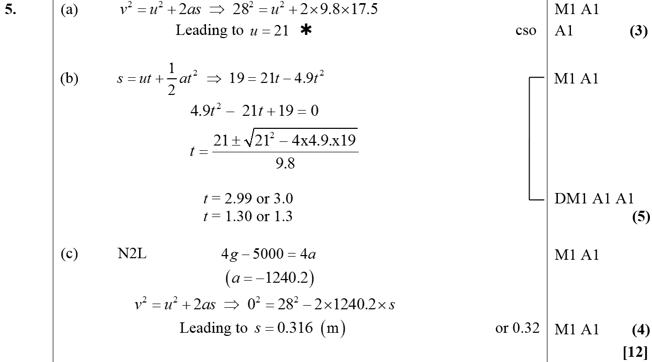
May 2012
A
B
C

Slide 29
May 2013

Slide 30
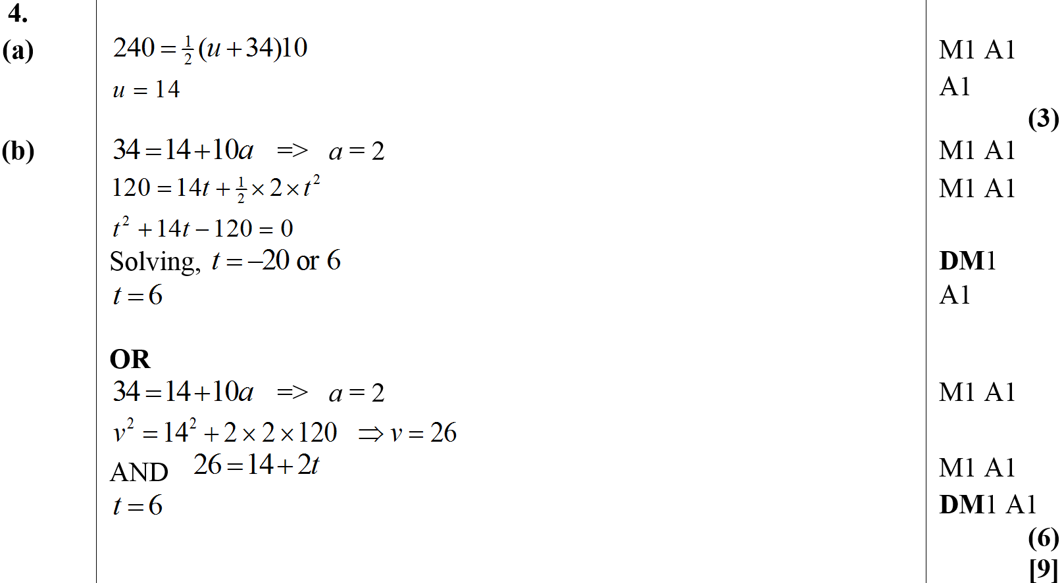
May 2013
A
B
Alternative B

Slide 31
June 2015

Slide 32
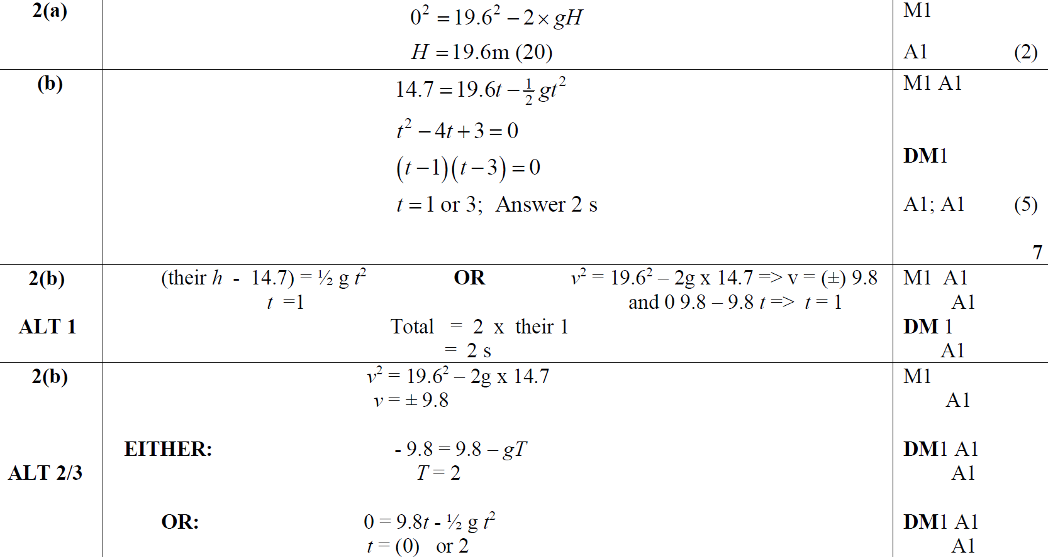
June 2015
A
B
B Alternative 1
B Alternative 2 & 3

Slide 33
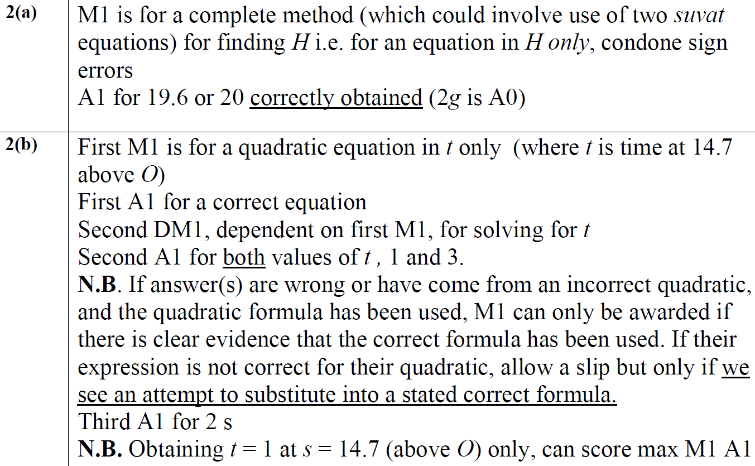
June 2015
A Notes
B Notes

Slide 34
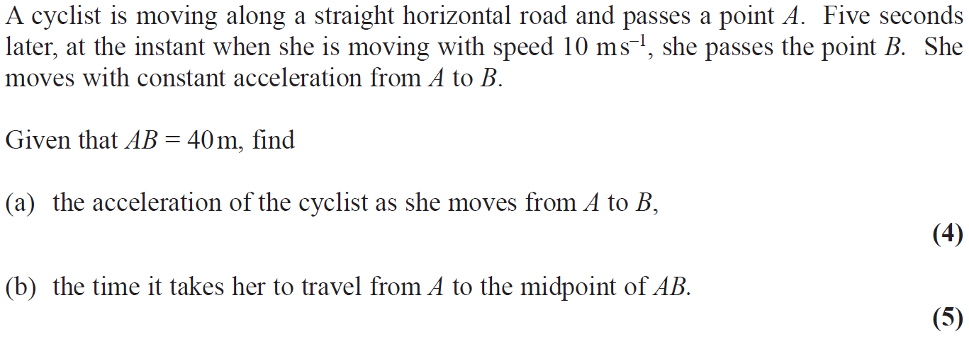
June 2017

Slide 35
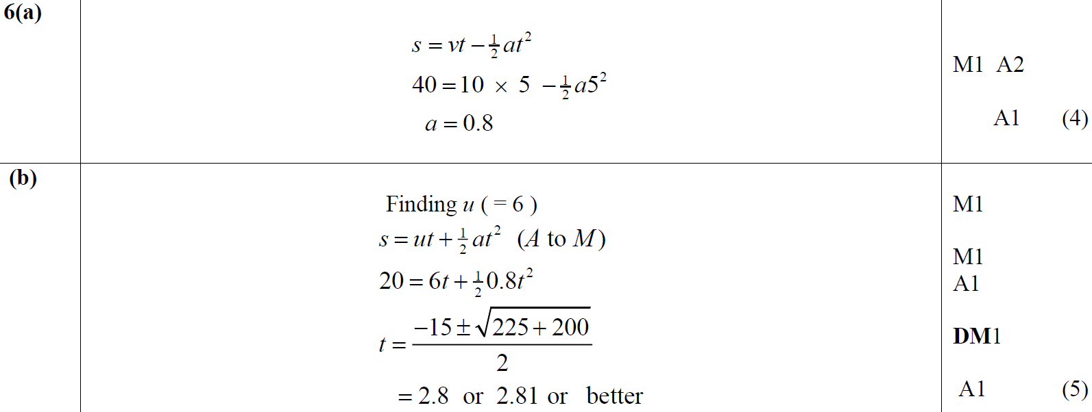
June 2017
A
B

Slide 36
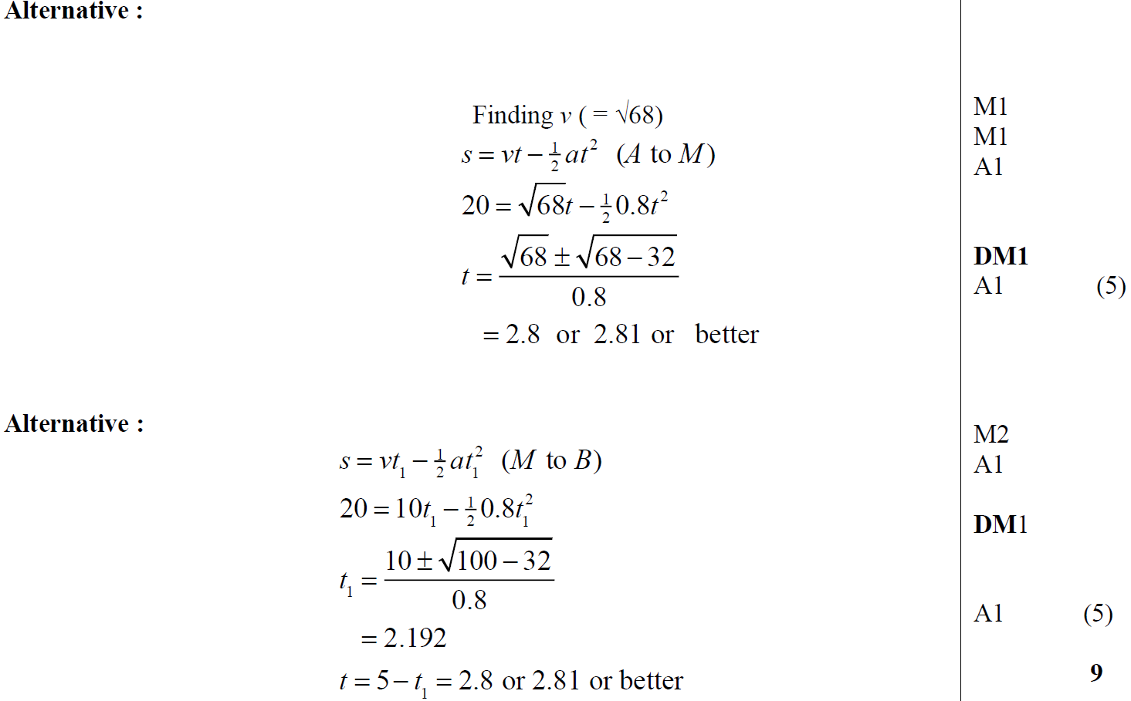
June 2017
B Alternative 1
B Alternative 2

Slide 37
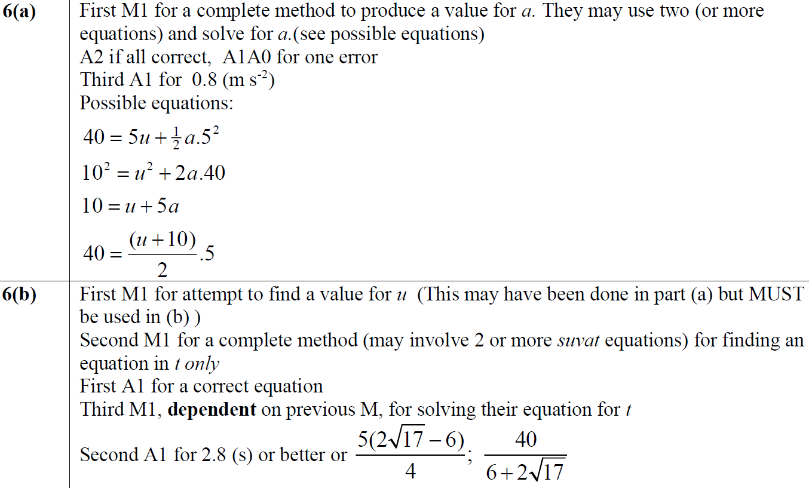
June 2017
A Notes
B Notes

Slide 38
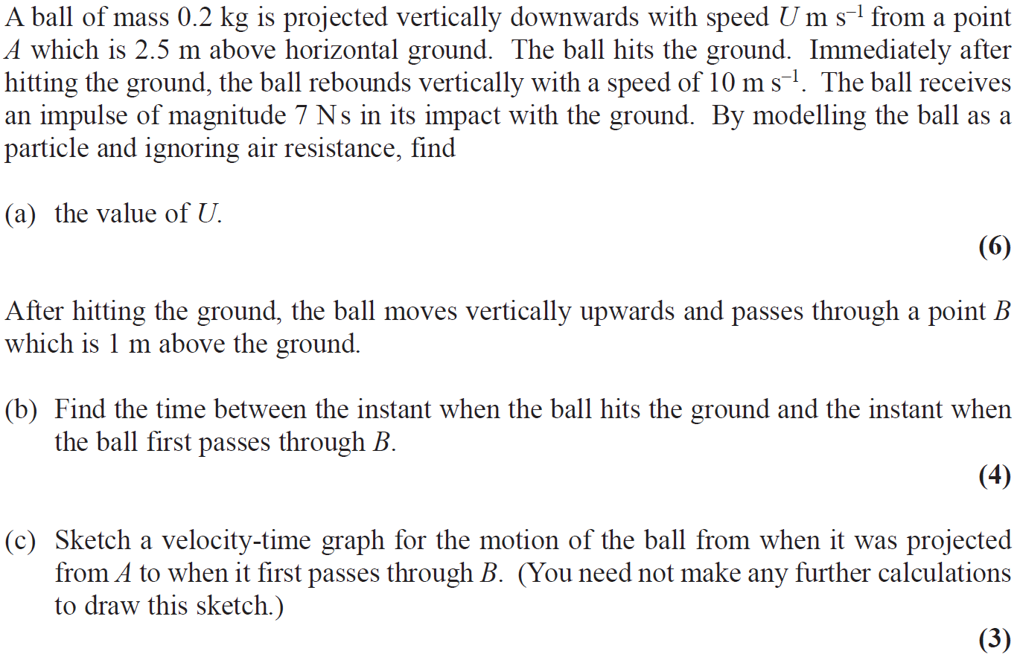
June 2018

Slide 39
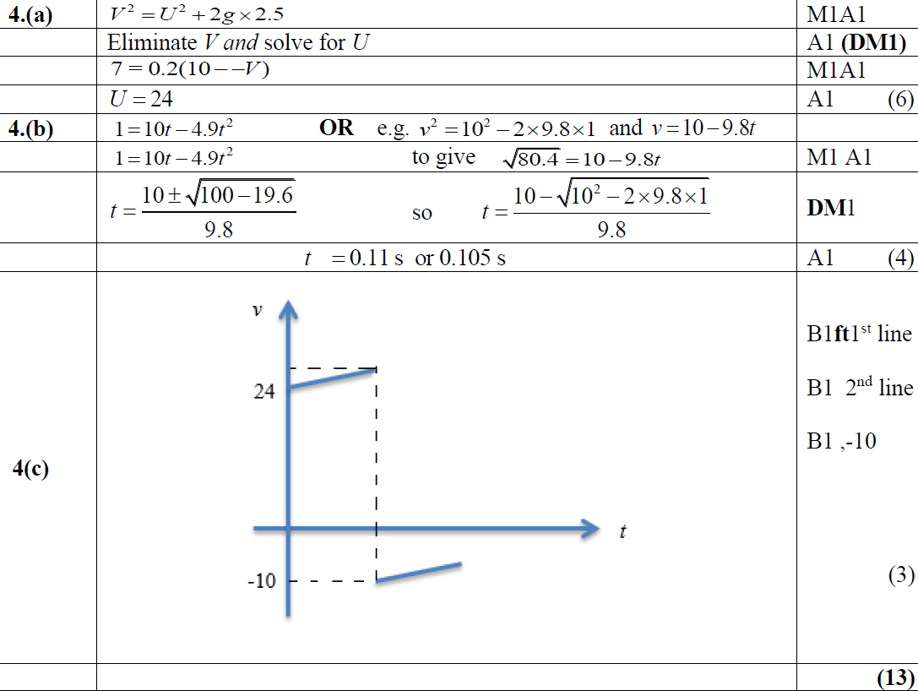
June 2018
A
B
C

Slide 40
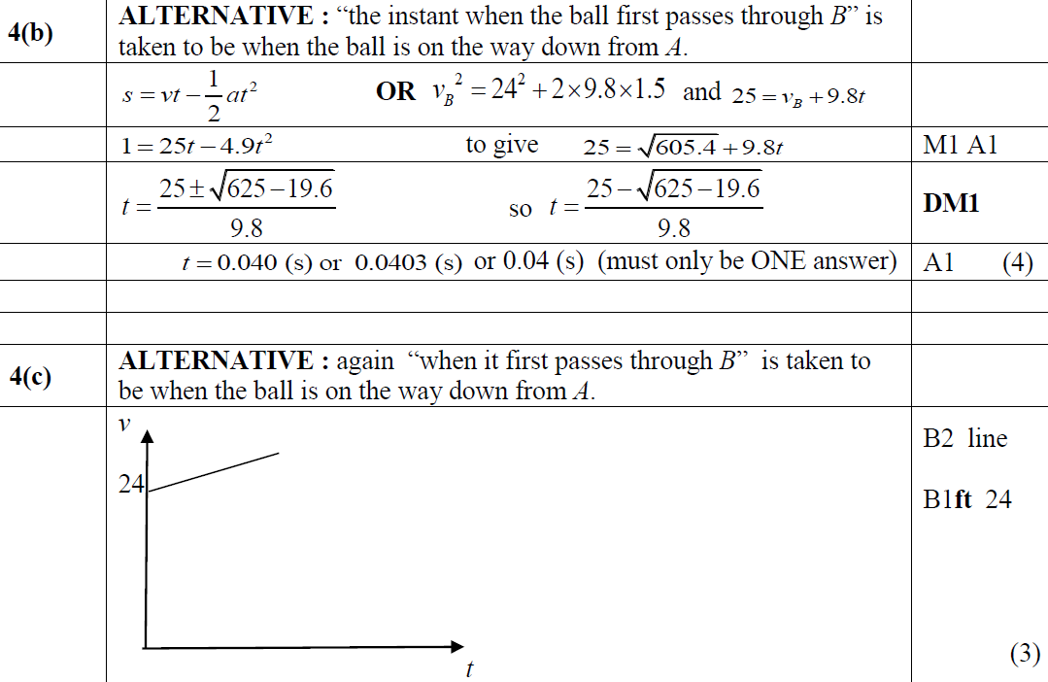
June 2018
B Alternative
C Alternative

Slide 41
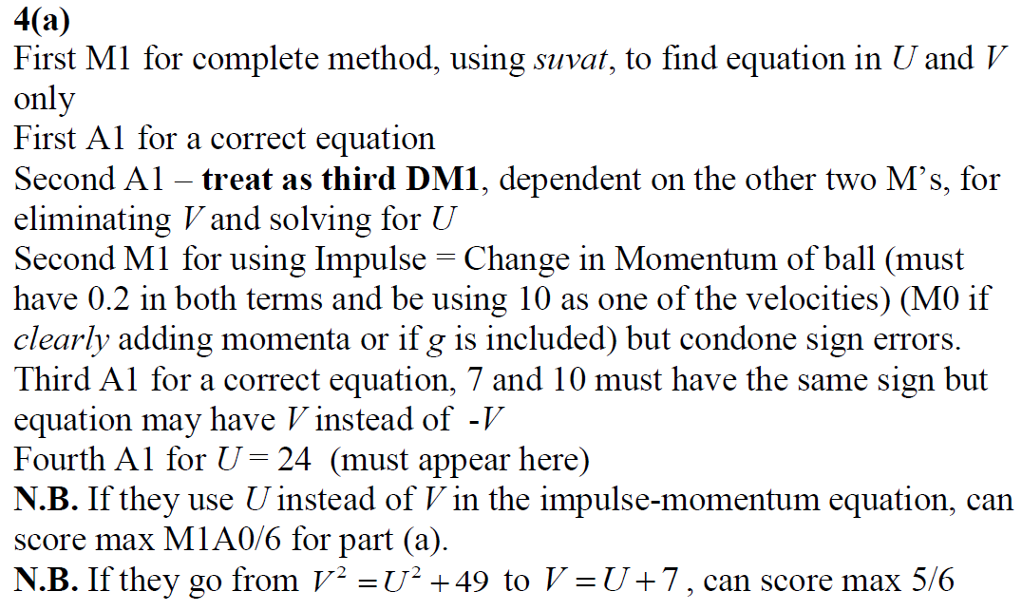
June 2018
A Notes

Slide 42
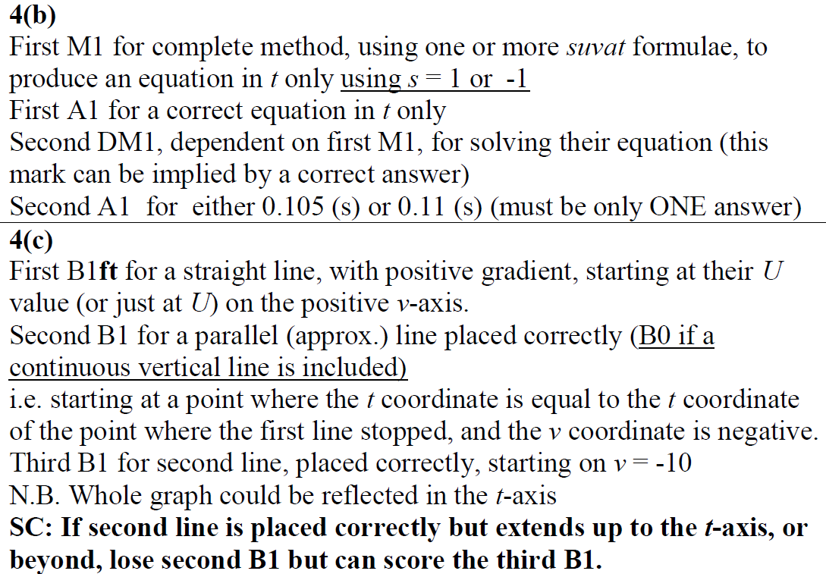
June 2018
B Notes
C Notes

Slide 43
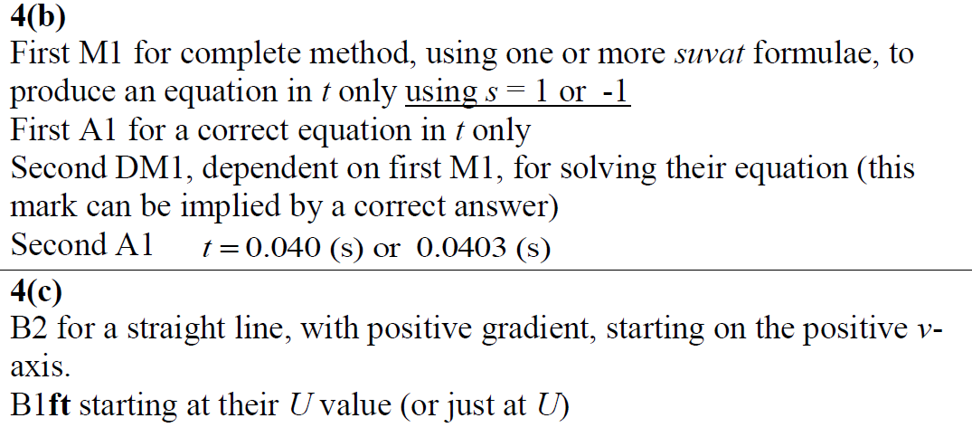
June 2018
B Further Notes
C Further Notes

Slide 44
Old Spec Q’s
Kinematics (SUVAT)
Practice E (i)
Practice E (ii)
Practice F
Practice G
Practice I (i)
Practice I (ii)
Specimen
SAM
2018

Slide 45
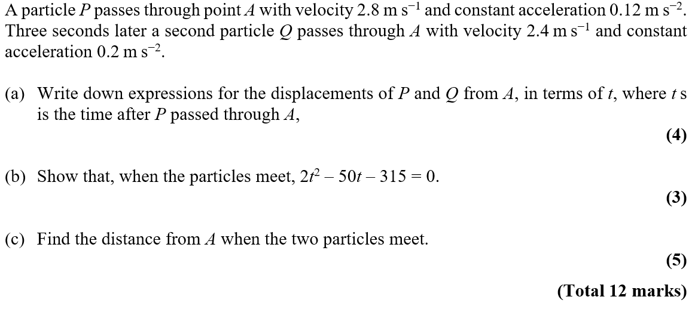
Practice E

Slide 46
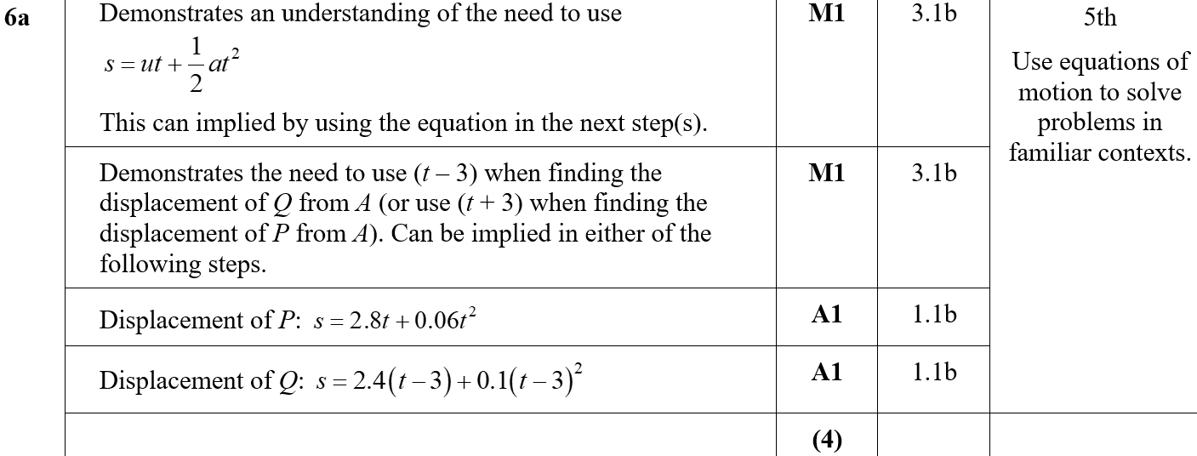
Practice E
A
A notes

Slide 47
Practice E
B

Slide 48
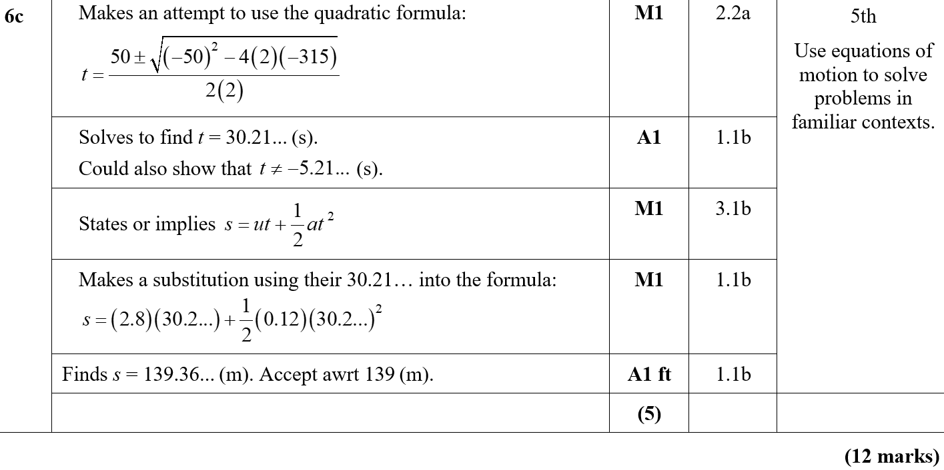
Practice E
C
C notes

Slide 49
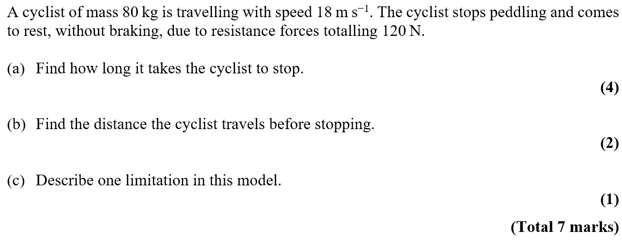
Practice E

Slide 50
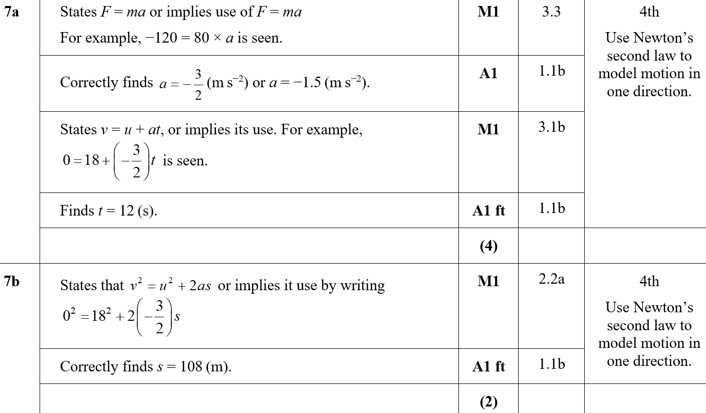
Practice E
A
B

Slide 51
Practice E
C
A notes
B notes

Slide 52
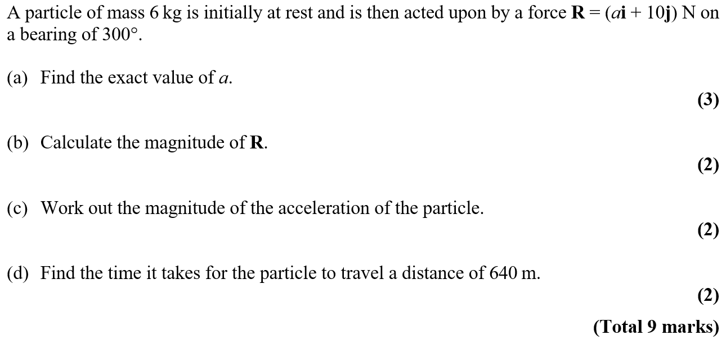
Practice F

Slide 53
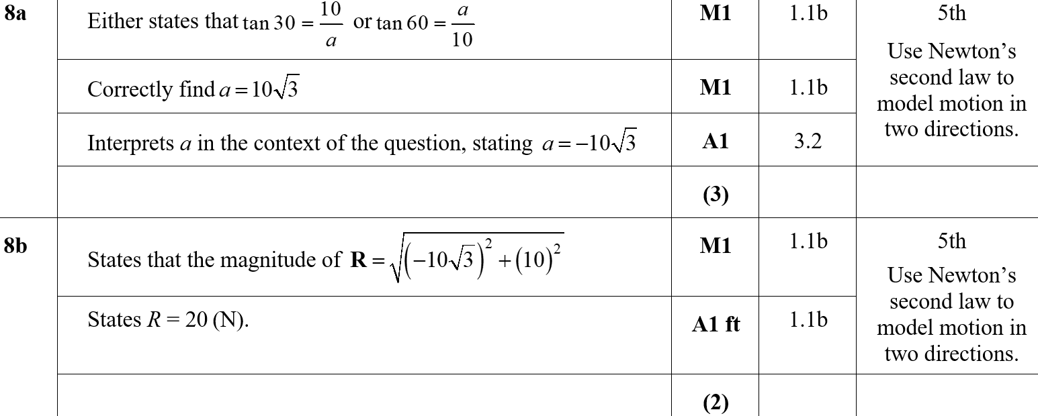
Practice F
A
B
B notes

Slide 54
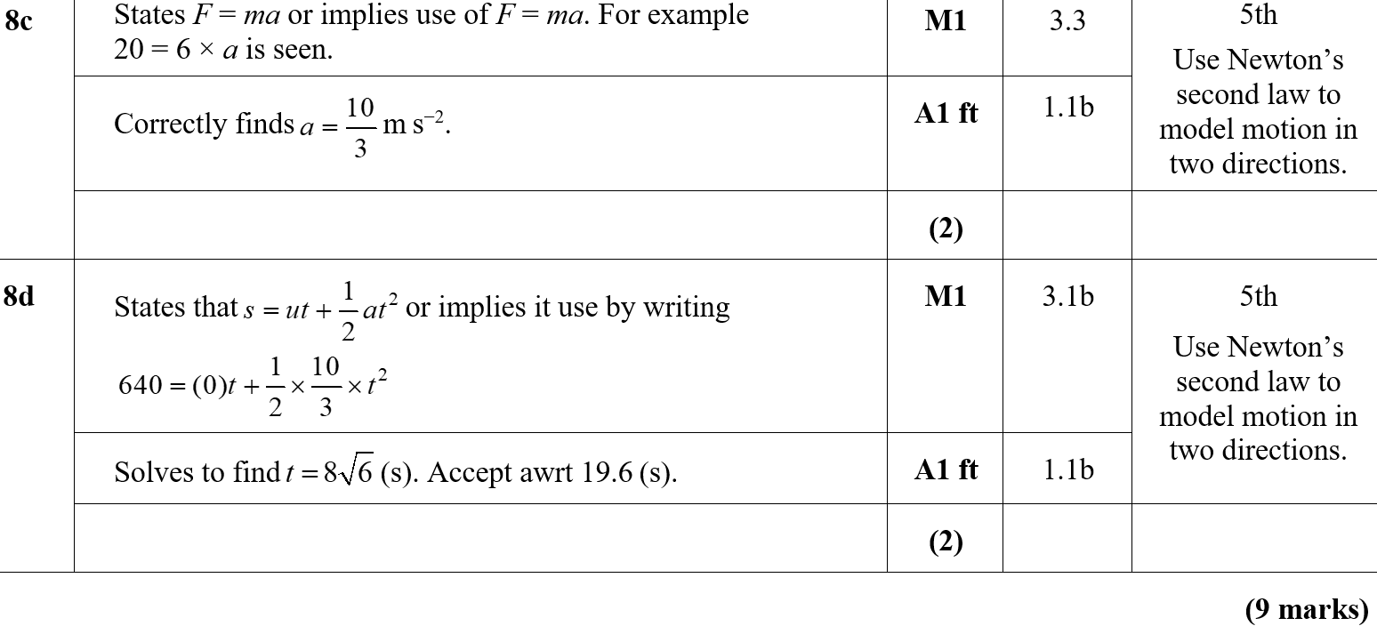
Practice F
C
D
C notes
D notes

Slide 55
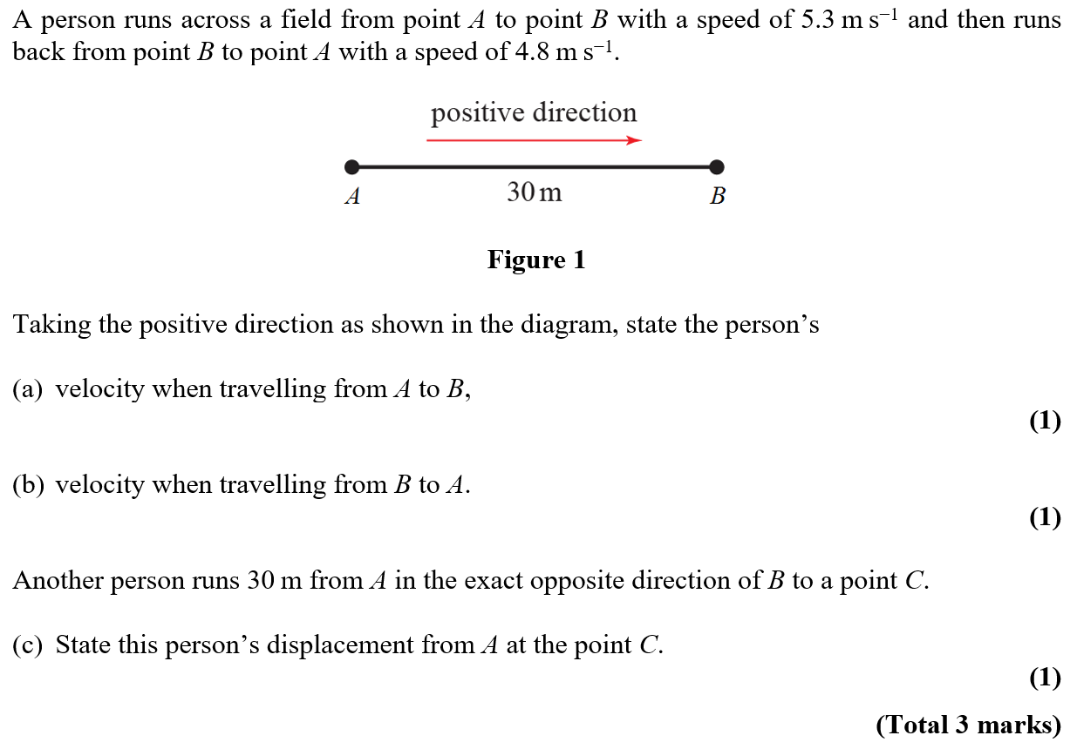
Practice G

Slide 56
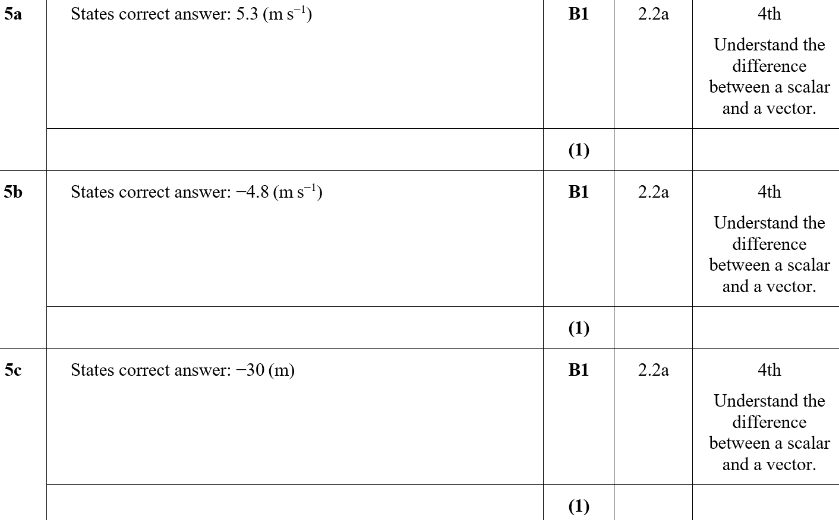
Practice G
A
B
C

Slide 57
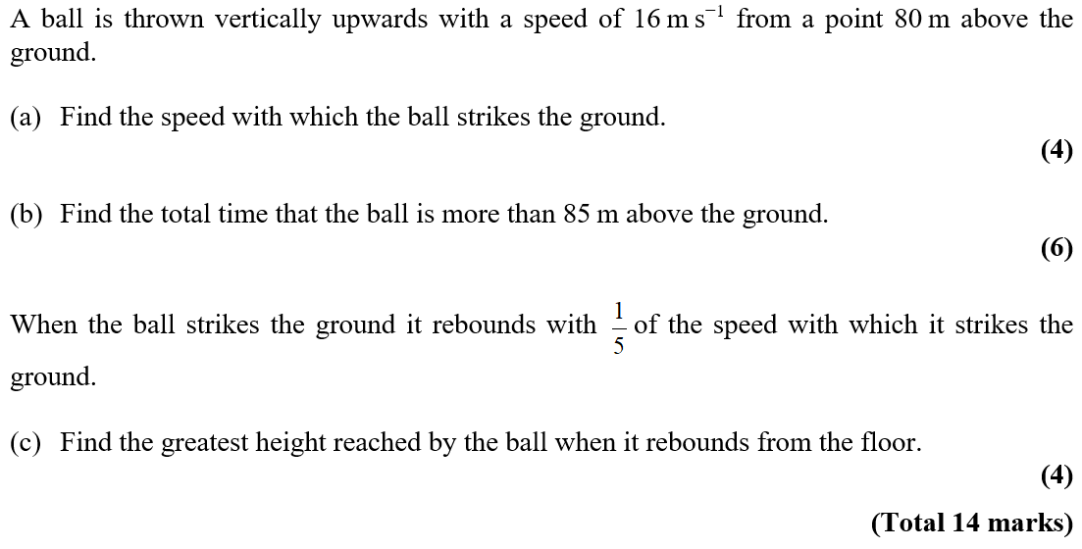
Practice I

Slide 58
Practice I
A

Slide 59
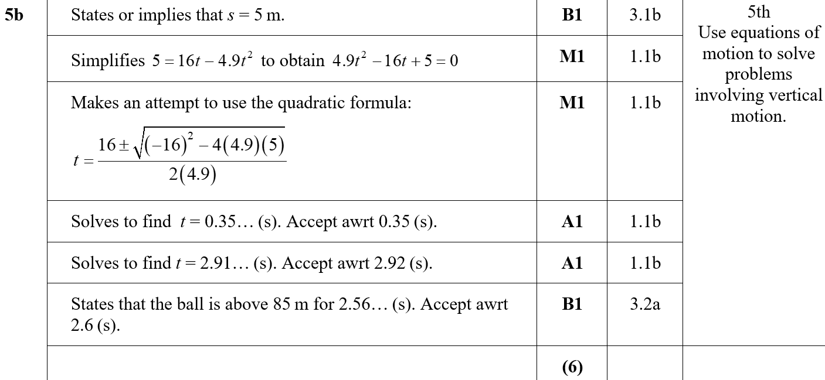
Practice I
B

Slide 60
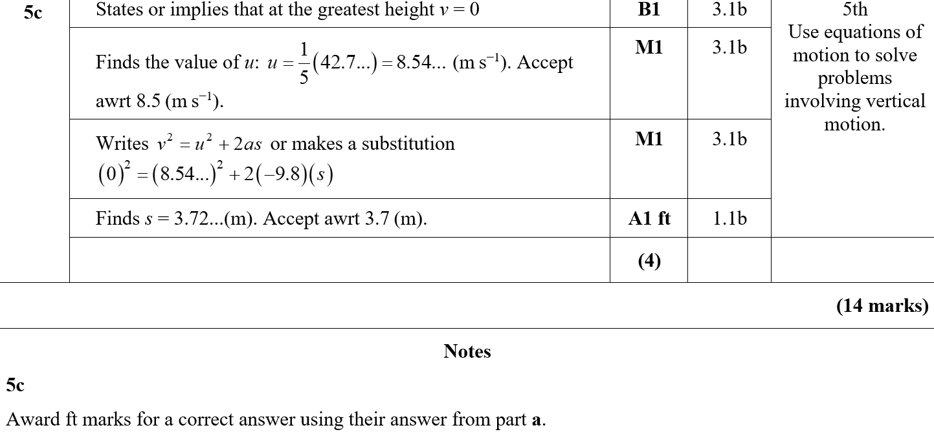
Practice I
C
C notes

Slide 61
Practice I

Slide 62
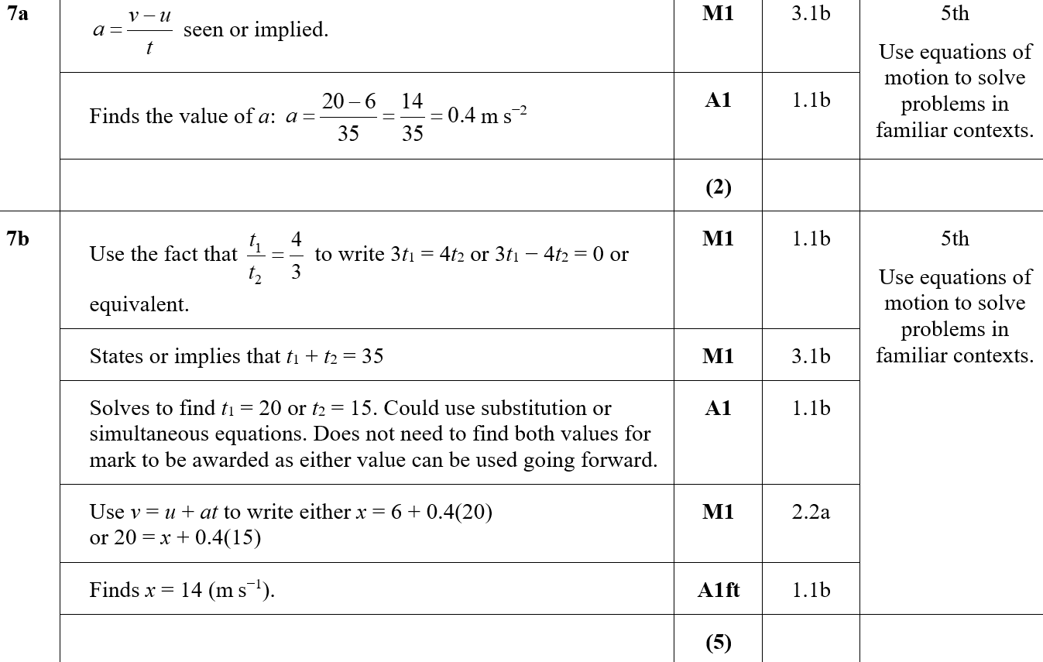
Practice I
A
B

Slide 63
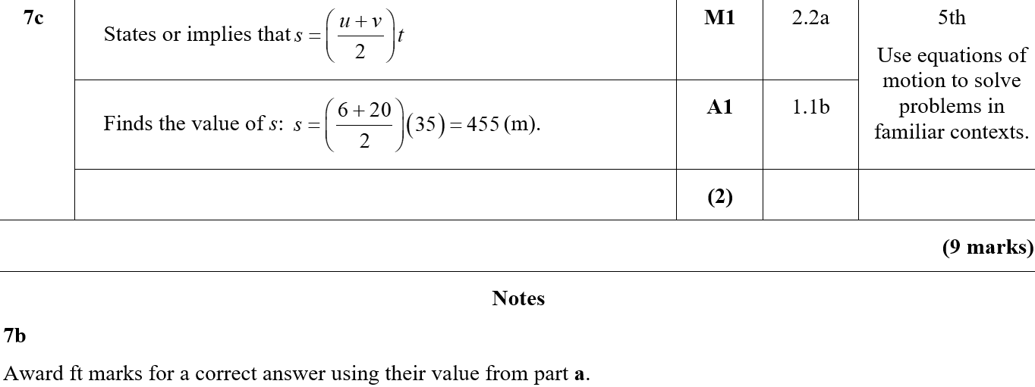
Practice I
C
B notes

Slide 64
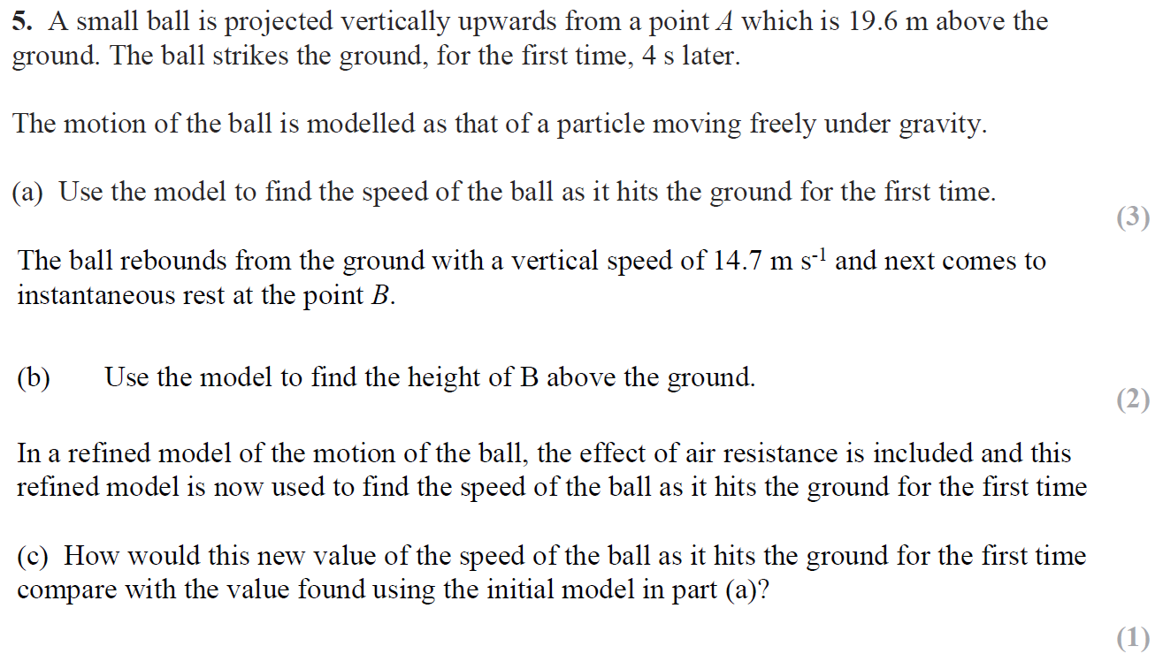
Specimen

Slide 65
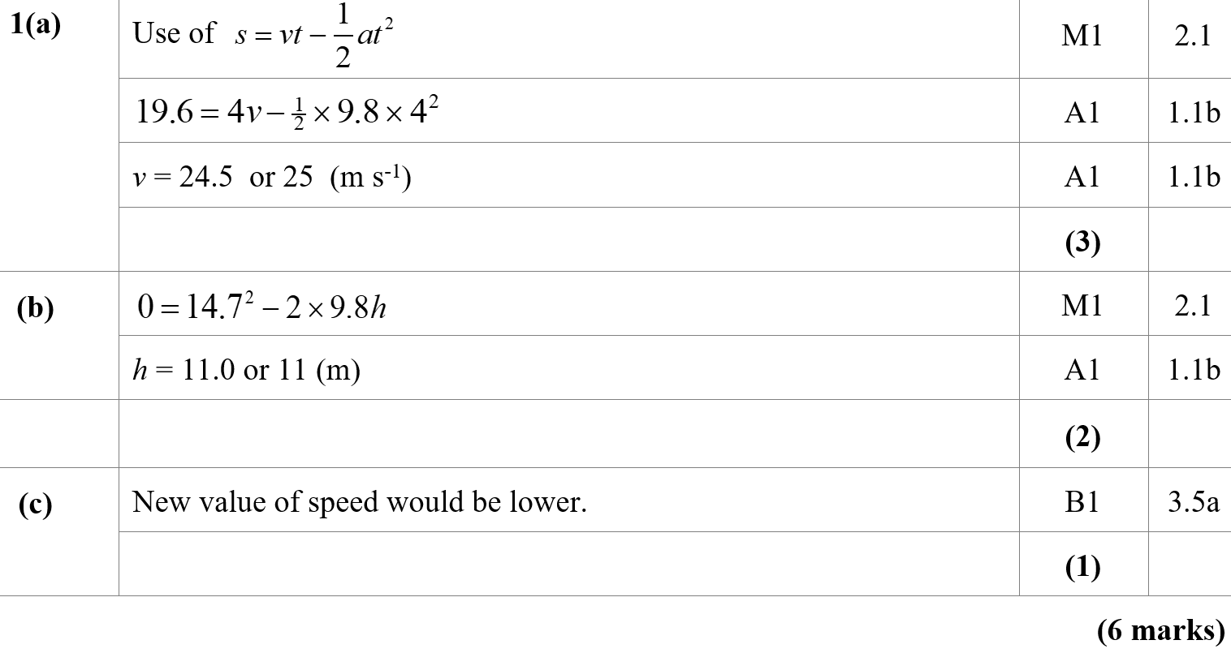
Specimen
A
B
C

Slide 66
Specimen
A notes
B notes
C notes

Slide 67
SAM

Slide 68
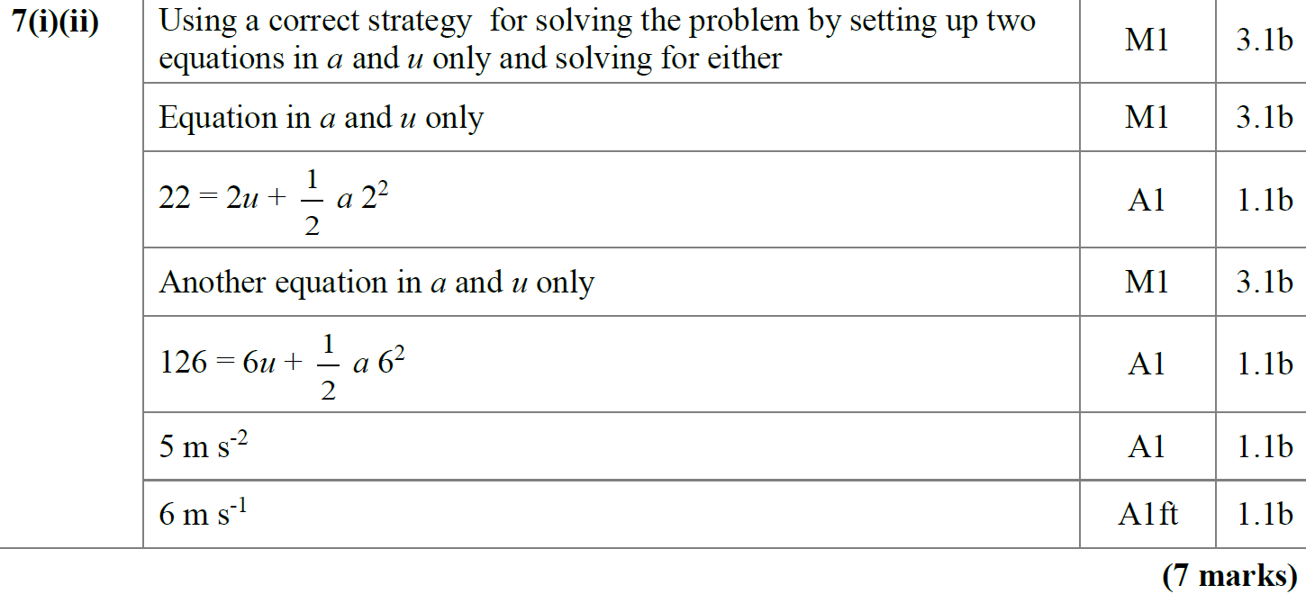
SAM
A

Slide 69
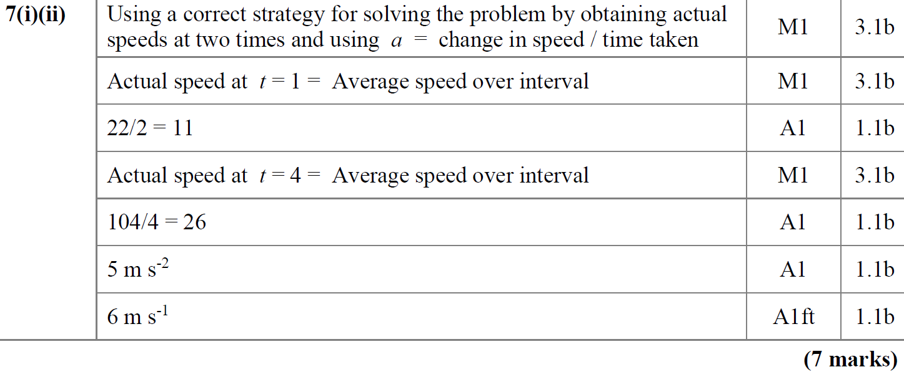
SAM
A Alternative

Slide 70
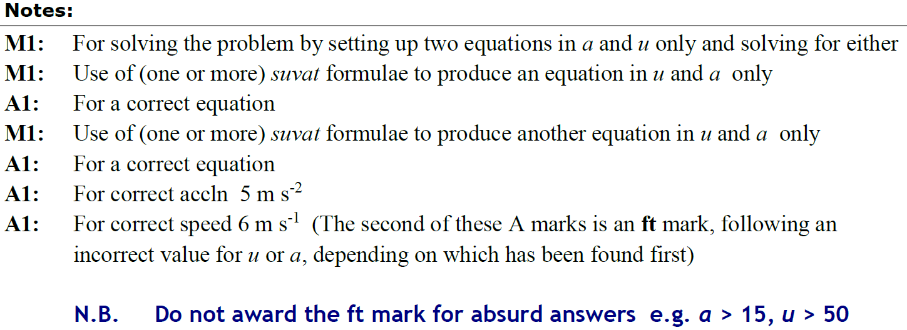
SAM
A notes

Slide 71
SAM
A Alternative notes

Slide 72
2018

Slide 73
2018
A
A (SF)

Slide 74
2018
A notes

Slide 75
New Spec Q’s
Old Spec Kinematics (Time-Series graphs)
June 2006
May 2011
June 2007
May 2012
Jan 2008
Jan 2013
May 2008
May 2013
Jan 2009
June 2014
Jan 2010
June 2015
May 2010
June 2016
Jan 2011
June 2018

Slide 76
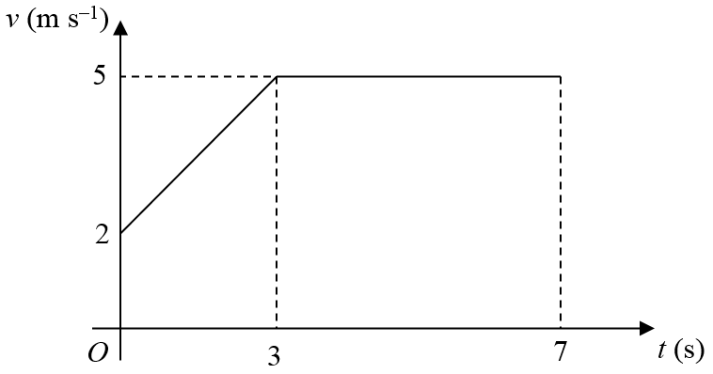
June 2006

Slide 77
June 2006
A
B
C
A & B Notes
C Notes

Slide 78
June 2007

Slide 79
June 2007
A
B
C

Slide 80
Jan 2008

Slide 81
Jan 2008
A
B
C

Slide 82
May 2008

Slide 83
May 2008
A
B

Slide 84
Jan 2009

Slide 85
Jan 2009
A
B

Slide 86
Jan 2010

Slide 87
Jan 2010
A
B

Slide 88
May 2010

Slide 89
May 2010
A
B

Slide 90
Jan 2011

Slide 91
A (i)
Jan 2011
A (ii)
B

Slide 92
May 2011

Slide 93
May 2011
A
B
C
D

Slide 94
Jan 2012

Slide 95
Jan 2012
A
B
C
D
E

Slide 96
May 2012

Slide 97
May 2012
A
B
C

Slide 98
Jan 2013

Slide 99
Jan 2013
A
B
C

Slide 100
Jan 2013
D

Slide 101
May 2013

Slide 102
May 2013
A
B
C
D

Slide 103
June 2014

Slide 104
June 2014
A
B
C
D

Slide 105
June 2014
E
General Notes
A Notes
B Notes

Slide 106
June 2014
C Notes
D Notes
E Notes

Slide 107
June 2015

Slide 108
June 2015
A
B (i) & (ii)
B (iii)
C

Slide 109
June 2015
A Notes
B Notes
C Notes

Slide 110
June 2016

Slide 111
June 2016
A
A notes

Slide 112
June 2016
B
B Alternative

Slide 113
June 2016
B Notes

Slide 114
June 2018

Slide 115
June 2018
A
B
C

Slide 116
June 2018
B Alternative
C Alternative

Slide 117
June 2018
A Notes

Slide 118
June 2018
B Notes
C Notes

Slide 119
June 2018
B Further Notes
C Further Notes

Slide 120
Old Spec Q’s
Kinematics (time-series graphs)
Practice F
Practice G
Specimen
SAM
2018

Slide 121
Practice F

Slide 122
Practice F
A
A notes

Slide 123
Practice F
B
B notes

Slide 124
Practice G

Slide 125
Practice G
A
A notes

Slide 126
Practice G
B
B notes

Slide 127
Specimen

Slide 128
Specimen
A
B

Slide 129
Specimen
C
D

Slide 130
Specimen
A notes
B notes
C notes
D notes

Slide 131
SAM

Slide 132
SAM
A
A notes

Slide 133
SAM
B
C

Slide 134
SAM
B notes
C notes

Slide 135
2018

Slide 136
2018
A (i)
A (ii)
A (iii)
B

Slide 137
2018
C

Slide 138
2018
A (i) (SF)
A (ii) (SF)
A (iii) (SF)

Slide 139
2018
B (SF)
C (SF)

Slide 140
2018
A (i) notes
A (ii) notes
A (iii) notes
B notes
C notes

Slide 141
New Spec Q’s
Old Spec Vectors
Jan 2006
Jan 2009
May 2009
Jan 2012
June 2016
June 2017
June 2018

Slide 142
Jan 2006

Slide 143
Jan 2006
i
ii
Alternative Method

Slide 144
Jan 2009

Slide 145
Jan 2009
A
B
C

Slide 146
May 2009

Slide 147
May 2009
A
B

Slide 148
Jan 2012

Slide 149
Jan 2012
A
B
C

Slide 150
June 2016

Slide 151
June 2016
A
A Alternative
B

Slide 152
June 2016
A notes

Slide 153
June 2016
A Alternative with simultaneous equations notes

Slide 154
June 2016
A Alternative 1 with magnitudes and directions notes

Slide 155
June 2016
A Alternative 2 with magnitudes and directions notes
B Notes

Slide 156
June 2017

Slide 157
June 2017
A
A notes

Slide 158
June 2018

Slide 159
June 2018
A
B
C

Slide 160
June 2018
A notes
B notes

Slide 161
Old Spec Q’s
Vectors
Practice F (i)
Practice F (ii)
Practice H
Practice I

Slide 162
Practice F

Slide 163
Practice F
A

Slide 164
Practice F
B

Slide 165
Practice F

Slide 166
Practice F
A
B
B notes

Slide 167
Practice F
C
D
C notes
D notes

Slide 168
Practice H

Slide 169
Practice H
A
B

Slide 170
Practice H
C
D
B notes

Slide 171
Practice I

Slide 172
Practice I
A
B
C

Slide 173
Practice I
B notes
C notes

Slide 174
New Spec Q’s
Old Spec Kinematics (connected particles)
June 2006
May 2013 (i)
June 2007
May 2013 (ii)
Jan 2008
June 2014
May 2008
June 2015
May 2009
June 2016 (i)
Jan 2010
June 2016 (ii)
May 2010
June 2017 (i)
Jan 2012
June 2017 (ii)
May 2012
June 2018
Jan 2013

Slide 175
June 2006

Slide 176
June 2006
A
B
C
D

Slide 177
June 2006
A Notes
B Notes
C Notes
D Notes

Slide 178
June 2007

Slide 179
June 2007
A
B
C
D
E

Slide 180
Jan 2008

Slide 181
Jan 2008
A
B
C
D

Slide 182
May 2008

Slide 183
May 2008
A
B
C

Slide 184
May 2008
D
E

Slide 185
May 2009

Slide 186
May 2009
A
B
C

Slide 187
Jan 2010

Slide 188
Jan 2010
A
B
C
D

Slide 189
May 2010

Slide 190
May 2010
A
B
C

Slide 191
Jan 2012

Slide 192
Jan 2012
A
B

Slide 193
May 2012

Slide 194
May 2012
A
B
C
D
E

Slide 195
Jan 2013

Slide 196
Jan 2013
A
B
C
D

Slide 197
May 2013

Slide 198
May 2013
A
B

Slide 199
May 2013

Slide 200
May 2013
A
B
C

Slide 201
June 2014

Slide 202
June 2014
A
B
C

Slide 203
June 2014
D
Alternative D

Slide 204
June 2014
A Notes
B Notes

Slide 205
June 2014
C Notes
D Notes

Slide 206
June 2015

Slide 207
June 2015
A
B
A notes
B notes

Slide 208
June 2016

Slide 209
June 2016
A
B

Slide 210
June 2016
A notes
B notes

Slide 211
June 2016

Slide 212
June 2016
A
B

Slide 213
June 2016
A notes
B notes

Slide 214
June 2017

Slide 215
June 2017
A
A notes

Slide 216
June 2017

Slide 217
June 2017
A
B
C

Slide 218
June 2017
D
E
A notes
B notes
C notes

Slide 219
June 2017
D notes
E notes

Slide 220
June 2018

Slide 221
June 2018
A
B
A notes

Slide 222
June 2018
B notes

Slide 223
Old Spec Q’s
Kinematics (connected particles)
Practice G
Practice J
Specimen
SAM
2018

Slide 224
Practice G

Slide 225
Practice G
A
B
B notes

Slide 226
Practice G
C
D
C notes

Slide 227
Practice J

Slide 228
Practice J
A
B
B notes

Slide 229
Practice J
C
C notes

Slide 230
Practice J
D
D notes

Slide 231
Specimen

Slide 232
Specimen
A (i)
A (ii)
B
C

Slide 233
Specimen
A (i) notes
A (ii) notes
B notes
C notes

Slide 234
SAM

Slide 235
SAM
A (i)
A (ii)
B
C

Slide 236
SAM
D
A (i) notes
A (ii) notes
B notes

Slide 237
SAM
C notes
D notes

Slide 238
2018

Slide 239
2018
A
B
C

Slide 240
2018
D
A (SF)
B (SF)

Slide 241
2018
C (SF)
D (SF)

Slide 242
2018
A notes
B notes

Slide 243
2018
C notes

Slide 244
2018
D notes

Slide 245
New Spec Q’s
Old Spec Algebraic Models/ Calculus
June 2006
June 2011
May 2009
June 2013
Jan 2010
June 2015
June 2010
June 2016
Jan 2011
June 2017

Slide 246
June 2006

Slide 247
June 2006
A

Slide 248
May 2009

Slide 249
May 2009
A
B

Slide 250
Jan 2010

Slide 251
Jan 2010
A

Slide 252
June 2010

Slide 253
June 2010
A

Slide 254
Jan 2011

Slide 255
Jan 2011
A
B
C

Slide 256
June 2011

Slide 257
June 2011
A
B

Slide 258
June 2011
C

Slide 259
June 2013

Slide 260
June 2013
A
B
B alternative 1

Slide 261
June 2013
B Alternative 2
B Alternative 3
C

Slide 262
June 2015

Slide 263
June 2015
A
B
C

Slide 264
June 2016

Slide 265
June 2016
A

Slide 266
June 2016
A Alternative

Slide 267
June 2016
B

Slide 268
June 2017

Slide 269
June 2017
A
B
C

Slide 270
June 2017
D
D Alternative 1
D Alternative 2

Slide 271
Old Spec Q’s
Algebraic Models/ Calculus
no calculus
Practice E
Practice F
Specimen
Practice G
SAM
Practice H (i)
2018
Practice H (ii)
Practice J

Slide 272
Practice E

Slide 273
Practice E
A (i)
A (ii)

Slide 274
Practice E
B

Slide 275
Practice E
C
A (i) notes
A (ii) notes
B notes

Slide 276
Practice F

Slide 277
Practice F
A
A notes

Slide 278
Practice G

Slide 279
Practice G
A
A notes

Slide 280
Practice H

Slide 281
Practice H
A
A notes

Slide 282
Practice H

Slide 283
Practice H
A
B

Slide 284
Practice H
C

Slide 285
Practice J

Slide 286
Practice J
A
B

Slide 287
Practice J
C

Slide 288
Practice J
D (i)
D (ii)

Slide 289
Practice J
B notes
C notes

Slide 290
Specimen

Slide 291
Specimen
A
B
C

Slide 292
Specimen
A notes
B notes
C notes

Slide 293
SAM

Slide 294
SAM
A
B

Slide 295
SAM
A notes
B notes

Slide 296
2018

Slide 297
2018
A
B

Slide 298
2018
C
A (SF)

Slide 299
2018
B (SF)
C (SF)
A notes

Slide 300
2018
B notes
C notes

