Slide 1
GCSE (2017-19)
Revision Past Paper Questions
(OCR)
Go back to home screen to select a topic
Go back to topic screen to select a question
‘Solutions’
Go to the mark scheme for that question
Go back to the question from the mark scheme
Or go back to first solutions
Or see more solutions
Next

Slide 2
Notes on operating this resource
When creating this, I used and to quickly navigate between slides directly before or after the slide in question.
As some mark schemes give additional notes, you can continue to see answers by clicking but you will not return to the original question with one click of .
To view the original question again, continue to click which should take you back.
Next

Slide 3
Notes on this resource and the GCSE exam
To maximise visibility, the working space for many questions was reduced to enlarge questions as much as possible. It is therefore recommended that pupils complete these questions on a separate piece of paper, rather than the PowerPoint itself. Although questions that require you to work on them have been edited to let you print off.
Where the official scheme of work has not been too helpful (comments such as ‘correct graph’) I have added correct solutions on the diagrams or axes. These should, however, not turn up if you wanted to print out the slides to work on (as is often the case with these style of questions).
There were issues when grouping some topics either into ‘Algebra’ or ‘Number’ as, although the majority of questions were based numerically, some were set with algebraic constants to test understanding behind the method (usually towards the end of a paper). If you cannot find a topic in ‘Algebra’, the best bet would be to look in ‘Number’ and vice versa.
Similarly, to practise some harder algebraic skills you may want to try some of the later questions within the ‘Number’ topics such as Ratio, Surds and Standard Form, or see the ‘show that’ section.
Within each major topic (Algebra, number etc.) there is a lot of overlap and some questions may appear in more than one sub-category. If you want to practice a particular skill that is a part b) section, you may want to first reveal the answer to part a), or practice questions from earlier in that paper where there is less overlap.
Next

Slide 4
Notes on this resource and the GCSE exam
Some topics which appear a lot (such as rounding) have not been duplicated. Instead, questions which only and specifically deal with this issue are listed in that topic.
I have included all show that/ prove questions within the ‘show that…/ prove’ section as these can help support mathematical structures of answers. Traditional prove questions are highlighted in purple here too.
While not being on the new syllabus (2017) Questions do seem to have changed since this was brought in, with more crossovers between sub-topics and some especially hard questions towards the end of papers.
Finally, please bear in mind the size of this resource. I have undoubtedly made mistakes when putting it together. If you notice anything or have any suggestions to make it even better, please contact me on twitter and I will update it.
All Questions were found online on the mathsmadeeasy website or maths genie – links to videos for solutions are also on this site if you are confused from the mark scheme.
Any secure papers requiring passwords for entry were not used to keep them secure and for potential mock use.

Slide 5
Notes on OCR Papers
There are generally around 20 Questions per paper, with more complex and problem solving questions towards the end. There are 100 marks on each 90 minute paper (meaning an average of 5 marks per question, just under a minute per mark).
Some Questions have exemplar responses which can be accessed by pressing the solutions (superman) button again.

Slide 6
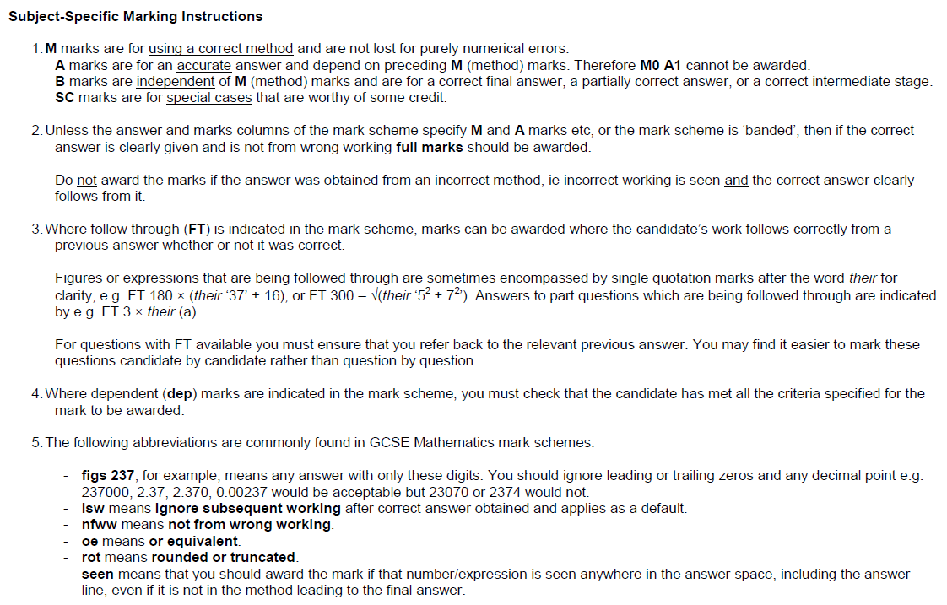
Notes on OCR Mark scheme notes
Next

Slide 7
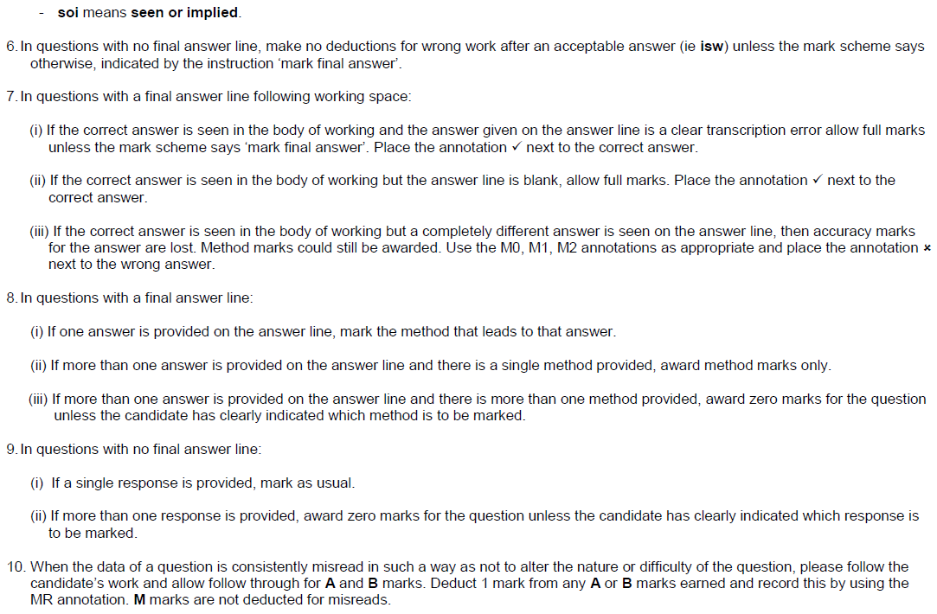
Notes on OCR Mark scheme notes continued
Next

Slide 8
Notes on OCR Mark scheme notes continued

Slide 9
OCR Notes
Home
OCR Mark scheme guide
Algebra
Show that…/ Proof
Probability, Sets & Statistics
Number
Shape & Space

Slide 10
Notes on Algebra Questions for OCR
Algebra
There is a lot of overlap between sub-topics and with the ‘number’ topic
Indices questions often ask to interpret the values of indices and could be considered more of a ‘number’ topic, but there are still many questions which require algebraic manipulation skills.
Other quadratic questions require you to understand the general shape and there is a lot of overlap with other graphs and when they may cross axes.
Drawing other non-linear graphs and understanding them, as well as their roots are grouped in the Drawing and using graphs sub-topic
Functions questions appear to be in the form of function machines

Slide 11
Algebra
Algebra
Simplifying Basic Expressions
Expanding Brackets
Substitution
Drawing and Using Graphs
Solving Simple Equations
Factorising
Algebraic Fractions
Linear Graphs & Gradients
Forming Equations
Solving Quadratics
Quadratic Inequalities
Linear Inequalities
Manipulating Formulae/ Changing the Subject
Completing the Square
Functions
Graphical Transformations
Simultaneous Equations
Indices
Sequences
Iterations
Notes

Slide 12
Simplifying Basic Expressions
Algebra
Simplifying Basic Expressions
None to date

Slide 13
Indices
Algebra
Indices
June 2017
2H Q15
May 2018
1H Q2
SAM
3H Q7
June 2017
3H Q16
June 2018
2H Q12
Practice
2H Q11
June 2017
3H Q17
June 2018
2H Q20
Practice
3H Q8
Nov 2017
1H Q2
June 2018
3H Q4
Nov 2017
2H Q16
Nov 2018
2H Q1
Rewriting as another power
Properties of Numbers
Negative & fractional
See also:
Differentiation
Standard Form

Slide 14
Algebra
Indices
SAM 3H Q7

Slide 15
Algebra
Indices
SAM 3H Q7
A

Slide 16
Algebra
Indices
Practice 2H Q11

Slide 17
Algebra
Indices
Practice 2H Q11
A

Slide 18
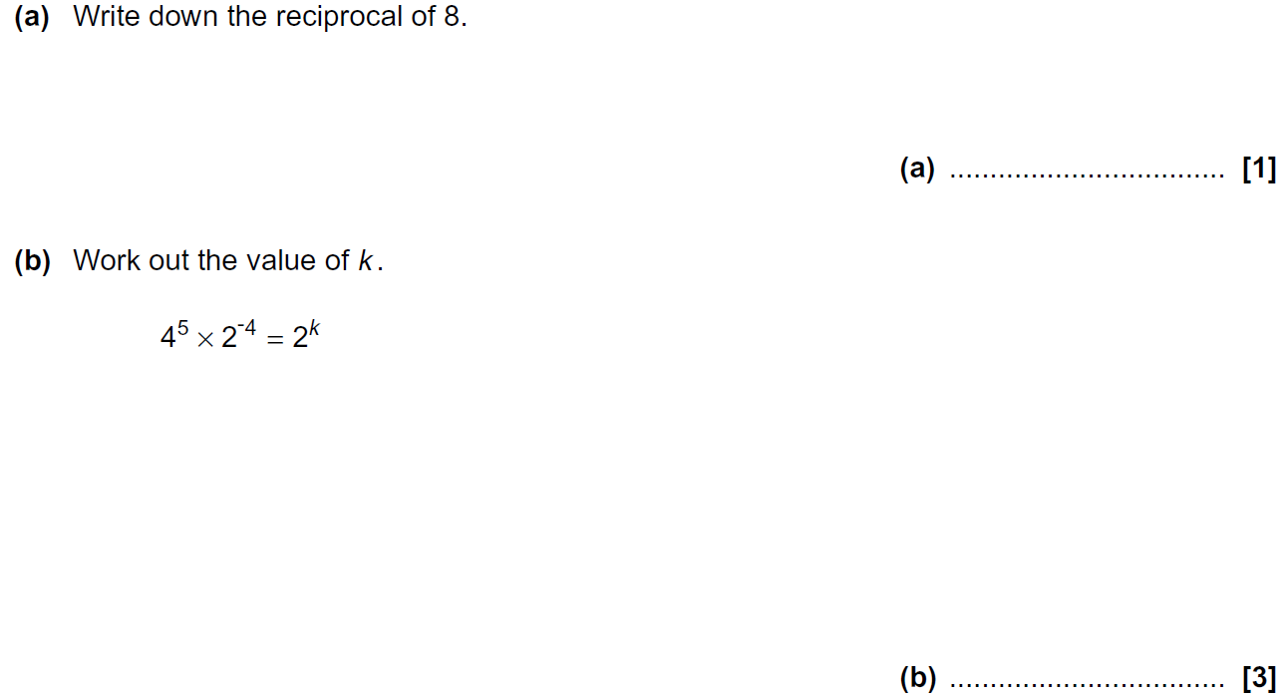
Algebra
Indices
Practice 3H Q8

Slide 19
Algebra
Indices
Practice 3H Q8
A
B

Slide 20
Algebra
Indices
June 2017 2H Q15

Slide 21
Algebra
Indices
June 2017 2H Q15
A (i)
A (ii)
B

Slide 22
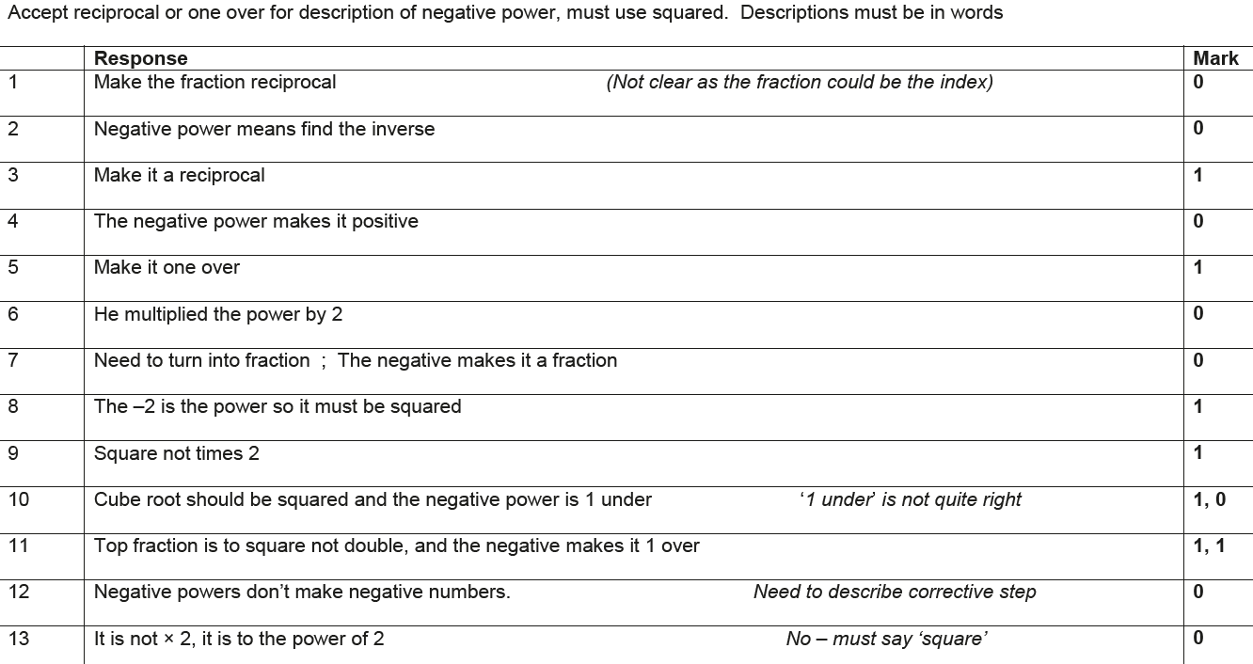
Algebra
Indices
June 2017 2H Q15
B Exemplar responses

Slide 23
Algebra
Indices
June 2017 3H Q16

Slide 24
Algebra
Indices
June 2017 3H Q16
A
B

Slide 25
Algebra
Indices
June 2017 3H Q17

Slide 26
Algebra
Indices
June 2017 3H Q17
A

Slide 27
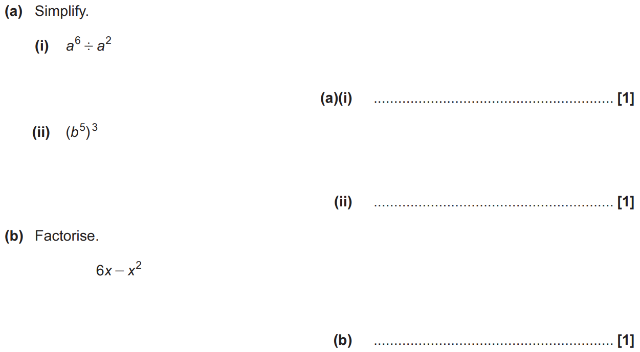
Algebra
Indices
Nov 2017 1H Q2

Slide 28
Algebra
Indices
Nov 2017 1H Q2
A (i)
A (ii)
B

Slide 29
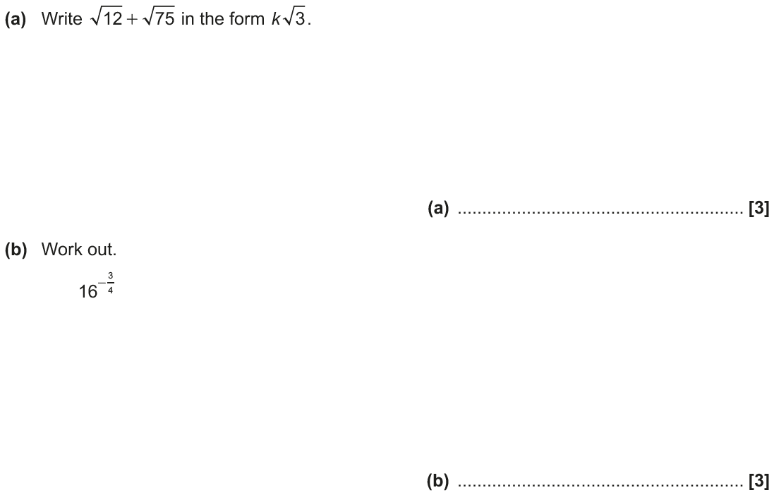
Algebra
Indices
Nov 2017 2H Q16

Slide 30
Algebra
Indices
Nov 2017 2H Q16
A
B

Slide 31
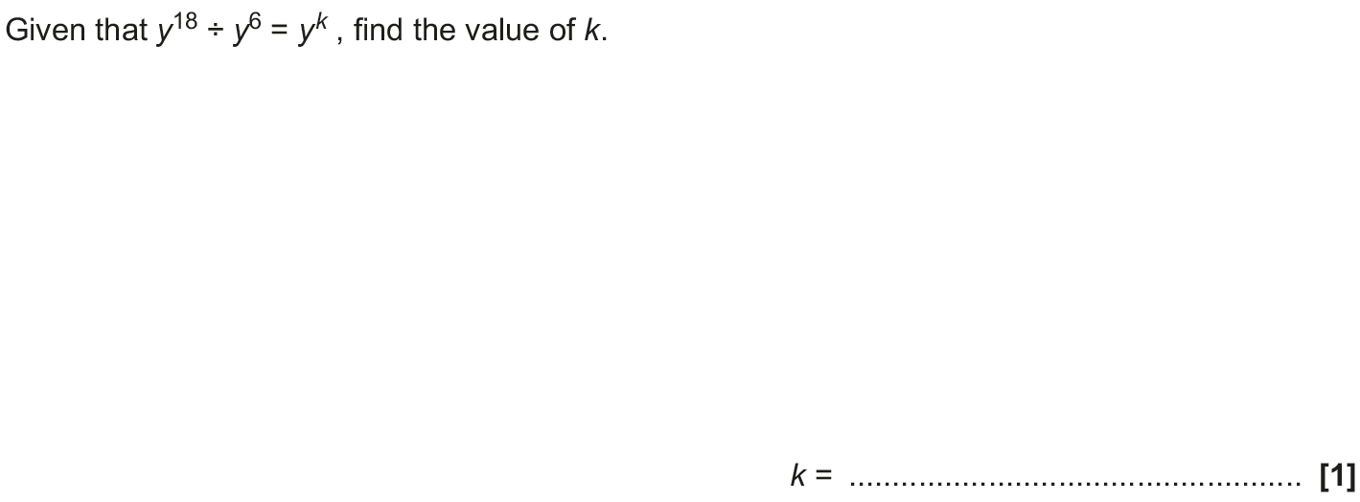
Algebra
Indices
May 2018 1H Q2

Slide 32
Algebra
Indices
May 2018 1H Q2
A

Slide 33
Algebra
Indices
June 2018 2H Q12

Slide 34
Algebra
Indices
June 2018 2H Q12
A

Slide 35
Algebra
Indices
June 2018 2H Q20

Slide 36
Algebra
Indices
June 2018 2H Q20
A (i)
A (ii)
B

Slide 37
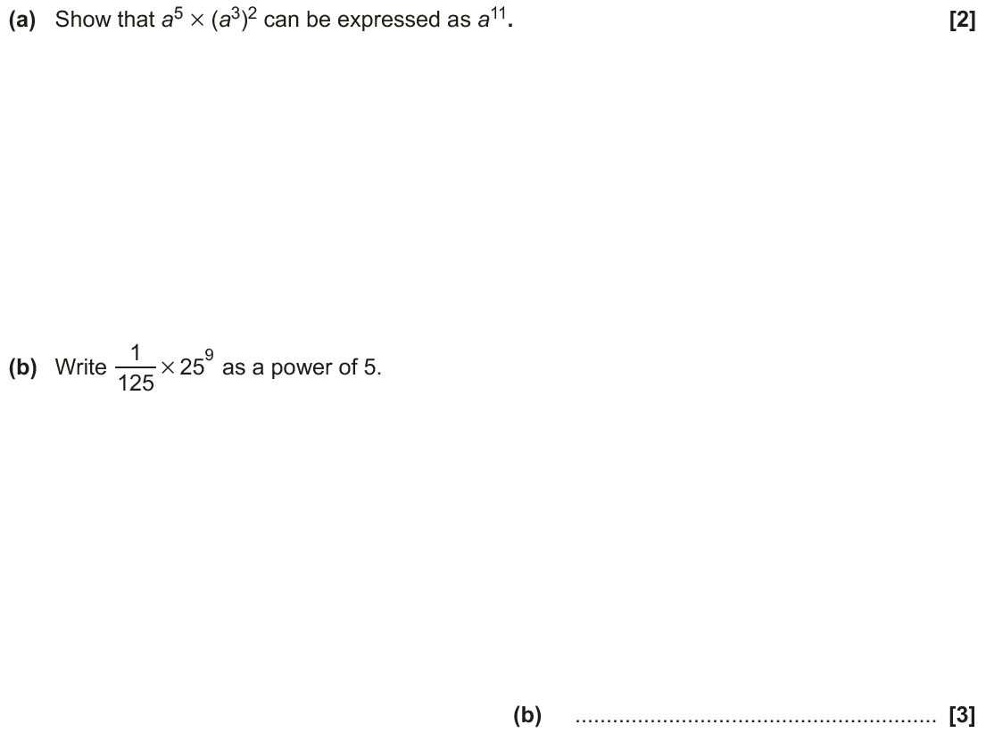
Algebra
Indices
June 2018 3H Q4

Slide 38
Algebra
Indices
June 2018 3H Q4
A
B

Slide 39
Algebra
Indices
Nov 2018 2H Q1

Slide 40
Algebra
Indices
Nov 2018 2H Q1
A
B

Slide 41
Linear Graphs & Gradients
Algebra
Linear Graphs & Gradients
June 2017
3H Q5
SAM
1H Q14
Nov 2017
3H Q17
SAM
3H Q14
June 2018
2H Q18
Practice
2H Q18
June 2018
3H Q5
Practice
3H Q10
Nov 2018
1H Q18
Mainly Co-ordinates
With equation of circle and tangents
Simultaneous Equations
See also:
Linear Inequalities
Time-Series

Slide 42
Algebra
Linear Graphs & Gradients
SAM 2H Q14

Slide 43
Algebra
Linear Graphs & Gradients
SAM 2H Q14
A

Slide 44
Algebra
Linear Graphs & Gradients
SAM 3H Q14

Slide 45
Algebra
Linear Graphs & Gradients
SAM 3H Q14
A

Slide 46
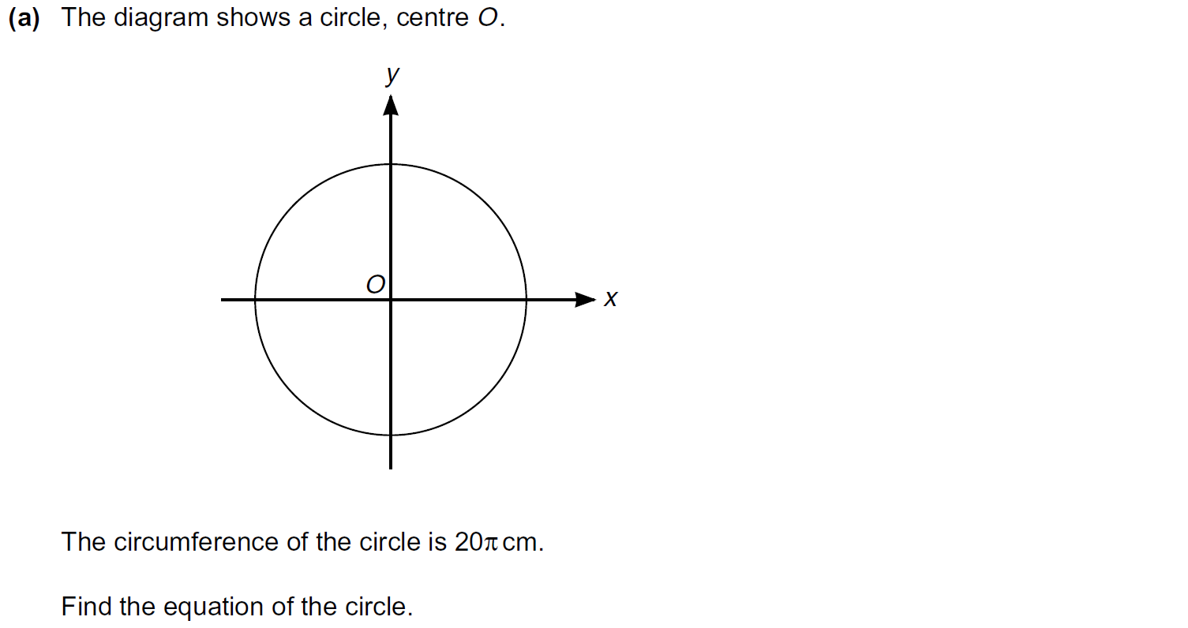
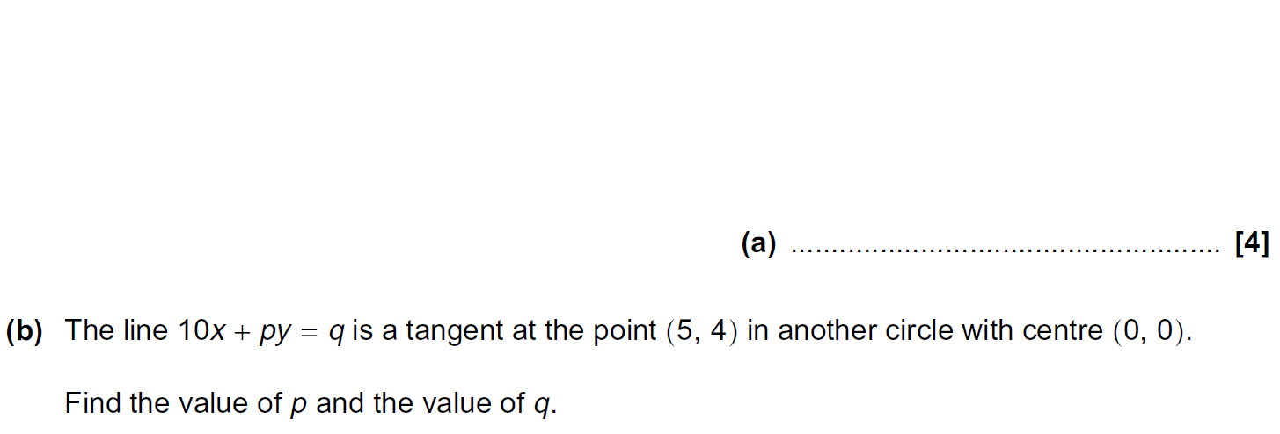
Algebra
Linear Graphs & Gradients
Practice 2H Q18

Slide 47
Algebra
Linear Graphs & Gradients
Practice 2H Q18
A
B

Slide 48
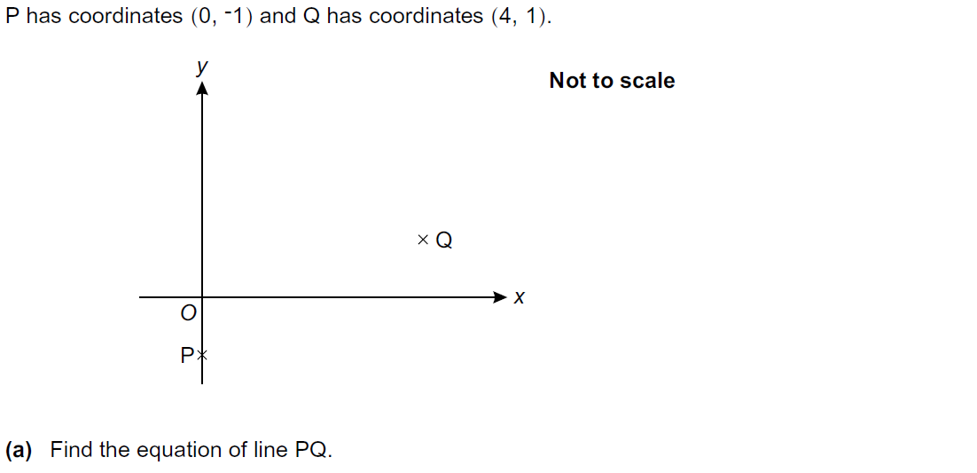
Algebra
Linear Graphs & Gradients
Practice 3H Q10

Slide 49
Algebra
Linear Graphs & Gradients
Practice 3H Q10
A
B

Slide 50
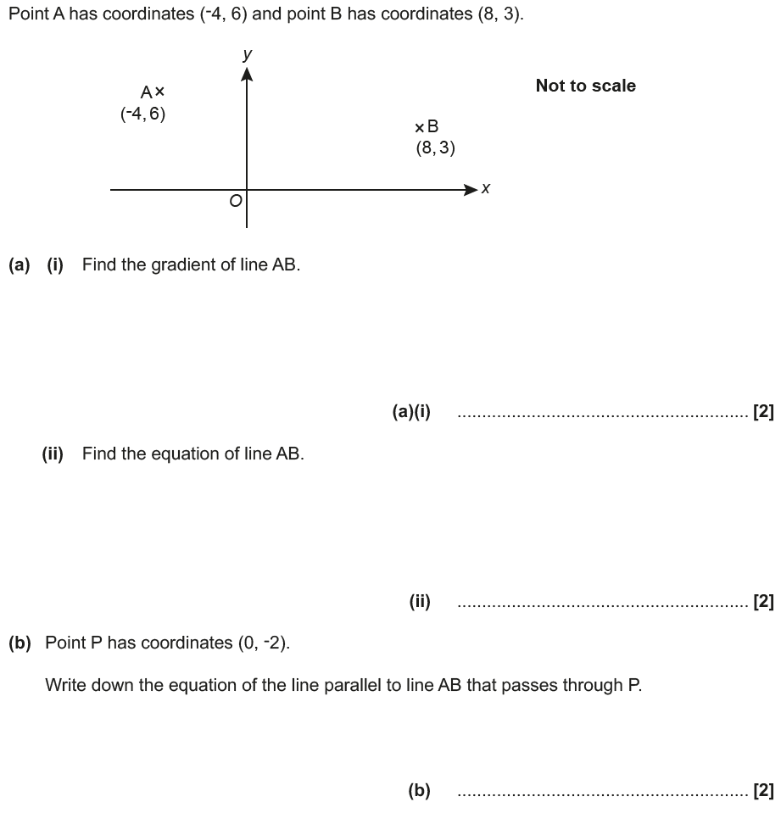
Algebra
Linear Graphs & Gradients
June 2017 3H Q5

Slide 51
Algebra
Linear Graphs & Gradients
June 2017 3H Q5
A (i)
A (ii)
B

Slide 52
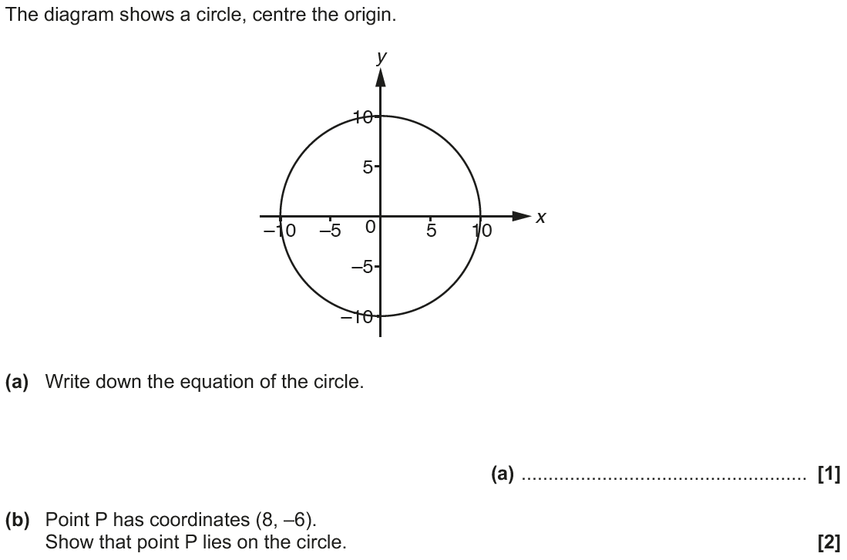
Algebra
Linear Graphs & Gradients
Nov 2017 3H Q17

Slide 53
Algebra
Linear Graphs & Gradients
Nov 2017 3H Q17
A
B
C

Slide 54
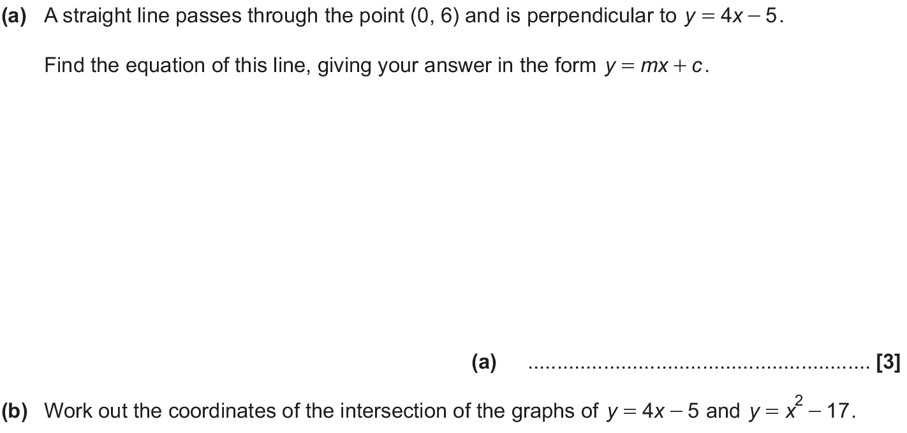
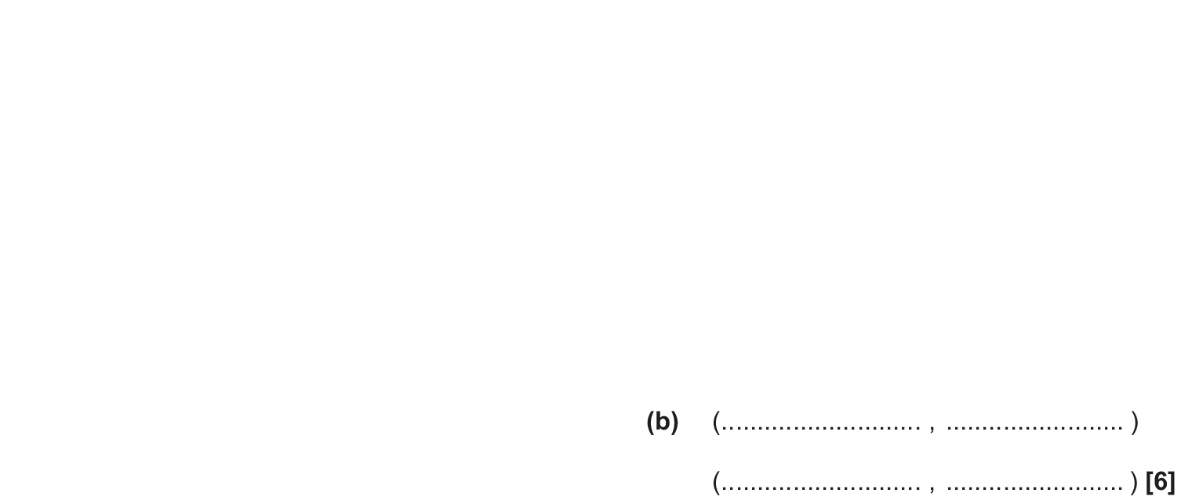
Algebra
Linear Graphs & Gradients
June 2018 2H Q18

Slide 55
Algebra
Linear Graphs & Gradients
June 2018 2H Q18
A
B

Slide 56
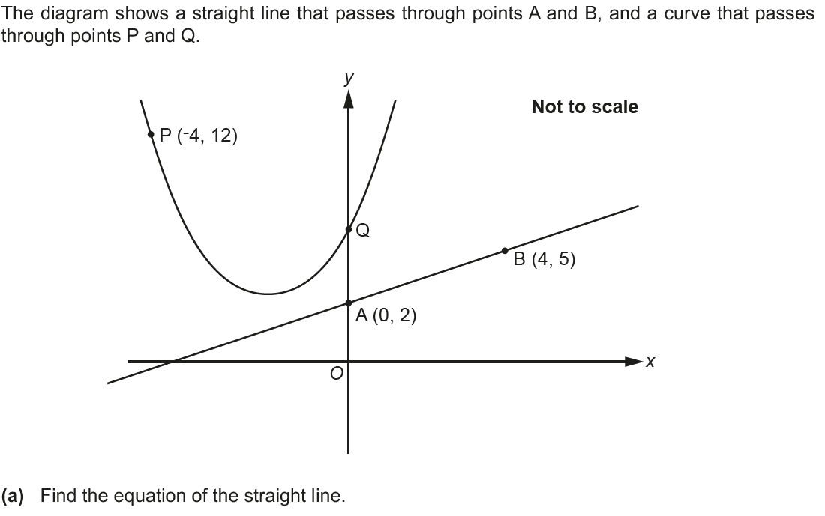
Algebra
Linear Graphs & Gradients
June 2018 3H Q5

Slide 57
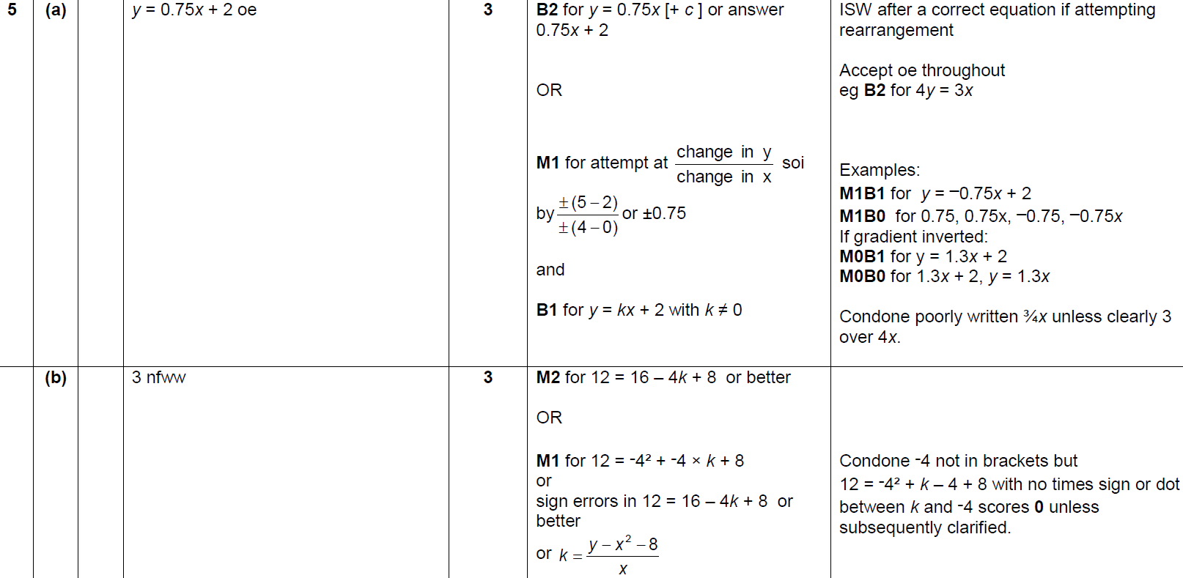
Algebra
Linear Graphs & Gradients
June 2018 3H Q5
A
B

Slide 58
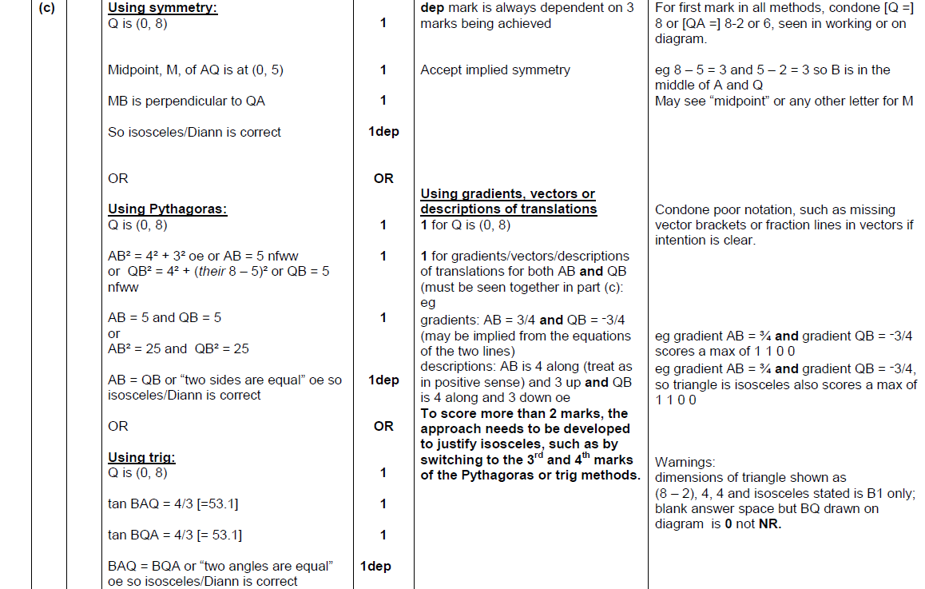
Algebra
Linear Graphs & Gradients
June 2018 3H Q5
C

Slide 59
Algebra
Linear Graphs & Gradients
Nov 2018 1H Q18

Slide 60
Algebra
Linear Graphs & Gradients
Nov 2018 1H Q18
A

Slide 61
Drawing and Using Graphs
Algebra
Drawing and Using Graphs
May 2017
1H Q17
Nov 2017
3H Q17
SAM
1H Q4*
Nov 2018
1H Q10
June 2017
2H Q19
May 2018
1H Q17
Practice
1H Q15
Nov 2018
1H Q21
June 2017
3H Q7
June 2018
2H Q9
Practice
2H Q18
Nov 2018
3H Q10*
Nov 2017
1H Q5
June 2018
3H Q9
*Mainly Proportion
Intercepts and roots
Circles
Recognising shapes of graphs
See also:
Graphical Transformations

Slide 62
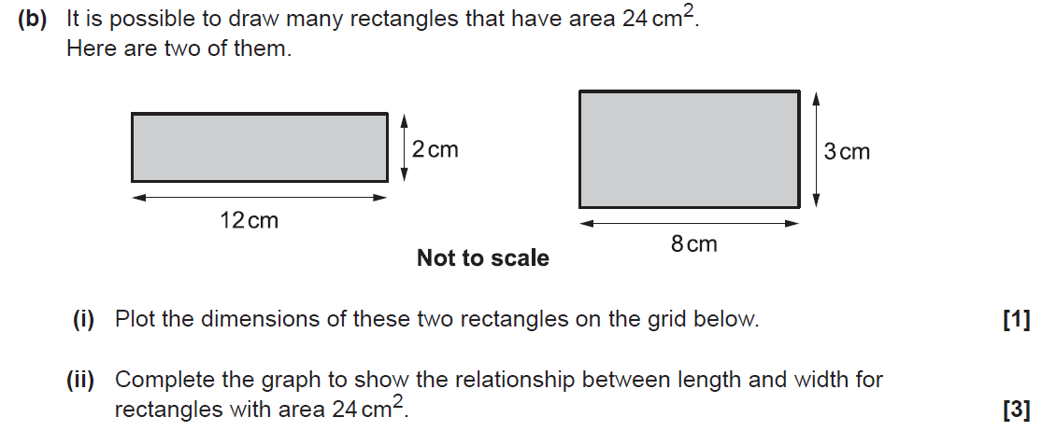
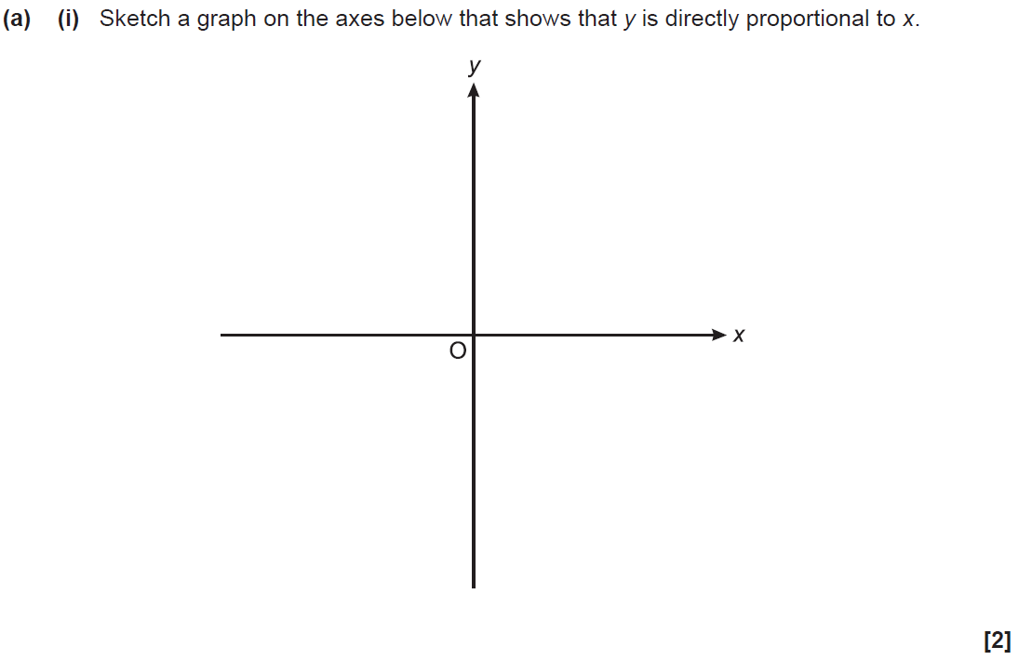
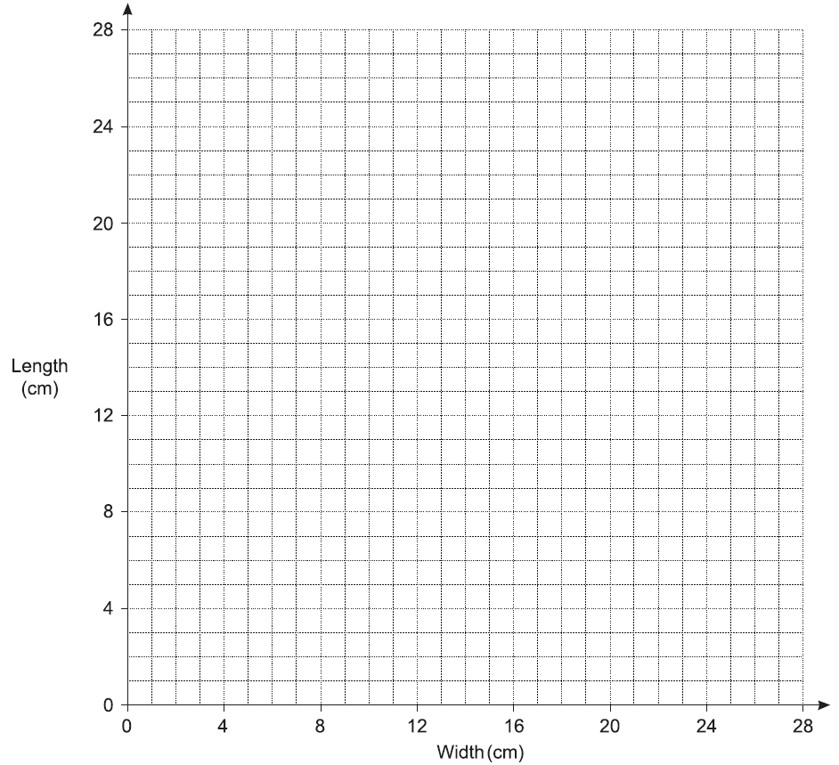
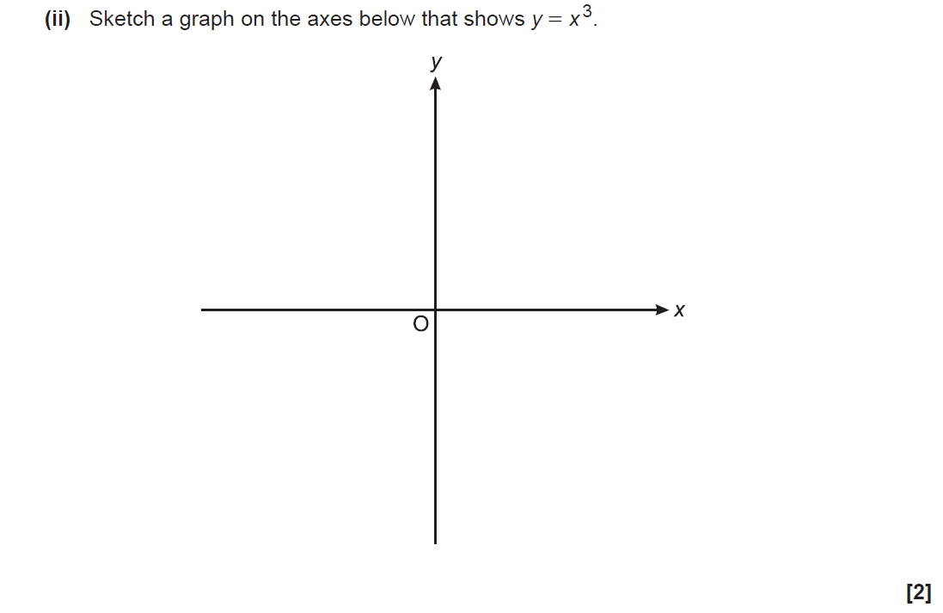
Algebra
Drawing and Using Graphs
SAM 1H Q4

Slide 63
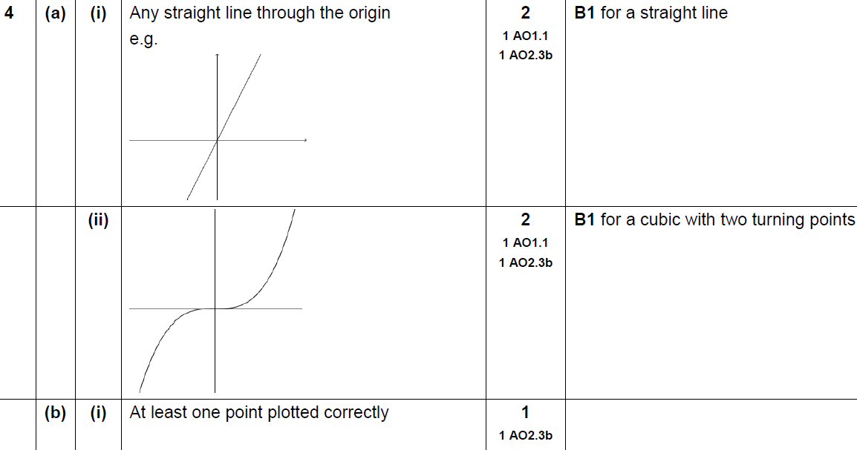
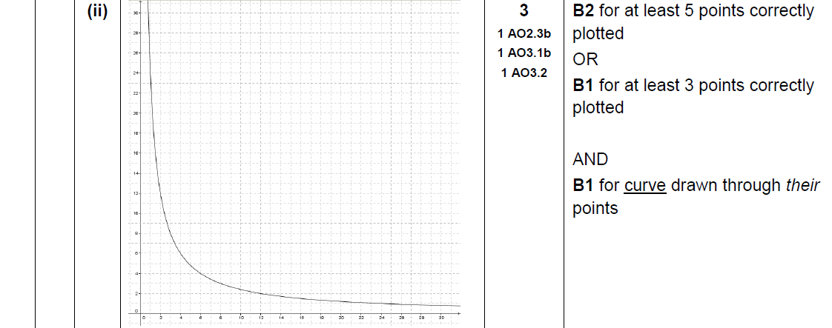
Algebra
Drawing and Using Graphs
SAM 1H Q4
A (i)
A (ii)
B (i)
B (ii)

Slide 64
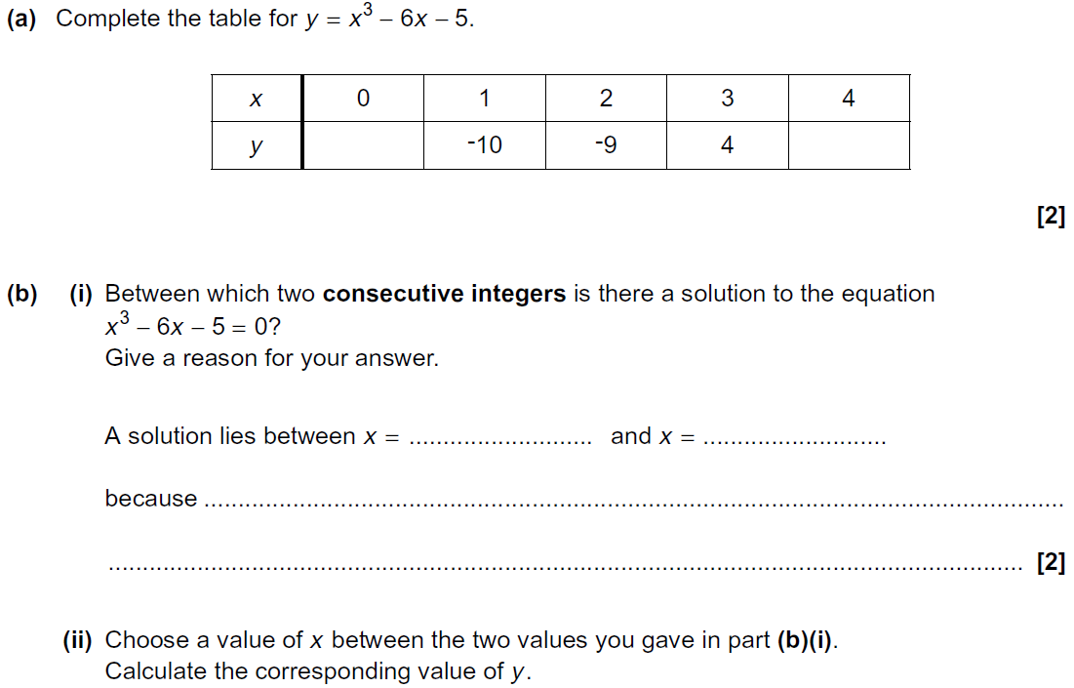
Algebra
Drawing and Using Graphs
Practice 1H Q15

Slide 65
Algebra
Drawing and Using Graphs
Practice 1H Q15
A
B (i)
B (ii)
B (iii)

Slide 66
Algebra
Drawing and Using Graphs
Practice 2H Q18

Slide 67
Algebra
Drawing and Using Graphs
Practice 2H Q18
A
B

Slide 68
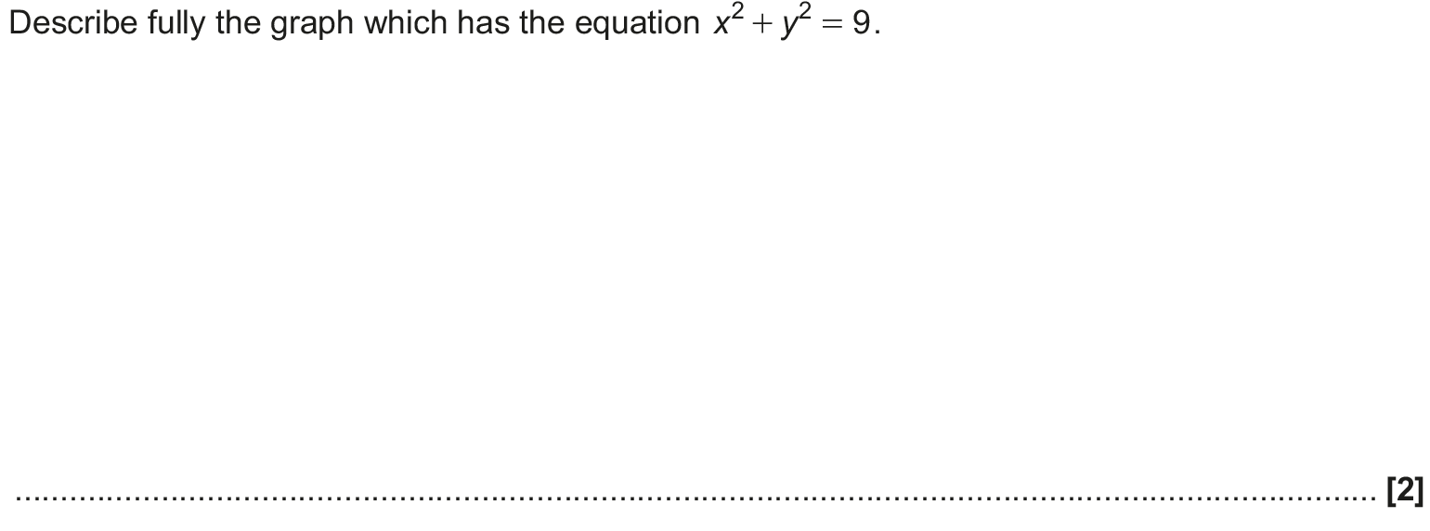
Algebra
Drawing and Using Graphs
May 2017 1H Q17

Slide 69
Algebra
Drawing and Using Graphs
May 2017 1H Q17
A

Slide 70
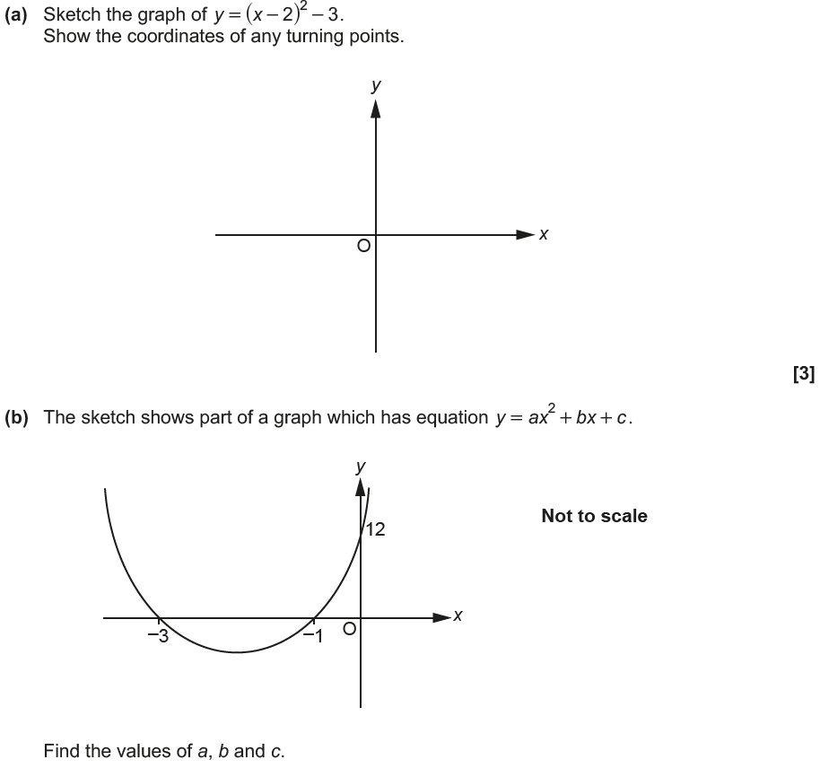
Algebra
Drawing and Using Graphs
June 2017 2H Q19

Slide 71
Algebra
Drawing and Using Graphs
June 2017 2H Q19
A
B

Slide 72
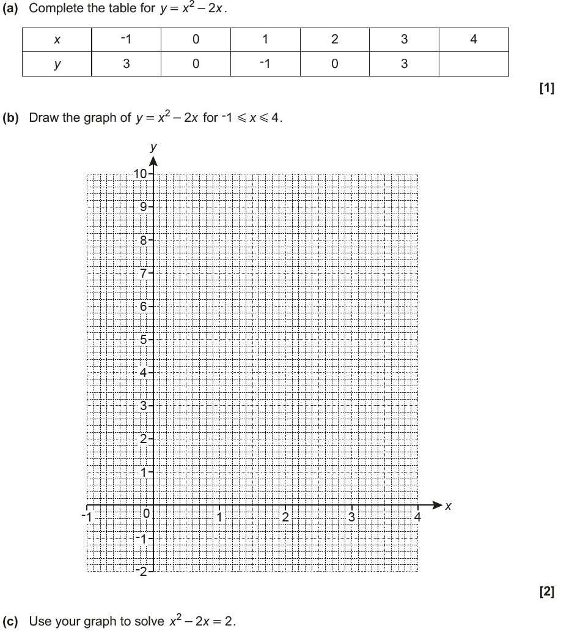
Algebra
Drawing and Using Graphs
June 2017 3H Q7

Slide 73
Algebra
Drawing and Using Graphs
June 2017 3H Q7
A
B
C

Slide 74
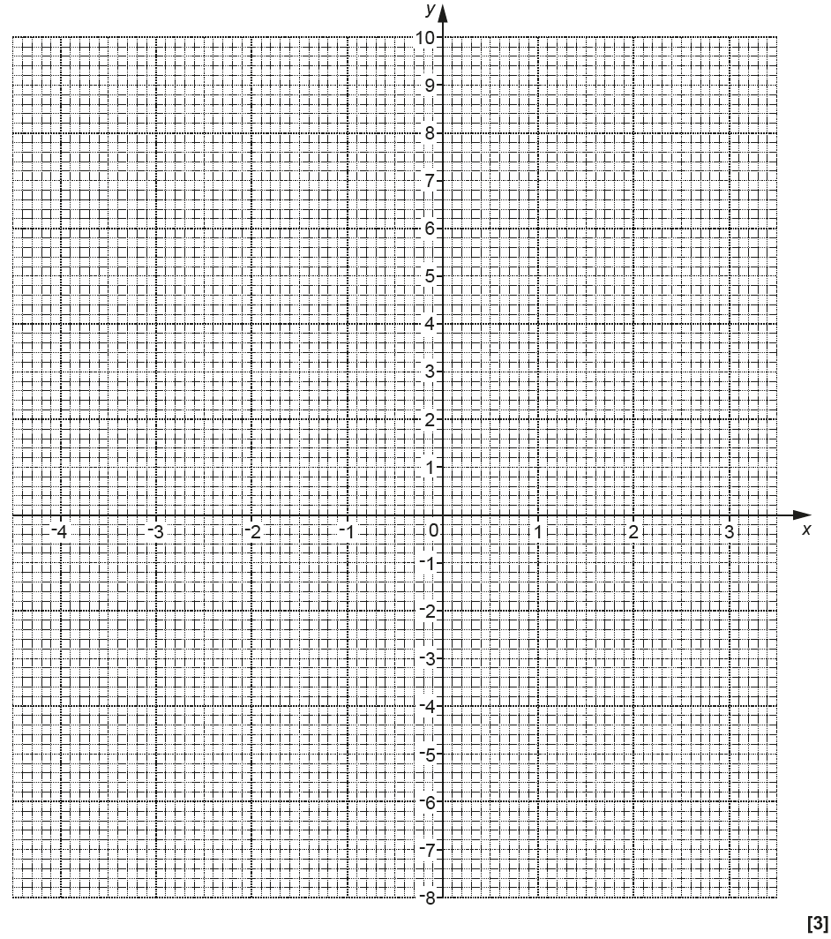
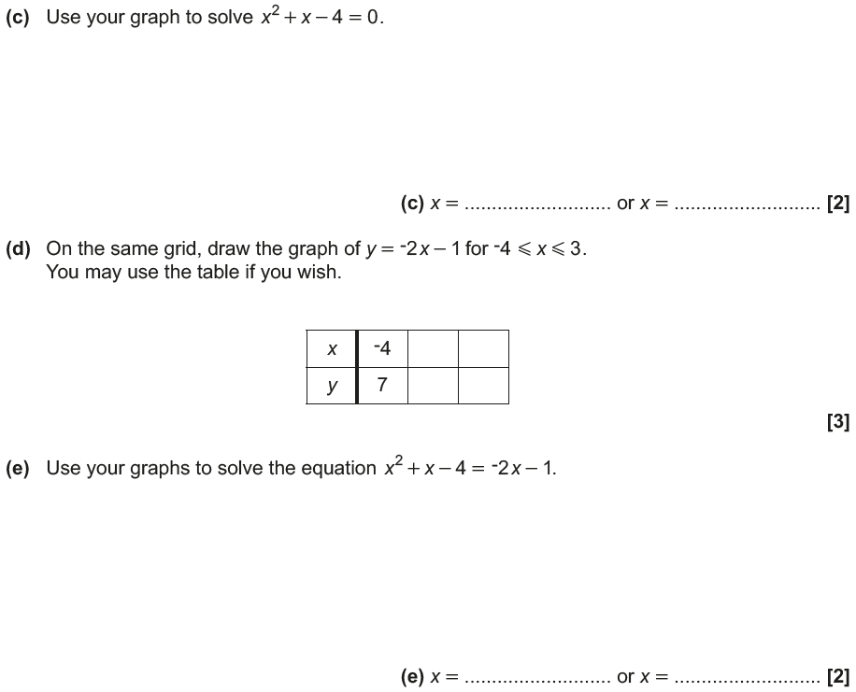
Algebra
Drawing and Using Graphs
Nov 2017 1H Q5
Reveal Graph (b)
Reveal Graph (d)

Slide 75
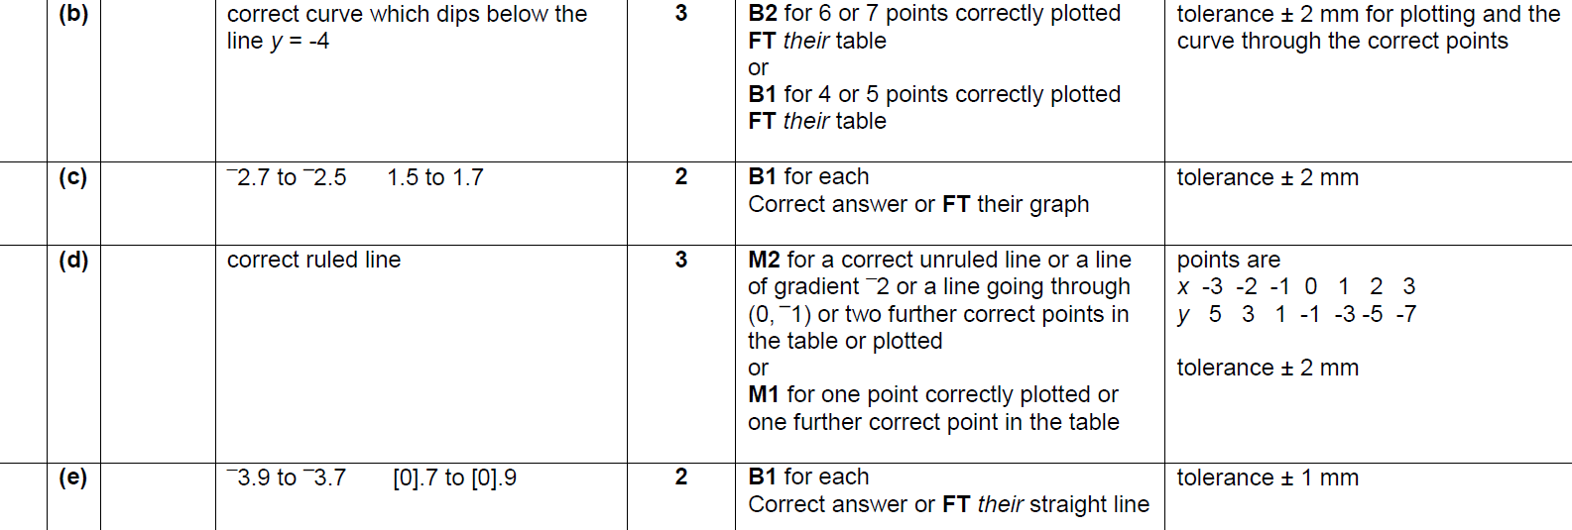
Algebra
Drawing and Using Graphs
Nov 2017 1H Q5
A
B
C
D
E

Slide 76
Algebra
Drawing and Using Graphs
Nov 2017 3H Q17

Slide 77
Algebra
Drawing and Using Graphs
Nov 2017 3H Q17
A
B
C

Slide 78
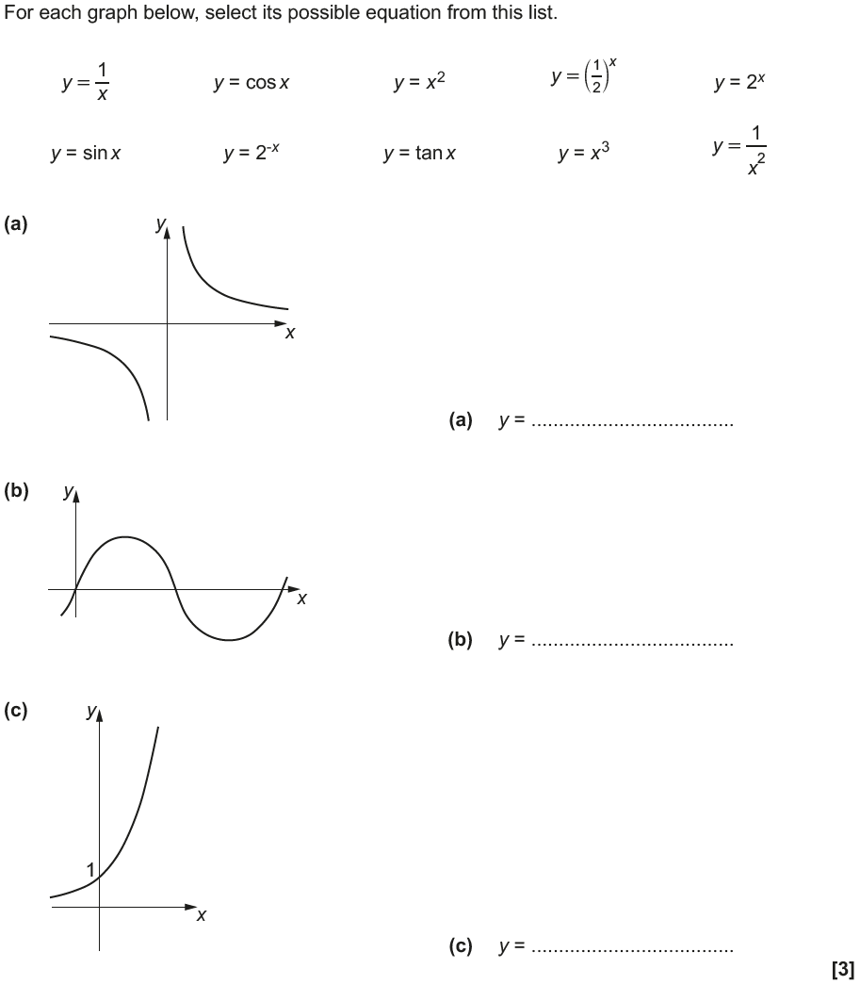
Algebra
Drawing and Using Graphs
May 2018 1H Q17

Slide 79
Algebra
Drawing and Using Graphs
May 2018 1H Q17
A
B
C

Slide 80
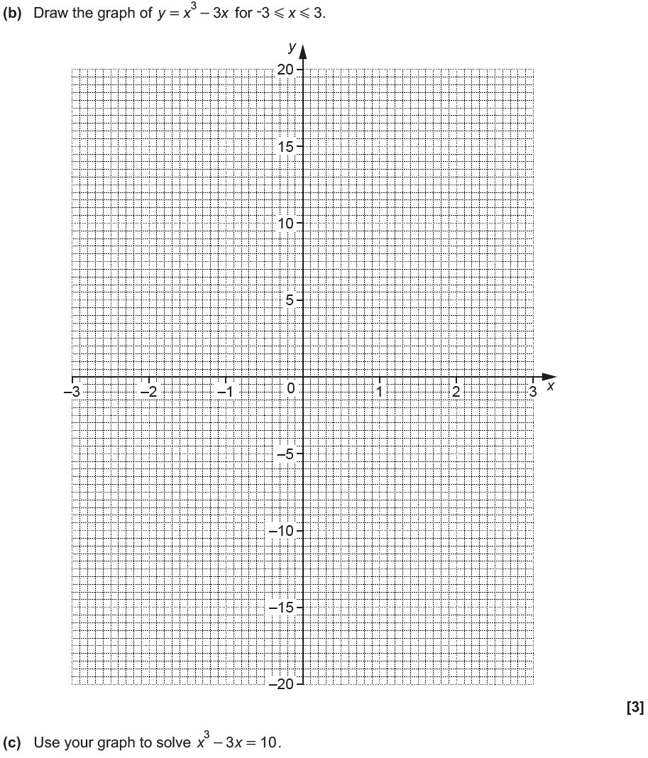
Algebra
Drawing and Using Graphs
June 2018 2H Q9
Reveal graph

Slide 81
Algebra
Drawing and Using Graphs
June 2018 2H Q9
A
B
C

Slide 82
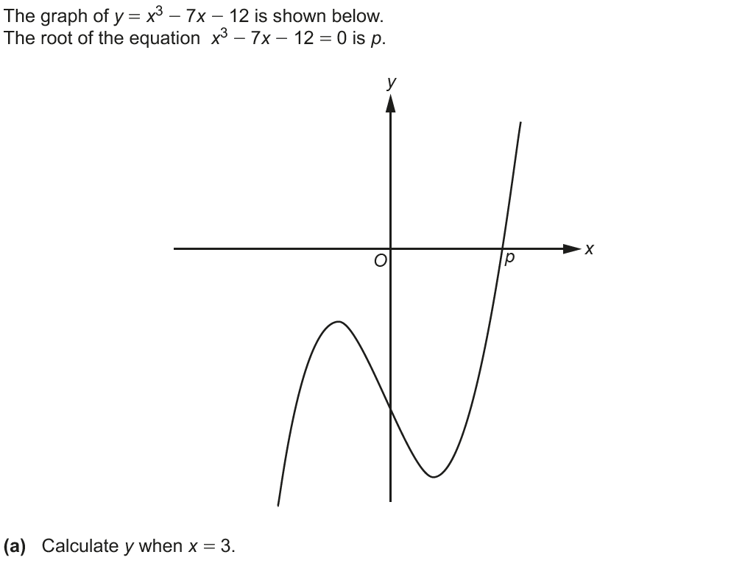
Algebra
Drawing and Using Graphs
June 2018 3H Q9

Slide 83
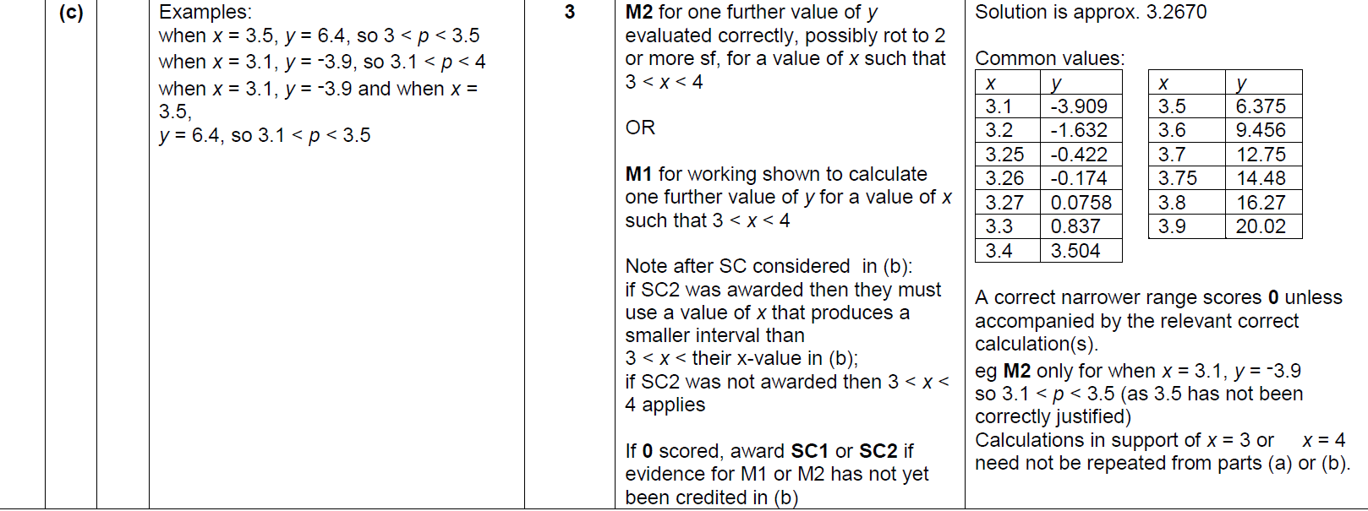
Algebra
Drawing and Using Graphs
June 2018 3H Q9
A
B
C

Slide 84
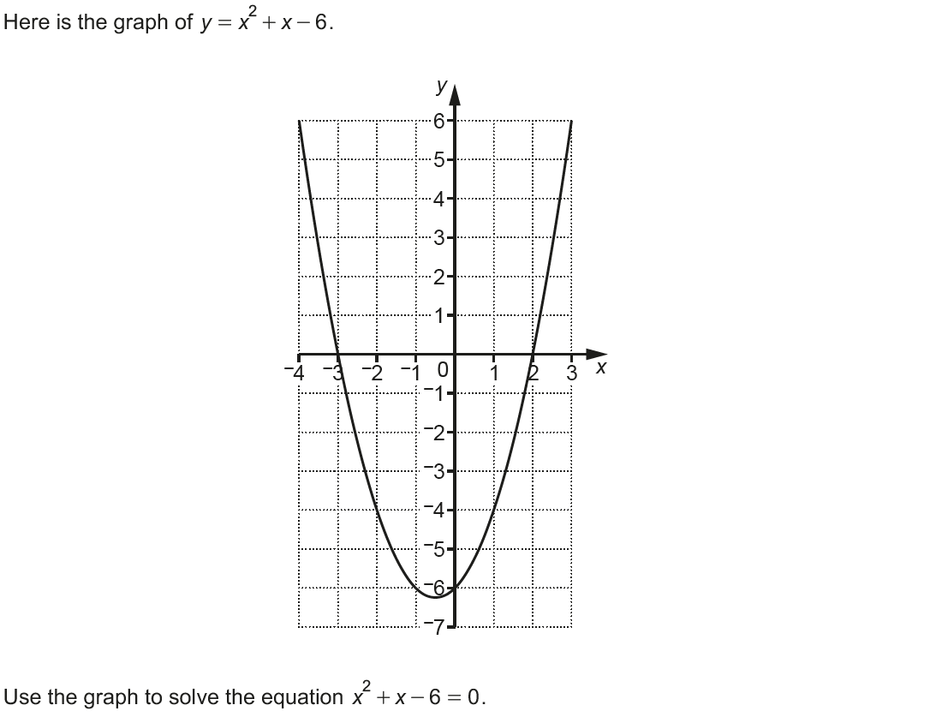
Algebra
Drawing and Using Graphs
Nov 2018 1H Q10

Slide 85
Algebra
Drawing and Using Graphs
Nov 2018 1H Q10
A

Slide 86
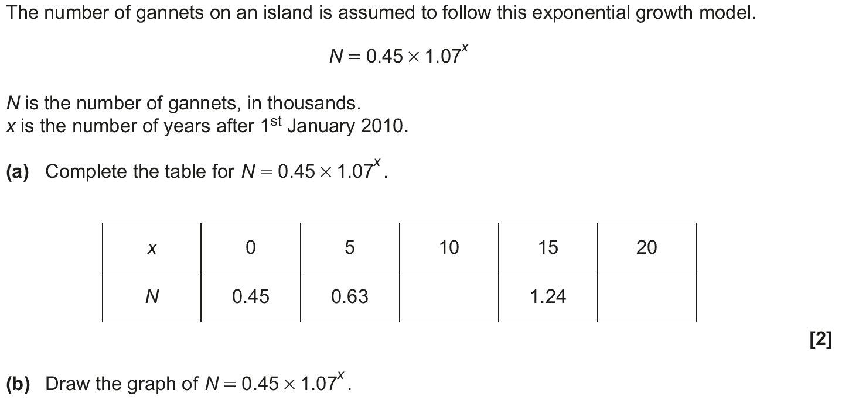
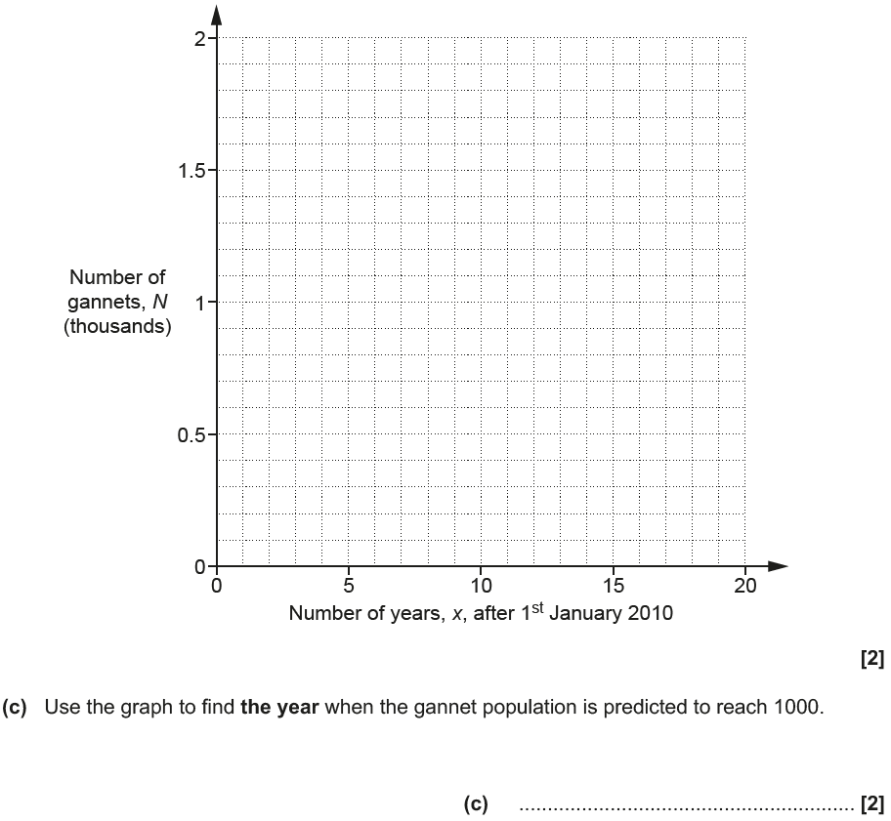
Algebra
Drawing and Using Graphs
Nov 2018 1H Q21
Reveal graph

Slide 87
Algebra
Drawing and Using Graphs
Nov 2018 1H Q21
A
B
C

Slide 88
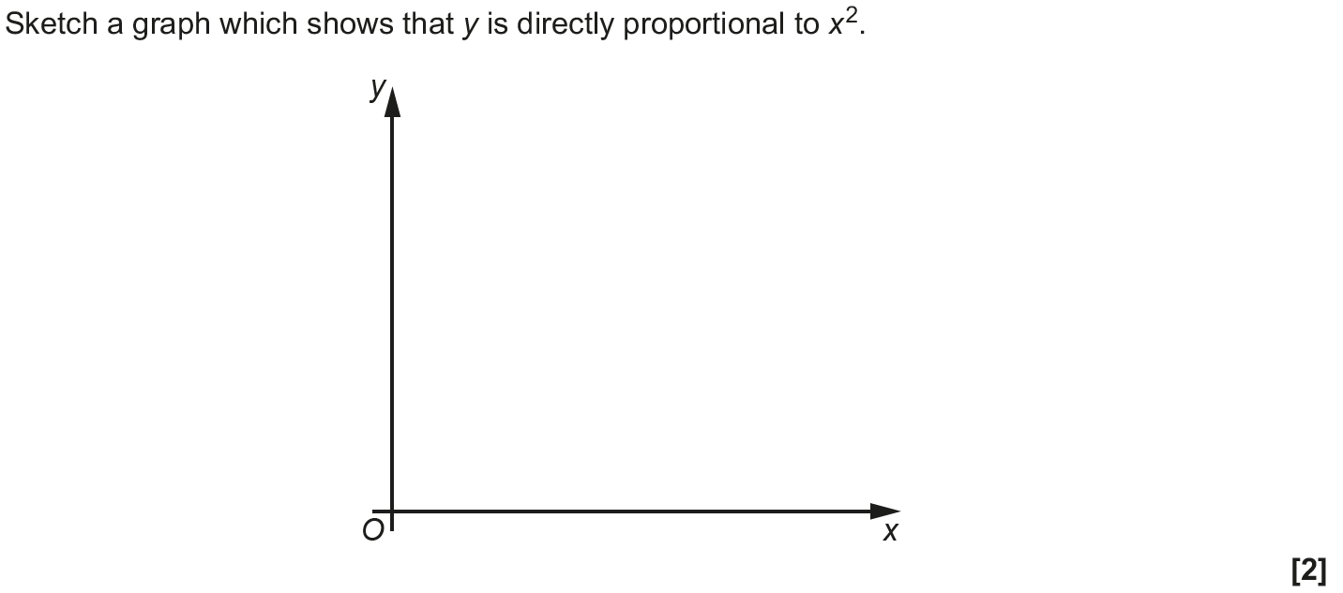
Algebra
Drawing and Using Graphs
Nov 2018 3H Q10

Slide 89
Algebra
Drawing and Using Graphs
Nov 2018 3H Q10
A

Slide 90
Substitution
Algebra
Substitution
SAM
1H Q3
May 2017
1H Q4
May 2018
1H Q12
SAM
2H Q16
May 2017
1H Q10
June 2018
3H Q5
SAM
3H Q17
Nov 2017
2H Q11
June 2018
3H Q9
Practice
1H Q2
Nov 2017
3H Q1
Sequences
Iterations
See also:
Upper & Lower Bounds
Direct & Inverse Proportion
Drawing & Using Graphs
Volume & Surface Area
Functions

Slide 91
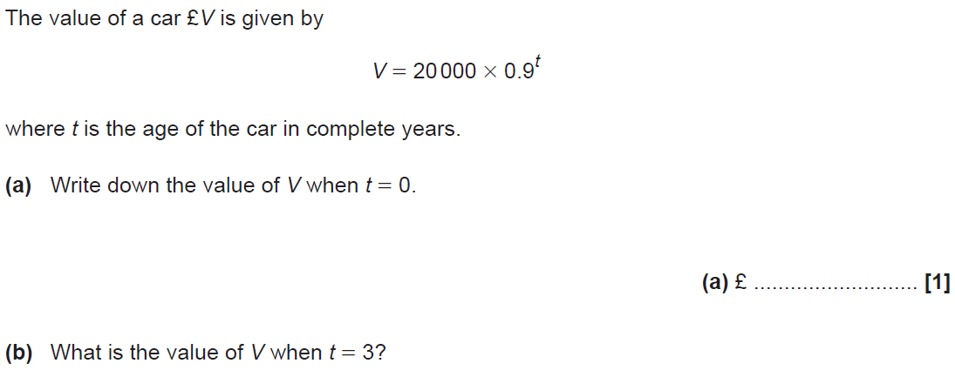
Algebra
Substitution
SAM 1H Q3

Slide 92
Algebra
Substitution
SAM 1H Q3
A
B
C

Slide 93
Algebra
Substitution
SAM 2H Q16

Slide 94
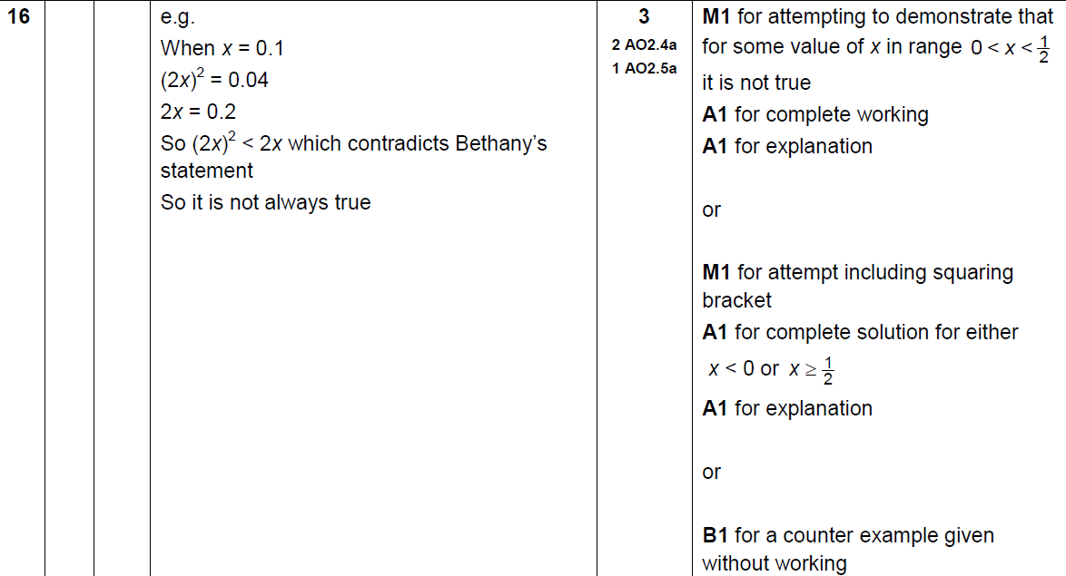
Algebra
Substitution
SAM 2H Q16
A

Slide 95
Algebra
Substitution
SAM 3H Q17

Slide 96
Algebra
Substitution
SAM 3H Q17
A

Slide 97
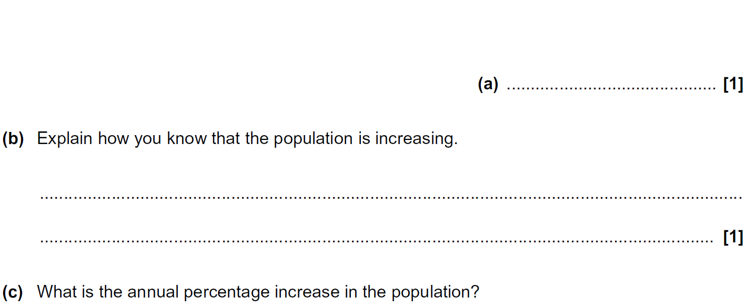
Algebra
Substitution
Practice 1H Q2

Slide 98
Algebra
Substitution
Practice 1H Q2
A
B
C
D

Slide 99
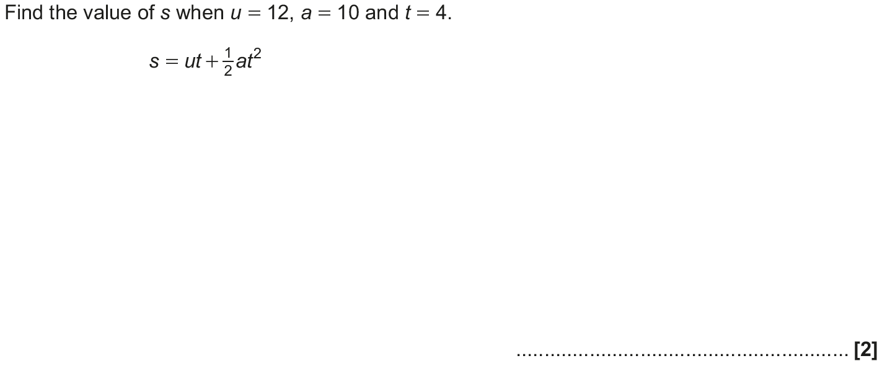
Algebra
Substitution
May 2017 1H Q4

Slide 100
Algebra
Substitution
May 2017 1H Q4
A

Slide 101
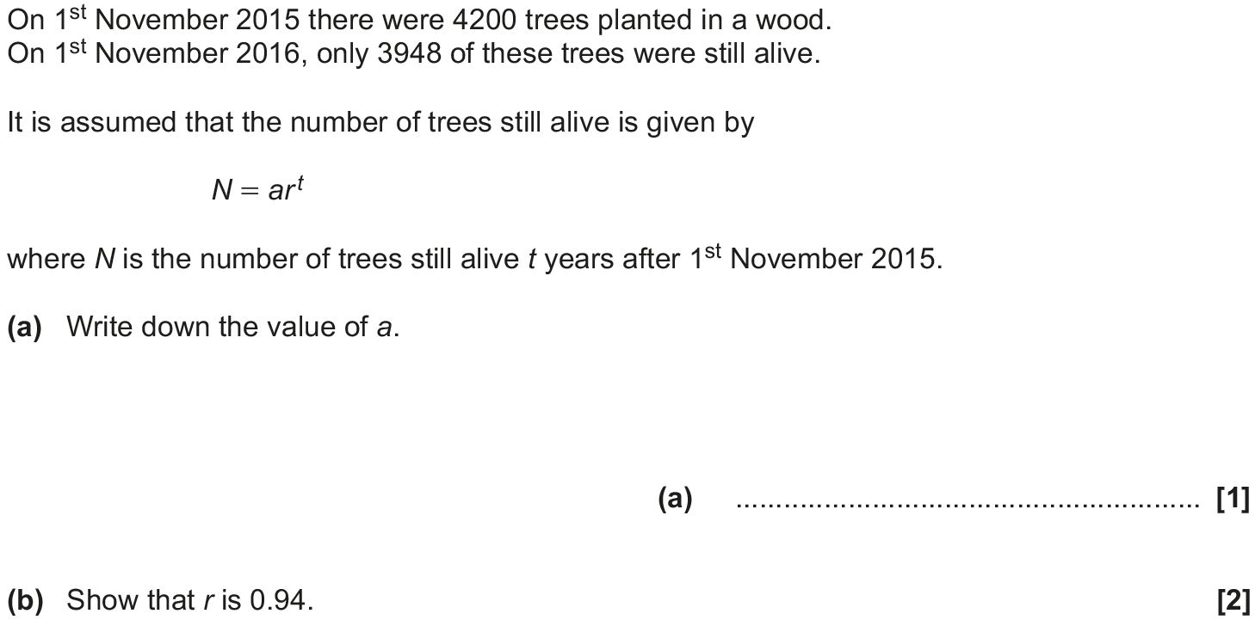
Algebra
Substitution
May 2017 1H Q10

Slide 102
Algebra
Substitution
May 2017 1H Q10
A
B
C

Slide 103
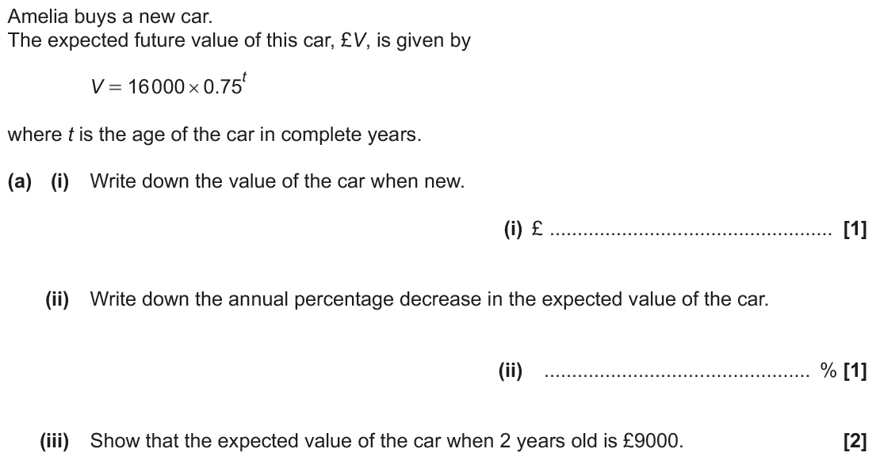
Algebra
Substitution
Nov 2017 2H Q11

Slide 104
Algebra
Substitution
Nov 2017 2H Q11
A (i)
A (ii)
A (iii)
B

Slide 105
Algebra
Substitution
Nov 2017 3H Q1

Slide 106
Algebra
Substitution
Nov 2017 3H Q1
A
B

Slide 107
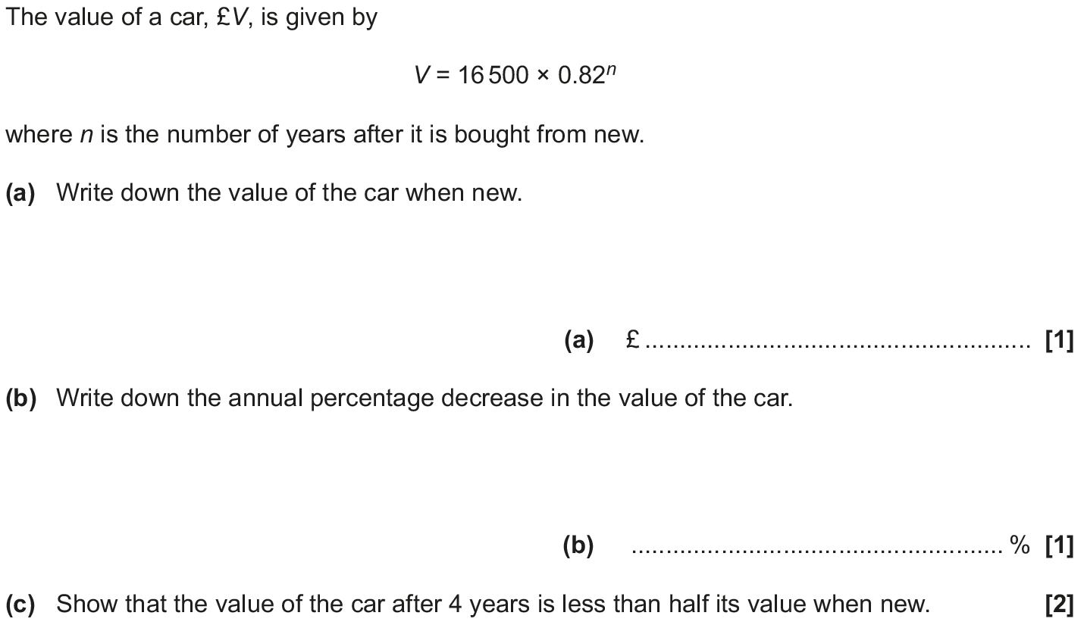
Algebra
Substitution
May 2018 1H Q12

Slide 108
Algebra
Substitution
May 2018 1H Q12
A
B
C

Slide 109
Algebra
Substitution
June 2018 3H Q5

Slide 110
Algebra
Substitution
June 2018 3H Q5
A
B

Slide 111
Algebra
Substitution
June 2018 3H Q5
C

Slide 112
Algebra
Substitution
June 2018 3H Q9

Slide 113
Algebra
Substitution
June 2018 3H Q9
A
B
C

Slide 114
Solving Simple Equations
Algebra
Solving Simple Equations
Practice
3H Q3
June 2017
2H Q10
Linear Inequalities
Sequences
See also:
Forming Equations
Substitution
Algebraic Fractions

Slide 115
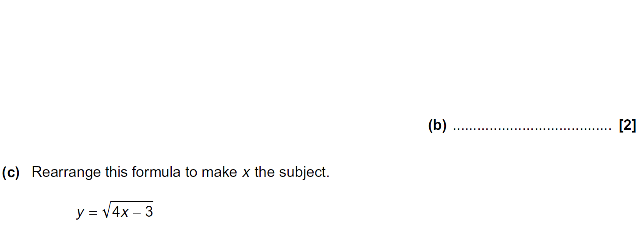
Algebra
Solving Simple Equations
Practice 3H Q3

Slide 116
Algebra
Solving Simple Equations
Practice 3H Q3
A
B
C

Slide 117
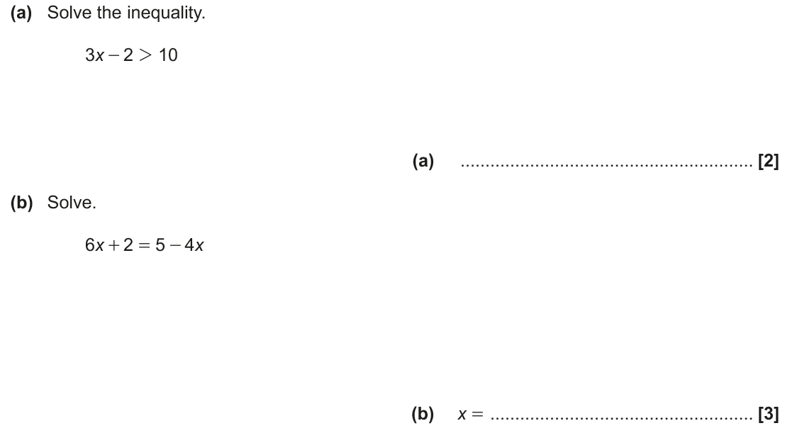
Algebra
Solving Simple Equations
June 2017 2H Q10

Slide 118
Algebra
Solving Simple Equations
June 2017 2H Q10
A
B

Slide 119
Graphical Transformations
Algebra
Graphical Transformations
Practice
2H Q13
Nov 2018
3H Q18
Trig
See also:
Completing the Square

Slide 120
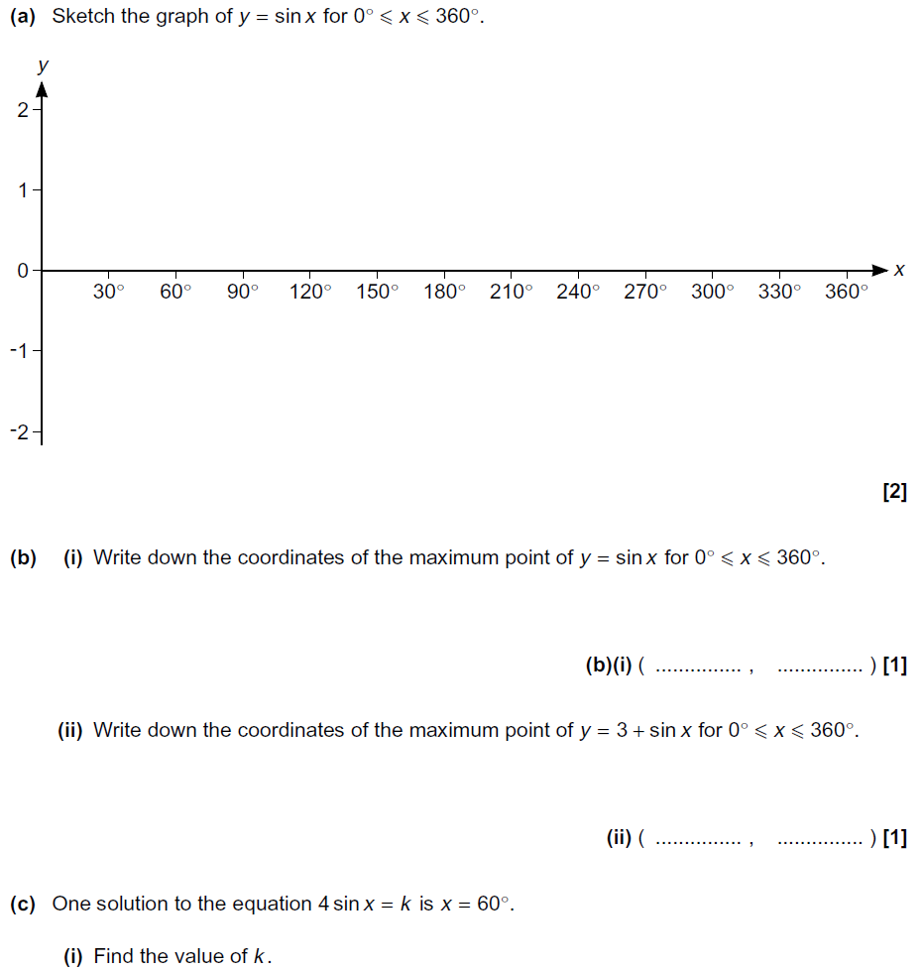
Algebra
Graphical Transformations
Practice 2H Q13
Show Graph

Slide 121
Algebra
Graphical Transformations
Practice 2H Q13
A
B (i)
B (ii)
C (i)
C (ii)

Slide 122
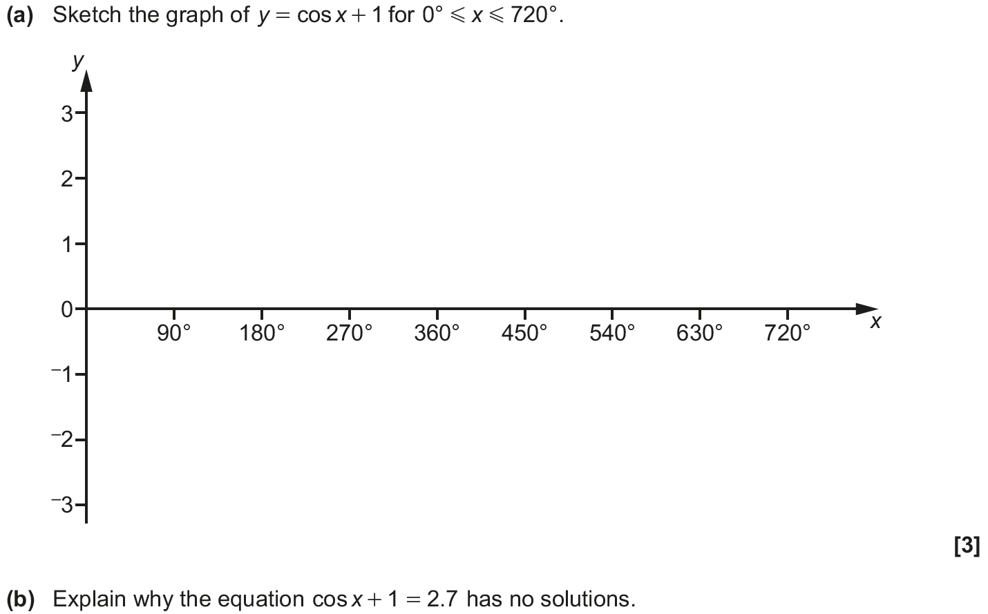
Algebra
Graphical Transformations
Nov 2018 3H Q18

Slide 123
Algebra
Graphical Transformations
Nov 2018 3H Q18
A
B

Slide 124
Linear Inequalities
Algebra
Linear Inequalities
June 2017
2H Q10
SAM
3H Q2
Nov 2017
3H Q18
Practice
3H Q3
June 2018
2H Q2
Nov 2018
2H Q14
Graphical

Slide 125
Algebra
Linear Inequalities
SAM 3H Q2

Slide 126
Algebra
Linear Inequalities
SAM 3H Q2
A (i)
A (ii)
B
C

Slide 127
Algebra
Linear Inequalities
Practice 3H Q3

Slide 128
Algebra
Linear Inequalities
Practice 3H Q3
A
B
C

Slide 129
Algebra
Linear Inequalities
June 2017 2H Q10

Slide 130
Algebra
Linear Inequalities
June 2017 2H Q10
A
B

Slide 131
Algebra
Linear Inequalities
Nov 2017 3H Q18
Show
Hide

Slide 132
Algebra
Linear Inequalities
Nov 2017 3H Q18
A
B
C

Slide 133
Algebra
Linear Inequalities
June 2018 2H Q2

Slide 134
Algebra
Linear Inequalities
June 2018 2H Q2
A

Slide 135
Algebra
Linear Inequalities
Nov 2018 2H Q14

Slide 136
Algebra
Linear Inequalities
Nov 2018 2H Q14
A

Slide 137
Sequences
Algebra
Sequences
May 2017
1H Q19
SAM
2H Q10
Nov 2017
2H Q2
SAM
3H Q3
May 2018
1H Q19
Practice
1H Q5
Nov 2018
1H Q17
Practice
2H Q14
Nov 2018
2H Q16
Quadratic
Geometric

Slide 138
Algebra
Sequences
SAM 2H Q10

Slide 139
Algebra
Sequences
SAM 2H Q10
A
B
C
D

Slide 140
Algebra
Sequences
SAM 3H Q3

Slide 141
Algebra
Sequences
SAM 3H Q3
A (i)
A (ii)
B
C

Slide 142
Algebra
Sequences
Practice 1H Q5

Slide 143
Algebra
Sequences
Practice 1H Q5
A
B

Slide 144
Algebra
Sequences
Practice 2H Q14

Slide 145
Algebra
Sequences
Practice 2H Q14
A
B
C

Slide 146
Algebra
Sequences
May 2017 1H Q19

Slide 147
Algebra
Sequences
May 2017 1H Q19
A
B

Slide 148
Algebra
Sequences
Nov 2017 2H Q2

Slide 149
Algebra
Sequences
Nov 2017 2H Q2
A (i)
A (ii)
B

Slide 150
Algebra
Sequences
May 2018 1H Q19

Slide 151
Algebra
Sequences
May 2018 1H Q19
A

Slide 152
Algebra
Sequences
Nov 2018 1H Q17

Slide 153
Algebra
Sequences
Nov 2018 1H Q17
A

Slide 154
Algebra
Sequences
Nov 2018 1H Q16

Slide 155
Algebra
Sequences
Nov 2018 1H Q16
A
B

Slide 156
Iterations
Algebra
Iterations
Nov 2017
3H Q12
SAM
1H Q19
Nov 2018
3H Q15

Slide 157
Algebra
Iterations
SAM 1H Q19

Slide 158
Algebra
Iterations
SAM 1H Q19
A
B

Slide 159
Algebra
Iterations
Nov 2017 3H Q12

Slide 160
Algebra
Iterations
Nov 2017 3H Q12
A
B

Slide 161
Algebra
Iterations
Nov 2018 3H Q15

Slide 162
Algebra
Iterations
Nov 2018 3H Q15
A

Slide 163
Manipulating Formulae/ Changing the Subject
Algebra
Manipulating Formulae/ Changing the Subject
June 2017
2H Q5
Practice
1H Q12
Nov 2017
3H Q1
Practice
3H Q3
Nov 2018
2H Q9
See also:
Volume & Surface Area
Forming Equations
Functions

Slide 164
Algebra
Manipulating Formulae/ Changing the Subject
Practice 1H Q12

Slide 165
Algebra
Manipulating Formulae/ Changing the Subject
Practice 1H Q12
A

Slide 166
Algebra
Manipulating Formulae/ Changing the Subject
Practice 3H Q3

Slide 167
Algebra
Manipulating Formulae/ Changing the Subject
Practice 3H Q3
A
B
C

Slide 168
Algebra
Manipulating Formulae/ Changing the Subject
June 2017 2H Q5

Slide 169
Algebra
Manipulating Formulae/ Changing the Subject
June 2017 2H Q5
A
B (i)
B (ii)

Slide 170
Algebra
Manipulating Formulae/ Changing the Subject
Nov 2017 3H Q1

Slide 171
Algebra
Manipulating Formulae/ Changing the Subject
Nov 2017 3H Q1
A
B

Slide 172
Algebra
Manipulating Formulae/ Changing the Subject
Nov 2018 2H Q9

Slide 173
Algebra
Manipulating Formulae/ Changing the Subject
Nov 2018 2H Q9
A

Slide 174
Forming Equations
Algebra
Forming Equations
May 2017
1H Q9
SAM
3H Q9
SAM
1H Q5
Nov 2017
2H Q6
Practice
1H Q4
SAM
2H Q5
May 2018
1H Q9
Practice
1H Q8
SAM
2H Q6
Nov 2018
1H Q5
Practice
2H Q6
SAM
2H Q19
Nov 2018
3H Q11
Practice
3H Q17
Nov 2018
3H Q12
Functions
See also:
Show that…
Direct & Inverse Proportion
Sequences

Slide 175
Algebra
Forming Equations
SAM 1H Q5

Slide 176
Algebra
Forming Equations
SAM 1H Q5
A

Slide 177
Algebra
Forming Equations
SAM 2H Q5

Slide 178
Algebra
Forming Equations
SAM 2H Q5
A

Slide 179
Algebra
Forming Equations
SAM 2H Q6

Slide 180
Algebra
Forming Equations
SAM 2H Q6
A

Slide 181
Algebra
Forming Equations
SAM 2H Q19

Slide 182
Algebra
Forming Equations
SAM 2H Q19
A

Slide 183
Algebra
Forming Equations
SAM 3H Q9

Slide 184
Algebra
Forming Equations
SAM 3H Q9
A

Slide 185
Algebra
Forming Equations
Practice 1H Q4

Slide 186
Algebra
Forming Equations
Practice 1H Q4
A

Slide 187
Algebra
Forming Equations
Practice 1H Q8

Slide 188
Algebra
Forming Equations
Practice 1H Q8
A

Slide 189
Algebra
Forming Equations
Practice 2H Q6

Slide 190
Algebra
Forming Equations
Practice 2H Q6
A

Slide 191
Algebra
Forming Equations
Practice 3H Q17

Slide 192
Algebra
Forming Equations
Practice 3H Q17
A
B

Slide 193
Algebra
Forming Equations
May 2017 1H Q9

Slide 194
Algebra
Forming Equations
May 2017 1H Q9
A
B

Slide 195
Algebra
Forming Equations
Nov 2017 2H Q6

Slide 196
Algebra
Forming Equations
Nov 2017 2H Q6
A

Slide 197
Algebra
Forming Equations
May 2018 1H Q9

Slide 198
Algebra
Forming Equations
May 2018 1H Q9
A

Slide 199
Algebra
Forming Equations
Nov 2018 1H Q5

Slide 200
Algebra
Forming Equations
Nov 2018 1H Q5
A

Slide 201
Algebra
Forming Equations
Nov 2018 3H Q11

Slide 202
Algebra
Forming Equations
Nov 2018 3H Q11
A

Slide 203
Algebra
Forming Equations
Nov 2018 3H Q12

Slide 204
Algebra
Forming Equations
Nov 2018 3H Q12
A

Slide 205
Completing the Square
Algebra
Completing the Square
May 2017
1H Q16
June 2017
2H Q19
SAM
2H Q20
Nov 2017
1H Q16
Practice
1H Q14
May 2018
1H Q15
Nov 2018
2H Q18
Transforming Quadratics
See also:
Functions

Slide 206
Algebra
Completing the Square
SAM 2H Q20

Slide 207
Algebra
Completing the Square
SAM 2H Q20
A
B

Slide 208
Algebra
Completing the Square
Practice 1H Q14

Slide 209
Algebra
Completing the Square
Practice 1H Q14
A
B

Slide 210
Algebra
Completing the Square
May 2017 1H Q16

Slide 211
Algebra
Completing the Square
May 2017 1H Q16
A

Slide 212
Algebra
Completing the Square
June 2017 2H Q19

Slide 213
Algebra
Completing the Square
June 2017 2H Q19
A
B

Slide 214
Algebra
Completing the Square
Nov 2017 1H Q16

Slide 215
Algebra
Completing the Square
Nov 2017 1H Q16
A
B

Slide 216
Algebra
Completing the Square
May 2018 1H Q15

Slide 217
Algebra
Completing the Square
May 2018 1H Q15
A
B
C

Slide 218
Algebra
Completing the Square
Nov 2018 2H Q18

Slide 219
Algebra
Completing the Square
Nov 2018 2H Q18
A (i)
A (i)
B

Slide 220
Simultaneous Equations
Algebra
Simultaneous Equations
SAM
1H Q8
May 2017
1H Q9
SAM
2H Q6*
Nov 2017
2H Q19
SAM
2H Q19
May 2018
1H Q9
SAM
3H Q2
June 2018
2H Q18
Practice
1H Q8
*not really designed to be sim eq, but can be answered in this way
Nov 2018
3H Q17
Practice
1H Q16
Quadratic
Graphical

Slide 221
Algebra
Simultaneous Equations
SAM 1H Q8

Slide 222
Algebra
Simultaneous Equations
SAM 1H Q8
A (i)
A (ii)
B

Slide 223
Algebra
Simultaneous Equations
SAM 2H Q6

Slide 224
Algebra
Simultaneous Equations
SAM 2H Q6
A

Slide 225
Algebra
Simultaneous Equations
SAM 2H Q19

Slide 226
Algebra
Simultaneous Equations
SAM 2H Q19
A

Slide 227
Algebra
Simultaneous Equations
SAM 3H Q2

Slide 228
Algebra
Simultaneous Equations
SAM 3H Q2
A (i)
A (ii)
B
C

Slide 229
Algebra
Simultaneous Equations
Practice 1H Q8

Slide 230
Algebra
Simultaneous Equations
Practice 1H Q8
A

Slide 231
Algebra
Simultaneous Equations
Practice 1H Q16

Slide 232
Algebra
Simultaneous Equations
Practice 1H Q16
A

Slide 233
Algebra
Simultaneous Equations
May 2017 1H Q9

Slide 234
Algebra
Simultaneous Equations
May 2017 1H Q9
A
B

Slide 235
Algebra
Simultaneous Equations
Nov 2017 2H Q19

Slide 236
Algebra
Simultaneous Equations
Nov 2017 2H Q19
A

Slide 237
Algebra
Simultaneous Equations
May 2018 1H Q9

Slide 238
Algebra
Simultaneous Equations
May 2018 1H Q9
A

Slide 239
Algebra
Simultaneous Equations
June 2018 2H Q18

Slide 240
Algebra
Simultaneous Equations
June 2018 2H Q18
A
B

Slide 241
Algebra
Simultaneous Equations
Nov 2018 3H Q17

Slide 242
Algebra
Simultaneous Equations
Nov 2018 3H Q17
A

Slide 243
Solving Quadratics
Algebra
Solving Quadratics
SAM
3H Q2
May 2017
1H Q18
May 2018
1H Q20
SAM
3H Q17
Nov 2017
1H Q13
Nov 2018
1H Q16
Practice
2H Q12
Nov 2017
1H Q18
Nov 2018
3H Q12
Practice
3H Q17
May 2018
1H Q16
Completing the Square
See also:
Simultaneous Equations
Quadratic Inequalities

Slide 244
Algebra
Solving Quadratics
SAM 3H Q2

Slide 245
Algebra
Solving Quadratics
SAM 3H Q2
A (i)
A (ii)
B
C

Slide 246
Algebra
Solving Quadratics
SAM 3H Q17

Slide 247
Algebra
Solving Quadratics
SAM 3H Q17
A

Slide 248
Algebra
Solving Quadratics
Practice 2H Q12

Slide 249
Algebra
Solving Quadratics
Practice 2H Q12
A
B
C

Slide 250
Algebra
Solving Quadratics
Practice 3H Q17

Slide 251
Algebra
Solving Quadratics
Practice 3H Q17
A
B

Slide 252
Algebra
Solving Quadratics
May 2017 1H Q18

Slide 253
Algebra
Solving Quadratics
May 2017 1H Q18
A
B

Slide 254
Algebra
Solving Quadratics
Nov 2017 1H Q13

Slide 255
Algebra
Solving Quadratics
Nov 2017 1H Q13
A
B

Slide 256
Algebra
Solving Quadratics
Nov 2017 1H Q18

Slide 257
Algebra
Solving Quadratics
Nov 2017 1H Q18
A

Slide 258
Algebra
Solving Quadratics
May 2018 1H Q16

Slide 259
Algebra
Solving Quadratics
May 2018 1H Q16
A

Slide 260
Algebra
Solving Quadratics
May 2018 1H Q20

Slide 261
Algebra
Solving Quadratics
May 2018 1H Q20
A

Slide 262
Algebra
Solving Quadratics
Nov 2018 1H Q16

Slide 263
Algebra
Solving Quadratics
Nov 2018 1H Q16
A

Slide 264
Algebra
Solving Quadratics
Nov 2018 3H Q12

Slide 265
Algebra
Solving Quadratics
Nov 2018 3H Q12
A

Slide 266
Quadratic Inequalities
Algebra
Quadratic Inequalities
SAM
2H Q16
Nov 2017
2H Q17
SAM
2H Q20

Slide 267
Algebra
Quadratic Inequalities
SAM 2H Q16

Slide 268
Algebra
Quadratic Inequalities
SAM 2H Q16
A

Slide 269
Algebra
Quadratic Inequalities
SAM 2H Q20

Slide 270
Algebra
Quadratic Inequalities
SAM 2H Q20
A
B

Slide 271
Algebra
Quadratic Inequalities
Nov 2017 2H Q17

Slide 272
Algebra
Quadratic Inequalities
Nov 2017 2H Q17
A

Slide 273
Factorising
Algebra
Factorising
June 2017
2H Q5
Nov 2017
1H Q2
Practice
2H Q12
Nov 2017
2H Q4
Nov 2018
1H Q13
Nov 2018
2H Q20
See also:
Algebraic Fractions
Solving Quadratics

Slide 274
Algebra
Factorising
Practice 2H Q12

Slide 275
Algebra
Factorising
Practice 2H Q12
A
B
C

Slide 276
Algebra
Factorising
June 2017 2H Q5

Slide 277
Algebra
Factorising
June 2017 2H Q5
A
B (i)
B (ii)

Slide 278
Algebra
Factorising
Nov 2017 1H Q2

Slide 279
Algebra
Factorising
Nov 2017 1H Q2
A (i)
A (ii)
B

Slide 280
Algebra
Factorising
Nov 2017 2H Q4

Slide 281
Algebra
Factorising
Nov 2017 2H Q4
A
B

Slide 282
Algebra
Factorising
Nov 2018 1H Q13

Slide 283
Algebra
Factorising
Nov 2018 1H Q13
A

Slide 284
Algebra
Factorising
Nov 2018 2H Q20

Slide 285
Algebra
Factorising
Nov 2018 2H Q20
A
B

Slide 286
Expanding Brackets
Algebra
Expanding Brackets
June 2017
2H Q17
SAM
3H Q17
Nov 2017
1H Q13
Practice
2H Q12
June 2018
2H Q17
Nov 2018
2H Q20
Triple Brackets
See also:
Surds
Solving Simple Equations

Slide 287
Algebra
Expanding Brackets
SAM 3H Q17

Slide 288
Algebra
Expanding Brackets
SAM 3H Q17
A

Slide 289
Algebra
Expanding Brackets
Practice 2H Q12

Slide 290
Algebra
Expanding Brackets
Practice 2H Q12
A
B
C

Slide 291
Algebra
Expanding Brackets
June 2017 2H Q17

Slide 292
Algebra
Expanding Brackets
June 2017 2H Q17
A
B

Slide 293
Algebra
Expanding Brackets
Nov 2017 1H Q13

Slide 294
Algebra
Expanding Brackets
Nov 2017 1H Q13
A
B

Slide 295
Algebra
Expanding Brackets
June 2018 2H Q17

Slide 296
Algebra
Expanding Brackets
June 2018 2H Q17
A

Slide 297
Algebra
Expanding Brackets
Nov 2018 2H Q20

Slide 298
Algebra
Expanding Brackets
Nov 2018 2H Q20
A
B

Slide 299
Algebraic Fractions
Algebra
Algebraic Fractions
June 2017
2H Q17
June 2017
3H Q16
SAM
1H Q20
May 2018
1H Q20
Practice
3H Q15
June 2018
3H Q19
Nov 2018
3H Q21

Slide 300
Algebra
Algebraic Fractions
SAM 1H Q20

Slide 301
Algebra
Algebraic Fractions
SAM 1H Q20
A
B

Slide 302
Algebra
Algebraic Fractions
Practice 3H Q15

Slide 303
Algebra
Algebraic Fractions
Practice 3H Q15
A

Slide 304
Algebra
Algebraic Fractions
June 2017 2H Q17

Slide 305
Algebra
Algebraic Fractions
June 2017 2H Q17
A
B

Slide 306
Algebra
Algebraic Fractions
June 2017 3H Q16

Slide 307
Algebra
Algebraic Fractions
June 2017 3H Q16
A
B

Slide 308
Algebra
Algebraic Fractions
May 2018 1H Q20

Slide 309
Algebra
Algebraic Fractions
May 2018 1H Q20
A

Slide 310
Algebra
Algebraic Fractions
June 2018 3H Q19

Slide 311
Algebra
Algebraic Fractions
June 2018 3H Q19
A

Slide 312
Algebra
Algebraic Fractions
Nov 2018 3H Q21

Slide 313
Algebra
Algebraic Fractions
Nov 2018 3H Q21
A

Slide 314
Functions
Algebra
Functions
June 2017
3H Q14
SAM
1H Q8
June 2018
3H Q17
Nov 2018
1H Q11
With graphs
*mainly graphs

Slide 315
Algebra
Functions
SAM 1H Q8

Slide 316
Algebra
Functions
SAM 1H Q8
A (i)
A (ii)
B

Slide 317
Algebra
Functions
June 2017 3H Q14

Slide 318
Algebra
Functions
June 2017 3H Q14
A
B

Slide 319
Algebra
Functions
June 2017 3H Q14
C

Slide 320
Algebra
Functions
June 2018 3H Q17

Slide 321
Algebra
Functions
June 2018 3H Q17
A
B

Slide 322
Algebra
Functions
Nov 2018 1H Q11

Slide 323
Algebra
Functions
Nov 2018 1H Q11
A
B

Slide 324
Show that…/ Proof
Show that…/ Proof
(algebraic)
SAM
1H Q11
Practice
1H Q12
May 2017
1H Q10
Nov 2017
2H Q11
June 2018
2H Q15
SAM
1H Q17
Practice
1H Q13
June 2017
2H Q8
Nov 2017
2H Q18
June 2018
3H Q4
Nov 2018
2H Q13
SAM
1H Q20
Practice
2H Q15
June 2017
2H Q14
Nov 2017
3H Q14
June 2018
3H Q9
Nov 2018
2H Q20
SAM
2H Q14
Practice
2H Q17
June 2017
2H Q21
Nov 2017
3H Q17
June 2018
3H Q14
Nov 2018
3H Q5
SAM
2H Q16*
Practice
3H Q11
June 2017
3H Q17
May 2018
1H Q12
June 2018
3H Q19
Nov 2018
3H Q16
*By counter-example
SAM
3H Q7
Practice
3H Q15
Nov 2017
1H Q17
May 2018
1H Q13
Nov 2018
1H Q2
Nov 2018
3H Q21
Proof of algebraic properties
SAM
3H Q8
Practice
3H Q17
Nov 2017
2H Q8
June 2018
2H Q8
Nov 2018
1H Q22
Circle Theorems
Vectors
Iterations
Similar Shapes
Proof
see also:
Recurring Decimals
Fractions
Surds

Slide 325
Show that…
SAM 1H Q11

Slide 326
Show that…
SAM 1H Q11
A
B

Slide 327
Show that…
SAM 1H Q17

Slide 328
Show that…
SAM 1H Q17
A

Slide 329
Show that…
SAM 1H Q17

Slide 330
Show that…
SAM 1H Q17
A

Slide 331
Show that…
SAM 1H Q20

Slide 332
Show that…
SAM 1H Q20
A
B

Slide 333
Show that…
SAM 2H Q14

Slide 334
Show that…
SAM 2H Q14
A

Slide 335
Show that…
SAM 2H Q16

Slide 336
Show that…
SAM 2H Q16
A

Slide 337
Show that…
SAM 3H Q7

Slide 338
Show that…
SAM 3H Q7
A

Slide 339
Show that…
SAM 3H Q8

Slide 340
Show that…
SAM 3H Q8
A
B

Slide 341
Show that…
Practice 1H Q12

Slide 342
Show that…
Practice 1H Q12
A

Slide 343
Show that…
Practice 1H Q13

Slide 344
Show that…
Practice 1H Q13
A
B

Slide 345
Show that…
Practice 2H Q15

Slide 346
Show that…
Practice 2H Q15
A
B

Slide 347
Show that…
Practice 2H Q15

Slide 348
Show that…
Practice 2H Q15
A
B

Slide 349
Show that…
Practice 2H Q17

Slide 350
Show that…
Practice 2H Q17
A

Slide 351
Show that…
Practice 3H Q11

Slide 352
Show that…
Practice 3H Q11
A
B (i)
B (ii)
C

Slide 353
Show that…
Practice 3H Q15

Slide 354
Show that…
Practice 3H Q15
A

Slide 355
Show that…
Practice 3H Q17

Slide 356
Show that…
Practice 3H Q17
A
B

Slide 357
Show that…
May 2017 1H Q10

Slide 358
Show that…
May 2017 1H Q10
A
B
C

Slide 359
Show that…
June 2017 2H Q8

Slide 360
Show that…
June 2017 2H Q8
A
B

Slide 361
Show that…
June 2017 2H Q14

Slide 362
Show that…
June 2017 2H Q14
A
B

Slide 363
Show that…
June 2017 2H Q21

Slide 364
Show that…
June 2017 2H Q21
A
B

Slide 365
Show that…
June 2017 3H Q17

Slide 366
Show that…
June 2017 3H Q17
A

Slide 367
Show that…
Nov 2017 1H Q17

Slide 368
Show that…
Nov 2017 1H Q17
A
B

Slide 369
Show that…
Nov 2017 2H Q8

Slide 370
Show that…
Nov 2017 2H Q8
A
B

Slide 371
Show that…
Nov 2017 2H Q11

Slide 372
Show that…
Nov 2017 2H Q11
A (i)
A (ii)
A (iii)
B

Slide 373
Show that…
Nov 2017 2H Q18

Slide 374
Show that…
Nov 2017 2H Q18
A

Slide 375
Show that…
Nov 2017 3H Q14

Slide 376
Show that…
Nov 2017 3H Q14
A
B

Slide 377
Show that…
Nov 2017 3H Q17

Slide 378
Show that…
Nov 2017 3H Q17
A
B
C

Slide 379
Show that…
May 2018 1H Q12

Slide 380
Show that…
May 2018 1H Q12
A
B
C

Slide 381
Show that…
May 2018 1H Q13

Slide 382
Show that…
May 2018 1H Q13
A
B

Slide 383
Show that…
June 2018 2H Q8

Slide 384
Show that…
June 2018 2H Q8
A
B (i)
B (ii)

Slide 385
Show that…
June 2018 2H Q15

Slide 386
Show that…
June 2018 2H Q15
A

Slide 387
Show that…
June 2018 3H Q4

Slide 388
Show that…
June 2018 3H Q4
A
B

Slide 389
Show that…
June 2018 3H Q9

Slide 390
Show that…
June 2018 3H Q9
A
B
C

Slide 391
Show that…
June 2018 3H Q14

Slide 392
Show that…
June 2018 3H Q14
A
B (i)
B (ii)

Slide 393
Show that…
June 2018 3H Q19

Slide 394
Show that…
June 2018 3H Q19
A

Slide 395
Show that…
Nov 2018 1H Q2

Slide 396
Show that…
Nov 2018 1H Q2
A
B

Slide 397
Show that…
Nov 2018 1H Q22

Slide 398
Show that…
Nov 2018 1H Q22
A

Slide 399
Show that…
Nov 2018 2H Q13

Slide 400
Show that…
Nov 2018 2H Q13
A
B

Slide 401
Show that…
Nov 2018 2H Q20

Slide 402
Show that…
Nov 2018 2H Q20
A
B

Slide 403
Show that…
Nov 2018 3H Q5

Slide 404
Show that…
Nov 2018 3H Q5
A
B
C

Slide 405
Show that…
Nov 2018 3H Q16

Slide 406
Show that…
Nov 2018 3H Q16
A

Slide 407
Show that…
Nov 2018 3H Q21

Slide 408
Show that…
Nov 2018 3H Q21
A

Slide 409
Notes on Number Questions for OCR
Number
There is again a large overlap between a lot of sub-topics, which knowledge of multiple concepts such as percentages, fractions and decimals all required to solve a single question (particularly later on in papers). For this reason an extra sub topic was created.
Ratio and basic proportion cover a variety of different questions with extremely similar steps used when solving them. As similar approaches can be used for all of them, I did not create multiple sub-topics.
Properties of numbers largely deals with prime factor decomposition and using this to find the HCF and LCM of numbers, but also the general principles of types of numbers such as primes.
Decimals, Fractions percentages (and ratios to a lesser extent) are all use commonly through the probability topic.
Exponential modelling questions appear in every paper- these have been placed within the percentages topic

Slide 410
Number
Number
Using a Calculator/ BIDMAS
Standard Form
Surds
Properties of Numbers
Rounding & Estimation
Upper & Lower Bounds
Recurring Decimals
Combinations
Fractions
Percentages
Decimals
FDPR mixed context
Ratio & Basic Proportion
Direct & Inverse Proportion
Compound Measures
Notes

Slide 411
Number
Using a Calculator / BIDMAS
May 2017 1H Q1

Slide 412
Number
Using a Calculator / BIDMAS
May 2017 1H Q1
A
B

Slide 413
Standard Form
Number
Standard Form
June 2017
3H Q1
Nov 2017
3H Q5
SAM
1H Q13
June 2018
2H Q1
Practice
3H Q6
Nov 2018
2H Q1
Nov 2018
3H Q3

Slide 414
Number
Standard Form
SAM 1H Q13

Slide 415
Number
Standard Form
SAM 1H Q13
A

Slide 416
Number
Standard Form
Practice 3H Q6

Slide 417
Number
Standard Form
Practice 3H Q6
A
B

Slide 418
Number
Standard Form
June 2017 3H Q1

Slide 419
Number
Standard Form
June 2017 3H Q1
A
B
C

Slide 420
Number
Standard Form
Nov 2017 3H Q5

Slide 421
Number
Standard Form
Nov 2017 3H Q5
A
B
C (i)
C (ii)

Slide 422
Number
Standard Form
June 2018 2H Q1

Slide 423
Number
Standard Form
June 2018 2H Q1
A
B

Slide 424
Number
Standard Form
Nov 2018 2H Q1

Slide 425
Number
Standard Form
Nov 2018 2H Q1
A
B

Slide 426
Number
Standard Form
Nov 2018 3H Q3

Slide 427
Number
Standard Form
Nov 2018 3H Q3
A

Slide 428
Surds
Number
Surds
June 2017
2H Q15
SAM
1H Q12
Nov 2017
1H Q15
SAM
2H Q15
Nov 2017
2H Q16
Practice
1H Q17
June 2018
2H Q20
See also:
Trig Exact Values & Graphs
Solving Quadratics (non-calc)

Slide 429
Number
Surds
SAM 1H Q12

Slide 430
Number
Surds
SAM 1H Q12
A

Slide 431
Number
Surds
SAM 2H Q15

Slide 432
Number
Surds
SAM 2H Q15
A
B

Slide 433
Number
Surds
Practice 1H Q17

Slide 434
Number
Surds
Practice 1H Q17
A
B

Slide 435
Number
Surds
June 2017 2H Q15

Slide 436
Number
Surds
June 2017 2H Q15
A (i)
A (ii)
B

Slide 437
Number
Surds
June 2017 2H Q15
B Exemplar responses

Slide 438
Number
Surds
Nov 2017 1H Q15

Slide 439
Number
Surds
Nov 2017 1H Q15
A

Slide 440
Number
Surds
Nov 2017 2H Q16

Slide 441
Number
Surds
Nov 2017 2H Q16
A
B

Slide 442
Number
Surds
June 2018 2H Q20

Slide 443
Number
Surds
June 2018 2H Q20
A (i)
A (ii)
B

Slide 444
Properties of Numbers
Number
Properties of Numbers
May 2017
1H Q3
SAM
1H Q11
Nov 2017
2H Q3
SAM
2H Q7
Nov 2017
3H Q2
SAM
2H Q16
May 2018
1H Q3
SAM
3H Q3
Nov 2018
1H Q8
Prime factors/ HCF/ LCM
See also:
Sets
Proof

Slide 445
Number
Properties of Numbers
SAM 1H Q11

Slide 446
Number
Properties of Numbers
SAM 1H Q11
A
B

Slide 447
Number
Properties of Numbers
SAM 2H Q7

Slide 448
Number
Properties of Numbers
SAM 2H Q7
A

Slide 449
Number
Properties of Numbers
SAM 2H Q16

Slide 450
Number
Properties of Numbers
SAM 2H Q16
A

Slide 451
Number
Properties of Numbers
SAM 3H Q3

Slide 452
Number
Properties of Numbers
SAM 3H Q3
A (i)
A (ii)
B
C

Slide 453
Number
Properties of Numbers
May 2017 1H Q3

Slide 454
Number
Properties of Numbers
May 2017 1H Q3
A
B

Slide 455
Number
Properties of Numbers
Nov 2017 2H Q3

Slide 456
Number
Properties of Numbers
Nov 2017 2H Q3
A

Slide 457
Number
Properties of Numbers
Nov 2017 3H Q2

Slide 458
Number
Properties of Numbers
Nov 2017 3H Q2
A

Slide 459
Number
Properties of Numbers
May 2018 1H Q3

Slide 460
Number
Properties of Numbers
May 2018 1H Q3
A (i)
A (ii)
B

Slide 461
Number
Properties of Numbers
Nov 2018 1H Q8

Slide 462
Number
Properties of Numbers
Nov 2018 1H Q8
A (i)
A (ii)
B (i)
B (ii)

Slide 463
Combinations
Number
Combinations
June 2017
2H Q14
SAM
1H Q17
Nov 2017
1H Q8
Practice
2H Q15
May 2018
1H Q13

Slide 464
Number
Combinations
SAM 1H Q17

Slide 465
Number
Combinations
SAM 1H Q17
A

Slide 466
Number
Combinations
Practice 2H Q15

Slide 467
Number
Combinations
Practice 2H Q15
A
B

Slide 468
Number
Combinations
June 2017 2H Q14

Slide 469
Number
Combinations
June 2017 2H Q14
A
B

Slide 470
Number
Combinations
Nov 2017 1H Q8

Slide 471
Number
Combinations
Nov 2017 1H Q8
A
B

Slide 472
Number
Combinations
May 2018 1H Q13

Slide 473
Number
Combinations
May 2018 1H Q13
A
B

Slide 474
Rounding & Estimation
Number
Rounding
June 2018
3H Q3
Practice
2H Q17
Nov 2018
2H Q2

Slide 475
Number
Rounding
Practice 2H Q17

Slide 476
Number
Rounding
Practice 2H Q17
A

Slide 477
Number
Rounding
June 2018 3H Q3

Slide 478
Number
Rounding
June 2018 3H Q3
A

Slide 479
Number
Rounding
Nov 2018 2H Q2

Slide 480
Number
Rounding
Nov 2018 2H Q2
A

Slide 481
Upper & Lower Bounds
Number
Upper & Lower Bounds
May 2017
1H Q2
June 2018
3H Q14
SAM
2H Q8
June 2017
3H Q11
Nov 2018
3H Q4
Practice
1H Q1
Nov 2017
1H Q12
Nov 2018
3H Q16

Slide 482
Number
Upper & Lower Bounds
SAM 2H Q8

Slide 483
Number
Upper & Lower Bounds
SAM 2H Q8
A

Slide 484
Number
Upper & Lower Bounds
Practice 1H Q1

Slide 485
Number
Upper & Lower Bounds
Practice 1H Q1
A (i)
A (ii)
B

Slide 486
Number
Upper & Lower Bounds
May 2017 1H Q2

Slide 487
Number
Upper & Lower Bounds
May 2017 1H Q2
A

Slide 488
Number
Upper & Lower Bounds
June 2017 3H Q11

Slide 489
Number
Upper & Lower Bounds
June 2017 3H Q11
A

Slide 490
Number
Upper & Lower Bounds
Nov 2017 1H Q12

Slide 491
Number
Upper & Lower Bounds
Nov 2017 1H Q12
A

Slide 492
Number
Upper & Lower Bounds
June 2018 3H Q14

Slide 493
Number
Upper & Lower Bounds
June 2018 3H Q14
A
B (i)
B (ii)

Slide 494
Number
Upper & Lower Bounds
Nov 2018 3H Q4

Slide 495
Number
Upper & Lower Bounds
Nov 2018 3H Q4
A

Slide 496
Number
Upper & Lower Bounds
Nov 2018 3H Q16

Slide 497
Number
Upper & Lower Bounds
Nov 2018 3H Q16
A

Slide 498
Fractions
Number
Fractions
SAM
3H Q15
June 2017
2H Q1
Practice
2H Q9
June 2018
2H Q1
Practice
3H Q8
June 2018
2H Q6
Tree Diagrams
Context
See also
FDPR mixed context
Basic Probability
Multiple Events

Slide 499
Number
Fractions
SAM 3H Q15

Slide 500
Number
Fractions
SAM 3H Q15
A

Slide 501
Number
Fractions
Practice 2H Q9

Slide 502
Number
Fractions
Practice 2H Q9
A
B
C

Slide 503
Number
Fractions
Practice 3H Q8

Slide 504
Number
Fractions
Practice 3H Q8
A
B

Slide 505
Number
Fractions
June 2017 2H Q1

Slide 506
Number
Fractions
June 2017 2H Q1
A

Slide 507
Number
Fractions
June 2018 2H Q1

Slide 508
Number
Fractions
June 2018 2H Q1
A
B

Slide 509
Number
Fractions
Nov 2018 2H Q6

Slide 510
Number
Fractions
Nov 2018 2H Q6
A

Slide 511
Ratio & Basic Proportion
Number
Ratio & Basic Proportion
June 2017
2H Q3
May 2017
1H Q1
SAM
1H Q1
June 2017
2H Q7
SAM
2H Q19
June 2018
2H Q10
SAM
1H Q4
June 2017
3H Q2
Practice
2H Q2
Nov 2018
3H Q5
SAM
1H Q6
Nov 2017
1H Q6
Practice
2H Q4*
Nov 2018
3H Q6
SAM
2H Q2
Nov 2017
2H Q8
Practice
3H Q1
Nov 2018
3H Q9
SAM
2H Q4
Nov 2017
2H Q9
Nov 2018
3H Q10
Nov 2017
3H Q13
Inverse Proportion in context
Proportion Graphs
*Conversion Graphs
See also
FDPR mixed context
Pie Charts
Similar Shapes

Slide 512
Number
Ratio & Basic Proportion
SAM 1H Q1

Slide 513
Number
Ratio & Basic Proportion
SAM 1H Q1
A

Slide 514
Number
Ratio & Basic Proportion
SAM 1H Q4

Slide 515
Number
Ratio & Basic Proportion
SAM 1H Q4
A (i)
A (ii)
B (i)
B (ii)

Slide 516
Number
Ratio & Basic Proportion
SAM 1H Q6

Slide 517
Number
Ratio & Basic Proportion
SAM 1H Q6
A

Slide 518
Number
Ratio & Basic Proportion
SAM 2H Q2

Slide 519
Number
Ratio & Basic Proportion
SAM 2H Q2
A
B
C

Slide 520
Number
Ratio & Basic Proportion
SAM 2H Q4

Slide 521
Number
Ratio & Basic Proportion
SAM 2H Q4
A
B

Slide 522
Number
Ratio & Basic Proportion
SAM 2H Q19

Slide 523
Number
Ratio & Basic Proportion
SAM 2H Q19
A

Slide 524
Number
Ratio & Basic Proportion
Practice 2H Q2

Slide 525
Number
Ratio & Basic Proportion
Practice 2H Q2
A

Slide 526
Number
Ratio & Basic Proportion
Practice 2H Q4

Slide 527
Number
Ratio & Basic Proportion
Practice 2H Q4
A
B (i)
B (ii)
C

Slide 528
Number
Ratio & Basic Proportion
Practice 3H Q1

Slide 529
Number
Ratio & Basic Proportion
Practice 3H Q1
A
B

Slide 530
Number
Ratio & Basic Proportion
June 2017 2H Q3

Slide 531
Number
Ratio & Basic Proportion
June 2017 2H Q3
A

Slide 532
Number
Ratio & Basic Proportion
June 2017 2H Q3
A Exemplar responses

Slide 533
Number
Ratio & Basic Proportion
June 2017 2H Q7

Slide 534
Number
Ratio & Basic Proportion
June 2017 2H Q7
A
B

Slide 535
Number
Ratio & Basic Proportion
June 2017 3H Q2
Construction line 1
Construction line 2
Construction line 3
note: AD = 12cm
Construction line 4
Construction line 5
Shaded region

Slide 536
Number
Ratio & Basic Proportion
June 2017 3H Q2
A (i)
A (ii)
B

Slide 537
Number
Ratio & Basic Proportion
Nov 2017 1H Q6

Slide 538
Number
Ratio & Basic Proportion
Nov 2017 1H Q6
A

Slide 539
Number
Ratio & Basic Proportion
Nov 2017 2H Q8

Slide 540
Number
Ratio & Basic Proportion
Nov 2017 2H Q8
A
B

Slide 541
Number
Ratio & Basic Proportion
Nov 2017 2H Q9

Slide 542
Number
Ratio & Basic Proportion
Nov 2017 2H Q9
A

Slide 543
Number
Ratio & Basic Proportion
Nov 2017 3H Q13

Slide 544
Number
Ratio & Basic Proportion
Nov 2017 3H Q13
A
B

Slide 545
Number
Ratio & Basic Proportion
May 2018 1H Q1

Slide 546
Number
Ratio & Basic Proportion
May 2018 1H Q1
A
B

Slide 547
Number
Ratio & Basic Proportion
June 2018 2H Q10

Slide 548
Number
Ratio & Basic Proportion
June 2018 2H Q10
A
B

Slide 549
Number
Ratio & Basic Proportion
June 2018 2H Q10
B Exemplar responses

Slide 550
Number
Ratio & Basic Proportion
Nov 2018 3H Q5

Slide 551
Number
Ratio & Basic Proportion
Nov 2018 3H Q5
A
B
C

Slide 552
Number
Ratio & Basic Proportion
Nov 2018 3H Q6

Slide 553
Number
Ratio & Basic Proportion
Nov 2018 3H Q6
A

Slide 554
Number
Ratio & Basic Proportion
Nov 2018 3H Q9

Slide 555
Number
Ratio & Basic Proportion
Nov 2018 3H Q9
A
B

Slide 556
Number
Ratio & Basic Proportion
Nov 2018 3H Q10

Slide 557
Number
Ratio & Basic Proportion
Nov 2018 3H Q10
A

Slide 558
Compound Measures
Number
Compound Measures
June 2017
3H Q8
SAM
2H Q9
May 2018
1H Q5
SAM
3H Q1
Nov 2018
1H Q2
Practice
2H Q17
Nov 2018
2H Q4
Practice
3H Q4
Nov 2018
2H Q5
See also:
Time-Series

Slide 559
Number
Compound Measures
SAM 2H Q9

Slide 560
Number
Compound Measures
SAM 2H Q9
A

Slide 561
Number
Compound Measures
SAM 3H Q1

Slide 562
Number
Compound Measures
SAM 3H Q1
A
B

Slide 563
Number
Compound Measures
Practice 2H Q17

Slide 564
Number
Compound Measures
Practice 2H Q17
A

Slide 565
Number
Compound Measures
Practice 3H Q4
*4cm in a straight line from Cambridge to Newcastle

Slide 566
Number
Compound Measures
Practice 3H Q4
A
B

Slide 567
Number
Compound Measures
June 2017 3H Q8

Slide 568
Number
Compound Measures
June 2017 3H Q8
A

Slide 569
Number
Compound Measures
May 2018 1H Q5
*11.6 cm in a straight line from P to Q

Slide 570
Number
Compound Measures
May 2018 1H Q5
A
B

Slide 571
Number
Compound Measures
May 2018 1H Q5
B Exemplar responses

Slide 572
Number
Compound Measures
Nov 2018 1H Q2

Slide 573
Number
Compound Measures
Nov 2018 1H Q2
A
B

Slide 574
Number
Compound Measures
Nov 2018 2H Q4

Slide 575
Number
Compound Measures
Nov 2018 2H Q4
A

Slide 576
Number
Compound Measures
Nov 2018 2H Q5

Slide 577
Number
Compound Measures
Nov 2018 2H Q5
A
B

Slide 578
Direct & Inverse Proportion
Number
Direct & Inverse Proportion
May 2017
1H Q15
May 2018
1H Q11
SAM
1H Q15
June 2017
3H Q12
June 2018
3H Q6
Practice
1H Q13
Nov 2017
1H Q11
Nov 2018
1H Q14

Slide 579
Number
Direct & Inverse Proportion
SAM 1H Q15

Slide 580
Number
Direct & Inverse Proportion
SAM 1H Q15
A

Slide 581
Number
Direct & Inverse Proportion
Practice 1H Q13

Slide 582
Number
Direct & Inverse Proportion
Practice 1H Q13
A
B

Slide 583
Number
Direct & Inverse Proportion
May 2017 1H Q15

Slide 584
Number
Direct & Inverse Proportion
May 2017 1H Q15
A
B
C
D
E

Slide 585
Number
Direct & Inverse Proportion
June 2017 3H Q12

Slide 586
Number
Direct & Inverse Proportion
June 2017 3H Q12
A

Slide 587
Number
Direct & Inverse Proportion
Nov 2017 1H Q11

Slide 588
Number
Direct & Inverse Proportion
Nov 2017 1H Q11
A

Slide 589
Number
Direct & Inverse Proportion
May 2018 1H Q11

Slide 590
Number
Direct & Inverse Proportion
May 2018 1H Q11
A

Slide 591
Number
Direct & Inverse Proportion
June 2018 3H Q6

Slide 592
Number
Direct & Inverse Proportion
June 2018 3H Q6
A

Slide 593
Number
Direct & Inverse Proportion
Nov 2018 1H Q14

Slide 594
Number
Direct & Inverse Proportion
Nov 2018 1H Q14
A

Slide 595
Decimals
Number
Decimals
None to date
Tree Diagrams
See also
FDPR mixed context
Basic Probability
Multiple Events

Slide 596
FDPR mixed context
Number
FDPR mixed context
June 2017
3H Q4
Nov 2017
3H Q6
SAM
2H Q15*
June 2018
2H Q4
June 2018
3H Q2
Fractions
Decimals
Percentages
Ratios
*And Surds!

Slide 597
Number
FDPR mixed context
SAM 2H Q15

Slide 598
Number
FDPR mixed context
SAM 2H Q15
A
B

Slide 599
Number
FDPR mixed context
June 2017 3H Q4

Slide 600
Number
FDPR mixed context
June 2017 3H Q4
A

Slide 601
Number
FDPR mixed context
Nov 2017 3H Q6

Slide 602
Number
FDPR mixed context
Nov 2017 3H Q6
A (i)
A (ii)
B

Slide 603
Number
FDPR mixed context
June 2018 2H Q4

Slide 604
Number
FDPR mixed context
June 2018 2H Q4
A

Slide 605
Number
FDPR mixed context
June 2018 3H Q2

Slide 606
Number
FDPR mixed context
June 2018 3H Q2
A

Slide 607
Percentages
Number
Percentages
May 2017
1H Q5
May 2018
1H Q11
May 2017
1H Q10*
May 2018
1H Q12*
Practice
1H Q2*
June 2017
2H Q4*
June 2018
2H Q6
SAM
1H Q3*
Practice
1H Q3
June 2017
2H Q12
June 2018
3H Q15
SAM
1H Q15
Practice
2H Q5
June 2017
3H Q1
Nov 2018
1H Q1
SAM
3H Q4
Practice
3H Q5
Nov 2017
2H Q7
Nov 2018
1H Q4
Nov 2017
2H Q11*
Nov 2018
2H Q7
Nov 2017
3H Q7
Nov 2018
2H Q11
Best Buys
*Exponential models
Compound/ Repeated Change
See also:
FDPR mixed context
Sequences (geometric)

Slide 608
Number
Percentages
SAM 1H Q3

Slide 609
Number
Percentages
SAM 1H Q3
A
B
C

Slide 610
Number
Percentages
SAM 1H Q15

Slide 611
Number
Percentages
SAM 1H Q15
A

Slide 612
Number
Percentages
SAM 3H Q4

Slide 613
Number
Percentages
SAM 3H Q4
A
B

Slide 614
Number
Percentages
Practice 1H Q2

Slide 615
Number
Percentages
Practice 1H Q2
A
B
C
D

Slide 616
Number
Percentages
Practice 1H Q3

Slide 617
Number
Percentages
Practice 1H Q3
A

Slide 618
Number
Percentages
Practice 2H Q5

Slide 619
Number
Percentages
Practice 2H Q5
A

Slide 620
Number
Percentages
Practice 3H Q5

Slide 621
Number
Percentages
Practice 3H Q5
A

Slide 622
Number
Percentages
May 2017 1H Q5

Slide 623
Number
Percentages
May 2017 1H Q5
A

Slide 624
Number
Percentages
May 2017 1H Q10

Slide 625
Number
Percentages
May 2017 1H Q10
A
B
C

Slide 626
Number
Percentages
June 2017 2H Q4

Slide 627
Number
Percentages
June 2017 2H Q4
A
B
C

Slide 628
Number
Percentages
June 2017 2H Q12

Slide 629
Number
Percentages
June 2017 2H Q12
A

Slide 630
Number
Percentages
June 2017 3H Q1

Slide 631
Number
Percentages
June 2017 3H Q1
A
B
C

Slide 632
Number
Percentages
Nov 2017 2H Q7

Slide 633
Number
Percentages
Nov 2017 2H Q7
A

Slide 634
Number
Percentages
Nov 2017 2H Q11

Slide 635
Number
Percentages
Nov 2017 2H Q11
A (i)
A (ii)
A (iii)
B

Slide 636
Number
Percentages
Nov 2017 3H Q7

Slide 637
Number
Percentages
Nov 2017 3H Q7
A

Slide 638
Number
Percentages
May 2018 1H Q11

Slide 639
Number
Percentages
May 2018 1H Q11
A

Slide 640
Number
Percentages
May 2018 1H Q12

Slide 641
Number
Percentages
May 2018 1H Q12
A
B
C

Slide 642
Number
Percentages
June 2018 2H Q6

Slide 643
Number
Percentages
June 2018 2H Q6
A

Slide 644
Number
Percentages
June 2018 3H Q15

Slide 645
Number
Percentages
June 2018 3H Q15
A

Slide 646
Number
Percentages
Nov 2018 1H Q1

Slide 647
Number
Percentages
Nov 2018 1H Q1
A

Slide 648
Number
Percentages
Nov 2018 1H Q4

Slide 649
Number
Percentages
Nov 2018 1H Q4
A

Slide 650
Number
Percentages
Nov 2018 2H Q7

Slide 651
Number
Percentages
Nov 2018 2H Q7
A

Slide 652
Number
Percentages
Nov 2018 2H Q11

Slide 653
Number
Percentages
Nov 2018 2H Q11
A

Slide 654
Recurring Decimals
Number
Recurring Decimals
June 2017
2H Q13
Nov 2017
2H Q12
Practice
2H Q9
June 2018
2H Q13
Nov 2018
3H Q14

Slide 655
Number
Recurring Decimals
Practice 2H Q9

Slide 656
Number
Recurring Decimals
Practice 2H Q9
A
B
C

Slide 657
Number
Recurring Decimals
June 2017 2H Q13

Slide 658
Number
Recurring Decimals
June 2017 2H Q13
A
B

Slide 659
Number
Recurring Decimals
Nov 2017 2H Q12

Slide 660
Number
Recurring Decimals
Nov 2017 2H Q12
A
B

Slide 661
Number
Recurring Decimals
June 2018 2H Q13

Slide 662
Number
Recurring Decimals
June 2018 2H Q13
A
B

Slide 663
Number
Recurring Decimals
Nov 2018 3H Q14

Slide 664
Number
Recurring Decimals
Nov 2018 3H Q14
A
B

Slide 665
Notes on Shape & Space Questions for OCR
Shape & Space
Advanced Trig refers to the cosine and sine rules, as well as the formula for the area of a triangle. Exact trig values may also appear here.
Basic Trig, as with Pythagoras only refer to the use of 2D right angled triangles (although these may be in a 3D context). There are lots of questions which require both trigonometry and Pythagoras in their approach.
Bearing questions may appear throughout the topic.
I have included cylinder questions within the Prisms sub-topic due to ease of grouping questions together.
The sectors questions highlighted in orange are only those questions where the angle is not easily divisible from 360 (90 and 60 are not highlighted)

Slide 666
Shape & Space
Shape & Space
Angles and Properties of Polygons
Angles (Including Parallel Lines)
Vectors
Transformations of Shapes
Circle Theorems
Constructions
Similar Shapes
Volume & Surface Area
2D Area & Perimeter
Circles & Sectors
Prisms
Basic Trigonometry
Advanced Trigonometry
Pythagoras
Trig Exact Values & Graphs
Notes
Many Q’s require Trig & Pythag

Slide 667
Angles and Properties of Polygons
Shape & Space
Polygons
June 2017
2H Q8
Nov 2017
1H Q7
Practice
1H Q4
Nov 2017
2H Q10
Nov 2018
3H Q11
Properties of Quadrilaterals

Slide 668
Shape & Space
Polygons
Practice 1H Q4

Slide 669
Shape & Space
Polygons
Practice 1H Q4
A

Slide 670
Shape & Space
Polygons
June 2017 2H Q8

Slide 671
Shape & Space
Polygons
June 2017 2H Q8
A
B

Slide 672
Shape & Space
Polygons
Nov 2017 1H Q7

Slide 673
Shape & Space
Polygons
Nov 2017 1H Q7
A

Slide 674
Shape & Space
Polygons
Nov 2017 2H Q10

Slide 675
Shape & Space
Polygons
Nov 2017 2H Q10
A

Slide 676
Shape & Space
Polygons
Nov 2018 3H Q11

Slide 677
Shape & Space
Polygons
Nov 2018 3H Q11
A

Slide 678
Angles (Including Parallel Lines)
Shape & Space
Angles (Including Parallel Lines)
Practice
2H Q1
Nov 2017
3H Q9
Bearings
Parallel lines
See Also:
Similar shapes (congruent triangles)

Slide 679
Shape & Space
Angles (Including Parallel Lines)
Practice 2H Q1

Slide 680
Shape & Space
Angles (Including Parallel Lines)
Practice 2H Q1
A
B

Slide 681
Shape & Space
Angles (Including Parallel Lines)
Nov 2017 3H Q9

Slide 682
Shape & Space
Angles (Including Parallel Lines)
Nov 2017 3H Q9
A

Slide 683
Transformations of Shapes
Shape & Space
Transformations of Shapes
May 2017
1H Q11
June 2017
3H Q9
SAM
2H Q1
Nov 2017
2H Q5
Practice
3H Q9
May 2018
1H Q6
Nov 2018
2H Q10
Invariant Points & Lines
See also:
Graphical Transformations

Slide 684
Shape & Space
Transformations of Shapes
SAM 2H Q1

Slide 685
Shape & Space
Transformations of Shapes
SAM 2H Q1
A
B

Slide 686
Shape & Space
Transformations of Shapes
Practice 3H Q9
Reveal Shape B
B

Slide 687
Shape & Space
Transformations of Shapes
Practice 3H Q9
A
B

Slide 688
Shape & Space
Transformations of Shapes
May 2017 1H Q11
T₁ .
T₃
T₂
T_{4 .}
.
T₅
Reveal Shape T₁ (a)
Hide T₁
Reveal Shape T₂
Hide T₂
Reveal Shape T₃
Hide T₃
Reveal Shape T₄
Hide T₄
Reveal Shape T₅
Hide T₅

Slide 689
Shape & Space
Transformations of Shapes
May 2017 1H Q11
A
B (i)
B (ii)

Slide 690
Shape & Space
Transformations of Shapes
June 2017 3H Q9
A₁
Reveal Shape A₁ (a)
Hide A₁

Slide 691
Shape & Space
Transformations of Shapes
June 2017 3H Q9
A
B (i)
B (ii)

Slide 692
Shape & Space
Transformations of Shapes
Nov 2017 2H Q5
A₁
Reveal Shape A₁ (a)
Hide A₁

Slide 693
Shape & Space
Transformations of Shapes
Nov 2017 2H Q5
A
B
C

Slide 694
Shape & Space
Transformations of Shapes
May 2018 1H Q6

Slide 695
Shape & Space
Transformations of Shapes
May 2018 1H Q6
A
B

Slide 696
Shape & Space
Transformations of Shapes
Nov 2018 2H Q10
A₂
A₁
Reveal Shape A₁ (i)
Hide A₁
Reveal Shape A₂ (ii)
Hide A₂

Slide 697
Shape & Space
Transformations of Shapes
Nov 2018 2H Q10
A (i)
A (ii)
B

Slide 698
Constructions
Shape & Space
Constructions
June 2017
3H Q2
Nov 2017
1H Q3
May 2018
1H Q7
Nov 2018
1H Q7

Slide 699
Shape & Space
Constructions
June 2017 3H Q2
Construction line 1
Construction line 2
Construction line 3
note: AD = 12cm
Construction line 4
Construction line 5
Shaded region

Slide 700
Shape & Space
Constructions
June 2017 3H Q2
A (i)
A (ii)
B

Slide 701
Shape & Space
Constructions
Nov 2017 1H Q3
Construction line 1
Construction line 2
Construction line 3
Construction line 4
Reveal Points
note: BD = 12cm

Slide 702
Shape & Space
Constructions
Nov 2017 1H Q3
A
B

Slide 703
Shape & Space
Constructions
May 2018 1H Q7
14 km line
Construction line 1
Construction line 2
Construction line 3
Reveal Region
note: AB = 12cm

Slide 704
Shape & Space
Constructions
May 2018 1H Q7
A
B

Slide 705
Shape & Space
Constructions
May 2018 1H Q7
B Exemplar responses

Slide 706
Shape & Space
Constructions
Nov 2018 1H Q7
Construction line 1
Construction line 2
Construction line 3
Construction line 4
Construction line 5
Construction line 6
Construction line 7
Reveal Region

Slide 707
Shape & Space
Constructions
Nov 2018 1H Q7
A
B
C

Slide 708
Vectors
Shape & Space
Vectors
June 2017
2H Q11
Nov 2017
3H Q16
SAM
2H Q1
June 2018
2H Q3
SAM
2H Q18
June 2018
3H Q10
Nov 2018
3H Q20
Show/ Prove that

Slide 709
Shape & Space
Vectors
SAM 2H Q1

Slide 710
Shape & Space
Vectors
SAM 2H Q1
A
B

Slide 711
Shape & Space
Vectors
SAM 2H Q18

Slide 712
Shape & Space
Vectors
SAM 2H Q18
A

Slide 713
Shape & Space
Vectors
June 2017 2H Q11
Example ans (i)
Example ans (ii)

Slide 714
Shape & Space
Vectors
June 2017 2H Q11
A
B
C

Slide 715
Shape & Space
Vectors
Nov 2017 3H Q16

Slide 716
Shape & Space
Vectors
Nov 2017 3H Q16
A (i)
A (ii)
B
C

Slide 717
Shape & Space
Vectors
June 2018 2H Q3

Slide 718
Shape & Space
Vectors
June 2018 2H Q3
A
B

Slide 719
Shape & Space
Vectors
June 2018 3H Q10

Slide 720
Shape & Space
Vectors
June 2018 3H Q10
A

Slide 721
Shape & Space
Vectors
Nov 2018 3H Q20

Slide 722
Shape & Space
Vectors
Nov 2018 3H Q20
A
B

Slide 723
Similar Shapes
Shape & Space
Similar Shapes
June 2017
3H Q9
SAM
1H Q9
June 2018
3H Q12*
SAM
3H Q16
June 2017
3H Q13
SAM
1H Q10
June 2018
3H Q18
Practice
2H Q10*
Nov 2017
2H Q10
SAM
1H Q13
Nov 2018
1H Q19
Practice
3H Q12
Nov 2017
3H Q13
SAM
3H Q12
Nov 2018
2H Q17
June 2018
3H Q11
*Similar triangle proof
SF in area and volume
Congruent triangles (proof)

Slide 724
Shape & Space
Similar Shapes
SAM 1H Q9

Slide 725
Shape & Space
Similar Shapes
SAM 1H Q9
A
B

Slide 726
Shape & Space
Similar Shapes
SAM 1H Q10

Slide 727
Shape & Space
Similar Shapes
SAM 1H Q10
A

Slide 728
Shape & Space
Similar Shapes
SAM 1H Q13

Slide 729
Shape & Space
Similar Shapes
SAM 1H Q13
A

Slide 730
Shape & Space
Similar Shapes
SAM 3H Q12

Slide 731
Shape & Space
Similar Shapes
SAM 3H Q12
A

Slide 732
Shape & Space
Similar Shapes
SAM 3H Q16

Slide 733
Shape & Space
Similar Shapes
SAM 3H Q16
A (i)
A (ii)
B

Slide 734
Shape & Space
Similar Shapes
Practice 2H Q10

Slide 735
Shape & Space
Similar Shapes
Practice 2H Q10
A
B
C

Slide 736
Shape & Space
Similar Shapes
Practice 3H Q12

Slide 737
Shape & Space
Similar Shapes
Practice 3H Q12
A

Slide 738
Shape & Space
Similar Shapes
June 2017 3H Q9
A₁
Reveal Shape A₁ (a)
Hide A₁

Slide 739
Shape & Space
Similar Shapes
June 2017 3H Q9
A
B (i)
B (ii)

Slide 740
Shape & Space
Similar Shapes
June 2017 3H Q13

Slide 741
Shape & Space
Similar Shapes
June 2017 3H Q13
A

Slide 742
Shape & Space
Similar Shapes
Nov 2017 2H Q10

Slide 743
Shape & Space
Similar Shapes
Nov 2017 2H Q10
A

Slide 744
Shape & Space
Similar Shapes
Nov 2017 3H Q13

Slide 745
Shape & Space
Similar Shapes
Nov 2017 3H Q13
A
B

Slide 746
Shape & Space
Similar Shapes
June 2018 3H Q11

Slide 747
Shape & Space
Similar Shapes
June 2018 3H Q11
A

Slide 748
Shape & Space
Similar Shapes
June 2018 3H Q12

Slide 749
Shape & Space
Similar Shapes
June 2018 3H Q12
A

Slide 750
Shape & Space
Similar Shapes
June 2018 3H Q18

Slide 751
Shape & Space
Similar Shapes
June 2018 3H Q18
A
B

Slide 752
Shape & Space
Similar Shapes
Nov 2018 1H Q19

Slide 753
Shape & Space
Similar Shapes
Nov 2018 1H Q19
A

Slide 754
Shape & Space
Similar Shapes
Nov 2018 2H Q17

Slide 755
Shape & Space
Similar Shapes
Nov 2018 2H Q17
A

Slide 756
Volume & Surface Area
Shape & Space
Volume & Surface Area
June 2017
3H Q8
SAM
1H Q13
Nov 2017
3H Q15
SAM
2H Q10
June 2018
2H Q14
Practice
2H Q17
June 2018
3H Q13
Nov 2018
1H Q6
Viewing angles
With Formulae
See also:
Prisms

Slide 757
Shape & Space
Volume & Surface Area
SAM 1H Q13

Slide 758
Shape & Space
Volume & Surface Area
SAM 1H Q13
A

Slide 759
Shape & Space
Volume & Surface Area
SAM 2H Q10

Slide 760
Shape & Space
Volume & Surface Area
SAM 2H Q10
A
B
C
D

Slide 761
Shape & Space
Volume & Surface Area
Practice 2H Q17

Slide 762
Shape & Space
Volume & Surface Area
Practice 2H Q17
A

Slide 763
Shape & Space
Volume & Surface Area
June 2017 3H Q8

Slide 764
Shape & Space
Volume & Surface Area
June 2017 3H Q8
A

Slide 765
Shape & Space
Volume & Surface Area
Nov 2017 3H Q15

Slide 766
Shape & Space
Volume & Surface Area
Nov 2017 3H Q15
A

Slide 767
Shape & Space
Volume & Surface Area
June 2018 2H Q14

Slide 768
Shape & Space
Volume & Surface Area
June 2018 2H Q14
A

Slide 769
Shape & Space
Volume & Surface Area
June 2018 3H Q13

Slide 770
Shape & Space
Volume & Surface Area
June 2018 3H Q13
A
B

Slide 771
Shape & Space
Volume & Surface Area
Nov 2018 1H Q6

Slide 772
Shape & Space
Volume & Surface Area
Nov 2018 1H Q6
A

Slide 773
Prisms
Shape & Space
Prisms
SAM
1H Q2
Practice
3H Q17
Cylinders
See also:
Volume & Surface Area

Slide 774
Shape & Space
Prisms
SAM 1H Q2

Slide 775
Shape & Space
Prisms
SAM 1H Q2
A

Slide 776
Shape & Space
Prisms
Practice 3H Q17

Slide 777
Shape & Space
Prisms
Practice 3H Q17
A
B

Slide 778
2D Area & Perimeter
Shape & Space
2D Area & Perimeter
Nov 2017 2H Q6
June 2018 2H Q7
Nov 2018 3H Q12
Time-Series
See also:
Circles & Sectors
Prisms
Advanced Trigonometry

Slide 779
Shape & Space
2D Area & Perimeter
Nov 2017 2H Q6

Slide 780
Shape & Space
2D Area & Perimeter
Nov 2017 2H Q6
A

Slide 781
Shape & Space
2D Area & Perimeter
June 2018 2H Q7

Slide 782
Shape & Space
2D Area & Perimeter
June 2018 2H Q7
A

Slide 783
Shape & Space
2D Area & Perimeter
Nov 2018 3H Q12

Slide 784
Shape & Space
2D Area & Perimeter
Nov 2018 3H Q12
A

Slide 785
Circles & Sectors
Shape & Space
Circles & Sectors
May 2017
1H Q6
SAM
1H Q18
Nov 2017
2H Q1
SAM
2H Q12
Nov 2017
3H Q8
Practice
1H Q7
May 2018
1H Q8
Practice
3H Q7
Nov 2018
2H Q12
Nov 2018
3H Q13
Drawing and Using Graphs
Sectors
See also:
Prisms
Volume & Surface Area

Slide 786
Shape & Space
Circles & Sectors
SAM 1H Q18

Slide 787
Shape & Space
Circles & Sectors
SAM 1H Q18
A

Slide 788
Shape & Space
Circles & Sectors
SAM 2H Q12

Slide 789
Shape & Space
Circles & Sectors
SAM 2H Q12
A

Slide 790
Shape & Space
Circles & Sectors
Practice 1H Q7

Slide 791
Shape & Space
Circles & Sectors
Practice 1H Q7
A

Slide 792
Shape & Space
Circles & Sectors
Practice 3H Q7

Slide 793
Shape & Space
Circles & Sectors
Practice 3H Q7
A

Slide 794
Shape & Space
Circles & Sectors
May 2017 1H Q6

Slide 795
Shape & Space
Circles & Sectors
May 2017 1H Q6
A

Slide 796
Shape & Space
Circles & Sectors
Nov 2017 2H Q1

Slide 797
Shape & Space
Circles & Sectors
Nov 2017 2H Q1
A
B

Slide 798
Shape & Space
Circles & Sectors
Nov 2017 3H Q8

Slide 799
Shape & Space
Circles & Sectors
Nov 2017 3H Q8
A

Slide 800
Shape & Space
Circles & Sectors
May 2018 1H Q8

Slide 801
Shape & Space
Circles & Sectors
May 2018 1H Q8
A

Slide 802
Shape & Space
Circles & Sectors
Nov 2018 2H Q12

Slide 803
Shape & Space
Circles & Sectors
Nov 2018 2H Q12
A

Slide 804
Shape & Space
Circles & Sectors
Nov 2018 3H Q13

Slide 805
Shape & Space
Circles & Sectors
Nov 2018 3H Q13
A

Slide 806
Circle Theorems
Shape & Space
Circle Theorems
June 2017
2H Q16
June 2017
3H Q13
SAM
1H Q16
May 2018
1H Q8
Practice
1H Q10
June 2018
2H Q16
Nov 2018
2H Q19
Proof

Slide 807
Shape & Space
Circle Theorems
SAM 1H Q16

Slide 808
Shape & Space
Circle Theorems
SAM 1H Q16
A
B

Slide 809
Shape & Space
Circle Theorems
Practice 1H Q10

Slide 810
Shape & Space
Circle Theorems
Practice 1H Q10
A
B

Slide 811
Shape & Space
Circle Theorems
June 2017 2H Q16

Slide 812
Shape & Space
Circle Theorems
June 2017 2H Q16
A
B

Slide 813
Shape & Space
Circle Theorems
June 2017 3H Q13

Slide 814
Shape & Space
Circle Theorems
June 2017 3H Q13
A

Slide 815
Shape & Space
Circle Theorems
May 2018 1H Q8

Slide 816
Shape & Space
Circle Theorems
May 2018 1H Q8
A

Slide 817
Shape & Space
Circle Theorems
June 2018 2H Q16

Slide 818
Shape & Space
Circle Theorems
June 2018 2H Q16
A
B

Slide 819
Shape & Space
Circle Theorems
Nov 2018 2H Q19

Slide 820
Shape & Space
Circle Theorems
Nov 2018 2H Q19
A
B

Slide 821
Basic Trigonometry
Shape & Space
Basic Trigonometry
May 2017
1H Q7
June 2018
2H Q11
SAM
2H Q17
June 2017
3H Q18
June 2018
3H Q12
Practice
1H Q11
Nov 2017
1H Q14
Nov 2018
1H Q20
Practice
3H Q2*
Nov 2017
2H Q8
Nov 2018
2H Q13
May 2018
1H Q8
3D
*May use Pythagoras instead

Slide 822
Shape & Space
Basic Trigonometry
SAM 2H Q17

Slide 823
Shape & Space
Basic Trigonometry
SAM 2H Q17
A
B

Slide 824
Shape & Space
Basic Trigonometry
Practice 1H Q11

Slide 825
Shape & Space
Basic Trigonometry
Practice 1H Q11
A

Slide 826
Shape & Space
Basic Trigonometry
Practice 3H Q2

Slide 827
Shape & Space
Basic Trigonometry
Practice 3H Q2
A

Slide 828
Shape & Space
Basic Trigonometry
May 2017 1H Q7

Slide 829
Shape & Space
Basic Trigonometry
May 2017 1H Q7
A
B

Slide 830
Shape & Space
Basic Trigonometry
June 2017 3H Q18

Slide 831
Shape & Space
Basic Trigonometry
June 2017 3H Q18
A
B

Slide 832
Shape & Space
Basic Trigonometry
Nov 2017 1H Q14

Slide 833
Shape & Space
Basic Trigonometry
Nov 2017 1H Q14
A

Slide 834
Shape & Space
Basic Trigonometry
Nov 2017 2H Q8

Slide 835
Shape & Space
Basic Trigonometry
Nov 2017 2H Q8
A
B

Slide 836
Shape & Space
Basic Trigonometry
May 2018 1H Q8

Slide 837
Shape & Space
Basic Trigonometry
May 2018 1H Q8
A

Slide 838
Shape & Space
Basic Trigonometry
June 2018 2H Q11

Slide 839
Shape & Space
Basic Trigonometry
June 2018 2H Q11
A

Slide 840
Shape & Space
Basic Trigonometry
June 2018 3H Q12

Slide 841
Shape & Space
Basic Trigonometry
June 2018 3H Q12
A

Slide 842
Shape & Space
Basic Trigonometry
Nov 2018 1H Q20

Slide 843
Shape & Space
Basic Trigonometry
Nov 2018 1H Q20
A

Slide 844
Shape & Space
Basic Trigonometry
Nov 2018 2H Q13

Slide 845
Shape & Space
Basic Trigonometry
Nov 2018 2H Q13
A
B

Slide 846
Trig Exact Values & Graphs
Shape & Space
Trig Exact Values & Graphs
SAM
2H Q17
June 2017
3H Q15
June 2018
2H Q11
Practice
2H Q13
Nov 2017
2H Q8
Nov 2018
2H Q13
Practice
2H Q16
May 2018
1H Q17
Nov 2018
3H Q18
Solving equations
Graphs

Slide 847
Shape & Space
Trig Exact Values & Graphs
SAM 2H Q17

Slide 848
Shape & Space
Trig Exact Values & Graphs
SAM 2H Q17
A
B

Slide 849
Shape & Space
Trig Exact Values & Graphs
Practice 2H Q13
Show Graph

Slide 850
Shape & Space
Trig Exact Values & Graphs
Practice 2H Q13
A
B (i)
B (ii)
C (i)
C (ii)

Slide 851
Shape & Space
Trig Exact Values & Graphs
Practice 2H Q16

Slide 852
Shape & Space
Trig Exact Values & Graphs
Practice 2H Q16
A

Slide 853
Shape & Space
Trig Exact Values & Graphs
June 2017 3H Q15
Show Graph

Slide 854
Shape & Space
Trig Exact Values & Graphs
June 2017 3H Q15
A
B

Slide 855
Shape & Space
Trig Exact Values & Graphs
Nov 2017 2H Q8

Slide 856
Shape & Space
Trig Exact Values & Graphs
Nov 2017 2H Q8
A
B

Slide 857
Shape & Space
Trig Exact Values & Graphs
May 2018 1H Q17

Slide 858
Shape & Space
Trig Exact Values & Graphs
May 2018 1H Q17
A
B
C

Slide 859
Shape & Space
Trig Exact Values & Graphs
June 2018 2H Q11

Slide 860
Shape & Space
Trig Exact Values & Graphs
June 2018 2H Q11
A

Slide 861
Shape & Space
Trig Exact Values & Graphs
Nov 2018 2H Q13

Slide 862
Shape & Space
Trig Exact Values & Graphs
Nov 2018 2H Q13
A
B

Slide 863
Shape & Space
Trig Exact Values & Graphs
Nov 2018 3H Q18

Slide 864
Shape & Space
Trig Exact Values & Graphs
Nov 2018 3H Q18
A
B

Slide 865
Advanced Trigonometry
Shape & Space
Advanced Trigonometry
May 2017
1H Q14
SAM
3H Q13
June 2017
2H Q20
SAM
3H Q16
Nov 2017
1H Q17
Practice
2H Q16
May 2018
1H Q18
Practice
3H Q16
Nov 2018
3H Q19
Area

Slide 866
Shape & Space
Advanced Trigonometry
SAM 3H Q13

Slide 867
Shape & Space
Advanced Trigonometry
SAM 3H Q13
A

Slide 868
Shape & Space
Advanced Trigonometry
SAM 3H Q16

Slide 869
Shape & Space
Advanced Trigonometry
SAM 3H Q16
A (i)
A (ii)
B

Slide 870
Shape & Space
Advanced Trigonometry
Practice 2H Q16

Slide 871
Shape & Space
Advanced Trigonometry
Practice 2H Q16
A

Slide 872
Shape & Space
Advanced Trigonometry
Practice 3H Q16

Slide 873
Shape & Space
Advanced Trigonometry
Practice 3H Q16
A

Slide 874
Shape & Space
Advanced Trigonometry
May 2017 1H Q14

Slide 875
Shape & Space
Advanced Trigonometry
May 2017 1H Q14
A

Slide 876
Shape & Space
Advanced Trigonometry
June 2017 2H Q20

Slide 877
Shape & Space
Advanced Trigonometry
June 2017 2H Q20
A

Slide 878
Shape & Space
Advanced Trigonometry
Nov 2017 1H Q17

Slide 879
Shape & Space
Advanced Trigonometry
Nov 2017 1H Q17
A
B

Slide 880
Shape & Space
Advanced Trigonometry
May 2018 1H Q18

Slide 881
Shape & Space
Advanced Trigonometry
May 2018 1H Q18
A

Slide 882
Shape & Space
Advanced Trigonometry
Nov 2018 3H Q19

Slide 883
Shape & Space
Advanced Trigonometry
Nov 2018 3H Q19
A

Slide 884
Pythagoras
Shape & Space
Pythagoras
June 2017
2H Q20
SAM
1H Q11
June 2017
3H Q18
SAM
1H Q12
Nov 2017
1H Q14
Practice
1H Q7
June 2018
2H Q11
Practice
2H Q3
June 2018
3H Q12
Practice
3H Q2*
Nov 2018
1H Q3
Nov 2018
1H Q20
3D
*May use Trigonometry instead

Slide 885
Shape & Space
Pythagoras
SAM 1H Q11

Slide 886
Shape & Space
Pythagoras
SAM 1H Q11
A
B

Slide 887
Shape & Space
Pythagoras
SAM 1H Q12

Slide 888
Shape & Space
Pythagoras
SAM 1H Q12
A

Slide 889
Shape & Space
Pythagoras
Practice 1H Q7

Slide 890
Shape & Space
Pythagoras
Practice 1H Q7
A

Slide 891
Shape & Space
Pythagoras
Practice 2H Q3

Slide 892
Shape & Space
Pythagoras
Practice 2H Q3
A
B

Slide 893
Shape & Space
Pythagoras
Practice 3H Q2

Slide 894
Shape & Space
Pythagoras
Practice 3H Q2
A

Slide 895
Shape & Space
Pythagoras
June 2017 2H Q20

Slide 896
Shape & Space
Pythagoras
June 2017 2H Q20
A

Slide 897
Shape & Space
Pythagoras
June 2017 3H Q18

Slide 898
Shape & Space
Pythagoras
June 2017 3H Q18
A
B

Slide 899
Shape & Space
Pythagoras
Nov 2017 1H Q14

Slide 900
Shape & Space
Pythagoras
Nov 2017 1H Q14
A

Slide 901
Shape & Space
Pythagoras
June 2018 2H Q11

Slide 902
Shape & Space
Pythagoras
June 2018 2H Q11
A

Slide 903
Shape & Space
Pythagoras
June 2018 3H Q12

Slide 904
Shape & Space
Pythagoras
June 2018 3H Q12
A

Slide 905
Shape & Space
Pythagoras
Nov 2018 1H Q3

Slide 906
Shape & Space
Pythagoras
Nov 2018 1H Q3
A

Slide 907
Shape & Space
Pythagoras
Nov 2018 1H Q20

Slide 908
Shape & Space
Pythagoras
Nov 2018 1H Q20
A

Slide 909
Notes on Probability, Sets & Statistics Questions for OCR
Probability, Sets & Statistics
Basic Probability refers to single events and most questions go on to ask for expected outcomes from samples.
As tree diagrams deal with multiple events, this method may be a popular approach to the multiple events questions as they are, but the ‘tree diagram’ sub-topic contains questions which require a tree diagram to be drawn or analysed.
Probability also appears regularly in grouped data questions and sets, where questions involving conditional probability may be seen.
Multiple event probability questions often require sample spaces to be drawn.

Slide 910
Probability, Sets & Statistics
Probability, Sets & Statistics
Cumulative Frequency
Basic Probability
Box-Plots
Grouped Data
Multiple Events
Frequency Polygons
Averages*
Tree Diagrams
Scatter Diagrams & Correlation
Histograms
Sets
Pie Charts
Time-Series
Notes
*Including IQR for discrete data

Slide 911
Basic Probability
Probability, Sets & Statistics
Basic Probability
June 2017
2H Q9
SAM
1H Q7
Nov 2017
1H Q1
SAM
2H Q3
Nov 2017
3H Q4
SAM
2H Q6
June 2018
2H Q5
SAM
3H Q5
June 2018
3H Q7
Experimental/ using samples
See also:
Multiple Events
Sets

Slide 912
Probability, Sets & Statistics
Basic Probability
SAM 1H Q7

Slide 913
Probability, Sets & Statistics
Basic Probability
SAM 1H Q7
A
B (i)
B (ii)
C

Slide 914
Probability, Sets & Statistics
Basic Probability
SAM 2H Q3

Slide 915
Probability, Sets & Statistics
Basic Probability
SAM 2H Q3
A
B
C

Slide 916
Probability, Sets & Statistics
Basic Probability
SAM 2H Q6

Slide 917
Probability, Sets & Statistics
Basic Probability
SAM 2H Q6
A

Slide 918
Probability, Sets & Statistics
Basic Probability
SAM 3H Q5

Slide 919
Probability, Sets & Statistics
Basic Probability
SAM 3H Q5
A
B
C

Slide 920
Probability, Sets & Statistics
Basic Probability
June 2017 2H Q9

Slide 921
Probability, Sets & Statistics
Basic Probability
June 2017 2H Q9
A

Slide 922
Probability, Sets & Statistics
Basic Probability
June 2017 2H Q9
A Exemplar responses

Slide 923
Probability, Sets & Statistics
Basic Probability
Nov 2017 1H Q1

Slide 924
Probability, Sets & Statistics
Basic Probability
Nov 2017 1H Q1
A
B
C

Slide 925
Probability, Sets & Statistics
Basic Probability
Nov 2017 1H Q1
B Exemplar responses
C Exemplar responses

Slide 926
Probability, Sets & Statistics
Basic Probability
Nov 2017 3H Q4

Slide 927
Probability, Sets & Statistics
Basic Probability
Nov 2017 3H Q4
A
B
C

Slide 928
Probability, Sets & Statistics
Basic Probability
June 2018 2H Q5

Slide 929
Probability, Sets & Statistics
Basic Probability
June 2018 2H Q5
A
B

Slide 930
Probability, Sets & Statistics
Basic Probability
Nov 2018 3H Q7

Slide 931
Probability, Sets & Statistics
Basic Probability
Nov 2018 3H Q7
A
B (i)
B (ii)

Slide 932
Multiple Events
Probability, Sets & Statistics
Multiple Events
June 2017
3H Q6
SAM
2H Q3
June 2018
3H Q7
Nov 2017
2H Q14
Practice
1H Q6*
Nov 2018
1H Q22*
May 2018
1H Q10
Practice
2H Q8
Nov 2018
2H Q3
June 2018
2H Q8
Probability Space
*Mark Scheme suggests tree diagram
Algebraic modelling
See also:
Tree Diagrams

Slide 933
Probability, Sets & Statistics
Multiple Events
SAM 2H Q3

Slide 934
Probability, Sets & Statistics
Multiple Events
SAM 2H Q3
A
B
C

Slide 935
Probability, Sets & Statistics
Multiple Events
Practice 1H Q6

Slide 936
Probability, Sets & Statistics
Multiple Events
Practice 1H Q6
A

Slide 937
Probability, Sets & Statistics
Multiple Events
Practice 2H Q8

Slide 938
Probability, Sets & Statistics
Multiple Events
Practice 2H Q8
A
B (i)
B (ii)

Slide 939
Probability, Sets & Statistics
Multiple Events
June 2017 3H Q6

Slide 940
Probability, Sets & Statistics
Multiple Events
June 2017 3H Q6
A (i)
A (ii)
B

Slide 941
Probability, Sets & Statistics
Multiple Events
Nov 2017 2H Q14

Slide 942
Probability, Sets & Statistics
Multiple Events
Nov 2017 2H Q14
A
B

Slide 943
Probability, Sets & Statistics
Multiple Events
May 2018 1H Q10

Slide 944
Probability, Sets & Statistics
Multiple Events
May 2018 1H Q10
A

Slide 945
Probability, Sets & Statistics
Multiple Events
June 2018 2H Q8

Slide 946
Probability, Sets & Statistics
Multiple Events
June 2018 2H Q8
A
B (i)
B (ii)

Slide 947
Probability, Sets & Statistics
Multiple Events
June 2018 3H Q7

Slide 948
Probability, Sets & Statistics
Multiple Events
June 2018 3H Q7
A

Slide 949
Probability, Sets & Statistics
Multiple Events
Nov 2018 1H Q22

Slide 950
Probability, Sets & Statistics
Multiple Events
Nov 2018 1H Q22
A

Slide 951
Probability, Sets & Statistics
Multiple Events
Nov 2018 2H Q3

Slide 952
Probability, Sets & Statistics
Multiple Events
Nov 2018 2H Q3
A
B

Slide 953
Tree Diagrams
Probability, Sets & Statistics
Tree Diagrams
May 2017 1H Q13
Nov 2017 3H Q11
Nov 2018 3H Q7
See also:
Multiple Events

Slide 954
Probability, Sets & Statistics
Tree Diagrams
May 2017 1H Q13
$$0.3$$
Reveal tree diagram
$$0.8$$
$$0.4$$
Hide tree diagram

Slide 955
Probability, Sets & Statistics
Tree Diagrams
May 2017 1H Q13
A
B
C
D
E

Slide 956
Probability, Sets & Statistics
Tree Diagrams
Nov 2017 3H Q11

Slide 957
Probability, Sets & Statistics
Tree Diagrams
Nov 2017 3H Q11
A
B

Slide 958
Probability, Sets & Statistics
Tree Diagrams
Nov 2018 3H Q7

Slide 959
Probability, Sets & Statistics
Tree Diagrams
Nov 2018 3H Q7
A
B (i)
B (ii)

Slide 960
Sets
Probability, Sets & Statistics
Sets
June 2017
2H Q18
SAM
3H Q11
Nov 2017
1H Q9
Practice
3H Q14
May 2018
1H Q14
Nov 2018
1H Q9
Mark Scheme suggests Venn for probability Q

Slide 961
Probability, Sets & Statistics
Sets
SAM 3H Q11

Slide 962
Probability, Sets & Statistics
Sets
SAM 3H Q11
A
B (i)
B (ii)

Slide 963
Probability, Sets & Statistics
Sets
Practice 3H Q14

Slide 964
Probability, Sets & Statistics
Sets
Practice 3H Q14
A
B (i)
B (ii)

Slide 965
Probability, Sets & Statistics
Sets
June 2017 2H Q18

Slide 966
Probability, Sets & Statistics
Sets
June 2017 2H Q18
A

Slide 967
Probability, Sets & Statistics
Sets
Nov 2017 1H Q9

Slide 968
Probability, Sets & Statistics
Sets
Nov 2017 1H Q9
A

Slide 969
Probability, Sets & Statistics
Sets
May 2018 1H Q14

Slide 970
Probability, Sets & Statistics
Sets
May 2018 1H Q14
A
B

Slide 971
Probability, Sets & Statistics
Sets
Nov 2018 1H Q9

Slide 972
Probability, Sets & Statistics
Sets
Nov 2018 1H Q9
A
B

Slide 973
Cumulative Frequency
Probability, Sets & Statistics
Cumulative Frequency
May 2017
1H Q12
SAM
1H Q14
Nov 2017
2H Q15
Practice
1H Q9
Nov 2018
2H Q15

Slide 974
Probability, Sets & Statistics
Cumulative Frequency
SAM 1H Q14

Slide 975
Probability, Sets & Statistics
Cumulative Frequency
SAM 1H Q14
A (i)
A (ii)
B
C

Slide 976
Probability, Sets & Statistics
Cumulative Frequency
Practice 1H Q9

Slide 977
Probability, Sets & Statistics
Cumulative Frequency
Practice 1H Q9
A (i)
A (ii)
B
C

Slide 978
Probability, Sets & Statistics
Cumulative Frequency
May 2017 1H Q12

Slide 979
Probability, Sets & Statistics
Cumulative Frequency
May 2017 1H Q12
A

Slide 980
Probability, Sets & Statistics
Cumulative Frequency
Nov 2017 2H Q15

Slide 981
Probability, Sets & Statistics
Cumulative Frequency
Nov 2017 2H Q15
A (i)
A (ii)
B
C

Slide 982
Probability, Sets & Statistics
Cumulative Frequency
Nov 2018 2H Q15

Slide 983
Probability, Sets & Statistics
Cumulative Frequency
Nov 2018 2H Q15
A
B

Slide 984
Box-Plots
Probability, Sets & Statistics
Box-Plots
June 2018
3H Q16
SAM
2H Q13
Nov 2018
1H Q15

Slide 985
Probability, Sets & Statistics
Box-Plots
SAM 2H Q13

Slide 986
Probability, Sets & Statistics
Box-Plots
SAM 2H Q13
A
B
C
D

Slide 987
Probability, Sets & Statistics
Box-Plots
June 2018 3H Q16
Reveal diagram

Slide 988
Probability, Sets & Statistics
Box-Plots
June 2018 3H Q16
A
B
C
D

Slide 989
Probability, Sets & Statistics
Box-Plots
Nov 2018 1H Q15

Slide 990
Probability, Sets & Statistics
Box-Plots
Nov 2018 1H Q15
A
B (i)
B (ii)

Slide 991
Frequency Polygons
Probability, Sets & Statistics
Frequency Polygons
May 2017
1H Q8
Nov 2018
2H Q8

Slide 992
Probability, Sets & Statistics
Frequency Polygons
May 2017 1H Q8
Reveal Graph

Slide 993
Probability, Sets & Statistics
Frequency Polygons
May 2017 1H Q8
A
B

Slide 994
Probability, Sets & Statistics
Frequency Polygons
Nov 2018 2H Q8
Reveal Graph

Slide 995
Probability, Sets & Statistics
Frequency Polygons
Nov 2018 2H Q8
A
B
C
D

Slide 996
Probability, Sets & Statistics
Frequency Polygons
Nov 2018 2H Q8
B Exemplar responses

Slide 997
Probability, Sets & Statistics
Frequency Polygons
Nov 2018 2H Q8
D Exemplar responses

Slide 998
Grouped Data
Probability, Sets & Statistics
Grouped Data
Practice
1H Q9
Nov 2017
3H Q3
Practice
3H Q11
Nov 2018
3H Q2
Discrete Data

Slide 999
Probability, Sets & Statistics
Grouped Data
Practice 1H Q9

Slide 1000
Probability, Sets & Statistics
Grouped Data
Practice 1H Q9
A (i)
A (ii)
B
C

Slide 1001
Probability, Sets & Statistics
Grouped Data
Practice 3H Q11

Slide 1002
Probability, Sets & Statistics
Grouped Data
Practice 3H Q11
A
B (i)
B (ii)
C

Slide 1003
Probability, Sets & Statistics
Grouped Data
Nov 2017 3H Q3

Slide 1004
Probability, Sets & Statistics
Grouped Data
Nov 2017 3H Q3
A
B

Slide 1005
Probability, Sets & Statistics
Grouped Data
Nov 2018 3H Q2

Slide 1006
Probability, Sets & Statistics
Grouped Data
Nov 2018 3H Q2
A
B

Slide 1007
Averages
Probability, Sets & Statistics
Averages
June 2017 2H Q6
Nov 2017 3H Q3
June 2018 3H Q1
Nov 2018 3H Q2
IQR
Table of Data

Slide 1008
Probability, Sets & Statistics
Averages
June 2017 2H Q6

Slide 1009
Probability, Sets & Statistics
Averages
June 2017 2H Q6
A

Slide 1010
Probability, Sets & Statistics
Averages
Nov 2017 3H Q3

Slide 1011
Probability, Sets & Statistics
Averages
Nov 2017 3H Q3
A
B

Slide 1012
Probability, Sets & Statistics
Averages
June 2018 3H Q1

Slide 1013
Probability, Sets & Statistics
Averages
June 2018 3H Q1
A

Slide 1014
Probability, Sets & Statistics
Averages
Nov 2018 3H Q2

Slide 1015
Probability, Sets & Statistics
Averages
Nov 2018 3H Q2
A
B

Slide 1016
Histograms
Probability, Sets & Statistics
Histograms
June 2017
3H Q10
SAM
3H Q6
Nov 2017
1H Q10
Practice
3H Q11
June 2018
2H Q19
Nov 2018
1H Q12
Frequency Diagram*

Slide 1017
Probability, Sets & Statistics
Histograms
SAM 3H Q6

Slide 1018
Probability, Sets & Statistics
Histograms
SAM 3H Q6
A (i)
A (ii)
B

Slide 1019
Probability, Sets & Statistics
Histograms
Practice 3H Q11

Slide 1020
Probability, Sets & Statistics
Histograms
Practice 3H Q11
A
B (i)
B (ii)
C

Slide 1021
Probability, Sets & Statistics
Histograms
June 2017 3H Q10

Slide 1022
Probability, Sets & Statistics
Histograms
June 2017 3H Q10
A
B

Slide 1023
Probability, Sets & Statistics
Histograms
Nov 2017 1H Q10

Slide 1024
Probability, Sets & Statistics
Histograms
Nov 2017 1H Q10
A
B

Slide 1025
Probability, Sets & Statistics
Histograms
June 2018 2H Q19
Reveal Histogram
Frequency Density
1 2 3 4 5 6

Slide 1026
Probability, Sets & Statistics
Histograms
June 2018 2H Q19
A
B
C (i)

Slide 1027
Probability, Sets & Statistics
Histograms
June 2018 2H Q19
C (ii)
B Exemplar responses

Slide 1028
Probability, Sets & Statistics
Histograms
Nov 2018 1H Q12
Reveal Histogram

Slide 1029
Probability, Sets & Statistics
Histograms
Nov 2018 1H Q12
A

Slide 1030
Time-Series
Probability, Sets & Statistics
Time-Series
May 2017
1H Q15
SAM
2H Q11
Nov 2017
3H Q10
May 2017
1H Q20
SAM
3H Q10
June 2018
3H Q8
June 2017
2H Q2
Practice
3H Q13
Nov 2018
3H Q8
Nov 2017
2H Q13
Tangents/ Gradients
Trapeziums
See also:
Frequency Polygons

Slide 1031
Probability, Sets & Statistics
Time-Series
SAM 2H Q11

Slide 1032
Probability, Sets & Statistics
Time-Series
SAM 2H Q11
A
B

Slide 1033
Probability, Sets & Statistics
Time-Series
SAM 3H Q10

Slide 1034
Probability, Sets & Statistics
Time-Series
SAM 3H Q10
A
B

Slide 1035
Probability, Sets & Statistics
Time-Series
Practice 3H Q13

Slide 1036
Probability, Sets & Statistics
Time-Series
Practice 3H Q13
A (i)
A (ii)
B
C

Slide 1037
Probability, Sets & Statistics
Time-Series
May 2017 1H Q15

Slide 1038
Probability, Sets & Statistics
Time-Series
May 2017 1H Q15
A
B
C
D
E

Slide 1039
Probability, Sets & Statistics
Time-Series
May 2017 1H Q20

Slide 1040
Probability, Sets & Statistics
Time-Series
May 2017 1H Q20
A

Slide 1041
Probability, Sets & Statistics
Time-Series
June 2017 2H Q2

Slide 1042
Probability, Sets & Statistics
Time-Series
June 2017 2H Q2
A

Slide 1043
Probability, Sets & Statistics
Time-Series
Nov 2017 2H Q13

Slide 1044
Probability, Sets & Statistics
Time-Series
Nov 2017 2H Q13
A
B
C (i)
C (ii)

Slide 1045
Probability, Sets & Statistics
Time-Series
Nov 2017 3H Q10

Slide 1046
Probability, Sets & Statistics
Time-Series
Nov 2017 3H Q10
A

Slide 1047
Probability, Sets & Statistics
Time-Series
June 2018 3H Q8

Slide 1048
Probability, Sets & Statistics
Time-Series
June 2018 3H Q8
A
B
C

Slide 1049
Probability, Sets & Statistics
Time-Series
Nov 2018 3H Q8

Slide 1050
Probability, Sets & Statistics
Time-Series
Nov 2018 3H Q8
A (i)
A (ii)
B

Slide 1051
Pie Charts
Probability, Sets & Statistics
Pie Charts
June 2017
3H Q3
Nov 2018
3H Q1

Slide 1052
Probability, Sets & Statistics
Pie Charts
June 2017 3H Q3

Slide 1053
Probability, Sets & Statistics
Pie Charts
June 2017 3H Q3
A (i)
A (ii)
A (iii)
B

Slide 1054
Probability, Sets & Statistics
Pie Charts
June 2017 3H Q3
A (ii) Exemplar responses

Slide 1055
Probability, Sets & Statistics
Pie Charts
June 2017 3H Q3
A (iii) Exemplar responses

Slide 1056
Probability, Sets & Statistics
Pie Charts
June 2017 3H Q3
B Exemplar responses

Slide 1057
Probability, Sets & Statistics
Pie Charts
Nov 2018 3H Q1

Slide 1058
Probability, Sets & Statistics
Pie Charts
Nov 2018 3H Q1
A
B
C

Slide 1059
Scatter Diagrams & Correlation
Probability, Sets & Statistics
Scatter Diagrams & Correlation
June 2017
3H Q3
SAM
3H Q6
Nov 2017
1H Q4
Practice
2H Q7
May 2017
1H Q4
Nov 2017
3H Q1

Slide 1060
Probability, Sets & Statistics
Scatter Diagrams & Correlation
SAM 3H Q6

Slide 1061
Probability, Sets & Statistics
Scatter Diagrams & Correlation
SAM 3H Q6
A (i)
A (ii)
B

Slide 1062
Probability, Sets & Statistics
Scatter Diagrams & Correlation
Practice 2H Q7

Slide 1063
Probability, Sets & Statistics
Scatter Diagrams & Correlation
Practice 2H Q7
A (i)
A (ii)
B

Slide 1064
Probability, Sets & Statistics
Scatter Diagrams & Correlation
June 2017 3H Q3

Slide 1065
Probability, Sets & Statistics
Scatter Diagrams & Correlation
June 2017 3H Q3
A (i)
A (ii)
A (iii)
B

Slide 1066
Probability, Sets & Statistics
Scatter Diagrams & Correlation
June 2017 3H Q3
A (ii) Exemplar responses

Slide 1067
Probability, Sets & Statistics
Scatter Diagrams & Correlation
June 2017 3H Q3
A (iii) Exemplar responses

Slide 1068
Probability, Sets & Statistics
Scatter Diagrams & Correlation
June 2017 3H Q3
B Exemplar responses

Slide 1069
Probability, Sets & Statistics
Scatter Diagrams & Correlation
Nov 2017 1H Q4

Slide 1070
Probability, Sets & Statistics
Scatter Diagrams & Correlation
Nov 2017 1H Q4
A
B
C

Slide 1071
Probability, Sets & Statistics
Scatter Diagrams & Correlation
May 2018 1H Q4

Slide 1072
Probability, Sets & Statistics
Scatter Diagrams & Correlation
May 2018 1H Q4
A
B
C
D
E

Slide 1073
Probability, Sets & Statistics
Scatter Diagrams & Correlation
May 2018 1H Q4
A Exemplar responses

Slide 1074
Probability, Sets & Statistics
Scatter Diagrams & Correlation
Nov 2018 3H Q1

Slide 1075
Probability, Sets & Statistics
Scatter Diagrams & Correlation
Nov 2018 3H Q1
A
B
C

